Slide 1
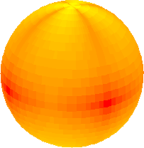
Towards the solution of the “quarkonium polarization puzzle”
Pietro Faccioli¹, Valentin Knünz², Carlos Lourenço³ in collaboration with João Seixas¹ and Hermine Wöhri³
1
3
2

Slide 2
The quarkonium polarization puzzle
In the early 90’s, CDF measured a ψ(2S) cross section 50 times larger than expected in the color singlet model (CSM): “the ψ’ anomaly”
In 1995, BBL gave birth to the NRQCD approach, which solved the ψ’ anomaly by adding a series of color octet terms; since they had free normalizations, fitted from the data, it is not surprising to see that the data could be reproduced (within the data uncertainties)
The validity of NRQCD was probed by fixing those free parameters and comparing a resulting prediction to independent measurements; this is where the polarization enters
The outcome is well known: NRQCD predicts transverse polarization, not observed in data
Note: Previous “equally anomalous” J/ψ measurements (by E789 and CDF) were not seen as a fundamental problem: too low p_{T} (E789) and too much affected by feed-down decays, of unknown fractions: the ψ(2S) was the smoking gun that killed the CSM

Slide 3
NRQCD factorization: the basic features
The heavy-quark mass provides a natural boundary between short- and long-distance QCD Quarkonium production can be factorized in two distinct phases:
_
possibly colored QQ pair of any possible ^{3S+1}L_{J} quantum numbers
quarkonium (H)
red
anti red
green
anti blue
2) non-perturbative evolution
to the observed bound state
Quantum numbers change!
1) perturbative phase
1) short-distance coefficients (SDCs): partonic cross sections (convolved with PDFs)
2) long-distance matrix elements (LDMEs): constant, universal, fitted from data
Σ
_
_
σ(A + B → H + X) =
σ{A + B → (QQ)_{C} [^{3S+1}L_{J}] + X}
⋅ P{(QQ)_{C} [^{3S+1}L_{J}] → H}
_{S, L, C}
_
QQ angular momentum and colour configuration

Slide 4
NRQCD factorization: the basic features
The heavy-quark mass provides a natural boundary between short- and long-distance QCD Quarkonium production can be factorized in two distinct phases:
_
possibly colored QQ pair of any possible ^{3S+1}L_{J} quantum numbers
quarkonium (H)
red
anti red
green
anti blue
2) non-perturbative evolution
to the observed bound state
Quantum numbers change!
1) perturbative phase
1) short-distance coefficients (SDCs): partonic cross sections (convolved with PDFs)
2) long-distance matrix elements (LDMEs): constant, universal, fitted from data
functions of kinematics: p_{T}, y, etc
not universal:
different in pp, e⁺e–, etc.
calculated in pQCD, depend on α_{S} order; might change shapes from LO to NLO
constant: independent of kinematics
universal:
the same in pp, e⁺e–, etc.
insensitive to the “rest” of the event
determined from fitting data → testable by over-constraining theory

Slide 5
The LDMEs and the v scaling
_
The LDMEs P{(QQ)_{C} [^{3S+1}L_{J}] → H} depend on the relative velocity of the quark pair in the bound state, according to definite scaling rules (proportional to powers of v²):
S-wave H : J/ψ, ψ’, ϒ [³S₁ , 1– –]
^{3S+1}L_{J} → | ¹S₀ | ³S₁ | ¹P₁ | ³P_{J} | ³D_{J} | ¹D₂
Colour Singlet | v⁸ | 1 | v⁸ | v⁸ | v⁸ | v¹²
Colour Octet | v⁴ | v⁴ | v⁸ | v⁴ | v⁸ | v¹²
P-wave H : χ_{cJ} , χ_{bJ} [³P_{J} , J⁺⁺]
^{3S+1}L_{J} → | ¹S₀ | ³S₁ | ¹P₁ | ³P_{J} | ³D_{J} | ¹D₂
Colour Singlet | v⁶ | v⁶ | v¹⁰ | v² | v¹⁰ | v¹⁰
Colour Octet | v⁶ | v² | v⁶ | v⁶ | v⁶ | v¹⁰
Relative contributions
are different
for S and P quarkonia !
ψ : v² ∼ 0.2
ϒ : v² ∼ 0.1
v² tends to be small (non-relativistic):
Most LDMEs can be neglected: less free parameters to be fitted Otherwise the fits would be under-constrained, given the accuracy of available data

Slide 6
NRQCD in action: a pedagogical example
The J/ψ cross section is fitted adding the (free) ¹S₀, ³S₁, ³P_{J} octets to the (fixed) ³S₁ singlet
Curves: SDC functions at NLO by M. Butenschön and B. Kniehl
Note: the fit starts at p_{T} = 3 GeV
total
The ³S₁ and ³P_{J} octet terms dominate at high p_{T}
What does this imply for the polarization ?

Slide 7
NRQCD in action: a few basic inputs
Quarkonium polarization is characterized by λ_{θ}, experimentally measured as the polar anisotropy of the decay dilepton angular distribution, usually in the helicity frame
The theoretical λ_{θ} is calculated from the transverse and longitudinal cross sections
Each color singlet and octet term has a specific polarization associated
The ³S₁ singlet changes from λ_{θ} = +1 at LO to λ_{θ} = -1 at NLO, but has a negligible impact
The important octet terms for S-wave quarkonia are:
Dominance of the ³S₁ and ³P_{J} octet terms → λ_{θ} ≈ +1, for high-p_{T} S-wave quarkonia
Note: in theory, the sub-processes are not physically observable on their own, only inclusively; some calculations even give negative cross sections… and λ_{θ} > +1
σ_{T} − σ_{L}
σ_{T} + σ_{L}
¹S₀ → λ_{θ} = 0 at LO, NLO, etc; isotropic wave function
³S₁ → λ_{θ} = +1 at LO, NLO, etc, at high p_{T}, where the fragmenting gluon is real
³P_{J} → λ_{θ} >> +1 at NLO, while at LO it is 0...

Slide 8
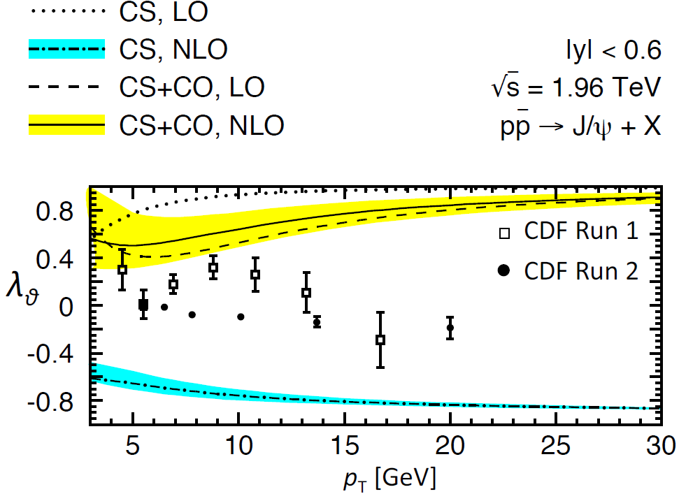
Polarization: NRQCD vs. pre-LHC data
The CDF J/ψ polarization results disagree with the NRQCD prediction: puzzle !
But the data from Run 1 and 2 are inconsistent (as the CDF and D0 Y(1S) polarizations)
Besides, feed-down effects blur the picture (CDF ψ(2S) result has poor statistics)
→ Not seen as strong evidence of a fundamental problem…

Slide 9
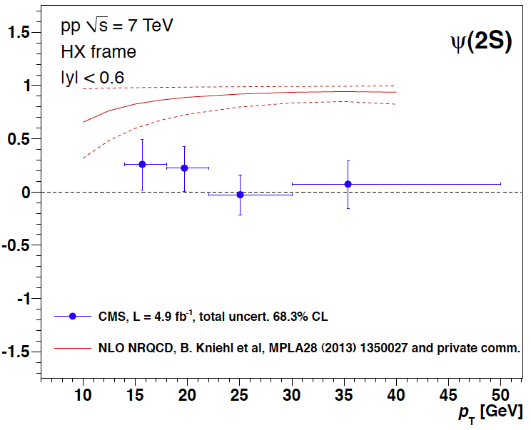
Polarization: NRQCD vs. LHC data
CMS measured ψ(2S) polarization: no feed-down excuses…
CMS, LHCb and ALICE J/ψ results are in good agreement: no data inconsistencies
→ The puzzle is a real problem and not caused by unreliable data
How to solve it?
λ_{θ}

Slide 10
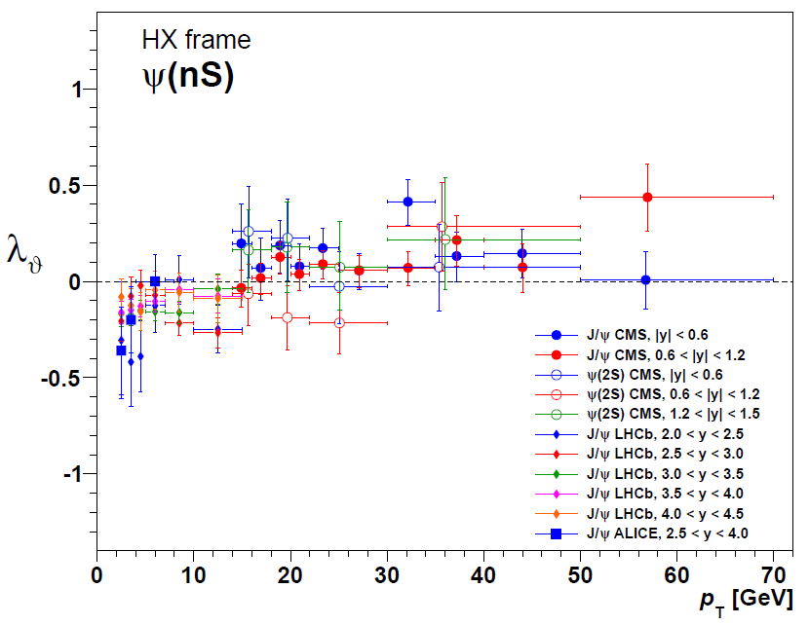
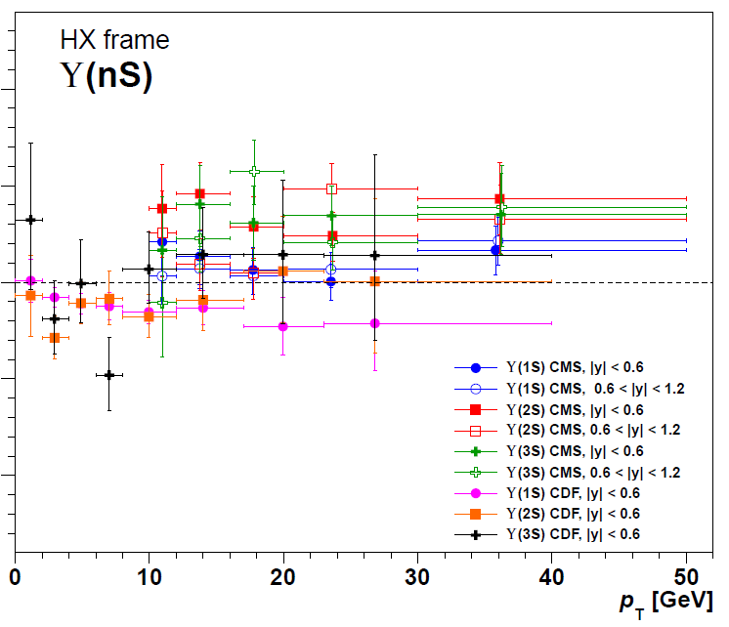
A data-driven inspiration
LHC S-wave quarkonia polarizations cluster around the unpolarized limit, with no strong changes from directly-produced states to those affected by P-wave feed-down decays
λ_{θ}
The simplest (“zero-order”) explanation: all quarkonia are produced by a single mechanism, with a large contribution of the (unpolarized) ¹S₀-octet channel
But we saw that this is not a dominant term in the fits to the cross sections… Right?

Slide 11
A second look at the NRQCD fits
Let’s consider how individual contributions in the NRQCD calculations compare to data
The colour-singlet ³S₁ contribution is fixed (no free normalization) and represents a tiny fraction of the total cross section

Slide 12
A second look at the NRQCD fits
Let’s consider how individual contributions in the NRQCD calculations compare to data
The octet ¹S₀ contribution alone is steeper (at low p_{T}) than the measured cross section;
its polarization is zero
Reminder: Color-octet contributions have fixed shape but adjustable normalizations (the LDMEs).

Slide 13
A second look at the NRQCD fits
Let’s consider how individual contributions in the NRQCD calculations compare to data
The octet ³S₁ contribution alone is less steep than the measured cross section;
its polarization is transverse

Slide 14
A second look at the NRQCD fits
Let’s consider how individual contributions in the NRQCD calculations compare to data
The octet ³P_{J} contribution changes sign from low to high p_{T} !
its polarization is “hyper-transverse”

Slide 15
A second look at the NRQCD fits
All together now…
The data points are poorly fitted…
The high-statistics low-p_{T} points drive the fit
Reminder: the fit starts at p_{T} = 3 GeV

Slide 16
A matter of NRQCD validity domain?
Let’s isolate the high-p_{T} asymptotic behaviors, by normalizing curves to the last CDF point
The octet ¹S₀ term has the shape most similar to the data → and this is the unpolarized contribution !
The “NRQCD region” may start here !

Slide 17
Towards better NRQCD global fits
We have started working on a significantly improved NRQCD fit framework:
Analysis is made as a function of thresholds in p_{T} / M to answer the basic question: has NRQCD factorization a domain of validity?
Both cross sections and polarizations are used as simultaneous constraints
Experimental correlated uncertainties (luminosity, etc) and polarization-dependent acceptances are accounted for; inconsistent measurements are not used
Theoretical uncertainties are accounted as difference between LO and NLO calculations
Note: The “global fits” shown in the next slides only include hadro-production data Note: The bottomonium SDCs are obtained from the charmonium ones* using p_{T} / M scaling
*by M. Butenschön and B. Kniehl, calculated for M = 2 m_{c}

Slide 18
SDCs from LO to NLO
Theoretical uncertainties (perturbative calculations) are small for the ¹S₀ and ³S₁ !
The octets ¹S₀ and ³S₁ rapidly stabilize at high p_{T}, while the ³P_{J} contribution changes drastically from LO to NLO;
in cross section and in polarization
[a.u.]
LO
NLO
S-octet dominance would solve the problem of the slowly-converging perturbative series in NRQCD Neglecting the ³P_{J} makes the calculations much more stable And gives more constrained fits to the data
LO: dashed

Slide 19
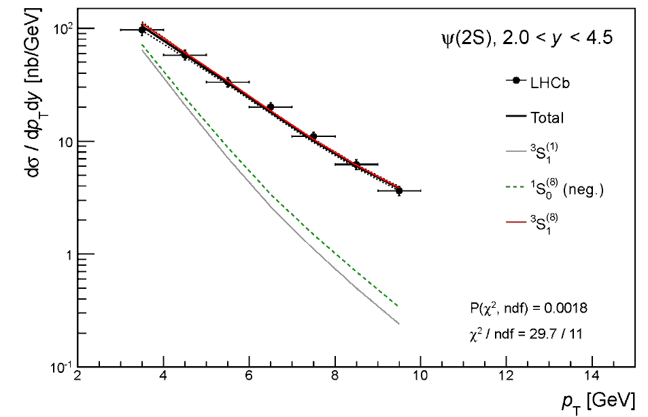
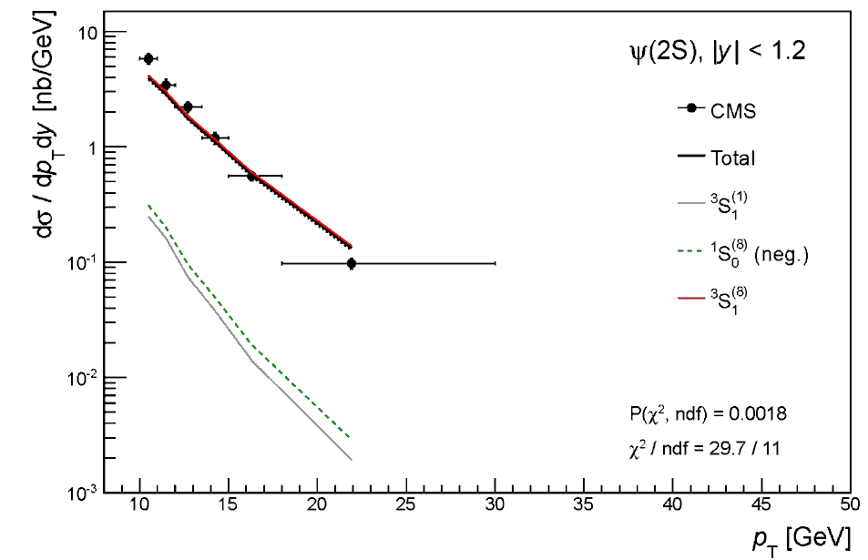
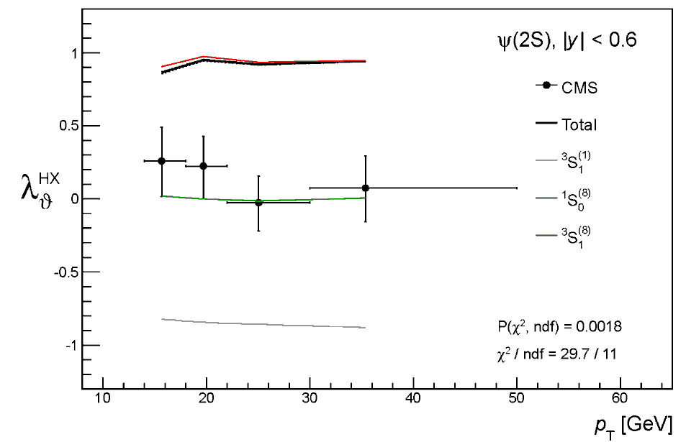
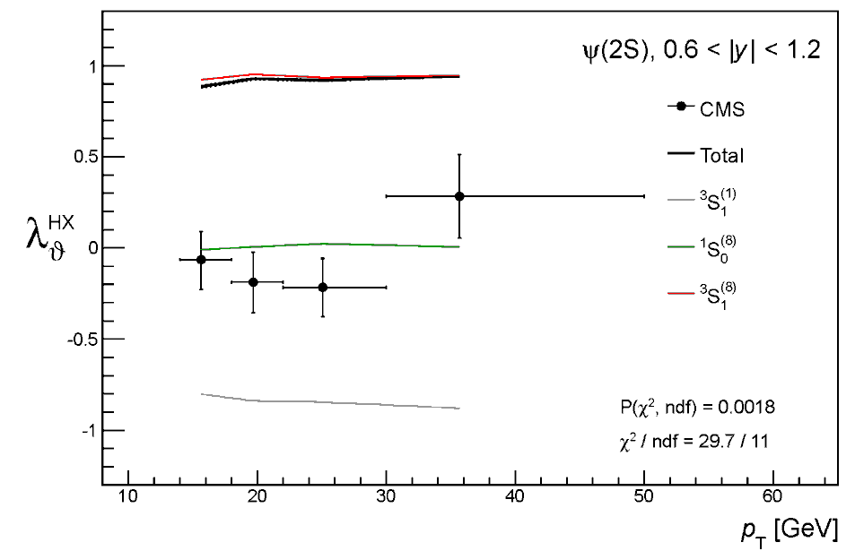
The “standard” fit approach, p_{T} > 3 GeV
ψ(2S)
Data fitted down to lowest p_{T} /M, without polarization constraint
LHCb
(prediction)
(prediction)
Polarization data
not included in fit!
³S₁⁽⁸⁾ dominates
¹S₀⁽⁸⁾ small and negative
P(χ²)
1.8E-3

Slide 20
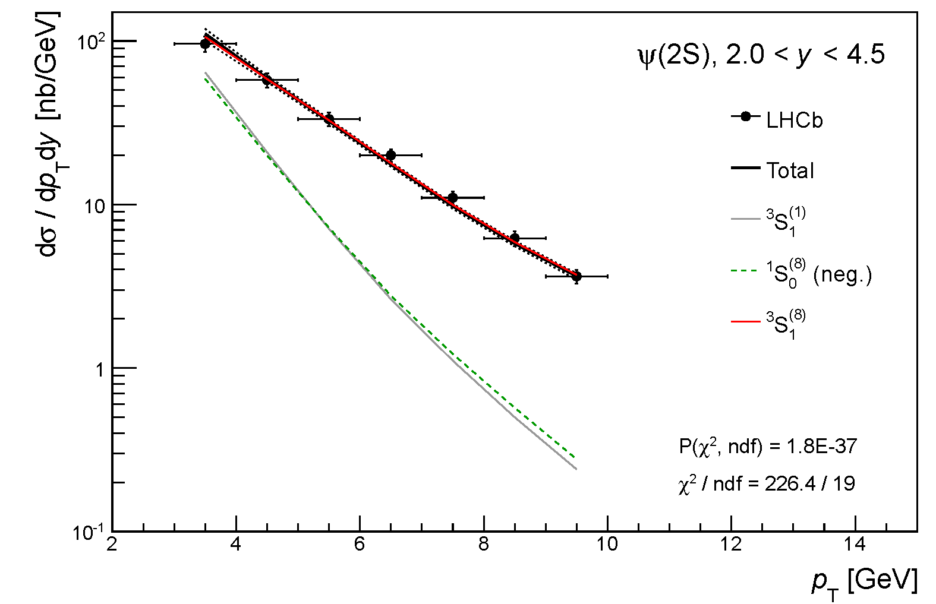
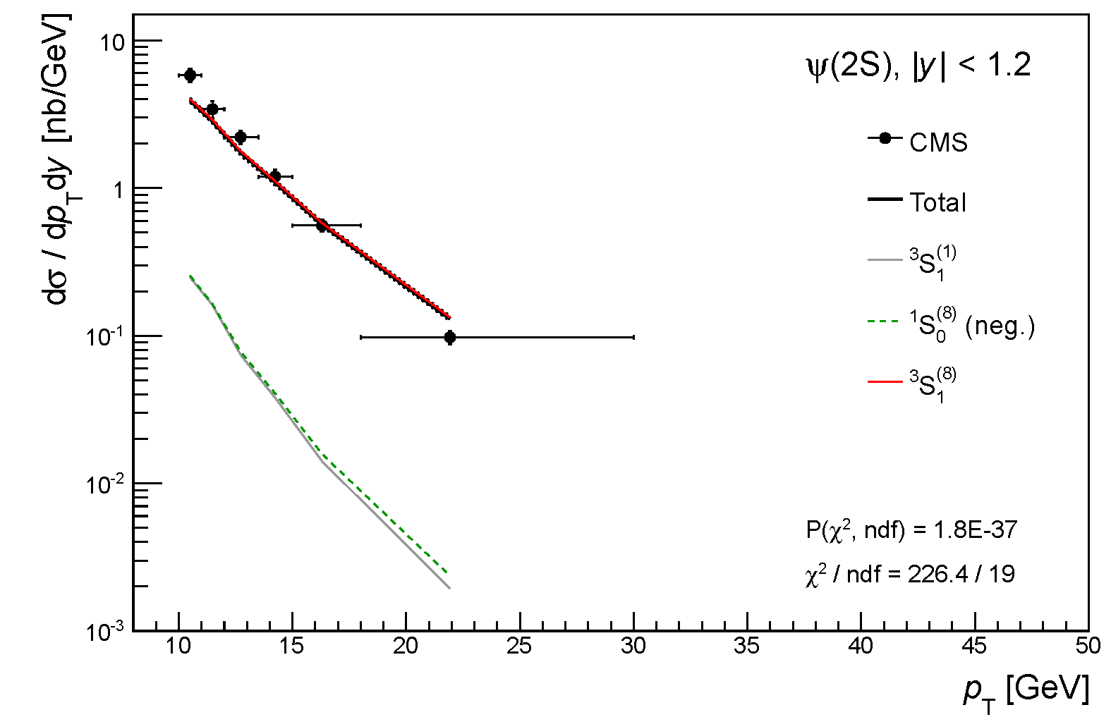
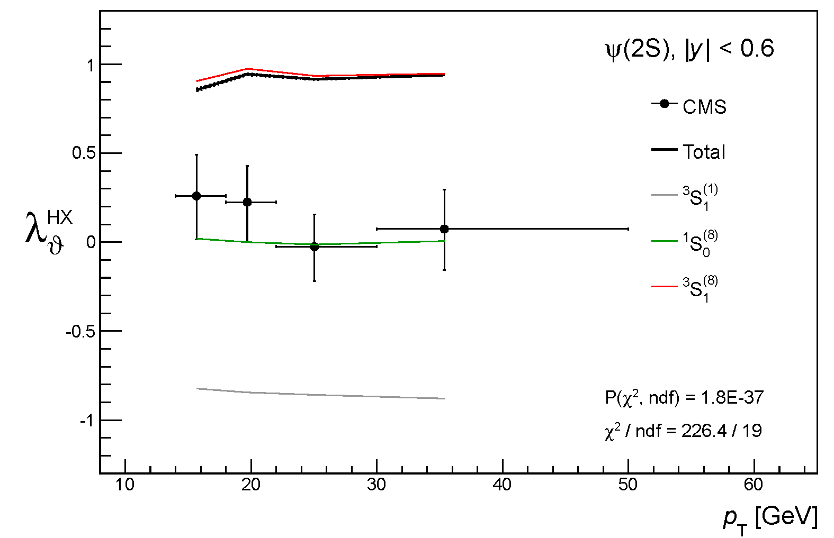
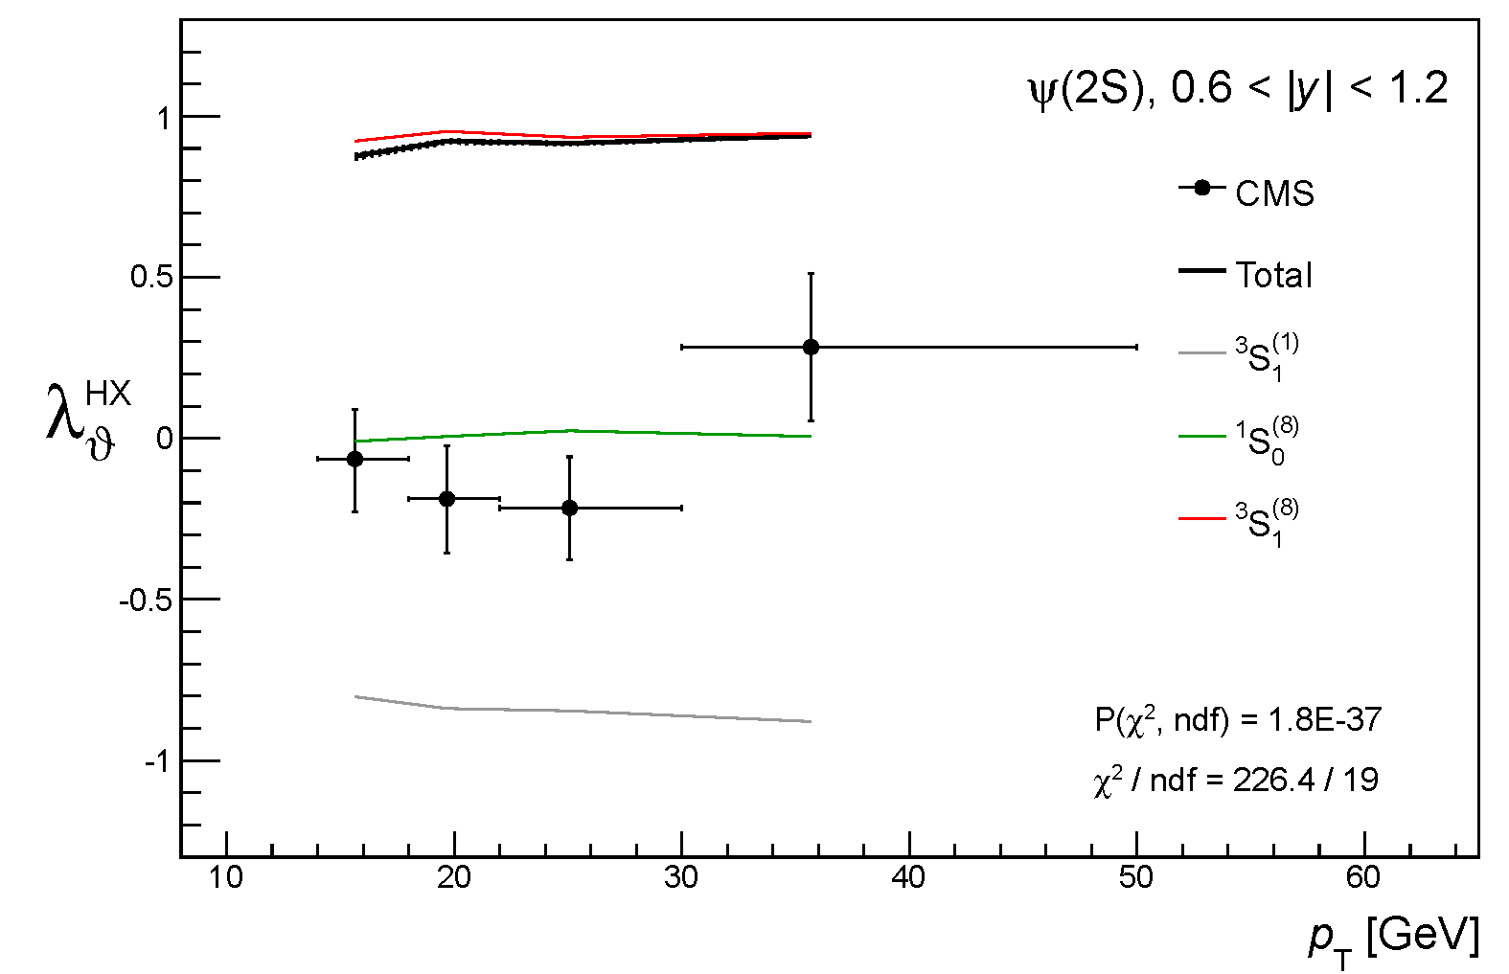
Global fit, p_{T} > 3 GeV
ψ(2S)
Data fitted down to lowest p_{T} /M, with polarization constraint
Polarization data
included in fit!
No visible change, ³S₁⁽⁸⁾ still dominates
P(χ²)
1.8E-37

Slide 21
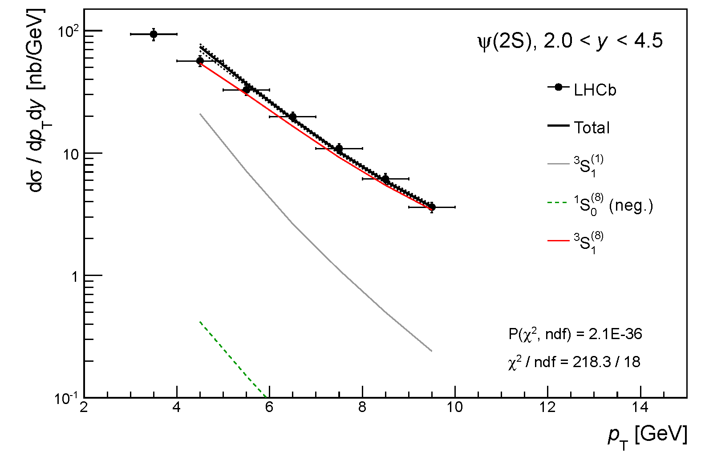
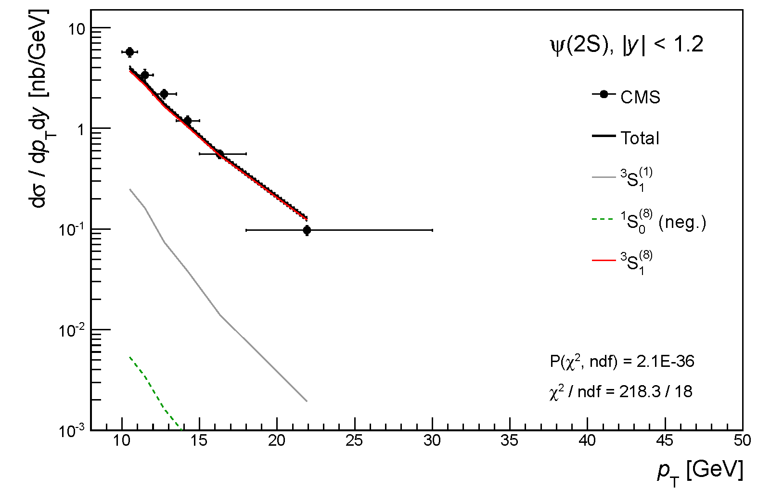
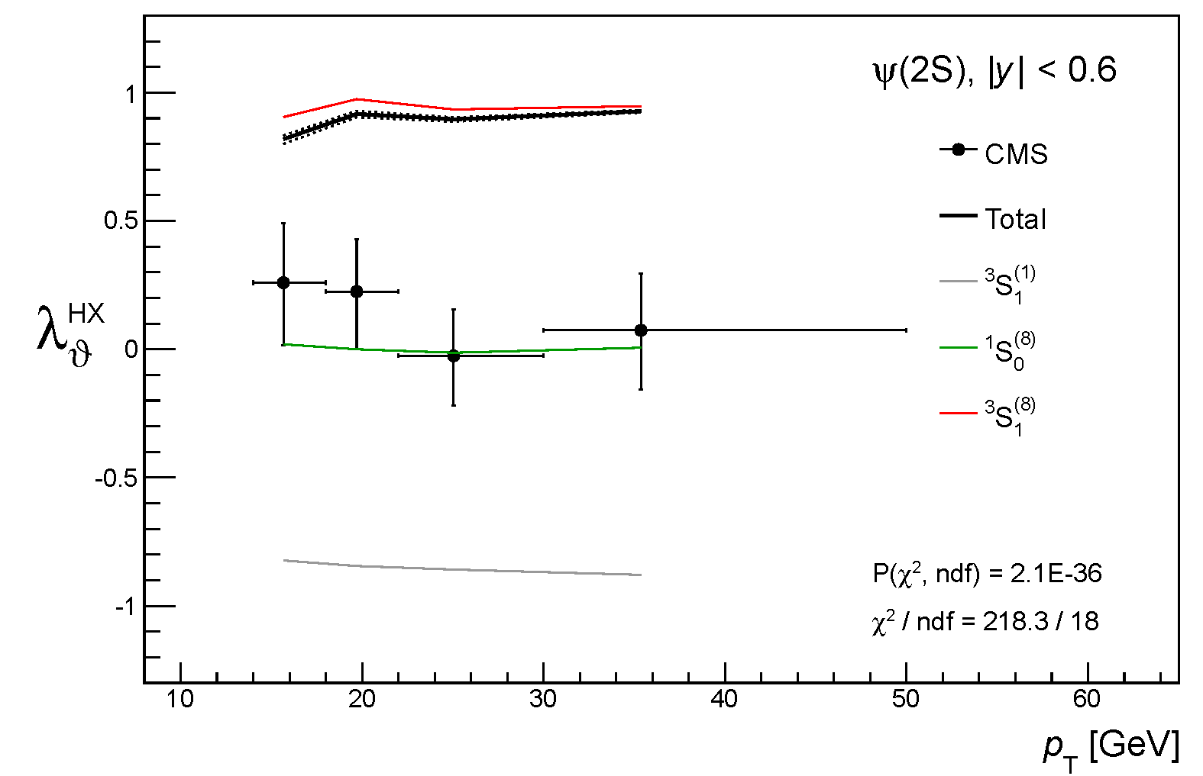
Global fit, p_{T} > 4 GeV
ψ(2S)
³S₁⁽⁸⁾ starts decreasing
¹S₀⁽⁸⁾ less negative
P(χ²)
2.1E-36

Slide 22
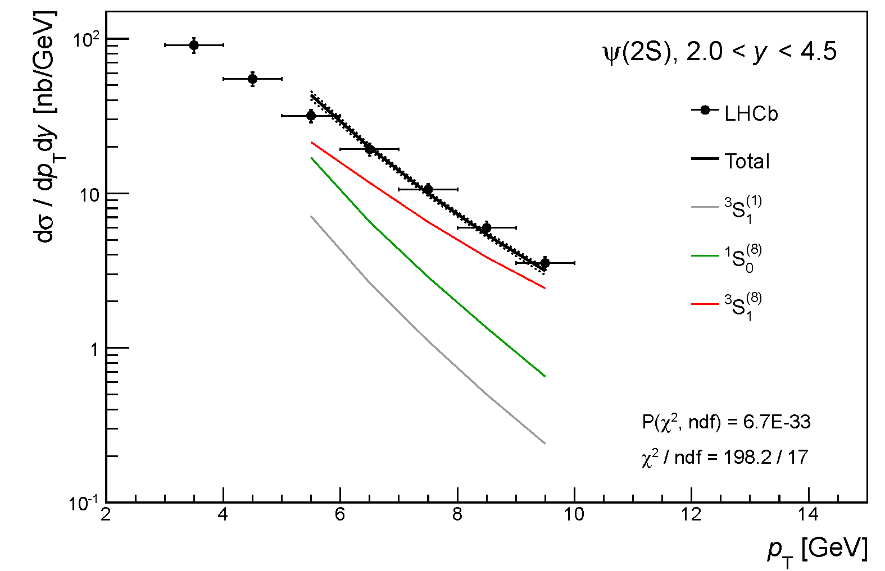
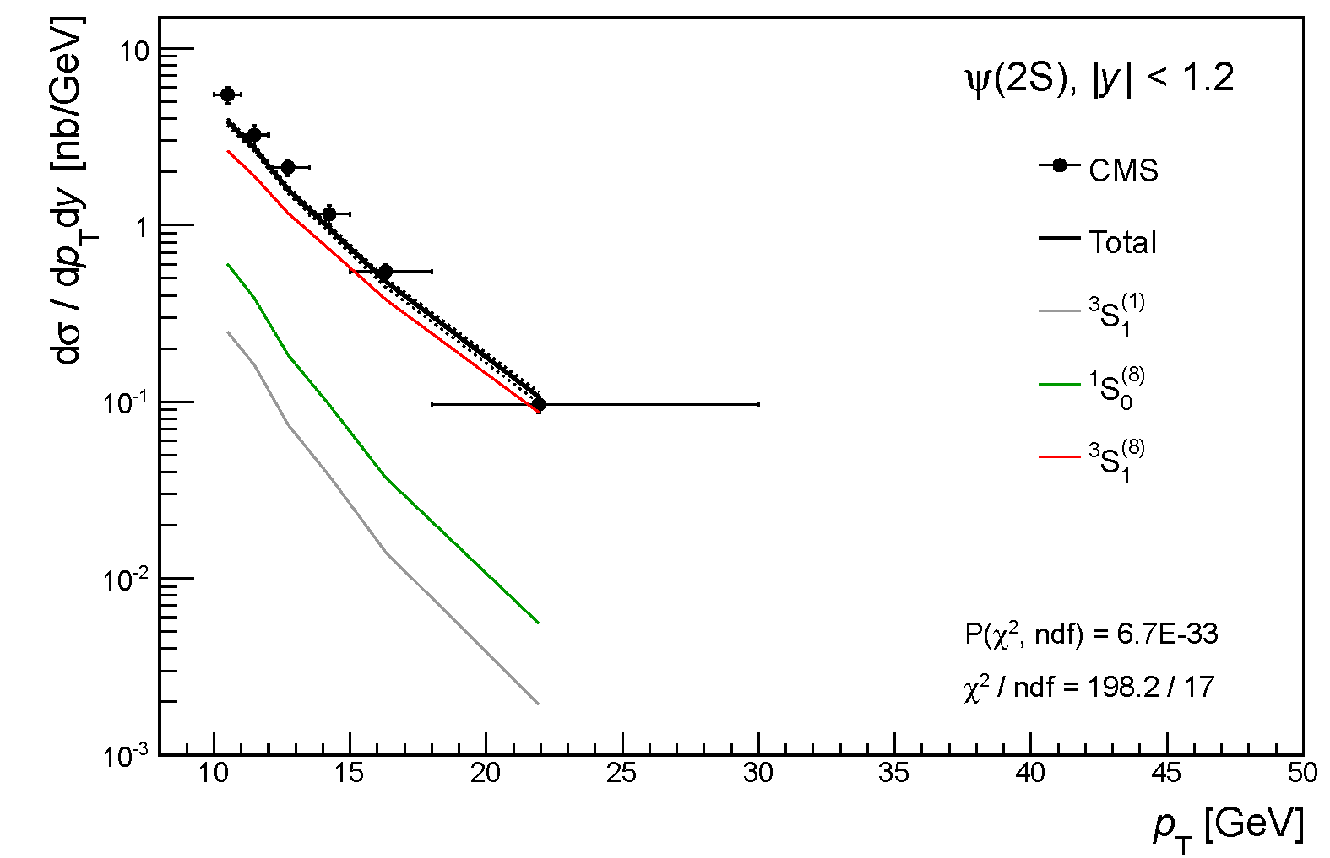
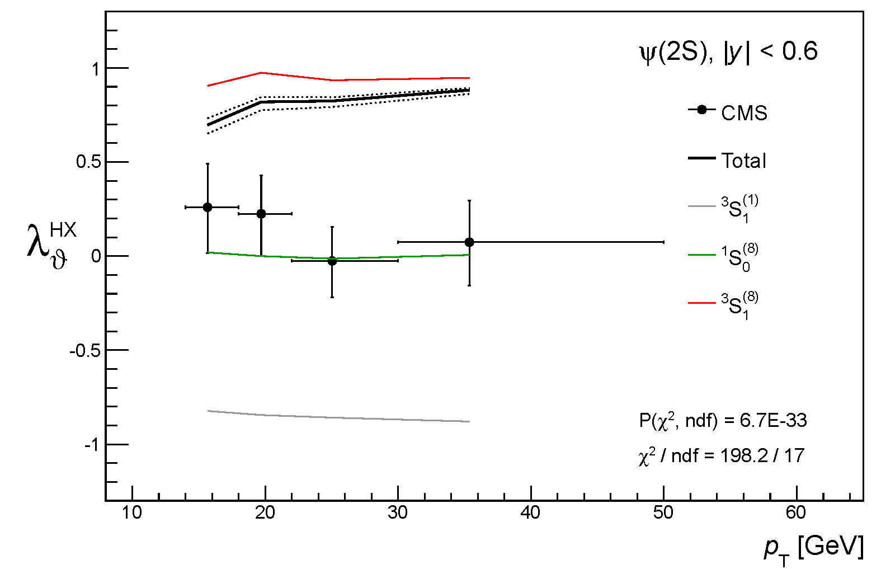
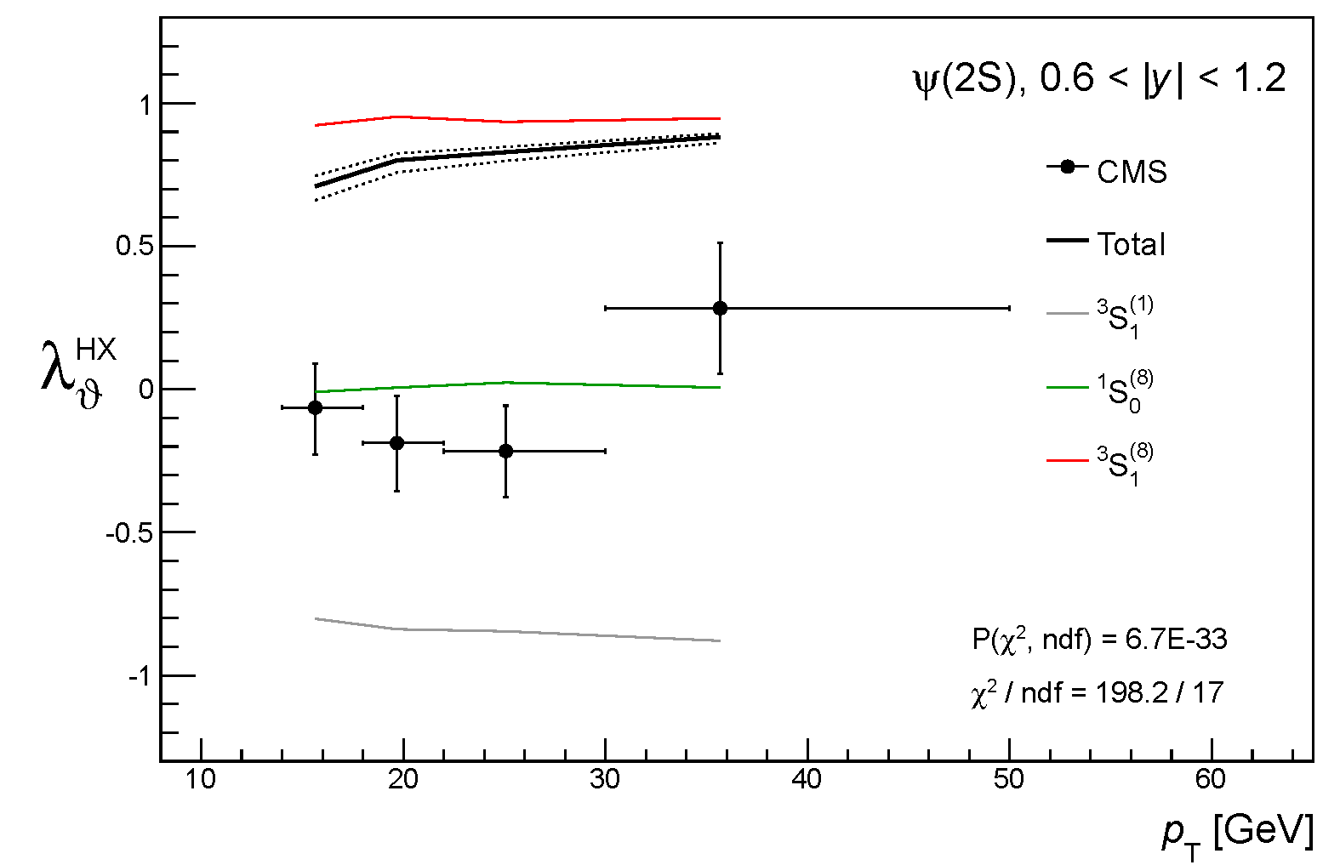
Global fit, p_{T} > 5 GeV
ψ(2S)
³S₁⁽⁸⁾ decreases
¹S₀⁽⁸⁾ is positive and increases
P(χ²)
0.67E-32

Slide 23
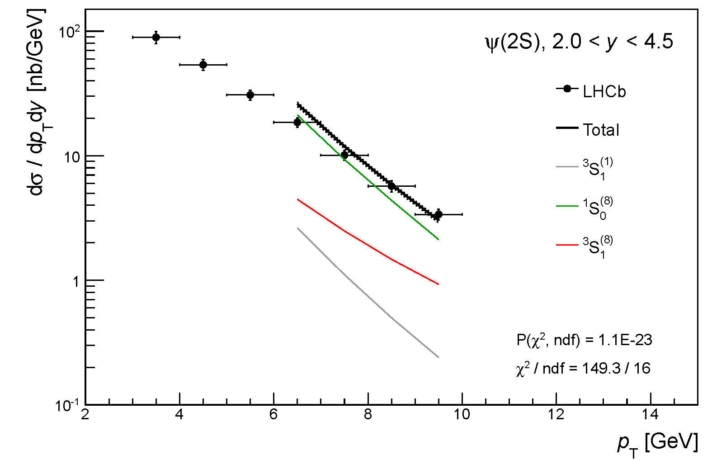
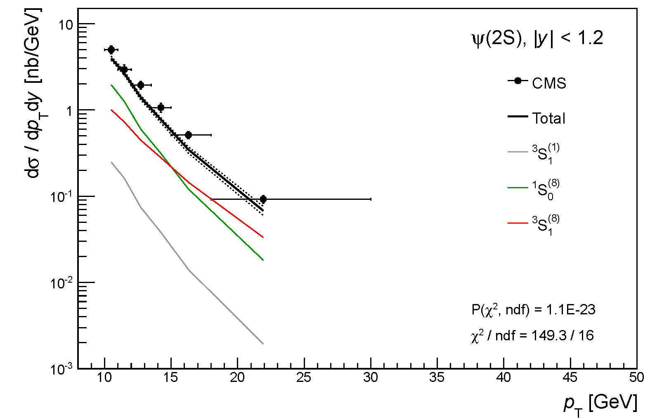
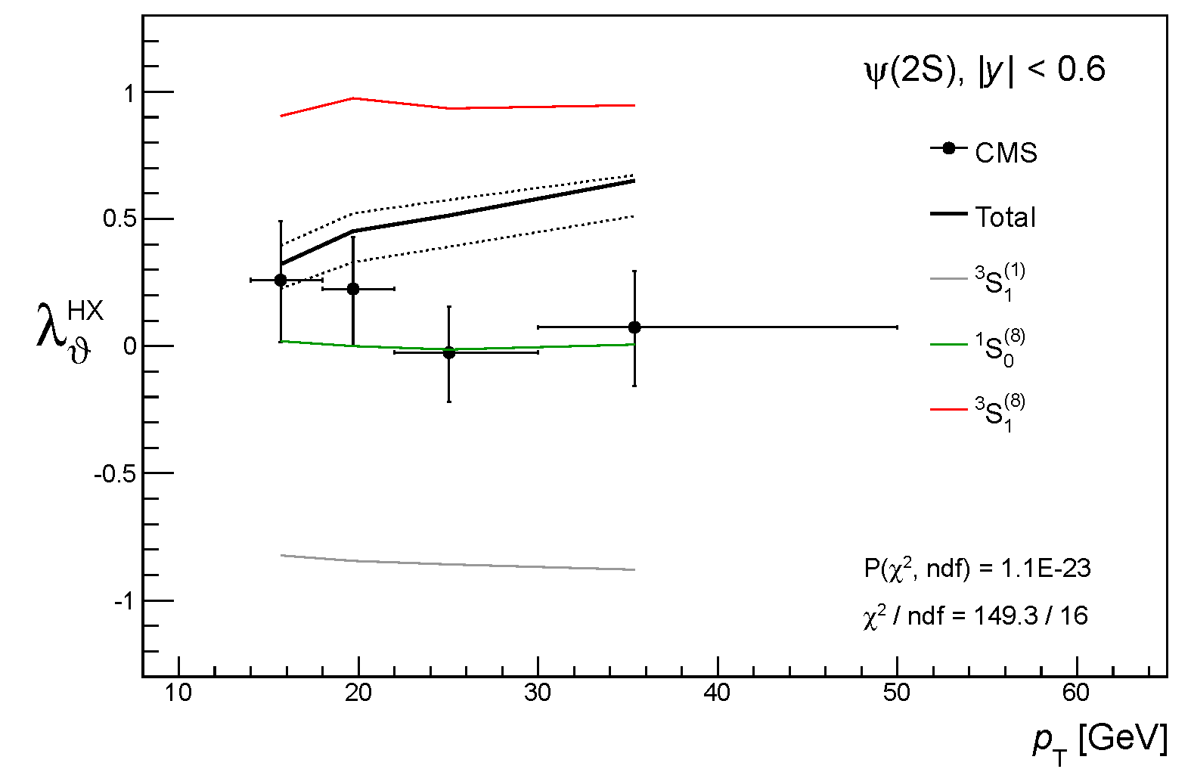
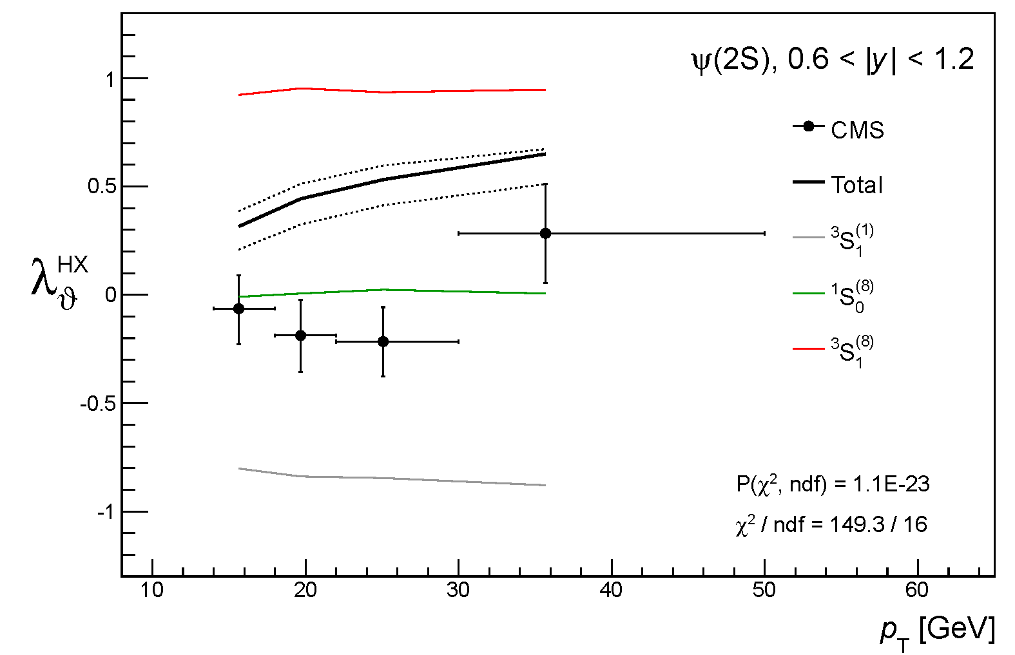
Global fit, p_{T} > 6 GeV
ψ(2S)
³S₁⁽⁸⁾ and ¹S₀⁽⁸⁾ start exchanging their roles
polarization is changing
P(χ²)
1.1E-23

Slide 24
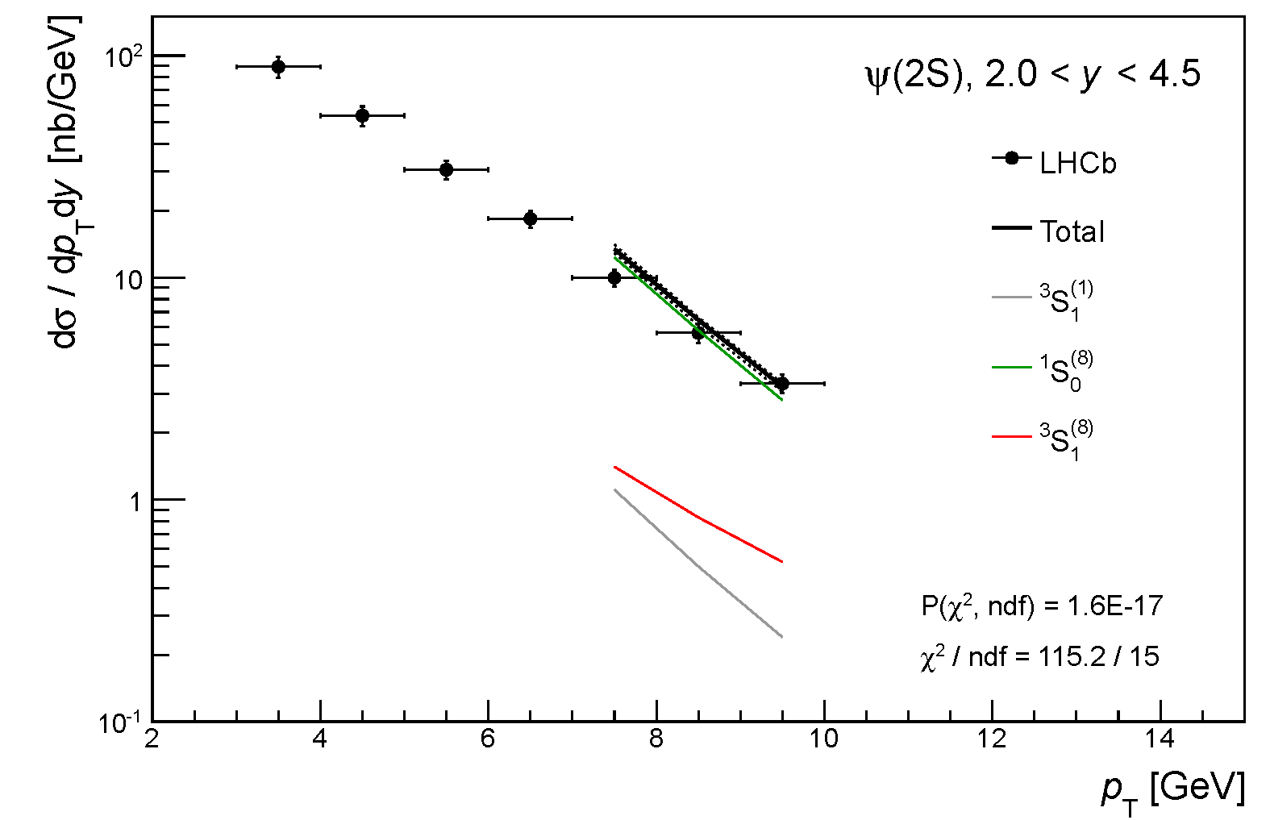
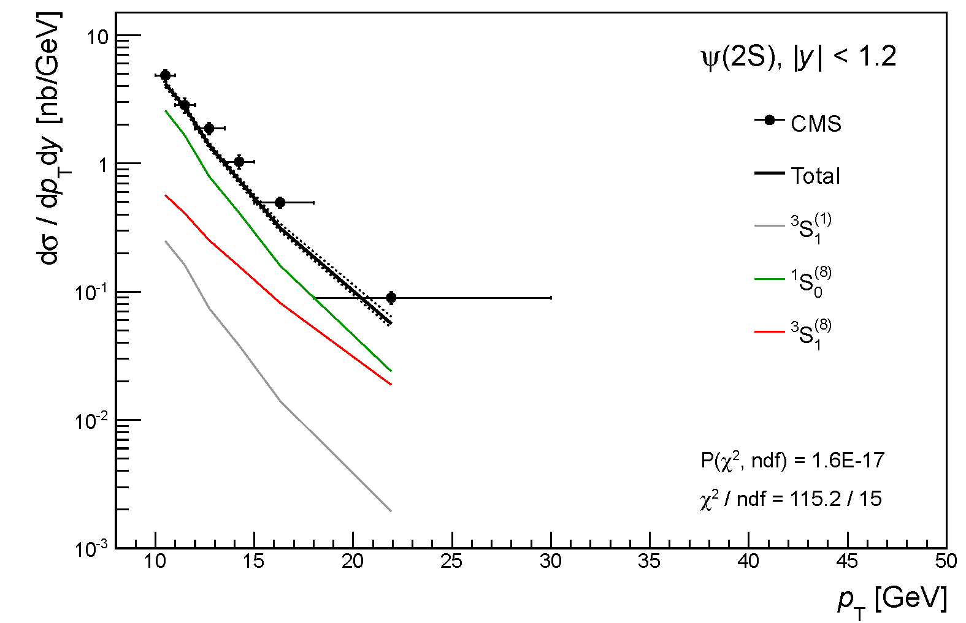
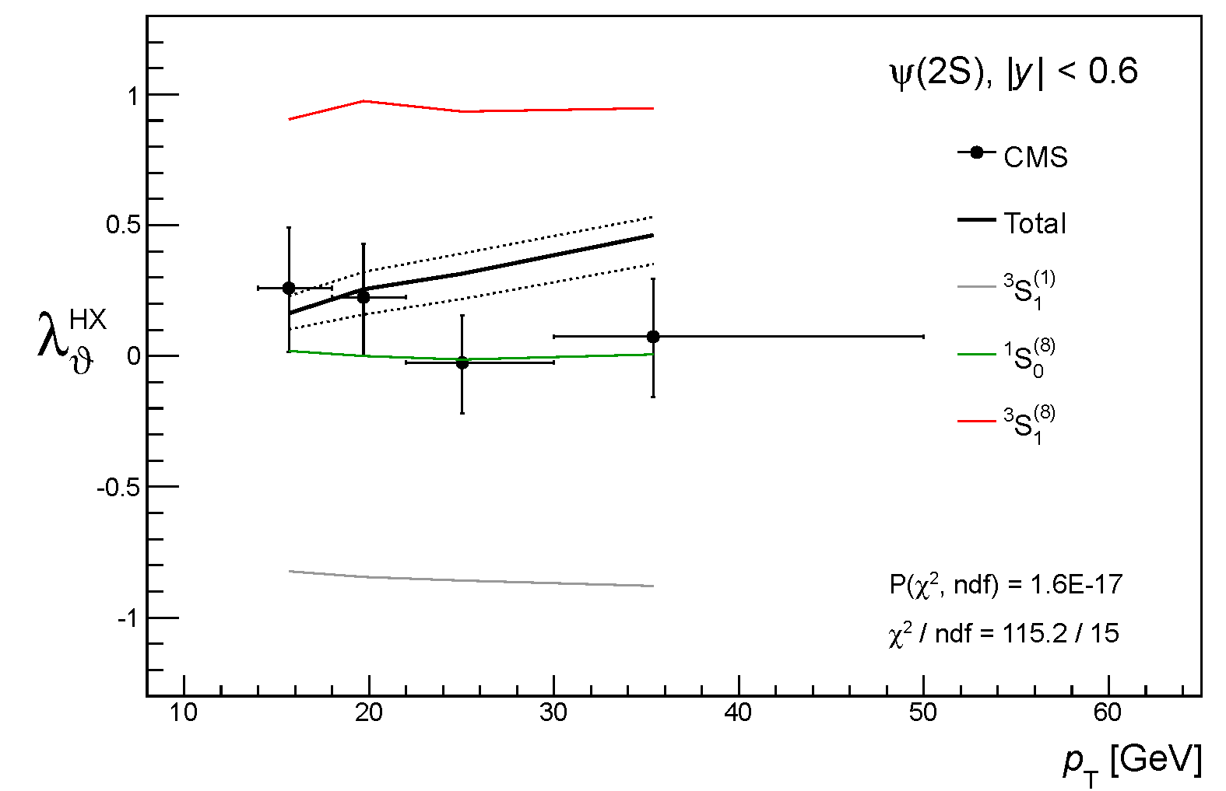
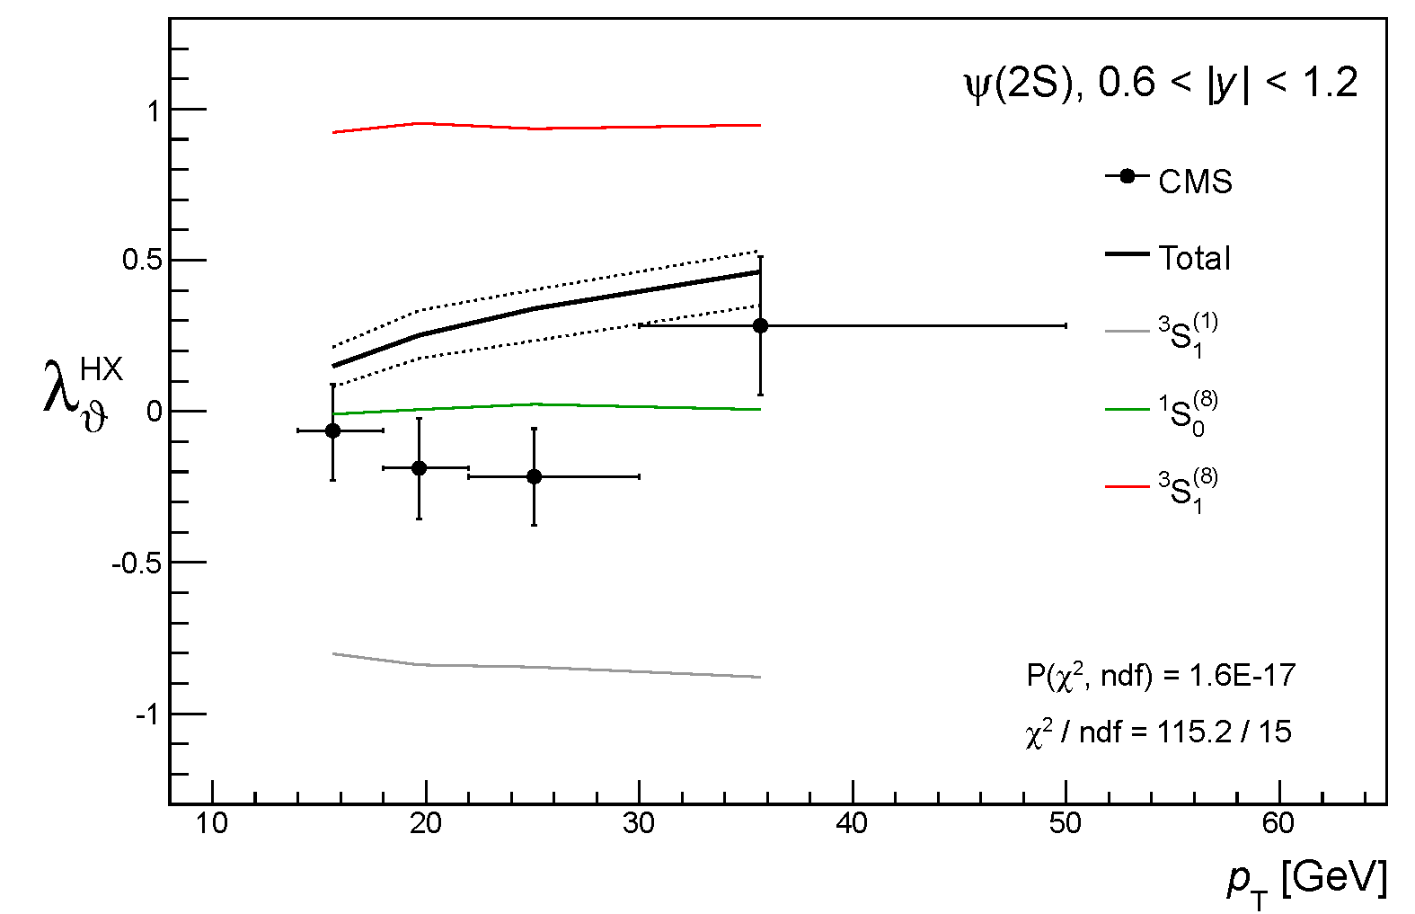
Global fit, p_{T} > 7 GeV
ψ(2S)
¹S₀⁽⁸⁾ is now the main contribution
polarization closer to data
P(χ²)
1.6E-17

Slide 25
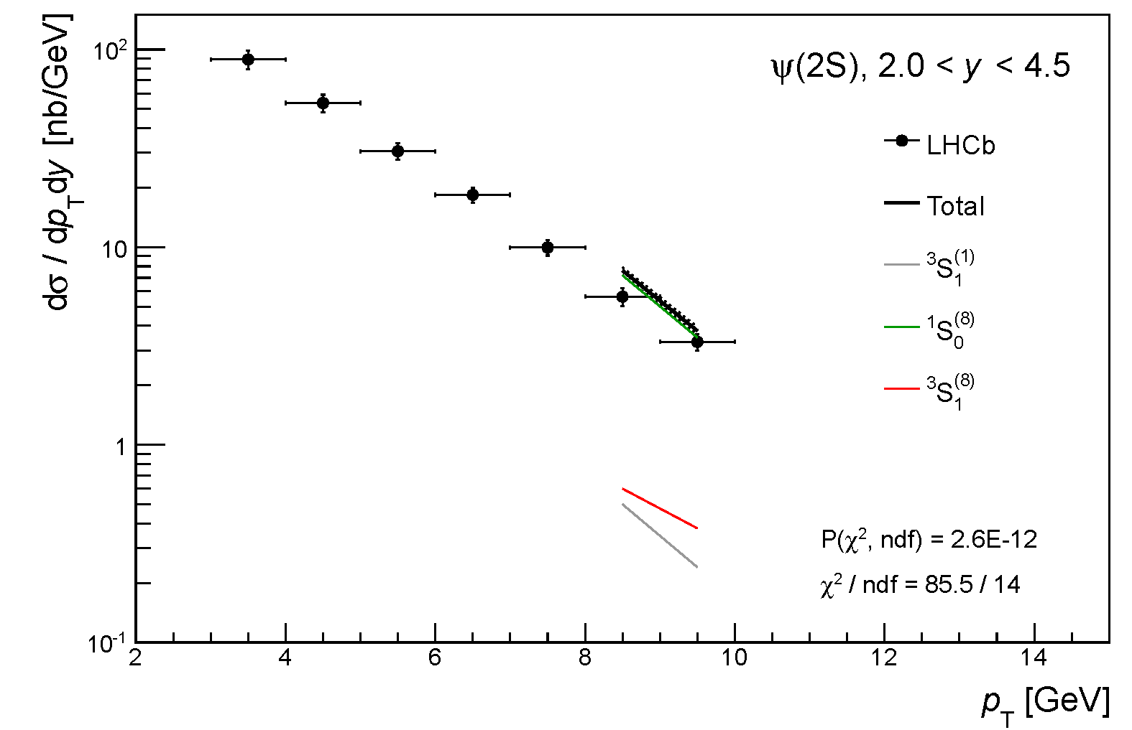
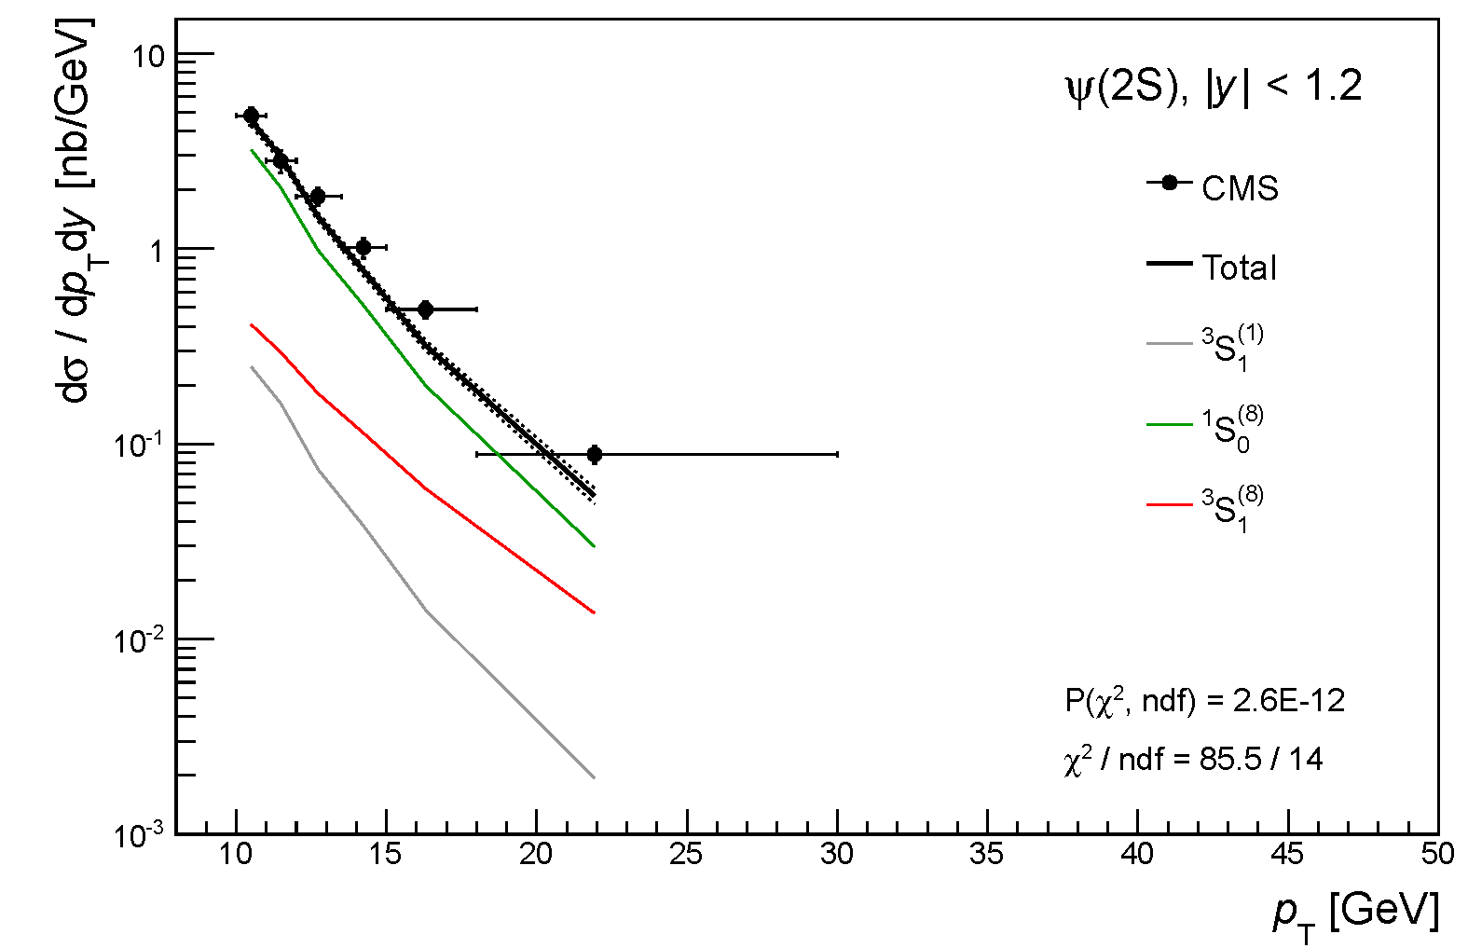
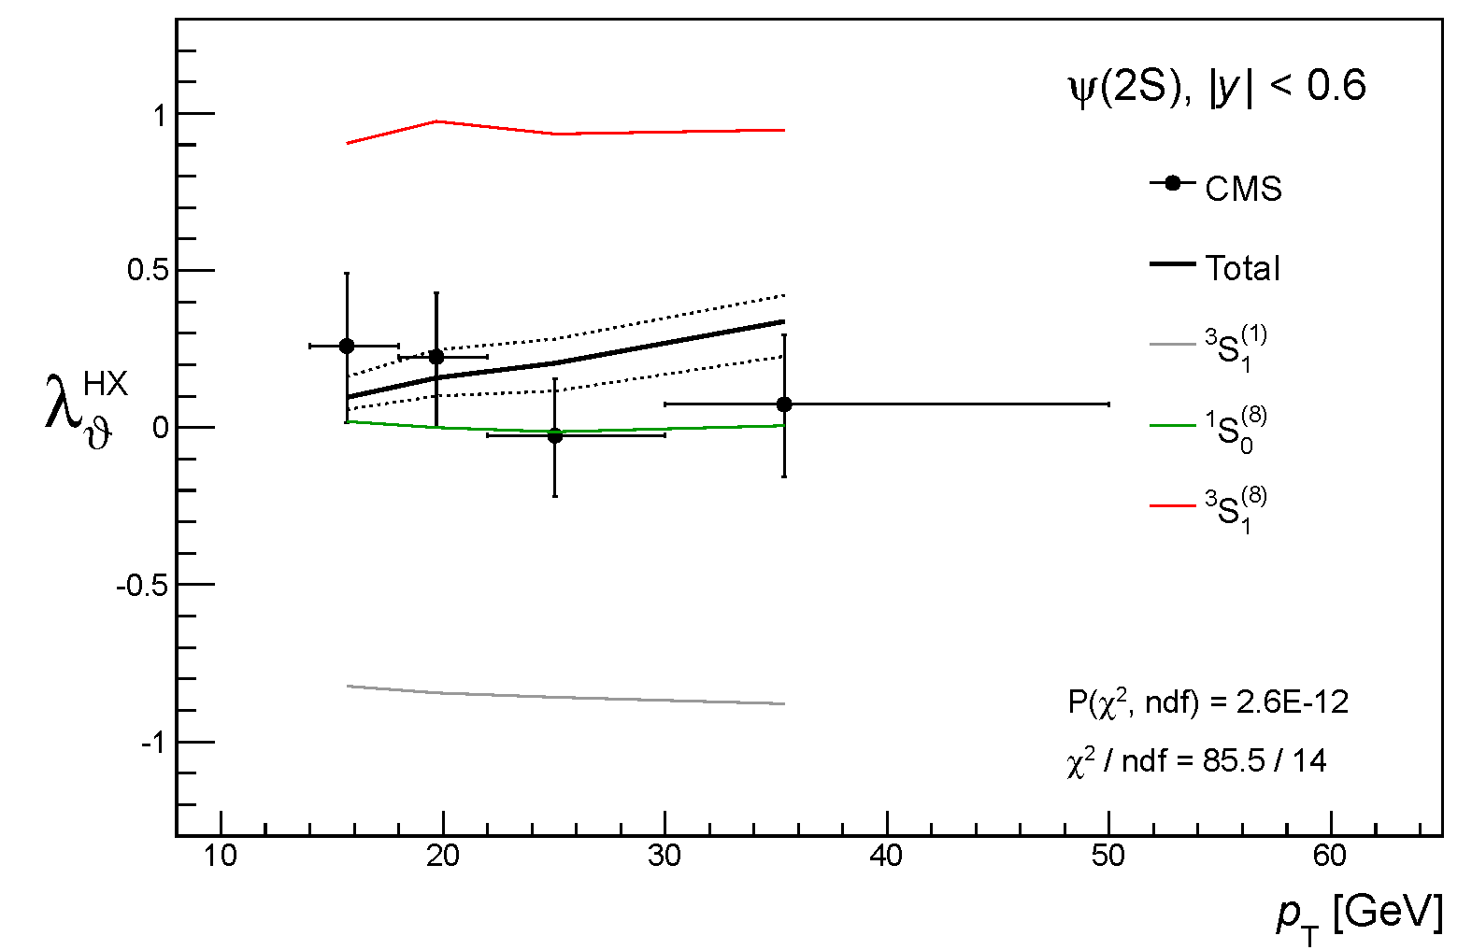
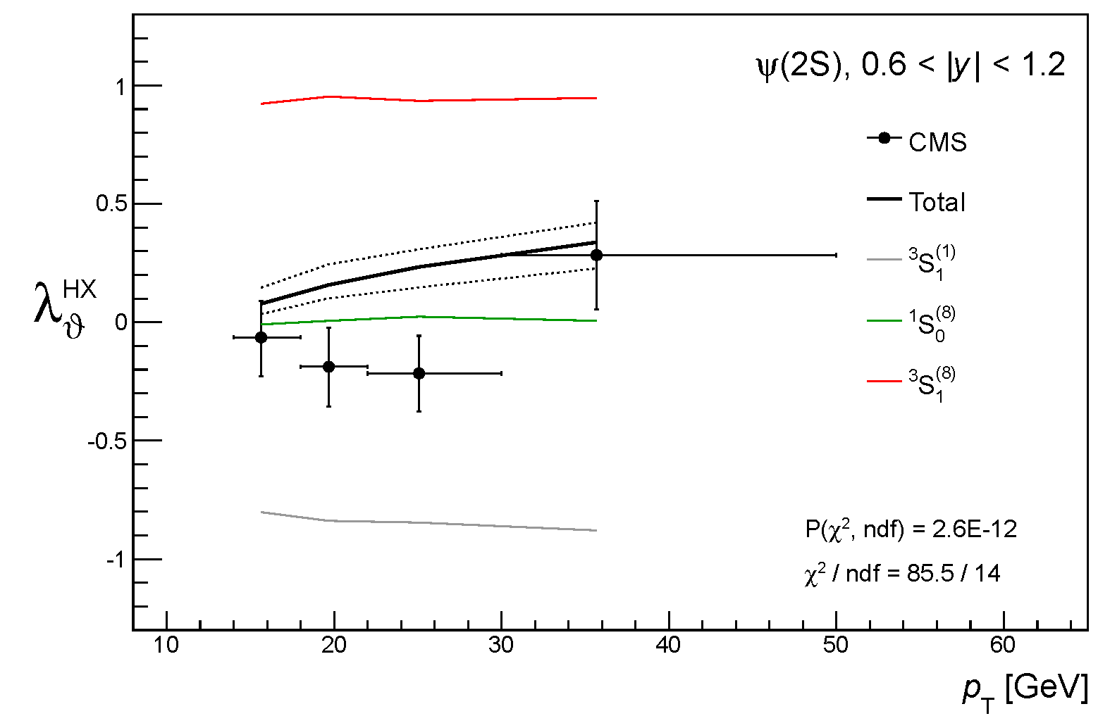
Global fit, p_{T} > 8 GeV
ψ(2S)
¹S₀⁽⁸⁾ is now the main contribution
polarization closer to data
P(χ²)
2.6E-12

Slide 26
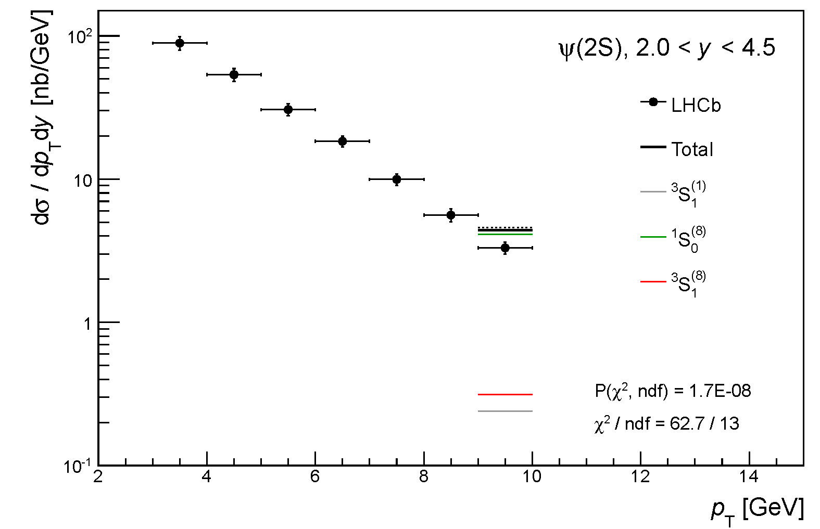
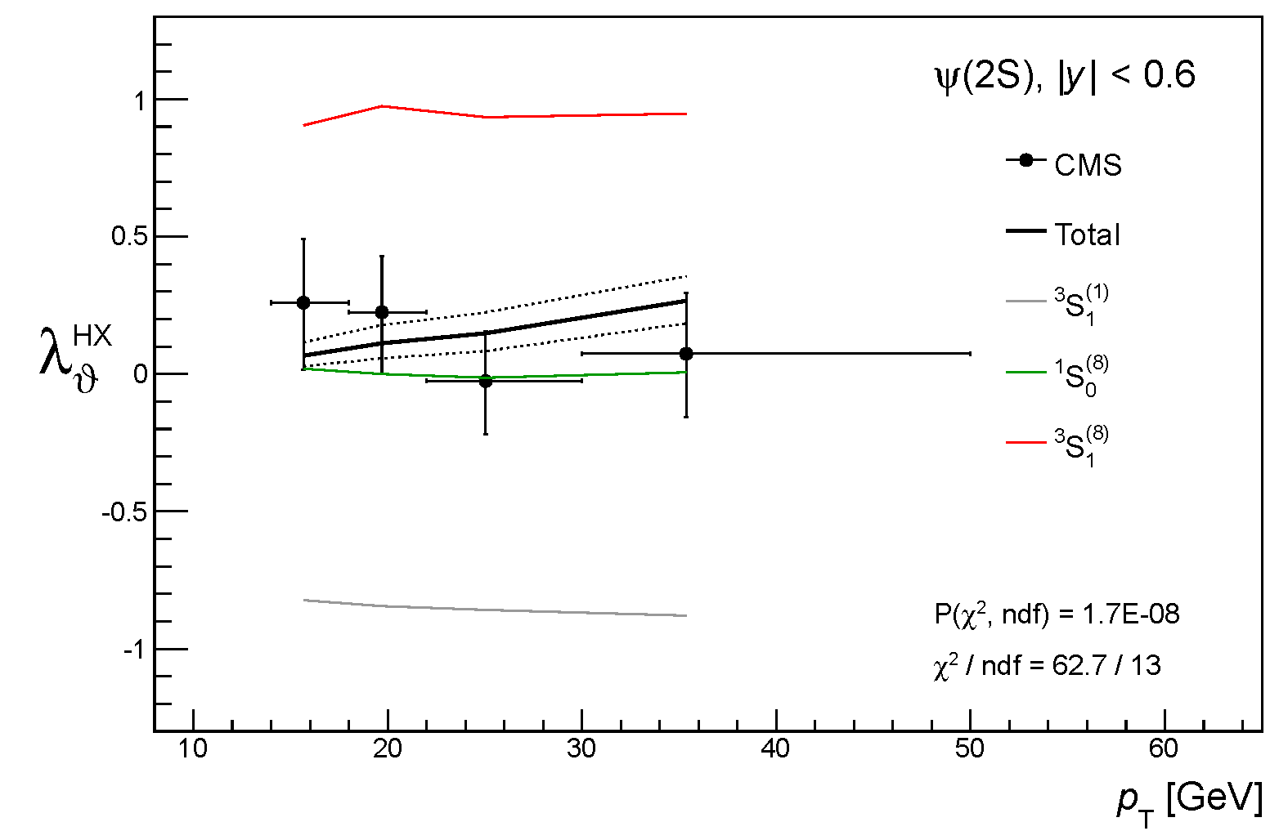
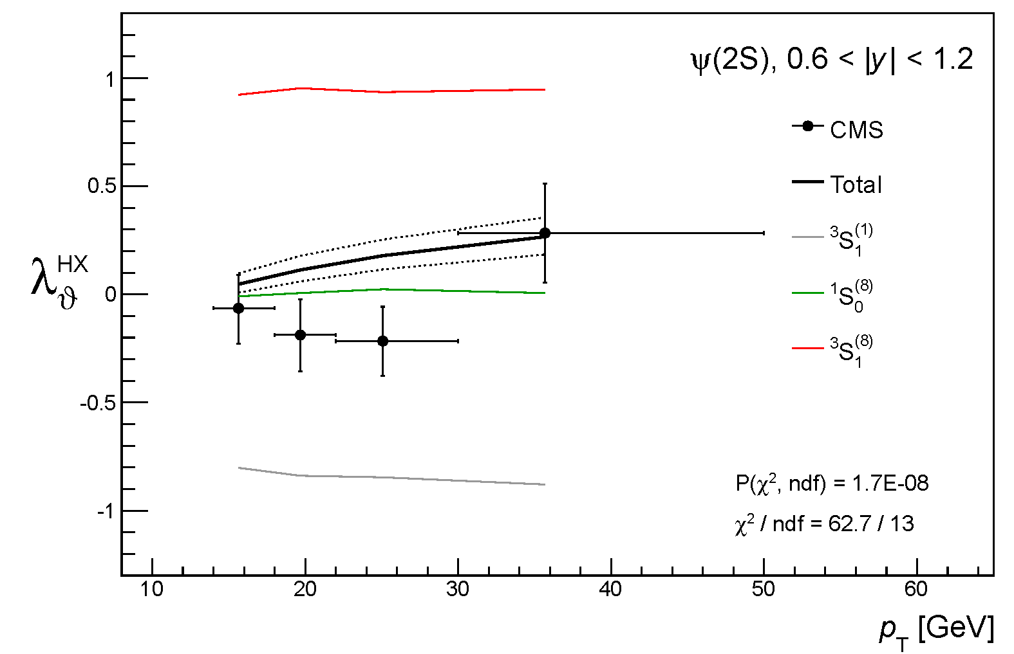
Global fit, p_{T} > 9 GeV
ψ(2S)
¹S₀⁽⁸⁾ is now the main contribution
polarization closer to data
P(χ²)
1.7E-8

Slide 27
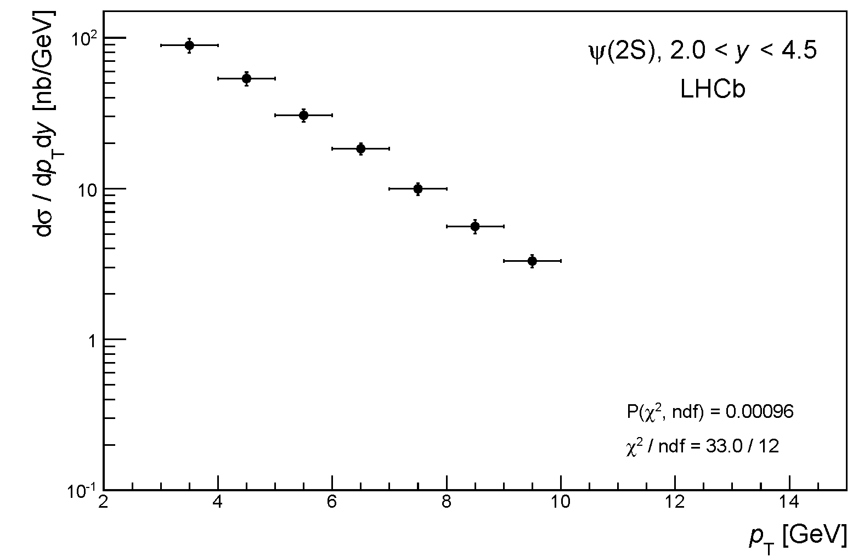
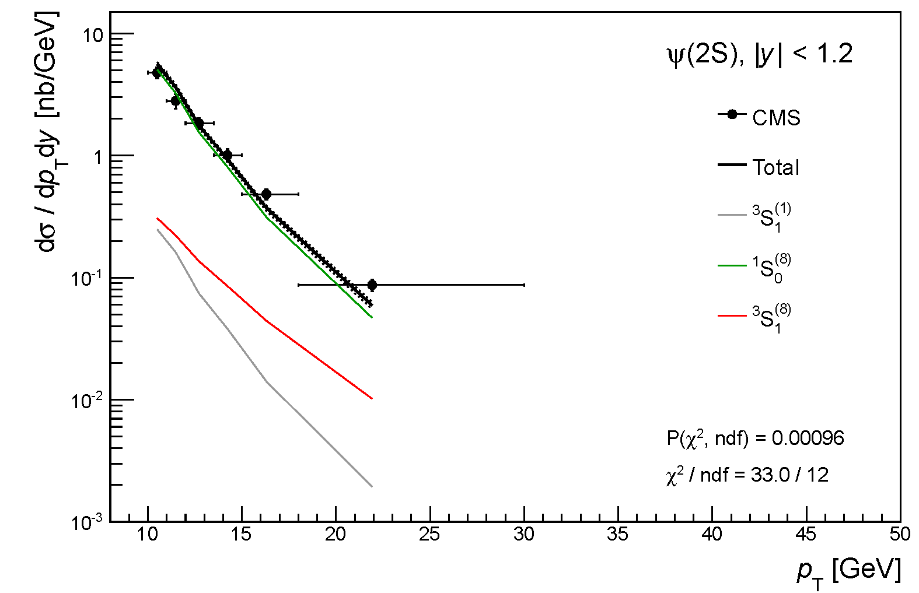
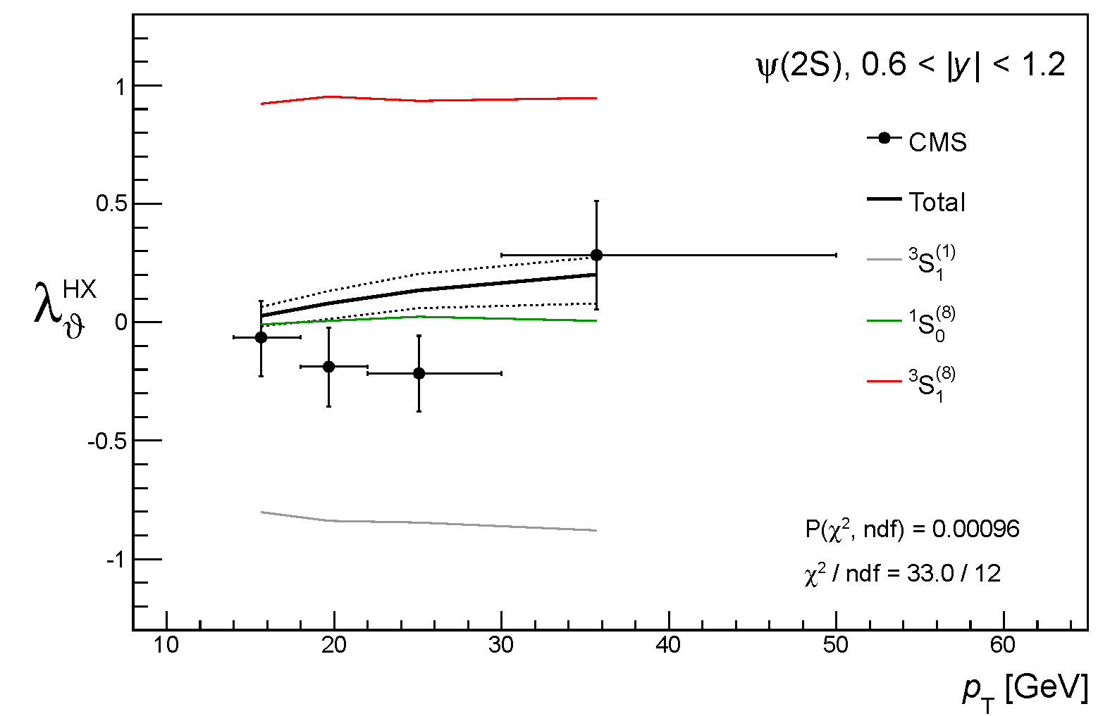
Global fit, p_{T} > 10 GeV
ψ(2S)
LHCb data not used
¹S₀⁽⁸⁾ dominates
polarization quite close to data
P(χ²)
0.96E-3

Slide 28
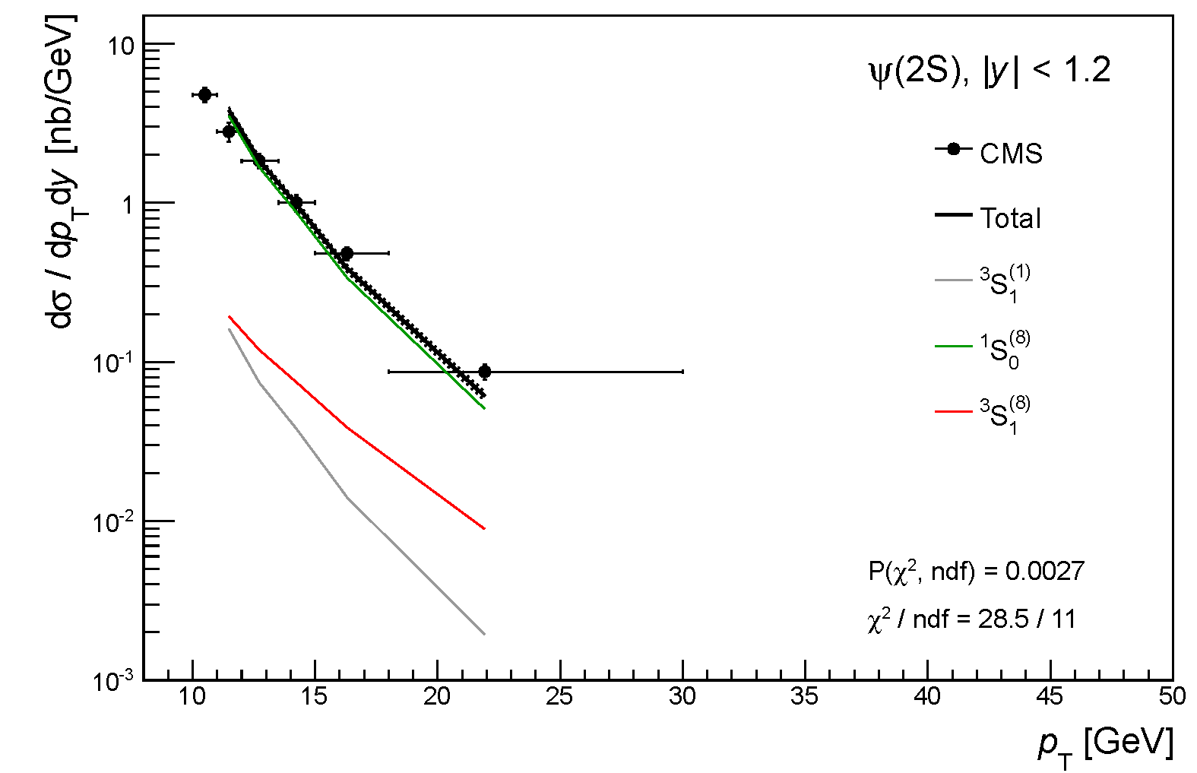
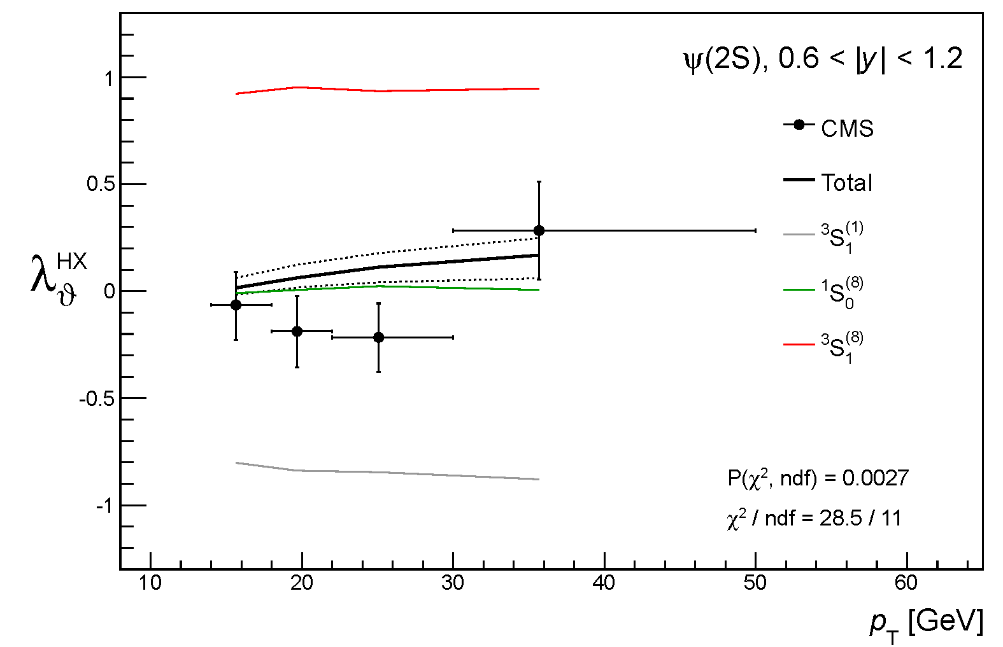
Global fit, p_{T} > 11 GeV
ψ(2S)
¹S₀⁽⁸⁾ dominates
polarization quite close to data
P(χ²)
2.7E-3

Slide 29
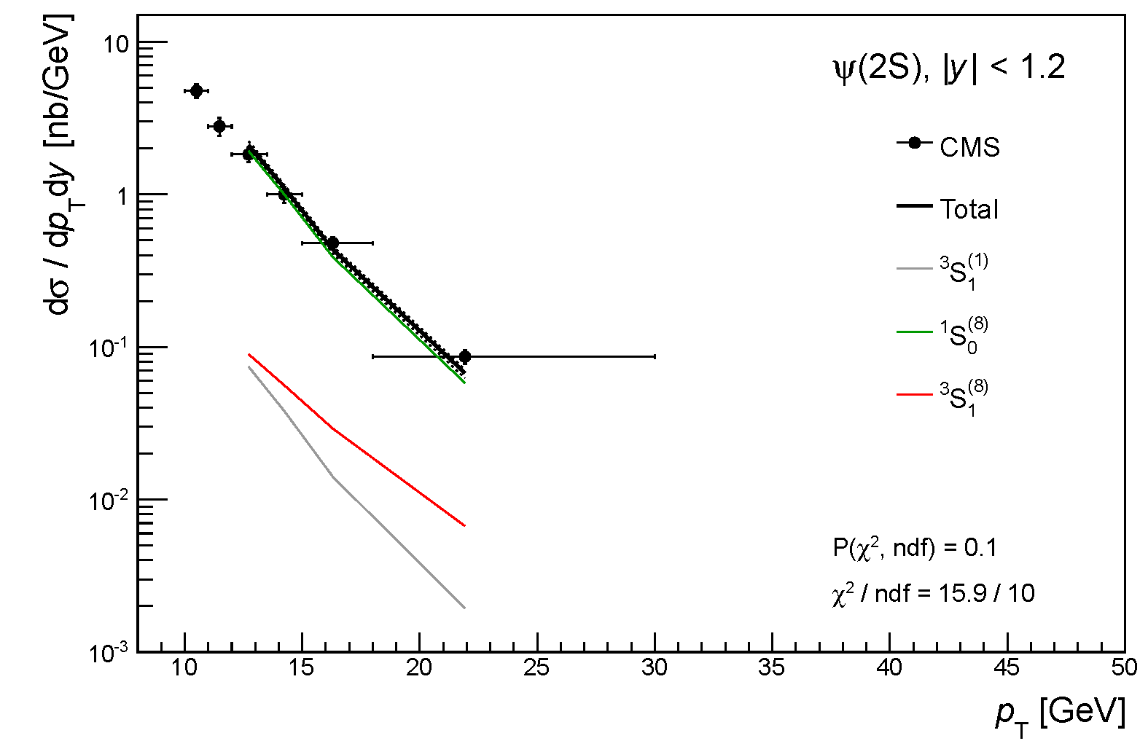
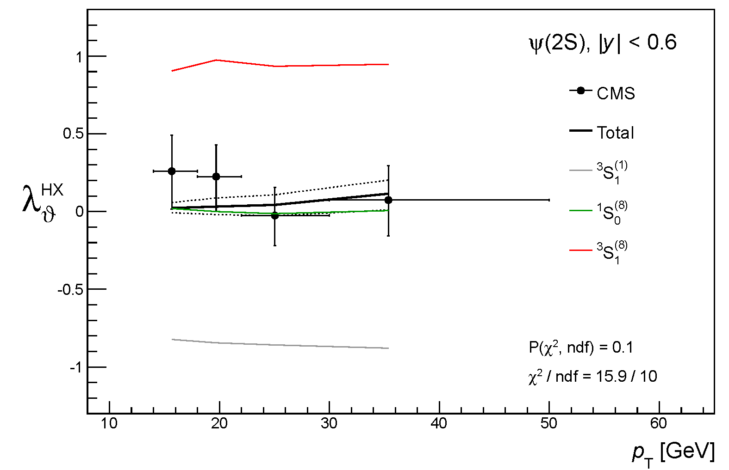
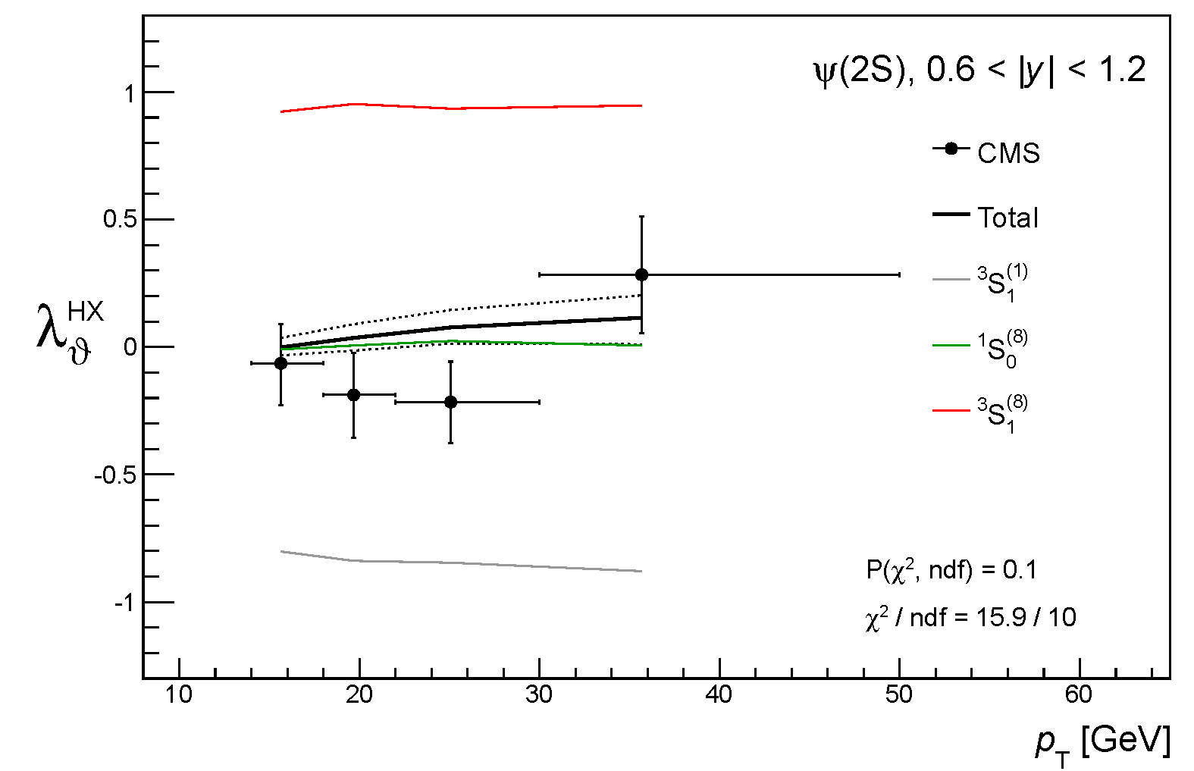
Global fit, p_{T} > 12 GeV
ψ(2S)
¹S₀⁽⁸⁾ dominates
results are stable
P(χ²)
10%

Slide 30
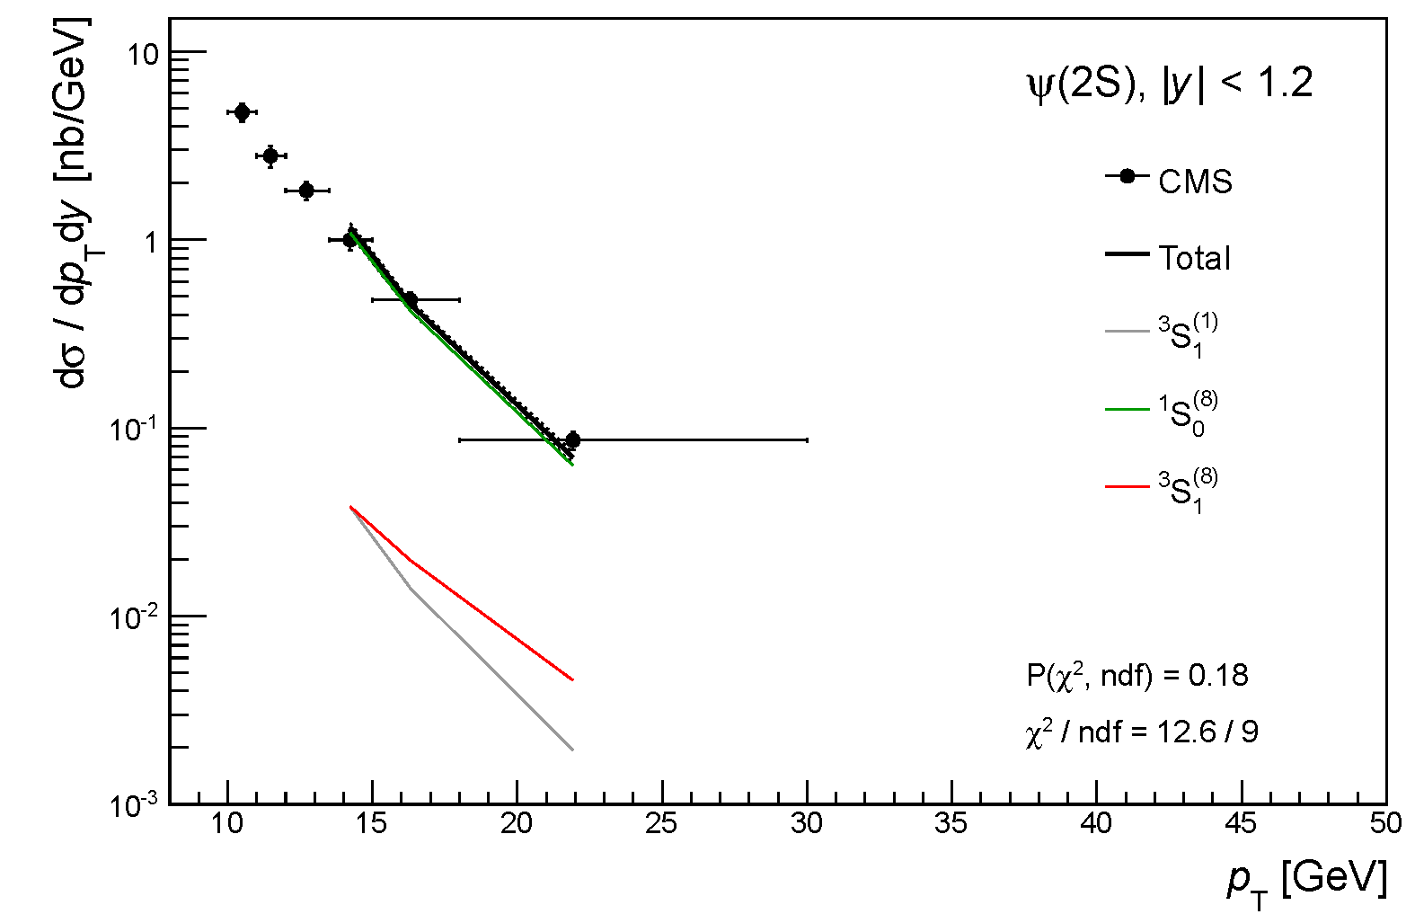
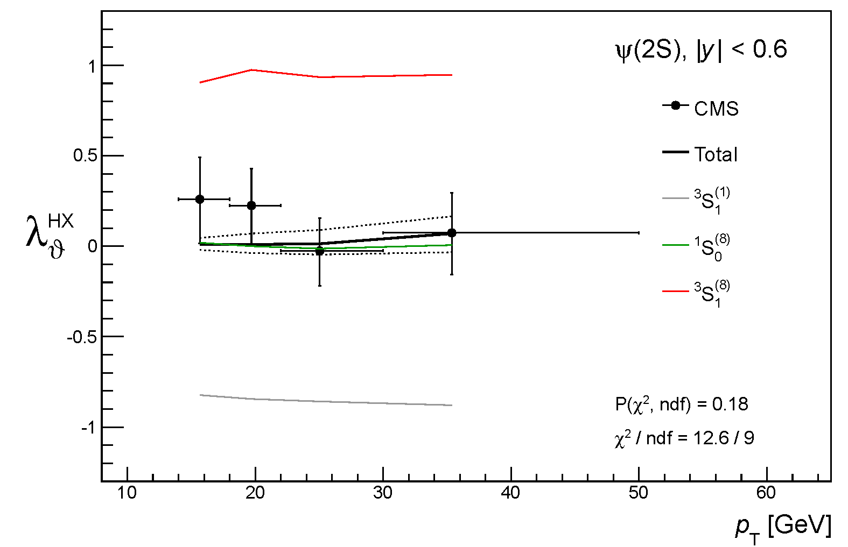
Global fit, p_{T} > 13 GeV
ψ(2S)
¹S₀⁽⁸⁾ dominates
good agreement with data
P(χ²)
18%

Slide 31
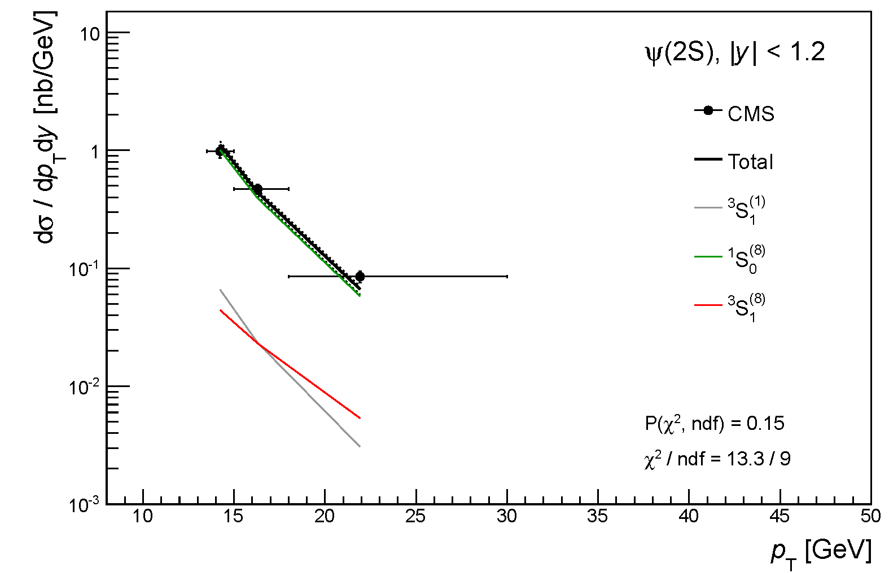
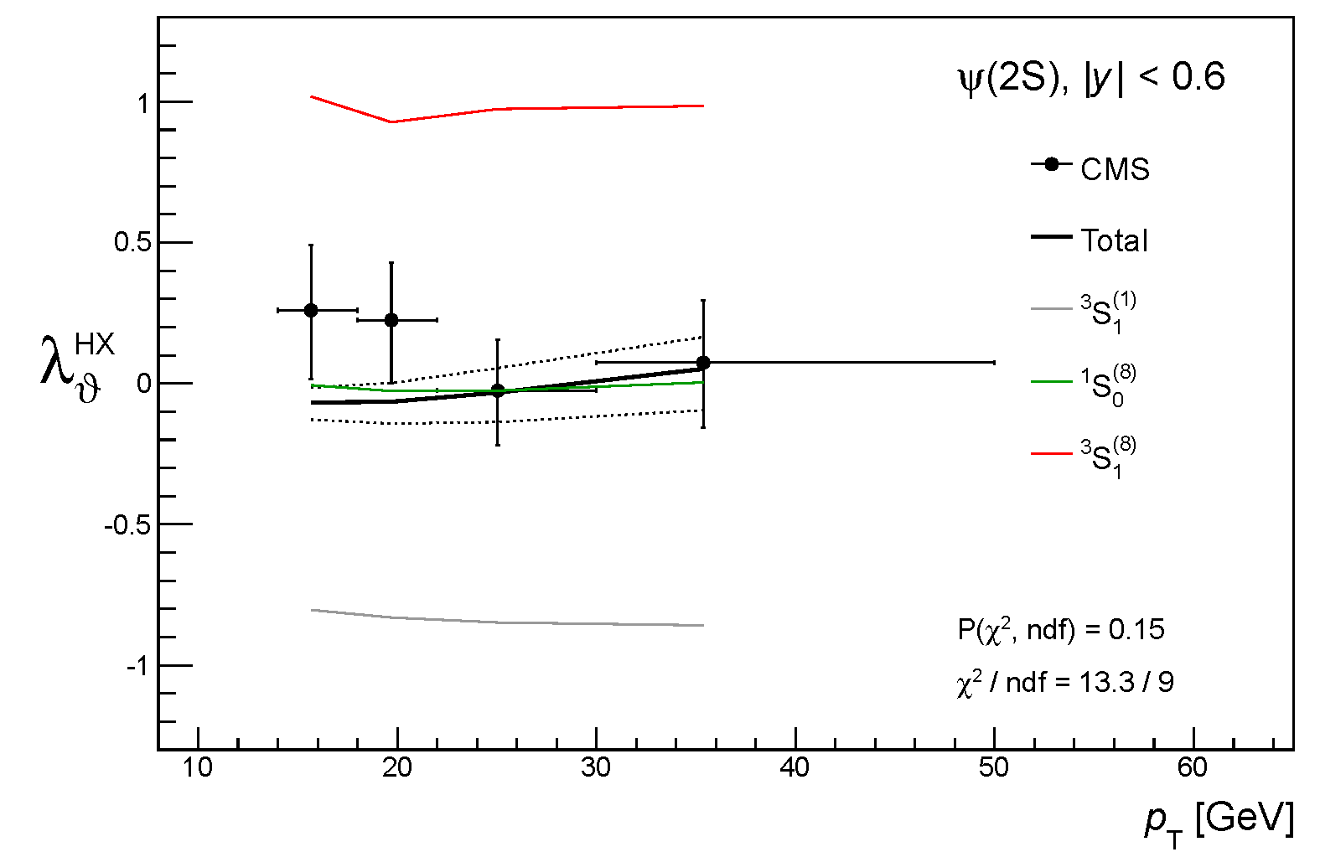
Global fit, p_{T} > 13 GeV
ψ(2S)
Improvements w.r.t. previous slide:
SDC curves rescaled by M_{H} / 3 GeV
theoretical uncertainties added (from difference NLO-LO)
Most correct fit procedure, so far…
Note: for the ψ(2S) p_{T} = 13 GeV → p_{T} / M = 3.5
¹S₀⁽⁸⁾ dominates
good agreement with data
P(χ²)
15%

Slide 32
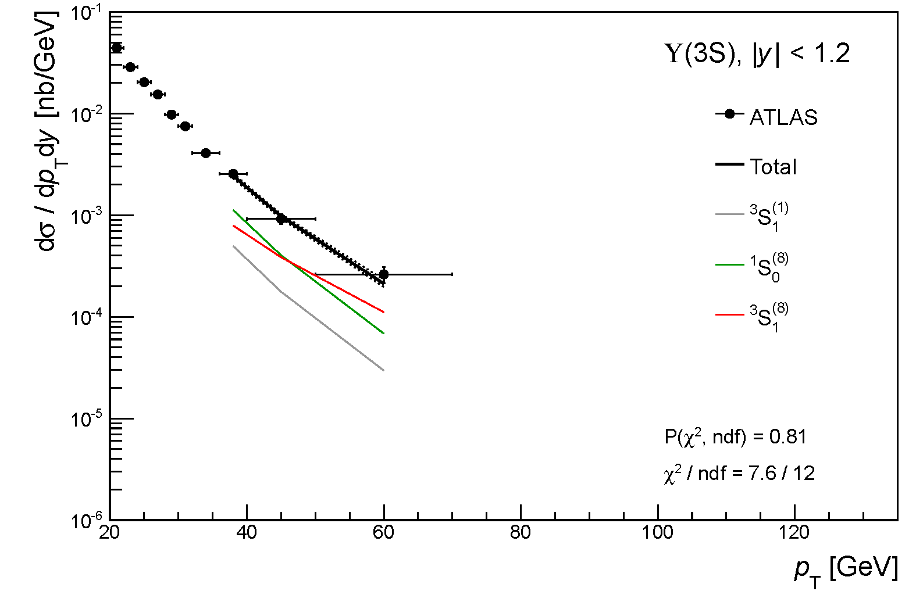
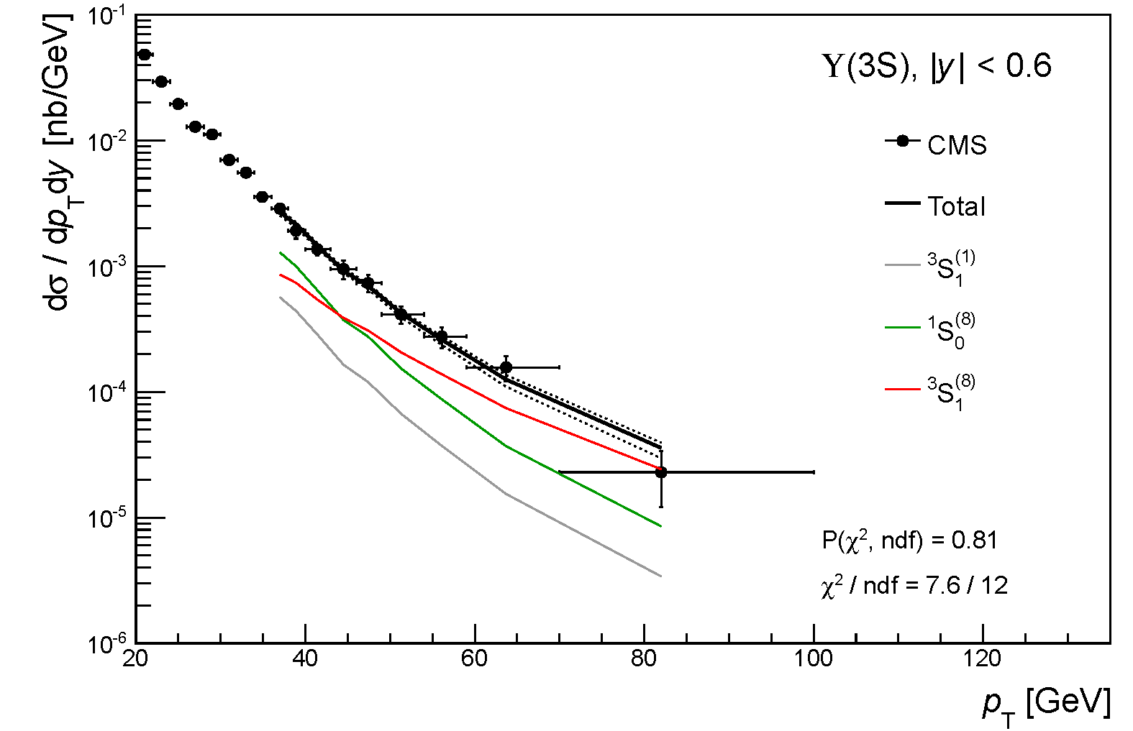
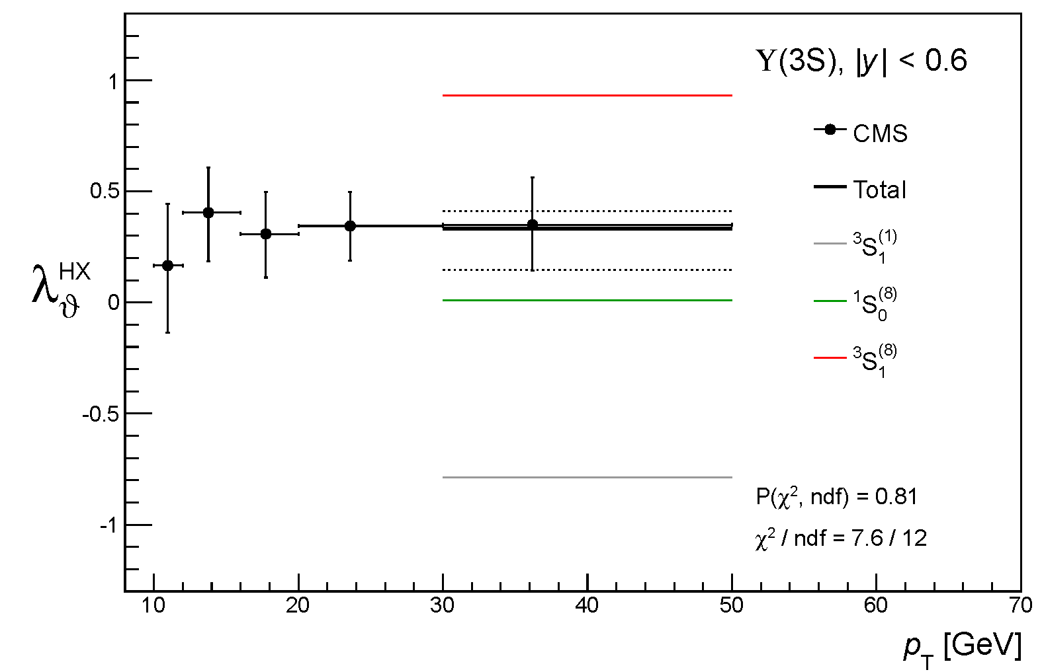
Global fit, p_{T} / M > 3.5
ϒ(3S)
Same fit procedure, applied to the ϒ(3S) meson
ATLAS
will ³S₁⁽⁸⁾ dominate at higher p_{T} ?
transverse polarization for the ϒ(3S) ?
P(χ²)
81%

Slide 33
Extrapolating polarization to higher p_{T}
Color bands reflect experimental and theoretical uncertainties (to be taken seriously)
ψ(2S)
ϒ(3S)
data points used in the fits

Slide 34
Extrapolating polarization to higher p_{T}
Color bands reflect experimental and theoretical uncertainties (to be taken seriously)
ψ(2S)
ϒ(3S)
data points used in the fits
plus NLO NRQCD “standard” predictions

Slide 35
Extrapolating polarization to higher p_{T}
Color bands reflect experimental and theoretical uncertainties (to be taken seriously)
J/ψ+ψ(2S)
ϒ(1S)+ϒ(2S)+ϒ(3S)
data points used in the fits
plus NLO NRQCD “standard” predictions
plus 1S and 2S measurements (not included in the fis)

Slide 36
Summary
Instead of asking if NRQCD is the correct theory, we search for its domain of validity: above which p_{T} / M does it describe the data?
We move the polarization data from the periphery to the center of the study, realizing that it is the most stringent constraint in discriminating the theory terms
This “Copernican revolution” provides a simple solution to the puzzle !
And comes together with several nice features: - the fits are stable and the results evolve continuously with the p_{T} / M cut
- the results do not involve negative cross sections nor unphysical polarizations (λ_{θ} > 1)
- and are insensitive to the lack of perturbative convergence of the mysterious ³P_{J} octet
The path for further progress includes:
= new measurements at high p_{T} and of the P-wave polarizations
= more efforts in understanding the P-octet term
Many thanks to Mathias Butenschön and Bernd Kniehl for kindly providing their detailed calculations and to Sergei Baranov and Geoff Bodwin for many discussions

