Slide 1
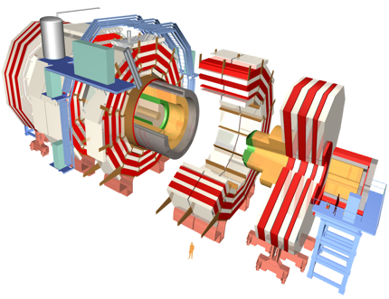
Quarkonium production and polarization in pp collisions with CMS
Valentin Knünz* (HEPHY Vienna)
on behalf of CMS
Hard Probes 2013
Stellenbosch, South Africa
*Supported by FWF grant P 24167-N16

Slide 2
The big picture in a nutshell
Hadron formation… a mystery within the SM; “QCD is full of surprises and challenges” (J. Lykken)
V(r)
“Confining”
r
“Coulomb”
Almost all the visible matter in the universe is made of hadrons; the Higgs mechanism deals with only 0.1% of the total mass…

Slide 3
The big picture in a nutshell
Quarkonia are the QCD analogues of the positronium
Hadron formation… a mystery within the SM; “QCD is full of surprises and challenges” (J. Lykken)
Quarkonium production… is an ideal probe to study hadron formation
bottomonium
= bb states
_
red
quarkonium production
green
anti red
anti blue

Slide 4
The big picture in a nutshell
Hadron formation… a mystery within the SM; “QCD is full of surprises and challenges” (J. Lykken)
Quarkonium production… is an ideal probe to study hadron formation
As will be explained in detail later in this talk,
NRQCD calculations fit p_{T}-differential cross sections to extract long-distance matrix elements (LDMEs) and then predict the quarkonium polarization
The pre-LHC polarization measurements (affected by some inconsistencies) were left out of the LDME fits
LHC cross sections and polarizations can provide significant improvements: more reliable analysis methods and higher p_{T} reach

Slide 5
The big picture in a nutshell
Hadron formation… a mystery within the SM; “QCD is full of surprises and challenges” (J. Lykken)
Quarkonium production… is an ideal probe to study hadron formation
As will be explained in detail later in this talk,
NRQCD calculations fit p_{T}-differential cross sections to extract long-distance matrix elements (LDMEs) and then predict the quarkonium polarization
The pre-LHC polarization measurements (affected by some inconsistencies) were left out of the LDME fits
LHC cross sections and polarizations can provide significant improvements: more reliable analysis methods and higher p_{T} reach
The present results are limited to S-wave states, affected by feed-down from P-wave decays…
Next measurements: cross sections, feed-down fractions and polarizations of P-wave quarkonia
bottomonium
= bb states
_
γ
γ
γ

Slide 6
CMS: excellent performance in quarkonium reconstruction
Υ ➝ μ⁺μ⁻
χ_{c} ➝ J/ψ + γ
Photon energy resolution
Dimuon mass resolution
CMS PAS-BPH-12-006
EPJC 72 (2012) 2251
Υ ➝ μ⁺μ⁻
High-p_{T} coverage
J/ψ ➝ μ⁺μ⁻
Huge silicon tracker
Very strong field
Broad acceptance
Flexible trigger
Powerful DAQ
Vertexing and decay length resolution
CMS PAS-BPH-12-006
arXiv:1307.6070

Slide 7
S-wave cross sections and P-wave ratios
The Y(nS) differential cross sections were measured in the p_{T} range 10–100 GeV (!) for |y| < 0.6
Acceptance corrections depend on polarization; using the measured polarizations reduced the biggest uncertainty of previous measurements
The three S states show similar patterns; P-wave feed-down contribution does not seem to significantly affect the p_{T} trends
χ_{c} ➝ J/ψ + γ
EPJC 72 (2012) 2251
Υ ➝ μ⁺μ⁻
The photons emitted in χ decays have ~1% probability to convert and be reconstructed in the silicon tracker
The e⁺e⁻ tracking provides ~5 MeV mass resolution, crucial to resolve the two states
Efficiencies cancel almost completely in the χ_{c2} / χ_{c1} cross-section ratio
CMS PAS-BPH-12-006

Slide 8
Results on P-wave charmonia
The χ_{c2} / χ_{c1} cross-section ratio has been measured vs. p_{T}, up to much higher p_{T} and with smaller uncertainties than previous measurements Systematic uncertainties are dominated by fit to mass distribution
To compare with theory calculations: - the photon p_{T} distribution was extrapolated down to 0 GeV - care is needed regarding assumed polarizations, that can significantly change the result
χ_{c2}
χ_{c1}
B χ_{c2}
B χ_{c1}
|y(J/ψ)| < 1.0
p_{T}(γ) > 0.5 GeV
|y(J/ψ)| < 1.0
p_{T}(γ) > 0 GeV
band: syst. uncertainty
EPJC 72 (2012) 2251

Slide 9
Results on P-wave bottomonia
The χ_{b2}(1P) / χ_{b1}(1P) cross-section ratio has been measured vs. p_{T}, for the first time in a hadron collider
Systematic uncertainties are dominated by fit to mass distribution
Mass resolution of 5 MeV resolves the two peaks, separated by only 19 MeV
NEW
Cross-section ratio seems to be rather flat with p_{T}
No low-p_{T} increase, contrary to the theory prediction of Likhoded et al., PRD 86 (2012) 074027
PRD 86 (2012) 084027
|y(Y)| < 1.5
|η(γ)| < 1
band: total uncertainty
CMS--PAS-‐BPH-‐13-‐005

Slide 10
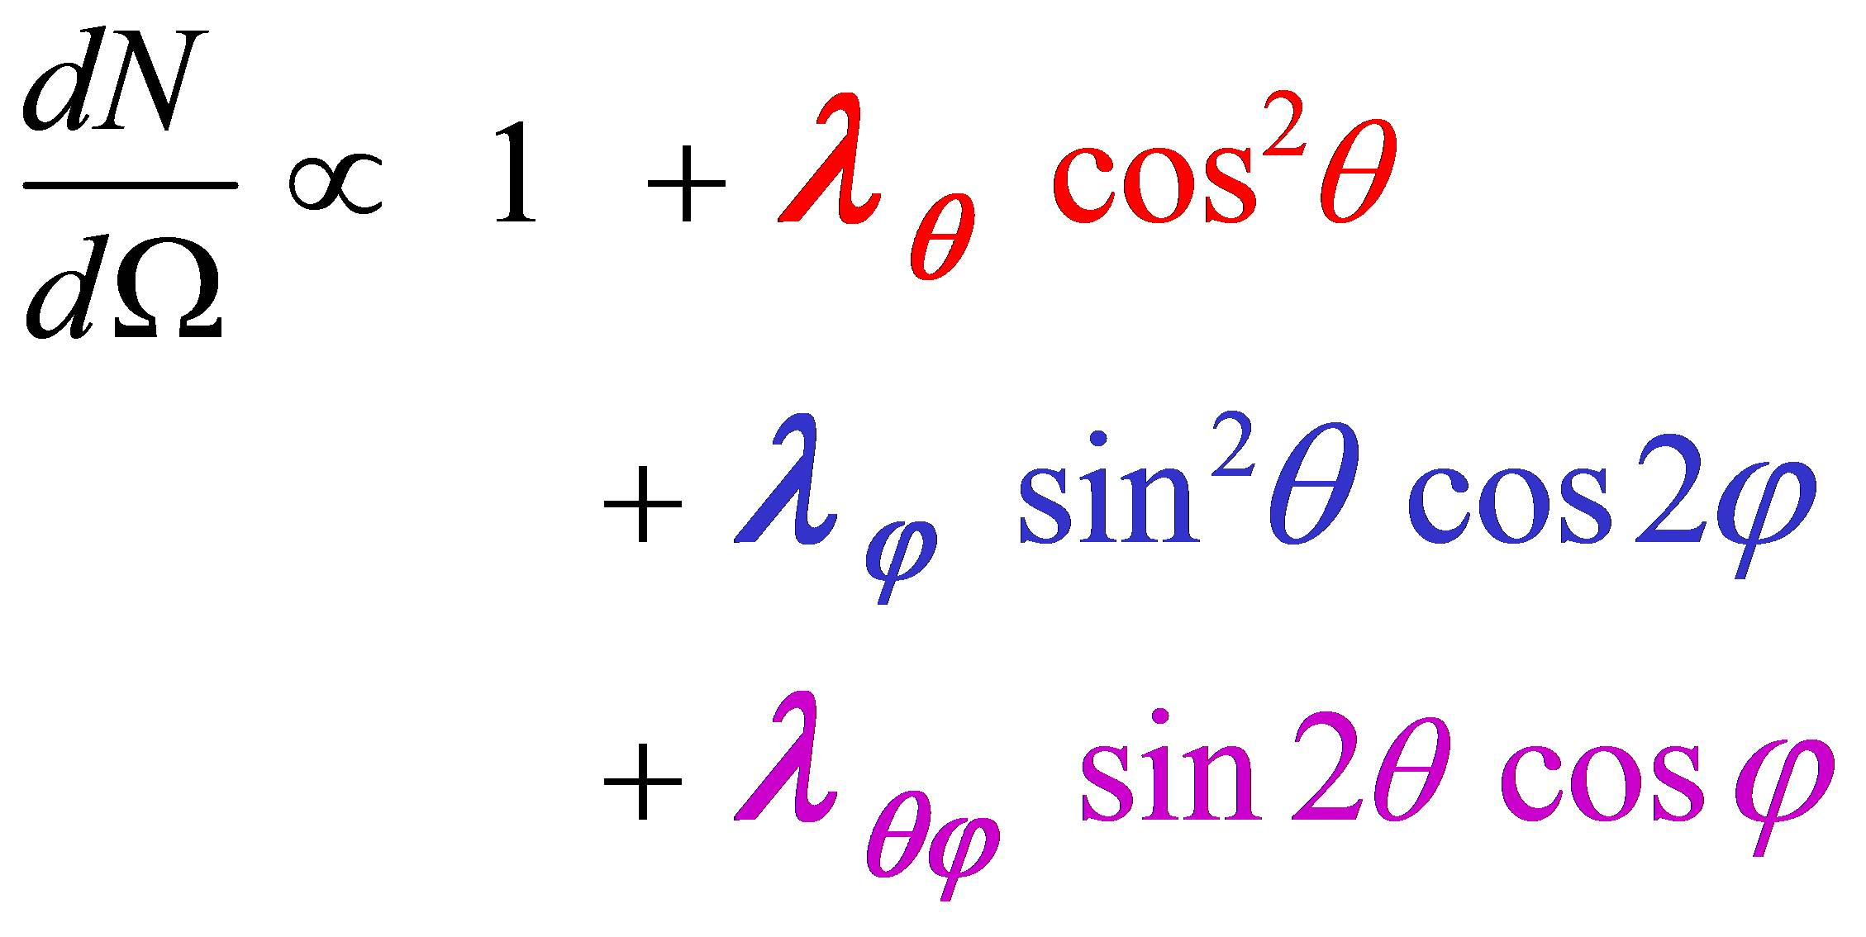
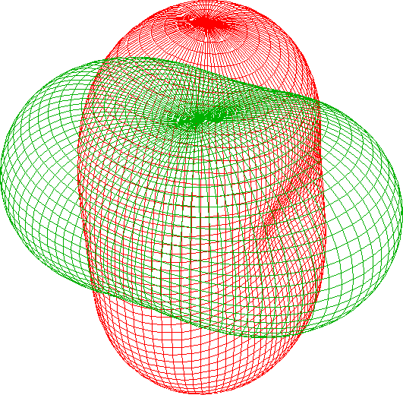
Quarkonium polarization analyses
Quarkonia polarizations are measured from the angular decay distributions in dimuon decays
We measure the full angular distribution and report the λ_{θ}, λ_{φ} and λ_{θφ} polarization parameters (in 3 frames)
J_{z} = ± 1
λ_{θ} = +1
J_{z} = 0
λ_{θ} = −1

Slide 11
Quarkonium polarization analyses
Quarkonia polarizations are measured from the angular decay distributions in dimuon decays
We measure the full angular distribution and report the λ_{θ}, λ_{φ} and λ_{θφ} polarization parameters (in 3 frames) for five S states, vs. p_{T} and in several |y| ranges
J_{z} = ± 1
λ_{θ} = +1
J_{z} = 0
λ_{θ} = −1
Y(1S)
Y(2S)
Y(3S)
PRL 110 (2013) 081802

Slide 12
Quarkonium polarization analyses
Quarkonia polarizations are measured from the angular decay distributions in dimuon decays
We measure the full angular distribution and report the λ_{θ}, λ_{φ} and λ_{θφ} polarization parameters (in 3 frames) for five S states, vs. p_{T} and in several |y| ranges
The underlying continuum background is removed using invariant mass distribution; and the non-prompt charmonia using the decay length
PRL 110 (2013) 081802
Y(1S)
Y(2S)
Y(3S)
arXiv:1307.6070

Slide 13
Quarkonium polarization analyses
Quarkonia polarizations are measured from the angular decay distributions in dimuon decays
We measure the full angular distribution and report the λ_{θ}, λ_{φ} and λ_{θφ} polarization parameters (in 3 frames) for five S states, vs. p_{T} and in several |y| ranges
The underlying continuum background is removed using invariant mass distribution; and the non-prompt charmonia using the decay length
Main experimental challenges:
precise mapping of (di)muon efficiencies (T&P)
reliable background modeling (sidebands) Uncertainties are dominated by systematics at low p_{T} and by statistics at high p_{T}
PRL 110 (2013) 081802

Slide 14
Quarkonium polarization results
No strong anisotropies seen in any of the measurements
arXiv:1307.6070
PRL 110 (2013) 081802
Polar anisotropy
Charmonia
Bottomonia
Azimuthal anisotropy
Total uncertainties at 68.3% CL

Slide 15
Quarkonium polarization results
No strong anisotropies seen in any of the measurements
arXiv:1307.6070
PRL 110 (2013) 081802
Polar anisotropy
Charmonia
Bottomonia
Azimuthal anisotropy
Total uncertainties at 68.3% CL

Slide 16
Quarkonium polarization results
No strong anisotropies seen in any of the measurements
arXiv:1307.6070
PRL 110 (2013) 081802
Polar anisotropy
Charmonia
Bottomonia
Azimuthal anisotropy
Total uncertainties at 68.3% CL

Slide 17
Quarkonium polarization results
No strong anisotropies seen in any of the measurements
arXiv:1307.6070
PRL 110 (2013) 081802
Polar anisotropy
Charmonia
Bottomonia
Azimuthal anisotropy
Total uncertainties at 68.3% CL

Slide 18
Quarkonium polarization results
No strong anisotropies seen in any of the measurements
Good consistency between CMS, LHCb, ALICE
arXiv:1307.6070
arXiv:1307.6379
PRL 108 (2012) 082001
PRL 110 (2013) 081802
Polar anisotropy
Charmonia
Bottomonia
Azimuthal anisotropy
Total uncertainties at 68.3% CL

Slide 19
Quarkonium polarization results
No strong anisotropies seen in any of the measurements
Good consistency between CMS, LHCb, ALICE and CDF
arXiv:1307.6070
arXiv:1307.6379
PRL 108 (2012) 082001
PRL 110 (2013) 081802
PRL 108 (2012) 151802
Polar anisotropy
Charmonia
Bottomonia
Azimuthal anisotropy
Total uncertainties at 68.3% CL

Slide 20
The NRQCD factorization approach
NRQCD is an effective field theory that factorizes quarkonium production in two steps:
production of the initial quark-antiquark pair (perturbative QCD)
hadronization of the quark pair into a bound quarkonium state (non-perturbative QCD)
The SDCs can be calculated perturbatively while the LDMEs are determined from fitting data.
The LDMEs are (assumed to be) universal constants and should follow a hierarchy in powers of v, the relative velocity of the quark pair in the quarkonium system
For S-state production, the ¹S₀, ³S₁ and ³P_{J} octet terms “scale” with v⁴; the other LDMEs are suppressed
n = ^{2S+1}L_{J}^{[C]} , C = 1,8
Quantum numbers of the heavy quark pair
S, L, J = spin, orbital and total ang. momentum
Short-distance coefficients (SDC)
Long-distance matrix elements (LDME)

Slide 21
CMS data vs. NLO NRQCD: Y(nS)
arXiv:1305.0748
Gong et al. use hadroproduction data, including the CMS Y(nS) polarization results, to fit the CO LDMEs
The Y(1S) and Y(2S) predictions include the effect of feed-down decays of P-wave states, while the Y(3S) is assumed to be 100% directly produced
The unknown feed-down fractions and polarizations of the P states give the model the freedom needed to fit the Y(1S) and Y(2S) polarizations
λ_{θ}
λ_{θ}
λ_{θ}
PRL 110 (2013) 081802

Slide 22
CMS data vs. NLO NRQCD: J/ψ
PRL 108 (2012) 172002 + private communication
Butenschön and Kniehl use hadro- and photo-production data, excluding polarization results, to fit the color octet LDMEs; feed-down decays are not accounted for
O(³S₁^{[1]}) = 1.32 GeV³
O(¹S₀^{[8]}) = 0.0497 GeV³
O(³S₁^{[8]}) = 0.00224 GeV³
O(³P_{J}^{[8]}) = −0.0161 GeV⁵
The ³S₁ and ³P_{J} octet terms dominate dσ/dp_{T} at high p_{T} transverse polarization is predicted
This prediction fails to describe the CMS measurements
JHEP 02 (2012) 011
arXiv:1307.6070
Many thanks to Mathias Butenschön and Bernd Kniehl for sending us their calculations and explaining them in detail

Slide 23
CMS data vs. NLO NRQCD: ψ(2S)
PRL 108 (2012) 172002 + private communication
Butenschön and Kniehl use hadro- and photo-production data, excluding polarization results, to fit the color octet LDMEs; ψ(2S) is the only S-wave quarkonium unaffected by feed-down decays
O(³S₁^{[1]}) = 0.76 GeV³
O(¹S₀^{[8]}) = −0.00247 GeV³
O(³S₁^{[8]}) = 0.00280 GeV³
O(³P_{J}^{[8]}) = 0.00168 GeV⁵
The ³S₁ octet term dominates dσ/dp_{T} at high p_{T}
transverse polarization is predicted
This prediction fails to describe the CMS measurements The ¹S₀^{[8]} and ³P_{J}^{[8]} terms have negative SDC x LDME
JHEP 02 (2012) 011
arXiv:1307.6070
Many thanks to Mathias Butenschön and Bernd Kniehl for sending us their calculations and explaining them in detail

Slide 24
Summary
Cross sections and polarizations have been measured for five S-wave quarkonium states in pp collisions at √s = 7 TeV
Y(1S), Y(2S) and Y(3S)
both cross sections and polarizations measured with 4.9 fb⁻¹ of data collected in 2011
J/ψ and ψ(2S)
cross sections measured with only 37 pb⁻¹ of data, collected in 2010 data
polarizations measured with 4.9 fb⁻¹ of data collected in 2011
The χ_{c2} / χ_{c1} and χ_{b2}(1P) / χ_{b1}(1P) cross-section ratios have also been measured, at 7 and 8 TeV, respectively
The menu will “soon” be complemented with more 8 TeV measurements:
cross sections and feed-down fractions of P-wave states (χ_{c} and χ_{b})
polarizations of P-wave states (χ_{c1} ; χ_{c2} ; etc)
J/ψ and ψ(2S) cross sections up to very high p_{T}
all information in
twiki/bin/view/CMSPublic/PhysicsResultsBPH

Slide 25
Further reading
NEW
J/ψ and ψ(2S) production cross sections
CMS, EPJC 71 (2011) 1575 [L = 314 nb⁻¹, 7 TeV]
CMS, JHEP 02 (2012) 011 [L = 37 pb⁻¹, 7 TeV]
Υ(nS) production cross section
CMS, PRD 83 (2011) 112004 [L = 3 pb⁻¹, 7 TeV]
CMS, CMS PAS-BPH-12-006 [4.9 fb⁻¹, 7 TeV]
Relative production rate of χ_{c2} and χ_{c1} CMS, EPJC 72 (2012) 2251 [4.6fb⁻¹, 7 TeV]
Relative production rate of χ_{b2}(1P) and χ_{b1}(1P) CMS, CMS PAS‐BPH‐13‐005 [20.7 fb⁻¹, 8 TeV] (to be made public soon)
J/psi and ψ(2S) polarizations
ALICE: PRL 108 (2012) 082001 [100 nb⁻¹, 7 TeV]
CMS, arXiv:1307.6070 [4.9 fb⁻¹, 7 TeV]
LHCb: arXiv:1307.6379 [0.37 fb⁻¹, 7 TeV]
Υ(nS) polarizations
CMS, PRL 110 (2013) 081802 [4.9 fb⁻¹, 7 TeV]
CDF, PRL 108 (2012) 151802 [6.7 fb⁻¹, 1.96 TeV]
NLO NRQCD studies of ψ(nS) and Y(nS) cross sections and polarizations
M. Butenschön and B. Kniehl, PRL 108 (2012) 172002
B. Gong et al, arXiv:1305.0748

Slide 26
Backup
NEW

Slide 27
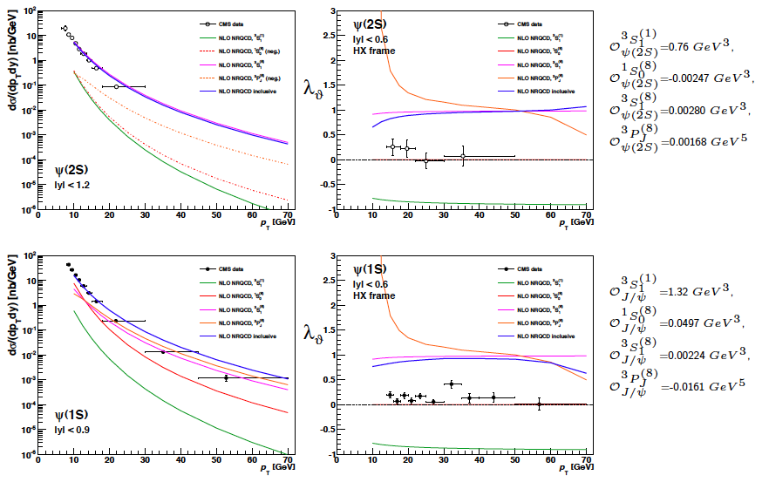
Singlet and octet terms in NRQCD at NLO
NEW

Slide 28
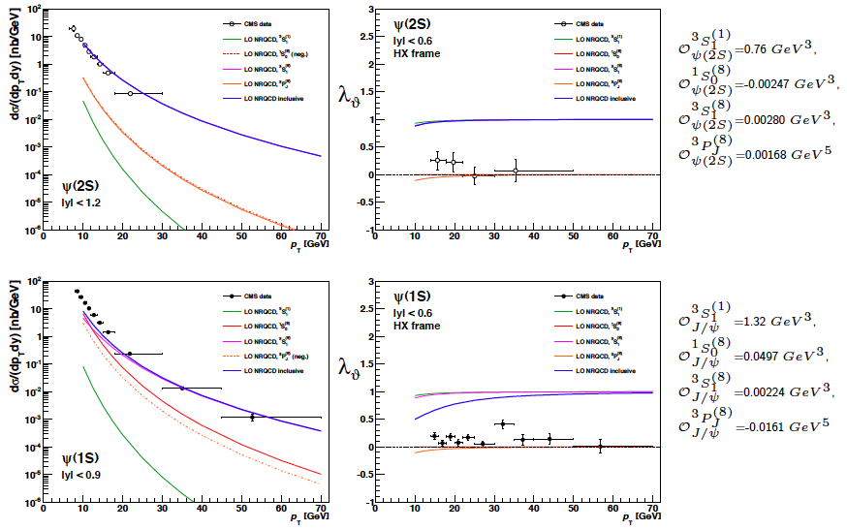
Singlet and octet terms in NRQCD at LO
NEW

