Slide 1




Azimuthal Anisotropy in U+U Collisions
Hui Wang (BNL) and Paul Sorensen (bnl)
for the STAR Collaboration

Slide 2
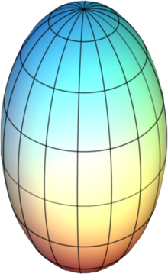
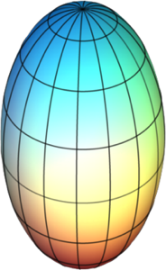
Motivation for U+U Collisions
Allows us to manipulate the initial geometry and study
How multiplicity depends on N_{part} and N_{coll}
Path-length dependence of jet quenching (and many other effects)
U+U Collisions
Au+Au Collisions
+
+
Slightly Oblate
+
Prolate
Can we preferentially select body-body or tip-tip collisions?

Slide 3
Selecting Body-Body or Tip-Tip
Since in most calculations, multiplicity depends on N_{part} and N_{coll} and since v₂ is propotional to the initial eccentricity
*idealizations
small N_{ch} and large v₂
N_{part} = 10
N_{coll} = 5
N_{part} = 10
N_{coll} = 25
large N_{ch} and small v₂
If dN/dη depends on N_{coll} or thickness, dN/dη should correlate with small v₂. →Central U+U collisions are ideal for testing particle production
Strategy: select events with few spectators (fully over-lapping), then measure v₂ vs multiplicity: how strong is the correlation?

Slide 4
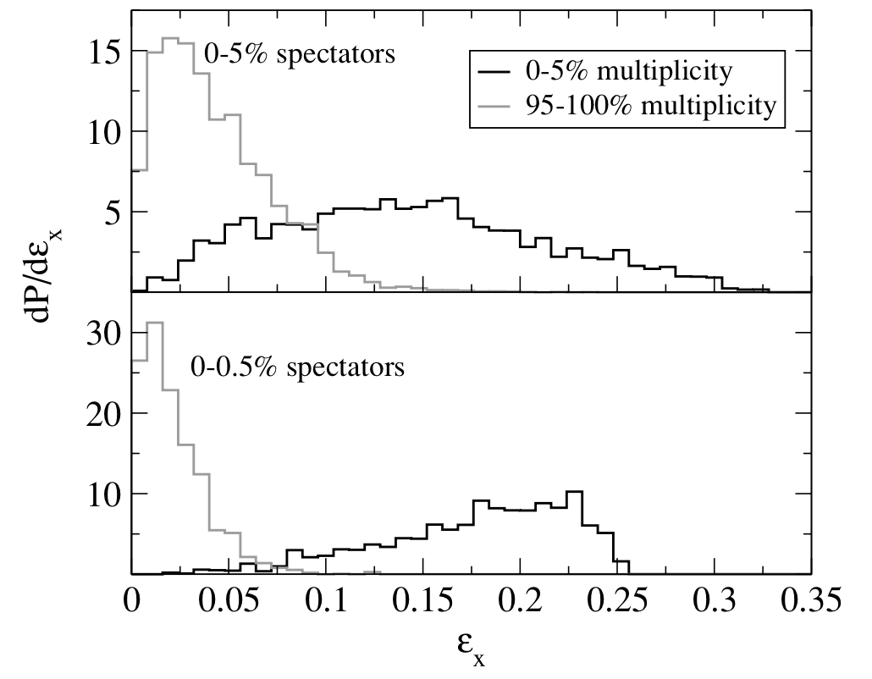
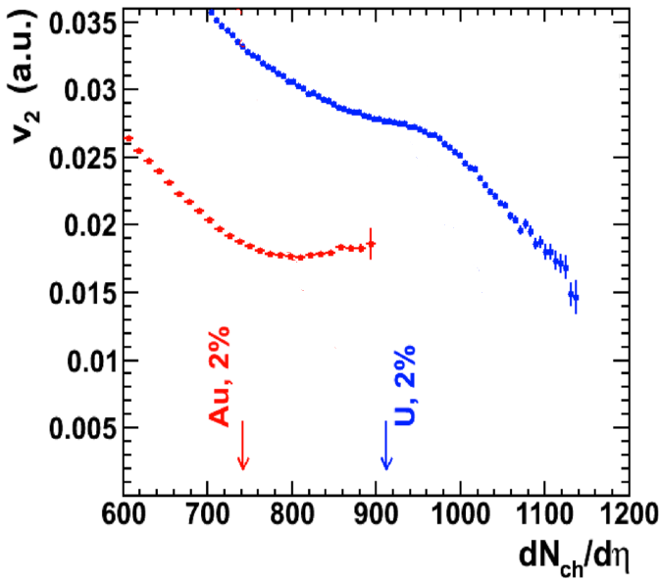
Expectations from Models
including all configurations of
impact parameters and Euler angles
0-5% fewest spectators
0-0.5% fewest spectators
highest multiplicity
lowest multiplicity
Anthony Kuhlman and Ulrich Heinz
Phys. Rev. C 72, 037901 (2005)
Sergei A. Voloshin
Phys. Rev Lett. 105, 172301 (2010)
Simulations show that after selecting most fully overlapping collisions,
  high multiplicity events correlate with small eccentricity (tip-tip)
  lower multiplicity with large eccentricity (body-body)
The correlation of tip-tip collisions with high multiplicity and small eccentricity, leads to a kink in v₂ at high dN/dη

Slide 5
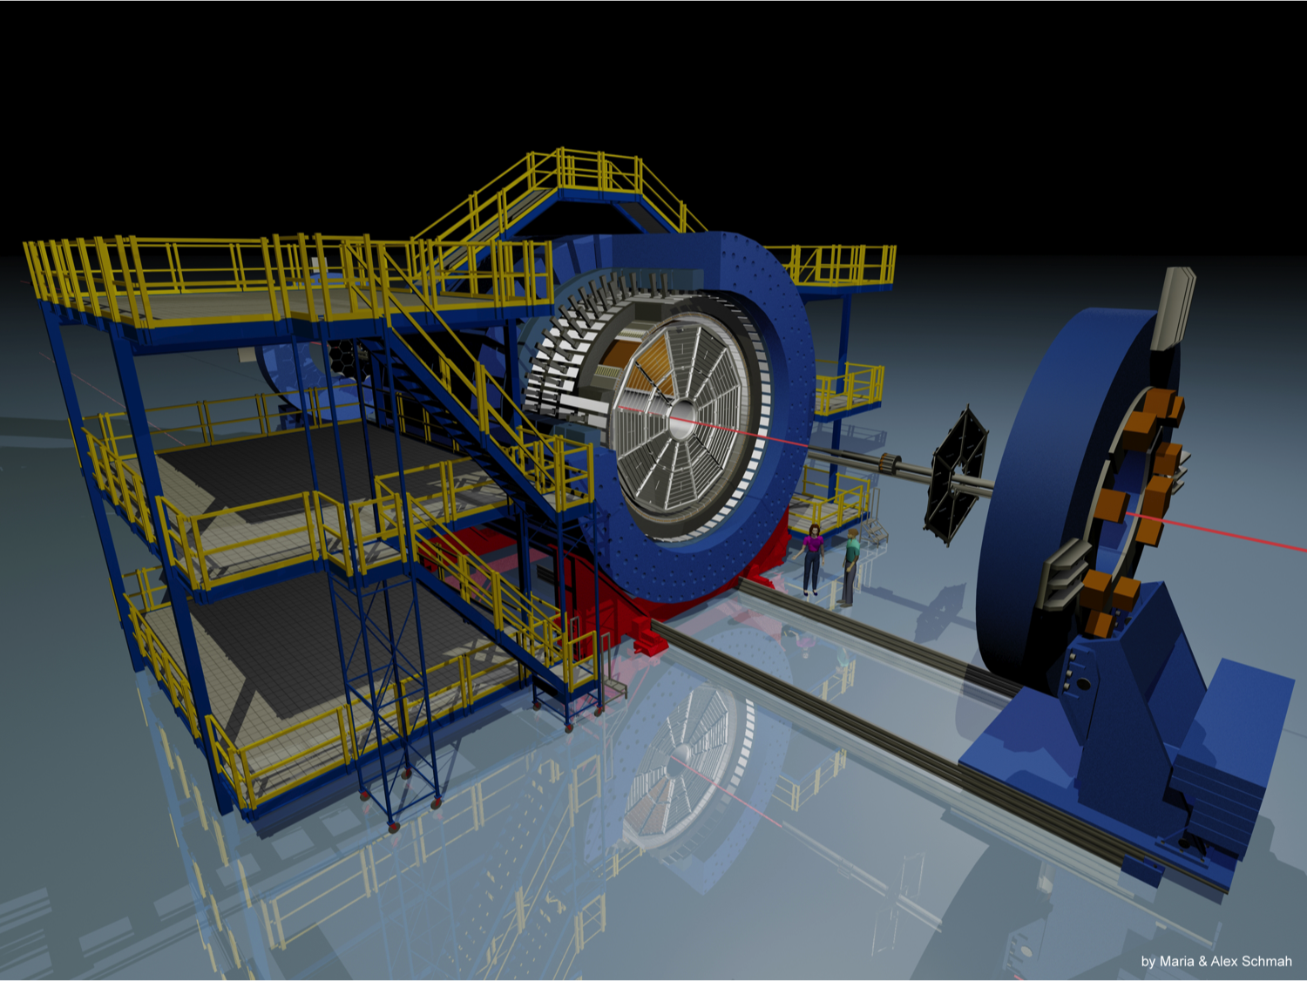
STAR Detector and Data Set
  Full azimuthal coverage
Efficient tracking
  |η| < 1.0
  p_{t} > 0.2 GeV/c
U+U data collected in a 3 week exploratory run
ZDCs counting spectator neutrons used to select central collisions
A | √s_{nn} GeV | Year | Events (x10⁶)
Au | 200 | 2011 | 700 (mini-bias)
U | 193 | 2012 | 360 (mini-bias) 13 (central 1% ZDC)
We’ve measured the efficiency corrected 2nd and 4th cumulants using Q-cumulants
Bilandzic, et. al. Phys. Rev. C 83: 044913,2011

Slide 6
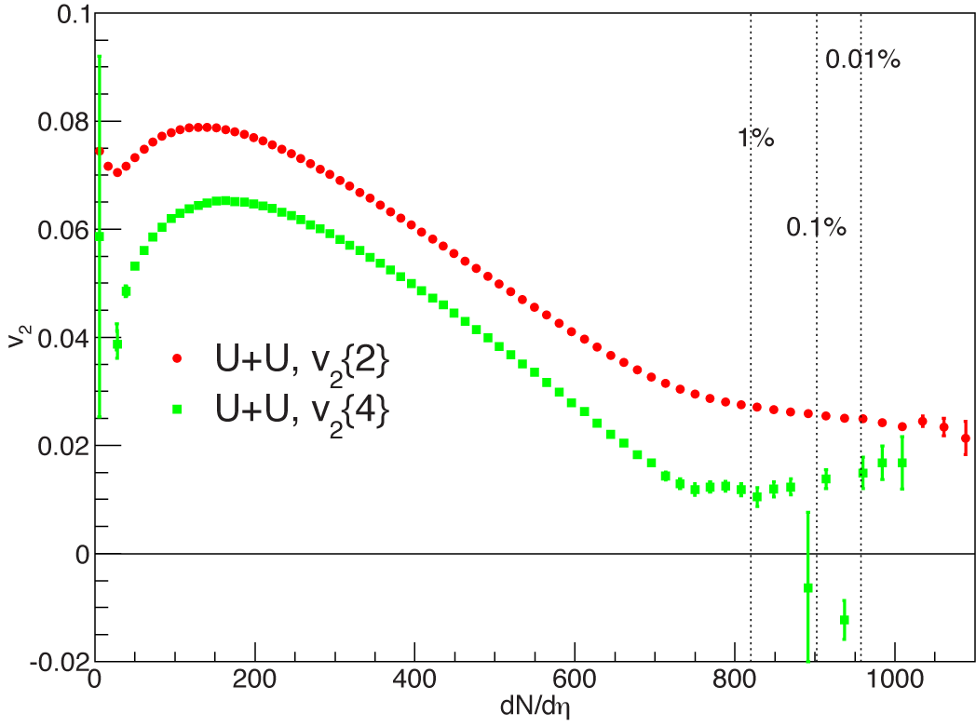
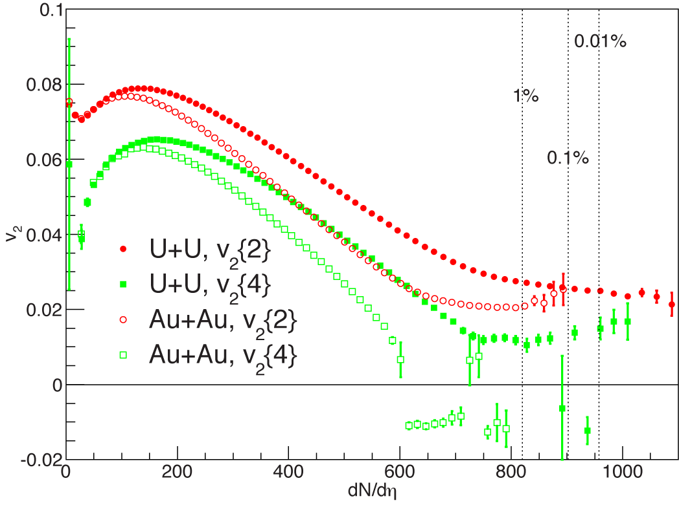

Minimum-bias U+U and Au+Au
No evidence of knee structure for central U+U
  Glauber model suggest knee structure at ~2% centrality
Knee washed out by additional multiplicity fluctuations?¹
The U+U v₂{4} results are non-zero in central
  Result of intrinsic prolate shape of the Uranium Nucleus
  Au v₂{4}⁴ becomes consistent with zero
¹Maciej Rybczyński, et. al.
Phys.Rev. C87 (2013) 044908
*Negative v₂{4}⁴ presented as negative v₂{4}
v₂{4} data: we see the prolate shape of Uranium ✓
The lack of a knee indicates a weakness in our multiplicity models

Slide 7
Glauber Model
Assume deformed Woods-Saxon distribution
Average number of particles from each nucleon follows 2-component model
Generate N_{ch} by sampling a negative binomial distribution with parameters n_{AA} and k=2
Hiroshi Masui, et. al.
Physics Letters B 679 (2009) 440–444
Species | A | R | d | β₂ | β₄ | NN cross section
Au+Au | 197 | 6.38 | 0.535 | -0.131 | -0.031 | 42
U+U | 238 | 6.81 | 0.605 | 0.28 | 0.093 | 41.2

Slide 8
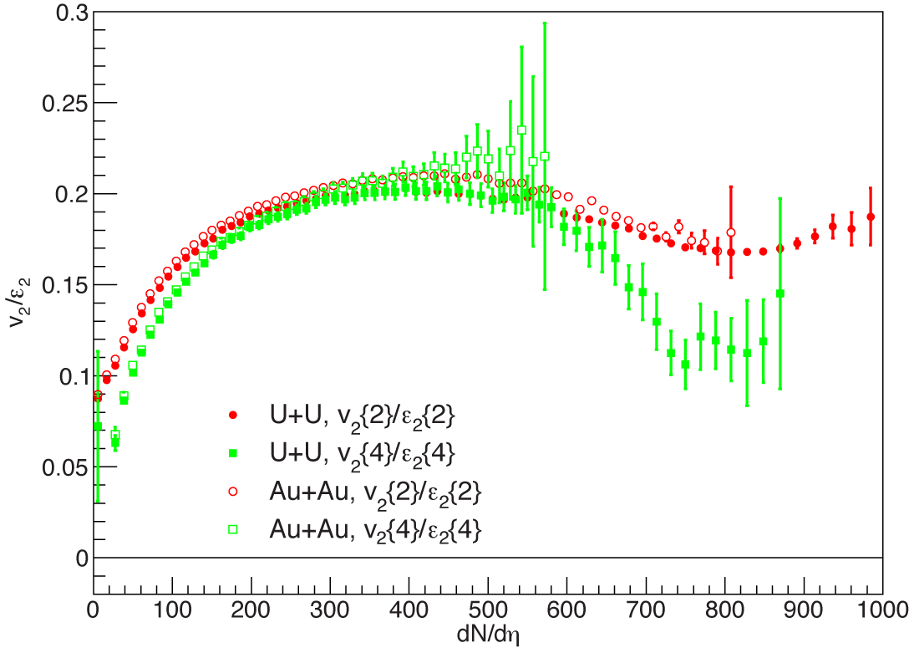
v₂/ε₂
v₂/ε₂ follows the same trend for U+U and Au+Au
  As long as the oblate shape of Au is accounted for
Instead of saturating or slowly rising, v₂/ε₂ drops in most central collisions
The drop is sharper for v₂{4}/ε₂{4}
geometry dominated by initial state physics
geometry dominated by impact parameter
Results are consistent with an overestimation of ε₂ in central collisions or deviation from v₂∝ε₂ (non-flow, hydro fluctuations?)
Very central collisions provide a stringent test of models

Slide 9
Studying Full Overlap Events
v₂
minimum bias
fully overlapping
dN/dη
Minimum bias: impact
parameter dominates
geometry and multiplicity
Central ZDC selection b->0
Au+Au dN/dη is dominated by fluctuations
    No correlation between v₂ and multiplicity
U+U dN/dη depends on nuclear geometry & fluct.
      Larger v₂ associated with small multiplicity
Use slope of v₂ vs. dN/dη in U+U to look for correlation between dN/dη and geometry
Use Au+Au as the control sample to show we are selecting full overlap

Slide 10
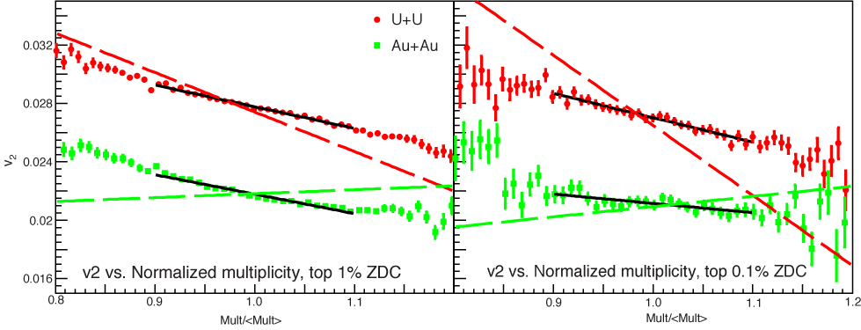
v₂ vs. Multiplicity In Fully Overlapping Events
Glauber
Mult: |η|<1
U+U
Au+Au
top 1% ZDC
top 0.1% ZDC
Mult/⟨Mult⟩
Mult/⟨Mult⟩
We expect a strong negative slope for U+U and a zero or slightly positive slope for Au+Au
  Dash lines are Glauber model eccentricities scaled by <v₂>/<ε₂>
U+U slope is weaker than models predicted, but gets stronger for tighter cuts
Au+Au slope is negative instead of positive, gets closer to zero for tighter cuts
We fit the slope to see how it evolves as the number of spectators decreases and collisions become more and more overlapping

Slide 11
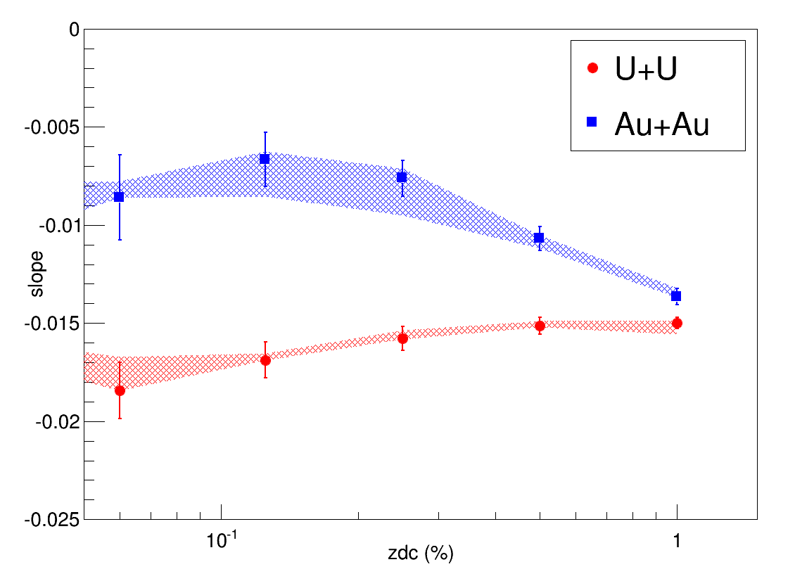
Slope vs. ZDC
%ZDC | U+U | Au+Au
0.125 | 6 | 4
0.25 | 7 | 5
0.5 | 9 | 6
1.0 | 12 | 8
2.0 | 17 | 12
Estimated number of spectator neutrons in each direction
more overlapping
fewer spectators
Systematical errors are estimated by varying fitting range and p_{t} efficiency correction
For tighter cuts, the U+U slope becomes steeper than the Au+Au control sample
Demonstrates that multiplicity is larger for tip-tip U+U collisions and can be used to select tip-tip vs body-body enhanced samples

Slide 12
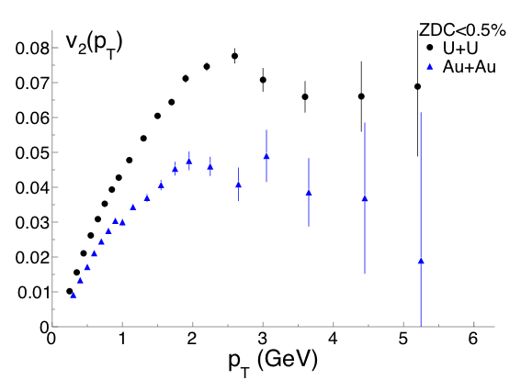
Toward Path Length Dependence of Quenching
Analysis technique:
HBT and jet-like small ∆η correlations subtracted from ⟨cos2(φ_{i}–φ_{j})⟩(∆η) for each p_{T}. See back-up.
Larger difference in-plane vs out-of-plane path length in U+U?
  Need to split U+U results into multiplicity bins (body-body vs. tip-tip)
  A larger sized data sample of central U+U events will be needed

Slide 13
Summary
No evidence of kink structure in central v₂ results from current analysis: fluctuations larger than NBD with k=2?
v₂/ε₂ turns over in central collisions for both Au+Au and U+U!?
ZDC and multiplicity in combinaation provide a way to select body-body or tip-tip enhanced samples of central U+U collisions
    High multiplicity events are biased toward tip-tip collisions, low multiplicity toward body-body
    Data show weaker correlations than model predictions: larger multiplicity fluctuations?
U+U collisions provide new opportunities to study path-length dependent jet quenching
    More statistics are necessary for detailed studies
Maciej Rybczyński, et. al., Phys.Rev. C87 (2013) 044908

Slide 14
Back Up

Slide 15
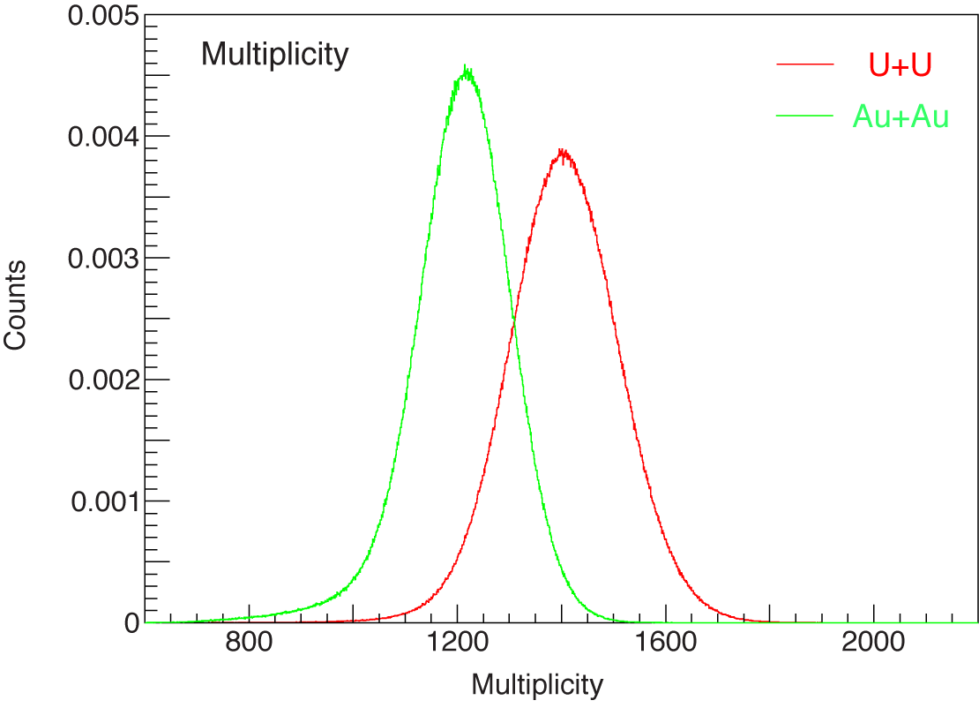
Multiplicity
The corrected multiplicity distribution for 1% central ZDC events

Slide 16
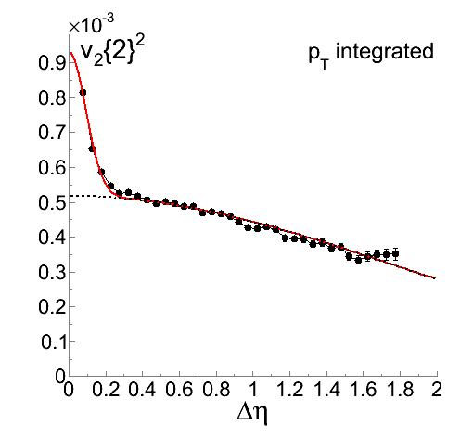
Δη dependence
The peak at small Δη is dominated by HBT at low pt and by jets at higher p_{T}
HBT peak only persists to ~0.8 GeV. At ~1.5 GeV, a distinguishable jet-like peak emerges.
We subtract the narrow peaks from our results and integrate the remaining v₂²(∆η) weighted by the number of pairs vs ∆η in each p_{T} bin. We then calculate v₂(p_{T}) using:

Slide 17
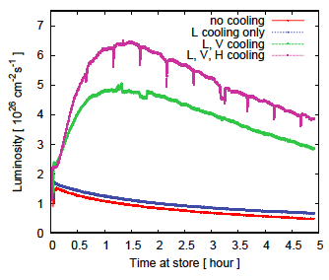
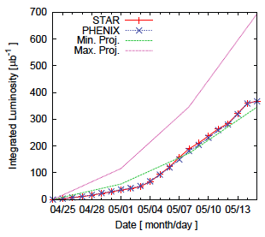
Collection of U+U data sample
goal
cooling starts
no cooling
Implementation of cooling led to huge improvement in accessible luminosity
Made achievement of goals possible

Slide 18
Studying Full Overlap Events
+
+
Impact Parameter
+
+
U+U:
Or
Or
U+U:
+
Geometry
+
Geometry
Multiplicity
Multiplicity
Au+Au:
Impact Parameter
Au+Au:
Fluctuation
Without selection on over-lapping region, the impact parameter will dominant geometry
We will see correlations between v₂ and multiplicity for both Au+Au and UU
  Larger v₂ associated with small multiplicity
With the selection on fully over-lapping region, the impact parameter effects are reduced
The multiplicity difference in Au+Au is dominant by fluctuations
  No correlation between v₂ and multiplicity
The multiplicity difference in U+U is dominant by geometry
    Larger v₂ associated with small multiplicity

Slide 19
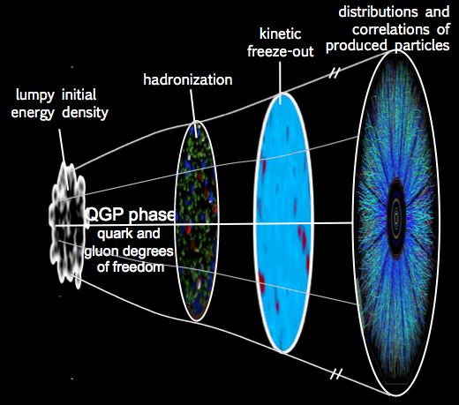
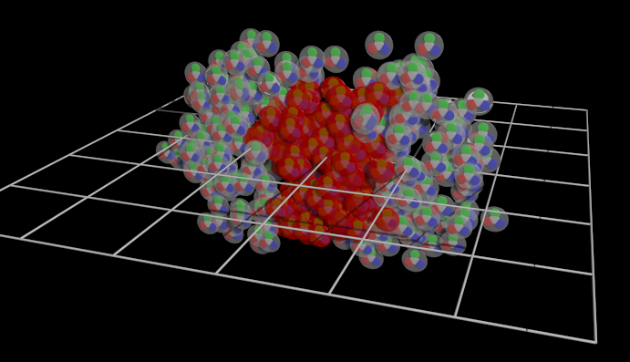
Measurements of v₂
Early spatial anisotropy leads to anisotropy in the final momentum space
  Cumulants of the ⟨e^{inφ}⟩ distribution characterize the momentum space anisotropy
We’ve measured the 2nd and 4th cumulants using the direct cumulant method
Bilandzic, et. al. Phys.Rev.C83:044913,2011

Slide 20
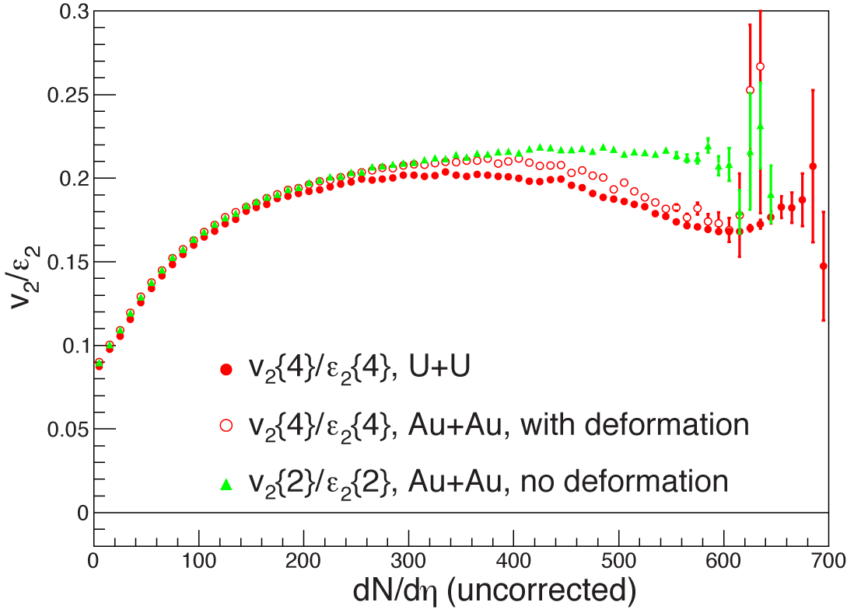
Effects of deformation in Au
QM2012
Previous study assume no deformation for Au nuclei
With deformation in Au+Au, the split between U+U and Au+Au is reduced

