Slide 1
Detail study of the medium created in Au+Au collisions with high p_{T} probes by the PHENIX experiment at RHIC
Takao Sakaguchi
Brookhaven National Laboratory
For the PHENIX Collaboration

Slide 2
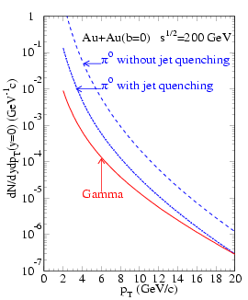
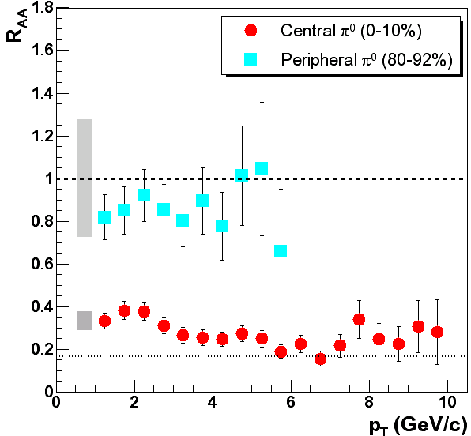
Hard scattering as densimeter
Parton may change its momentum in the medium.
Energy loss through Gluon radiation, etc..
Effect may be path-length and system dependent ~a densimeter~.
Look at leading particles of jet as a measure of jet energy.
PHENIX, π⁰ in Au+Au, PRL. 91, 072301 (2003)
π⁰ without energy loss
π⁰ with energy loss
Yield [GeV⁻¹c]
Energy loss =Yield suppress
p_{T} [GeV/c]
X.-N., Wang, PRC 58 (1998)2321

Slide 3
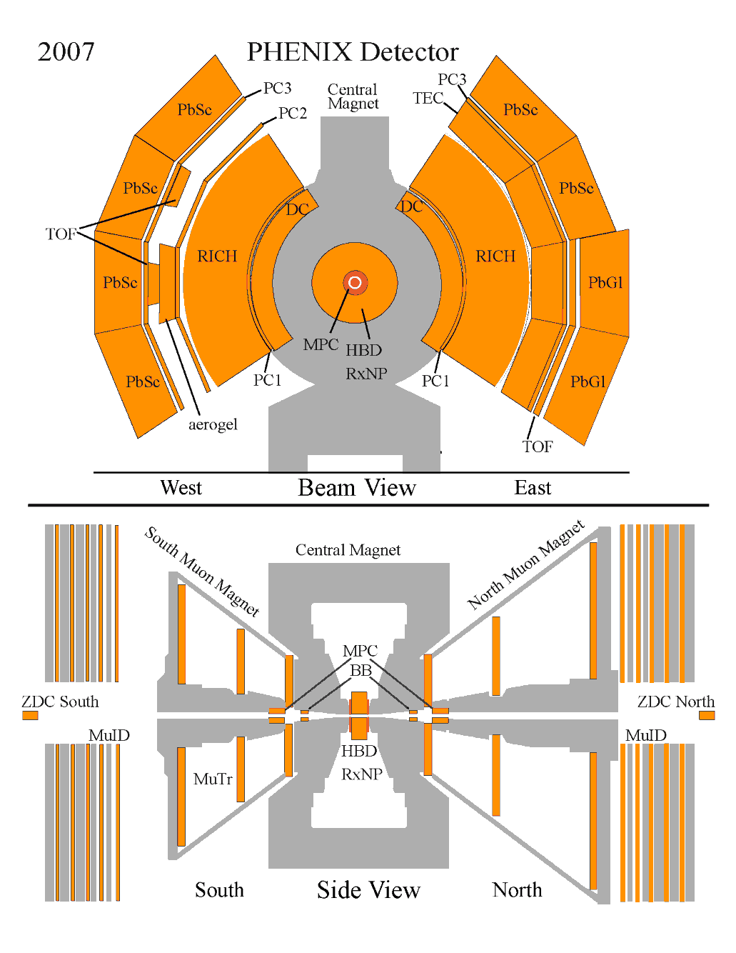
Setup for measurement
View From Beam
Event triggered by a coincidence of BBC South and BBC North.
Sitting in 3.1<|η|<3.9
π⁰ and η measurement
EMCal(PbSc, PbGl): Energy measurement and identification of real photons.
Tracking(DC, PC): Veto to Charged particles.
EMCal
View From Side
π⁰
η
Results presented here are obtained from 0.813 nb⁻¹ Au+Au 200GeV events recorded by PHENIX in 2007.

Slide 4
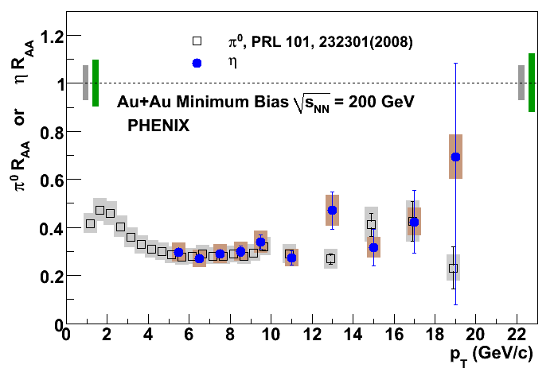
π⁰ and η R_{AA}
200GeV Au+Au collision system.
π⁰ and η nicely agree.
Very nice agreement between RHIC Year-2004 and 2007 results for π⁰.
PRC87, 034911 (2013)
Black: Year-2004, Red: Year-2007
MinBias
0-10%
Black- 2004
Red - 2007
PRC82, 011902(R) (2010)
20-30%
40-50%
MinBias, Black: π⁰, Blue: η
60-70%
80-93%

Slide 5
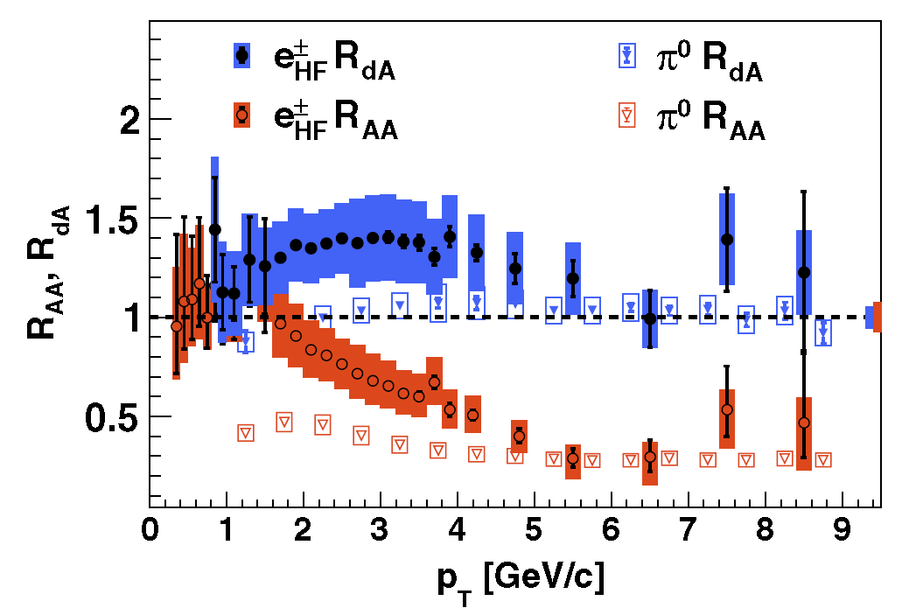
Flavor similarity?
Different quark flavor may give different interaction.
Mass ordering (dead-cone effect, etc.)
At high p_{T} (p_{T}>5GeV/c), electrons from heavy quark (c,b) show similar R_{AA} and R_{dA} as π⁰’s from light quark (u,d) or gluons.
PHENIX, PRL. 109, 242301 (2012)

Slide 6
Path-length dependence of energy loss
Comparison of R_{AA} between data and models in in- and out-plane
Different path-length in in-plane (event plane direction) and out-plane.
PRC87, 034911 (2013)

Slide 7
Path-length dependence of energy loss
Comparison of R_{AA} between data and models in in- and out-plane
Different path-length in in-plane (event plane direction) and out-plane
Data favor AdS/CFT-inspired model (very strong coupling) rather than pQCD-inspired (suggesting energy loss is L³ dependent?).
PRC87, 034911 (2013)

Slide 8
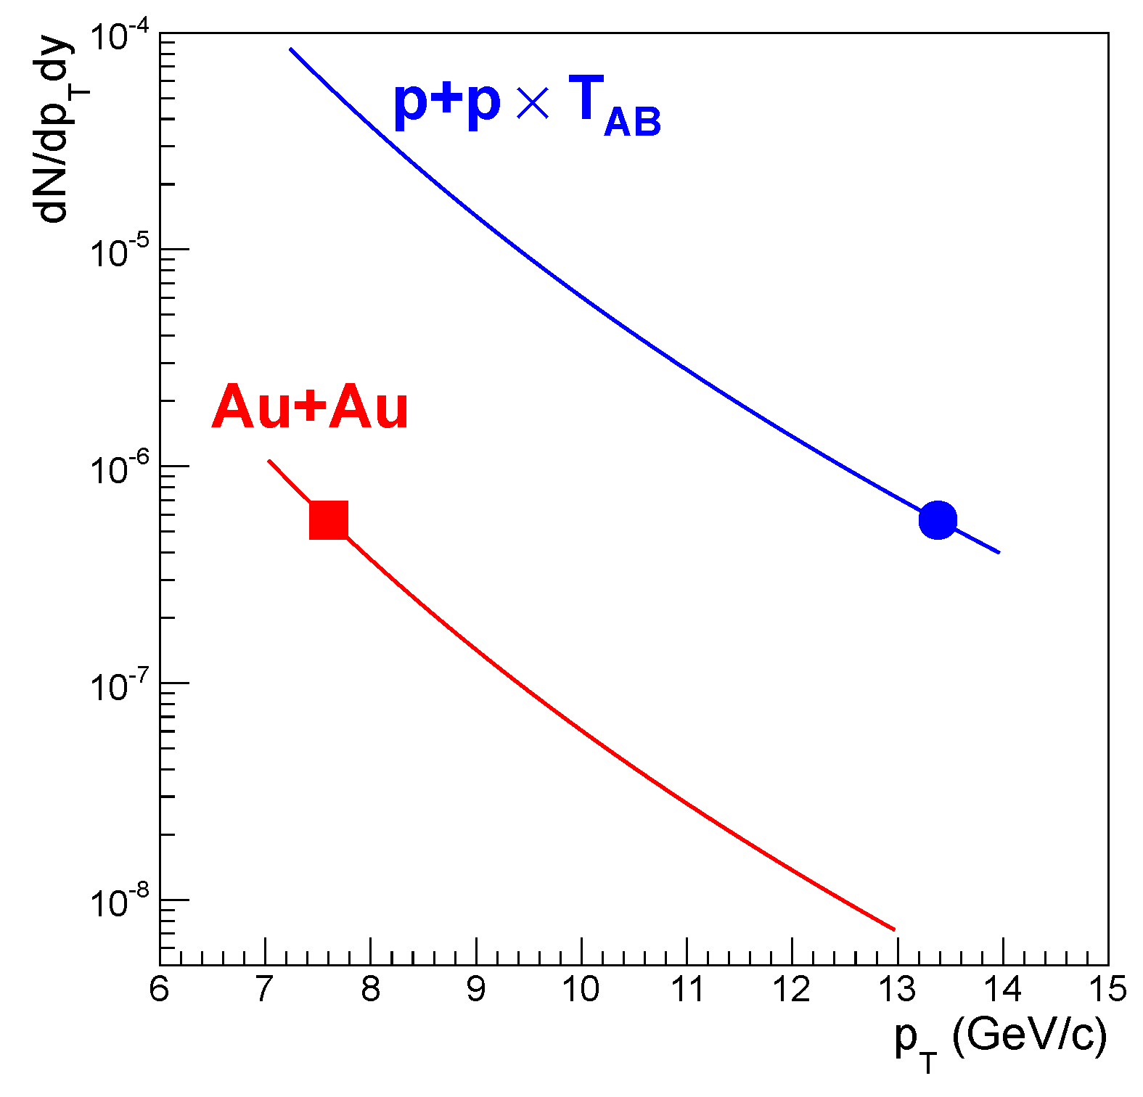
Fractional momentum loss of partons
Measured fractional momentum loss (δp_{T}/p_{T}) instead of R_{AA}
In A+A collisions
δp_{T}/p_{T}=0.2 in 0-10% centrality, =0.02 in 70-80% centrality
PRC87, 034911 (2013)
δp_{T}/p_{T}
δp_{T}
p_{T}

Slide 9
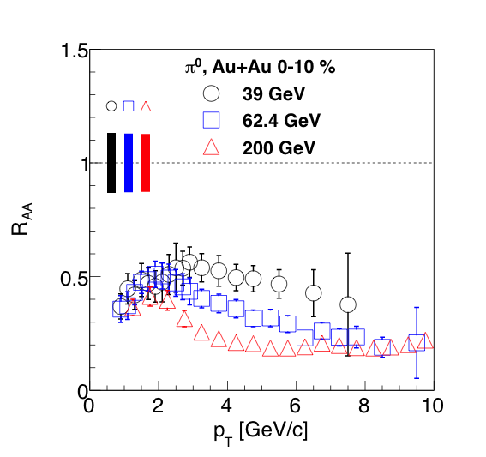
Energy dependence of δp_{T}/p_{T} (I)
δp_{T}/p_{T} decreases significantly going from 200 to 62, 39GeV.
Significantly different δp_{T}/p_{T} even the R_{AA} is similar.
PRL109, 152301 (2012)
R_{AA}

Slide 10
Energy dependence of δp_{T}/p_{T} (II)
δp_{T}/p_{T} from 62GeV to 2.76TeV!: ~0.3 for LHC
PRL109, 152301 (2012)
PRC87, 034911 (2013)
LHC
RHIC

Slide 11
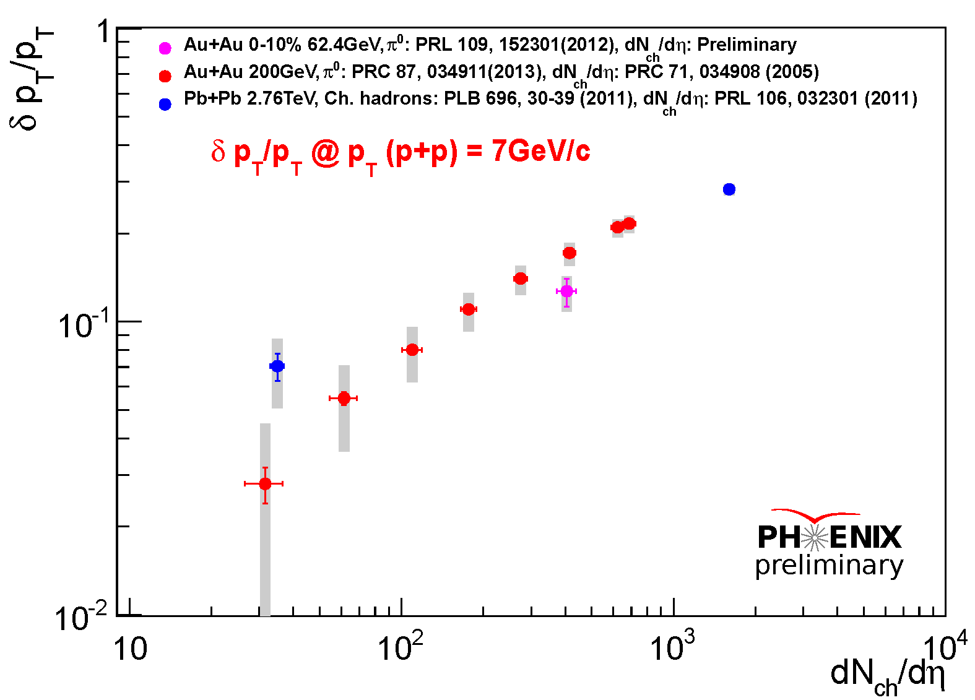
Detail study of δp_{T}/p_{T} systematics
Plotting against dN_{ch}/dη (as a measure of energy density)
dN_{ch}/dη are obtained in given centrality at given cms energy.
δp_{T}/p_{T}‘s at p_{T}=7GeV/c of p+p are plotted.

Slide 12
Detail study of δp_{T}/p_{T} systematics
200GeV trend points to ALICE 0-5% point?

Slide 13
Consistency with previous studies
PHENIX studied fractional momentum loss in two publications
PRC76, 034904 (2007), PRL101, 232301 (2008)
Assuming the spectra shape is power-law with the power “n”, we can write:
In this study, if we assume dN_{ch}/dη ∝ N_{part}, we can write the relationship as follows:

Slide 14
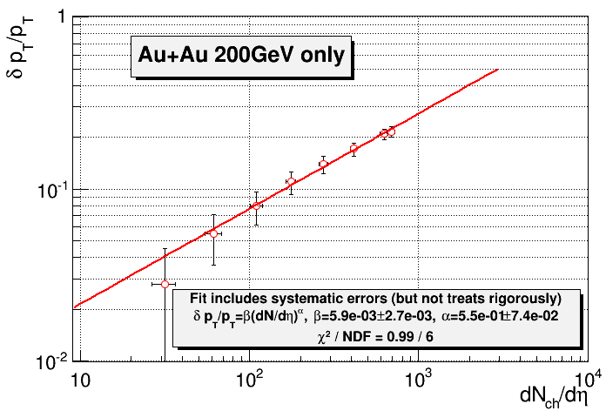
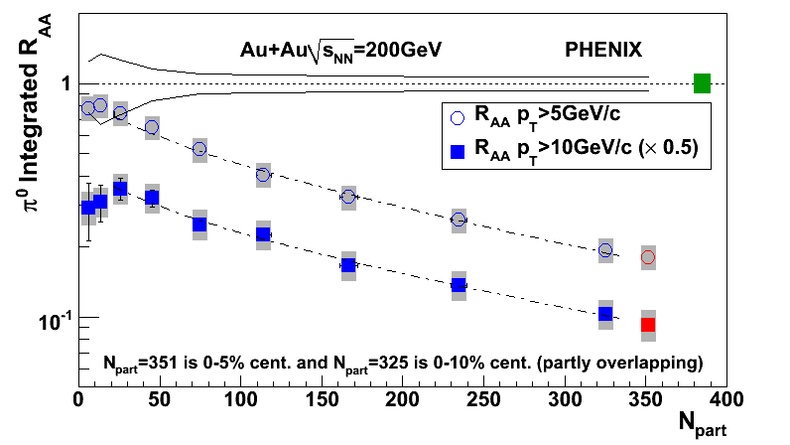
Consistency with previous studies
PHENIX studied fractional momentum loss in two publications
PRC76, 034904 (2007), PRL101, 232301 (2008)
Assuming the spectra shape is power-law with the power “n”, we can write:
In this study, if we assume dN_{ch}/dη ∝ N_{part}, we can write the relationship as follows:
PRL101, 232301 (2008)

Slide 15
v_{n} of high p_{T} probes

Slide 16
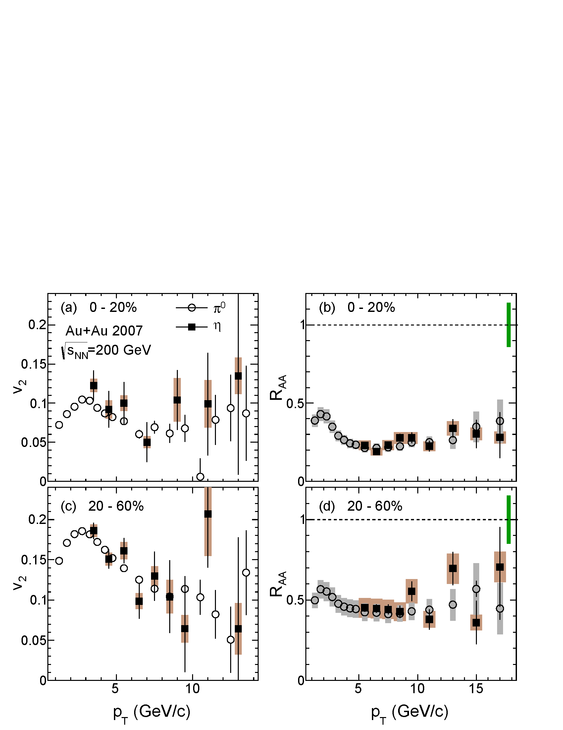
v₂ of high p_{T} π⁰ and η
v₂ of π⁰ and η are measured up to 14GeV/c.
They are very consistent as they are for R_{AA}.
We can reach to higher p_{T} with η as accumulating more statistics.
PHENIX, arxiv:1309.4437

Slide 17
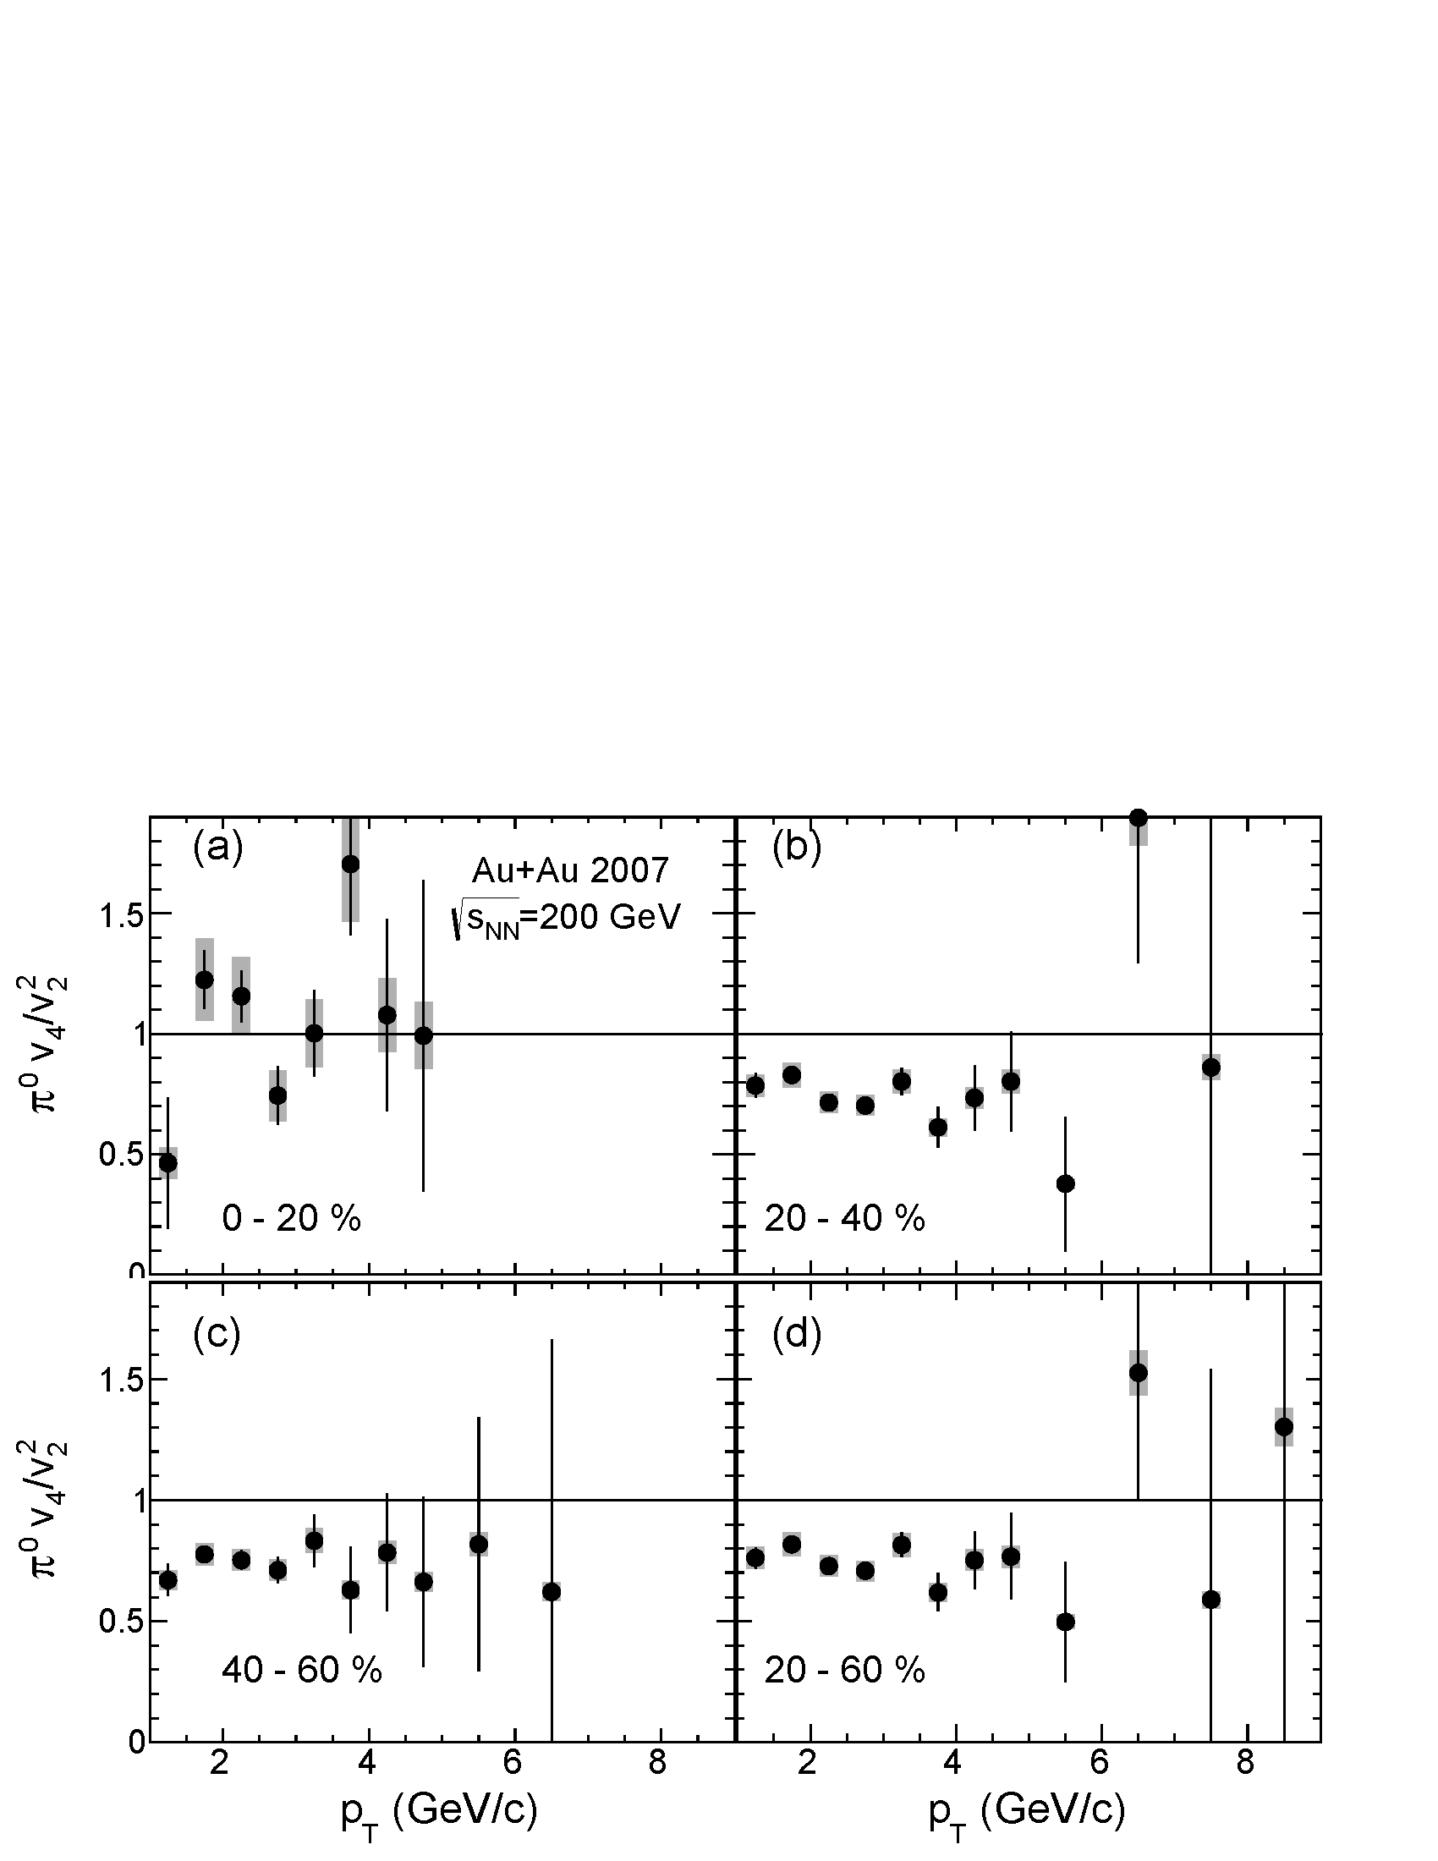
v₄ and v₂ of high p_{T} π⁰
v₄ of π⁰ is measured up to 10GeV/c (using Ψ₂ event plane).
v₄/v₂² is computed.
Flatness of the ratio shows applicability of hydrodynamics..?
PHENIX, arxiv:1309.4437

Slide 18
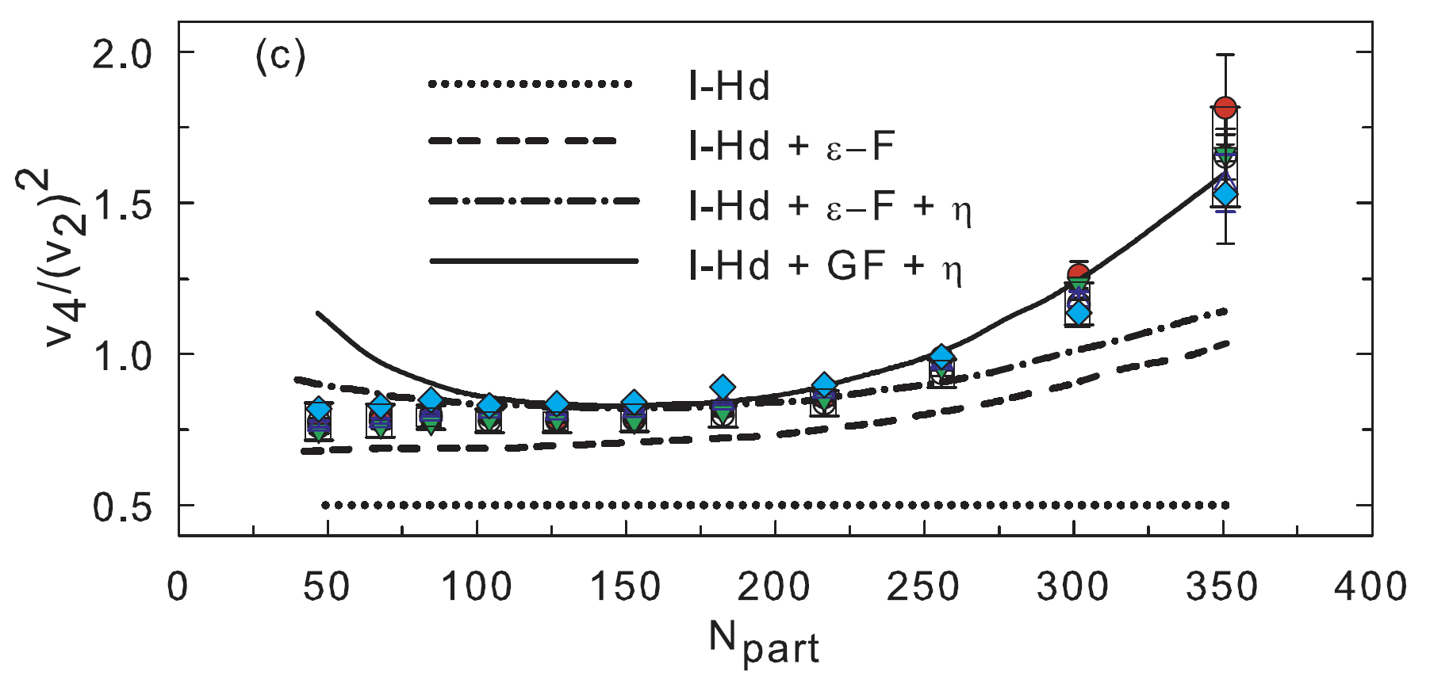
Centrality dependence of v₄/v₂²
Charged hadron v₄/v₂² compared with models
Ideal hydrodynamics only (I-Hd)
with eccentricity fluctuation (I-Hd + ε-F)
with viscosity (I-Hd + ε-F + η) and Gaussian fluctuation (I-Hd + GF + η)
Different points correspond to six p_{T} ranges in 0.5-3.6GeV/c
PHENIX, PRL105, 062301 (2010)

Slide 19
Hydro scaling extends to higher p_{T}?
Plotted π⁰ v₄/v₂² for p_{T}>4GeV/c over charged hadron results.
Hydro description still holds for this region?
Note possible effects from differential energy loss and/or jet bias
See prediction, e.g., Bravina et. al., PRC87, 034901(2013)
- - - - - Points from π⁰ (p_{T}>4GeV/c)
Others from charged hadrons (p_{T}<4GeV/c)
PHENIX, PRL105, 062301 (2010)

Slide 20
Summary
π⁰ and η are measured in 200GeV Au+Au collisions.
π⁰ and η give very consistent results in R_{AA}.
π⁰ and HF electrons R_{AA} and R_{dA} have similar trend at high p_{T}.
Similar degree of final state interaction for light and heavy quarks?
Emission-angle dependent π⁰ yield favors AdS/CFT-inspired energy loss model.
Centrality, system, and energy dependence of fractional momentum loss is studied.
A trend is seen from 200GeV Au+Au to 2.76TeV Pb+Pb
Hydro description still holds for p_{T}>4GeV/c?
From v₄/v₂² measurement at high p_{T}
Possible effects from differential energy loss and/or jet bias

Slide 21
Backup

Slide 22
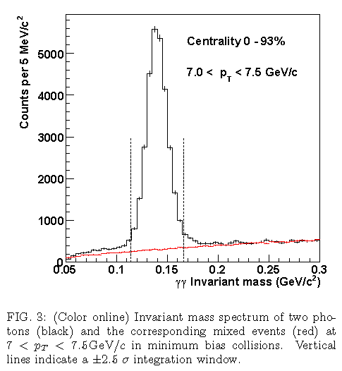
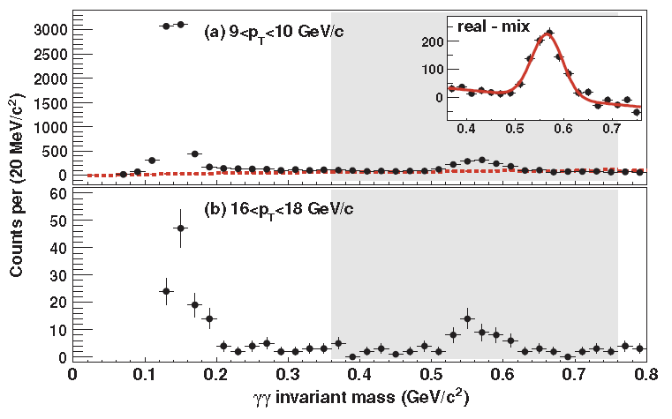
How we measure π⁰, η?
Reconstruct hadrons via 2γ invariant mass in EMCal (example is in Au+Au)
Subtract Combinatorial background
Compute Mass using γs from different events. (mixed-event technique)
PRC87, 034911 (2013)
PRC82, 011902(R) (2010)
π⁰
η
π⁰
η

Slide 23
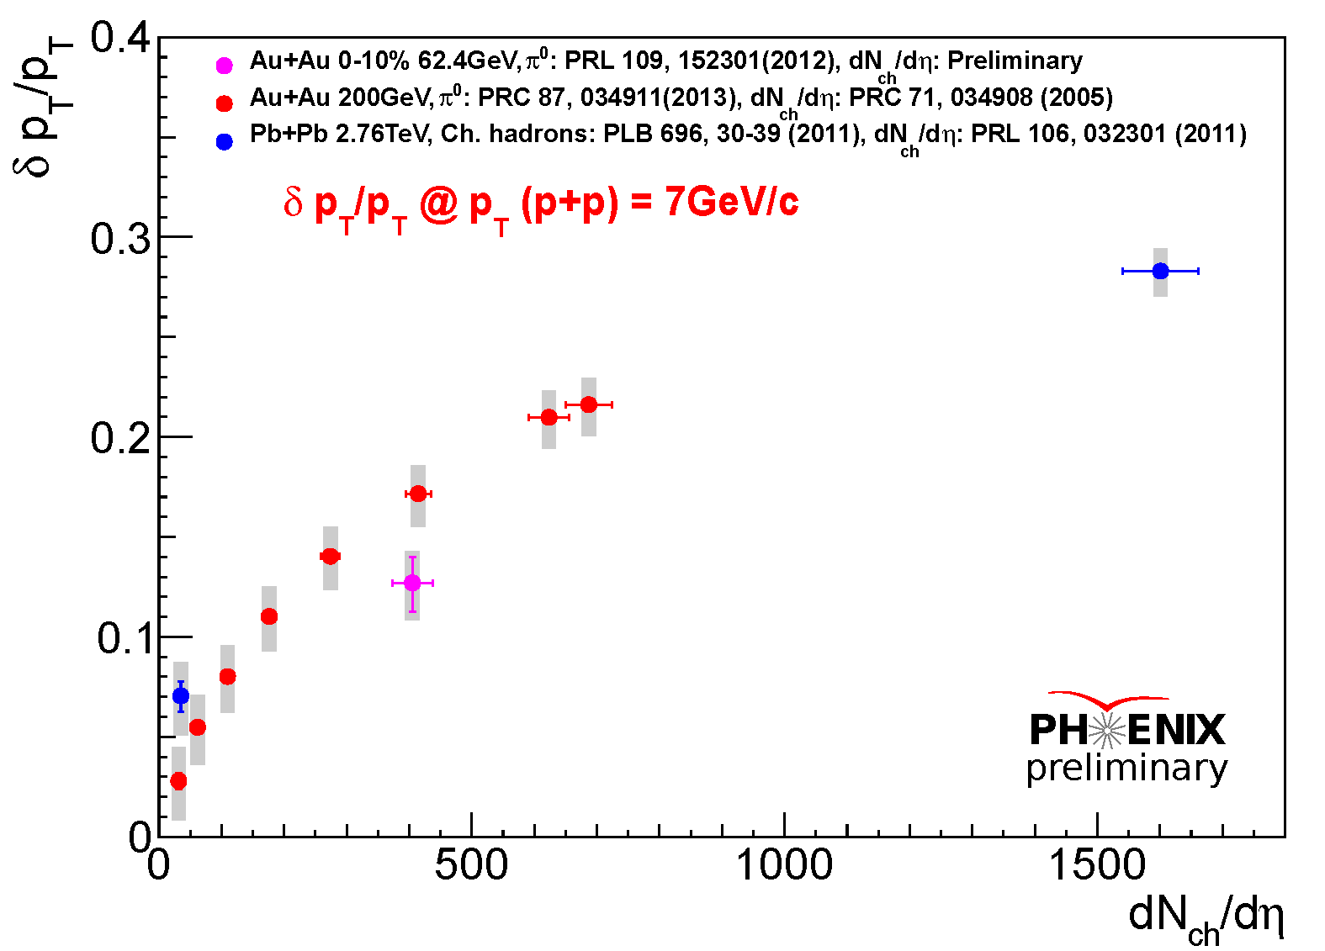
Detail study of δp_{T}/p_{T} systematics
Plotting against dN_{ch}/dη (as a measure of energy density)
dN_{ch}/dη obtained in given centrality at given cms energy
δp_{T}/p_{T}‘s at p_{T}=7GeV/c of p+p are plotted

Slide 24
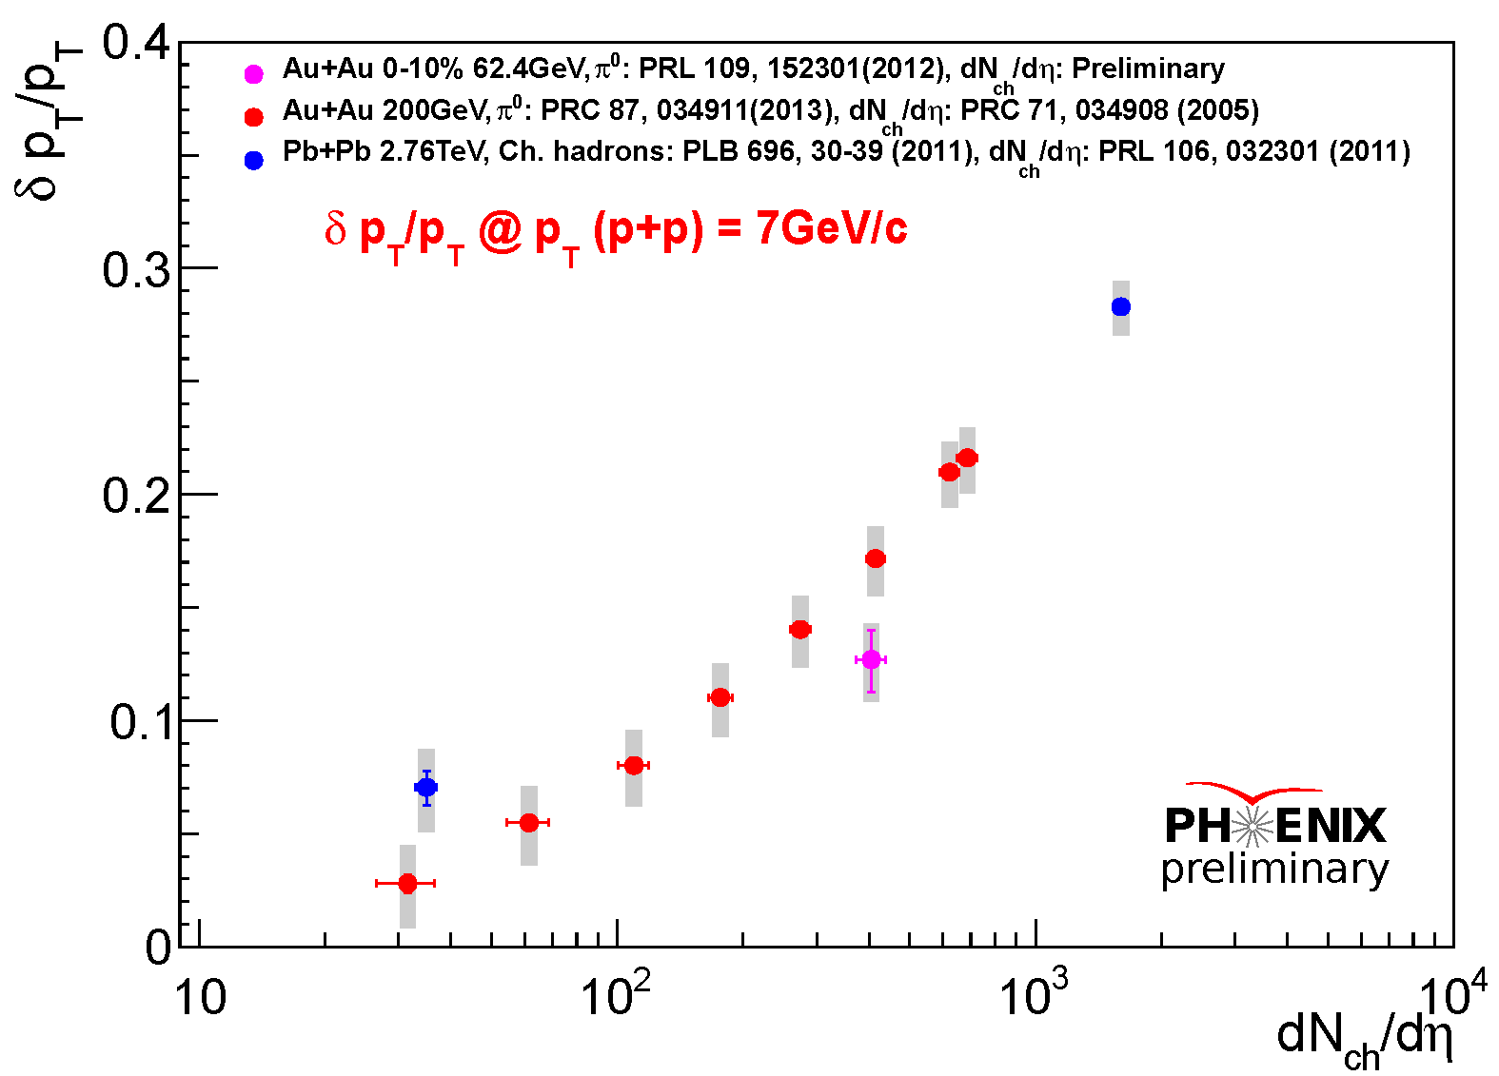
Detail study of δp_{T}/p_{T} systematics
Re-plotted same data points in log-scale for dN_{ch}/dη
δp_{T}/p_{T}‘s at p_{T}=7GeV/c of p+p are plotted

Slide 25
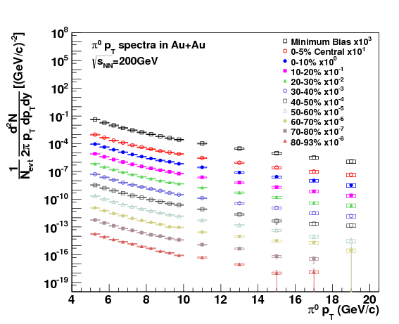
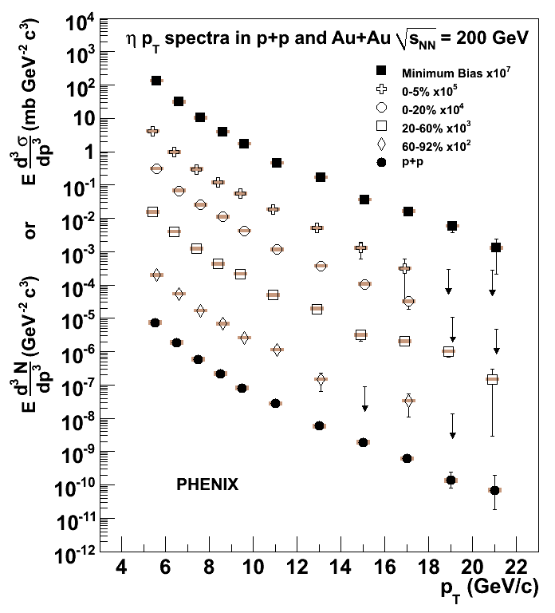
π⁰, η spectra in Au+Au
Spectra reached to ~20GeV/c for π⁰ and ~22GeV/c for η
π⁰
η

Slide 26
Systematic errors
π⁰ systematic errors
source | type | 5GeV | 10GeV | 15GeV | 20GeV
peak extraction | B | 2 | 2 | 2 | 2
acceptance | C | 2.5 | 2.5 | 2.5 | 2.5
PID efficiency | B | 7 | 8 | 8.5 | 9
energy scale | B | 7.5 | 8 | 8 | 8
photon conversion | C | 2 | 2 | 2 | 2
cluster merging | B | 0 | 0 | 8 | 18
total |  | 11 | 12 | 15 | 22
Type A: point-by-point fluctuating errors
Type B: p_{T}-correlated errors
Type C: overall normalization errors
η systematic errors
source | type | 5GeV | 10GeV | 15GeV
peak extraction | B | 4 | 3.5 | 3
acceptance | C | 2.5 | 2.5 | 2.5
PID efficiency | B | 7 | 8 | 8.5
energy scale | B | 11 | 12 | 12
photon conversion | C | 2 | 2 | 2
total |  | 12 | 15 | 15

Slide 27
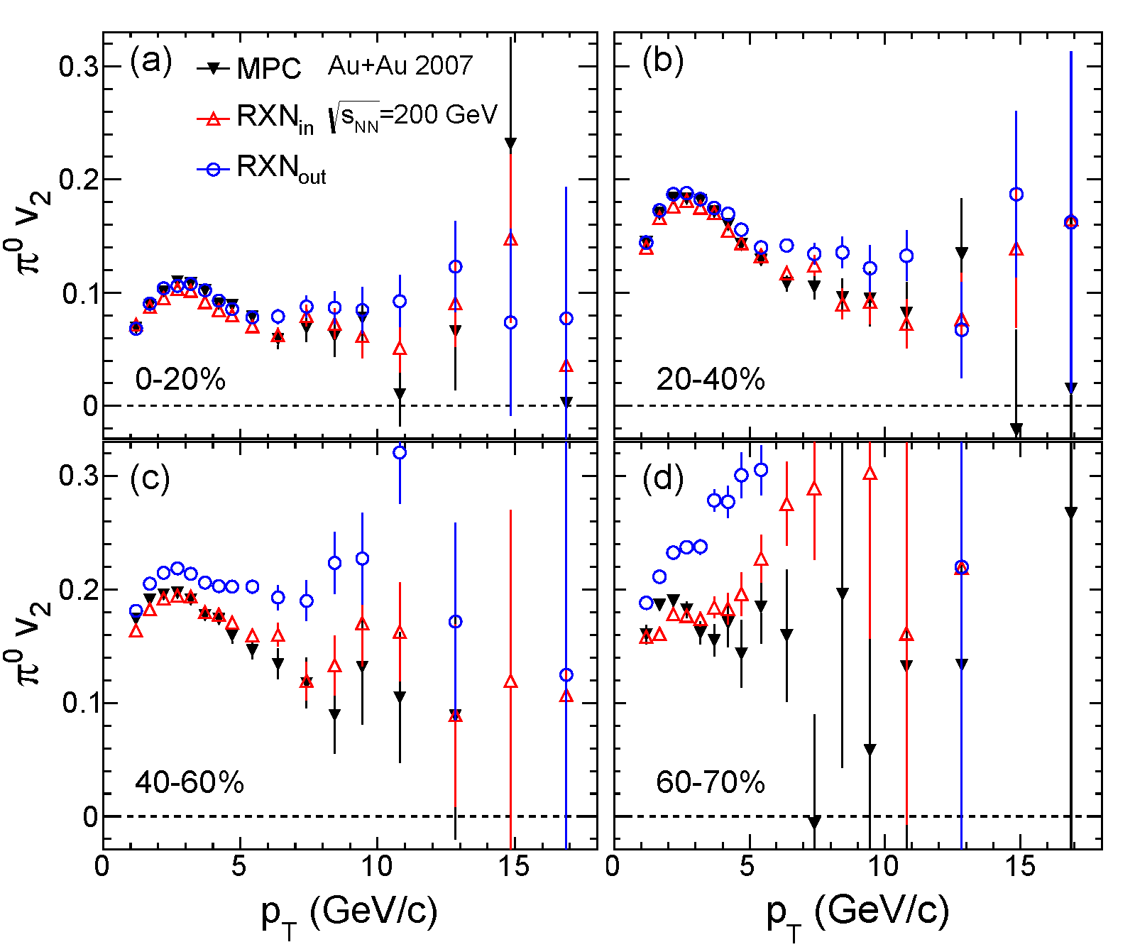
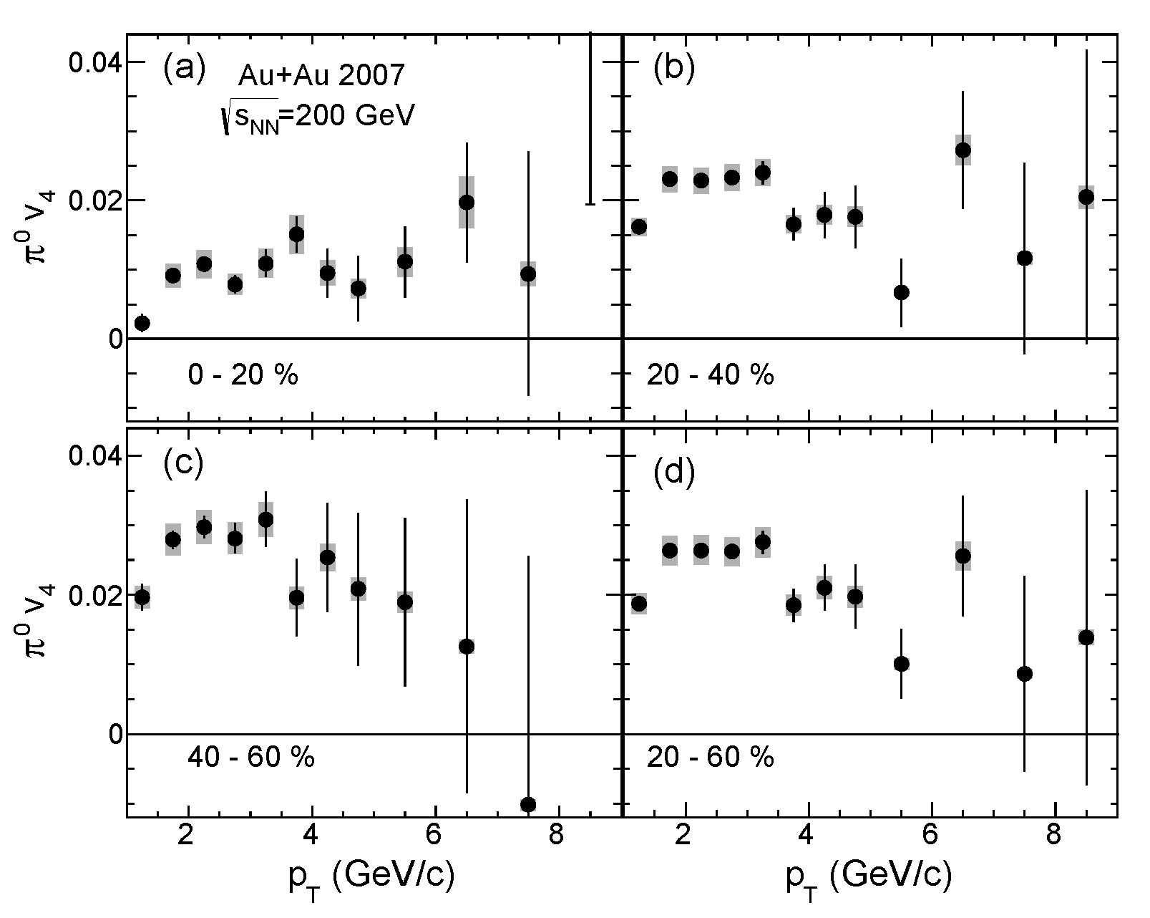
v₄ and v₂ of high p_{T} π⁰
v₄ of π⁰ is measured up to 10GeV/c (using Ψ₂ event plane)
PHENIX, arxiv:1309.4437
π⁰ v₄
π⁰ v₂

Slide 28
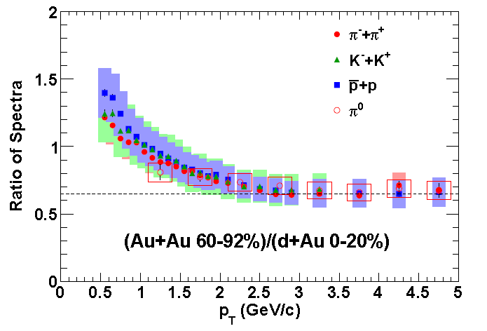
d+Au and Au+Au system similarity?
Au+Au 60-92% and d+Au 0-20% have similar N_{part}, N_{coll}
Ratios of all ID’ed hadron spectra are on the same curve
Common production mechanism?
If all CNM scales with N_{part}, ratios may mean E_{loss} in the medium in peripheral Au+Au
Low p_{T} increase may rise from rapidity shift in d+Au
arXiv:1304.3410

