Slide 1




Heavy Quarks at Low-x
J. Matthew Durham
durham@lanl.gov

Slide 2
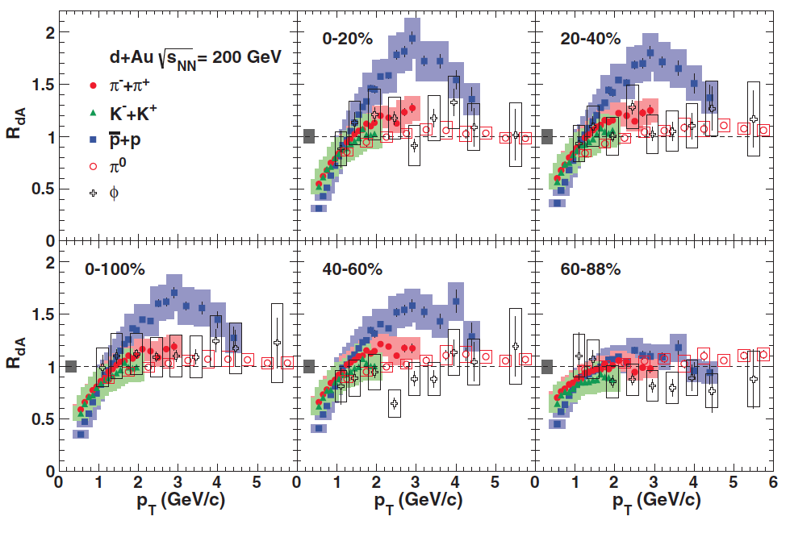
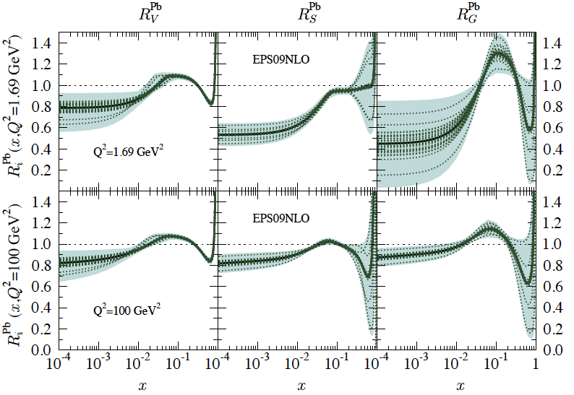
The Nuclear Initial State
Collisions of nuclei are inherently different from collisions of bare nucleons
Nuclear PDF is modified: S, AS, EMC, saturation?
  RHIC probes a unique crossover region in x, both shadowing and anti-shadowing regions easily accessible
  Heavy quarks especially sensitive
  to gluon nPDF
PRC 88 024906
Partonic interactions in nucleus
  kT kicks (“traditional” explanation
  of Cronin, but mass dependence?)
  Energy loss
Baryon enhancement, recombination?
Possible hydrodynamic phenomena
NONE of these effects are accounted for with a p+p reference
How we can study these effects:
-Look in different rapidity ranges (effectively varies x, co-mover density)
-Change system size (d+Au ->Cu+Cu->Au+Au, vary path length, temp, etc)
-Vary beam energy (BES at RHIC, RHIC vs LHC)

Slide 3
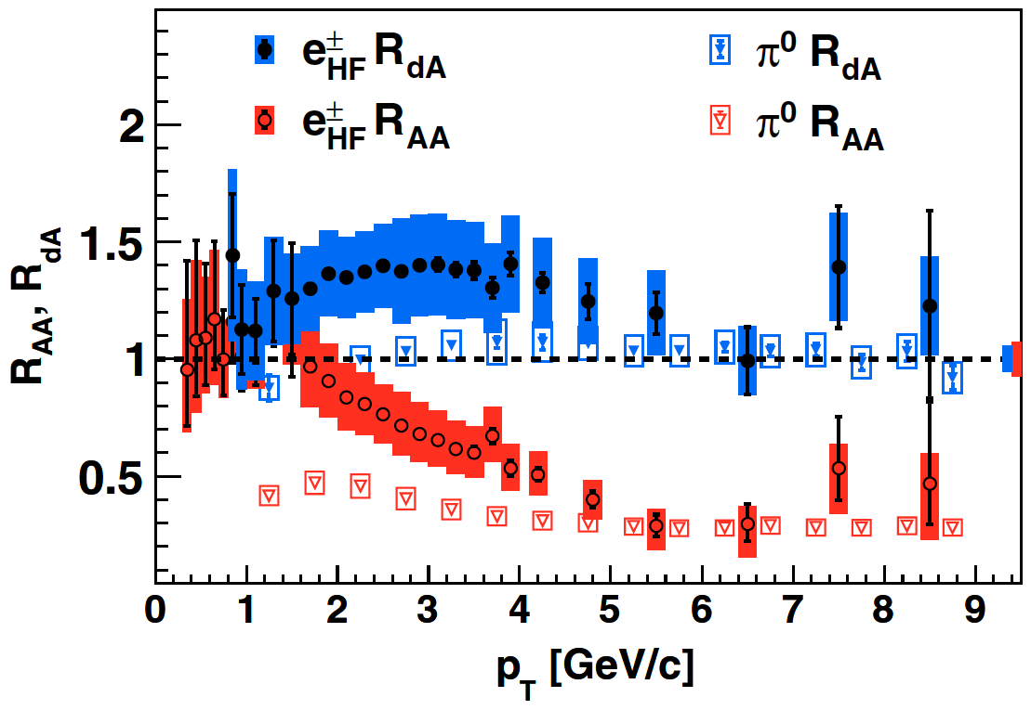
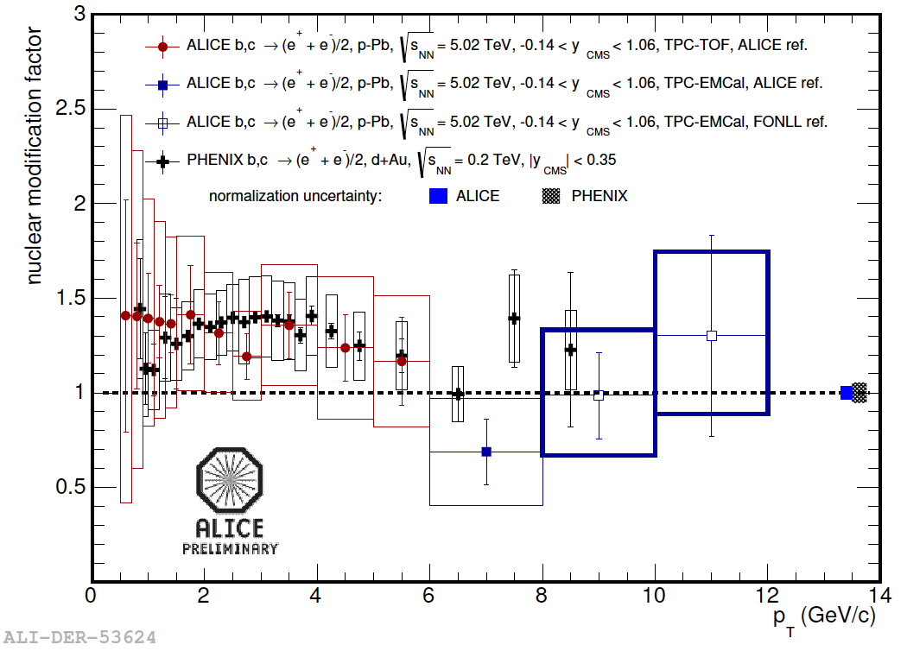
Heavy Quark Initial State
PRL 109, 242301 (2012)
M. Heide, SQM13
-HF electrons at RHIC show enhancement at midrapidity in dA
-Different pattern from pi0
-Light and heavy quarks have different baseline in AA collisions
Surprise: Prelim ALICE data shows identical phenomena at LHC, despite very different x range for charm.
PDF modification is not dominant effect on charm in pA? Then what is?
BRAND SPANKIN’ NEW finalized results in this talk:
-Forward rapidity open heavy flavor muons in d+Au, arXiv:1310.1005
-Mid-rapidity open heavy flavor electrons in Cu+Cu, arXiv:1310.8286

Slide 4
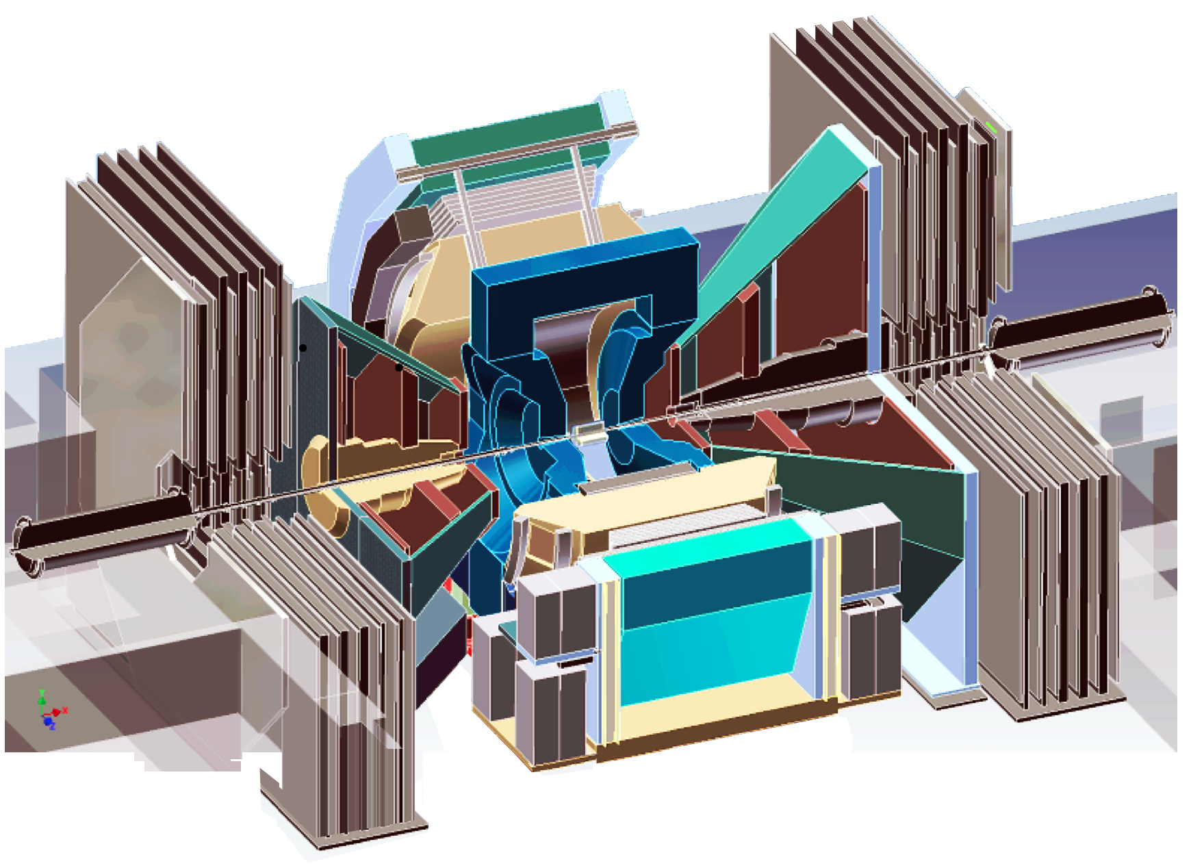
Open Heavy Flavor at PHENIX
Semi-leptonic decays of HF hadrons:
Electrons: |y| <0.35
-Tracked with DC,PC
-ID with RICH, EmCal
Muons: 1.2 < |y| < 2.2
~10λ hadron absorbers
-Tracked with wire chambers
-Further muon ID with layers of steel and streamer tubes
e
μ
μ
Au
d

Slide 5

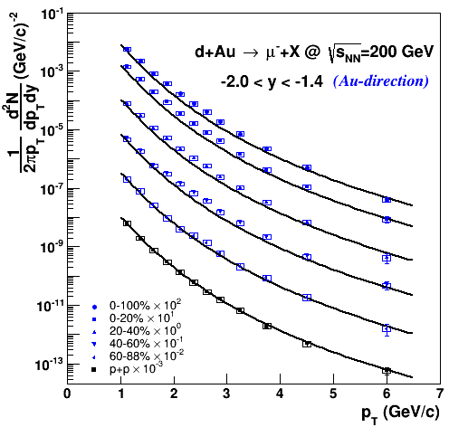
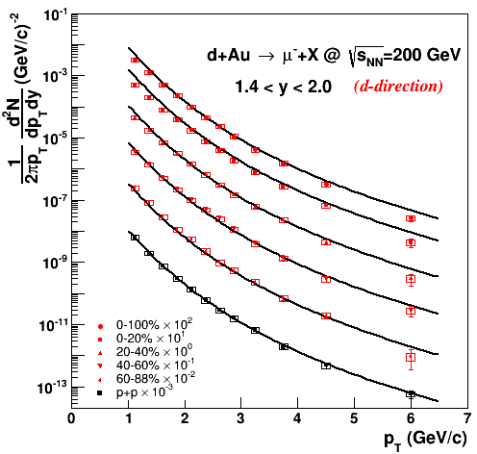
Open HF μ in d+Au
Charm and bottom hadrons which decay to μ+X at fwd/bkwd rapidity
arXiv:1310.1005
μ
Backward
Forward
μ
Au
Anti-shadowing region
Shadowing region
d

Slide 6
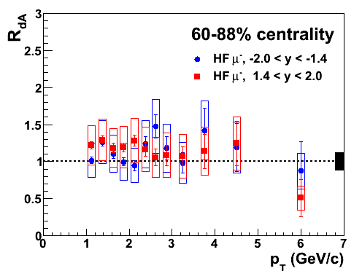
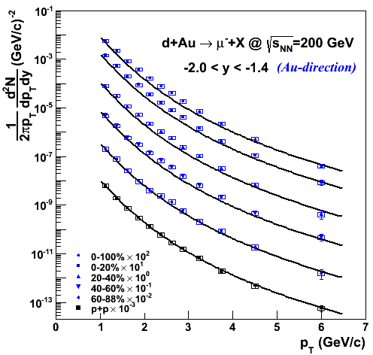
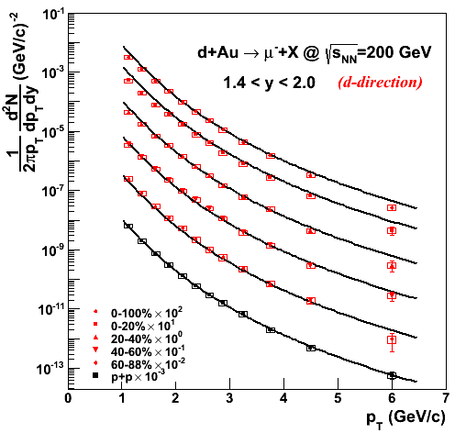
Nuclear Modification R_{dA}
arXiv:1310.1005
Backward
Forward
Note: J/psi ->mu contributions subtracted. Open HF muons isolated.

Slide 7
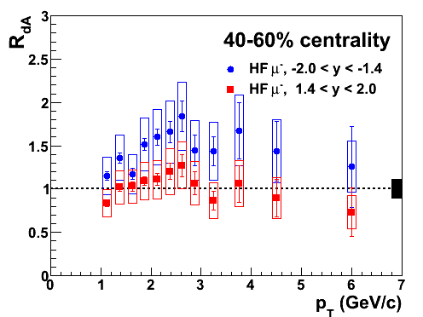
Nuclear Modification R_{dA}
arXiv:1310.1005
arXiv:1310.1005
Backward
Forward
Note: J/psi ->mu contributions subtracted. Open HF muons isolated.

Slide 8
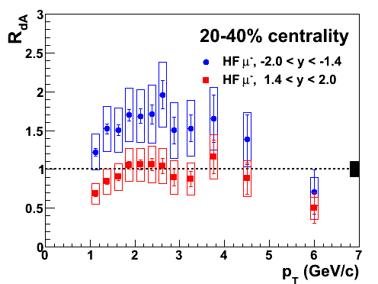
Nuclear Modification R_{dA}
arXiv:1310.1005
arXiv:1310.1005
Backward
Forward
Note: J/psi ->mu contributions subtracted. Open HF muons isolated.

Slide 9
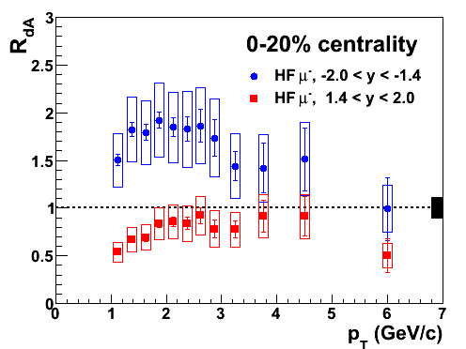
Nuclear Modification R_{dA}
arXiv:1310.1005
arXiv:1310.1005
Backward
Forward
Note: J/psi ->mu contributions subtracted. Open HF muons isolated.

Slide 10
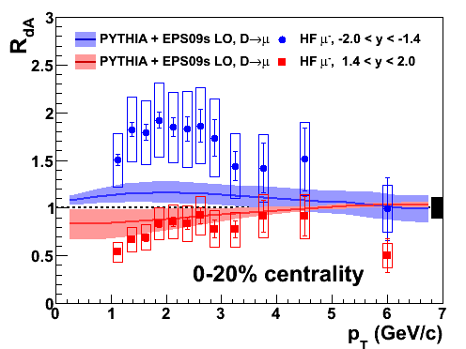
Nuclear Modification R_{dA}
arXiv:1310.1005
arXiv:1310.1005
Compare with EPS09s PDF + PYTHIA D mesons
Helenius,Eskola,Honkanen, Salgado, JHEP 1207, 073 (2012)
Forward: Cronin + suppression, consistent
with EPS09s shadowing, within experimental and theoretical errors
Backward: Enhancement not reproduced by nPDF alone. Additional effects possible; kT scattering in nucleus, interactions with comovers? Hadron chemistry altered?
Backward
Forward

Slide 11
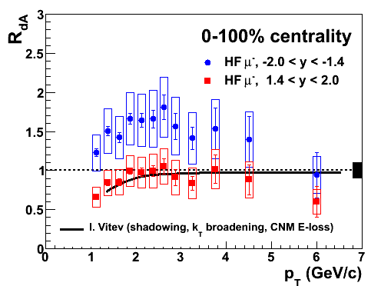
Nuclear Modification R_{dA}
arXiv:1310.1005
arXiv:1310.1005
Prediction from
I. Vitev
Phys. Rev. C 75, 064906 (2007)
Calculation includes Cronin broadening via parton scattering, shadowing, energy loss in cold nuclear matter
No calculations exist for backwards rapidity
Backward
Forward

Slide 12
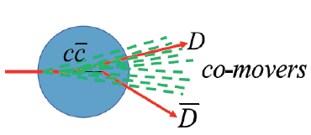
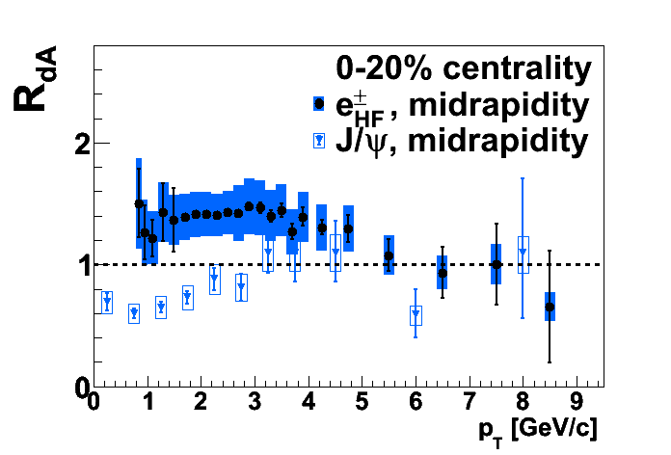
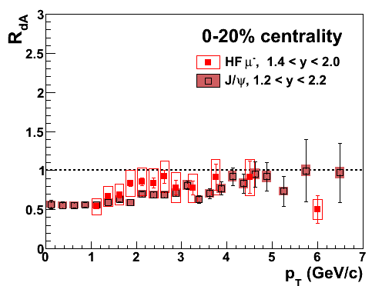
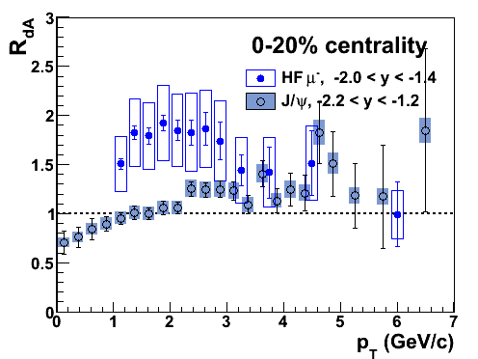
Open HF versus J/ψ
Sensitive to same initial state effects: gluon shadowing, kT broadening, partonic energy loss in nucleus
One BIG difference: nuclear breakup of charmonia bound states
*Keep in mind different kinematics for decay leptons from single charm quark versus fully reconstructed cc state
Forward: similar behavior
-Short time in nucleus
-Low comover density
Mid- and backwards rapidity: DIFFERENT behavior
enhanced open HF versus suppressed J/ψ
->Direct evidence for significant breakup of cc
Theorists: How much does this open HF data constrain J/ψ breakup?
Can your model simultaneously reproduce trends for open and hidden HF?

Slide 13
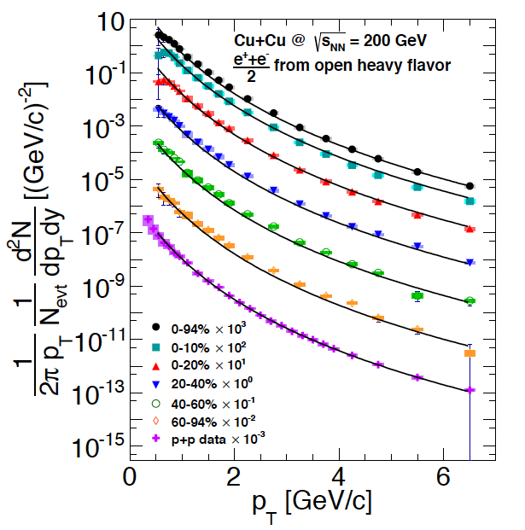
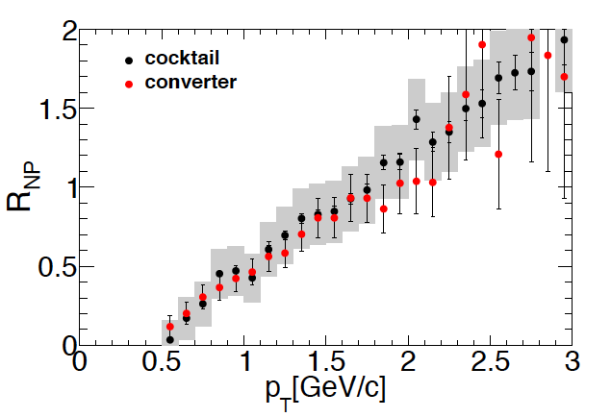
Open HF e in Cu+Cu
Charm and bottom hadrons which decay to e+X at midrapidity
arXiv:1310.8286
Two independent experimental methods:
Cocktail - statistically subtract bg electrons (for high pT)
Converter - increase photonic bg by well-defined amount (for low pT)
e
Near anti-shadowing/shadowing crossover
Excellent agreement
d+Au: N_{coll} < ~15
Cu+Cu 5<N_{coll}<~180
Au+Au: 15<N_{coll}<~1000
Cu
Cu

Slide 14
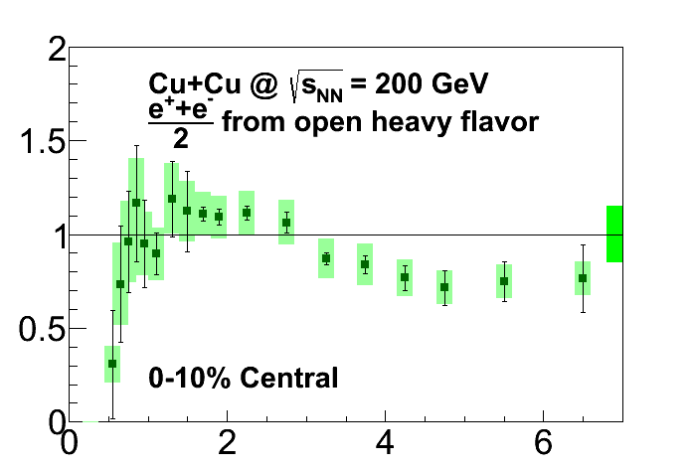
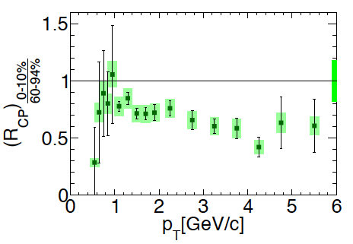
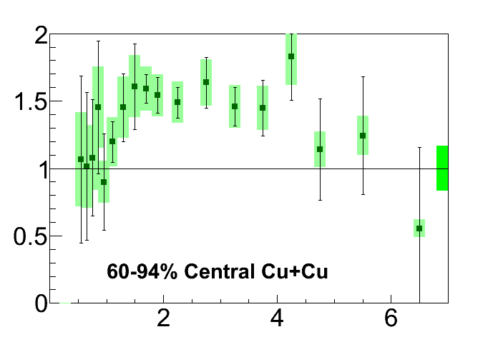
Nuclear Modification R_{CuCu}
Central R_{CuCu}:
slight suppression
Enhancement in peripheral not accounted for with pp reference…
Peripheral R_{CuCu}:
SURPRISE!
Significant enhancement
Rcp shows significant suppression emerging within Cu+Cu system.

Slide 15
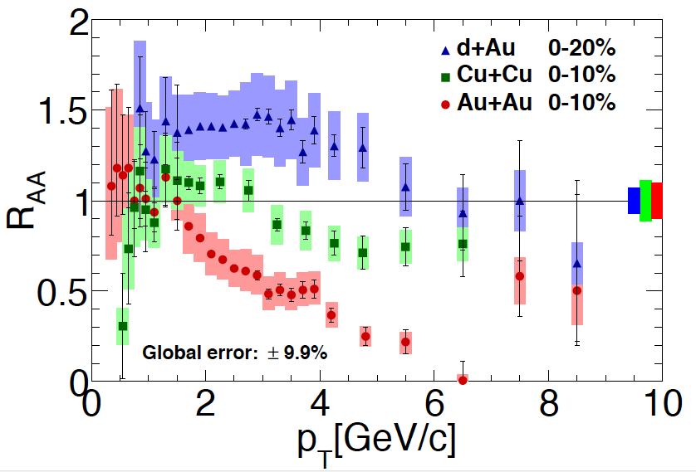
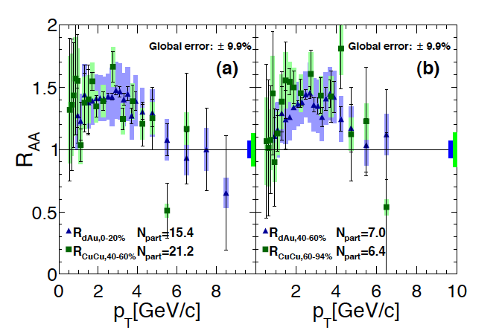
Trend across system size
central d+Au ≈ peripheral Cu+Cu

Slide 16
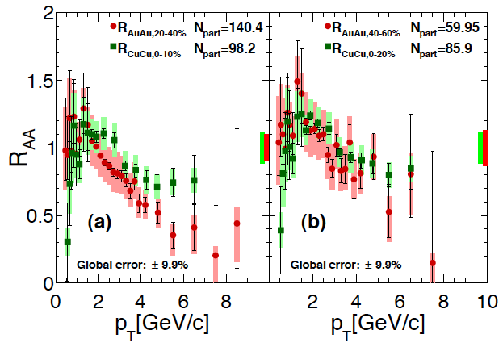
Trend across system size
central Cu+Cu ≈ peripheral Au+Au

Slide 17
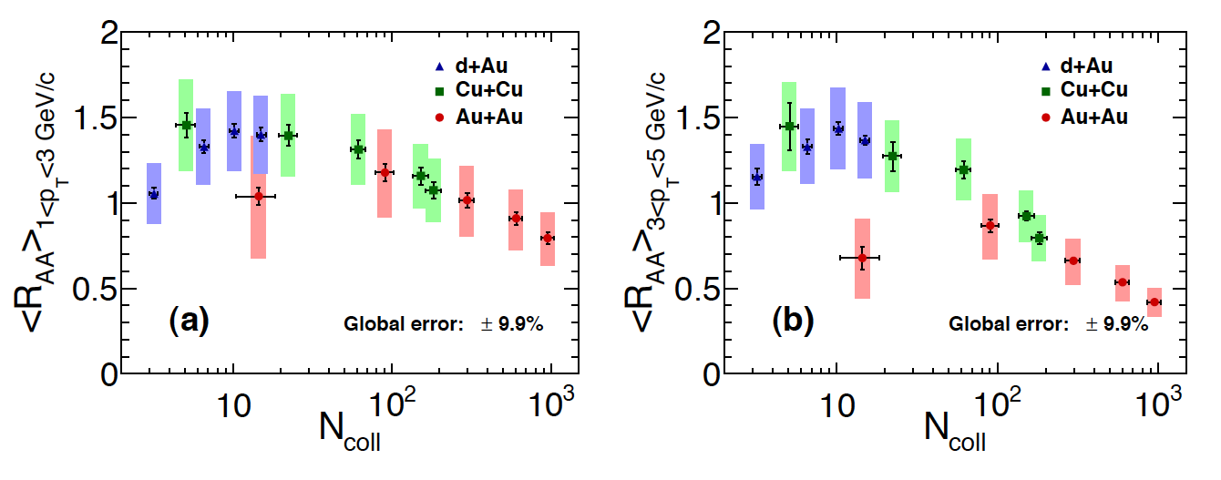
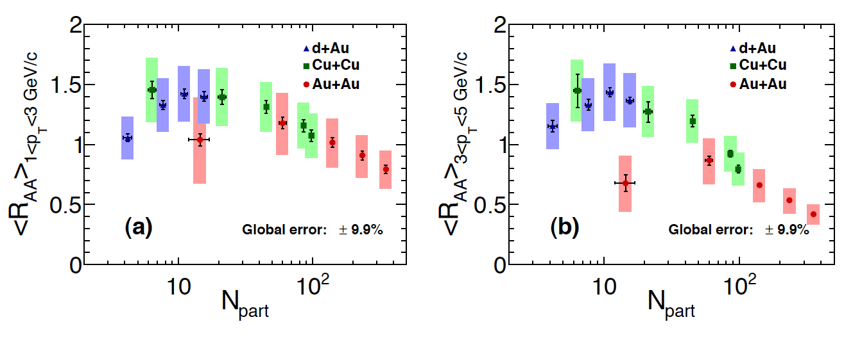
Trend across system size
Theorists: Can your successful A+A models describe this whole trend?

Slide 18
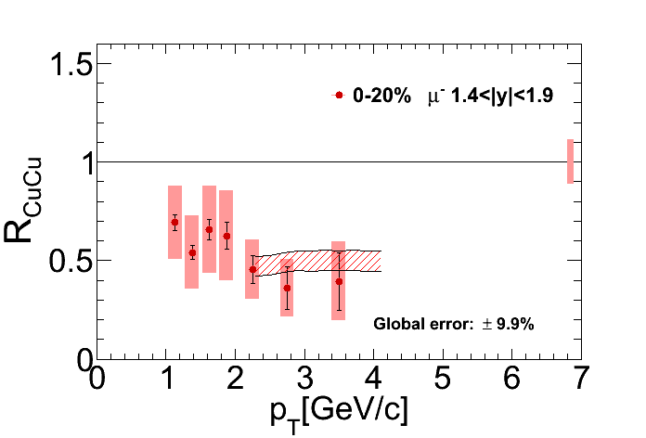
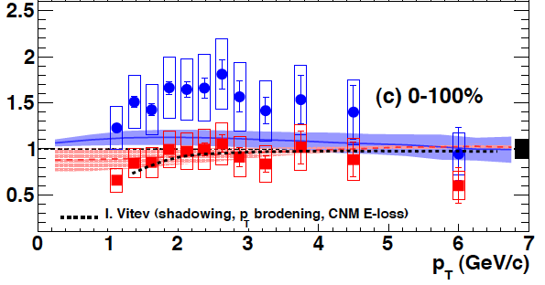
Summary
Forward rapidity: HF suppression, consistent with shadowing, energy loss models
d+Au
Backward and mid rapidity: open HF enhancement in dA, peripheral CuCu
But J/ψ suppressed. Need theoretical input!
d+Au
Clear trend of HF enhancement to suppression with increasing reaction volume.

Slide 19
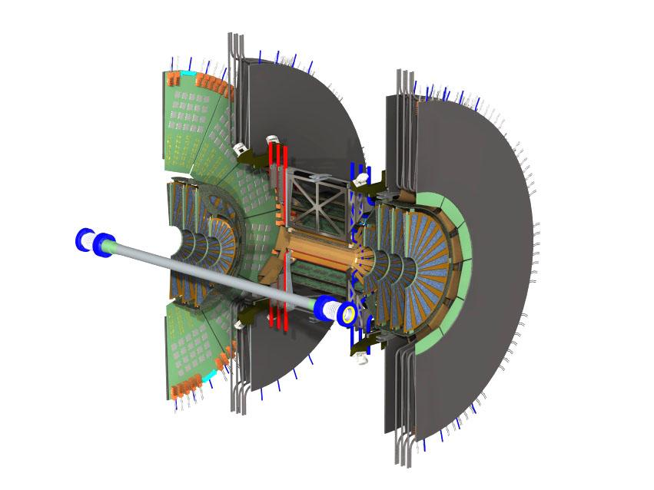
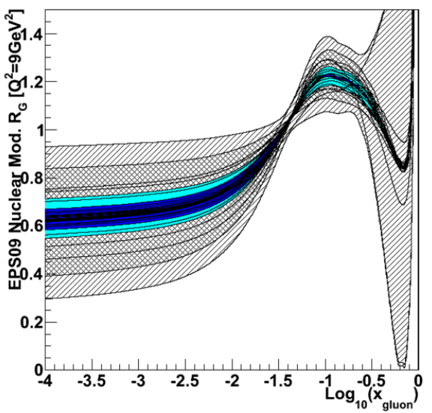
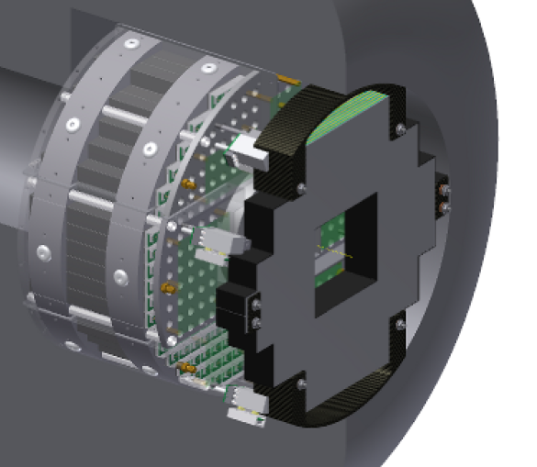
Future of Low-x at PHENIX
Installed and taking data: FVTX
Silicon detector for precision tracking at forward rapidity, covering PHENIX muon arms
-b/c muon separation
-ψ(2s) at forward rapidity
-Drell Yan dimuon production
Soon to come: MPC-EX
Preshower for enhanced capability of forward calorimeter
Far forward direct photon measurement to constrain low-x PDFs
PHENIX request for 2015 RHIC beam includes p+C, p+Cu, p+Au

Slide 20
BACKUPS

Slide 21
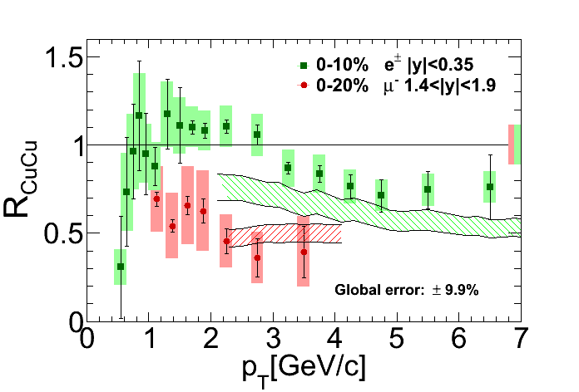
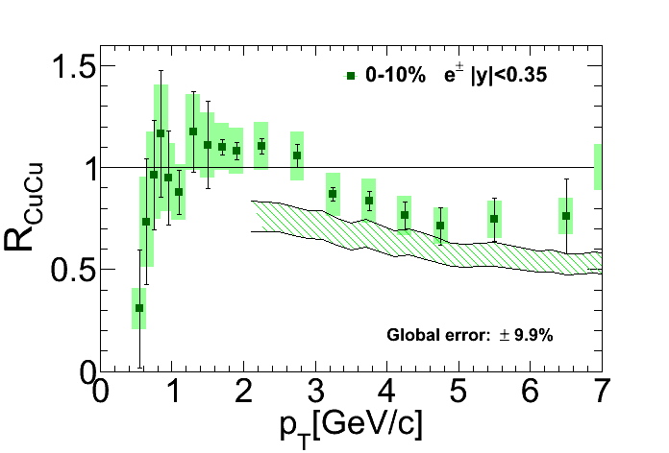
Nuclear Modification R_{CuCu}
Prediction from
Sharma, Vitev, Zhang, PRC 80, 054902 (2009)
Also describes forward Cu+Cu HF muon production
Model describes forward d+Au data, and mid- and forward Cu+Cu data (with additional HNM energy loss) in a consistent framework.

Slide 23
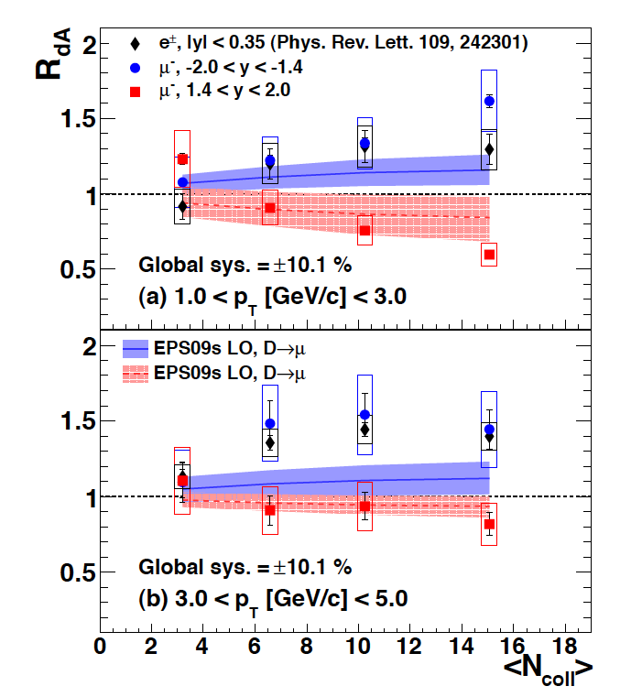

Slide 24
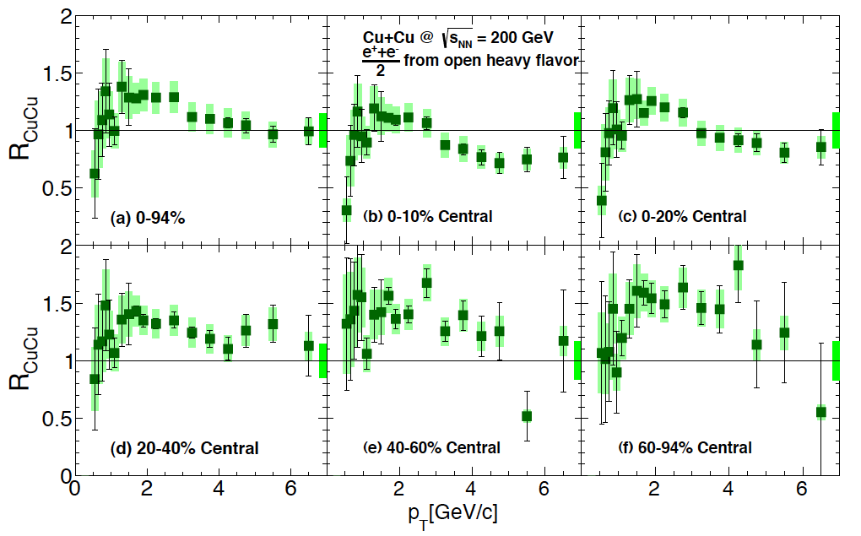
Nuclear Modification R_{CuCu}

Slide 25
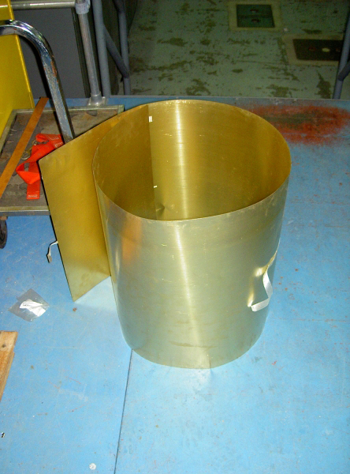
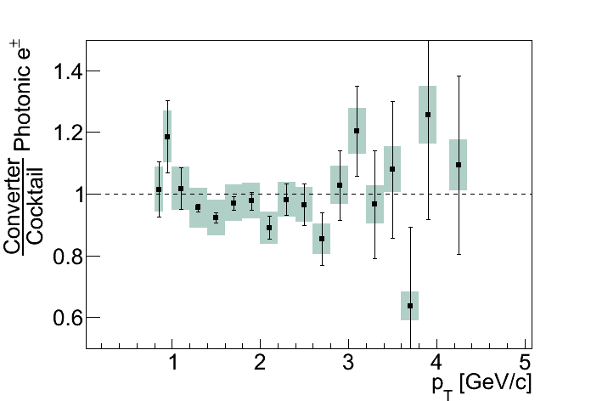
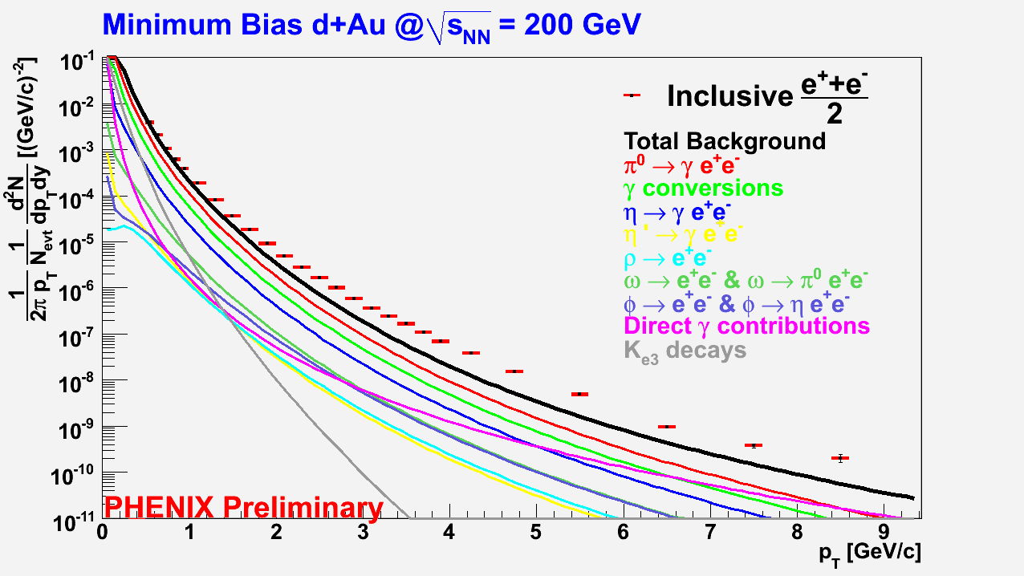
Electron Methodology
Converter method
Dominated by low stats of conv-in data (1 day)
Cocktail method
Excellent agreement between two independent methods
Dominated by uncertainty on pion spectra

Slide 26
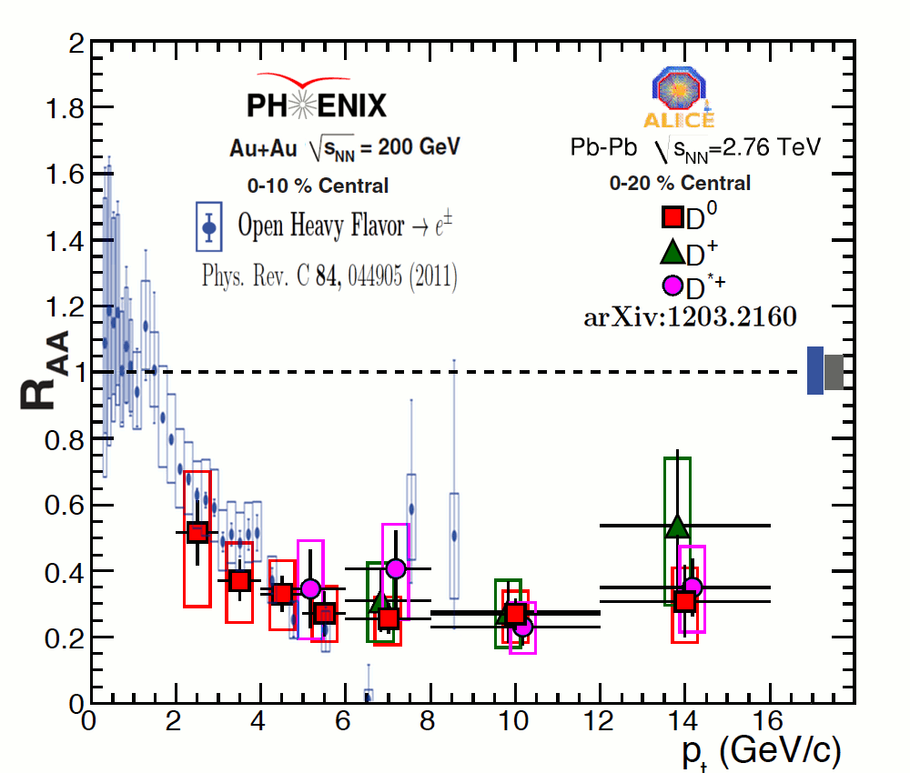
Open HF in A+A
One of the most striking results from RHIC:
Large suppression of open heavy flavor mesons
Heavy quarks produced only in initial hard scattering
Perturbative QCD techniques applicable

