Slide 1
Nuclear modification factor and elliptic flow of muons from heavy-flavour decays in Pb-Pb collisions at √s_{NN}=2.76 TeV with ALICE
Shuang Li for the ALICE Collaboration
Institute of Particle Physics, CCNU, Wuhan, China
Key Laboratory of Quark & Lepton Physics, MoE, China
Laboratoire de Physique Corpusculaire, CNRS/IN2P3, Clermont-Ferrand, France
The 6th International Conference of Hard and Electromagnetic Probes of High-Energy Nuclear Collisions, Cape Town, South Africa, November 4-8, 2013
1

Slide 2
Outline
Heavy flavours as probes of the QGP
ALICE setup
Nuclear modification factor and elliptic flow of muons from heavy-flavour decays in Pb-Pb collisions
Summary and outlook
2

Slide 3
Heavy flavours (charm & beauty) as probes of the QGP
Heavy flavours produced in initial hard scatterings & experience the full evolution of the system: sensitivity to medium properties
Heavy flavours in pp collisions
baseline for p-A and A-A collisions;
test pQCD-based calculations.
Heavy flavours in p-A collisions
investigate cold nuclear matter (CNM) effects: shadowing etc.
Heavy flavours in A-A collisions
Nuclear modification factor
mass and colour charge dependence of parton energy loss: ${∆E}_{g}>{∆E}_{u,d,s}>{∆E}_{c,b}$;
[Phys. Rev. D69 (2004) 114003, Phys. Rev. D71 (2005) 054027]
Elliptic flow
low p_{T} region: transport coefficients of heavy quarks in the medium, degree of thermalization of heavy quarks in QGP;
high p_{T} region: path length dependence of heavy quark energy loss.
3

Slide 4
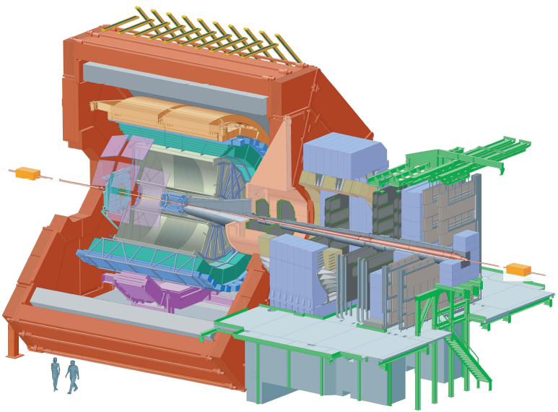
ALICE setup
Time-Projection Chamber (TPC)
|η|<0.9;
charged track reconstruction;
particle identification;
event plane for muon flow analysis.
Inner Tracking System (ITS)
|η|<0.9;
vertex reconstruction;
Event trigger.
Front absorber
Dipole magnet
μ
Trigger chambers
VZERO
2.8<η<5.1, -3.7<η<-1.7;
centrality determination;
event plane reconstruction;
event trigger.
Tracking chambers
-4<η<-2.5
Muon Spectrometer
4

Slide 5
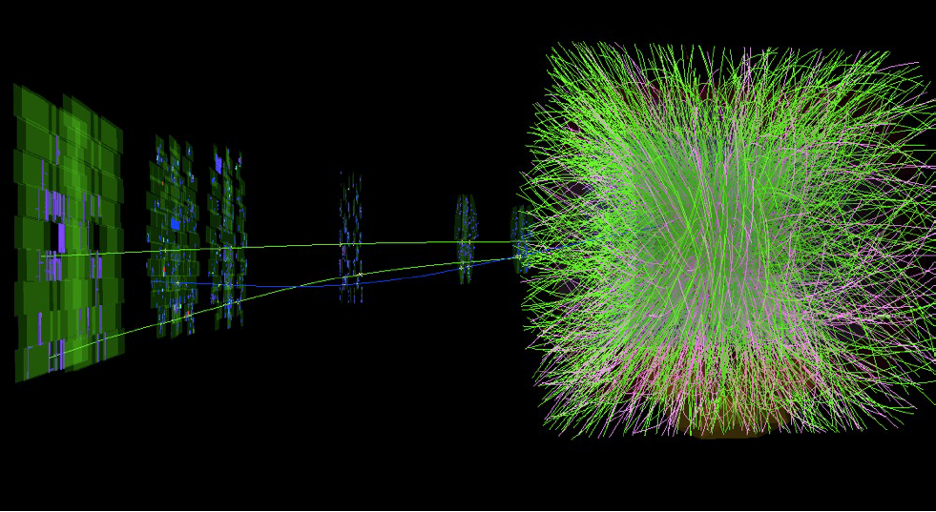
R_{AA} of muons from heavy-flavour decays
$$R_{AA}= \frac{1}{<T_{AA}>}\frac{{{dN}_{AA}}/{dp_{T}}}{{{dσ}_{pp}}/{dp_{T}}}$$
5

Slide 6
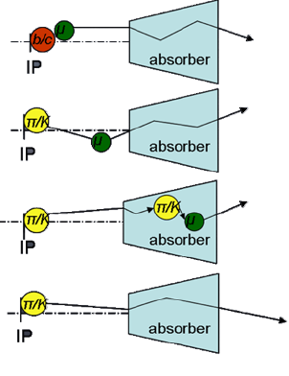
Data sample and muon selection
Data sample
pp collisions at √s=2.76 TeV collected in 2011, muon trigger, L_{int}=19 nb⁻¹;
Pb–Pb collisions collected in 2010, minimum bias trigger, L_{int}=2.7 μb⁻¹.
Muon Track selection
$−4<η<−2.5$: acceptance of ALICE MUON spectrometer;
${{170}_{}^{0}<θ}_{abs}<{178}^{0}$: geometry of the spectrometer;
muon trigger matching: reject hadrons that cross the absorber;
momentum times distance of closest approch (pxDCA < 6σ): remove beam-gas and particles produced in the absorber.
μ from
heavy flavours
μ from
primary K/π
(i.e. decay μ)
μ from
secondary K/π
punch through hadrons
6

Slide 7
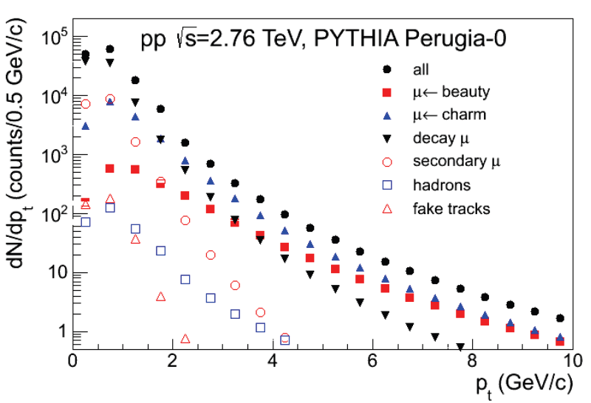
Decay muon subtraction in p-p collisions
Strategy
extract dN/dp_{T} of K/π decay muons from simulation (PYTHIA or Phojet);
normalize to measured muon yield at low p_{T};
subtract from inclusive dN/dp_{T} to obtain heavy-flavour decay muon spectrum;
estimated fraction of decay muons: 19% of total muon yield for p_{T} > 4 GeV/c.
Systematic uncertainty
model (13%): estimated by using different inputs (PYTHIA and Phojet);
transport code (5-20%, depending on p_{T}): estimated by varying yield of muons from secondary K/π by 100%.
7

Slide 8
Decay muon subtraction in Pb-Pb collisions
input: K/π spectra in pp collisions and R_{AA} in Pb–Pb collisions at central rapidity measured with ALICE; [J. Phy. G, G38 (2011) 124014 & 124080]
extrapolate K/π spectra in pp collisions to forward rapidity by means of Monte-Carlo simulations according to [Phys. Rev. D76, (2007) 092002]
with $σ_{y}$=3.3 estimated from PYTHIA and Phojet (systematic uncertainty: ~15%);
get K/π spectra in Pb–Pb collisions at forward rapidity by scaling the extrapolated charged K/π spectra with their R_{AA} at central rapidity
varying K/π R_{AA} within 100% to estimate the systematic uncertainty on unknown quenching effect at forward rapidity;
produce the K/π decay muon background in Monte-Carlo with fast detector simulation
(7%-11% of total muon yield in the region p_{T} > 4 GeV/c).
8

Slide 9
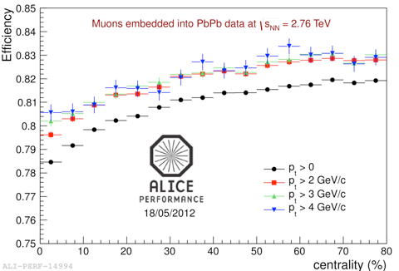
Efficiency correction
in pp collisions:
efficiency from simulation using beauty (charm) signals from NLO pQCD predictions as inputs (negligible difference between efficiencies of charm and beauty decay muons);
systematic uncertainty on misalignment 1%×p_{T} (in GeV/c).
in Pb-Pb collisions:
the centrality dependence of tracking efficiency is estimated via embedding procedure;
efficiency decreases by 4±1% in the 10% most central collisions w.r.t. peripheral collisions.
9

Slide 10
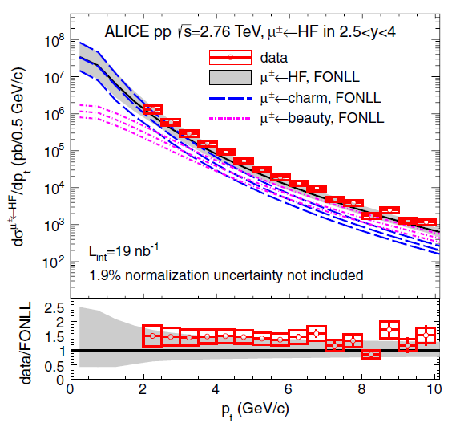
The pp reference
[Phys. Rev. Lett. 109 (2012) 112301]
The FONLL pQCD calculations are in agreement with data within experimental and theoretical uncertainties; [JHEP, 9805 (1998) 007; JHEP 10 (2012) 137]
baseline for the study of heavy quark in-medium effects in Pb-Pb and p-Pb collisions.
10

Slide 11
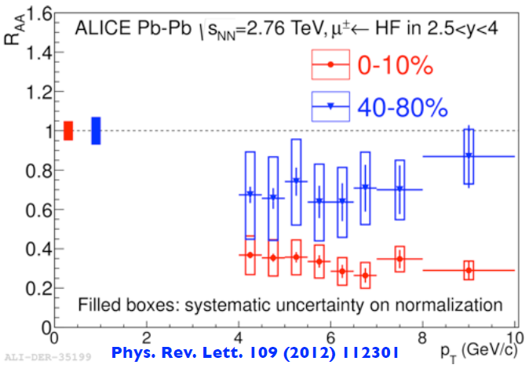
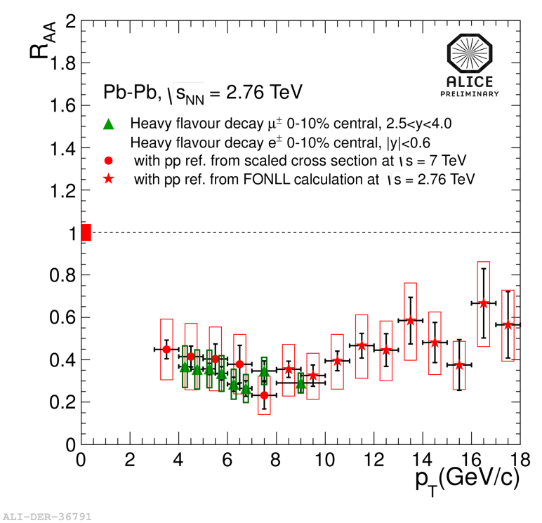
R_{AA} of muons from heavy-flavour decays at forward rapidity
suppression of HF decay muon yield observed in the measured p_{T} interval (4<p_{T} <10 GeV/c);
R_{AA} independent of p_{T} within the measured momentum range;.
stronger suppression in central than in peripheral collisions, reaching a factor of about 3-4 in the 10% most central collisions;
R_{AA} of heavy-flavour decay muons at forward rapidity (2.5<y<4) is compatible with that of heavy-flavour decay electrons at mid-rapidity (|y|<0.6).
11

Slide 12
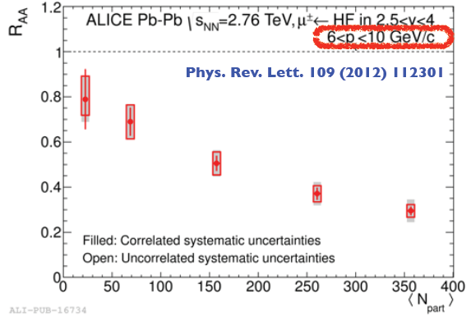
R_{AA} of muons from heavy-flavour decays at forward rapidity
The suppression of heavy-flavour decay muons in the high p_{T} range at forward rapidity exhibits a strong increase with increasing centrality;
according to FONLL calculations in pp collisions, beauty hadron decays are the dominant source of heavy-flavour decay muons in 6<p_{T}<10 GeV/c.
12

Slide 13
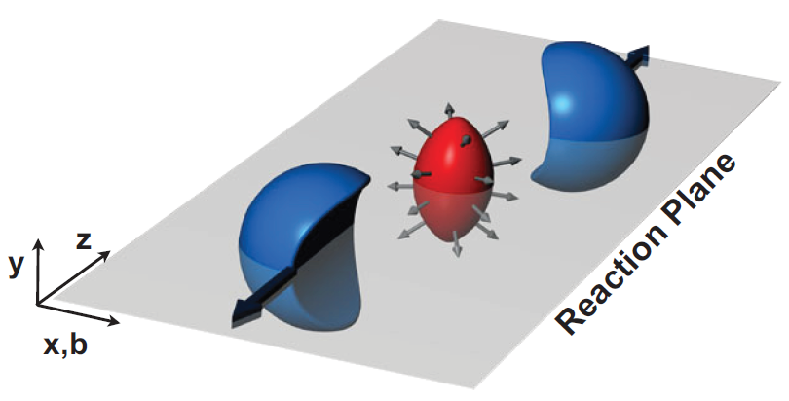
Elliptic flow of muons from heavy-flavour decays
$${E\frac{d^{3}N}{d^{3}\vec{p}}}_{}=\frac{1}{2π}\frac{d^{2}N}{p_{T}dp_{T}dy}(1+2\sum_{n=1}^{∞}{v_{n} cos[n\left(φ−Ψ_{RP}\right)]\text{)} }$$
$$v_{2}\left(p_{T},y\right)=<cos2(φ−Ψ_{RP})>$$
13

Slide 14
Data sample and analysis strategy
Data sample: data collected in 2011, central and semi-central events
central trigger, 0-10%, 8.7×10⁶ events;
semi-central trigger, 10-40%, 8.0×10⁶ events.
Particle Selection:
particles of interest (POI),
muon tracks at forward rapidity, -4<η<-2.5;
same selection criteria as used in R_{AA} analysis;
reference particles (RP): measured in TPC and provide reference for muon flow analysis,
charged tracks measured at mid-rapidity, |η|<0.8;
various selection and acceptance cuts are used to estimate the uncertainty on reference flow.
Analysis methods:
two particle correlation methods: scalar product (SP) with |Δη|>1; 2nd order
Q-cumulant (QC2);
multi-particle correlation methods: 4th order Q-cumulant (QC4);
Lee-Yang-Zeros (LYZ) with sum and product generating functions.
14

Slide 15
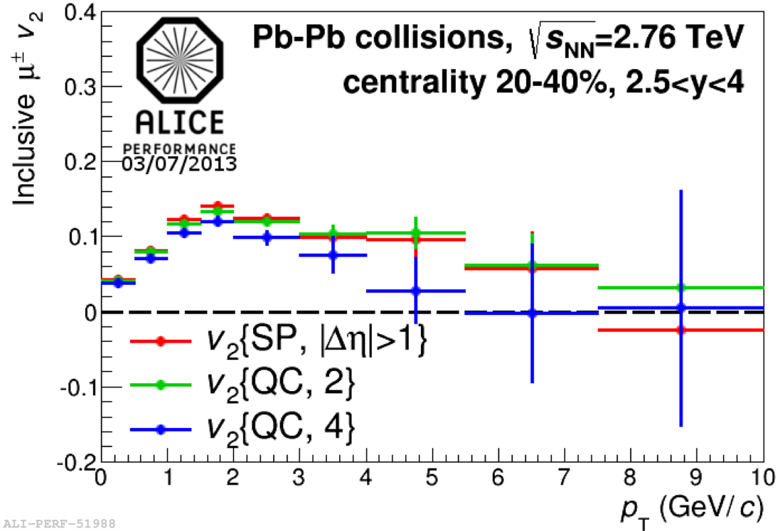
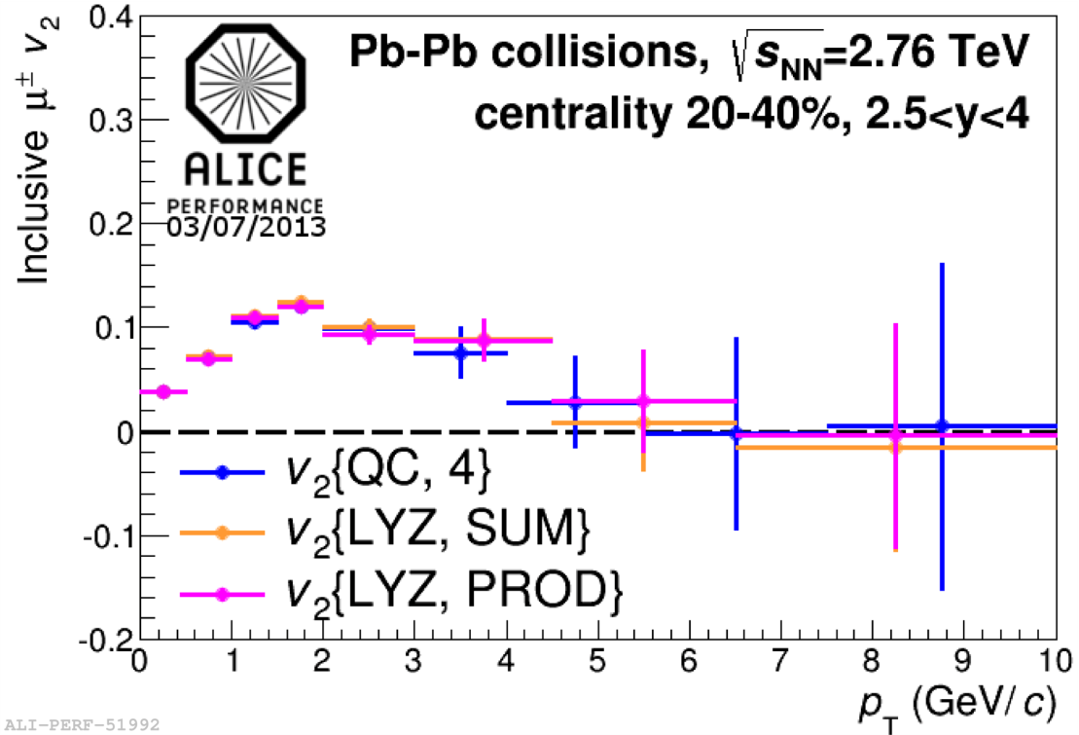
Inclusive muon v₂
results from QC4 are systematically lower than those from two-particle correlation methods
(SP and QC2)
due to different contributions of non-flow correlations and flow fluctuations.
4-particle Q-cumulants give same v₂ as Lee-Yang zeroes within uncertainties
indication that non-flow effects are suppressed with 4-particle Q-cumulants;
smaller v₂ values with multi-particle flow methods than with two-particle methods is an indication of flow fluctuation effects.
15

Slide 16
Background flow estimation
$$v_{2}^{μ\overset{←}{}HF}=\frac{v_{2}^{inclusive μ}−v_{2}^{decay μ}∙f_{decay μ}^{}}{1−f_{decay μ}^{}}$$
Decay muon v₂ estimation:
parameterize the p_{T} and η dependence of charged hadron v₂ measured by ATLAS and extrapolate to forward rapidity [ATLAS: Phys. Lett. B707 (2012) 330];
charged hadron v₂(p_{T}) extrapolated to forward rapidity used as input v₂ of pions and kaons, separately, and produce the v₂ of decay muons in the acceptance of ALICE muon spectrometer via the same fast simulation strategy as in R_{AA} analysis.
systematic uncertainty on decay muons v₂
input v₂ bias | ~ 9%
extrapolation | 9%-12%
input data fluctuations | 13%-15% (at high p_{T})
K/π weights | <1%
Decay muon fraction with the same method used for R_{AA} analysis:
15% at p_{T} = 3 GeV/c, 5% at p_{T} = 10 GeV/c.
16

Slide 17
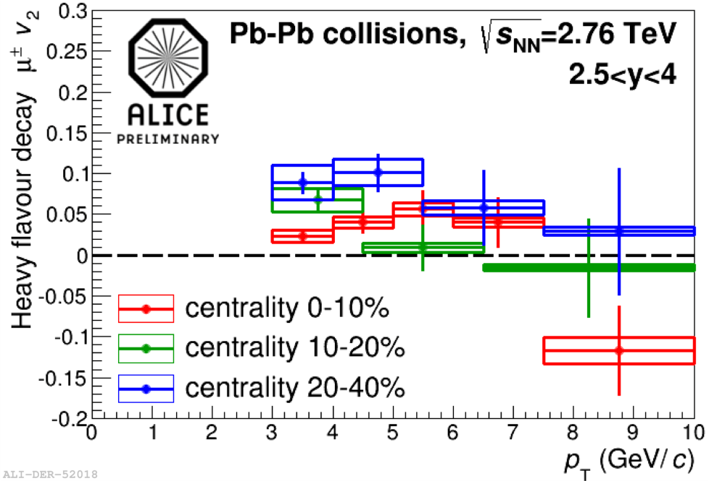
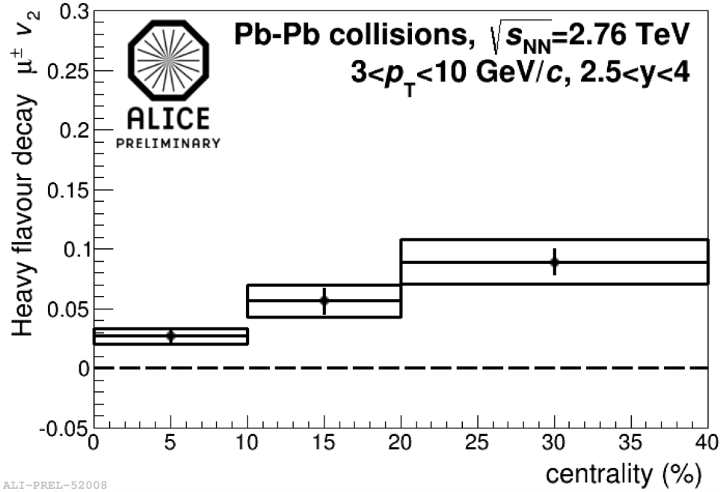
Elliptic flow of muons from heavy-flavour decays: 2-particle cumulants
p_{T}-differential v₂ of muons from heavy-flavour decays measured in 3 < p_{T} < 10 GeV/c;
clear increase of v₂ from central to semi-central collisions, in centrality range 0-40%;
observation of a positive v₂ in semi-central collisions at intermediate p_{T} with a 3σ significance when combining statistical and systematic uncertainties.
17

Slide 18
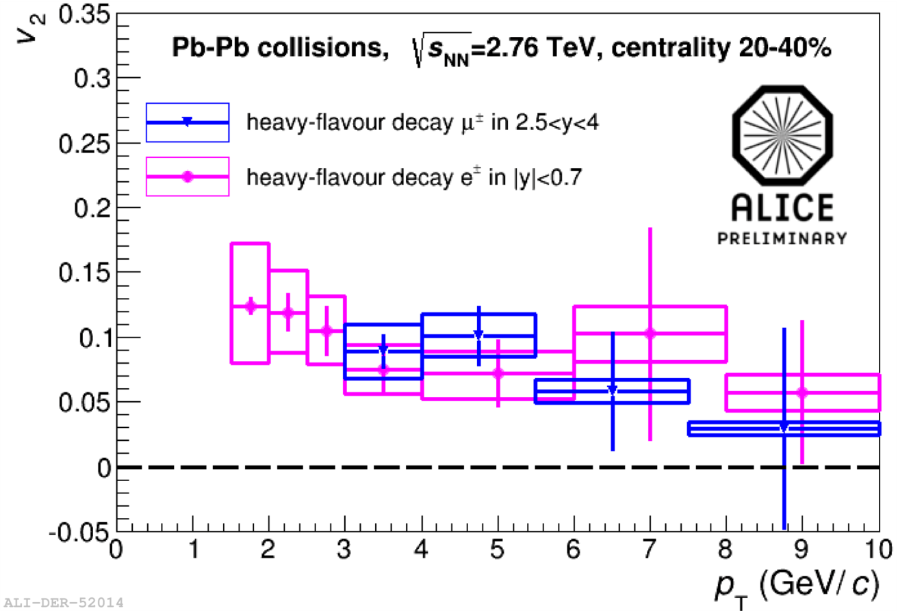
Comparison with v₂ of heavy-flavour decay electrons
v₂ of heavy-flavour decay muons at forward rapidity (2.5<η<4) is compatible with that of heavy-flavour decay electrons at mid-rapidity (|η|<0.7) within uncertainties.
18

Slide 19
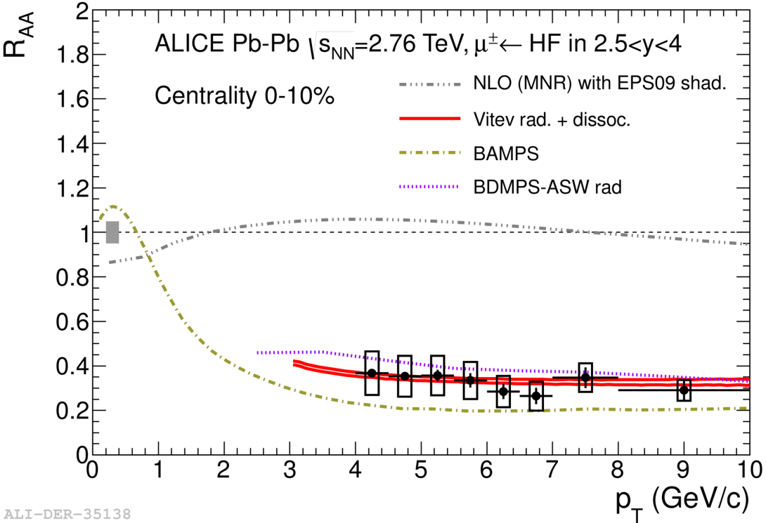
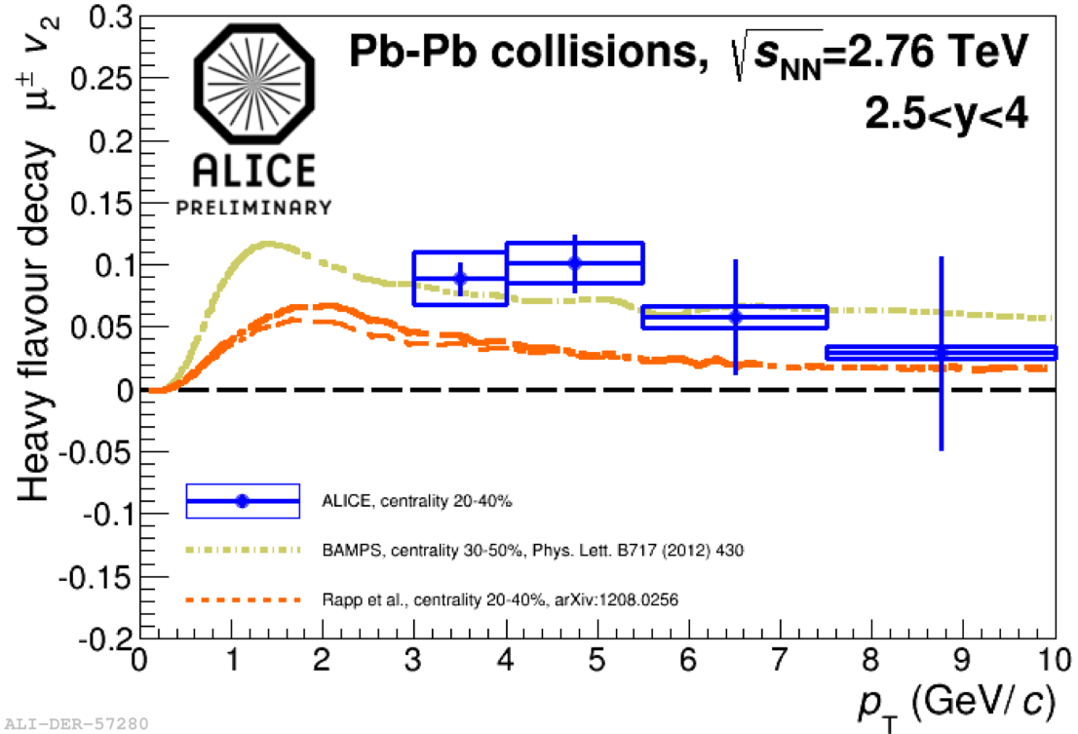
p_{T}-differential R_{AA} & v₂ of muons from heavy-flavour decays: model comparisons
theoretical models of R_{AA}: EPS09 shad., JHEP, 0904:065 (2009); Vitev rad.+dissoc, Phys. Lett.. B 713: (2013) 224; BAMPS, J. Phys. G 38: (2011) 124152; BDMPS+ASW rad., Phys. Rev. D71: (2005) 054027
theoretical models of v₂: BAMPS, Phys. Lett., B717: (2012) 430; Rapp et al, arXiv:1208.0256;
EPS09 predictions indicate that shadowing effects are expected to be small;
simultaneous reproduction of R_{AA} and v₂ is a challenge for theoretical models (more in
D. Caffarri and A. Rossi talks).
19

Slide 20
Summary and outlook
R_{AA} of muons from heavy-flavour decays measured as a function of p_{T} and centrality:
strong suppression of high p_{T} muons from heavy-flavour decays is observed in central collisions;
no significant dependence on p_{T} in 4<p_{T}<10 GeV/c;
the ongoing analysis of the p-Pb run should allow us to quantify initial state effects at forward and backward rapidity.
v₂ of muons from heavy-flavour decays measured as a function of p_{T} and centrality :
v₂ in 20-40% centrality class is larger than that in the most central collisions;
observation of a positive v₂ (3σ effect) in semi-central collisions;
suggest that c (and b) quarks suffer significant re-scatterings in the medium and inherit the azimuthal anisotropy produced by the collective expansion of the fireball.
20

Slide 21
Backup

Slide 22
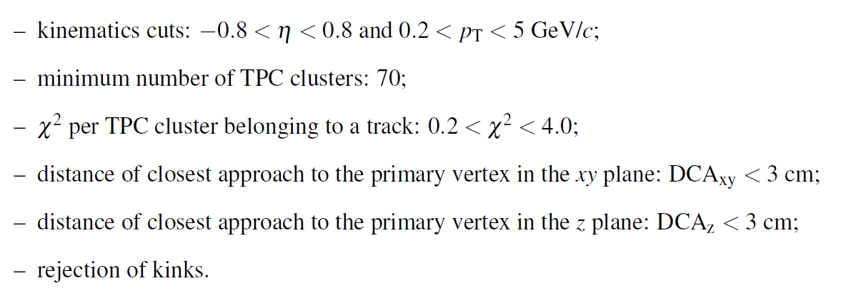
Standard 2010 TPC standalone track cuts
21

Slide 23
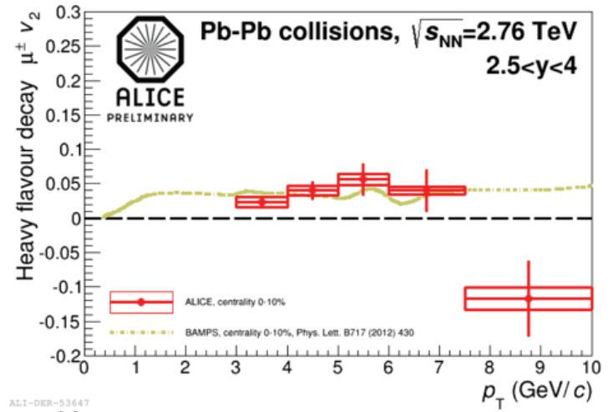
p_{T}-differential v₂ of Muons From Heavy-flavour Decays: model comparisons
0-10%
22

