Slide 1



p-Pb collisions: particle production and centrality determination in ALICE
C. Oppedisano
on behalf of the ALICE Collaboration

Slide 2
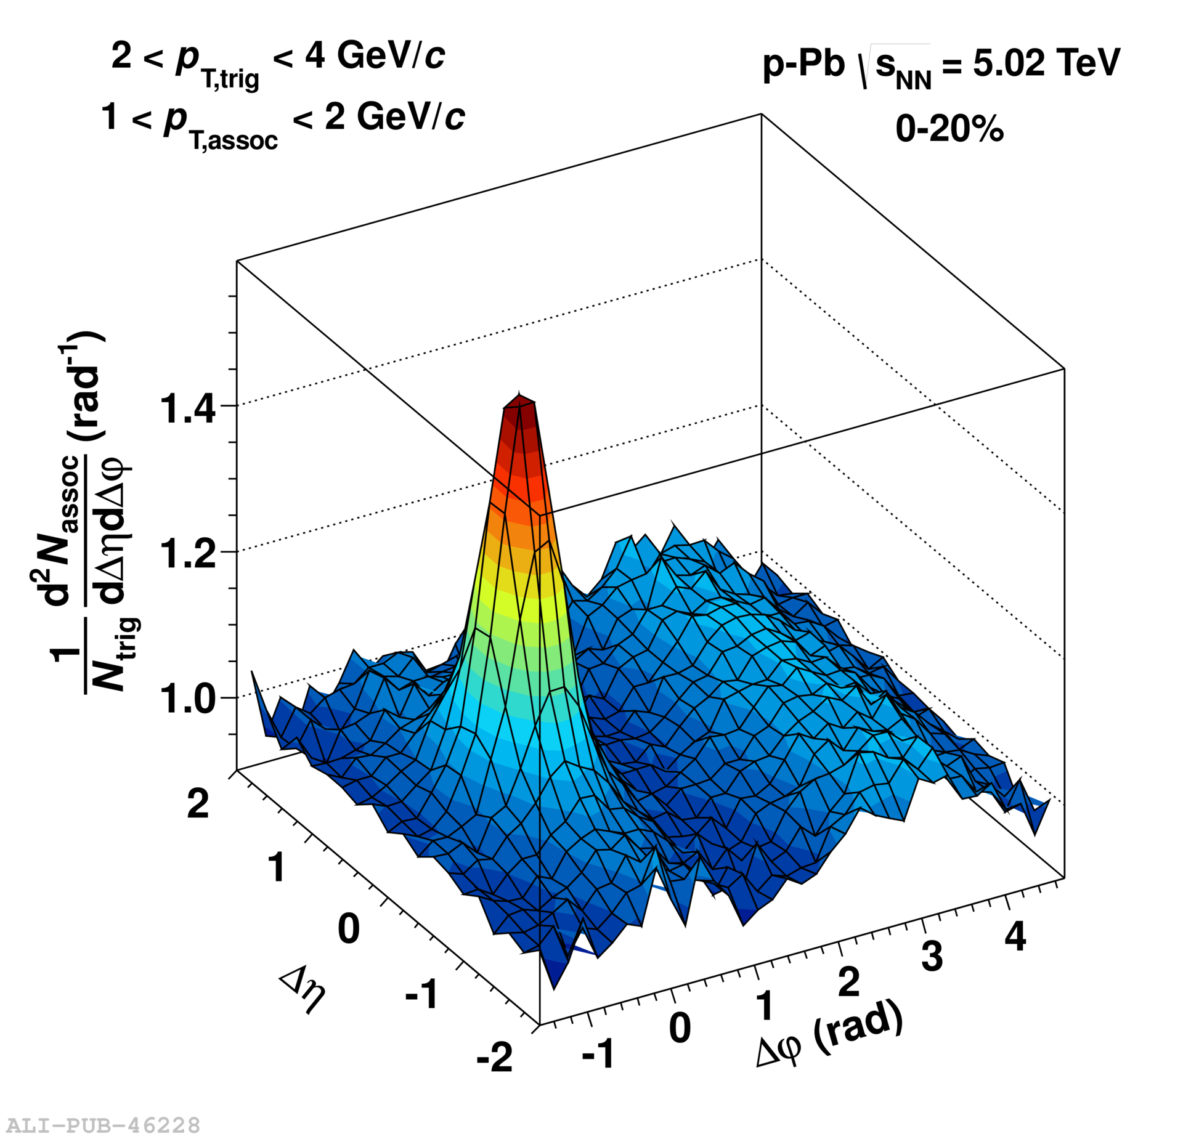
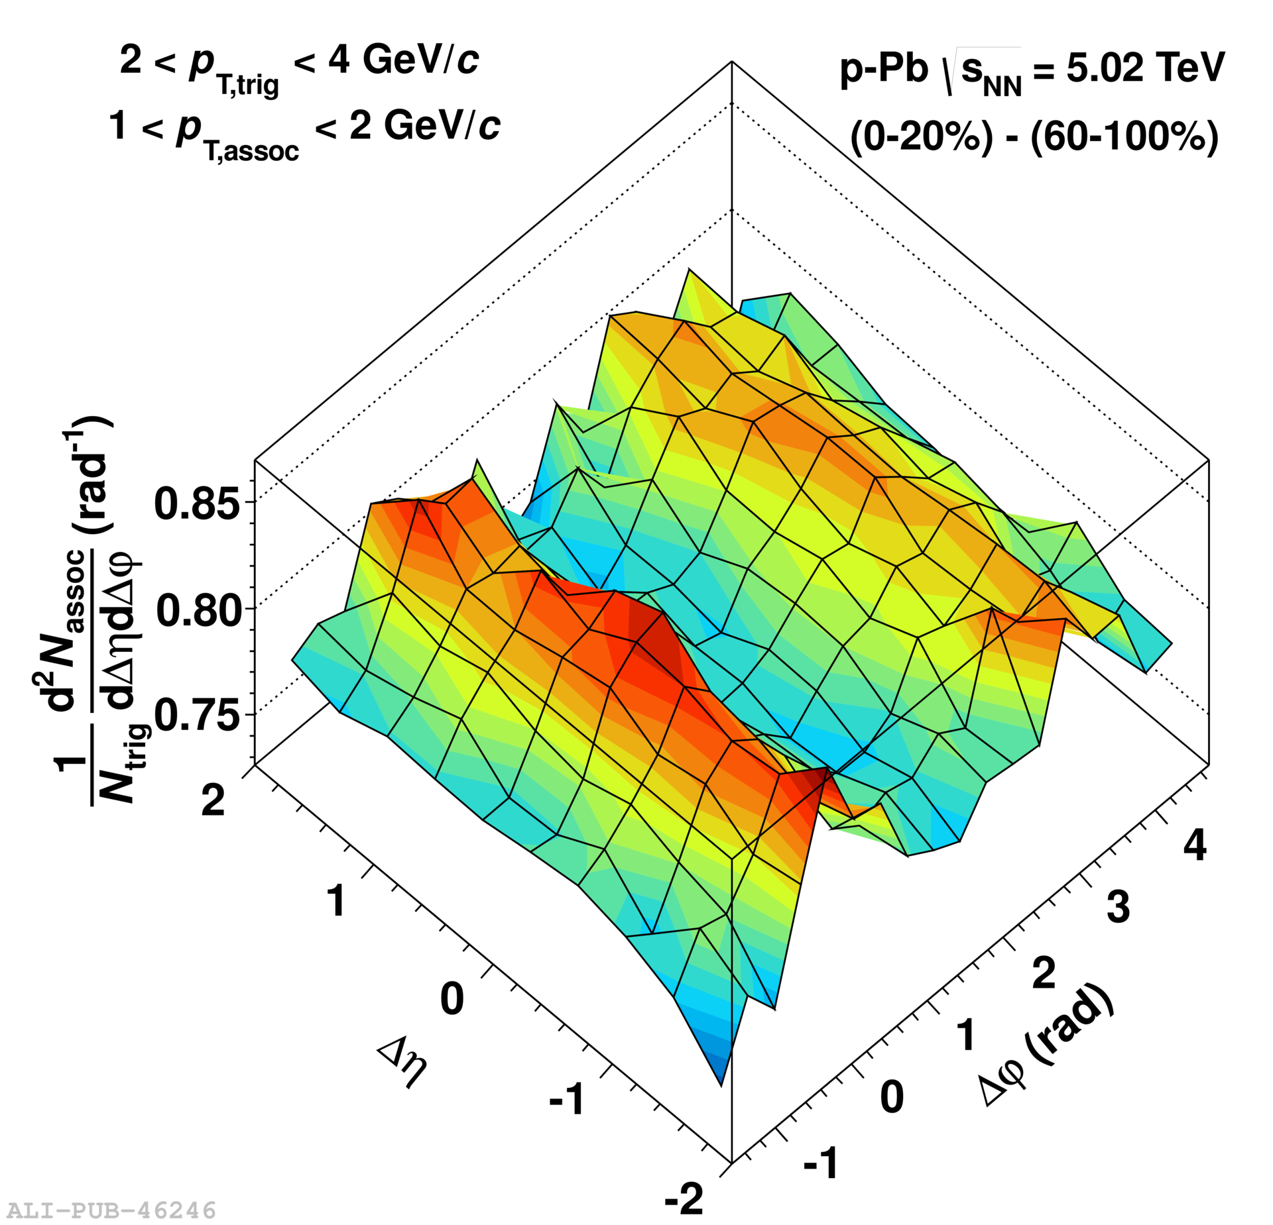
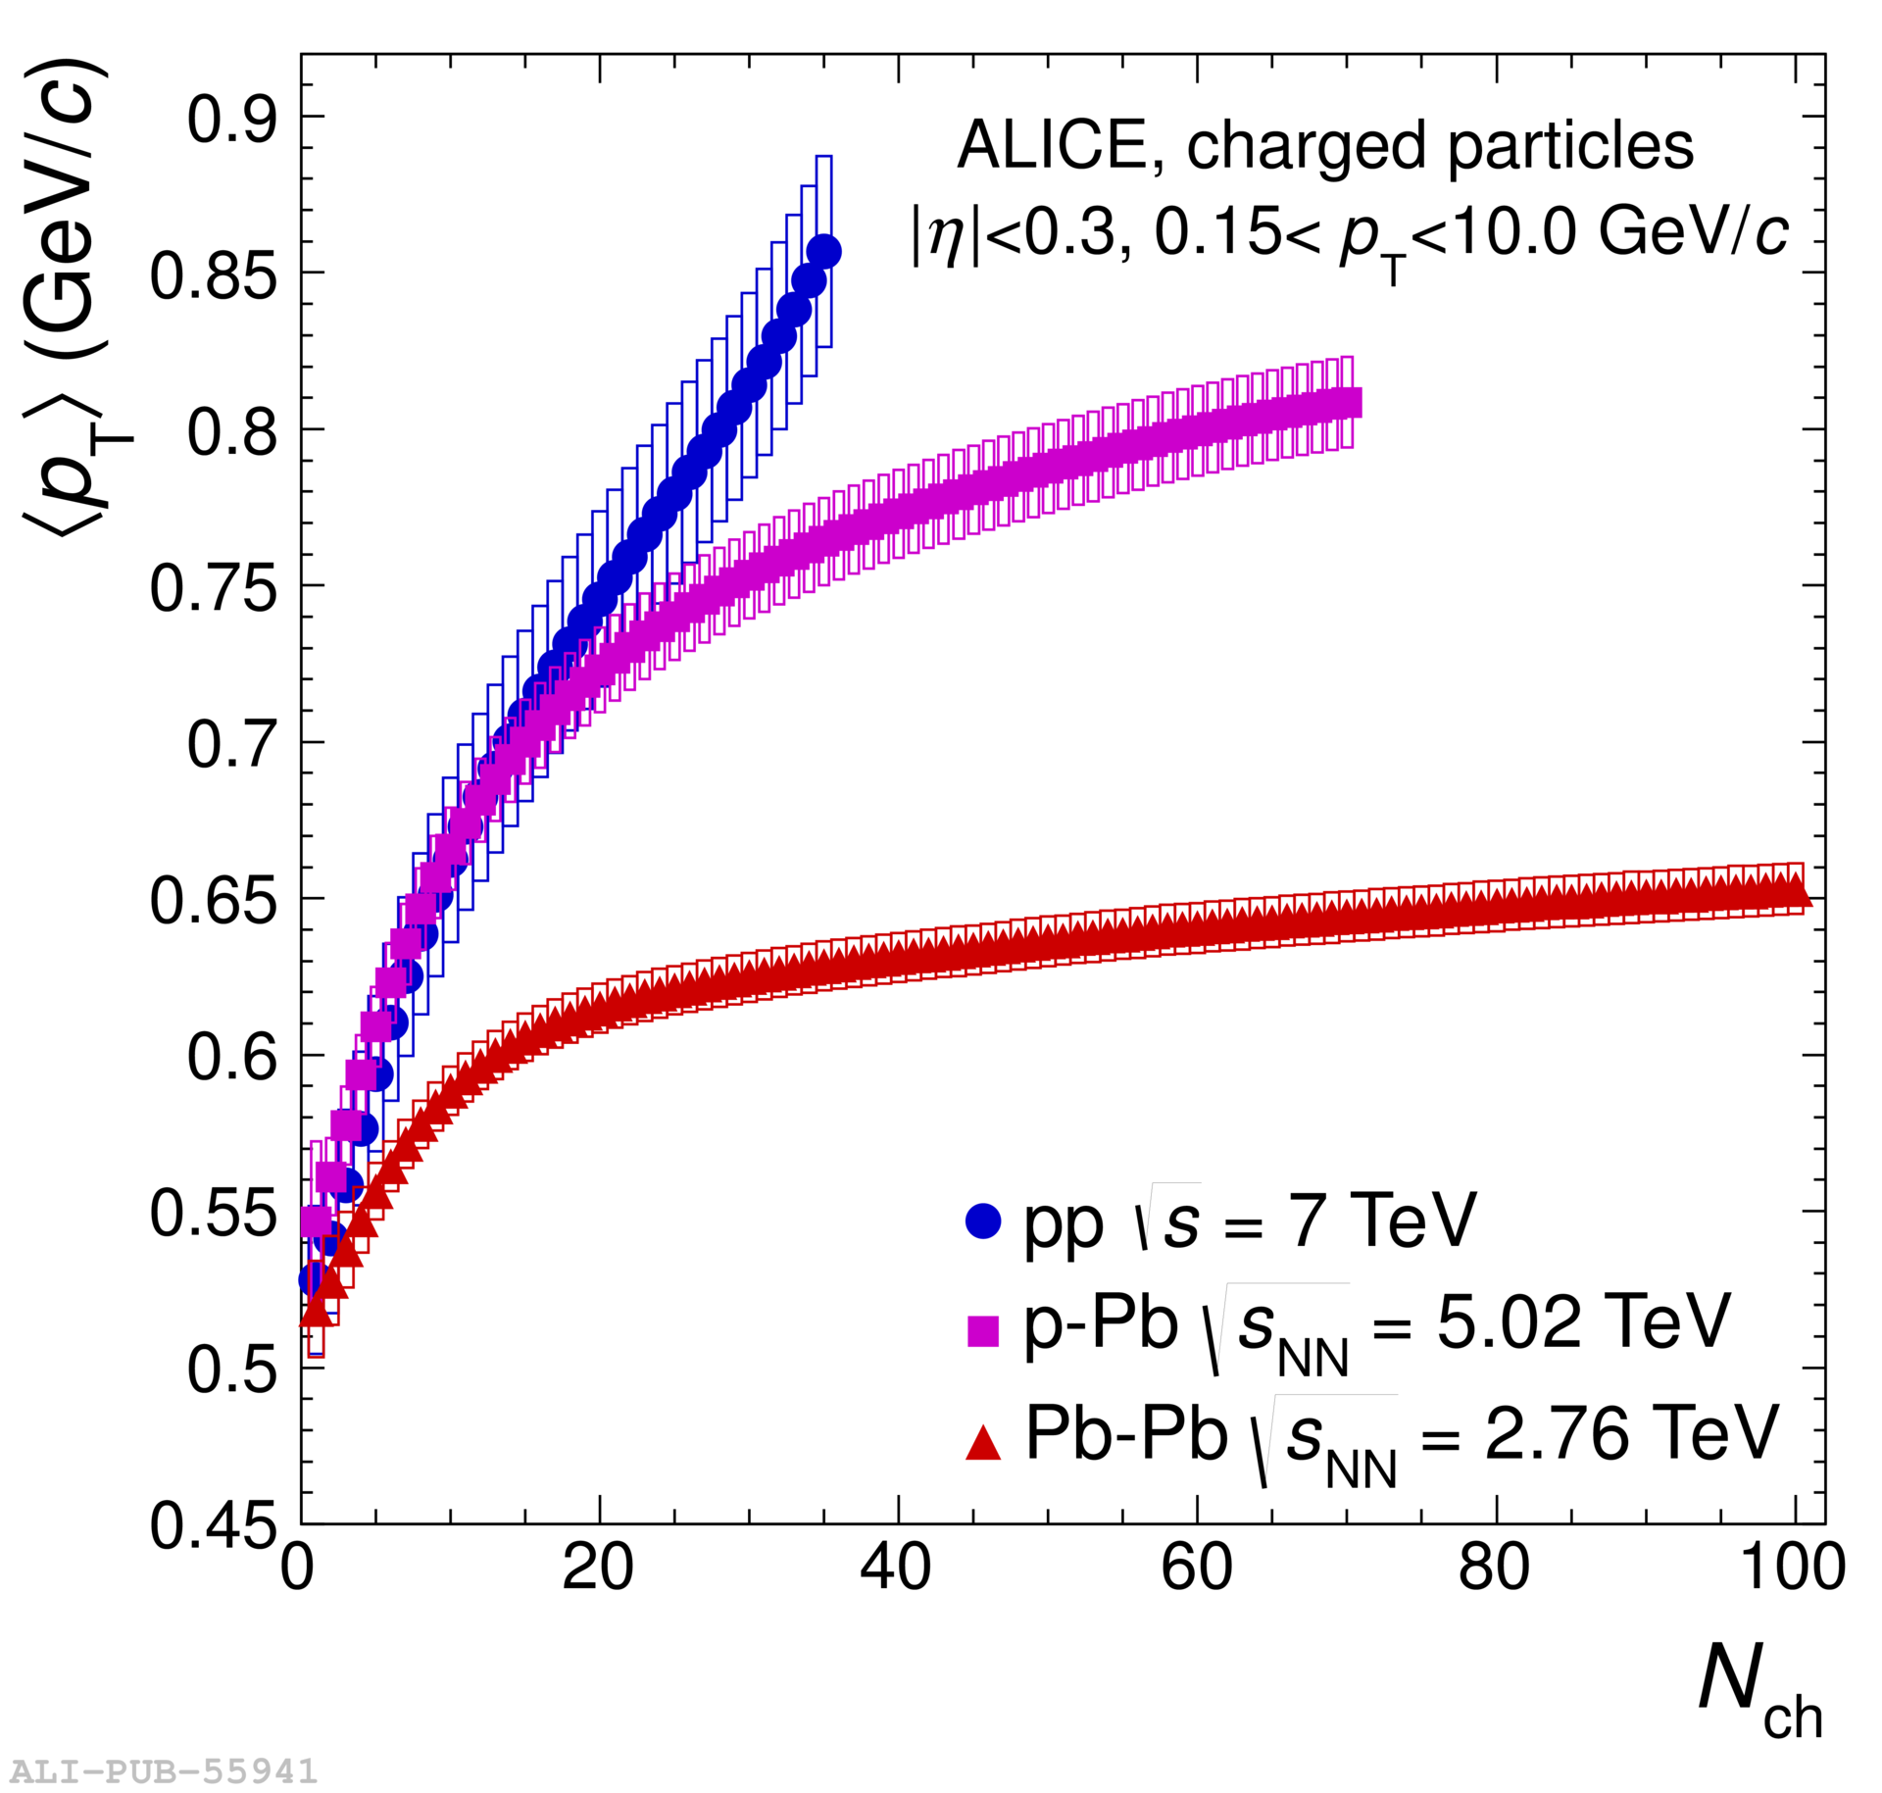
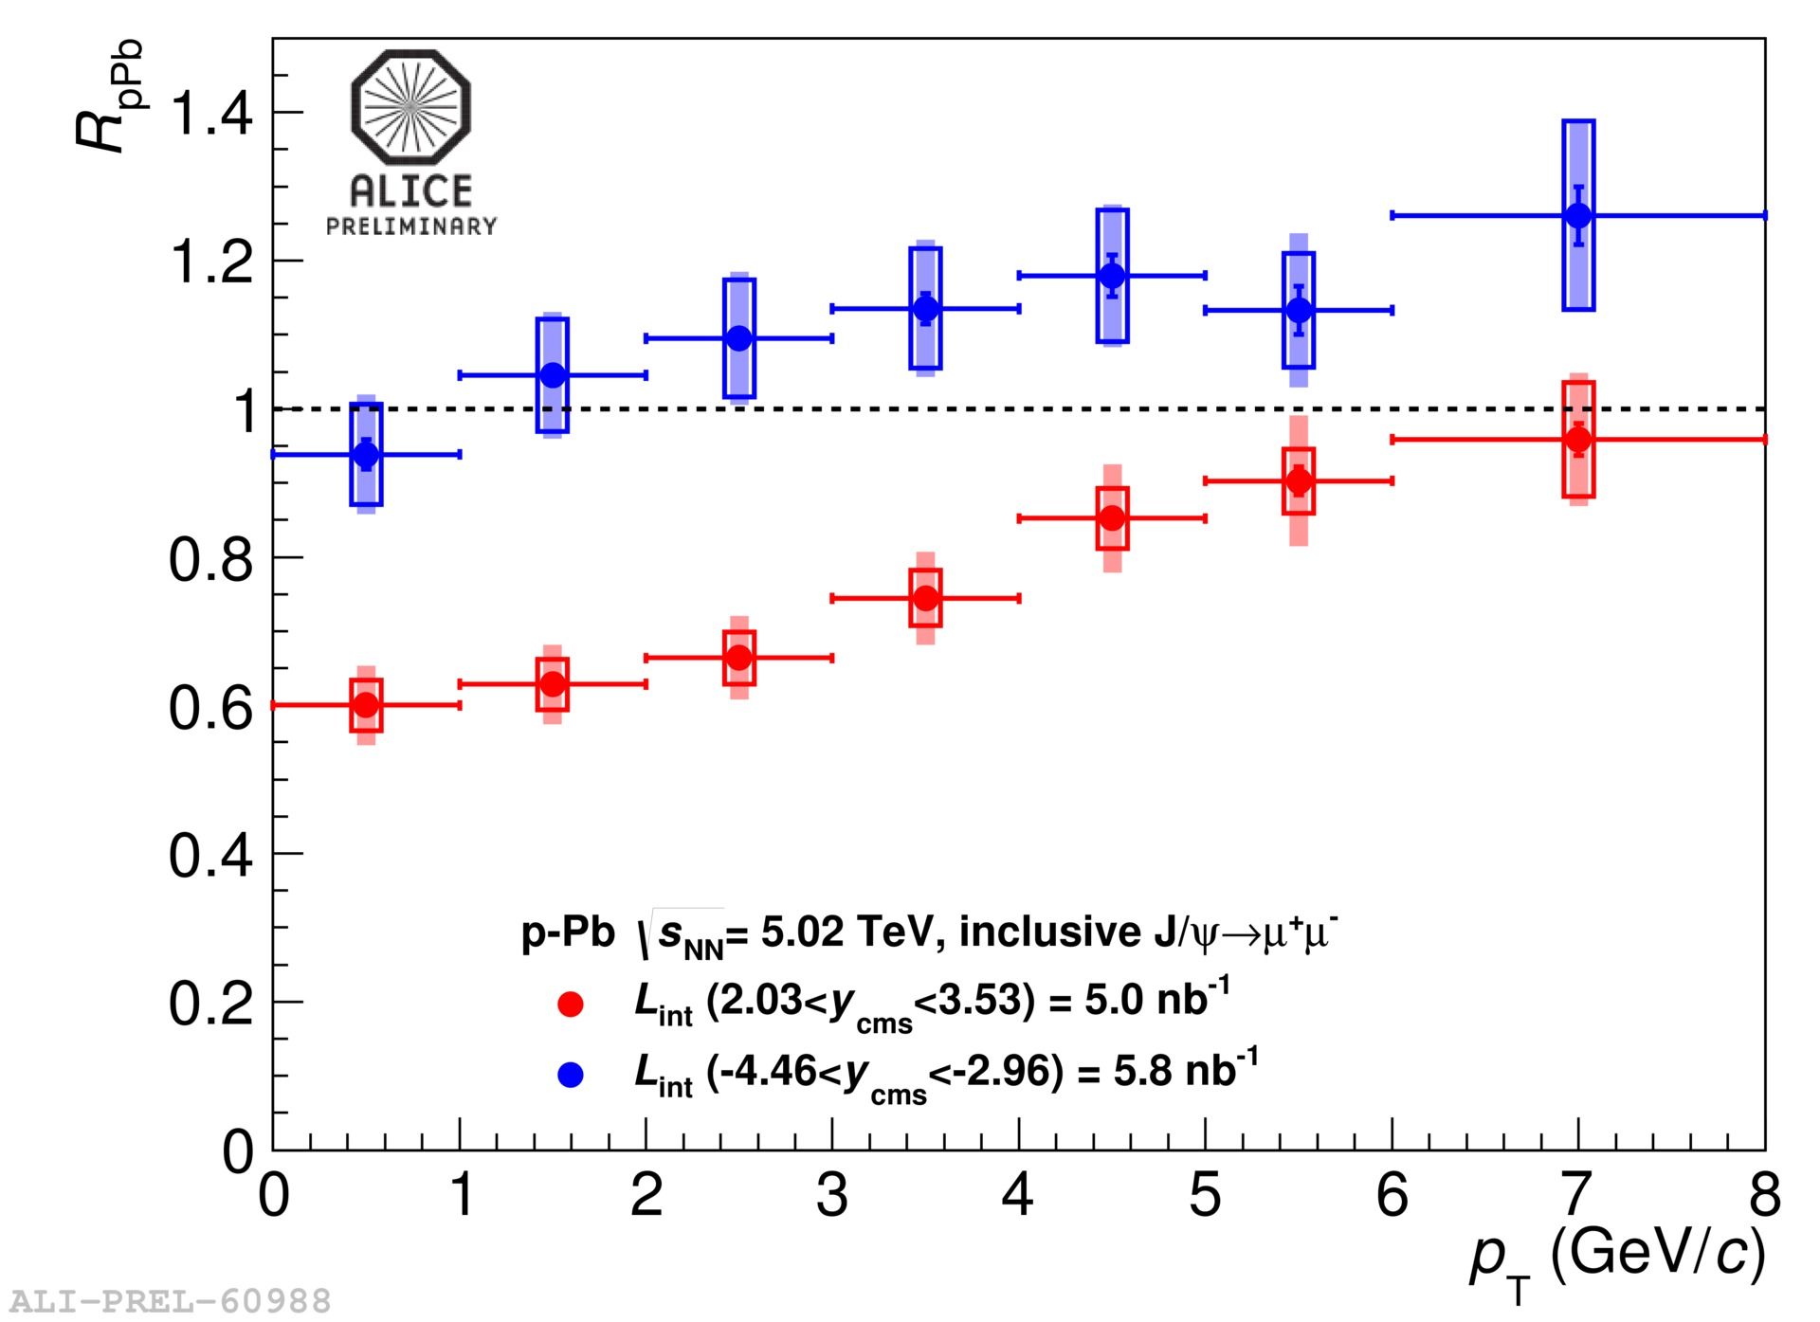
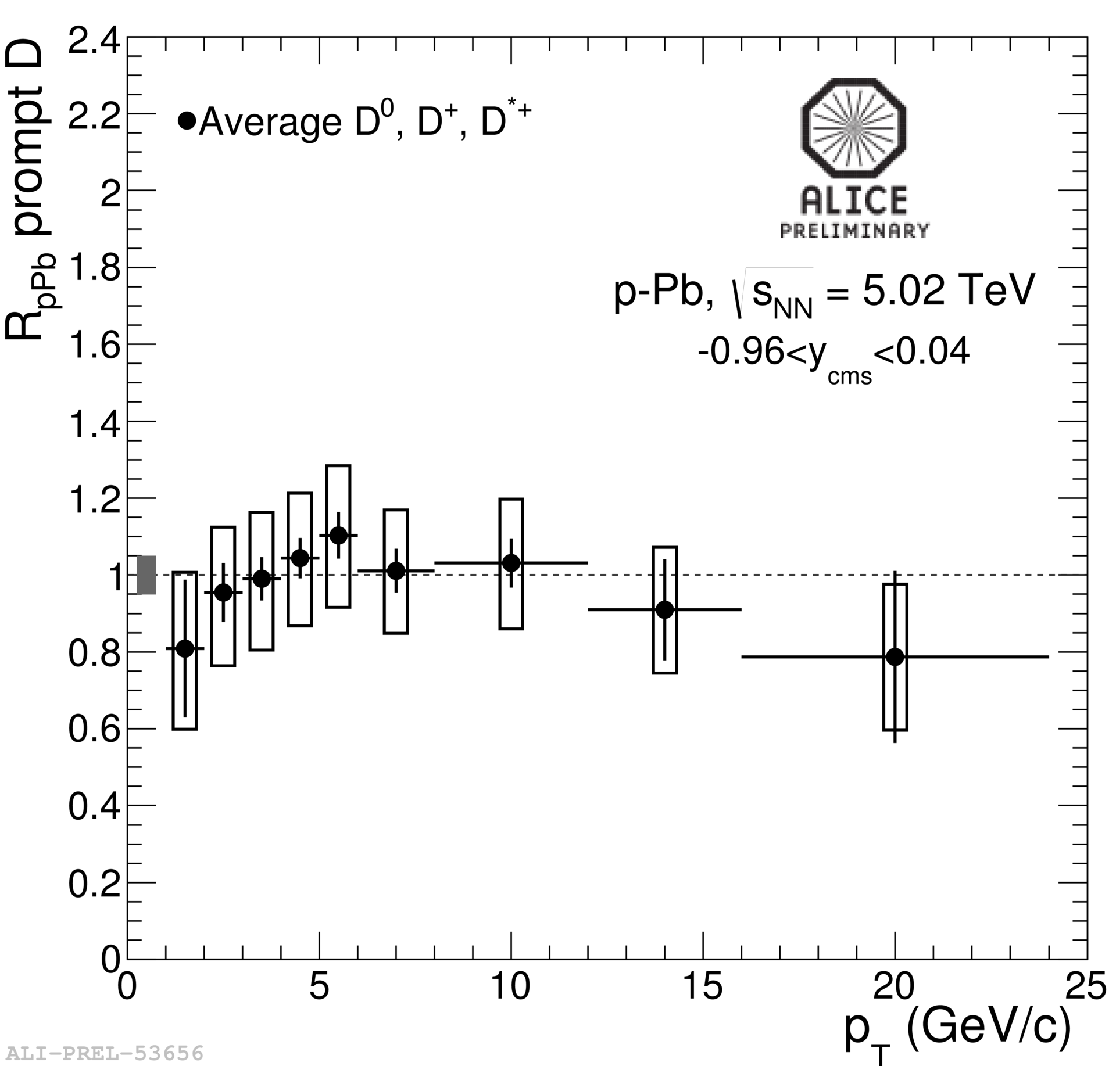
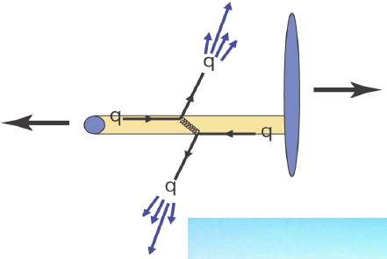
p-Pb collisions and centrality
p-Pb collisions
 study of high density QCD in saturation region
reference for heavy ion studies
disentangle cold nuclear matter effects
many interesting results from
p-Pb collisions at √s = 5.02 TeV
Centrality
many initial state observables depend on the number of binary p-N collisions, N_{coll}
need to classify events in percentiles of the hadronic cross-section
centrality determination crucial to compare with different energies/systems
  Outline of the presentation:
    centrality (N_{coll}) determination
    are N-N collisions biased?
Pb
p

Slide 3
Nuclear modification factor R_{pPb}
ALICE, Phys. Rev. Lett. 110, 082302 (2013)
MB sample  the average number of binary collisions <N_{coll}> is determined by p-N cross-section and total p-Pb cross-section:
 study nuclear modification factor as a function of centrality
 compare p-Pb effects with incoherent superposition of binary p-N collisions
 define centrality classes using different estimators
 define <N_{coll}> in each event class

Slide 4
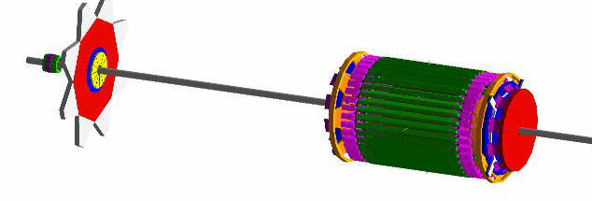
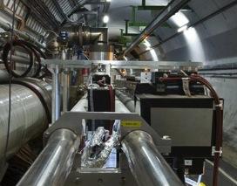
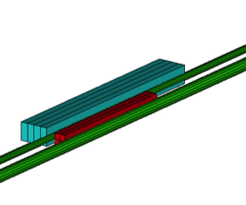
Centrality estimators
MULTIPLICITY
VERY FORWARD ENERGY
V0A
SPD
V0C
ZERO DEGREE
MIDRAPIDITY
2 innermost ITS layers (pixel)
|η|< 2, |η|<1.4
FORWARD
RAPIDITY
V0 scintillator hodoscopes
V0A z = 3.4 m 2.0<η<5.1
V0C z = -0.9 m -3.7<η<-1.7
Zero Degree Calorimeters (ZDC) ±112.6 m
neutron ZDC (ZN) |η|>8.7
proton ZDC (ZP)
Particle production is modeled by Negative Binomial Distribution (NBD)
Need a model to describe nucleus fragmentation and the following
nucleon emission
“Slow” Nucleon Model (SNM)
Centrality estimators:
CL1  clusters in 2nd pixel layer
V0M  total (V0A+V0C) multiplicity
V0A  V0 multiplicity (Pb-remnant side)
ZNA  ZN energy (Pb-remnant side)
ZPA  ZP energy (Pb-remnant side)

Slide 5
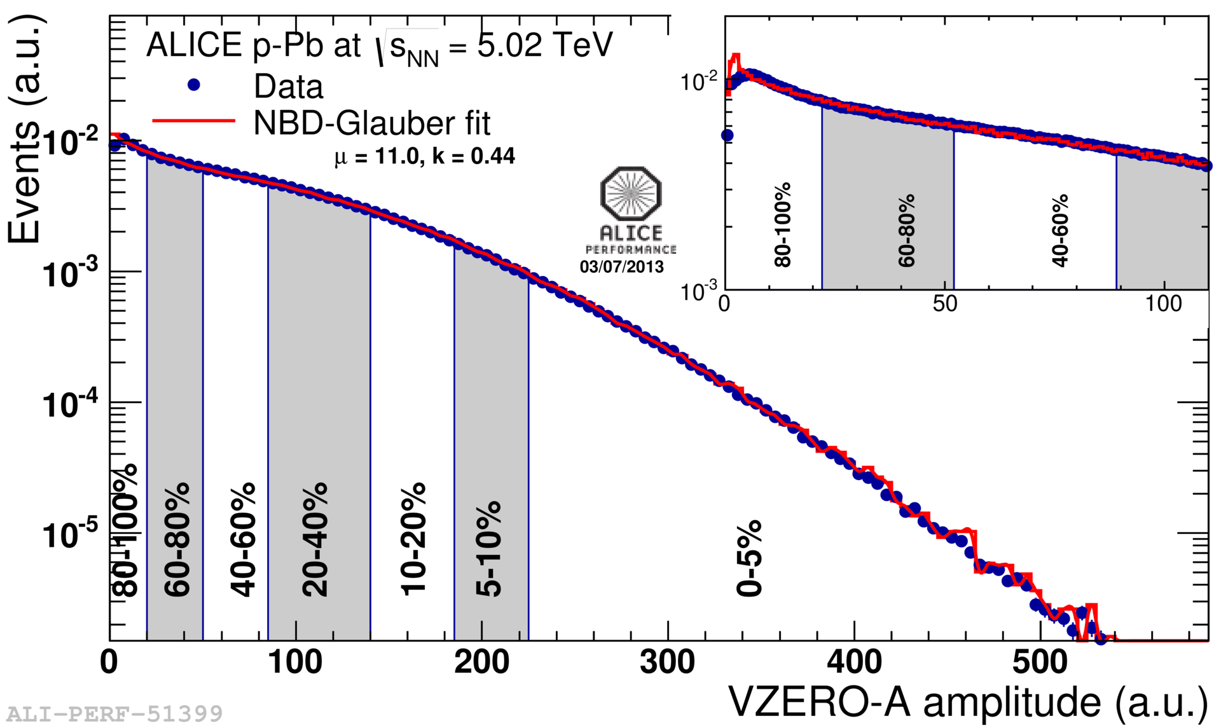
Glauber fit + NBD
ALICE, Phys. Rev. C 88, 044909 (2013)
Same procedure as for Pb-Pb
Glauber MC to obtain P(Npart) assuming N_{part}= number of particle sources (ancestors)
multiplicity distribution per ancestor from Negative Binomial Distribution (NBD)
minimization procedure to find NBD parameter values
centrality classes defined slicing measured multiplicity distributions in percentiles of cross-section
<N_{part}>, <N_{coll}>, <T_{pA}> for each centrality class from Glauber
Glauber MC parameters:
Woods-Saxon nuclear ρ:
R = (6.62 ± 0.06) fm
a = (0.546 ± 0.01) fm
Minimum NN distance:
d = (0.4 ± 0.4) fm
p-N cross-section:
σ_{pN} = (70 ± 5) mb
Proton radius:
R_{p} = (0.6 ± 0.2) fm

Slide 6
Glauber fit + SNM
Similar procedure but coupled with a model for slow nucleon emission (SNM)
No model is currently available for LHC energies!
Features of emitted nucleons weakly dependent on projectile energy from 1 GeV to 1 TeV
 “Phenomenological” model based on experimental results at lower energies
 number of protons and neutrons as a function of N_{coll}
 kinematical properties of emitted slow nucleons
 able to reproduce essential features of the spectrum, still ongoing work!
F. Sikler, arXiv: 0304.065

Slide 7
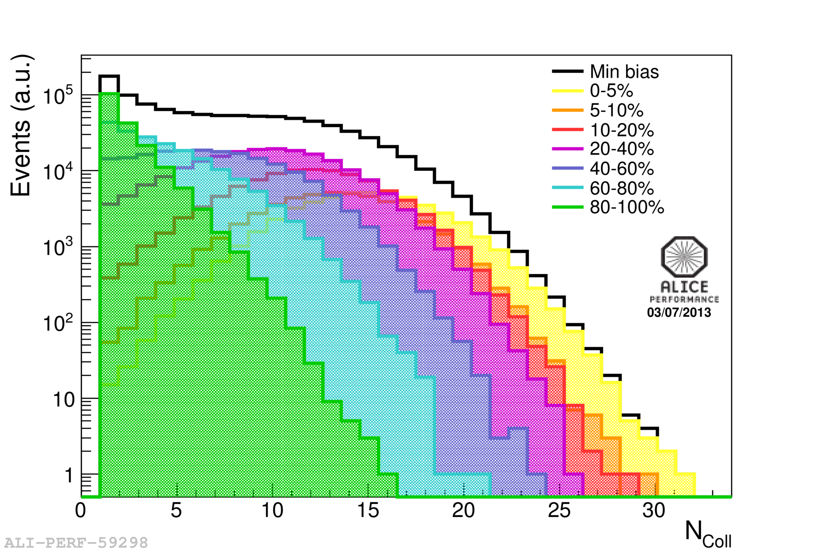
<N_{coll}>
Slice the measured distribution  corresponding class in MC distribution  <N_{coll}>
N_{coll}
V0A
0-5%
5-10%
10-20%
20-40%
40-60%
60-80%
80-100%
<N_{coll}>
N_{coll}
similar values from different estimators
variation of same magnitude as systematic from Glauber and from MC closure test
* Glauber systematic error estimated varying
parameters
* MC closure test using HIJING

Slide 8
Biases in p-N collisions?
p-Pb
Pb-Pb
p-A vs. A-A collisions
looser correlation between N_{part} and impact parameter
large multiplicity fluctuations compared to the width of N_{part} distribution
a fixed N_{coll} value can contribute to different centrality classes
large fluctuations originate a bias
N_{part} vs. b
multiplicity vs. N_{part}

Slide 9
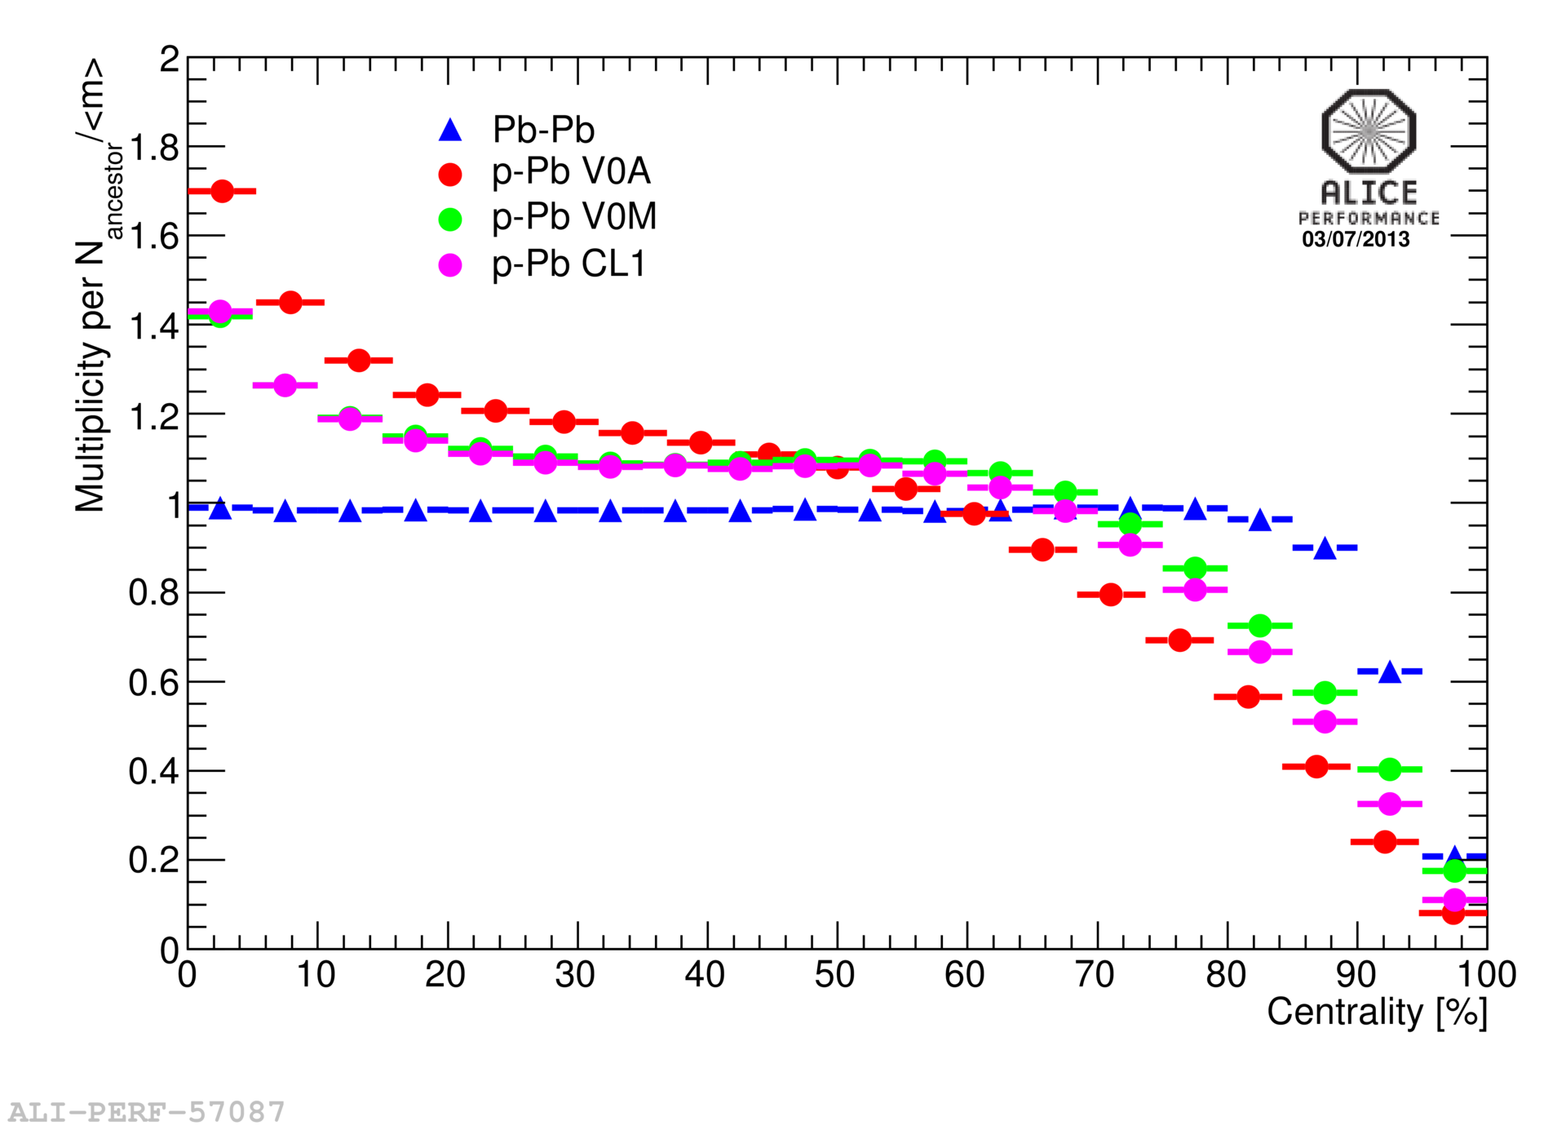
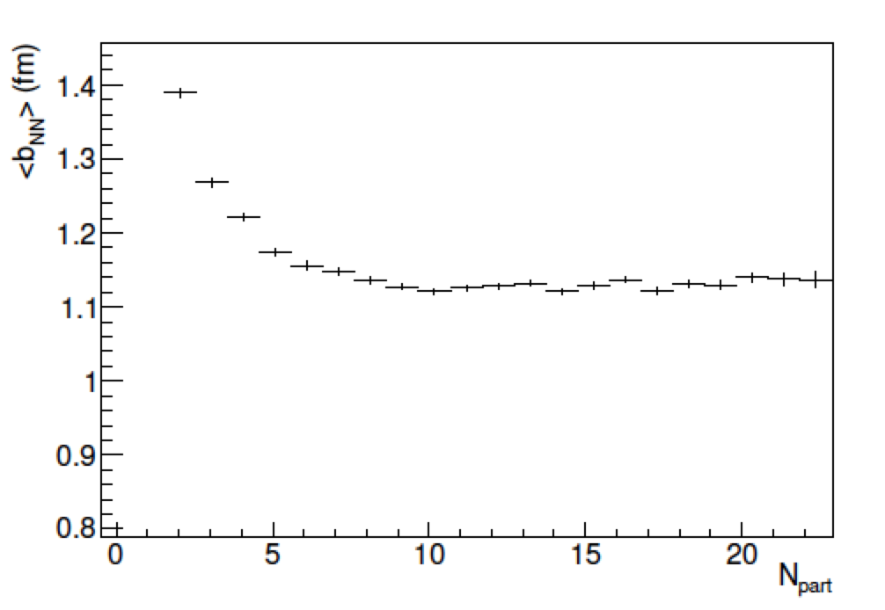
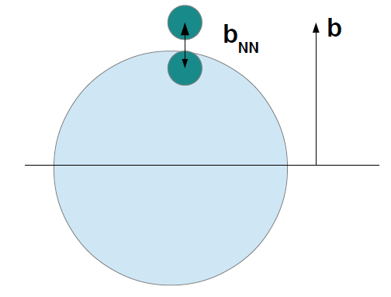
Bias through Glauber MC
Glauber MC
Multiplicity fluctuations
Ratio between multiplicity per ancestor and average multiplicity from NBD <m> vs. centrality
large deviations from unity for peripheral and central collisions
most central (peripheral) collisions have on average much higher (lower) multiplicity
bias on multiplicity
Glauber MC
Average N-N impact parameter <b_{NN}>
<b_{NN}> larger for peripheral collisions

Slide 10
Biases and binary scaling
Models including multi-parton interactions (MPI) have fluctuations in the number of particle sources (hard scatterings n_{hard})  <n_{hard}>(b_{NN}) = σ_{hard}T_{N}(b_{NN})
bias on multiplicity bias on hard scatterings
central (peripheral) collisions have a larger (lower) than average n_{hard}
effect enhanced in peripheral collisions where b_{NN} larger than average reduces
MPI probability
At high p_{T} another source of bias
correlations between high p_{T} particles and centrality estimators that measure multiplicity in the tracking region
for very peripheral collisions multiplicity estimators act as a veto on hard processes
  jet-veto effect
Centrality in p-Pb
For a given centrality class hard processes scale with
For a fixed p-Pb impact parameter b, <n_{hard}> depends on <b_{NN}>
 reduced number of hard scatterings for peripheral events

Slide 11
Biased <N_{coll}> and Q_{pPb}
Centrality based on multiplicity measurements  deviation from binary scaling
Effect reduced increasing the rapidity separation between tracking and centrality measurements
CL1  strong bias (full overlap with tracking region
+ additional bias in peripheral events from jet veto effect)
V0M  reduced bias (outside tracking region)
V0A  small bias (contribution from Pb fragmentation region)
ZNA  smallest bias (slow nucleon emission independent from hard processes)
BIAS
 can not be used to scale pp data
Defined “biased” ratios for centrality selected data Q_{pPb}
  Q_{pPb}≠R_{pPb}
  Q_{pPb} expected to differ from unity at high p_{T}

Slide 12
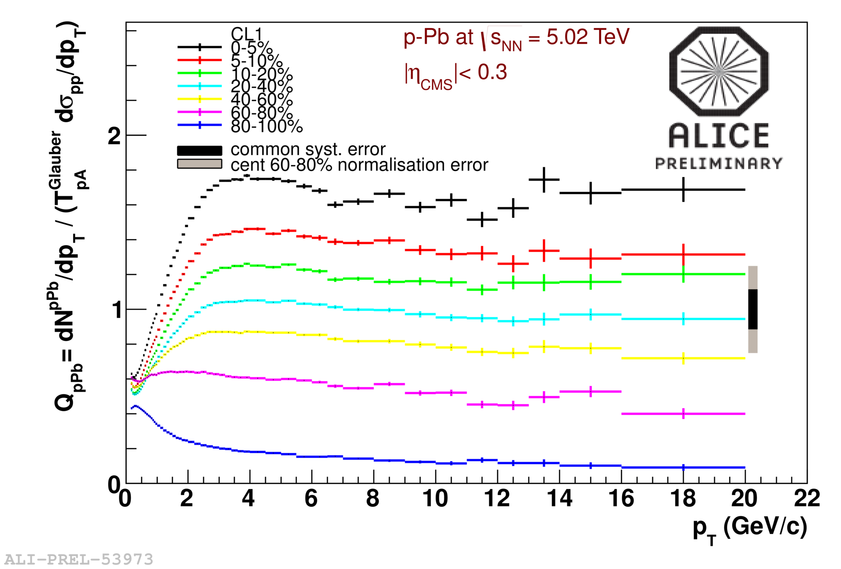
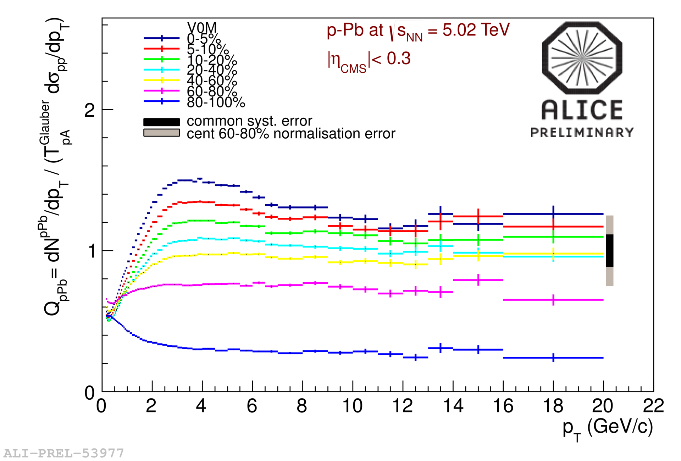
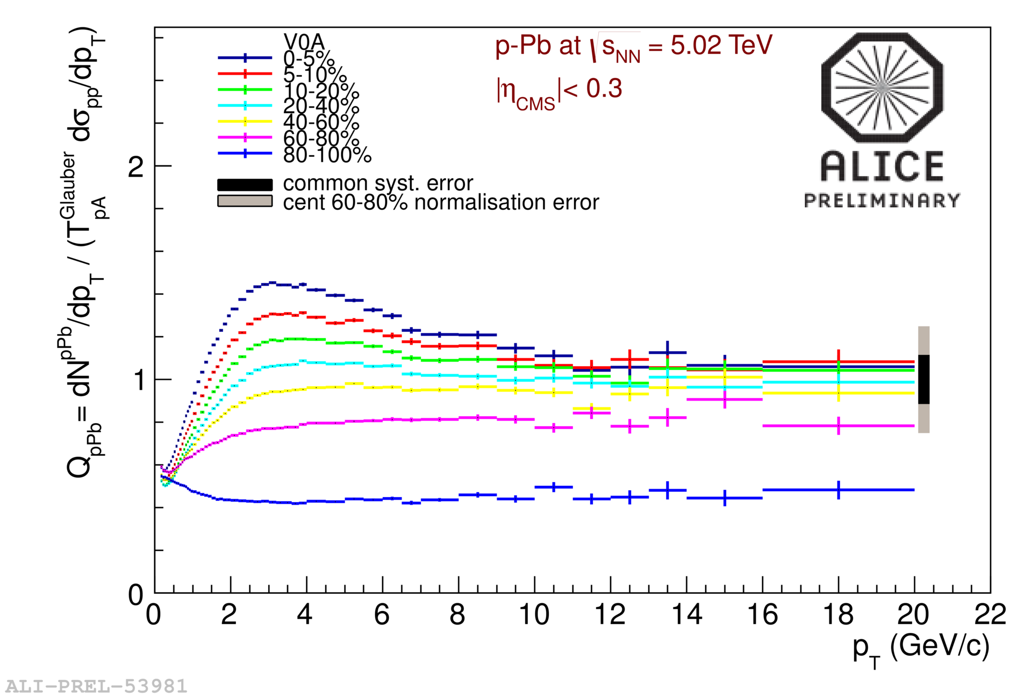
Q_{pPb}
CL1
clear indication of jet-veto bias in most peripheral bin selected using CL1
no jet-veto bias in V0A
Q_{pPb} spread between centrality classes reduced increasing the rapidity gap
0-5%
5-10%
10-20%
20-40%
40-60%
60-80%
80-100%
V0M
V0A

Slide 13
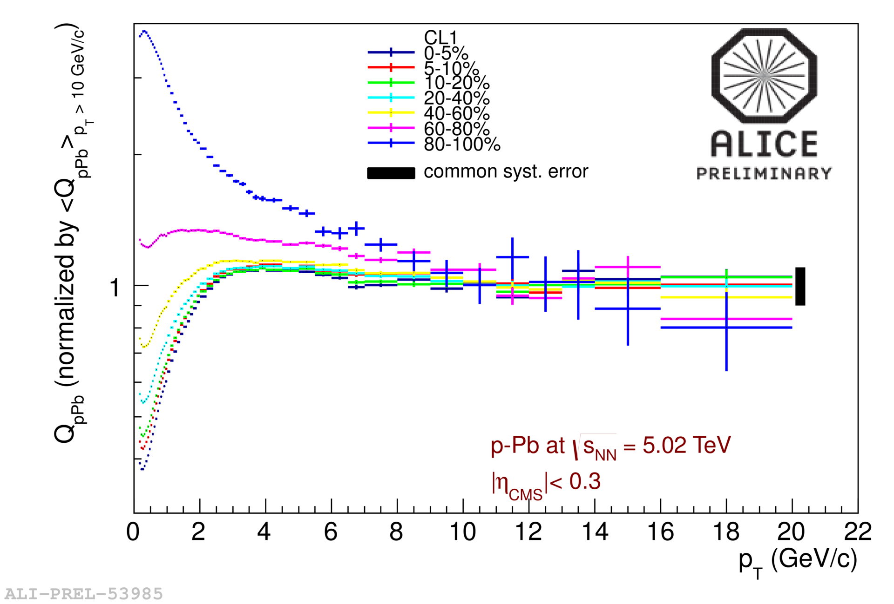
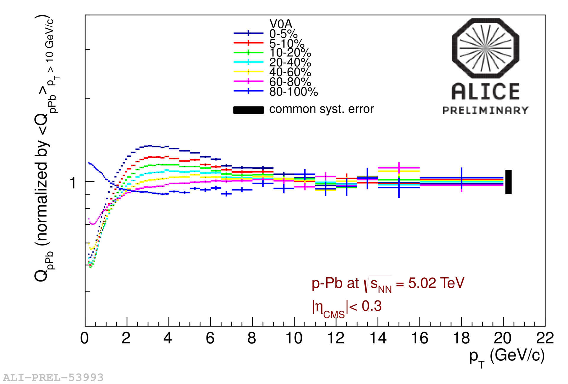
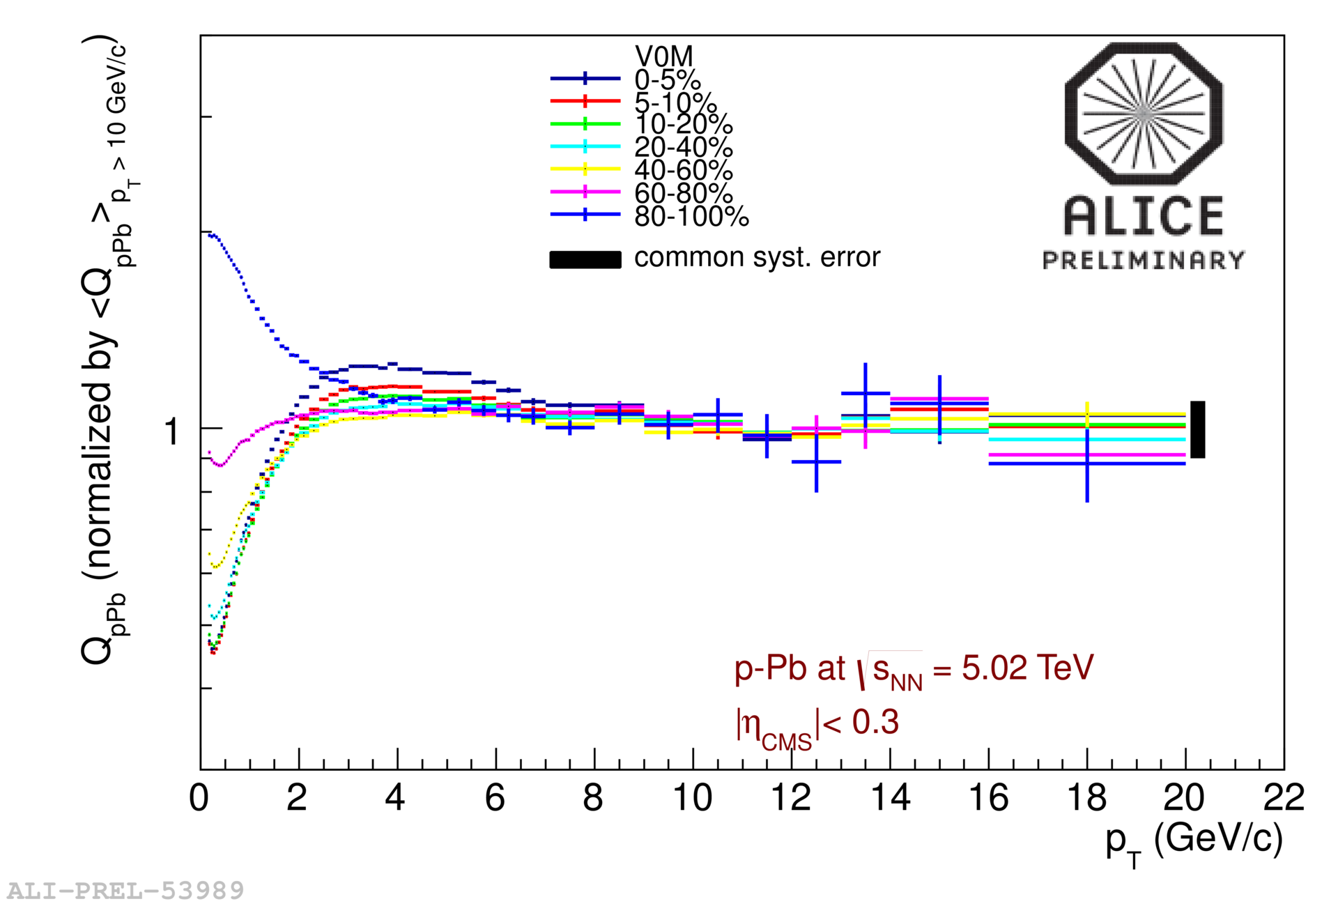
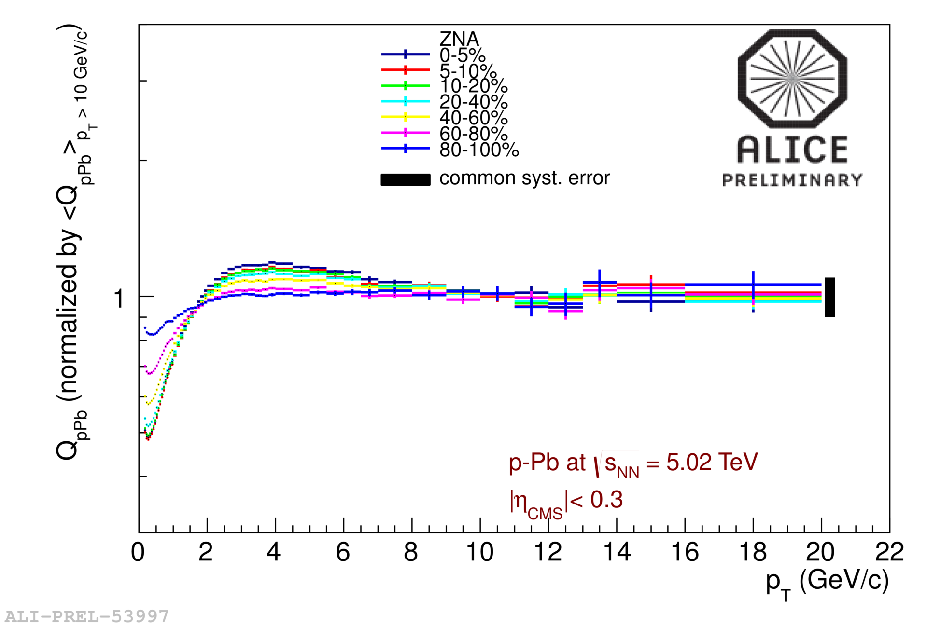
Q_{pPb} normalized to high p_{T}
CL1
V0A
0-5%
5-10%
10-20%
20-40%
40-60%
60-80%
80-100%
shape only
V0M
ZNA
ZN selects more similar event classes

Slide 14
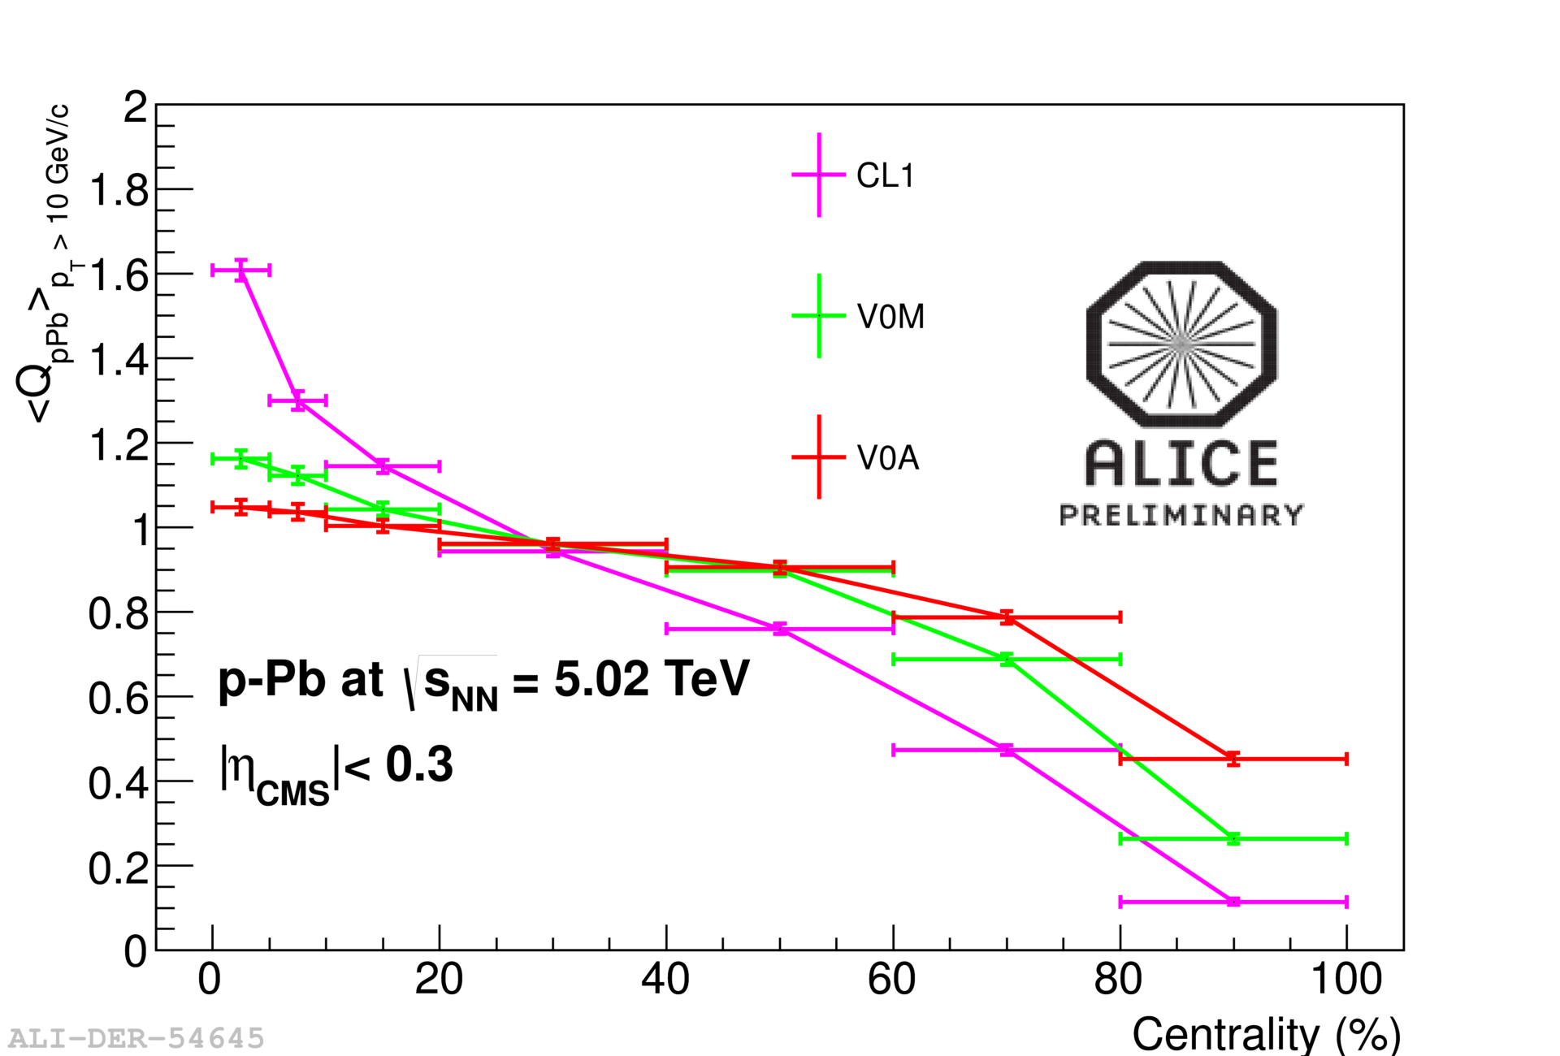
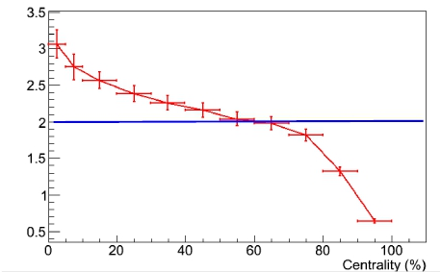
<Q_{pPb}> at high p_{T}
<Q_{pPb}> for p_{T}>10 GeV/c vs. centrality
same centrality dependence as seen for multiplicity bias from Glauber MC
Glauber MC
TOY MC  p-Pb collision = N_{coll} p-p collisions superimposed with N_{coll} distributed according to Glauber MC
number of hard scatterings per collision shows strong deviations from N_{coll} scaling
high p_{T} particle production seems to scale as the incoherent superposition of N-N collisions
TOY MC:
Pythia6 (Perugia 2011)
+ Glauber MC
n_{hard}/N_{coll}

Slide 15
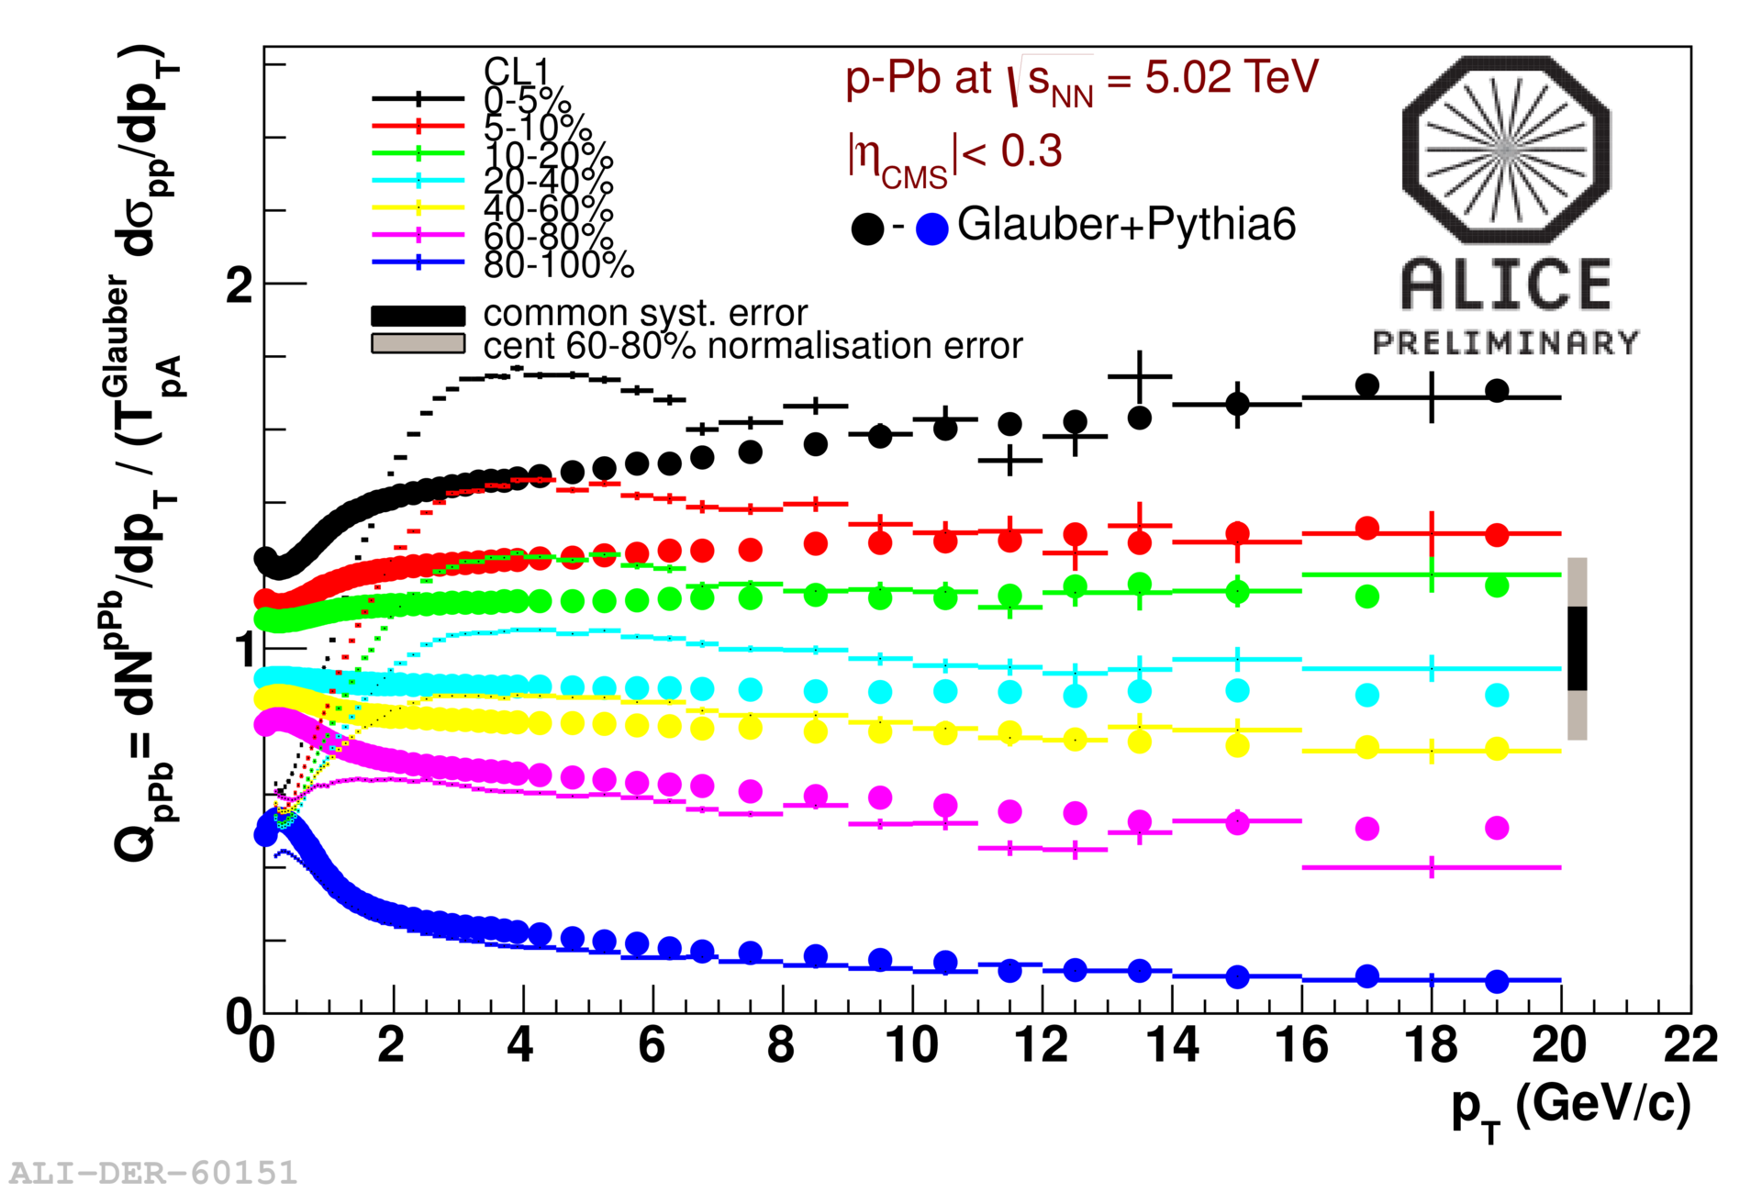
Scaling at high p_{T}
PYTHIA6 (Perugia 2011) simulations + Glauber N_{coll} distribution
* centrality from multiplicity in |η|<1.4
* <N_{coll}> from MC
CL1
incoherent superposition of p-p collisions reproduces the bias at high p_{T} over the whole centrality range
good agreement at low p_{T} for the most peripheral bin where also the jet-veto effect is reproduced

Slide 16
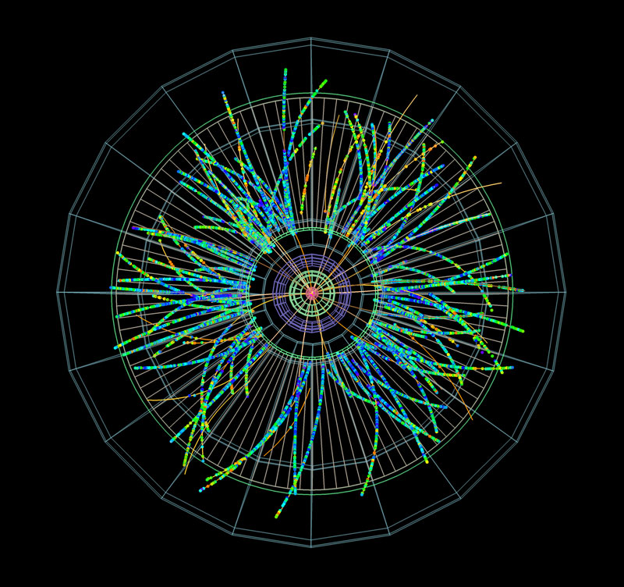
Summary and outlook
asymmetric nature of p-A collisions and low particle multiplicities generate a bias on multiplicity that corresponds to a bias on hard scatterings
centrality estimators based on multiplicity measurements show a deviation from binary scaling
the bias is reduced increasing the rapidity gap between centrality estimator and tracking region
the bias can be quantified by the number of hard scatterings in p-N collisions
incoherent superposition of p-p collisions reproduces observed features at high p_{T}
ZDC should provide the less biased centrality estimator
a more sophisticated model for slow nucleon emission would be useful
WORK
IN PROGRESS

Slide 17
BACKUP

Slide 18
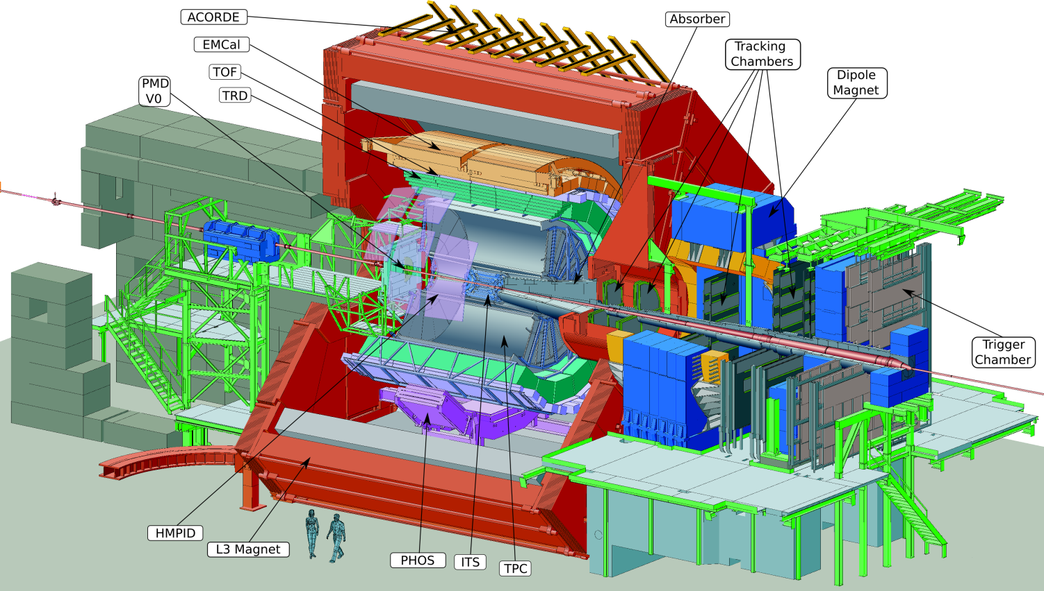
ALICE
@midrapidity (|η|<0.9):
TRACKING & PID: ITS, TPC
CHARGED PARTICLE ID: TPC, TOF, TRD, HMPID
NEUTRAL PARTICLE ID: EMCAL, PHOS
@forward rapidities:
μ MEASUREMENT: μ spectrometer TRIGGER & EVENT CHARACTERIZATION: VZERO, T0, ZDC

Slide 19
p-Pb data taking
Dedicated LHC run in 2013 at √s = 5.02 TeV (p at √s = 4 TeV, Pb at √s_{NN} = 1.57 TeV)
ALICE maximum luminosity 4 x 10²⁷ cm⁻² s⁻¹
10 kHz of hadronic interaction rate
ALICE collected 30 nb⁻¹ integrated luminosity
p-Pb trigger
signal in either V0A or V0C
offline trigger V0A AND V0C used to reduce background (beam-gas) along with a timing check on particle arrival time in V0 and ZDC detectors
selected sample: NSD + EM + SD events
efficiency = 98% for NSD collisions, negligible contamination from EM and SD interactions
Total p-Pb cross section: σ^{pPb} = 2100 mb
STARLIGHT estimate for EM cross-section (proton excitation in EM field of Pb nucleus): σ^{EM} = 200 mb
RELDIS prediction for total EMD cross-section (dissociation of Pb nucleus due to the proton EM field): σ^{EMD} = (33.9 ± 2.4) mb
cross-section for single-diffractive events: σ^{SD} = 100 mb
O. Djuvsland and J. Nystrand, Phys. Rev. C 83, 041901 (2011)
I.A. Pshenichnov et al. Phys.Rev. C 60 044901(1999)

Slide 20
Systematic from Glauber
Default values varied within known uncertainties
Nuclear density profile: Woods-Saxon (2pF):
 radius = (6.62 ± 0.06) fm
 skin depth = (0.546 ± 0.01) fm
 intra-nucleon distance = (0.4 ± 0.4) fm
Cross section  σ_{NN} = (70 ± 5) mb
p radius  R_{p} = (0.6 ± 0.2) fm
Systematic uncertainty:
4-5% in peripheral events
10% in central events

Slide 21
MC closure test
MC closure test
performed using HIJING
Centrality (%) | HIJING | Glauber + NBD | difference (%)
0-5 | 14.9 | 15.3 | +2.7
5-10 | 13.6 | 13.5 | -0.7
10-20 | 12.1 | 11.9 | +1.7
20-40 | 9.72 | 9.51 | -2.2
40-60 | 6.16 | 6.37 | +3.4
60-80 | 2.97 | 3.56 | +20
80-100 | 1.45 | 1.79 | +23
MB | 6.69 | 6.9 | +3.1

Slide 22
Slicing different estimaors
0-5%
5-10%
10-20%
20-40%
40-60%
60-80%
80-100%

Slide 23
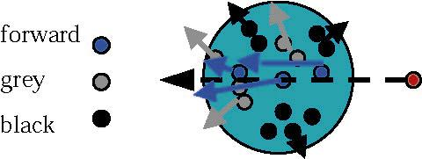
Slow nucleon model (I)
At fixed target experiments centrality in p-A determined detecting slow nucleons
Hadron-nucleus collisions  slow nucleons = gray + black components
(classification from emulsion experiments related to track grain density)
Gray nucleons  soft nucleons knocked out by wounded nucleons
Black nucleons  low energy target fragments from nucleus de-excitation, evaporation
SLOW NUCLEONS | β [c units] | p [MeV/c] | E_{kin} [MeV]
Black | 0 ÷ 0.25 | 0 ÷ 250 | 0 ÷ 30
Gray | 0.25 ÷ 0.70 | 250 ÷ 1000 | 30 ÷ 400
nucleus
forward
gray
black
p
Features of slow nucleon emission are weakly dependent on beam energy from 1 GeV to 1 TeV  emission dictated by nuclear geometry
F. Sikler, hep-ph/0304065
kinematical distributions described by independent statistical emission from a moving frame
isotropic emission from a source moving with velocity β
number distribution of black/gray nucleons follows binomial distributions

Slide 24
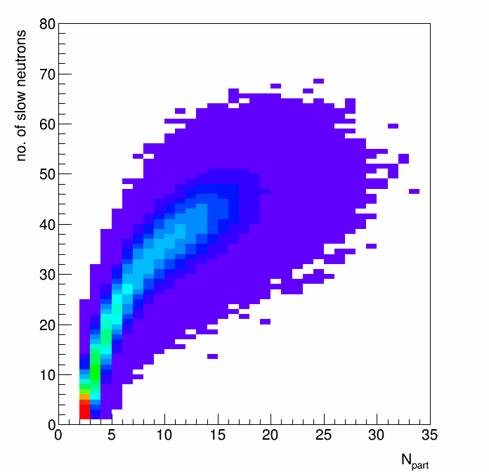
Slow nucleon model (II)
PROTONS
E910 (p-Au @ 18 GeV/c) fit to N_{gray} vs. N_{coll}
<N_{gray p}> = (c₀ + c₁ N_{coll} + c₂ N_{coll}) (A_{Pb}/A_{Au})^{2/3}
COSY (p-Au @ 2.5 GeV) measured the fraction of black over gray protons <N_{black p}> = 0.65* <N_{gray} p>
NEUTRONS
COSY measured Light Charged Particle (Z<=7) vs. total number of protons/neutrons
LCP = (<N_{gray p}> + <N_{black p}>)/α
 α free parameter to reproduce n multiplicities at LHC energies
(α = 0.585 @ COSY, α = 0.565 for LHC)
<N_{slow n}> = <N_{black n}> + <N_{gray n}> = a + b/(c-LCP)
 a, b, c obtained from a fit to COSY distribution are finely tuned
results from p induced spallation reactions (0.1-10 GeV)
<N_{black n}> = 0.9 * <N_{slow n}> <N_{gray n}> = 0.1 * <N_{slow n}>
N_{gray p}, N_{black p}, N_{gray n}, N_{black n} from binomial distributions
I. Chemakin et al., Phys. Rev. C 60 024902 (1999)
A. Letourneau, Nucl. Phys. A 712 (2002) 133

Slide 25
Insight from the MC
N_{coll} scaling  n_{hard}/N_{coll} = const
No. of hard scatterings per N-N collision vs. N_{coll}
no multiplicity bias
deviations from N_{coll} scaling
  at low N_{coll} (peripheral): geometry <b_{NN}>
  at high N_{coll} (central): energy conservation (break down of factorization)
n_{hard}/N_{coll}
HIJING
p-Pb 5.02 TeV
No shadowing
N_{coll}
TOY MC:
Pythia6 (Perugia 2011)
+ Glauber MC)
p-Pb collisions described as incoherent superposition of N-N collisions
No. of hard scatterings per N-N collision vs. centrality from multiplicity in |η|<1.4
ONLY multiplicity bias
strong deviations from N_{coll} scaling at low and high centralities
n_{hard}/N_{coll}

