Slide 1
Jet quenching at RHIC and LHC from finite endpoint momentum strings
Andrej Ficnar, Steven S. Gubser and Miklos Gyulassy
Andrej Ficnar Columbia University
Hard Probes 2013 November 5, 2013

Slide 2
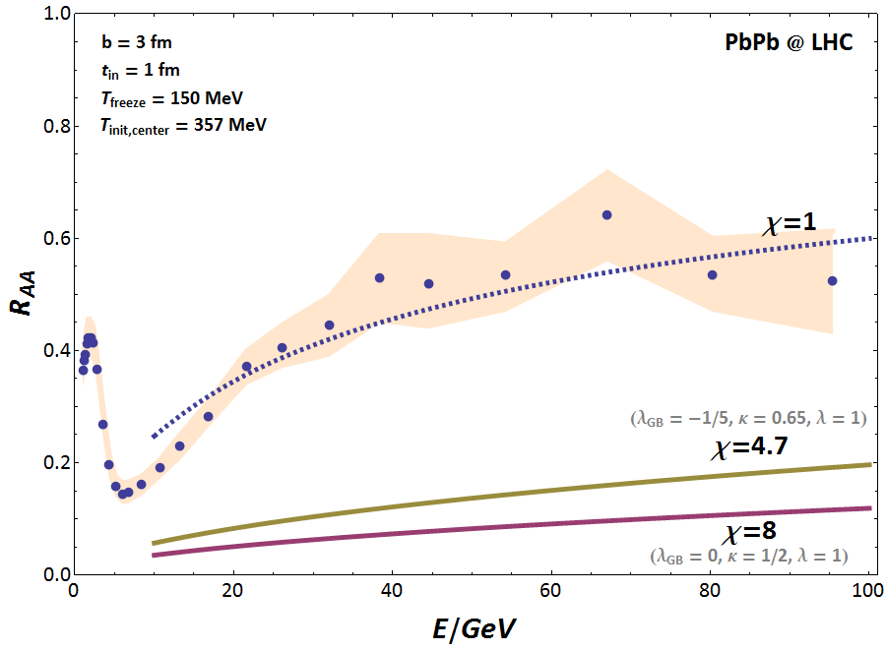
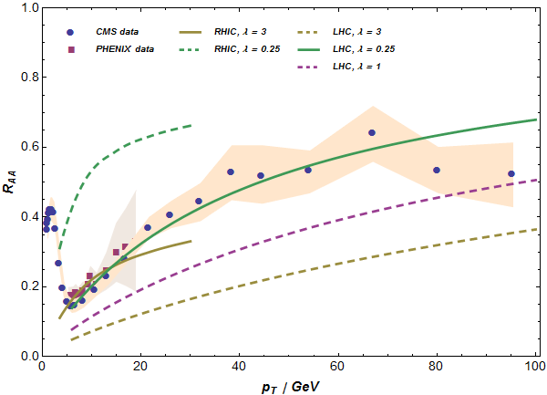
Summary
❶
Light quark energy loss from falling strings not adequate
❸
Better match with the RHIC and LHC suppression data
❷
Finite endpoint momentum (shooting) strings offer better physical picture:
Finite endpoint momentum strings at RHIC and LHC | Andrej Ficnar | Hard Probes 2013
2/13

Slide 3
❶ AdS/CFT, light quarks and energy loss

Slide 4
AdS/CFT in a nutshell
AdS/CFT conjecture:
Take the ‘t Hooft limit:
one can study strongly coupled gauge theories by doing classical, two-derivative (super)gravity calculations
Here: use SYM to gain insight on processes in sQGP
medium properties encoded in the metric
Maldacena, 1998
Type IIB string theory on
(3+1)-dim. SYM
Finite endpoint momentum strings at RHIC and LHC | Andrej Ficnar | Hard Probes 2013
3/13

Slide 5
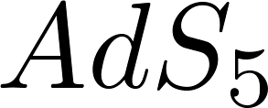
Light quarks as falling strings
(boundary)
D7-brane
Introduce ‘quarks’:
Karch & Katz, 2002
Light ‘quarks’:
Finite temperatures:
black hole
Finite endpoint momentum strings at RHIC and LHC | Andrej Ficnar | Hard Probes 2013
4/13

Slide 6
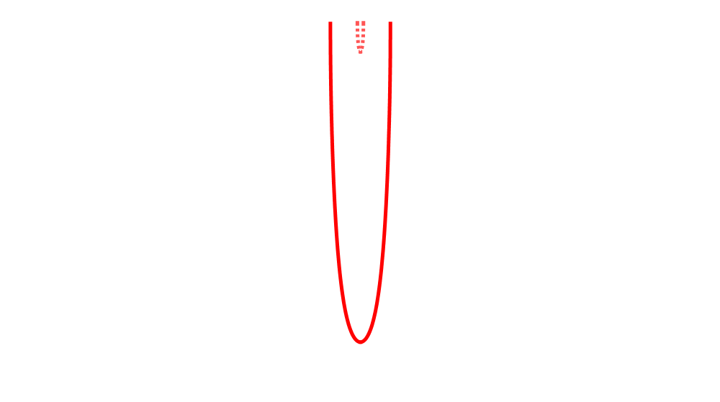
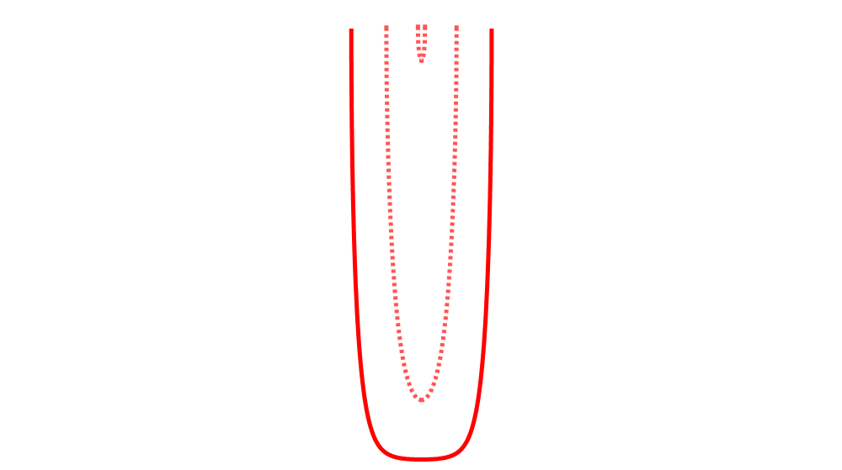
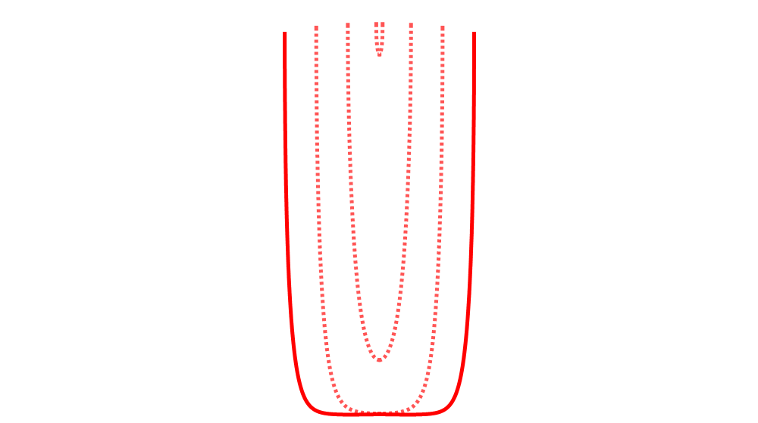
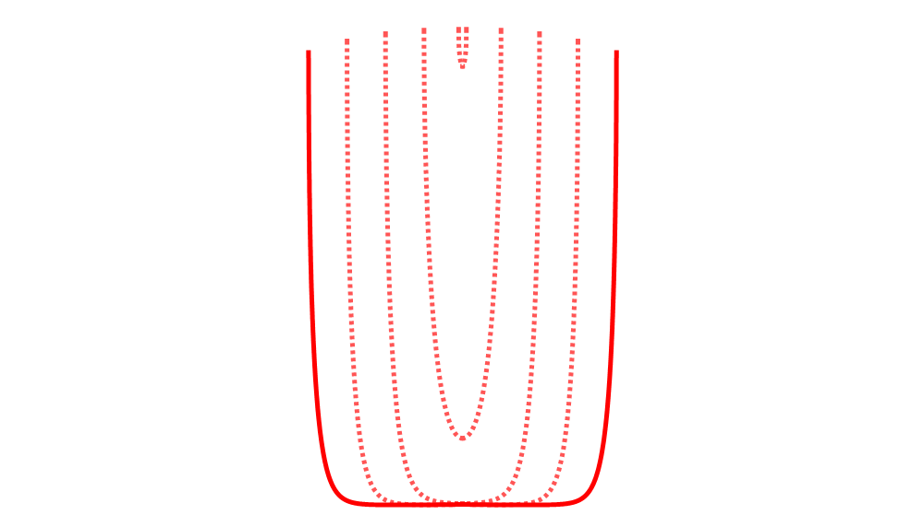
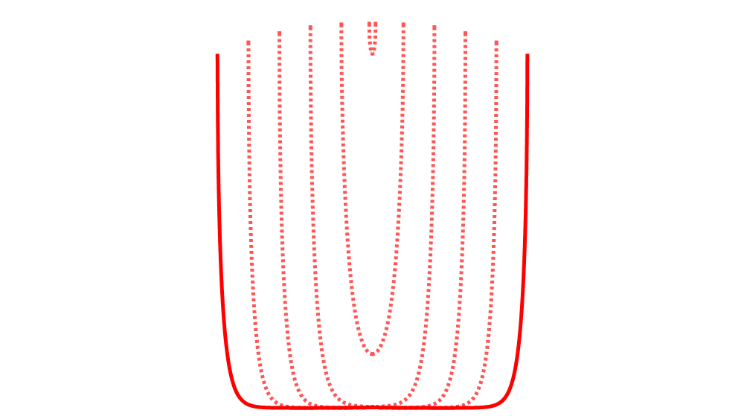
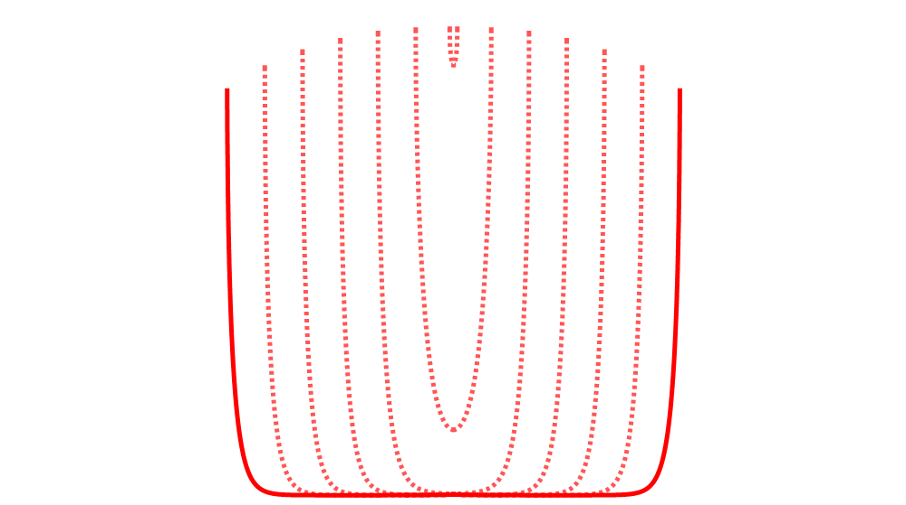
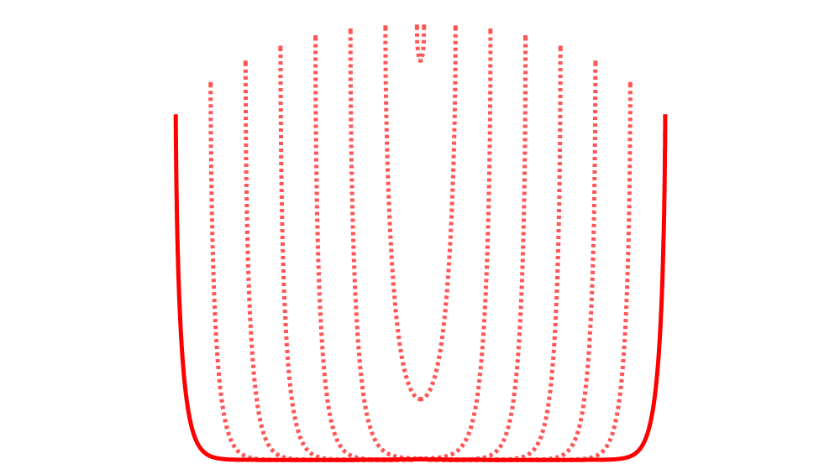
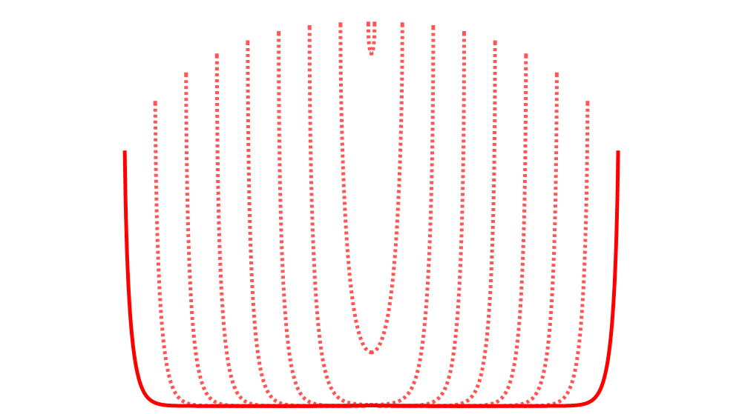
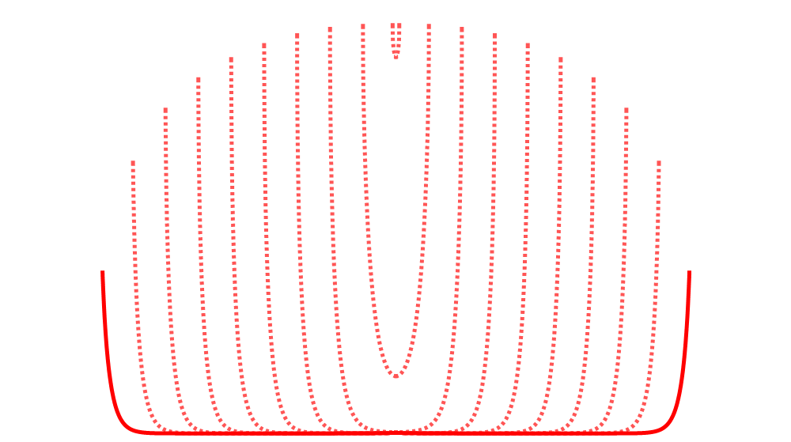
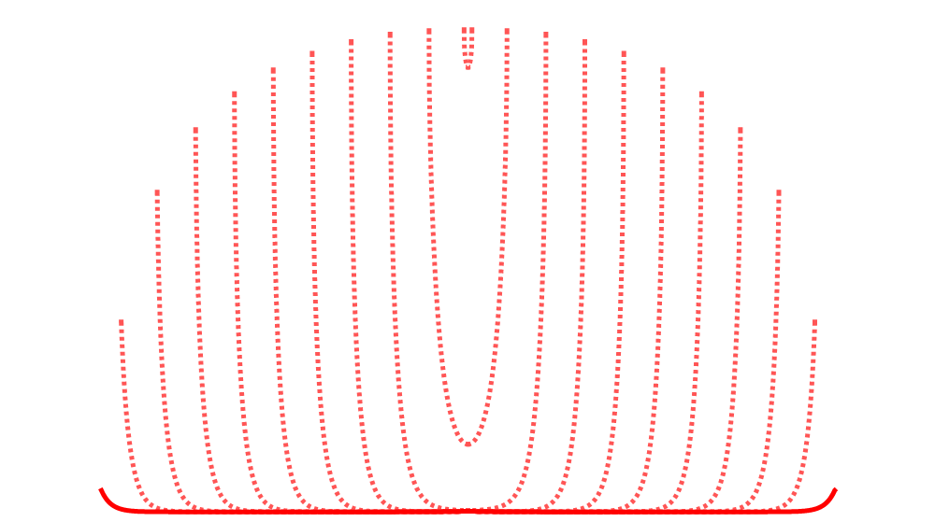
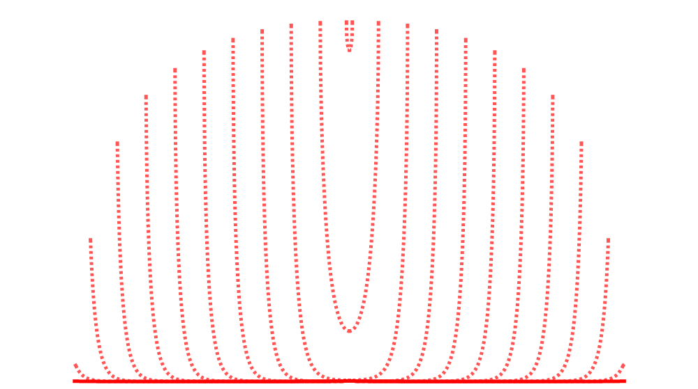
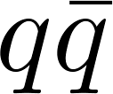
Light quarks as falling strings
(boundary)
D7-brane
Open strings on a D7 brane = dressed pairs
Chesler et al., 2009
Falling strings
Light ‘quarks’:
Finite temperatures:
black hole
stopping distance Δx
Finite endpoint momentum strings at RHIC and LHC | Andrej Ficnar | Hard Probes 2013
4/13

Slide 7
Energy loss of light quarks
Maximum stopping distance in
Here: (numerically:
For and we need instantaneous energy loss
Need energy loss formalism for non-stationary strings
Susceptible to initial conditions and depends on the “jet” definition
Modified Bragg peak and numerically
Using these two we can compute
Correct shape, but a very low magnitude ⇨ jet quenching too strong
Higher derivative corrections increase it, but not enough
Chesler et al., 2009
Gubser et al., 2008
Chesler et al., 2009
analytically:
Ficnar & Gubser, 2013
Ficnar, 2012
Ficnar, Noronha & Gyulassy, 2012
Finite endpoint momentum strings at RHIC and LHC | Andrej Ficnar | Hard Probes 2013
5/13

Slide 8
❷ Finite momentum at string endpoints

Slide 9
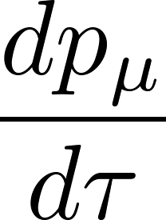
Finite momentum at string endpoints
Introduce finite endpoint momentum:
A more realistic description of an energetic quark:
Endpoint  quark
String  color field
Clear definition of the energy loss: energy drained from the endpoint into the bulk of the string
Ficnar & Gubser, 2013
Finite endpoint momentum strings at RHIC and LHC | Andrej Ficnar | Hard Probes 2013
6/13

Slide 10
Finite endpoint momentum - kinematics
Endpoint trajectories are null geodesics in
Maximum distance they travel is greater:
“shooting strings”
Finite endpoint momentum strings at RHIC and LHC | Andrej Ficnar | Hard Probes 2013
7/13

Slide 11
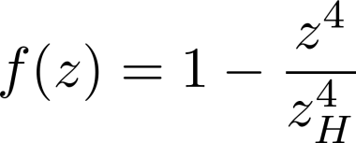
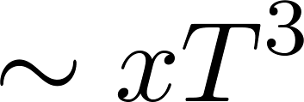
Finite endpoint momentum - energy loss
A universal form of the energy loss:
Local quantity, independent of initial conditions & bulk shape of string
Independent of energy stored in the endpoint ( increases with )
Solve for (critical) null geodesics:
Ficnar, Gubser & Gyulassy, to appear
for small
like pQCD collisional e-loss
for intermediate
like pQCD radiative e-loss (only path dep.)
for large
old “AdS” e-loss
e.g.
Marquet & Renk, 2010
Finite endpoint momentum strings at RHIC and LHC | Andrej Ficnar | Hard Probes 2013
8/13

Slide 12
❸ Pion R_{AA} at RHIC and LHC

Slide 13
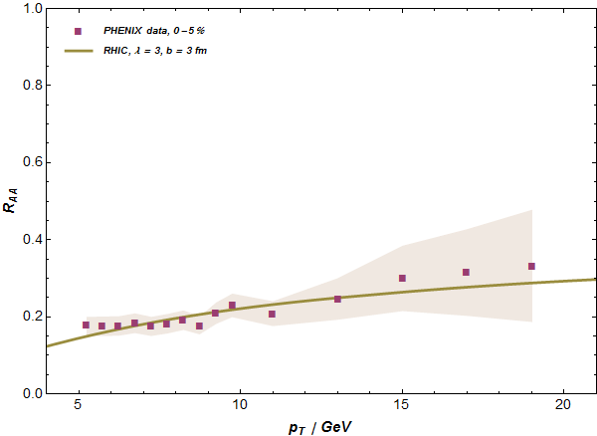
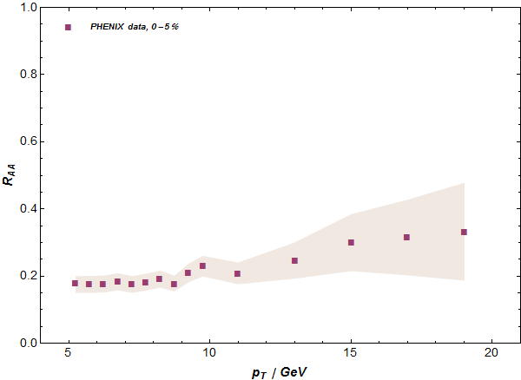
Conformal R_{AA} - RHIC central
Dynamical, expanding plasma with optical Glauber and blast wave for transverse expansion
Ficnar, Gubser & Gyulassy, to appear
PHENIX, 2012
Finite endpoint momentum strings at RHIC and LHC | Andrej Ficnar | Hard Probes 2013
9/13

Slide 14
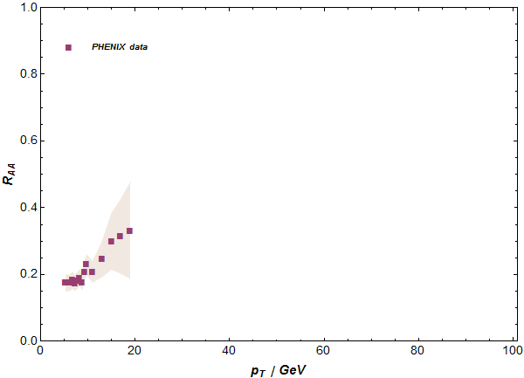
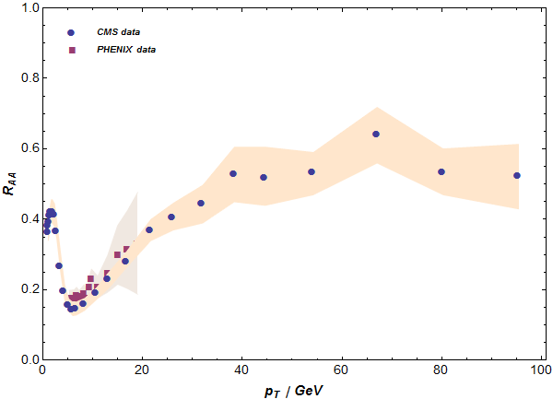
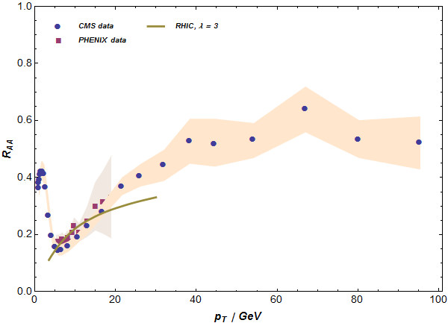
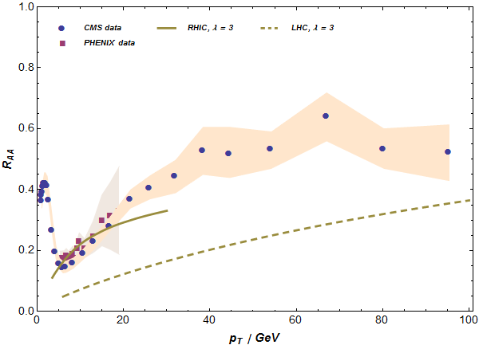
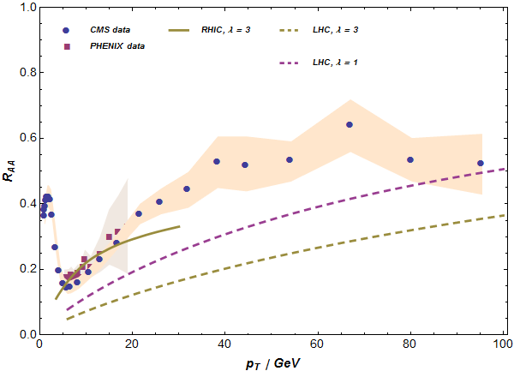
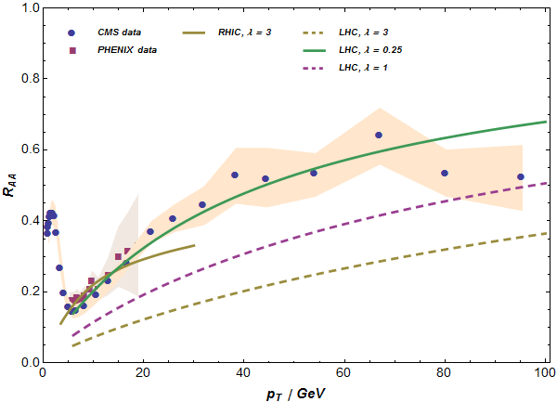
Conformal R_{AA} – RHIC & LHC central
CMS, 2012
PHENIX, 2012
“surprising transparency” of LHC
Horowitz &
Gyulassy, 2011
Finite endpoint momentum strings at RHIC and LHC | Andrej Ficnar | Hard Probes 2013
10/13

Slide 15
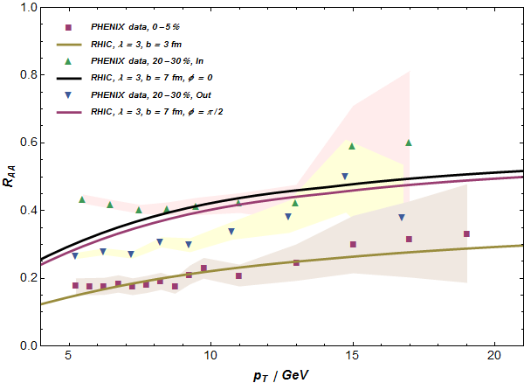
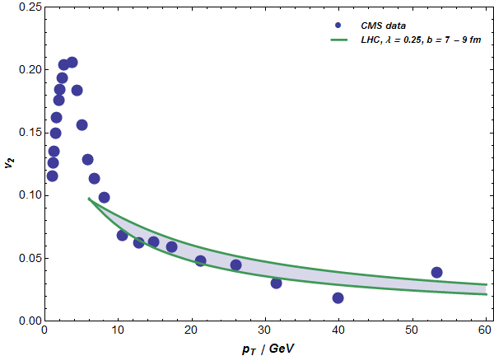
Conformal R_{AA} – RHIC & LHC non-central
Need better transverse expansion
in
out
central
Finite endpoint momentum strings at RHIC and LHC | Andrej Ficnar | Hard Probes 2013
11/13

Slide 16
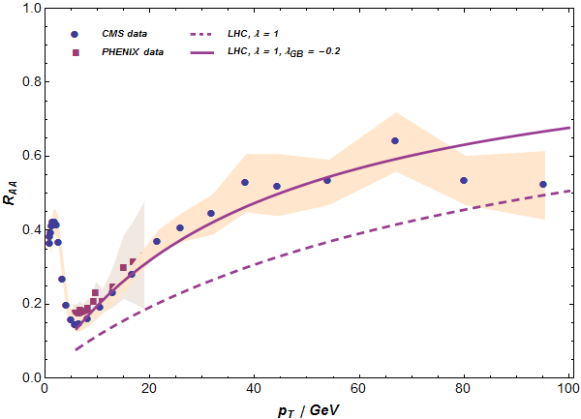
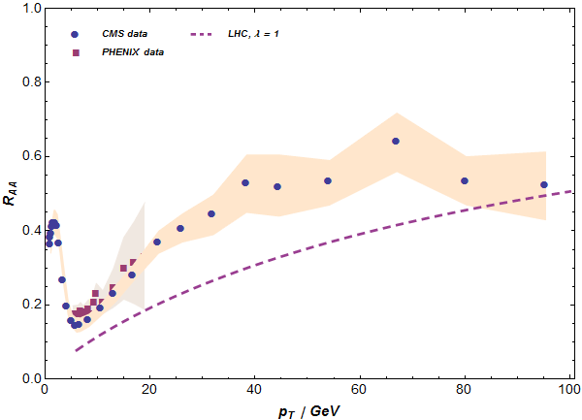
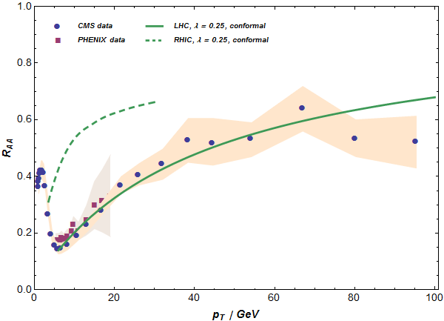
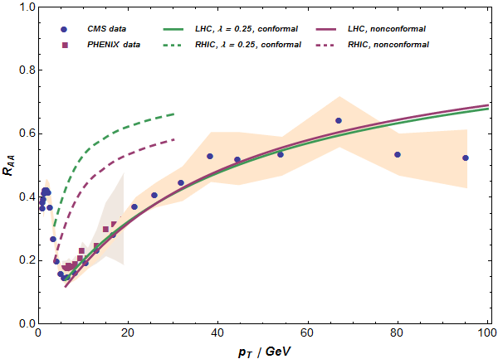
GB-corrected & non-conformal R_{AA}
Non-conformal (bottom-up) deformations that fit the lattice data for thermodynamics and Polyakov loops ⇨ increase energy loss at low temperatures
conformal
higher derivative (Gauss-Bonnet) corrections ( corrections)
non-conformal

Finite endpoint momentum strings at RHIC and LHC | Andrej Ficnar | Hard Probes 2013
12/13

Slide 17
Conclusions & prospects

Slide 18
Conclusions & prospects
Light quark energy loss via falling strings not adequate
Issues with initial conditions and “jet” definitions
R_{AA} severely underpredicted
Finite endpoint momentum (shooting) strings offer better picture:
More realistic description of an energetic quark
Clear definition of energy loss
Local quantity, independent of string initial conditions
Encodes interesting physics (path dependence)
Better match with the RHIC and LHC light hadron suppression data
Prospects:
Fluctuations, better transverse expansion, non-conformal aspects
Heavy quarks
Finite corrections
Finite endpoint momentum strings at RHIC and LHC | Andrej Ficnar | Hard Probes 2013
13/13

