Slide 1

Heavy Ion Collisions
An Introduction
Hard Probes Summer School 2013
Cape Town, South Africa
Tom Dietel
University of Cape Town

Slide 2
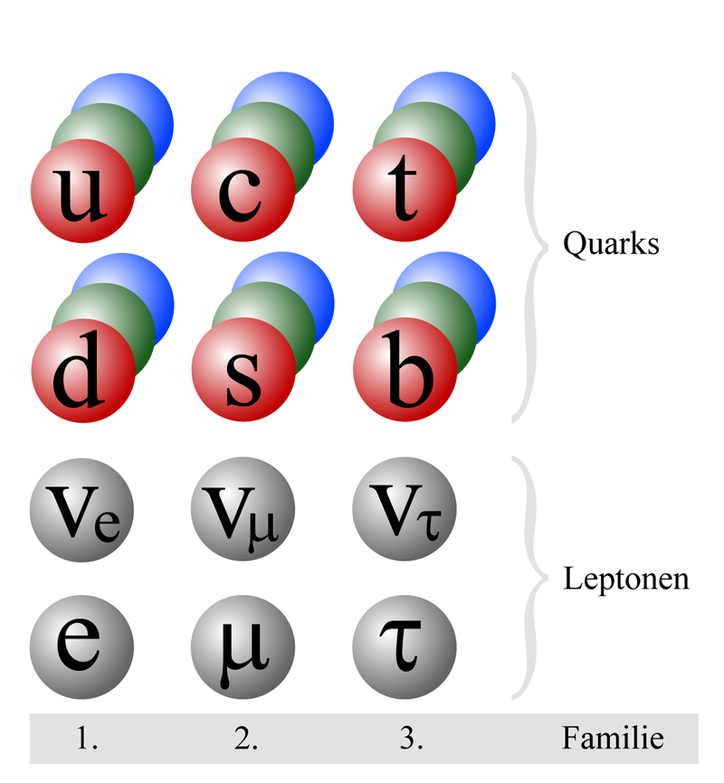
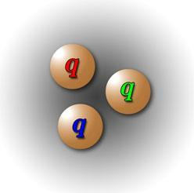
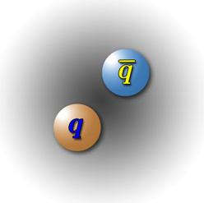
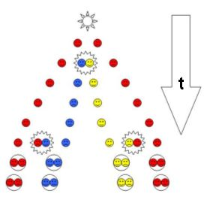
QCD - Confinement
quarks confined in hadrons
  baryons: 3 (anti-) quarks
  mesons: quark + anti-quark
separation of quarks impossible
  large distance → high energy
  → additional particle production

Slide 3
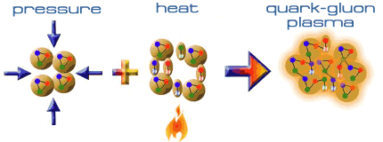
Quark-Gluon Plasma
Compression
reduce distance between nucleons
Heating
thermally create pions
fill space between nucleons
hadrons overlap
quarks roam freely over large volume (deconfinement)
Quark-Gluon Plasma

Slide 4
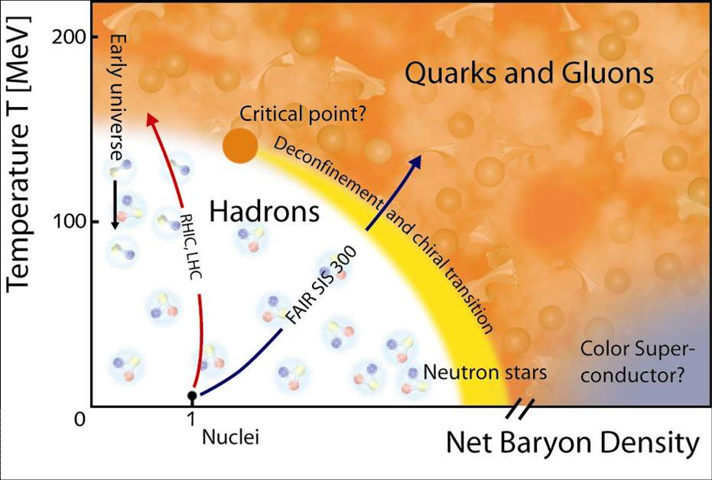
Phase Diagram of Nuclear Matter

Slide 5
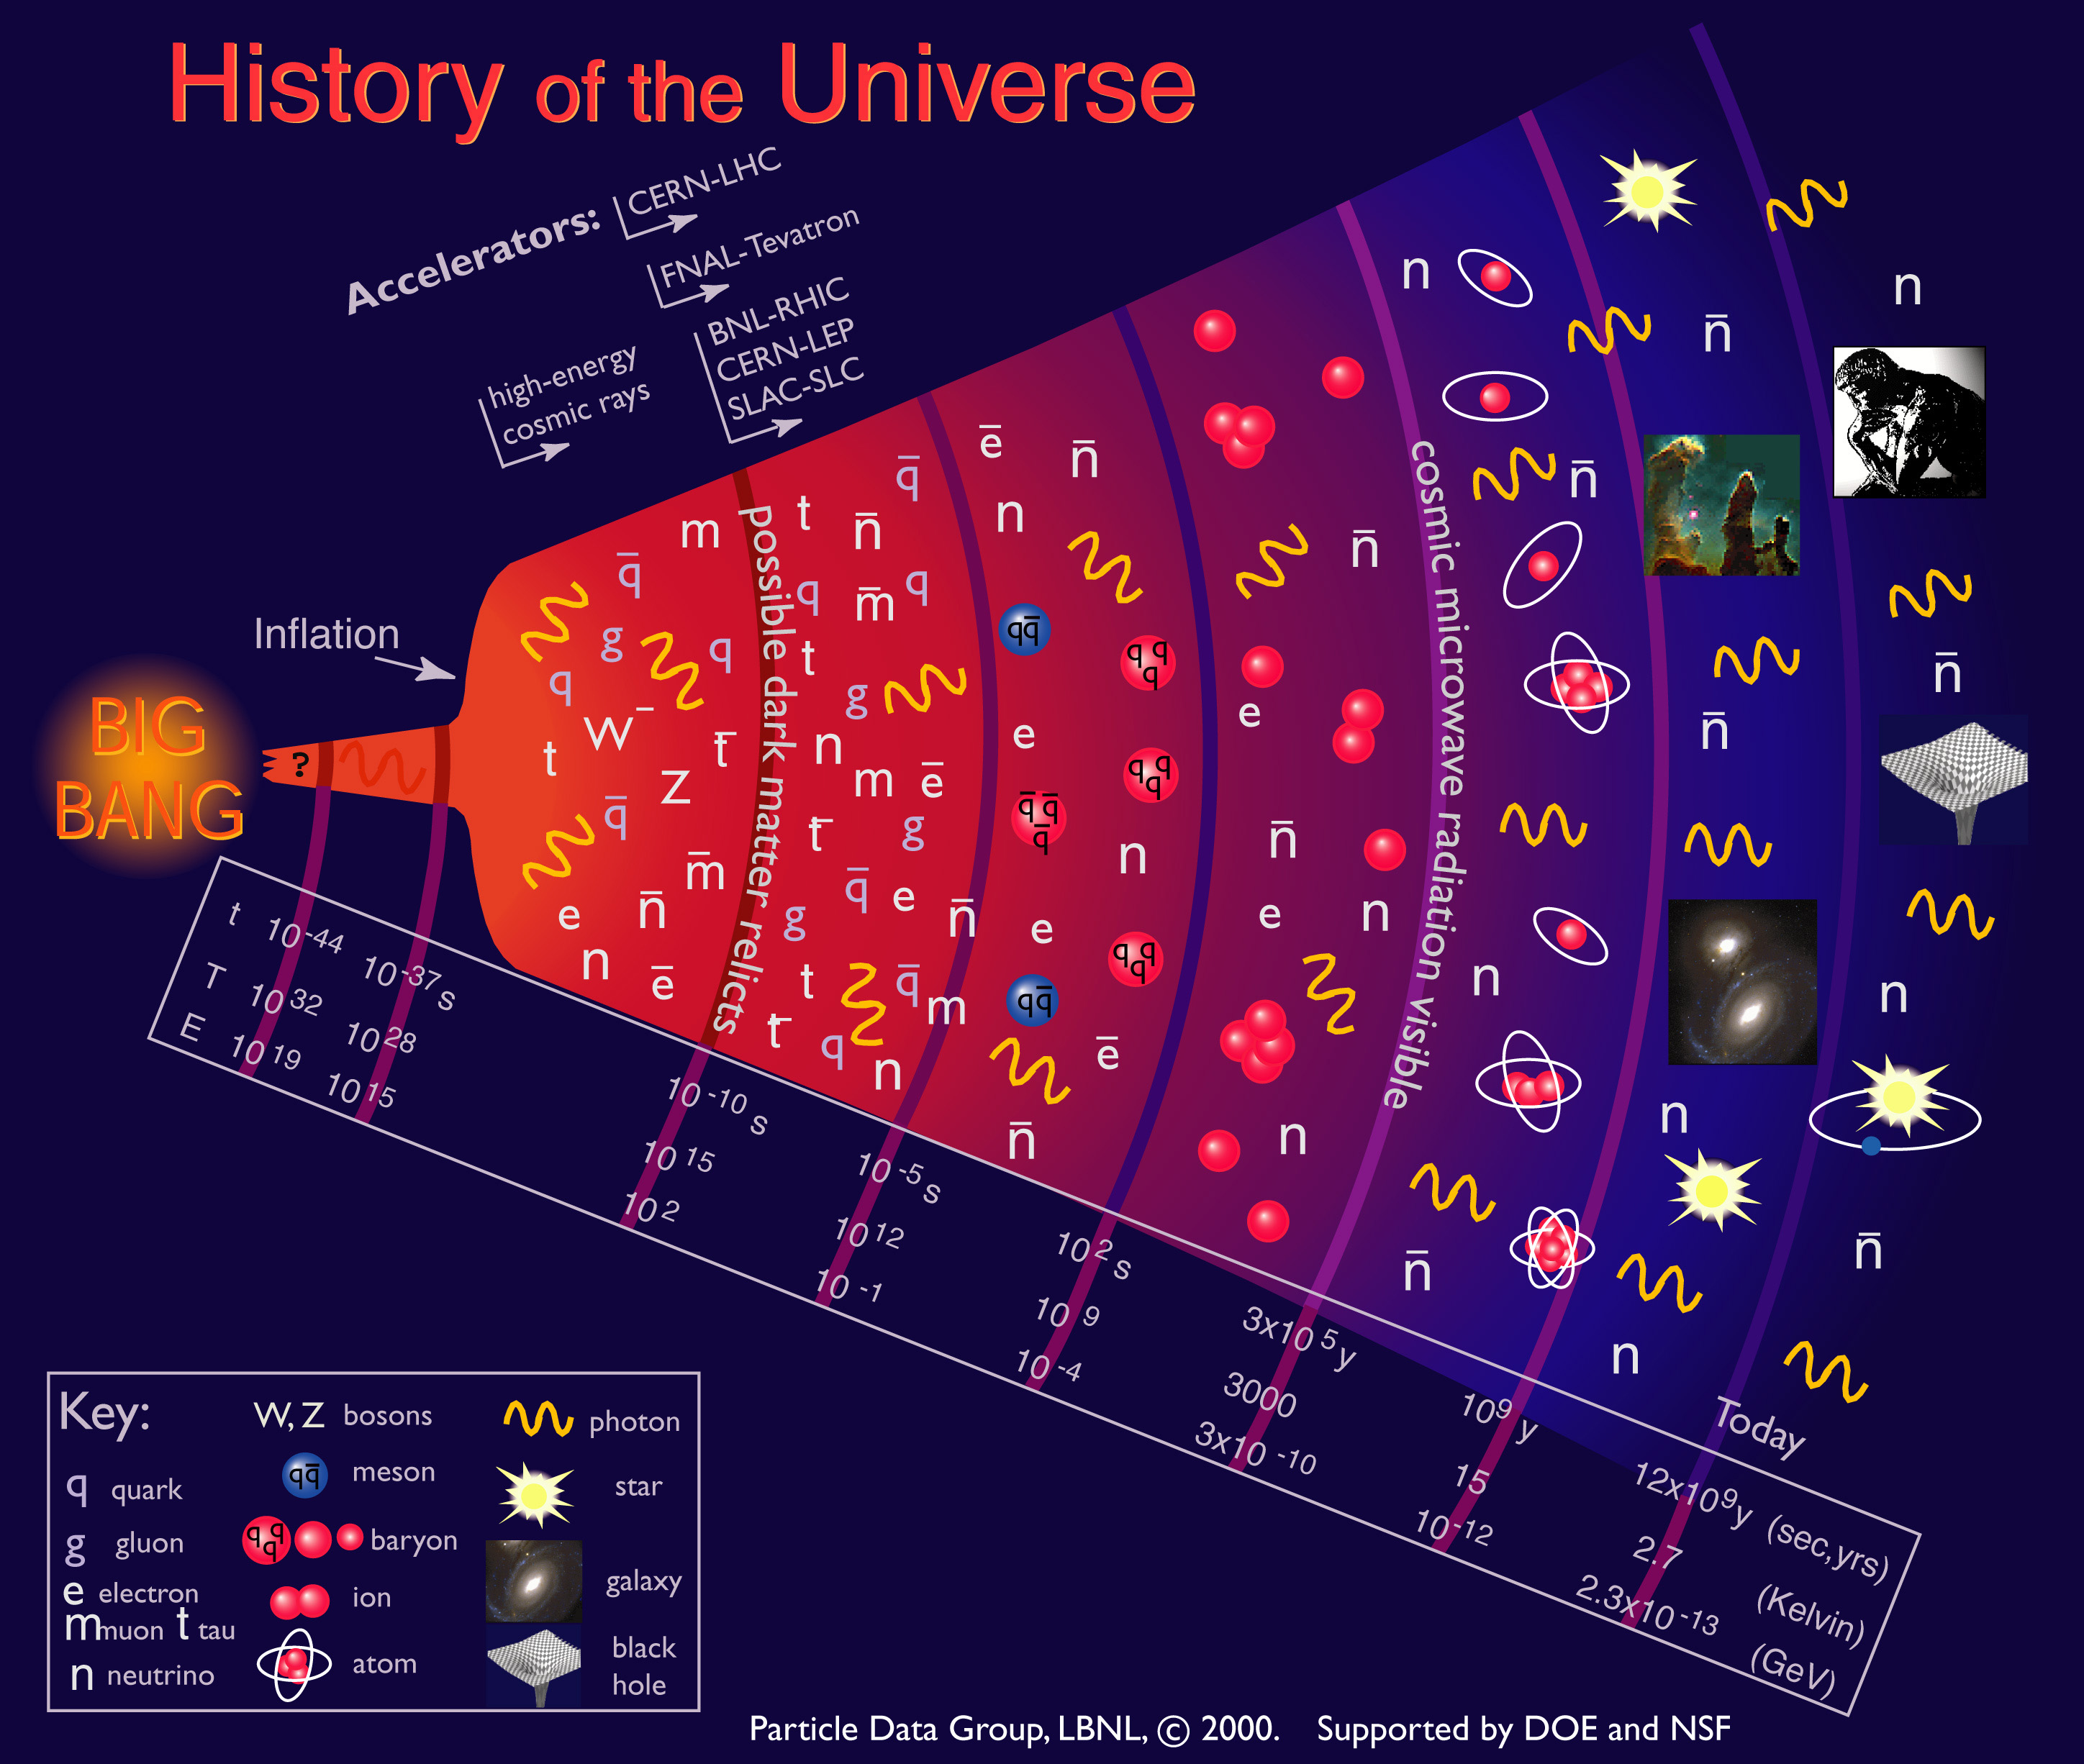
Notes:
13.75 Milliarden Jahre
Expansion
Dichte - Energiedichte

Slide 6

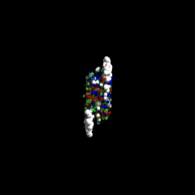
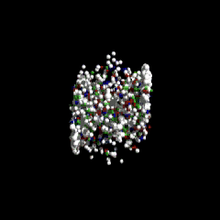
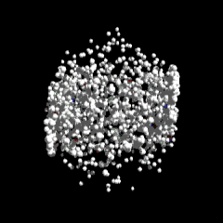
QGP in the Laboratory
deposit large amount of energy and matter in small, but finite volume
→ high-energy collisions of heavy nuclei
example: ²⁰⁸Pb + ²⁰⁸Pb @ √s_{NN}=2.76 TeV
  E_{total} = 1.15 PeV ≈ 0.2 mJ
  typ. volume: (10-20 fm)³
  energy density: few 100 GeV/fm³
  typical timescale: 10 fm/c ≈ 10⁻²²s

Slide 7
Questions to be answered…
Does the hot nuclear matter thermalize?
  prerequisite for thermodynamics
Is the matter deconfined?
  are hadrons or partons the relevant degrees of freedom?
  do we create a Quark-Gluon Plasma?
What are the properties of the QGP?
  temperature, energy density, viscosity
How do known objects interact with the QGP?
  quarks (light & heavy), quarkonia

Slide 8
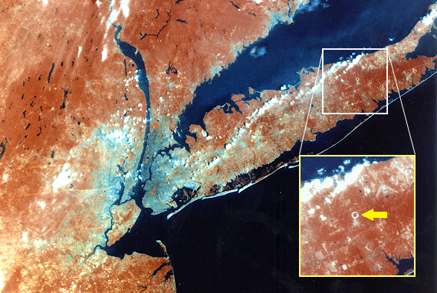
Brookhaven National Lab
New York City

Slide 9
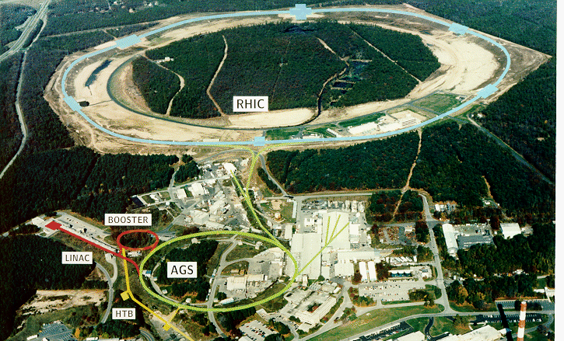
Alternating Gradient Synchrotron (AGS)
Heavy-Ion Program 1986-2000
single beam on fixed target √s_{NN} ≈ 5.5GeV
5 large HI experiments
E802/E866/E917
E810
E814/E877
E864
E895
Notes:
spin program

Slide 10




Relativistic Heavy Ion Collider - RHIC
since 2000
STAR
PHENIX
PHOBOS (until 2005)
BRAHMS (until 2006)
2 independent rings; √s_{nn} 200 GeV circumference 3.8 km
Notes:
spin program

Slide 11
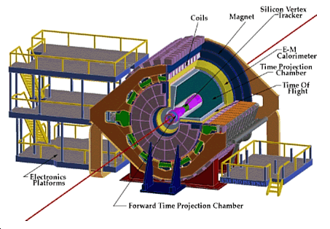
STAR @ RHIC

Slide 12
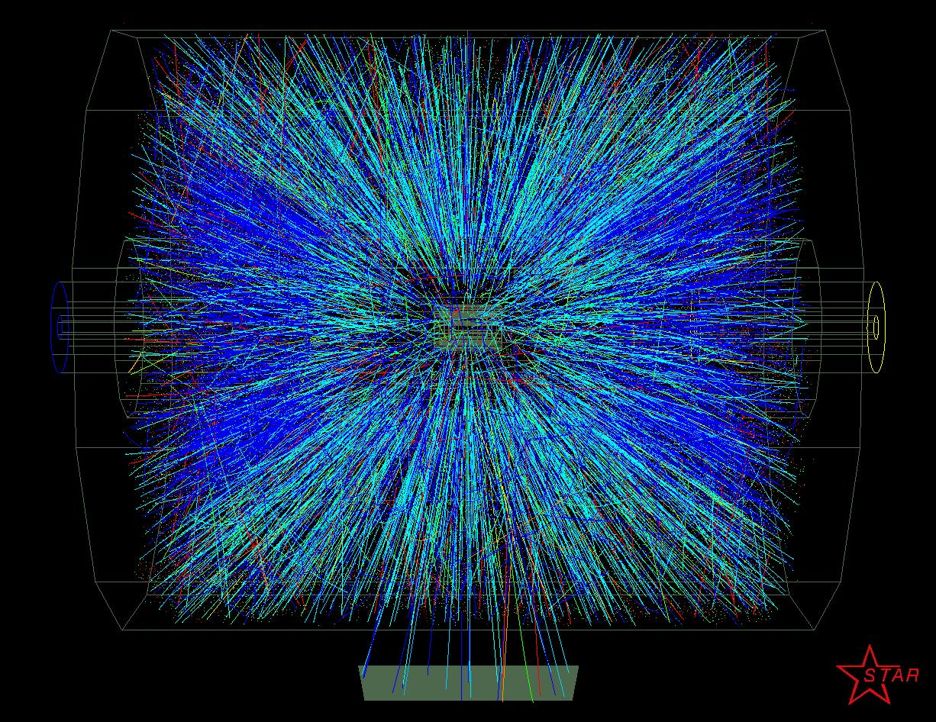
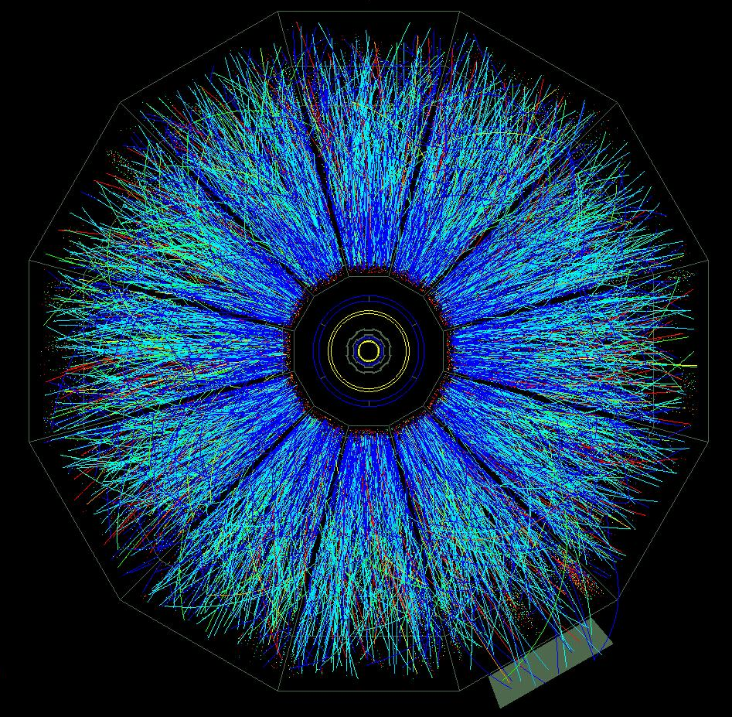
STAR TPC
Au+Au collision at RHIC
200GeV per nucleon pair
up to 1500 tracks
STAR TPC
length: 4m
diameter: 4m
B = 0.5T

Slide 13
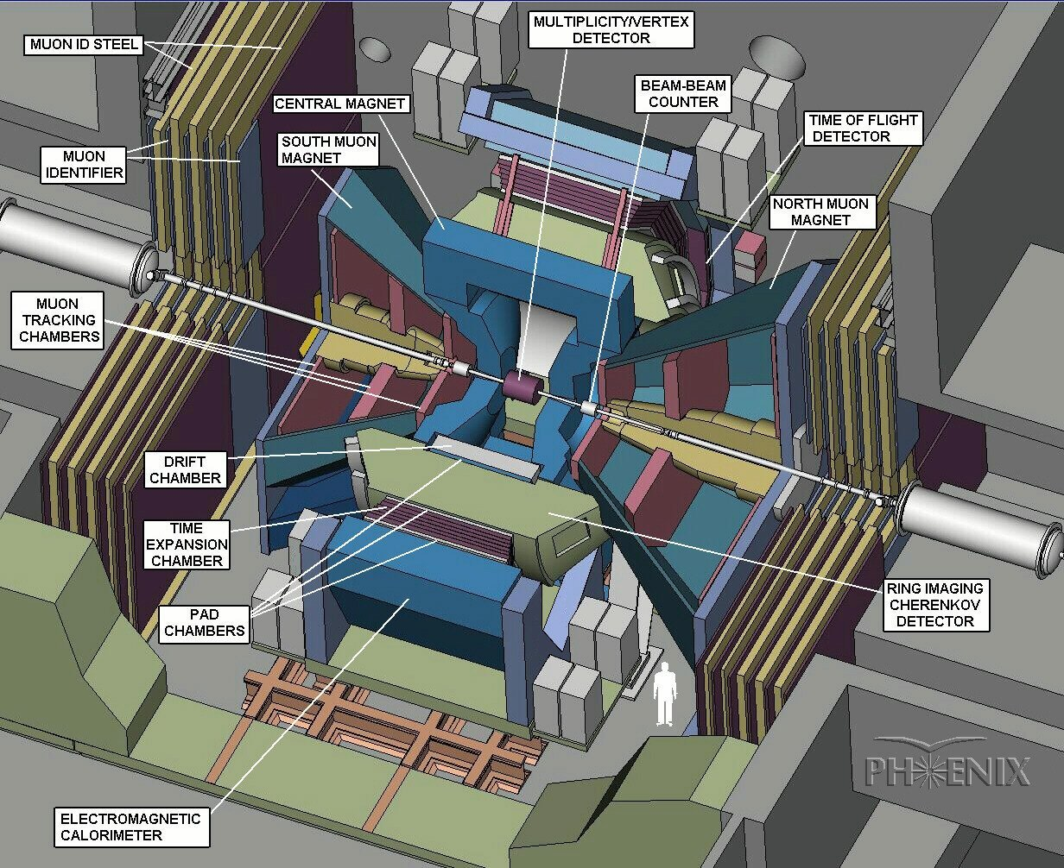
PHENIX @ RHIC

Slide 14
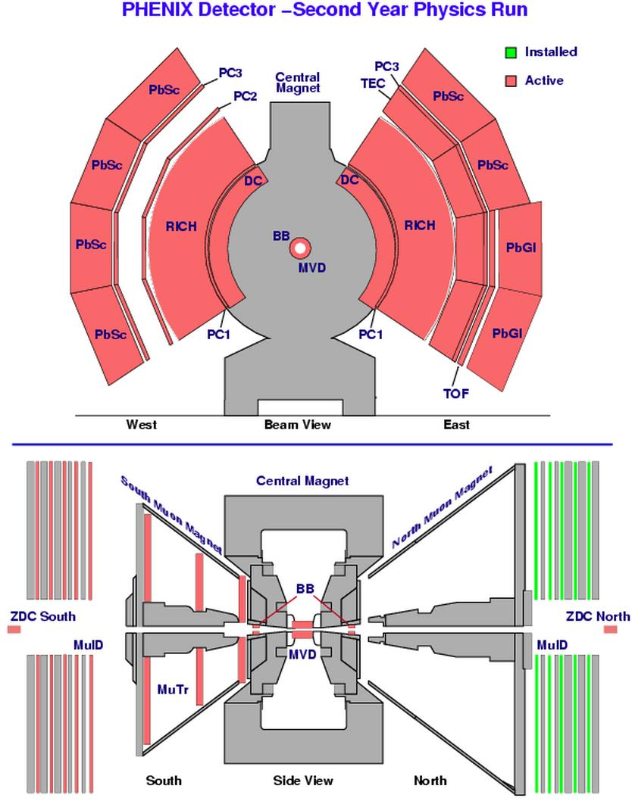
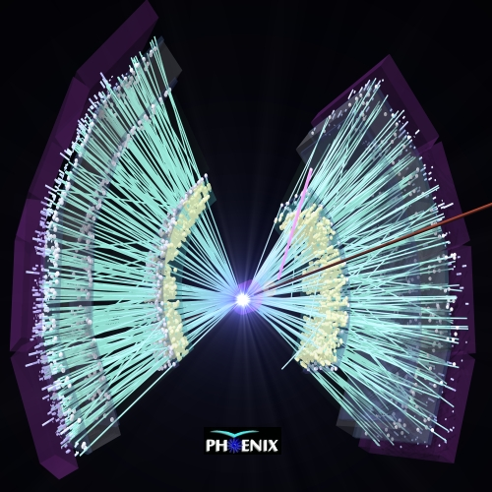
PHENIX @ RHIC
focus on photons, (di-)electrons, muons
good resolution
high rate
small acceptance

Slide 15

CERN SPS
1986-2004: √s = 17 GeV; circumference 6.9 km
NA35/49/61
NA38/50/60
NA44
NA45/CERES
NA57
North area (NA)
SPS
West area (WA)
WA80/98 WA97 → NA57

Slide 16
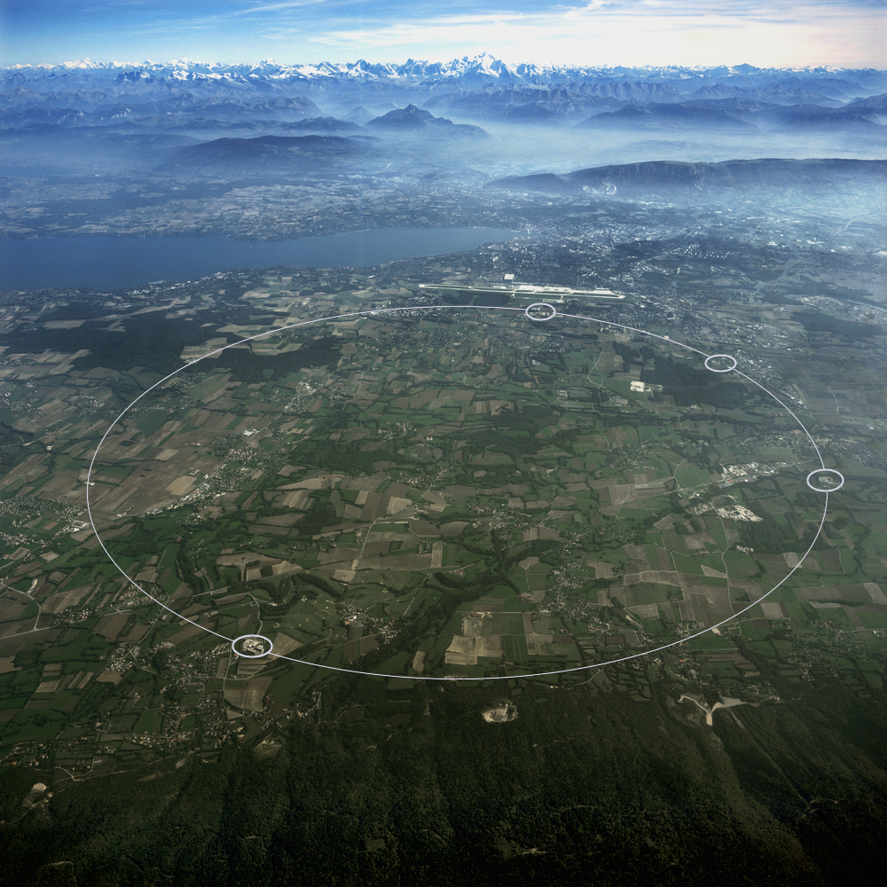
CERN LHC
LHCb
ATLAS
ALICE
CMS

Slide 17
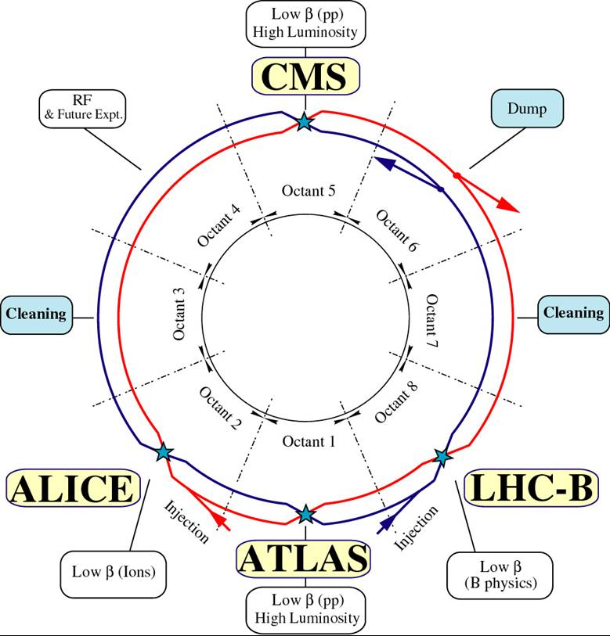
Large Hadron Collider
p-p
√s=8 (14) TeV
Pb-Pb
√s_{NN}=2.76 (5.5) TeV
p-Pb
√s_{NN}=5.02 TeV

Slide 18
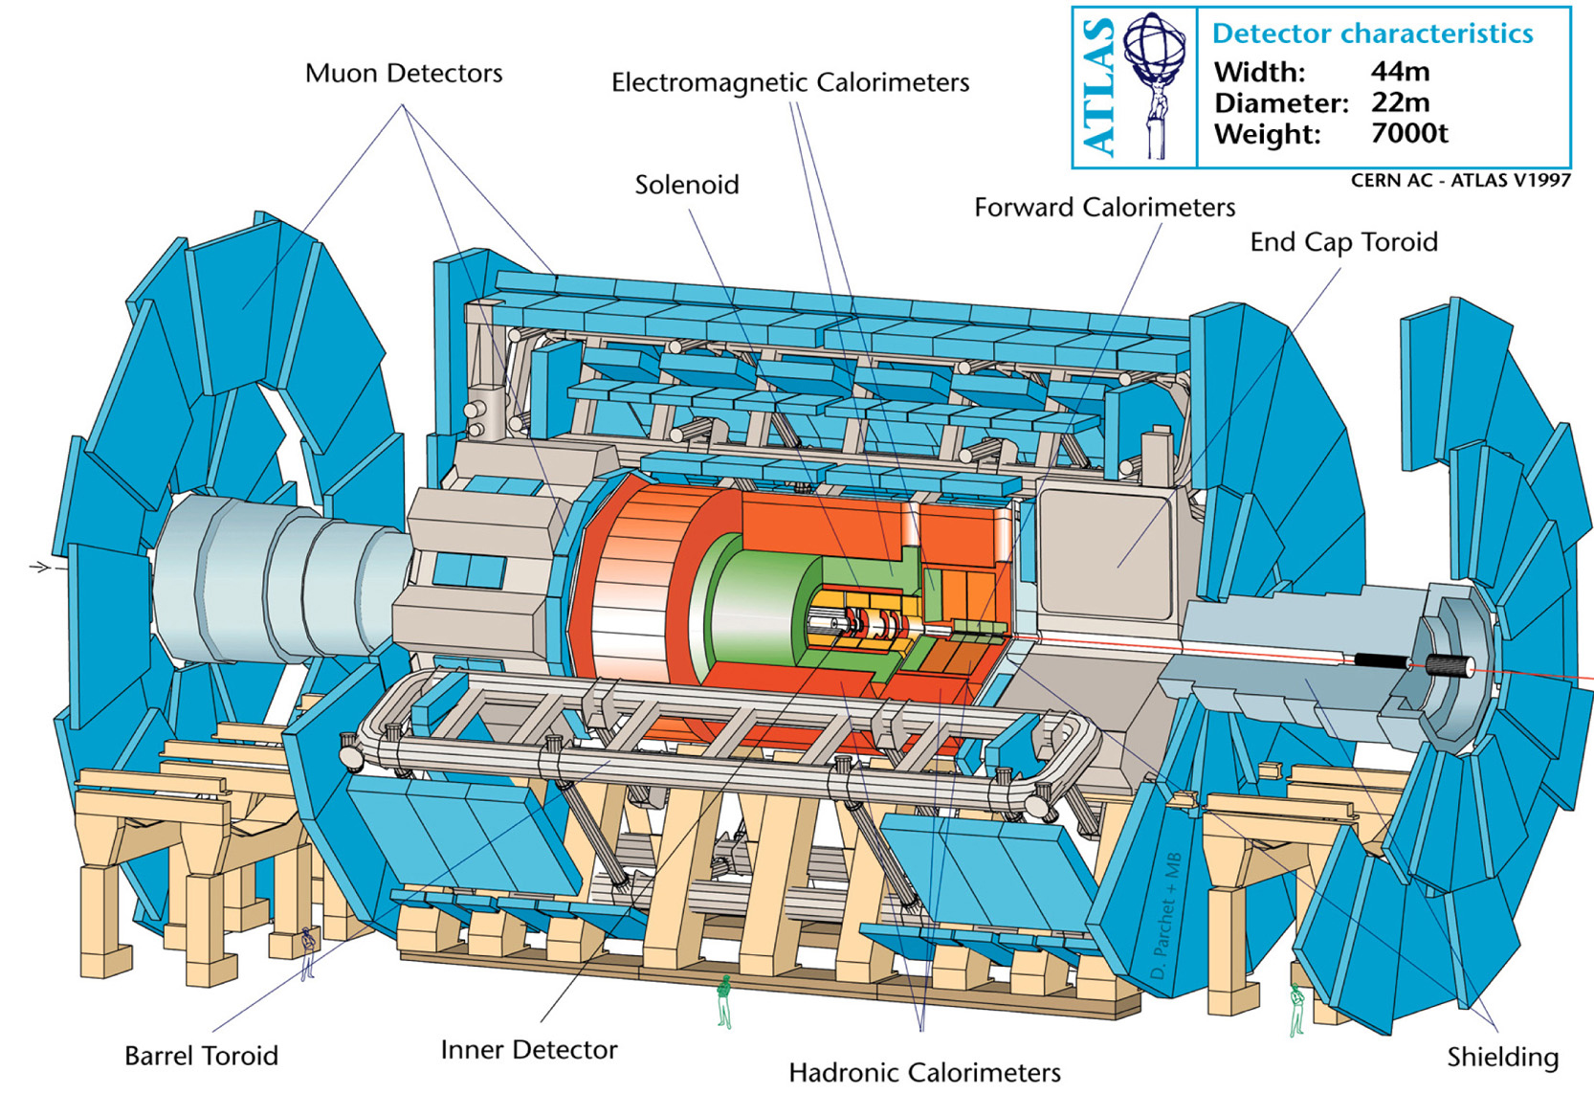
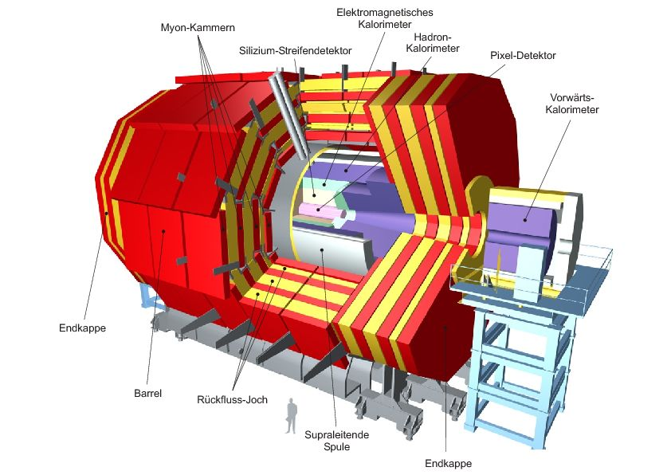
ATLAS and CMS
High-energy Experiments
rare, high energy probes
very high event rates
  several 100M events / s
focus on high energy
  10s or 100s of GeV
Heavy-Ion Programs
relatively small groups: ~ 100 physicists in each experiment
focus on hard probes: jets, photons, W/Z in HI collisions
limited low-p_{T}, PID capabilities

Slide 19
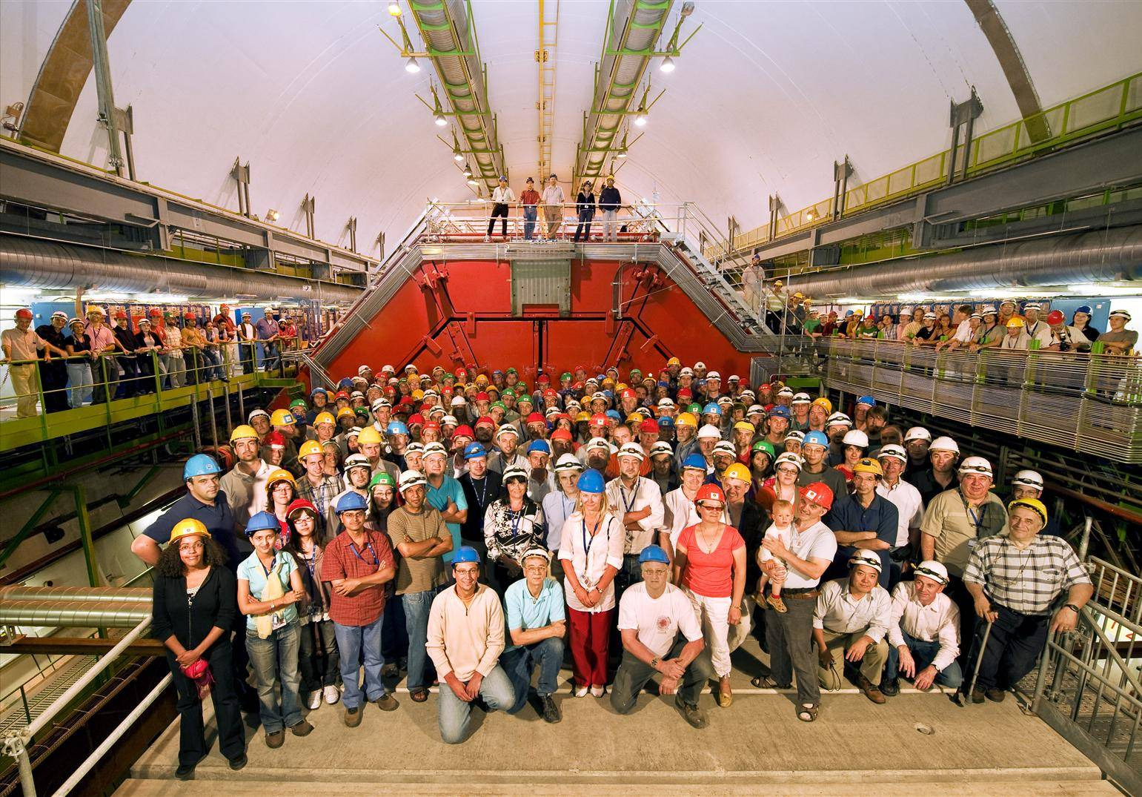
The ALICE Experiment
1200 members, 131 institutes, 36 countries

Slide 20
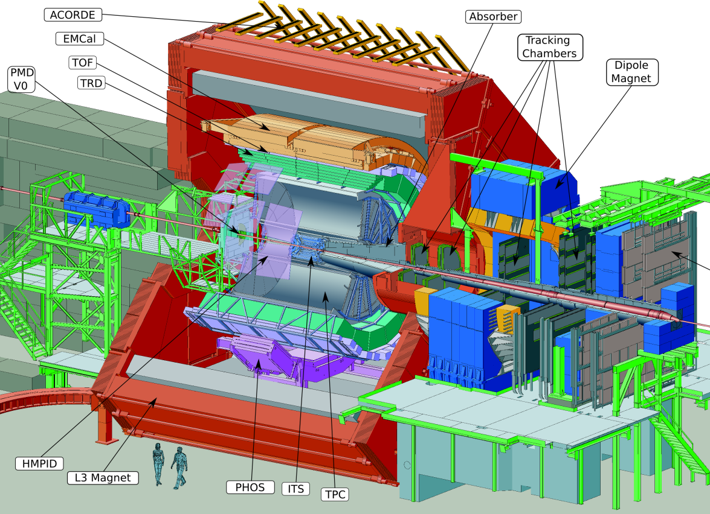

Slide 21


Slide 22
Accelerators for (Ultra)relativistic Nuclei
 | AGS | SPS | RHIC | LHC
 | BNL | CERN | BNL | CERN
 | fixed target |  | collider
max. beam momentum | 29 ZGeV/c | 450 ZGeV/c | 2x 250 ZGeV/c | 2x 4 ZTeV/c (2x 7 ZTeV/c)
projectiles | p…Au | p…Pb | p…Au | p…Pb
HI operation | 1986-2000 | 1986-2004 | since 2000 | since 2010
√s_{NN} for Pb, Au | < 4.8GeV | 6-17 GeV | 8-200 GeV | 2.76 TeV
total E_{cms} | Au+Au 600 GeV | Pb+Pb, Pb+Au 3200 GeV | Au+Au 40 TeV | Pb+Pb 1150 TeV
# of produced hadrons | 900 | 2400 | 7500 | 20000
Notes:
energy of a r=2mm water drop dripping from .5 m height - audible

Slide 23
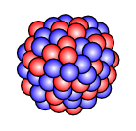
Nucleus-Nucleus Collisions
What happens when we collide two heavy nuclei?
Initial state: independent nucleons, something else?
Geometry: which parts of the nuclei interact?
Where doe the energy go?

Slide 24
Parameters of Heavy-Ion Collisions
projectile nuclei
as heavy as possible → create large systems
(usually) spherical → simple geometry
²⁰⁸Pb (CERN), ¹⁹⁷Au (BNL), several lighter nuclei, ²³⁸U (heavy, but deformed)
collision energy
CMS energy per nucleon-nucleon pair: √s_{NN}
beam energy
  often in units of AGeV (GeV × mass number A) or ZGeV (GeV × atomic number Z)
example – RHIC: ¹⁹⁷Au: Z=79 A=197
E_{beam} = 100 AGeV = 19700 GeV = 250 ZGeV
√s_{NN} = 200 GeV
√s = 39400 GeV
impact parameter – centrality
0 < b < 2R ≈ 15 fm
how do you measure the impact parameter?

Slide 25
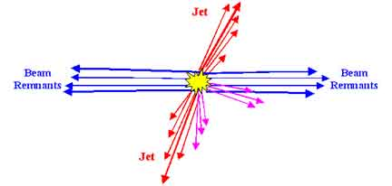
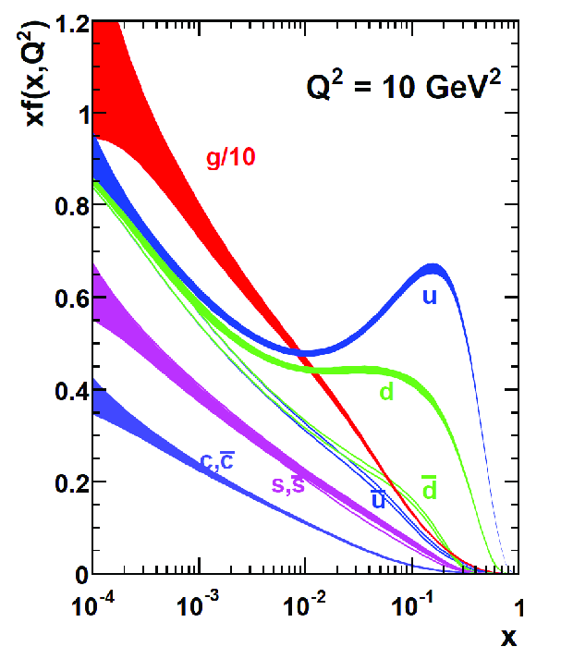
Proton-Proton Collision
single parton-parton interaction
  mostly small momentum transfer
  very small probability for multi-parton interactions
remnant continues to move in in beam direction
  can interact again, if there is another hadron
  still looks more or less like a proton…

Slide 26
Impact Parameter and Centrality
The impact parameter b is an important quantity in heavy-ion collisions.
Central collisions:
small impact parameter
large overlap of nuclei
Peripheral collisions:
large impact parameter
(b ≈ 2 R_{Pb})
small overlap of nuclei
b
central
b
peripheral

Slide 27
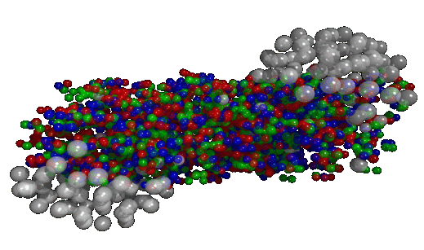
Participants and Spectators
Spectators
Participants
Spectators: nucleons that do not interact inelastically
Participants: nucleons with at least one inelastic interaction → N_{part}
(Binary) Collisions: inelastic nucleon-nucleon interactions → N_{coll}
more than one collision allowed per nucleon

Slide 28
Observables Related to Centrality
Charged particle multiplicity (N_{ch}) or
transverse energy (E_{T}) at or near mid-rapidity
Spectators
Energy in beam
direction (E_{ZDC})
Participants
Impact parameter, N_{part}, N_{coll} cannot be measured
Possible measurements:
particle multiplicity
transverse energy
spectator nucleons / neutrons / protons

Slide 29
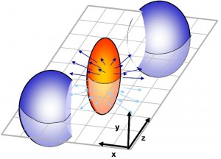
Reaction Plane and Overlap Region
Reaction plane (RP)
defined by impact parameter b and beam direction z
specified by angle to horizontal plane
Overlap region
volume covered by participants
lenticular or almond shaped
Not detector coordinates!

Slide 30
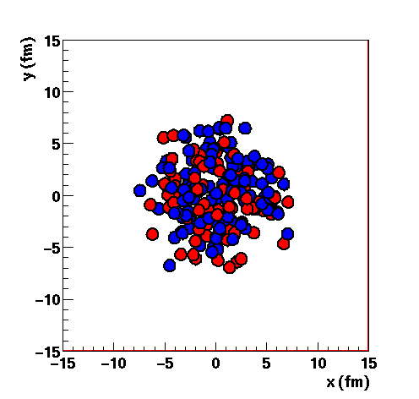
Glauber Monte-Carlo Simulation
distribute nucleons according to Woods-Saxon distribution (for projectile and target) - from e-scattering experiments
choose impact parameter b randomly
nucleon-nucleon collision happens if distance
simulate many collisions to obtain
  number of participating nucleons <N_{part}>
  number of binary collisions between nucleons <N_{coll}>
Au nucleus in Glauber MC

Slide 31
Glauber Monte-Carlo

Slide 32
Glauber Fit to Data
Glauber MC must be connected to measurable observable:
e.g. # of TPC tracks, signal in V0 detector
N_{part}, N_{coll} from Glauber MC
fold with distribution of #particles per participant: gaussian, poissonian, negative binomial
fit data distributions with Glauber MC parametrisations
Divide data sample in centrality bins using detector signal
most central (0-5%) to peripheral (60-80%, 80-90%)
determine 〈N_{coll}〉, 〈N_{part}〉 for each bin

Slide 33
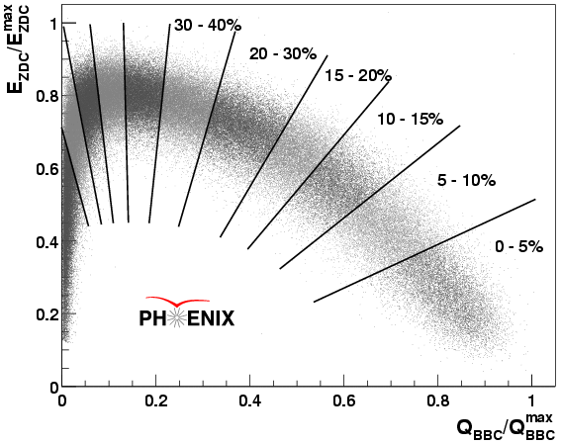
Centrality & Spectator Neutrons
Zero-Degree Calorimeter (ZDC)
hadron calorimeter in beam direction (0°)
measure spectator neutrons
Peripheral:
nuclei remain almost intact
few neutrons “kicked out”
Central
most neutrons interact inelastically
Mid-central
max. number of spectator neutrons
Number of spectator neutrons
Number of particles near mid-rapidity

Slide 34
Saturation – Color Glass Condensate
higher parton density in high-energy collisions
  parton density in increases at low-x
  p_{parton} = x × p_{nucleon}
relativistic effects
  length contraction → thin layer of gluons
  time dilation → processes in nuclei are slow
saturation due to recombination of gluons
→ lecture by Tuomas Lappi
→ lecture by Paul Sorensen
→ results from p-Pb @ LHC

Slide 35
Early (Pre-Equilibrium) Phase
Nucleons break up into many partons
“free” quarks and gluons for short time
quarks did not have time to form color-neutral objects
quark and gluon momenta, energies result from initial scatterings
Is this a Quark-Gluon Plasma?
QGP is a state of matter, i.e. a thermodynamic system in equlibrium

Slide 36
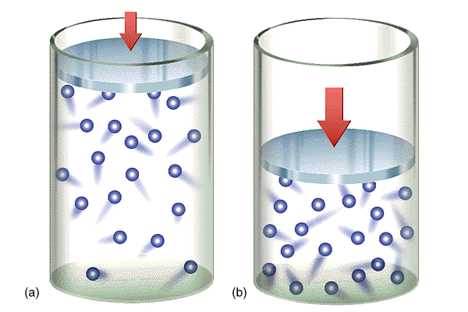
Thermodynamics
Thermodynamic system
macroscopic state variables
e.g. T,P,µ)
equation of state (EOS)
e.g. ideal gas: PV=nRT
Statistical Thermodynamics
predict distribution of microscopic quantities, e.g. energy, momenta, number of particles
exact configuration not known, not relevant
Local and Global Equilibrium
equilibrium: system is described by EOS
global equilibrium: homogeneous system, no change with time
local equilibrium in inhomogeneous or time-dependent systems
  small volumes / small times follow EOS
  description of changes

Slide 37
Thermalization
Is this a Quark-Gluon Plasma?
QGP requires (local)
equilibrium!
parton properties (E, p)
  from initial scatterings
  not determined by EOS
  → no equilibrium
No! This is not (yet) a QGP
Interactions between quarks and gluons
redistribute the energy
seem to bring the system to (local) equilibrium
equilibration seems to be achieved quickly (order of 1 fm/c)

Slide 38
Initial Anisotropy
Symmetries
two spherical nuclei, same radius
rotation by 180° around y-axis
mirroring on reaction plane (x-z) – up/down
Mid-rapidity: z=0
mirror symmetry – left/right
Overlap Region at mid-rapidity
up/down and left/right symmetry
“lenticular” or “almond” shaped
Reality is not that simple
initial state fluctuation, determination of RP,…
Paul Sorensen – Fri 15h
Not detector coordinates!

Slide 39
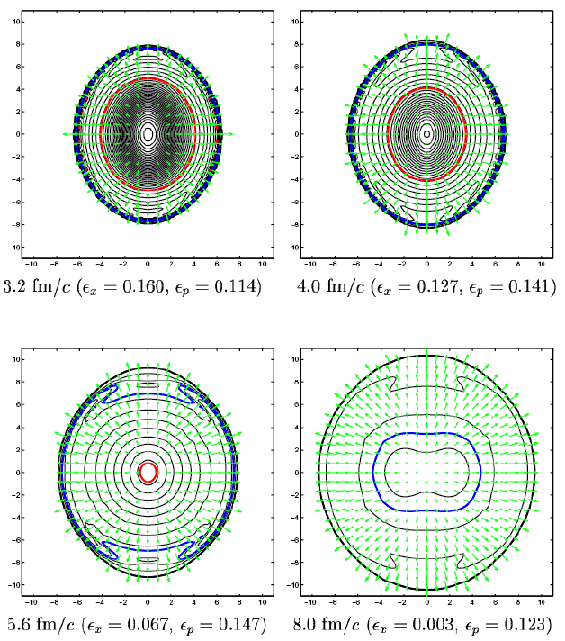
Fireball Evolution
Pressure gradients in fireball accelerate medium → flow
→ Relativistic Hydrodynamics
Radial and longitudinal expansion
increasing volume
cool-down
In-plane
shorter axis → larger pressure gradient → stronger acceleration
Out-of-plane
longer axis → smaller pressure gradient → weaker acceleration
Faster expansion in plane
→ elongation changes from out-of-plane to in-plane

Slide 40
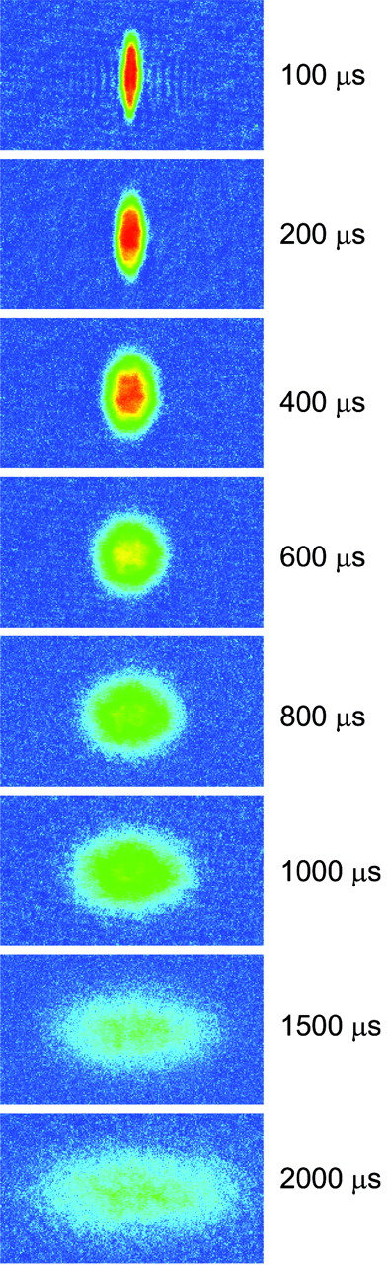
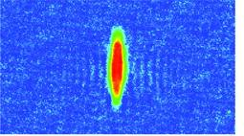
Analogy: Strongly Coupled Atoms
Time after releasing
atoms from trap
Cold atomic gas (⁶Li, T = 10⁻⁶ K)
Tuneable coupling (Feshbach resonance)
Weak coupling:
No momentum anisotropy
Strong coupling: Collective elliptic flow
O’ Hara et. al
Science 298 (2002) 5601

Slide 41
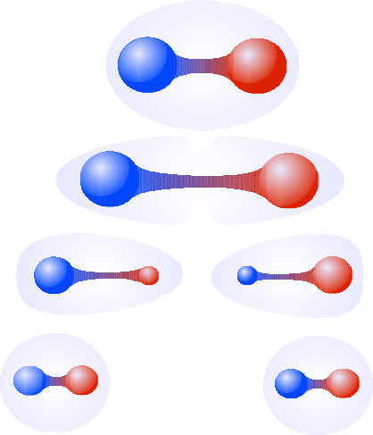
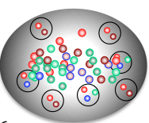
Hadronization
Fragmentation (pp)
separation of color charges impossible
creation of quark-antiquark pairs
formation of color-neutral hadrons
Coalescence (QGP)
quarks already exist
expansion → decreasing density → cool-down
hadrons formed by re-combination or coalescence of quarks

Slide 42
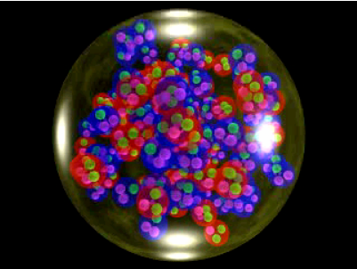
Hadron Gas
Hadronization → hadron gas
high density
high temperature
Interactions in hadron gas
typical energy scale: <200 MeV
inelastic: change hadron species, e.g.:
π⁰+p → π⁺+n
Λ(uds)+π→p+K
elastic: change hadron motion
Chemical Freeze-Out
last inelastic interaction
fixes abundance of particle species
Thermal Freeze-Out
last elastic interaction
fixes momentum spectra

Slide 43
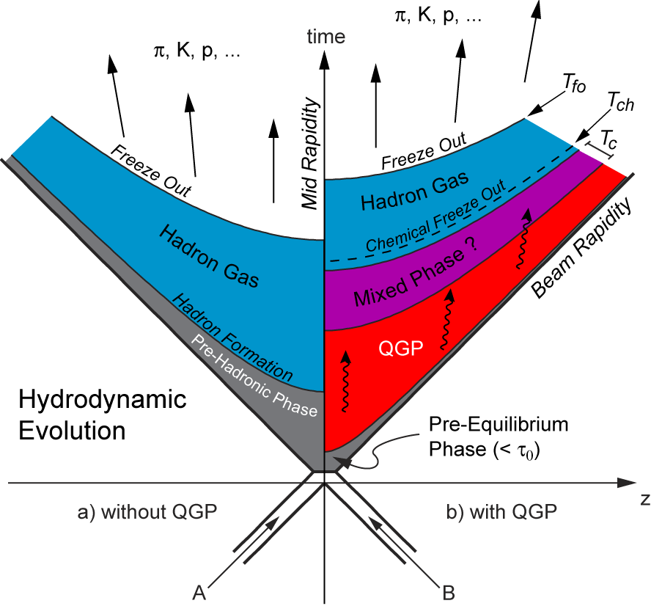
QGP: Temporal Evolution
initial scatterings
interaction of incoming partons
pre-equilibrium phase
redistribution of energy
(local) thermal equilibrium
quark-gluon plasma
quasi-free quarks and gluons
hadronisation
recombination of quarks and gluons to hadrons
hadron gas
expansion, cool down

Slide 44
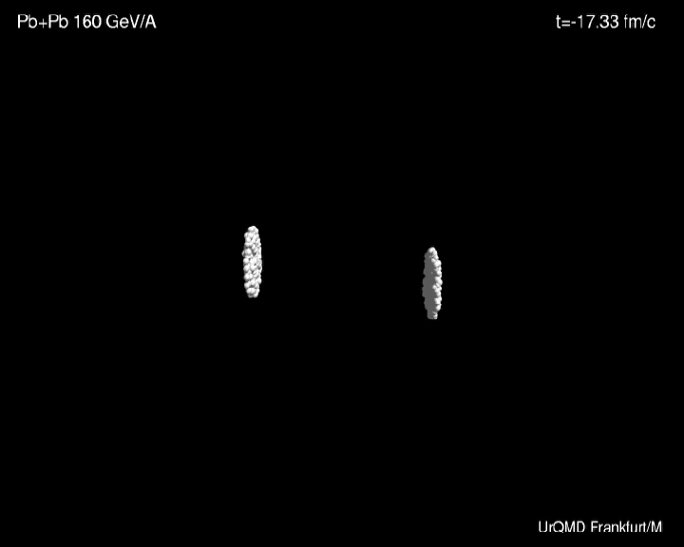

Slide 45
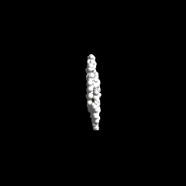
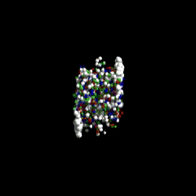
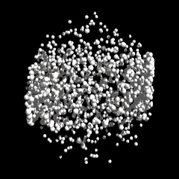
Heavy Ion Collision

Slide 46
Probing the QGP
scattering experiments
external illumination
not possible
soft observables
produced in the medium
bulk particle production
hard probes
production in hard initial scatterings
interaction with medium

Slide 47
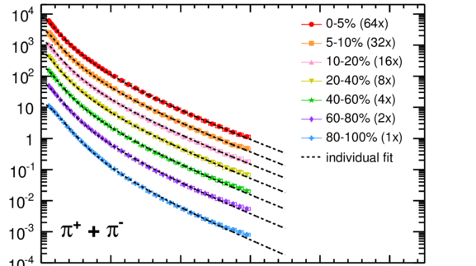
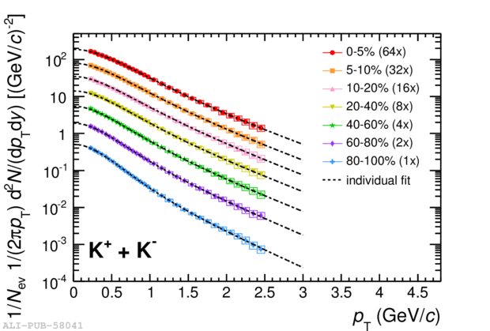
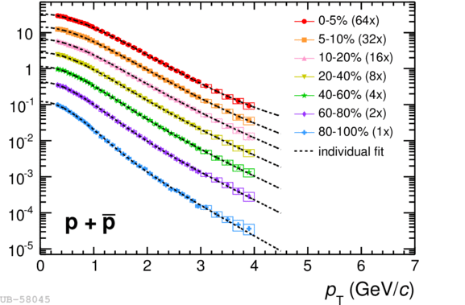
Soft Observables
Properties of particles created in the hot medium
momentum spectra (velocities)
abundance of hadron species
anisotropy (flow)
→ relevant for jet quenching
  Paul Sorensen (Fri afternoon)
Soft observables depend on:
system size, energy (density)
initial anisotropy
number of participants
Not part of this conference

Slide 48
Hard Probes
Objects from hard scatterings (Q,m >> T_{QGP}) and their interaction with the QGP
energy available only in hard initial scatterings → early production
experience full evolution of HI collision
interact with QGP&HHG
→ modification
often prominent signatures
Topic of this conference!
jets (high momentum partons)
  energy loss – jet quenching
  Paul Sorensen (Fri)
  Tom Dietel (Sat morning)
heavy quarks
  m_{c}≈1.5GeV, m_{b}≈4.5GeV
  mass dependence of E-loss
  Paul Sorensen (Sun morning)
prompt photons, W&Z bosons
  prompt photons = LO processes
  Tom Dietel (Sat afternoon)
low energy photons
  not really hard
  but often considered here
  Tom Dietel (Sat afternoon)

Slide 49
Statistical Model

Slide 50
Statistical Model
Assumption: thermal production of all hadrons in macro-canonical ensemble
→ hadron abundances are fixed by partition function
+ : fermions
- : bosons
For any conserved quantum number exists a chemical
potential μ, conservation laws give boundary conditions:
Baryon number:
Leaving two free
parameters:
Strangeness:
Charge:

Slide 51
Statistical Model at RHIC
simultaneous fit of hadron multiplicities
  correct for decays, feed-down, widths…
  reasonable fit quality (χ²)
→ T = 162 MeV
μ_{B} = 24 MeV
100 000x hotter than
center of the sun

Slide 52
Statistical Model in ALICE
Fit with all particles
rather poor fit
T=152 MeV
lower than RHIC?
Fit w/o protons
better fit
T=164 MeV
consistent with RHIC

Slide 53
Chemical Freeze-Out Temperature
A. Andronic, P. Braun-Munzinger ^{, J. Stachel}
A. Nucl. Phys. A772 (2006) 167 [nucl­th/0511071]
strong rise in T up to √s_{NN} ≈ 20 GeV (top SPS energy)
T ≈ 160 MeV constant at RHIC and LHC (not shown)
  temperature at chemical freezeout (last inelastic collision) in hadronic phase
Indication of deconfined phase at T > 160 MeV

Slide 54
Phase Diagram of Nuclear Matter
increasing T for small √s_{NN}
const T≈160 MeV
for √s_{NN}>10GeV
consistent with lattice QCD
  crossover phase transition at SPS,RHIC energies
  1st order phase transition, critial point predicted
  search ongoing
baryon free region at mid-rapidity

