Slide 1
High-performance Signal and
Data Processing:
Challenges in Astro- and Particle Physics and Radio Astronomy
Instrumentation
Chairs
Professor Michael Inggs (University of Cape Town)
Professor Bruce Mellado (University of the Witwatersrand)
Monday 27 to Friday 31 January 2014
Wits University, Professional Development Hub and School of Physics

Slide 2
LASER and
Raman
Spectroscopy
Theoretical
High-energy Physics
National Institute
For Theoretical Physics NITheP
NMR
Mössbauer
Materials Physics Research Institute
(MPRI)
Theoretical
Solid State Physics
CoE
Strong Materials
Internal resources
Research Areas
School of Physics
Hosted
External resources
CERN
ATLAS
Ion Implantation
Astronomy
Astrophysics
Radiation and
Health Physics
Nuclear Structure
Physics
CERN
ISOLDE
distance

Slide 3
Southern Africa Research Areas
Hartebeesthoek Radio Astronomy Observatory
HartRAO
Square
Kilometre Array
SKA
Astronomy
Astrophysics
High Energy Stereoscopic System
H.E.S.S.
Cherenkov Telescope Array
CTA
H.E.S.S. II

Slide 4
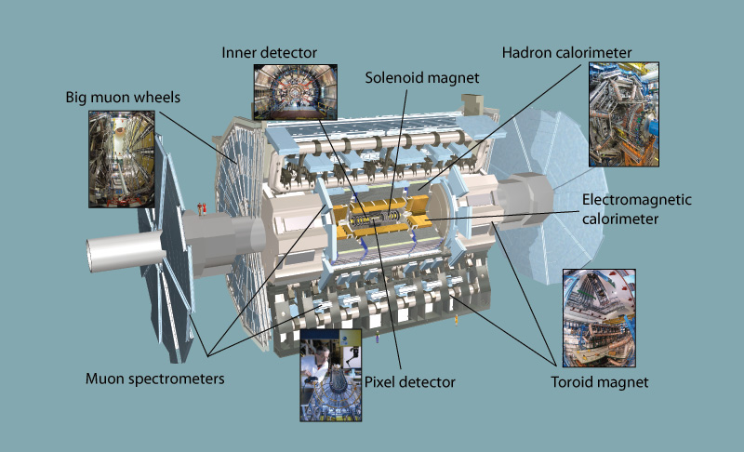
ATLAS detector CERN

Slide 6
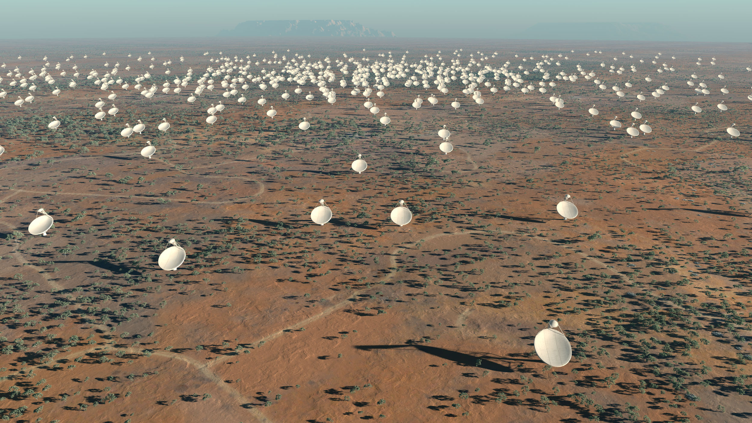
The SKA at the centre of the African platform for multi-ν astronomy

Slide 7
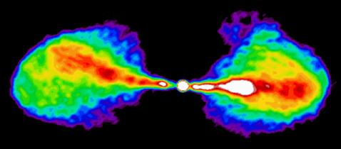
VLA (Very Large Array) in New Mexico
27 radio telescopes

Slide 8
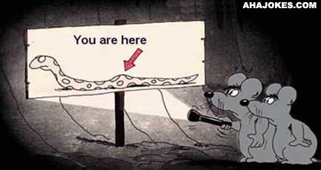
Traditional data processing

Slide 9
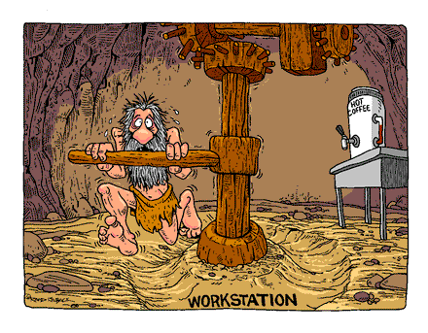

Slide 10
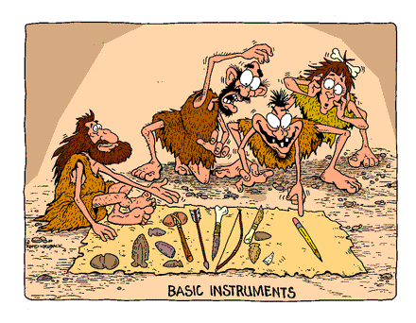

Slide 11
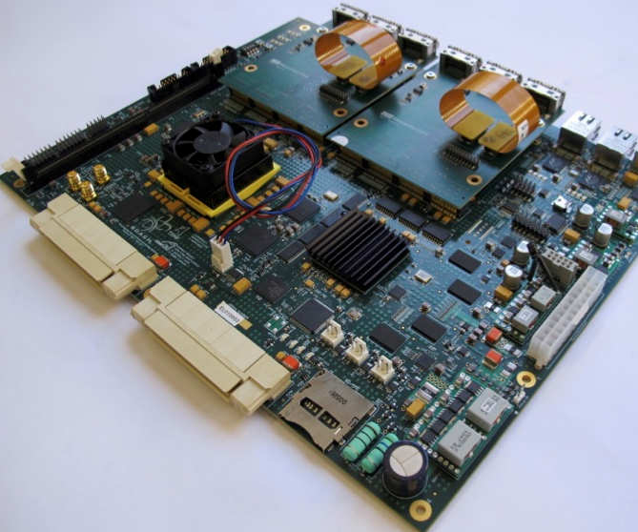
Modern instrumentation

Slide 12
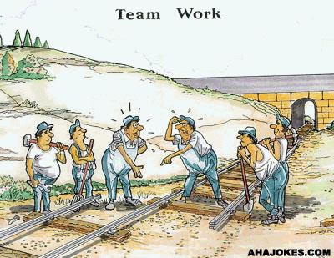

Slide 14
Don’t suffer from data overload!

Slide 15
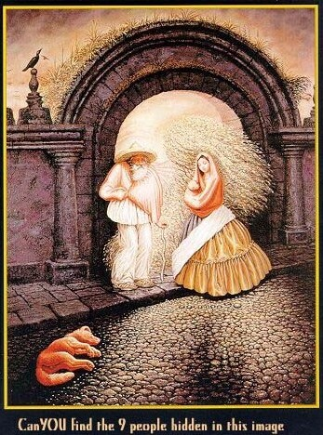

Slide 16
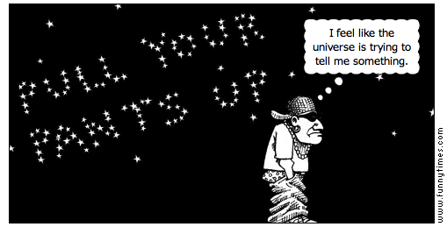
There is a message out there for you!

Slide 17
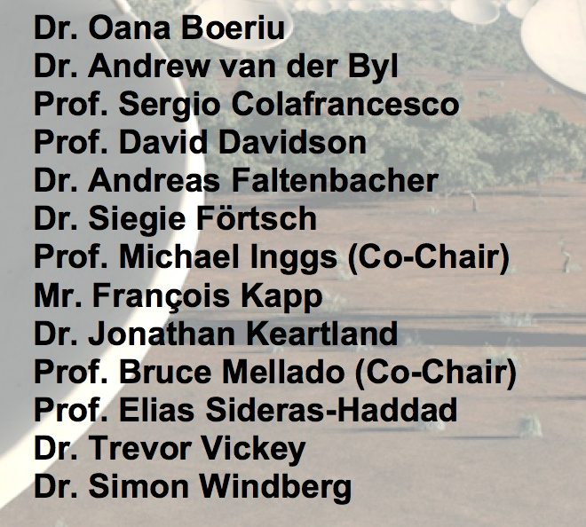
Special thanks to the Organising Committee

