Slide 1
CYBER-INFRASTRUCTURE IN SOUTH AFRICA
Daniel Adams
High-performance Signal and Data Processing: Challenges in Astro- and Particle Physics and Radio Astronomy Instrumentation
27-31 January 2014, WITS

Slide 2
Outline
Impact of cyber-infrastructure;
Implementation of SANReN
Implementation of CHPC
Implementation of DIRISA
Towards an national integrated cyber-infrastructure system
What’s next?
Presentation www.dst.gov.za

Slide 3
The Focus of Cyber-Infrastructure
Cyber-infrastructures are needed to address the complex, multi-disciplinary, cross-cutting and cross-border needs of modern science;
They exploit advances in ICT; integrate hardware for computing, networks for data, observatories and experimental facilities, as well as an interoperable suite of software and middleware services and tools;
Currently, the main components of the SA national cyber-infrastructure system are:
Centre for High Performance Computing (CHPC);
South African National Research Network (SANReN);
Data Intensive Research Initiative of SA (DIRISA);
SAGrid Initiative

Slide 4
The Research Infrastructure Ecosystem
Research Infrastructures are central and an integral part of an ecosystem: a driver for Knowledge generation and exploitation;
and Innovation both nationally and internationally

Slide 5
The Impact of Infrastructures
IMPACT
Wealth creation
Jobs
Poverty eradication
New products
Technology
Services
Competitive World
Human capital for knowledge generation
Research Infrastructure and state-of-the-art equipment

Slide 6
Research Infrastructures
Delivering highly skilled people to the labour market
Improving the performance of existing businesses
Economic
Impact
Creating new businesses
Improving public policy and public services
Attracting R&D investment from global business
DIUS ‘Economic Impact Framework’ – May 2007

Slide 7
Why the Government should support R&D (1)?
Deputy President Motlanthe (STI Summit, 20-21 July 2013):
- “The benefits of science, technology and innovation are not only potentially immense for us, but more crucially – constitute the preconditions for South Africa’s development;”
- “Government knows only too well the indispensability of science, technology and innovation if it is to deliver on the historical challenge of addressing social inequality, poverty and unemployment;”
To create an environment conducive for SA to become an investment destination; and
To achieve a truly knowledge economy – prioritising skills development as well as research capacity and human capital development.
Presentation www.dst.gov.za

Slide 8
Why the Government should support R&D(2)?
To develop a representative, high-level human capital able to pursue locally relevant, globally competitive research and innovation activities;
To ensure availability of and access to internationally comparable research and innovation infrastructure in order to generate new knowledge and train new researchers;
To strategically develop priority science areas in which South Africa enjoys a competitive advantage, by promoting internationally competitive research and training activities and outputs – knowledge generation; and
To facilitate knowledge exploitation: patenting, knowledge into products and services (innovation)
Presentation www.dst.gov.za

Slide 9
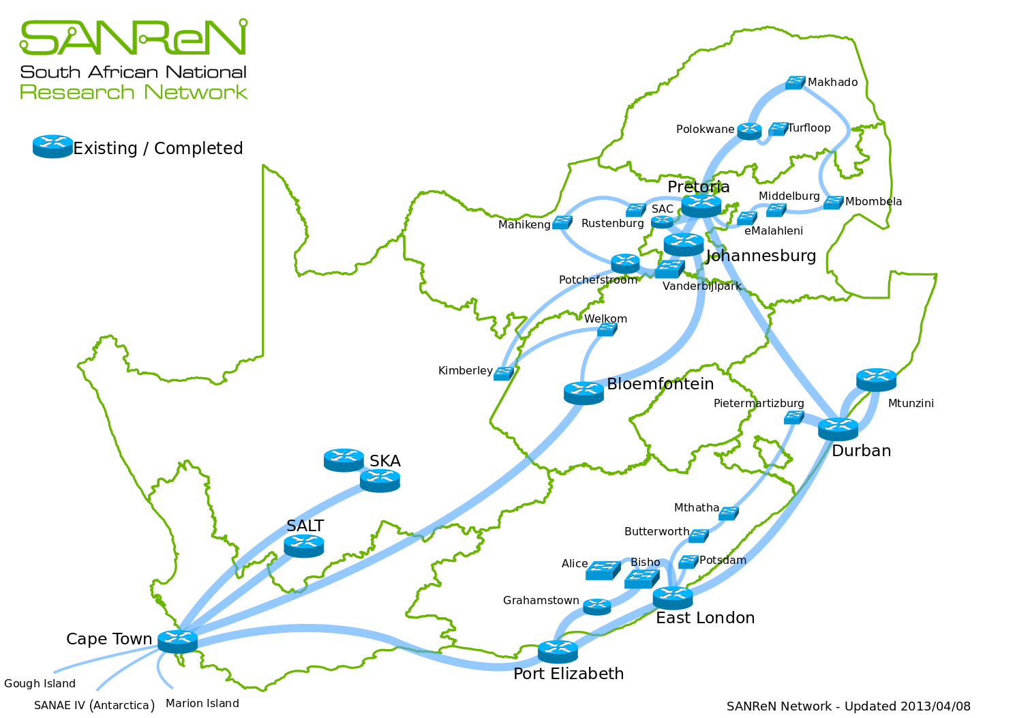
SOUTH AFRICAN NATIONAL RESEARCH NETWORK (SANReN)

Slide 10
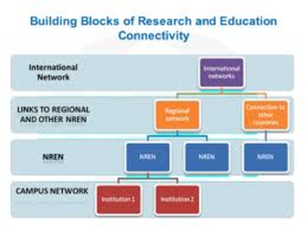
South African National Research Network (SANReN)
Original SANReN objectives:
Establish a high bandwidth research network for the South African research community with international links to global research networks;
Play the role of a NReN;
Provide a platform for research in high speed networking; and
Enable accelerated Human Capital Development through the network’s use.
Benefits to be delivered by SANReN:
Maximum accessibility and bandwidth
to research and higher educational institutions;
Support national science projects;
Global/International connectivity;
Create platforms to enable SA researchers to participate in international collaborations;
Enable value added services.
CSIR MI implements the network, TENET manages the network

Slide 11
Investments
Rand (Millions)
Year

Slide 13
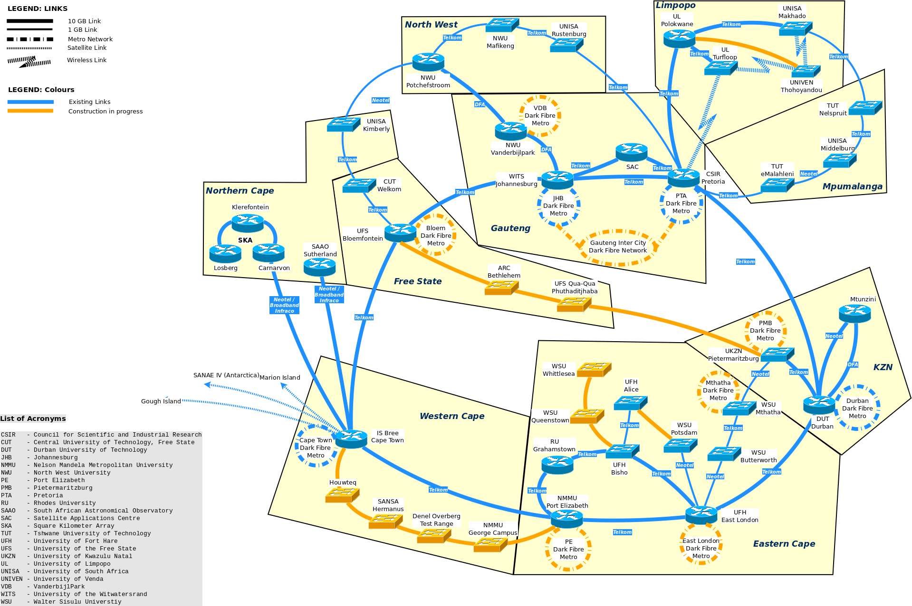
National network and metro networks

Slide 14
UNISA - Makhado Campus
National Backbone and Sites to Benefit
UNISA - Giyani Campus
UNIVEN - Main Campus
UL – Turfloop Campus
UL- Edupark Campus
TUT – Polokwane Campus
Click on the green circles next to:
- Makhado
- Polokwane
- Nelspruit
- Mafikeng
- Alice
- Pietermaritzburg
UNISA – Polokwane Campus
29 Sites
UNISA – Rustenburg
ARC - ITSC
UNISA – Mafikeng
TUT - Nelspruit
NWU – Mafikeng
NWU – Potchefstroom
UNISA - Nelspruit
UNISA – Potchefstroom
UNISA - Middelburg
NWU – Vanderbijlpark
15 Sites
VUT – Main Campus
TUT - eMalahleni
UNISA – Vanderbijlpark
NWU – Emfuleni
NLSA - Mzunduzi
NWU – Faranani
DUT - Riverside
CUT - Kimberley
5 Sites
UNISA - PMB
CUT Welkom
10 Sites
CSIR - PMB
4 Sites
WSU – Zamakulungisa
WSU – Nelson Mandela
36 Sites
UFH - Alice
UNISA - Mthatha
WSU – iBika
WSU – Potsdam
WSU – Chiselhurst
WSU – College street
UNISA – East London
UFH - Bisho
8 Sites
RU - Grahamstown
SAIAB- Grahamstown

Slide 15
Impact
SANReN: to date, 147 research sites connected;
Internet costs to beneficiaries reduced by a factor of more than 10;
When completed SANReN network will provide world-class connectivity to > 750 000 users (students, academics and researchers) (400 000 UNISA!) (DHET estimate 1.2m HEI & >1m FET students in future);
SKA site connectivity helped secure the bid;
SA now able to participate more meaningfully in international science projects; and
Potential impact on FET Colleges … and Schools?

Slide 16
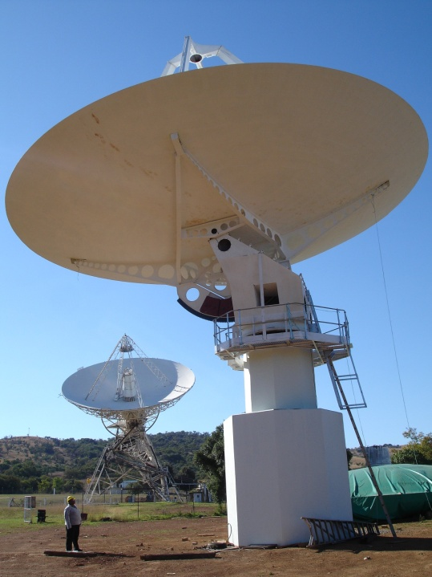
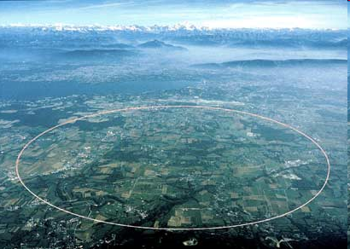
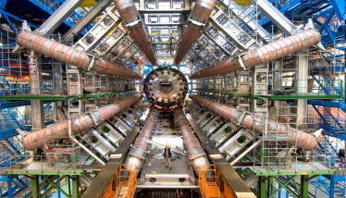
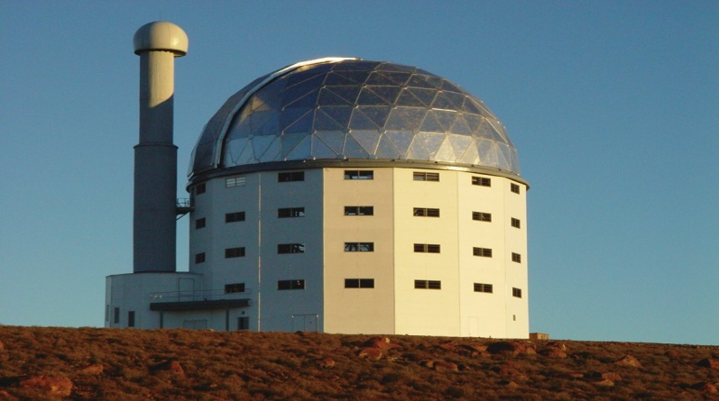
Big Science Projects
Impact
Equal Opportunities
and Access:
Quality teaching and learning
Competitive and collaborative
Research
CERN
SALT
SKA
SANReN
UCT
Rural and remotely
located HEIs

Slide 17
SANReN: An Enabling Infrastructure
Value Added Services: Eduroam (a secure, world-wide roaming access service; allows researchers to use wireless networks to access Internet for free;
Enabling more efficient access and usage of expensive instrumentation (eg remote control of instruments, telescopes, etc.);
Enabling sharing of resources via Grid and Cloud (computing, data, etc.); and
Enabling Collaboration tools (Virtual Research Organisations, EVO conferencing, shared journals)
Notes:
17
17

Slide 18
Modern Research …
Research has become global with international groups working collaboratively on problems (Radio Astronomy, CERN, Southern Oceans, … );
Research has become increasingly data bound / driven, either because of:
Small number of massive data sets (CERN, SKA, e-VLBI, Climate etc), or
Tsunami of small (globally) distributed data sets (health, bio-informatics, agriculture, maritime etc)
Big challenges of our day demand international collaboration;
… hence Global Virtual Research Organisations the vehicle for effective collaboration

Slide 19
International connectivity (1)
Why do we need International Connectivity?
National Science (Data) projects:
SANAE/SANAP (Dedicated Satellite Connectivity)
MeerKAT & SALT
CHPC, Universities & SA-Grid
International Science Collaboration initiatives such as:
CERN (CHPC, UJ, Wits, iThemba, …) –SA Tier 2 data centre
HartRAO e-VLBI (2 Gbps light Path to JIVE)
Africa-VLBI (coming)
SKA
Establish GOLE (Global Optical Lightpath Exchange) to facilitate Light Paths ( dedicated end-to-end circuits) for Science
Collaboration with West Coast NRENs

Slide 20
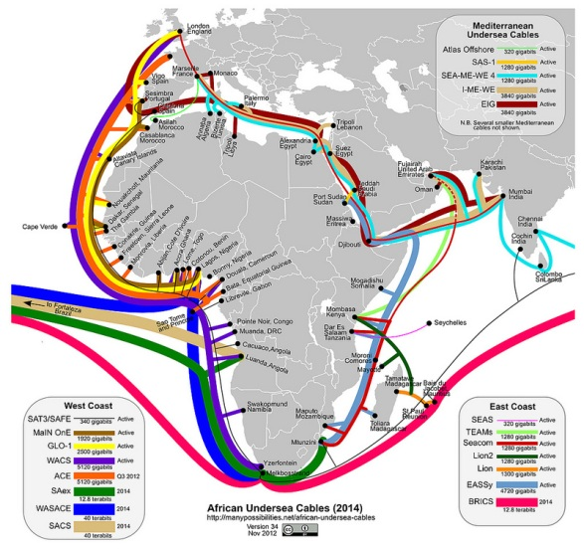
International connectivity (2)
What is currently available (TENET)?
10 Gbps via SEACOM
5 Gbps emergency redundancy via WACS
What will be available in the near future (TENET and SANReN)?
- 10 Gbps via SEACOM;
- >20 Gbps via WACS

Slide 21
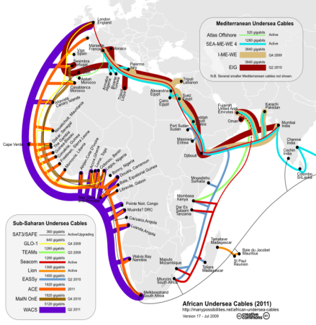
West Africa Cable System
WACS … Why do ‘we’ need it?
Extreme data national Science Projects will not succeed without WACS
Light paths (dedicated end-to-end circuits) are required for science
Sufficient capacity needed (TENET’s SEACOM capacity will run out)
Present redundancy costly

Slide 23
Centre for High Performance Computing
DST initiative managed by CSIR’s Meraka Institute - launched in May 2007,
largest system on continent, currently over 500 users;
Objective is to build world-class research, innovation and human capacity
within the NSI;
A platform for research, development and innovation
- Foster partnerships with South African research communities
- Flagship Projects: Climate Change, Energy security, HIV/AIDS
- Establish Specialist Interest Groups (SIGs) in visualisation, finance, epidemiology and computational biology
Advanced Computer Engineering – to develop skills for local
supercomputer architecture development (MoA with T-Platforms, Russia);
Stimulate the uptake of hpc in industry (30% of capacity and resources available for industry)
Will support initiatives such as the Advanced Manufacturing Initiative,
Biotechnology and KAT/MeerKAT, Space Science as well as addressing
developmental issues such as infectious diseases

Slide 24
Investments: CHPC (3:10)
Total investment: R452.8 m; world-class, national, Tier 1 facility

Slide 25
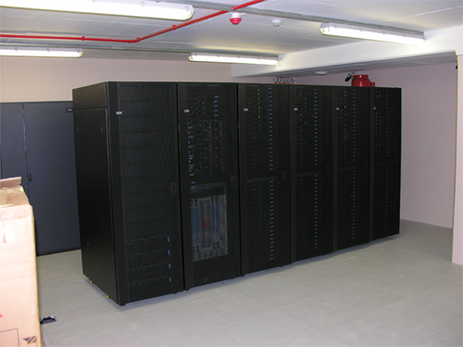
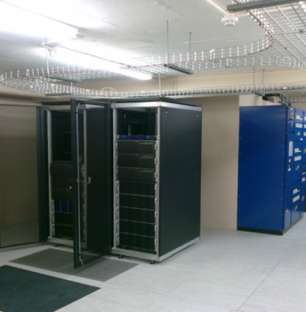
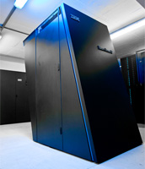
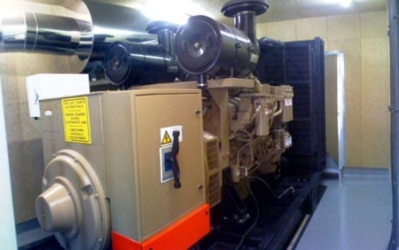
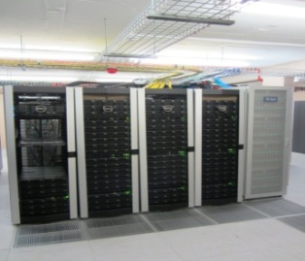
HPC INFRASTRUCTURE
A stable operational environment with fully back-up facilities to ensure continuous service delivery.
State-of-the art HPC systems ranked amongst the best in the world.
Increasing integration capacity locally to reduce the cost of maintenance and deployment of HPC systems.
Second Node already started in Pretoria for disaster recovery and data related services.
2007: 2.5TFLOPS
Test-bed machines for next generation HPC
2008 : 14.9 TFLOPS
20 000 liters of Diesel → 8hrs of operation – 1MWatt and back-up batteries for continuity in operation
2009 : 27.44 TFLOPS upgraded to 61 TFLOPS in 2011

Slide 26
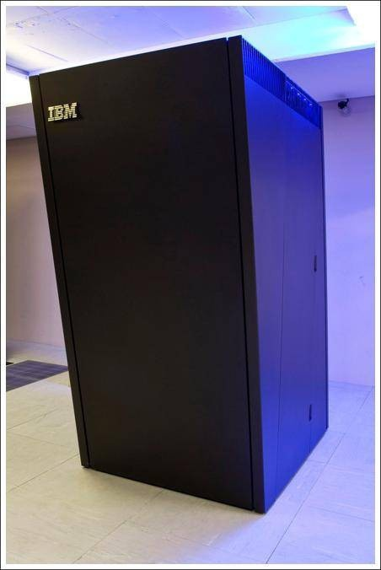
BlueGene for Africa Initiative
Partnership with IBM: Development of HPC on continent
Flagship Projects
Science &
Collaboration
Infrastructure
Human & Regional Capacity Development
Fellowship and Mobility

Slide 27
Capacity Building Activities
An annual HPC winter school hosted in collaboration with universities focusing on fundamentals of HPC and geared towards new researchers, with at least 50 participants;
The HPC student cluster building challenge to improve the integration skills in the country started in 2012 in partnership with OEMs;
More than 80 domain-specific workshops and short-courses to improve the efficient utilisation of HPC facilities;
A national software licenses to reduce license costs for scientists and promote collaboration;
New entrants in HPC coming from non-traditional domains such as medicine and creative arts sectors;
Enable South African scientists participation in global science projects.

Slide 28
Impact of CHPC
Twice elected to the TOP500 list;
Hosting a CERN Tier 2 data node;
Key local partner in the development and design of the KAT7/MeerKAT design;
Selected as member of the Science Data Processor (SDP) consortium: SKA international;
Team SA won the international Student Cluster Challenge in Leipzig, Germany (June 2013)

Slide 29
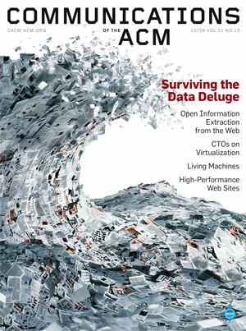
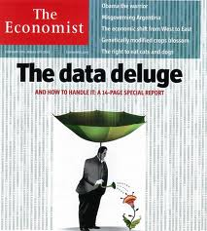
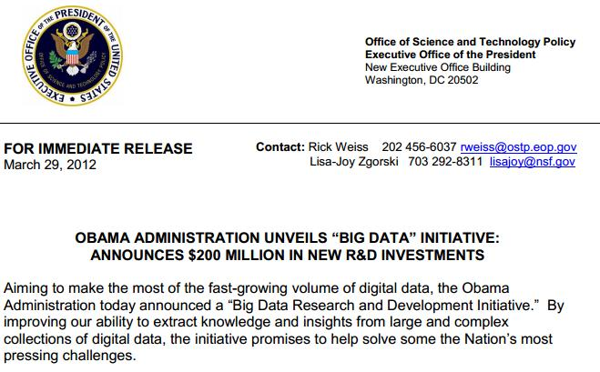
Digital Data has hit the “Tipping Point” as a Global Priority
DATA INTENSIVE RESEARCH INITIATIVE OF SA (DIRISA)

Slide 30
Components for effective data exchange
Sensor networks, major scientific instruments, streaming data,
modeling, computation, simulation, data collections,
file systems, databases, government
data, long tail, etc.
Metadata
Identifiers
Curation
Policy
Discovery
Analysis
Tools
Acquisition
Storage
Preservation
Interoperability
Access
Services
Infrastructure, Facilities, Operations
Software, Policies, Education
Discovery, Insight, Re-use

Slide 31
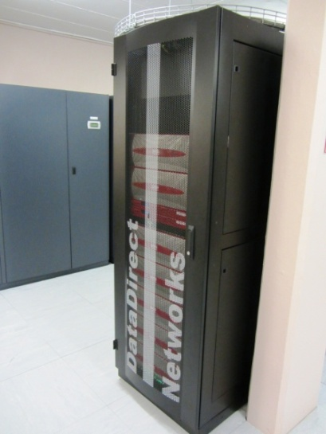
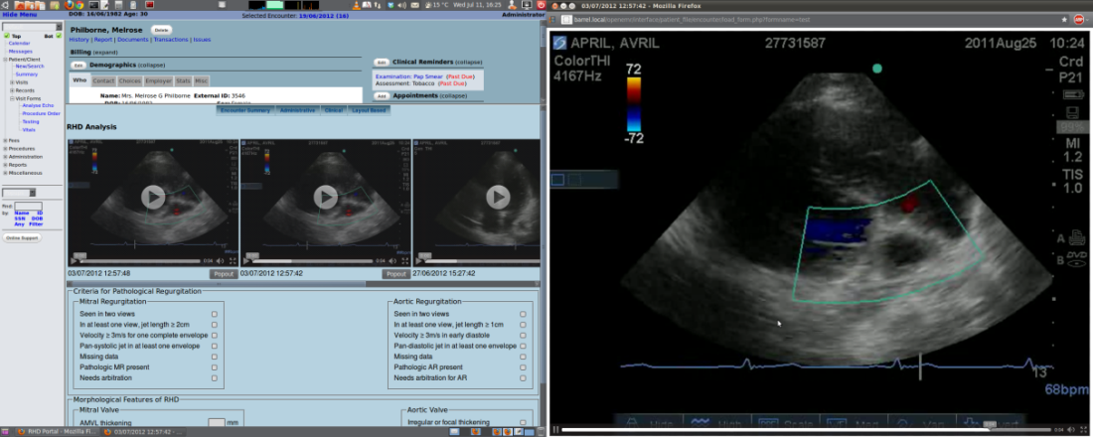
DIRISA Status
User portals developed
http://access.chpc.ac.za → provides services to climate modeling groups;
http://saeon.chpc.ac.za → Earth observation;
http://saaoads.chpc.ac.za → a mirror facility for NASA data available locally for astronomy groups.
Phase I infrastructure built in replication format between Pretoria and Cape Town;
A total of 2 Petabytes of storage linked through SANReN and access HPC systems;
Rheumatic heart-disease portal developed for medical applications and to form the basis of telemedicine applications in the center

Slide 32
TOWARDS A
NATIONAL INTEGRATED
CYBER-INFRASTRUCTURE SYSTEM

Slide 33
Towards A National Integrated Cyber-infrastructure System
CHPC
High-end / high performance Computing
Facilitate Research
Specialist Interest Groups:
Bioinformatics/Epidemiology
Humanities
Engineering
Foster Innovation
SANReN
(NREN)
High-bandwidth Network
Strengthen Collaboration
DIRISA
Large Data Initiative
Partners:
Tertiary Education
Government Departments
Industry
Promote Private Public Partnership
Accelerate Human Capital Development
Grid and Cloud: “Enabling Dynamic Services”

Slide 34
What’s next? (1)
International bandwidth procurement
Need to ensure more and redundant capacity for science needs
SKA, MeerKAT, SA-Grid, Bioinformatics, satellite imagery (remote sensing), etc.
Upgrading of the national backbone network
Ring closures
Increase capacity
Dark fibre - independence from market variables
AfricaConnect involvement
Services…

Slide 35
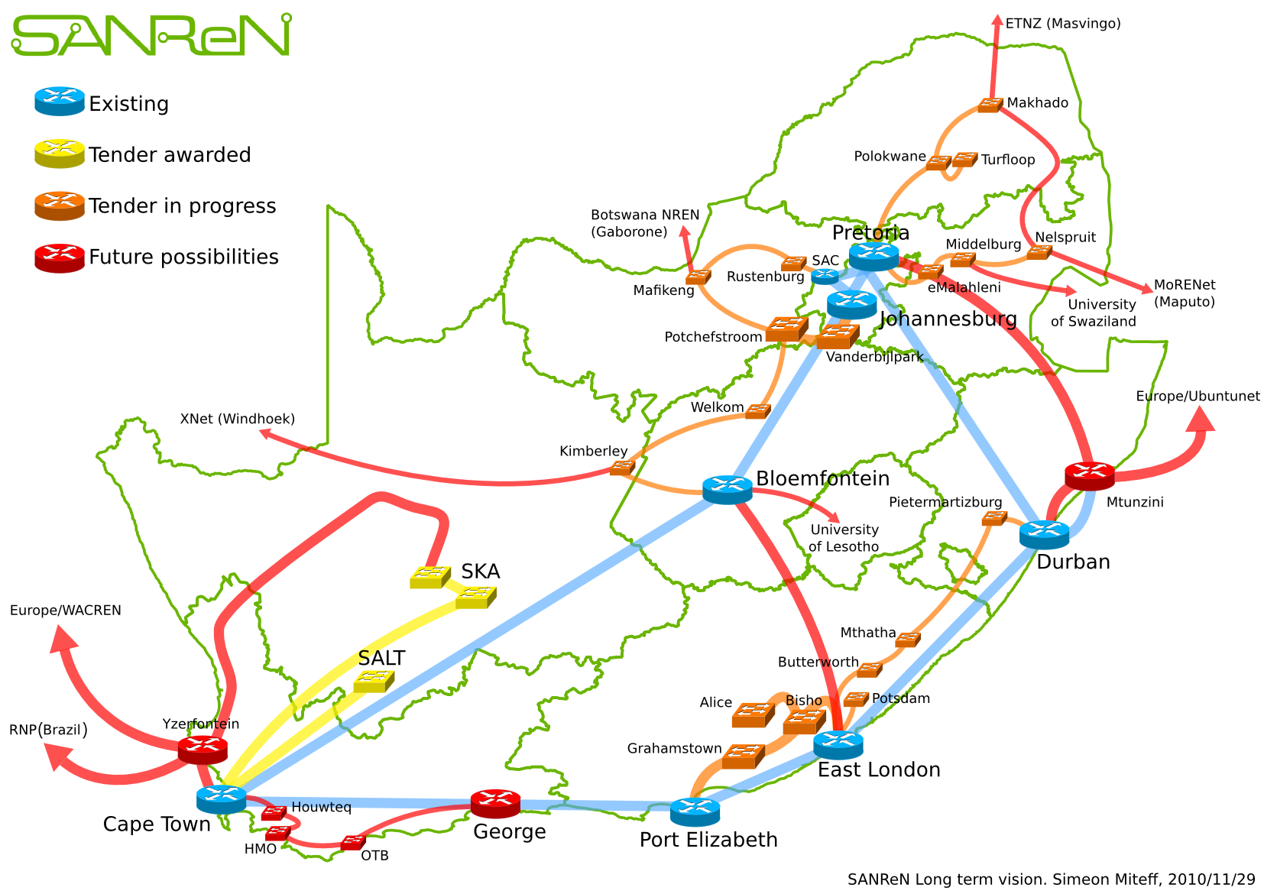
National Backbone
Metros
To-border connectivity

Slide 36
What’s next? (2)
Challenges in cyber-infrastructure deployment:
Peta/Exascale computing is driving a new trend;
Development and maintenance of scientific software;
Education and training urgently needed to be able to utilize the benefits from the investments in Cyber-infrastructure;
Access to data and information;
Cyber-infrastructure to be driven by research, development and innovation agenda

Slide 37
Presentation www.dst.gov.za

