Slide 1
ARM processors as a low-cost alternative tool for Big Science: FFTs for Radio Astronomy
Mitchell Cox
University of the Witwatersrand, Johannesburg

Slide 2
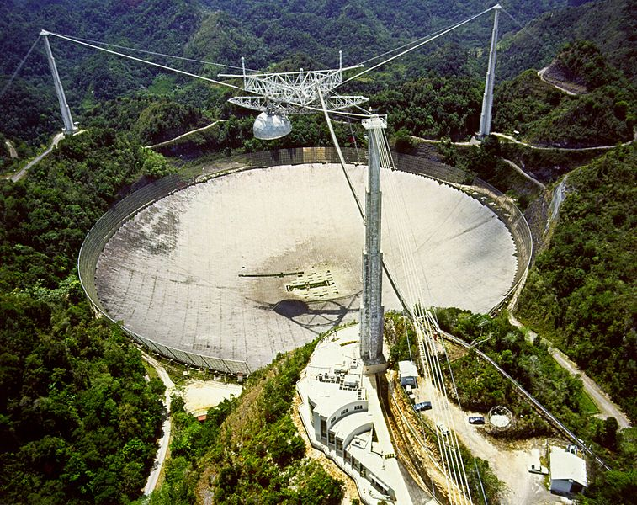
> 2016
1963
Notes:
Radio astronomy is changing. With thousands of antennas and terabytes of data throughput per second, new projects such as the Square Kilometre Array radio telescope are pushing the current limits of technology today, just as radio telescopes such as Arecibo did many years ago.

Slide 3
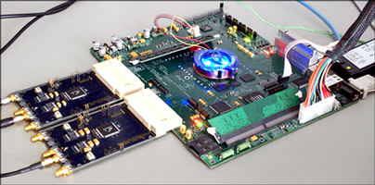
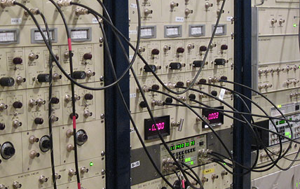
2013
1963
Notes:
Besides the obvious differences, modern telescopes will use something called software defined radio which allows hundreds of radio channels to be monitored from different areas of the sky simultaneously, compared to the relatively limited analog radio receivers used in the past.

Slide 4
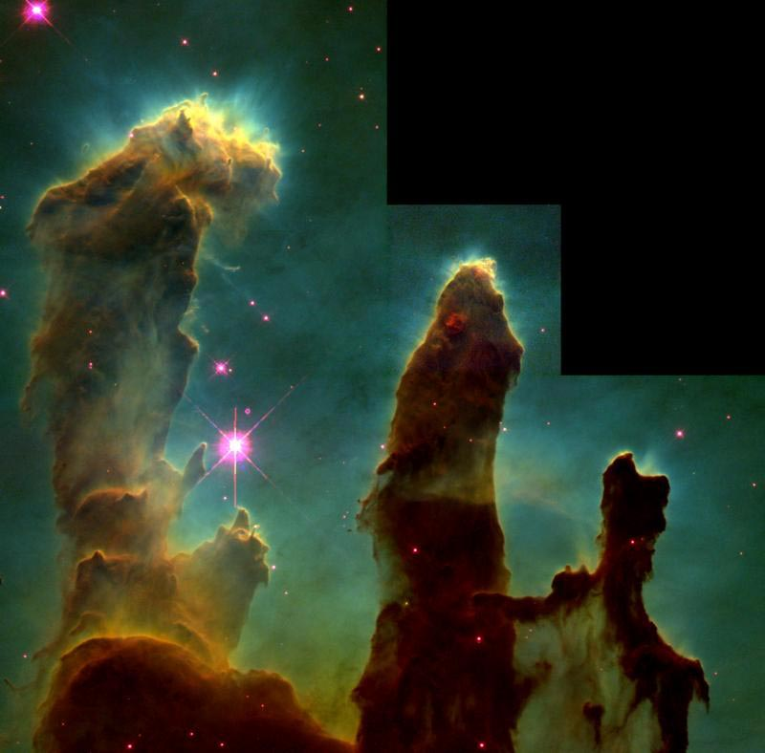
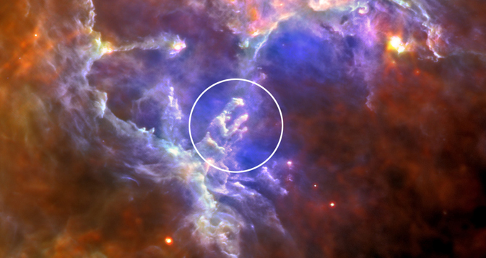
1995
2011
Notes:
This is one of my favourite nebulas, and most of you will recognise the top photo as the eagle nebula or pillars of creation. The lower image illustrates to me what modern technology is enabling – look at how much of the surrounding area was missed the first time around!

Slide 5
Computing Challenges
Capital and Running Cost.
Massive parallel data throughput.
Notes:
This presentation will be focussed on a single component of the high throughput supercomputing required for modern radio astronomy, but it is important to mention the major challenges and considerations for this supercomputer:
**CLICK**
How much does it cost? How expensive is it to run?
**CLICK**
And critically, can it handle the massive data throughput at the required data precision?

Slide 6
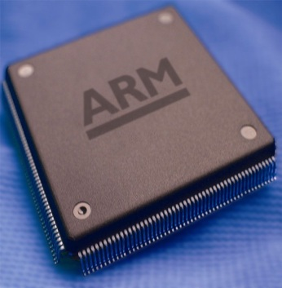
ARM Processors?
< 5 W Power Consumption
> 0.5 GFLOPS per Watt
2000
2014
Notes:
ARM processors have been in use for many years. Their use in smart phones, tablets and other mobile devices has driven rapid increases in performance while maintaining the necessity for low energy consumption and low price.
Is ARM a perfect fit for the computing challenges I just mentioned? This leads me to the question I asked for this research…

Slide 7
Can ARM processors be used as a low cost alternative to GPUs and x86 CPUs for massively parallel FFT computations?
Notes:
Can ARM processors be used as a low cost alternative to GPUs and common x86 CPUs for massively parallel Fast Fourier Transform computations?

Slide 8
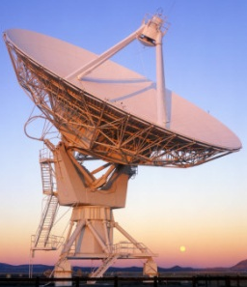
Software Defined Radio
Front End (FPGA)
ADC
Digital Down Conversion
Course Channeliser
Packetise
Ethernet
Antenna 1
F Engine
(FFT, etc.)
X Engine
(cross-correlation)
Storage, Imaging, etc.
…
Antenna n
Correlator (Back End)
Notes:
This is a simplified flow diagram for software defined radio that can be used in radio astronomy, to illustrate where the FFT operation fits in.
An analog to digital converter digitises the analog signal from the antenna which is potentially at a high frequency such as several hundred MHz or even GHz. This signal is down-converted to a lower frequency and then coarsely channelised, or split into many manageable segments before being formed into packets to be sent via a fast ethernet connection.
These steps are performed simultaneously and individually for each and every antenna in the array. All of the data streams converge to a central supercomputer where they are further channelised into even smaller segments.
**CLICK**
This fine channelization step is where I propose ARM processors can be used. The multitude of channels produced by this step are cross correlated with each other in the X engine step after which the data is in a format ready for scientific processing. ARM processors are a potential candidate for the X engine step as well, but I will not discuss this in this presentation.

Slide 9
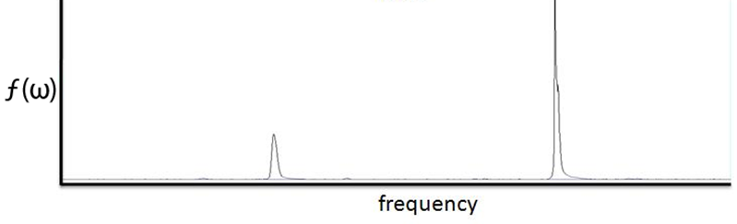
Background The Fast Fourier Transform (FFT)
Complexity is O(N log N) instead of O(N²). Fast!
$$ℱ\left[f\left(t\right)\right] \underset{→}{ } f\left(ω\right)$$
$$X_{k}=\sum_{n=0}^{N−1}{x_{n}}e^{\frac{−i2πkn}{N}}$$
Notes:
Before I proceed, you may be wondering what the Fast Fourier Transform actually is… The fourier transform converts a signal from the time domain, seen here as a high frequency signal mixed with a low frequency decaying signal, into the frequency domain, resulting in two spikes at the respective frequencies.
These two spikes could be separated and reconstructed conveniantly into the two separate signals, for a simple example of channelisation!
The fast fourier transform is an algorithm to compute the discrete fourier transform on a computer. It is ‘fast’ because it dramatically decreases the number of operations required to achieve the same result. The more points in the FFT, the higher the frequency resolution, but the more computationally complex it is.
For example, a 32 768 point DFT would take about 1 million operations, but the FFT only takes 147 000 – a speedup of about 85% in this case!

Slide 10
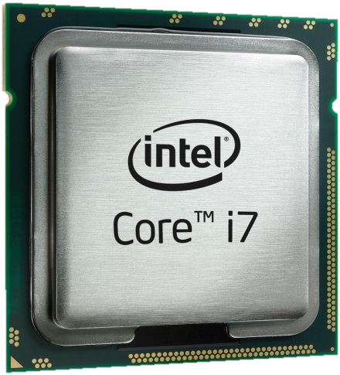
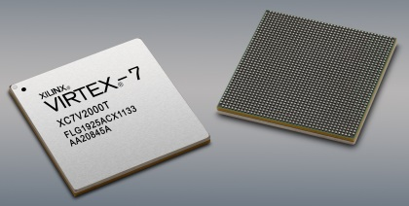
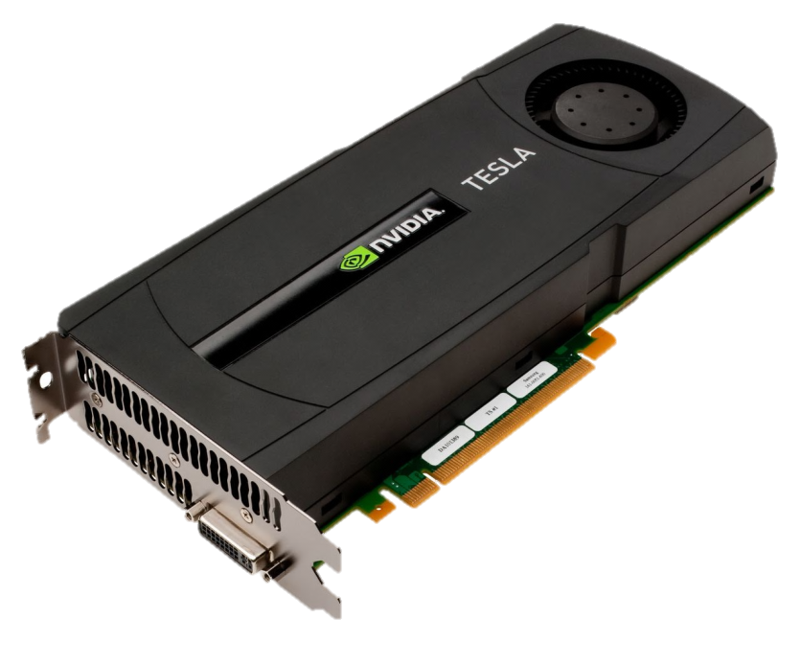
Currently
Notes:
FFT computations can be performed on many different platforms.
Obviously a standard x86 CPU in a server could be used, or a high performance GPU. Finally, Field Programmable Gate Arrays or Application Specific Integrated Circuits could be used for maximum performance.
Each of these methods has their disadvantages, be it low energy efficiency **CLICK**, high cost **CLICK** or a throughput bottleneck **CLICK**.
**CLICK** This brings us to the ARM platform.

Slide 11
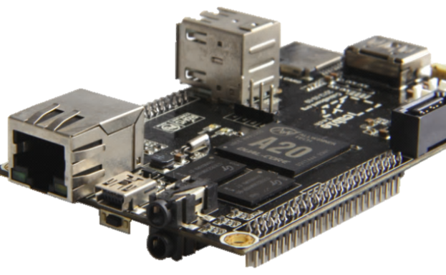
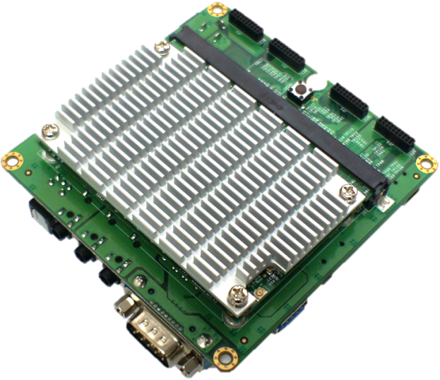
ARM Research Methodology
Cortex-A7
Cubieboard2
1 GHz, 2 cores
2.4 W Maximum
Cortex-A9
Wandboard Quad
1 GHz, 4 cores
5 W Maximum
Notes:
The ARM architecture commonly in use today is ARMv7, with several different cores available:
The Cortex-A9 is one of the higher performance ARM processors and is found in most smart-phones, for example. The Cortex-A7 is more modern than the A9 and has slightly more advanced floating point math features, but due to it’s intended very low power design, it’s overall performance is slightly lower than the A9.
I tested a dual core 1 GHz Cortex-A7 and a quad core 1 GHz Cortex-A9. I also recorded the power consumption while testing and noted a maximum of 2.4 W for the Cortex-A7 and 5 W for the Cortex-A9.

Slide 12
The FFTW Library
www.fftw.org
Latest version: 3.3.3
Fully supports ARM instruction sets
Notes:
The Fastest Fourier Transform in the West library was used to perform the benchmarks to gauge theoretical FFT performance.
FFTW is an open source FFT library who’s performance beats most commercial libraries but most importantly it has support for ARM processors. The ARM NEON instruction set is used which greatly improves performance because of NEONs Single Instruction Multiple Data capabilities.

Slide 13
FFTW Parameters
Single Precision Complex 1D FFT
2, 4, 8, …, 2 097 152 = 2², …, 2²¹
Benchmark returns:
$MFLOPS=\frac{5 N \log_{2}{N}}{{FFTTime}_{μs}}$
${Throughput}_{Byte/s}= \frac{{Size}_{Bytes}}{{Time}_{s}}$
Notes:
All tests were performed on single precision complex one dimensional FFTs. Typically double precision is used for science applications, but single precision is adequate in the context of radio astronomy channelization.
I tested a wide range of FFT sizes, from 2 to 2 million. Typically, in practise it is unlikely that FFT’s larger than several hundred thousand points would be used.
The FFTW benchmark returns an average MFLOPS estimate which is based on an approximate number of floating point operations in the algorithm. The time (usually in microseconds) it takes to perform one run of an FFT is a more accurate measurement for a specific FFT size as it can be used to extrapolate theoretical FFT throughput.
I should note that I used the most recent working version of the GCC compiler to build the FFTW library. The GCC version does impact performance, especially on the Cortex-A7 for which the compiler is not very mature.
On to the results!

Slide 14
Notes:
Both of these graphs are showing fairly raw FFTW results. The top graph is the MFLOPS value that is reported by FFTW. This can be compared to other FFT benchmarks out there. Notice how the quad core (green line) makes a large difference with FFT sizes between 4 and 65 thousand.
The bottom graph shows the FFT size in bytes divided by the FFT time, to result in how many MB per second could be processed. Both of these graphs are for 2 threads Cortex-A7 and A9, as well as the Cortex-A9 with all 4 threads. This is not the best result attainable, but throughputs of over 100MB/s are typical!

Slide 15
Best Case Throughput
Notes:
The results can be improved even further by taking a best case for any number of threads per FFT size. For example, an 8 point FFT runs fastest with one thread, so the total theoretical performance is 4 times (in the case of a quad core) the single thread performance. Similar logic applies to 2 cores for both processors.
The Cortex-A9 is clearly superior in performance to the Cortex-A7, especially for smaller FFT sizes. This is mainly due to the fact that the Cortex-A9 on test has 4 cores and the Cortex-A7 only has 2.
The peak performance on the Cortex-A9 is 1300 MB/s for an 8 point FFT. From 8192 to 65536 the performance is between 200 and 400 MB/s. The Cortex-A7 performance is typically a third of the Cortex-A9.

Slide 16
IO Throughput
iMX6 Cortex-A9 PCI-Express Throughput
Tested by Freescale Semiconductor (Manufacturer)
Drivers and hardware were not optimal
 | Theoretical Throughput (Mb/s) | Theoretical Throughput (MB/s) | Measured Throughput (MB/s)
Fast Ethernet | 100 | 12.5 | RX: 9.5 TX: 10.5
Gigabit Ethernet | 1000 | 125 | RX: 20 TX: 50
PCI-Express Gen2 x1 | 5000 | 500 | RX: 211 TX: 344
Notes:
A large FFT throughput of several hundred MB/s is useless unless it’s possible to transfer data onto and off of the processor at that speed. This table shows theoretical and measured throughputs of Ethernet and PCI-Express, two common and affordable communication busses on ARM.
The Cortex-A9 processor that was tested supports a PCI-Express Gen2 x1 link which theoretically allows up to 500MB/s of data throughput. A relatively un-optimised benchmark performed by the manufacturer shows up to 344 MB/s which is adequate for most of the larger FFT’s.
The Cortex-A7 that was tested only supports a 100 Mb ethernet link which is about 10 MB/s. This is clearly unsatisfactory. Even gigabit ethernet is limiting, at around 125 MB/s ideal throughput.
I should mention that it is possible to encode the data in a way to minimise IO throughput, but a discussion on this is not a part of the scope of this presentation.

Slide 17
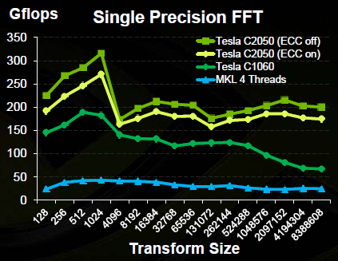
nVidia Tesla C2050 GPU Benchmarks
Reference: Official nVidia C2050 Benchmarks
Notes:
nVidia Tesla GPUs are commonly used for high performance computing. The graph above, which is from nVidia, shows single precision FFT performance for several different GPUs of similar generation to the Cortex-A9 processor that has been tested.
The yellow line is of primary interest. The GPU is able to attain a minimum of 150 GFLOPS.

Slide 18
nVidia Tesla C2050 GPU Worst Case Throughput
$MFLOPS=\frac{5 N \log_{2}{N}}{{FFTTime}_{μs}}$
${Throughput}_{Byte/s}= \frac{{Size}_{Bytes}}{{Time}_{s}}$
PCI-Express is throughput bottleneck:
~ 5 GB/s
 | FFT Size | GFLOPS | Effective FFT Time (us) | Maximum Throughput (GB/s)
C2050 GPU Single Precision | 131 072 | 150 | 74.27 | ~ 14.1
Notes:
As a worst case calculation, so in other words the largest FFT with the minimum GFLOPS, we can see that the processing power of the GPU can maintain about 14 GB/s. The PCI-Express throughput is the bottleneck here, at about 5 GB/s. This implies that there will be unused processing power on the GPU.

Slide 19
Intel i7 2 GHz Benchmarks
i7 Power > 10 x ARM Power
i7 Performance < 10x ARM Performance
Notes:
Since the official FFTW results database did not include recent CPU’s such as the Intel i7, I performed my own benchmarks.
The orange line on the graph is the theoretical best case MB/s throughput for a 2 GHz Intel i7 processor. This is several times greater than the throughputs attained by the ARM processors, but the CPU has more than 10 times the power consumption of the ARM processors but less than 10 times the performance boost.
So, how does ARM compare in power consumption?

Slide 20
Notes:
It is theoretically possible to connect multiple processors in parallel to increase the total throughput and so these results have been normalised to the GPU, which attains 5 GB/s FFT throughput and can be seen as the purple line.
The top graph shows the theoretical number of processors of each platform to attain 5 GB/s throughput at the various FFT sizes seen at the bottom. For larger FFTs, several tens of ARM processors are required, but due to their low individual cost this is feasible.
The bottom graph shows the theoretical total power consumption of the number of processors in the top graph. Notice how both ARM based solutions have very good power consumption, only being surpassed by the GPU after 2 million points!

Slide 21
Hypothetical Example 32 768 Point FFT: 5 GB/s Throughput
Notes:
This shows a quick hypothetical example of a system that requires 5GB/s of throughput on a 32 768 point single precision, 1 dimensional complex FFT.
As I mentioned in the slide before, several ARM processors would be required in parallel to meet these requirements, but as a simple estimate, the cost of a Cortex-A9 based solution is similar to the cost of the GPU based solution.
The power consumption of the Cortex-A9 based system is less than a third of the GPUs! The power consumption of the Cortex-A7 based solution is half that of the GPU based solution, but the initial cost is higher because many more processors are required.
When one takes the host infrastructure into account, the power consumption of the ARM solution should actually be even better, as a GPU based solution generally still requires a separate CPU to function, which is not taken into account here.

Slide 22
Conclusion
Is an ARM solution affordable?
Cost is similar to GPU based solution.
Is ARM energy efficient?
Cortex-A7 and A9 less than half GPU power.
Can ARM handle high throughput?
Parallel high throughput: PCI-Express.
Does ARM have the necessary math precision?
FFTW accuracy is good.
ARM has no SIMD double precision.
Notes:
If you think back to the beginning of this presentation I mentioned that a high throughput supercomputer for FFTs needs to meet several requirements which I have listed for you on this slide.
The Cortex-A9 solution is indeed affordable as in theory it would cost similar to a GPU based solution.
**CLICK**
Both the Cortex-A9 and A7 are more than twice as energy efficient as the next best processor, the GPU.
**CLICK**
If used in parallel, and therefore restricting their use to high throughput applications such as the F-Engine FFT, and ARM based solution can handle the high throughputs required assuming a high throughput IO link such as PCI-Express is available.
**CLICK**
Although I did not go into detail on the topic of math precision, the ARM solution is perfect when single precision is required. ARM does not yet have as high performance double precision, but in the near future, newer ARM architectures may include these instruction sets. I performed precision measurements on the accuracy of FFTW and the FFT precision was comparable to other processors.
**CLICK**

Slide 23
Questions and Comments?
mitch@enox.co.za
Notes:
Thank you and I hope you found this presentation interesting!
I will be writing detailed proceedings and if you would like a copy please let me know.

Slide 24
Backup Slides

Slide 25
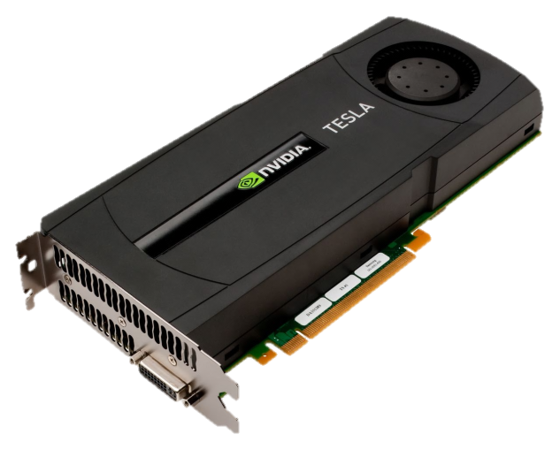
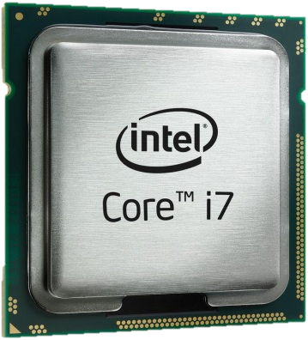
Results Analysis
System | Power Consumption (W) | 32 768 FFT Throughput (MB/s) | Capital Cost (Each) | Normalised Throughput | Equivalent Systems | Equivalent Power (W) | Equivalent Cost
Cortex-A7, 1 GHz | 2.4 | 89 | R 600 | 1.8% | 57 | 137 | R 34 200
Cortex-A9, 1 GHz | 5 | 295 | R 1 000 | 5.9% | 17 | 85 | R 17 000
Intel i7, 2 GHz | 200 | 2677 | R 10 000 | 53.5% | 2 | 400 | R 20 000
Tesla GPU | 295 | 5000 | R 15 000 | 100.0% | 1 | 295 | R 15 000
Notes:
As a more detailed summary, if the throughputs are extrapolated and the costs per system are calculated, it can be seen that the Cortex-A9 platform is similar in initial capital cost to a GPU based system.
A system based on x86 processors can achieve high performance but the cost and power consumption is high.
The Cortex-A7 is not economical, but if a quad core Cortex-A7 processor became available, with a high-throughput link such as PCI-Express, it may become a viable option.
The power consumption of a Cortex-A9 based system is a third of the GPU based system, meaning running costs will be low.

Slide 26
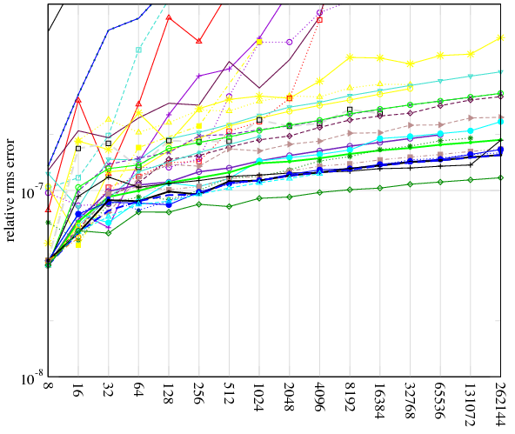
Results Accuracy Comparison
ARM NEON not IEEE 754 compliant:
Certain small values treated as zero.
Notes:
Finally, one outstanding measurement is the accuracy of the calculations done by the ARM CPU, compared to the accuracy of other platforms. The accuracy of the ARM platform is very similar to other general purpose CPU’s, shown on the right.
The reason for the decreasing accuracy at larger FFT sizes compared to other CPU’s is because of the NEON floating point unit in the ARM processors. The NEON unit is not fully IEEE 754 compliant, which means that denormal (or certain small values close to zero), are treated as zero, which will obviously lead to inaccuracies.
Overall, the precision of FFT on ARM is of the same order of magnitude as other processors and need not be considered further for the purpose of this study.

