Slide 1
SURVEY OF HIGH-LEVEL OPEN-SOURCE TOOL-FLOWS FOR RAPID PROTOTYPING OF SDR WAVEFORMS
Student (Msc): Khobatha Oriel Setetemela
Supervisor: Prof Michael Inggs
Co-supervisor: Dr Simon Winberg
Notes:
Ladies and gentlemen, good morning. I am Khobatha.I am working on an Msc project under the supervision of Prof Michael Inggs.The overarching aim of the project is to survey and evaluate potential high level design tool-flows for design and implementation of software defined radio waveforms.

Slide 2
Outline
Motivation – Design Productivity Gap
Basics – SDR Overview
Survey Methodology
Ideal High Level SDR Tool-Flow Requirements
Survey of Potential High-Level SDR Tools
Conclusions
Notes:
I have planned the presentation as shown. I will start first with the central motivating problem for this research – the design productivity gap. Then give a bit of background on SDRs showing how it is affected by the design productivity gap. A generic specification of an ideal high level tool-flow for SDR waveforms will be described. This ideal tool-flow is used as a reference to evaluate a plethora of existing potential high level tools. Conclusions and future work will then follow.

Slide 3
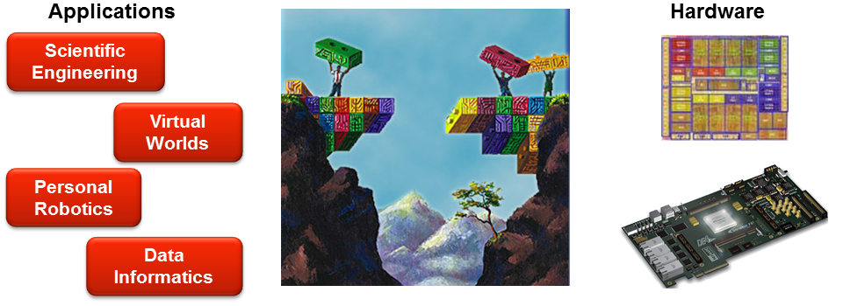
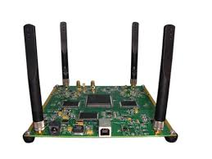
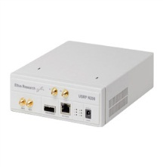
The Design Producity Gap
Hardware complexity doubles about every 18 months
Hardware increases in computing potential – eg. GPPs, DSPs, FPGAs
Hardware capabilities are increasing faster than designer’s abilities to design for them
Software Defined Radios
original image: http://ppl.stanford.edu/main/
Notes:
Gordon Moore predicted about two decades ago that computing hardware will exponentially increase in complexity. This prediction has been observed – we have seen and continue to see tremendous increases in complexity, and also computing power, of computing architectures – from general purpose processors (GPPs) such as the popular multicore architecture, application specific processors (ASPs) such as digital signal processors to reconfigurable fabrics such as field programmable gate arrays (FPGAs). The challenge however, is that, though hardware is becoming more and more complex and thereby more powerful, it is becoming increasingly hard and hard to develop software that harnesses the computing potential in this hardware. Software is lagging behind – and this is widening the productivity gap.

Slide 4
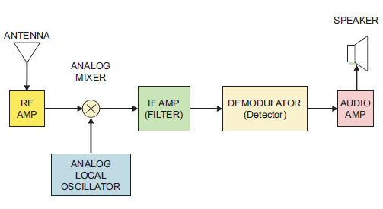
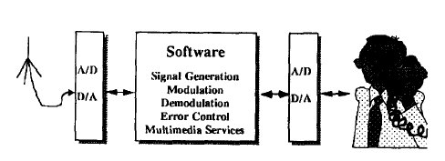
From Hardware-defined to Software-defined Radio
Traditional Hardware-defined radio:
Fixed functionality E.g: FM only
Require new HW to support new
radio standard/protocols
Not sustainable!
Software-defined radio:
“Some or all of the physical layer
functions are SW-defined” (SDR Forum)
High-performance programmable DSP devices (GPPs: parallel C++, DSPs: C, FPGAs: HDL, GPGPUs: C/OpenCL)
E.g MeerKAT receiver
SDR Handbook (2010)
Mitola (1992)
Notes:
A traditional radio is hardware-defined.It has a fixed architecture.That is it is typically designed to support only one radio standard.To add support for a new standard, a completely new hardware is required.This architecture is not sustanaible as …

Slide 5
Survey Methodology
System-engineer requirements for an Ideal High-Level SDR Tool-Flow
Evaluate a selected set of potential high-level open-source tools against the Ideal SDR Tool-Flow requirements
Make recommendations based on the evaluations

Slide 6
Ideal High-Level SDR Tool-Flow Requirements
Be easy-to-learn and easy-to-use
Support both algorithm (module) and system-level design
Provide a library of common communications and signal processing primitives
Provide sufficient high-level HW abstraction mechanisms
Provide efficient, quick verification and debug facilities
Facilitate easy cross-platform design portability
Support one-click code generation
Support heterogeneous processing on SDR devices
Produce good quality designs
Easy integration with legacy design and verification tools
Comply with SDR standards eg. SCA (Adopted by the SDR Forum)

Slide 7
Ideal High-Level SDR Tool-Flow
 |  | Algorithm and system-level Library of DSP primitives Hardware abstraction
 |  | Efficient, quick verification and debug facilities
 |  | Once-click code generation
 |  | Efficient, quick verification and debug facilities
 |  | Easy integration with legacy tools Heterogeneous processing Good quality designs
SDR Specification
High level modeling
High level verification
SDR Design Flow Standard Compliance
(E.g SCA)
Code
generation
Low level verification
System Implementation
In-situ test and validation

Slide 8
Overview of Potential High-Level SDR Waveform Design Tools
 | Open-Source | Proprietary
Textual | MiGen Python Toolbox MyHDL Python Package Delite DSL Framework Legup C HLS xPilot HLS Chisel Scala HCL | Cynthesizer HLS Catapult HLS Mitrion C HercuLes HLS Vivado HLS Bluespec HLS
Model-based | ALOE (SCA) SynDex Ptolemy II GNU Radio REDHAWK (SCA) OSSIE (SCA) | Hotrod Spectra SDR SCARI (SCA) SystemVue ESL Mathworks HDL Coder & Verifier CASPER MSSGE
The list is not exhaustive. But it gives a sufficient state-of-the-art sampling of high level design methodology efforts for narrowing the design productivity gap.

Slide 9
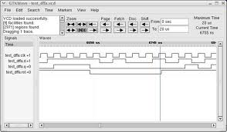
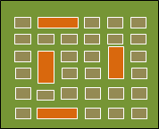
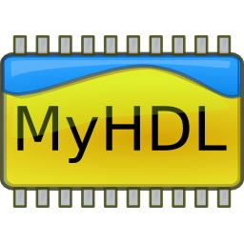
MyHDL
A Python package that makes it possible to use Python as a digital hardware description and verification language
Python as a HDL and a HVL
Rich Python’s fast-prototyping features and libraries
Built-in high-level simulator that supports co-simulation with conventional HDL simulators
Conversion of Python subset to
generic synthesizable HDL
FPGA/ASIC implementation only
Python (HDL) Model
Simulation
<Co-simulation>
HDL Code Generation
Synthesisable Verilog/VHDL
Implementation
<Traditional flow>

Slide 10
Ptolemy II
A rich Java-based framework for experimenting with AOD design techniques
Targeted primarily at modelling, design and simulation of concurrent, real-time, embedded systems
High-level design capture using Java or graphically using Vergil GUI
Code generation from the high-level AOD models (Embedded Java, C)
Ptolemy II AO Model
(Graphical/Java)
Functional Verification
<>
Code Generation
<copernicus/cal/cg>
Embedded C, Java code
Implementation
<Traditional flows>

Slide 11
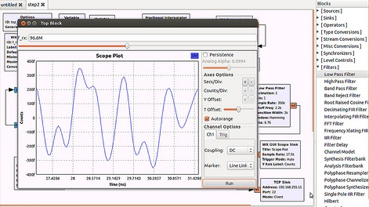
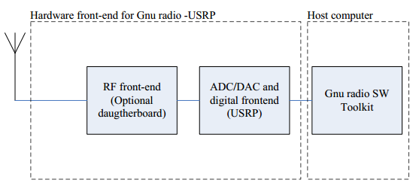
GNU Radio
A development toolkit that provides a dataflow-based signal processing scheduler (the heart of GNU Radio) and common processing blocks to implement SDRs
Most popular SDR SW platform
High-level design entry using Python or graphically using GRC
Built-in rich library of communications and
signal processing primitives

Slide 12
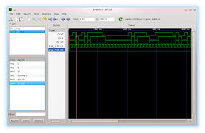
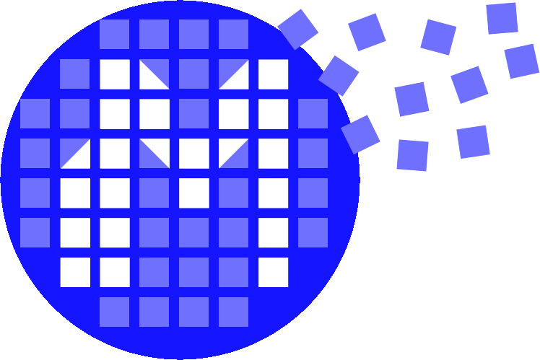
MiGen Toolbox
A much-improved metaprogramming toolbox for generating complex hardware from Python
Python as a metalanguage for HDL
Synthesiser that builds Python subset (FHDL) into generic HDL
Dataflow programming system
SoC bus infrastructure (Wishbone, CSR)
Simulator that supports Python test-benches
Online training access (EDA playground)
Direct interface with 3rd party EDA tools
Python (FHDL) Model
Simulation
<Icarius Verilog>
HDL Code Generation
Synthesisable Verilog
Implementation

Slide 13
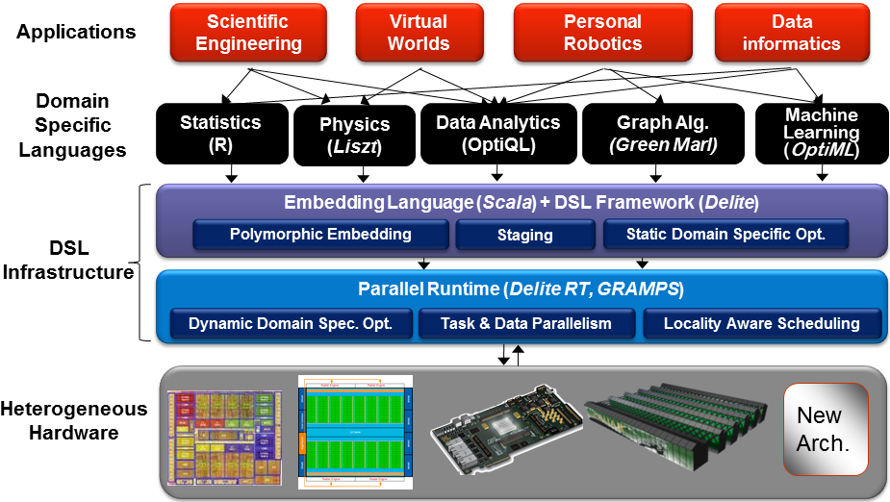
Delite
A highly-extensible compiler framework and heterogeneous runtime for parallel embedded domain-specific languages (DSLs)
Primary goal is to solve the parallel programming challenge for modern heterogeneous architectures (Multicore GPPs, GPUs, Clusters, FPGAs etc)
Image: Kunle et al (2007)

Slide 14
Delite Tool-flow
Scala DSL Model
Design entry using high-performance, highly productive, implicitly parallel DSLs
Optimisers for parallel code (generic and domain-specific)
Heterogeneous code generators (Multicore GPPs: Scala/C++ and GPUs: CUDA)
Heterogeneous runtime (GPP only, GPP + GPU)
Functional Validation
<scala test-bench>
Heterogeneous Compilation
<delite compiler>
Code generation
Binding
DEG
Heterogeneous Implementation
<delite runtie>
GPU
GPP

Slide 15
Conclusions
Design productivity gap is one of the grandest challenges of modern computing
It cuts across all computing applications
It limits innovation and technology adoption E.g SDRs
There is high and varied activity in both academia and industry to address this challenge
High-level design is the generally followed approach
Bring rich high-level SW design techniques to HW design
High-level design techniques will play a paramount role in bridging the design productivity gap for SDR
But it will take time and tremendous effort to completely escape from traditioinal HDLs (2030?)
The following problems remain to be addressed to make the high-level (SDR) design methodology a mature reality
Standardisation, Heterogeneous processing, HW/SW co-design

Slide 16
Thank You!

Slide 17
Useful Links
Delite
Project page: http://stanford-ppl.github.io/Delite/
Source code: https://github.com/stanford-ppl/delite
MiGen
Project page: http://milkymist.org/3/migen.html
Source code: https://github.com/m-labs/migen
MyHDL
Project page: http://www.myhdl.org/doku.php
Source code: https://bitbucket.org/jandecaluwe/myhdl
Ptolemy
Project page: http://ptolemy.eecs.berkeley.edu/ptolemyII/
GNU Radio
Project page: http://gnuradio.org/redmine/projects/gnuradio/wiki
EDA Playground (MiGen and MyHDL)
Project page: http://www.edaplayground.com/

