Slide 1
A scalable heterogeneous computing architecture for software defined radio on RHINO
Matthew Bridges
Supervised by
Dr. Simon Winberg
Friday 31 January 2014

Slide 2
Introduction
RHINO & Building a Transceiver

Slide 3
What is the RHINO? In short!
ROACH’s little brother, developed at UCT
Xilinx’s Spartan 6 LX150T FPGA
TI’s AM3517 ARM processor
2x FPGA Mezzanine Card Connectors
20Gbps Networking
COTS ADC & DAC Cards
Cost is < $1800
Lots of ADC choices

Slide 4
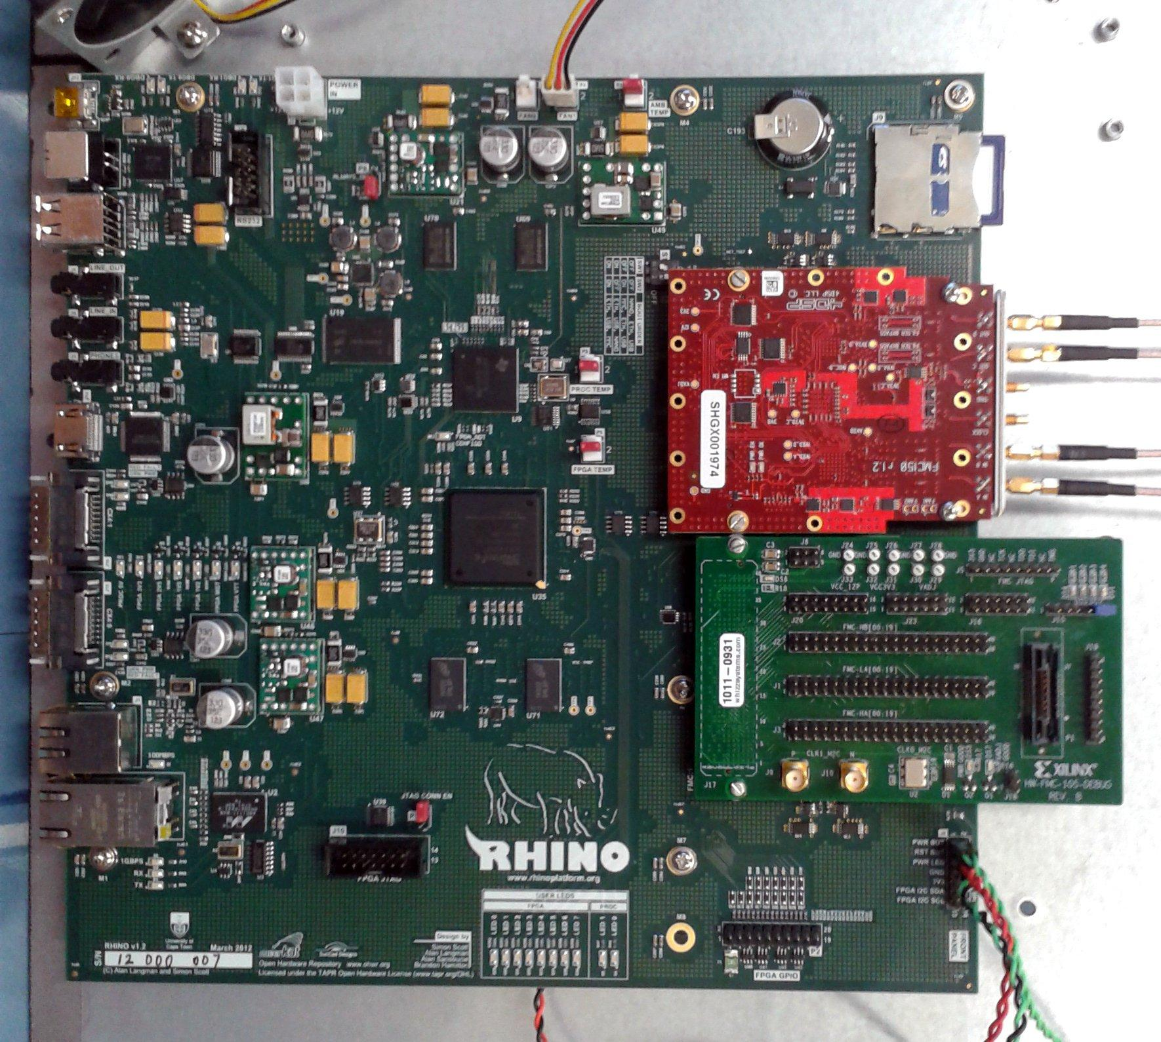

Slide 5
Project Aim:
“To develop and build a Transceiver with Multiple Inputs and Outputs using the RHINO”
Design Requirements:
Scalable and Accessible to future developers and Novices.
Open-source and free from any licensing.
Must abide by or create a standard way of adding new IP to the system.
Signal Integrity must be maintained.

Slide 6
The Design
Architectures, Busses, IP, Primitives and Programming Paradigms

Slide 7
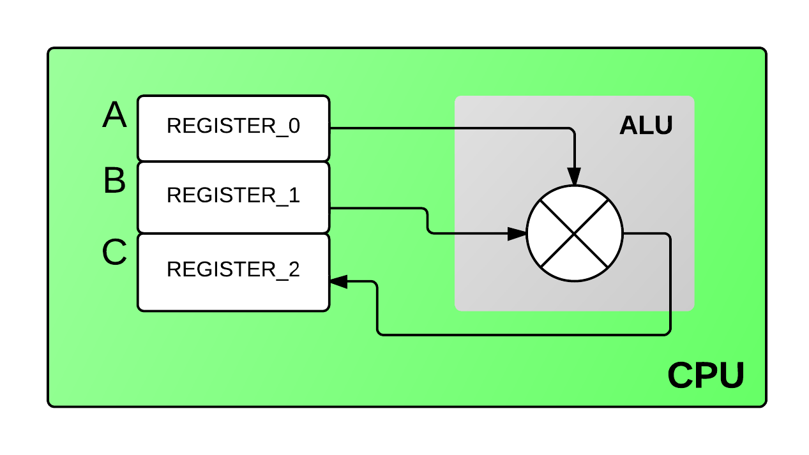
Programming Paradigms I
CPU Paradigm
C = A * B;

Slide 8
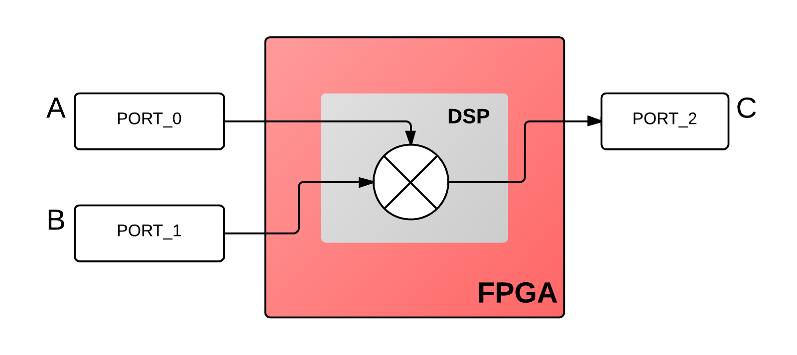
Programming Paradigms II
FPGA Paradigm
C <= A * B;

Slide 9
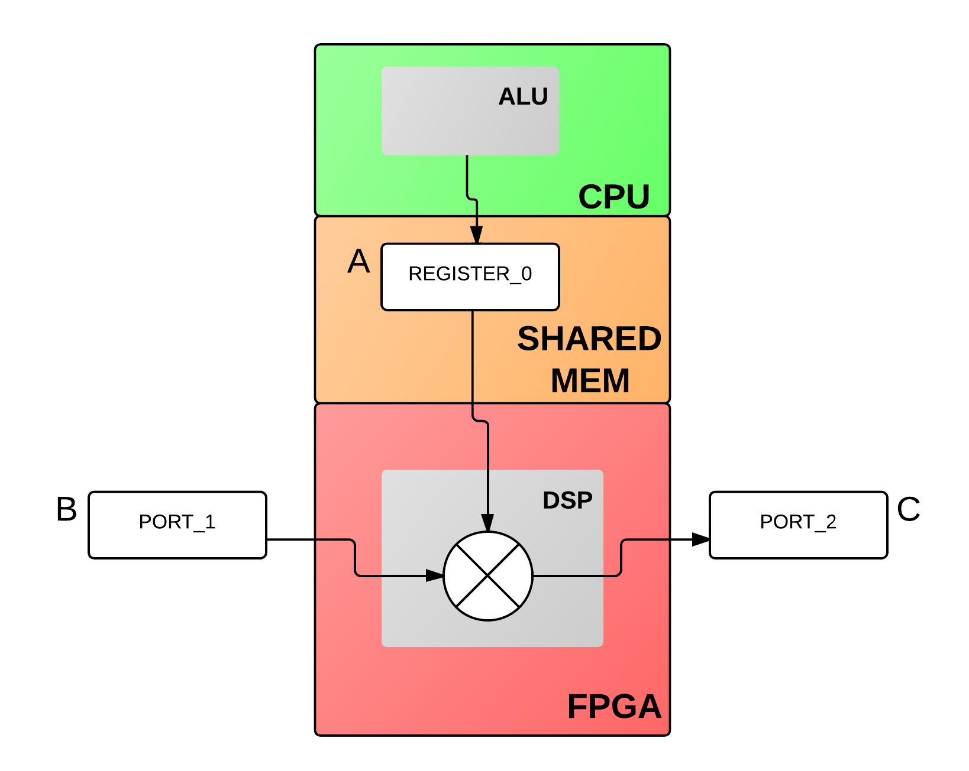
Programming Paradigms III
Paradigm of this Heterogeneous Architecture.
A = i++;
reg[0] <= A;
C <= B * reg[0];

Slide 10
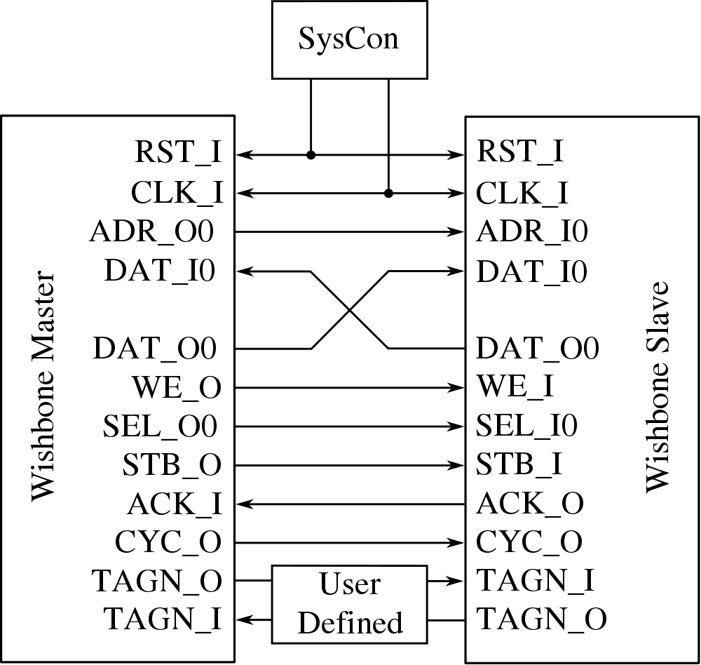
The Wishbone Bus

Slide 11
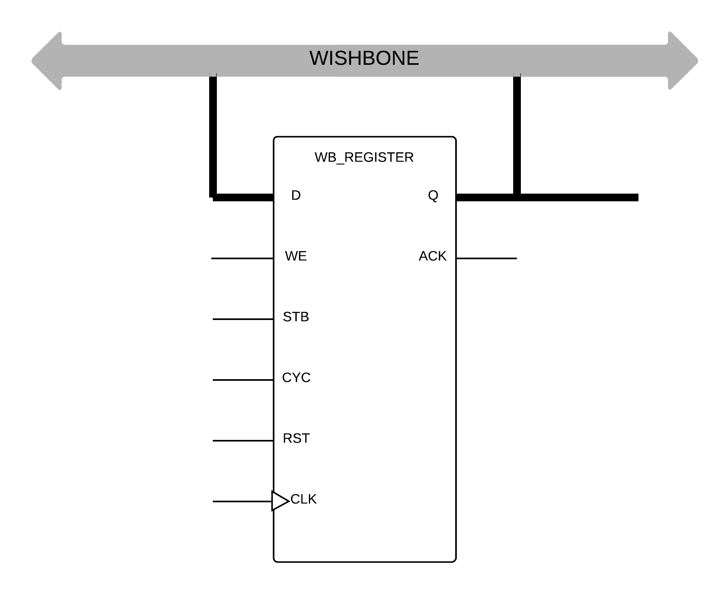
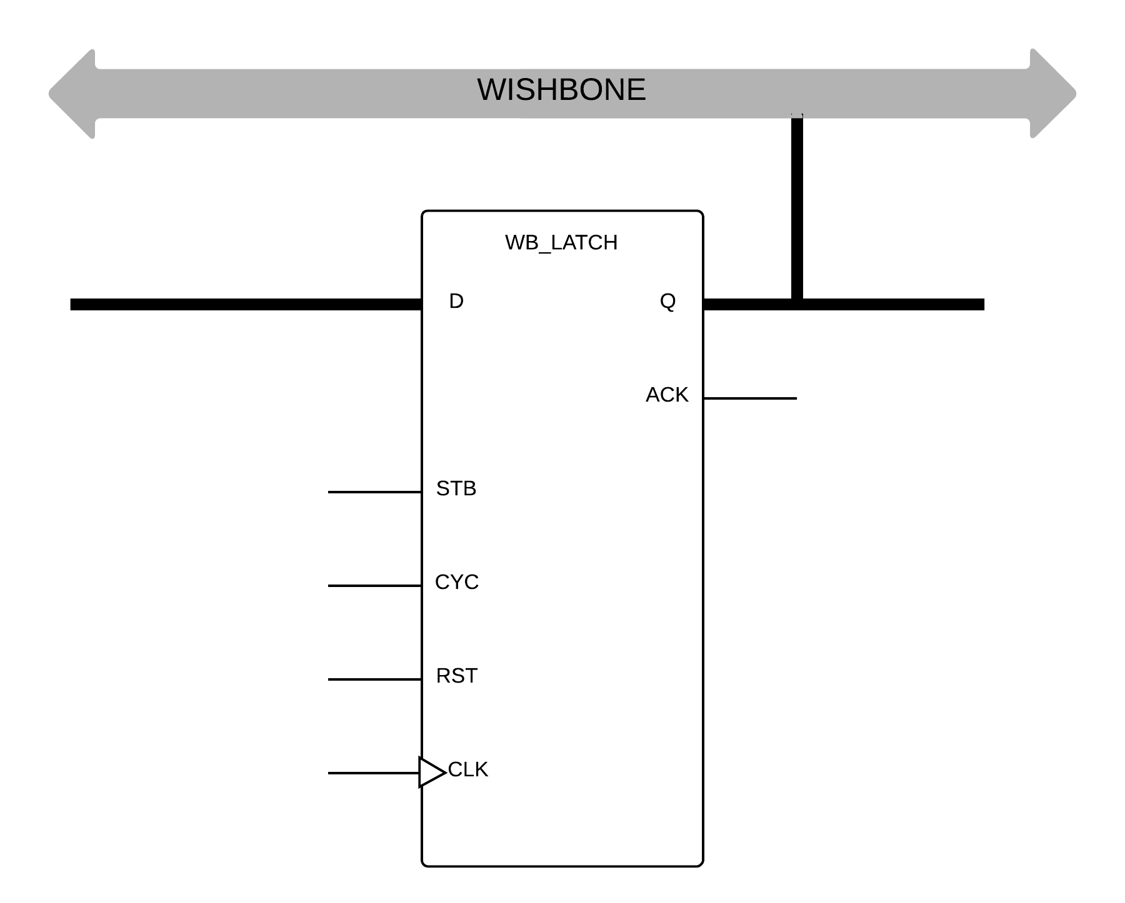
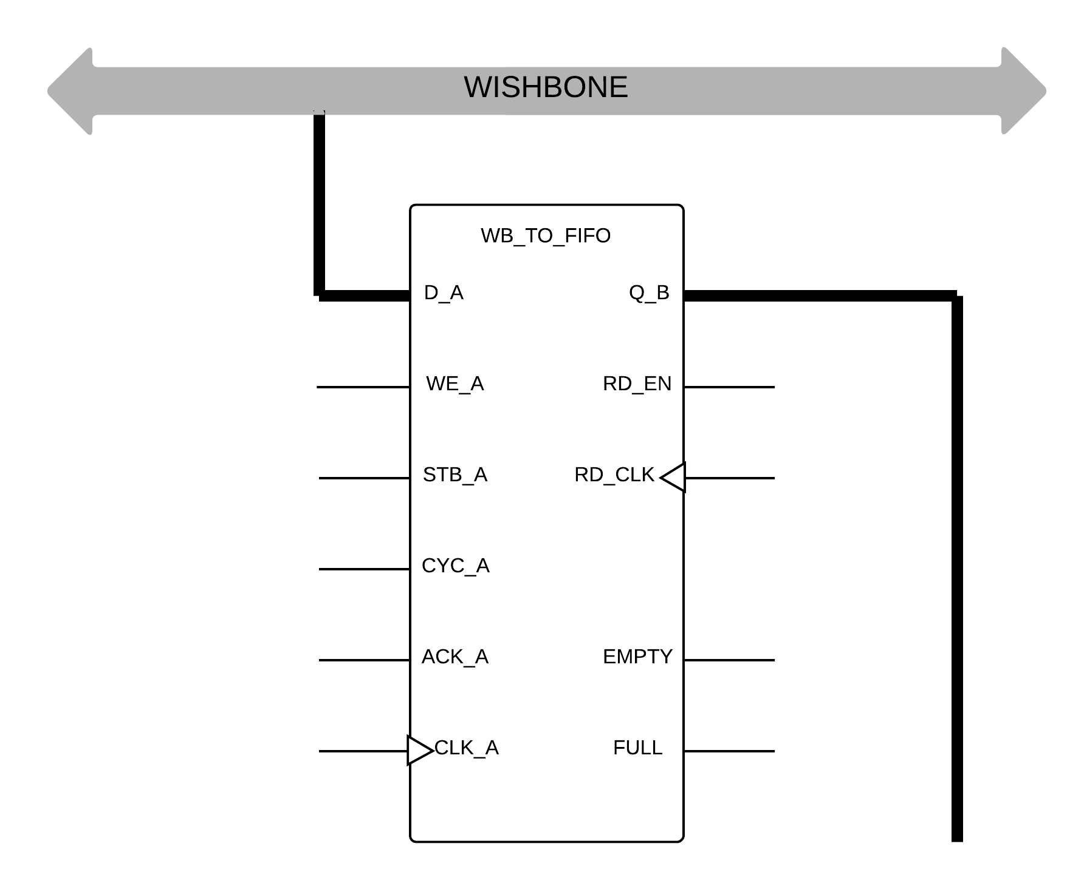
Wishbone Primitives
Allow users to create “VARIABLES”
Read-Write, Read-Only, Queue
Abstract away complicated Wishbone Bus
NB: Use of primitives motivated by Wesley New’s research.

Slide 12
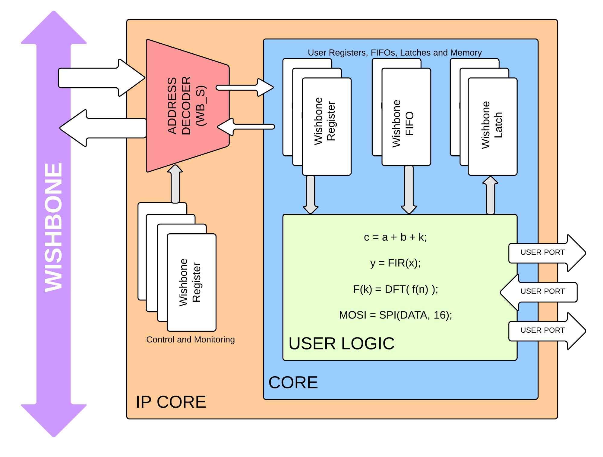
Structure of an IP Core

Slide 13
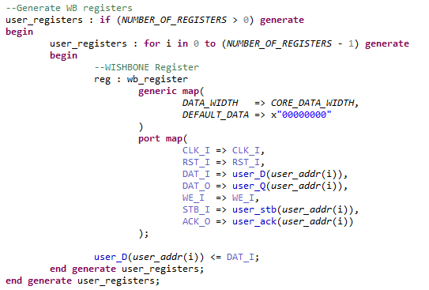
Self Generating User Memory
The code for the user’s memory is generated by the code itself, not by the developer!

Slide 15
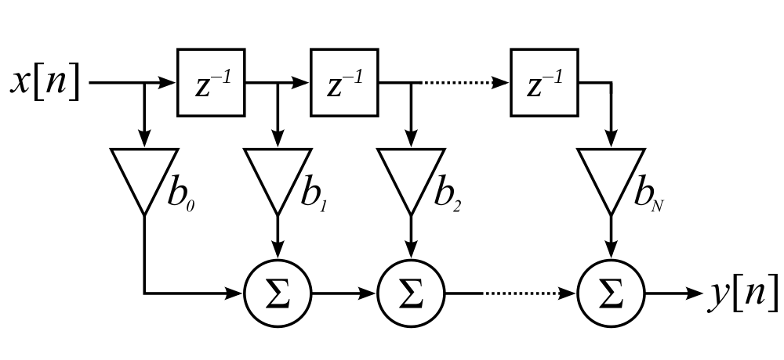
Programmable FIR
Replacing coefficients with registers

Slide 16
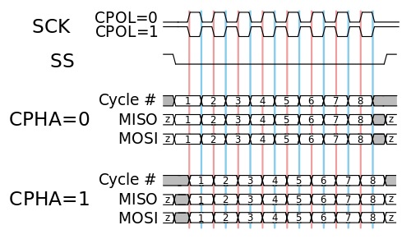
Importance of Generic HDL

Slide 17
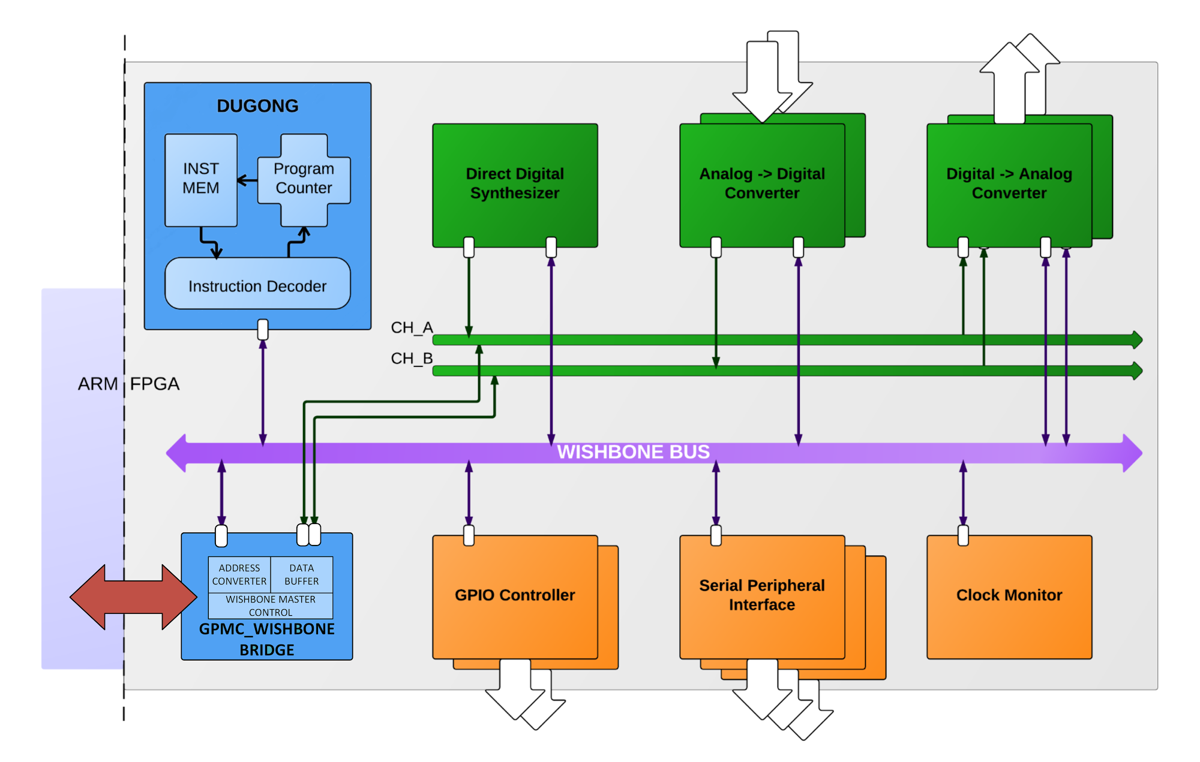
An Example Application Design

Slide 18
Results
Real World Data...

Slide 19
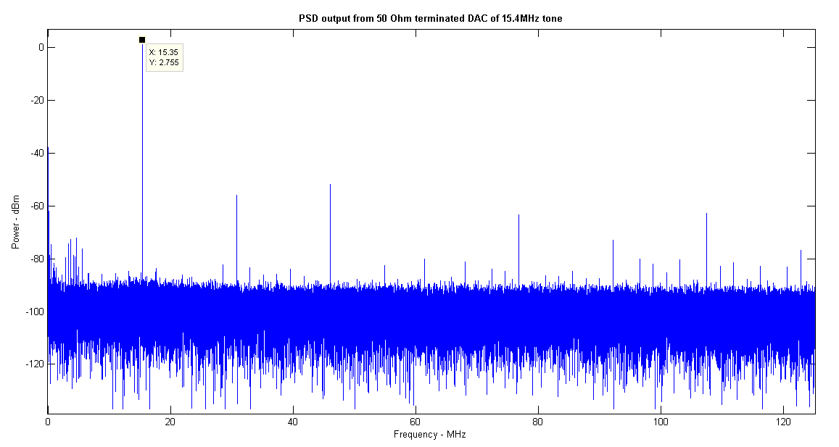
DAC and DDS

Slide 20
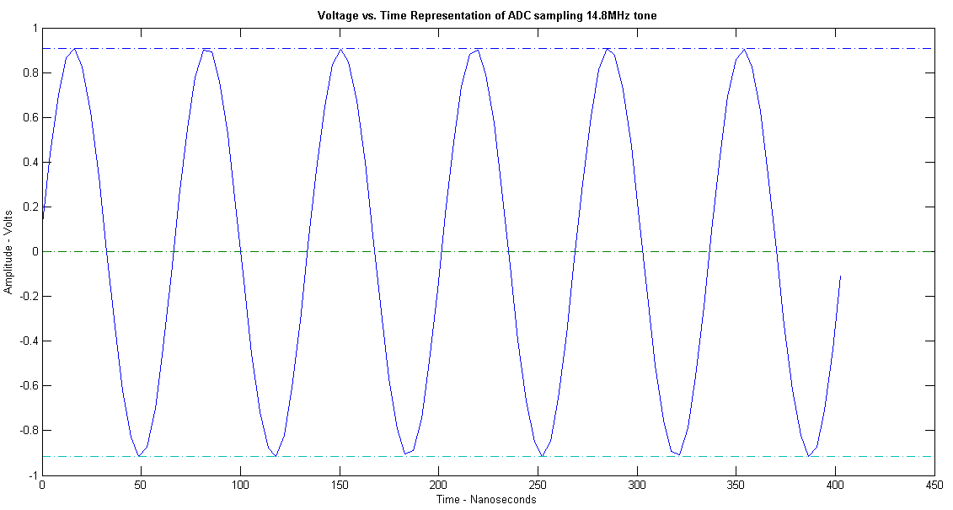
ADC Time Domain

Slide 21
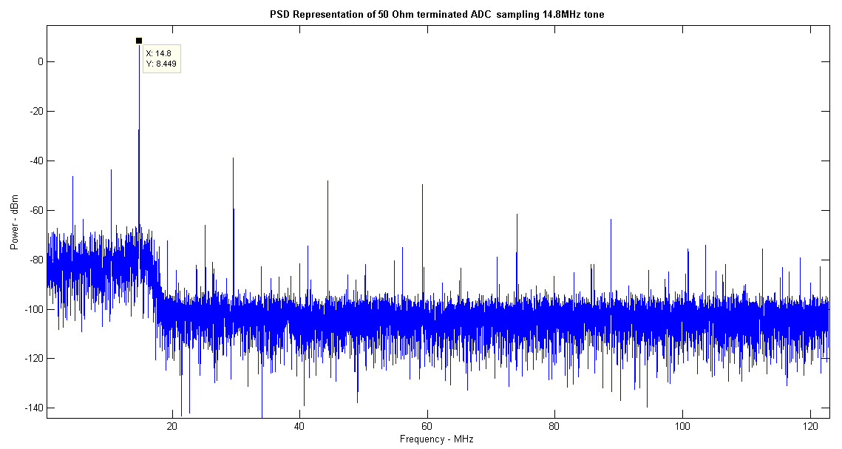
ADC Frequency Domain

Slide 22
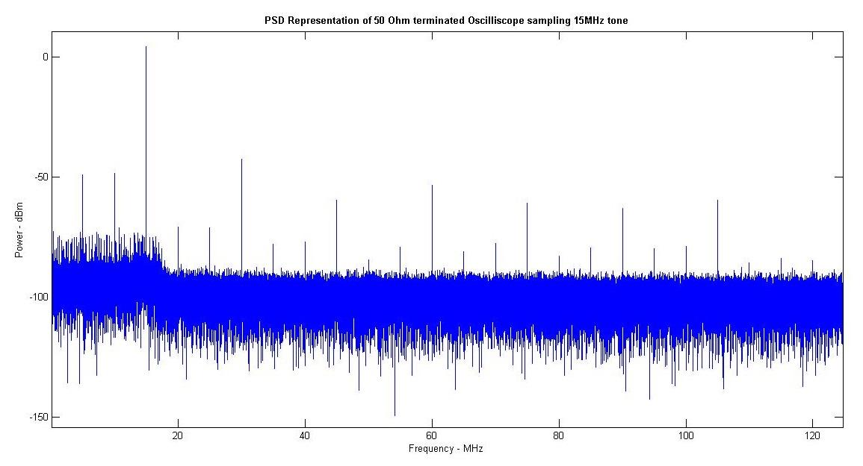
Sig Gen Frequency Domain

Slide 23
Conclusions
And Thankyou!

Slide 24
Concluding Remarks
The architecture is working and stable.
This architecture should make FPGAs more accessible and improve algorithms.
A transceiver was developed but conclusive testing is still required.
The project needs algorithm developers.
There is nothing binding this architecture to the RHINO

Slide 25
Thank you to my funders!

Slide 26
Question?
www.github.com/matthewbridges/dugong

