Slide 1
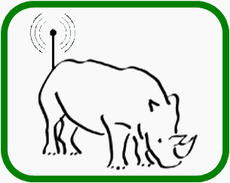
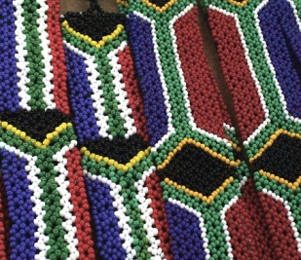
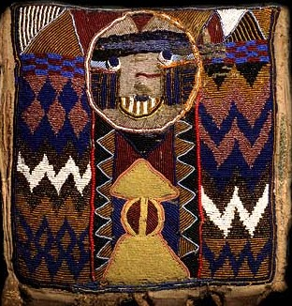
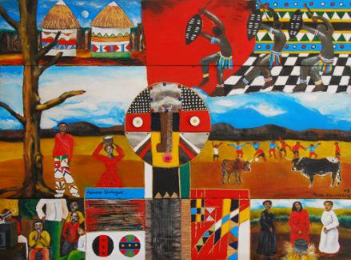
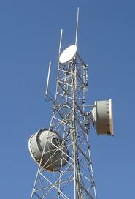
Integrated view of the Reconfigurable Hardware Interface for computiNg and radiO (RHINO) Project
Presented by:
Dr. Simon Winberg
Radar Remote Sensing research Group (RRSG)
Dept. Electrical Engineering
University of Cape Town
30-01-2014
High Performance Signal and Data Processing Workshop 2014

Slide 2
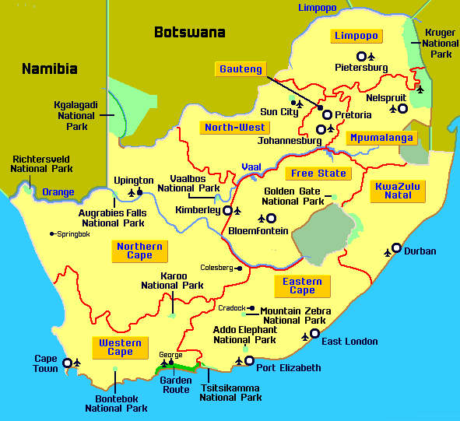
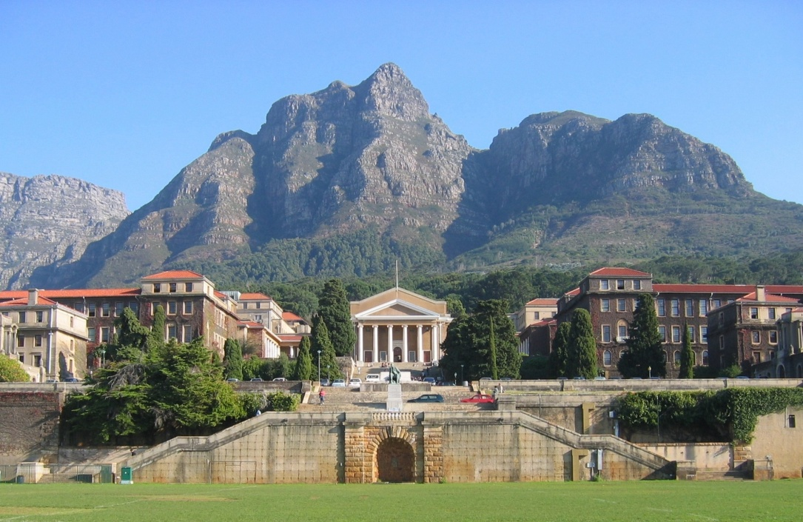
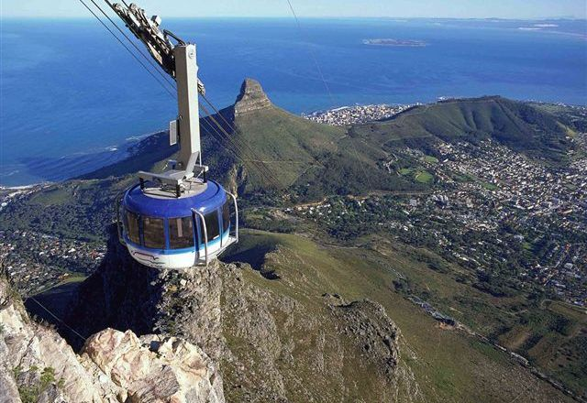
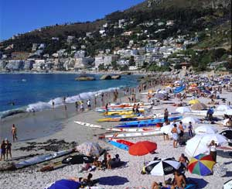
Where our team is from…
South Africa
University of Cape Town (upper campus)
Some views from Cape Town

Slide 3
Consider this short scenario...

Slide 4
“FPGA have sure made possibly many innovations!
If I use one in a new project, are there any particular drawbacks I should be aware of?...”
Developer in industry using Microprocessors / CPUs...

Slide 5
Drawbacks…
I suppose so: Can takes a while to learn the tools for one thing…
Actually there are quite a few other things too…
My response

Slide 6
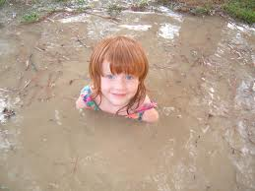
Any Drawbacks?!
Here’s just a few
FPGA Firmware a specialized form of development that combines challenges of both s/w and h/w… and then some
Has a limited number of IO pins that can connect up with external signals.
Susceptible to EM disturbances, PCB and other components needs to be suitably placed to avoid interfering with functioning of FPGA.
Typically a slower clock than most fast CPUs nowadays (e.g. 100MHz clock speed).
Eeek!
Often can’t achieve full utilization of PLBs
Typically has lots of pins that need to be soldered on, needing small track width and multilayer PCBs
Limitations of internal interconnects
Place & route can take a long time to complete
Only does the digital part – still need analogue components, user interface, and circuitry that interacts with the outside world.
Things can get rather… muddy!

Slide 7
Some of the significant difficulties include effective...
Skills development
Design reuse
Knowledge exchange

Slide 8
Outline
15%
Intro to RHINO
SDR Objectives for Rhino
Skills development challenges
Integrated view of the parts
Further projects
Conclusion

Slide 9
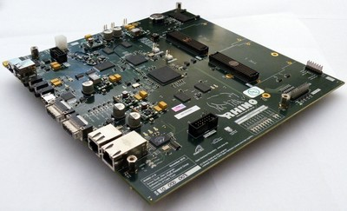
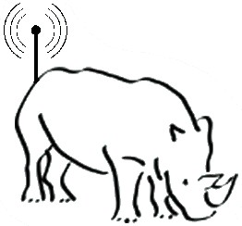
The RHINO platform
Reconfigurable Hardware Interface for computiNg and radiO (RHINO)
...
Currently $1750
www.rhinoplatform.org
Schematics are all open and freely available, can rework and refab your own version.
Tutorials
Documents
Resources
Updates/News
Links
PCB Design S. Scott & A. Langman
Lower cost than ROACH or BEE platform; but various tradeoffs were made, i.e. smaller FPGA, less memory, etc. than ROACH.

Slide 10
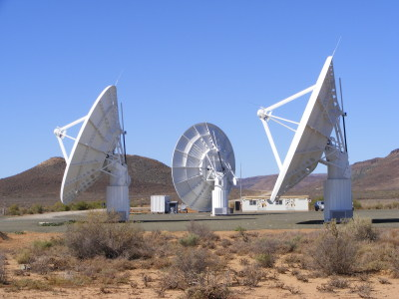
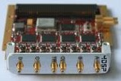
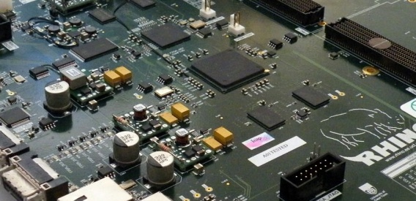
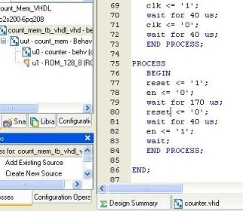
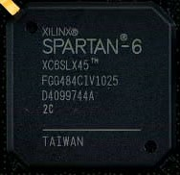
Overarching purpose of the RHINO Project
Building skills in application development and R&D using FPGA-based reconfigurable computers
With a focus on firmware / software for…
Radio astronomy digital backend processing &
Software Defined Radio (SDR) digital signal processing
Reconfigurable computing
Wireless Telecomms.
skilled
graduates
Radio astronomy DBE
Radar

Slide 11
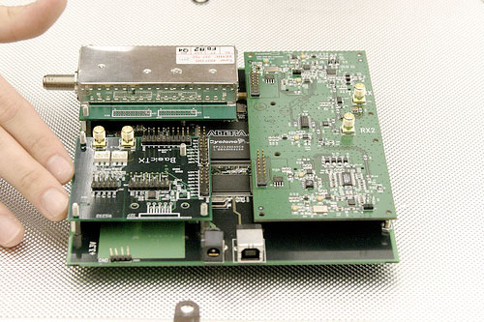
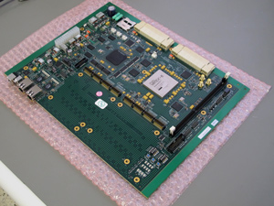
Why Rhino?
Existing systems
Why Rhino:
ROACH
GnuRadio (USRP I,II)
BEE
FLEX
BladeRF
Bitshark
HPSDR (Radio Amaeurs)
WARP (Rise University)
Others
A training platform
Collaborative with MeerKAT
Rhino developed ‘in-house’
Open hardware
Open source
BORPH
Reusable & scalable platform design → Reusable source
+ Objectives:
Aims for KATCP support
Connectivity to GnuRadio
USRP
ROACH
RHINO

Slide 12
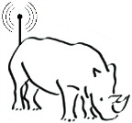
Rhino Architecture
2x 256MB DDR3 SDRAM
USB, SD Card, 100Mbps Ethernet, audio and video
2x 128MB DDR2 SDRAM
2x FMC Connectors
256MB NAND Flash
2x CX4 (10Gbps Ethernet)
(RHINO 1.x has no ADC/DAC, this provided by FMC add-on boards)

Slide 13
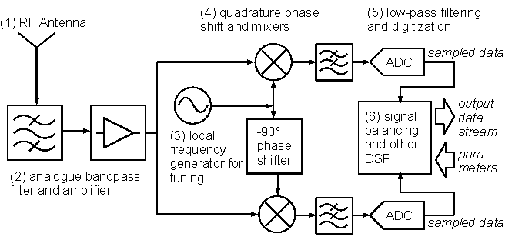
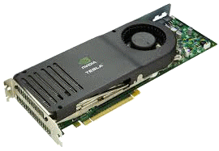
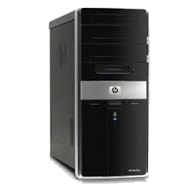
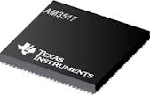
Software Defined Radio (SDR)
A radio system with many of its primary functionality (or ‘front-end’ components) implemented in software instead of hardware
Subsystem breakdown of a SDR system
Software
FPGA
Further
Processing
Hardware
control
Just showing the receiver, which is relevant to radio astronomy applications
ARM
Image based work by Blossom (2004) and Jondral (2005)

Slide 14
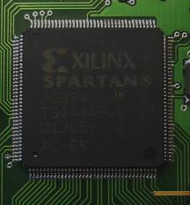
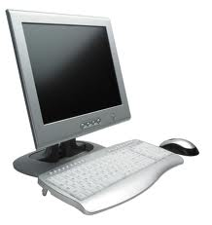
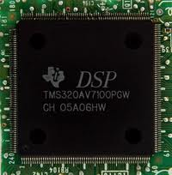
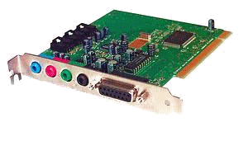
Towards a ‘World’ of SDR potential applications and prototyping
Radio ‘primary functionality’ examples:
Band selection / tuning
Frequency keying
Modulation or demodulation
Filtering
Software aspect of SDR system in the form:
Basic concept of a
Field Programmable Gate Array (FPGA)
Lots of gates (and other devices) that can be re-connected in many ways to create a digital circuit.
FPGA firmware
Programs running
on PC with sound card
Software on a DSP
Our Focus

Slide 15
36%
Skills development challenges
Needing to draw on knowledge of a variety of
specialized fields

Slide 16
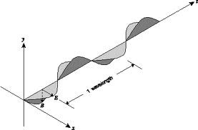
Skills required for SDR
Radio communications
theory
EM radiation
Properties of radio waves
Propagation of radio waves
Antenna design
Frequency bands and their characteristics
Band licensing and management
...
Bold items a focus

Slide 17
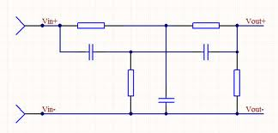
Skills required for SDR
Radio communications
theory
H/W interfacing and standards
Power analysis
Interference, shielding
Signal conditioning
Helps to know Circuit design & analysis esp. if doing analogue i/f
Analogue Electronics

Slide 18
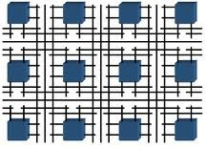
Skills required for SDR
Radio communications
theory
Digital Systems
and
Electronics
HDL coding (e.g. VHDL or Verilog)
Implement font-end processing, ADCs
High-speed DSP
Changing analogue methods to digital equivalents
Backend processing C / Python / Java etc
Analogue Electronics
I=V/R
P=I²R

Slide 19
Skills required for SDR
Radio communications
theory
Digital Systems
and
Electronics
Analogue Electronics
Reconfigurable Computing Approach to Software Defined Radio
I=V/R
P=I²R

Slide 20
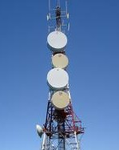
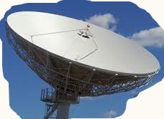
Towards... Building local knowledge & stimulating & prototyping radio-related systems
A decentralised community of practice (COP) from different universities and organisations
The RHINO platform as a ‘boundary object’* used within the COP
RHINO reconfigurable computer designed to be such a ‘boundary object’ for software defined radio applications
* Star, Susan; Griesemer, James (1989). "Institutional Ecology, 'Translations' and Boundary Objects: Amateurs and Professionals in Berkeley's Museum of Vertebrate Zoology, 1907-39". Social Studies of Science 19 (3): 387–420.

Slide 21
That brings us to…
54%
Integrated View of
The Rhino Project

Slide 22
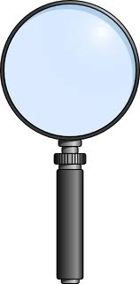
Parts of the Rhino Project
Platform Design and System firmware
MiGen & DSL for SDR
CASPER interface
Toolchain investigation & benchmarking
RF front-end, internal bus & ADC/DAC Integration
Comms & digital data transport
Training Resources
...
Brief look
at the parts...
Brief view on each one and a look at where the project has got to so far
Application Development / Prototyping

Slide 23
Parts of the Rhino Project
Platform Design and System firmware
MiGen & DSL for SDR
CASPER interface
Toolchain investigation & benchmarking
RF front-end & ADC/DAC Integration
Comms & digital data transport
MiGen
DSL using
Delite
...
Training Resources
ROME
Application Development / Prototyping

Slide 24
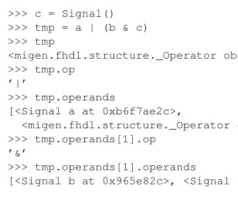
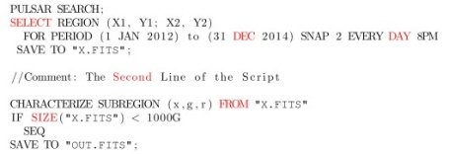
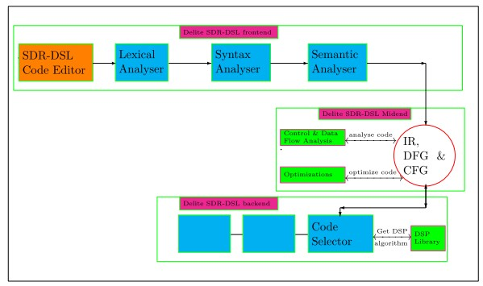
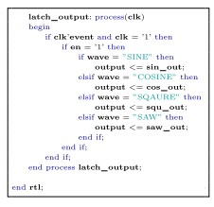
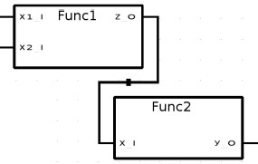
Parts of the Rhino Project
Platform Design and System firmware
MiGen
SBT code
MiGen & DSL for SDR
CASPER interface
Toolchain investigation & benchmarking
RF front-end & ADC/DAC Integration
Comms & digital data transport
DSL using Delite
MiGen
DSL using
Delite
Training Resources
Rhino Object Modelling Environment (ROME)
ROME
S. Katz
Application Development / Prototyping
Block diagram of design chain
L. Mohapi

Slide 25
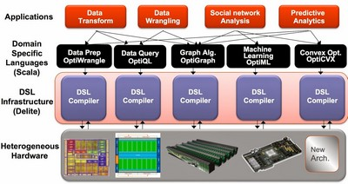
SDR-DSL
Development of a text-based Domain Specific Language (DSL) for Software Defined Radio (SDR) - Referred to as SDR-DSL
(OptiSDR)
Building on support of a DSL development tool such as the Delite framework developed at the Pervasive Parallelism Lab.
Project by: Lerato Mohapi

Slide 26
MiGen: Milkymist Generator collaboration with M-Labs
Migen innovation and developers:
Sebastien Bourdeauducq and Alan Langman
Initially aimed for Milkymist platform by M-Labs, port to RHINO
What is Migen?
A Python-based tool aimed to automate the VLSI design process
Approaching the challenges of HDL coding from a different perspective
http://milkymist.org/3/
How does it differ to MyHDL?
MyHDL = A hardware description language based on Python
MiGen = A Python library to generate HDL (Verilog)

Slide 27
MiGen collaboration with M-Labs
Operation of Migen
Python acts as a ‘Meta-Language’ (i.e. A language to describe a language)
Uses methods for generating logic (metaprogramming) through "generate" statements.
Replaces the event-driven paradigm with the notions of combinatorial and synchronous statements
Allows design's logic to be constructed from a Python program: This enables hardware designers to take advantage of the richness of the Python language: object oriented programming; function parameters; generators; operator overloading; libraries, etc.... All helping to build well organized, reusable and elegant designs.
Snippet of MiGen code

Slide 28
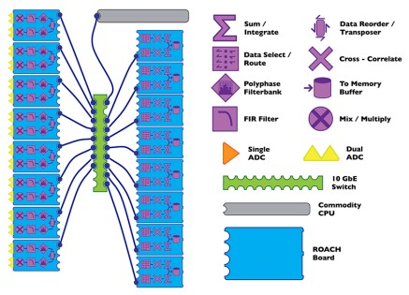
Parts of the Rhino Project
Platform Design and System firmware
MiGen & DSL for SDR
CASPER interface
Toolchain investigation & benchmarking
RF front-end & ADC/DAC Integration
Comms & digital data transport
Generated HDL ...
Interface
configuration
GPMC
Interface
block
Training Resources
CASPER toolchain and Simulink modelling system
Application Development / Prototyping
A. van der Byl & W. New

Slide 29
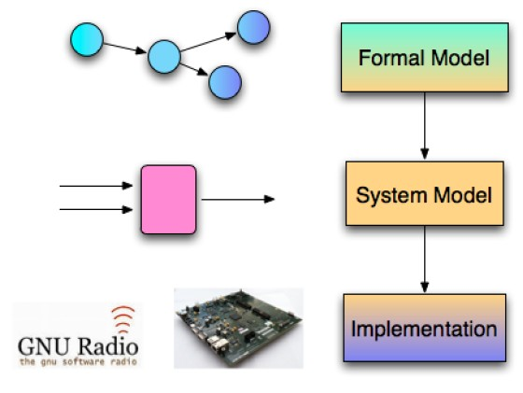
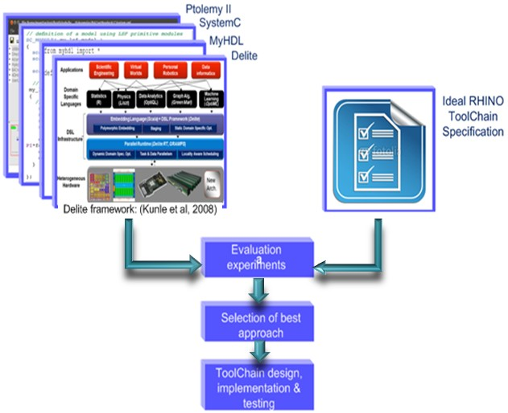
Parts of the Rhino Project
74%
Platform Design and System firmware
MiGen & DSL for SDR
CASPER interface
Toolchain investigation & benchmarking
RF front-end & ADC/DAC Integration
Comms & digital data transport
Evaluating current elec design tools
Supporting scripts and applications
Comparison of developer effort
* Image source
Training Resources
“Taming the RHINO: towards a simplified design tool-chain for the RHINO platform”
Khobatha Setetemela
Application Development / Prototyping

Slide 30
Taming the Rhino: Towards a simplified tool-chain for the RHINO platform
Specifications: done visually using signal processing graphs
Functional verification using MyHDL and simulator (Xilinx ISim) to test specifications
Software/Hardware partitioning
Implementation of HDL and
CPU-based signal processing functions
Compiling HDL to generate bitfile for FPGA, and compile code for the CPU(s). (This done by BORPH support tools)
Generate BORPH files (i.e. config data to be loaded into BORPH running on the ARM processor), and generation of a GNU Radio interface block.
Deployment and running on hardware.
= manual operations
= automated operation
Project by: Khobatha Setetemela (Msc student)
Details presented tomorrow

Slide 31
Parts of the Rhino Project
Platform Design and System firmware
MiGen & DSL for SDR
CASPER interface
Toolchain investigation & benchmarking
RF front-end, internal bus & ADC/DAC Integration
RF front-end & ADC/DAC Integration
Comms & digital data transport
ADC/ ADC HDL interface block
4DSP FMC105
Training Resources
Digilent Pmods
24-channel MIMO
channelizer
M. Bridges;
focus for new MSc students in 2014
Application Development / Prototyping

Slide 32
Putting The Rrrr in RHINO
Matthew Bridges | Dept. Electrical Engineering | University of Cape Town
Developing an open source Architecture for FPGA based Digital Radio.
A set of Gate-ware cores and controller.
Designed to allow software based configuration.

Slide 33
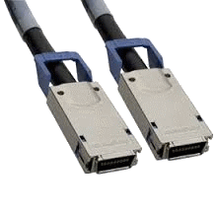
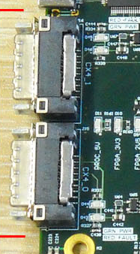
Parts of the Rhino Project
84%
Platform Design and System firmware
10GB Eth interfacing and performance testing
MiGen & DSL for SDR
CASPER interface
Toolchain investigation & benchmarking
RF front-end & ADC/DAC Integration
Comms & digital data transport
RHINO ARM Cluster Control Management System (RACCMS)
ARM apps
Training Resources
BORPH
RACCMS
V. Valerie Chiriser
Application Development / Prototyping

Slide 34
RACCMS¹ Functional Diagram
¹ RHINO ARM Cluster Control Management System
by: Valerie Chiriseri (Msc student)
Creates standard for developing registers accessible from ARM to FPGA through GPMC interface
...
BORPH Linux Driver
Translates network packets into relevant function calls using a lookup table
Created using .sym file when .bof file is generated
ARM-PC Cluster Server-Client App
Communication Protocol between the two
Enables C-based code to control RHINO cluster
GUI RACCMS uses to display outputs

Slide 35
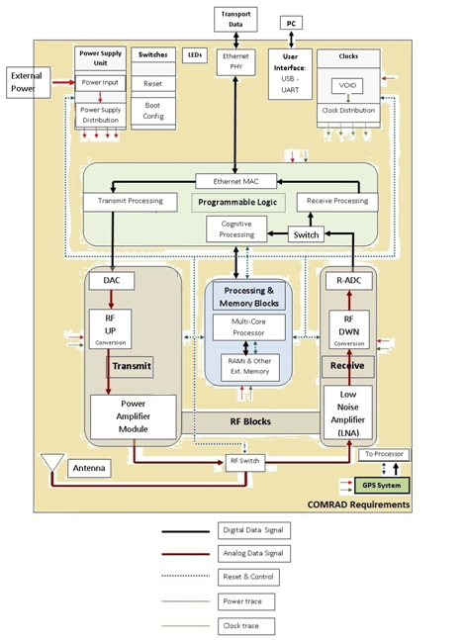
Building on from RHINO
White RHINO
Platform Design and System firmware
RHINO radar
MiGen & DSL for SDR
CASPER interface
Toolchain investigation & benchmarking
RF front-end, internal bus & ADC/DAC Integration
RF front-end & ADC/DAC Integration
Comms & digital data transport
White RHINO platform for whitespaces radio application development, spectrum monitoring, commications, radar, etc.
RHINO Radar using RHINO platform to develop radar systems
Training Resources
Brief view on each one and a look at where the project has got to so far
Application Development / Prototyping

Slide 36
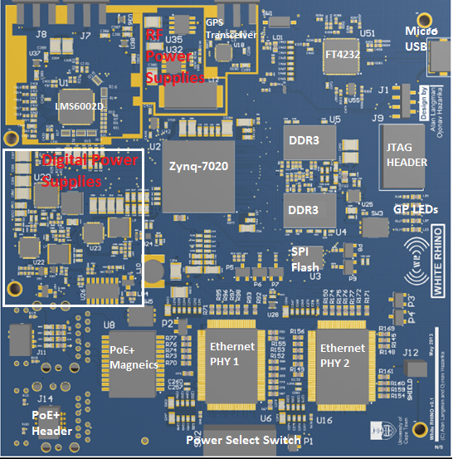
White-RHINO
By: Ojonav Hazarika
(Main supervisor: A Mishra)
Much Un-Used spectrum!
Called ‘Whitespaces’ …
e.g. Transition from Analog to Digital TV freed many channels, these are ‘TV whitespaces’
In 2008, FCC was first organization to make TV Band spectrum avail to unlicensed users.
Sharing of Spectrum done by either spectrum sensing or a database management system.
AIM: develop a hardware platform which can operate as Whitespace Communication node with radar detection as its commensal operation.
Applications ideas: communications, ATC, border monitoring, cognitive radio prototyping

Slide 37
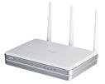
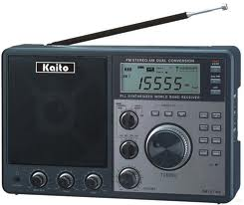
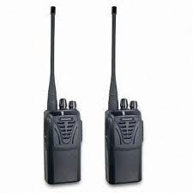
Prototyping SDR Applications on a Reconfigurable Computer (RC*)
Plans for sample radio applications, e.g. undergrad projects:
Wireless router
WiMAX receiver
FM radio
Television
Radio direction finder
Spectrum analyzer
Two-way radio with voice disguiser
Radar (e.g. speed sensor)
Some electronic products that can be emulated using a RHINO platform
Some benefits of reconf. computing:
Quicker prototypes
Hardware reuse
Faster infrastructure upgrades

Slide 38
Conclusions
100%
The various parts of the Rhino project are taking shape
Combination of Xilinx ISE and BORPH works, but more tool support, esp. For prototyping, e.g. Effective use of MiGen and a specialized DSL, could make things quicker and easier.
Main focus for now needs to be on more firmware libraries, signal sampling, and integration with existing HDL processing modules

Slide 39
Acknowledgements
SKA MeerKAT (Karoo Array Telescope) for funding HPC training and the Rhino platform
Xilinx donation of electronic components and software tools
Texas Instruments for donation of development resources and hardware

Slide 40
Thank you!

Slide 41
Any Questions?
110%

Slide 42
Extra Slides

Slide 43
Rhino v1.0 schematic

