Slide 1
Application of Data Intensive Science To The Electrical Energy Grid
Albert Dove, Ivan Hofsajer & Willie Cronje
School of Electrical and Information
Engineering
University of the Witwatersrand

Slide 2
Contents
Problems with the electrical energy grid
Proposed solution
Examples
Comparison
Conclusions

Slide 3
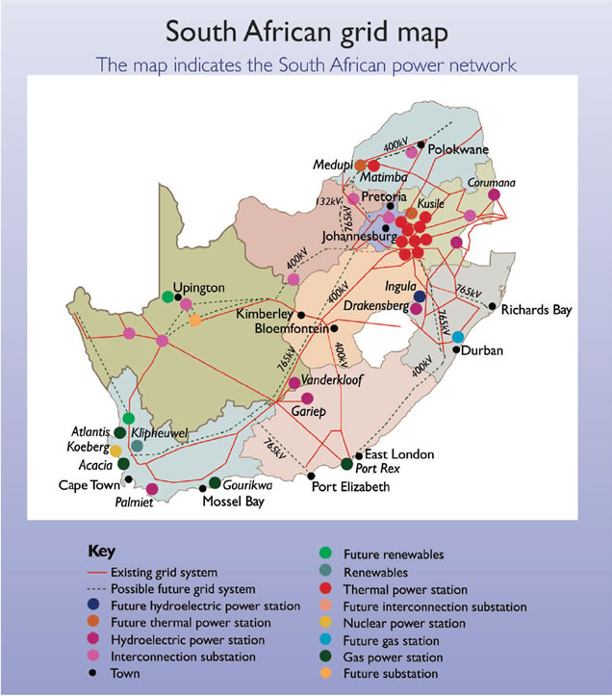
Energy Grid

Slide 4
Old Energy grid
Transmission
Power station
Customer
Easy maintenance
Cost effective
Supply
Demand

Slide 5
Evolution of grid
Increased demand
Supply
Grid cannot cope
Physical instability
Increased Supply
Increased demand

Slide 6
Possible Solutions
Generation
Match These
Demand
Distance
Why can’t we do this?

Slide 7
Measurement points
System Control
Load shedding
Control guy
Switching points
Large number of measurement points
Interventions
Maximise management and control

Slide 8
Metering
Measure: Voltage, Current & Phase
Each for 3 phases
Each for 4 harmonics
36 measurements
At 50 Hz
1800 measurements/s
8 bit resolution
14,4 kb/s
20 million users
288 Gb/s
= Big data stream

Slide 9
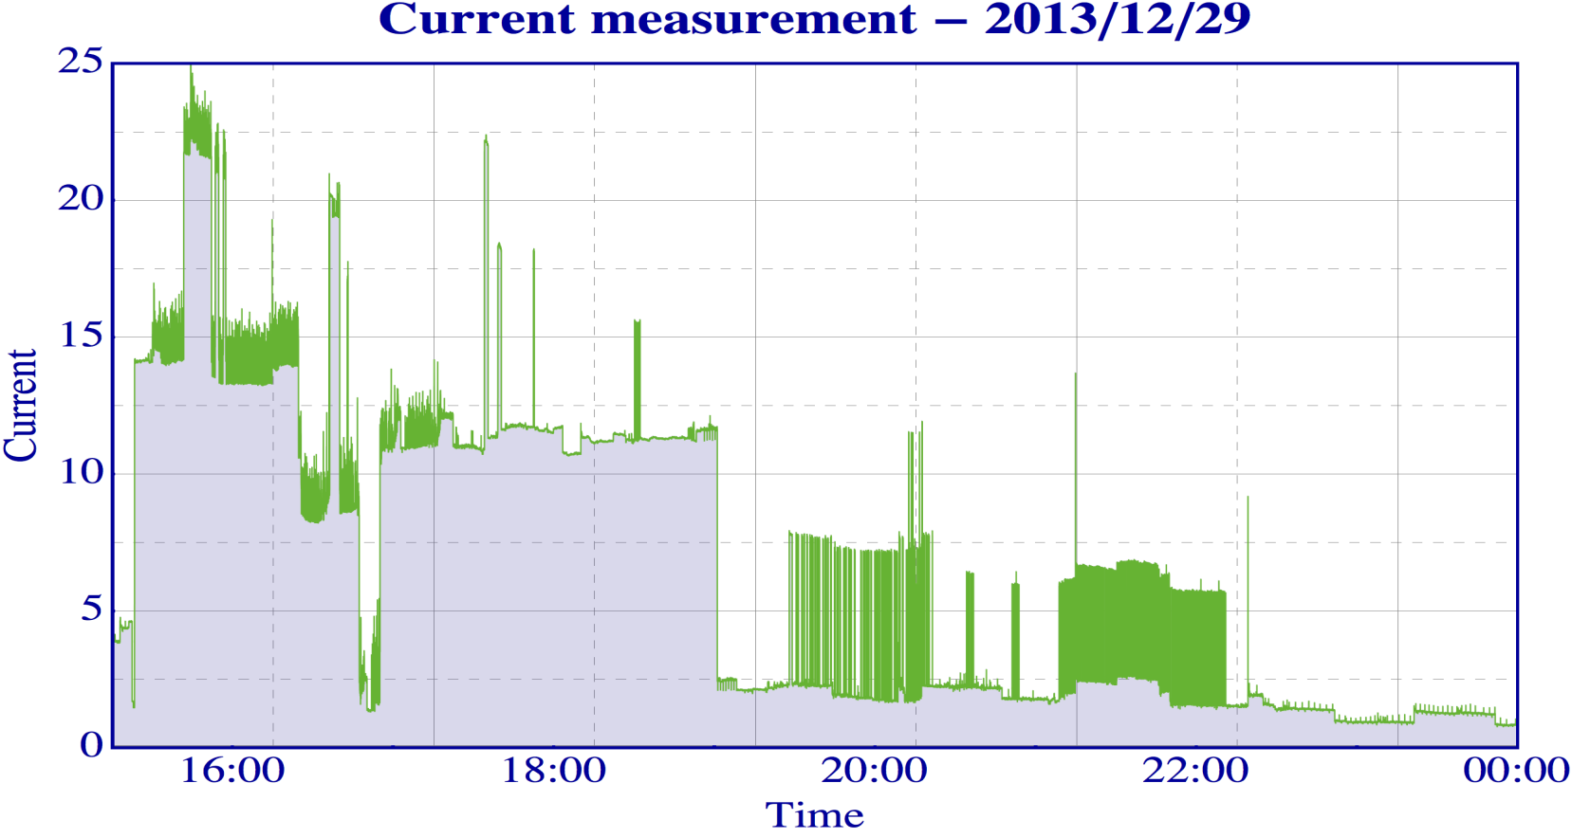
Example
Time domain
Washing machine
Geyser
Picture from W Cronje

Slide 10
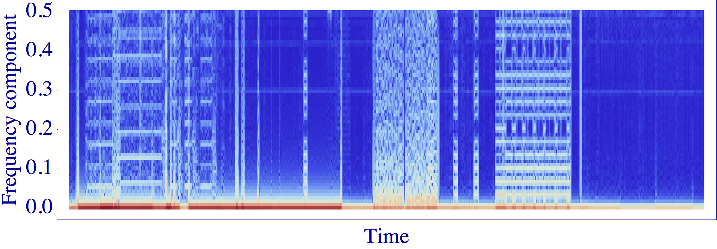
Frequency domain

Slide 11
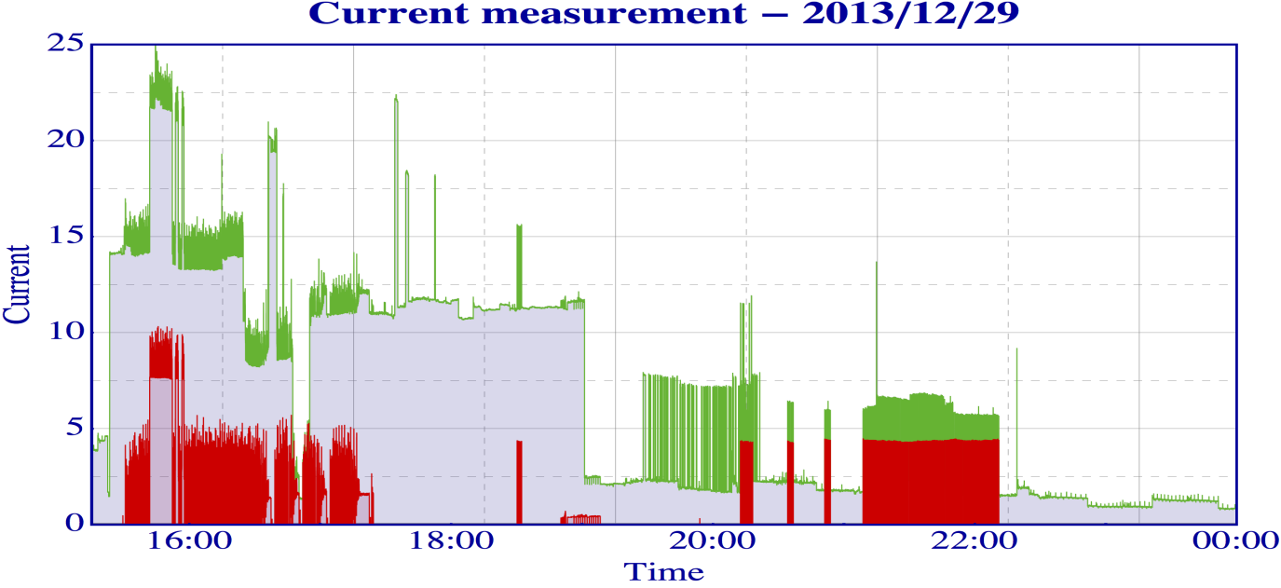
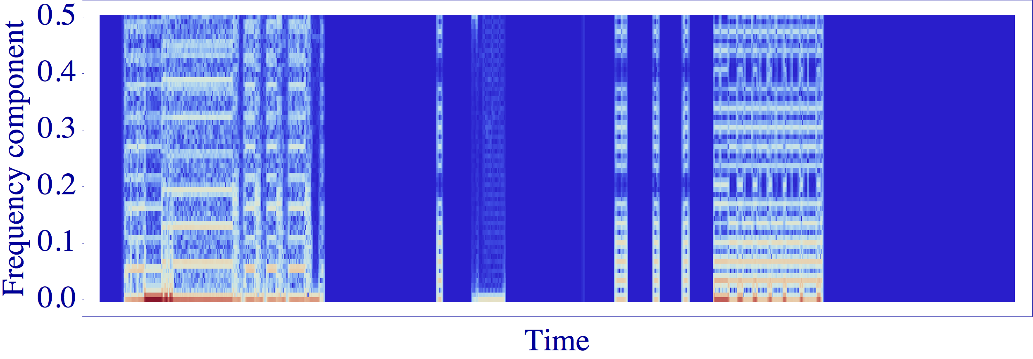
Frequency domain
Washing machine only

Slide 12
Useful Information
Manage loads
Re- route power

Slide 13
Architecture
Fast intervention
pre-processing
Aggregation
Central processing
Archived
14.4 kb/s
Intervention
Slower intervention
users
Sub cycle fast: 1 sec
Medium: 1 min
Slow: 1 hour
Intelligent Energy Grid Data System

Slide 14
Is this the same problem?
Yes
Big Data
Data reduction
Stream continuously
High performance computing
Customised hardware
No
Spread out
Two way communication
Continuously operational, 24hrs- forever
Processed data is different

Slide 15
Conclusions
What can be borrowed?
Design philosophy
Advanced distributed data processing infrastructure HPC
Fast interactive data management
Fast decision making software
Optimised long distance data streaming/transport
Computing intensive data calibration and reconstruction

Slide 16
Thank you!

