Slide 1
Parallel and Distributed Computing with MATLAB
High-performance Signal and Data Processing: Challenges in Astro- and Particle Physics and Radio Astronomy Instrumentation
30 January 2014, Johannesburg

Slide 2
Agenda
Introduction
Introduction to Parallel Computing
Built in Parallel Support
Composite Arrays and Batch Processing
Using GPUs
Built in GPU Support
GPU Arrays
Distributed GPU Computing
Scaling Up to a Cluster
Concluding Remarks

Slide 3
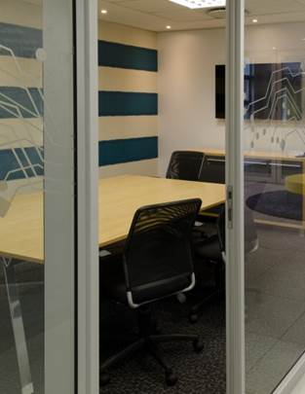
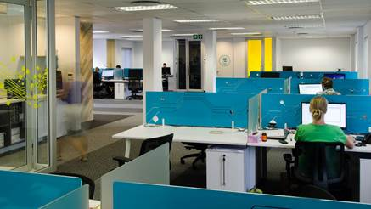
Welcome
David Gray
Sales Manager
Cheri Meyer-Palmer
Sales Account Manager
Nigel De Bruin
Sales Account Manager
Vicky Makhathini
Sales Account Manager (Education)
Nicole Wilson
Applications Engineer

Slide 4
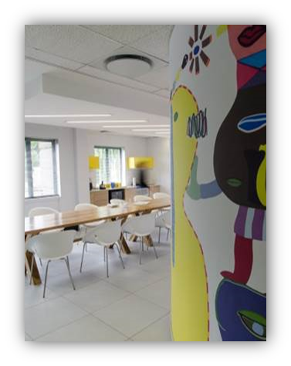
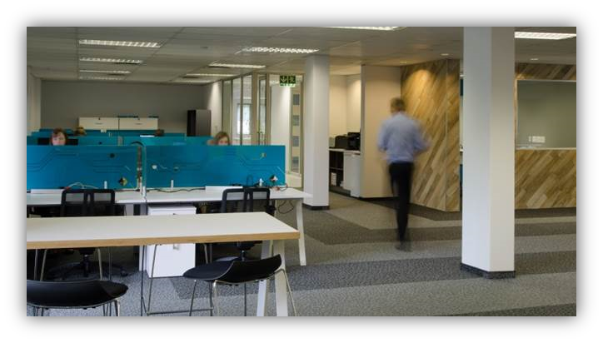
About OPTI-NUM solutions
Technical Computing and Model-Based Design solutions using MathWorks tools
  Sales and support of MathWorks products for Southern Africa
  Consulting and training services
Started by a group of Wits University researchers in 1992
  Founding member is now VP of Development at MathWorks
19 staff, with over 50% technically focussed

Slide 5
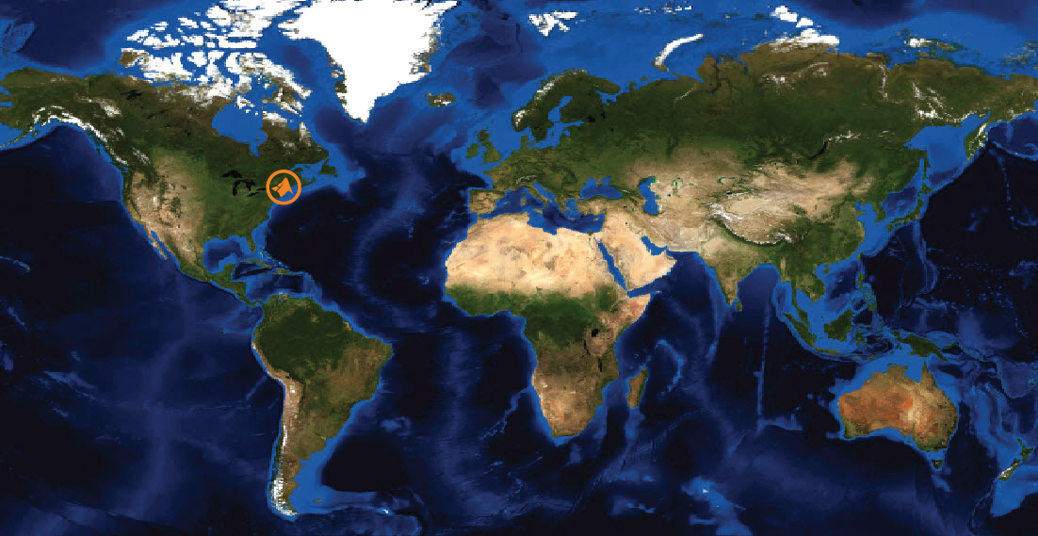
MathWorks at a Glance

Slide 6
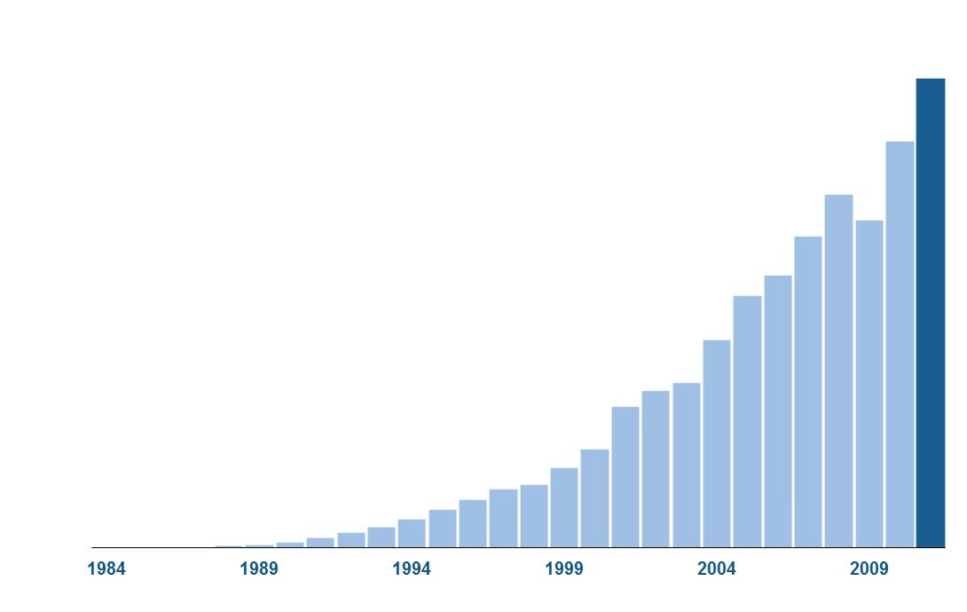
MathWorks Today
Revenue of $750M in 2012
More than 60% of revenue from outside the U.S.
2800 employees worldwide
More than 1 million users
In 175+ countries

Slide 7

Customer-Driven Business
  Two major releases per year
Software improvements driven by customers
All customers subscribed to Software Maintenance Service get:
  Access to every release
  Technical support
R2013b
Notes:
Two major releases per year: Ryyyya and Ryyyyb
MathWorks software improvements driven mainly by customers
Enhancement requests drive new features
Support requests and bug reports drive bug-fixes
All customers subscribed to Software Maintenance Service get
Access to every release
Technical support

Slide 8
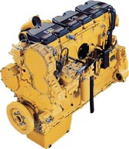
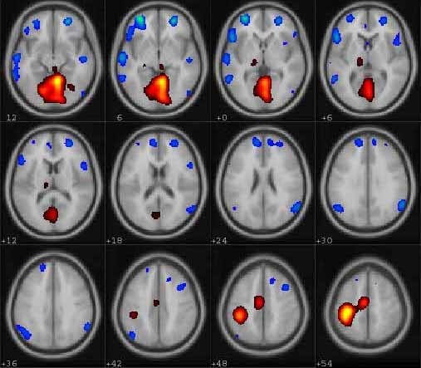

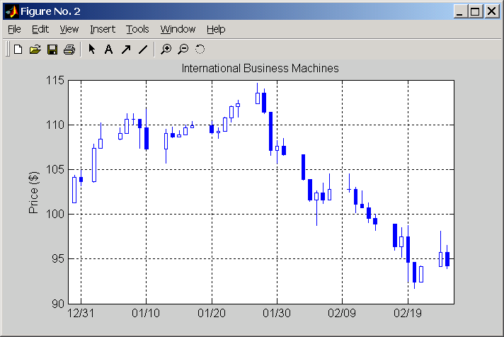
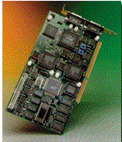

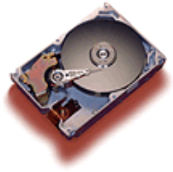
Key Industries
Aerospace and Defense
Automotive
Biotech and Pharmaceutical
Communications
Education
Electronics and Semiconductors
Energy Production
Financial Services
Industrial Automation and
Machinery

Slide 9
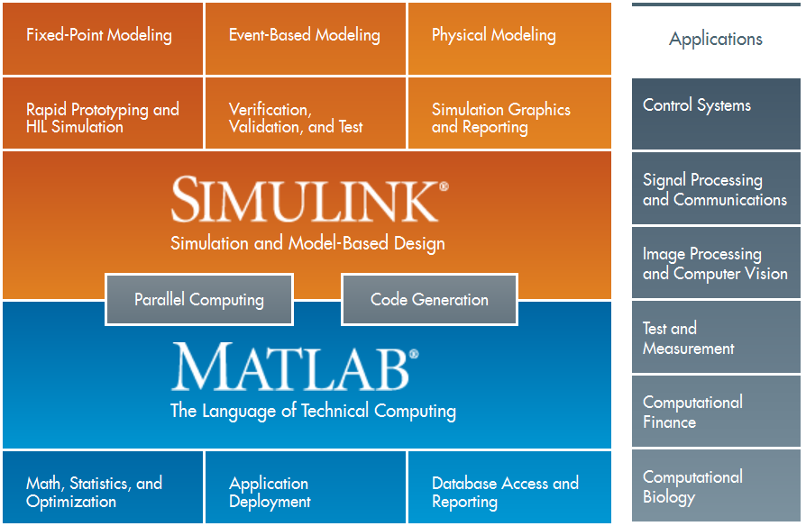
MathWorks Product Overview

Slide 10
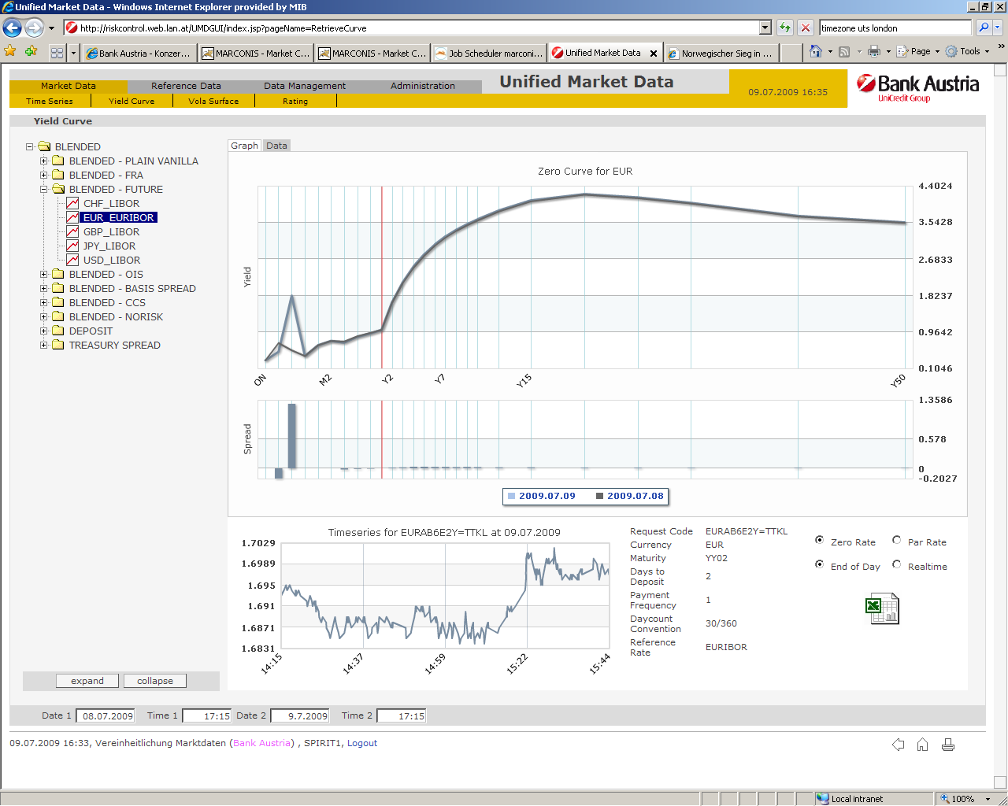
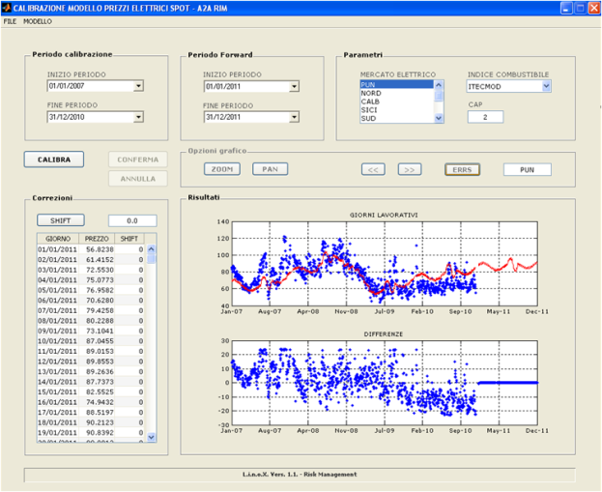
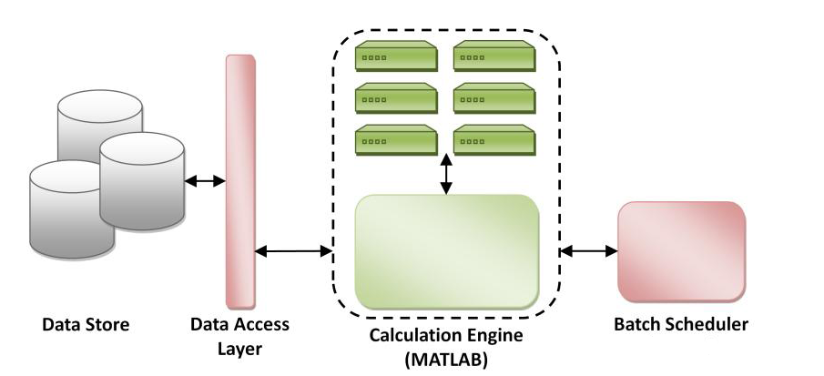
MATLAB in Financial Services
The top 15 asset-management companies worldwide
9 of the top 10 U.S. commercial banks
Top 4 South African banks
12 of the top 15 hedge funds
The reserve banks of all OECD member countries
The top 3 credit rating agencies
The Top 10 US Insurance Companies
3 of the top 4 Reinsurance Companies worldwide
Notes:
In fact, MATLAB has become one of the premier tools used in the finance industry primarily because it helps address these challenges. MATLAB is currently used by some of the most successful institutions in the industry, such as the top 15 asset management companies and 9 of the top 10 US commercial banks. Especially for the sake of this webinar the top 10 insurance companies as well 3 of the top 4 reinsurance companies are using MathWorks tools to analyse, model and create applications with MATLAB to be included in production environments.
0:30

Slide 11
Agenda
Introduction
Introduction to Parallel Computing
Built in Parallel Support
Composite Arrays and Batch Processing
Using GPUs
Built in GPU Support
GPU Arrays
Distributed GPU Computing
Scaling Up to a Cluster
Concluding Remarks

Slide 12
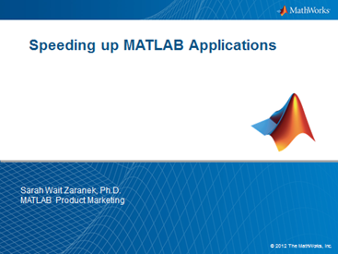
Questions to Consider
Have you applied best practices to your serial code?
  Techniques for addressing performance
    Vectorization
    Preallocation
  Identify using Profiler
  Focus on top bottlenecks
    Total number of function calls
    Time per function call
www.mathworks.com/company/events/webinars/wbnr49643.html
Notes:
[This is meant to be a quick review of Speeding up MATLAB]

Slide 13

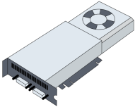

Questions to Consider
Have you applied best practices to your serial code?
Do you need to reduce your run-time?
Do you need to solve larger problems?
If so, do you have…
  A multi-core or multi-processor computer?
  Access to a computer cluster or cloud?
  A graphics processing unit (GPU)?

Slide 14
Solving big technical problems
Challenges
You could…
Solutions
Long running
Computationally intensive
Wait
Larger compute pool
(E.G. More processors)
Large data set
Reduce size
of problem
Larger memory pool
(E.G. More machines)
Notes:
As engineers and scientists we are in the business of solving large technical problems.
Our simulations and code have increased in complexity as we make more and more enhancements to more accurately describe our processes. The result is increasingly large parameter and design spaces, that simply take a huge amount of time to cover. And increasingly bigger data sets, which are a bit of chore to handle in our regular workstations.
Obviously simply using souped up systems is not a viable long term option. Problem sizes will catch up in no time. So we are left stranded with either waiting for computations to finish or reducing problem sizes.
One approach is to distribute the work among multiple processing units. In this approach different processors execute code simultaneously with the goal of reducing the overall execution time.
This problem benefits from a distributed approach as well. Rather than working with a single large data set (and the size constraints imposed on a single system), programmers can distribute the data among multiple processors or systems.
Other ways to present this slide:
Let’s get started by talking about what brings users to the DC tools in the first place – trying to solve big technical problems.
Here are some examples of users who have big problems:
- BioInformaticist working with the sequencing of the entire human genome.
- Flight Test Engineer for JSF program, which generates 7TB of data per test.
- Anybody, who doesn’t want (or can’t afford to) wait to get her answer.
<build>
Solving big problems is like trying to squeeze all of this stuff through a funnel into your computer, with often unacceptable results. This leads users to try one of two workarounds.
<build>
If they are fortunate enough that their problem runs on their computer, they wait – an hour, a day, a week … - and hope that they set up the problem right so that they (eventually) get meaningful results.
<build>
Certain users aren’t as fortunate – they can’t even fit their entire problem into their computer, typically because there isn’t enough memory. They have no choice but to reduce the size of their problem. For instance, they’ll use less data than they’d like for their analysis, or run a simulation fewer times than they’d prefer.
<build>
Distributed Computing tools help users address these limitations.
<build>
If time was the primary issue, they can use Parallel Computing Toolbox to distribute similar problems to independent processors. For instance, each computer processes it’s own little piece of the data, or runs a simulation over a single condition. This is what almost all of our users have done with Parallel Computing Toolbox. These are all problems that could be solved with one computer, but would take too long.,
<build>
Certain problems are just too big to be solved by a computer working on it’s own, and can only be solved by spreading out the work across multiple machines. Users can have multiple processors work in parallel on one big problem. While this could be done by the hearty few with Parallel Computing Toolbox2, v3 brings this capability to the general MATLAB user base.
#############################################
So what are the challenges that are pushing people toward needing greater computation power?
To start with, the number and size of the data sets that people are working with is growing rapidly
(CLICK)
It’s not uncommon to have data sets that are so large that they don’t fit on a single computer
(CLICK)
The other challenge is purely a performance one – the amount of time it takes to process all of your data is just too great
These challenges might be forcing you to make some tough decisions.
Do you decimate your data in order to process it?
Do you ignore some of your data?
Do you have to go to great lengths to be able to process your data because it’s so large?
In the next few examples, we’ll show you how you can use MATLAB to take advantage of your hardware investment to get your answers more easily, and more quickly…
One of the obvious solutions is to reduce the data to fit the computer or to do distribute the data and do your processing
#############################################
Improving MATLAB Productivity
As applications written in MATLAB grow, they often take
longer to execute. For instance, in a simulation, the code may
increase in complexity as programmers make enhancements to
more accurately model a process. Other refinements, such as
increasing the set of parameters used within a model, also
affect the execution time of the application. Programmers
constantly face the challenge of implementing all of the required functionality, while still achieving reasonable performance.
The ability simply to run the code on a faster system is most often not an option. Fortunately, there are other ways to optimize performance. One approach is to distribute the work among multiple processing units. In this approach different processors execute code simultaneously with the goal of reducing the overall execution time.
In addition to performance, the size of a data set is sometimes a concern. This problem benefits from a distributed approach as well. Rather than working with a single large data set (and the size constraints imposed on a single system), programmers can distribute the data among multiple processors or systems.

Slide 15
Hardware Architecture
Core
Processor
Primary Memory

Slide 16
Utilizing Additional Processing Power
Built-in multithreading (implicit)
  Core MATLAB
  Introduced in R2007a
  Utility for specific matrix operations
  Multiple threads in a single MATLAB computation engine
  Automatically enabled since R2008a
Parallel computing tools (explicit)
  Parallel Computing Toolbox
  MATLAB Distributed Computing Server
  Broad utility controlled by the MATLAB user
www.mathworks.com/discovery/multicore-matlab.html

Slide 17


Going Beyond Serial MATLAB Applications
Worker
Worker
MATLAB
Desktop (Client)
Worker
Worker
Worker
Worker

Slide 18

Parallel Computing Toolbox for the Desktop
Speed up parallel applications
Take advantage of GPUs
Prototype code for your cluster
Desktop Computer
Local
MATLAB
Desktop (Client)

Slide 19
Scale Up to Clusters and Clouds
Desktop Computer
Computer Cluster
Local
Cluster
Scheduler
MATLAB
Desktop (Client)

Slide 20
Scale Up to Clusters and Clouds
Cluster is multiple machines connected together
Grid is a collection of multiple clusters
  Typically not in same room
Cloud
Single processor
Multicore
Multiprocessor
Clusters
Grids

Slide 21
Considerations
What is the data transfer time
  Another machine in same room?
  Another machine in another country?
  Connection type?
What is your required speedup?
Are you sharing the cluster with other people?
What would be involved in parallelising your algorithm?

Slide 22
Programming Parallel Applications
Level of control
Required effort
Minimal
None
Some
Straightforward
Extensive
Involved

Slide 23
Programming Parallel Applications
Level of Control | CPU Parallel | GPU
Minimal | Support built into toolboxes | Built-in GPU support (support built into existing functions, GPU arrays)
Some | High-level programming constructs (parfor, batch, distributed arrays, composites) | Execute custom functions on the GPU array
Extensive | Low-level programming constructs (jobs/tasks, spmd) | Invoke CUDA kernels directly from MATLAB
 | Distributed GPU Computing
Notes:
MATLAB guiding star philosophy: The workers extend the MATLAB desktop to work not just on single resource, but multiple. These might be running on other cores or other computers.
/Note: improve MATLAB ‘desktop’ icon, if time and idea available/

Slide 24






Parallel Computing with MATLAB
Worker
Worker
Worker
TOOLBOXES
Worker
Worker
Worker
BLOCKSETS
Worker
Worker
Notes:
MATLAB guiding philosophy: The workers extend the MATLAB desktop to work not just on single resource, but multiple. These might be running on other cores or other computers.

Slide 25




Parallel Computing with MATLAB
Parallel Computing
Toolbox
MATLAB Distributed
Computing Server
MATLAB Workers
…
User’s Desktop
Compute Cluster
Notes:
This slide is a high-level overview of the parallel computing tools.
The MATLAB membrane → This is you, sitting at your desktop (or laptop) with your MATLAB open.
*Click*
With Parallel Computing Toolbox, it allows you to start up a pool of MATLAB workers to distribute your work. The toolbox allows you to open up to 12 workers, and on a multi-core machine, you can fully utilize your cores. You can think of these workers as “head-less” MATLABs which you can control with your client MATLAB.
The nice thing about this set up is that if you ever want to scale up to a cluster environment,
*Click*
the same Parallel Computing Toolbox can be used to communicate to MATLAB workers that reside on external networked computers. In this scenario, the workers are installations of MATLAB Distributed Computing Server. But the user can interact with the external MATLAB workers the same way they interact with the internal MATLAB workers

Slide 26
Agenda
Introduction
Introduction to Parallel Computing
Built in Parallel Support
Composite Arrays and Batch Processing
Using GPUs
Built in GPU Support
GPU Arrays
Distributed GPU Computing
Scaling Up to a Cluster
Concluding Remarks

Slide 27
Programming Parallel Applications
Level of Control | CPU Parallel | GPU
Minimal | Support built into toolboxes | Built-in GPU support (support built into existing functions, GPU arrays)
Some | High-level programming constructs (parfor, batch, distributed arrays, composites) | Execute custom functions on the GPU array
Extensive | Low-level programming constructs (jobs/tasks, spmd) | Invoke CUDA kernels directly from MATLAB
 | Distributed GPU Computing
Notes:
Parallel Computing Toolbox allows neural network trainingand simulation to run across multiple CPU cores on a single PC, oracross multiple CPUs on multiple computers on a network using MATLAB® Distributed Computing Server™.
Using multiple cores can speed calculations. Using multiplecomputers can allow you to solve problems using data sets too bigto fit in the RAM of a single computer. The only limit to problemsize is the total quantity of RAM available across all computers.

Slide 28
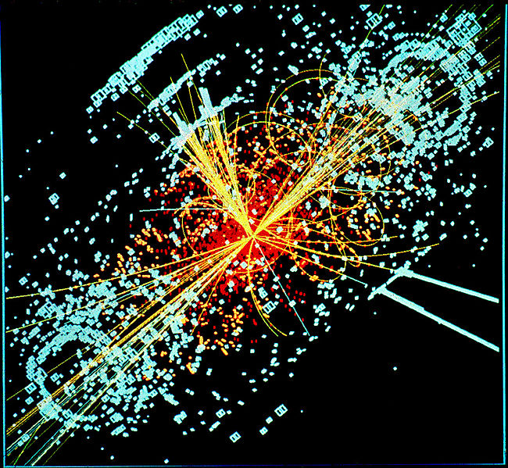
Example – Neural Networks
Aim: Use a Neural Network to classify two types of particles generated in high energy collider experiments, based different attributes:
Binary classification problem
78 different attributes (momentum, direction, mass, curvature, etc.)
50 000 examples in the dataset
Simulated particle collision in the Large Hadron Collider (LHC)
Acknowledgement of dataset: http://osmot.cs.cornell.edu/kddcup/faqs.html

Slide 29
Supervised Learning Workflow
Speed up Computations
Select Model
Data
Train the Model
Simulate Model
Import Data
Known data
Model
Model
Predicted Responses
Explore Data
Prepare Data
Known responses
New Data
Measure Accuracy
Notes:
Before we begin our demo, let us look at a typical workflow for supervised machine learning.
You begin by importing the data, pre-process it and clean it up. You may spend some time exploring the data, perhaps creating some visualizations and identifying your variables of interest.
In the next step, you would select a model and train the model on your data. Then you would measure the accuracy of the model for comparisons. You may then select another algorithm and repeat the process. This step can be iterative in nature.
Once you select the best model, you can use to make predictions on new data set.
As we are moving through this workflow, we will look for opportunities to speed up our computations. Many of the tasks in this workflow can be computationally intensive.
The two steps you can parallelize in this session are the callto train and the implicit callto sim (where the network net2 iscalled as a function).
In Neural Network Toolbox you can divide any data, such as x and t inthe previous example code, across samples. If x and t containonly one sample each, there is no parallelism. But if x and t containhundreds or thousands of samples, parallelism can provide both speedand problem size benefits.
# MATLAB #
Neural Net Pattern Recognition App – go through the tool and generate a simple script.

Slide 30
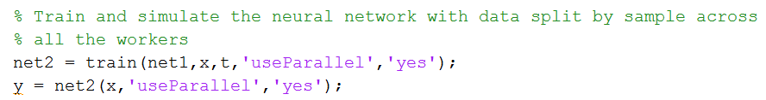
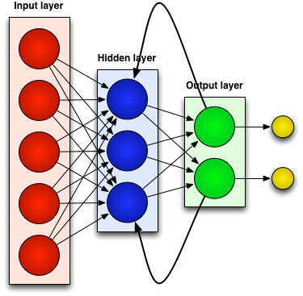
Example – Neural Networks
Utilising Built-In Support
Goals:
Distribute the training dataset across workers
Distribute the simulation dataset across workers
Parallelise training and simulation with the least possible effort
Notes:
MultiCoreComputing_demo1

Slide 31
Example – Neural Networks
Utilising Built-In Support
Summary:
Set “useParallel” to “yes” to make use of built-in parallelisation
Dataset distributed evenly across workers
No knowledge of parallel computing required

Slide 32
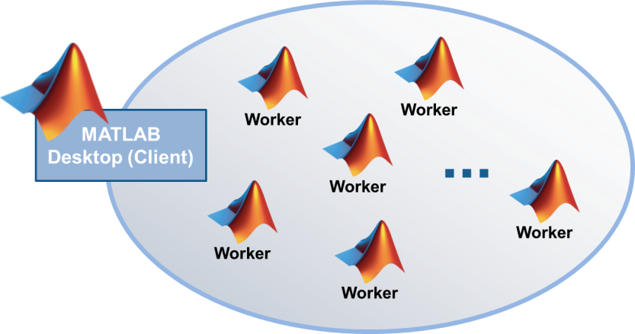
Tools Providing Parallel Computing Support
Optimization Toolbox, Global Optimization Toolbox
Statistics Toolbox
Signal Processing Toolbox
Neural Network Toolbox
Image Processing Toolbox
…
BLOCKSETS
Directly leverage functions in Parallel Computing Toolbox
www.mathworks.com/products/parallel-computing/builtin-parallel-support.html
Notes:
As of R2013a, there are 17 toolboxes with built-in support

Slide 33
Agenda
Introduction
Introduction to Parallel Computing
Built in Parallel Support
Composite Arrays and Batch Processing
Using GPUs
Built in GPU Support
GPU Arrays
Distributed GPU Computing
Scaling Up to a Cluster
Concluding Remarks

Slide 34
Programming Parallel Applications
Level of Control | CPU Parallel | GPU
Minimal | Support built into toolboxes | Built-in GPU support (support built into existing functions, GPU arrays)
Some | High-level programming constructs (parfor, batch, distributed arrays, composites) | Execute custom functions on the GPU array
Extensive | Low-level programming constructs (jobs/tasks, spmd) | Invoke CUDA kernels directly from MATLAB
 | Distributed GPU Computing
Notes:
MATLAB guiding star philosophy: The workers extend the MATLAB desktop to work not just on single resource, but multiple. These might be running on other cores or other computers.
/Note: improve MATLAB ‘desktop’ icon, if time and idea available/

Slide 35
Composites
Data type for which variables are created in the client session but data is created directly on the workers
Represent cell arrays in their display and usage
Use to prepopulate values on workers before training starts

Slide 36

Example – Neural Networks
Manually divide data across the workers
Motivation:
Problem size is too big for the host computer
Some workers are on computers that are faster or have more memory than others
Goal:
Use Composites to specify which subsets of the data should go on which workers
Notes:
MultiCoreComputing_demo2
%% Composites
% Use Composite data types to manually divide the data across cores.
%%
% Sequentially create a series of random datasets and save to separate
% files
%%
% Load the datasets sequentially across parallel workers, and train and
% simulate a network on the Composite data.
%
% When TRAIN or SIM is called with Composite data, the 'useParallel'
% argument is automatically set to 'yes'.
%%
% Convert the Composite output returned by SIM, by accessing each element
% separately to deal with memory limitations
%
% Combine the Composite value into one local value if memory limitations
% are not an issue

Slide 37
Example – Neural Networks
Manually divide data across the workers
Summary:
Composites can be used to specify which subsets of the dataset should reside on which workers
Manually defining the elements of Composite values sequentially allows much bigger problems to be defined
You can perform load balancing by distributing the data with differing numbers of samples per worker

Slide 38
Offload Computations with batch
MATLAB
Desktop (Client)
Work
Worker
Worker
Worker
Result
Worker
Notes:
Notes:
Many customers do not realize that we have a batch command in PCT.
Customers that do know we have batch, often think that a matlabpool is automatically opened with batch.
Some customers wish they had “PCT on the cluster” batch with matlabpool can address that desire, but of course, the Workers will not necessarily be on the same physical remote computer.

Slide 39
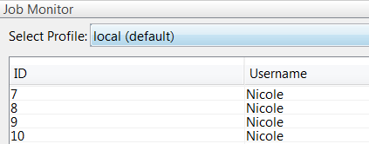
Example – Neural Networks
Offload data to workers using BATCH
Goal:
Interactively and programmatically offload computations to one or more workers
Load results back from workers when computations are complete
Notes:
MultiCoreComputing_demo3_1 and 3_2
## MATLAB ##
NB. Close any open pools before starting!

Slide 40
Example – Neural Networks
Offload data to workers using BATCH
Summary:
Interactively offload computations to another worker to free up the client session of MATLAB for other work
Run offloaded computation in parallel by making use of additional workers
Job manager allows you to see what jobs are running

Slide 41
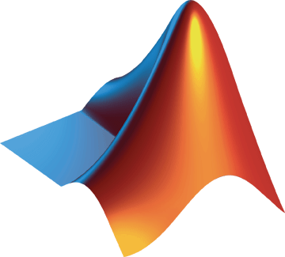
Performance Gain with More Hardware
Using More Cores (CPUs)
Using GPUs
Core 1
Core 2
Core 3
Core 4
Device Memory
Cache
Notes:
The Parallel Computing Toolbox addresses two main types of problems.
*Click*
The first type is what we call “Task-Parallel” problems. These in general are computations that take a long time to run. Here are a couple typical representations of a long-running computation. One involves for-loops and the other involves serial execution of tasks. This type of problem can utilize additional resources to run the tasks in parallel.
*Click*
The second type is what we call “Data-Parallel” problems. These involve dealing with large data that cannot be easily handled by a single machine. In contrast to “Task-Parallel”, this type of problem can be dealt with by distributing the data across multiple resources to solve the problem
For both types of problems, the toolbox is designed to utilize multi-core/multi-processor computers or network of computers.

Slide 42
Agenda
Introduction
Introduction to Parallel Computing
Built in Parallel Support
Composite Arrays and Batch Processing
Using GPUs
Built in GPU Support
GPU Arrays
Distributed GPU Computing
Scaling Up to a Cluster
Concluding Remarks

Slide 43
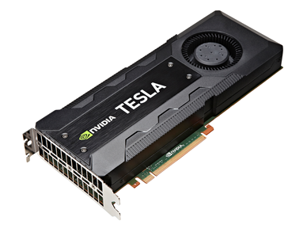

What is a Graphics Processing Unit (GPU)
Originally for graphics acceleration, now also used for scientific calculations
Massively parallel array of integer and
floating point processors
  Typically hundreds of processors per card
  GPU cores complement CPU cores
Dedicated high-speed memory
New: GPU functionality in
R2010b
* Parallel Computing Toolbox requires NVIDIA GPUs with Compute Capability 1.3 or higher, including NVIDIA Tesla 20-series products. See a complete listing at www.nvidia.com/object/cuda_gpus.html
Notes:
[Note: in 2014, the requirement will change to compute capability 2.0. The notification will appear on the website first. Check here: http://www.mathworks.com/discovery/matlab-gpu.html]

Slide 44
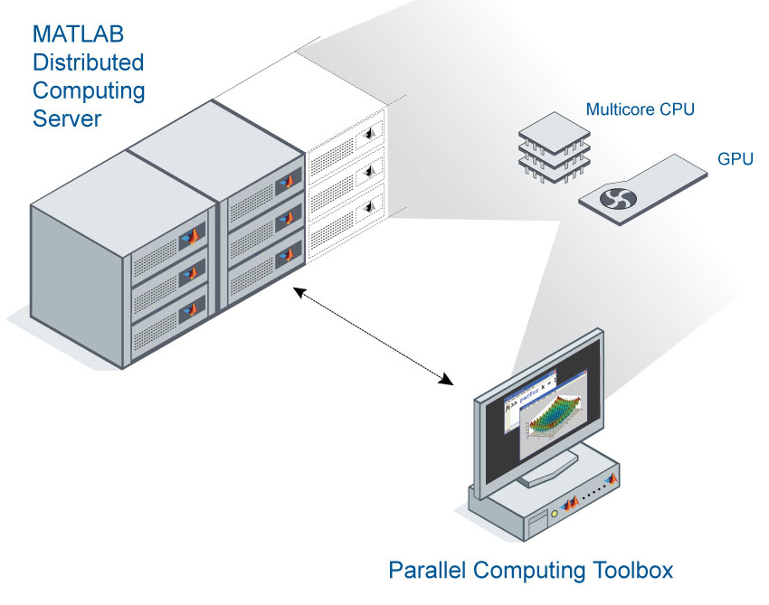
GPU Performance – not all cards are equal
Tesla-based cards will provide best performance
Realistically, expect 4x to 15x speedup (Tesla) vs CPU
See GPUBench on MATLAB Central for examples
www.mathworks.com/matlabcentral/fileexchange/34080-gpubench
Laptop GPU GeForce
Desktop GPU GeForce / Quadro
High Performance Computing GPU
Tesla / Quadro
Notes:
Notes:
In some cases, we have seen 30x speed-up, but if we see more than 30x speed-up, we usually look back at our serial code and see if there is something we could have done better serially.
The high-end cards are often physically larger, since they are likely to have more memory and more cooling.
The highest-end cards, like the Tesla K20, are designed to be used for extended periods of time.
Even if you don’t have a GPU yet, you can download GPU bench and run gpuBenchReport to see results for hardware we’ve tested.

Slide 45
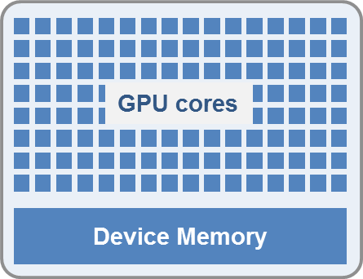
Criteria for Good Problems to Run on a GPU
Massively parallel:
  Calculations can be broken into hundreds
  or thousands of independent units of work
  Problem size takes advantage of many GPU cores
Computationally intensive:
  Computation time significantly exceeds CPU/GPU data transfer time
Algorithm consists of supported functions:
  Growing list of Toolboxes with built-in support
    www.mathworks.com/products/parallel-computing/builtin-parallel-support.html
  Subset of core MATLAB for gpuArray, arrayfun, bsxfun
    www.mathworks.com/help/distcomp/using-gpuarray.html#bsloua3-1
    www.mathworks.com/help/distcomp/execute-matlab-code-elementwise-on-a-gpu.html#bsnx7h8-1
Notes:
A GPU can accelerate an application if it fits both of the following criteria:
Massively parallel—The computations can be broken down into hundreds or thousands of independent units of work. You will see the best performance all of the cores are kept busy, exploiting the inherent parallel nature of the GPU.
Computationally intensive—The time spent on computation significantly exceeds the time spent on transferring data to and from GPU memory. Because a GPU is attached to the host CPU via the PCI Express bus, the memory access is slower than with a traditional CPU. This means that your overall computational speedup is limited by the amount of data transfer that occurs in your algorithm.
Applications that do not satisfy these criteria might actually run slower on a GPU than on a CPU.

Slide 46
Programming Parallel Applications
Level of Control | CPU Parallel | GPU
Minimal | Support built into toolboxes | Built-in GPU support (support built into existing functions, GPU arrays)
Some | High-level programming constructs (parfor, batch, distributed arrays, composites) | Execute custom functions on the GPU array
Extensive | Low-level programming constructs (jobs/tasks, spmd) | Invoke CUDA kernels directly from MATLAB
 | Distributed GPU Computing
Notes:
MATLAB guiding star philosophy: The workers extend the MATLAB desktop to work not just on single resource, but multiple. These might be running on other cores or other computers.
/Note: improve MATLAB ‘desktop’ icon, if time and idea available/

Slide 47
Programming Parallel Applications
Level of Control | CPU Parallel | GPU
Minimal | Support built into toolboxes | Built-in GPU support (support built into existing functions, GPU arrays)
Some | High-level programming constructs (parfor, batch, distributed arrays, composites) | Execute custom functions on the GPU array
Extensive | Low-level programming constructs (jobs/tasks, spmd) | Invoke CUDA kernels directly from MATLAB
 | Distributed GPU Computing
Notes:
MATLAB guiding star philosophy: The workers extend the MATLAB desktop to work not just on single resource, but multiple. These might be running on other cores or other computers.
/Note: improve MATLAB ‘desktop’ icon, if time and idea available/

Slide 48
Agenda
Introduction
Introduction to Parallel Computing
Built in Parallel Support
Composite Arrays and Batch Processing
Using GPUs
Built in GPU Support
GPU Arrays
Distributed GPU Computing
Scaling Up to a Cluster
Concluding Remarks

Slide 49

Example – Neural Networks
GPU Computing using support built Into existing functions
Goals:
Utilise dedicate high-speed memory and highly parallel nature of GPU to train and simulate neural network
Perform GPU programming with little to no knowledge of GPUs
Notes:
GPUComputing_demo1
Issue: SIM doesn’t run on GPU

Slide 50
Example – Neural Networks
GPU Computing using support built Into existing functions
Summary:
Set “useGPU” flag to “yes” to utilise GPU support built into existing functions
No knowledge of GPUs required

Slide 51
Agenda
Introduction
Introduction to Parallel Computing
Built in Parallel Support
Composite Arrays and Batch Processing
Using GPUs
Built in GPU Support
GPU Arrays
Distributed GPU Computing
Scaling Up to a Cluster
Concluding Remarks

Slide 52
GPU Arrays
>> A = someArray(1000, 1000);
>> G = gpuArray(A); % Push to GPU memory
…
>> F = fft(G);
>> x = G\b;
…
>> z = gather(x); % Bring back into MATLAB

Slide 53
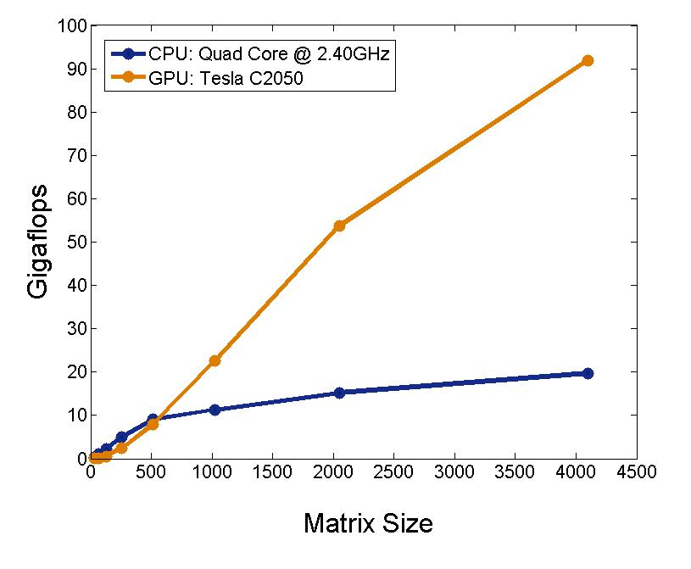
Performance: A\b with Double Precision

Slide 54

Example – Neural Networks
GPU Computing using GPU Arrays
Goals:
Improve speed on the GPU by converting data to GPU Arrays before training and simulation
Notes:
GPUComputing_demo2
Issue: GPU Arrays don’t work. Maybe leave this out!
When a GPU is used in the previous examples, train and sim take MATLAB matricesor cell arrays and convert them to GPU arrays before training andsimulation. sim then takes the GPU array resultand converts it back to a matrix or cell array before returning it.
An alternative is to supply the data arguments as values alreadyconverted to GPU arrays. The Parallel Computing Toolbox commandfor creating a GPU array from a matrix is named accordingly. To get the value back from the GPU use gather.

Slide 55
Example – Neural Networks
GPU Computing using GPU Arrays
Summary:
Improved speed on the GPU by converting data to GPU Arrays before training and simulation
GPU Arrays are easy to use and supported by a number of built-in functions
Data format and the use of the TANSIG sigmoid transfer function have an impact on the performance of the neural network on the GPU.
Notes:
GPUComputing_demo2
Nndata2gpu: However, for neural network calculations on a GPU to be efficient,matrices need to be transposed and the columns padded so that the first element in each column aligns properly in the GPU memory. Dothis with the function nndata2gpu.
Now you can train, simulate the network, and convert the returnedGPU array back to MATLAB with the complement function gpu2nndata.When training with gpuArray data, the network's input and outputsmust be configured manually with regular matrices using the configure functionbefore training.
Tansig → elliotsig: On GPUs and other hardware where you might want to deploy yourneural networks, it is often the case that the exponential function exp isnot implemented with hardware, but with a software library. Thiscan slow down neural networks that use the tansig sigmoidtransfer function. An alternative function is the Elliot sigmoidfunction whose expression does not include a call to any higher order functions. Before training, the network's tansig layers can be converted to elliotsig layers.
Now training and simulation might be faster on the GPU and simplerdeployment hardware.

Slide 56
Programming Parallel Applications
Level of Control | CPU Parallel | GPU
Minimal | Support built into toolboxes | Built-in GPU support (support built into existing functions, GPU arrays)
Some | High-level programming constructs (parfor, batch, distributed arrays, composites) | Execute custom functions on the GPU array
Extensive | Low-level programming constructs (jobs/tasks, spmd) | Invoke CUDA kernels directly from MATLAB
 | Distributed GPU Computing
Notes:
MATLAB guiding star philosophy: The workers extend the MATLAB desktop to work not just on single resource, but multiple. These might be running on other cores or other computers.
/Note: improve MATLAB ‘desktop’ icon, if time and idea available/

Slide 57
Programming Parallel Applications (GPU)
Ease of Use
Greater Control
Advanced programming constructs: arrayfun, bsxfun, spmd
Interface for experts: CUDAKernel, MEX support
www.mathworks.com/help/releases/R2013a/distcomp/executing-cuda-or-ptx-code-on-the-gpu.html
www.mathworks.com/help/releases/R2013a/distcomp/create-and-run-mex-files-containing-cuda-code.html

Slide 58
Agenda
Introduction
Introduction to Parallel Computing
Built in Parallel Support
Composite Arrays and Batch Processing
Using GPUs
Built in GPU Support
GPU Arrays
Distributed GPU Computing
Scaling Up to a Cluster
Concluding Remarks

Slide 59
Programming Parallel Applications
Level of Control | CPU Parallel | GPU
Minimal | Support built into toolboxes | Built-in GPU support (support built into existing functions, GPU arrays)
Some | High-level programming constructs (parfor, batch, distributed arrays, composites) | Execute custom functions on the GPU array
Extensive | Low-level programming constructs (jobs/tasks, spmd) | Invoke CUDA kernels directly from MATLAB
 | Distributed GPU Computing
Notes:
MATLAB guiding star philosophy: The workers extend the MATLAB desktop to work not just on single resource, but multiple. These might be running on other cores or other computers.

Slide 60
Example – Neural Networks
Distributed GPU Computing
Goals:
Combine multicore computing and GPU computing to run calculations across multiple GPUs and/or CPUs
Notes:
Distributed and GPU computing can be combined to run calculations across multiple GPUs and/or CPUs on a single PC or clusters of PCs with MATLAB Distributed Computing Server.
The simplest way to do this is to direct train and sim to do so, after opening parpool with the cluster profile you want. The 'showResources' option is especially recommended in this case, to verify that the expected hardware is being employed.
The above lines of code use all available workers. One worker for each unique GPU employs that GPU, while other workers operate as CPUs. In some cases, it might be faster to use only GPUs. For instance, if a single computer has three GPUs and four workers each, the three workers that are accelerated by the three GPUs might be speed limited by the fourth CPU worker. In these cases, you can direct train and sim to use only workers with unique GPUs.

Slide 61
Example – Neural Networks
Distributed GPU Computing
Summary:
Multicore computing and GPU computing can be combined to run calculations across multiple GPUs and/or CPUs
GPUs and CPUs can be on a single PC or on clusters of PCs
Use built-in support or divide data manually using Composites and SPMD
Notes:
GPUComputing_demo3
Distributed and GPU computing can be combined to run calculationsacross multiple GPUs and/or CPUs on a single PC or clusters of PCswith MATLAB Distributed Computing Server.
The simplest way to do this is to direct train and sim todo so, after opening parpool with the clusterprofile you want. The 'showResources' option isespecially recommended in this case, to verify that the expected hardwareis being employed.
The above lines of code use all available workers. One workerfor each unique GPU employs that GPU, while other workers operateas CPUs. In some cases, it might be faster to use only GPUs. Forinstance, if a single computer has three GPUs and four workers each,the three workers that are accelerated by the three GPUs might bespeed limited by the fourth CPU worker. In these cases, you can direct train and sim touse only workers with unique GPUs.
As with simple distributed computing, distributed GPU computingcan benefit from manually created Composite values. Defining theComposite values yourself lets you indicate which workers to use,how many samples to assign to each worker, and which workers use GPUs.
For instance, if you have four workers and only three GPUs,you can define larger datasets for the GPU workers.

Slide 62
Agenda
Introduction
Introduction to Parallel Computing
Built in Parallel Support
Composite Arrays and Batch Processing
Using GPUs
Built in GPU Support
GPU Arrays
Distributed GPU Computing
Scaling Up to a Cluster
Concluding Remarks

Slide 63
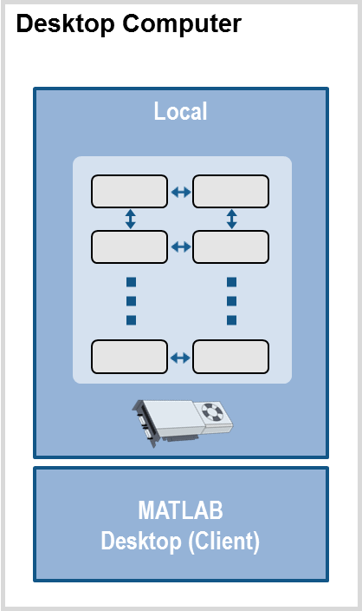
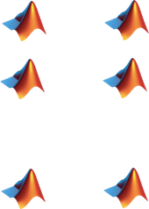
Use MATLAB Distributed Computing Server
Prototype code
MATLAB code
Local
Notes:
MATLAB Distributed Computing Server is a product that allows you to move your Parallel Computing toolbox workflow to cluster hardware. In the most common configuration, you will be able to access Workers on the cluster directly from a desktop MATLAB session acting as the client. In other configurations, your client session might be a remote login session. In either case, to use the Distributed Computing Server, you need to follow three steps:
Step 1: prototype your code with the Parallel Computing Toolbox on your desktop.
Even with a basic desktop or laptop, you can use Parallel Computing Toolbox sytnax and get your algorithms up and running.

Slide 64
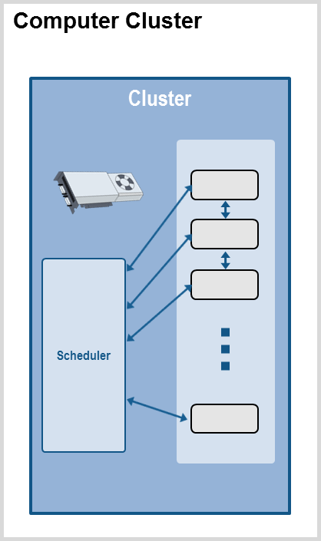

Use MATLAB Distributed Computing Server
Prototype code
Get access to an enabled cluster
Cluster
Notes:
Your second step is to get access to an enabled cluster. You will need to ensure that your Cluster Administrator has installed and integrated MATLAB Distributed Computing Server with your cluster.
As a general guideline, if each computer in your cluster meets the system requirements for MATLAB, you can probably run MATLAB Distributed Computing Server on that cluster.
for MATLAB, you can probably run MATLAB Distributed Computing Server on that cluster.
Your Administrator‘s last step will be to create a Cluster Profile that you and your colleagues can share to get access to the cluster resources.
The version of your client MATLAB and Parallel Computing Toolbox session will need to match the version of MATLAB Distributed Computing Server.
<click>

Slide 65
Use MATLAB Distributed Computing Server
Prototype code
Get access to an enabled cluster
Switch cluster profile to run on cluster resources
MATLAB code
Local
Cluster
Notes:
Step 3: Once your code is working, and you have a cluster profile, you smiply need to change your cluster profile on the client system to use your computer cluster.
You can import the profile directly though the parallel menu in teh MATLAB toolstrip.
<click> [ Profile Changes]
After you have changed the profile, when you execute parallel computing syntax from your client session, your computations will be made with the cluster hardware.

Slide 66
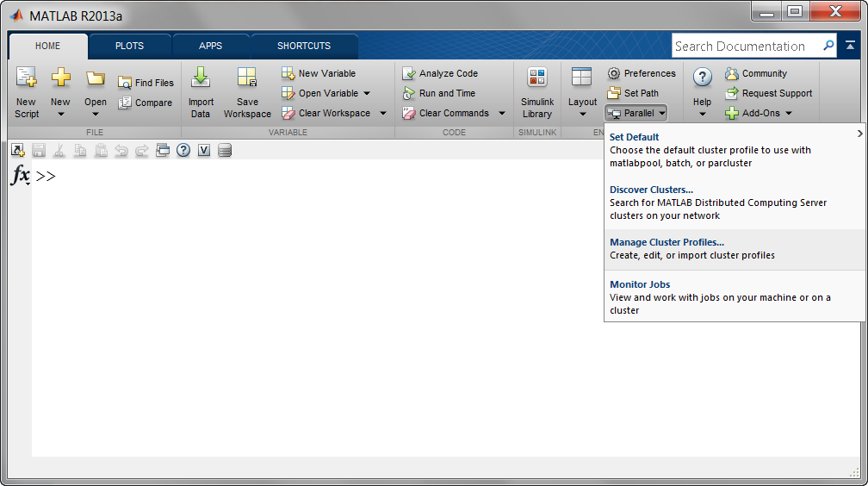
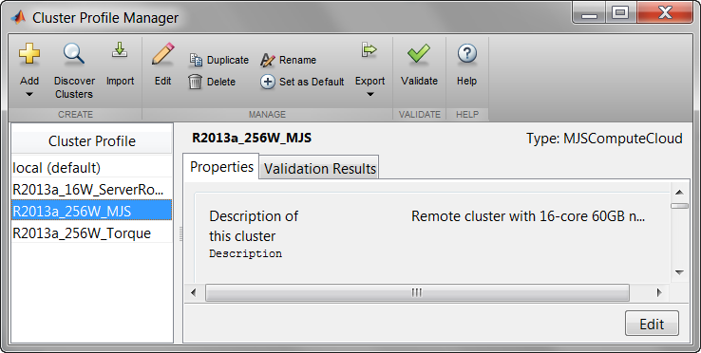
Migrate from Desktop to Cluster
Scale to computer cluster
Desktop interface
  Set defaults
  Discover clusters
  Manage profiles
  Monitor jobs
Command-line API
Notes:
[This is a placeholder/summary for a demonstration of how one uses the MATLAB client to interfaces with Workers on a cluster. No cluster access is actually needed. You can show it all just with PCT.
Recommendation: Show the parallel menu. Show how to manage Profiles. Show the job monitor.
There are not direct command line versions of everything one would do with the parallel menu.
The command line API refers to changing profiles when opening a matlabpool, setting profiles as part of batch syntax, using parcluster, etc.
One cannot start the job monitor directly from the command line command, but this code would do it:
function jobmonitor(action)
% JOBMONITOR - Launches the Job Monitor
if strcmpi(action , 'open')
% Open the client
instance = javaMethodEDT('getInstance','com.mathworks.toolbox.distcomp.ui.desk.JobMonitorDesktopClient');
javaMethodEDT('showUI',instance);
elseif strcmpi(action , 'close')
% Close the client
dt = javaMethodEDT('getDesktop','com.mathworks.mlservices.MatlabDesktopServices');
javaMethodEDT('hideClient', dt, 'Job Monitor');
else
error('Unknown option');
end
]

Slide 67
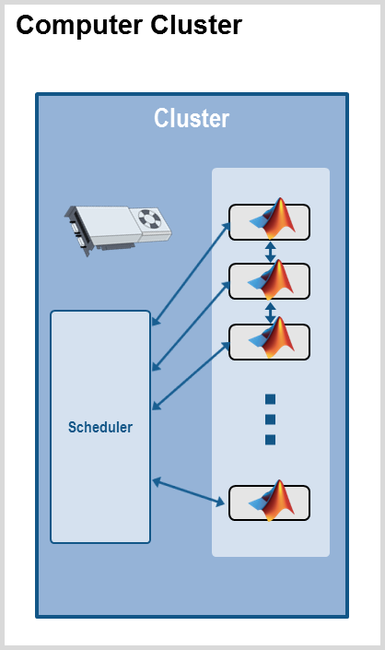
MATLAB Distributed Computing Server
Extension of desktop parallel computing
Pre-built framework and infrastructure
Simplified license and maintenance
Notes:
We’ve talked about using MATLAB Distributed Computing Server, but I haven’t given you a specific description of the product itself.
<click>
The best way to describe it is as an extension of Parallel Computing Toolbox that provides easy access to multiple MATLAB computational engines on a computer cluster.
<click>
MATLAB Distributed Computing Server provides a complete pre-built cluster solution. We provide an execution framework and the underlying communication infrastructure to allow cluster computers to work for you as a single system. We provide the infrastructure to allow your Cluster Administrator to integrate with your cluster hardware and existing scheduler, and we provide a basic scheduler if you don’t already have one.
<click>
MATLAB Distributed Computing Server is licensed as a separate base product, and is more cost effective than purchasing large numbers of concurrent licenses.
Distributed Computing Server is licensed by number of Workers, or simultaneous
MATLAB engines, needed. You purchase a license size based on the number of simultaneous Workers you will need to reach your goals. That is, you don’t need to license the total number of cores in your cluster.
As your needs expand, upgrading to use more workers can be as simple as updating your license file.

Slide 68

Dynamic Licensing Model
Users have access to their licensed products
Server does not check out any licenses on the client
User can exit MATLAB once the job is queued
MATLAB
User A
MATLAB
User B
Notes:
MATLAB Distributed computing Server uses a dynamic licensing model that accounts for both MATLAB and Toolboxes. The only licenses that are checked-out are Distributed Computing Server licenses: one Worker for each computational engine used.
<click>
To ensure that your desktop code runs on your cluster, the dynamic licensing model and Distributed Computing Server installation give your cluster-side computation engines access to use any compatible toolbox that you could access from your desktop license.
<click>
The server does not check out any Toolbox (or MATLAB) licenses on the client-side, so you don’t need to worry about taking resources away from your (or anyone else’s) desktop session.
<click>
For non-interactive jobs with the Distributed Computing Server, you can even exit your MATLAB session after your job has been queued and then retrieve your job at a later time.
The dynamic licensing model adds to the cost-effectiveness of the solution, and ensures that your Distributed Computing Server computations have access to the same Toolboxes you can access from your desktop MATLAB session.

Slide 69
Take Advantage of Cluster Hardware
Offload computation:
  Free up desktop
  Access better computers
Scale speed-up:
  Use more cores
  Go from hours to minutes
Scale memory:
  Utilize distributed arrays
  Solve larger problems without re-coding algorithms
MATLAB
Desktop (Client)
Notes:
<click>
There are a few primary reasons to move your Parallel Computing Toolbox workflow from a Desktop computer to a cluster:
<click>
You might want to perform computations on a cluster to free up your desktop computer for other work. You could submit a job to a cluster and retrieve the results when they‘re done. You could even shut down your local computer while you wait.
If your desktop or laptop computer is not very powerful, you could use the cluster just to get access to a better computer.
<click>
Many of us want to move to a cluster to decrease run time by using more hardware. Getting computations to take minutes rather than hours allows you to make updates to code and execute multiple runs all in the same day.
<click>
If you have an array that is too large for your computer's memory, you can use distributed arrays to store the data across multiple computers, so that each computer contains only a part of the array. A growing number of MATLAB matrix operations and functions have been enhanced to work with distributed arrays using the Parallel Computing Toolbox. These enhanced functions allow you to use your desktop session to operate on the entire distributed array as a single entity .

Slide 70
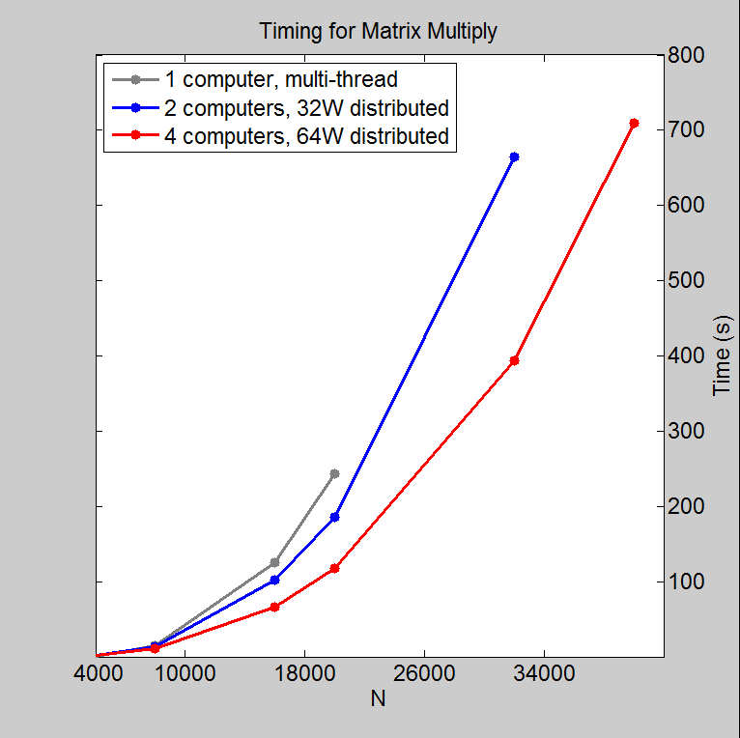
Investigation: Distributed Calculations
Effect of number of computers on execution time
N | Time (s)
 | 1 node, multi-threaded | Distributed
 |  | 2 nodes, 32W | 4 nodes, 64W
4000 | 2 | 3 | 3
8000 | 16 | 14 | 12
16000 | 126 | 102 | 67
20000 | 244 | 187 | 118
32000 | - | 664 | 394
40000 | - | - | 710
Processor: Intel Xeon E5-2670
16 cores, 60 GB RAM per compute node
10 Gigabit Ethernet
Notes:
In this example, I executed matrix multiplication of random complex matrices of various sizes, and tracked the execution time (of the matrix multiply only) as a function of N and the number of compute nodes and Workers used. For the single node case, I did not use distributed arrays, and I took advantage of implicit multithreading. For the other cases, I used distributed arrays and pools of single-threaded workers. Each node used had 16 physical cores and 60 GB of RAM, so I had plenty of physical memory available on a single node for the N=20000 case, but would use the majority of system memory for the N=32000 case.
This slide summarizes the results.
Note in the table, that it was not advantageous to use distributed arrays for problems with N<8000. These problems are small enough to fit in a modestly-sized computer, and are such that the timing is dominated by the overhead of the distributed computation.
The figure on the right directly represents the data in the table for cases with N>=8000. We note that as we double the number of Workers used, we come close to reducing the computation time by half. Using all 32 available Workers with 2 nodes was faster than the single node case with N=20000.
Most importantly, we observe that we can solve larger problems by using more nodes (computers).
Internal notes:
We do not recommend using large memory systems which utilize multiple motherboards. There are issues with CPU affinitization and can also be concerns with our SLA (for core MATLAB).
For the single node case, I ran with batch and set maxNumCompThreads to 16. I was not doing anything else with that node at the time.
All of this was run on Amazon EC2.
This does not use 2d block-cyclic calculations
Please see: http://www.mathworks.com/help/distcomp/examples/benchmarking-a-b.html?prodcode=DM&language=en for a deeper explanation of sizing for problems like this. Of specific interest is the “Expected Performance” curve toward the middle of the write-up. Best performance is at the start of the plateau, EC2 performance is likely all on the initial rise ( does not reach optimal due to ample resources).
See the backup hidden slide for a more in-depth treatment of choosing the right number of workers.

Slide 71
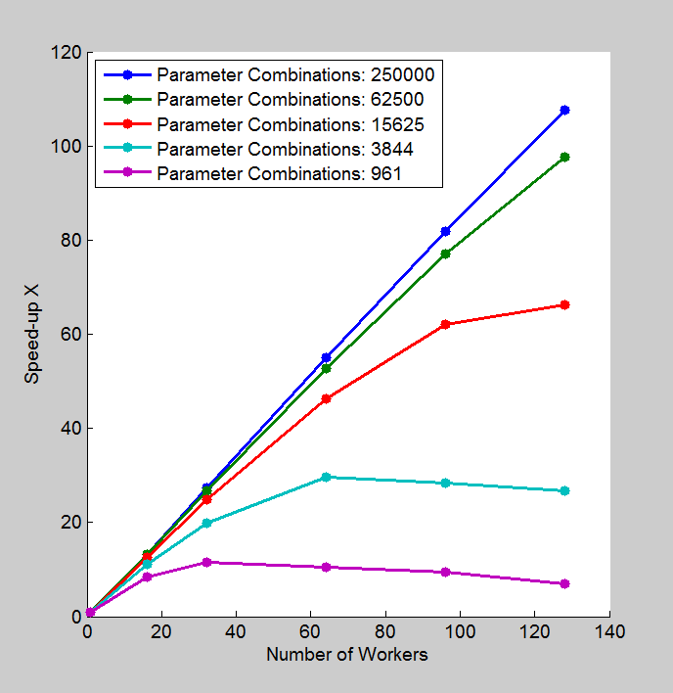
Benchmark: Parameter Sweep of ODEs
Scaling case study for a fixed problem size with a cluster
Workers | Computation time (minutes)
 | Number of combinations
 | 961 | 3844 | 15625 | 62500 | 250000
1 | 5 | 20 | 81 | 325 | 1292
16 | 0.6 | 2 | 6 | 25 | 98
32 | 0.4 | 1 | 3 | 12 | 47
64 | 0.5 | 0.6 | 1.7 | 6 | 23
96 | 0.5 | 0.7 | 1.3 | 4 | 16
128 | 0.6 | 0.7 | 1.1 | 3.1 | 12
Processor: Intel Xeon E5-2670
16 cores per node
Notes:
Notes:
Computation time is from tic/toc around just the parfor
I used batch
I ran this on Amazon EC2 (no need to advertise that, but it is true!)
For this benchmark, we ran the ODE parameter sweep for different numbers of parameter combinations, and different numbers of Workers.
In this case, my cluster has 128 cores, and I used up to 128 Workers. I ran one case at a time. The 1 Worker case provides a single-threaded baseline.
This slide summarizes the results. The plots on the right directly represent the data in the table.
We note that for the smaller problems, as we increase the number of Workers, eventually, the overhead for including more workers offsets the additional speed-up.
In general, the speedup achieved by using a cluster depends on the problem size and complexity as well as the underlying hardware and networking infrastructure. One should expect to be able to achieve reduced computation times on the order of 1 minute. That is, for best scaling, one needs to start with a long-running computationally intensive problem.
This example shows how overhead influences expectation in terms of parfor performance. One could make similar observations looking at the effect of the matlabpool setup.

Slide 72
Agenda
Introduction
Introduction to Parallel Computing
Built in Parallel Support
Composite Arrays and Batch Processing
Using GPUs
Built in GPU Support
GPU Arrays
Distributed GPU Computing
Scaling Up to a Cluster
Concluding Remarks

Slide 73
MathWorks Product Overview

Slide 74


Learn More
Online Resources
  www.mathworks.com
  www.optinum.co.za
Other services offered by OPTI-NUM solutions
  Technical Support
  Training
  Consulting
  Private Seminars
Notes:
Where to go to learn more.

Slide 75
Online Resources - MathWorks
Create MathWorks account
Manage your account
Obtain product updates
View and report bugs
Documentation
Downloads
File exchange
Newsgroup
Blogs
Webinars
Newsletters
www.mathworks.com
Notes:
How to reconcile the slides with showing on the website?

Slide 76

Online Resources – OPTI-NUM solutions
Training schedule
Upcoming seminars and events
Upcoming webinars
Latest news stories
Submit sales or technical support queries
Contact the consulting team
www.optinum.co.za

Slide 77
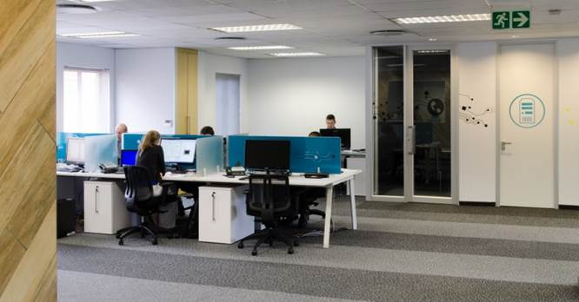
Technical Support
Part of Software Maintenance Service
Assistance from Applications Engineers with Bachelors degree or higher
Over 300 queries resolved in 2012
Queries can be submitted:
  By emailing support@optinum.co.za
  On the OPTI-NUM solutions website
  On the MathWorks website

Slide 78
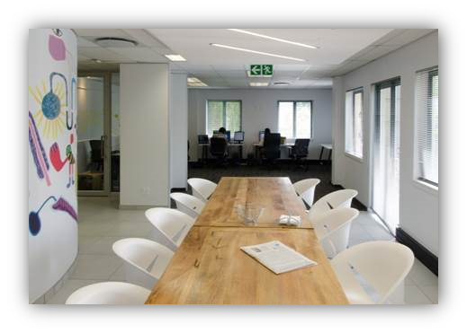
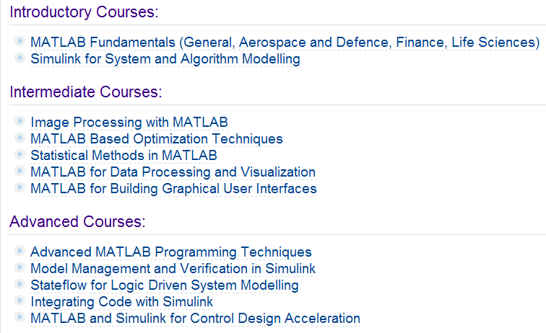
Training
Public training
  At our offices in Hyde Park Corner
On-site Training
  Groups of four or more
For more information email sales@optinum.co.za

Slide 79








Consulting Services
Provided by a team of experienced engineers
Projects range from ramp-up to full system implementation
For more information, email consulting@optinum.co.za
Notes:
Ramp-up: for people wanting to get started quickly – jump start a project and teach them how to use the tools at the same time.
System Implementation: Full or partial.
Previous projects have been in communications, finance, process, aerodef, energy production, automotive
Gareth to get permission for use of Tellumat, Denel Dynamics, Powertech, Anglo Technical Systems & as many more as possible

Slide 80
Questions?

Slide 81
What Next?
View some webinars:
  Parallel Computing with MATLAB on Multicore Desktops and GPU’s
  GPU Computing with MATLAB
Do some reading:
  MATLAB
  Parallel Computing Toolbox
  MATLAB Distributed Computing Server
Related Blogs:
  Loren on the Art of MATLAB – Parallel Computing Entries
Keep up do date with training, free seminars and other events being hosted by OPTI-NUM solutions here

Slide 82
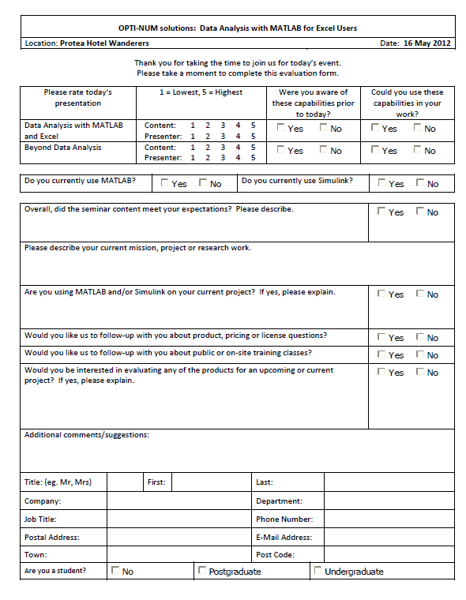
Seminar Evaluation
Thank you for attending the workshop
Please take a few moments to fill out the evaluation form
  Would you like us to send you more information on the material covered today?
  Would you like a trial of the products used?

Slide 83
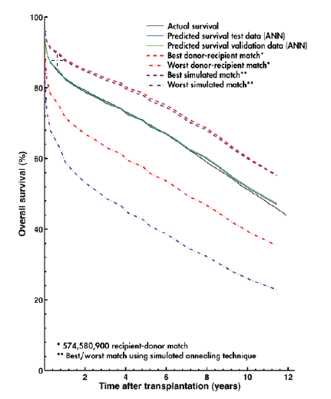
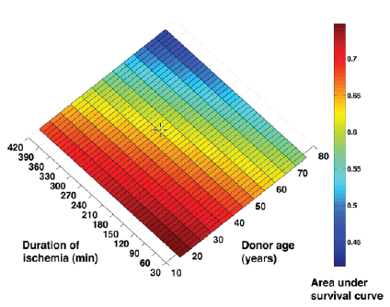
Lund University Develops an Artificial Neural Network for Matching Heart Transplant Donors with Recipients
Challenge
Improve long-term survival rates for heart transplant
recipients by identifying optimal recipient and donor matches
Solution
Use MathWorks tools to develop a predictive artificial neural network model and simulate thousands of risk-profile combinations on a 56-processor computing
cluster
Results
  Prospective five-year survival rate raised by up
  to 10%
  Network training time reduced by more than two-thirds
  Simulation time cut from weeks to days
Plots showing actual and predicted survival, best and worst donor-recipient match, best and worst simulated match (left); and survival rate by duration of ischemia and donor age (right).
“I spend a lot of time in the clinic, and don’t have the time or the technical expertise to learn, configure, and maintain software. MATLAB makes it easy for physicians like me to get work done and produce meaningful results.”
Dr. Johan Nilsson
Skåne University Hospital
Lund University
Notes:
Primary Industry: Biotech and Pharmaceutical
Secondary Industries: Academia
Product Capabilities: Data Analysis, Mathematical Modeling, Parallel Computing
Applications: Computational Biology
Products Used: MATLAB, MATLAB Distributed Computing Server, Neural Network Toolbox, Parallel Computing Toolbox
Country: Sweden
Lund University Develops an Artificial Neural Network for Matching Heart Transplant Donors with Recipients
A heart transplant recipient’s survival depends on dozens of variables, including the weight, gender, age, and blood type of both donor and recipient, and the ischemic time— or the time during a transplant when there is no blood flow to the organ.
To better understand transplant risk factors and improve patient outcomes, researchers at Lund University and Skåne University Hospital in Sweden use artificial neural networks (ANNs) to explore the complex nonlinear relationships among multiple variables. The ANN models are trained using donor and recipient data obtained from two global databases: the International Society for Heart and Lung Transplantation (ISHLT) registry and the Nordic Thoracic Transplantation Database (NTTD). The Lund researchers accelerated the training and simulation of their ANNs by using MATLAB, Neural Network Toolbox, and MathWorks parallel computing products.
“Many of the techniques we use are computer-intensive and time-consuming,” says Dr. Johan Nilsson, Associate Professor in the Division of Cardiothoracic Surgery at Lund University. “We used Parallel Computing Toolbox with MATLAB Distributed Computing Server to distribute the work on a 56-processor cluster. This enabled us to rapidly identify an optimal neural network configuration using MATLAB and Neural Network Toolbox, train the network using data from the transplantation databases, and then run simulations to analyze risk factors and survival rates.”
The Challenge
Understanding how various risk factors affect survival rates involved hundreds of thousands of computationally and data-intensive operations—for example, the team had to test hundreds of ANN configurations to identify the best one. An analysis of six variables requires the simulation of 30,000 different combinations. Simulating all these combinations for 50,000 patients took weeks using an open-source software package.
Nilsson and his colleagues encountered reliability problems with the software they were using, as well. “The software was unstable, which led to crashes during long, multiday simulations,” Nilsson explains. “In addition, some of the results it produced were not quite right. When we publish our findings, we need to be very sure we can trust the results.”
“I spend a lot of time in the clinic, and don’t have the time or the technical expertise to learn, configure, and maintain software. MATLAB makes it easy for physicians like me to get work done and produce meaningful results.”
- Dr. Johan Nilsson, Skåne University Hospital, Lund University
The Solution
To address the speed and reliability challenges, Lund University researchers developed their initial ANN model using MATLAB and Neural Network Toolbox. To find the optimal network configuration, they wrote MATLAB scripts that varied the number of hidden nodes used in the network for a range of weight decay (or regularization) values.
The team used Parallel Computing Toolbox and MATLAB Distributed Computing Server to accelerate the simulation of more than 200 ANN configurations. They then evaluated the results to find the best-performing configuration.
After training the ANN using donor and recipient information from the databases, they verified the model’s accuracy by simulating outcomes for 10,000 patients that had been omitted from the training set. They then compared the results against actual survival rates.
In the next phase, the team conducted thousands of simulations in parallel to rank the 57 risk factors considered in the study for predicting long-term survival.
Using results from Monte Carlo simulations on the computer cluster and simulated annealing techniques, the researchers identified the best and worst possible donors for any particular recipient.
As a final step, the team developed an automated process that ranks the recipient waiting list to identify the best candidates for a prospective donor.
In the next major phase of the project, Lund University researchers are using the ANN to investigate the use of Human Leukocyte Antigen (HLA) genetic profiles to match donors with recipients.
The Results
■ Prospective five-year survival rate raised by up to 10%. “In a simulated randomized trial, the preliminary results show that the ANN model we developed using MATLAB and Neural Network Toolbox would transplant approximately 20% more patients than would have been considered using traditional selection criteria,” says Nilsson. “The prospective five-year survival rate for the ANN-selected patients was 5–10% higher than those matched with the criteria physicians use today.”
■ Network training time reduced by more than two-thirds. “Using Neural Network Toolbox and MATLAB, it took us 5 to 10 minutes to train our ANNs,” says Nilsson. “Training took 30 to 60 minutes using open-source software. That is a big difference, because we were training and evaluating hundreds of network configurations.”
■ Simulation time cut from weeks to days. “When we switched to MATLAB and MathWorks parallel computing technologies, we completed experiments that regularly took 3 to 4 weeks in about 5 days,” says Nilsson. “More importantly, the simulations were completed reliably, with no crashes.”
Learn More About Lund University: www.lunduniversity.lu.se, www.med.lu.se/aicts
This project is a collaboration with:
• The Department of Clinical Sciences Lund at Lund University and Skåne University Hospital
• The Department of Astronomy and Theoretical Physics at Lund University
• The Competence Center of Clinical Research at Skåne University Hospital

