Slide 1
An ATCA framework for the ATLAS Front to Back End Electronics for the Phase II Upgrade at the LHC
Robert Reed | University of the Witwatersrand

Slide 2
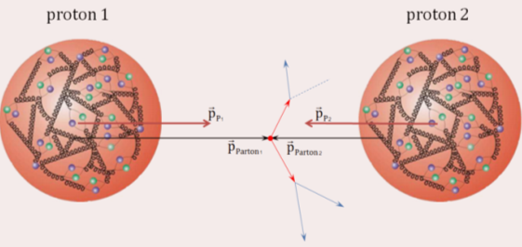
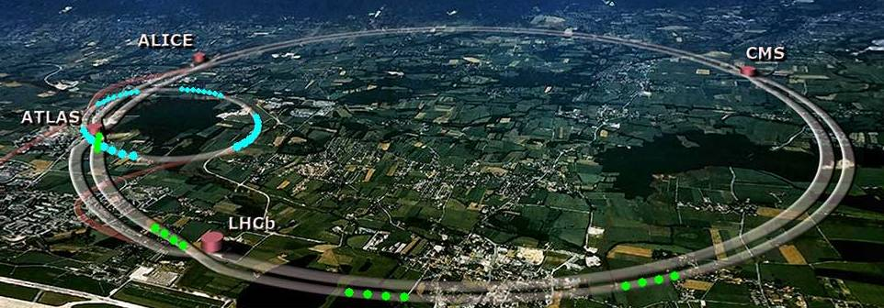
The Large Hadron Collider
Largest experiment in history
Total energy 14 TeV
Protons at speeds of
0.999 999 991 C
Notes:
The large hadron collider situated between Switzerland and France is the worlds most powerful particle accelerator, achieving a centre of mass energy of 14 TeV. It achieves this by accelerating packets of protons in opposite directions around a 27km ring almost 100m beneath the ground.
There are four intersecting points where packets consisting of 115 billion protons cross one another and only about 20 collisions happen per crossing. In total this gives 600 million collisions per second and that’s a lot of data. In order to process these collisions we need to identify the shrapnel that is produced and store the data. This is where some of the most advanced detectors in the world come into play.

Slide 3
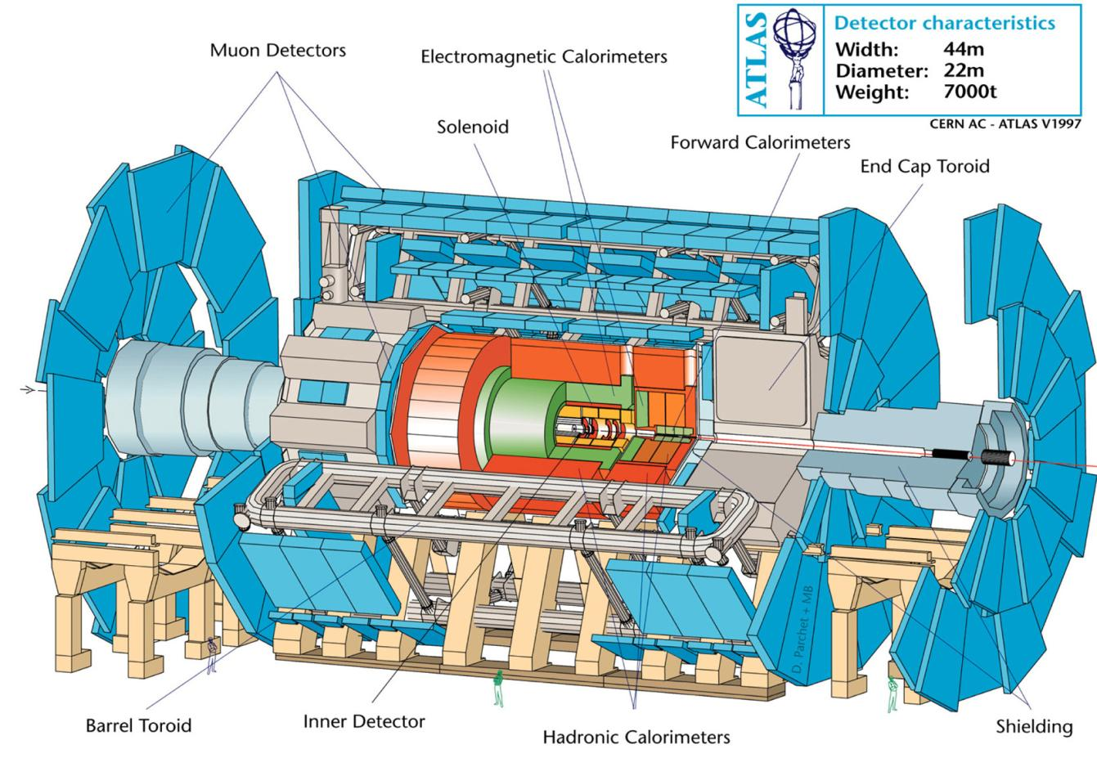
The ATLAS Detector
Notes:
The ATLAS detector is the largest of the seven detectors and is one of two general purpose detectors that discovered the Higgs boson in July 2012. The detector can be considered to be a series of concentric rings and starting from the inside out these are: The Inner detector, electromagnetic and hadron calorimeters and the outer muon detector.
The Tile Calorimeter or TileCal is the main part of the hadron calorimeter shown here in orange.

Slide 4
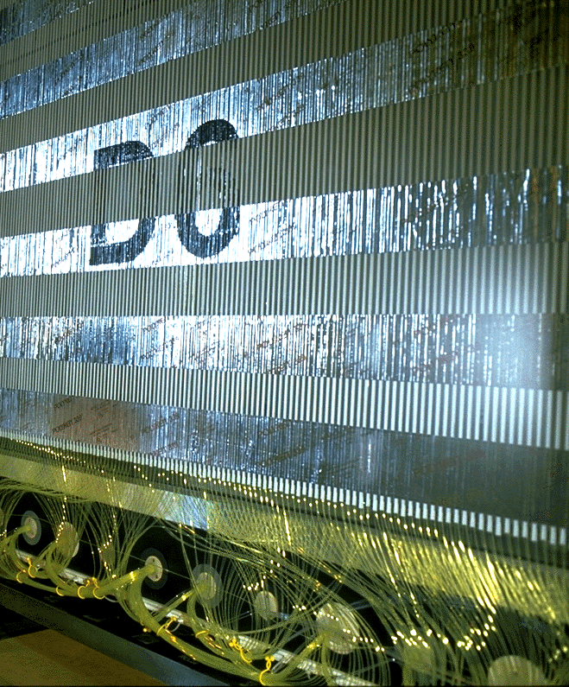
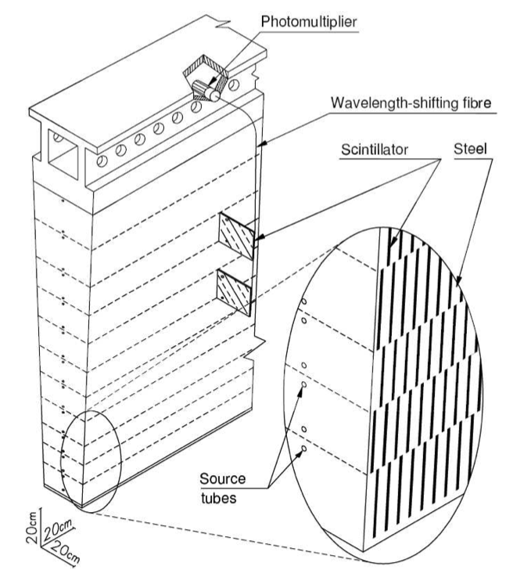
Tile Calorimeter
PMT
Notes:
It consists of a plastic scintilator sandwiched between an absorber material. In this case steel.
As particles pass through they emit light as they deposit energy into the scintilator and the larger the energy the brighter the light. The light is guided through optic fibre cables to Photo Multiplier Tubes where the pulse is digitized. The PMTs can be seen at the bottom of the picture.

Slide 5
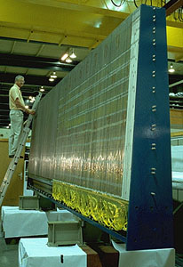
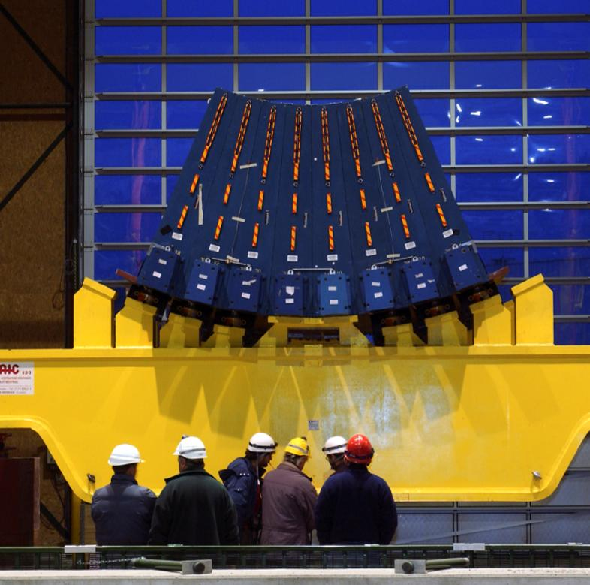
Tile Calorimeter
Notes:
These slices then make up what a wedge or pizza slice. They are stacked together and then inserted into the detector.

Slide 6
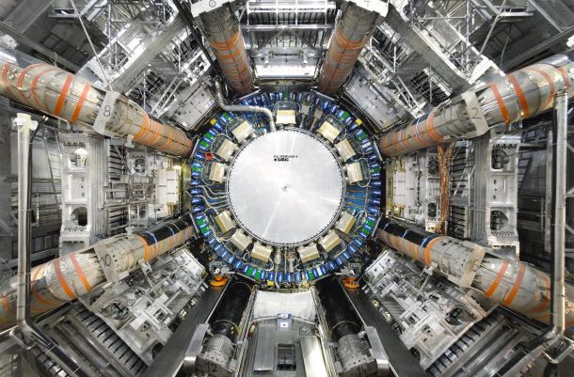
Tile Calorimeter
Notes:
So here is the TileCal inserted into the detector. If we go back a slide we can see the scale of one slice where the man is standing on the ladder. And back here we can really get an idea of how big this detector is.
The PMTs are located in the little blue boxes which you can see in the middle. These boxes are what we call super drawers. They are about 10 meters long and contain all the electronics to digitize the data and to perform the level one triggering. So this is the first step in selecting the interesting physics.

Slide 7
Data Acquisition
Notes:
In order to cope with the increased luminosity which will be about a factor of 10 in 2022. The electronics on these super drawers will be upgraded. I wont go into much detail about this but I will give an overview since the Digitizing and processing of the signal is a complex process. The pulse from the PMTs is first digitized by the ADC, then goes into a pipeline which you can think of as a buffer while the event selection takes place. The interesting events are then sent through to the Read Out Drivers which are off the detectors and this is sent to level 2 and level 3 triggering. The input data comes in at a rate of 40 MHz and reduced to 100 KHz.
There are some issues having the electronics sitting inside the detector. Such as radiation damage or single event upsets but also logistical issues if a component breaks or something malfunctions then you cant just simply walk in and replace it with out getting a healthy dose of cancer.
The current total bandwidth is around 165 Gbps and after the upgrade in 2022 it will be around 20 Tbps. About a factor of 120 X larger. To achieve this we need to use quite sophisticated electronics and they are quite sensitive devices so you dont want them in this radiation environment. ( CLICK )

Slide 8
Data Acquisition - SROD
On Detector
Off Detector
On Detector
Off Detector
Notes:
The current development of the super read out driver will allow a lot of the functionality and electronics to be taken off the detector and placed in the back end. So now there are none of those issues that we had before but we also have all the data coming out the detector going into the backend. So the system is heading towards being modular in design.

Slide 9
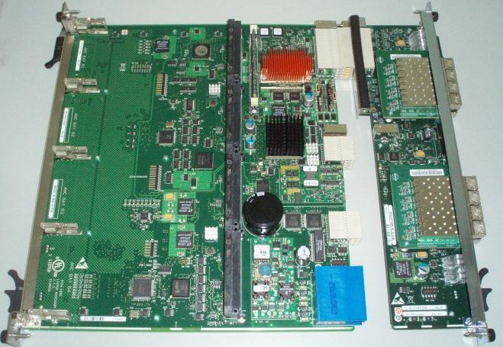
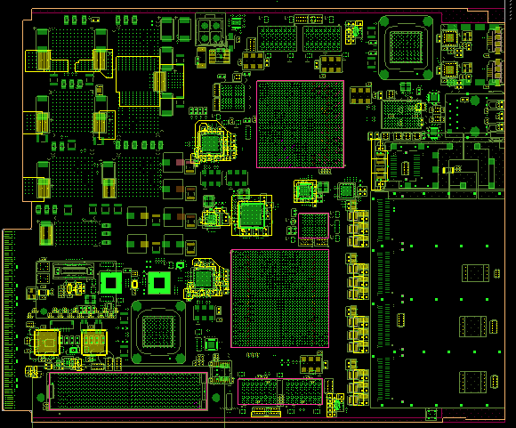
Atca - Carrier
Provides all auxiliary Support:
Mechanical
Power
Connectivity
Management
Notes:
It’s a double sized AMC card. The Advanced Mezzanine Card has or AMC has specific criteria that it has to meet. This is defined by the PICMG group or PCI Industrial Computer Manufacturers Group. This is a consortium of over 220 companies to adhere to an industrial standard to increase availability, cross platform support and time to market.
The carrier board provides all auxiliary functions. (Mechanical support, power, connectivity and management etc). Plan to have a working demonstrator not necessarily house in an ATCA at first but have it working by June this year. So preparing the ATCA to house the sROD is not a mechanically complex but we do need to understand how the software will interact with the board. How the board can use the Intelligent Platform Management Bus will be more complex.

Slide 10
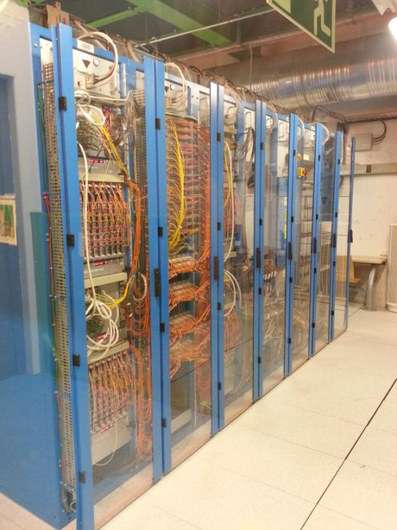
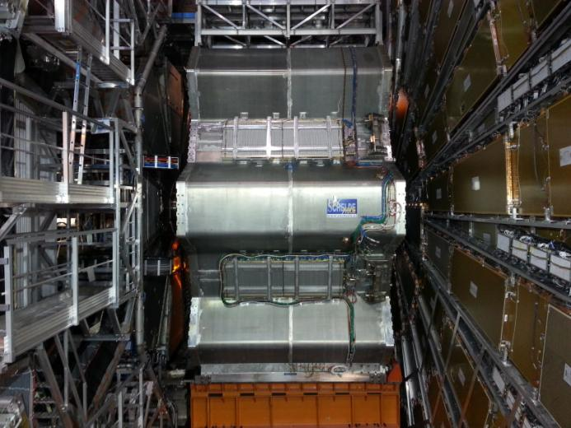
Atca at cern
Notes:
The ATCA will replace the entire VME crates that are currently being used.

Slide 11
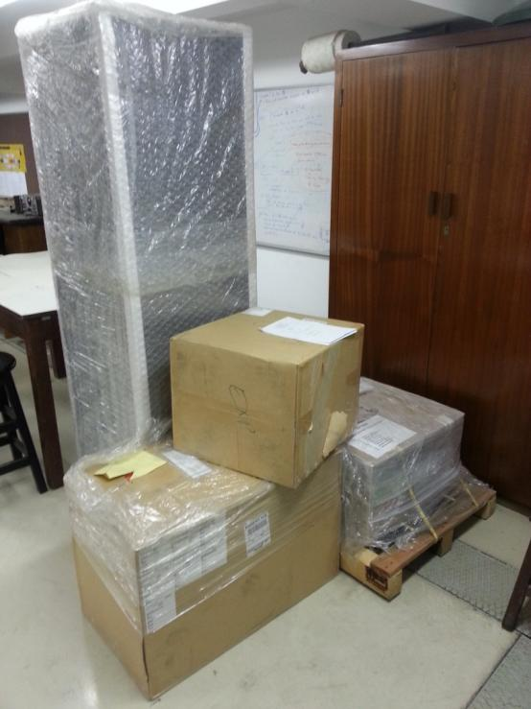
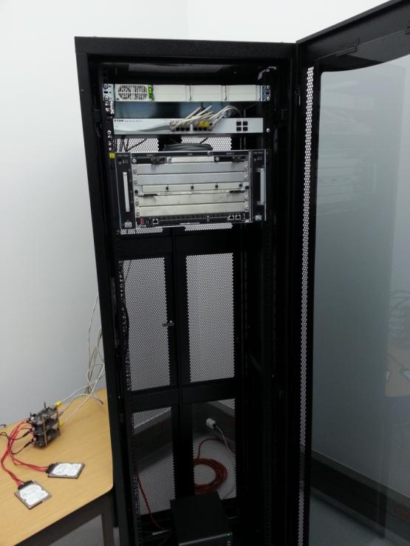
ATCA CRATE
Currently Situated in 3rd Year Labs
Notes:
The ATCA was delivered to WITS not to long ago and its now completely set up. Its currently being housed in the 3rd Year labs where the hands on sessions have been. So what exactly is this ATCA. Its an Advanced Telecommunications Computing Architecture. So essentially a very smart shelf.
It manages the hardware on a low level. The design is exceptionally modular. So if you insert a blade into the shelf it will initiate the power up sequence, the connectivity and allows full remote diagnostics and control of the device. Along with a lot of other functionality.

Slide 12
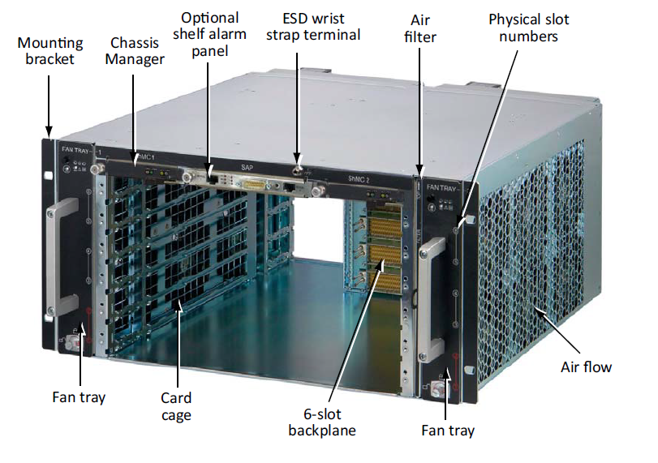
ATCA Chassis
Notes:
This is a diagram of the chassis. This distributes the power and has all the foundations like switching and mounting brackets etc. This version is a six slot chassis with a dual star topology. The bottom two slots are both connected to all the other slots. This offers a layer of redundancy to prevent down time.

Slide 13
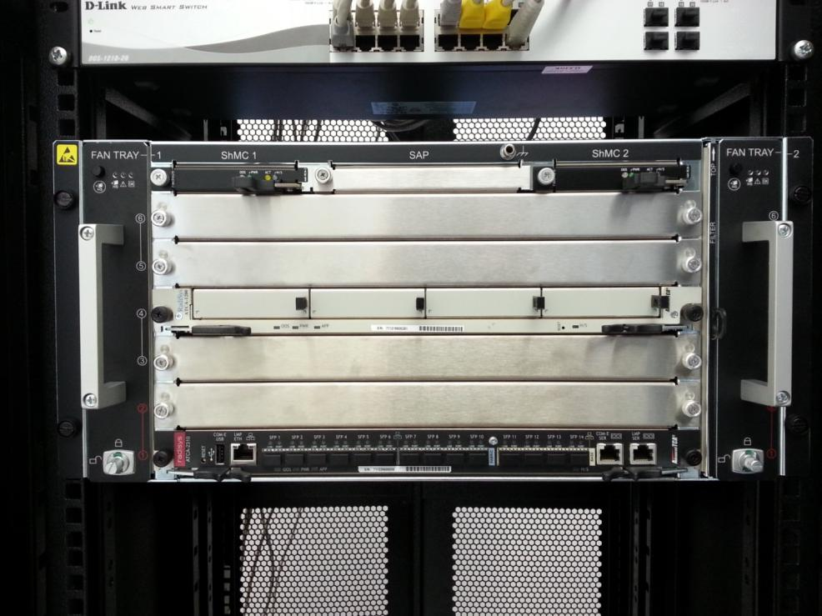
ATCA chassis
ATCA 6206 Chassis
ATCA 2100 Carrier Board
ATCA 2310 SCM
480 Gb Bandwidth
10G Switching
256 superdrawers
8 draws per sROD
32 sRODS in total
Notes:
On our set up we are only using two of the six slots right now. So there is a lot of space for future projects and developments. In the middle we have the Carrier board. I showed this in the picture with the sROD earlier. You would slot the sROD into two of the spaces on the carrier board. Two sRODS can be housed on one Carrier board. This is just for the demonstration project. For the actual upgrade in 2022 the sROD will be designed to use an entire blade. You will slot the sROD directly into the chassis.
At the bottom we have a Switching Control Module. This is the heart of the high performance platform. This model offers 10Gbit Switching, shelf management, networking timing and system management. The switch connects all modules (Blades) that are connected to the chassis. You can configure the ATCA to have two SCM and have one as a redundant in case of system failure. Such a system will not be needed so you could fit 5 sRODS in a chassis and this can support 40 super drawers. This is more than enough for the demonstrators needs. Since the throughput is handled on the sROD and not the switch itself. A 10G switch in the case is enough for monitoring and diagnostic purposes.
For the final upgrade to handle all 256 superdrawers we would need 32 sRODS (8 superdrawers per sROD) and these could fit into 3 16 slot ATCA chassis and this would just about fit on one rack.

Slide 14
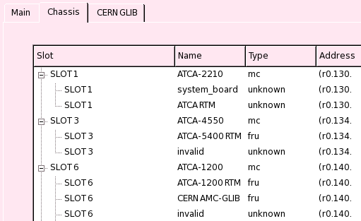
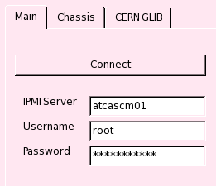
The way forward
Waiting for the demonstrator to be manufactured
Integrate the sROD into the ATCA
Duplicate the demonstrator project here at WITS
Allows testing and development of high through-put electronics at WITS
Develop software
Connect and monitor
devices real time

Slide 15
Questions

