Slide 1

Advances in Radon Research and Protection in Cameroon
Saïdou ^{1,2}
¹Research Centre for Nuclear Science and Technology, Institute of Geological and Mining Research, Yaoundé, Cameroon
²Nuclear Physics Laboratory, Physics Department, Faculty of Science, University of Yaoundé I, Yaoundé, Cameroon
African Nuclear Physics Conference, September 20-24, 2021

Slide 2
Outline
Introduction
Radon measurements and dosimetry
  Electret Ionization Chambers (EIC) (²²²Rn)
  RADUET detectors (²²²Rn and ²²⁰Rn)
  Thoron Progeny monitors (TnP)
  RADTRAK detectors (²²²Rn)
Results and Discussion
  Indoor ²²²Rn, ²²⁰Rn and TnP concentrations
  Inhalation dose due to ²²²Rn and ²²⁰Rn
  Importance of direct progeny measurements for correct estimation of effective dose due to ²²²Rn and ²²⁰Rn
  Rn Regulation and National Radon Action Plan
  Dosimetry of inhaled ²¹⁹Rn progeny and uncertainty on dose coefficients
Conclusion and Perspectives

Slide 3
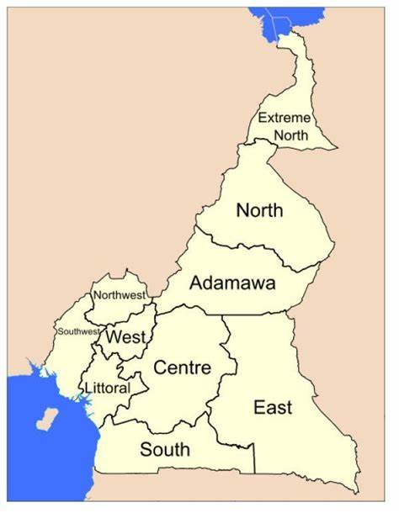
Introduction
Cameroon is located between Central and West Africa.
It is extended on 475 000 km² and has about 25 million of inhabitants.
Cameroon has ten Regions and the most populated cities are Yaoundé, political capital and Douala, economic capital.
Cameroon is currently among top countries having underground mineral ressources
Uranium, thorium, gold, diamond, cobalt, nickel, iron, rare-earth elements, etc. Most of the ore deposits are not yet exploited.
Radon measurements indoors started in 2012 with focus on mining and ore bearing areas. Various techniques were used: Electret Ionization Chambers, RADUET and RADTRAK detectors.
Up to date, radon has been measured in about 2500 houses.
We will focus our presentation on RADUET and RADTRAK data.

Slide 4
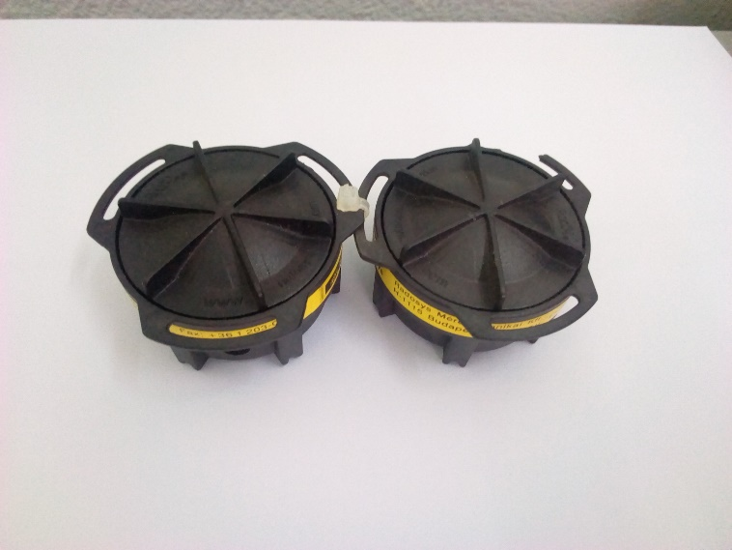
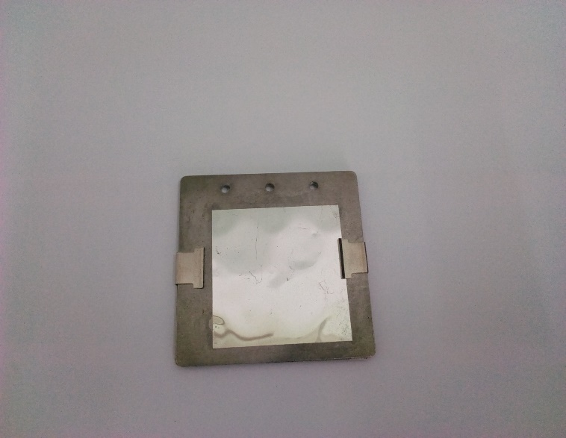
Material and Methods
²²²Rn, ²²⁰Rn and TnP measurements in dwellings
450 RADUET detectors and 350 TnP monitors were deployed for two months in the houses of East, Littoral, North, and South Regions with highlight on mining and ore bearing areas.
Detectors were collected and sent back to Hirosaki University in Japan for analysis.

Slide 5
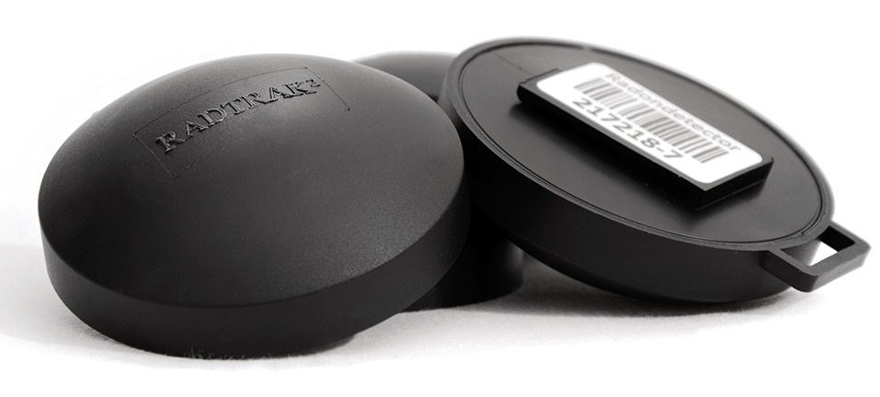
Material and Methods
²²²Rn measurements in dwellings
A total of 1400 RADTRAK detectors were deployed in the whole country without any discrimination (mining areas or not, ore bearing areas or not).
After two months of exposure, detectors were collected and sent back for analysis to RADONOVA Laboratories in Uppsala, Sweden.

Slide 6
Material and methods
Dosimetry of inhaled ²¹⁹Rn progeny
The effective dose coefficients of inhaled ²¹⁹Rn were calculated separately for three modes (AMTD=1 nm, AMAD=60 nm and 500 nm) using biokinetic and dosimetric models developed in the recent OIR Publications Series of ICRP. The biokinetic models of ²¹¹Pb and ²¹¹Bi have been implemented and solved in BIOKMOD.

Slide 7
Results and discussion
  Indoor radon, thoron and thoron progeny concentrations
Rn, Tn and TnP concentrations range between 3-2620 Bq.m⁻³, 4-700 Bq.m⁻³, and 0.4-36 Bq.m⁻³ respectively.
The corresponding arithmetic means are 103 Bq.m⁻³, 107 Bq.m⁻³ and 6.8 Bq.m⁻³.
Arithmetic mean at the national scale is well above the world average value of 40 Bq.m⁻³ given by UNSCEAR.
Region | Arithmetic mean (Bq.m⁻³) |  |  | Range (Bq.m⁻³)
 | ²²²Rn | ²²⁰Rn | TnP | ²²²Rn | ²²⁰Rn | TnP
Adamawa | 133 | - | - | 30-540 | - | -
Centre | 48 | - | - | 3-235 | - | -
East | 80 | 92 | 6 | 27-300 | 4-383 | 0.6-19
Far North | 157 | - | - | 62-310 | - | -
Littoral | 95 | 80 | 4.6 | 3-436 | 4-246 | 1.5-13
North | 48 | 94 | 6.4 | 4-2260 | 24-238 | 4-9
North-West | - |  |  | -
South | 113 | 160 | 10.3 | 23-2620 | 6-700 | 0.4-36
South-West | - |  | - | -
West | 140 | - | - | 30-530 | - | -

Slide 8
Results and discussion
  Indoor radon, thoron and thoron progeny concentrations
Region | Percentage (%) of houses having radon above the Reference Levels |  |  | Percentage (%) of houses having thoron above some specific levels
 | ≥100 Bq.m⁻³ | ≥200 Bq.m⁻³ | ≥300 Bq.m⁻³ | ≥100 Bq.m⁻³ | ≥200 Bq.m⁻³ | ≥300 Bq.m⁻³
Adamawa | 58 | 14 | 5 | - | - | -
Centre | 6 | 2 | 0 | - | - | -
East | 33 | 2 | 1 | 19 | 9 | 2
Far North | 90 | 16 | 1 | - | - | -
Littoral | 33 | 1 | 1 | 32 | 3 | 0
North | 20 | 3 | 3 | 43 | 2 | 1
North-West | - | - | - | - | - | -
South | 47 | 2 | 1 | 56 | 33 | 15
South-West | - | - | - | - | - | -
West | 72 | 13 | 3 | - | - | -
On average 49%, 9%, and 2% of all surveyed houses have ²²²Rn concentrations above 100, 200 and 300 Bq.m⁻³ respectively.
It clearly appears the importance to put in place Rn regulation and national Rn action plan in Cameroon.
Adamawa, Far North and West have on average radon concentrations higher than those of other regions.
The city of Ngaoundéré, capital of the Adamawa Region appears as the most Rn-exposed area with 28% of houses having Rn above the reference level of 300 Bq.m⁻³.

Slide 9
Results and discussion
  Indoor radon, thoron and thoron progeny concentrations
The highest Rn concentration of 2620 Bq.m⁻³ was found in the South Region.
Additional field works are ongoing in the whole country to measure geogenic Rn, indoor Rn, Tn, RnP, TnP using other techniques.
Rn prone areas of the country will be located.
Prior to inhalation dose assessment, the equilibrium factor of Rn and Tn should be known.

Slide 10
Results and discussion
  Indoor radon, thoron and thoron progeny concentrations
Only Tn equilibrium factors were calculated from experimental data while the value of 0.4 given by UNSCEAR was used for Rn.
Tn equilibrium factors range between 0.01-0.6 with the arithmetic mean of 0.09 higher than the world average value of 0.02 given by UNSCEAR.
Tn equilibrium factor varied according to seasons, the type of dwelling, building materials and localities (ex: Lolodorf).

Slide 11
Results and discussion
Inhalation dose due to radon and thoron indoors
Region | Mean dose (mSv.yr⁻¹) |  | Range (mSv.yr⁻¹)
 | ²²²Rn | ²²⁰Rn | ²²²Rn | ²²⁰Rn
Adamawa | 2.5 | - | 0.8-10.2 | -
Centre | 0.9 | - | 0.06-4.5 | -
East | 1.5 | 2 | 0.5-5.7 | 0.13-4
Far North | 3 | - | 1.2-4 | -
Littoral | 1.8 | 1 | 0.05-8.2 | 0.3-3
North | 0.9 | 1.8 | 0.07-43 | 0.34-6.2
North West | - | - | - | -
South | 2.1 | 2.2 | 0.4-50 | 0.08-8
South West | - | - | - | -
West | 2.6 | - | 0.6-10 | -
Inhalation dose due to ²²²Rn and ²²⁰Rn exposure indoors ranges between 0.06-50 mSv.yr⁻¹ and 0.08-8 mSv.yr⁻¹.
The mean value for ²²²Rn at the national level is 1.9 mSv.yr⁻¹ higher than the world average value of 1.2 mSv.yr⁻¹ (0.2-10 mSv.yr⁻¹) given by UNSCEAR.
The mean value of inhalation dose due to Tn exposure indoors is 1.75 mSv.yr⁻¹.

Slide 12
Results and discussion
Inhalation dose due to radon and thoron indoors
The contribution of Tn to inhalation dose due to Rn and Tn exposure ranges between 12–67, 3–80, 7–70 and 7–60% in the North, South, East and Littoral regions respectively.
The corresponding average values are 49, 53, 31 and 26% respectively.
It clearly highlights the importance to consider Tn in inhalation dose assessment of Rn to avoid biased results in epidemiological studies.

Slide 13
Results and discussion
Inhalation dose due to radon and thoron indoors
This result contributes to bring out the urgent need to regulate Tn exposure at the international level.
A reference level combining radon and thoron should be explored.

Slide 18
Results and discussion
The importance of direct progeny measurements for correct estimation of effective dose due to radon and thoron
Total effective dose determined directly from thoron and its progeny was compared with the doses estimated using the equilibrium factor (F_{Tn}) of 0.02 given by UNSCEAR.
Thoron effective dose traditionally determined varied according to the equilibrium factor used, and remained different from that of the direct measurement which uses EETC.
So, the internal radiation dose resulting from the direct measurement seems more realistic. It can better inform about the thoron contribution to the total effective dose due to radon and thoron. The risk of public exposure to thoron may therefore be higher than that of radon in many parts of the world if F_{Tn}=0.02 is no longer used in estimating total effective dose.
This study confirms the conclusions of UNSCEAR and ICRP on the important contribution of thoron and its associated progeny in the effective dose.

Slide 20
Results and discussion
Radon regulation and national radon action plan
The collected data on Rn using EICs and RADUET detectors helped to build a Technical Cooperation Project with IAEA on Establishing a national Rn plan for controlling public exposure due to Rn indoors implemented from 2018 to 2020.
Equipment received from the project:
1500 radon track detectors ;
01 Radon calibration system ;
01 Equipment for radon measurements in soil ;
01 In-situ gamma spectrometer ;
20 integral radon monitors (RadonEye)

Slide 21
Results and discussion
Radon regulation and national radon action plan
Regulation on Rn was drafted by the regulatory body from 2019-2020 and the process to adopt it is ongoing.
The national Rn action plan was validated during a national workshop in October 2020 involving all the national stakeholders.
To efficiently implement the young national Rn action plan, mitigation of high Rn levels in houses and workplaces, Rn prevention, capacity building on Rn risk communication, Rn regulation should be strengthened or taken into account.
A new project on Strengthening National Rn Action Plan to Mitigate Public Exposure to Rn in Dwellings and at Workplaces in Cameroon will be launched shortly within the framework of 2022-2023 IAEA TC Cycle.

Slide 22
Results and discussion
Dosimetry of inhaled ²¹⁹Rn progeny
The inhalation of actinon progeny provided the highest dose to the lungs and ET airways.
The calculations indicated that the most exposed region of the lung tissues for ²¹¹Pb was the bronchial for the unattached and attached fractions respectively for particle size of 1 nm and 500 nm and the bronchiolar for the attached fraction of 60 nm.
However, the most exposed region of the lung tissues for ²¹¹Bi was bronchiolar for unattached fraction (1nm) and bronchiole for attached fractions (60 nm and 500 nm particles size).

Slide 23
Results and discussion
Dosimetry of inhaled ²¹⁹Rn progeny
The inhalation dose coefficients of actinon progeny found in this work were much closer to those of the ICRP 137.
Furthermore, in order to work out the dose conversion coefficient for actinon (²¹⁹Rn) decay products, a study of activity size distributions and measurement of activity concentration of actinon progeny is recommended to be conducted in hospitals during the treatment of prostate cancer metastasis with ²²³Ra.

Slide 25
Results and discussion
Uncertainty on dose coefficients of actinon progeny
Taking into account of the Activity Median Thermodynamic Diameter (AMTD) of 1 nm representing the unattached mode and the Activity Median Aerodynamic Diameters (AMAD) of 60 nm and 500 nm for attached mode, the overall relative uncertainties of inhaled dose coefficients of ²¹¹Bi and ²¹¹Pb for the reference adult (male and female) in some specific conditions are respectively:
8.5% and 8.6% for unattached particles (AMTD= 1 nm)
9.1% and 8.7% for attached particles (nucleation mode AMAD= 60 nm)
8.1% and 7.7% for attached particles (accumulation mode AMAD= 500 nm).

Slide 26
Results and discussion
Uncertainty on dose coefficients of actinon progeny
Specific conditions:
Considering the relative uncertainty on the Specific Absorbed Fractions, the radiation and tissues weighting factor, the number of nuclear transformations per activity intake, and target region fractional weights at 5%, and also considering correlation between SAFs at 5% to take into account the importance of target and source organs.
Finally ICRP should continue improving biokinetic and dosimetric models to make them more physiological realistic to reduce the above uncertainties.

Slide 27
Uncertainties on the Assessment of Effective Dose Coefficients of ²¹⁹Rn Progeny
Atangana Bingana Martin Serge*, Hamadou Issa*, Saïdou*, §, †
*Nuclear Physics Laboratory, Faculty of Science, University of Yaoundé I, P.O. Box 812 Yaoundé, Cameroon
§Nuclear Technology Section, Institute of Geological and Mining Research, P.O. Box 4110 Yaoundé, Cameroon
†Corresponding author
Nuclear Physics Laboratory, Faculty of Science, University of Yaoundé I, P.O. Box 812 Yaoundé, Cameroon.
Nuclear Technology Section, Institute of Geological and Mining Research, P.O. Box 4110 Yaoundé, Cameroon
E-mail: saidous2002@yahoo.fr/ous.saidou@gmail.com

Slide 28
Conclusion and perspectives
Rn has been measured in about 2500 houses at the national scale.
Collected data brought out the importance to develop Rn regulation and national Rn action plan.
Regulation on Rn was drafted and the validation process is ongoing.
The national Rn action plan was validated during a national workshop in 2020 involving all the national stakeholders.
The next step is to make operational the national Rn plan and Rn regulation by emphasizing on Rn-risk communication, Rn mitigation and integration of radon issue in building codes.
Rn-risk mapping will be extended to all the country to locate the Rn prone areas for radiological protection of the public. Rn measurements at workplaces will be considered.
At the international level there is requirement to take into consideration Tn exposure in the regulation of Rn. Thus Tn reference levels or combined Rn-Tn reference levels should be defined.
International scientific collaboration will continue and will be strengthened.

Slide 29
Thank you for your kind attention

