Slide 1
Simulation of Monte-Carlo events at the LHC using a Generative model based on Kernel Density Estimation
First Pan-African Astro-Particle and Collider Physics Workshop
Nidhi Tripathi
School of Physics
University of the Witwatersrand, Johannesburg, SA
Supervisors:
Prof. Bruce Mellado
Dr. Xifeng Ruan

Slide 2
Outline
Introduction.
2. Results.
3. Conclusion.

Slide 3
Machine Learning
Introduction
Machine learning algorithms are used to make a prediction or classification.
Machine learning algorithms are generally used for different applications such as weather forecasting, stock trading, facial recognition, medical prediction, spam detection and commodity sales among others.
Machine learning is a sub-fields of artificial intelligence.
Ref: https://www.ibm.com/za-en/cloud/learn/machine-learning#toc-machine-le-SzgJbkmk

Slide 4
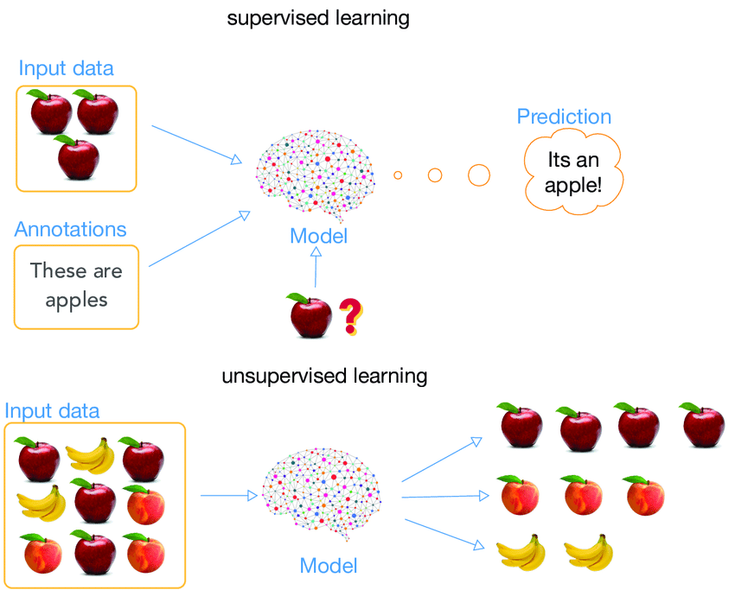
Introduction
Machine Learning Methods
Supervised Learning
Supervised machine learning:
Unsupervised machine learning:
Semi-supervised learning:
Unsupervised Learning

Slide 5
Introduction
Generative Models
In recent years generative model rapidly being applied, adapted and developed for fast, accurate simulation essential for particle physics experiments. A generative model tries to learn the probability distribution that generates the sample data. A Generative Model is a powerful way of learning any kind of data distribution using unsupervised learning.
Types of generative model are:
Variational autoencoder
Generative adversarial network
Gaussian Mixtures
Kernel Density Estimation

Slide 6
Introduction
Generative Models
In recent years generative model rapidly being applied, adapted and developed for fast, accurate simulation essential for particle physics experiments. A generative model tries to learn the probability distribution that generated the data.
Types of generative model are:
Variational autoencoder
Generative adversarial network
Gaussian Mixtures
Kernel Density Estimation

Slide 7
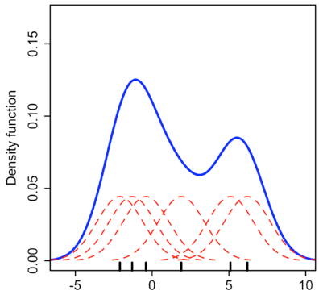
Kernel density estimation
Introduction
Kernel density estimation or KDE is a non-parametric way to estimate the probability density function of a random variable. In other words, the aim of KDE is to find probability density function (PDF) for a given dataset. With this generative model, new samples can be drawn.
For a sample of (x₁,x₂,…,x_{n}) the kernel density estimate, is given by:
p(x)=$\frac{1}{nh} \sum_{j=1}^{n}{K} \left({x−xj \atop h}\right)$
where K(a) is the kernel function and h is the smoothing parameter, also called the bandwidth.
Source: Wikipedia
Ref: https://en.wikipedia.org/wiki/Kernel_density_estimation#:~:text=In%20statistics%2C%20kernel%20density%20estimation,on%20a%20finite%20data%20sample.

Slide 8
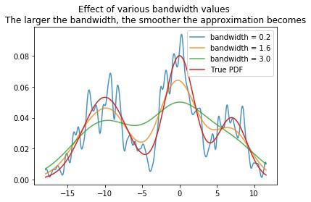
Introduction
Tuning The Bandwidth Parameter
The scikit-learn library allows the tuning of the bandwidth parameter via cross-validation and returns the parameter value that maximizes the log-likelihood of data.
The function we can use to achieve this is GridSearchCV(), which requires different values of the bandwidth parameter.
Source: Wikipedia

Slide 9
KDE Results
In the search for new bosons, the Zγ final state data is used as a pure background sample. Using Scikit-learn and NumPy libraries the KDE generative model is constructed to take the pre-processed Zγ data and generate a sample dataset.
Zγ fast simulated dataset:
['mlly', 'phi_zy', 'eta_zy', 'pt_zy', 'e_zy', 'mll', 'phi_ll', 'eta_ll', 'pt_ll', 'e_ll', 'dR_ll', 'MET', 'MET_phi', 'Nj', 'Ncj', 'dPhi_ll', 'dPhi_METZy', 'llpt_mlly']

Slide 10
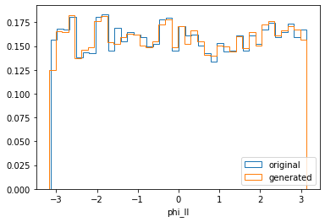
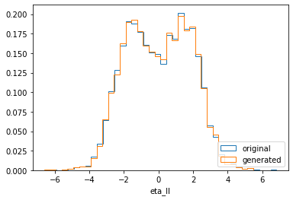
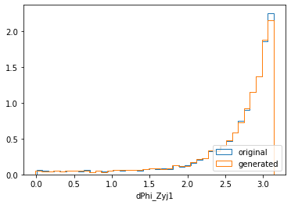
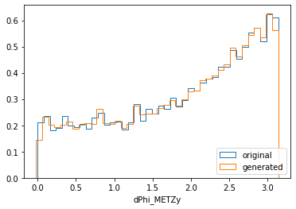
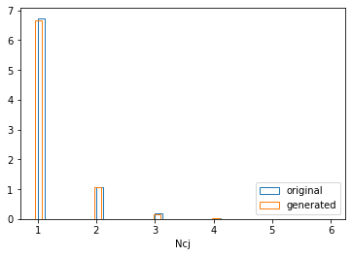
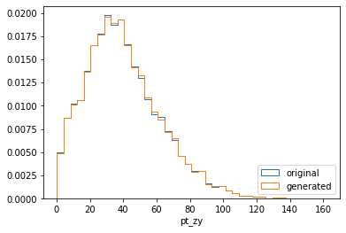
KDE Results
Bandwidth= 0,01, Sample Size= 100,000
Frequency
Frequency

Slide 11
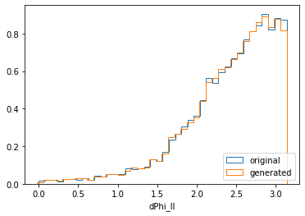
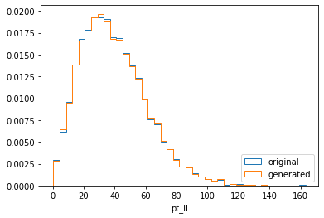
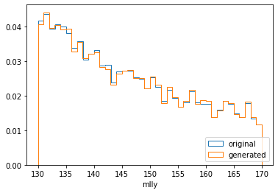
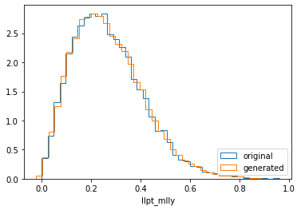
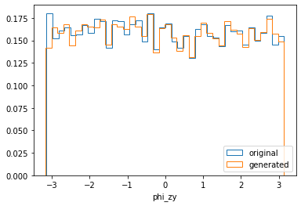
KDE Results
Bandwidth= 0,01, Sample Size= 100,000
Frequency
Frequency

Slide 12
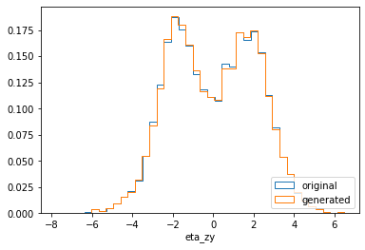
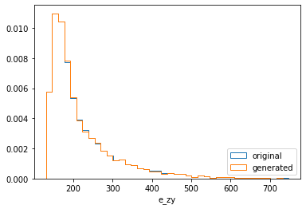
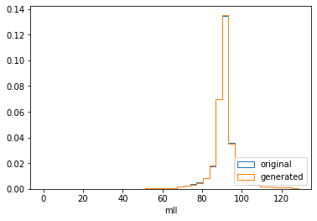
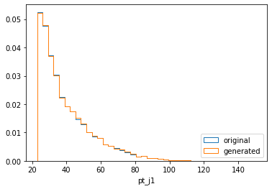
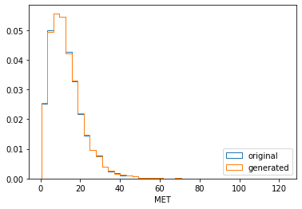
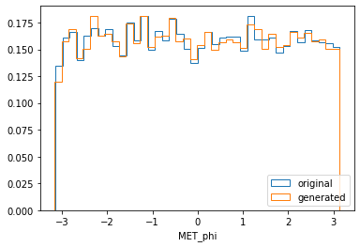
KDE Results
Bandwidth= 0,01, Sample Size= 100,000
Frequency
Frequency

Slide 13
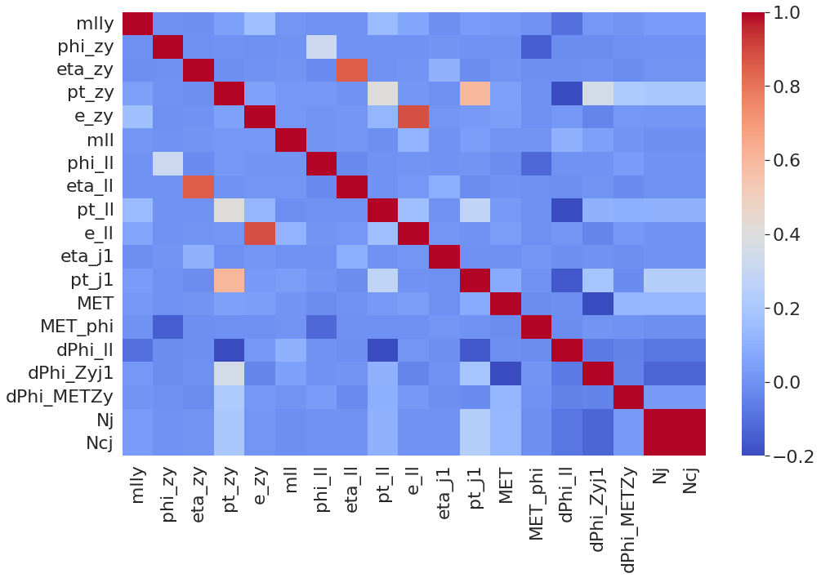
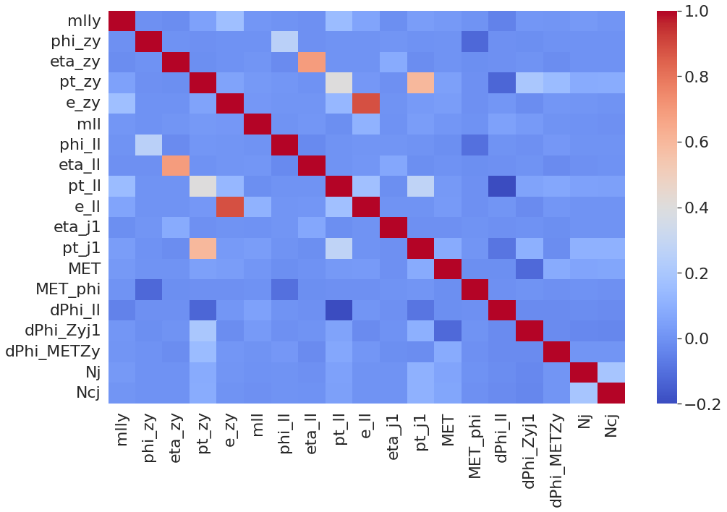
KDE Results
Correlation heatmap
Original Events
Generated Events

Slide 14
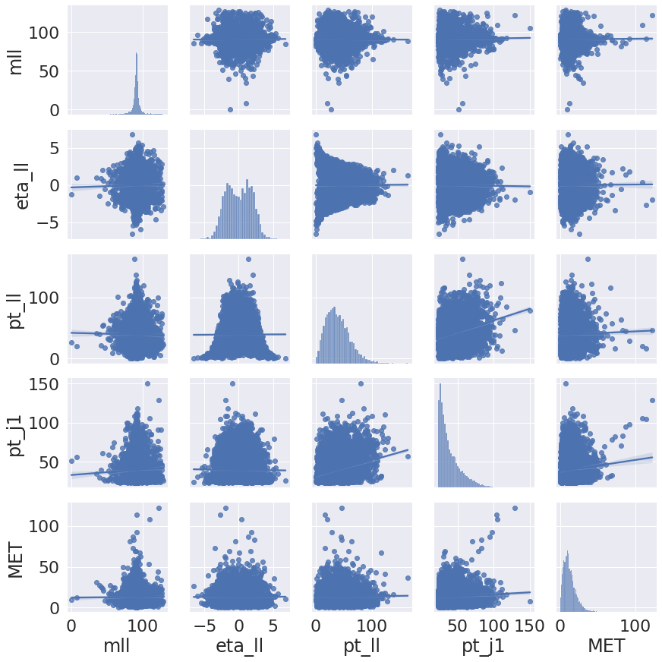
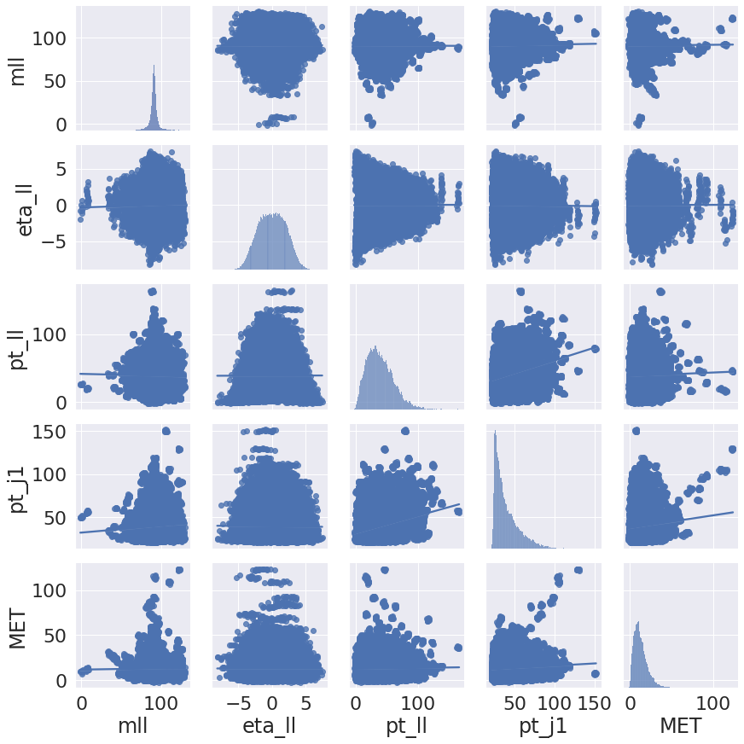
KDE Results
Original data pair plot
Generated data pair plot

Slide 15
Conclusion
Kernel density estimation (KDE ) sampling model performs well.
The performance of KDE model degrades exponentially with high dimensional data sets, this phenomenon is called “curse of dimensionality”.
Continue investigation for better KDE performance on new datasets.

