Slide 1


Monitoring and Analysis of the ATLAS Tile calorimeter Low-Voltage Power Supplies temperature data.
Lungisani Sipho Phakathi
Supervised
by
Mgr. Juraj Smieško, PhD, Filipe Martins & Dr Betty Kibirige

Slide 2
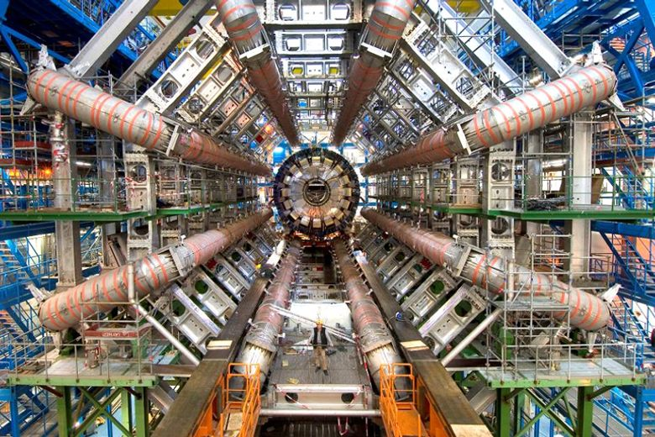
Content
CERN
  Large Hardron Collider
  ATLAS
  Tile Calorimeter
Tile-In-One
Detector Control System
Goals and Objective
Current Results
Conclusion

Slide 3
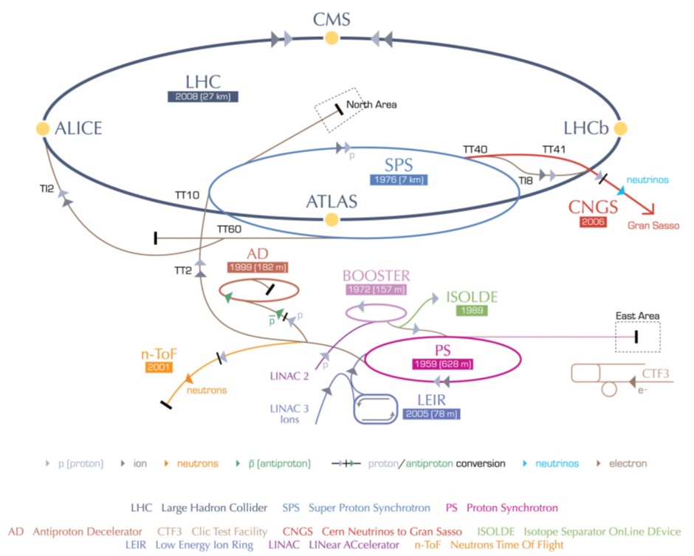
Large Hadron Collider
The European Organisation for Nuclear Research (CERN), based in France and Switzerland is Europe’s foremost particle physics laboratory
The Large Hadron Collider (LHC) is the world’s most powerful particle accelerator, giving high energy proton-proton collision at an energy of 13TeV situated at CERN.

Slide 4
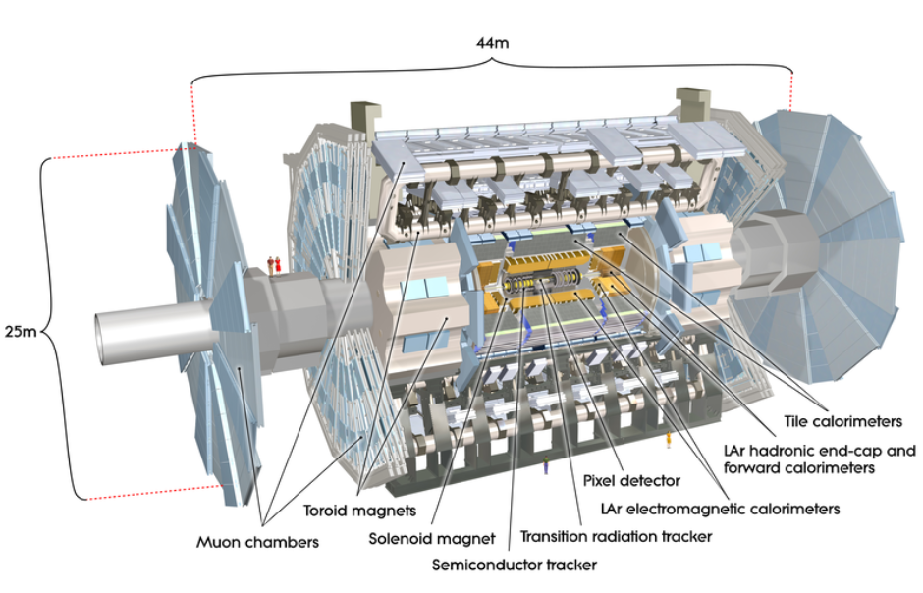
ATLAS DETECTOR
Out of four detectors, the main focus is based on ATLAS detector as it is the one of two general-purpose proton-proton experiments at the LHC.

Slide 5
Tile Calorimeter
One of the sub-detectors of ATLAS is the Tile calorimeter.
Numerous tasks must be performed by different tools that were developed independently in order
to ensure its proper operation and
assess the quality of the data.

Slide 6
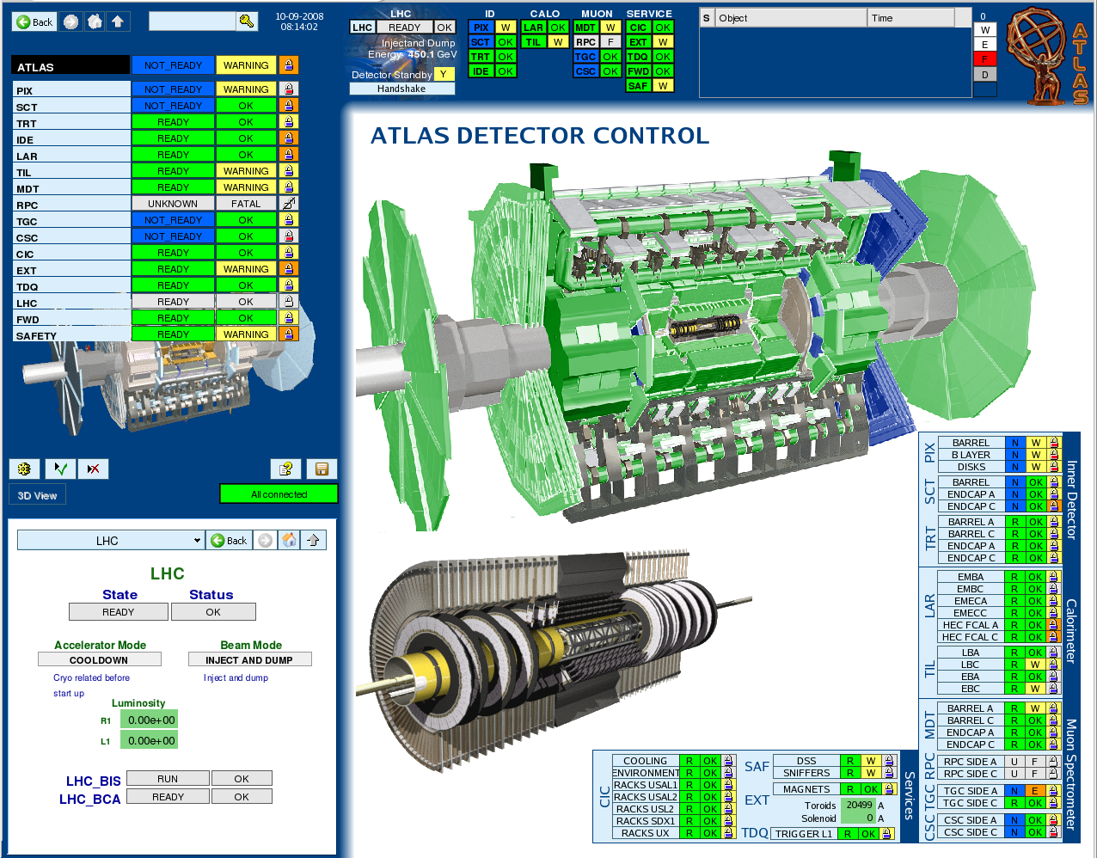
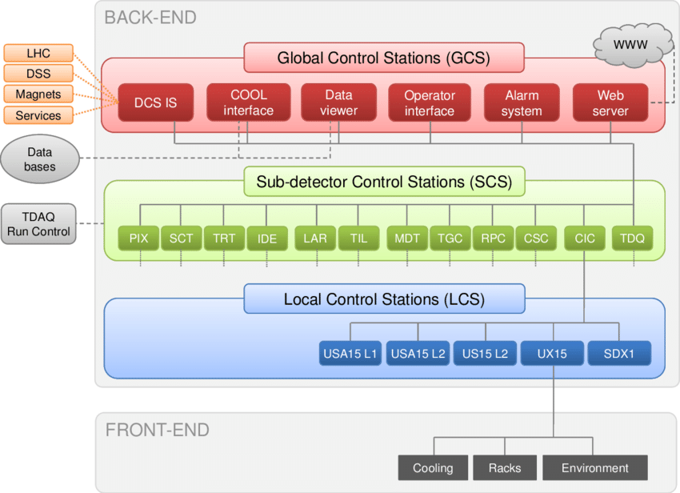
Detector Control System (DCS)

Slide 7
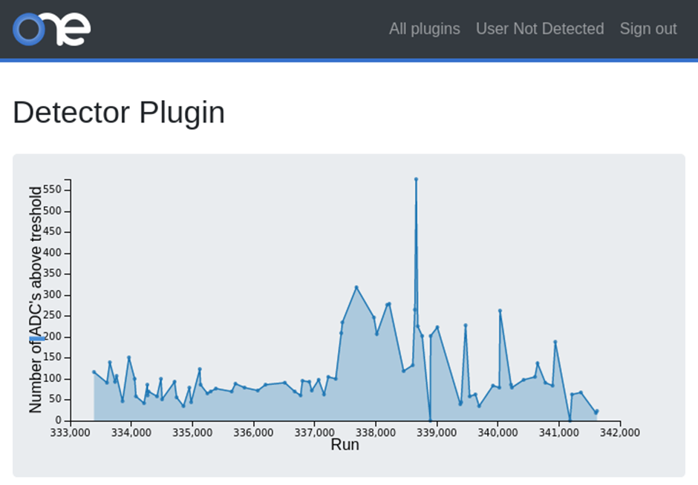
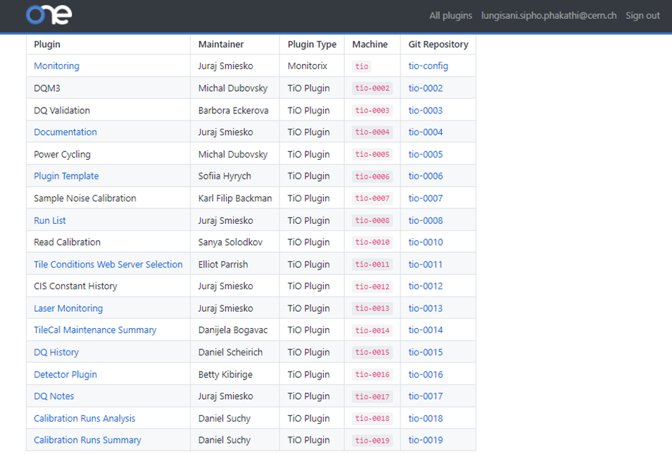
Tile-In-One: Plugin
Tile-in-One (TiO) is a collection of small sized independent web tools called plugins.

Slide 8
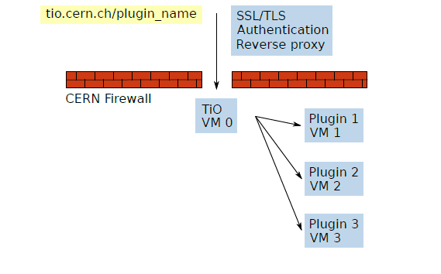
Tile-In-One: Architecture
The TiO web platform is designed with the flexibility and ease of maintenance.
One plugin needs data from several
different data sources. Having one VM
per plugin allows the plugin developers
to setup it in the required way without
interference of other plugins.
ATLAS DCS Data Viewer (DDV) allows
access to the historical data.

Slide 9
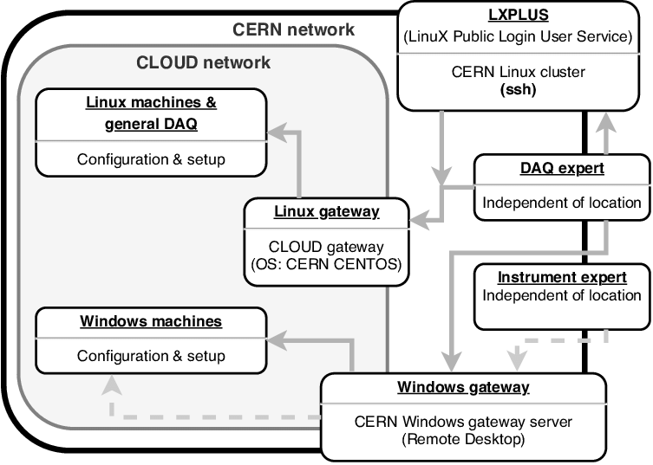
Goals and Objectives:
To access the DCS temperature data
Visualising temperature data using interactive plotting library
  Plotly.js library is used for graphical
Collecting the DCS temperature data, analyse and display the status of the module to the user

Slide 10
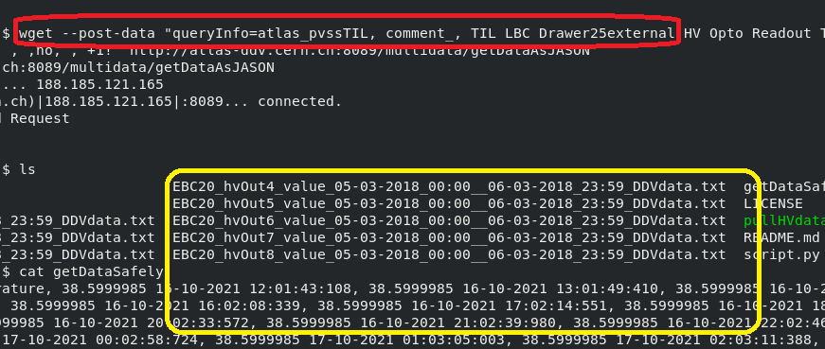
The function of a Detector Plugin
The detector plugin was using “wget” command to query the DDV server to collect data and the results comes in the form of a text file that needs to be converted to a csv file.
Output was then drawn using d3.js to be visualised by the user.

Slide 11
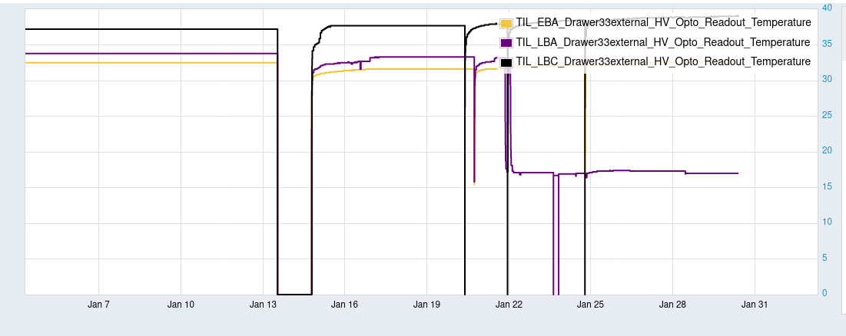
Still need to be analysed

Slide 12
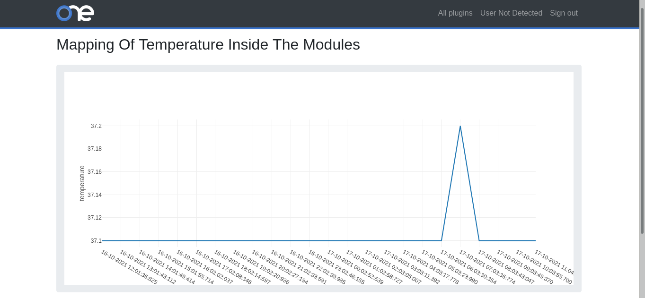
Results of current status
HTTP REQUESTS
TEMPORARY SOLUTION
PLOTLY.js LIBRARY FUNCTIONALITY

Slide 13
Discussion and conclusion
The main focus is on showing one plugin properly
Collecting data at the different times
Comparing the data for checking with the previous periods of last 24hrs
Accessing the quality of the cooling of the module
Present in an easy way the actual temperature values across different modules
There is still more need to be done

