Slide 1
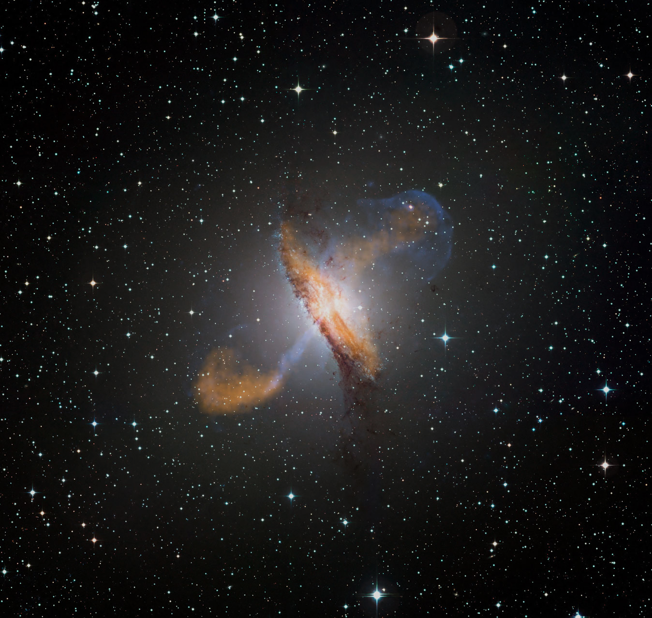



Very-High-Energy Neutrino Production in Jetted Active Galactic Nuclei
Markus Böttcher
SARChI Chair of Astrophysics and Space Physics
North-West University
Potchefstroom, South Africa
This work is based on the research supported in part by the National Research Foundation of South Africa (Grant Number 64789).

Slide 2
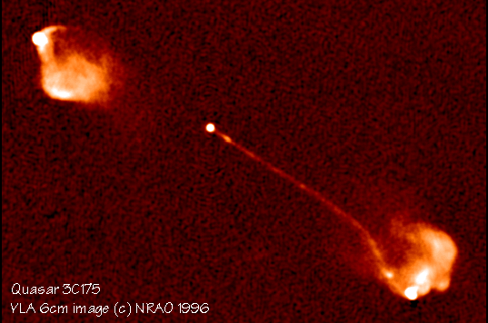
Blazars
0
Class of AGN consisting of BL Lac objects and gamma-ray bright quasars
Rapidly (often intra-day) variable
Strong gamma-ray sources
Radio jets, often with superluminal motion
Radio and optical polarization

Slide 3
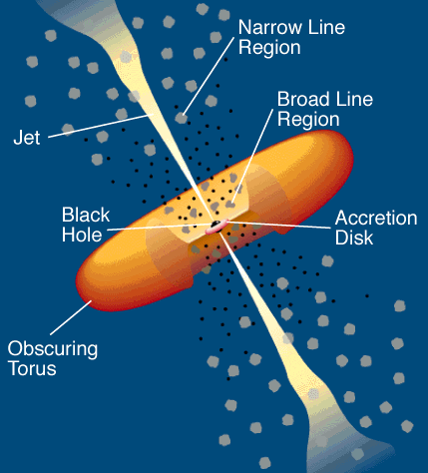
(Lepto-)Hadronic Blazar Models
0
Injection, acceleration of ultrarelativistic electrons and protons
Proton-induced radiation mechanisms:
Relativistic jet outflow with Γ ≈ 10
νF_{ν}
γ^{-q}
Q_{e,p} (γ,t)
ν
Proton synchrotron
γ₁
γ₂
γ
pγ → pπ⁰ π⁰ → 2γ
Synchrotron emission of primary e⁻
pγ → nπ⁺ ; π⁺ → μ⁺ν_{μ}
μ⁺ → e⁺ν_{e}ν_{μ}
νF_{ν}
→ secondary μ-, e-synchrotron
See talk by Q. King, T. Govenor, and M. Fu on Monday for a brief discussion of leptonic models
ν
Cascades …

Slide 4
Basics of Neutrino Production
p + γ → p + π⁰
or n + π⁺
π⁰ → 2γ
π⁺ → μ⁺ + ν_{μ} τ = 2.55×10⁻⁸ s
π⁻ → μ⁻ + ν_{μ}
μ⁺ → e⁺ + ν_{μ} + ν_{e} τ = 2.2×10⁻⁶ s
μ⁻ → e⁻ + ν_{μ} + ν_{e}

Slide 5
Photo-Pion Production
Fractional energy output
Spectral index of target photon field
(Mücke et al. 1998)
Total energy output in neutrinos is ~ approx. equal to energy output in photons:
~ 5 % of the original proton energy to every neutrino.

Slide 6
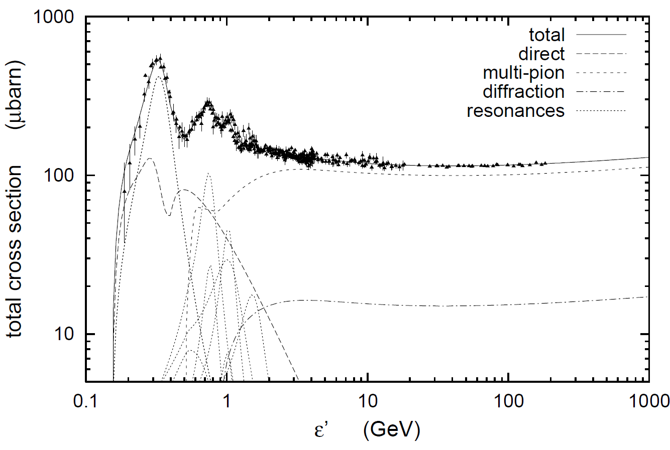
Photo-Pion Production
Δ⁺ resonance (1232 MeV)
σ(pγ→pπ⁰) : σ(pγ→nπ⁺) = 2:1
(Baldini et al. 1998; Mücke et al. 2000)

Slide 7
Photo-Pion Production
Spectral index (n[ε] ~ ε^{−α}) of target photon field
Interaction Probability
(Mücke et al. 1999)
Center-of-Momentum energy
For realistic target photon fields, most interactions occur near threshold (at Δ⁺ resonance).

Slide 8
Photo-pion production - Energetics
p-γ threshold: ~ 10¹⁷ eV E_{t,eV}⁻¹
At Δ⁺ resonance:
s = E_{p}’ E_{t}’ (1 – β_{p}’ μ) = E_{Δ+}² = (1232 MeV)²
Each neutrino takes about ~ 5 % of the proton’s energy
To produce IceCube neutrinos (~ 100 TeV → E_{ν} = 10¹⁴ E₁₄ eV):
Need protons with E’_{p} ~ 200 E₁₄ δ₁⁻¹ TeV
and target photons with E’_{t} ~ 1.6 E₁₄⁻¹ δ₁ keV

Slide 9
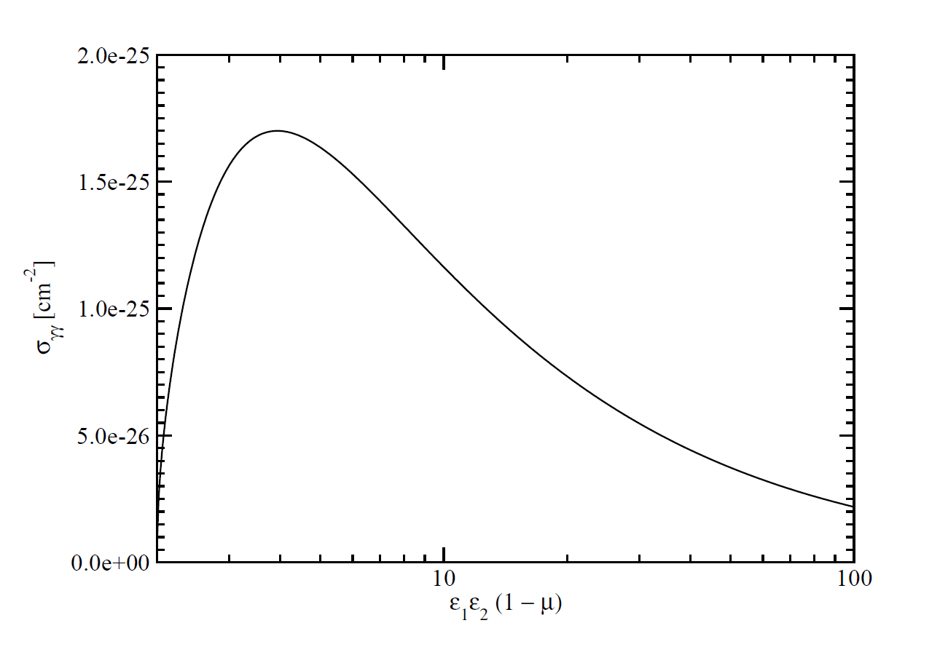
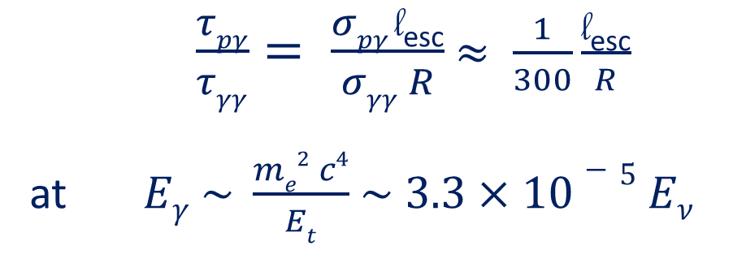
The pγ Efficiency Problem
Efficiency for protons to undergo pγ interaction ~ τ_{pγ} = l_{esc} σ_{pγ} n_{ph}
Likelihood of γ-ray photons to be absorbed ~ τ_{γγ} = R σ_{γγ} n_{ph}
Efficient neutrino production sites are likely to be optically thick to γ-rays
Expect no correlation between γ-ray and neutrino activity!
Correlation between neutrino activity and X-ray – soft γ-ray activity expected due to cascading!
(talk by Q. King, T. Govenor, and M. Fu Monday)
σ_{pγ}
σ_{γγ}
$\frac{τpγ}{τγγ}= \frac{σpγ \text{l}\text{esc}}{σγγ R}$ $≈ \frac{1}{300}\frac{\text{l}\text{esc}}{R}$
at $Eγ \sim \frac{me2 c4}{Et}$ $\sim 3.3×10−5 Eν$
l_{esc} = average length travelled by protons until escape
~ GeV – TeV γ-rays

Slide 10
Photo-Pion Models for TXS 0506+056
(Gao et al. 2019)
Models with p-γ induced γ-ray emission over-produce X-rays due to cascades!

Slide 11
Photo-Pion Models for TXS 0506+056
(Keivani et al. 2018)
(Gao et al. 2019)
Models producing neutrinos and gamma-rays require leptonic-dominated gamma-ray production!

Slide 12
Photo-pion production –
Origin of Target Photons
To produce IceCube neutrinos (~ 100 TeV → E_{ν} = 10¹⁴ E₁₄ eV):
Need protons with E’_{p} ~ 200 E₁₄ δ₁⁻¹ TeV
and target photons with E’_{t} ~ 1.6 E₁₄⁻¹ δ₁ keV
=> Not UHECRs!
=> X-rays!
(At least) two possible scenarios:
Target photons co-moving with the emission region
E_{t}^{obs} ~ 16 E₁₄⁻¹ δ₁²/(1+z) keV
Observed as hard X-rays
Can be ruled out from energetics constraints.
Target photons stationary in the AGN frame
E_{t}^{obs} ~ 160 E₁₄⁻¹/(1+z) eV
Observed as UV / soft X-rays
Plausible. All constraints can be met.

Slide 13
Photo-pion production –
Origin of Target Photons
Possible sources of external UV / soft X-ray target photons:
Broad Line Region?
(Padovani et al. 2019)
Slow-moving sheath
(Tavecchio & Ghisellini 2005)
Accretion flow (RIAF)
(Righi et al. 2019)

Slide 14
Summary
Jetted active galactic nuclei are likely sources of some of the IceCube-detected very-high-energy neutrinos.
Production of IceCube neutrinos requires
  Protons of ~ PeV energies
  Target photons of co-moving UV / X-ray energies
No correlation between γ-ray and neutrino activity necessarily expected, but correlation with X-rays.
IceCube 170922A / TXS 0506+056 and other possible neutrino – blazar correlations strongly favour
  leptonically-dominated γ-ray emission
  UV / soft X-ray target photon field external to the jet
Supported by the South African Research Chairs Initiative (SARChI) of the Department of Science and Innovation and the National Research Foundation of South Africa.

Slide 15
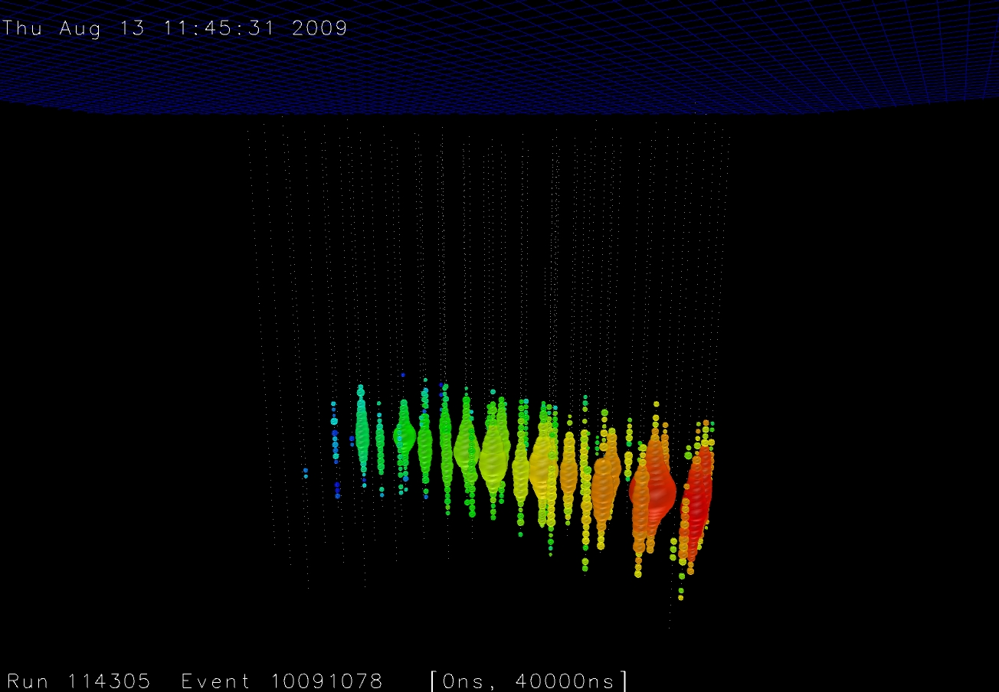
Thank you!
Any opinion, finding and conclusion or recommendation expressed in this material is that of the authors and the NRF does not accept any liability in this regard.

Slide 16
Backup Slides

Slide 17
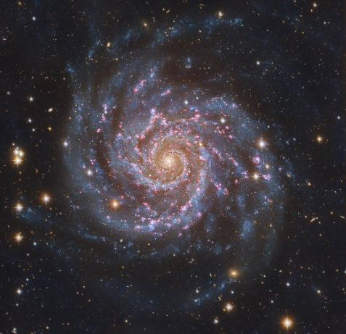
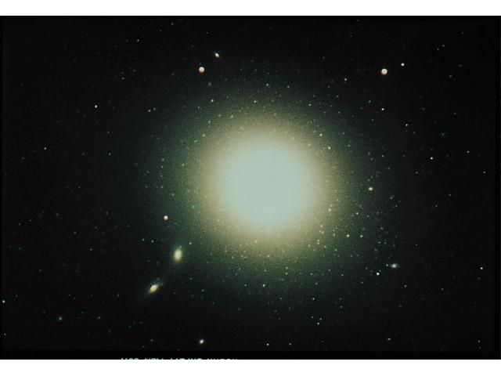
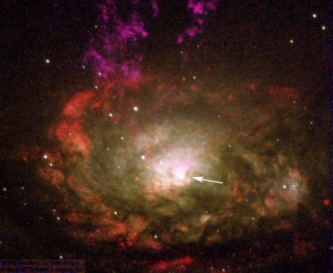
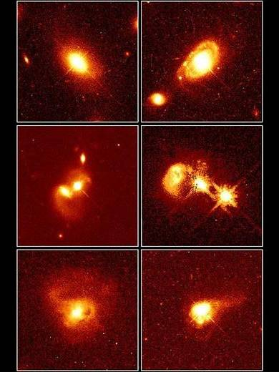
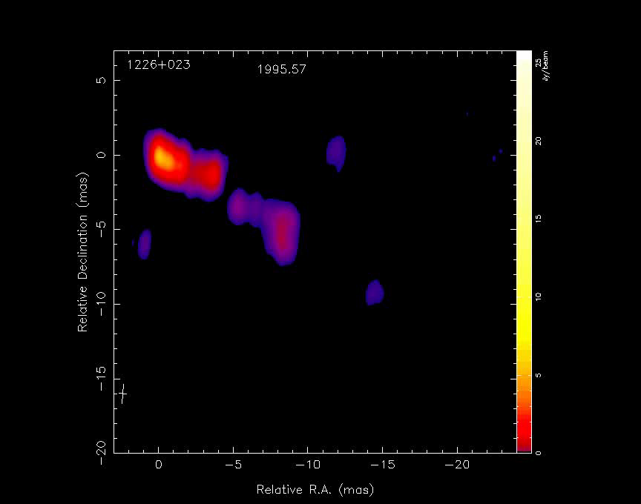
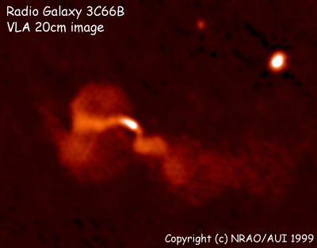
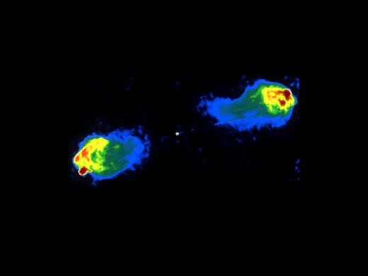
The AGN Zoo
Spirals
Ellipticals
Radio quiet
Radio quiet quasars
Radio loud
Seyferts
Radio spectrum
Flat Steep
Steep Spectrum Radio Quasars
Emission lines
Broad and narrow
Seyfert 1
Narrow
Seyfert 2
Radio galaxies
Blazars
Emission lines
FR I FR II
Weak/absent
BL Lac Objects
Strong
Flat Spectrum Radio Quasars

Slide 18
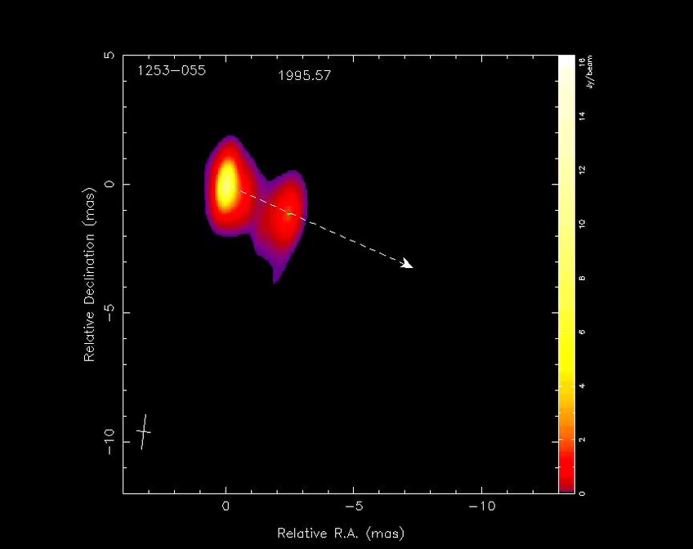
Superluminal Motion
The MOJAVE Project (Lister et al.)

Slide 19
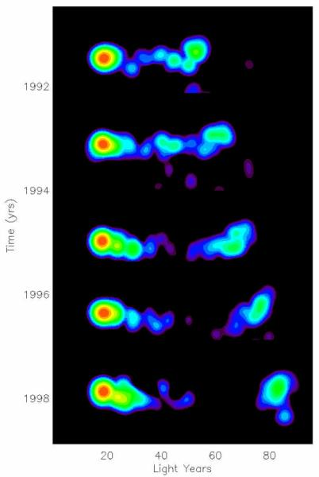
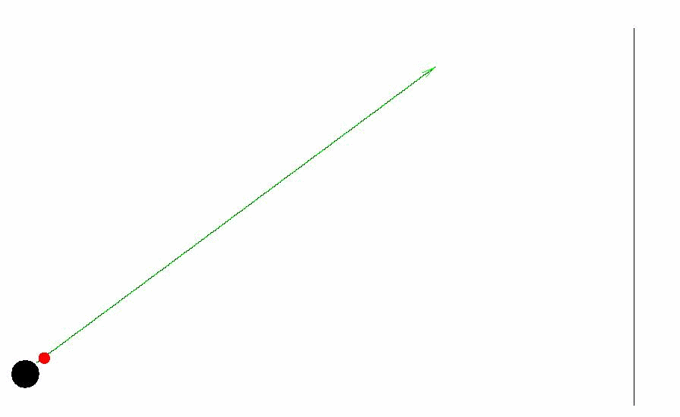
Superluminal Motion
0
Apparent motion at up to ~ 40 times the speed of light!

Slide 20
Relativistic Beaming / Boosting
In the stationary (observer’s) frame:
In the co-moving frame of the emission region:
δ = (Γ[1 – β_{Γ}cosθ])⁻¹: Doppler boosting factor
ν’
Γ = (1−β_{Γ}²)^{−1/2}
Beamed emission:
I_{ν} = δ³ I’_{ν’}
Isotropic emission I’_{ν’} at frequency ν’
ν = δ ν’
For power-law F_{ν} ∼ ν^{−α}:
F_{ν} = δ^{(3+α)} F’_{ν}
Time interval t’_{var}
Time interval
t_{var} = t’_{var} / δ

Slide 21
Relativistic Beaming / Boosting
F_{ν}
νF_{ν}
δ³
δ⁴
δ
δ^{3+α}
δ
L
______
ν^{−α}
νF_{ν}^{pk} ∼
4π d_{L}²
ν
ν
L ~ δ⁴ L’

Slide 22
Superluminal Motion
To observer
Δt_{obs} = Δt (1 – β cosθ)
Γ = (1 – β²)^{-1/2}
v sinθ
β = v/c
v_{⊥,app} =
1 – β cosθ
This is maximum for β = cosθ =>
v Δt sinθ
max
β_{⊥,app} = Γβ ≈ Γ
Jet
β_{⊥app} up to ~ 40 observed
v Δt cosθ
θ
v Δt
Γ ≥ 40 at least in some blazars!

Slide 23
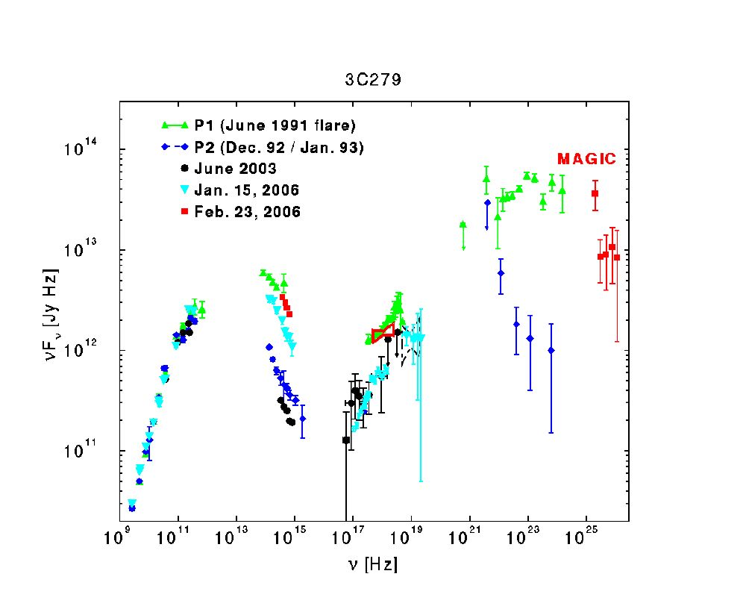
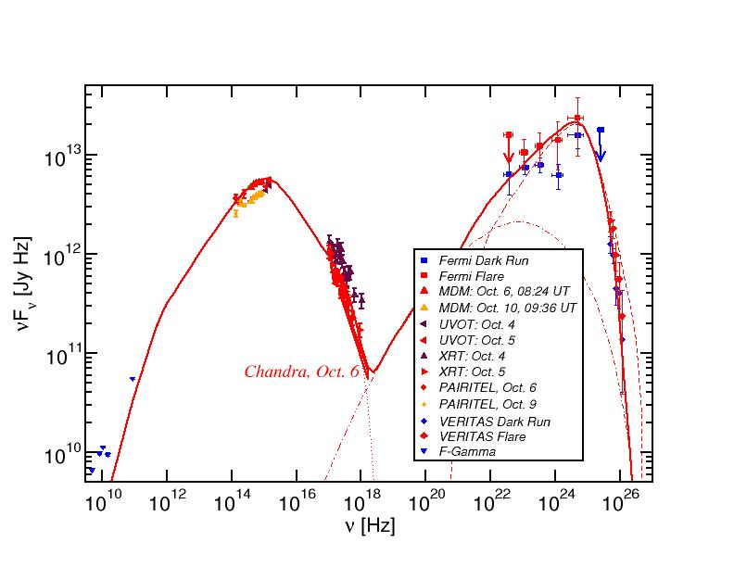
Blazar Spectral Energy Distributions (SEDs)
3C66A
Non-thermal spectra with two broad bumps:
Low-energy (electron synchrotron):
radio-IR-optical(-UV-X-rays)
High-energy (X-ray – γ-rays)

Slide 24
Blazar Models
0
Synchrotron emission
Relativistic jet outflow with Γ ≈ 10
νF_{ν}
Injection, acceleration of ultrarelativistic electrons
ν
Compton emission
Q_{e} (γ,t)
γ^{-q}
νF_{ν}
γ₁
γ₂
γ
ν
Leptonic Models
Seed photons:
Synchrotron (SSC), Accr. Disk + BLR (EC)

