Slide 1
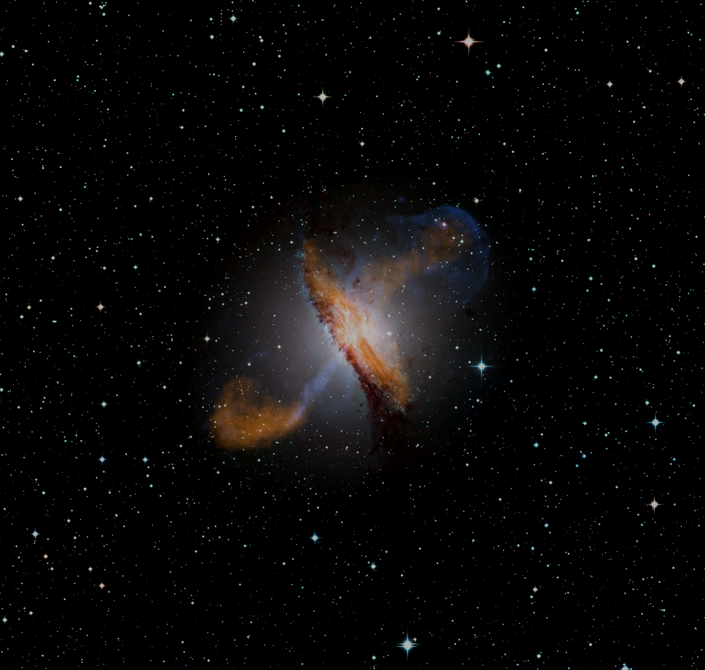




Correlation Between IceCube Neutrinos and X-ray Flaring Blazars
Matthew Fu¹, Timothy Govenor¹, Quentin King¹,
Parisa Roustazadeh^{1,2}, Markus Boettcher³
¹Bishop Watterson High School, Columbus, OH, USA
²Columbus State Community College, Columbus, OH, USA
³North-West University, Potchefstroom, South Africa
Supported by the South African Research Chairs Initiative (SARChI) of the Department of Science and Innovation and the National Research Foundation of South Africa (grant no. 64789).

Slide 2
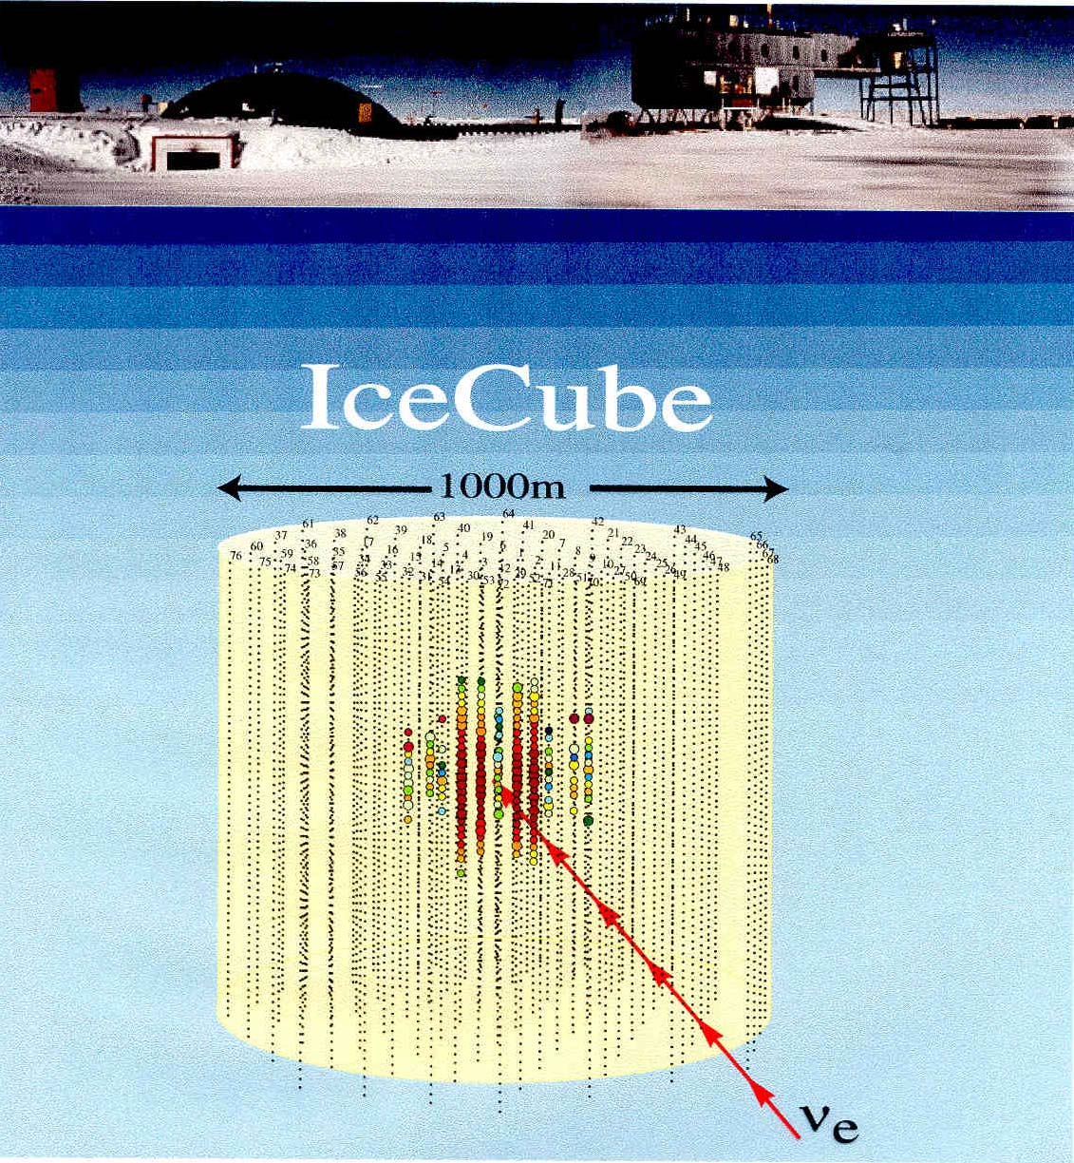
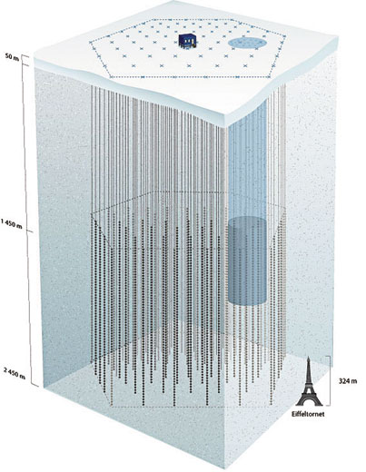
The IceCube Neutrino Detector at the South Pole
See Andrew Chen’s talk today and Anna Franckowiak’s talk Wednesday morning for more details
86 strings with 60 digital optical modules each.
Fully operational since 2010.

Slide 3
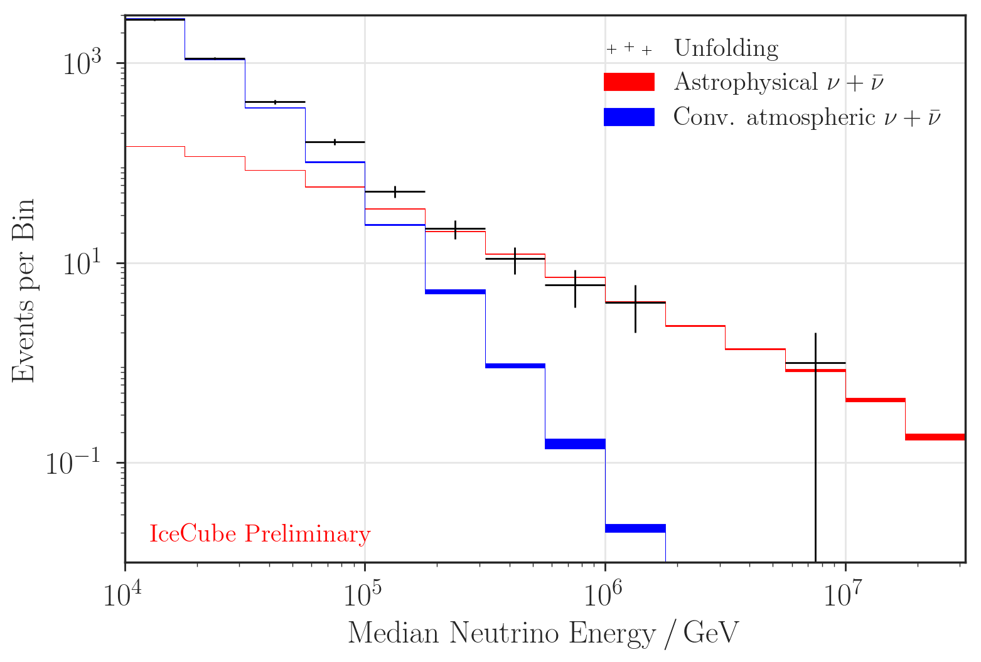
The IceCube Neutrino Spectrum
E_{ν} >> 100 TeV => Likely of astrophysical origin
Large background of atmospheric neutrinos from cosmic-ray interactions with the atmosphere.
First evidence for astrophysical neutrinos published in 2013.

Slide 4
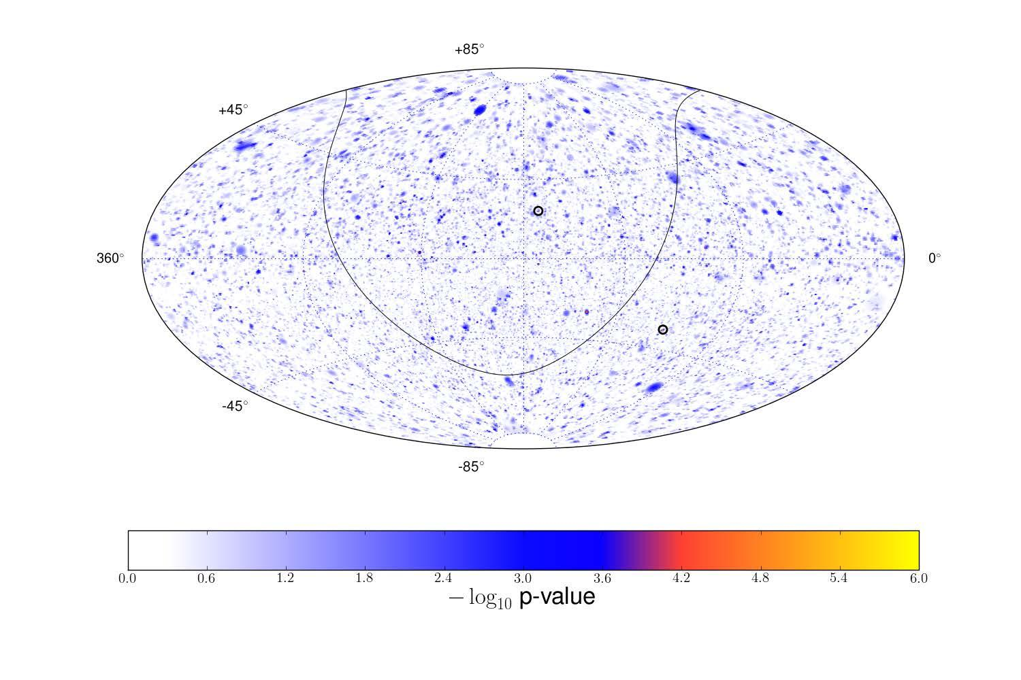
IceCube-Detected Neutrinos
All-sky map; time-dependent signal search
GB6 J1542+6129
NGC 1068
PKS 1424+240
TXS 0506+056
3.3 σ evidence of a cumulative excess of events from 110 potential sources, primarily driven by 4 active galactic nuclei:
NGC 1068, TXS 0506+056, PKS 1424+240, GB6 J1542+6129

Slide 5
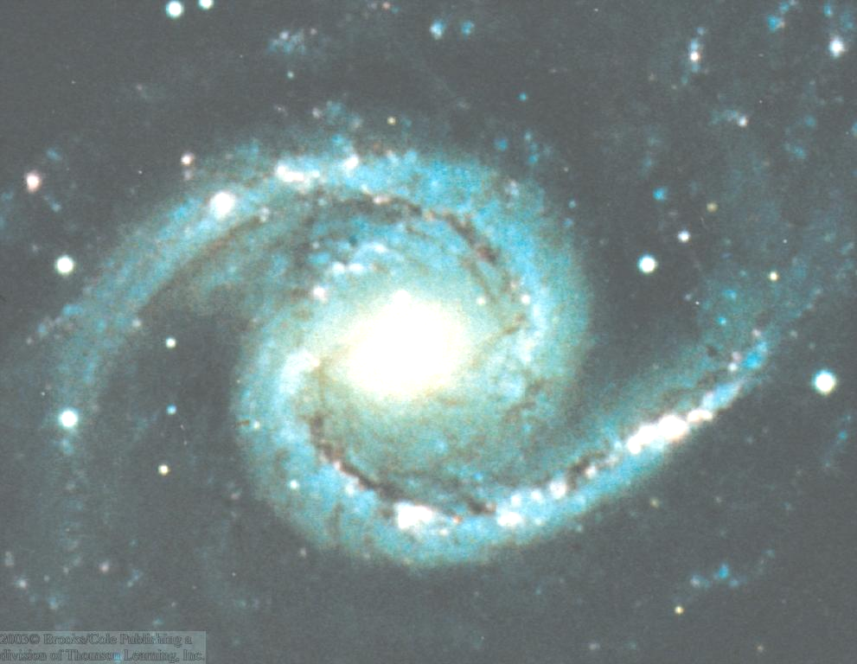
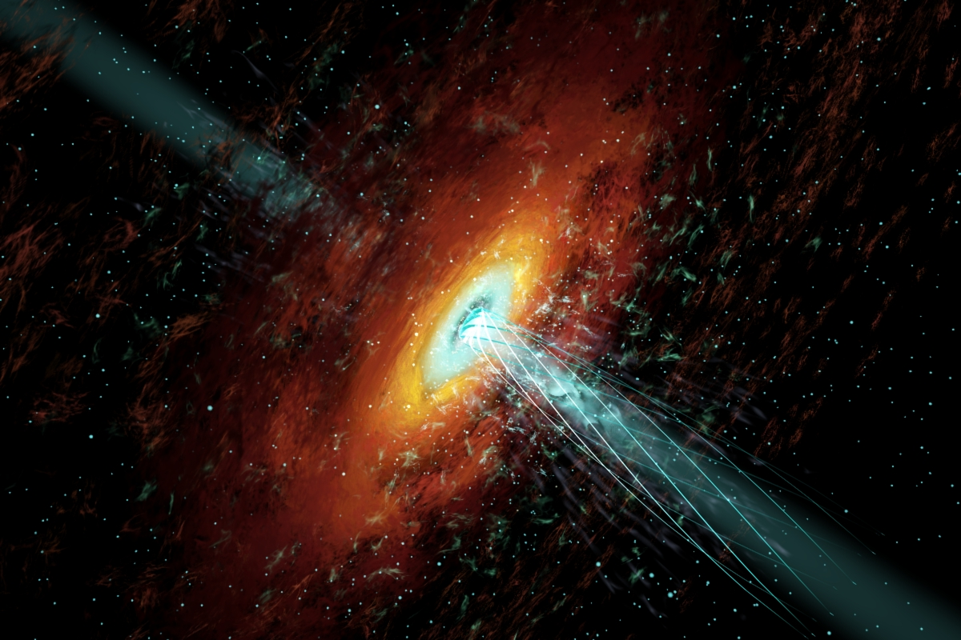
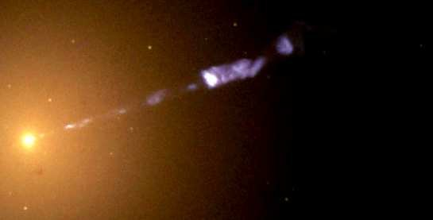
Active Galactic Nuclei (AGN)
Nuclei of galaxies with peculiar properties:
Extremely bright nuclei
Variability
High-Energy (X-/γ-ray) emission
Relativistic outflows (jets)

Slide 6
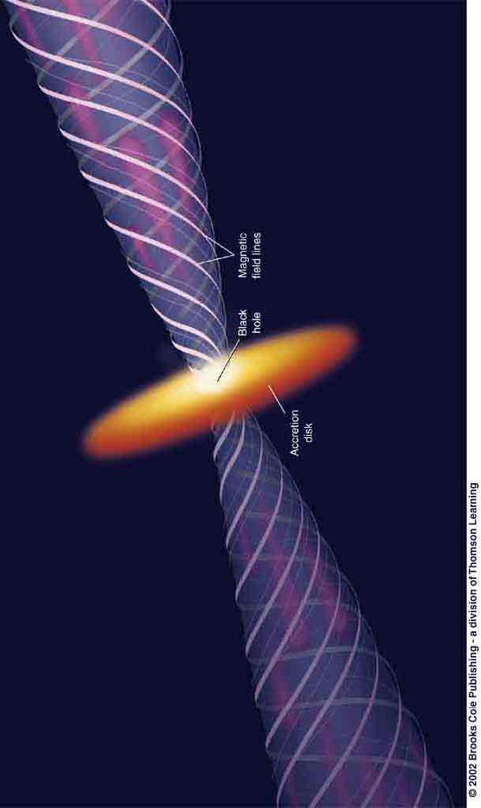
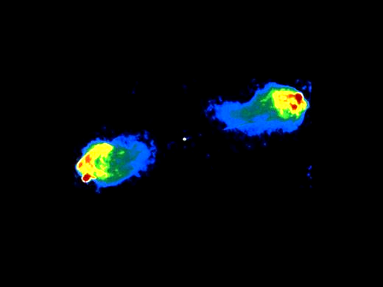
Types of radio-loud AGN and AGN Unification
Observing direction
Cyg A (radio)
Radio Galaxy:
Powerful radio lobes at the end points of the jets, where kinetic jet power is dissipated.

Slide 7
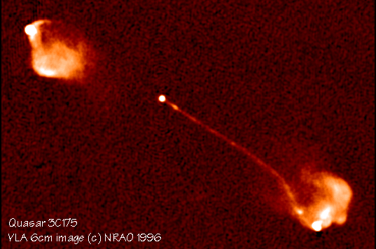
Types of radio-loud AGN and AGN Unification
Blazar:
Emission from the jet pointing towards us is Doppler boosted compared to the jet moving in the other direction (“counter jet”).
Observing direction

Slide 8
Blazars
Class of AGN consisting of BL Lac objects and gamma-ray bright quasars (Flat Spectrum Radio Quasars = FSRQs)
Rapidly (often intra-day) variable
Bright gamma-ray sources
Radio jets, often with superluminal motion
Notes:
If their optical spectrum does not show strong and broad emission lines, they are called BL Lacs or blazars of BL Lac type

Slide 9
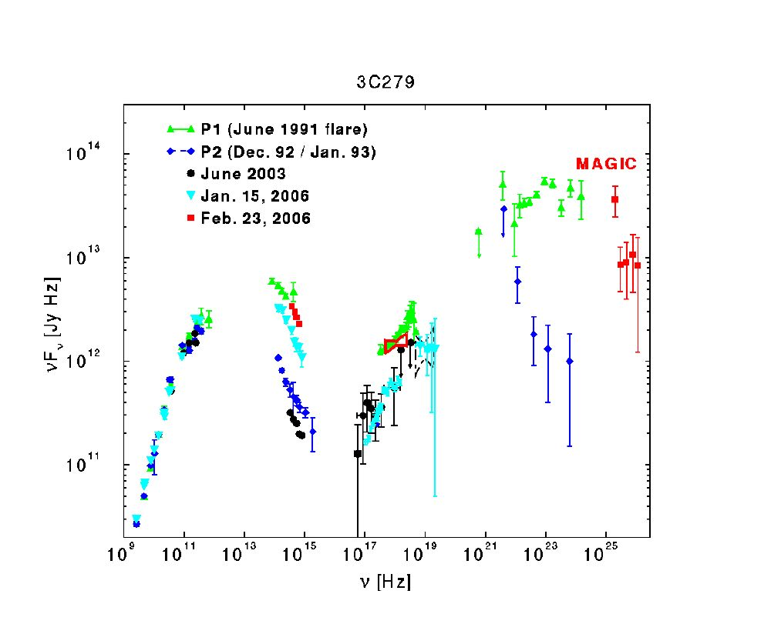
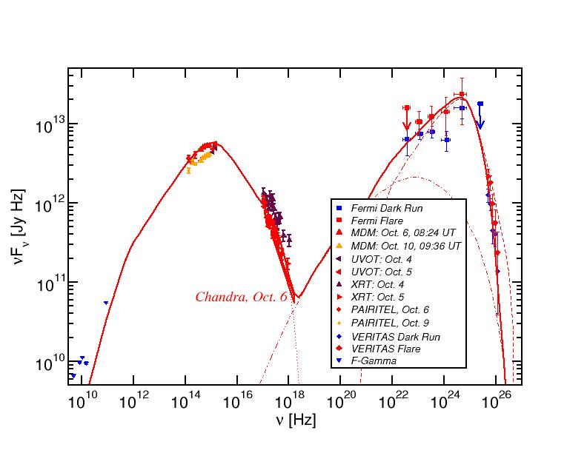
Blazar Spectral Energy Distributions (SEDs)
3C66A
Gamma-rays
X-rays
Non-thermal spectra with two broad bumps:
Low-energy (electron synchrotron):
radio-IR-optical(-UV-X-rays)
High-energy (X-ray – γ-rays): Either leptonic or hadronic emission

Slide 10
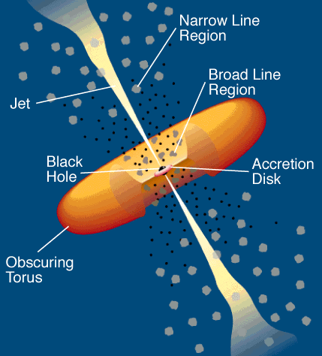
Blazar Models
Synchrotron emission
Relativistic jet outflow with Γ ≈ 10
νF_{ν}
ν
Injection, acceleration of ultrarelativistic electrons
Compton emission
νF_{ν}
ν
Leptonic Models
Seed photons:
Synchrotron (SSC), Accr. Disk + BLR (EC)
→ No neutrino production
Notes:
does not produce neutrenos

Slide 11
Blazar Models
Proton-induced radiation mechanisms:
Injection, acceleration of ultrarelativistic electrons and protons
Relativistic jet outflow with Γ ≈ 10
νF_{ν}
ν
Proton synchrotron
See Markus Boettcher’s talk Wednesday morning for more details
pγ → pπ⁰ π⁰ → 2γ
Synchrotron emission of primary e⁻
pγ → nπ⁺ ; π⁺ → μ⁺ν_{μ}
μ⁺ → e⁺ν_{e}ν_{μ}
νF_{ν}
Hadronic Models
→ secondary μ-, e-synchrotron
ν
Cascades …
Notes:
only model that produces neutrenos

Slide 12
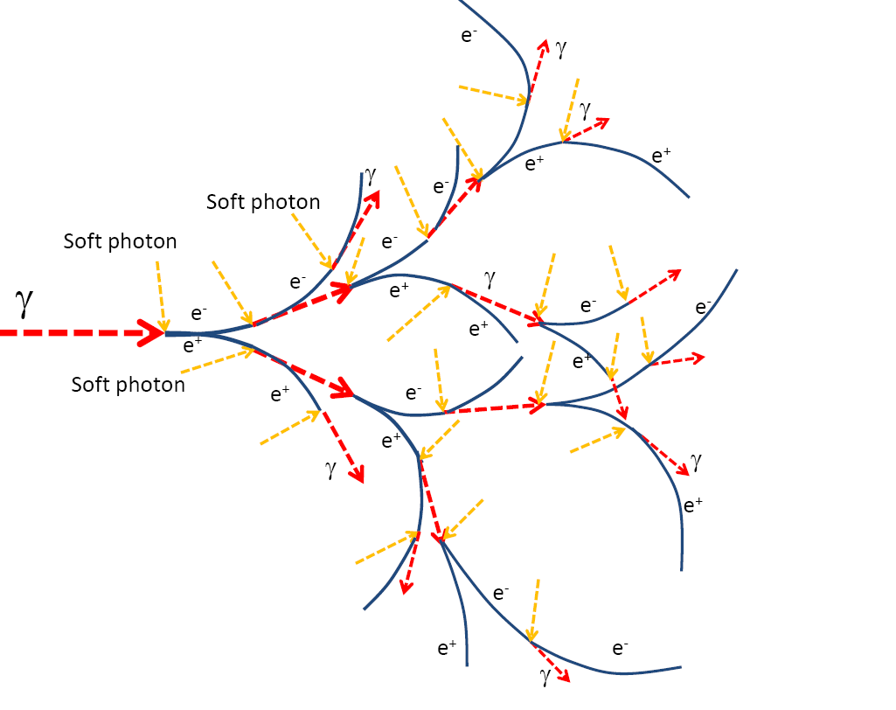
Electromagnetic cascades
Ultra-high-energy gamma-rays absorbed by lower-energy photons, producing secondary particles, producing more gamma-rays, absorbed again …
Radiation emerges at X-rays and soft gamma-rays
→ Look for correlations between neutrinos and X-ray flares!

Slide 13
Search for neutrino - X-ray
flare correlations
Investigate all potential neutrino alert - blazar associations identified in Giommi et al. (2020) + a few more recent tentative associations from ATels etc.
Search the archive of the Swift blazar monitoring programme for counterpart blazars observed
Identify the flux activity during the time of the IceCube alert.

Slide 14
Neutrino Alerts Investigated
Alert # | Source Name | Correlated X-ray flare?
IC-35 (“Big Bird”, 2012) IceCube-141209A IceCube-170922A IC-150926A IceCube-190221A IceCube-211208A IceCube-190730A IceCube-200107 IceCube-211208 IceCube-220304 IceCube-170922A IceCube-190730A IceCube-111216A | PKS 1424-418 GB6 J1040+0617 TXS 0506+056 4FGL J1258.7-0452 4FGL J1750.4-1721 PKS 0735+17 PKS 1502+106 3HSP J095507.9+35510 PKS 0735+17 TXS 0310+022 5BZB J0509+0541 5BZQ J1504+1029 3HSP J023248.5+201717 | Yes Yes Yes Yes Yes Yes No Yes Yes Yes yes Yes Yes

Slide 15
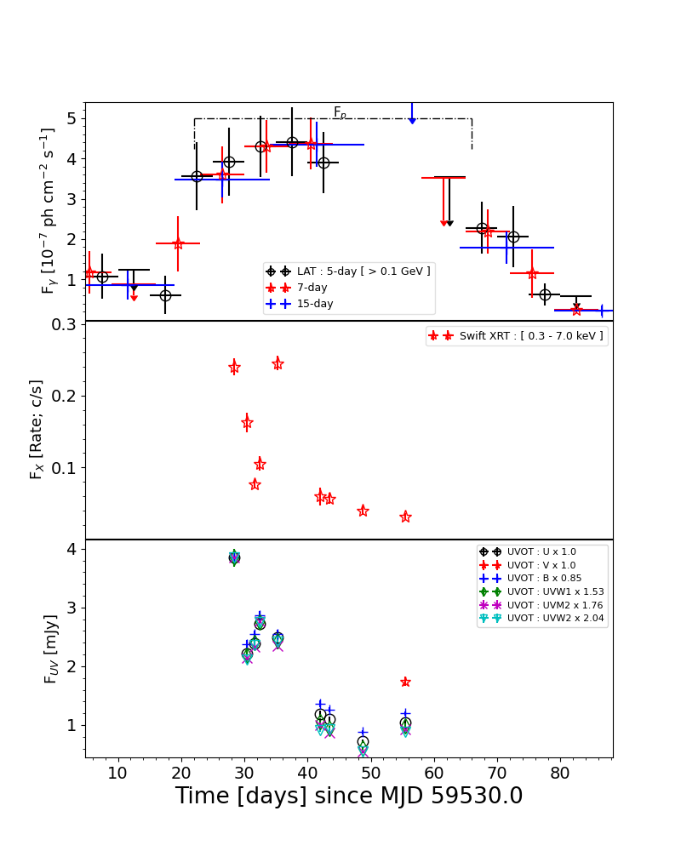
Examples of positive correlations
IceCube-211208 – PKS 0735+17
  FSRQ at z = 0.45
  Multi-wavelength flare, including X-rays and γ-rays, during and after the neutrino event
Chandra et al. (2022), in prep.

Slide 16
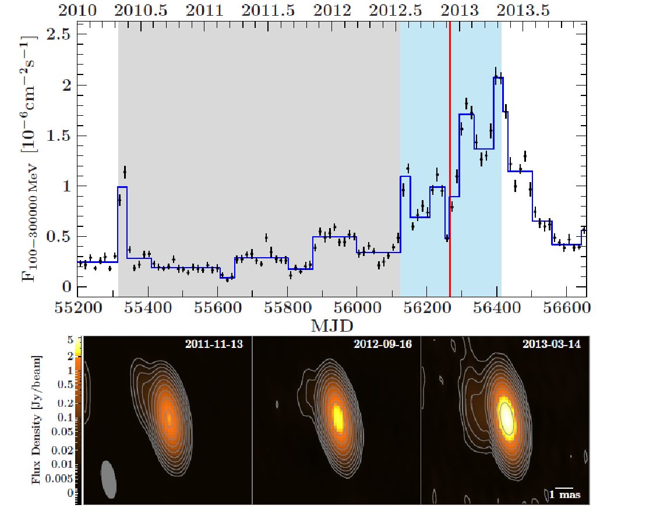
Tentative Associations of IceCube Neutrinos with Blazars
IC-35 (“Big Bird”, 2012) – PKS 1424-418 (Kadler et al. 2016)
  2 PeV neutrino (HESE) on
  4 December 2012
  FSRQ at z = 1.522
  Year-long γ-ray, X-ray, optical,
  and radio outburst.
  Radio outburst dominated by
  core-flux increase

Slide 17
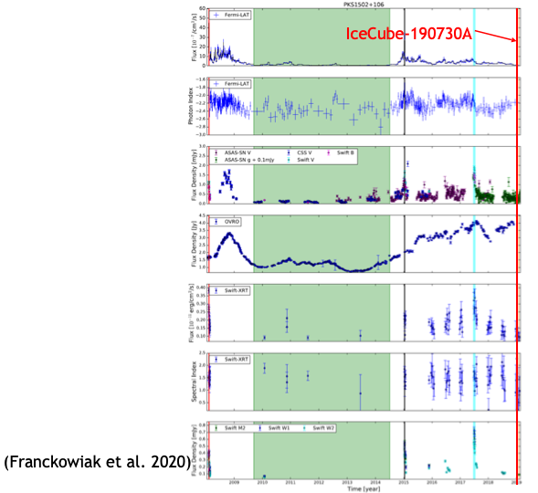
Tentative Associations of IceCube Neutrinos with Blazars - Counter-example!
IceCube-190730A – PKS 1502+106 (IceCube Collaboration et al. 2019; Franckowiak et al. 2020; Rodrigues et al. 2021)
Neutrino event during a long-term radio outburst
(started 2014), but low
γ-ray activity
Swift-XRT

Slide 18
Summary
Jetted active galactic nuclei are likely sources of very-high-energy neutrinos.
No correlation between γ-ray and neutrino activity necessarily expected, but X-ray – neutrino collection expected because of cascading.
Evidence for neutrino – X-ray cascades found in several cases, but at least one counter-example, and many cases without information about X-ray activity during neutrino alerts.
Supported by the South African Research Chairs Initiative (SARChI) of the Department of Science and Innovation and the National Research Foundation of South Africa (grant no. 64789).

Slide 19
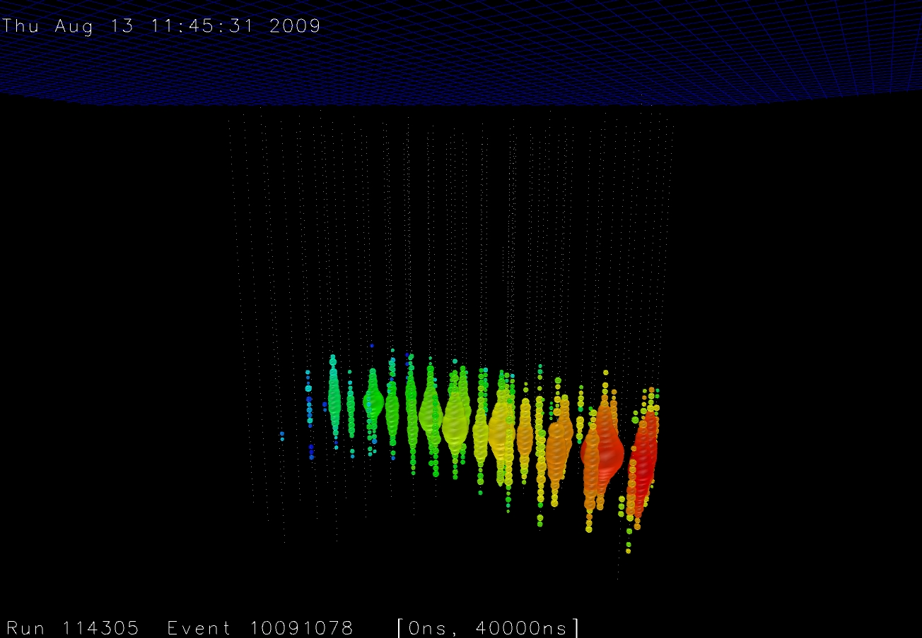
Thank you!
Any opinion, finding and conclusion or recommendation expressed in this material is that of the authors and the NRF does not accept any liability in this regard.

