Slide 1



Development of FARICH technique for the Super Charm-Tau Factory project.
Alexander Barnyakov
on behalf of BINP PID-group of SCT-collaboration
Budker Institute of Nuclear Physics, Novosibirsk, Russia
SCTF project overview
PID system
  FARICH technique progress
  FARICH with dual aerogel radiator concept
Summary
4–8 September 2023
CTICC, Cape Town, South Africa

Slide 2
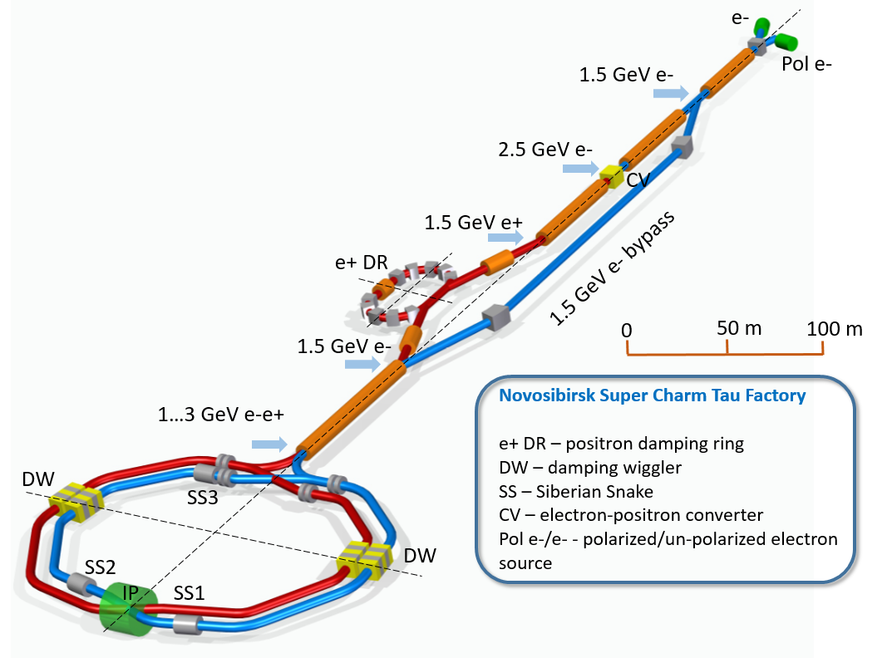
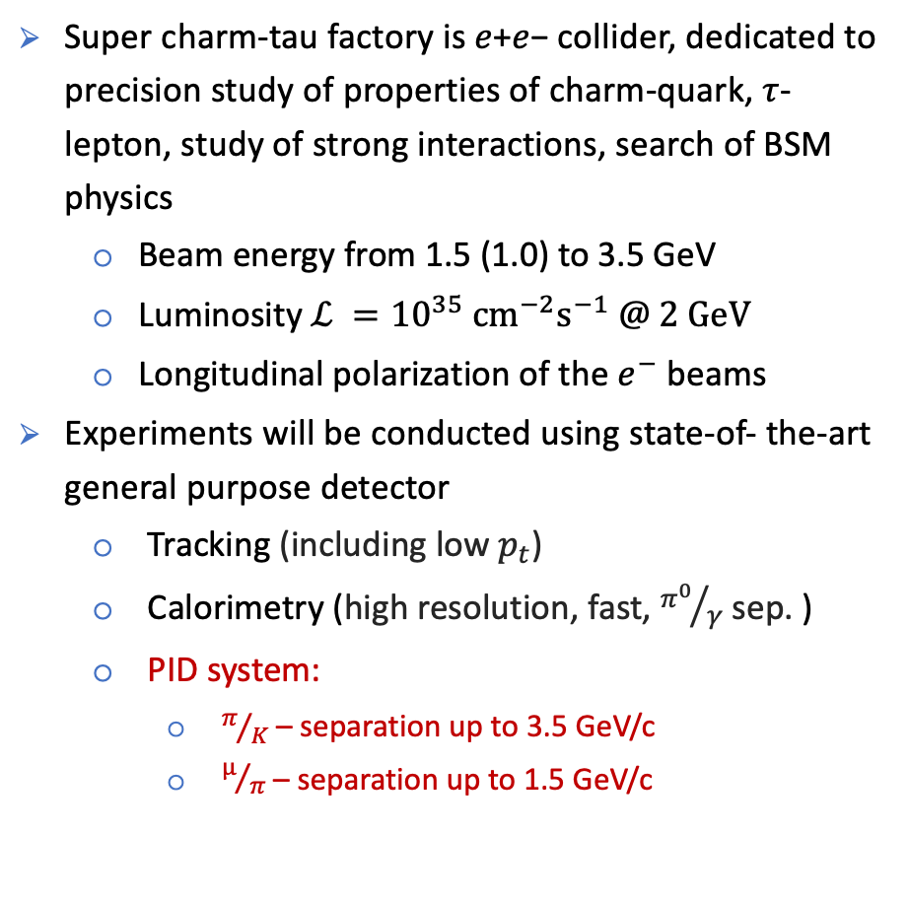
The SCT experiment
Super charm-tau factory is 𝑒+𝑒− collider, dedicated to precision study of properties of charm-quark, $τ$-lepton, study of strong interactions, search of BSM physics
  Beam energy from 1.5 (1.0) to 3.5 GeV
  Luminosity $ℒ ={10}^{35} {cm}^{−2}s^{−1} @ 2 GeV$
  Longitudinal polarization of the $e^{−}$ beams
Experiments will be conducted using state-of- the-art general purpose detector
  Tracking (including low $p_{t}$)
  Calorimetry (high resolution, fast, ${π^{0}}/γ$ sep. )
  PID system:
    $π/K$– separation up to 3.5 GeV/c
    $µ/π$ – separation up to 1.5 GeV/c
CDR
ctd.inp.nsk.su
5 м
3

Slide 3
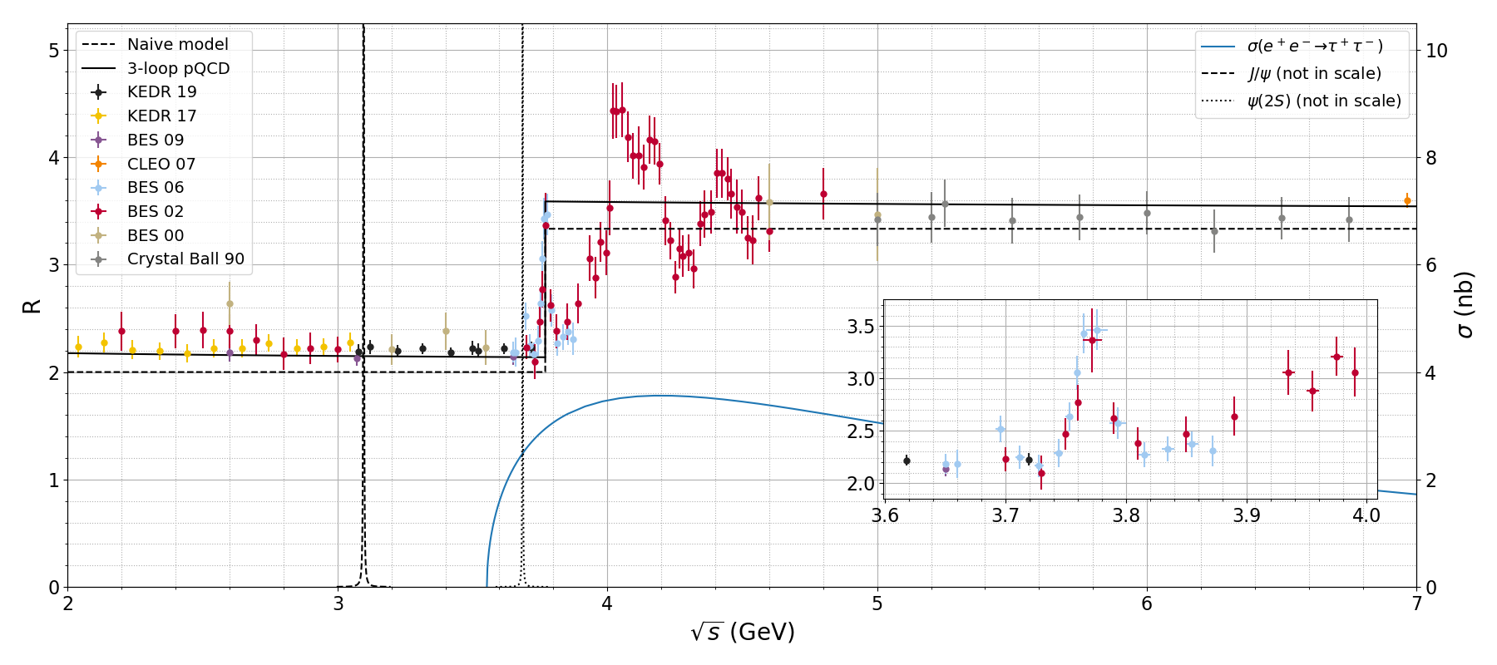











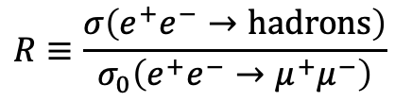








The SCT energy range
$$R≡\frac{σ\left(e^{+}e^{−}→hadrons\right)}{σ_{0}\left(e^{+}e^{−}→μ^{+}μ^{−}\right)}$$
Threshold production of nonrelativistic particles provides best conditions for their comprehensive study
$$J/ψ$$
$$ψ\left(2S\right)$$
$$ψ\left(4040\right)$$
$$Y\left(4230\right)$$
$$ℒ ={10}^{35} {cm}^{−2}s^{−1}$$
$$ψ\left(4160\right)$$
A one-year dataset
$$ψ\left(4415\right)$$
$$ψ\left(3770\right)$$
$2E$, $GeV$ | Events recorded
$$3.1$$ | $$1012 J/ψ$$
$$3.69$$ | $$1011 ψ(2S)$$
$$3.77$$ | $${10}^{9} D\overline{D}$$
$$4.17$$ | $${10}^{8} D_{s}{\overline{D}}_{s}$$
$$3.55÷4.3$$ | $$1010 τ τ$$
$$4.65$$ | $$108 Λ_{c}^{+}Λ_{c}^{−}$$
$$τ$$
$$D$$
$$D_{s}$$
$$Λ$$
$$Σ$$
$$Ξ$$
$$Λ_{c}$$
$$Ξ_{c}$$
$$Ξ_{cc}^{++}$$
$$Ω_{c}$$

Slide 4


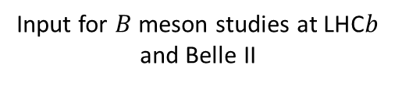
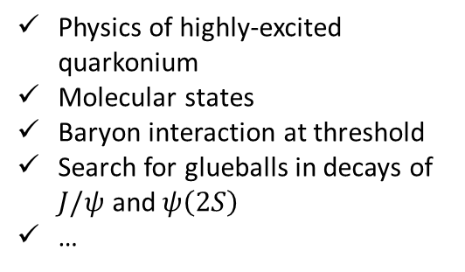

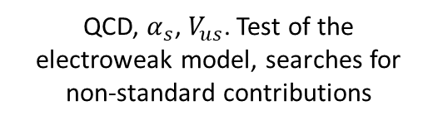
SCT Physics in a nutshell
Input for $B$ meson studies at LHC$b$ and Belle II
Measurement of the strong phases of $D$ decay amplitudes
Measurement of absolute branching fractions
Searches for rare and forbidden decays of the charm quark
$CP$ violation in charm
…
charm
QCD
Physics of highly-excited quarkonium
Molecular states
Baryon interaction at threshold
Search for glueballs in decays of $J/ψ$ and$ψ\left(2S\right)$
…
Precision measurement of the $τ$ lepton properties
Michel parameters, tests of lepton universality
Precision measurement of hadronic $τ$ decays
Search for $CP$ and T violation in $τ$ decays
…
tau
Test of the electroweak sector of the SM
QCD, $α_{s}$, $V_{us}$. Test of the electroweak model, searches for non-standard contributions

Slide 5
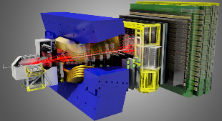


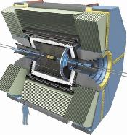
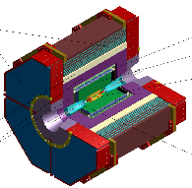





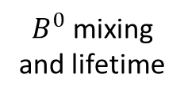



































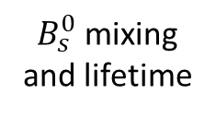



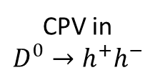
$$B^{0}→D^{0}π^{+}π^{−}$$
$$B^{+}→h_{1}^{+}h_{2}^{+}h_{3}^{−}$$
$$b→s/d γ$$
$$b→ulν$$
Only charged particles in the final state
CKM $α, β$
$$V_{ub}$$
$$V_{cb}$$
$B^{0}$ mixing and lifetime
$$B_{s}$$
$$Λ_{b}$$
CPV in $D^{0}→h^{+}h^{−}$
$τ$ lifetime
$$B→D^{0}τν$$
$$Υ\left(6S\right)$$
$$Ω_{b}$$
$$D^{0}→eμ$$
CKM $γ$
Charged Higgs
$$Σ_{b}$$
$$φ_{s}$$
$$B→K_{s}^{0}K_{s}^{0}K_{s}^{0}$$
$$B_{s}^{0}→μμ$$
$B_{s}^{0}$ mixing and lifetime
$$B→K^{∗}ll$$
$$Υ\left(5S\right)$$
$$B→D^{∗}τν$$
$$B→K_{s}^{0}π^{0}γ$$
$$B^{0}→μμ$$
$$τ→μμμ$$
$$B→K^{+}π^{−}π^{0}$$
$$B→hνν, τν$$
$$D^{0}→μμ$$
Charm spectroscopy
SUSY,
Charged Higgs
$$X\left(3872\right)→J/ψππ$$
$$α_{s}$$
$$D→lν$$
Charged Higgs
Clear BSM
Charm mixing
$$τ→hadrons$$
Clear BSM
LFU
$$D→invisible$$
Neutral particles in the final state
$$τ→lνν$$
$$τ→μγ$$
$$sinθ_{W}$$
Dark matter
Model-independent $D^{0}→K_{S}^{0}π^{+}π^{−}$
$$Z_{c}\left(3900\right)→J/ψπ$$
LFU
Quantum correlated $D^{0}{\overline{D}}^{0}$
Absolute branching fractions
SCT
CPV in charm
$$δ_{Kπ}$$
$$V_{cd}$$
Polarized beam
New CPV
$$J/ψ\left(c\overline{c}\right)→W^{+}s$$
$$J/ψ→hadrons$$

Slide 6
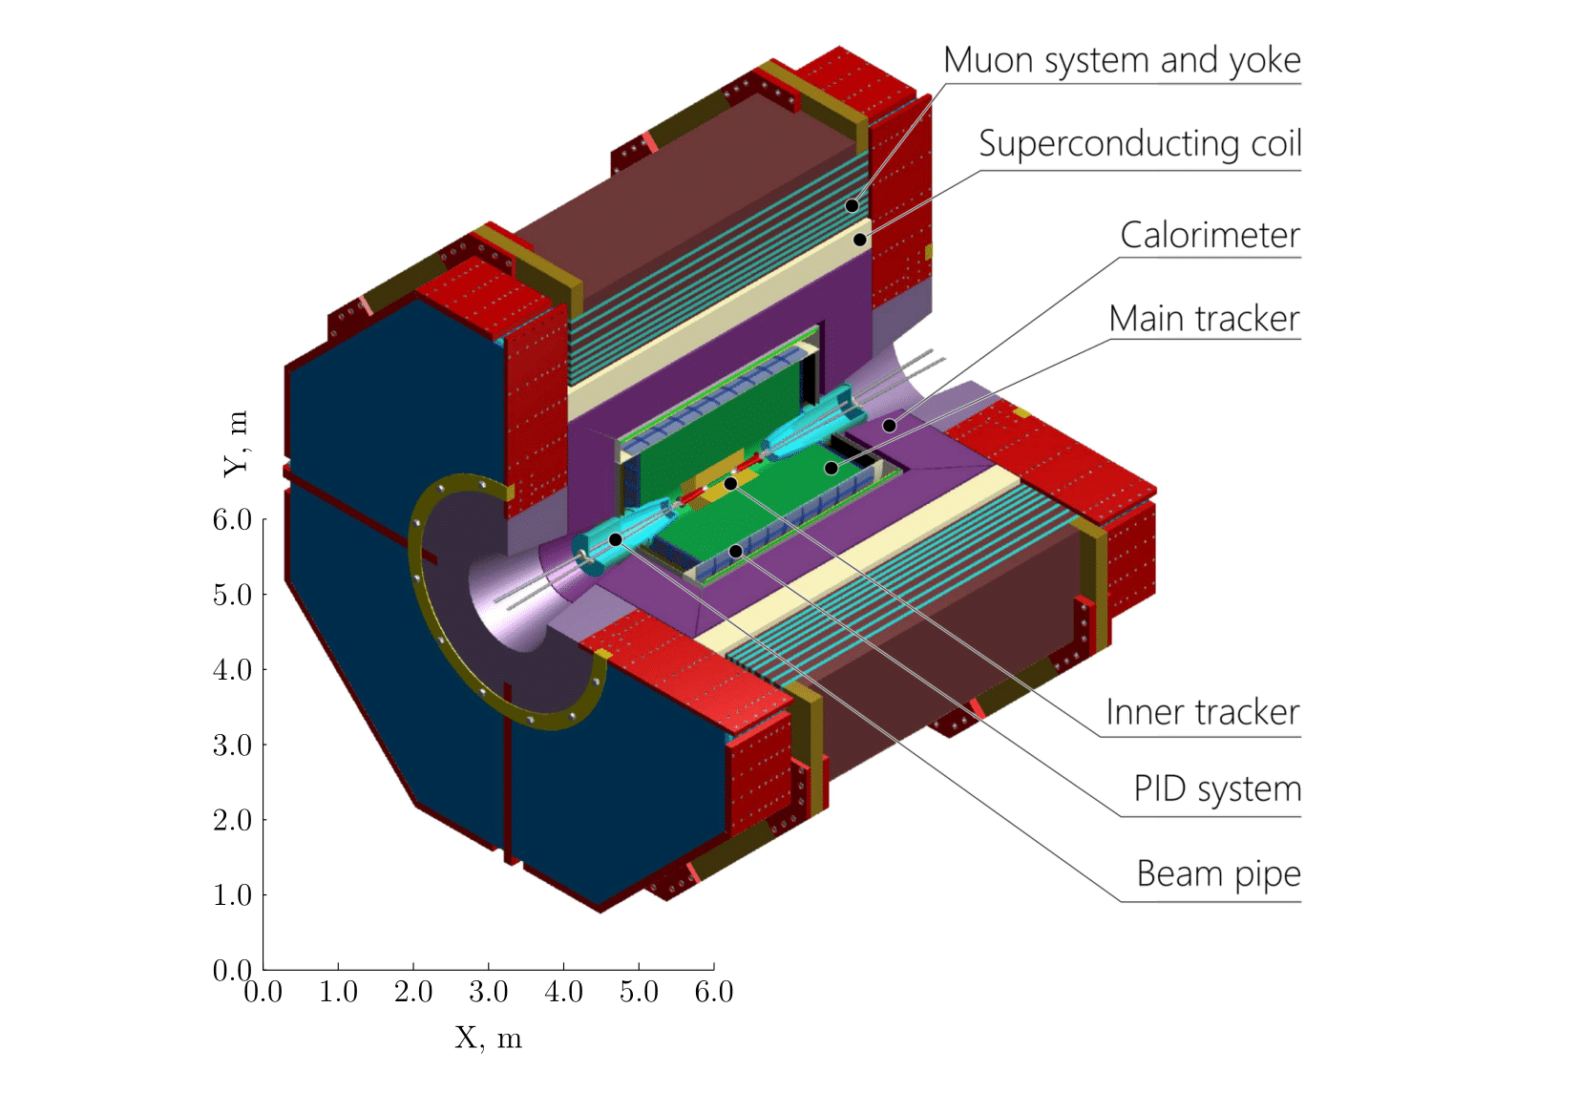
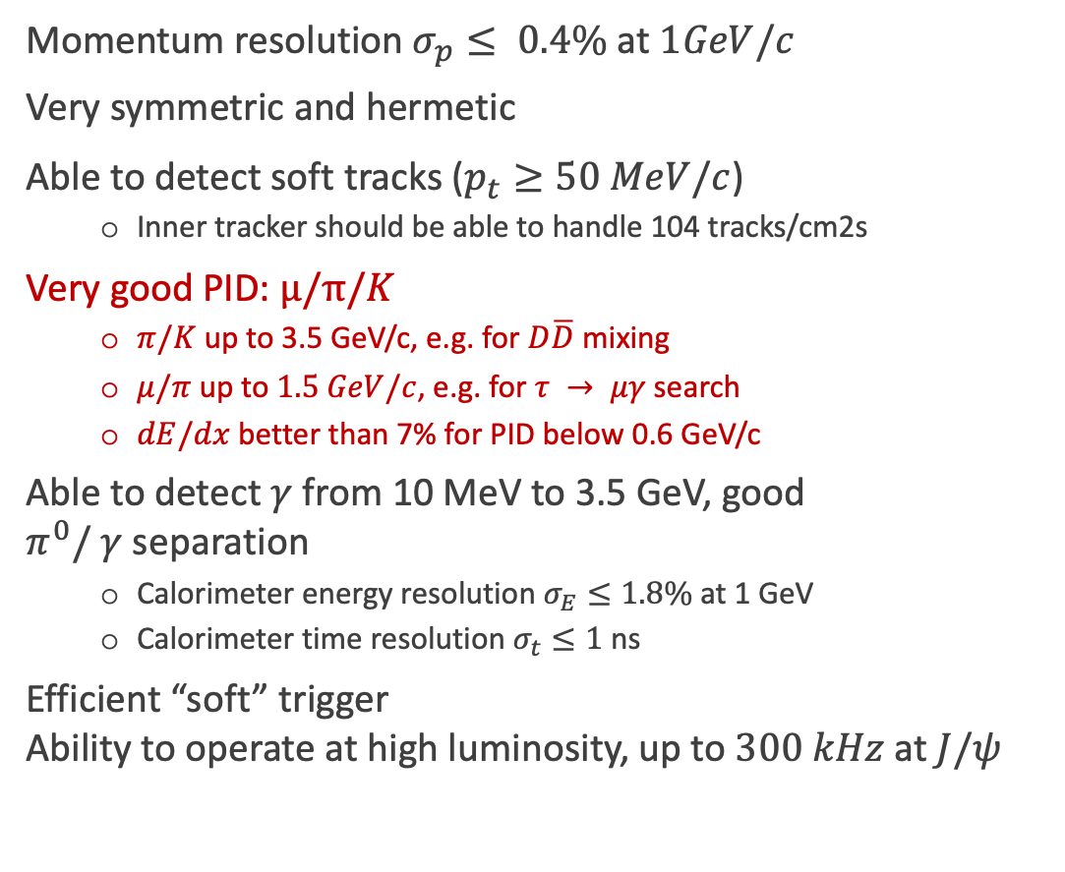
Detector concept
Momentum resolution $σ_{p}≤ 0.4\%$ at $1GeV/c$
Very symmetric and hermetic
Able to detect soft tracks ($p_{t}≥50 MeV/c$)
  Inner tracker should be able to handle 104 tracks/cm2s
Very good PID: $µ/π/K$
  $π/K$ up to 3.5 GeV/c, e.g. for $D\overline{D}$ mixing
  $μ/π$ up to $1.5 GeV/c$, e.g. for $τ → μγ$ search
  $dE/dx$ better than 7% for PID below 0.6 GeV/c
Able to detect $γ$ from 10 MeV to 3.5 GeV, good $π^{0}/ γ$ separation
  Calorimeter energy resolution $σ_{E}≤1.8\%$ at 1 GeV
  Calorimeter time resolution $σ_{t}≤1$ ns
Efficient “soft” trigger
Ability to operate at high luminosity, up to $300 kHz$ at $J/ψ$

Slide 7
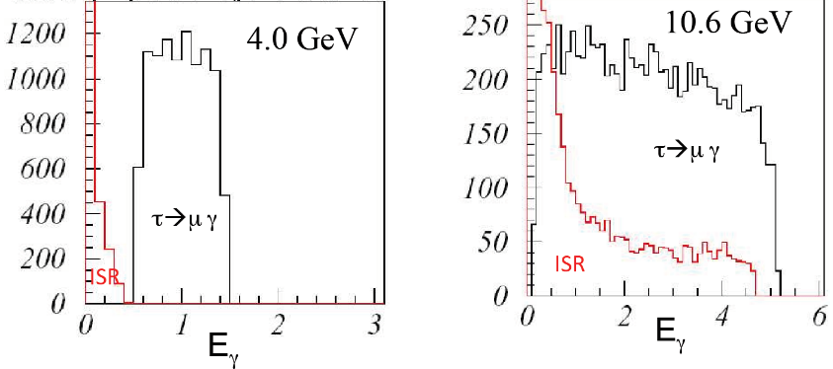
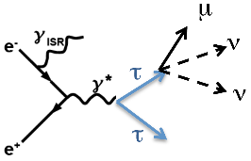
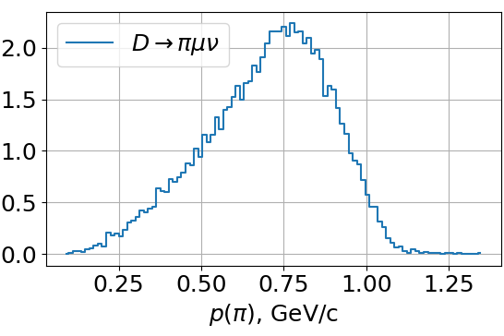
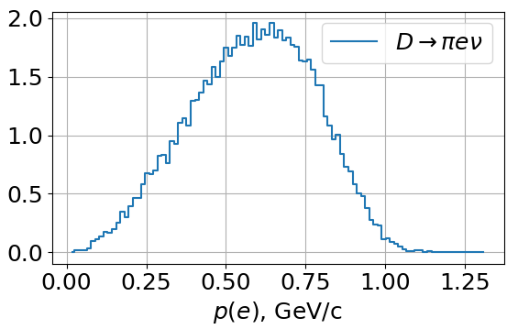
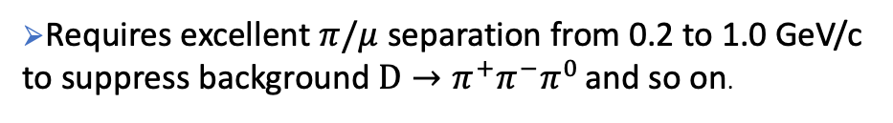

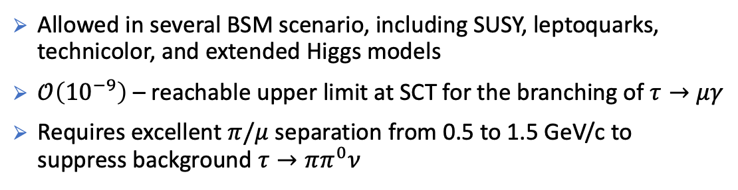
LFV with tau
Requirements for µ/π–separation from physics program
ISR photon background [arXiv:1206.1909 [hep-ex]]
$$τ→μγ$$
Allowed in several BSM scenario, including SUSY, leptoquarks, technicolor, and extended Higgs models
$𝒪\left({10}^{−9}\right)$ – reachable upper limit at SCT for the branching of $τ→μγ$
Requires excellent $π/μ$ separation from 0.5 to 1.5 GeV/c to suppress background $τ→ππ^{0}ν$
LU precise tests with D-mesons
$$D→μπν , D→eπν …$$
Requires excellent $π/μ$ separation from 0.2 to 1.0 GeV/c
to suppress background $D→π^{+}π^{−}π^{0}$ and so on.

Slide 8
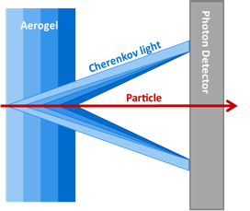
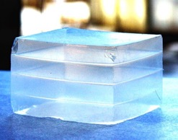
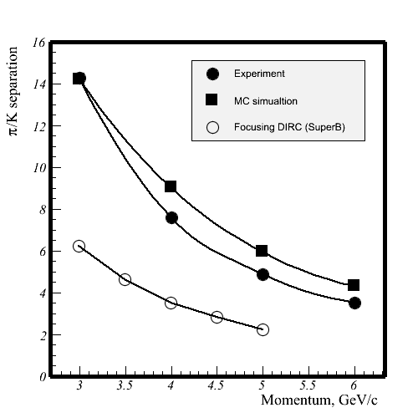
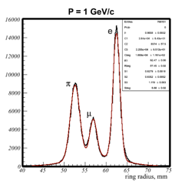
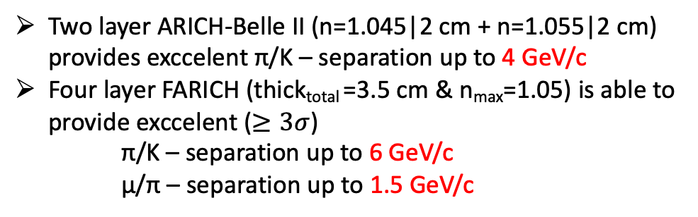
FARICH technique
2004÷2005
The first 4-layer monolithic sample
The Belle II (ARICH) is the first application of the method
n=1.030 6.0mm
n=1.027 6.3mm
n=1.024 6.7mm
n=1.022 7.0mm
Increase N_{pe} due thickness increase without σ_{Θc} degradation
T.Iijima et al., NIM A548 (2005) 383 and A.Yu.Barnyakov et al., NIM A553 (2005) 70
2017
Excellent PID capability were shown at CERN beam test in 2012
Two layer ARICH-Belle II (n=1.045|2 cm + n=1.055|2 cm) provides exccelent π/K – separation up to 4 GeV/c
Four layer FARICH (thick_{total} =3.5 cm & n_{max}=1.05) is able to provide exccelent ($≥3σ$)
    π/K – separation up to 6 GeV/c
    µ/π – separation up to 1.5 GeV/c
A.Yu. Barnyakov, et al., NIM A 732 (2013) 352
Notes:
Идея ФАРИЧ появилась в 2004 г.
Точность измерения черенковского угла связана с точностью измерения скорости, а значит с качеством разделения частиц.

Slide 9
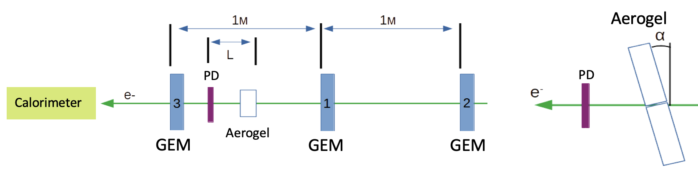
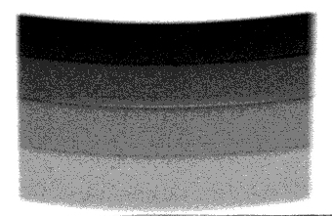
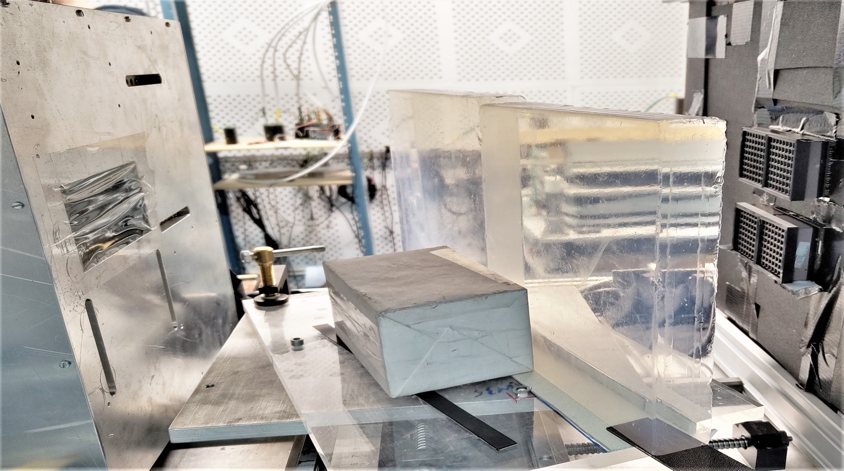
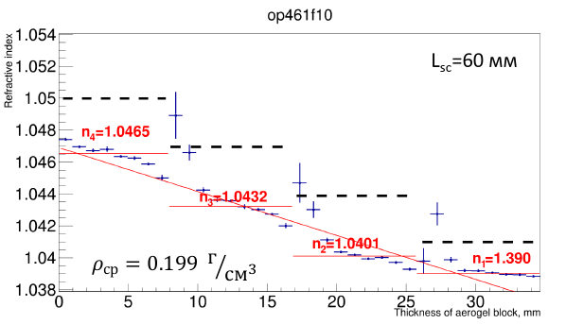

The largest focusing aerogel samples produced in 2022
MaPMT H12700 (Hamamatsu)
with mask 3х3 mm²
2 aerogel pcs
230x230x35 mm
GEM
$$e^{−}$$
Refractive index profile is measured with help of didgital X-ray setup at the BINP.
Single photon Cherenkov angle resolution is investigated with relativistic electrons at BINP beam test facilities ”Extracted beams of VEPP-4M complex”.

Slide 10
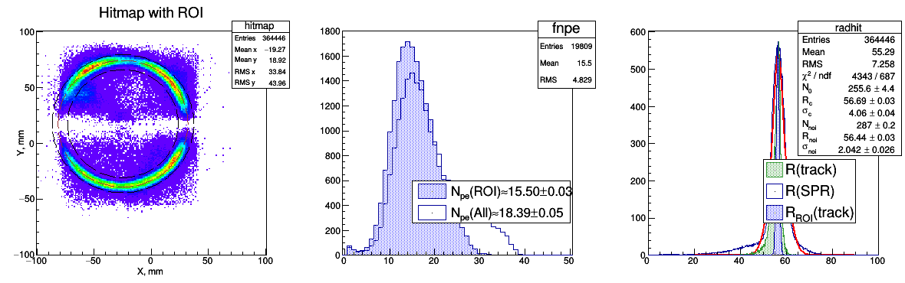
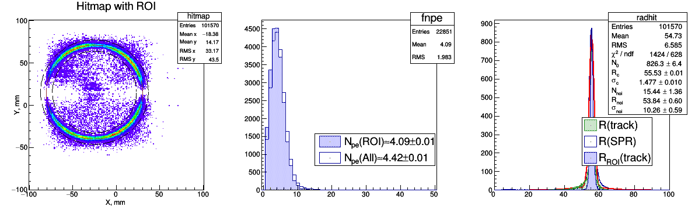
FARICH beam test 2023 results
Pixel 6x6 mm
Geom.Eff. ~ 80%
Pixel 3x3 mm
Geom.Eff. ~ 20%

Slide 11
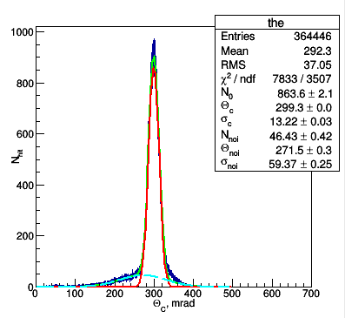
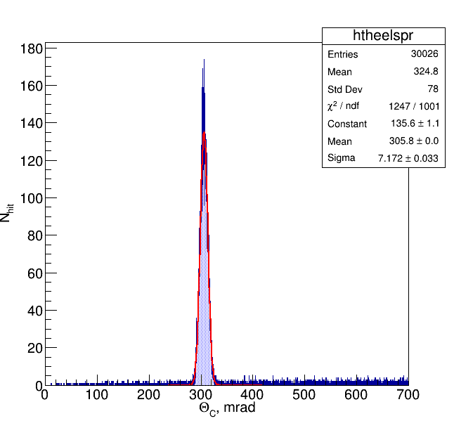
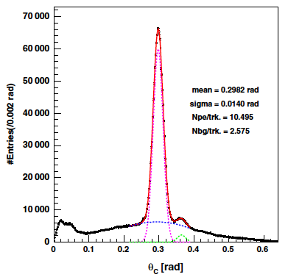
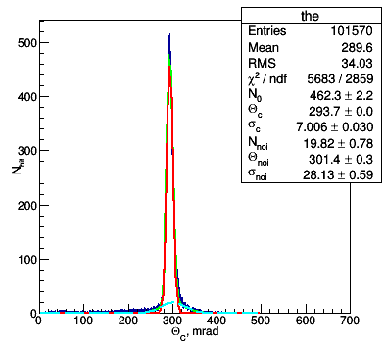
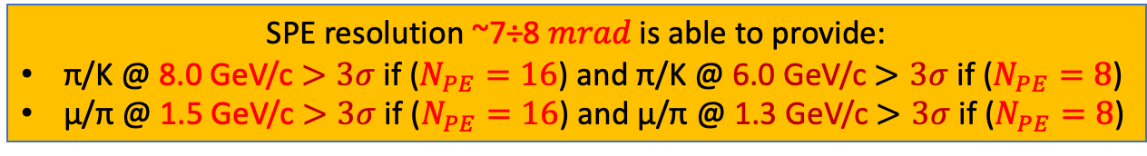
TBeam results consideration
Belle II
PTEP 2016, 033H01
TBeam
Simulation
Aerogel: 20+20 mm (Chiba Univ.)
n(400nm): 1.045 +1.055
Pixel: 5x5 mm
4-layers (Novosibirsk) –>
1.039 ÷ 1.046
6x6 mm
–
–
3x3 mm
4-layers (ideal profile)
1.041 ÷ 1.050
3x3 mm
Geom.Eff. ~ 90%
$$N_{pe}≈10.5$$
Geom.Eff. ~ 80%
$$N_{pe}≈16$$
Geom.Eff. ~ 20%
$$N_{pe}≈4$$
Dimensions of focusing aerogels 23x23x3.5 cm allow us to design the full-scale FARICH systems for the future particle physis experiments.
SPE resolution ~7÷8 𝑚𝑟𝑎𝑑 is able to provide:
π/K @ 8.0 GeV/c $>3σ$ if ($N_{PE}=16$) and π/K @ 6.0 GeV/c $>3σ$ if ($N_{PE}=8$)
µ/π @ 1.5 GeV/c $>3σ$ if ($N_{PE}=16$) and µ/π @ 1.3 GeV/c $>3σ$ if ($N_{PE}=8$)

Slide 12
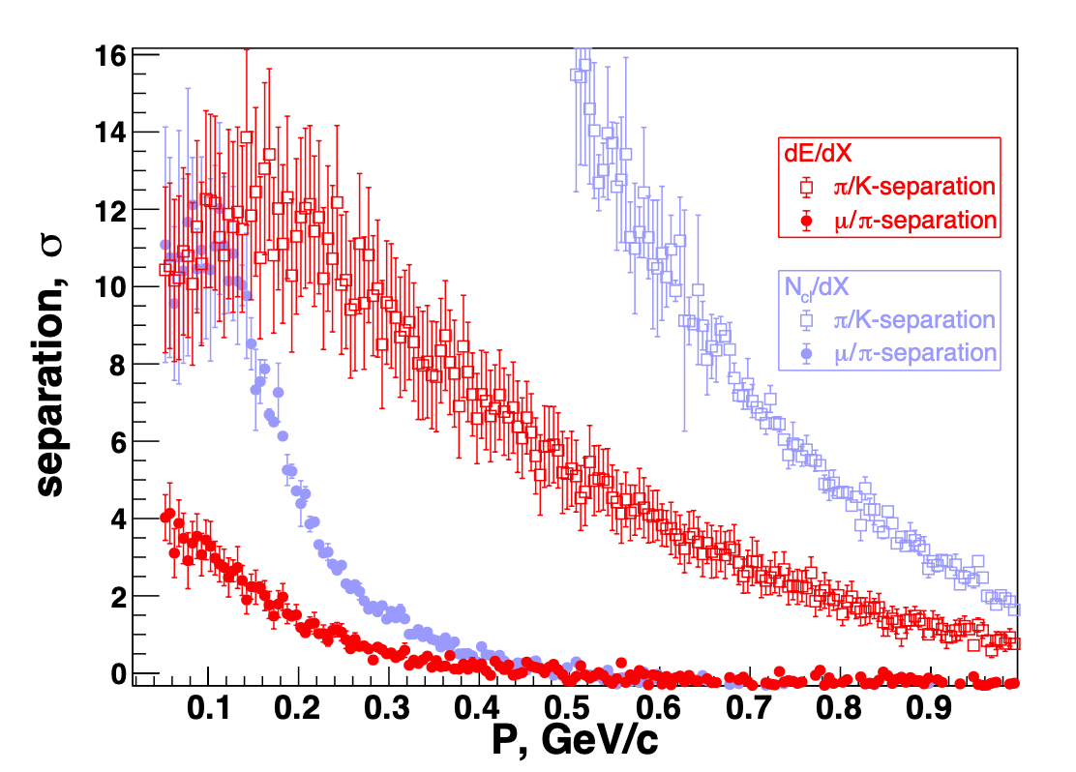
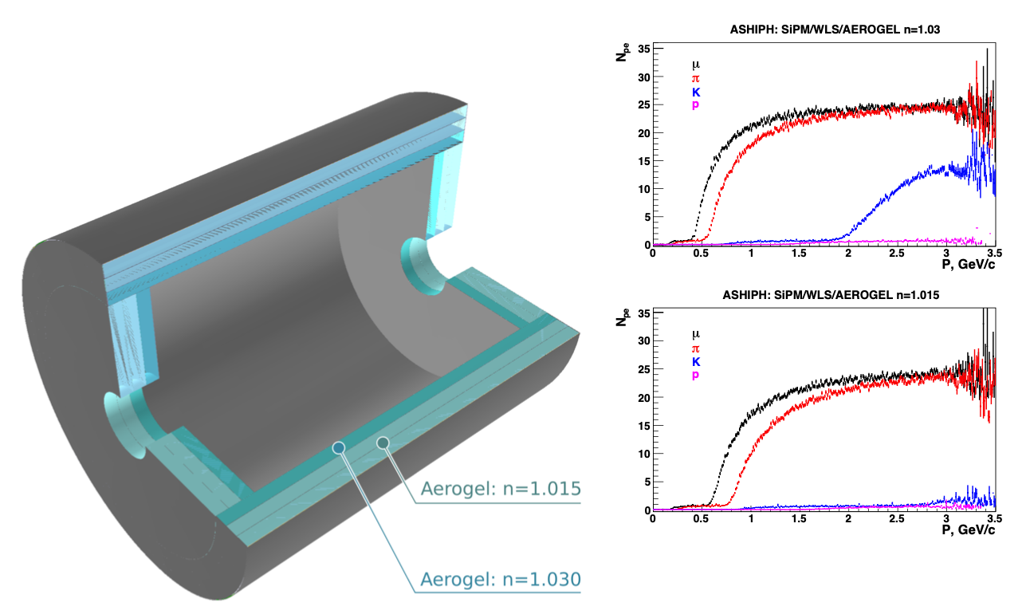

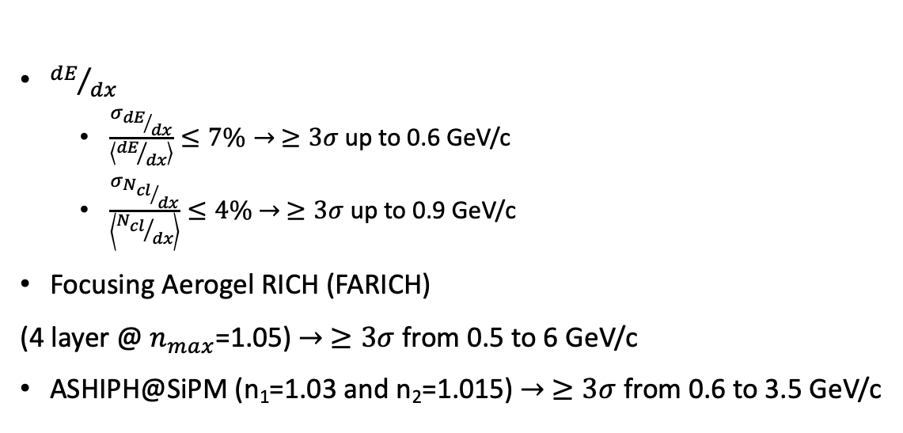
PID options for $π/K$ – separation
A.Yu. Barnyakov et al 2020 JINST 15 C04032
${dE}/{dx}$
  $\frac{σ_{{dE}/{dx}}}{\left\langle {dE}/{dx}\right\rangle }≤7\%→ ≥3σ$ up to 0.6 GeV/c
  $\frac{σ_{{N_{cl}}/{dx}}}{\left\langle {N_{cl}}/{dx}\right\rangle }≤4\%$ $→ ≥3σ$ up to 0.9 GeV/c
Focusing Aerogel RICH (FARICH)
(4 layer @ $n_{max}$=1.05) $→ ≥3σ$ from 0.5 to 6 GeV/c
ASHIPH@SiPM (n₁=1.03 and n₂=1.015) $→ ≥3σ$ from 0.6 to 3.5 GeV/c
Parametric simulation
EPJ Web of Conferences 212, 01012 (2019),
A.Yu. Barnyakov et al 2020 JINST 15 C04032
A.Yu. Barnyakov, et al., NIM A 732 (2013) 35

Slide 13
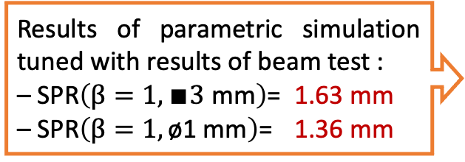



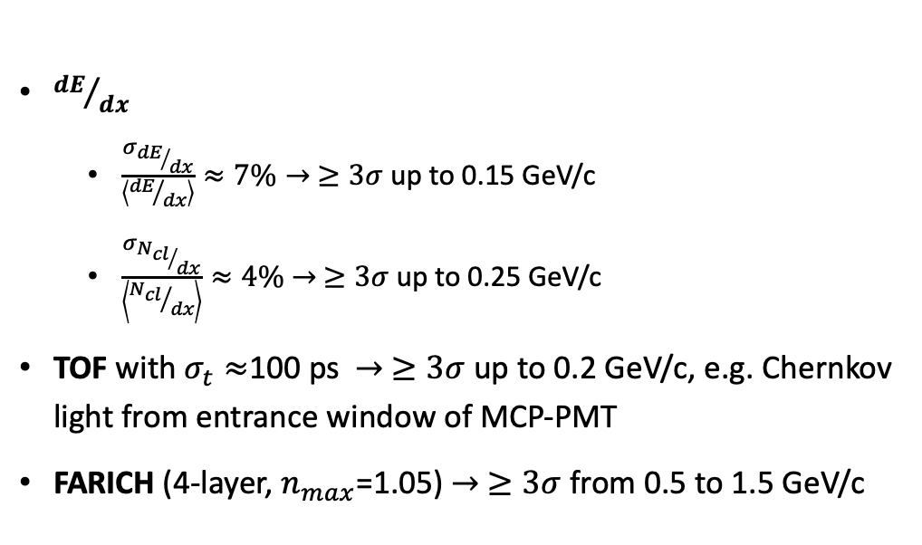
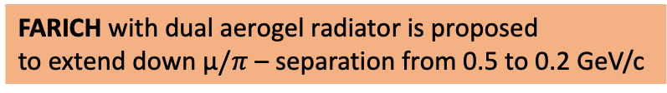
PID options for µ$/π$ – separation
${dE}/{dx}$
  $\frac{σ_{{dE}/{dx}}}{\left\langle {dE}/{dx}\right\rangle }≈7\%→ ≥3σ$ up to 0.15 GeV/c
  $\frac{σ_{{N_{cl}}/{dx}}}{\left\langle {N_{cl}}/{dx}\right\rangle }≈4\%$ $→ ≥3σ$ up to 0.25 GeV/c
TOF with $σ_{t}≈$100 ps $→ ≥3σ$ up to 0.2 GeV/c, e.g. Chernkov light from entrance window of MCP-PMT
FARICH (4-layer, $n_{max}$=1.05) $→ ≥3σ$ from 0.5 to 1.5 GeV/c
$∆T, ns$
0.1 1 10
$P, GeV/c$
Results of parametric simulation tuned with results of beam test :
– SPR$\left(β=1,∎3 \text{mm}\right)$= 1.63 mm
– SPR$\left(β=1, \text{ø1 }\text{mm}\right)$= 1.36 mm
FARICH with dual aerogel radiator is proposed
to extend down µ$/π$ – separation from 0.5 to 0.2 GeV/c
A.Yu.Barnyakov et al., NIMA 1039 (2022) 167044

Slide 14
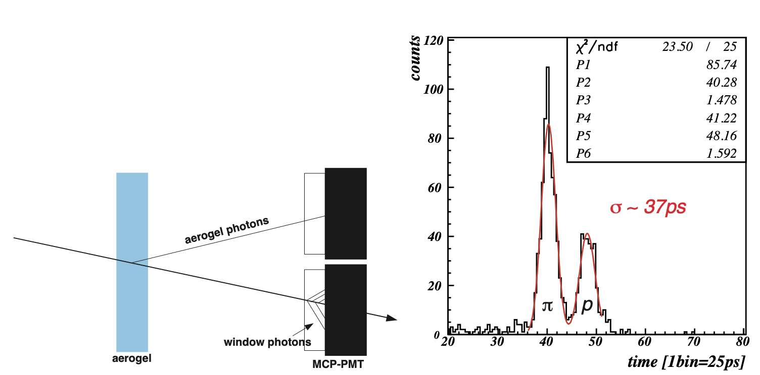
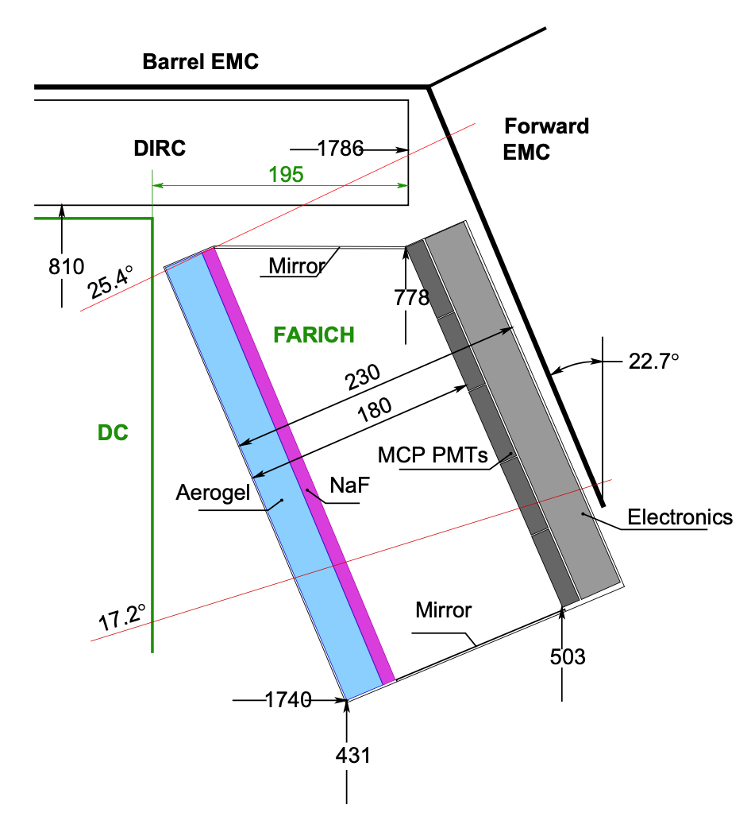
RICH with dual radiators is not very new idea!
P=2 GeV/c
Liquid + Gas:
  RICH – DELPHI
  CRID – SLD
    C₆F₁₂(n=1.278@190nm) + C₅F₁₀(n=1.00174@190nm)
Aerogel + Gas:
  HERMES
  RICH1 – LHCb
    Aer.(n=1.03@400nm) + C₄F₁₀(n=1.00137@400nm)
Aerogel + Crystal:
  RICH+ToF – SuperB:
    Aer.(n=1.05@400nm) + Quartz (n=1.47@400nm)
  FARICH – SuperB:
    3-layer aer. n_{max}=1.07@400nm + NaF (n=1.33@400nm)
Aerogel + Aerogel:
  FARICH – SCTF:
    4-layer aer. n_{max}=1.05@400nm + aer (n=1.12@400nm)
Aerogel is material with easy tunnable refractive index!

Slide 15
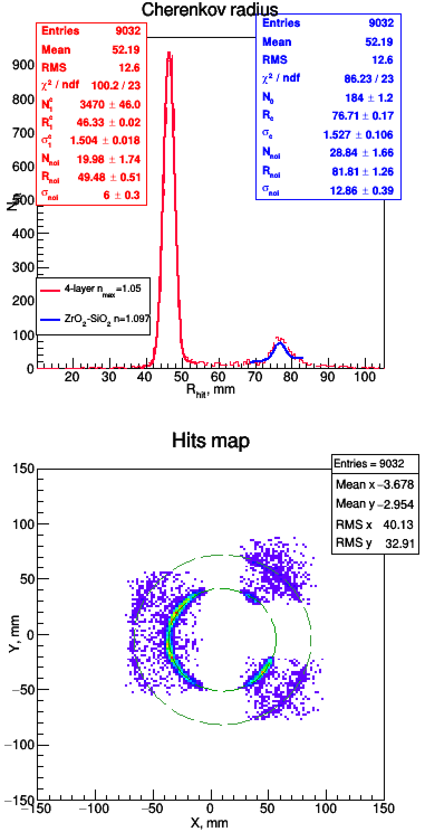
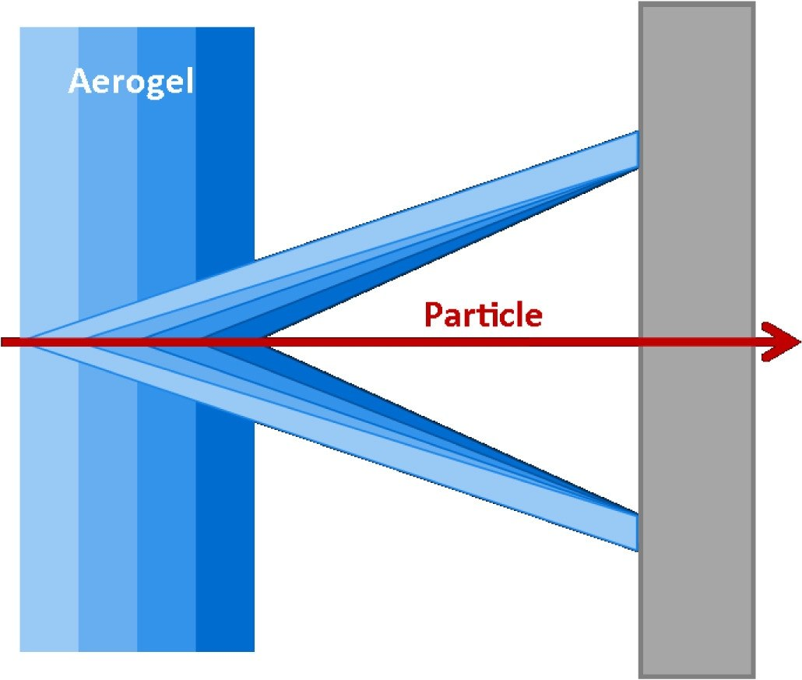

Beam tests results of FARICH with dual radiator
ZrO₂–SiO₂ aerogel:
Thickness 12 mm & ø20 mm;
L_{sc}(400nm)=21±0.5 mm;
ZrO₂ aerogel
Photon detector
4-layer SiO₂ aerogel:
100x100x35 mm;
L_{sc}(400nm)=37±0.3 mm;
GEM3
GEM2
Photon detector
4 MaPMT H12700 (Hamamatsu);
256 pixels with 3x3 mm size;
GEM1–GEM2
GEM1
GEM1–GEM2–GEM3

Slide 16









µ/π-separation via G4 simulation
FARICH: "ideal” $n$ profile
FARICH (“ideal”)+ZrO₂–aer. ($n$=1.12/12 mm)
$$N_{σ}=\frac{{\overline{R}}_{C}^{µ}−{\overline{R}}_{C}^{π}}{{\left(σ_{R}^{π}+σ_{R}^{µ}\right)}/2}$$
$${\left(L_{f}−t_{Zr}−t_{Fa}\right)∙\frac{\sqrt{\left({n_{Fa}^{min}}^{2}−1\right)−\frac{m^{2}}{p^{2}}}}{\sqrt{\frac{m^{2}}{p^{2}}+1}}≤R}_{Fa}≤\left(L_{f}−t_{Zr}\right)∙\frac{\sqrt{\left({n_{Fa}^{max}}^{2}−1\right)−\frac{m^{2}}{p^{2}}}}{\sqrt{\left({n_{Fa}^{max}}^{2}−2\right)+\frac{m^{2}}{p^{2}}}}$$
$${\left(L_{f}−t_{Zr}\right)∙\frac{\sqrt{\left({n_{Zr}}^{2}−1\right)−\frac{m^{2}}{p^{2}}}}{\sqrt{\frac{m^{2}}{p^{2}}+1}}≤R}_{Zr}≤L_{f}∙\frac{\sqrt{\left({n_{Zr}}^{2}−1\right)−\frac{m^{2}}{p^{2}}}}{\sqrt{\left({n_{Zr}}^{2}−2\right)+\frac{m^{2}}{p^{2}}}}$$

Slide 17







FARICH system concept for the SCTF
GEANT4 simulation
of edge effects
Aerogel layout
275 tiles 200x202x35 in barrel part
2x55 trapezoidal tiles in end caps:
2x12 – inner radius
2x18 – medium radius
2x25 – outer radius
Proximity focusing RICH
4-layer focusing aerogel
  n_{max} = 1.05 (1.07?), total thickness 35 mm
  $S_{aer}=15 m^{2}$
21 m² – total area of photon detectors
  • SiPMs – barrel part (16 m²)
  • MCP-PMT – endcap parts (4 m²)
~10⁶ pixels 3х3 mm² with pitch 4 mm
SHAPE | $$∆, mm$$ | Aerogel size, mm
 |  | 200 | 100 | 75 | 50
Parallelepiped | 6 | 0.86 | 0.74 | 0.62 | 0.5
Trapezoidal | 1 | 0.96 | 0.94 | 0.92 | 0.9
Notes:
Идея ФАРИЧ появилась в 2004 г.
Точность измерения черенковского угла связана с точностью измерения скорости, а значит с качеством разделения частиц.

Slide 18
Summary
In 2020-2023 the essential progress in FARICH technique development was achieved in Novosibirsk:
  The 4-layer focusing aerogel sample with 20x20x3.5 cm size were produced for the first time in the world –> the possibility to create full-scale systems based on 4-layer focusing aerogel Cherenkov radiators was demonstrated
  The measured SPR (~7 mrad) of FARICH based on 4-layer focusing aerogel is in good agreement with simulation and expectation
  Recent progress in high opticaly dense aerogel production with help of ZrO₂ dope allows us to consider new design of FARICH detector with dual aerogel radiator which able to provide exccelent µ/π – separation from 0.2 up to 1.5 GeV/c
For further progress of the FARICH option the development of position-sensetive photon detectors and compatible R/O electronics are highly required

Slide 19
Back up slides

Slide 20





Photon detector options
Due to axial magnetic field the SiPM is only one possible candidate for the cylindrical part of the FARICH system!!!
For the endacp regions there are three options of photon detectors.
SiPM arrays
MCP-PMT
HAPD
There are several manufacturer in the world.
It is required to develop and produce special R/O electronics and cooling system to operate with SiPMs in detector conditions
There are several manufacturers in the world.
PDE is not so high, it is limited by photoelectron collection efficiency (~60%) and geometrical efficiency is worse than for SiPM option. Severl vendors suggest MCP-PMT with CE=90%
There is no such a big problem with intrinsic noise rejecion in comparison with SiPM option
Specialised R/O elctronics is already developed for other experiments and could be adopted for the SPD experiment requirements
Only Hamamtsu produced such devices for the Belle II experiment and now it doesn’t produced anymore!
Expected PDE of such devices will less than for SiPM option but signficantly (1.5 times) higher than for MCP-PMT option.
Expected gain is about $1÷2∙{10}^{5}$
Development of specialised R/O elctronics is needed. It is possible to adopt some Belle II ARICH system expirience.
The S/N-ratio is about 1000, it means that only thermostabilization system to operate at the room temperature will enough for this option.
26.8 mm
59 mm
Planacon XP85112
8x8 pixels with 6x6 mm
Cost: 15 $k\$$
73 mm
KETEK PA3325-WB-0808
(BroadCom, USA)

Slide 21








R/O electronics cost estimation
There are two modern approaches in development of specialised R/O electronics:
– ASIC (Application Specialised Integrated Circuits)
– FPGA (Field Programable Gate Arrays)
The differences in performance, power consumption and costs are not sufficient today!!!
FPG-TDC (GSI)
TOFPET-II (PetSys)
$\frac{9 834€}{2×384}≈13€/chan$ if N_{ch}<1000 (2019)
A system with 30kChannel (HADES):
$170k€/30k≈6€/chan$ (2017)
$\frac{31 008€}{8×128}≈30€/chan$ if N_{ch}≤1000
Power consumption: ~55mW/chan
A system with 100kChannel:
$5€/chan$ (2020)
Power consumption:
15mW/chan (ASIC) + DAQ (FPGA)~60mW/chan

Slide 22



Advantages of the SCT factory
Threshold production of $τ$ leptons and charmed hadrons
Longitudinal polarization of the electron beam
  Well-defined initial state
  Low multiplicity of particles
  Kinematic constraints
  Boosted sensitivity to 𝒞𝒫 violation in baryons and $τ$ leptons
  Measuring the Weinberg angle
Coherent $D^{0}{\overline{D}}^{0}$ pairs
Full event reconstruction
  Measuring charm mixing and 𝒞𝒫 violation with unique techniques
  Measuring phases of the decay amplitudes
  Superior background suppression
  Measuring absolute branching fraction of charmed hadrons

Slide 23




Aerogels with high optical density
Sintering approach
ZrO₂ addition approach
230 мм
n=1.05
n=1.12
230 мм
n=1.2
n=1.25
L_{sc}(400nm)
The first sample of
SiO₂–ZrO₂ aerogel
n=1.13
Refractive index
The addition of small amount (0.03÷0.06 mol) of ZrO₂ in SiO₂ based aerogel alow us to produce highly transperant aerogels with high optical density:
Refractive index up to n=1.12
Rayleigh light scattering length L_{sc}(400nm) up to 30 mm
The main flaw
of this approach

Slide 24

Beam tests with FARICH in 2021-2022 at BINP
Electrons with E=2 GeV are used
4 MaPMTs (H12700 from Hamamatsu with pixel 6x6 mm) were used with different masks to reduce effective pixel size:
  Ø1 mm to investigate contribution from aerogel itself
  3x3 mm to measure realistic Single Photon Resoulution (SPR)
Three GEMs are used at beamline:
  Two before aerogel sample and one behind
  It alows us to restore Chernekov angle for each detected photon and mitigate multiple scattering affects at beam-line.
GEM3
GEM2
GEM1–GEM2
GEM1
GEM1–GEM2–GEM3
ZrO₂ aerogel
Photon detector
G N Abramov et al 2014 JINST 9 C08022

Slide 25


G4 simulation vs beam test results
TBeam results
Optical parameters for G4 simultion
G4 simulation results
PDE for H12700 from data-sheet
Pixel 3x3 mm with pitch 6mm
Focal distance L=172 mm
The main difference between G4sim and TBeam is a photon small angle scattering effect on aerogel surfaces and inside. These effects have not implemented in G4sim yet.

Slide 26






FARICH system concept for SCTF project
FARICH system for SCTF project
Focusing Aerogel RICH approach
First 4-layer aerogel
n=1.030 6.0mm
n=1.027 6.3mm
n=1.024 6.7mm
n=1.022 7.0mm
Variable $n$ allows to increase $Npe$ using thicker radiator without compromising $σ_{Θ_{c}}$
2012 test beam: µ/π separation >3σ at P=1 GeV/c was demonstrated
A.Yu. Barnyakov, et al., NIM A 732 (2013) 35
T.Iijima et al., NIM A548 (2005) 383
A.Yu.Barnyakov et al., NIM A553 (2005) 70
Main requirements for PID system:
$π/K$ separation $>4σ$ up to 3.5 GeV/c
$μ/π$ suppression $\sim 1/40$ for $0.5÷1.2 GeV/c$
Below 0.2 GeV/c $µ/π$ separation could be performed with help of tracking system by means dE/dx technique (cluster counting mode) or with ToF technique using Cherenkov light from entrance window of fast photon detectors ($TTS≤100 ps$)
FARICH with dual radiator was considered to provide $π/K$ separation in momentum range $0.2÷0.5{GeV}/c$
Proximity focusing RICH
4-layer or gradient aerogel radiator
n_{max} = 1.05 (1.07?), 35 mm thickness
21 m² total photon detector area
  SiPMs in barrel (16 m²)
  MCP PMTs in endcaps (5 m²)
$\sim 106$ pixels with 4 mm pitch & 3x3 mm² sensitive area
Notes:
Идея ФАРИЧ появилась в 2004 г.
Точность измерения черенковского угла связана с точностью измерения скорости, а значит с качеством разделения частиц.

