Slide 1
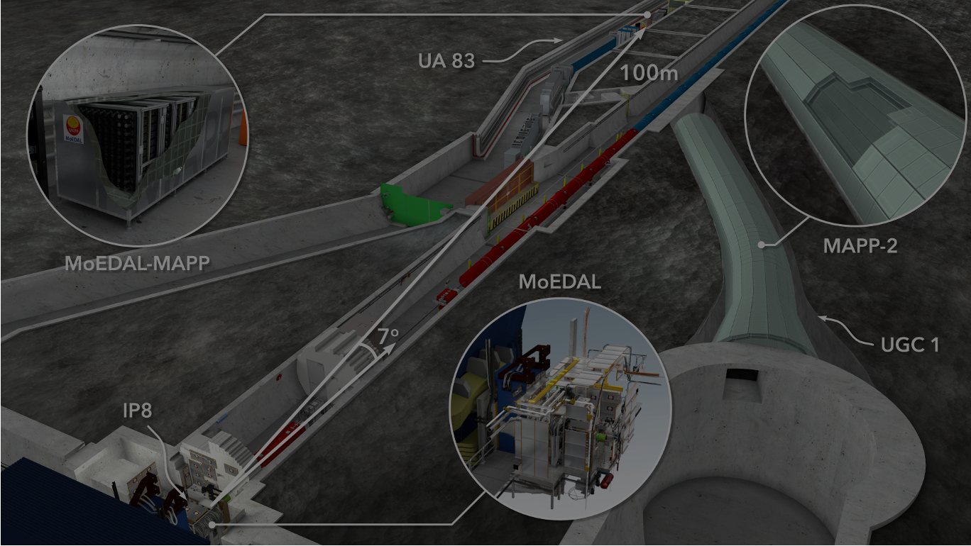
The MoEDAL-MAPP Installation at the LHC
Richard Soluk – University of Alberta
For the MoEDAL collaboration
TIPP 2023 – Cape Town, South Africa – Sept 4, 2023

Slide 2


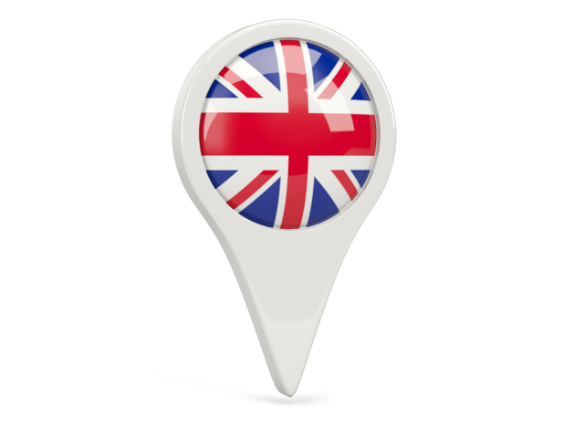





MoEDAL-MAPP 25 Institutes
UNITED KINGDOM
Imperial College London
Kings College London
Queen Mary University
Track Analysis Systems Ltd
IRIS Canterbury
KOREA
Centre for Quantum
Spacetime, Seoul
NORTH AMERICA
University of Alabama
University of Alberta
University of British Columbia
Concordia University
University of Montreal
University of Regina
Tuft’s University
University of Virginia
EUROPE
Technical University of Athens
University of Bologna
INFN Bologna
CERN, Switzerland
Czech Tech. University (IEAP)
Helsinki Institute of Physics
Institute of Space Sciences Romania
University of Valencia (IFIC)
University of Warsaw (Assoc.)
INDIA
University of Calcutta
National Institute of
Technology, Kuruksetra (Assoc.)
~70 Physicists & Engineers

Slide 3
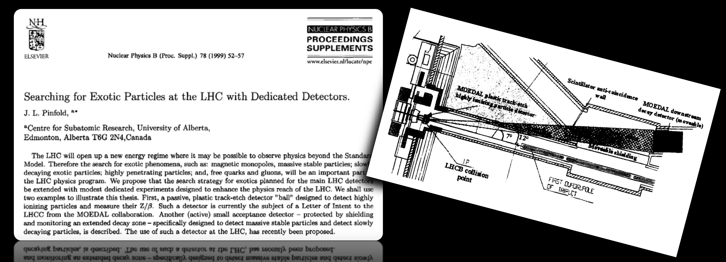
The MoEDAL-MAPP Philosophy
1st NoI to the LHCC in 1999
Dedicated Search Experiments (DSE):
Concentrate on particularly clear experimental signatures of new physics
Usually stand alone, modest size, lower cost with small teams ( <100)
Complementary to the main detectors ATLAS & CMS
MoEDAL [(Mo)nopole and Exotics Detector At the LHC] was the first DSE approved and operational at the LHC starting in run 1
MAPP [(M)oEDAL (A)pparatus for (P)enetrating (P)articles] under construction

Slide 4

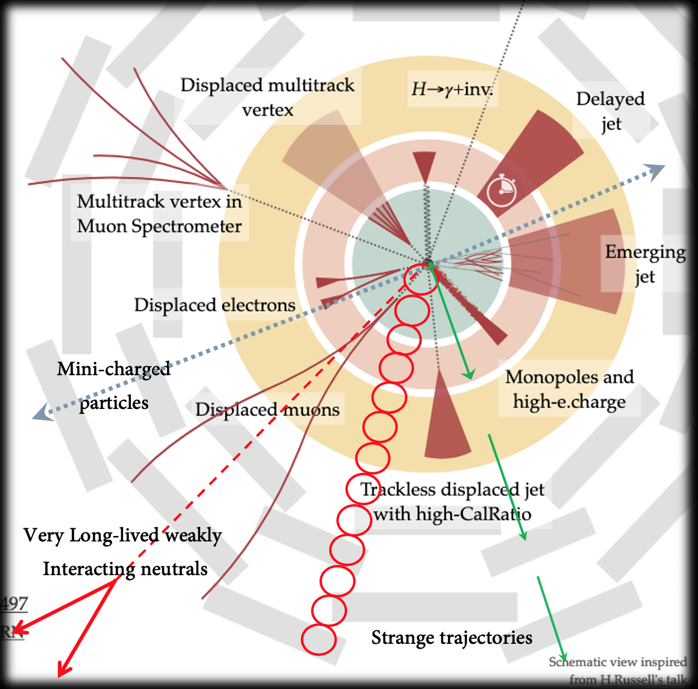
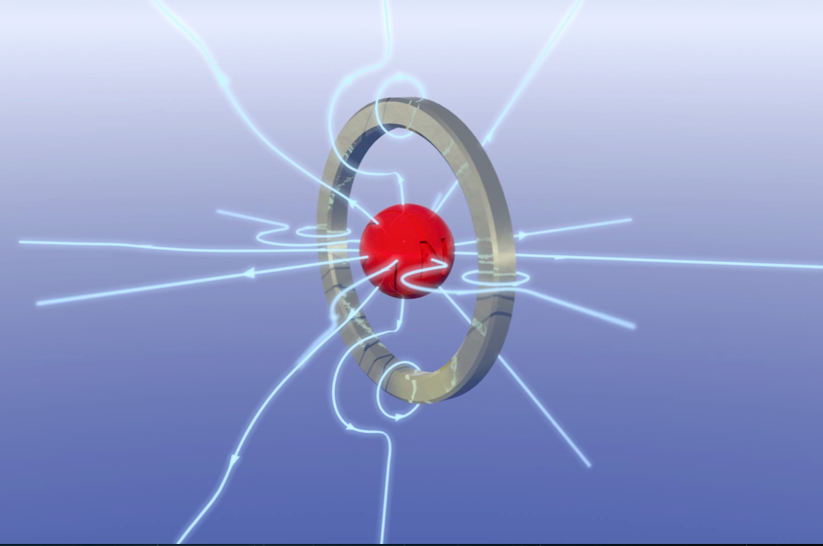
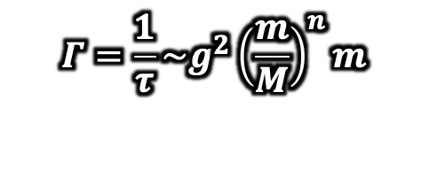
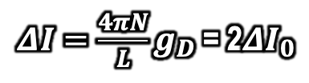
Avatars of New Physics…….
Long-lived Particles (LLPs)
$$Γ=\frac{1}{τ}\sim g^{2}{\left(\frac{m}{M}\right)}^{n}m$$
$ΔΙ=\frac{4πN}{L}g_{D}$ = 2$ΔI_{0}$
Highly-ionizing particles (HIPs)
Feebly interacting particles (FIPs)
Magnetic charge
-dE/dx ∝ g²
Electric charge
g =n68.5e
-dE/dx ∝ Z²/β²
Electric charge
z(<<1) β(~1)
-dE/dx ∝ z²/β²
Z ≥1 β < 1
……….for which ATLAS & CMS are not optimized

Slide 5
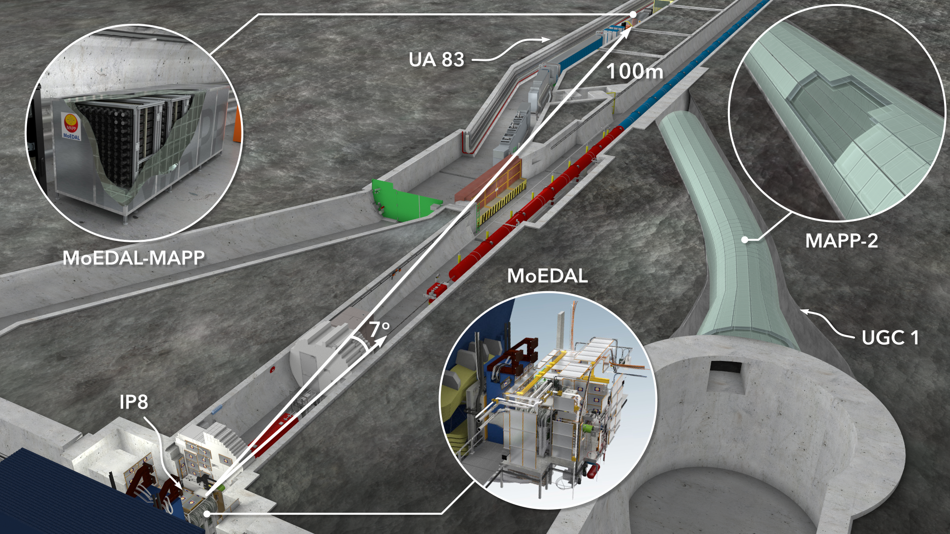
MoEDAL-MAPP A Multi-Decade Project
LLPs
LLPs
FIPs
UGC1
Phase-1 - MAPP-1 upgrade deployed: LHC-Run3 (2022-)
(Approved by CERN RB Dec.2021
Phase-2 - MAPP-2 upgrade to be deployed for HL-LHC (2027-)
(NoI supported by LHCC)
-1
HIPs
LHCb
Phase-0 - MoEDAL Detector for LHC Run 1 (2010 – 12), Phase-1 for Run 2 (2014-2108) and
Phase-2 for Run 3 (2022 - )
(Approved by CERN RB in 2010 & reapproved for LHC’s Run-3 in Dec. 2021

Slide 6
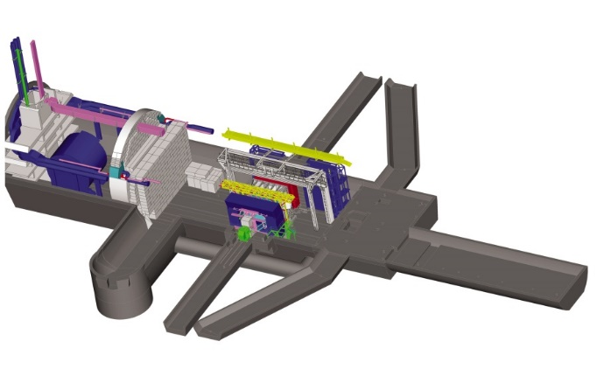
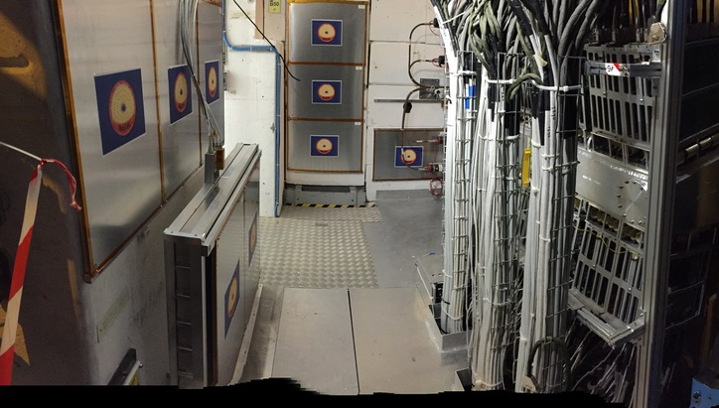
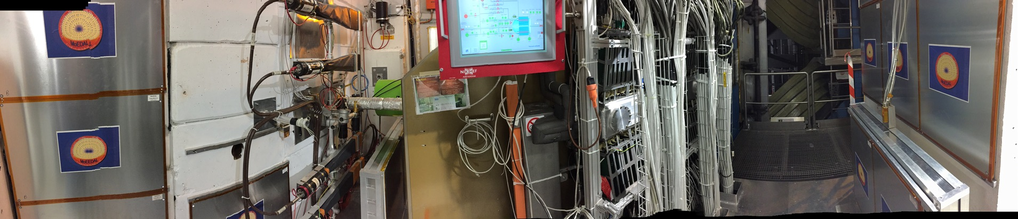
MoEDAL - The Baseline Detector
Search for Highly Ionizing Particles (HIPs)
  Emphasis on magnetic monopoles
LHCb asymmetrical design means very little material around the IP in the VELO alcove
VELO Alcove

Slide 7
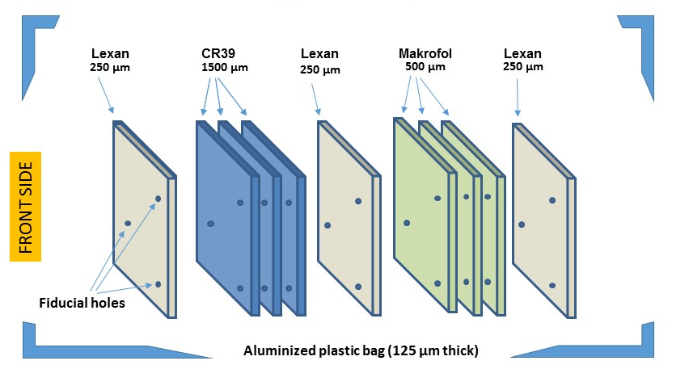
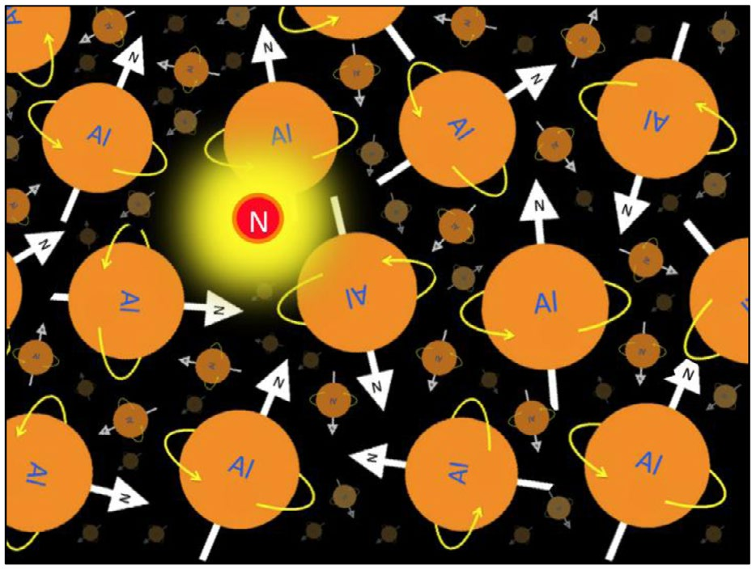
MoEDAL – Three Detector Technologies
Nuclear Track Detectors (NTD)
  Mainly CR39 and Makrofol but other plastics also deployed (different damage thresholds)
  HIP leaves trail of damage in plastic stack
  Etch to create permanent record
Magnetic Monopole Trappers (MMT)
  Large bulk of aluminum
  Magnetically charged particle will bind to high magnetic moment of the Al nuclei
  Creates unique magnetic signature in a magnetometer
TimePiX(TPX)
  Only active element
  Pixelated charge detector with both position and time sensitivity
  Small active area
VELO Alcove

Slide 8
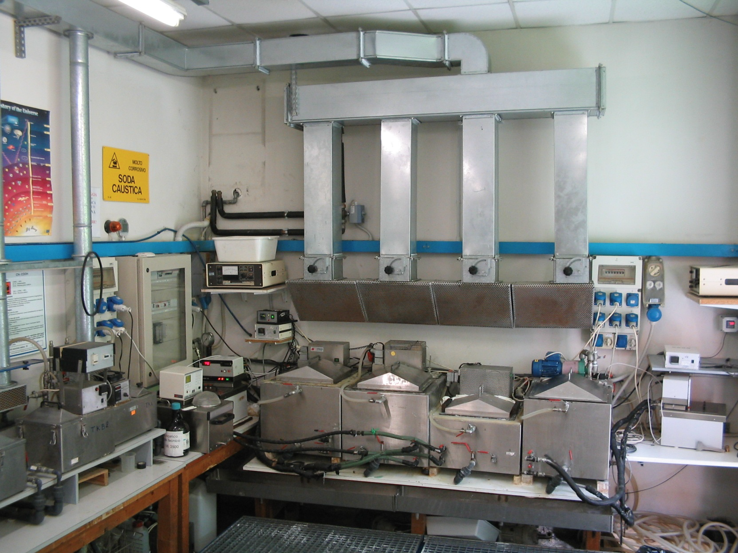
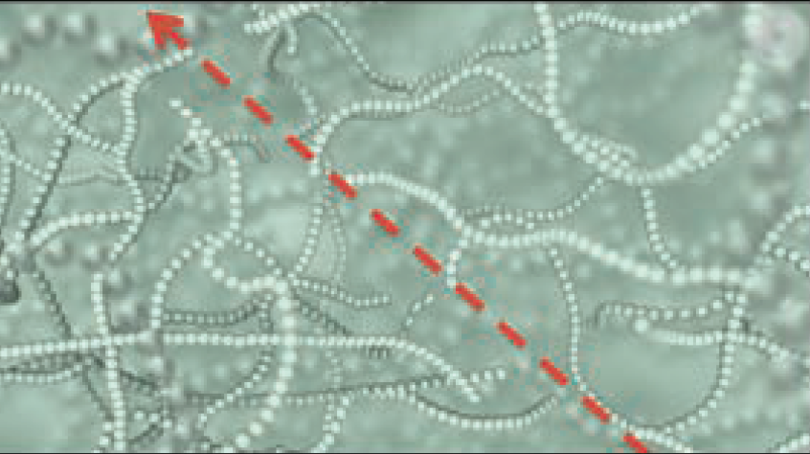
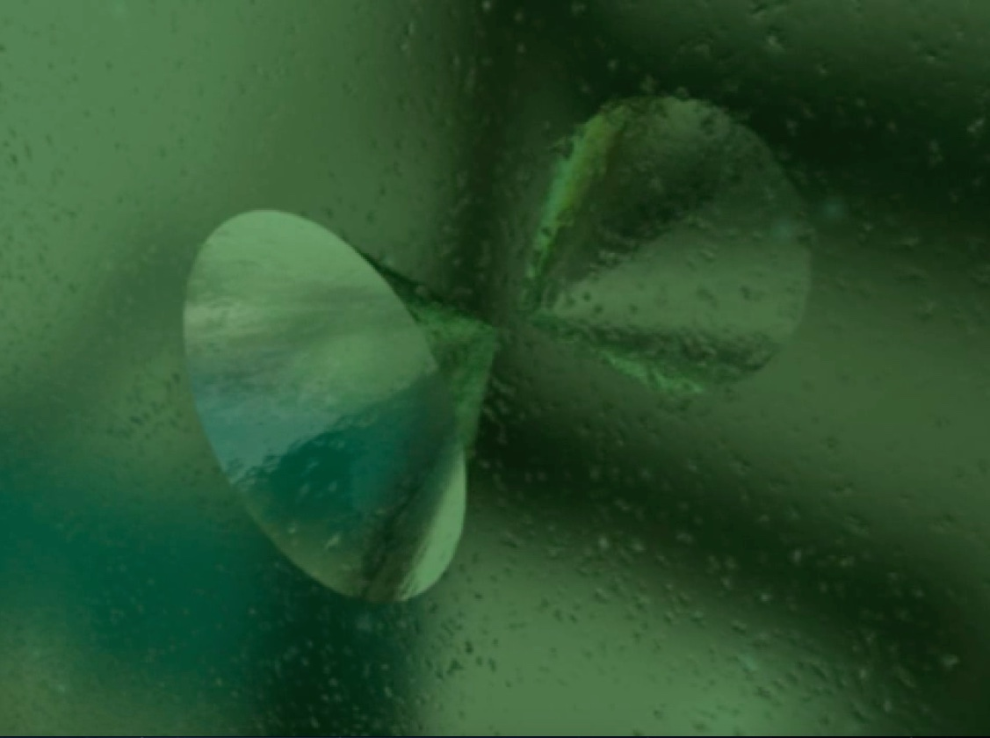
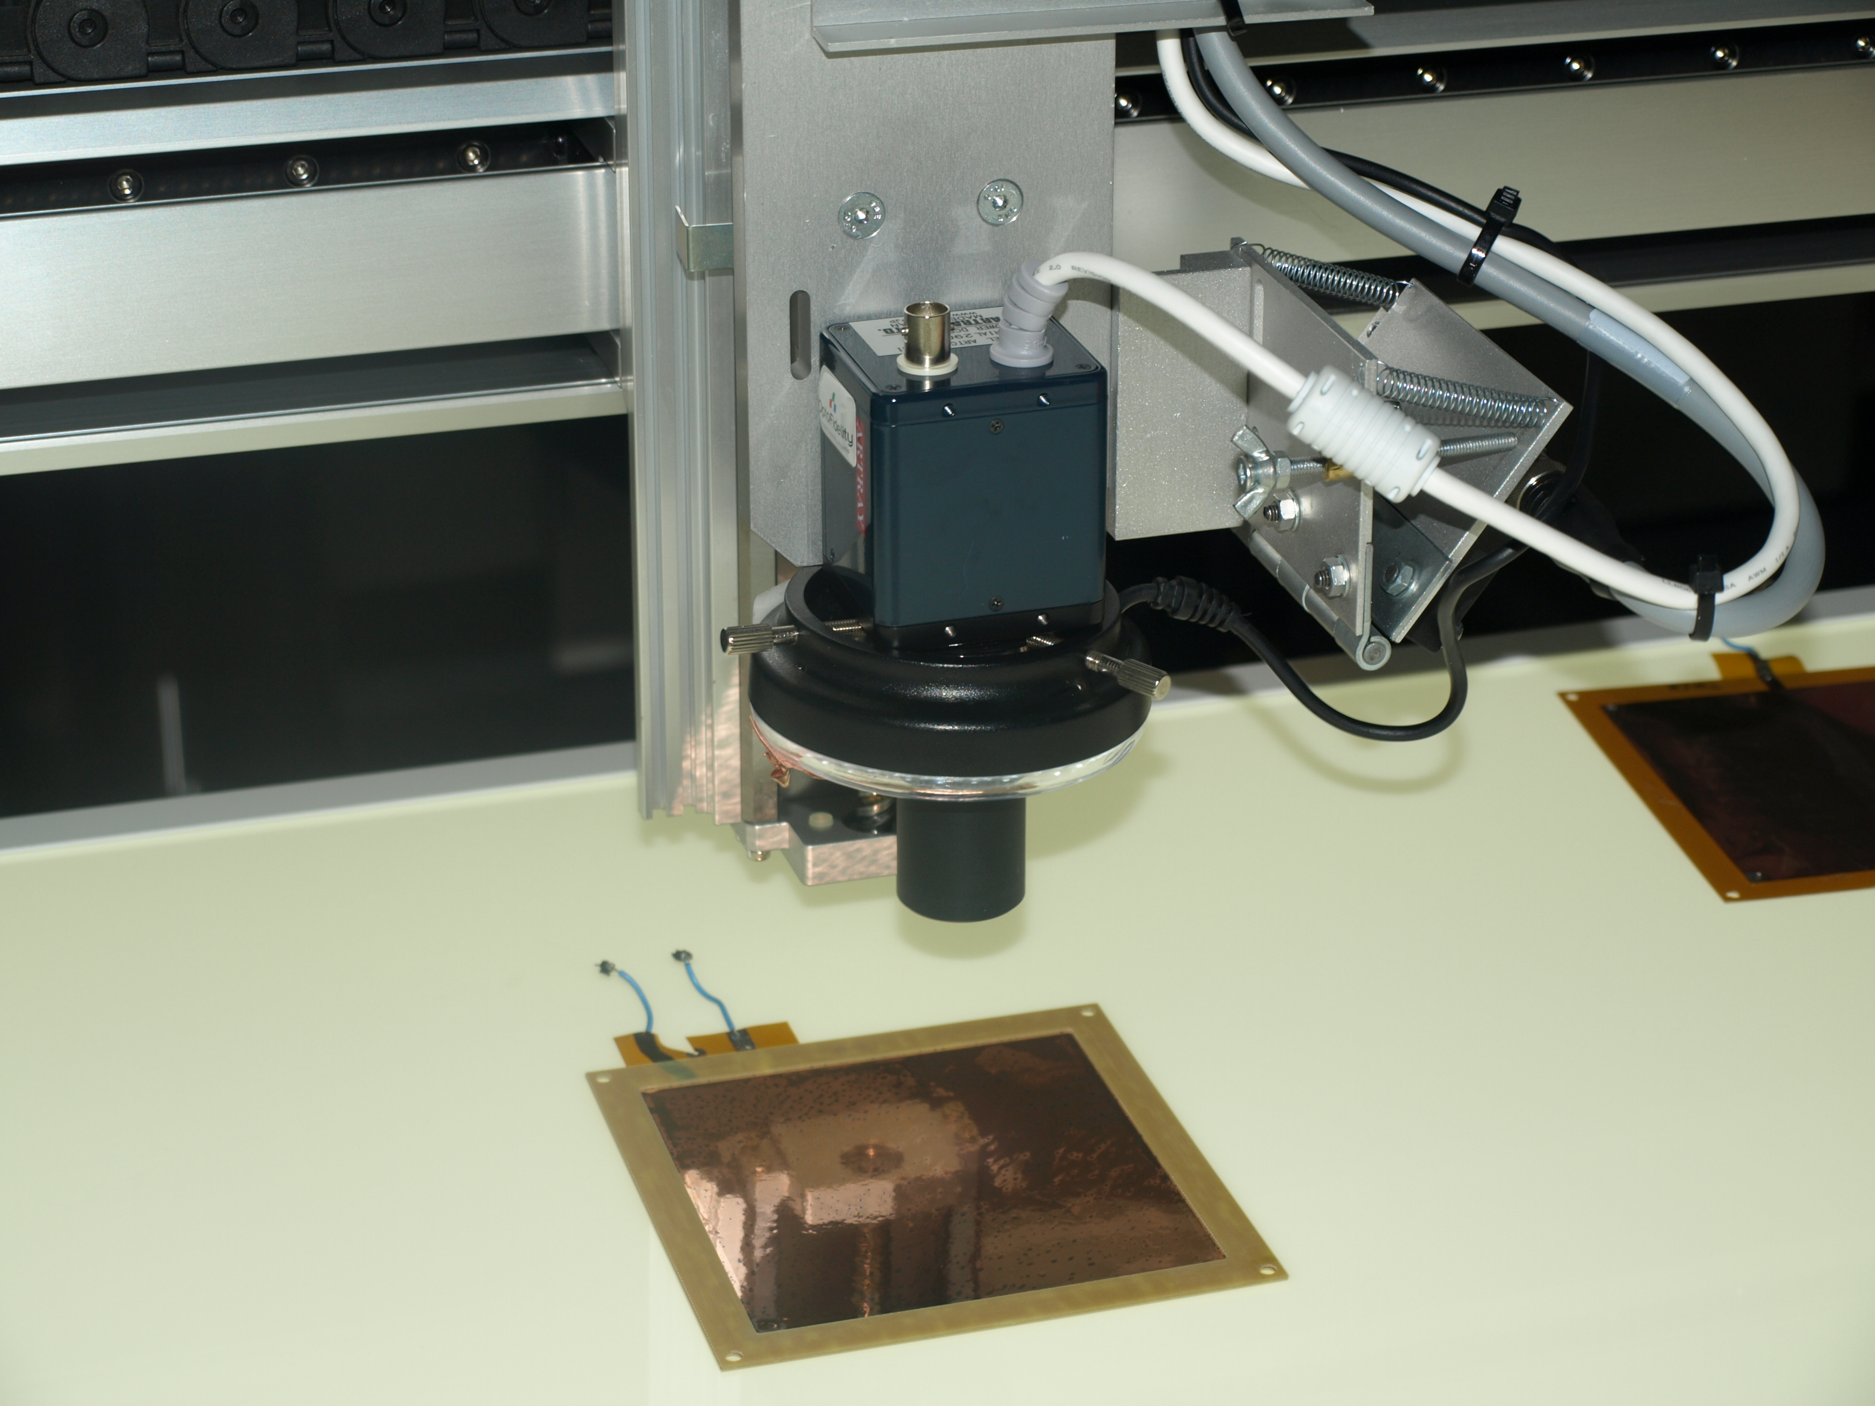
Nuclear Track Detectors
Chemical etching
Trail of damaged bonds
Ionizing particle leaves a trail of broken polymer bonds
  Degree of damage varies between plastics
Ionization damage increases etch rate along particle tracks resulting in etch pits
  Size of etch pits proportional to track z/β
Can be accurately calibrated using heavy ion beams
Permanent record of particle track
No trigger needed
Etch pits form on
both surfaces
Pits identified and
measured optically

Slide 9
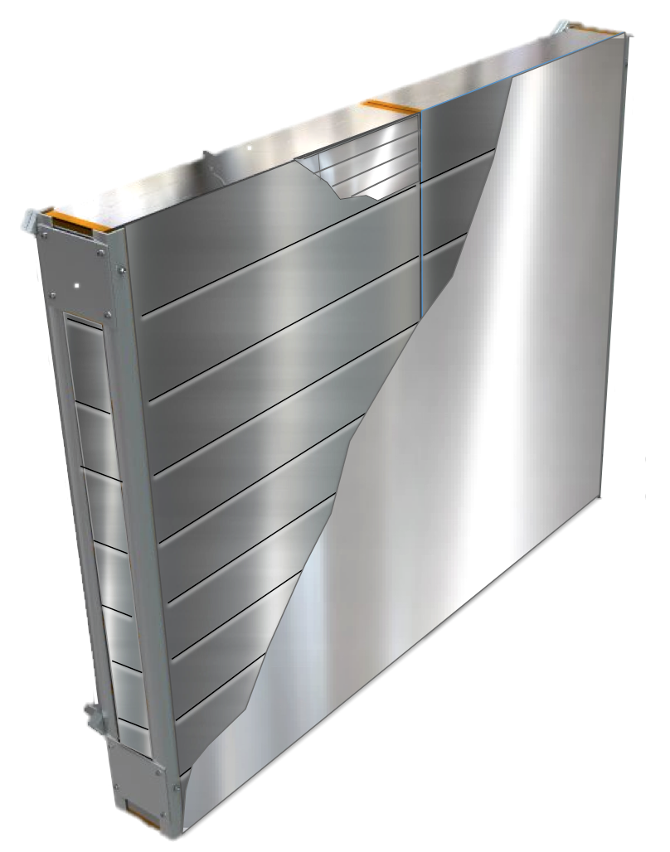
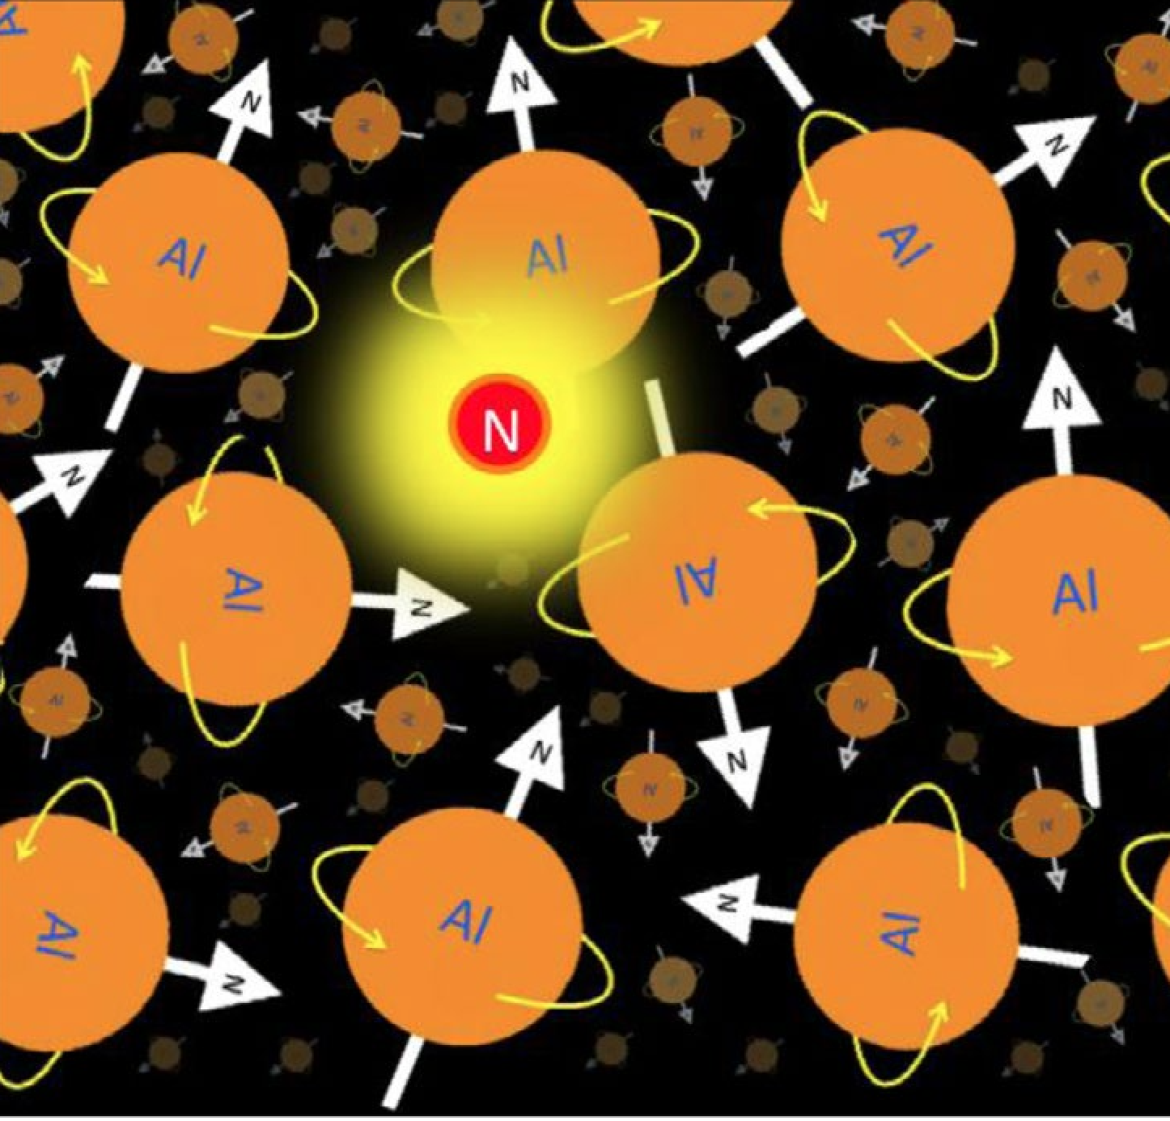
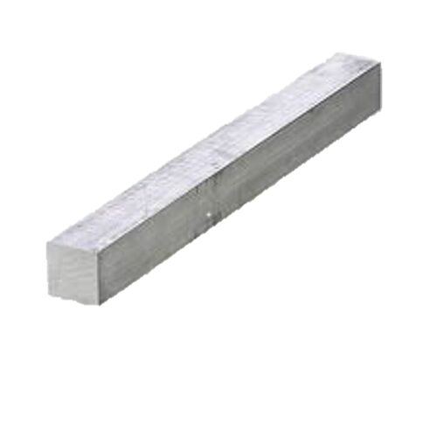
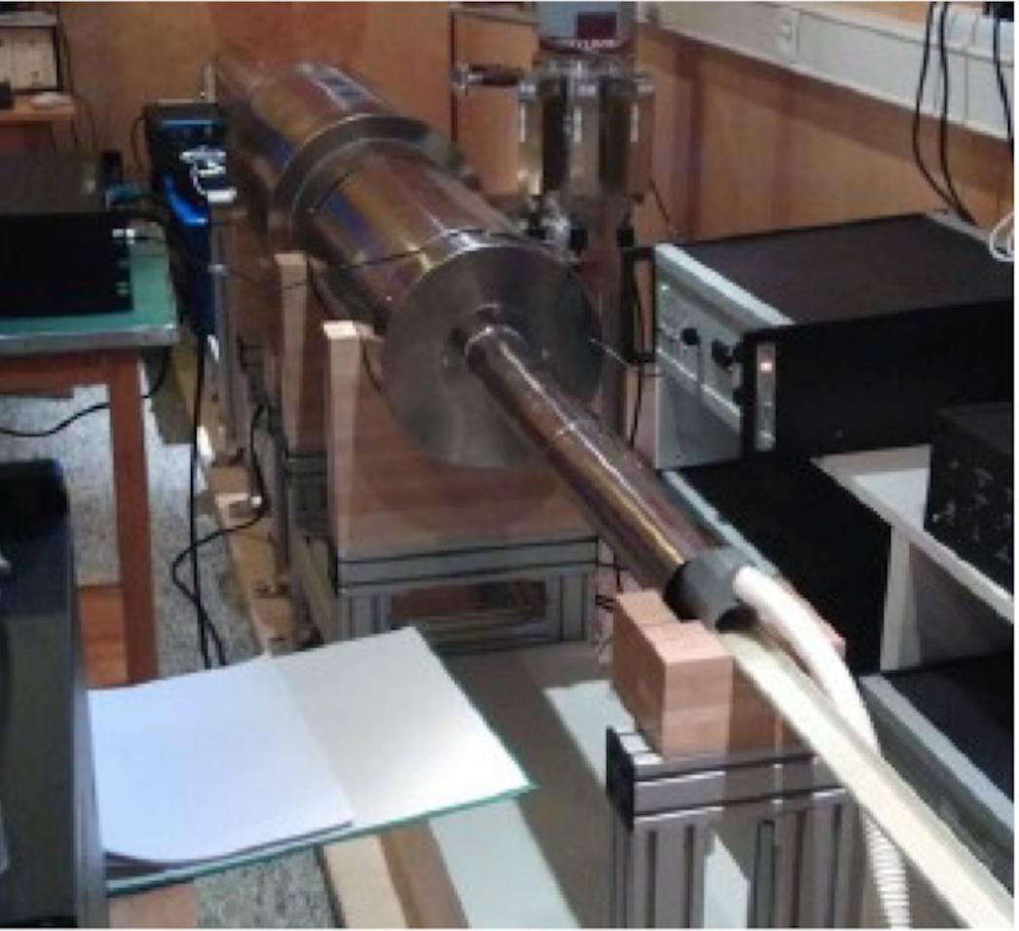
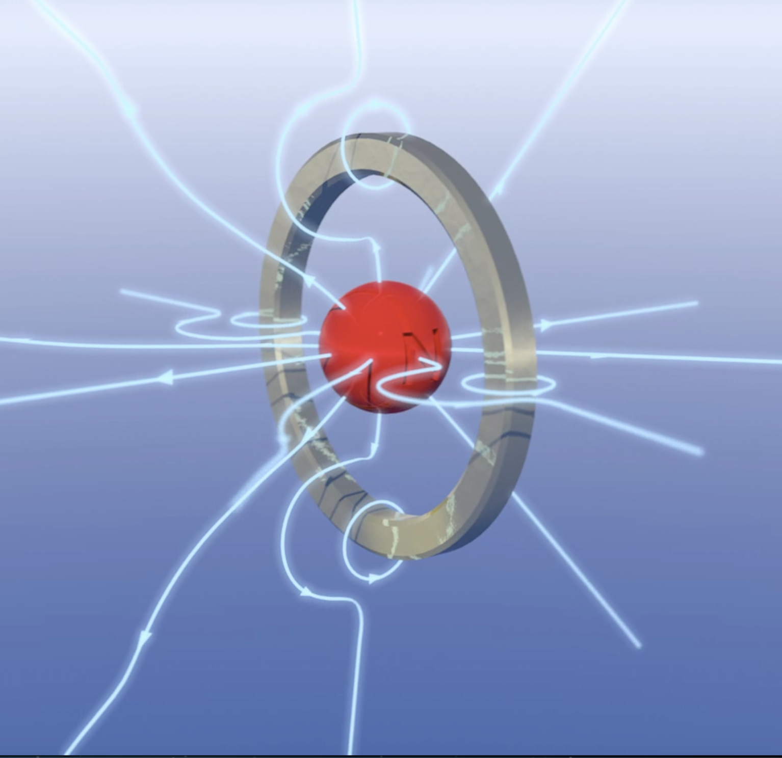
Magnetic Monopole Trappers
Monopole binds
to nucleus
Detectors disassembled
Aluminum has a high nuclear magnetic moment (3.63μN)
Sample size determined by magnetometer bore (typically about 4 cm diameter)
Scanned using a SQUID at ETH Zurich (high sensitivity)
Look for changes in persistent current
Calibrate using long dipoles
Magnetometer
scanning
Unique current produced
in SQUID

Slide 10
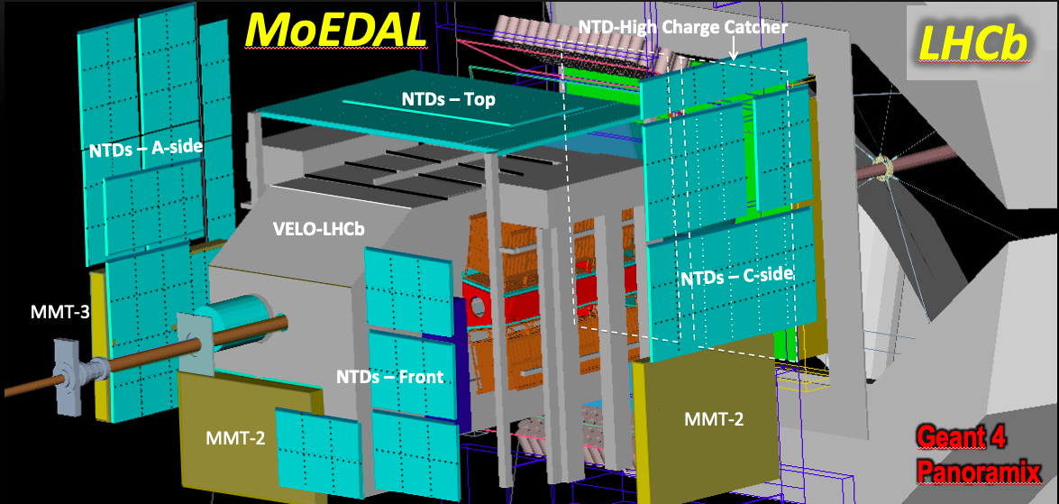
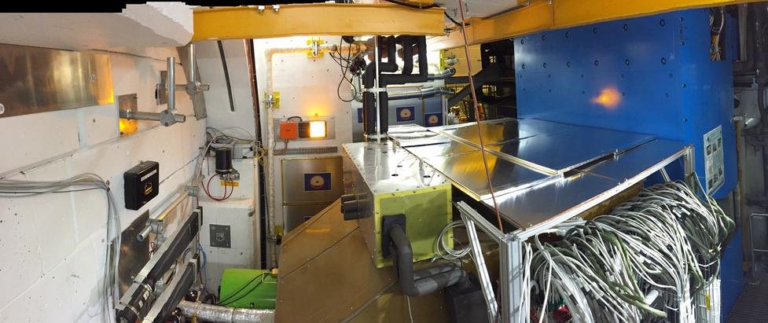
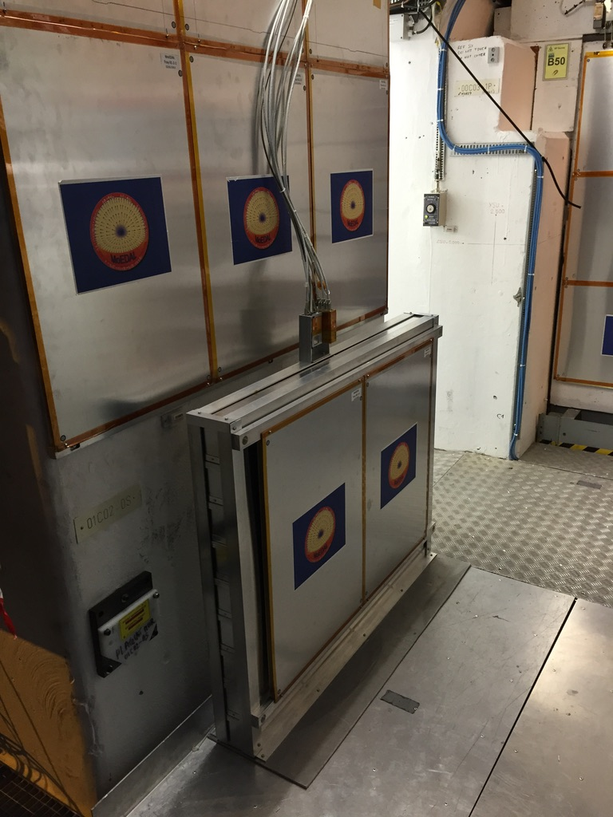
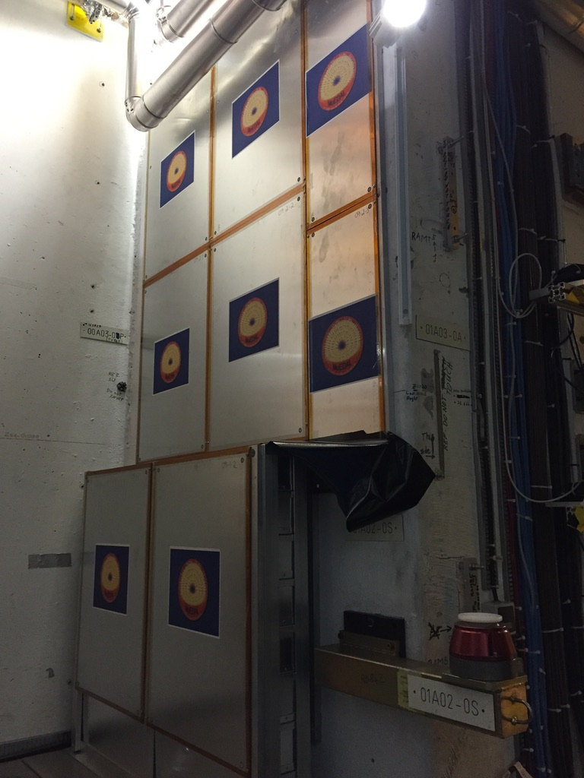
MoEDAL – LHC Run 2
Prototype detectors used in run 1
Official installation in 2014 for run 2
Geometry improved for run 3
VELO Alcove
Run 2 Configuration
186 stacks of NTDs
  24x24cm
  Multiple layers of CR39 and Makrofol
  Typically replaced once a year
2400 MMT bars
  Square cross section
  Solid aluminum (800kg)
  2.5x2.5x19 cm size
5 TPX2 detectors
  Various locations
  2 TPX3 added at end of run 2

Slide 11
The MAPP Detector
LLPs
LLPs
FIPs
UGC1
Phase-1 - MAPP-1 upgrade deployed: LHC-Run3 (2022-)
(Approved by CERN RB Dec.2021
Phase-2 - MAPP-2 upgrade to be deployed for HL-LHC (2027-)
(NoI supported by LHCC)
-1
HIPs
LHCb
Phase-0 - MoEDAL Detector for LHC Run 1 (2010 – 12), Phase-1 for Run 2 (2014-2108) and
Phase-2 for Run 3 (2022 - )
(Approved by CERN RB in 2010 & reapproved for LHC’s Run-3 in Dec. 2021

Slide 12
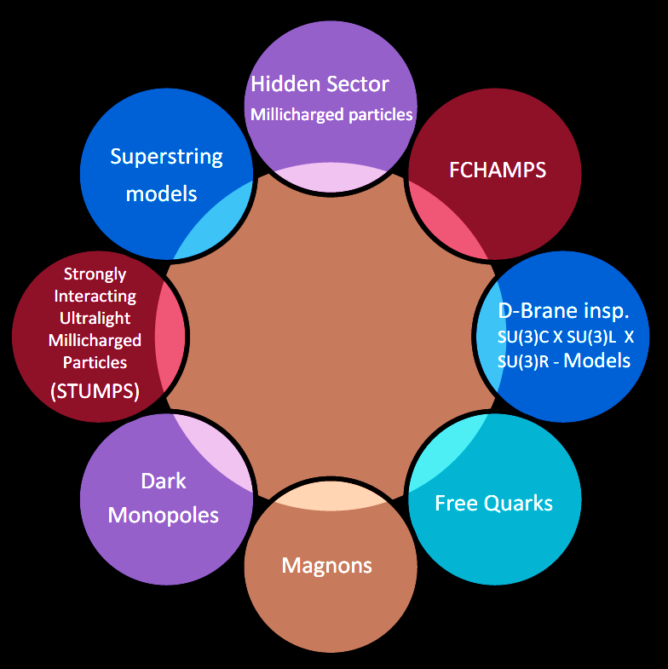
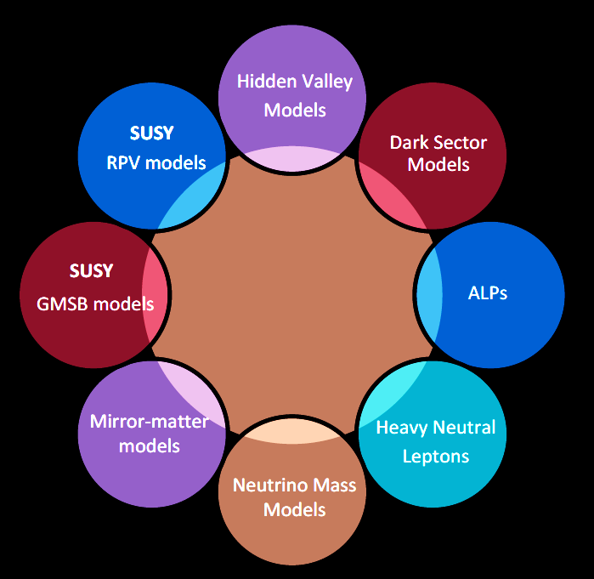
MAPP Physics Goals
Active scintillator-based detector
Phase 1 of MAPP is focused on low ionization particles, for instance millicharged particles
Also sensitive to neutral long lived particles that decay in the detector volume with charged decay products
Fractionally-Charged Particles
Long Lived
Particles

Slide 13
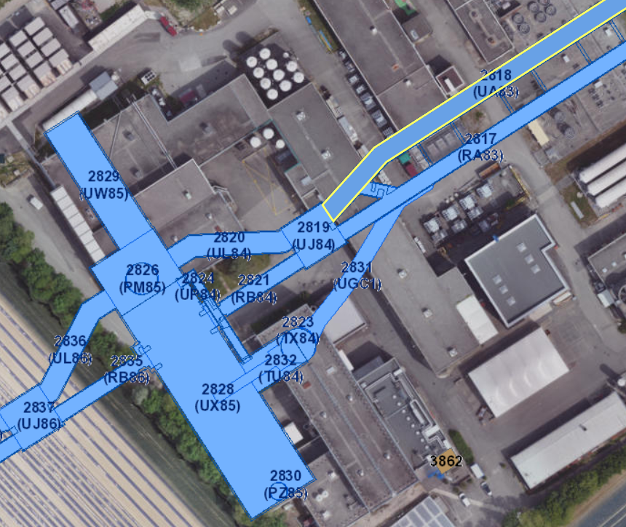
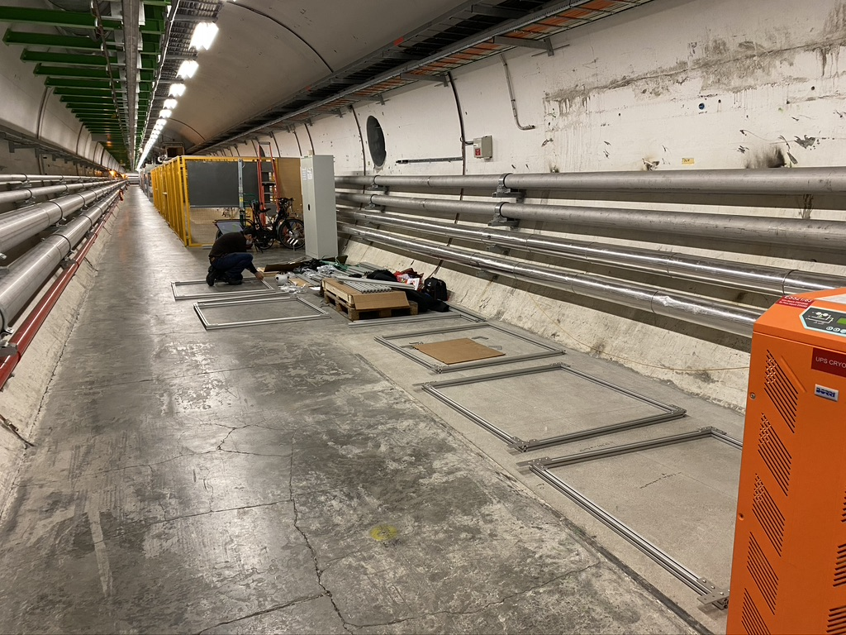
MAPP Location
Approved Dec 1, 2021
MAPP detector originally planned for UGC1 is now located in UA83
  UGC1 is an undeveloped space dating back to LEP construction
UA83
  ~110m underground
  ~40m shielding from IP
  Estimated dose <1mGy/yr (factor of 300 less than UGC1)
  Not classed as an activation zone
MAPP
UA83

Slide 14
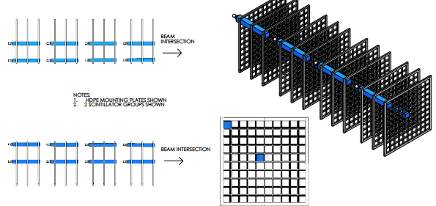
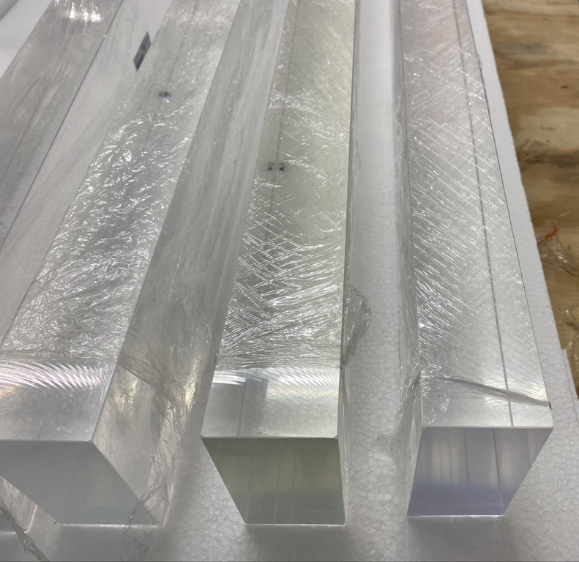
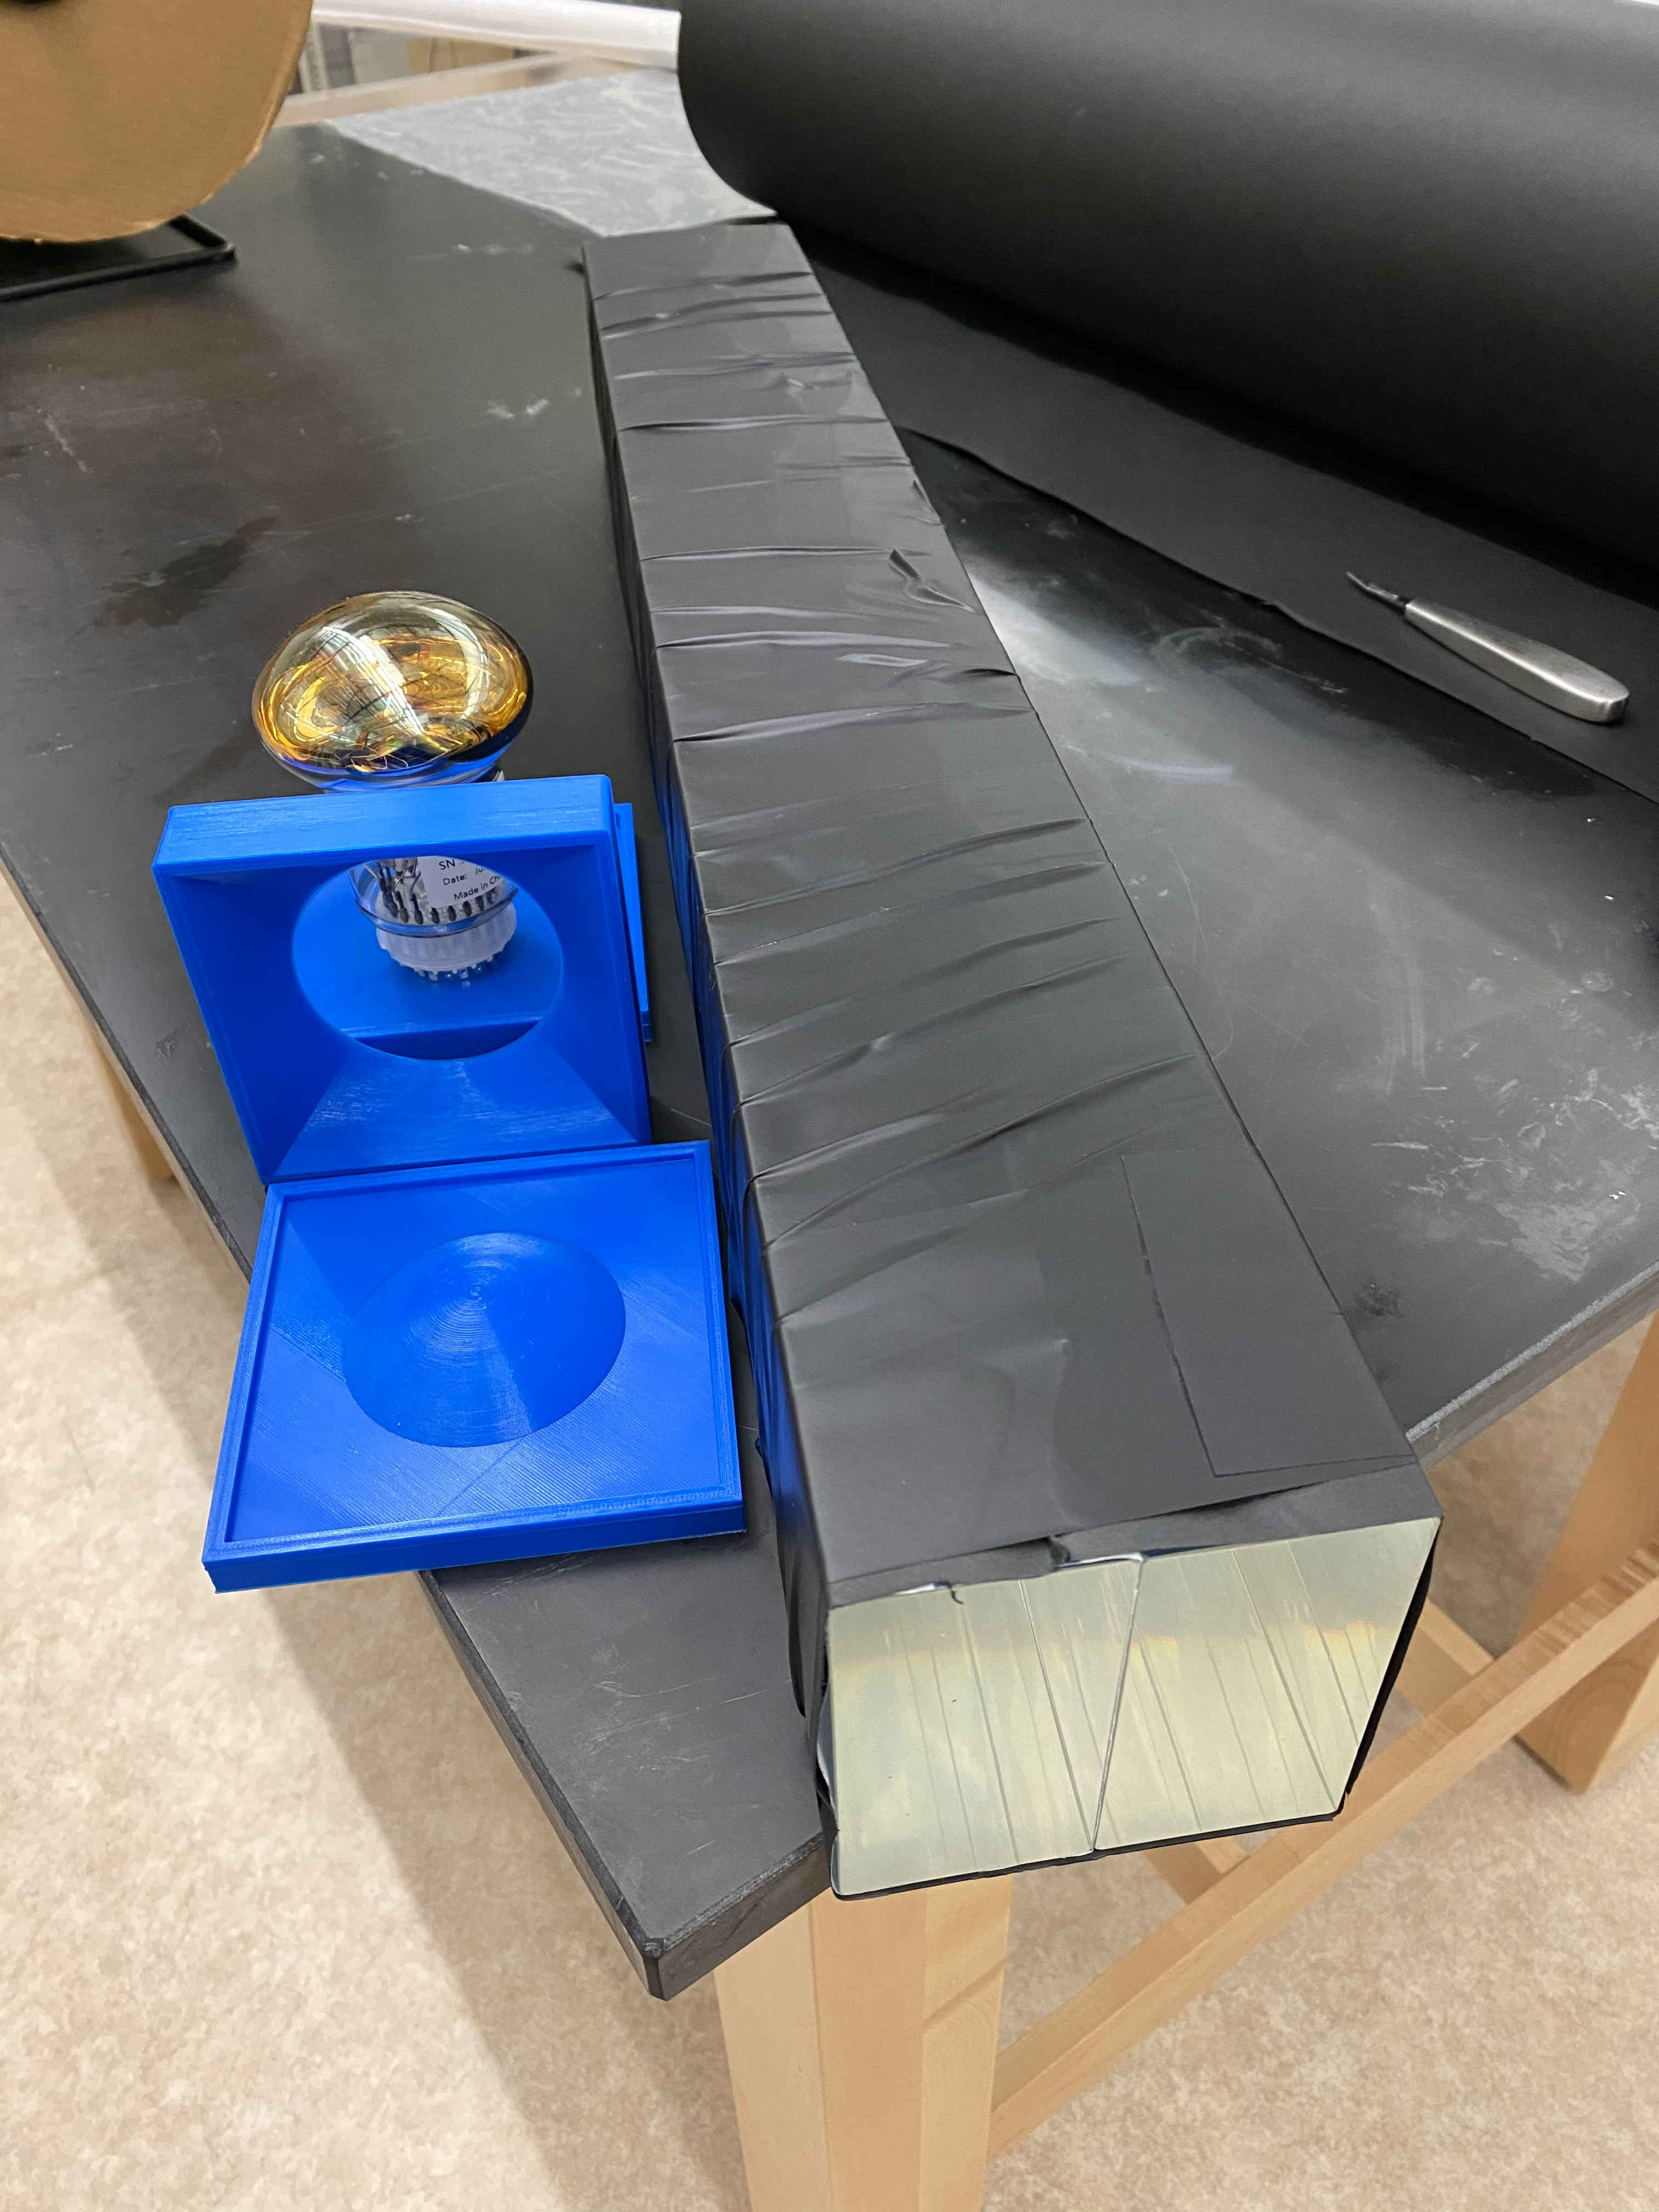
The MAPP Core Element
10 x 10 x 75 cm scintillator bars held in a HDPE grid
  Two 5cm thick scintillator bars are combined to form each 10x10 bar
PS scintillator (rather than PVT)
Light guide cast from Sylgard 184 silicone
HZC XP72B22 80mm PMT
  Out of business before last 100 PMTs produced

Slide 15
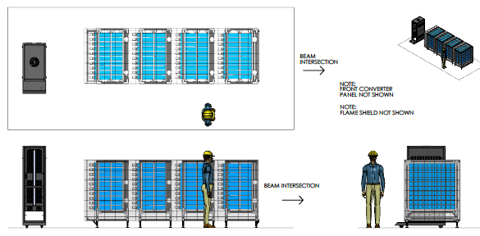
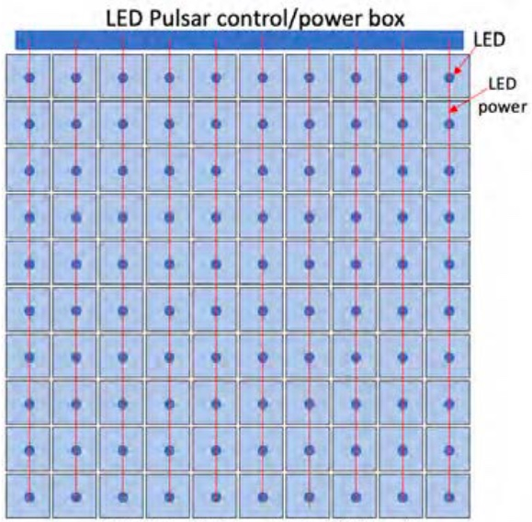
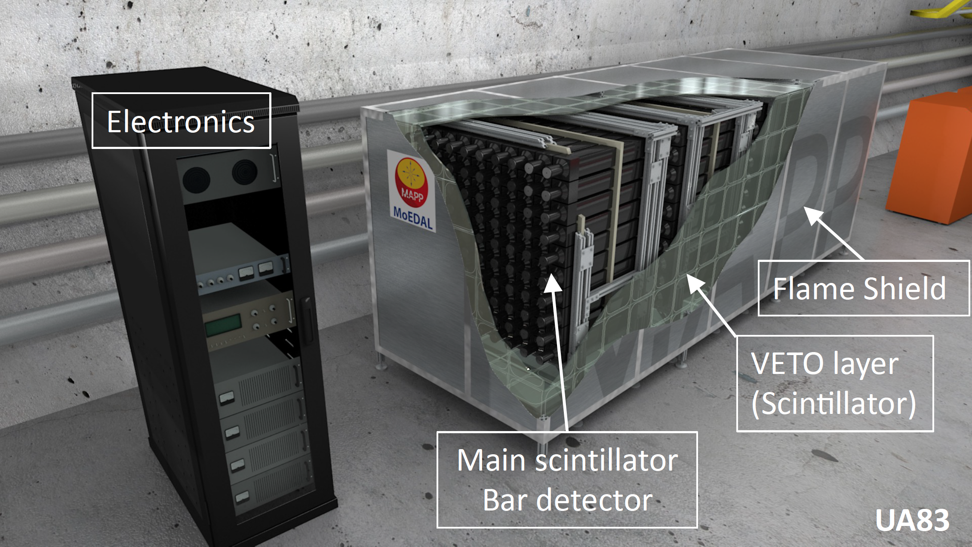
The MAPP Core Design
Scintillators are placed in a 10x10 array in T-slot aluminum frames
  4 frames surveyed to point to IP
4-fold coincidence to suppress noise
Particle from IP will see 300cm of active scintillator
Approximately 4 ton active volume
LED mounted on back of each bar for testing and monitoring

Slide 16
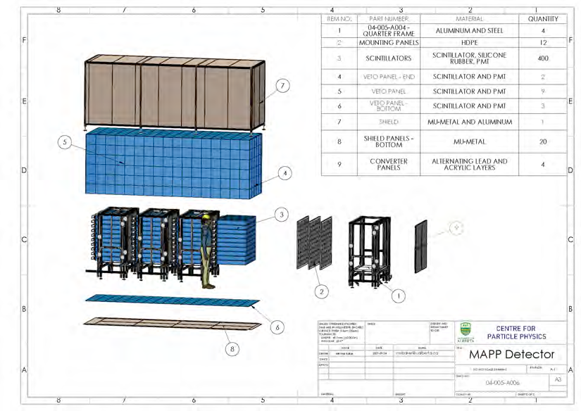
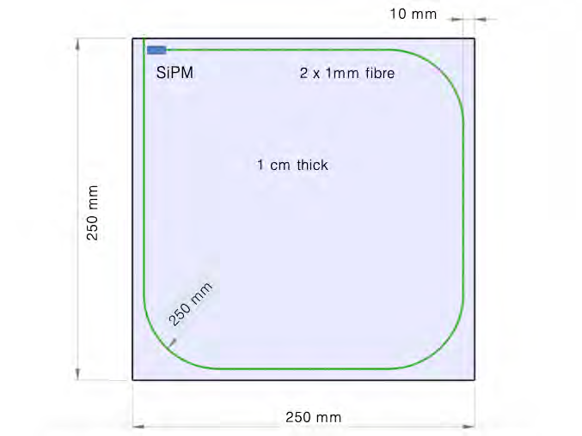
MAPP Additional Elements
Pb-scintillator radiators
  5 layers each of 6mm scintillator and 3/32” lead foil
  Read out with wavelength shifting fibers
  Four 60x60cm panels in each MAPP support frame
VETO Panels
  Hermetic veto around core scintillators
  10mm thick scintillator panels
  Embedded wavelength shifting fibers for readout

Slide 17
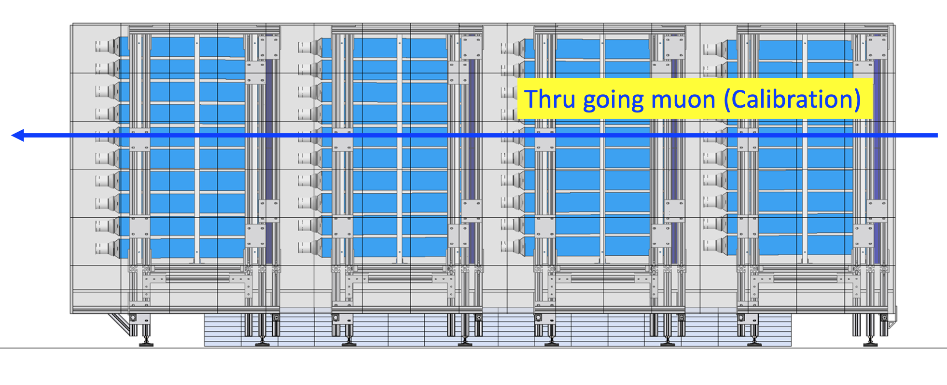
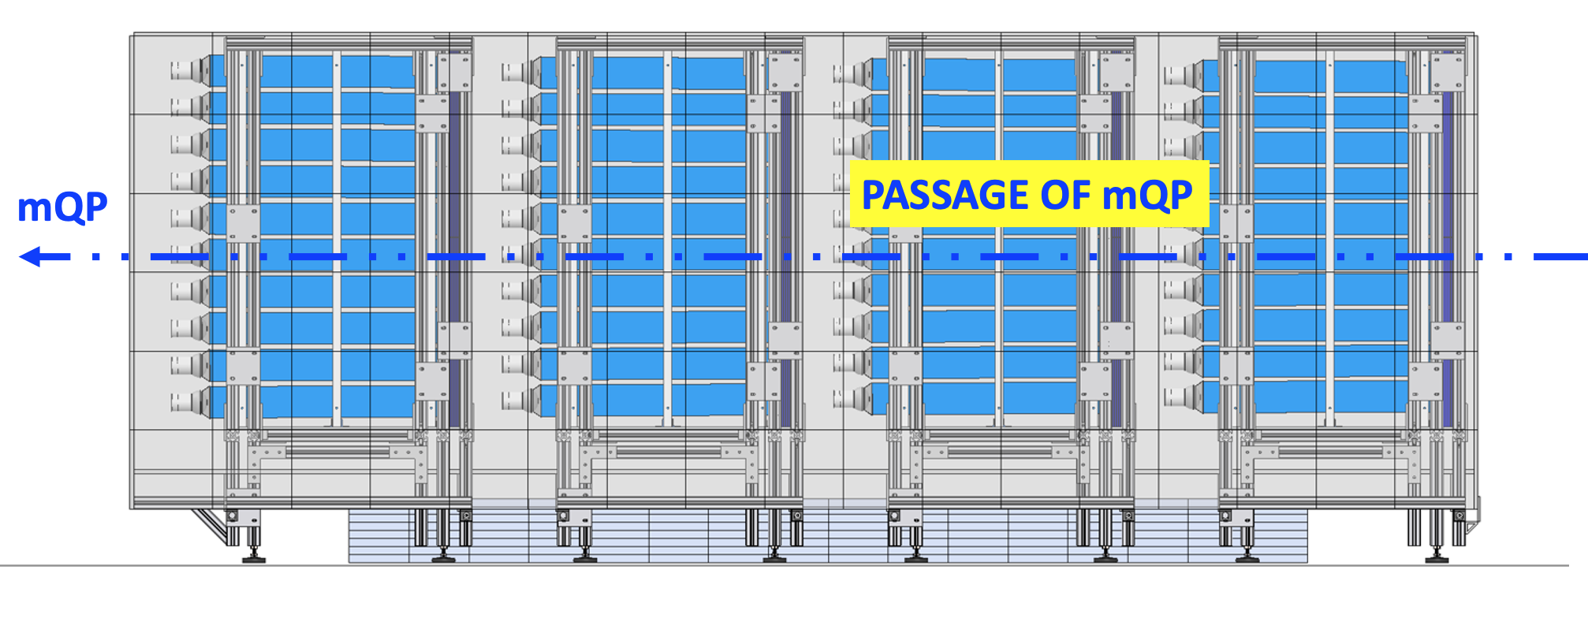
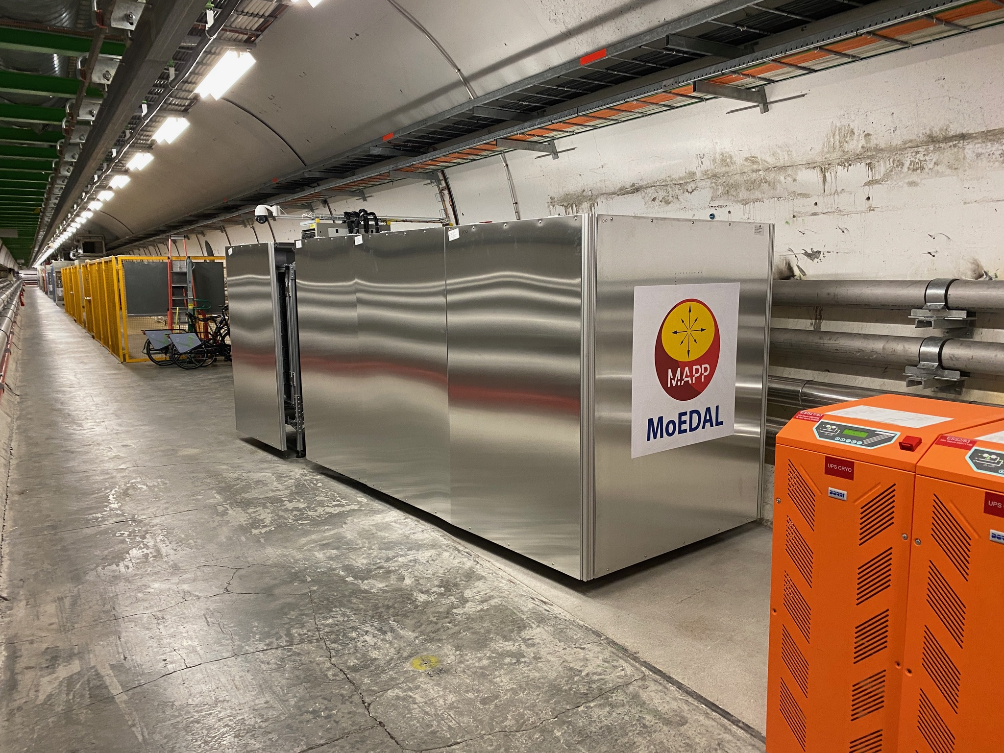
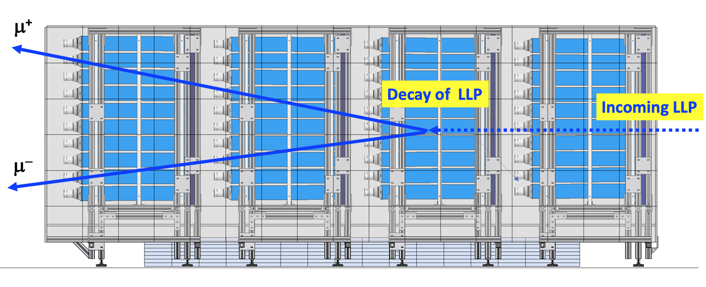
MAPP Detection Modes
Three main detection modes
  Muons from the IP
  Millicharged particles in 4-fold coincidence
  Displaced vertices

Slide 18
The MAPP-2 Detector
LLPs
LLPs
FIPs
UGC1
Phase-1 - MAPP-1 upgrade deployed: LHC-Run3 (2022-)
(Approved by CERN RB Dec.2021
Phase-2 - MAPP-2 upgrade to be deployed for HL-LHC (2027-)
(NoI supported by LHCC)
-1
HIPs
LHCb
Phase-0 - MoEDAL Detector for LHC Run 1 (2010 – 12), Phase-1 for Run 2 (2014-2108) and
Phase-2 for Run 3 (2022 - )
(Approved by CERN RB in 2010 & reapproved for LHC’s Run-3 in Dec. 2021

Slide 19
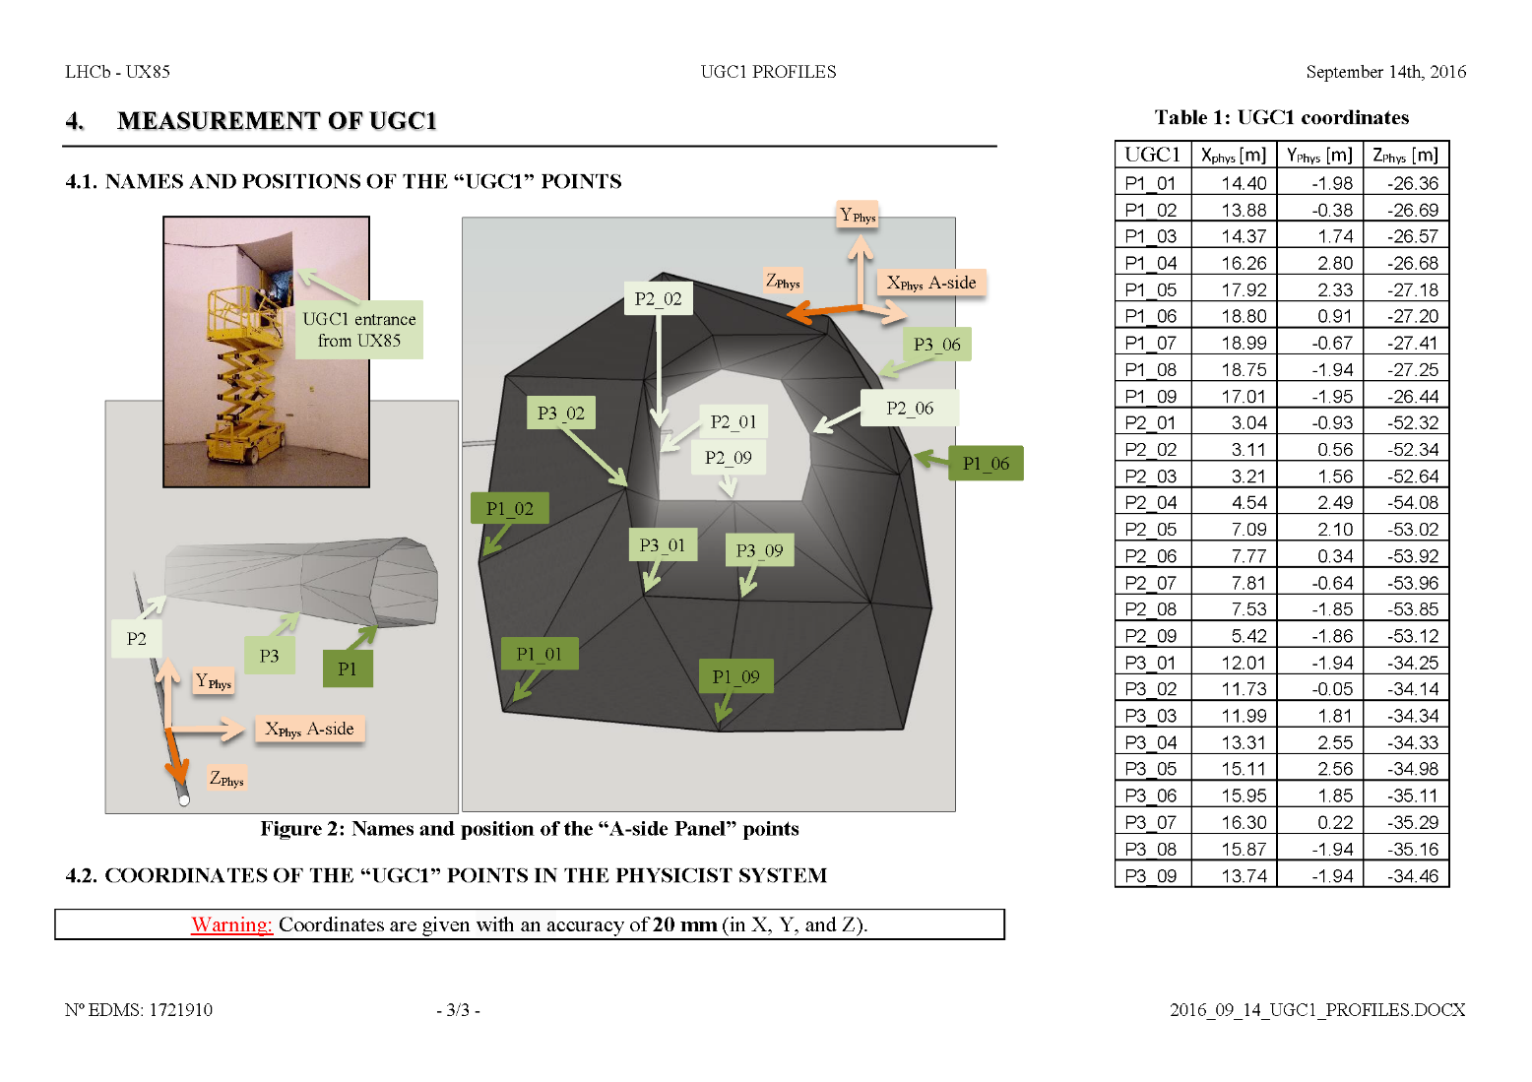
UGC1 Gallery
Back to UGC1
A large decay volume for detecting long lived particles?
Used for boring machine during LEP tunnel construction
During LEP era was used as storage by the DELPHI experiment
IP
UGC1 Gallery
LHC run 1
  Empty
  Only lights
LHC run 2
  Ethernet
  AC power
  Possible MAPP site
LHC run 3
  TPX computer?

Slide 20
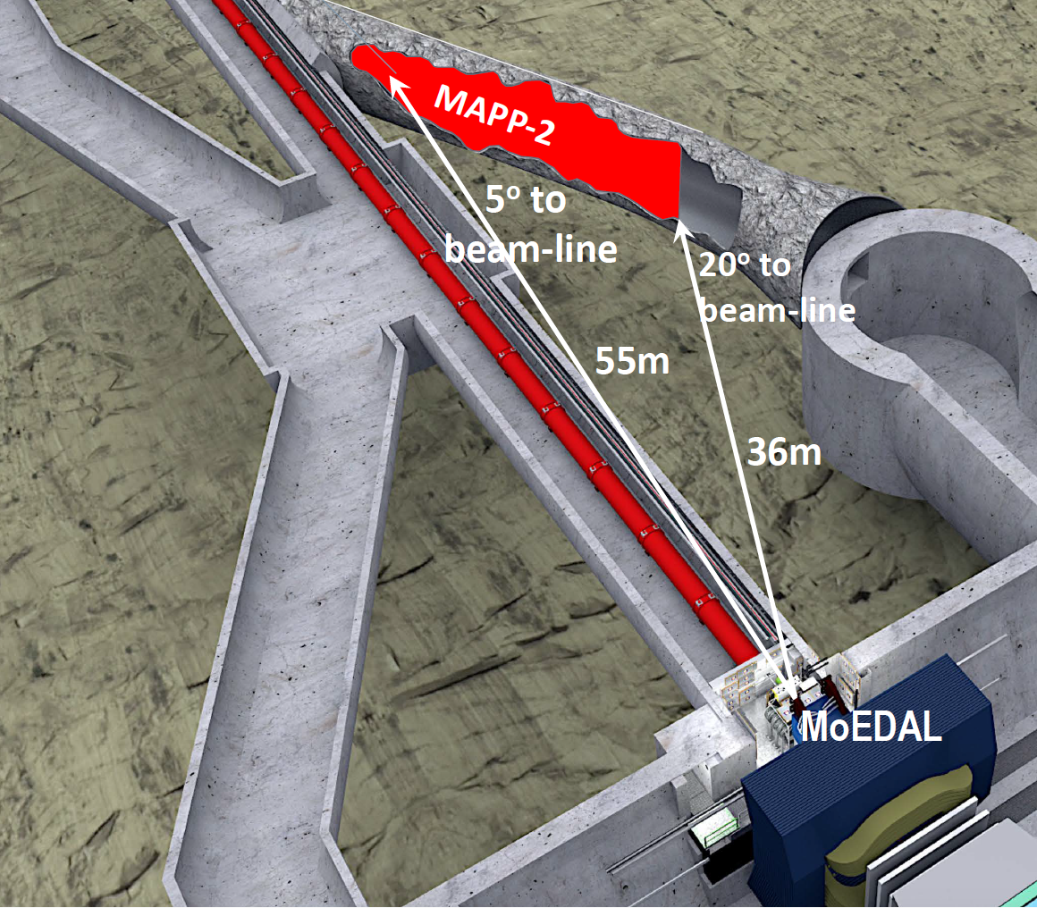
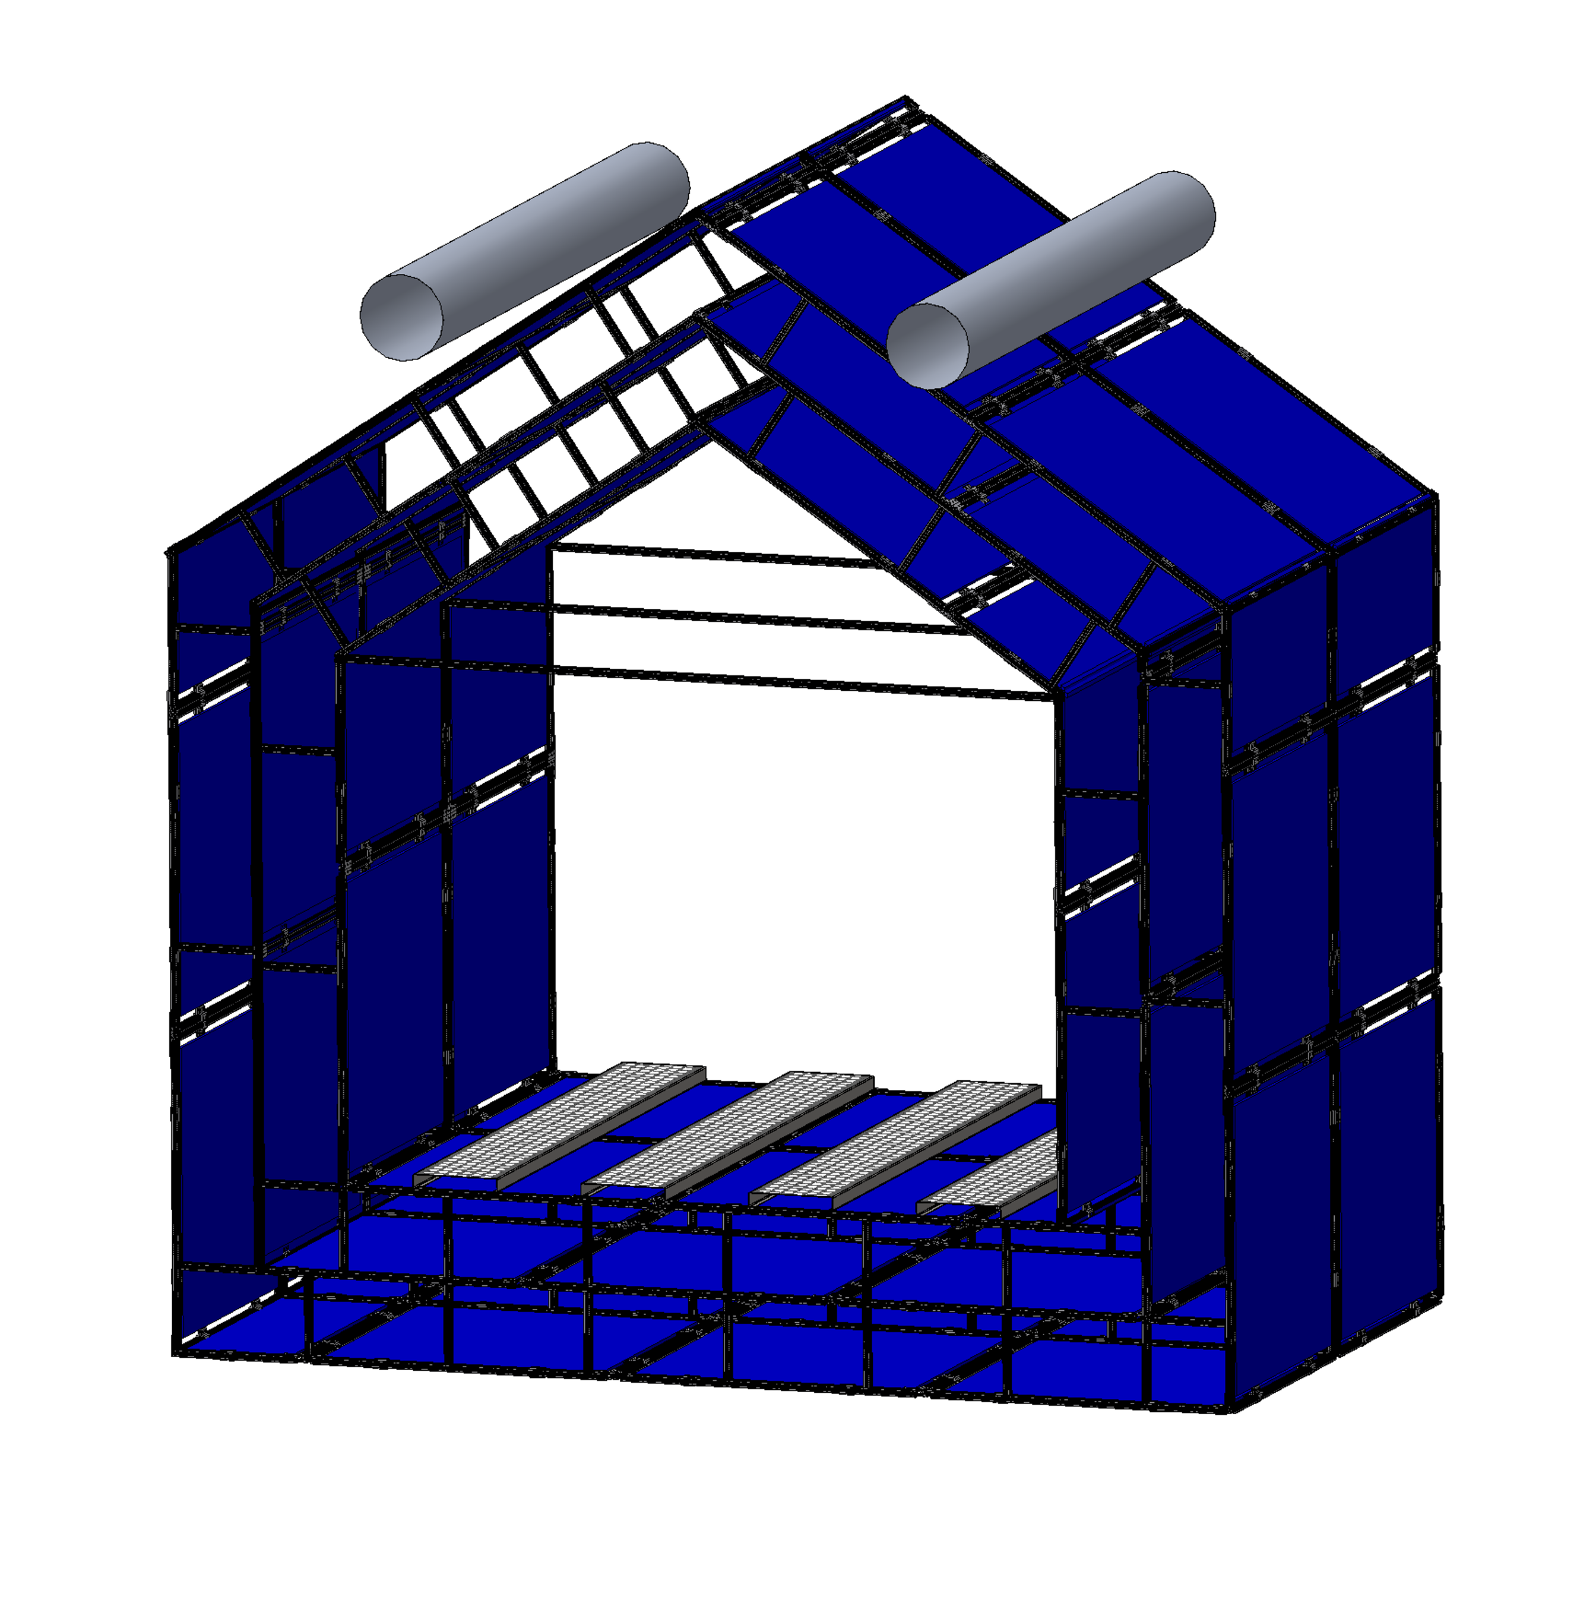
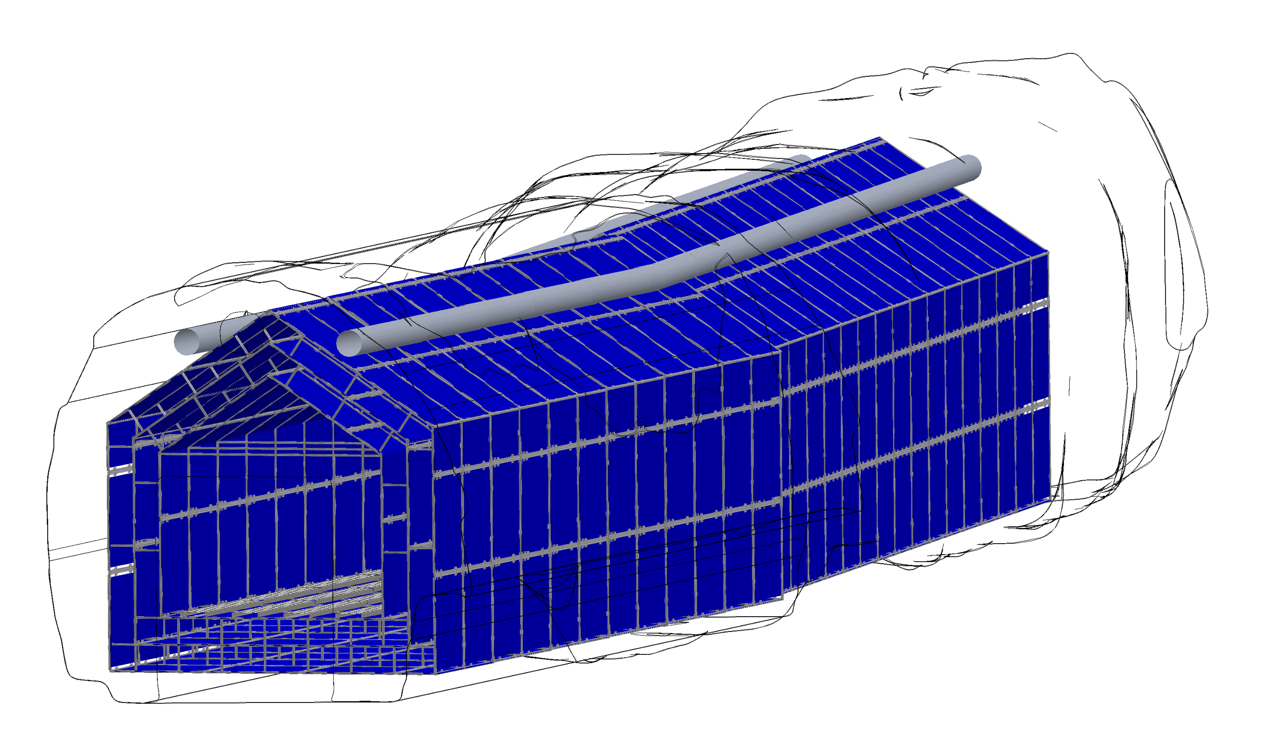
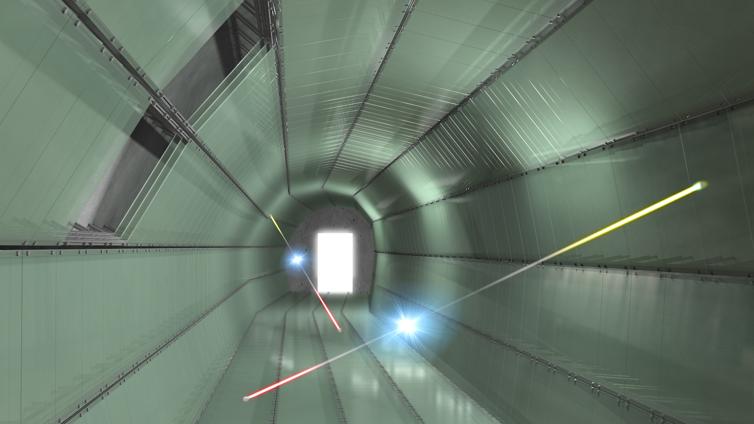
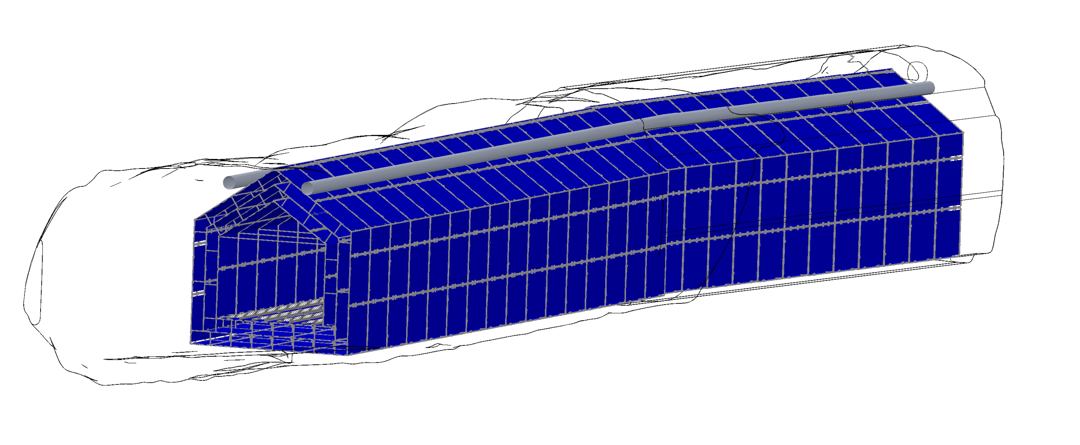
MAPP-2 for HL-LHC
Nested layers of scintillating panels
  x-y readout using wavelength shifting fibers
  ~1cm resolution
~1200 m³ of instrumented decay volume
MAPP-2
MAPP-1

Slide 21
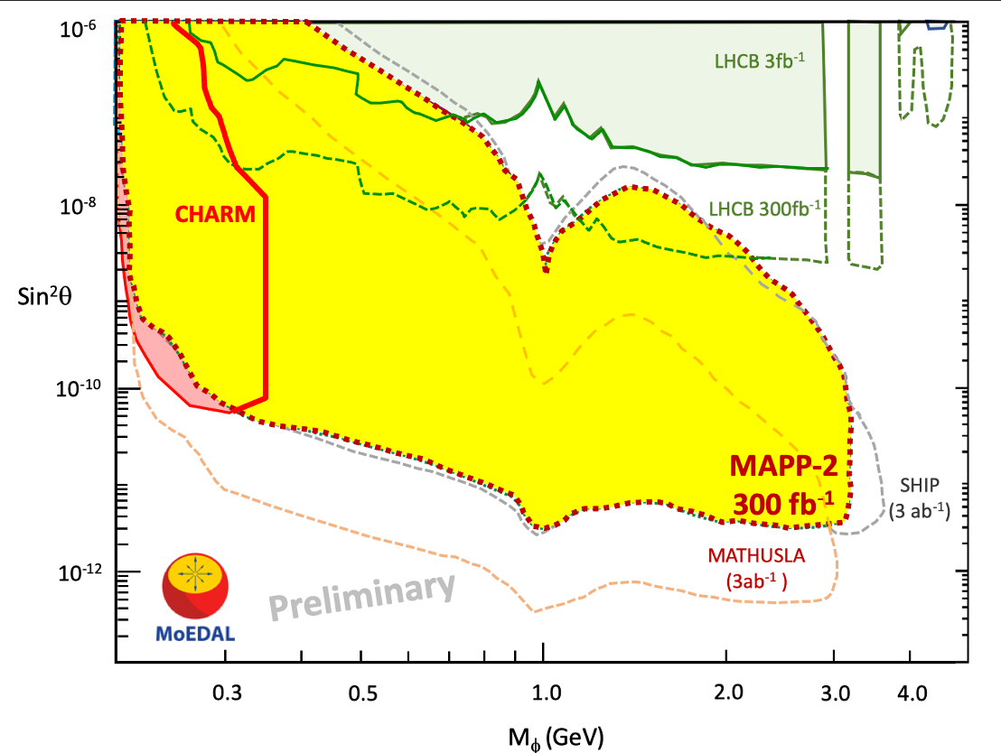
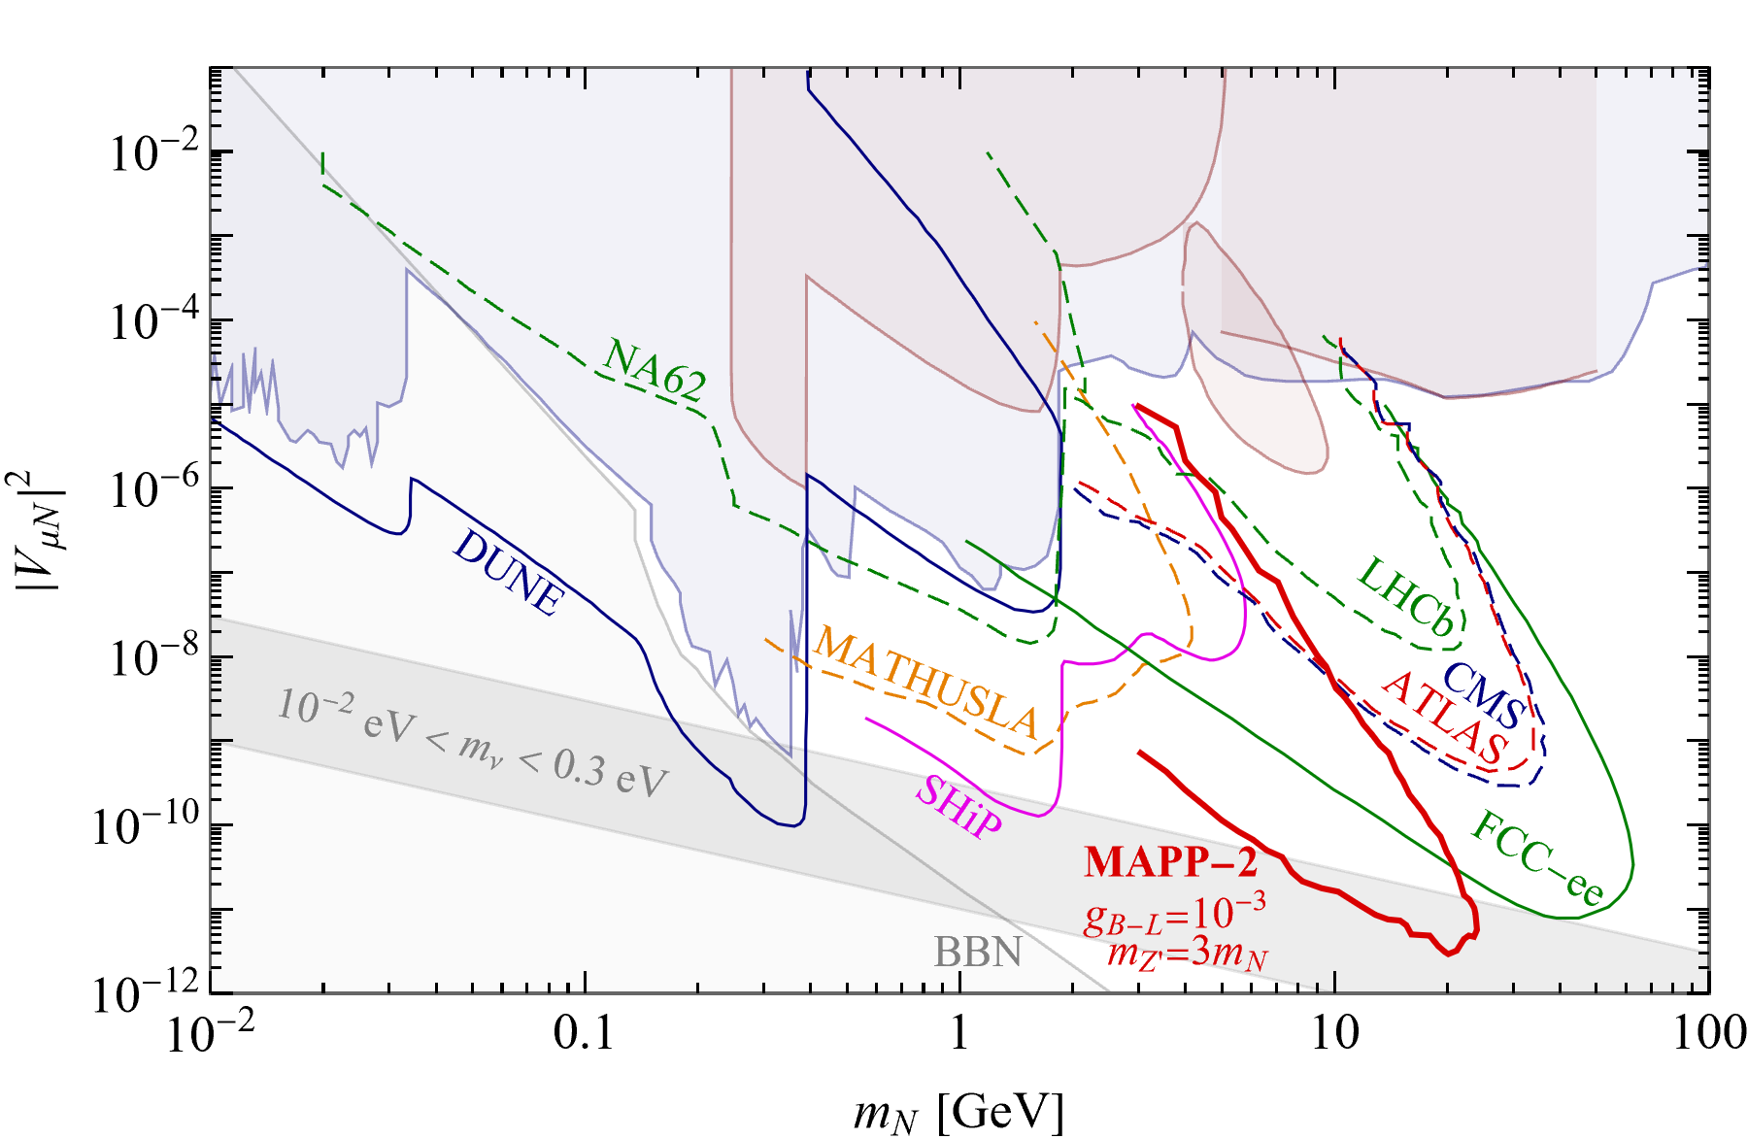

MAPP-2: Example Physics Studies
Benchmark process:
  Where the Higgs mixing portal admits inclusive B → X_{s}ɸ decays, where φ is a light CP-even scalar that mixes with the Higgs, with mixing angle θ ≪ 1.
  MAPP-2 each for 300 fb⁻¹ compared to CODEX-b, SHIP, MATHUSLA.
See Phys. Rev. D97 (1) (2018) 15023 for CODEX-b results.
Pair production of right-handed neutrinos from the decay of an additional neutral Z⁰ boson in the gauged B-L model – Phys. Rev. D100 (2019), 035005.
  No backgrounds/efficiencies are included
  Full Monte-Carlo simulation now available and being studied
Frank Deppisch, to be published in EPJ-ST

Slide 22


UGC1 Refurbishment
Door
Safety Requirement | Cost | Cost + Contingency
Fire Detection Emergency Red phone | 21,000 CHF 11,200 CHF | 23,100 CHF (10 %) 11,760 CHF (5 %)
Electrical Safety | 48,200 CHF | 53,000 (10 %)
Civil Engineering | 151,000 CHF | 166,100 CHF (10 %)
HVAC | 45,000 CHF | 54,000 CHF (20%)
Access and work at height at UGC1 | 10,000 CHF | 11,000 CHF (10 %)
Radiation Protection Patrol & Access System Requirement | 45,000 CHF 4,500 CHF | 49,500 CHF (10 %) Patrol System 4,725 CHF (5 %) Sector door
TOTAL | 335,900 CHF | 373,185 CHF
Safety assessment CERN EDMS #2487833
LHC tunnel
Civil work ~$0.5 million
Detector cost ~$3-4 million
Studies continue…

Slide 23


Other MoEDAL-MAPP Talks at TIPP 2023

Slide 24

Thank you for your attention…

