Slide 1
MCP-Based Detectors for Diagnostics of Circulating Beams in the NICA Accelerating Complex
Speaker: Dmitry Korovkin.
The team worked on the task: D.Korovkin, A.Baldin, P.Khariyuyzov,
D.Bogoslovski, A.Beloborodov, A.Safonov, S.Chetverikov.
TIPP 2023

Slide 2
Dubna and Cape Town
Dubna
Cape Town
Notes:
First, I would like to show the relative distance between Dubna and Cape Town. As you can see, there are thousands of kilometers between them.

Slide 3
Dubna
Notes:
In this photo, you can see our city Dubna, where the JINR is located. By the way, in this picture you can see the Volga River, which is the longest river in Europe.

Slide 4
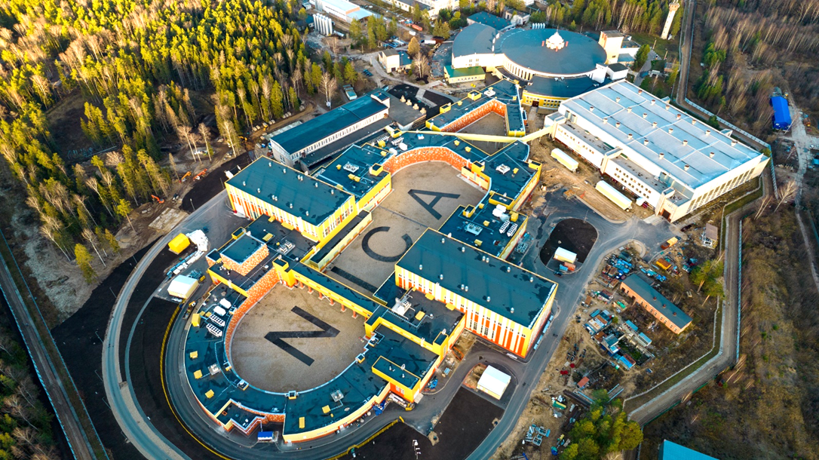
NICA Accelerating Complex
NICA - Nuclotron-based Ion Collider fAсility
NICA Collider parameters:
√sNN = 4-11 GeV/n heavy ion beams
luminosity L~10²⁷ cm⁻² c⁻¹ (Au)
Notes:
Let's talk a bit about NICA. NICA stands for Nuclotron-based Ion Collider Facility. The parameters of NICA include an energy range of four to eleven GeV per nucleon for heavy ions.Slide 5

Slide 5
Nuclotron and Booster accelerators
Notes:
This schematic represents the accelerators of NICA complex. Today we will talk about the Nuclotron and Booster accelerators.

Slide 6
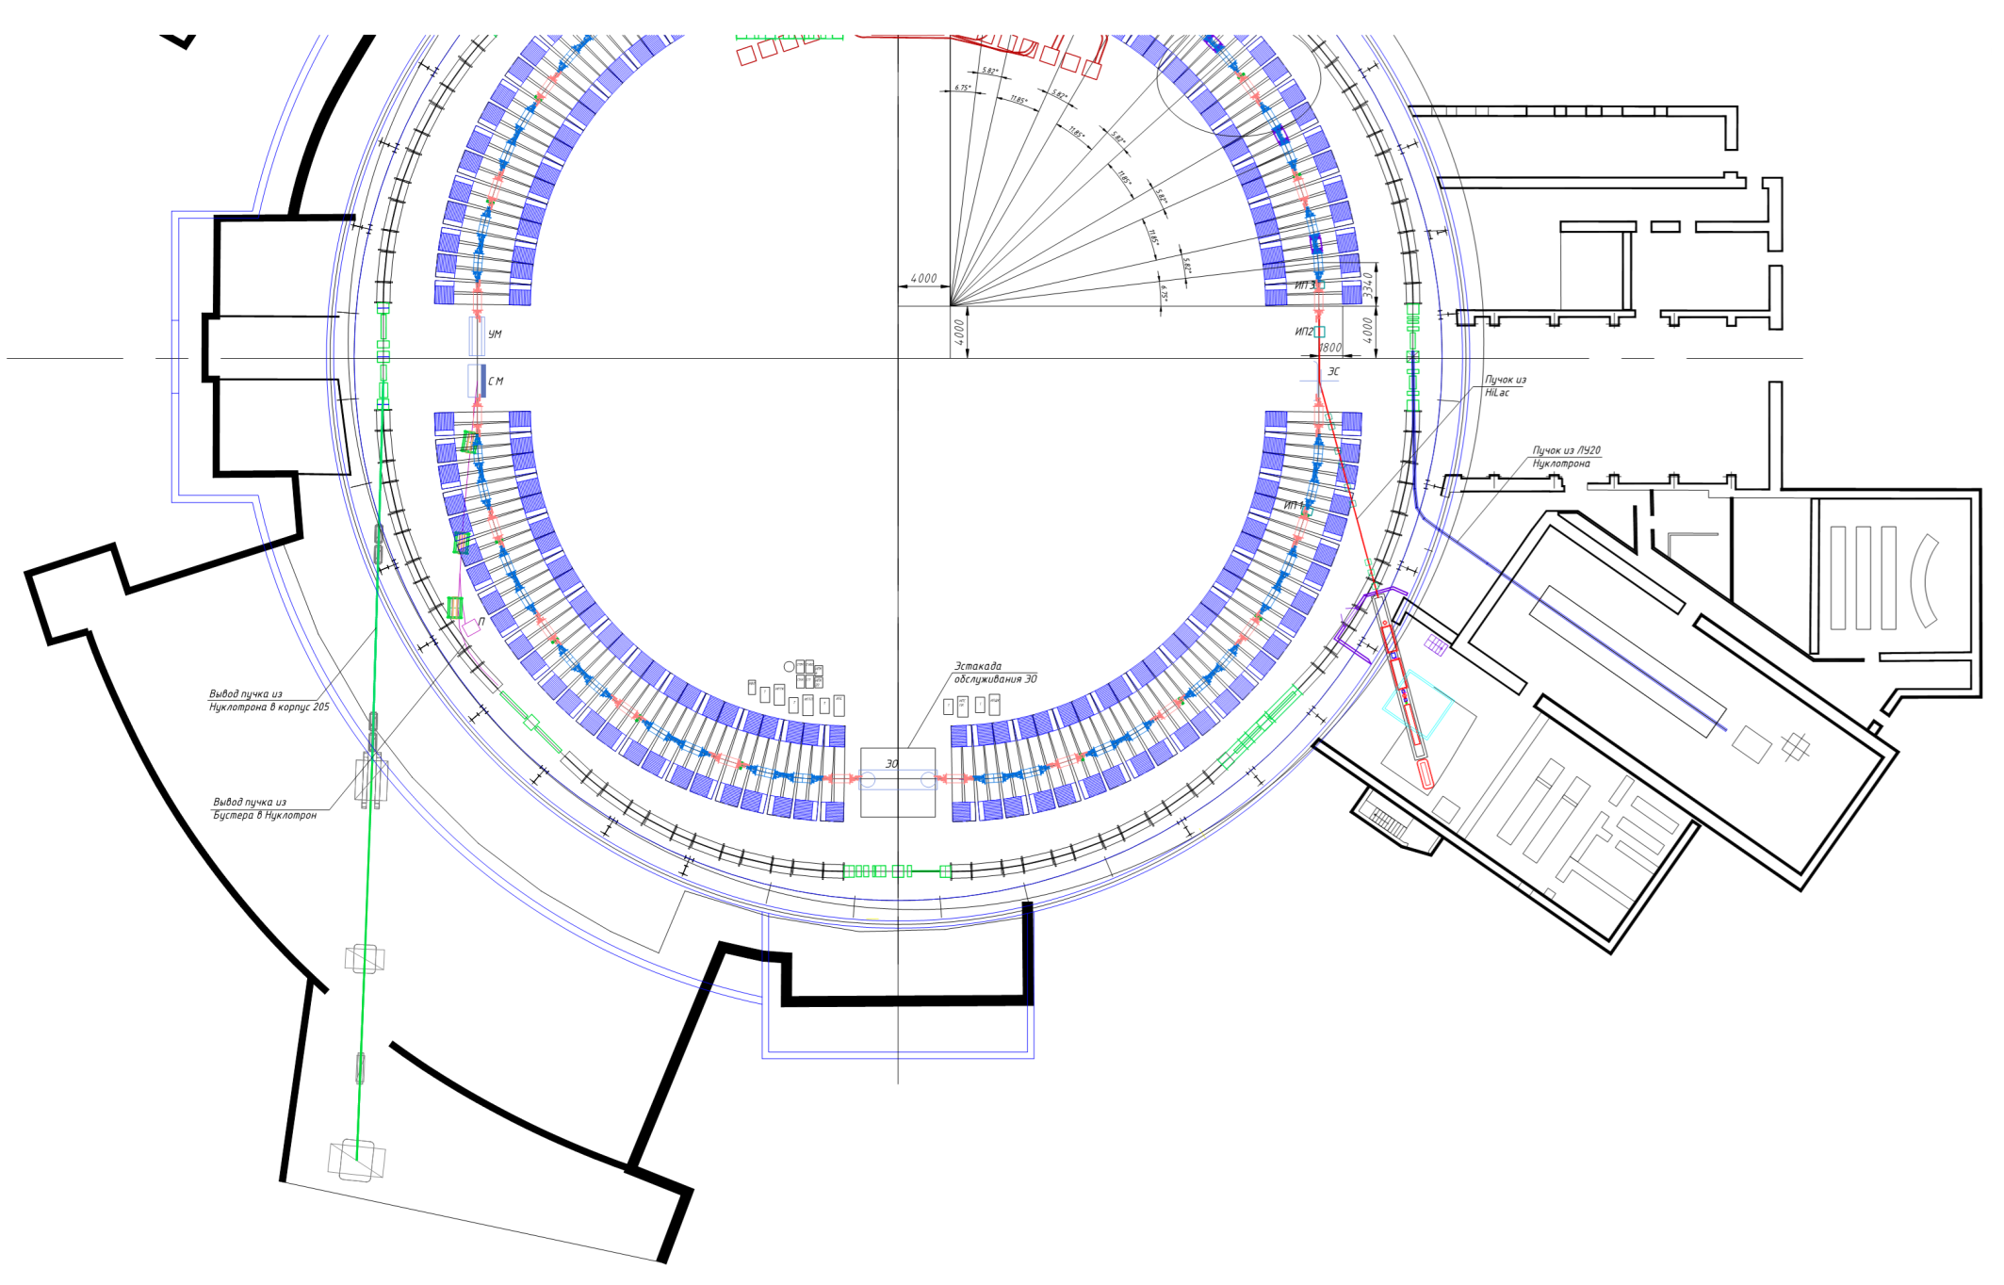
Diagnostic systems
Nuclotron: Superconducting synchrotron Kinetic energy — 4 GeV/n Perimeter — 251 m Intensity — 1.5*10⁹
Booster: Synchrotron Kinetic energy - 578 MeV/n Perimeter — 211 m Intensity — 2*10⁹
MCP-based profilometer in Booster
MCP-based profilometer in Nuclotron
Notes:
All of accelerators need to nondestuctive diagnostic. And today, I will introduce you to accelerators and our nondestuctive diagnostic systems. This is the profilometer in the Nuclotron. Nuclotron is the superconducting synchrotron with a kinetic energy of four GeV per nucleon. It has a perimeter of 251 meters and an intensity of 1.5 × 10^9 particles. Also, we have the profilometer in the Booster. Booster is the synchrotron with a kinetic energy of 578 MeV per nucleon. The perimeter is 211 meters, and the intensity is 2 × 10^9 particles.

Slide 7
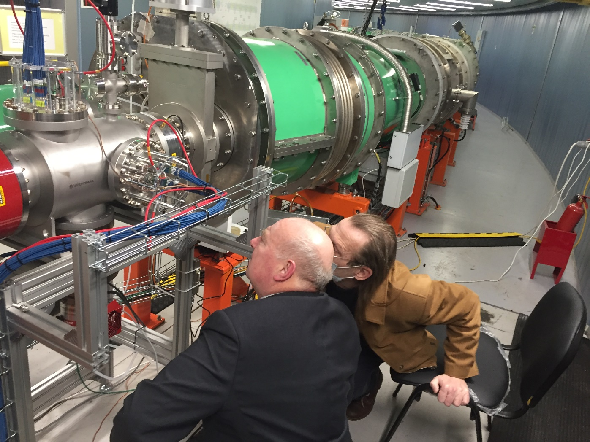
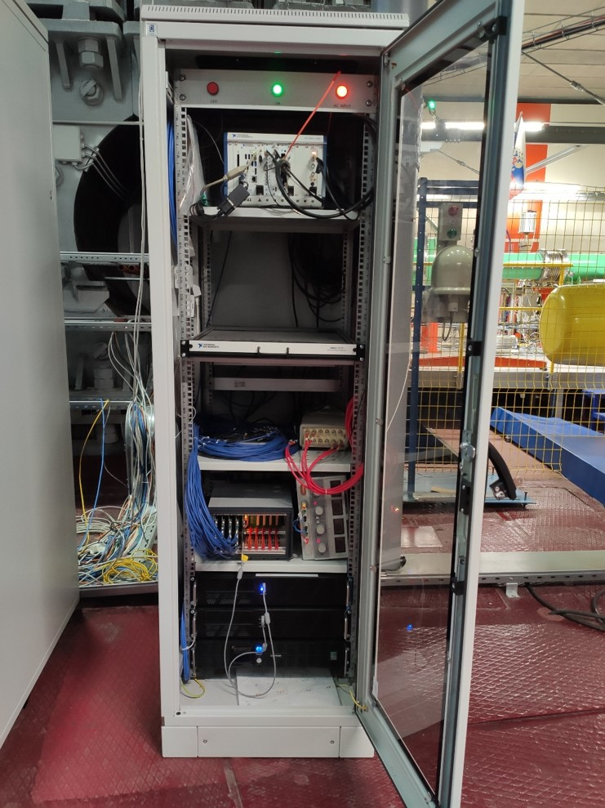
Location of the diagnostic system in the Booster ring
Notes:
This image showcases the nondestuctive diagnostic system in the Booster ring. The right picture displays the cabinet with the data acquisition system, while the left picture illustrates the diagnostic system itself.

Slide 8
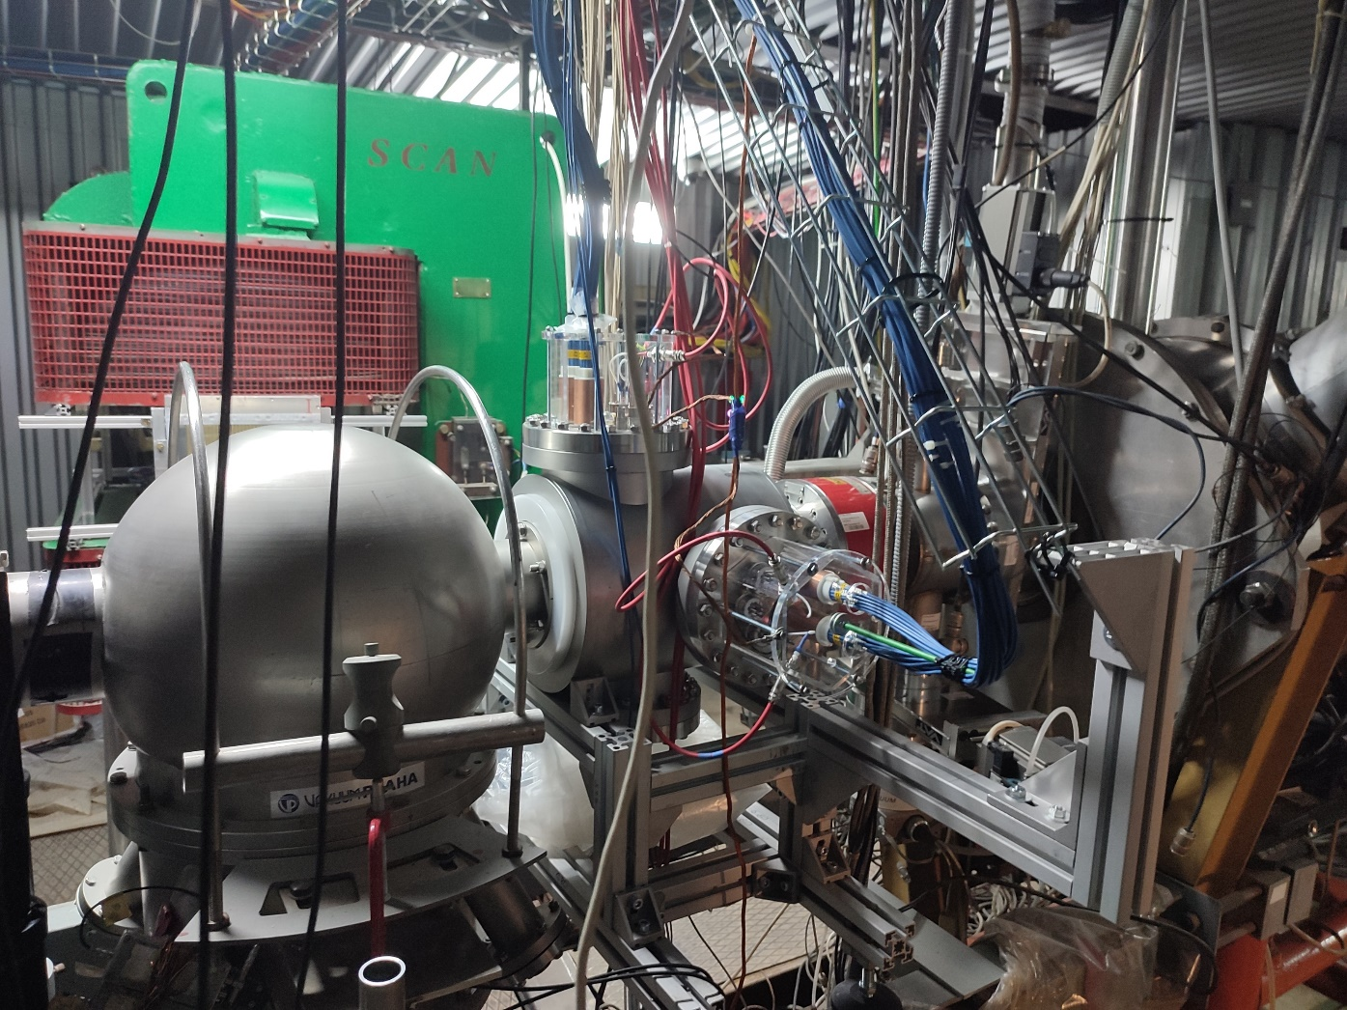
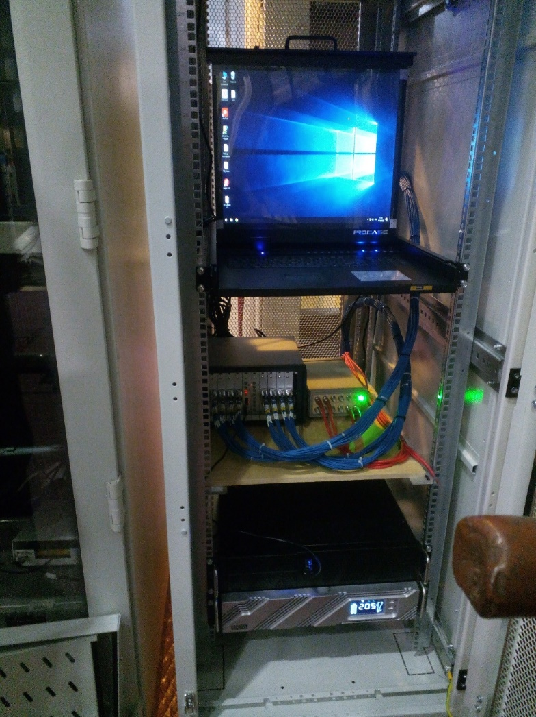
Location of the diagnostic system in the Nuclotron ring
Notes:
This image showcases the diagnostic system in the Nuclotron ring.

Slide 9
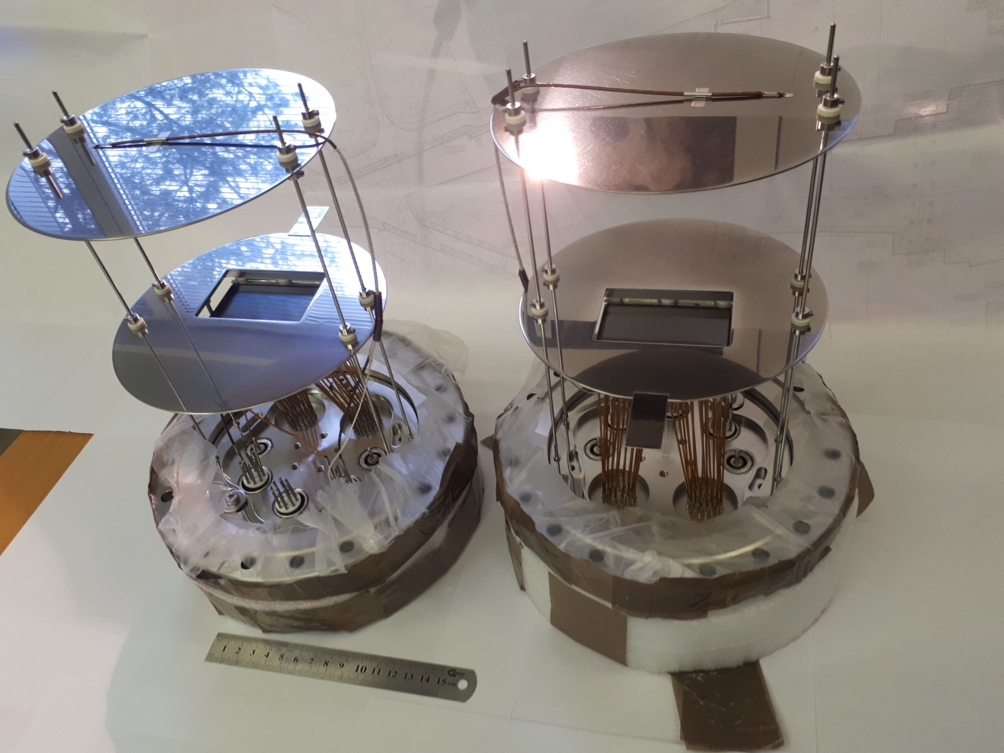
MCP-based profilometer
Booster:
Sensitive area: 60x40 mm
Channel diameter: 6 um
Thiсkness: 0.8 mm
Amplification: 10⁶
Nuclotron
Sensitive area: 27x54 mm
Channel diameter:6 um
Thiсkness: 0.4 mm
Amplification: 10⁶
Notes:
Next, I will introduce you the characteristics of our profilometer. The diagnostic system consists of two MCP plates for two axes. The characteristics are shown on the left. The sensitive area of the profilometer in the booster diagnostic system is sixty by forty millimeters, the channel diameter is sixteen microns, the thickness is eight hundred microns, and the amplification is ten to the power of six. For the Nuclotron diagnostic system, the sensitive area is twenty-seven by fifty-four millimeters, the channel diameter is sixty microns, the thickness is four hundred microns, and the amplification is ten to the power of six.

Slide 10
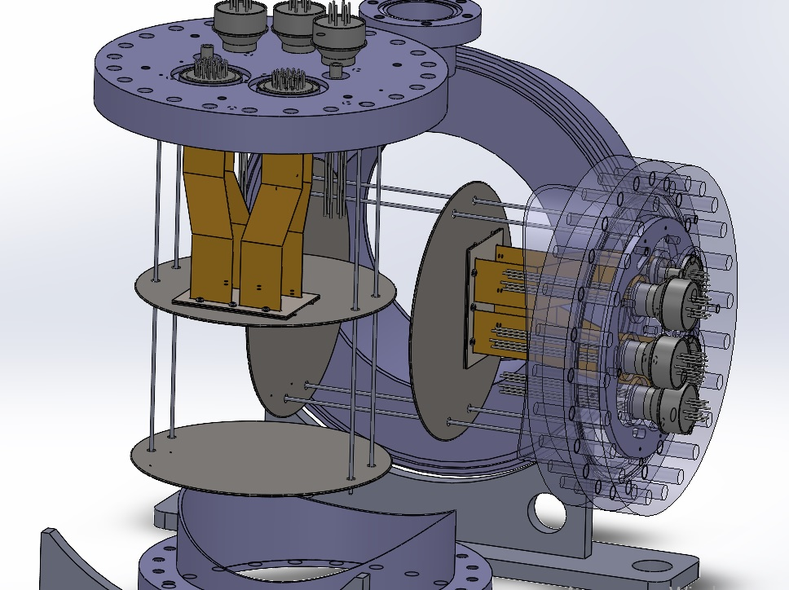
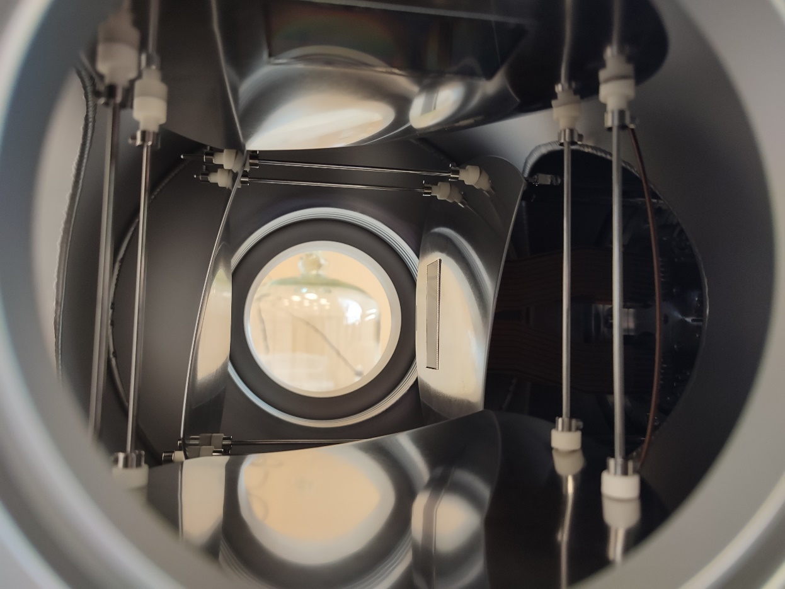
3D model and real view of profilometer
Notes:
This image showcases 3d model and real view of profilometer. How can you see, detector consists of two MCP plate.

Slide 11
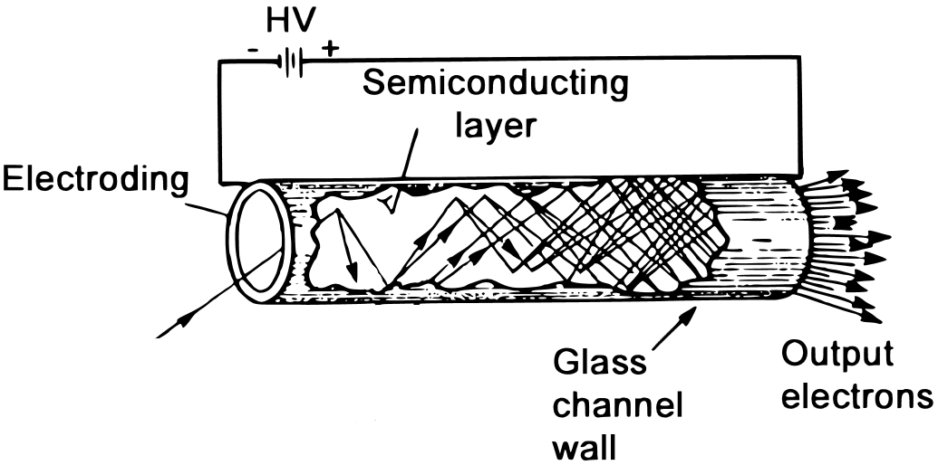
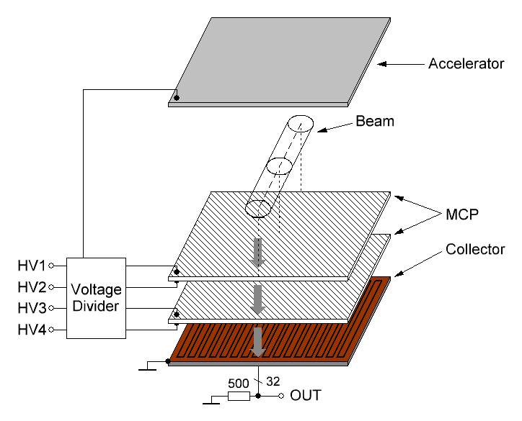
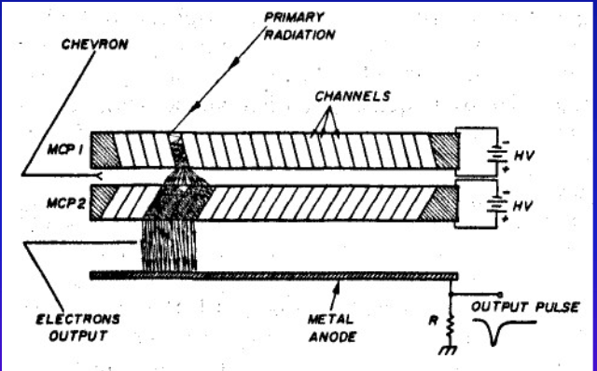
The principle of operation of MCP-based detector
Primary
radiation
Notes:
So, I want to show one slide about the principle of operation of MCP-based detector. The MCP plate consists of small-sized channels. Scheme is shown on the left. A Microchannel Plate (MCP) operates based on the principle of electron multiplication. When a primary radiation enters the channel, it collides with atoms in the channels, releasing a small number of secondary electrons. These secondary electrons are then accelerated by an electric field within the channels, leading to more collisions and the release of additional electrons. This process results in an electron avalanche, amplifying the original signal. Gain is ten to the power of three. If use second plate as chevron assembly, gain will increase to ten to the power of six. So, scheme our detector is shown on the right. Accelerated charged particles, passing the ion beam line, ionize residual gas. These ions are accelerated by electrostatic field toward the chevron assembly of the MCP detector and are registered by the detector.

Slide 12
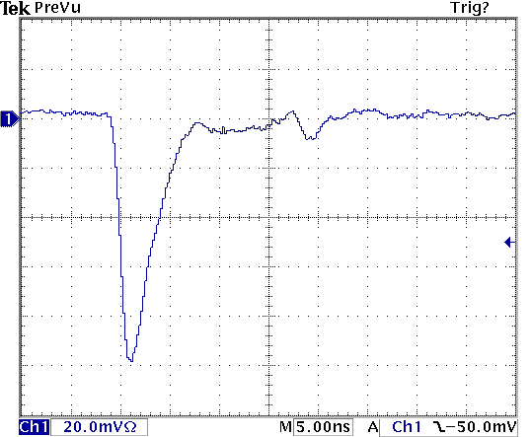
Signal from MCP
Notes:
As a result, we observe this typical signal from the detector. And then we need to data aqusition system.

Slide 13
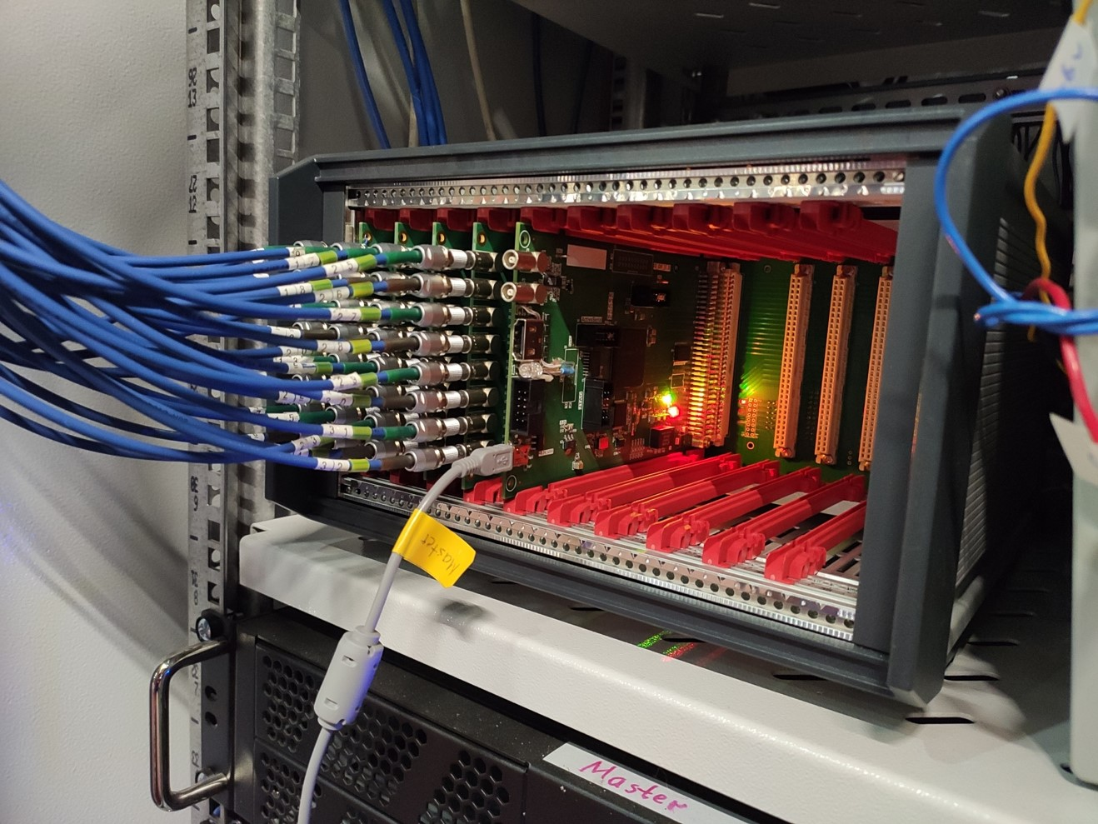
Data acquisition system
TIC64:
64-channel counter-discriminator
Individual threshold for each channel.
Width of pulse discrimination: 1.2 ns.
Parallel recording of two buffers with different time windows and delay.
Time windows: from 80 us to 100 s.
Based on FPGA.
Developed and manufactured by our group.
Notes:
The Tic sixty four is data aquisition system for MCP-based detectors. This system developed and manufactured by our group. Its features: sixty four channels counter-discriminator; individual threshold for each channel; width of pulse discrimination: one point two nanoseconds; parallel recording of two buffers with different time windows; time windows is from eighty microsecond to one hundered second. And it based on FPGA.

Slide 14
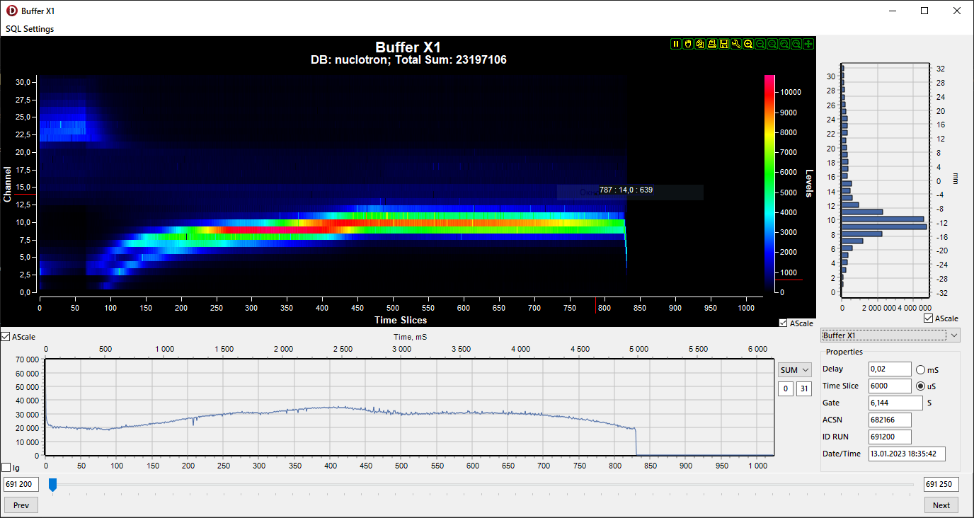
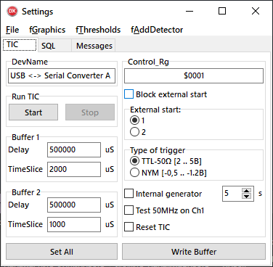
Control and visualization software
Control software
Visualization software
Notes:
Next, i`ll show you software. Left image showcases control software. We set time windows, delay, mode, and other parameters by control software. This software install at computer with connected TIC sixty four and read data from TIC sixty four and upload data in database. Right image showcases vizualization software. This software install at computer in accleration control room and download data from database and visualizes the data. The heatmap and the graphs in the center represent the time structure of the profile of the beam. Now let's take a closer look at them.

Slide 15
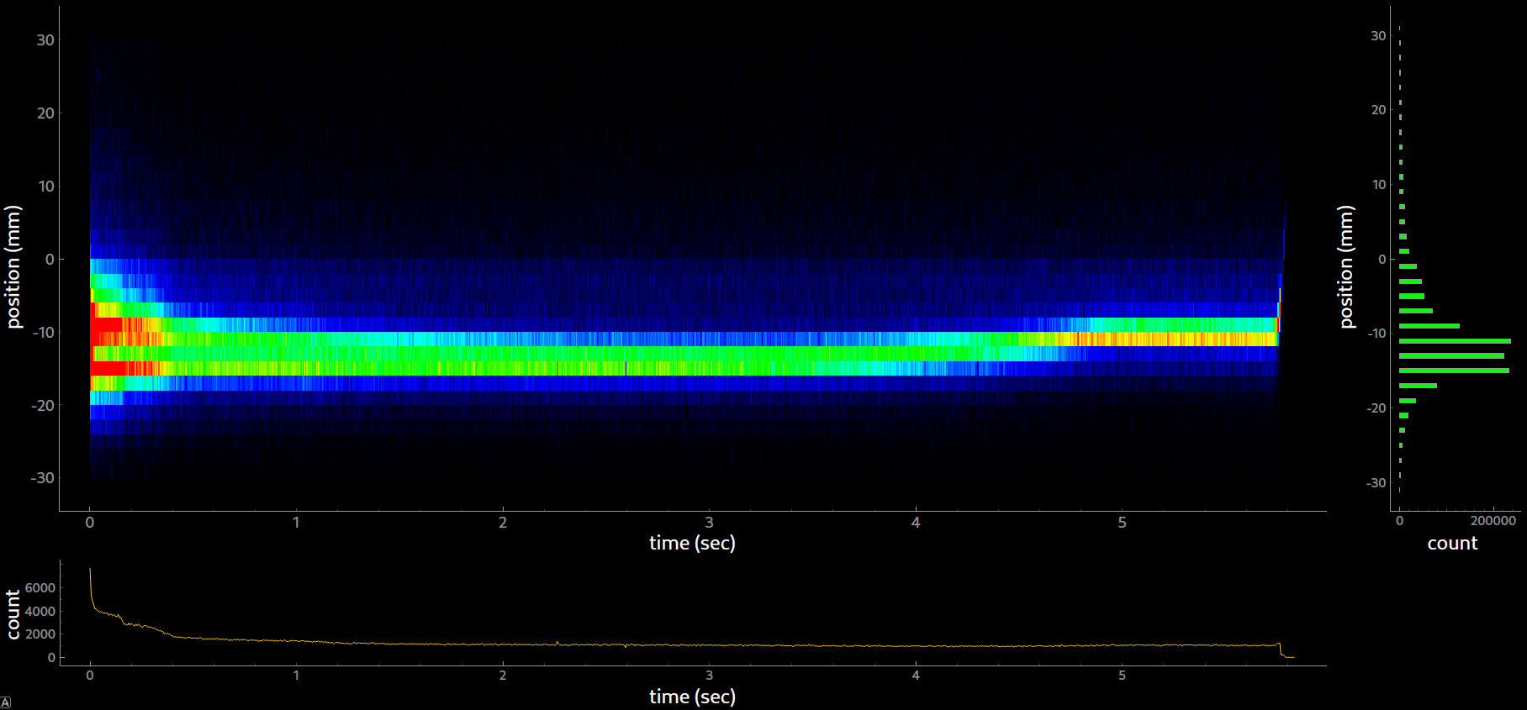
Example of data from profilometer
Notes:
Heatmap in center represent time structure of the profile of the beam. Horizontal axis is time, vertical axis is position. Histogram on the right represent profile of the beam integrated by time. Horizontal axis is count, vertical axis is position. Graph on the bottom represent the integrated intensity of the beam as a function time. Vertical axis is count, horizontal axis is time. These graphs visualize the behavior of the beam during one acceleration cycle for one axes.

Slide 16
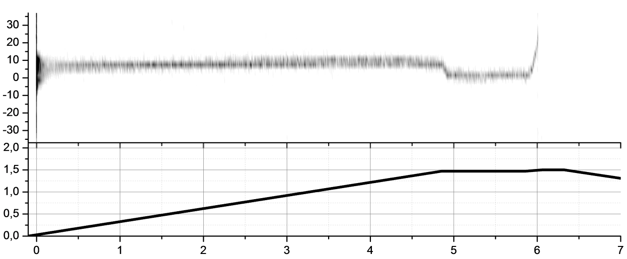
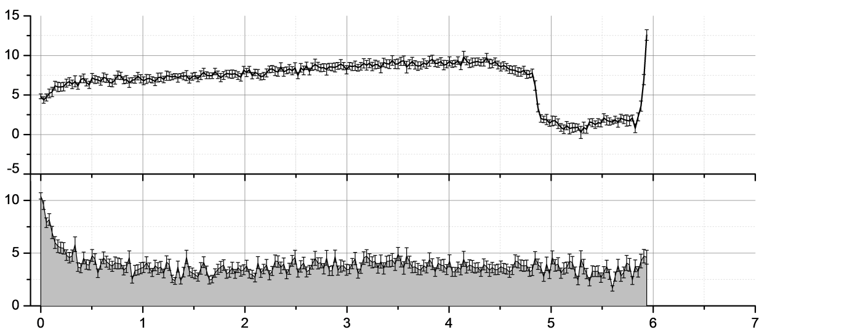
Diagnostics of circulating beam (deuterons 4 GeV/n)
Acceleration
The beam interacts with the vacuum chamber
Beam
Coordinate, mm
Injection moment
Beam orbit shifting
Magnetic
Field, T
Time, s
Beam
Coordinate, mm
Beam
Width, mm
Time, s
Notes:
Next, we will look at the data of profilometer of nuclotron. We can see four step of one acceleration cycle on the top heatmap. Injection moment, acceleration,beam orbit shifting for extracting to the experement, and at the end the remnants of beam interacts with the vacuum chamber. Additionally, we can compare this time structure of the profile of the beam with magnetic field on the graph below the heatmap. Also, we can get the coordinates of the beam center and the beam width from the beam profile.

Slide 17
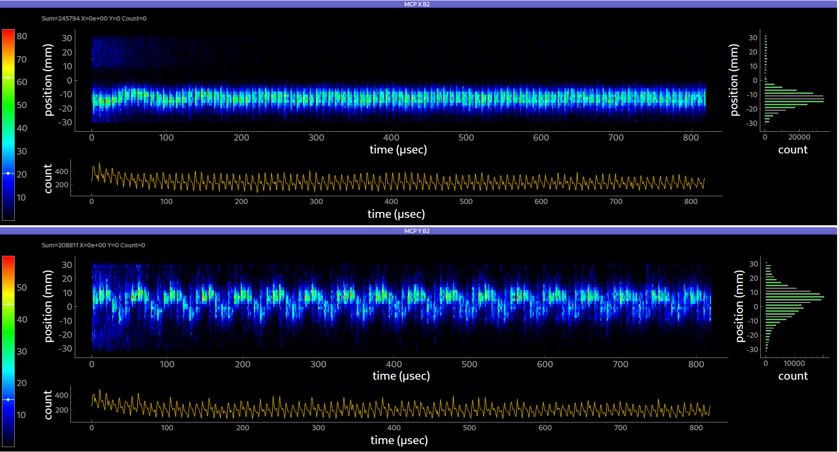
Example of data from the Booster profilometer
Notes:
This picture showcases one of features of data aquisition system. We configured the data acquisition system to obtain the profile of the first one hundred beam turns in the accelerator. As you can see, we can separate each beam revolution through our detector. On the itensity graph, each maxima is beam revolution through our detector. We can even measure betatron oscillations of the beam if necessary.

Slide 18
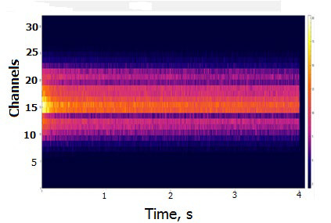
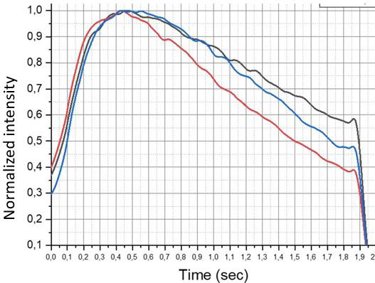
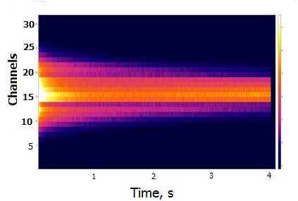
Electron cooling system of the Booster beam
Normalized intensity for different electron energy. Black curve – 1.82 keV, blue curve – 1.72 keV, red
curve – 1.76 keV.
Without electron cooling
with electron cooling
ELECTRON COOLER OF THE NICA BOOSTER AND ITS APPLICATIONS
13th Workshop on Beam Cooling and Related Topics COOL2021, Novosibirsk, Russia
Notes:
And next, i want to show you test of electron cooling system at the Booster acceleration by mcp-based profilometer. Electron cooling system need to reduce the 6D emittance of the beam. Two image on the left showcases profile of the beam with and without electron cooling system. It can be seen that the electron cooling has a beam narrowing effect. Image on the right showcases intensity beam obtained by mcp-based profilometer.Horizontal axes is time, vertical axes is intensity. As can be seen, the strong decrease in the lifetime of the ion beam occurs at the energy 1.76 keV, which is in good agreement with the theoretical value.

Slide 19
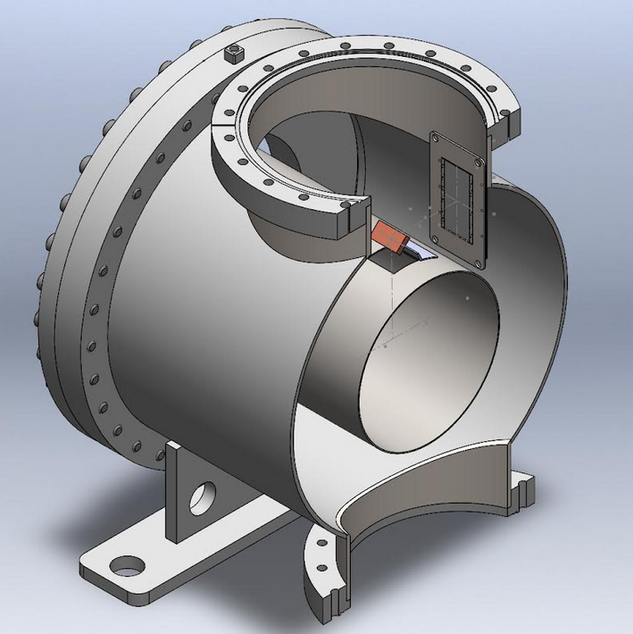
New type of MCP-based profilometer
Notes:
At the end my presentation, i want to show one feature of mcp based profilometer. When the accelerator is tuned to maximum intensity, our detector becomes overloaded. In picture on the right, we can observe the injection stage and the acceleration stage. At the beginning of the acceleration stage, the beam intensity is high, which leads to a reduction in the amplitude of the output signal from the detector. This can be seen as a dark spot on the time structure of the profile. And now we are developing a new type of detector that will register light from the interaction of the beam with residual gas. Image on the left showcases a prototype of a 3D model of an MCP-based profilometer with the registration of light, not ions.

Slide 20
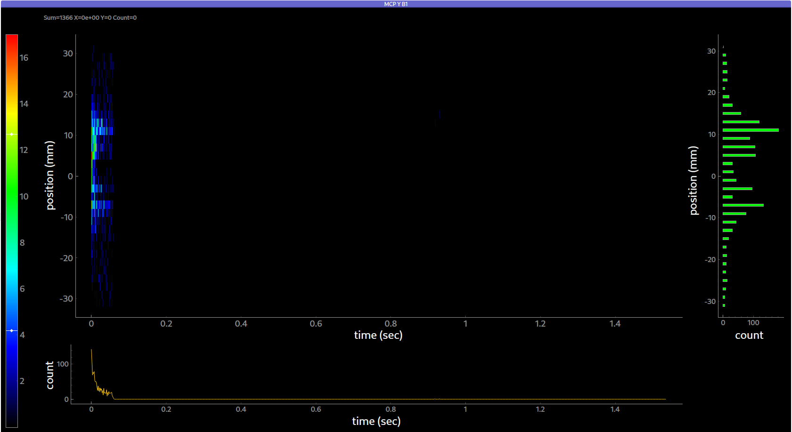
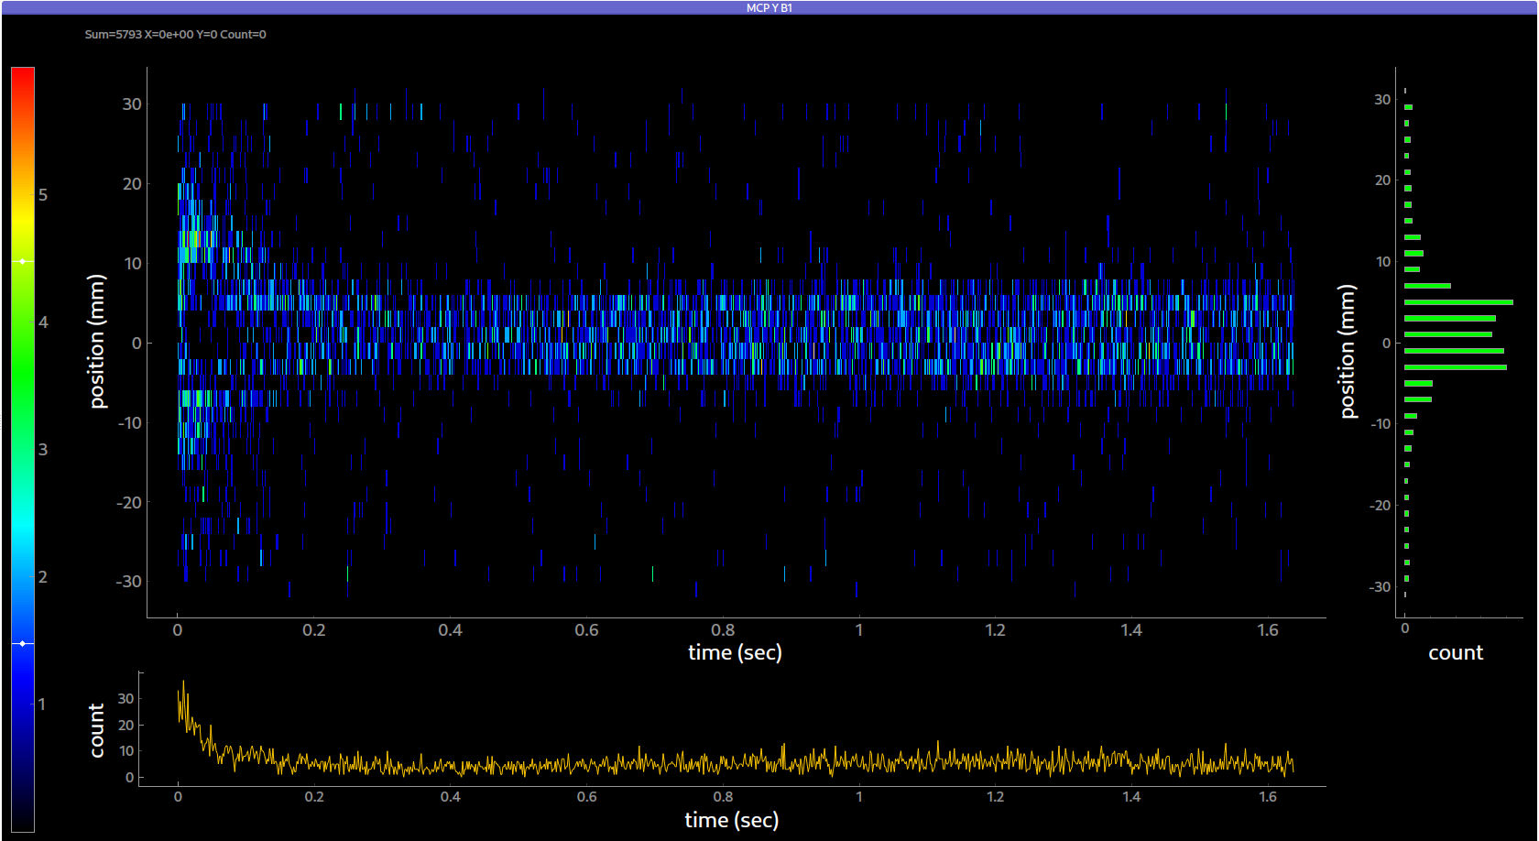
Conclusions
MCP-based profilometer have been developed, manufactured and installed in accelerators.
They work successfully and provide comprehensive data for the accelerator group.
We studied characteristics and capabilities of MCP-based profilometers.
The development of a new types of MCP-based profilometer has started.
Notes:
In fact, profilers are used when setting up the accelerator. Especially at low intensities, since at low intensities only the MCP-based profilometer able to register the beam.

Slide 21
Thank you for your attention!

Slide 22
MCP-Based Detectors for Diagnostics of Circulating Beams in the NICA Accelerating Complex
Speaker: Dmitry Korovkin.
The team worked on the task: D.Korovkin, A.Baldin, P.Khariyuyzov,
D.Bogoslovski, A.Beloborodov, A.Safonov, S.Chetverikov.
TIPP 2023

Slide 23
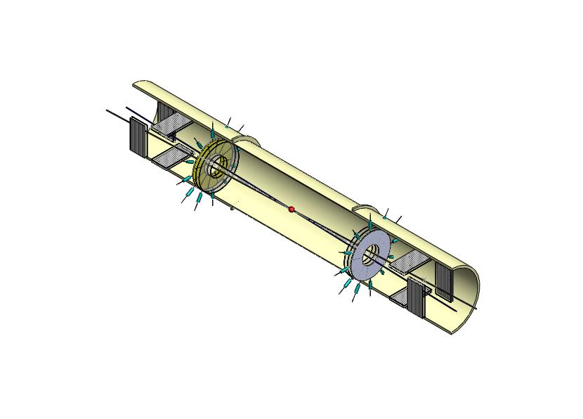
Beam-beam collisions counter for experiments at NICA
Notes:
Two compact detector systems are proposed to meet the challenges of the fast beam-beam collisions monitoring, event selection and the precise timing determination in proton-proton and nucleus-nucleus collisions at NICA. The systems are using Micro Channel Plate detectors (MCPs). The BBC uses the concept of the fast isochronous timing for the multi-pad readout of short (∼ 1ns) MCP signals, produced by the particles in the collisions of the beams.

Slide 27
