Slide 1




ALICE Inner Tracking System upgrade:
characterization of first chips fabricated in 65 nm
CMOS technology
Antonio Trifirò*
on behalf of the ALICE Collaboration
* Università degli Studi di Messina -
Dipartimento di Scienze Matematiche e Informatiche, Scienze Fisiche e Scienze della Terra
& Istituto Nazionale di Fisica Nucleare - Sez. di Catania
Italy

Slide 2
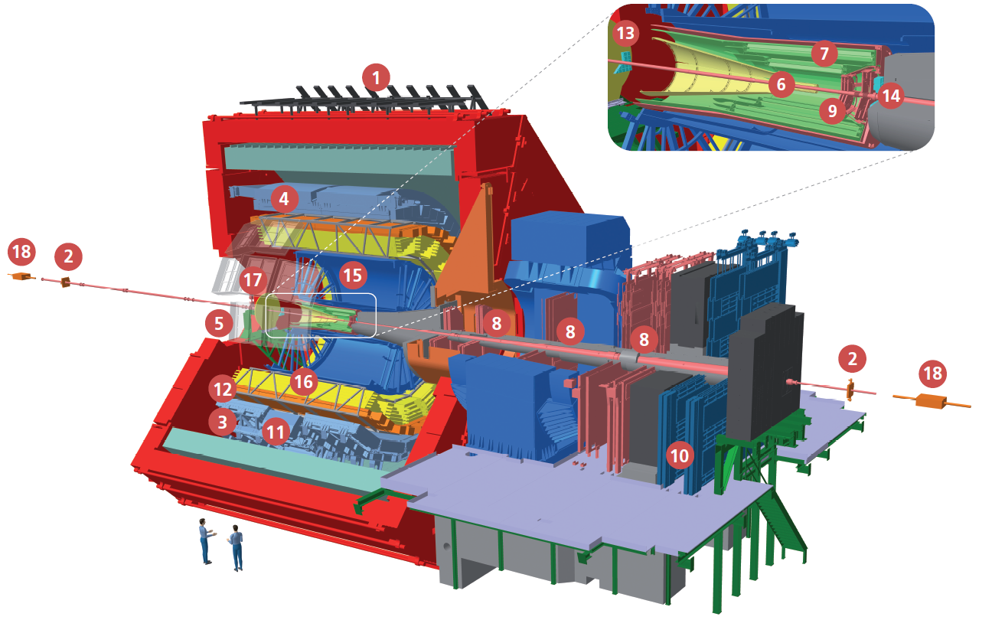
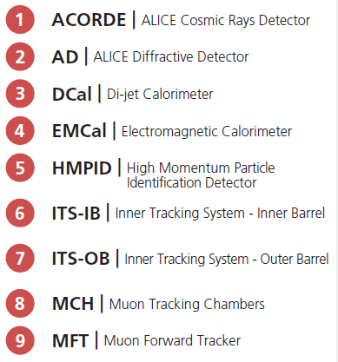
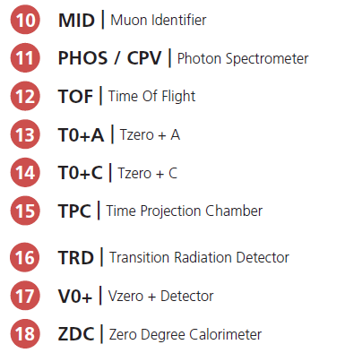
Outlook
Introduction
Motivation of Inner Tracking System upgrade
Overview of sensors development
First submissions in silicon
Sensor optimization
Qualification of the technology
Tests with radioactive source
Beam tests
Tests of radiation damage
2

Slide 3
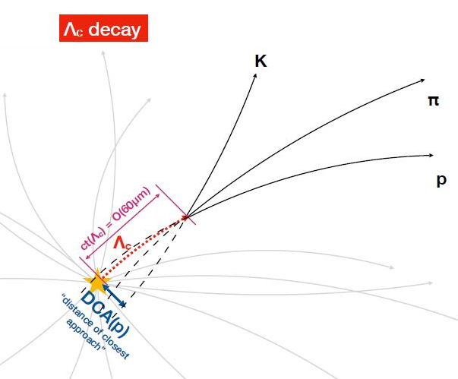
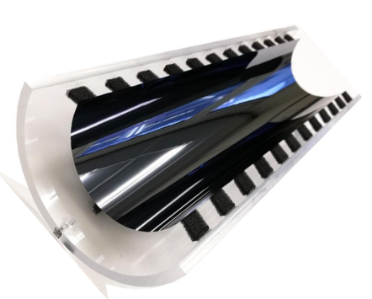
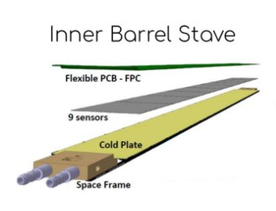
ITS Upgrade
- Short-lived heavy hadrons (cτ≈100µm)
- Resonances in the di-electron channel
- Clear separation of interaction vertexes
- Drastic reduction of e background
- Improvement of tracking resolution
- Reduction of material budget
ITS2 innermost 3 layers
ITS3 innermost 3 layers
Upgrade
See Valerio SARRITZU’s Pres.
Water Cooling
3

Slide 4
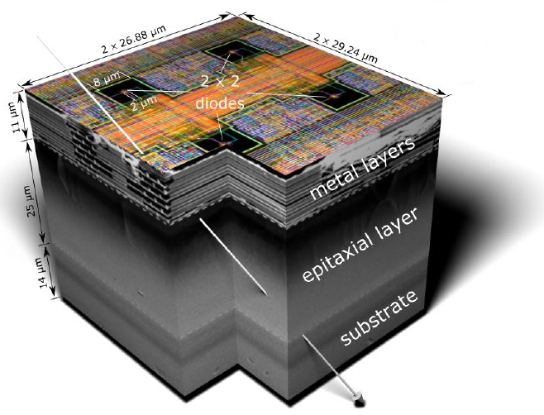
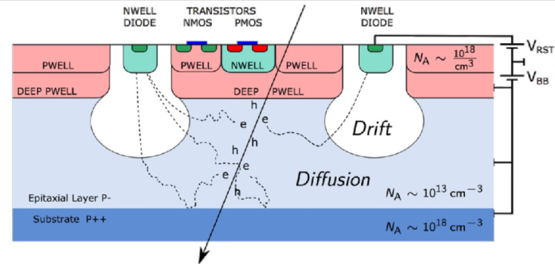
MAPS (Monolithic Active Pixel Sensors)
ALice PIxel DEtector (ALPIDE) technology: TowerJazz 180 nm (ITS2)
Detector & readout electronics in a single chip
↓
Elimination of hybrid structures
Low Capacitances → Reduction of Power (10-100mW/cm²)
Reduction of Material Budget &
Bending of large area sensors
↓
Thickness <50µm
↓
180 nm (ITS2) → 65nm (ITS3)
4

Slide 5
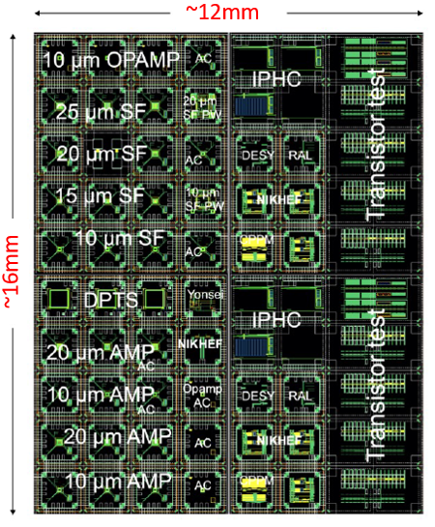
ASICs R&D
APTS (Analogue Pixel Test Structure)
STUDY OF DIFFERENT PIXEL DESIGNS
1° submissions in silicon with
65 nm Imaging Sensor process:
MLR1 (Multi-Layer per Reticle 1)
6×6 pixels (central 4×4 read out)
Pitch: 10, 15, 20, 25 μm
2 versions of output buffers
DPTS (Digital Pixel Test Structure)
STUDY THE IN-PIXEL FULL-DIGITAL FRONT END ELECTRONICS
32 × 32 pixels
Pitch: 15 ×15 µm²
Asynchronous digital readout
Time over Threshold information
Time encoded pixel position
CE65 (Circuit Exploratoire 65 nm)
STUDY PIXEL MATRIX UNIFORMITY
64 ×32 pixels with 15 µm pitch
48 ×32 pixels with 25 µm pitch
Analog Rolling shutter readout 10-40 MHz
3 in pixel architectures
5

Slide 6
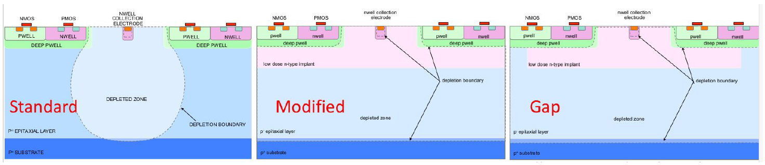
Sensor Optimization: 3 Different Types & 4 Splits
Low dose n-type implant
Low dose n-type implant
DEPLETED ZONE
DEPLETED ZONE
DEPLETED ZONE
deep p-well → Improvement of circuit-sensor isolation; deep n-well → Improvement of depletion
Split 1: default process
Split 2: first deep p-well adjustment to prevent
punch-through
Split 3: first deep p-well adjustment + deep n-well adjustment
Split 4: (opt. proc.) 1° deep p-well adj. + deep n-well adj. + 2° deep p-well adj. against local potential wells
Improvement: Charge Collection - Radiation Hardness - Charge Sharing
6

Slide 7
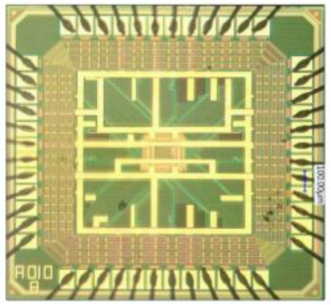
APTS (Analogue Pixel Test Structure)
APTS-SF
(Source Follower):
direct access to front-end amplitude, without signal processing
APTS-OA
(Operational Amplifier):
fast operational amplifier output buffer for better timing
7

Slide 8
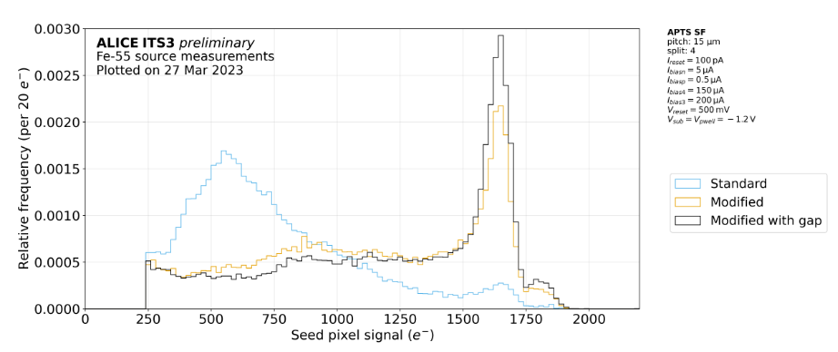
Sensor Optimization: 3 Different Types
⁵⁵Fe Source measurement
APTS-SF
8

Slide 9
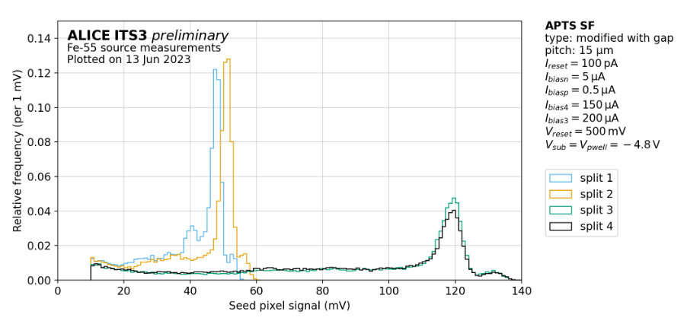
Sensor Optimization: 4 Splits
Split 1: default process
Split 2: first deep p-well adjustment to prevent punch-through
Split 3: first deep p-well adjustment + deep n-well adjustment
Split 4: (optimized process) first deep p-well adjustment +
deep n-well adjustment + second deep p-well adjustment against local potential wells
9

Slide 10
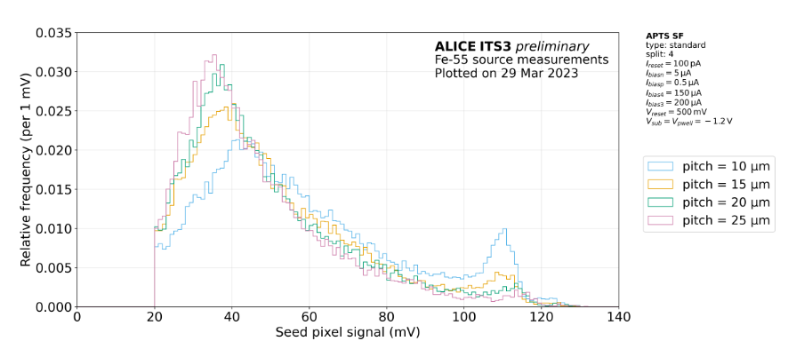
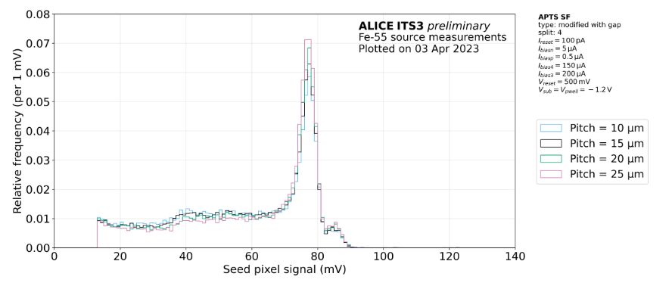
Standard
APTS-SF
Different Pitches
Modified
With Gap
10

Slide 11
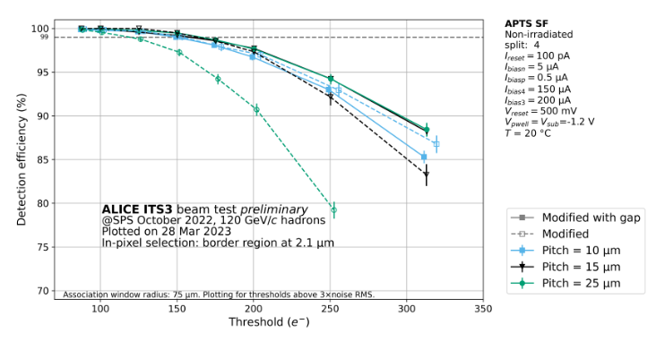
APTS-SF
Beam Test on different Pitches
11

Slide 12
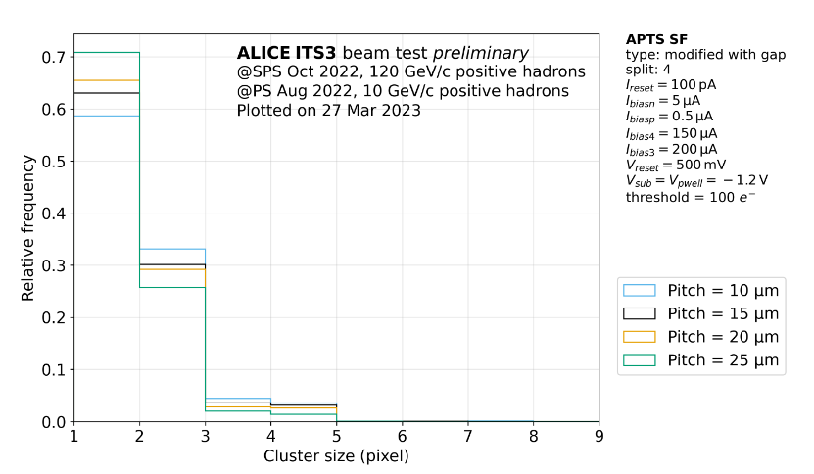
APTS-SF
Beam Test on different Pitches
12

Slide 13
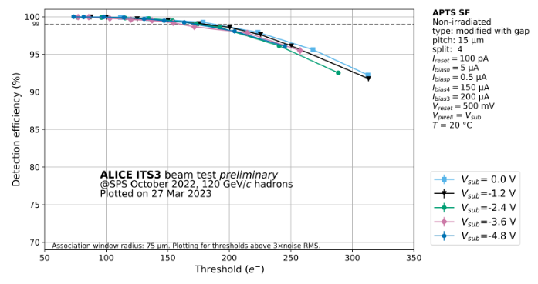
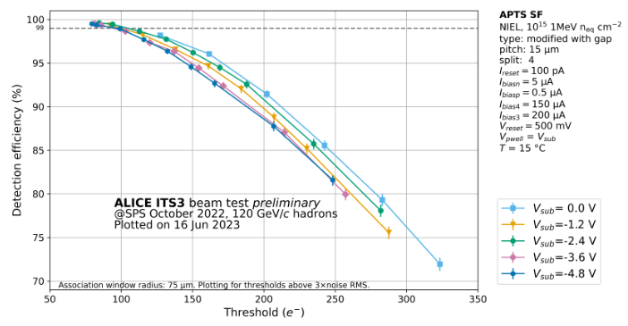
APTS-SF
Beam Test &
Radiation Hardness
After Irradiation with
10¹⁵ 1MeV n_{eq} cm⁻²
13

Slide 14
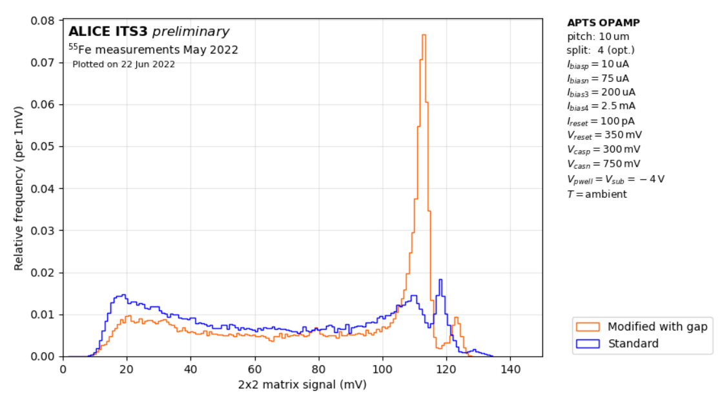
APTS-OPAMP EFFICIENCY
14

Slide 15
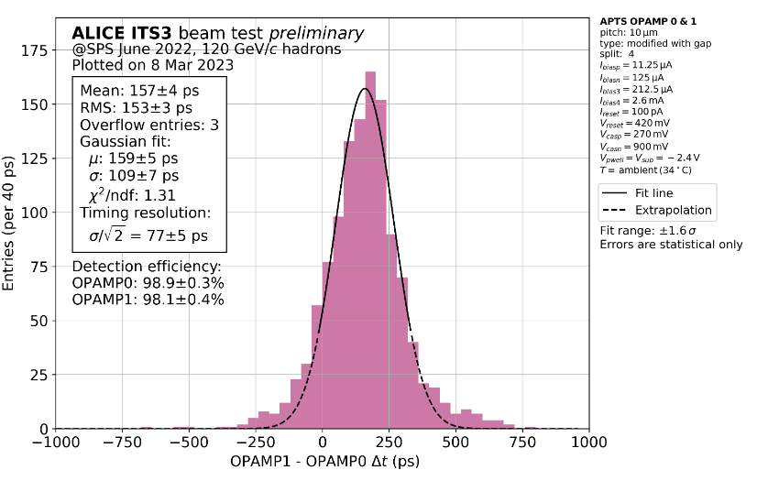
APTS-OPAMP TIMING RESOLUTION
15

Slide 16
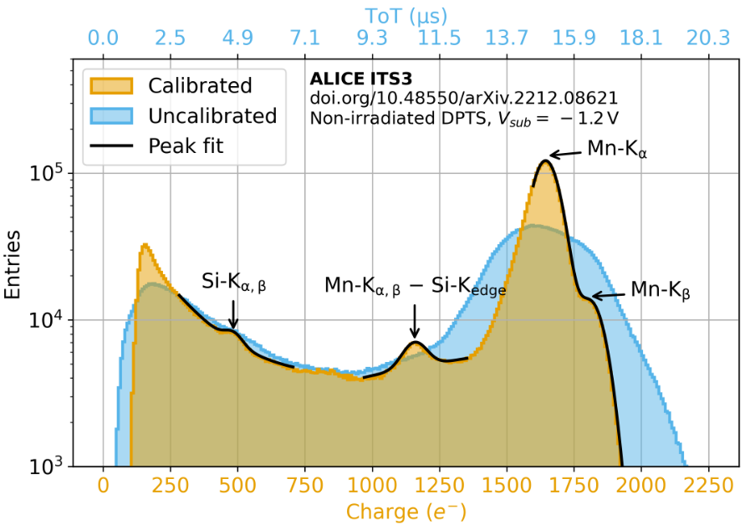
DPTS (Digital Pixel Test Structure)
32 × 32 pixels, pitch 15 ×15 µm²; only Mod. With Gap
⁵⁵Fe Source
measurement
16

Slide 17
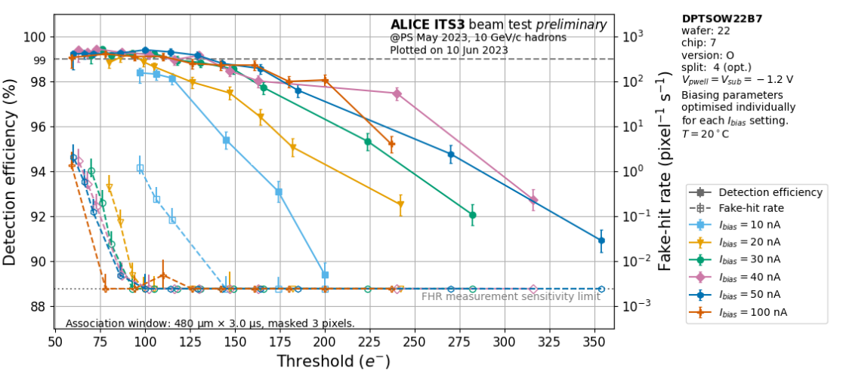
DPTS Performance vs. Power Consumption
Pixel Power ~I_{bias}
17

Slide 18
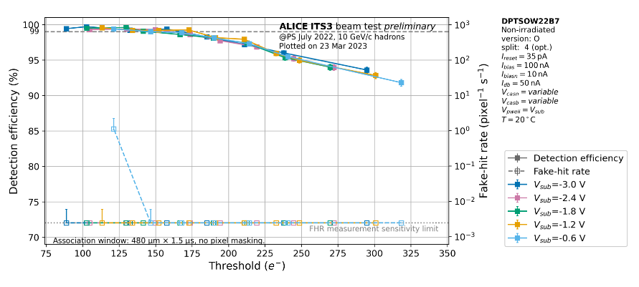
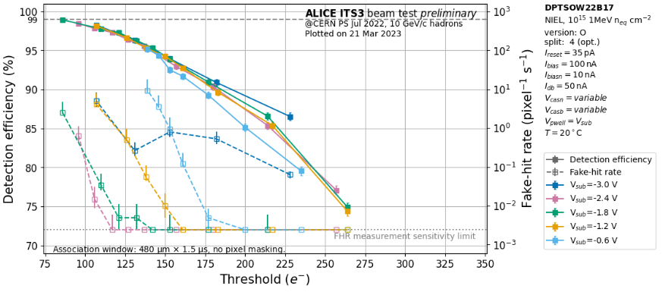
DPTS
Beam Test &
Radiation Hardness
After Irradiation with
10¹⁵ 1MeV n_{eq} cm⁻²
18

Slide 19
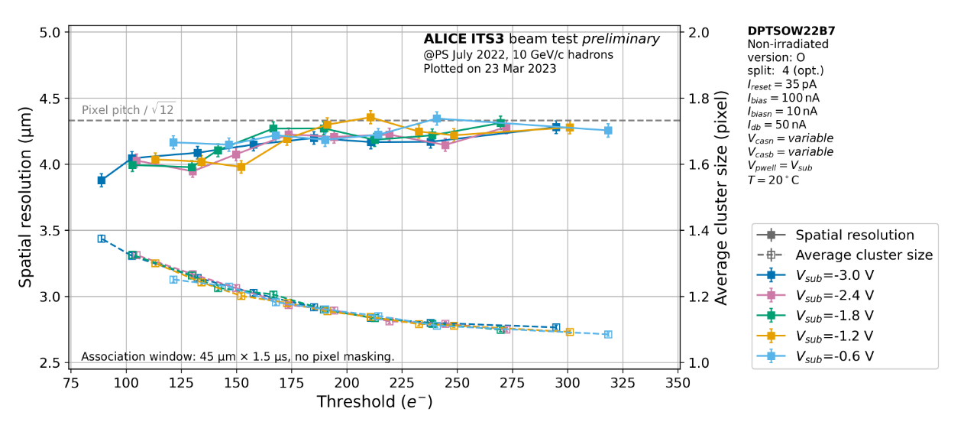
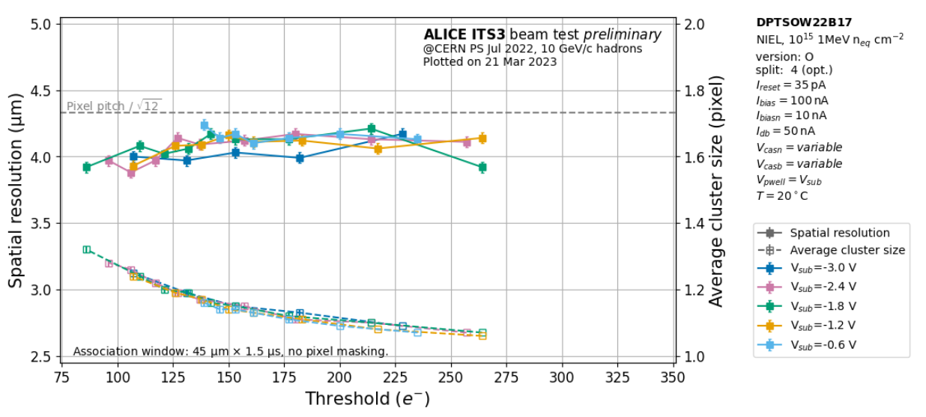
DPTS
Beam Test
&
Radiation Hardness
Not Irradiated
After Irradiation
19

Slide 20
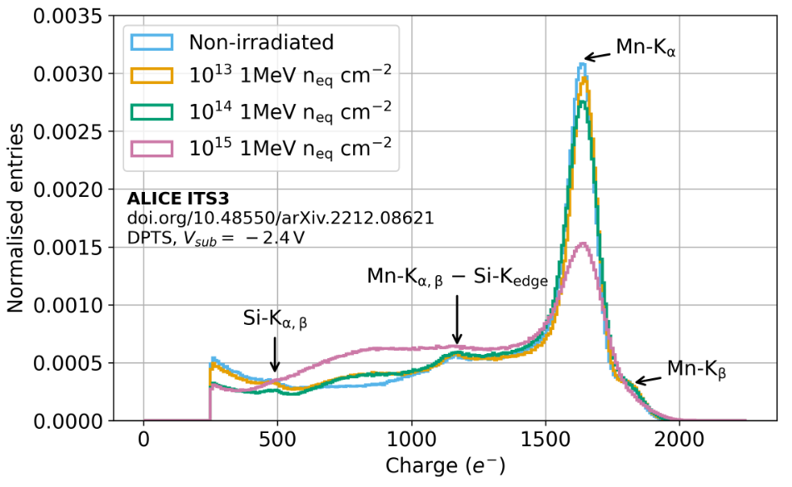
DPTS Source Measurement& Radiation Hardness
20

Slide 21
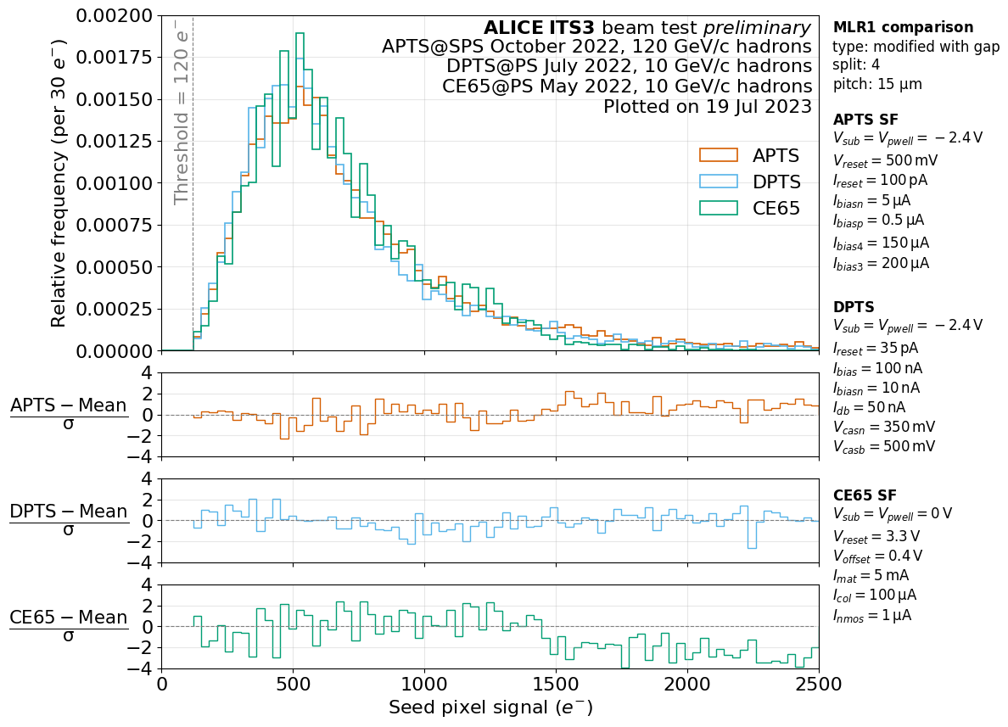
APTS – DPTS – CE65 comparison
Beam Test
21

Slide 22
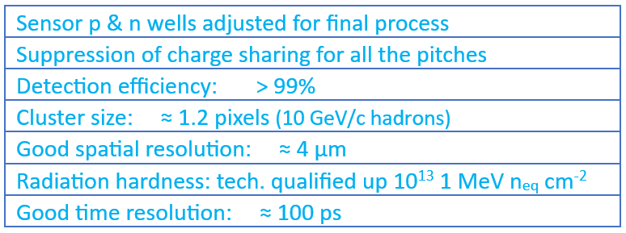
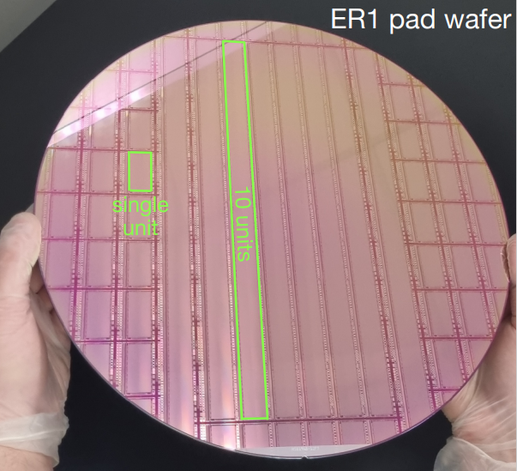
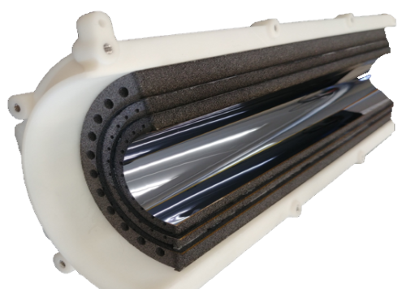
Conclusions
Different doping profiles, in-pixel electronics architectures and readout flavours implemented
Engineering Run 1 (ER1) directed to
large, stitched sensor chips
(See V. Sarritzu’s presentation)
Bent Monolithic Active Pixel Sensors
(See D. Colella’s presentation)
Sensor optimization also proven in 65 nm technology;
Technology qualified and ready for next steps
22

Slide 23
SPARE

Slide 24
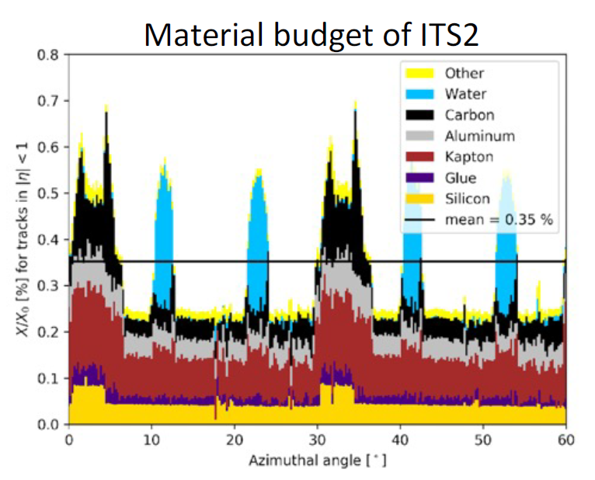
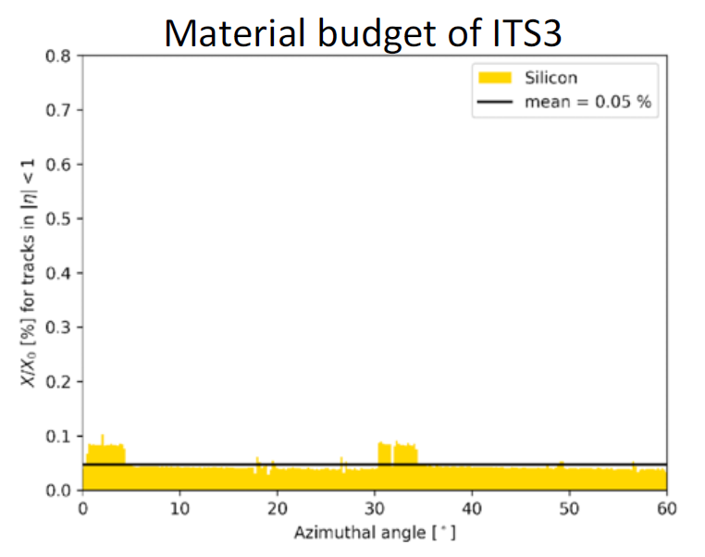
Reduction of Material Budget
Innermost Layer
X/X₀ [%] for tracks in |η|<1
Innermost Layer
X/X₀ [%] for tracks in |η|<1
Azimuthal angle [°]
Azimuthal angle [°]
24

Slide 25
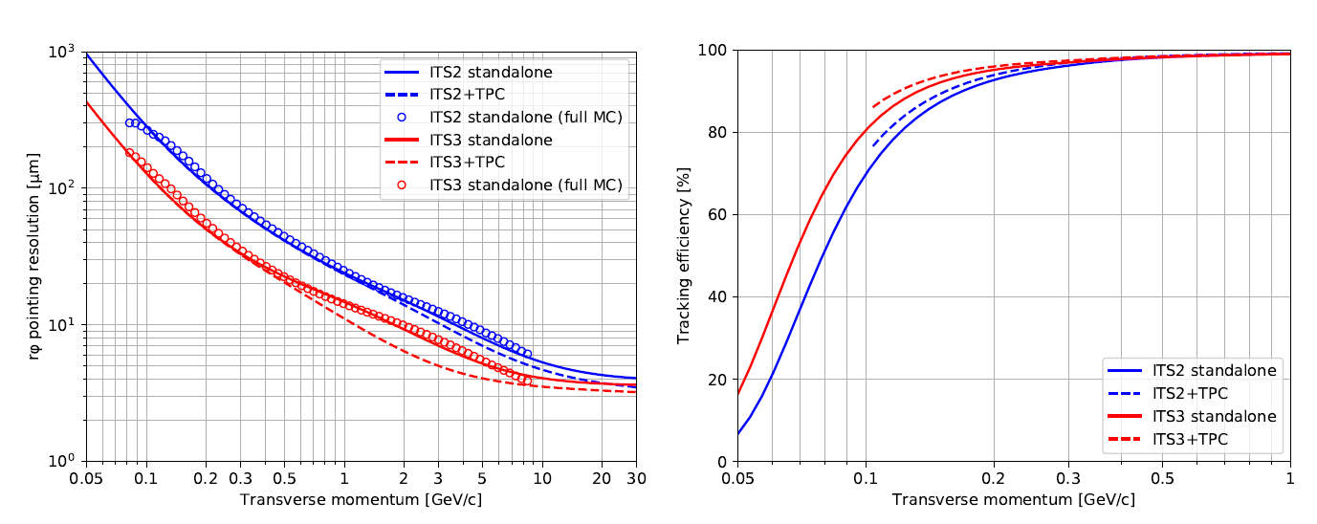
Improvement of Tracking
FMCT (Fast MonteCarlo Tool) simulations
25

Slide 26
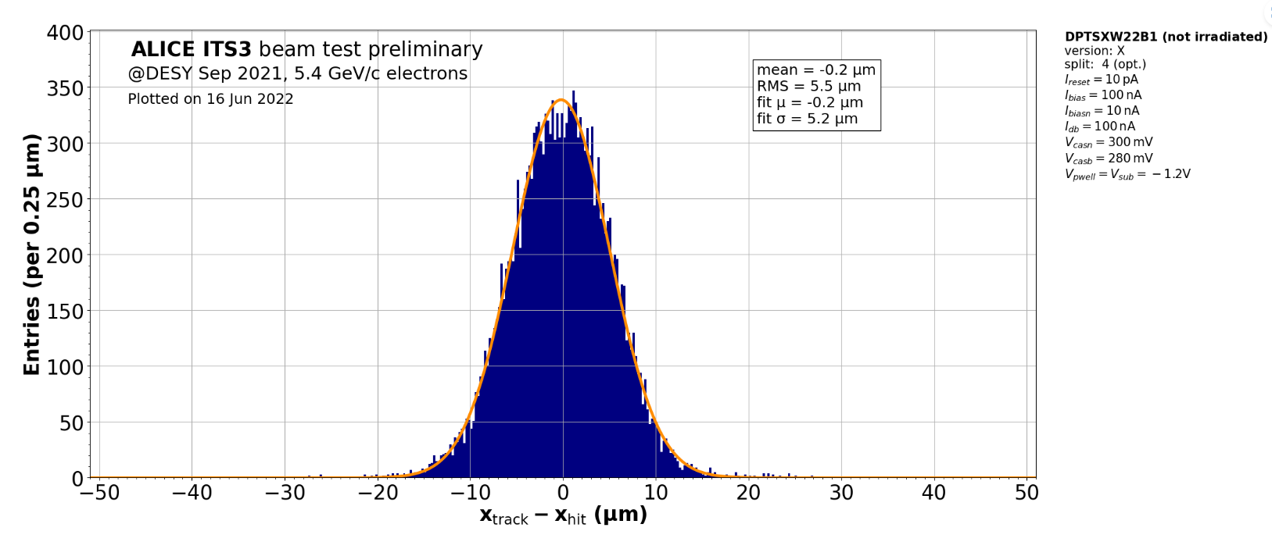
DPTS Spatial resolution
Spatial Residuals

Slide 27
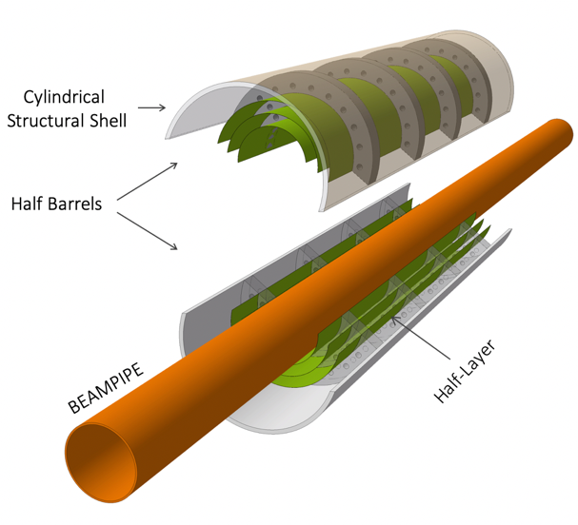
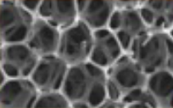
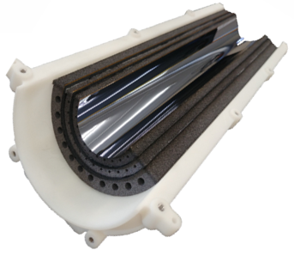
Carbon foam spacers
Reduction of the beam pipe:
Radius and thickness from
(18.2 mm, 800μm) to (16 mm, 500μm)
Removal of water cooling
↓
Reduction of power consumption
See Valerio SARRITZU’s Pres.
Removal of mechanical support
↓
Shape rigidity of large-size, bent silicon wafers
Truly cylindrical, wafer-scale sensor: R= 18, 24, 30 mm; L=28 cm
Uniformly distributed material → no systematic error
27

