Slide 1
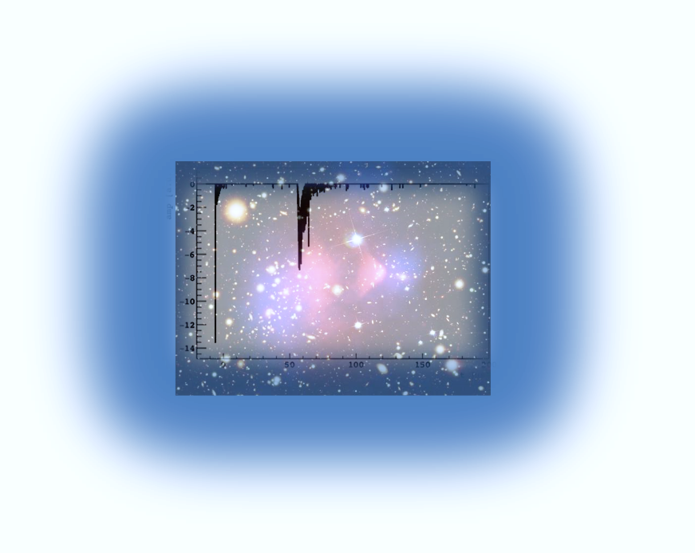
Low Radioactivity Argon for Dark Matter searches
Roberto Santorelli
CIEMAT – Madrid
(on behalf of the DarkSide Collaboration)
TIPP 2023 – CTICC Cape Town, 06/Sep/2023
Topical workshop on “New Horizons in TPCs” – Santiago de Compostela 6-October-20

Slide 2
Outline
LAr for Dark Matter direct searches
Ar-39 in atmospheric Ar
Radiopure UG-Ar: extraction and purification
DArT experiment @ LSC
Prospects of the UG-Ar for rare event searches
Conclusions

Slide 3
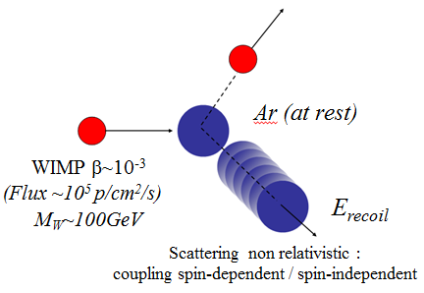
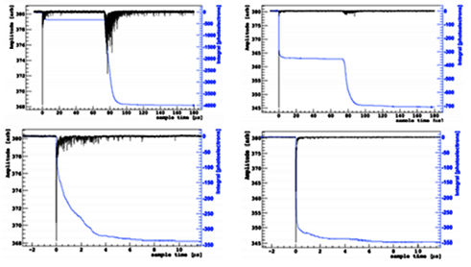
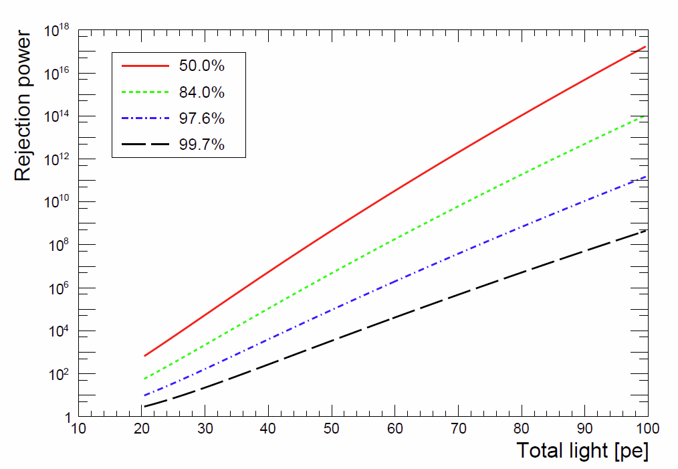
LAr: A Dream technology for DM search
Large Exposure (Mass × Time) : ∼100s tonne×year
Low Energy Threshold : ~10 keV
Event topology : alpha, muon..
Discrimination between Signal and Bkg: > 10⁸
Bkg Rate after cuts : <0.1 evt in the exposure
Background Interesting Signal
Ionization /
Scintillation
Scintillation
Pulse Shape
ArDM @ LSC
JCAP 12 (2018) 011
$${\left.\frac{Ionization}{Scintillation}\right|}_{ER}>{\left.\frac{Ionization}{Scintillation}\right|}_{NR}$$
Due to enhanced electron –ion
recombination for NR

Slide 4
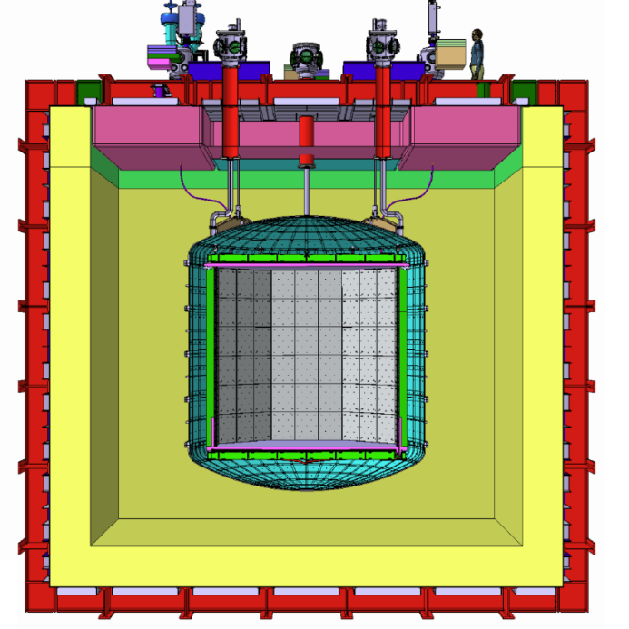
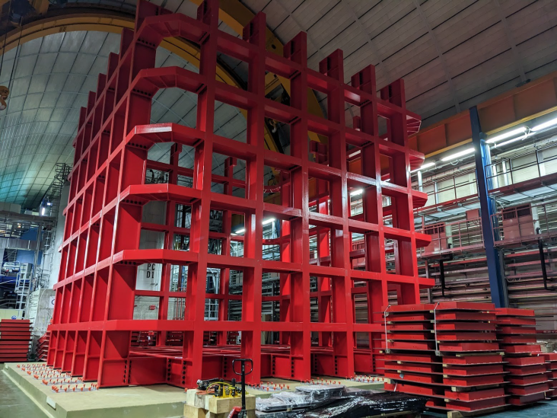
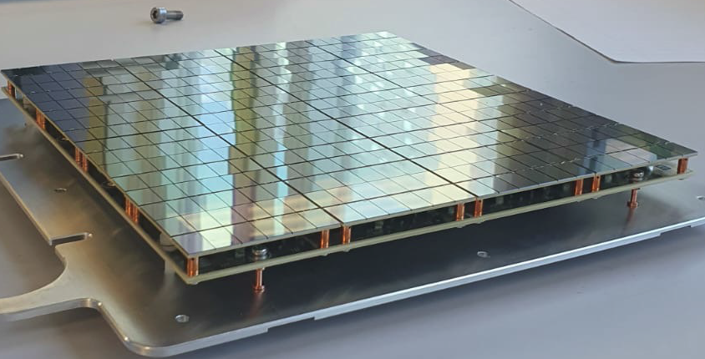
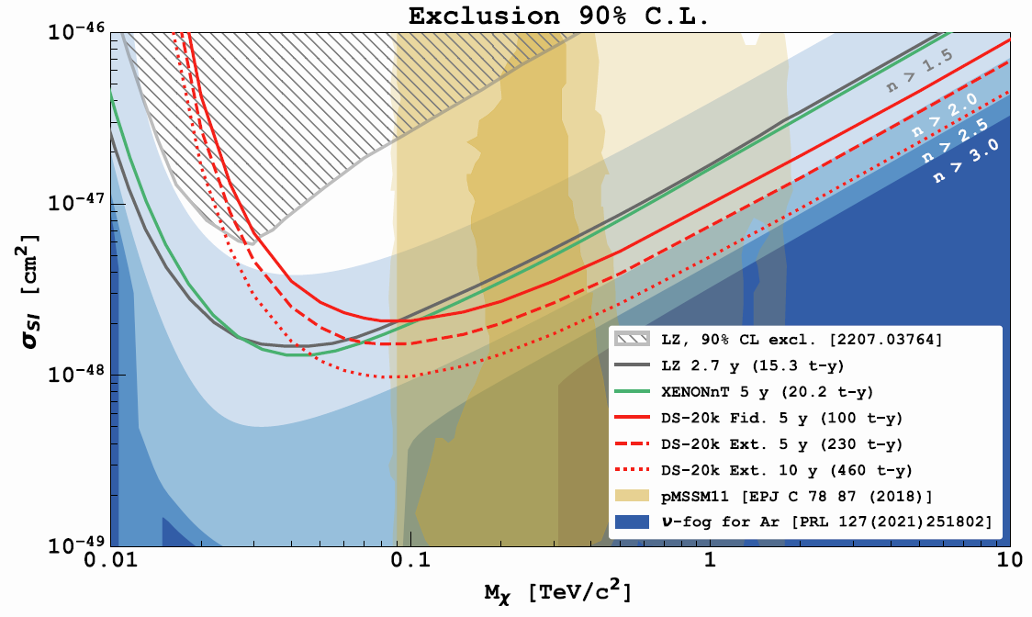
DarkSide-20k @ LNGS
DS-20k UG @ LNGS
≈650 t Ar in a membrane cryostat (VETO)
50 t (20 t FV) Ar target
21 m² cryogenic SiPMs
>10 phe/keV in the TPC (S1)
top/bottom planes Gd loaded (1%) acrylic (n- thermalization/capture)
365 cm drift
200 t⋅y: 6.3×10⁻⁴⁸cm² (90% C.L., 1 TeV/c²)
< 0.1 bkg in 200×20 t⋅y exposure ∼Background free

Slide 5
Frontiers
Large mass (tens to hundreds of tons) and long drift (some meters scale)
Very low thresholds ( ∼keV)
New sensors
Extreme radiopurity

Slide 6
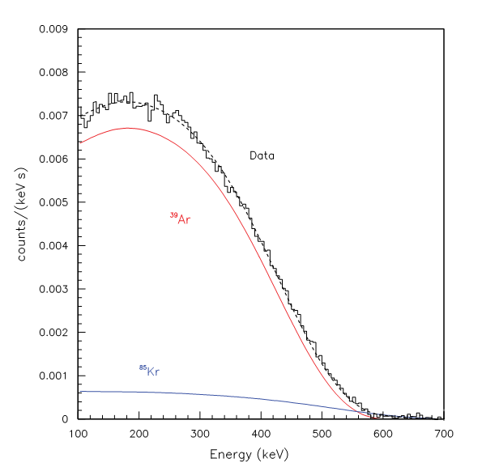
³⁹Ar in Atmospheric Argon (AAr)
β-emitter with 565 keV endpoint, T_{1/2}=269 y (cosmogenic)
Pure beta emitter, no accompanying gamma radiation
∼17 mBq/m³ in atmosphere
Present in AAr due to the production process (isotopic abundance ∼ 8×10⁻¹⁶ g(³⁹Ar)/g(^{Nat}Ar) )
“Measurement of the specific activity of Ar-39 in natural Argon”
NIM-A 574 (2007) 83–88
1.01 ± 0.02(stat) ± 0.08(syst) Bq/kg of ^{Nat}Ar
Pileup problems in multi-ton TPCs!!!

Slide 7
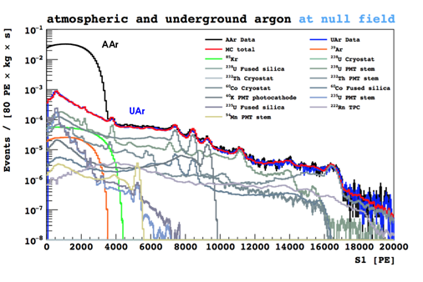
Radiopure target: Underground Argon (UAr)
Argon from underground gas reservoirs → shielded from cosmic rays
Production from natural radioactivity reactions (e.g. (α, n)-induced on ³⁹K) suppressed if the gas is from the mantle (ppb level of U and Th)
1400 ± 200 ³⁹Ar depletion factor in UAr with respect to AAr
Phys. Rev. D 93, 081101 (2016)
International effort underway to procure radiopure argon extracted from underground reservoirs

Slide 8
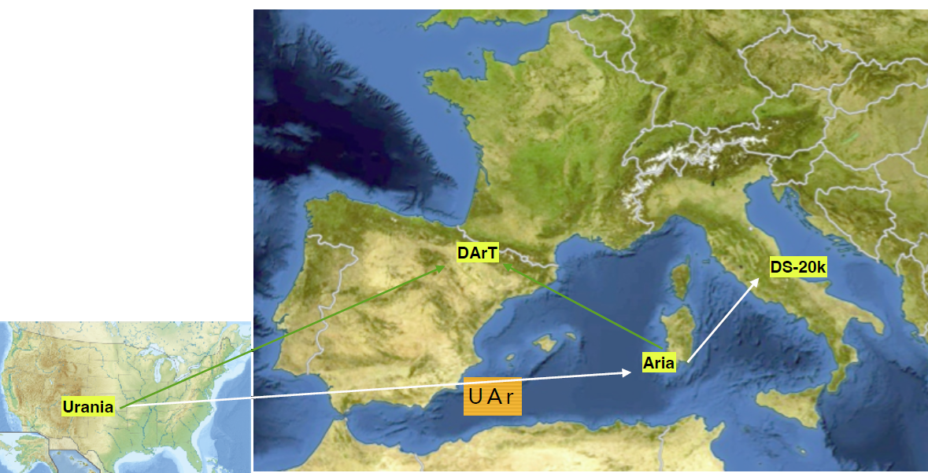
Extraction – Purification – Measurement
Three sites to extract, purify and measure the radiopure argon

Slide 9
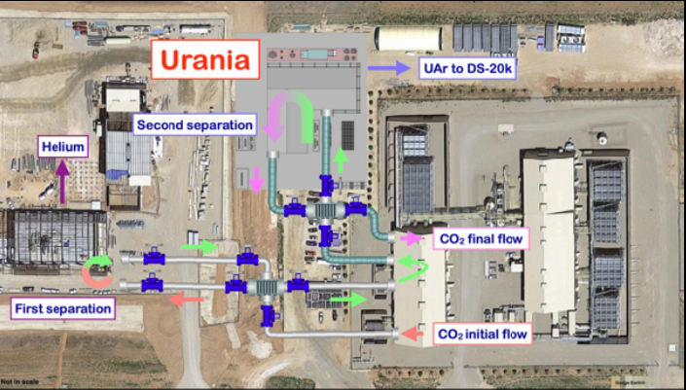
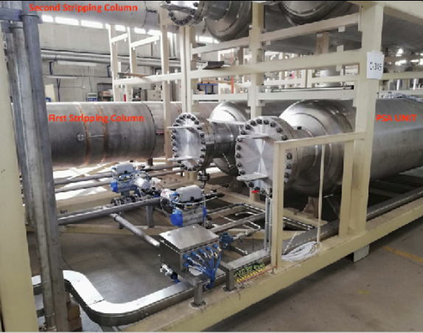
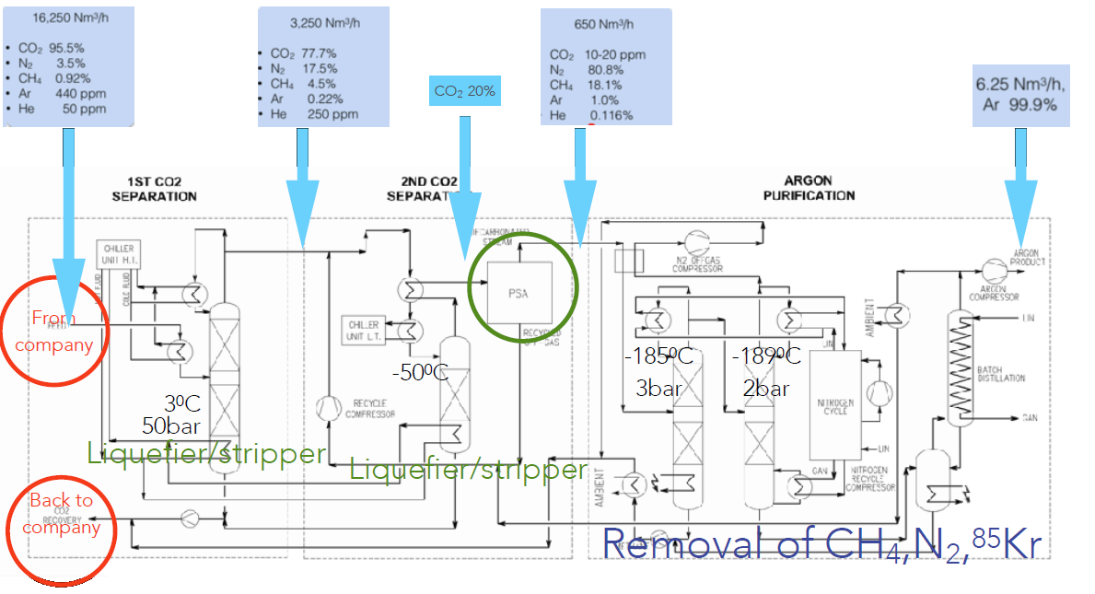
Extraction
URANIA project: Production ready for construction in Cortez mine, Colorado. First procurement of 60 ton from the CO₂ wells
∼250 kg/d, 99.99% purity
(120t +25th per 0vbb)

Slide 10
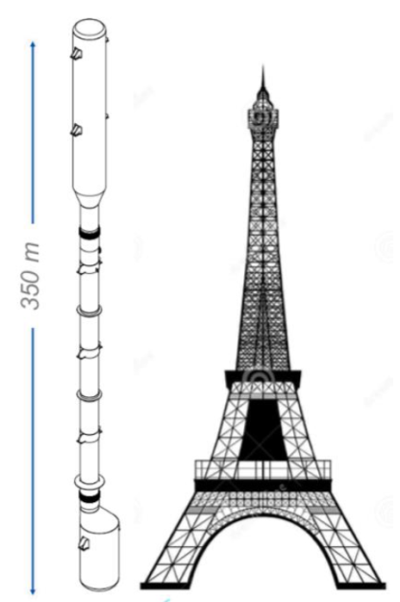
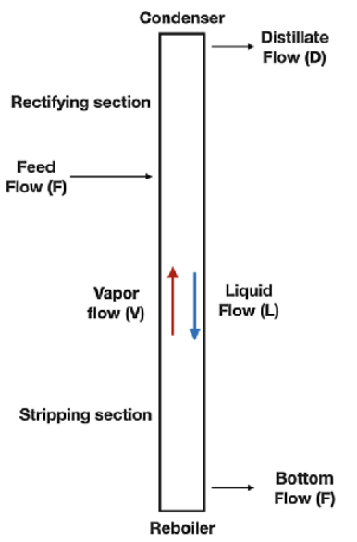
Purification to the detector grade
ARIA project: Ar chemical purification by cryogenic distillation (1t/day)
350 m height, 31.8 cm inner cryogenic distillation column (Sardinia, Italy)
The tallest ever built of this type
Designed to reduce the isotopic abundance of Ar-39 in UAr
by another factor of 10 per pass
Production rate with ARIA in chemical purification mode (DarkSide-20k): ∼1ton/day
Production rate with ARIA in isotopic separation mode: several kg d⁻¹
Medical applications (isotope supply)

Slide 11
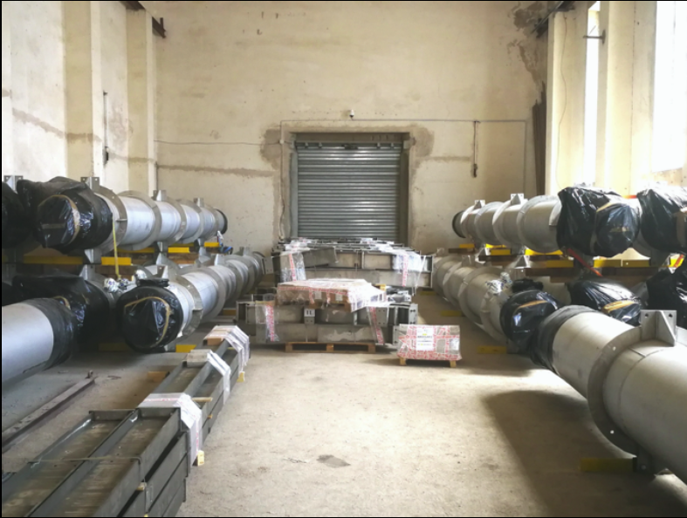
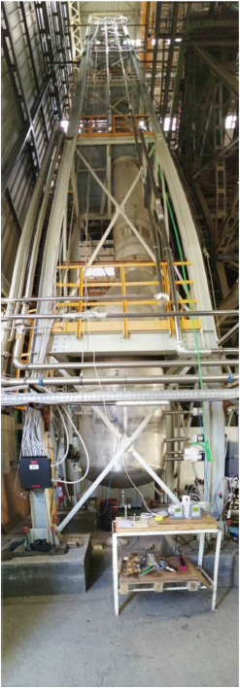
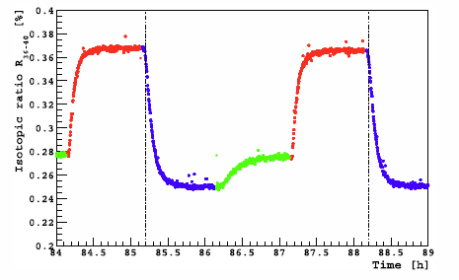
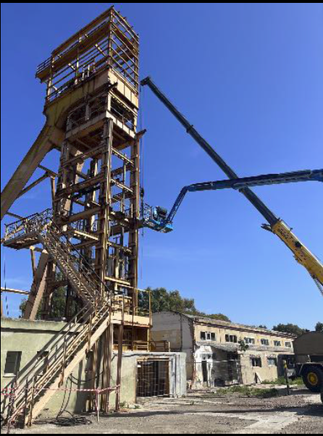
ARIA
SERUCI-0: short version of the Aria column using only the reboiler, the condenser, and one central module
SERUCI-1: 28 middle modules
Top module (Condenser) - 7m
Middle modules -12m
Bottom module (boiler) - 5m
Successful nitrogen
distillation run of the SERUCI-0 prototype installed outside the Carbosulcis coal mine
Isotopic ratio ³⁶Ar/⁴⁰Ar as a function of time.
Eur.Phys.J.C 83 (2023) 4, 435

Slide 12
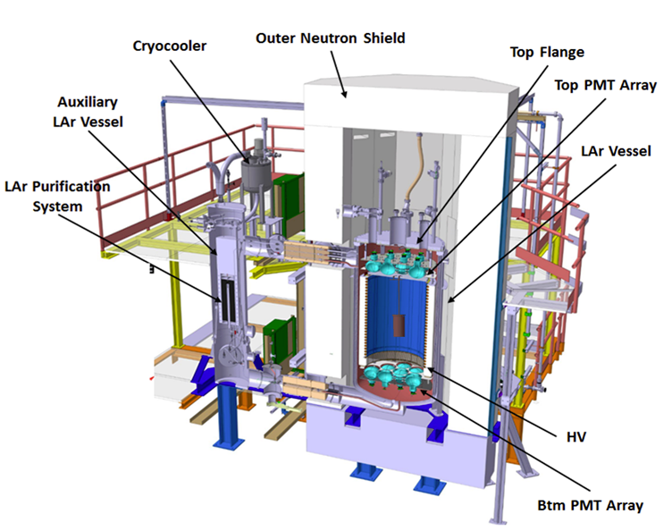
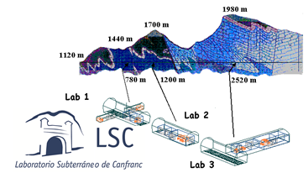
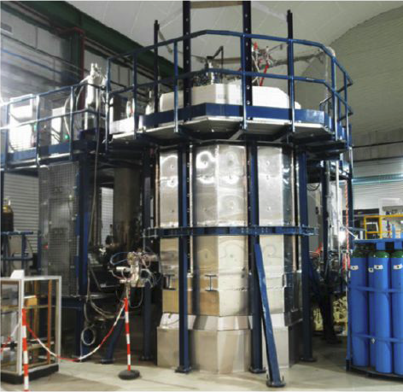
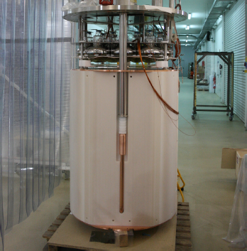
UAr radiopurity measurement @LSC:ArDM
Main Lab under mount Tobazo
~850 m rock
~2500 mwe
1400 m²
ArDM detector:
850 kg active volume (≈2 t total)
Cryogenic low rad. PMT arrays (R5912 2×12)
50 cm passive neutron shield (Poly, 20 ton)
Data taken 2014-2018

Slide 13
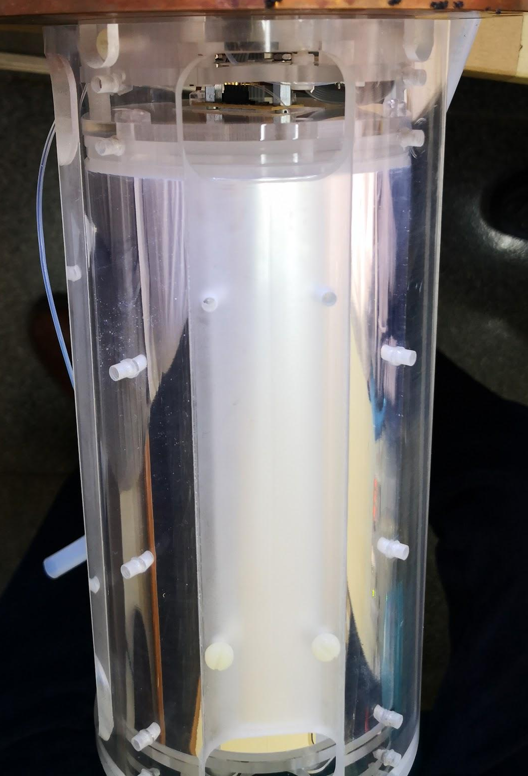
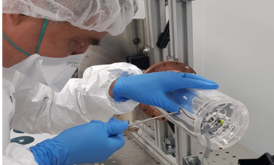
OFHC copper vessel with two top pipes.
Two 1 cm² SiPMs at top and bottom with the electronics integrated.
External acrylic support structure. Cylinder + two SiPM supports.
Internal acrylic cylinder and two disks covered with TPB (200 μg/cm²).
Reflector around SiPMs and between acrylic cylinders.
Act.volume of 1.4 kg: 620 evt/week for UAr (0.73 mBq/kg).

Slide 14
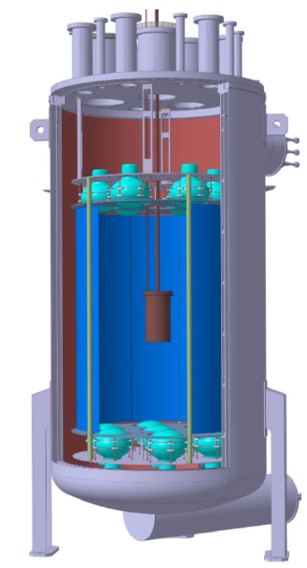
in ArDM
Signal: 𝛽 decays of ³⁹Ar (ROI ∈ [0,600] keV) with < 10 keV deposited in the veto (minimal veto threshold)
Background: untagged 𝛾 particles mainly from the radioactive decays in the detector materials (+ external)
Background source | Evts/week ROI | Untagged Evts/week ROI
ArDM Cryostat | 3164.4 | 218.3
ArDM PMTs | 1053.0 | 42.8
ArDM supp. structure | 28.5 | 0.6
Lead Belt | 150.5 | 16.2
DArT vessel | 16.6 | 5.4
Arlon SiPM | 40.9 | 23.5
Acrylic | 9.1 | 4.1
External without Pb | 117623.0 | 10020.5
Total without Pb | 122098.9 | 10301.7
External with Pb | 2596.2 | 155.7
Total with lead | 7209.9 | 465.5
Signal 620 evt/week (D.F. 1400)
→ S/B > 1 for UAr

Slide 15
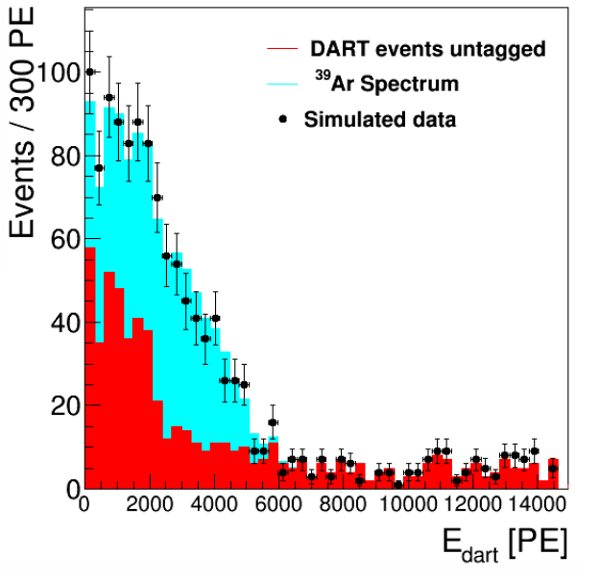
in ArDM
“Design and construction of a new detector to measure
ultra-low radioactive-isotope contamination of argon”
JINST 15 (2020) 02, P02024.
Depletion factor with respect to AAr | Statistical uncertainty [%]
10 | 0.4
100 | 1.3
1400 | 6.7
14000 | 41.1
Monte Carlo
DS-50
Installation in ArDM by the end of 2023
Commissioning of DArT in ArDM in 2024
Detector fully operative from early 2025
In the long term, DArT will measure on a regular basis the UAr batches received from URANIA/ARIA before their use in DarkSide-20k

Slide 16
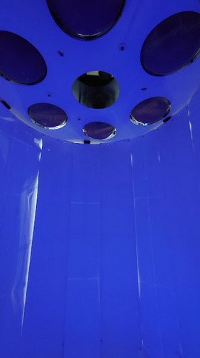
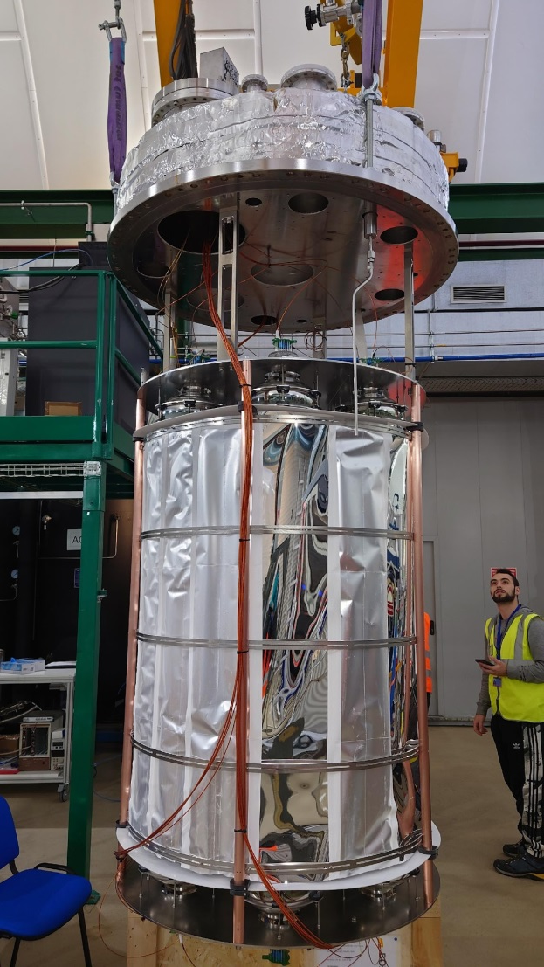
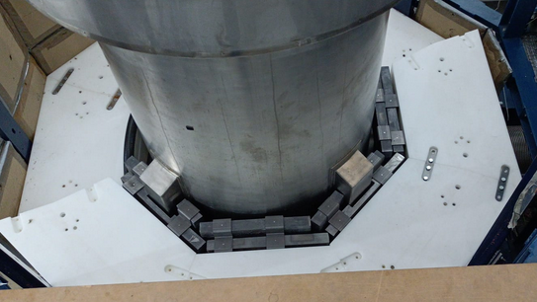
ArDM preparation
13 new cryogenic PMTs (R5912) for the veto
New reflector cage with TPB on the reflector panels
New 6 t inner Pb shield

Slide 17
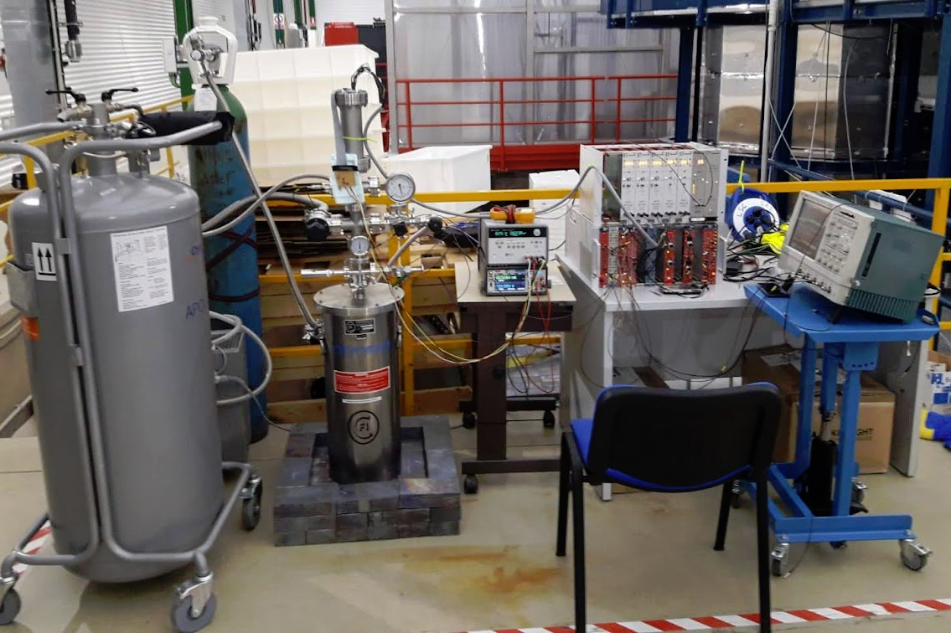
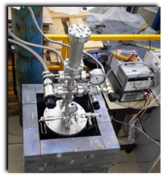
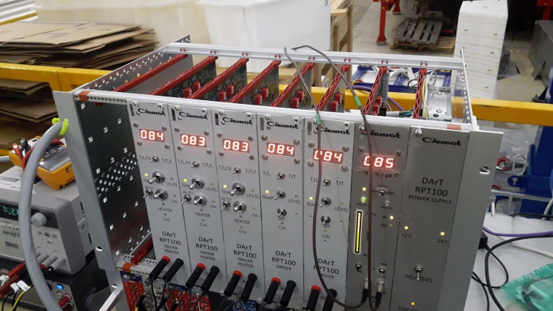
Commissioning in a test setup
Independent from ArDM
Control on the filling level performed by Arduino Mega acting on two (In & Out) cryogenic valves.
Automatic filling system
Filling triggered by level meter.
Online monitoring with a webcam on a raspberry.
Remote actuation possible via ssh for emergencies.
Several weeks of data taking in stable conditions

Slide 18
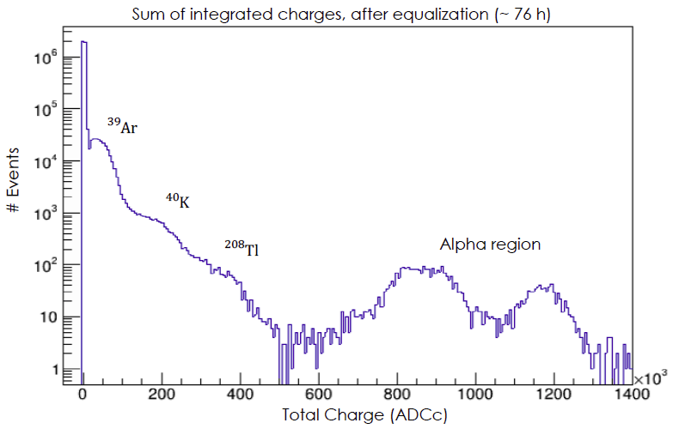
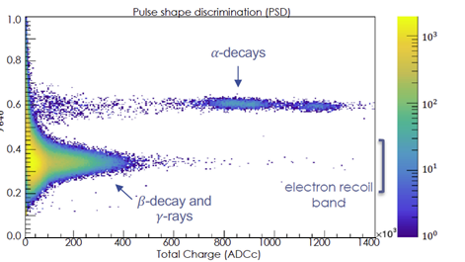
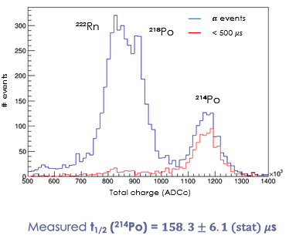
AAr data in the test setup
Data
α decay
𝜷 decay

Slide 19
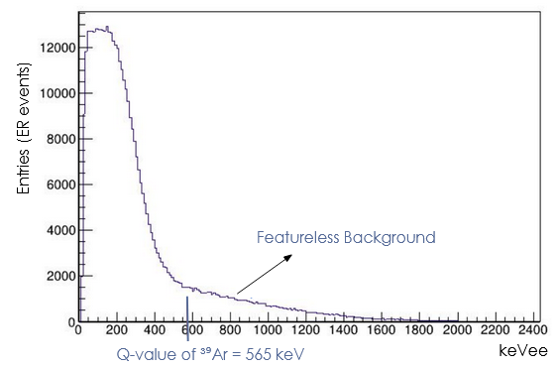
AAr data in the test setup
Preliminary
³⁹Ar rate ∼ 1 Hz
assuming a featureless linear bkg
(systematics under study)

Slide 20
UAr Transportation
We are considering liquid containers: final choice of specific container still to be made.
The activity of ³⁹Ar induced during extraction, purification and transport on surface, in baseline conditions, is evaluated to be <5% of the UAr activity measured in DarkSide-50 (Astropart.Phys. 152 (2023) 102878), and thus considered acceptable.
Other products in the UAr such as ³⁷Ar and ³H are shown not to be relevant due to short half-life and assumed purification methods.

Slide 21
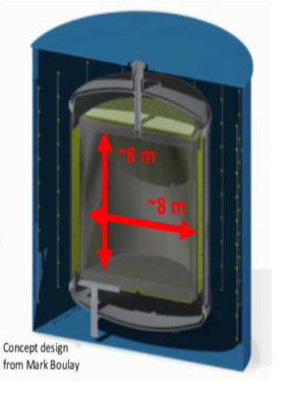
UAr for rare events searches
∼ 100 t produced for DarkSide-20k (starting Q4 of 2024)
We recently signed with the LEGEND Collaboration an agreement for the provision of 25 t of UAr for the LEGEND1000 argon veto, after the DarkSide-20k production (Ar-42 background mitigation).
A lot of interest from other experiments
COHERENT 1 t (CEvNS)
ARGO ∼300t (dark matter)
DUNE O(10,000) t
Conceptual studies : 3 kt x 10 yr

Slide 22
Conclusions
The small Ar-39 contamination does not make feasible to use atmospheric argon in the next generation of Dark Matter search experiments
~1400 depletion demonstrated in UAr: UAr will be key to the physics programs of the future DM direct search with argon
International effort underway to procure radiopure argon extracted from underground reservoirs with three different projects: URANIA, ARIA and DArT
First 2 y production for DS-20k by the end of 2024
A lot of interest from the rare event search community

Slide 23
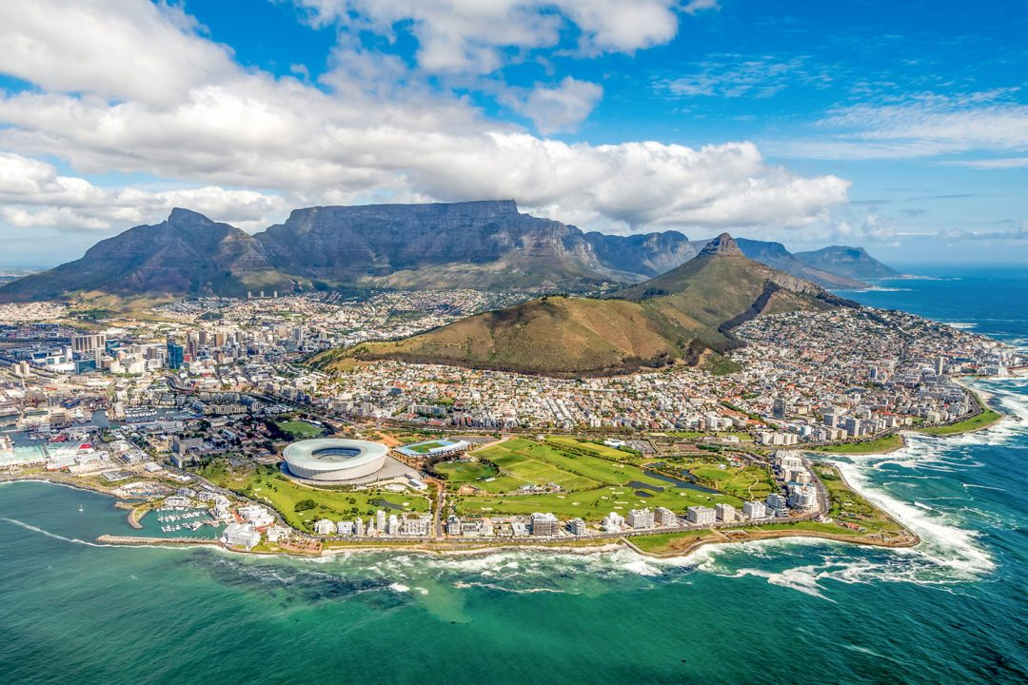
Thank you!

Slide 24
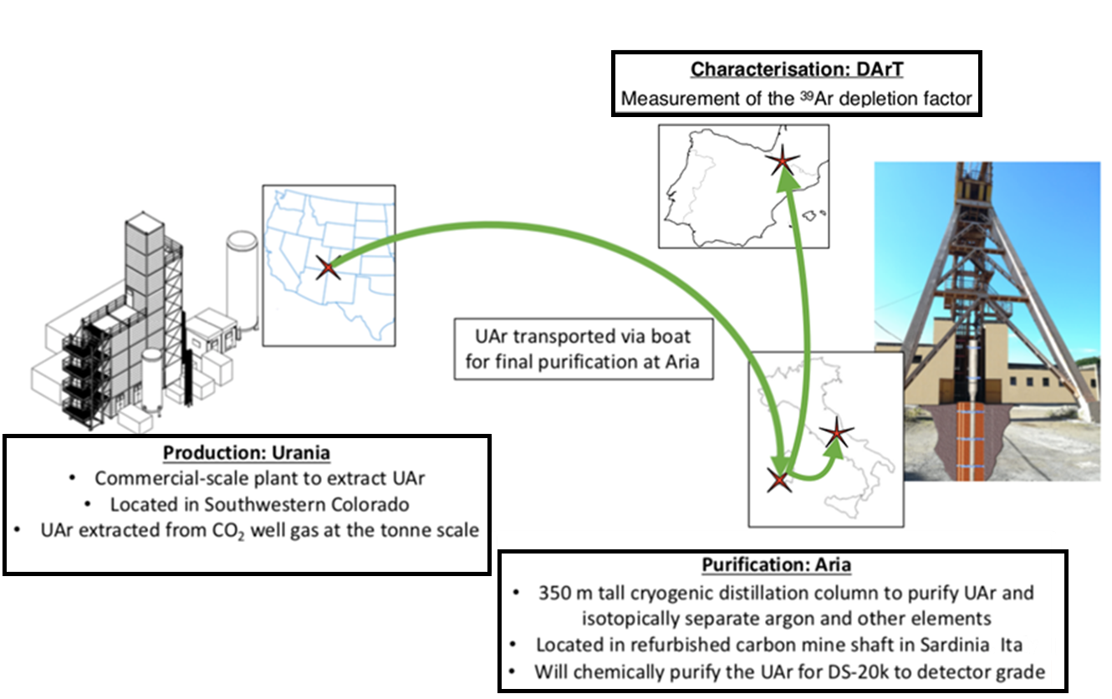
Extraction – Purification – Measurement

Slide 25
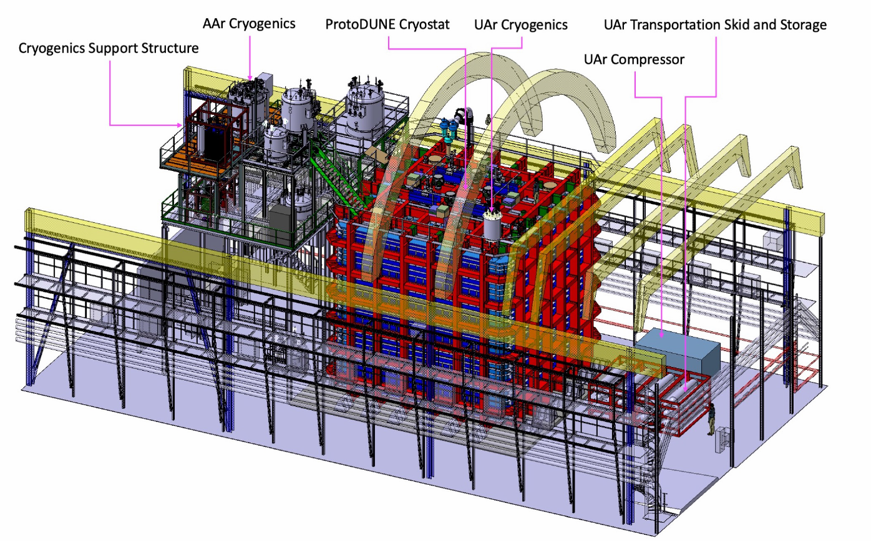
DarkSide-20k @ LNGS
≈650 t AAr in a membrane cryostat, proto-DUNE like
2 independent cryogenics purification loops
365 cm drift
50 t (20 t FV) low-radioactivity Ar (UAr)
21 m² cryogenic SiPMs
5 m² cryogenic SiPMs in the Veto
99 t UAr in total in a Ti vessel
TPC lateral walls + additional top/bottom planes
in Gd loaded (1%) acrylic (n- thermalization/capture)
>10 phe/keV in the TPC (S1)
>20 PE/e⁻ (S2)
2 phe/keV in the Veto
∼cm (xy) and ∼mm (z) pos. res.

Slide 26
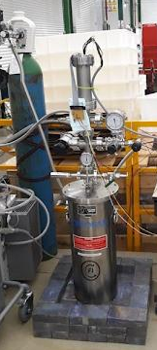
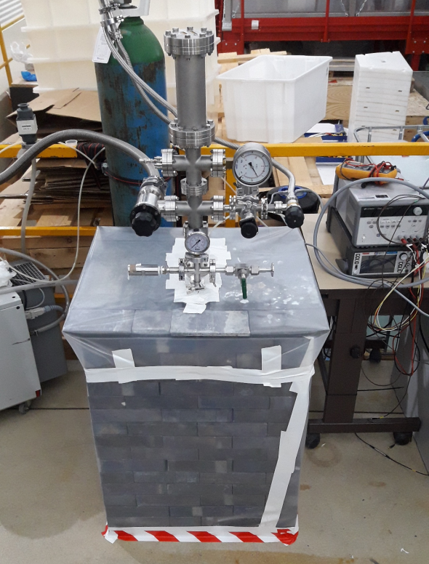
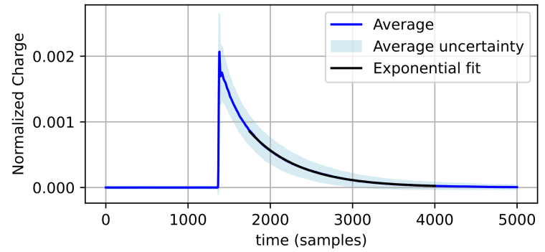
Commissioning in a test setup
Setting the operating conditions of the system
Long terms stability
Characterization of the DAQ
Study of the SiPM optimal operating conditions
Data transfer / processing / storage
Test of the reconstruction/analysis tools
Tuning of the MC
First study of the internal backgrounds
Data
α decay
Triplet lifetime ∼1230 ns
𝜷 decay

