Slide 1
Advancing RPC Detectors with Alternative Eco-Friendly Gas Mixtures and Recuperation systems
Gianluca Rigoletti, R. Guida, S. Juks, B. Mandelli, M. Verzeroli
06/09/2022
Notes:
Potential gases

Slide 2
Outline
RPCs at LHC
Alternative gases and low-GWP gas mixtures
Gas properties studies
Gas Recuperation system
Notes:
Meno punti

Slide 3
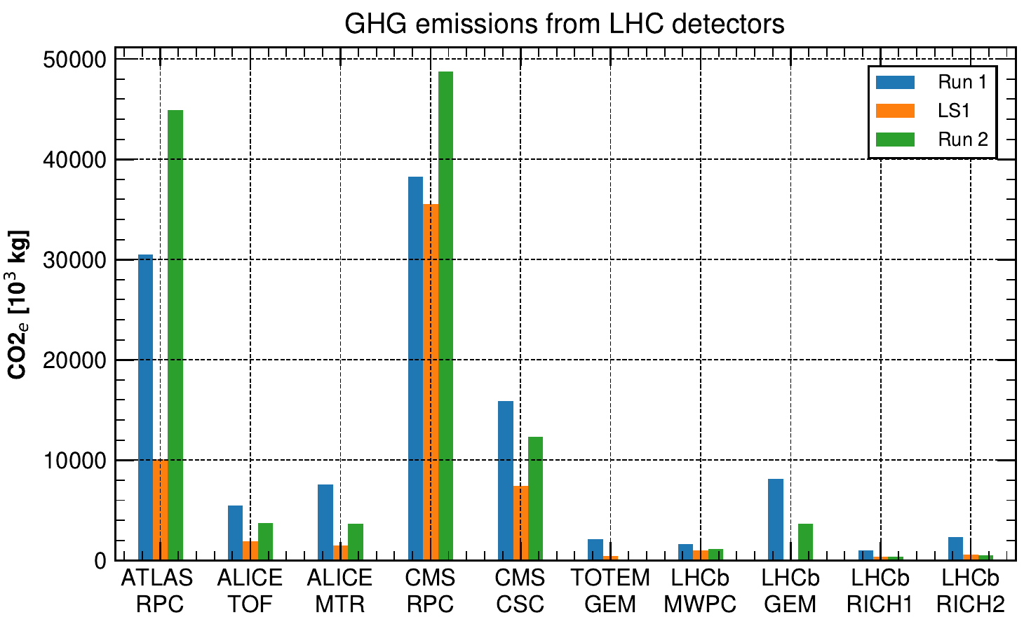
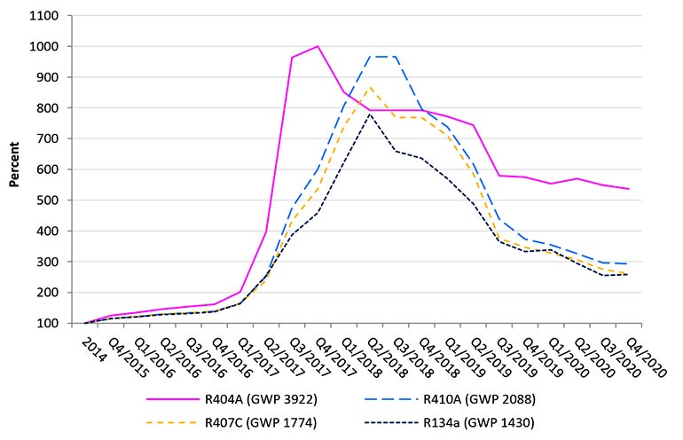
RPCs at LHC: GHG consumptions
RPCs at LHC are operated with 65-95% of R-134a
R-134 consumption during LHC Runs
Run 2: ~ 100 000 tCO2e/year emitted from R-134a consumption
Mostly due to leaks at detector level ⇒ reparation campaign in LS2
Environmental + Economical factors
R-134a price increased of about 2.5 times w.r.t to 2015
RPCs at LHC in Run 3
ATLAS RPC using 30% CO2 gas mixture
CMS RPC using part of recovered R-134a
Total GHG consumptions
65-95% R-134a (~2000 kg/month), 0.3-1% SF6 (~50 kg/month)
Increase due to
HFC/EU phase down
Industrial conversion to new low-GWP gases
R-134a +250%

Slide 4
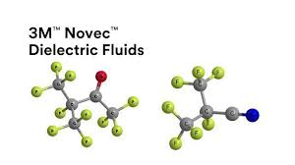
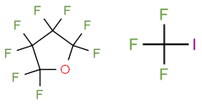
RPCs at LHC: SF6 and alternatives
SF6 use in RPCs
Electron quencher, streamer suppression
0.3% in HPL RPCs (ALICE MID, ATLAS RPC, CMS RPC)
7% in Glass RPCs (ALICE TOF)
Fluorinated gas with the known highest GWP ~ 22800
Remarkable properties
High dielectric strength ~ 2.5 x Air
High electron attachment → captures free electron to create slow heavy ions
Chemical inertness → stable molecule
Long lived in atmosphere
Non-flammable
Non-toxic
High vapour pressure at NTP → gas at room temperature and pressure
Energy industry engineered/tested some alternatives
3M NovecTM gases: Novec 5110 and 4710
HFOs and chlorinated HFOs: R-1233zd, R-1244ud
x-methane molecules: CF3I, CCl4
Other PFCs: C4F8O
SF6
GWP 22800
SF6 alternatives research still ongoing in electrical industry
Amolea
Novec 5110
Novec 4710
C4F8O
CF3I
GWP < 1
GWP < 1
GWP 2100
GWP 8700
GWP < 1

Slide 5
Goal of RPCs studies on alternative gases
Alternatives to/reduction of R-134a
Alternatives to SF6
Aging studies
HFO/R-1234ze as
main alternative
Non fluorinated gases
NovecTM 4710, 5110, C4F8O, CF3I, R-1224yd
RPC ECOGAS@GIF++ (AIDAInnova)
CO2 addition to the standard gas mixture
Goal:
Reduce GHG emissions from RPC @ LHC without changing the existing infrastructure (HV, FEBs, Gas Systems, etc.)
Gas Recuperation
Studies on gas properties
R-134a recuperation system
UV absorption
Water solubility
HF and other acids production

Slide 6
Alternatives and reduction of R-134a

Slide 7
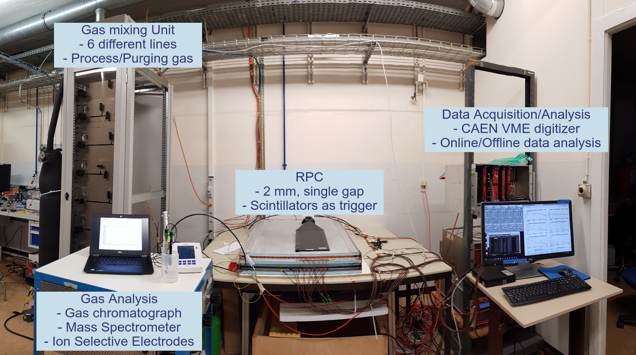
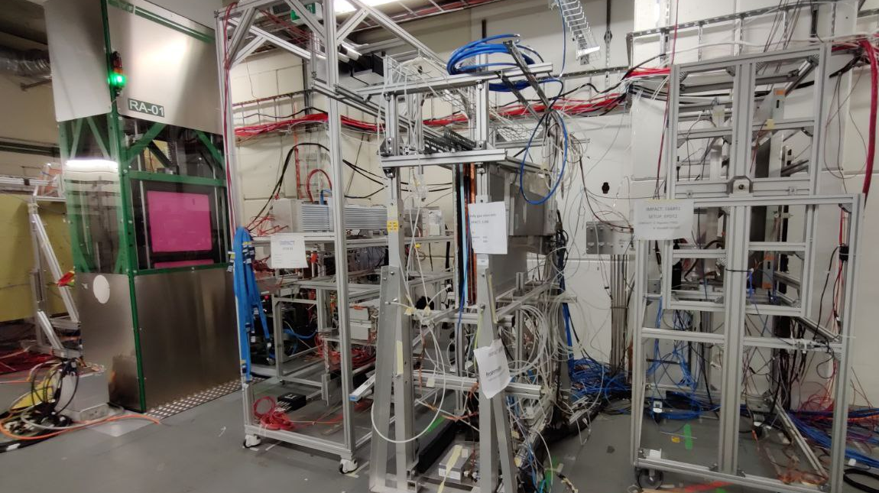
RPC performance studies: experimental setup
Laboratory setup
Single gap, 2 mm electrodes + 2 mm 80x100 cm² gap HPL
Tests of new gases
Gas mixtures fine tuning: up to 6 components, 0.01% precision
Low rates, cosmic muons
Raw waveform analysis: efficiency, st. prob., cluster size, time resolution, prompt charge
GIF++ setup
Muon beam + ¹³⁷Cs gamma source
Gas mixtures validation:
Muon beam at different background rates (ABS filters)
Long term studies: currents stability
Cosmic muons measurements
Muon beam
Gamma source
RPCs
Rotating RPC trolley

Slide 8
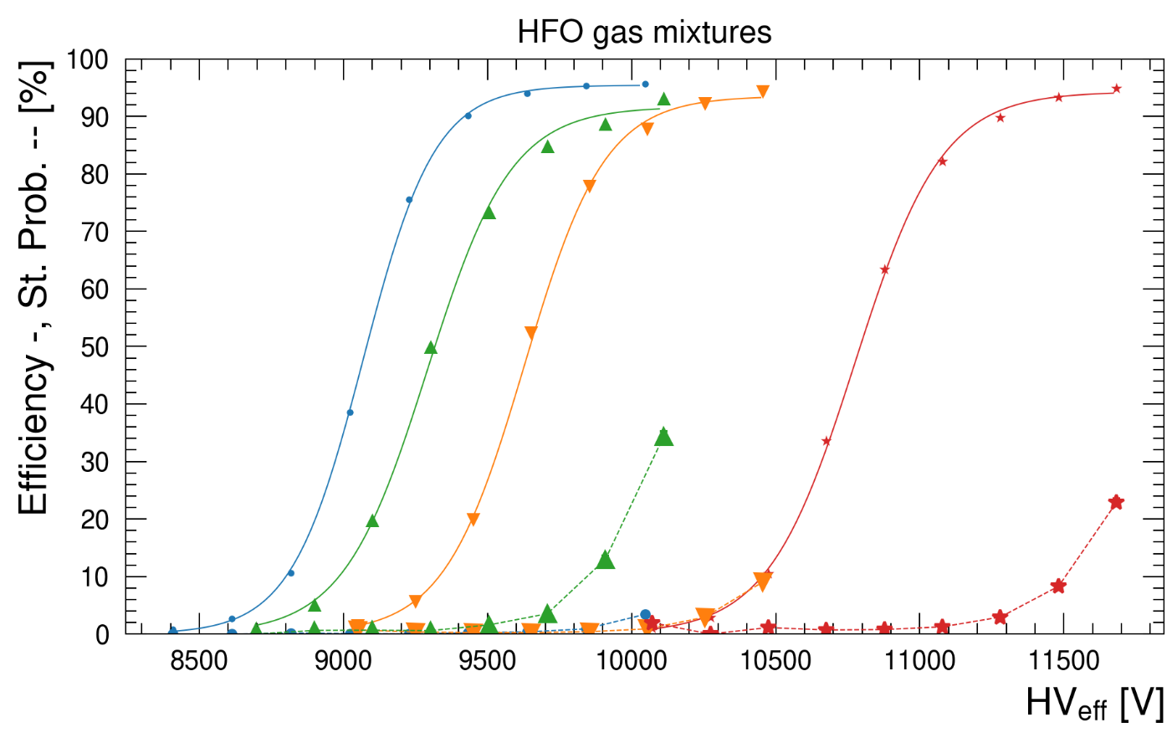
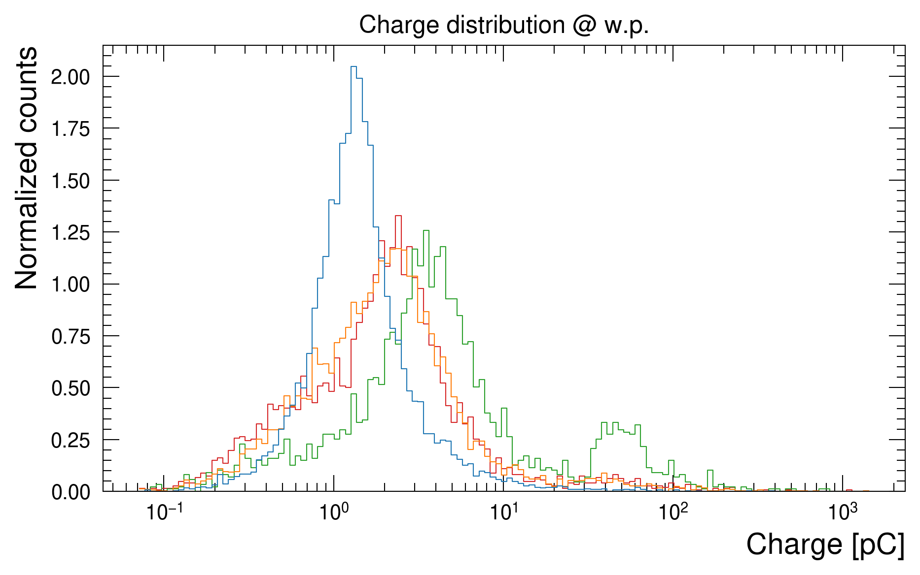
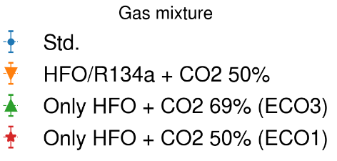
Alternative gases: R-1234ze (HFO)
+2 kV
R-1234ze (HFO) identified as possible replacement to R-134a
Extremely low GWP (~ 7)
Increasingly wider adoption in refrigerant industry
However, market price and availability not yet comparable to R-134a → Honeywell patented
Cannot replace 1:1 R-134a → w.p. too high → CO2/He required to lower w.p.
Long term effects still under investigation
R-1234ze performance with CO2 (+ R-134a) with cosmic muons
45% HFO + CO2 (ECO1) ⇒ w.p. too high (~11.6 kV)
25% HFO + CO2 (ECO3) ⇒ low GWP, high charge content → higher currents. Currently being tested by RPC ECOGAS collaboration ⇒ see TIPP talk
22% HFO + 22% R-134a + CO2 ⇒ higher GWP, lower charge content than HFO only. Possible compromise between performance and environment
45% HFO + CO2
25% HFO + CO2
22 %R-134a + 22% HFO + CO2

Slide 9
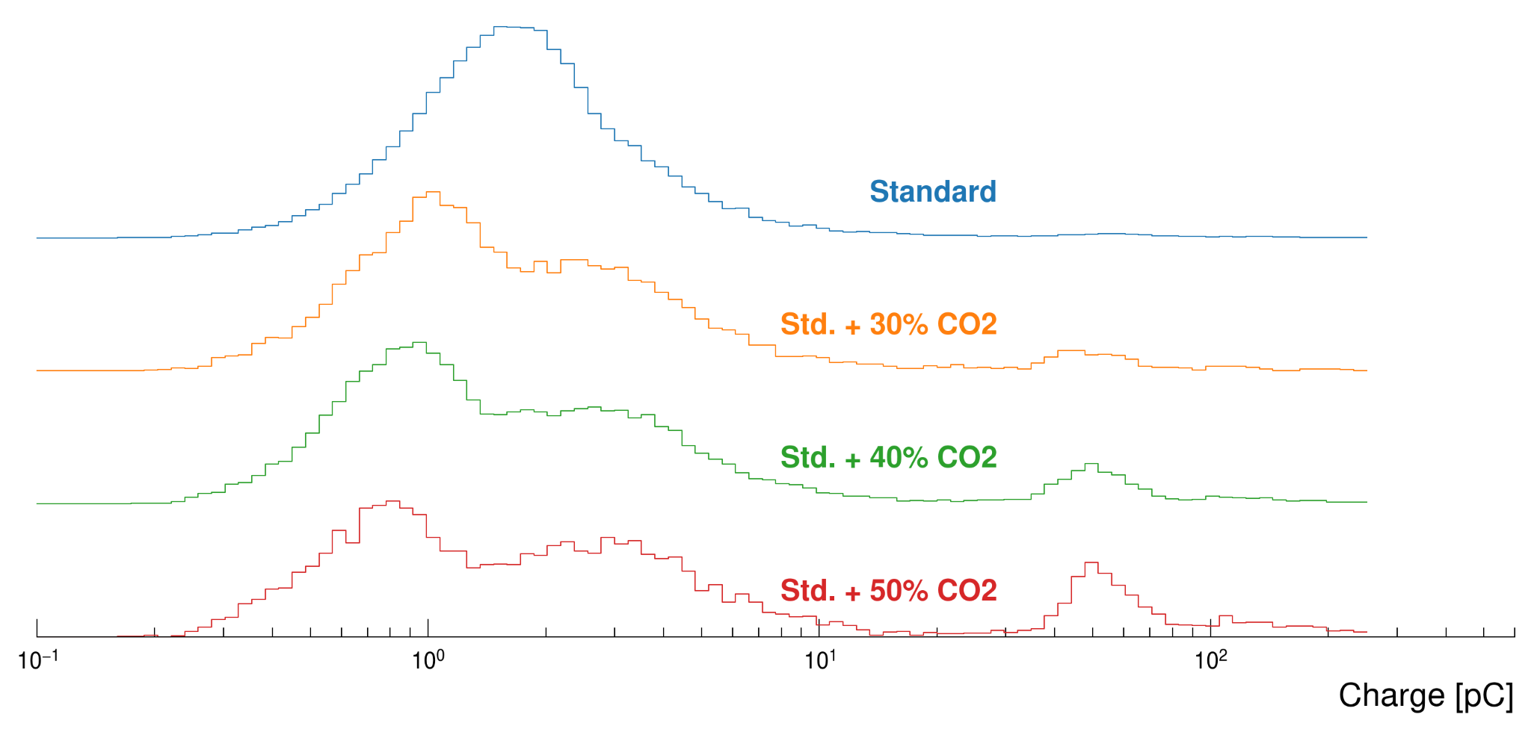
Mid-term solution to mitigate R-134a consumption
Studies on CO2 impact when added to the standard gas mixture: 30%, 40%, 50%
Tests performed with muon beam and gamma background Apr 2022
Increasing CO2 increases the charge content. 30% CO2 gas mixture chosen
Muon Beam, Source Off
Gamma background currents @ working point
- STD
- 30% CO2 + 1% SF6
- STD
- 30% CO2 + 1% SF6
Gas mixture fine tuning
SF6 increase to suppress streamers
R134a/CO2/i-C4H10/SF6 64/30/5/1 chosen
Most of foremost parameters matching those of std. gas mixture
Background currents @ w.p. ~ 15% higher
Gas mixture started to be used in the ATLAS RPC system for LHC run 3: Nucl.Instrum.Meth.A 1049 (2023) 168088

Slide 10
Alternatives to SF6

Slide 11
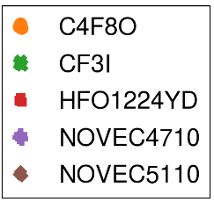
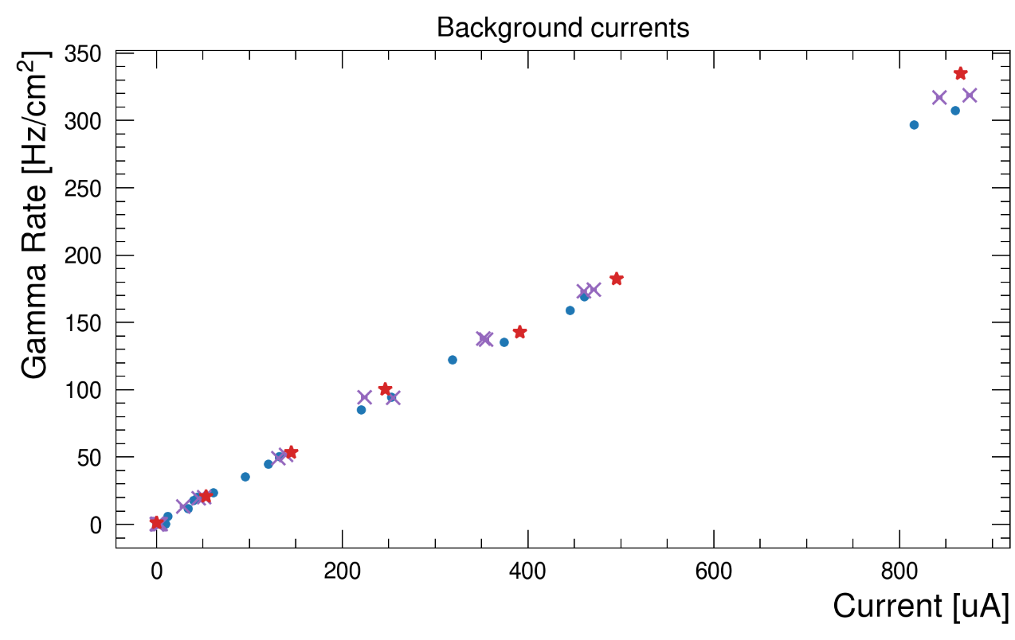
SF6 alternatives performance
Several gas tested in laboratory
C4F8O, CF3I, R-1224YD, Novec 4710, 5110
C4F8O, Novec 5110 ⇒ performance issues
CF3I ⇒ safety issues (mutagenic toxicity)
Novec 4710 and Amolea 1224yd selected for further studies with muon beam and gamma background
GIF++ tests with muon beam and gamma background
Novec 4710 0.1%, Amolea 1224yd 0.5% matching performance of Std mixture with 0.3% SF6
Novec 4710 selected for its performance but may react with water → chemical studies ongoing
Amolea 1224yd most of them contain Cl → understanding possible pollutants formation
Current [uA]
Gamma Rate [Hz/cm2]

Slide 12
Aging studies

Slide 13
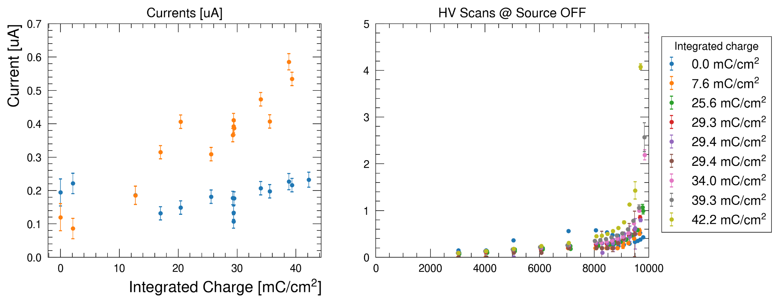
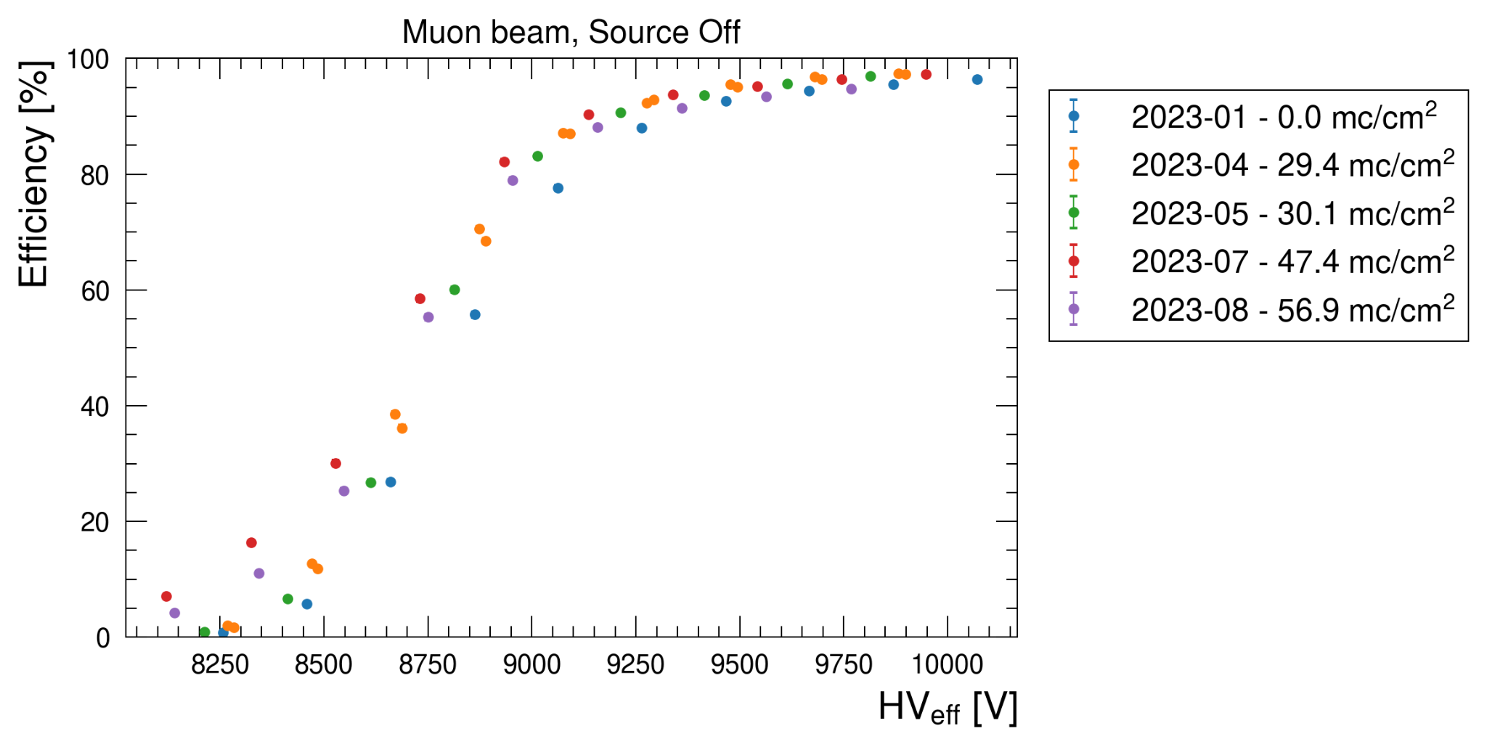
Aging studies: CO2 gas mixtures
Long term performance studies required to validate a gas mixture
Tests conducted at GIF++ with selected R-134a/CO2 gas mixture (HFO tests ⇒ see RPC ECOGAS talk)
Detectors constantly irradiated with speed factor ~ 5-10
HV scans to monitor detector currents + Muon test beam when available
Target integrated charge ~ 30 mC/cm2 for Run 3, ~300 mC/cm2 for HL-LHC
Preliminary results
No significant variation in Ohmic currents @ 6 kV
Slight increase in currents @ w.p. ⇒ under investigation
No variation in muon efficiency and other foremost parameter

Slide 14
Gas properties studies

Slide 15
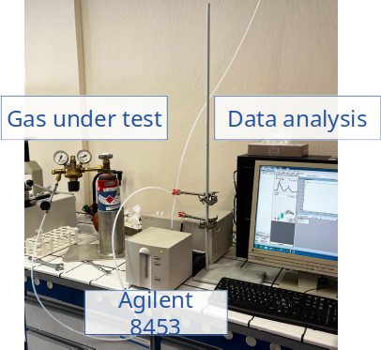
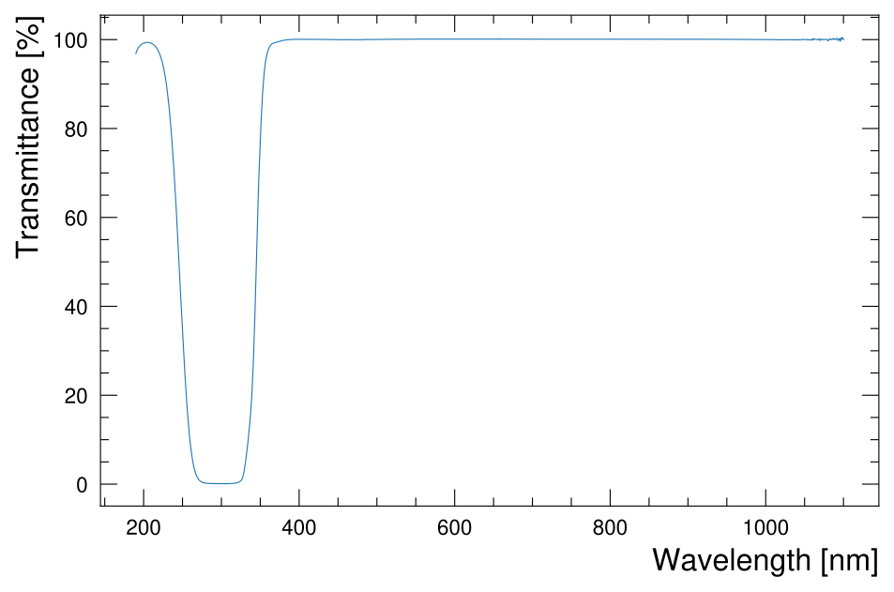
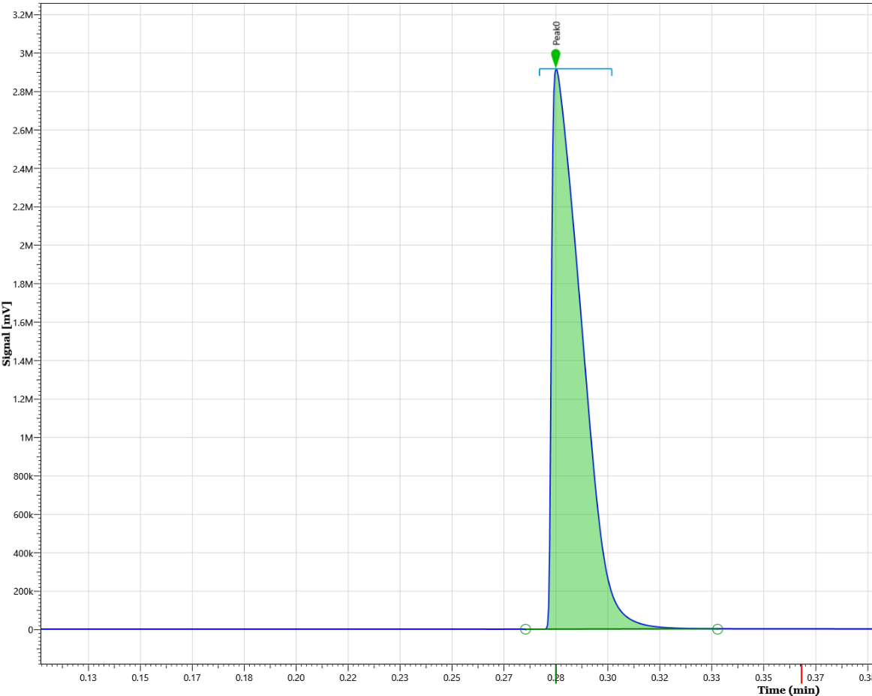
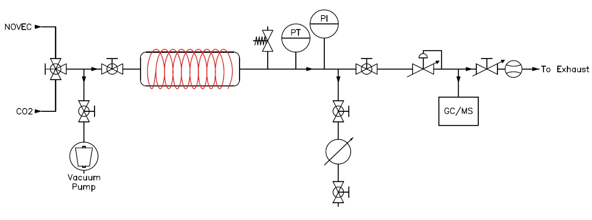
Chemical and physical properties of existing and new gases
Not only detector performance
Understanding physical and chemical properties of gases is fundamental to detector operation
Environmental chemistry helps understanding pollutants formation
Gas molecules interaction in the atmosphere and in the detector
Rain out → Water solubility → critical for humidified gas mixtures
Oxidation → Reactivity with OH-
Photolysis → UV (wavelength < 300 nm) → quenching properties
UV absorption tests
Several gas tested: Novecs, HFO, N2, CO2, i-C4H10 in 190-1100 nm range
Wavelength absorption spectra in the range 100-190 nm required for RPCs
No commercially available instruments (custom price >= 500 kCHF)
Dedicated setup to characterize amide production in Novec 4710
Solid amide products at ambient temperature. Concentration expected to be ppb
UV spectrometry
Novec 5110 UV Transmittance
UV - Visible Absorption
Thanks to B. Teissandier for helping in the measurements and providing the instrument
Novec 4710 Chromatogram
Novec 4710 water solubility setup schema
Signal [mV]
Time [min]

Slide 16
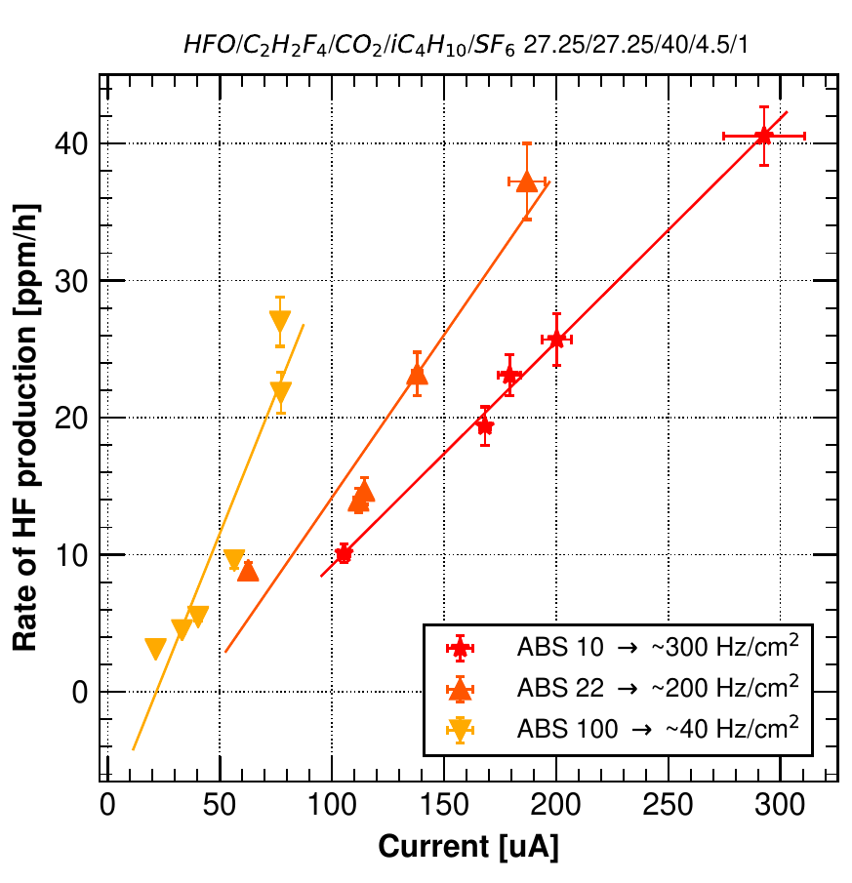
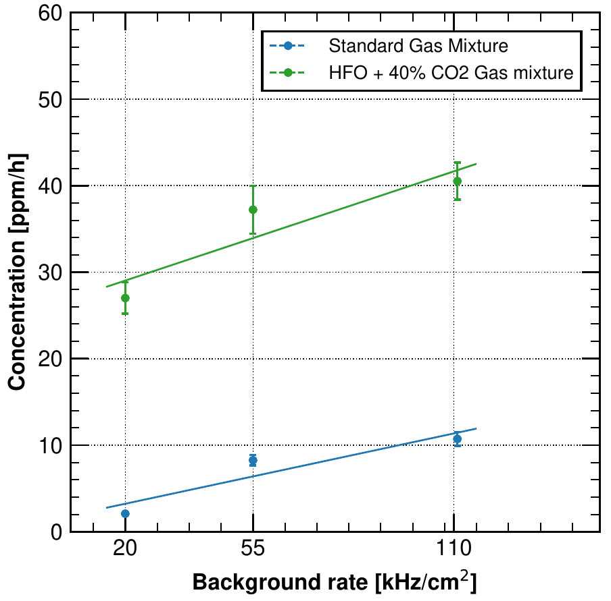
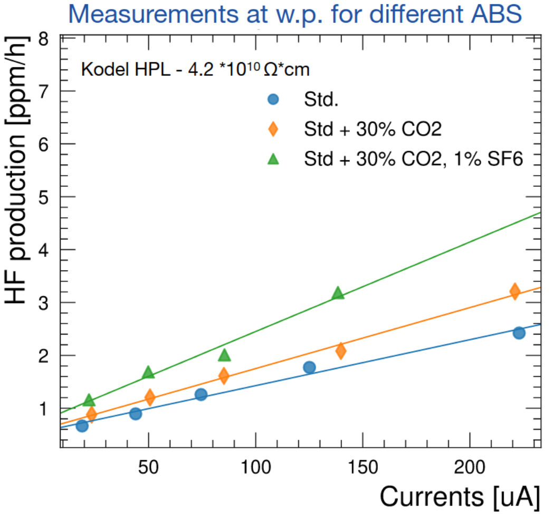
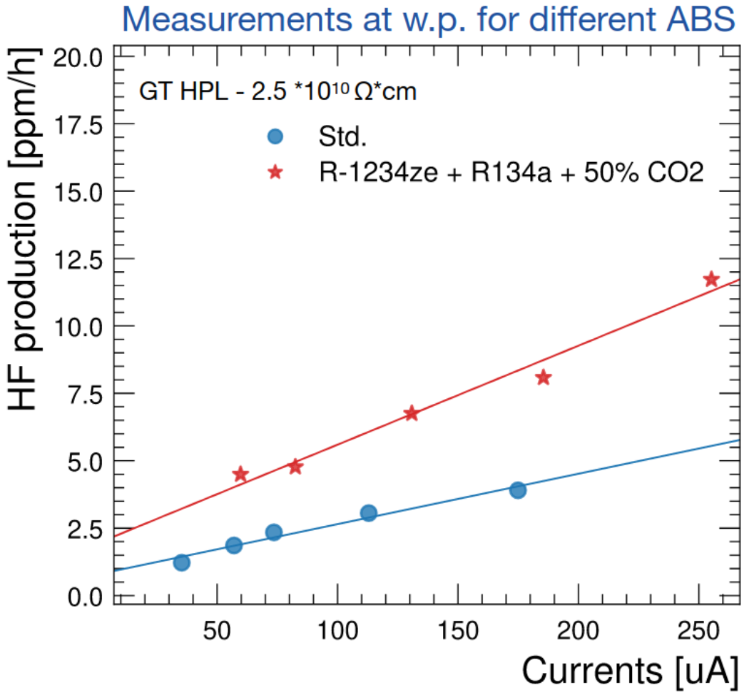
Impurities studies: F- measurements
R-134a/HFO + 40% CO2
Rate @ w.p.
2019 ⇒ Std., HFO + R-134a + 40% CO2
F- production does not depend only on the currents but also on the gap electric field
Tested R-1234ze gas mixture produced 4x more F- than std. gas mixture
2022 ⇒ Std, Std + CO2 (+1% SF6), HFO + R134a + 50% CO2
30% of CO2 in the standard gas mixture has the same F- production → F- production not proportional to R-134a
Using 1% SF6 to 30% CO2 + R-134a increases the F- production → under investigation
HFO + R134a + 50% CO2 produces 4x more F- than Std
Std. gas. mixture
1
R-134a/HFO + 40% CO2 gas mixture
2
F- [ppm/h]
F- [ppm/h]
4x F- production
Currents [uA]
Background rate [kHz/cm²]
F- [ppm/h]
F- [ppm/h]
5
4
3

Slide 17
Gas Recuperation

Slide 18
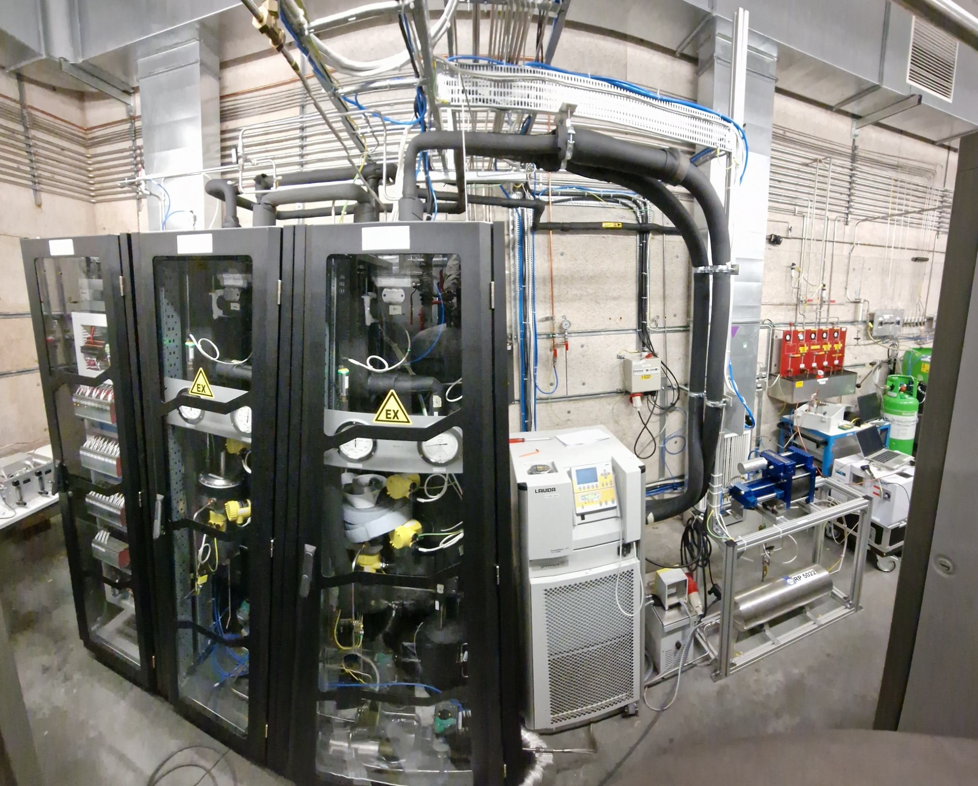
R-134a Recuperation system
RPCs LHC are operated with gas recirculation
Max. recirculation of 90% ⇒ impurities control
The remaining 10% needs to be fresh gas injected ⇒ gas is exhausted to atmosphere
R134a recuperation system
Goal: recover R-134a at the exhaust of RPC gas system
First prototype developed in 2019
2020-2022 R&D on first prototype to address azeotropic gas mixture:
R-134a forms an azeotrope with i-C4H10 ⇒ simple distillation by boiling temperature difference not possible
Maximum efficiency limited to ~ 80%
2023: new prototype built for the CMS RPC gas system ⇒ commissioning and operation
Control Rack
Column 1&2
Column 3&4
Storage
tank
Chiller -40, -10 °C
Compressor
Compressor buffer

Slide 19
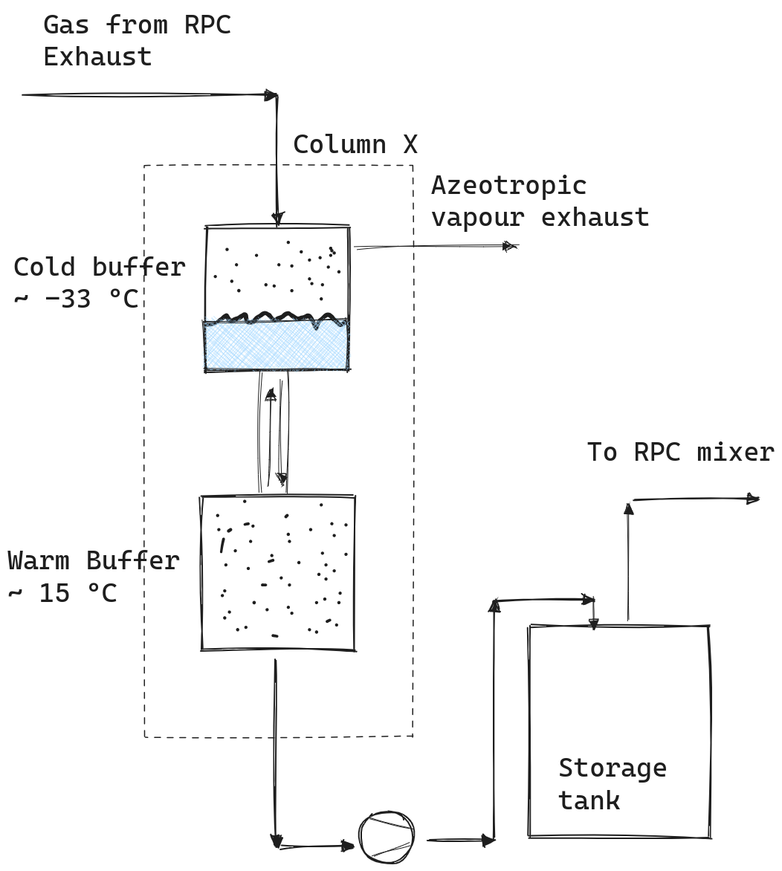
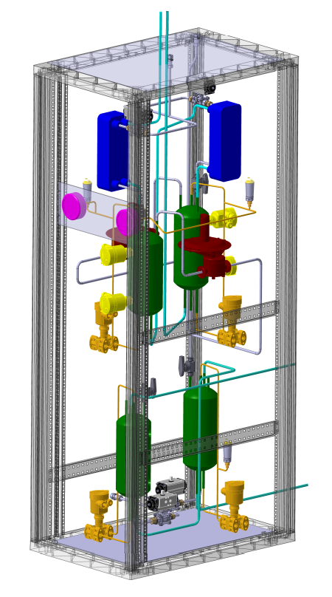
R-134a Recuperation system
Working design
Gas mixture completely cooled down to liquid in a “cold” buffer
Liquid mixture slowly heated up to gas into a “warm” buffer
Small thermodynamic equilibrium steps between vapour and liquid
Azeotropic vapour exhausted from cold buffer through a pressure controller
R-134a liquid extracted from cold buffer with a compressor
Compressor stores liquid in a tank ⇒ reused from CMS RPC mixer
Heat Exhanger
4
Cold Buffer
1
3
2
6
Warm buffer
5

Slide 20
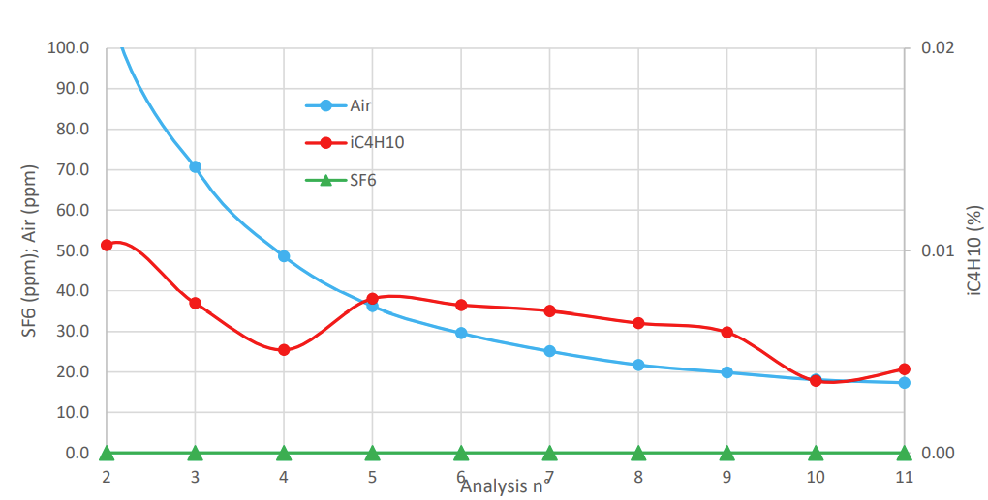
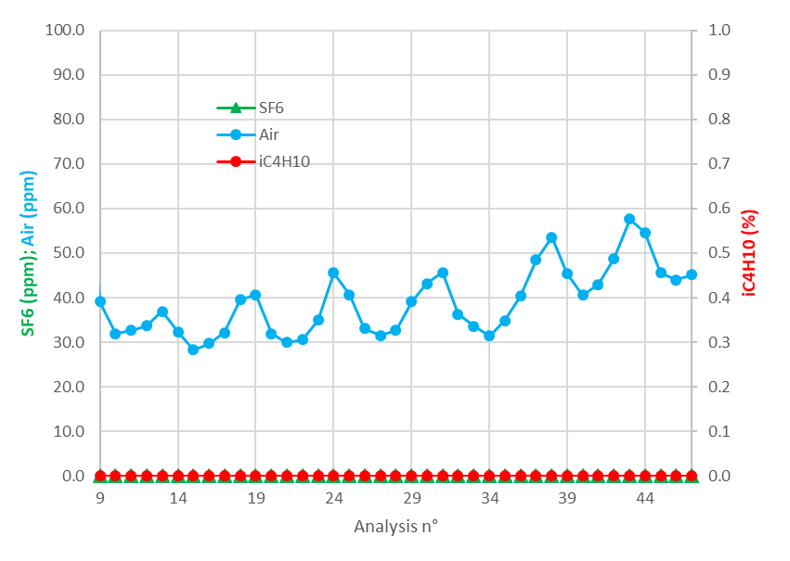
R-134a Recuperation system
Storage tank analyses
Performance and characteristics
Number of columns = 4
Filling rate = 200-400 ln/h
Extraction rate = 600 ln/h
Gas Quality monitoring from IR and GC analyses
I-C4H10 <= 0.1 %
N2 ~ 150 ppm
O2 ~ 30 ppm
Efficiency ~70-80%
Operation and future developments
Recuperated R-134a started to be used in CMS RPC mixer
Gradual increase of recuperated R-134a, from 50 to 400 ln/h
Better buffer’s temperature regulation for quality and efficiency
Future R&D: SF6 recuperation
Gas Analysis from warm buffer @ 400 ln/h

Slide 21
Conclusions
Several strategies to reduce GHG emissions from RPCs
Intensive R&D on alternative gases
R-134a main alternative seems to be R-1234ze
Short-mid term solution: addition of CO2 to std. gas mixture ⇒ GHG and costs reduction
SF6 alternatives are still undergoing lot of tests
Long term tests
R-1234ze tests ongoing with RPC ECOGAS collaboration
CO2/R-134a aging tests ongoing ⇒ no evidence of aging so far
Gas Properties studies
R-1234ze produces more F- than R-134a
UV tests to understand quenching properties of gases
Novec 4710 tests ongoing to understand amide production
Recuperation gas system
Designed for large LHC gas systems
Current prototype working at CMS RPC with ~70% efficiency and good gas quality
Fine tuning still ongoing to increase gas quality and efficiency

Slide 22
Thank you

Slide 23
Backup

Slide 24
R-134a + R-1234ze + CO2/He gas mixtures @ GIF++
R-134a + R-1234ze: two gas mixtures at high rates (1 CO2 50%, 1 He 30%):
He gas mixture has lower working point than CO2 one
CO2 + R-1234ze gas mixtures have slightly higher efficiency drop (-2 %)
He gas mixture has slightly lower currents than CO2 equivalent
Muon beam + gamma background
Notes:
Togliere time resolution

Slide 25
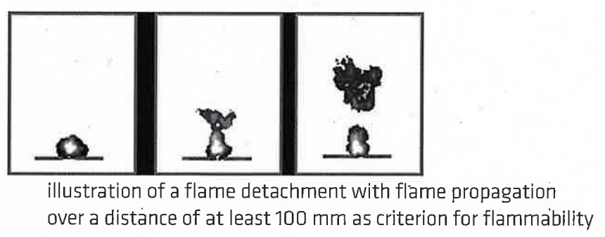
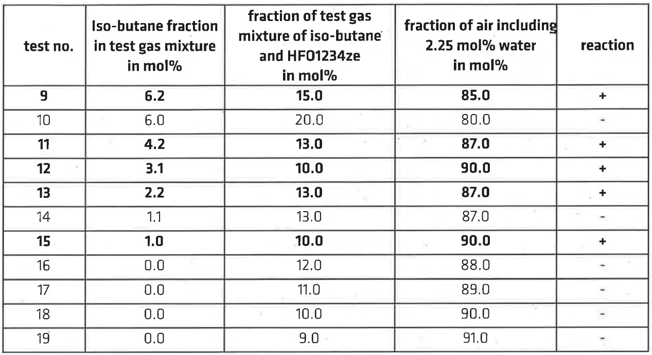
HFO flammability tests
Safety concerning HFO usage
R-1234yf classified as mildly flammable → Focus on R-1234ze
R-1234ze + i-C4H10 + 40% RH flammability test conducted:
ISO 1056 standard flammability test (detachement + flame propagation criteria) performed by external company
Results
Mixture with 1% i-C4H10 + R-1234ze is flammable
Water vapour plays an important role
HFOs alone + i-C4H10 is flammable → Effects of the CO2 on the mixtures to be understood/checked
https://edms.cern.ch/document/2463340/1

Slide 26
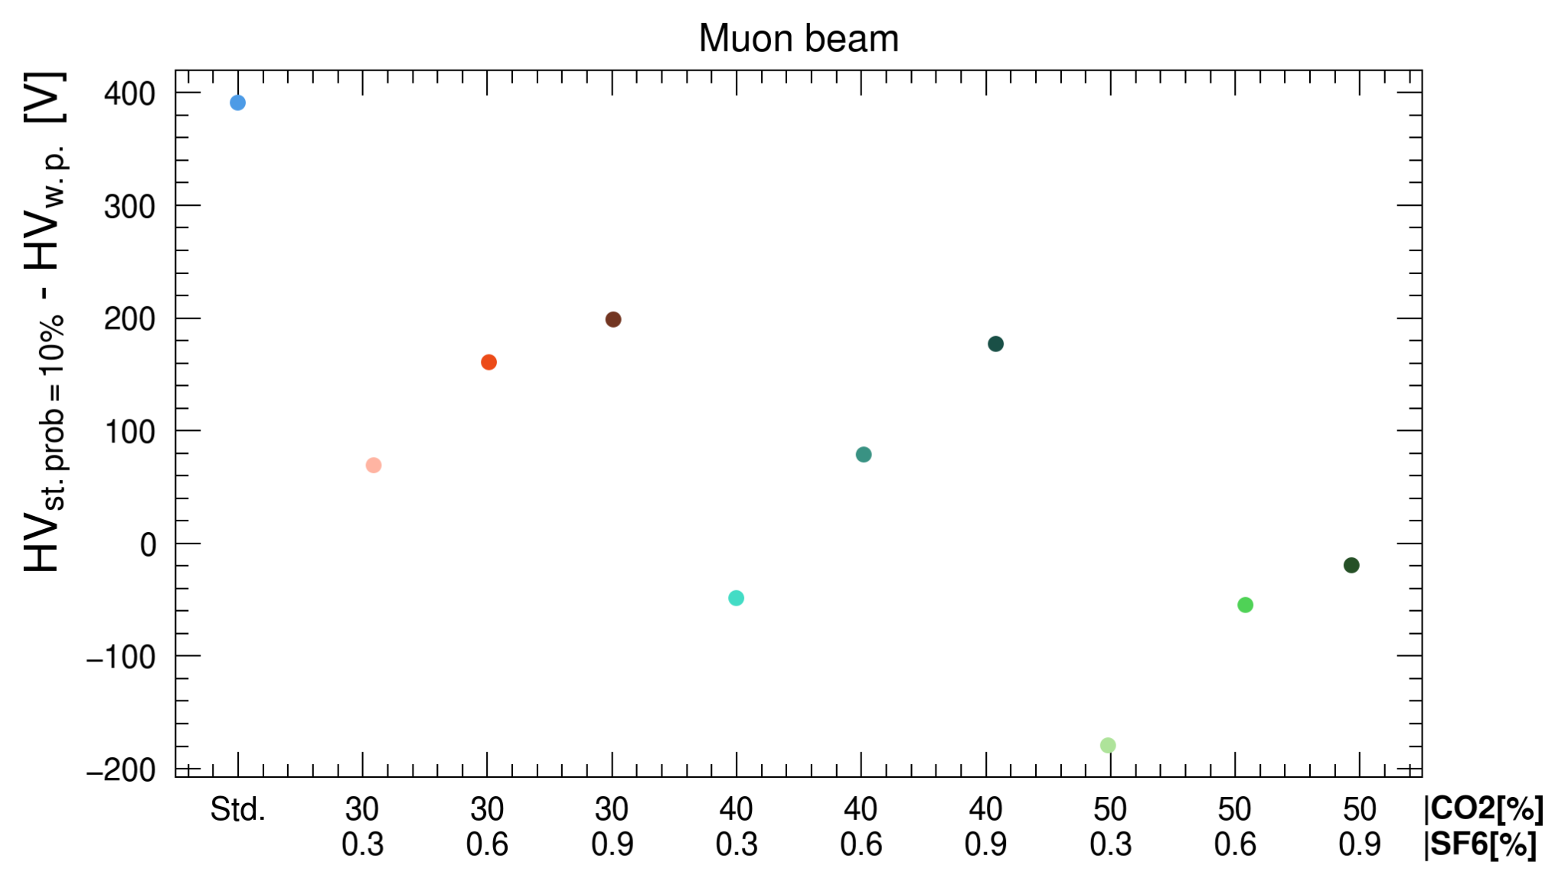
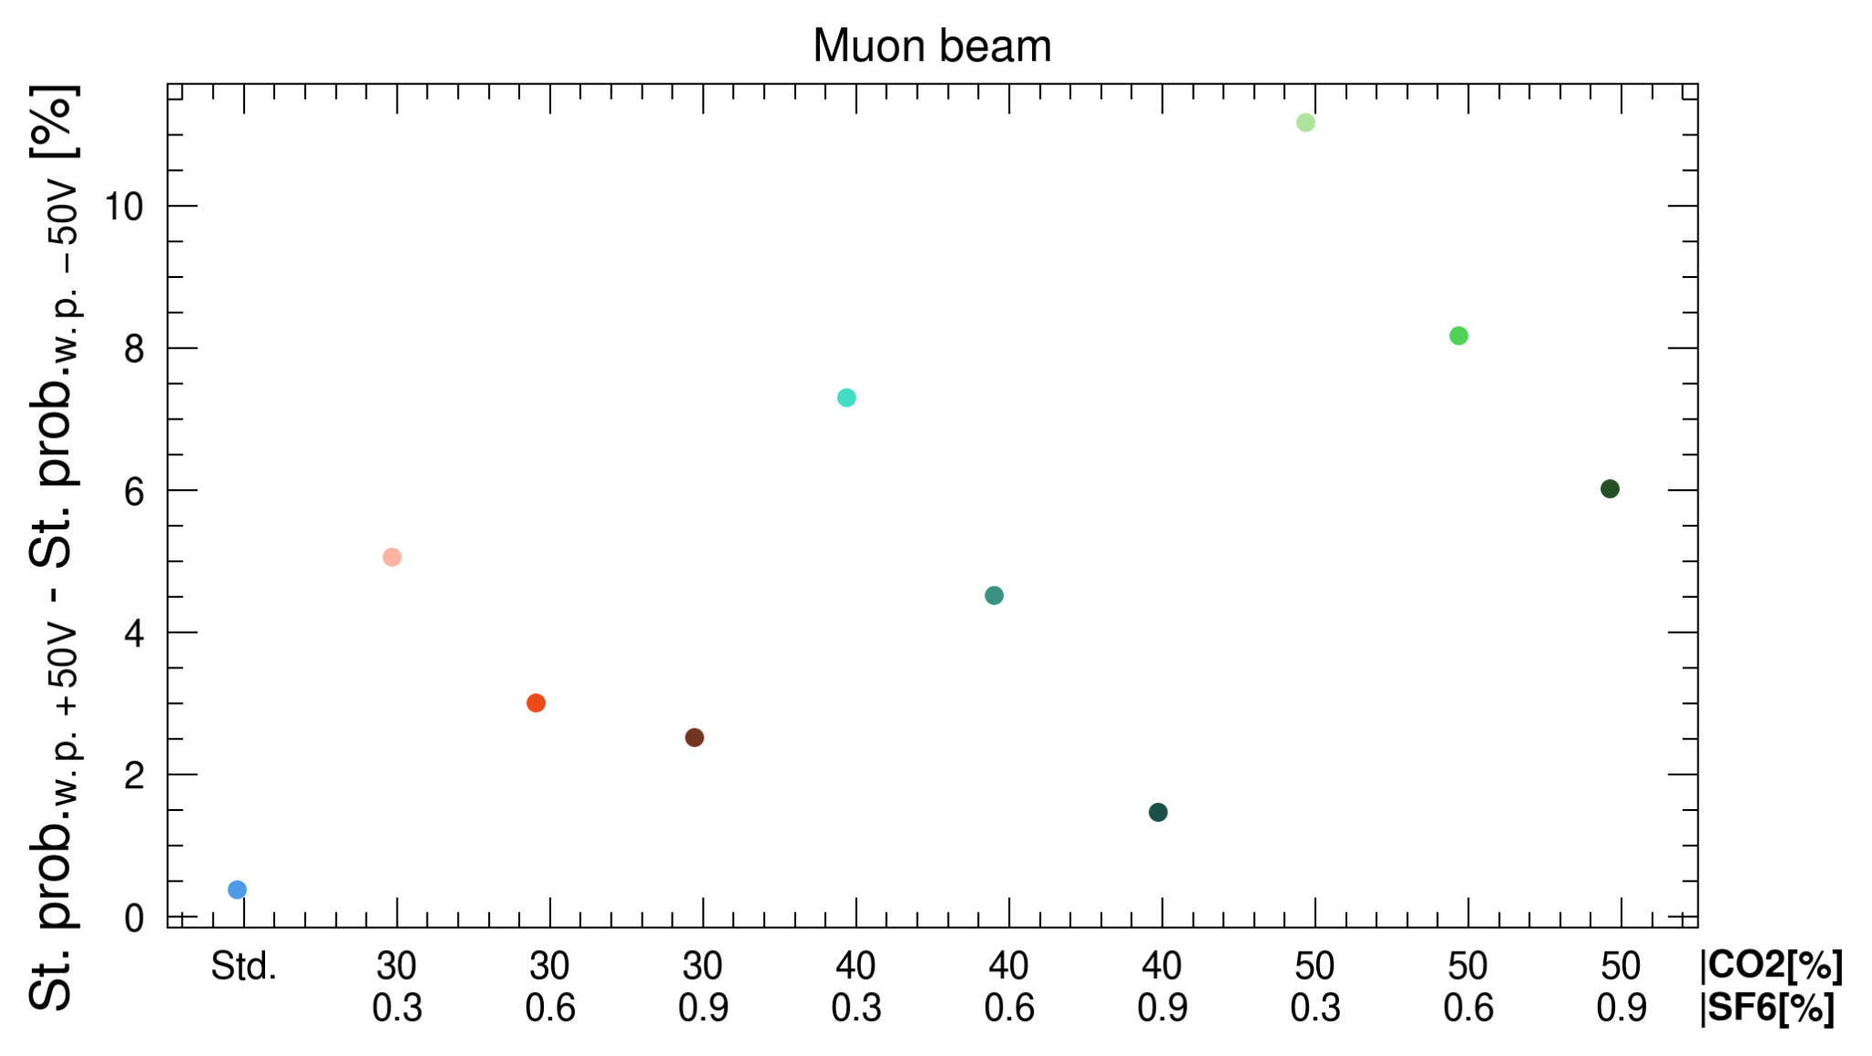
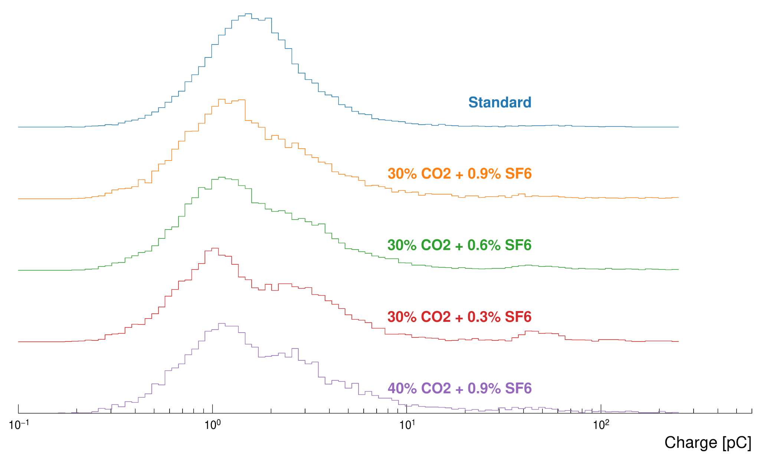
SF6 adjustment in CO2 + R-134a gas mixture
Efficiency - Streamer separation. Muon beam only
Combination (30%, 40%, 50%) CO2 x (0.3%, 0.6%, 0.9%) SF6
Higher efficiency-streamer separation for 30%/40% CO2 + 0.9% SF6 or 30% CO2 + 0.6% SF6 → selected gas mixtures
Lower variation of streamer probability for the same gas mixtures
SF6 increase
CO2 increase
Streamer variability. Muon beam only
Charge distribution @ w.p.
CO2 increase
SF6 increase

Slide 27
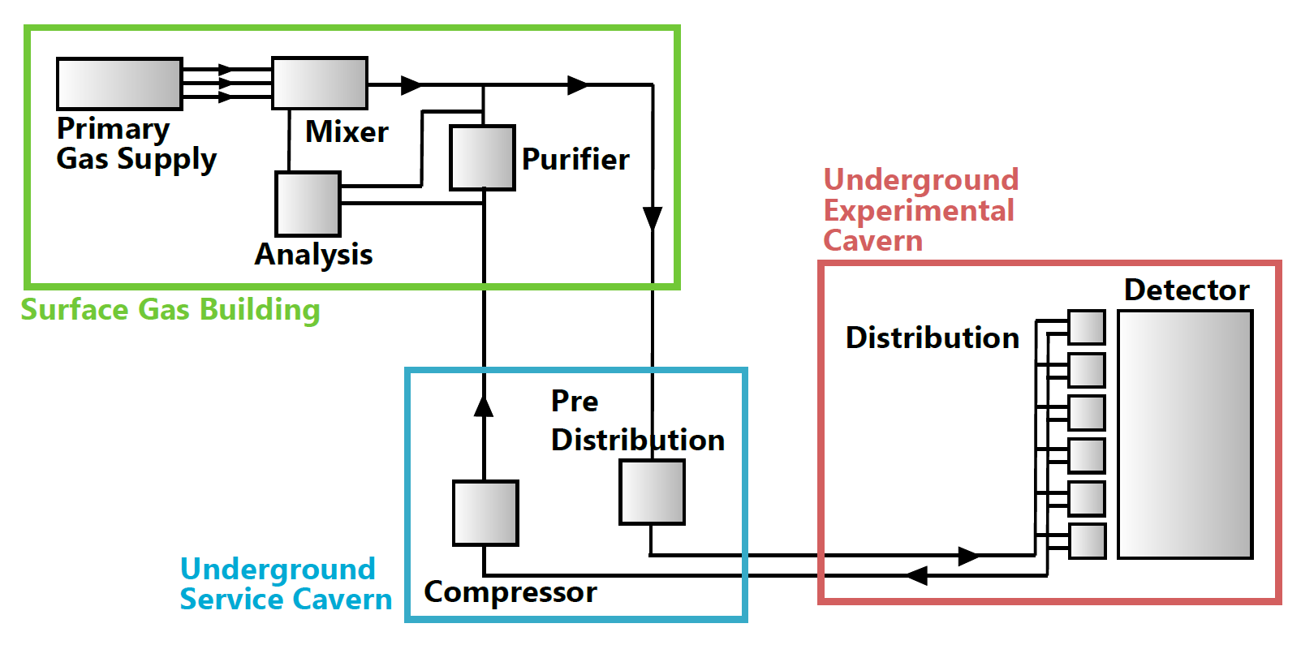
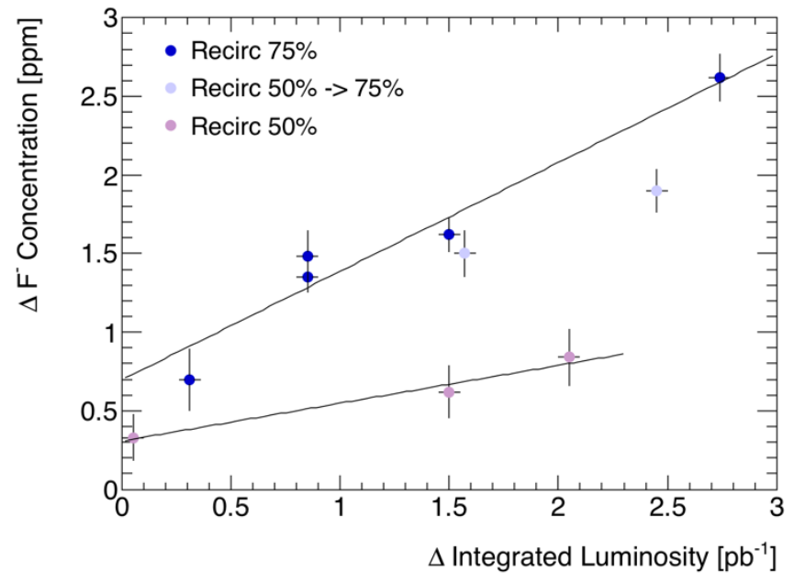
Optimization of gas system technologies
RPCs@LHC are operated with gas recirculation
RPC validated for 90% max. gas recirculation
Higher recirculation fractions leads to accumulation of impurities
Optimization of gas systems
Finer granularity in gas distribution racks ⇒ ATLAS RPC, LS2
Control valves for pressure control ⇒ CMS RPC, LS2
Gas system modifications for 4 component gas mixtures ⇒ ATLAS RPC, Run 3
Recuperate remaining 10% of recirculated gas ⇒ CMS RPC, Run 3
ALICE MID, Run 2 ISE measurement

Slide 28
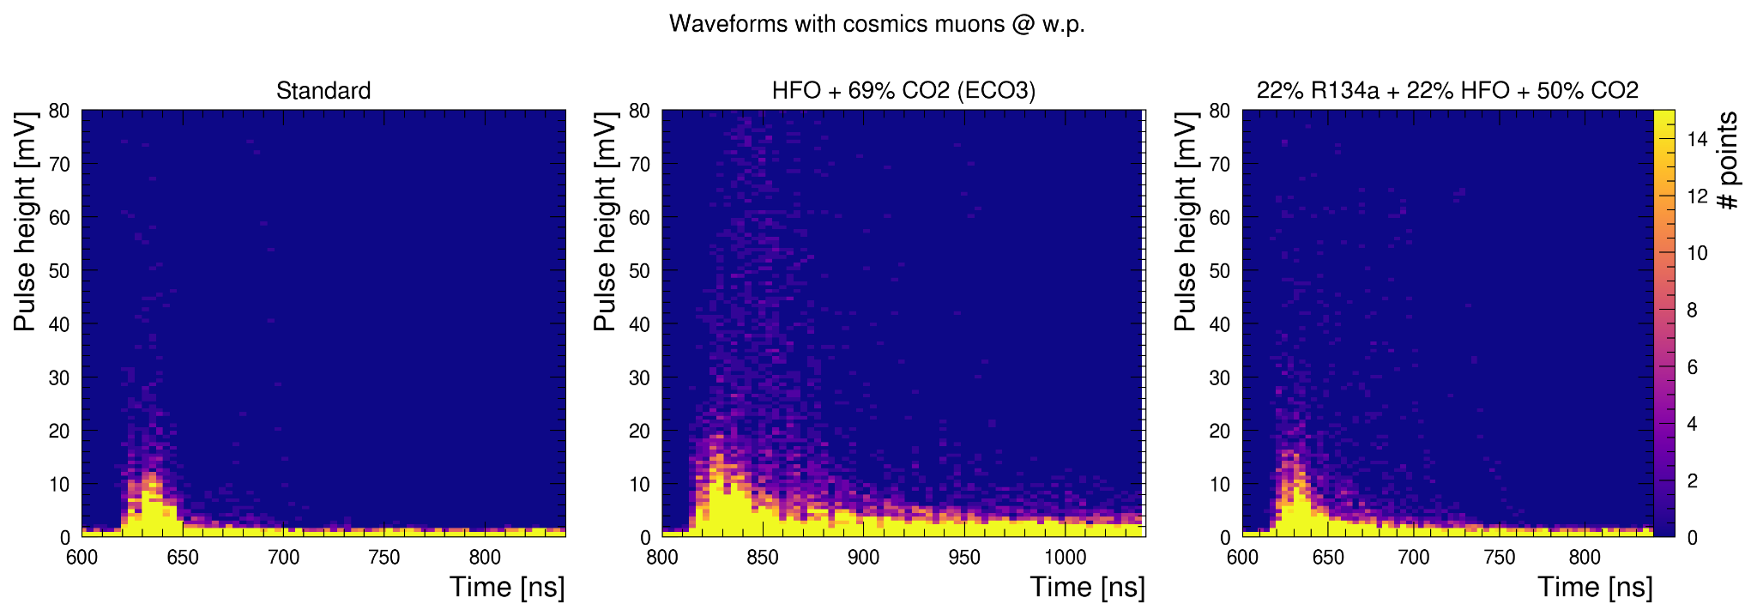
Waveforms of Std vs. HFO vs. HFO + R134a gas mixtures
HFO only → higher charge content:
bigger and longer signals
HFO + R-134a only: lower charge content and faster signals decay times

Slide 29
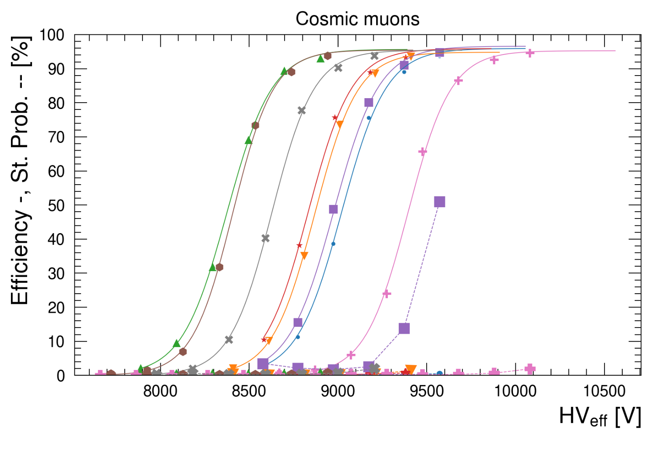
Reduction of R-134a: addition of non-fluorinated gas
Reduction of R-134a in the standard gas mixture by addition of a 4th, non-fluorinated gas
O2: good performance but highly reactive → lower flammability limit, higher currents due to oxidation reactions
Ne: good performance but no availability on the market
CO2: good performance → selected as main candidate for GIF++ tests
N2: high streamer contamination at low concentrations
He: good performance but problematic for PMTs in LHC caverns
N2O: discrete performance but increased working point of ~ 300 V
Ar: slightly high streamer probability

