Slide 1
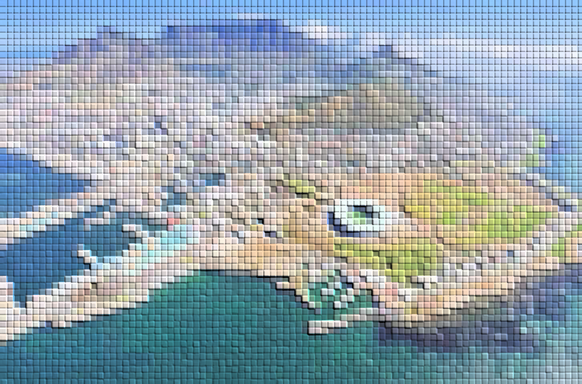
Significant performance recovery of SiPMs irradiation damage with in-situ current annealing
Xilei Sun
IHEP
Cape Town, 07/09 2023

Slide 2
Contents
Motivation
Irradiation test
In-situ current annealing
Performance test
Summary

Slide 3
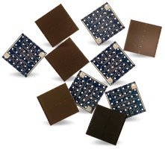
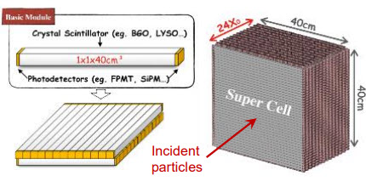
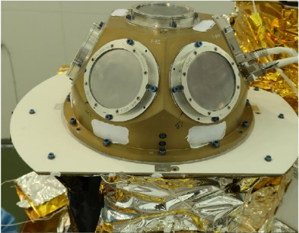
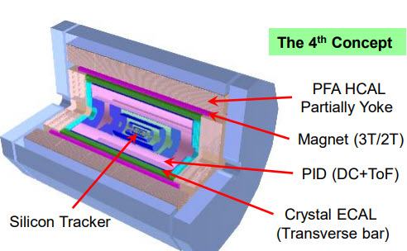
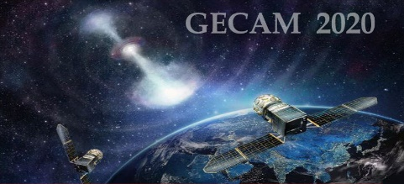
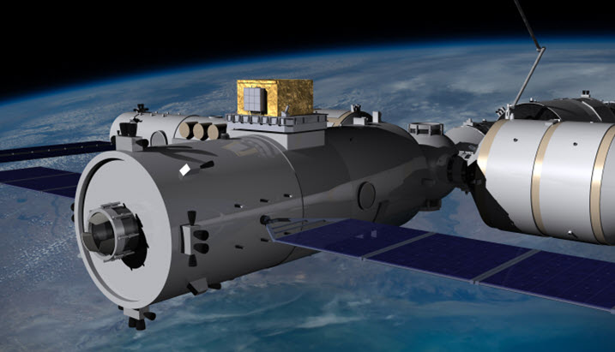
Motivation
SiPM-based detectors
Pros:
High Photon Detection Efficiency (PDE)
Fast Timing
Electromagnetic Field Insensitivity
High Voltage free
Compact Size
Array Configurations
Solid-State Robustness
Cons:
Dark Count
Radiation damage effects
High Granularity Calorimeter
Space particle detection

Slide 4
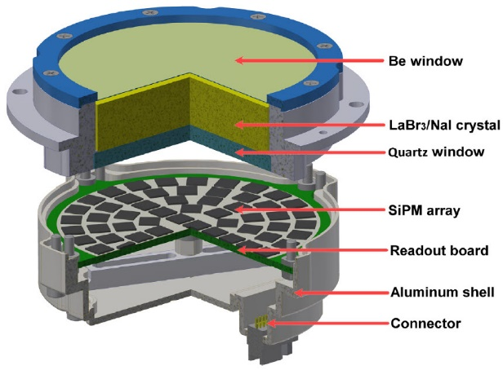
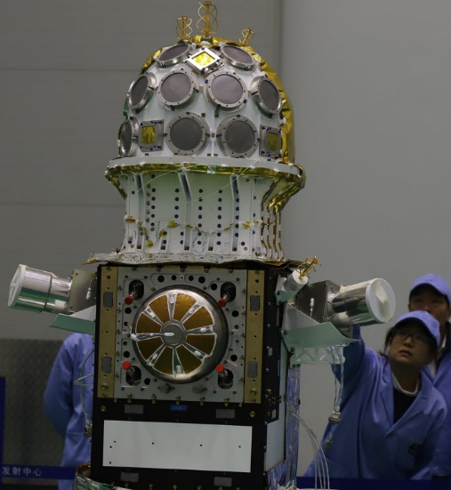
Compact Detectors for Microsatellite
Notes:
Compact detector ideal for microsatellite

Slide 5
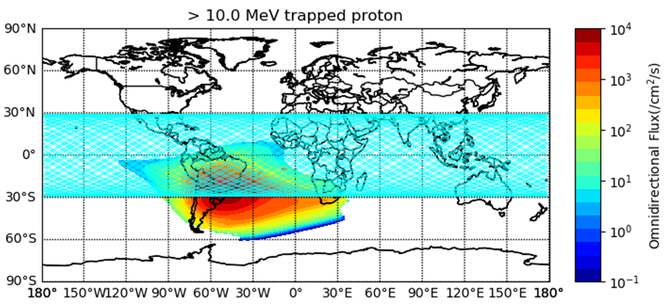
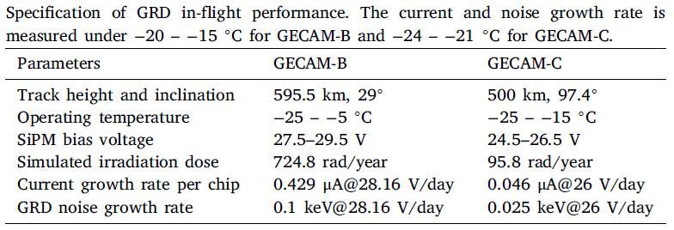
On-orbit Irradiation Damage
Nuclear Inst. and Methods in Physics Research, A 1056 (2023) 168586

Slide 6
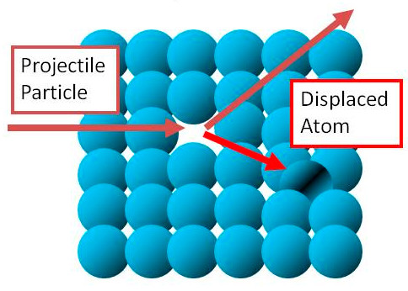
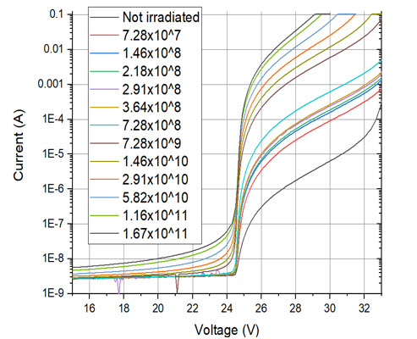
Types and Effects of Radiation Damage
Types:
lattice defects
Displacement Damage
Ionization Damage
Effects :
Picture from the Internet
Increased Dark Current
Decreased PDE and Gain
Deteriorating Energy Resolution
Raised Detection Threshold

Slide 7
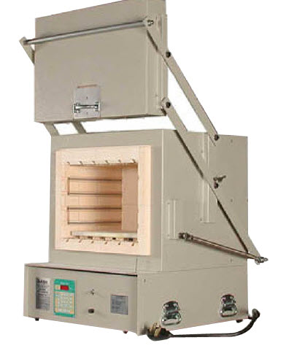
Strategies to combat radiation damage
Radiation-Hardened Design
Protective Shielding
Operational Techniques
Calibration
Annealing
off-line annealing
In-situ Current Annealing
Picture from the Internet

Slide 8
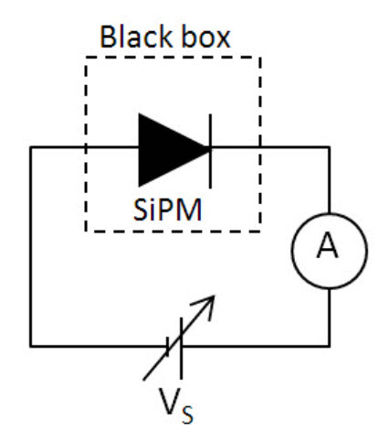
In-situ Current Annealing
No disassembly required
No External Heating Required
Passing a current through the SiPMs
Localized heating
Suitable for space applications and collider applications
T. Tsang et al 2016 JINST 11 P12002
M. Cordelli et al 2021 JINST 16 T12012
Picture from the Internet

Slide 9
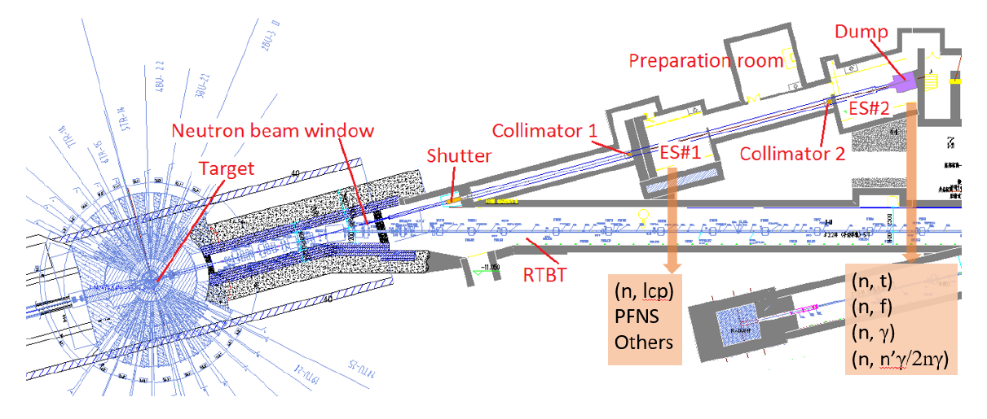
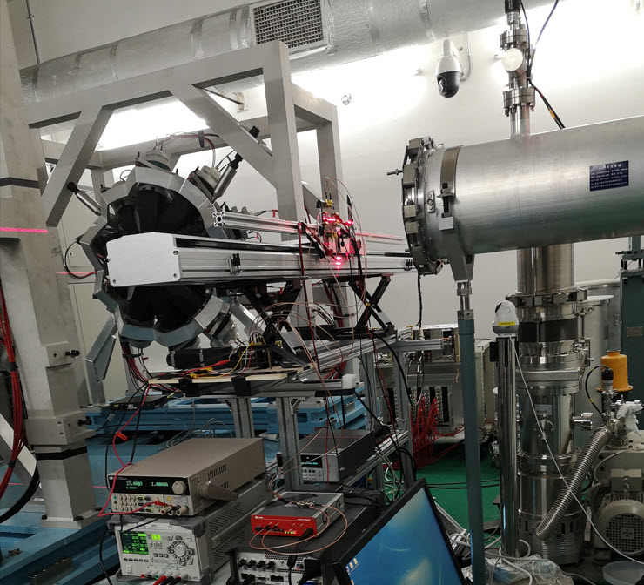
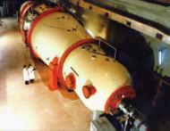
Experimental device - Irradiation Beam
Proton beam at China Institute of Atomic Energy (CIAE)
with 5∼10 × 10⁷ counts/cm²/s
Neutron beam at China Spallation Neutron Source (CSNS)
6.9 × 10⁶ counts/cm²/s

Slide 10
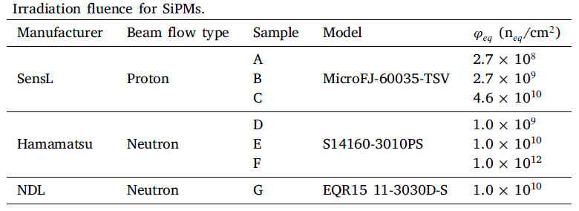
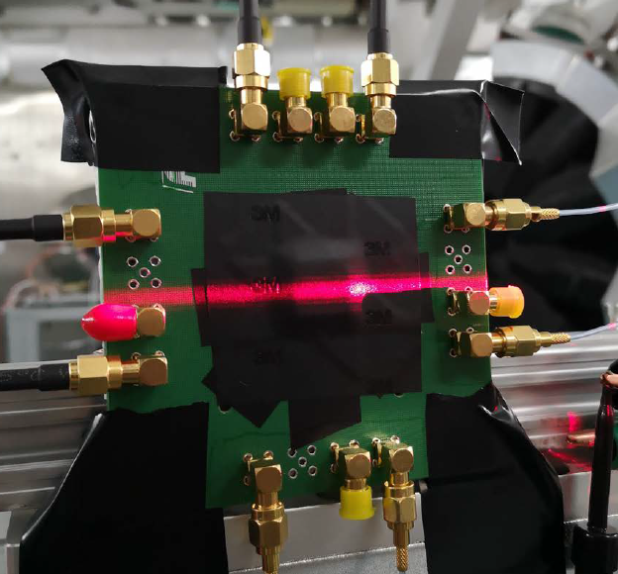
Experimental device - SiPMs
Sensl MicroFJ-60035-TSV
Hamamatsu S14160-3010PS
NDL EQR15 11-3030D-S

Slide 11
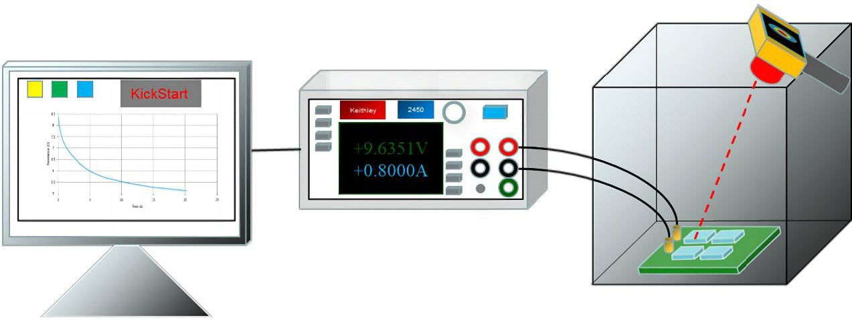
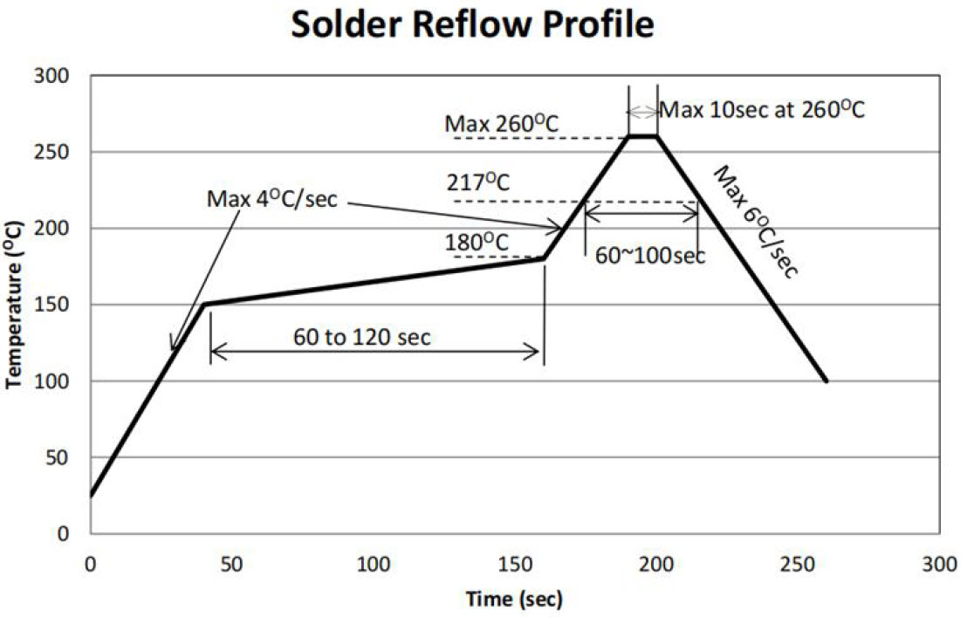
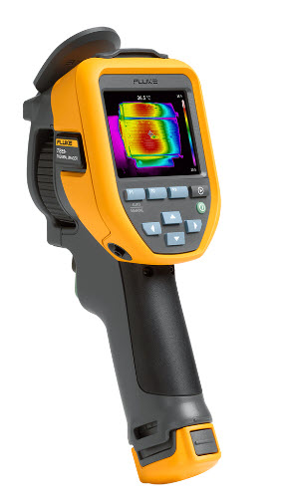
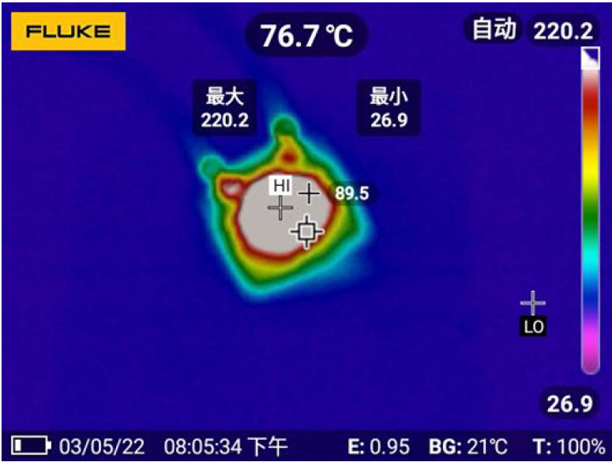
Experimental device – Annealing
Current source Keithley 2450
Thermal Camera Fluke TiS55+
Maximum T<260 ℃

Slide 12
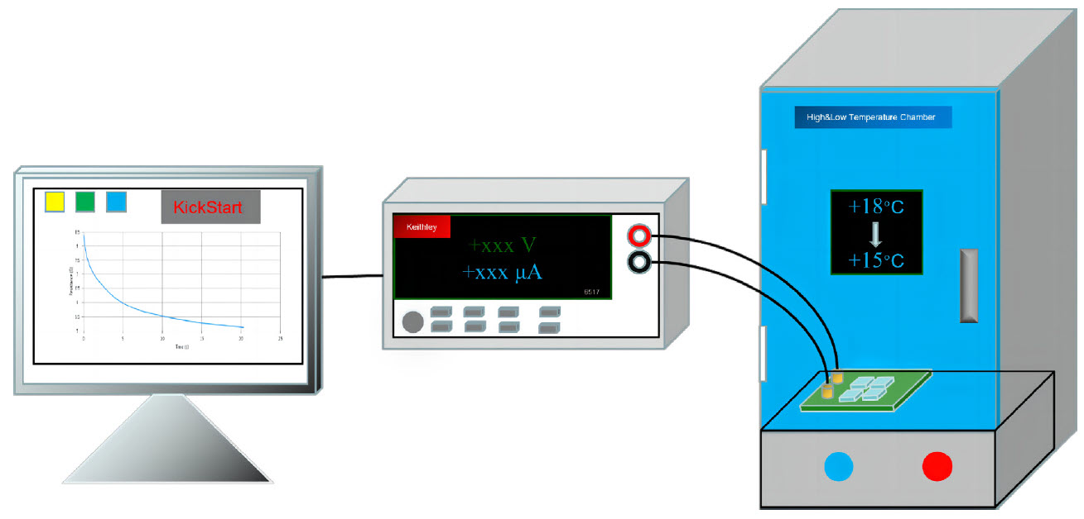
Experimental device – Performance test
Pico ammeter Keithley 6517
Cryogenic bins
LaBr3 scintillator crystal
Cs137 Excitation source
Data acquisition device 40 M/s

Slide 13
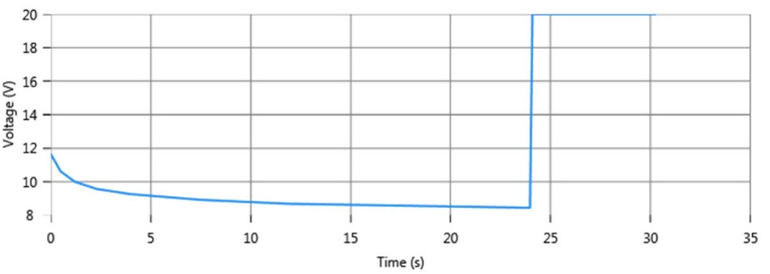
Results- Temperature vs Current and Time
(℃)
0.9A
I
0.8A
0.7A
0.6A
0.5A
(s)
MicroFJ-60035-TSV

Slide 14
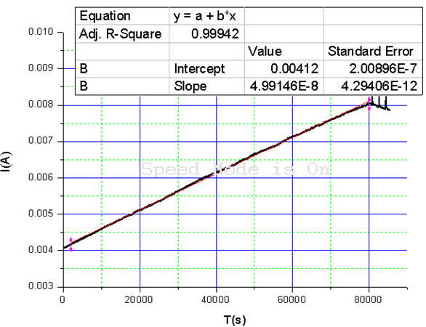
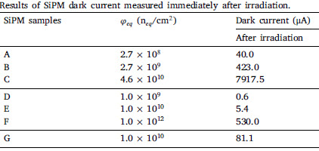
Results- Dark Current vs Radiation
Before
2 μA
(860)
0.03 μA
(180)
0.2 μA
(405)

Slide 15
Results- Dark current vs Annealing
2.7 × 10⁸ n𝑒𝑞/cm²
2.7 × 10⁹ n𝑒𝑞/cm²
4.6 × 10¹⁰ n𝑒𝑞/cm²
14%
10%
8%
MicroFJ-60035-TSV
MicroFJ-60035-TSV
MicroFJ-60035-TSV

Slide 16
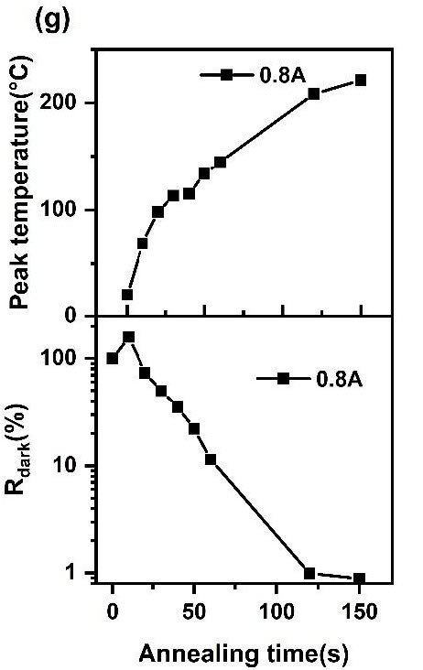
Results- Dark Current vs Annealing
1.0 × 10⁹ n_{𝑒𝑞}/cm²
1.0 × 10¹⁰ n_{𝑒𝑞}/cm²
1.0 × 10¹² n_{𝑒𝑞}/cm²
1.0 × 10¹⁰ n_{𝑒𝑞}/cm²
6%
1%
3%
0.9%
S14160-3010PS
S14160-3010PS
S14160-3010PS
EQR15 3030D SiPM

Slide 17
Results- Dark Current vs Radiation and Annealing
Neutron Flux(n_{𝑒𝑞}/cm²)
A: 2.7 × 10⁸
B: 2.7 × 10⁹
C: 4.6 × 10¹⁰
D: 1.0 × 10⁹
E: 1.0 × 10¹⁰
F: 1.0 × 10¹²
G:1.0 × 10¹⁰

Slide 18
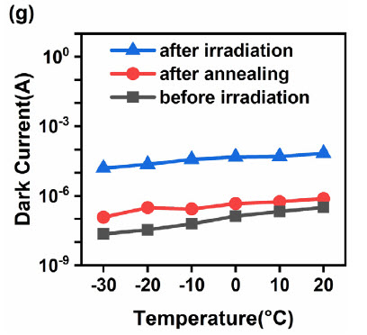
Performance- Dark Current vs Temperature
Neutron Flux(n_{𝑒𝑞}/cm²)
A: 2.7 × 10⁸
B: 2.7 × 10⁹
C: 4.6 × 10¹⁰
D: 1.0 × 10⁹
E: 1.0 × 10¹⁰
F: 1.0 × 10¹²
G:1.0 × 10¹⁰

Slide 19
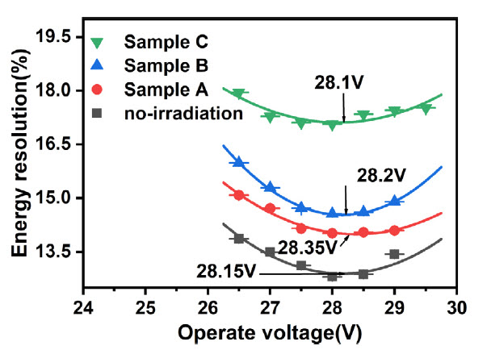
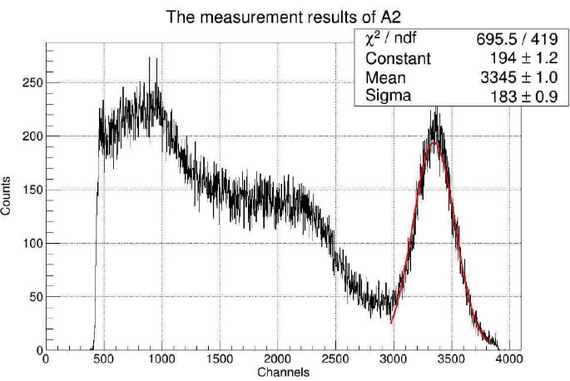
Performance- Energy Resolution vs Temperature

Slide 20
Performance- ADC vs Temperature
Fixed the operation voltage to 28.0 V

Slide 21
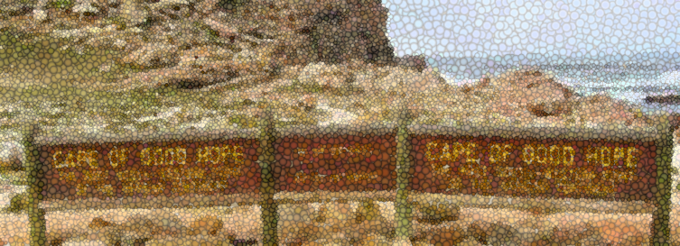
Summary
Radiation damage effects is a major limitation for SiPMs
In-situ annealing with short time can significantly restore performance partially
Optional technology for Space and Collider applications
Nuclear Inst. and Methods in Physics Research, A 1053 (2023) 168381

