Slide 1
A square PMT module with 256 channels of <100 ps timing accuracy
James Milnes
4th September 2023
Technology & Instrumentation in Particle Physics (TIPP2023)
Cape Town, South Africa

Slide 2
Photek Photomultiplier Tubes
AuraTek Photon Counting System (PCS)
PCS Readout with a Square PMT
Summary

Slide 3
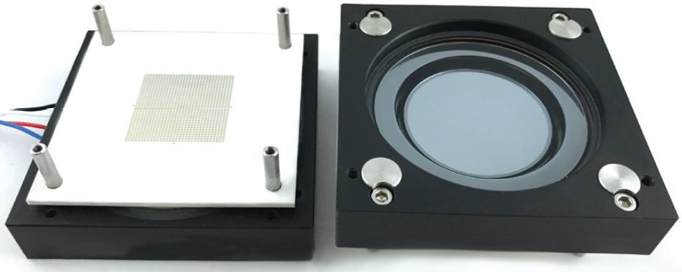
Photek PMTs - History
Microchannel Plate Photomultiplier Tubes
Photek have manufactured single channel MCP-PMTs since it began in 1991
10 mm to 40 mm diameter working areas
Used in both analogue and counting modes
Around 2010 developed first AuraTek multichannel PMT using multi-layer anode with pads to achieve high channel density
Standard unit MAPMT228 has 26.5 × 26.5 mm working area and an anode array of 32 × 32
Targeted for counting mode
2012 to 2017 saw the square PMT development for the TORCH project
Standard unit MAPMT253 has 53 × 53 mm working area and an anode array of 64 × 64
Targeted for counting mode

Slide 4
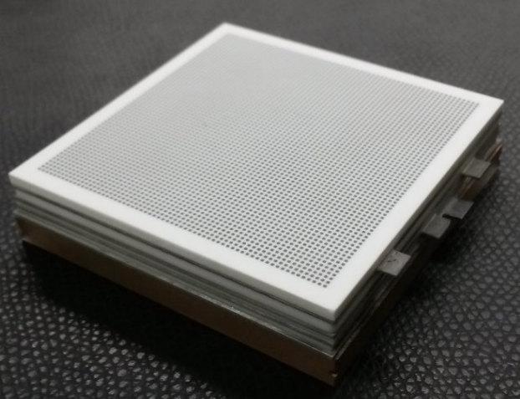
AuraTek Square: MAPMT253
Features
A 64×64 anode square MCP-PMT
Derived from novel PMT development with the TORCH group
Unique build provides short front (1.5 – 2 mm) and rear (3 mm) gaps
Results from the 15 µm pore MCP version previously published*
This study looks at MAPMT253 with 6 µm pore MCPs
*See Milnes et al, JINST 15 C02036 (2020)
Notes:
The device we are going to talk about today is the MAPMT253. It was derived from the TORCH project, with the PMT being part of an R&D effort to develop a new Particle Identification Detector proposed for the upgrade of the LHCb facility at CERN, we will discuss the TORCH anode concept later. We believe this device has a unique build which allows for tight gaps on either side of the MCP stack when compared to similar available devices. Results from the original device that used 15 um pore MCPs is available at the reference shown here, while this talk is looking at the new variant that uses MCPs with 6 um pores.

Slide 5
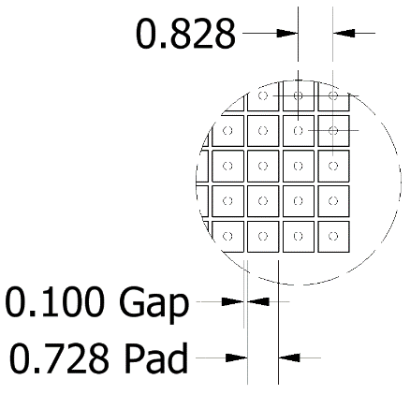
MAPMT253 Geometrical / Mechanical
Mechanical Properties | MAPMT253
Input Window Material | Fused Silica or Sapphire
Input Window Thickness (mm) | 5.0
Active area (mm) | 53×53
Photocathode – MCP Gap (mm) | 1.6
MCP – Anode Gap (mm) | 3.0
MCP Pore Diameter (μm) | 6 or 15
Bare Tube Dimensions (mm) | 59×59×13
Housed Tube Dimensions (mm) | 62×60×13
Native Anode Pattern | 64×64
Native Anode Pitch (mm) | 0.828
Notes:
This table shows the geometric details of the MAPMT253. The active area is 53 x 53 mm, which is generally referred to in the industry as a 2 inch square device. You can see the tight photocathode to MCP and MCP to anode gaps I mentioned earlier. The external physical dimensions of the 6 um device are the same as those for the 15 um version. On the right you can see the dimensions of the internal native anode pads, although I should say that for all of the results I am presenting today these were ganged together to either form an 8 x 8 or a 16 x 16 anode array.

Slide 6
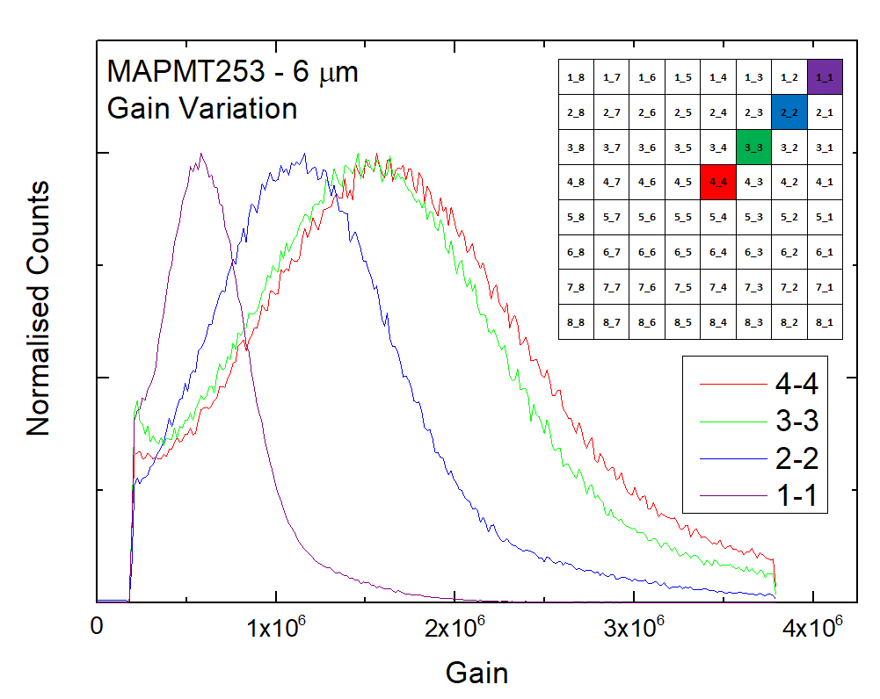
MAPMT253 – 6 µm
Electron Gain Uniformity
Test device configured with 8×8 readout pattern
These results show Peak / Valley ~ 3 and max/min ratio of 2.8
More than seen in 15 µm pore version (~1.5), possibly due to more flexible MCPs
Notes:
The first analysis looks at electron gain uniformity. This curve shows the gain distribution for single photons for different anode locations on an 8 x 8 array. As we move from the centre to one of the corner anodes you can see the gain decreasing, with a max / min ratio of about 2.8. This is larger than previously observed with 15 um pore devices that had a ratio of 1.5 to 2.0, this is possibly due to the increased flexibility of the 6 um pore MCPs allowing for more gap variation between the two MCPs in the chevron pair.

Slide 7
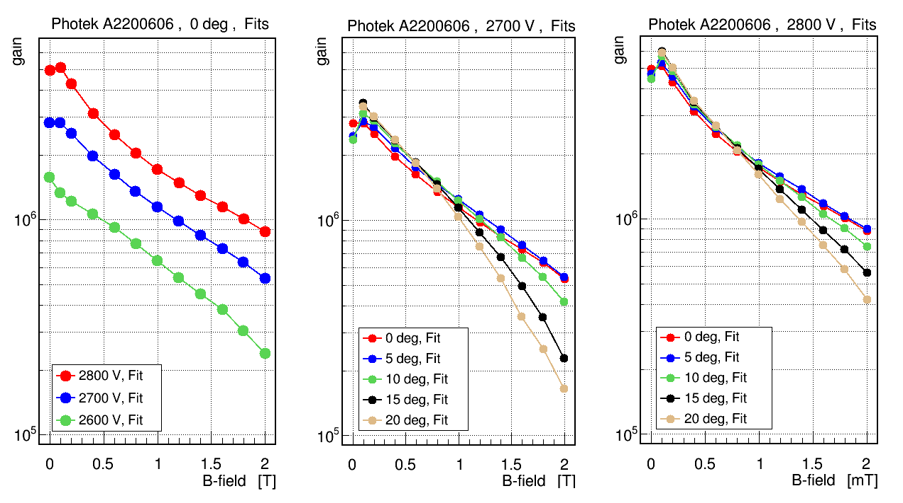
MAPMT253 – 6 µm
Magnetic Field Effects
The magnetic field impact on electron gain in the region 0 to 1 T appears similar to that observed in 10 and 15 µm pore ALD coated MCP devices, a factor of ~ 3 drop*
However, in the region 0 to 2 T the 6 µm pore devices show a considerable advantage, a factor of ~ 6 loss compared to > 15 for 10 µm
*See Lehmann et al, NIM A 952 (2020) 161821 & Milnes et al, JINST 15 C02036 (2020)
Magnetic field experiments by Erlangen team at the dipole magnet at FZ Jülich: Albert Lehmann, Merlin Böhm, Steffen Krauss and Daniel Miehling
Notes:
The other significant improvement anticipated with smaller pores is the ability to maintain the electron gain of the MCP stack in strong magnetic fields. This data was produced by a team from the University of Erlangen. Surprisingly the gain drop observed from 0 to 1 Tesla is similar to that previously published for equivalent devices with 10 and 15 um pores, with a factor of about 3 in the reduction of gain. However, when comparing the gain between 0 and 2 Tesla the 6 um pores show a noticeable improvement, with a loss factor of just 6 when compared to around 15 in other devices. There is published data showing that an ALD coating can increase the magnetic field susceptibility, and for the record all of these devices used coated MCPs, so it is possible an uncoated unit would show greater resilience to the magnetic field.

Slide 8
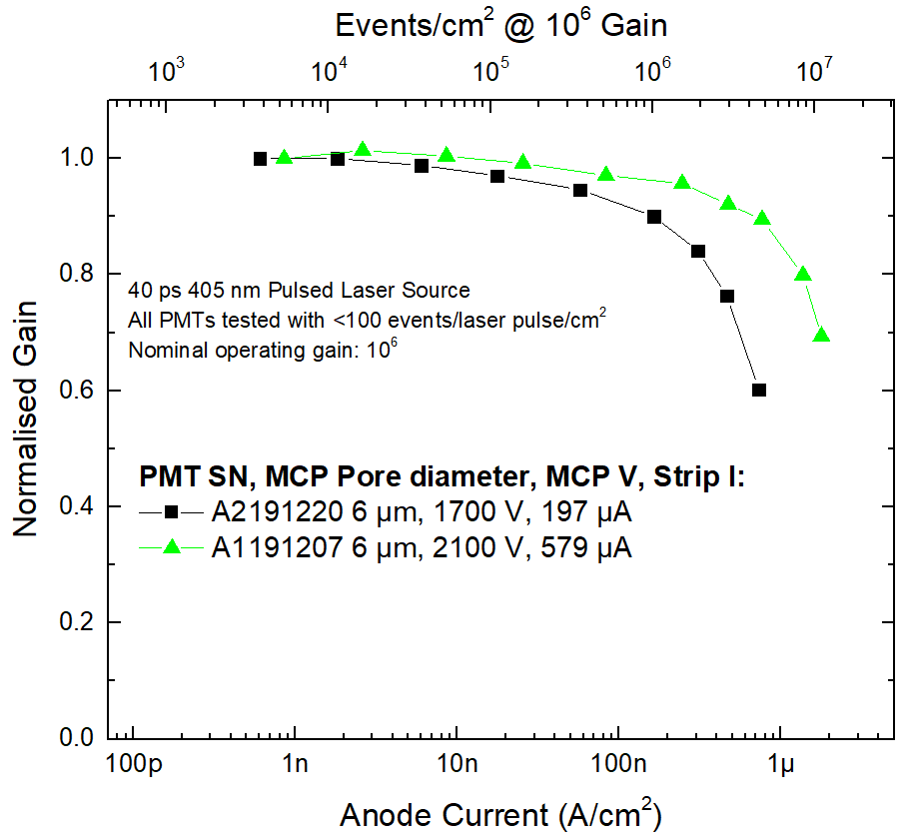
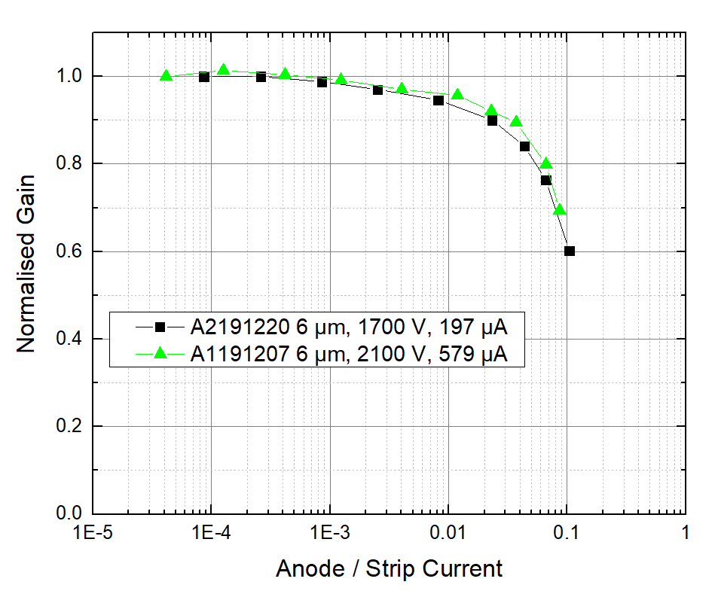
MAPMT253 – 6 µm
Rate Capability
Flood fill illumination with 405 nm 40 ps laser
Both PMTs operated at ~ 10⁶ gain
Full area illuminated
All anodes connected and total d.c. anode current measured
Ratio of total anode current to strip current is critical
Notes:
In most applications of these devices a very high count rate is anticipated. In order to assess the count rate capability we set up an experiment which flooded the full active area with a uniform illumination. All anodes were connected together and the global anode current was measured on a single picoammeter. To have a controlled increase in global anode current we used a short pulse laser and increased the repetition rate to drive the PMTs into saturation, but to avoid local saturation effects we ensured that the number of events per second per square cm was always less than 100. The relative drop in gain was referenced to the current measured at low count rates. The graph on the left shows two devices with different MCP strip currents, but when we take the ratio of the anode and the strip current, as shown on the right, the two curves almost overlap. This illustrates that this ratio is key, and that pushing the strip current is the main driver in the handling of high count rates. The device with the higher strip current was able to produce the equivalent of 10 million counts per second per square cm with a gain drop of only 20%, which represents a global rate of nearly 300 million counts per second.

Slide 9
MAPMT253
Photocathode Uniformity
The cathode uniformity was analysed by spot measurements using the Photek photometer
Photometer spot size ø ~ 11 mm
53 mm
11 mm
21 mm
53 mm
15 mm
15 mm
Notes:
This graph is taken from the previously published data on 15 um pore devices, but we do not expect any difference between 6 and 15 um units in photocathode sensitivity as they go through the same process chamber. Our photometer at Photek uses a light beam of approximately 1 square cm at defined wavelengths in the spectrum of interest. This fairly crude experiment simply moves that photometer beam to different locations on the photocathode surface, and while we cannot interrogate right up to the edge of the active area, we are satisfied that the values taken are all within the measurement error of the photometer. We will soon be bringing online a photocathode scanner that will allow greater clarity in this type of measurement.

Slide 10
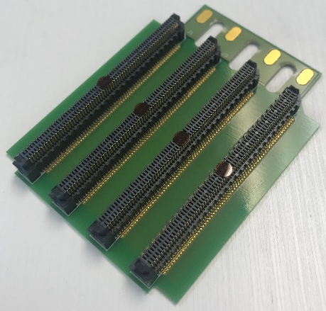
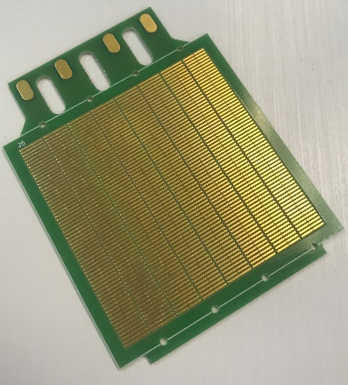
MAPMT253 – 15 µm
Fine Pitch Cross Talk
Test device configured with 8×64 readout pattern (TORCH design)
0.828 mm pitch between channels
Single photon gain peak ~ 1.2×10⁶
Threshold 50% of gain peak
Photek LPG-650 focussed to ~ 150 μm spot
Notes:
Again, this data is taken a 15 um pore PMT, but we do not expect pore size to have a significant impact on this feature. For this experiment we used the PCB designed for the TORCH project which ganged together the native anode pads to form an 8 x 64 array of rectangular anode channels. We then scanned a focussed laser spot through two neighbouring anodes along the fine pitch direction and measured the count rate at each point, with the threshold set to 50% of the peak. While each pad shows a good sharp transition on their edge and a reasonably flat top, there is a surprising amount of overlap between anodes which is as yet unexplained. This may be a measurement artifact or due to the laser spot being of comparable size. However, we are satisfied with the ability to resolve the native anode pitch of 0.828 mm.

Slide 11
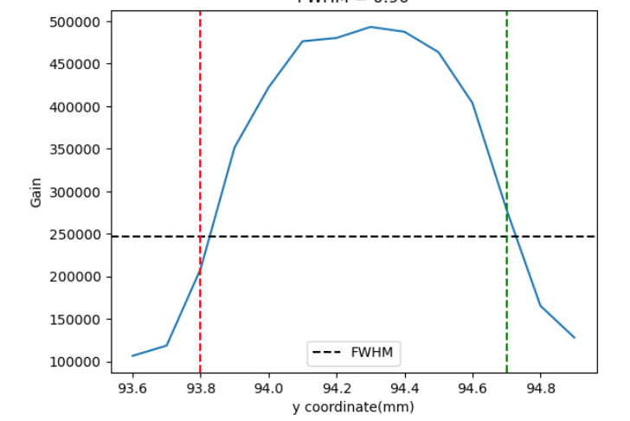
MAPMT253 – 15 µm
Pixel Size
Fine Pitch Cross Talk – Alternative method
0.828 mm
Test device configured with 8×64 readout pattern (TORCH design)
0.828 mm pitch between channels
Single photon gain measured on LeCroy Wavemaster 808Zi-A (8 GHz, 40 GS/s)
Laser spot scanned through single pixel; gain measured at 0.1 mm steps
FWHM ~ 0.9 mm
6.624 mm
Notes:
Again, this data is taken a 15 um pore PMT, but we do not expect pore size to have a significant impact on this feature. For this experiment we used the PCB designed for the TORCH project which ganged together the native anode pads to form an 8 x 64 array of rectangular anode channels. We then scanned a focussed laser spot through two neighbouring anodes along the fine pitch direction and measured the count rate at each point, with the threshold set to 50% of the peak. While each pad shows a good sharp transition on their edge and a reasonably flat top, there is a surprising amount of overlap between anodes which is as yet unexplained. This may be a measurement artifact or due to the laser spot being of comparable size. However, we are satisfied with the ability to resolve the native anode pitch of 0.828 mm.

Slide 12
MAPMT253 – 15 µm
Edge Effects
Perimeter anodes exhibit an inverted signal at a level of 2.5 – 3.0% of the peak pulse amplitude
The amplitude of this edge effect remains 2.5 – 3.0% of the peak signal independent of pulse amplitude
Since the amplitude of the edge effect is inverted it should not create false triggers
For reference, the average signal for a single photon in these measurements had amplitude of 12 mV
Adding a decoupling capacitor to the MCP Output electrode actually made the effect worse!
Added decoupling capacitor
Notes:
One feature that has been reported for square MCP-PMTs is unusual behaviour in anode channels around the perimeter, probably due to the active area being so close to the vacuum wall. It is most likely caused by electrical reflections and the difficulty in maintaining a decent common ground for all channels. To show this effect we stimulated one of the central channels with a multi-photon pulse and observed any pick-up on 3 selected channels, and it is clear that the effect is most pronounced in the corners. However, we believe this is well managed in our device and as the noise is positive in amplitude it is both too small and the wrong polarity to trigger false single photon events. We show on the right that using an external capacitor to decouple the MCP output face, which is believed to be the route through which these signals propagate, actually made the problem worse.

Slide 13

MAPMT253
Detective Quantum Efficiency
Detective Quantum Efficiency: DQE = Photocathode QE × MCP Collection Efficiency (CE)
Traditional MCPs have ~ 60% CE, limited by pore geometry
We have a method that:
  Directly measures the photocathode current
  Scales the input light to photon counting level
  Measures single photon detection rate, including electronic threshold effects
Using the same MCP glass and ALD coating as the MAPMT253, we have measured CE of ~ 90%
CE measured at Erlangen ~ 83% (±10%) Thanks to Albert Lehmann
Notes:
Detective Quantum Efficiency is the true percentage of photons that are detected at the anode of a PMT. It is the product of the quantum efficiency of the photocathode and the collection efficiency, or CE, of the MCP. Traditional MCPs only collect 60 – 70% of the photoelectrons released by the photocathode, and most of the loss is due to the packing fraction of the circular MCP pores arranged in the hexagonal pattern as shown here. The ALD coating added to the MCPs to improve tube lifetime has also been shown to improve the collection efficiency to be around 85 to 90%, through measurements we have made using the same MCP glass and ALD coating as we use in the MAPMT253. The method directly measures the photocurrent in a fixed set-up, the reference light source is then scaled down by a factor of ~ 2000 to single photon level, and we then measure the detected photon rate. We use a silicon cell to accurately measure the ratio of the two light levels. We have also had the CE of an MAPMT253 measured at Erlangen to be 83% with an error of ±10%.

Slide 14
Single Photon Timing Accuracy
MAPMT253 – 6 and 15 µm
200 V from photocathode to MCP input
Gain ~ 2 × 10⁶
1 photon per ~ 20 laser pulses
Photek LPG-405 laser source ~ 40 ps FWHM
LeCroy Wavemaster 808Zi-A (8 GHz, 40 GS/s)
Time stamped at 50% of peak amplitude to correct for amplitude variation
Referenced against laser trigger
PMTs configured with 8×8 readout pattern, single channel analysed
SN A3180815 – 15 µm pore MCPs
SN A2191220 – 6 µm pore MCPs

Slide 15
Single Photon Timing Accuracy
Improved Laser Results
An improved laser measurement on a single channel 10 mm MCP-PMT (PMT210, SN 22171219) showed a significant improvement in timing accuracy
This improvement is reflected in a follow-up measurement on an MAPMT253 with 6 µm pores
PMT210 SN 22171219 – 3 µm pore MCPs
MAPMT253 SN A3200606 – 6 µm pore MCPs

Slide 16
Single Photon Timing Accuracy
Improved Laser Results – Impact of Photocathode to MCP Voltage
MAPMT253 SN A3200606 – 6 µm pore MCPs

Slide 17
Photek Photomultiplier Tubes
AuraTek Photon Counting System (PCS)
PCS Readout with a Square PMT
Summary

Slide 18
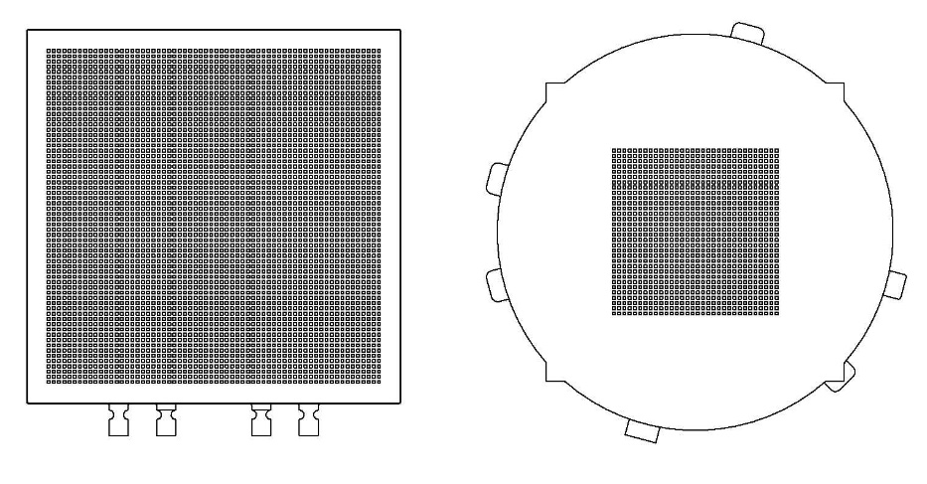
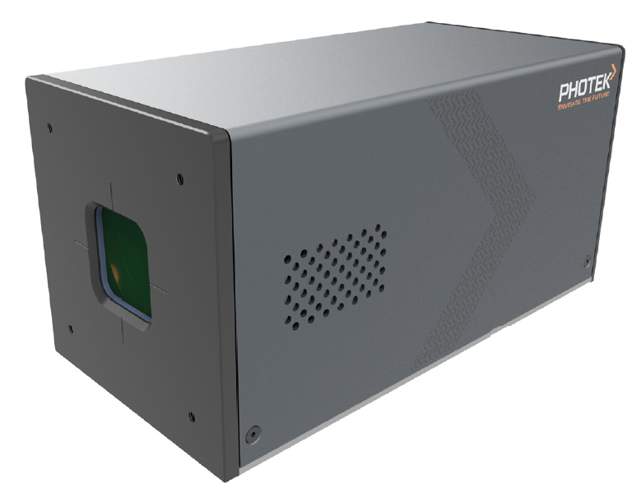
AuraTek PCS
TOFPET2 Integration with multi-anode MCP-PMT
TOFPET2d is an ASIC with 64 channels of integrated pre-amplifier, discriminator and time to digital convertor from PETsys Electronics
  Each channel can timestamp signals with a 30 ps TDC bin
  Maximum rate of 480 kHz per channel
We have developed the AuraTek PCS; a 256 channel photon counting system incorporating an MAPMT228 and 4x TOFPET2d ASICs
The MAPMT228 is a sibling device to the MAPMT253; round format, 32x32 anode pattern, tighter photocathode to MCP gap ~ 0.2 mm
For this device we gang anodes to reduce the 32x32 pattern to 16x16
AuraTek PCS now commercially available
MAPMT253
MAPMT228
Notes:
As the name suggests the TOFPET ASIC from PETsys electronics is designed for time-of-flight PET using silicon PMs. We have assessed various versions of the TOFPET ASIC with multi-anode MCP-PMTs and the TOFPET2d version has produced some very good results. The PCS-256 system that we have put together uses 4 ASICs to produce 256 channels, and this is used with an MAPMT228, which is the circular sibling PMT of the square MAPMT253, and has a native 32x32 anode pattern ganged down to 16x16, you can see the relative dimensions of the PMTs here.

Slide 19
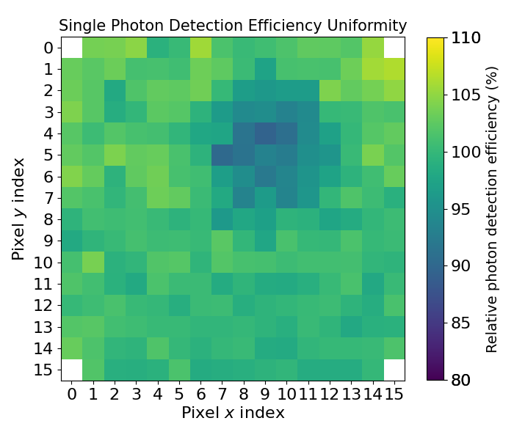
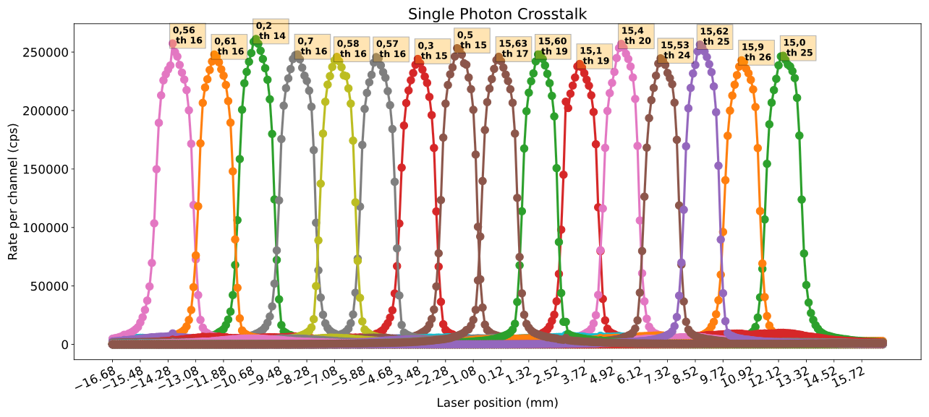
AuraTek PCS
Response Uniformity and Crosstalk
Each channel has an independent threshold and zero level which is adjusted to normalise the response
A linear scan of a 0.2 mm laser spot attenuated to single photon level shows the inter-channel crosstalk
Notes:
One of the issues with the earlier TOFPET1 ASIC was poor consistency in the counting efficiency between channels, partly caused by the control of the input threshold being on too coarse a scale. This is much improved in the 2d version as shown here, the image on the left is from a uniform flood fill of the active area, and the 1-D scan on the right is the count rate response when a short pulse laser, operating at single photon levels, is stepped through each channel in turn. Having a finer control on the threshold allows us to normalise the counting efficiency of each channel.

Slide 20
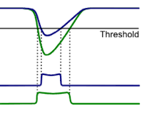
AuraTek PCS
Timing Calibration
The timing information for each photon event is logged by the TDC in each channel
The raw timing data is degraded by the amplitude walk caused by the gain variation in the single photon response of MCPs
Using the Time-over-Threshold technique restores the timing information
  The amplitude variation is captured by the pulse width
  This enables a correction to be implemented
Accumulated timing data is fitted to a double Gaussian by an automated function
The shift in the peak of the first fitted pulse is then fitted to a quadratic to apply the correction
Notes:
The TOFPET ASIC has an in-built TDC that logs the arrival time and also the pulse width for each event. MCPs are known to have a wide gain variation for single photons, and this has the effect of degrading the timing accuracy by adding jitter to the leading edge as shown here. By using the time-over-threshold technique we can capture the gain variation in the pulse width and apply a correcting factor to restore the timing accuracy. The upper graph shows the arrival time vs pulse width, and the 3D data shows a secondary artifact caused by a reflection in our dark box, but that is obscured when the raw data is collapsed into a 2D histogram as shown on the lower graph. By applying a polynomial correction factor we can significantly improve the timing accuracy and properly resolve the artifact, the fitted gaussian shown here has a sigma of 56 ps.

Slide 21
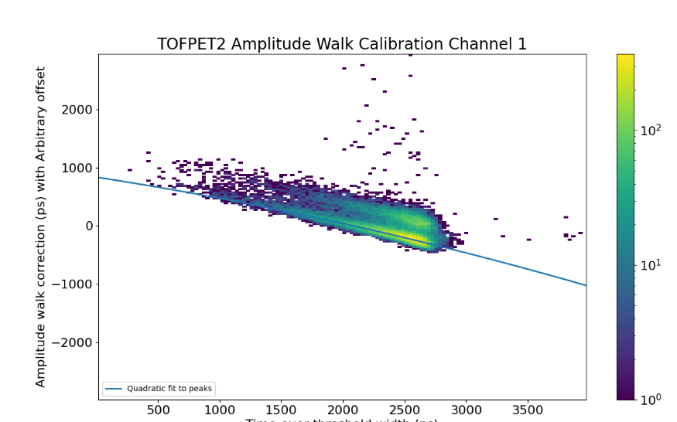
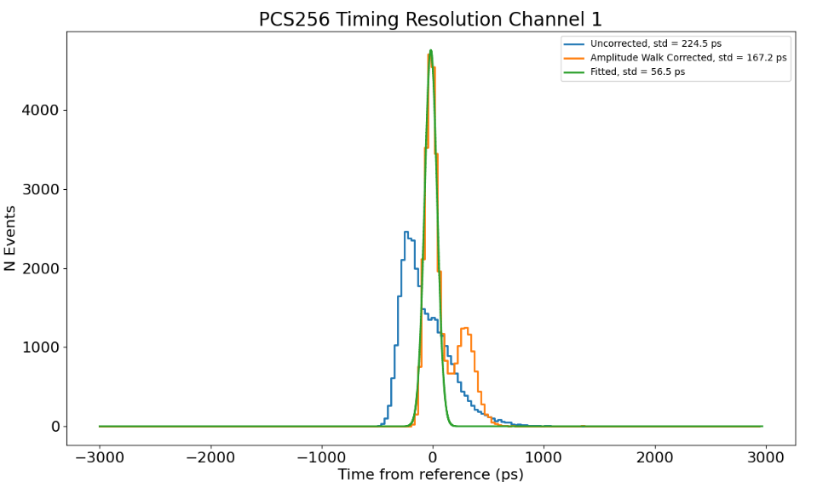
AuraTek PCS
Timing Calibration
Uncorrected rms = 224.5 ps
Corrected rms = 167.2 ps
Fitted rms = 56.5 ps
Arrival Time with arbitrary offset (ps)
Time over threshold width (ps)
Notes:
The TOFPET ASIC has an in-built TDC that logs the arrival time and also the pulse width for each event. MCPs are known to have a wide gain variation for single photons, and this has the effect of degrading the timing accuracy by adding jitter to the leading edge as shown here. By using the time-over-threshold technique we can capture the gain variation in the pulse width and apply a correcting factor to restore the timing accuracy. The upper graph shows the arrival time vs pulse width, and the 3D data shows a secondary artifact caused by a reflection in our dark box, but that is obscured when the raw data is collapsed into a 2D histogram as shown on the lower graph. By applying a polynomial correction factor we can significantly improve the timing accuracy and properly resolve the artifact, the fitted gaussian shown here has a sigma of 56 ps.

Slide 22
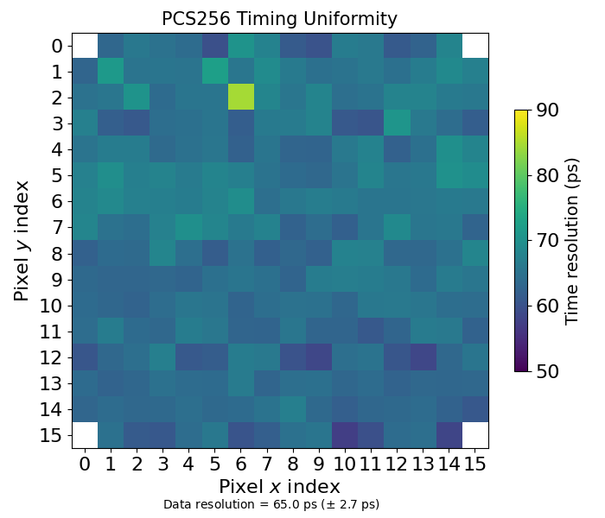
PCS-256
Timing Uniformity
The uniformity of the timing response was measured by scanning the 40 ps laser pulse across each channel and using Time-over-Threshold to correct for amplitude walk
This example shows an average σ of 65 ps
Notes:
This image just shows the uniformity of the timing accuracy by stepping a 40 ps laser pulse at single photon levels through each channel. The average sigma after time-over-threshold correction is 65 ps.

Slide 23
Photek Photomultiplier Tubes
AuraTek Photon Counting System (PCS)
PCS Readout with a Square PMT
Summary

Slide 24
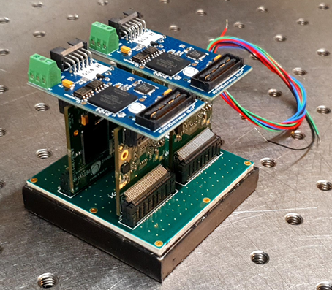
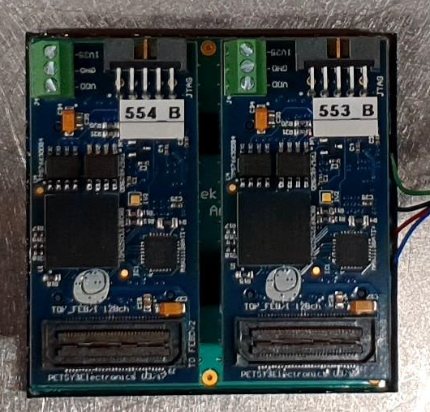
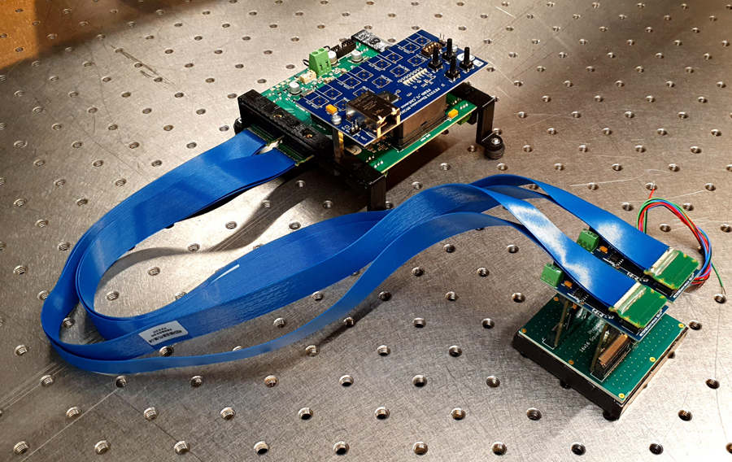
MAPMT253 & PCS
TOFPET2 Integration
We have demonstrated hardware compatibility between the square PMT with 16x16 readout PCB and the TOFPET2 front-end
Mechanical fit into the same envelop
Back-end electronics can be located remotely
Notes:
The outer envelop of the TOFPET2d front-end, the section that needs to be close to the PMT, fits into the same dimension as the square PMT. The rest of the readout can be located remotely as shown by the blue ribbon cables. We can envisage a 16x16 channel modular construction that easily allows tilling on all 4 sides.

Slide 25
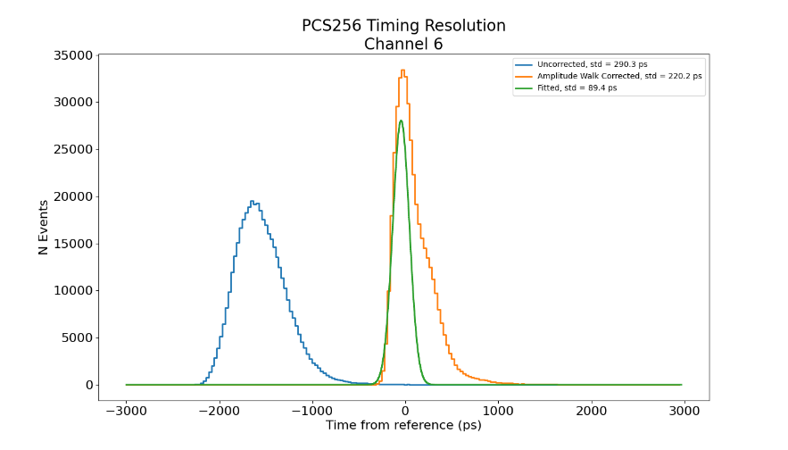

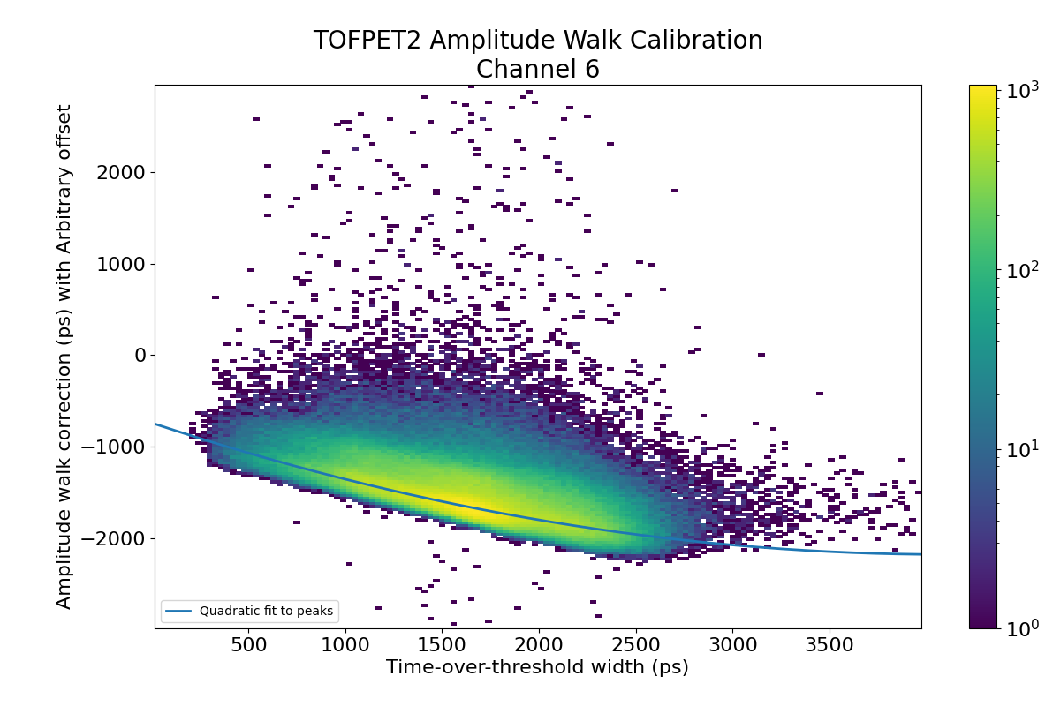
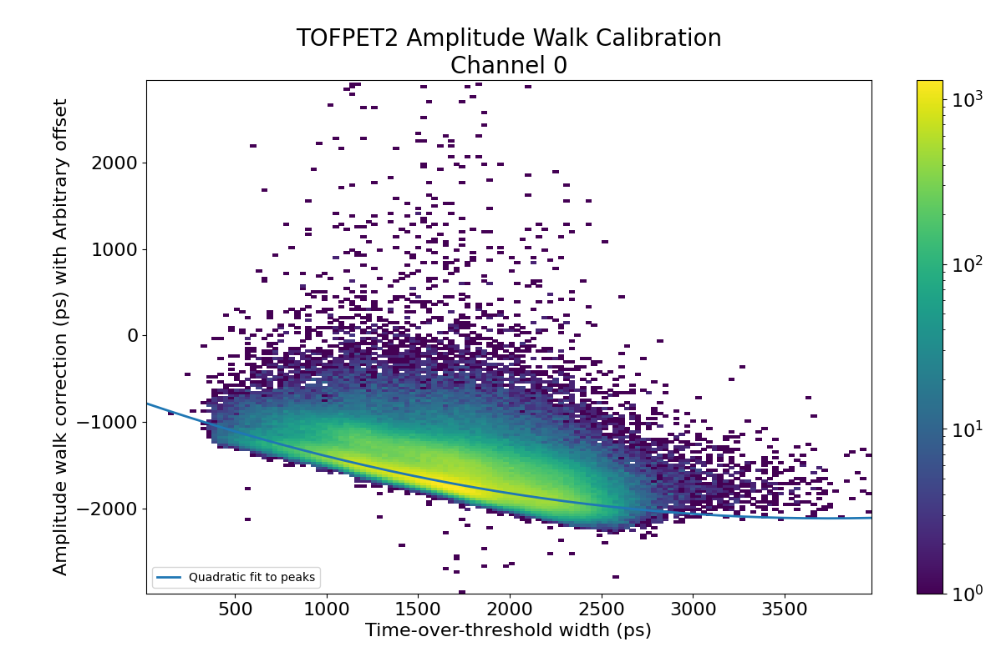
MAPMT253 & PCS
Examples of 256 channel Time-over-Threshold corrections
Notes:
The outer envelop of the TOFPET2d front-end, the section that needs to be close to the PMT, fits into the same dimension as the square PMT. The rest of the readout can be located remotely as shown by the blue ribbon cables. We can envisage a 16x16 channel modular construction that easily allows tilling on all 4 sides.

Slide 26
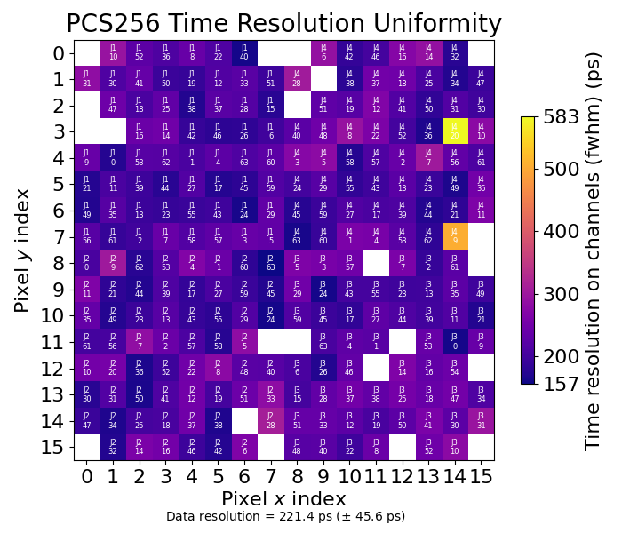
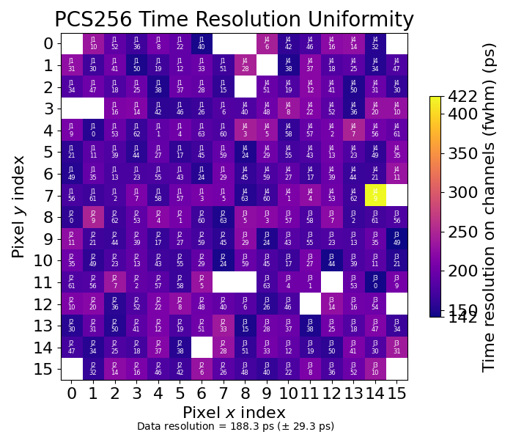
MAPMT253 & PCS
Time Resolution Map – FWHM of Fitted Peak
PC – MCP: 200 V
PC – MCP: 700 V
Notes:
The outer envelop of the TOFPET2d front-end, the section that needs to be close to the PMT, fits into the same dimension as the square PMT. The rest of the readout can be located remotely as shown by the blue ribbon cables. We can envisage a 16x16 channel modular construction that easily allows tilling on all 4 sides.

Slide 27

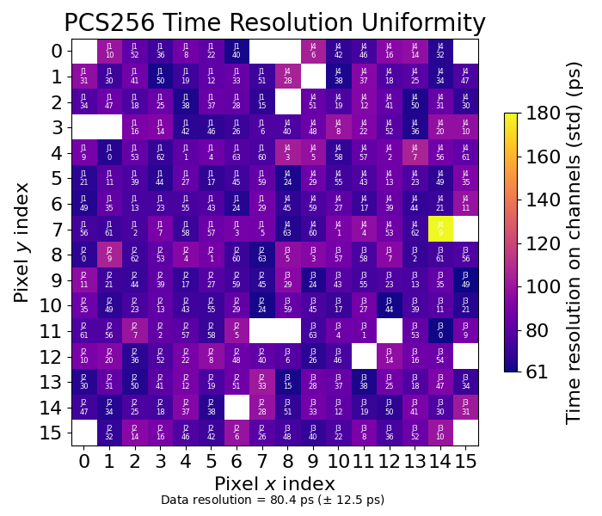
MAPMT253 & PCS
Time Resolution Map – rms of Fitted Peak
PC – MCP: 200 V
PC – MCP: 700 V
Notes:
The outer envelop of the TOFPET2d front-end, the section that needs to be close to the PMT, fits into the same dimension as the square PMT. The rest of the readout can be located remotely as shown by the blue ribbon cables. We can envisage a 16x16 channel modular construction that easily allows tilling on all 4 sides.

Slide 28
Photek Photomultiplier Tubes
AuraTek Photon Counting System (PCS)
PCS Readout with a Square PMT
Summary

Slide 29

Summary
Demonstrated the improved timing and magnetic field performance of a square MCP-PMT with 6 µm pores
Integrated a multi-anode PMT with TOFPET2 electronics to produce a 256 photon counting system with ~ 65 ps timing resolution
Demonstrated the same with a square MCP-PMT in a tight packing envelope with ~ 80 ps timing resolution
Thanks to Thomas Conneely, Ayse Duran and Amelia Markfort from Photek R&D for the measurements

