Slide 1






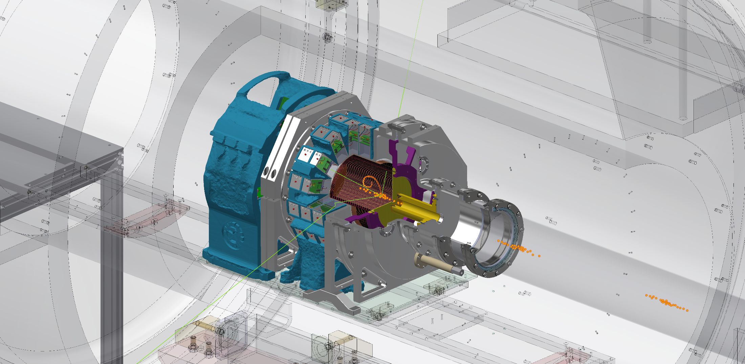
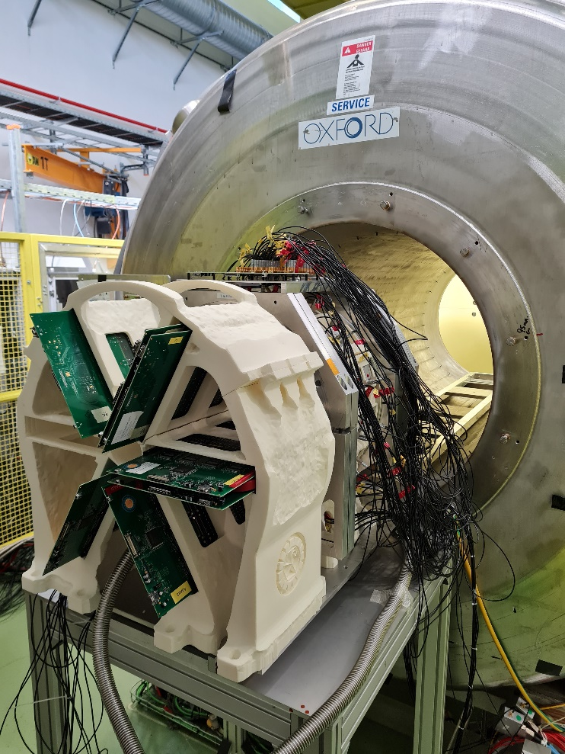
SpecMAT, the active target for nuclear transfer reactions studies at ISOLDE, CERN
Oleksii Poleshchuk
TIPP2023
Cape Town, 8 September 2023

Slide 2

Outline
Motivation to build SpecMAT
and its overview
Characterisation of the SpecMAT active target
A (d,³He) reaction for SpecMAT

Slide 3
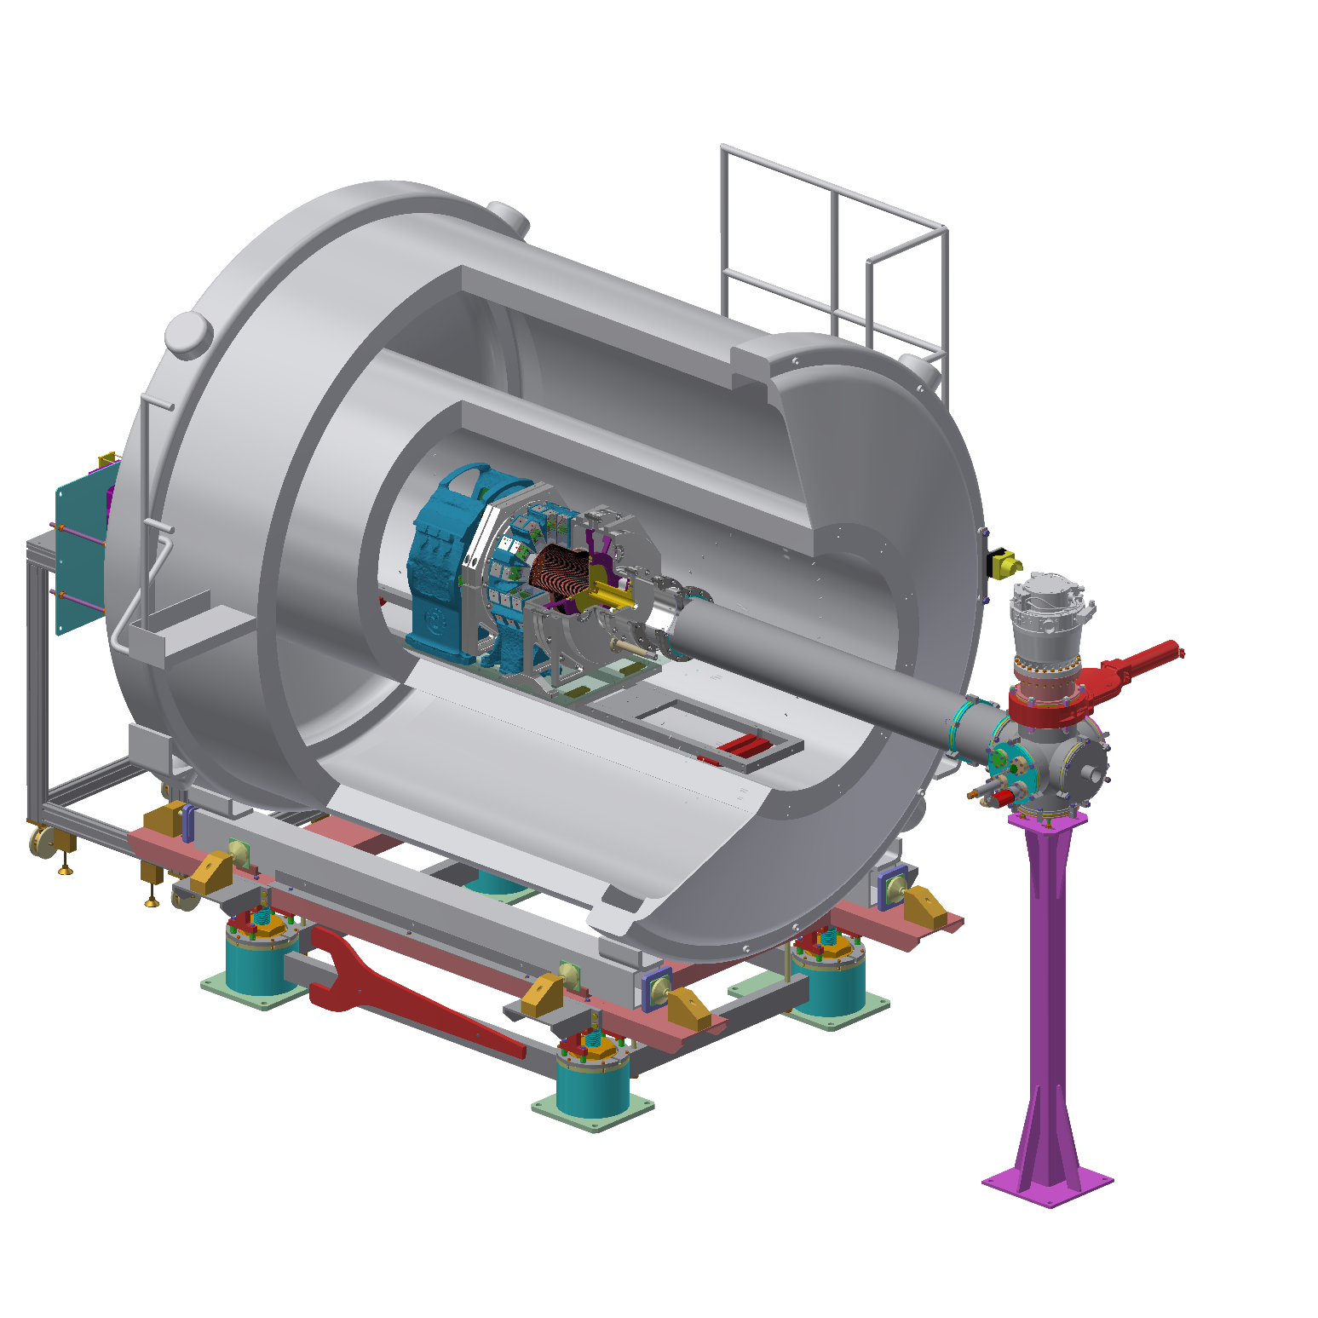
Motivation and
Overview

Slide 4
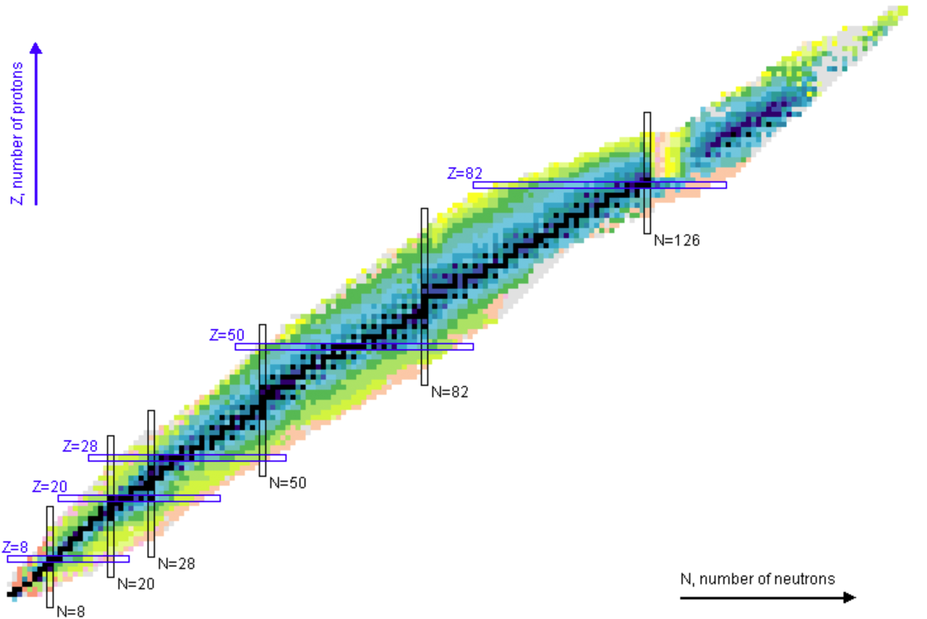

Physics motivation
Main goal: to study nuclei far from stability using transfer reactions.
Major challenges:
Low production rates of RIBs
Inverse kinematics of the nuclear reaction.
Possible solution:
A detector with high efficiency and good resolution

Slide 5
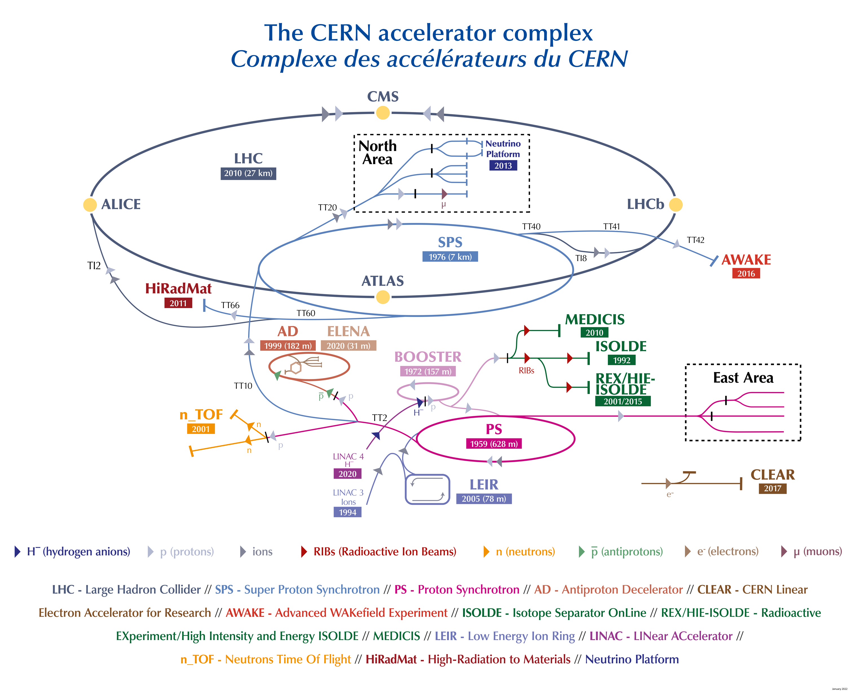

Slide 6

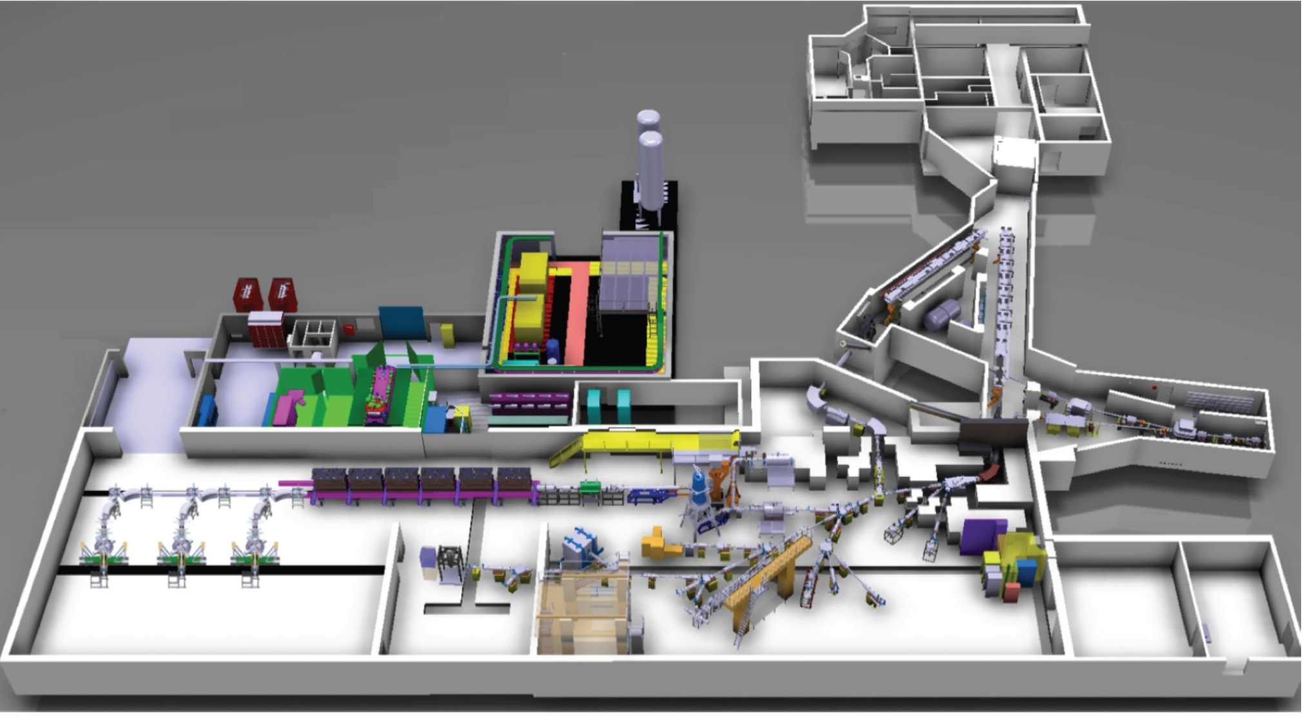
1.4GeV protons
RIB
HIE-ISOLDE

Slide 7

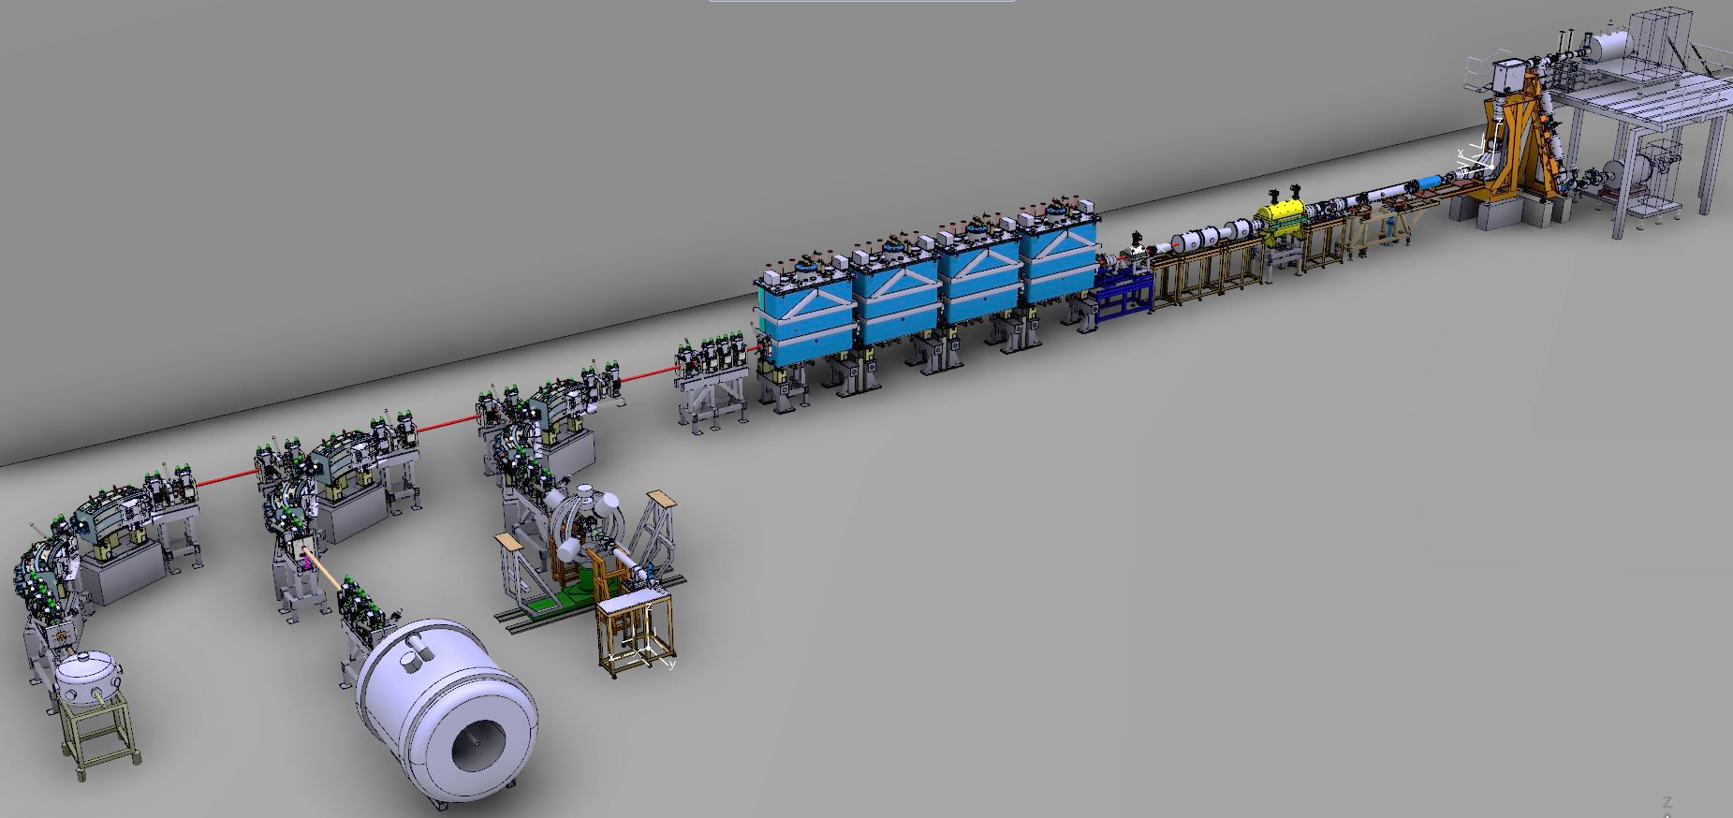
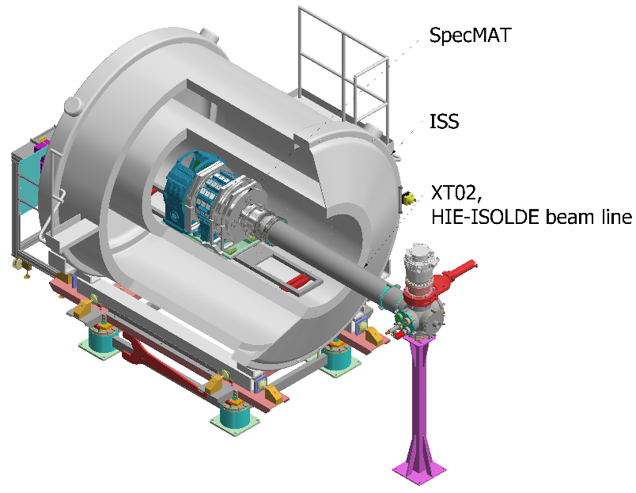
RIB
ISS
ISS
Currently: 2.5T
Perspective: 4T
SpecMAT
ISS = ISOLDE Solenoidal Spectrometer

Slide 8
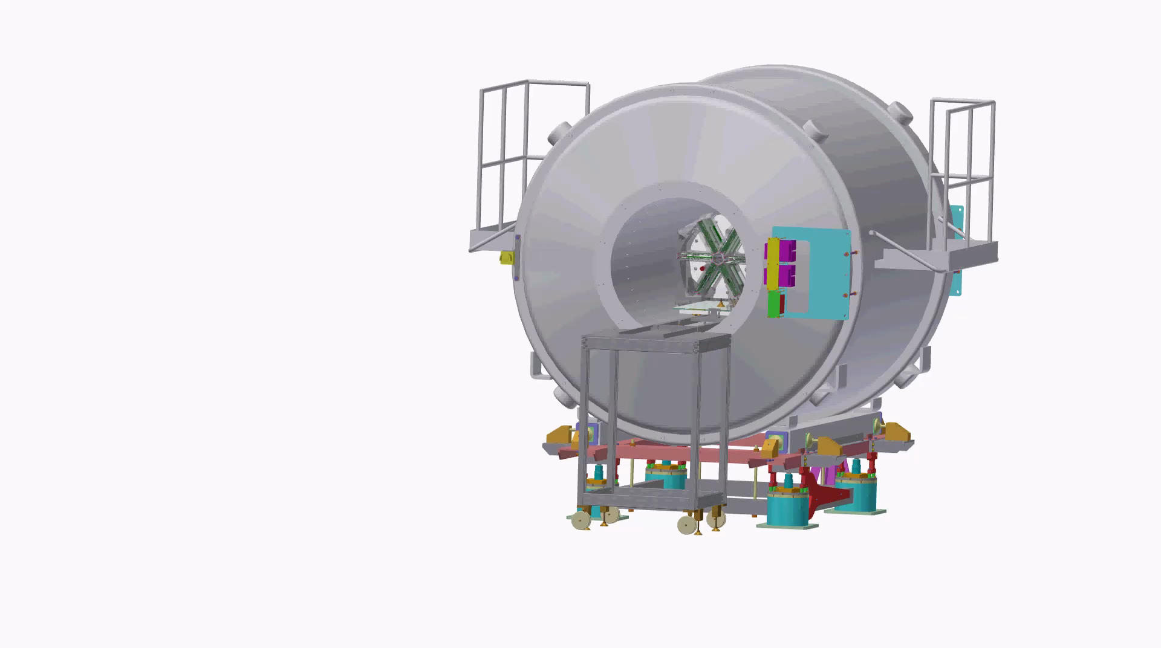

Slide 9
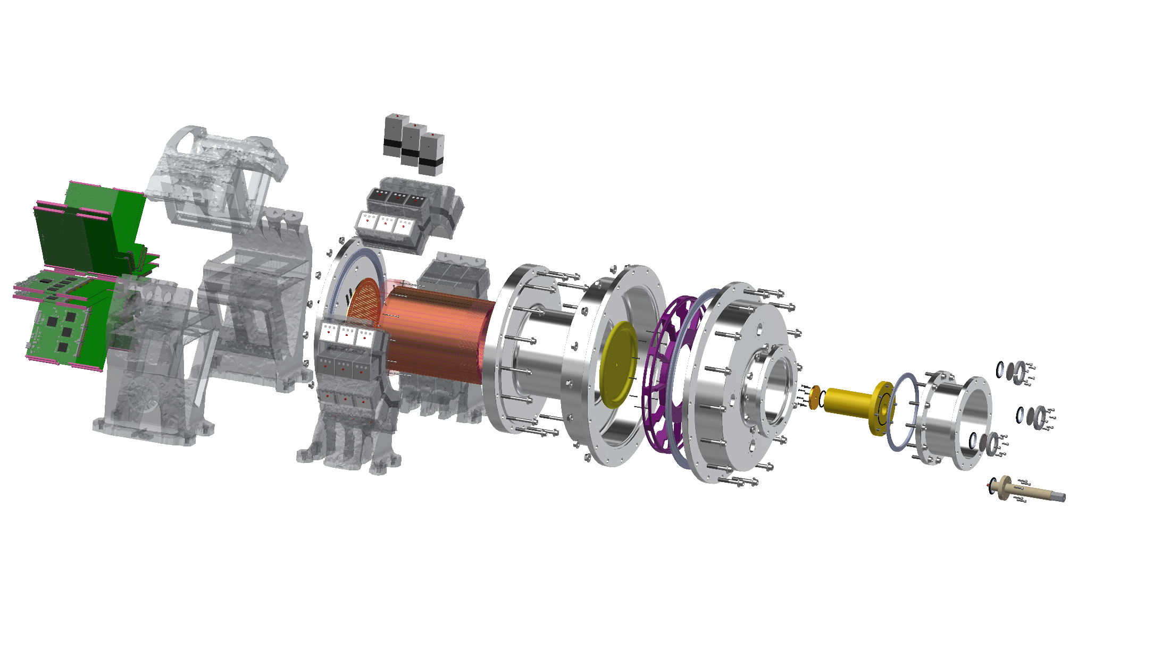
45 CeBr₃ 48×48×48mm
scintillation
detectors
Field cage
homogeneous electric field ~2%
Cathode
up to -32kV
Beam entrance
window
3-12 μm
Readout electronics
1-100MS/s 12bit
3072+256 channels
Gas chamber
up to 1 atm
min wall thickness 3mm
MICROMEGAS detector
2916 channels

Slide 10
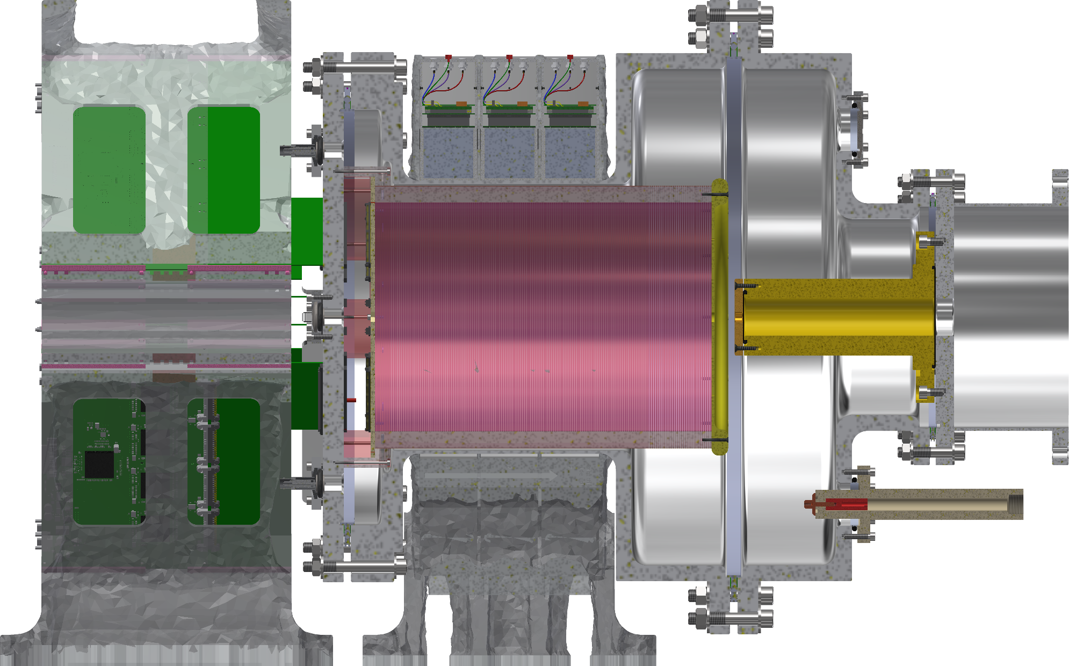
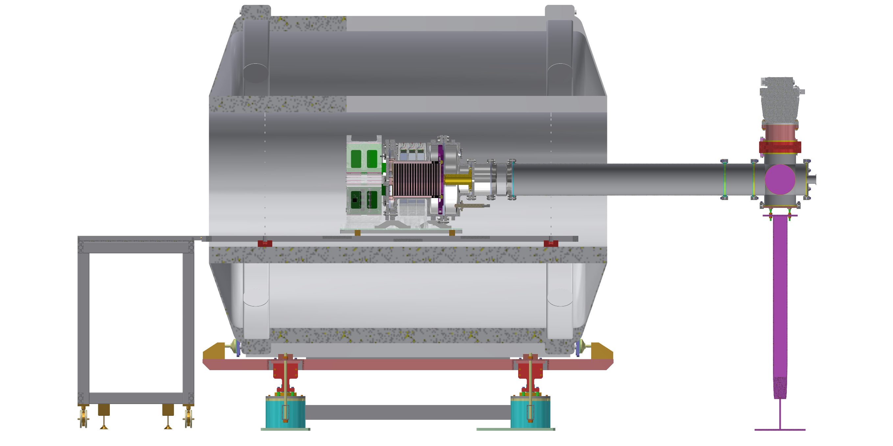

Electronics
MICROMEGAS
Scintillation detectors
Entrance window
$$γ$$
D₂
Beam line
(x₁, y₁, t₁)
(x₂, y₂, t₂)
(x₃, y₃, t₃)
(x₄, y₄, t₄)
(x₅, y₅, t₅)
…
³He
^{h}
⁻e
⁻e
^{h}
⁻e
^{h}
⁻e
^{h}
⁻e
^{h}
⁻e
^{h}
⁻e
^{h}
⁻e
⁻e
^{h}
⁻e
^{h}
⁷²Zn
⁻e
^{h}
B
⁷¹Cu
Gas chamber
Descriminate/identify particles
Energy
Angular distribution
Gamma-ray spectroscopy
Field cage

Slide 11
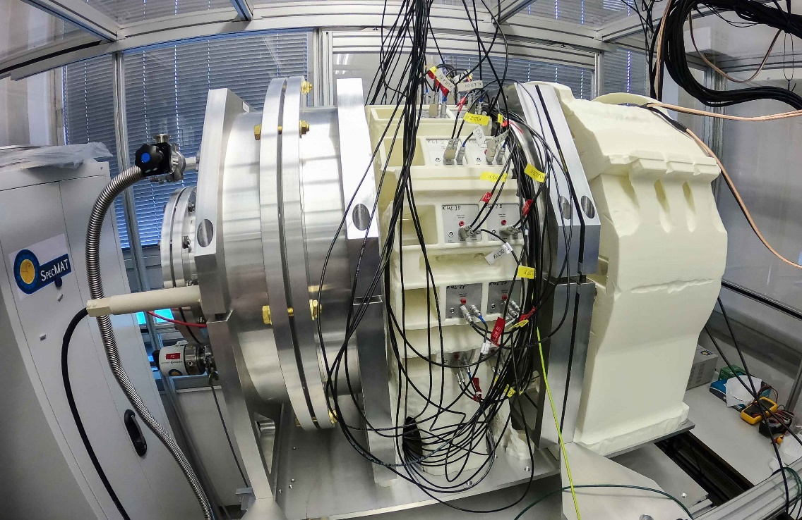
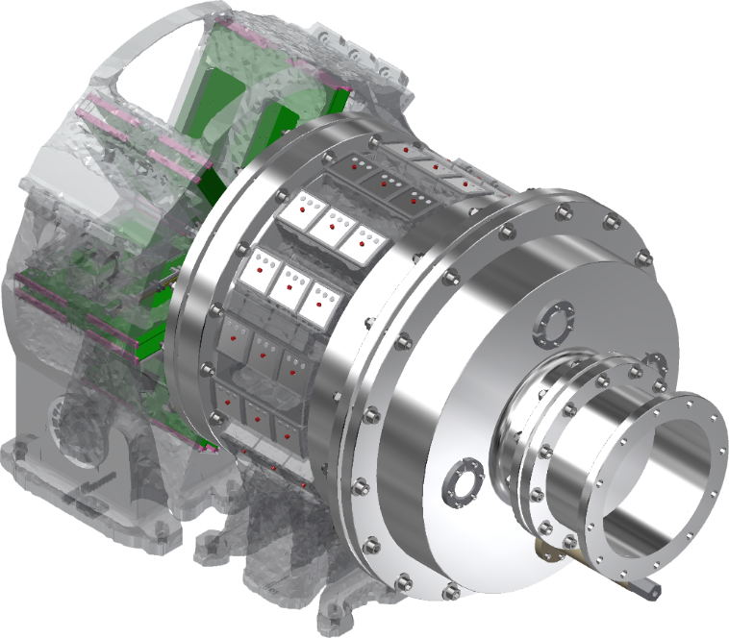
Characterisation of the SpecMAT active target

Slide 12


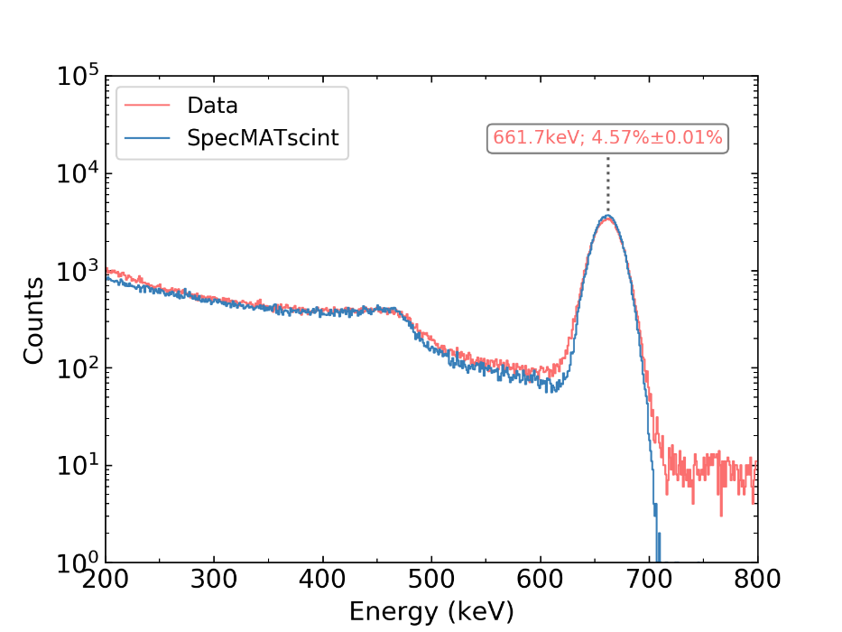
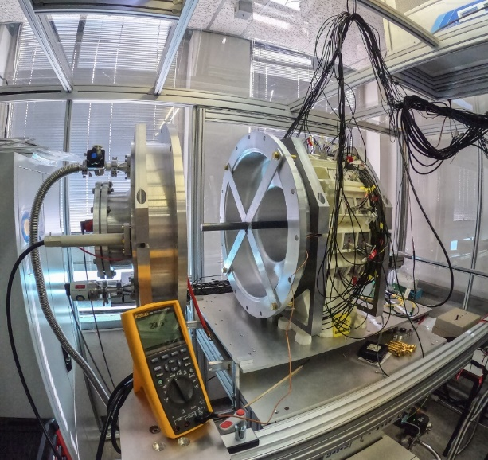
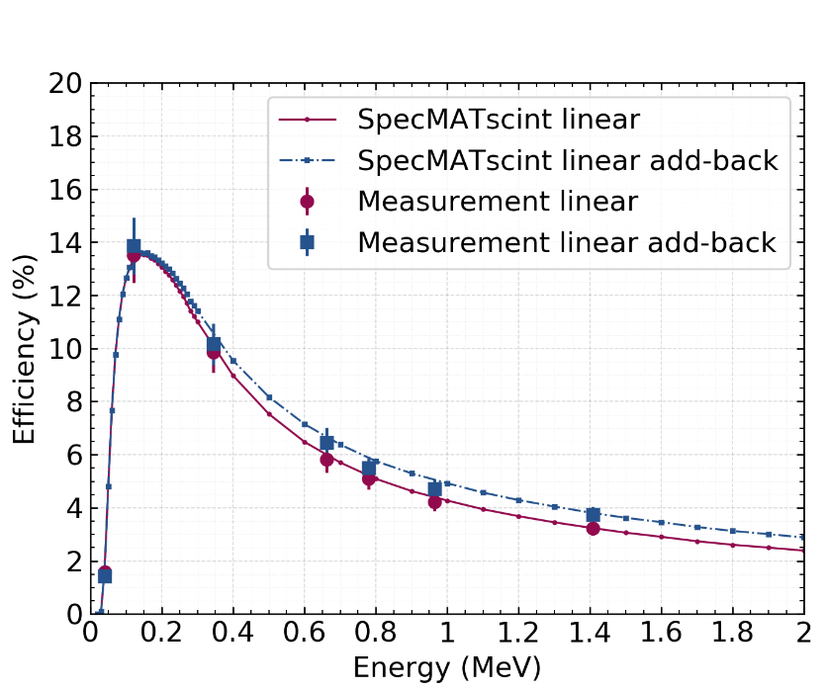
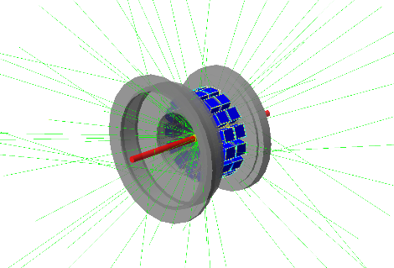
Characterisation of the array with 30 detectors, Measurement vs G4
+
Res: 30.5 keV(4.6%) @ 662keV
Linear source (Experimental condition)
Eff: ~6.5% @ 662keV

Slide 13
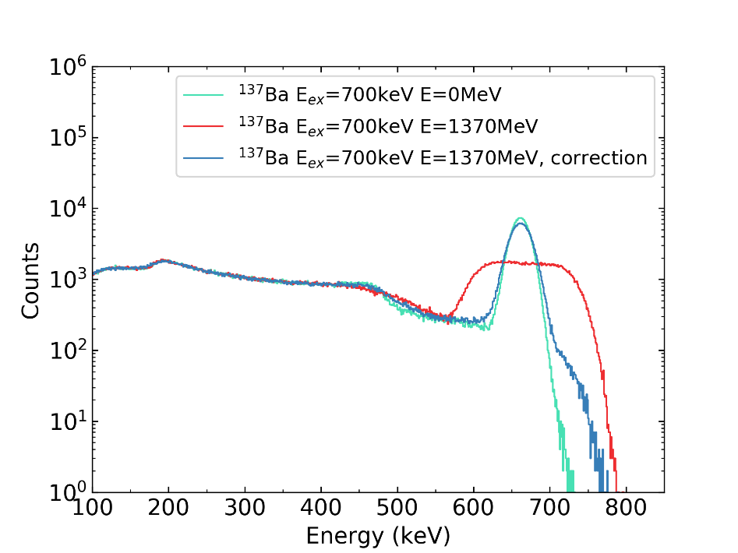
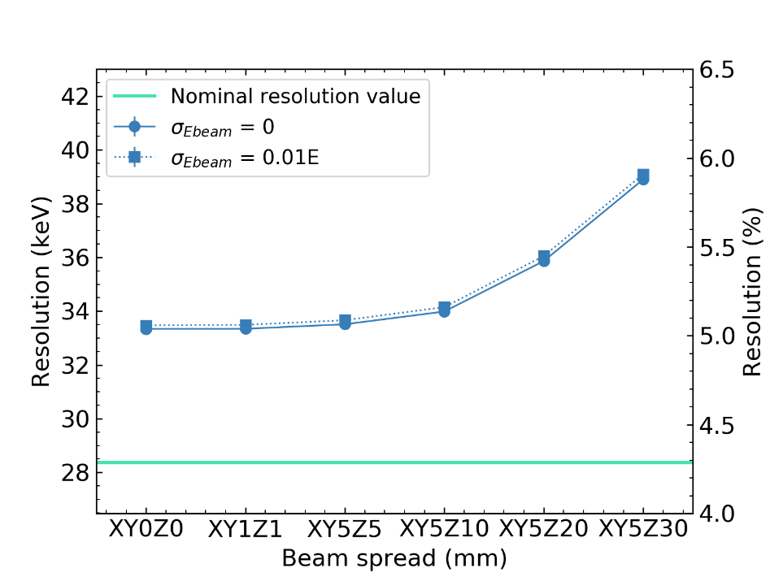
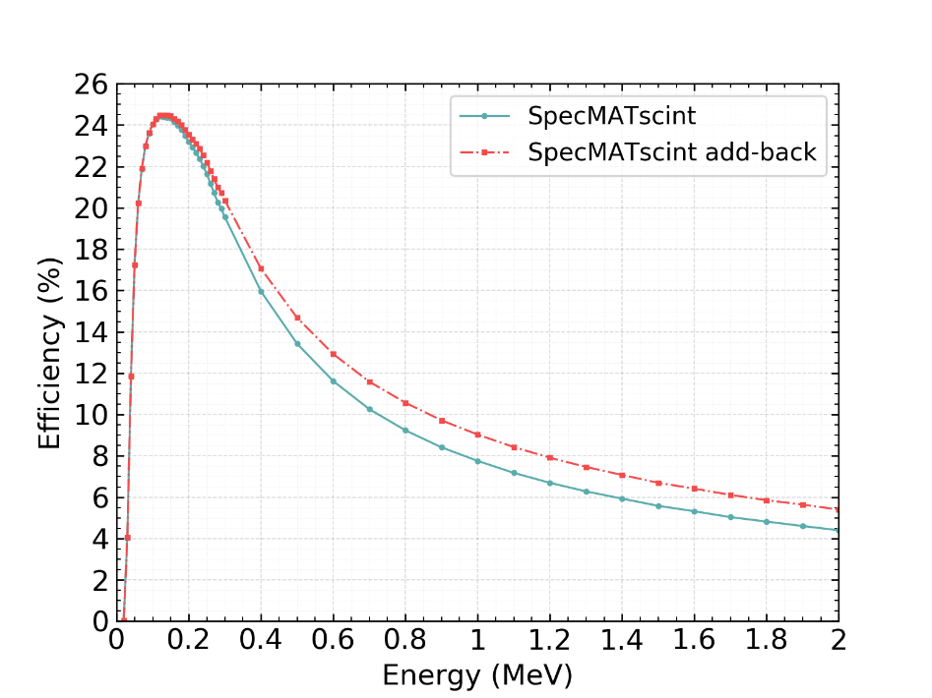
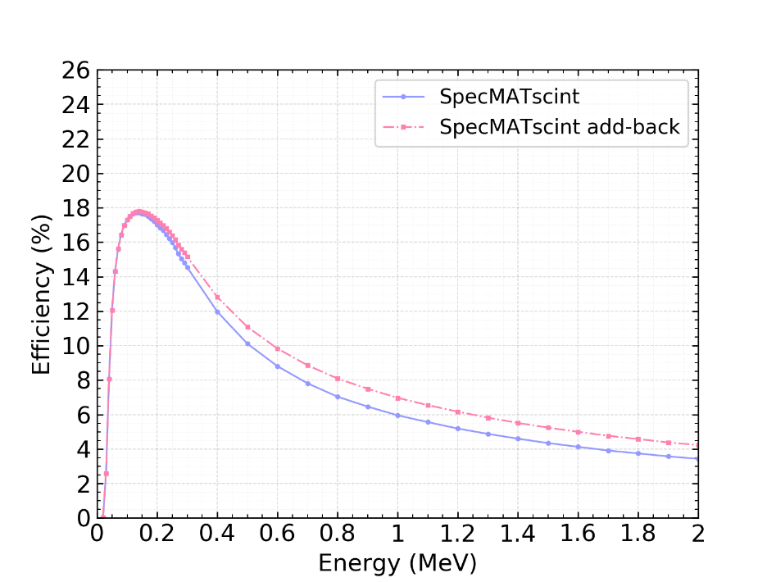
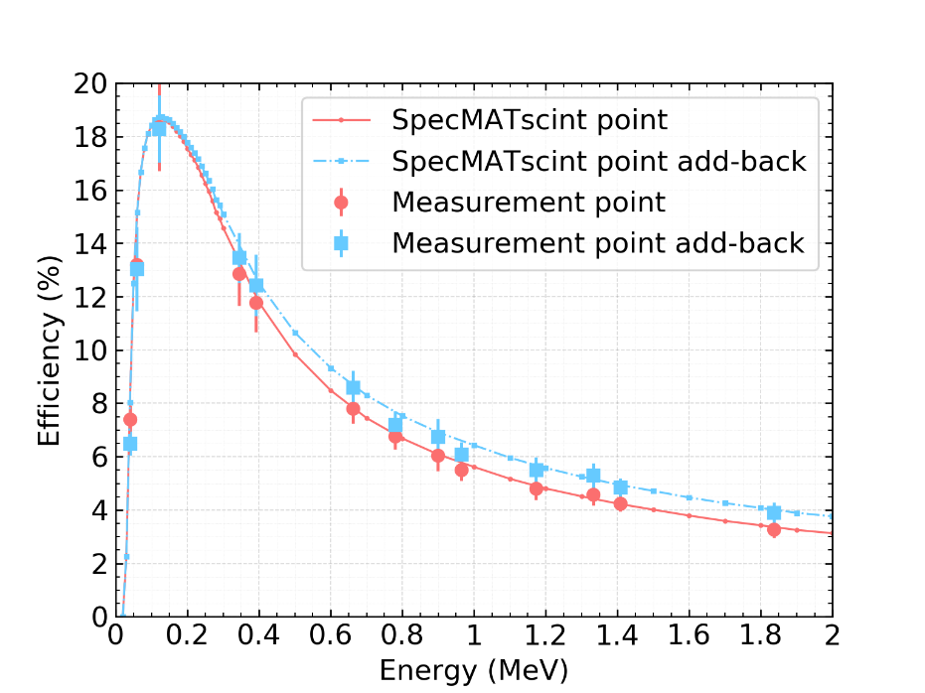
Characterisation of the array with 45 detectors, G4
E_{beam} = 10 MeV/u
Res: >33.5 keV(5%) @ 662keV
x45 CeBr₃
detectors
Point source
Linear source (Experimental condition)
Eff: ~13% @ 662keV
Eff: ~8.1% @ 662keV

Slide 14
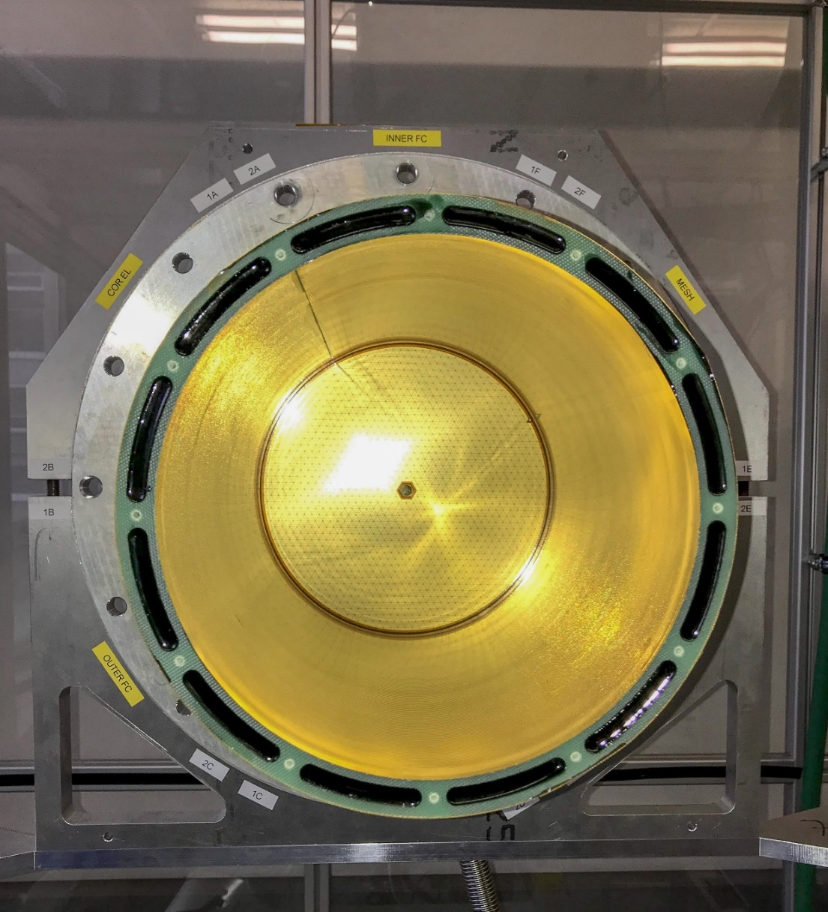
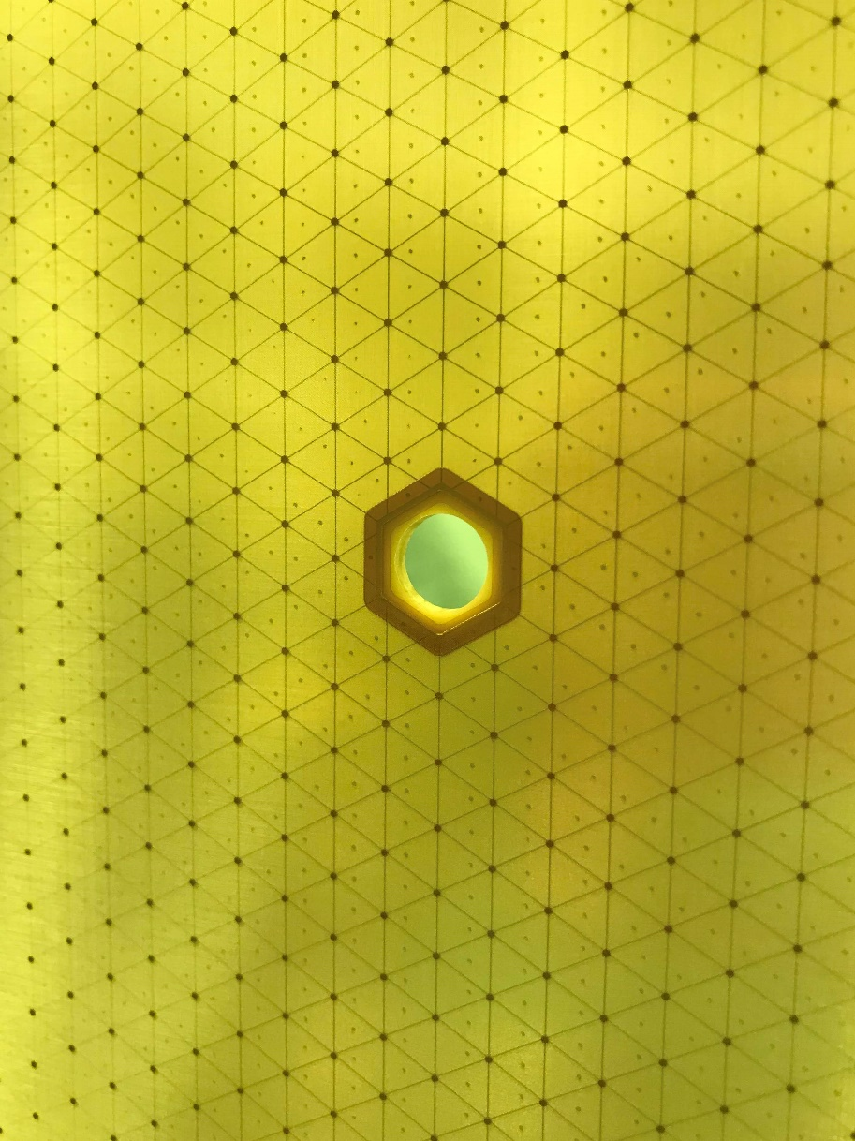
SpecMAT field cage

Slide 15
SpecMAT field cage
Beam direction
4.6 mm
323.5 mm
∅220 mm

Slide 16
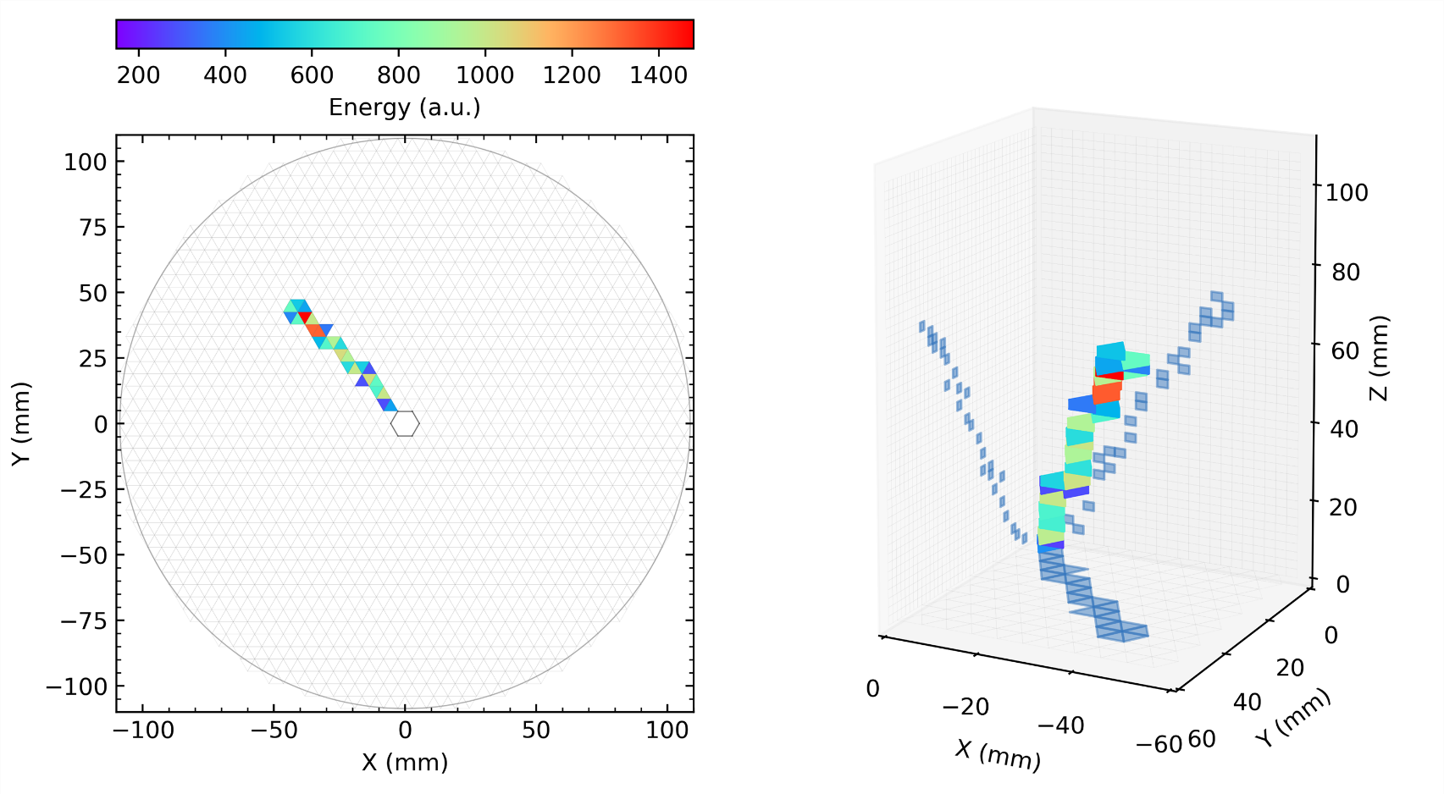
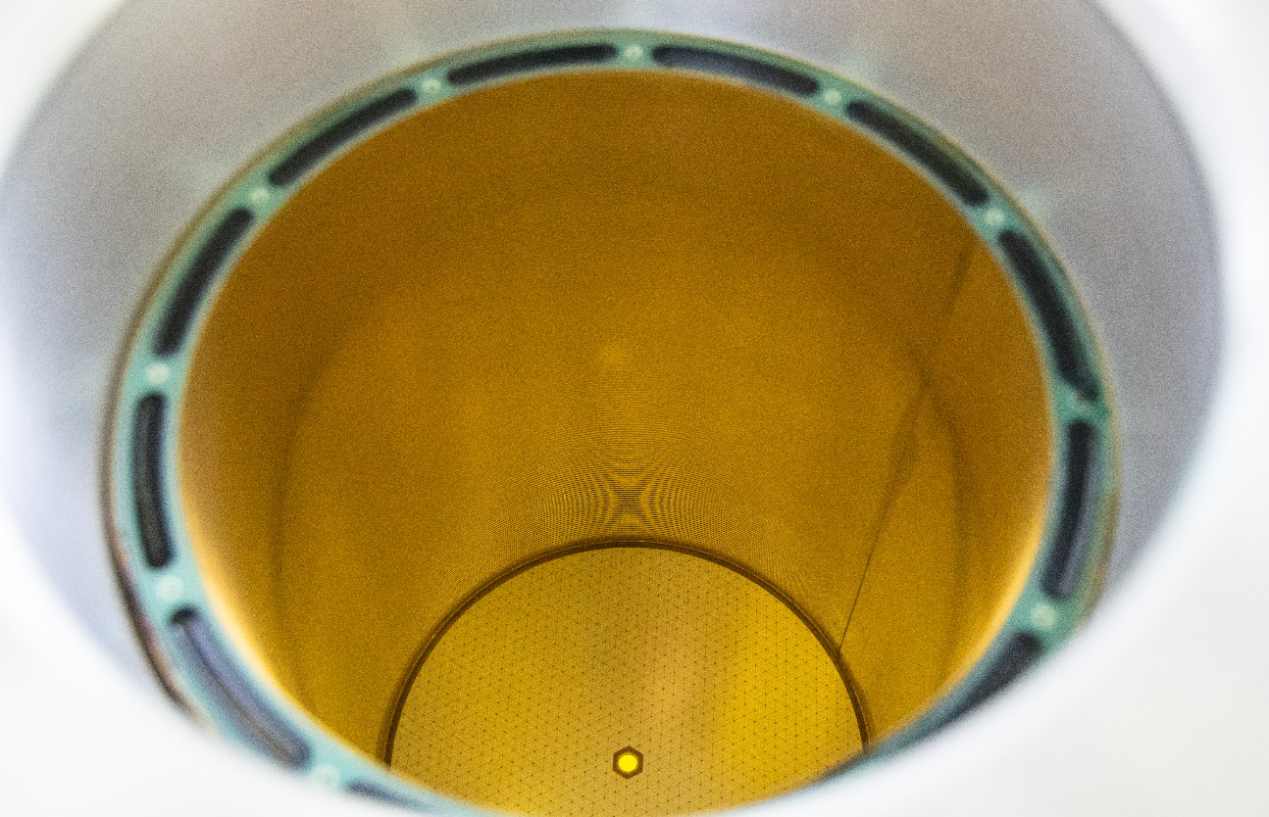
Measured α-particle track
in Ar95%CF₄5% @ 0.4mbar
Position of the source

Slide 17
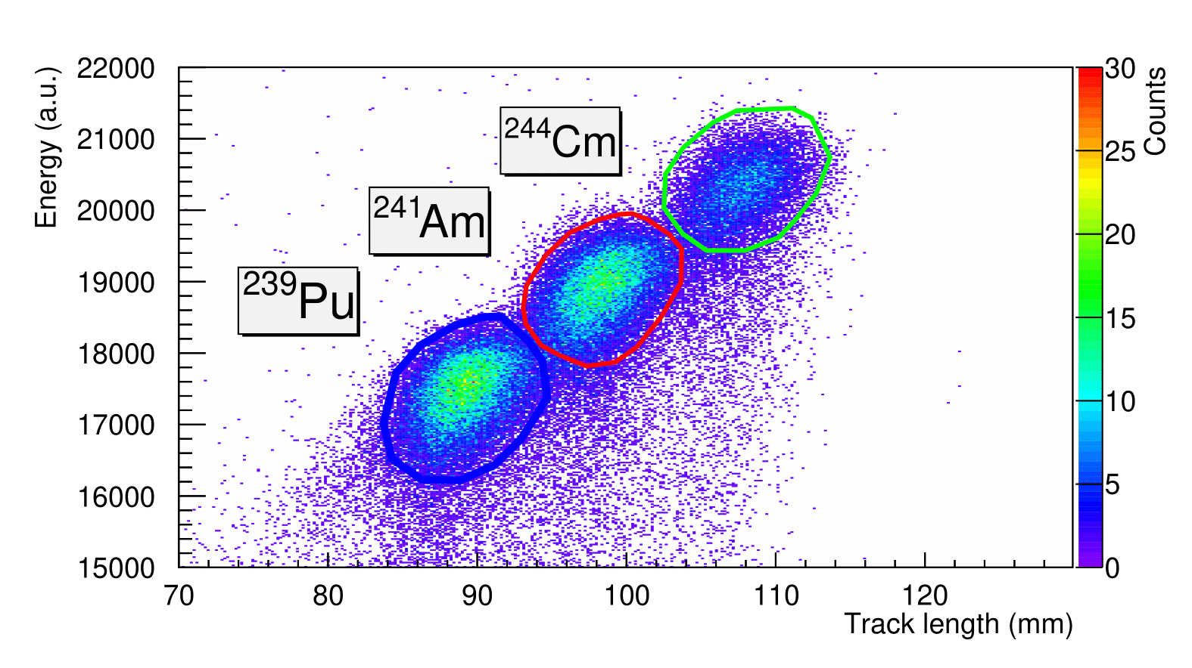
Measured α-particle spectra
in Ar95%CF₄5% @ 0.4mbar

Slide 18
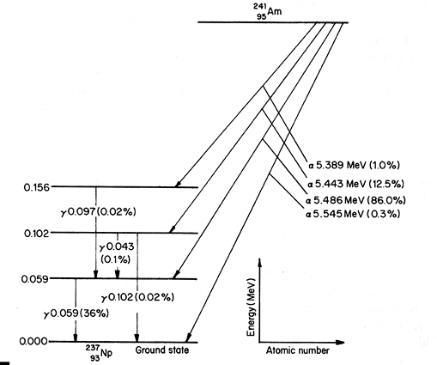
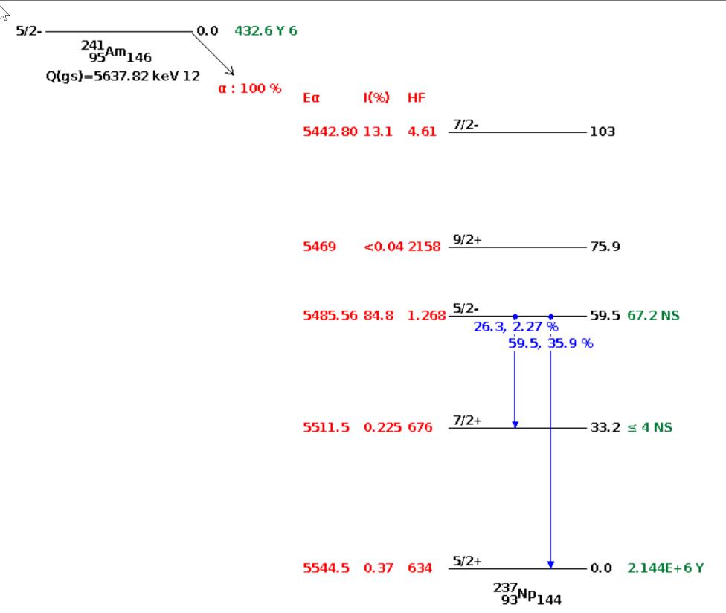
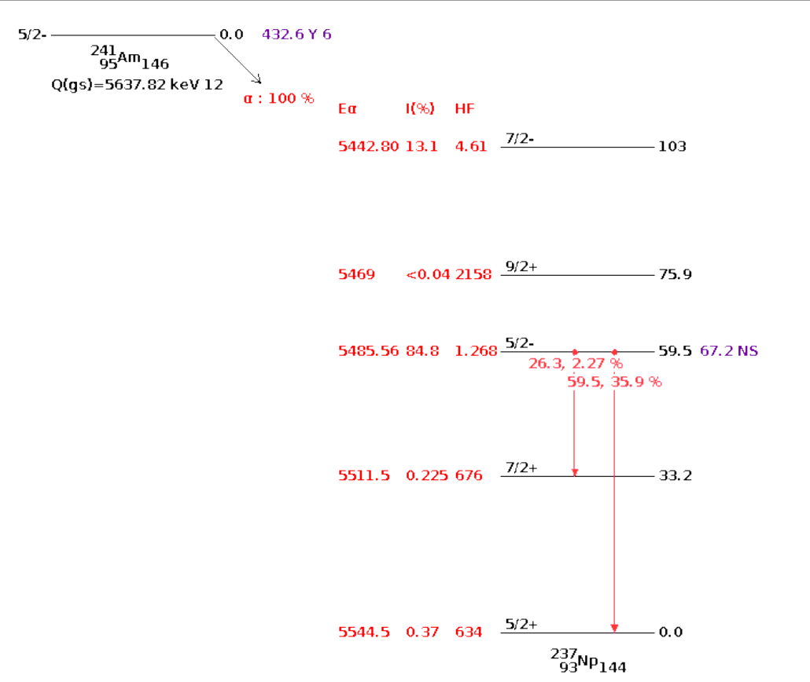
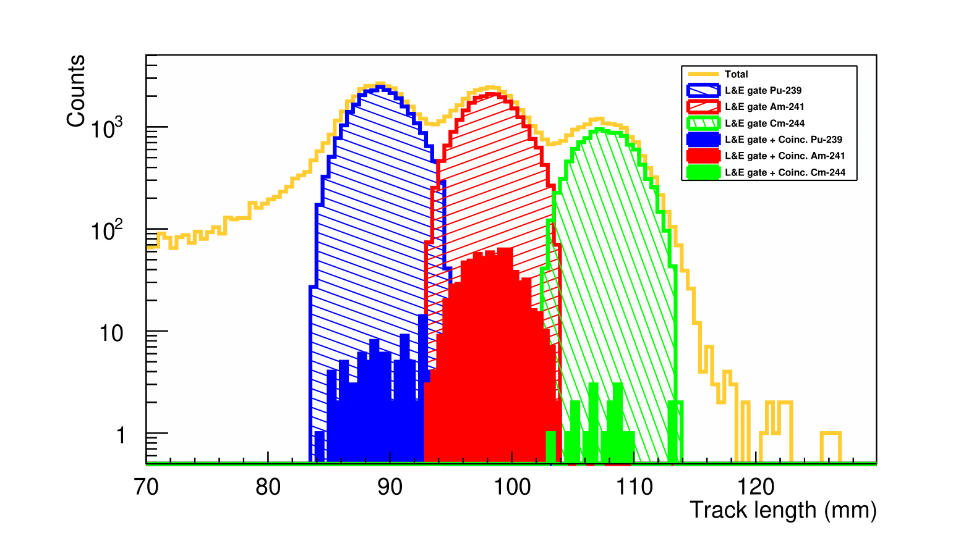
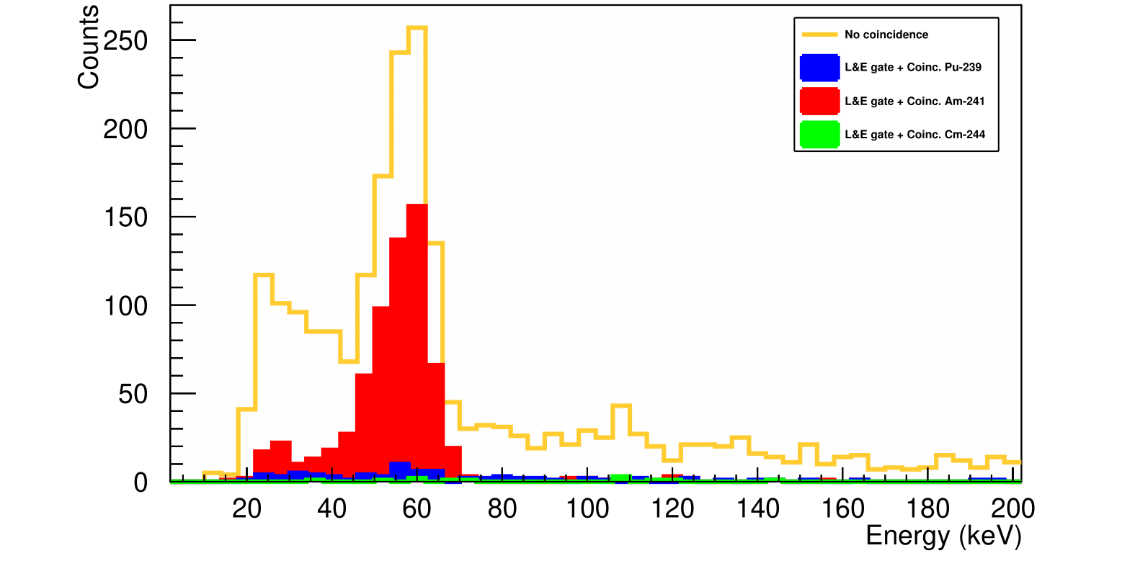
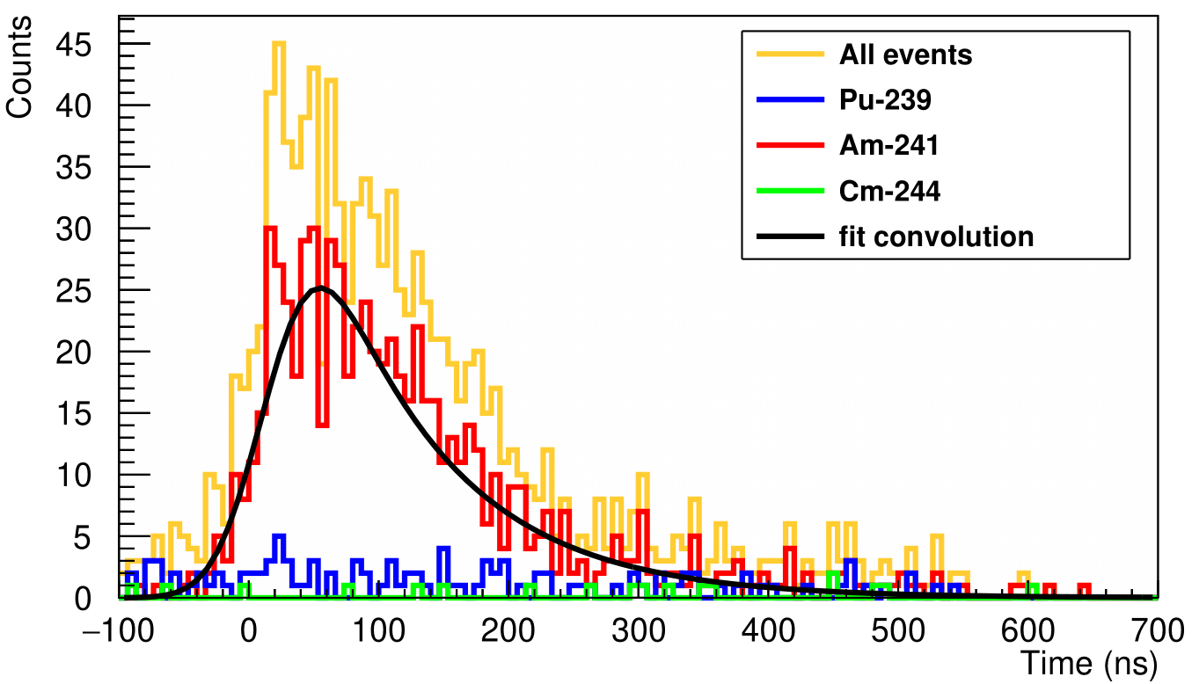
Measured α-γ correlation spectra
in Ar95%CF₄5% @ 0.4mbar
5485.56 keV
[physicsopenlab.org]
α-particle
59.5 keV
[nndc]
26.3 keV
T_{1/2} = 67.4(4.4) ns
γ-ray
O. Poleshchuk, R. Raabe, et.al., NIM A “The SpecMAT active target”
Volume 1015, 1 November 2021, 165765

Slide 19
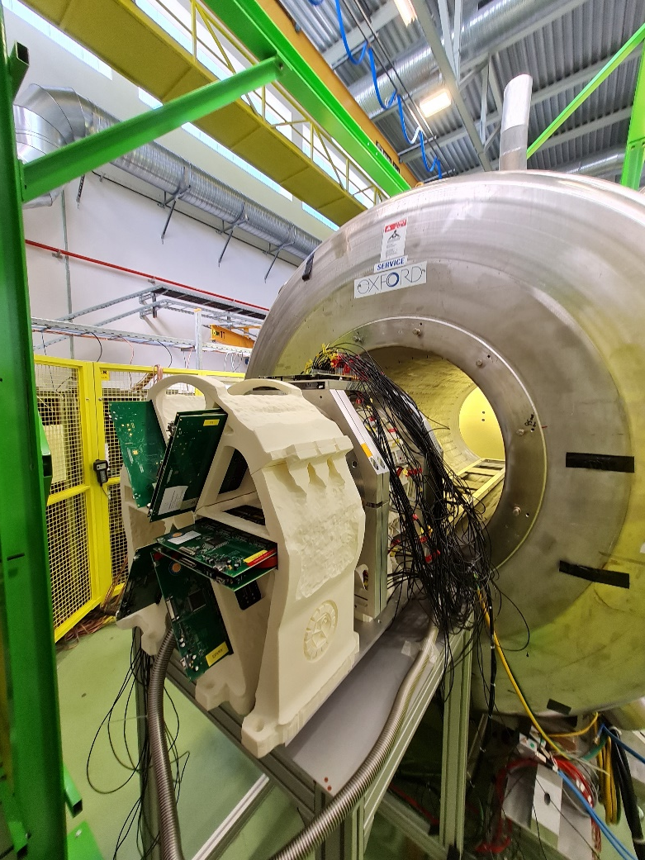
Offline tests of the SpecMAT active target in ISS 2022
A 4-alpha source was used for the characterisation: ¹⁴⁸Gd, ²³⁹Pu, ²⁴¹Am, ²⁴⁴Cm
Ar(90%)CF₄(10%)
Detector configuration | Pressure of ArCF4(10%), mbar
3 sectors + scint. in 2.5T | 100 / 250 / 350
3 sectors + scint. in 0T
Pressure, mbar | ¹⁴⁸Gd 3182 keV | ²³⁹Pu 5155 keV | ²⁴¹Am 5488 keV | ²⁴⁴Cm 5805 keV
 | Range, mm
100 | 190 | 369.7 | 404.496 | 438.848
250 | 76.84 | 147.9 | 161.797 | 175.537
350 | 54.73 | 105.63 | 115.568 | 125.38

Slide 20
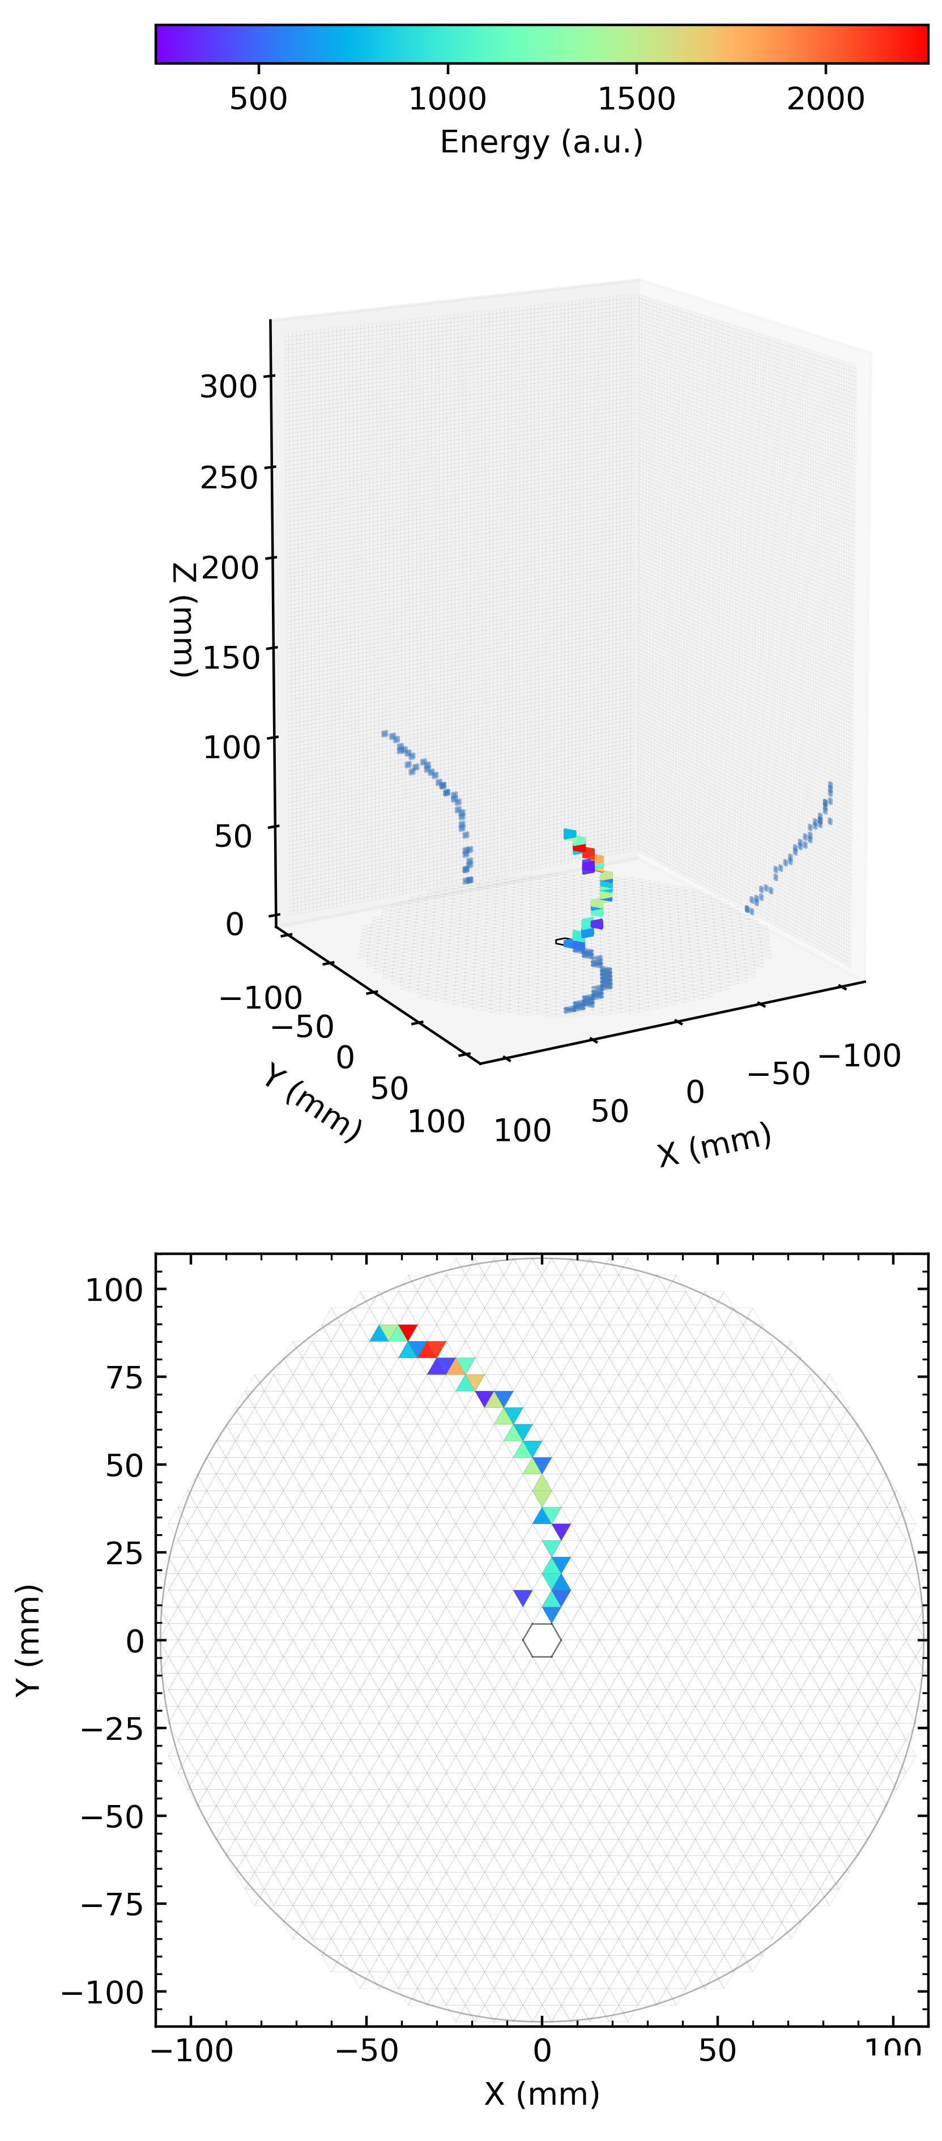
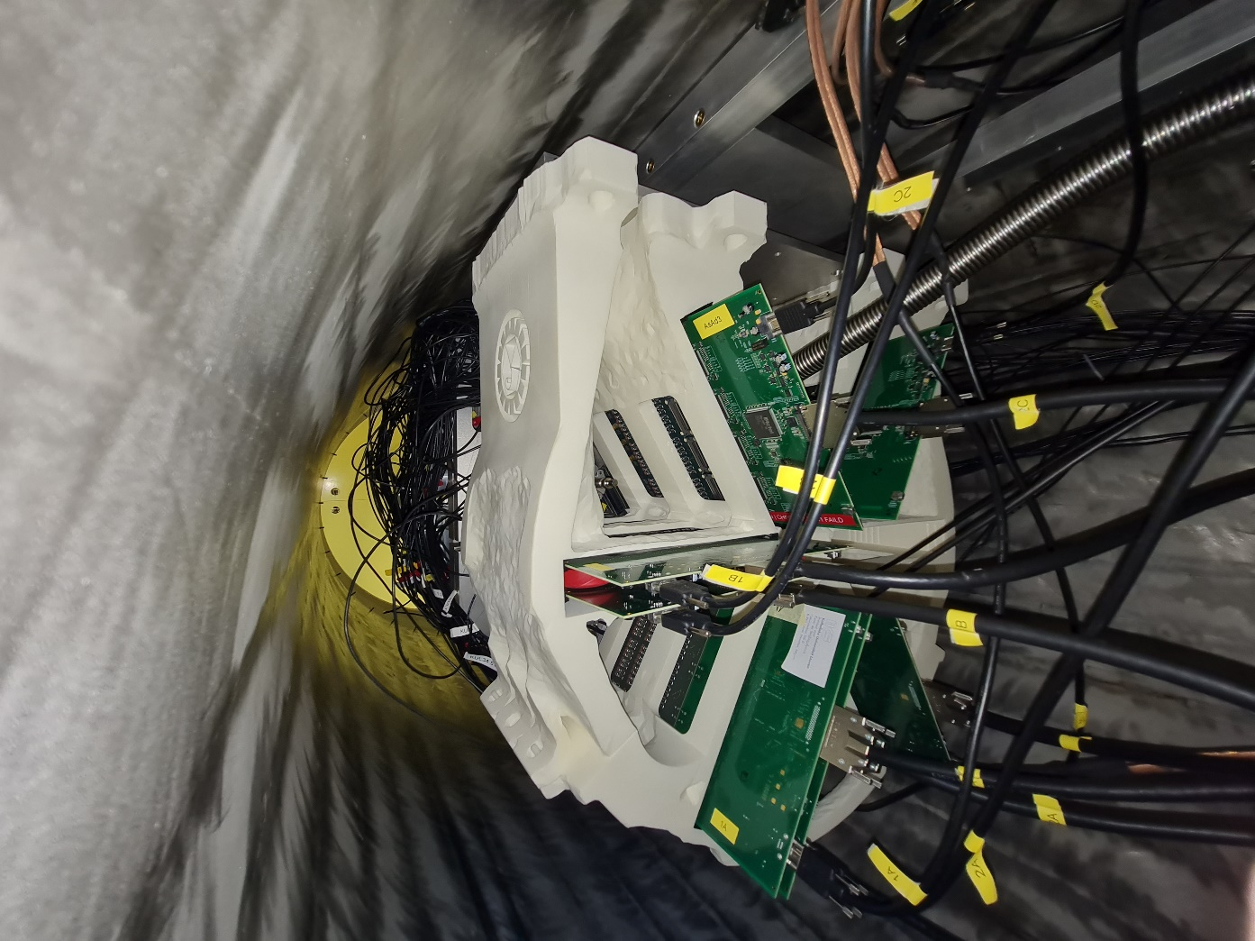
Tests of the SpecMAT active target in ISS
SpecMAT installed in ISS
Measured α-particle
track in B=2.5T

Slide 21
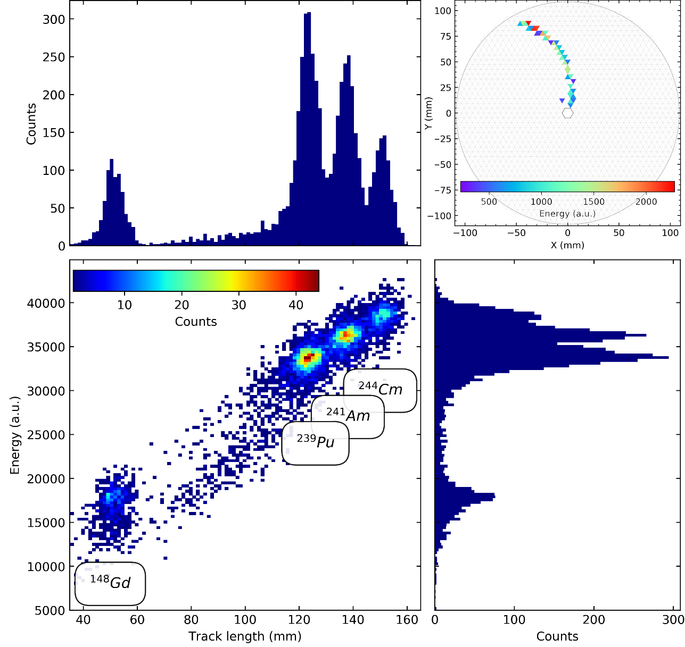
Tests of the SpecMAT active target in ISS
Comparison of the SpecMATscint G4 simulation
with preliminary analysis of the measurement
( Ar90%CF₄10% @ 250 mbar)
Measurement
results
Measured α-particle
track in B=2.5T

Slide 22
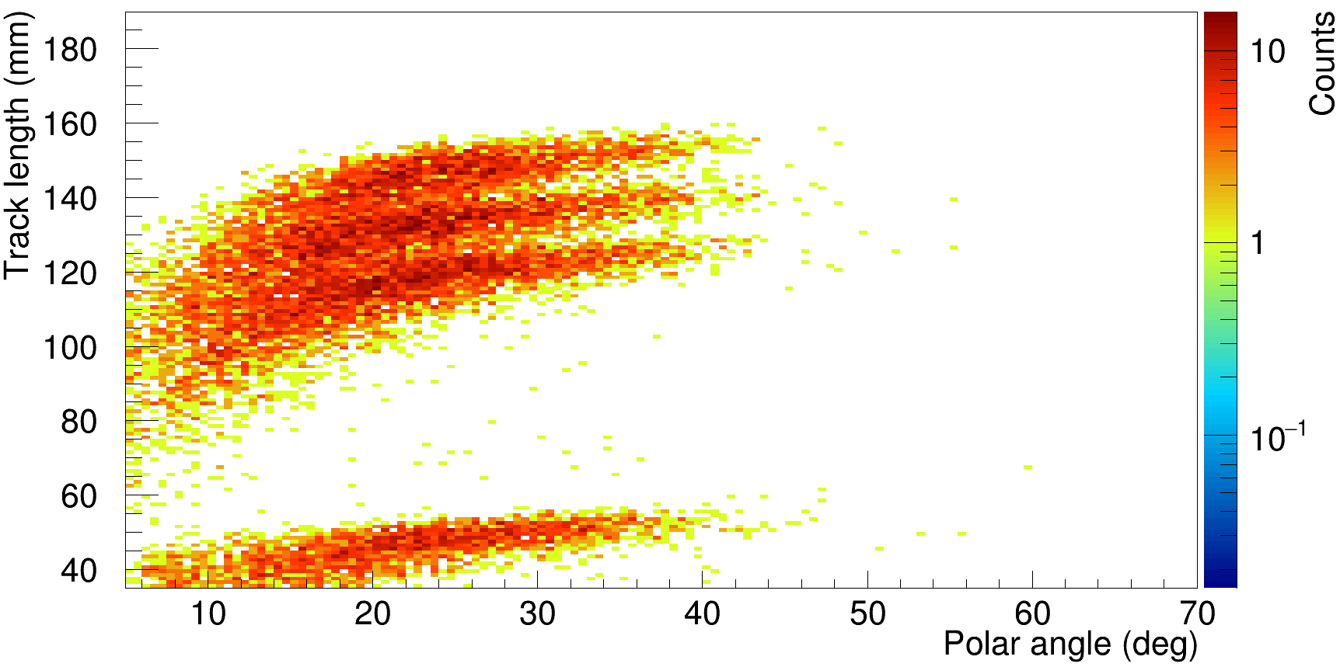
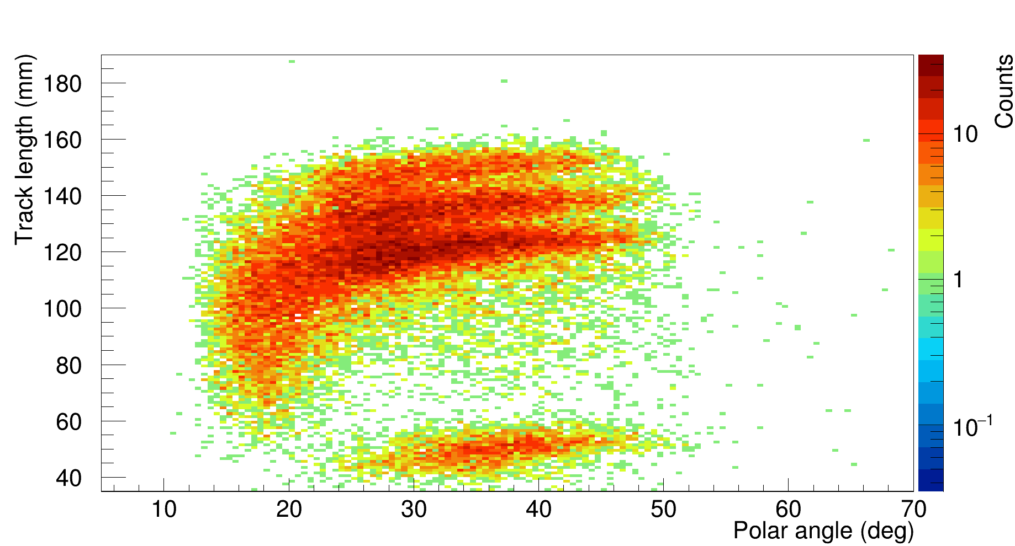
Tests of the SpecMAT active target in ISS
Comparison of the SpecMATscint G4 simulation
with preliminary analysis of the measurement
( Ar90%CF₄10% @ 250 mbar)
G4
²⁴⁴Cm
²⁴¹Am
²³⁹Pu
¹⁴⁸Gd
∅ 7mm
Measurement
∅ 7mm
Measured α-particle
track in B=2.5T

Slide 23
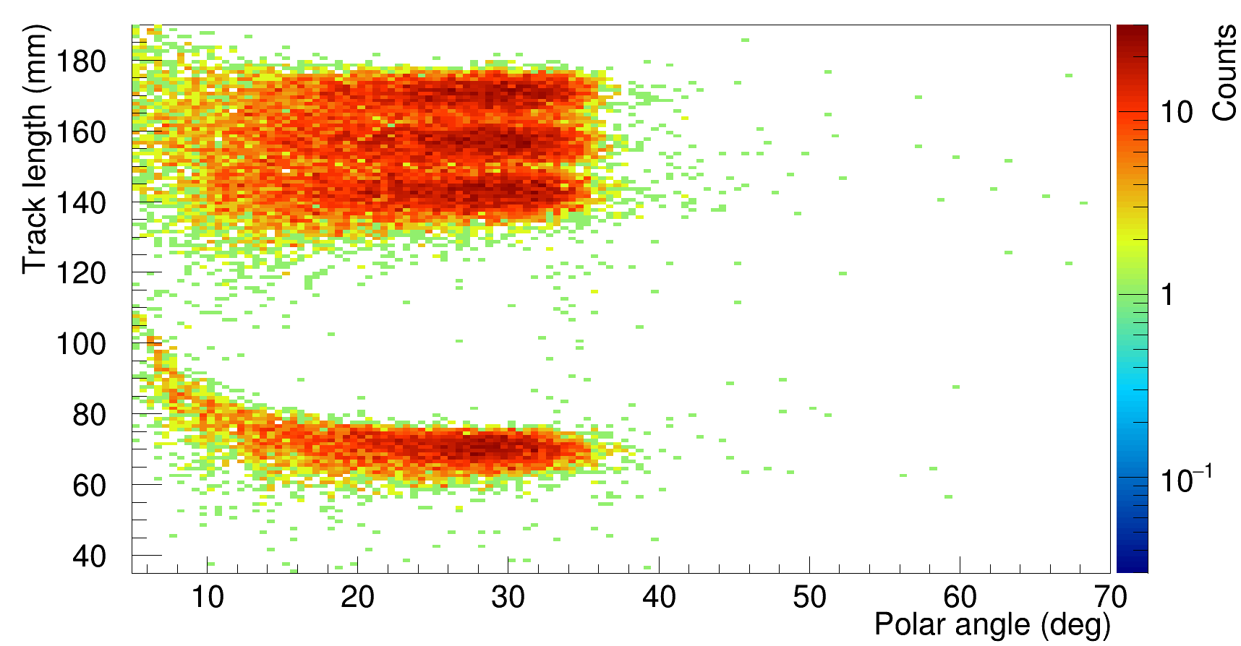
Tests of the SpecMAT active target in ISS
Comparison of the SpecMATscint G4 simulation
with preliminary analysis of the measurement
( Ar90%CF₄10% @ 250 mbar)
G4
²⁴⁴Cm
²⁴¹Am
²³⁹Pu
¹⁴⁸Gd
∅ 0.1mm
Measurement
∅ 7mm
Measured α-particle
track in B=2.5T

Slide 24
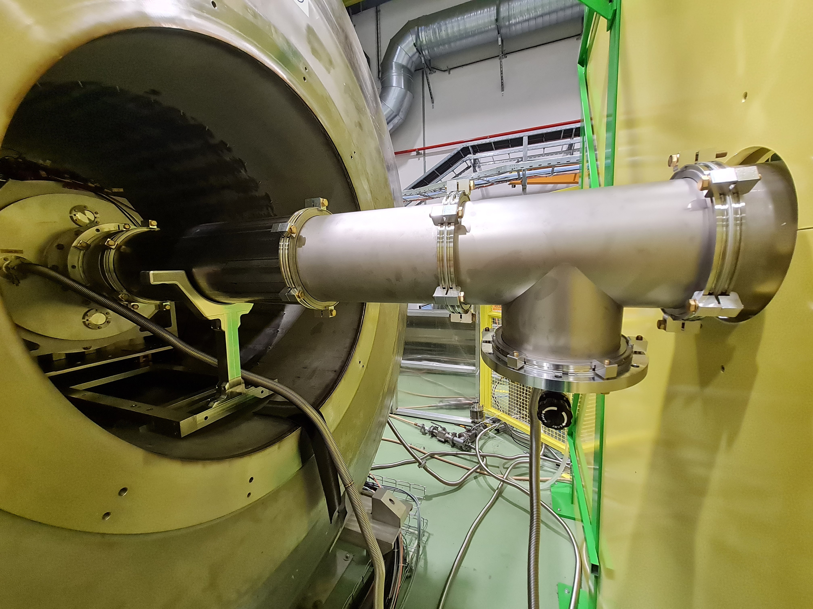
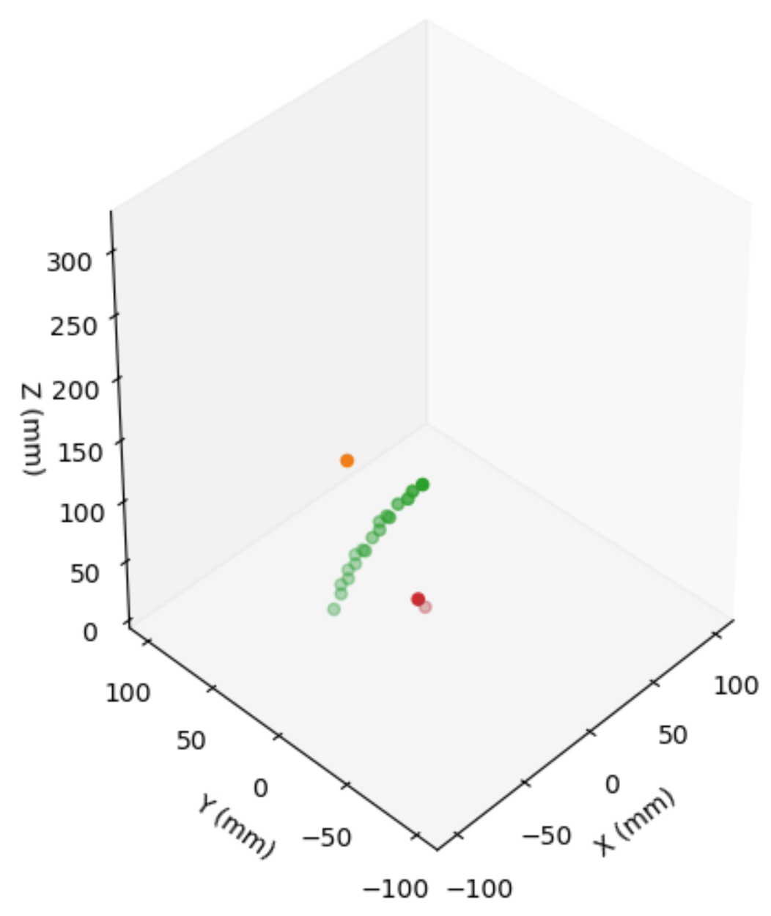
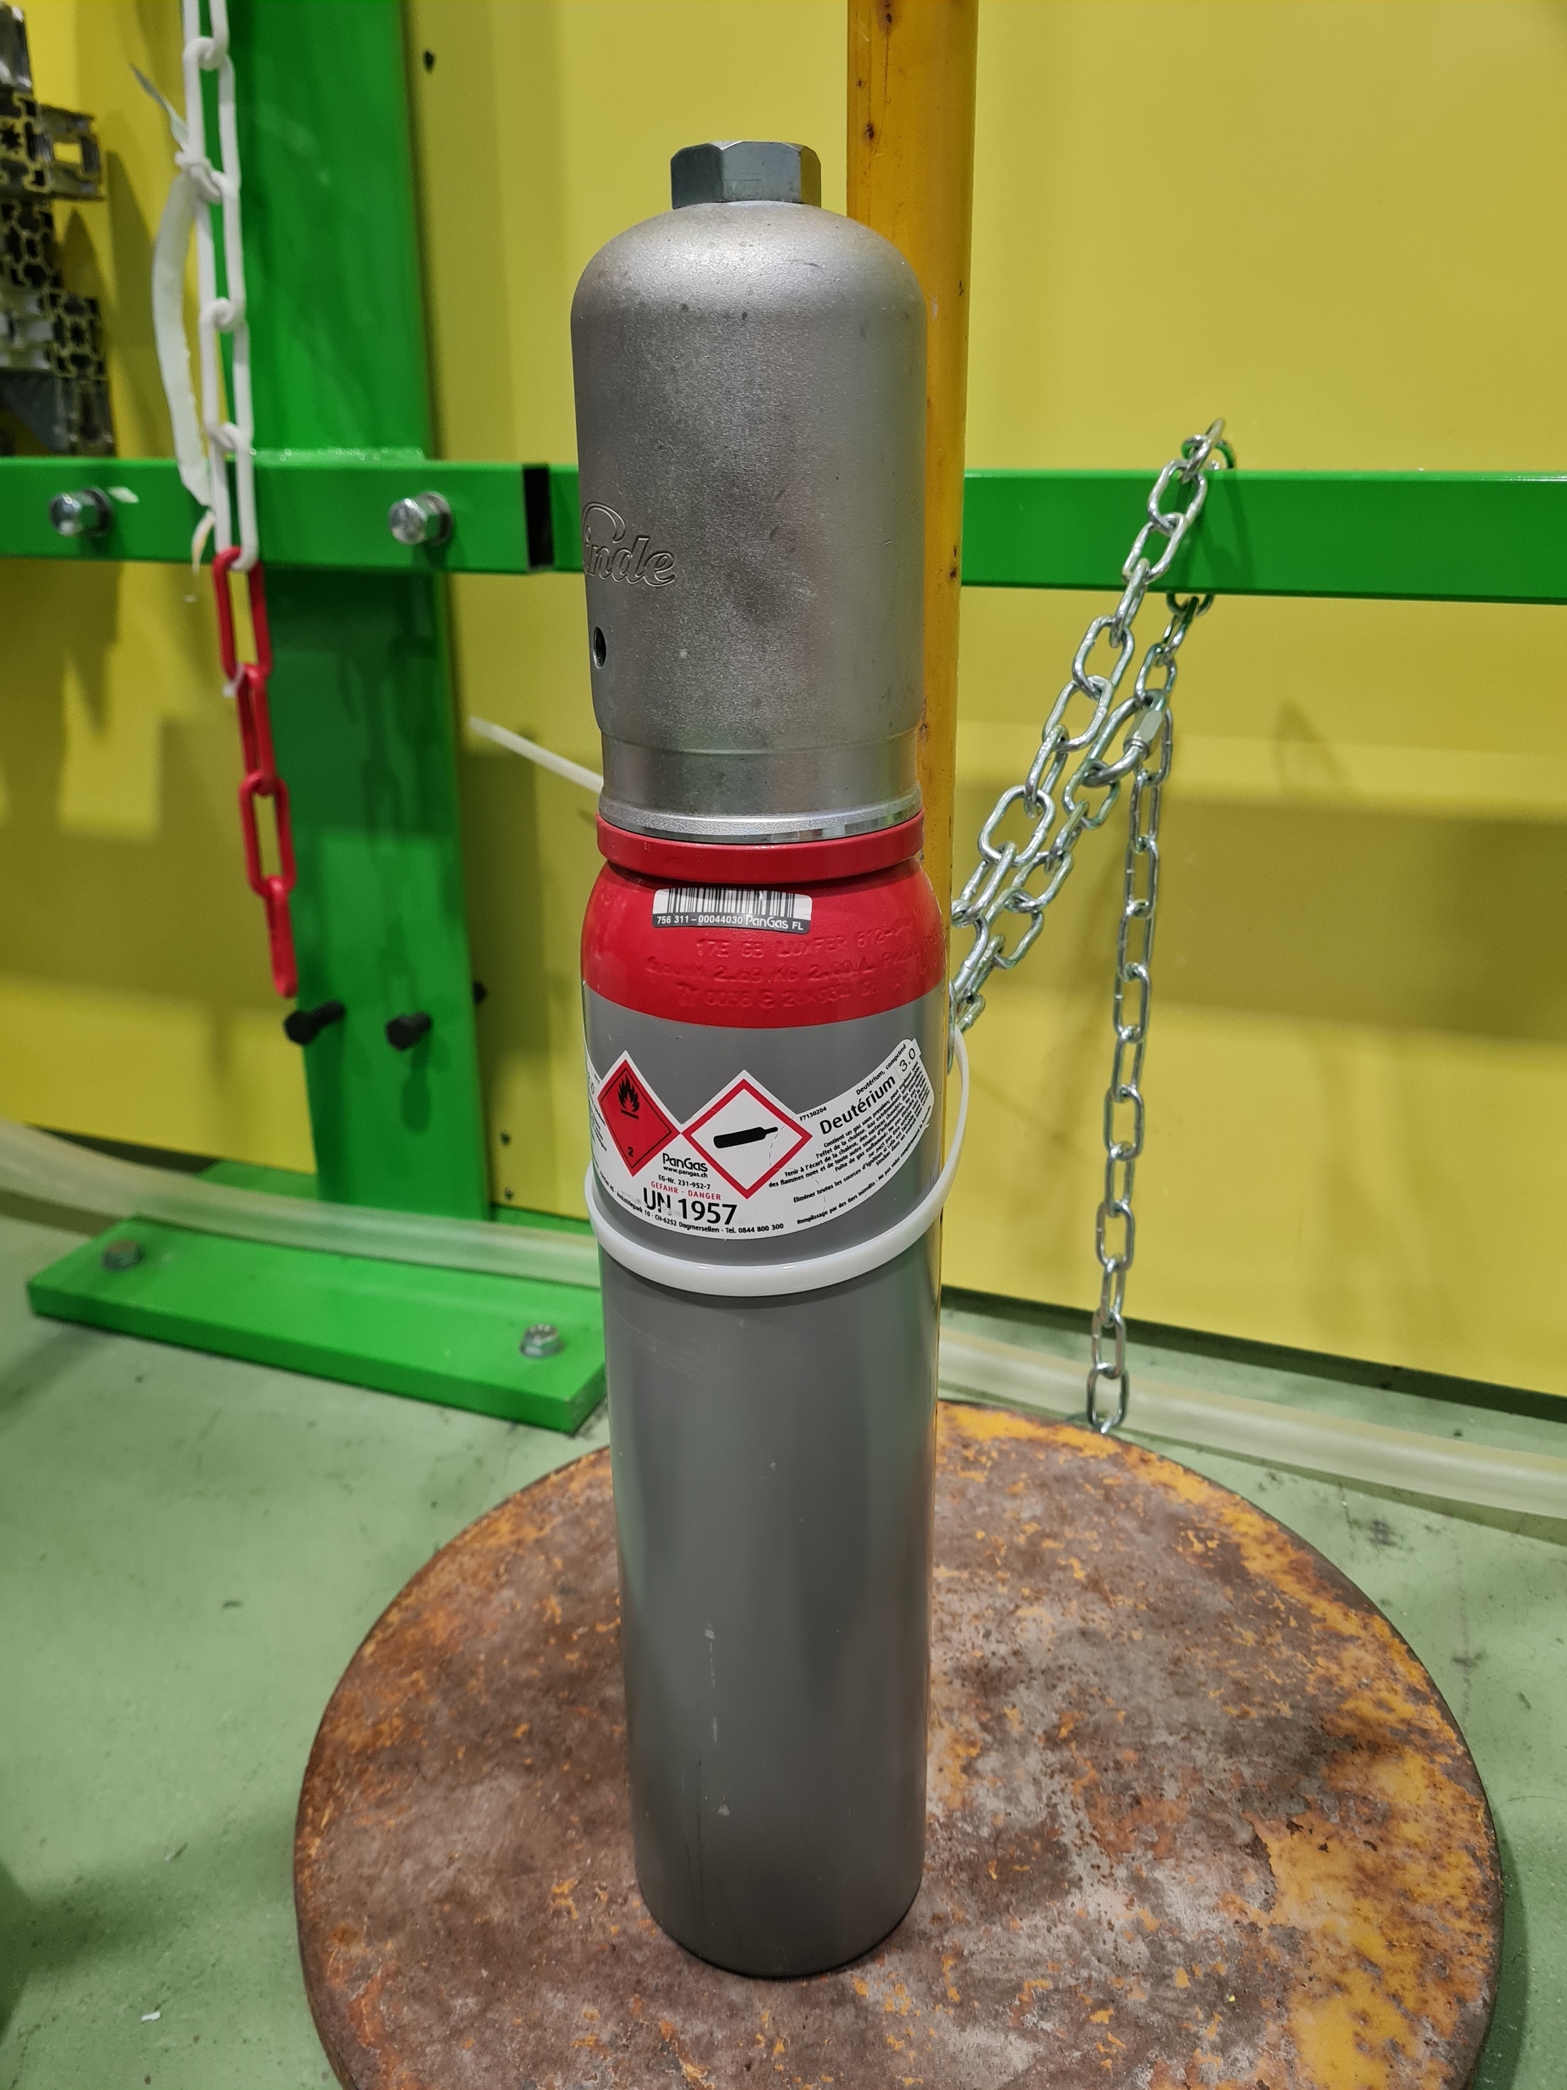
Online commissioning of SpecMAT at HIE-ISOLDE 2023
²²Ne @ 7.58 MeV/u on D₂ @ 800 mbar
8 𝜇m Mylar window → Beamline 8×10⁻⁸ mbar | Detector 800 mbar
Main reaction branches expected to observe:
²²Ne(d,d)
²²Ne(d,p)
²²Ne(d,³He)
²²Ne(d,t)
Analysis is ongoing

Slide 25
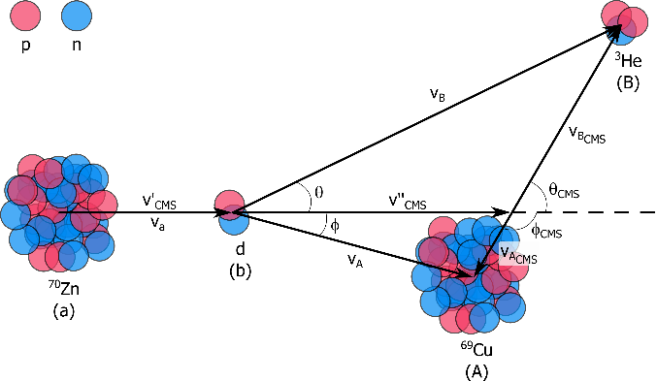
Physics perspectives
Simulation of a
⁷⁰Zn(d, ³He)⁶⁹Cu reaction

Slide 26
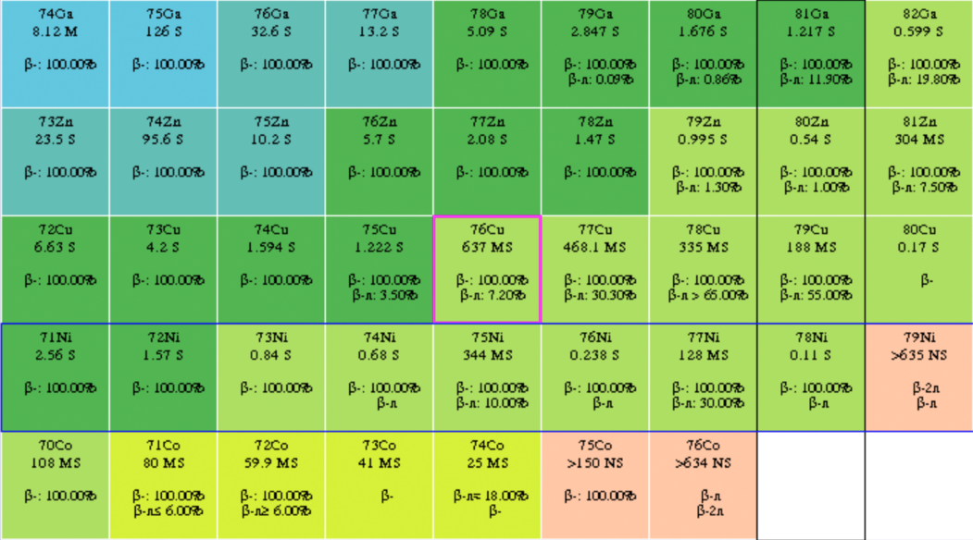
Physics case
Shell evolution in ⁶⁹⁻⁷⁵Cu
Z=28
Region of n-rich Ni towards ⁷⁸Ni
N=50

Slide 27
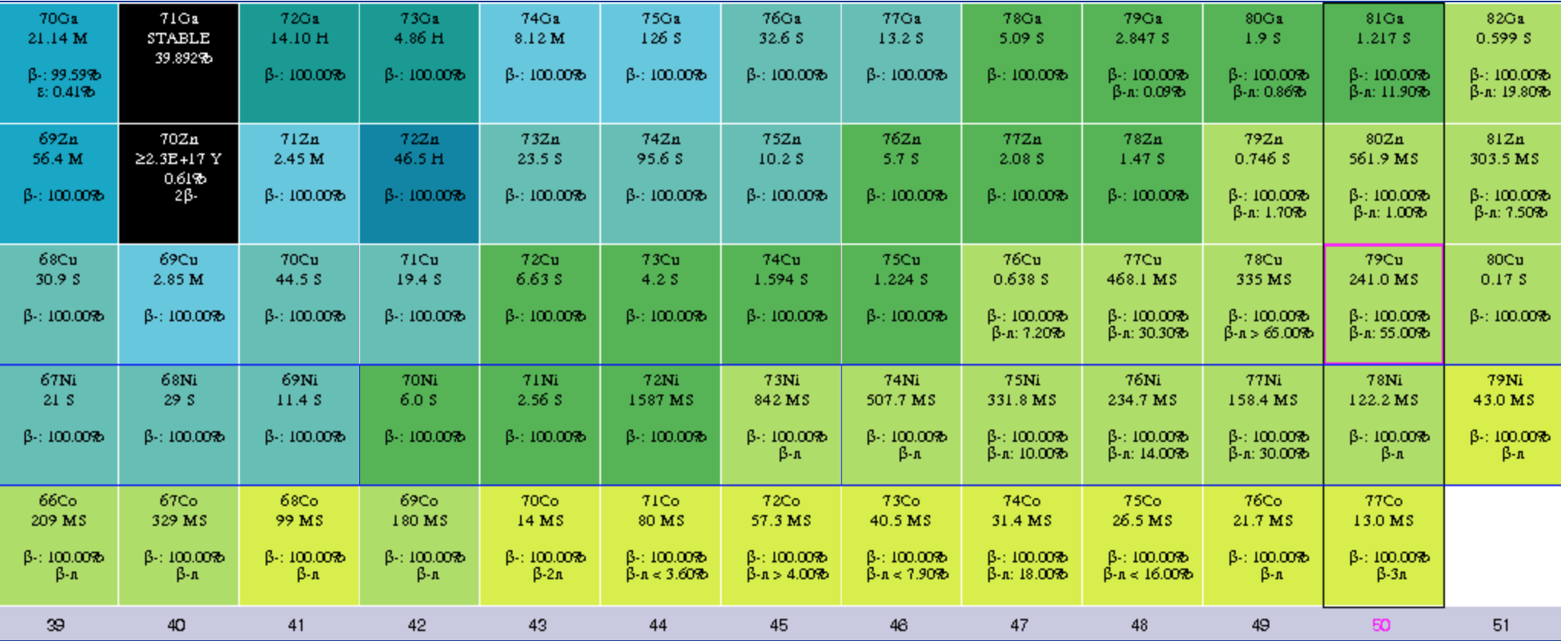
^{Physics case}
[K.Flanagan, Phys. Rev. Lett., vol. 103, p. 142501, Oct 2009]
Shell structure of
odd Cu isotopes via
nucleon transfer reactions on Zn:
⁷⁰Zn(d,³He)⁶⁹Cu
⁷²Zn(d,³He)⁷¹Cu
⁷⁴Zn(d,³He)⁷³Cu
⁷⁶Zn(d,³He)⁷⁵Cu
3/2
5/2
Z=28
Region of ⁷⁸Ni
1f_{5/2}
2p_{3/2}
(d,³He)
1f_{7/2}
[T. Otsuka, et al., PRL, 104, 012501 (2010)]
Protons in ⁷²Zn
Protons in ⁷¹Cu*

Slide 28
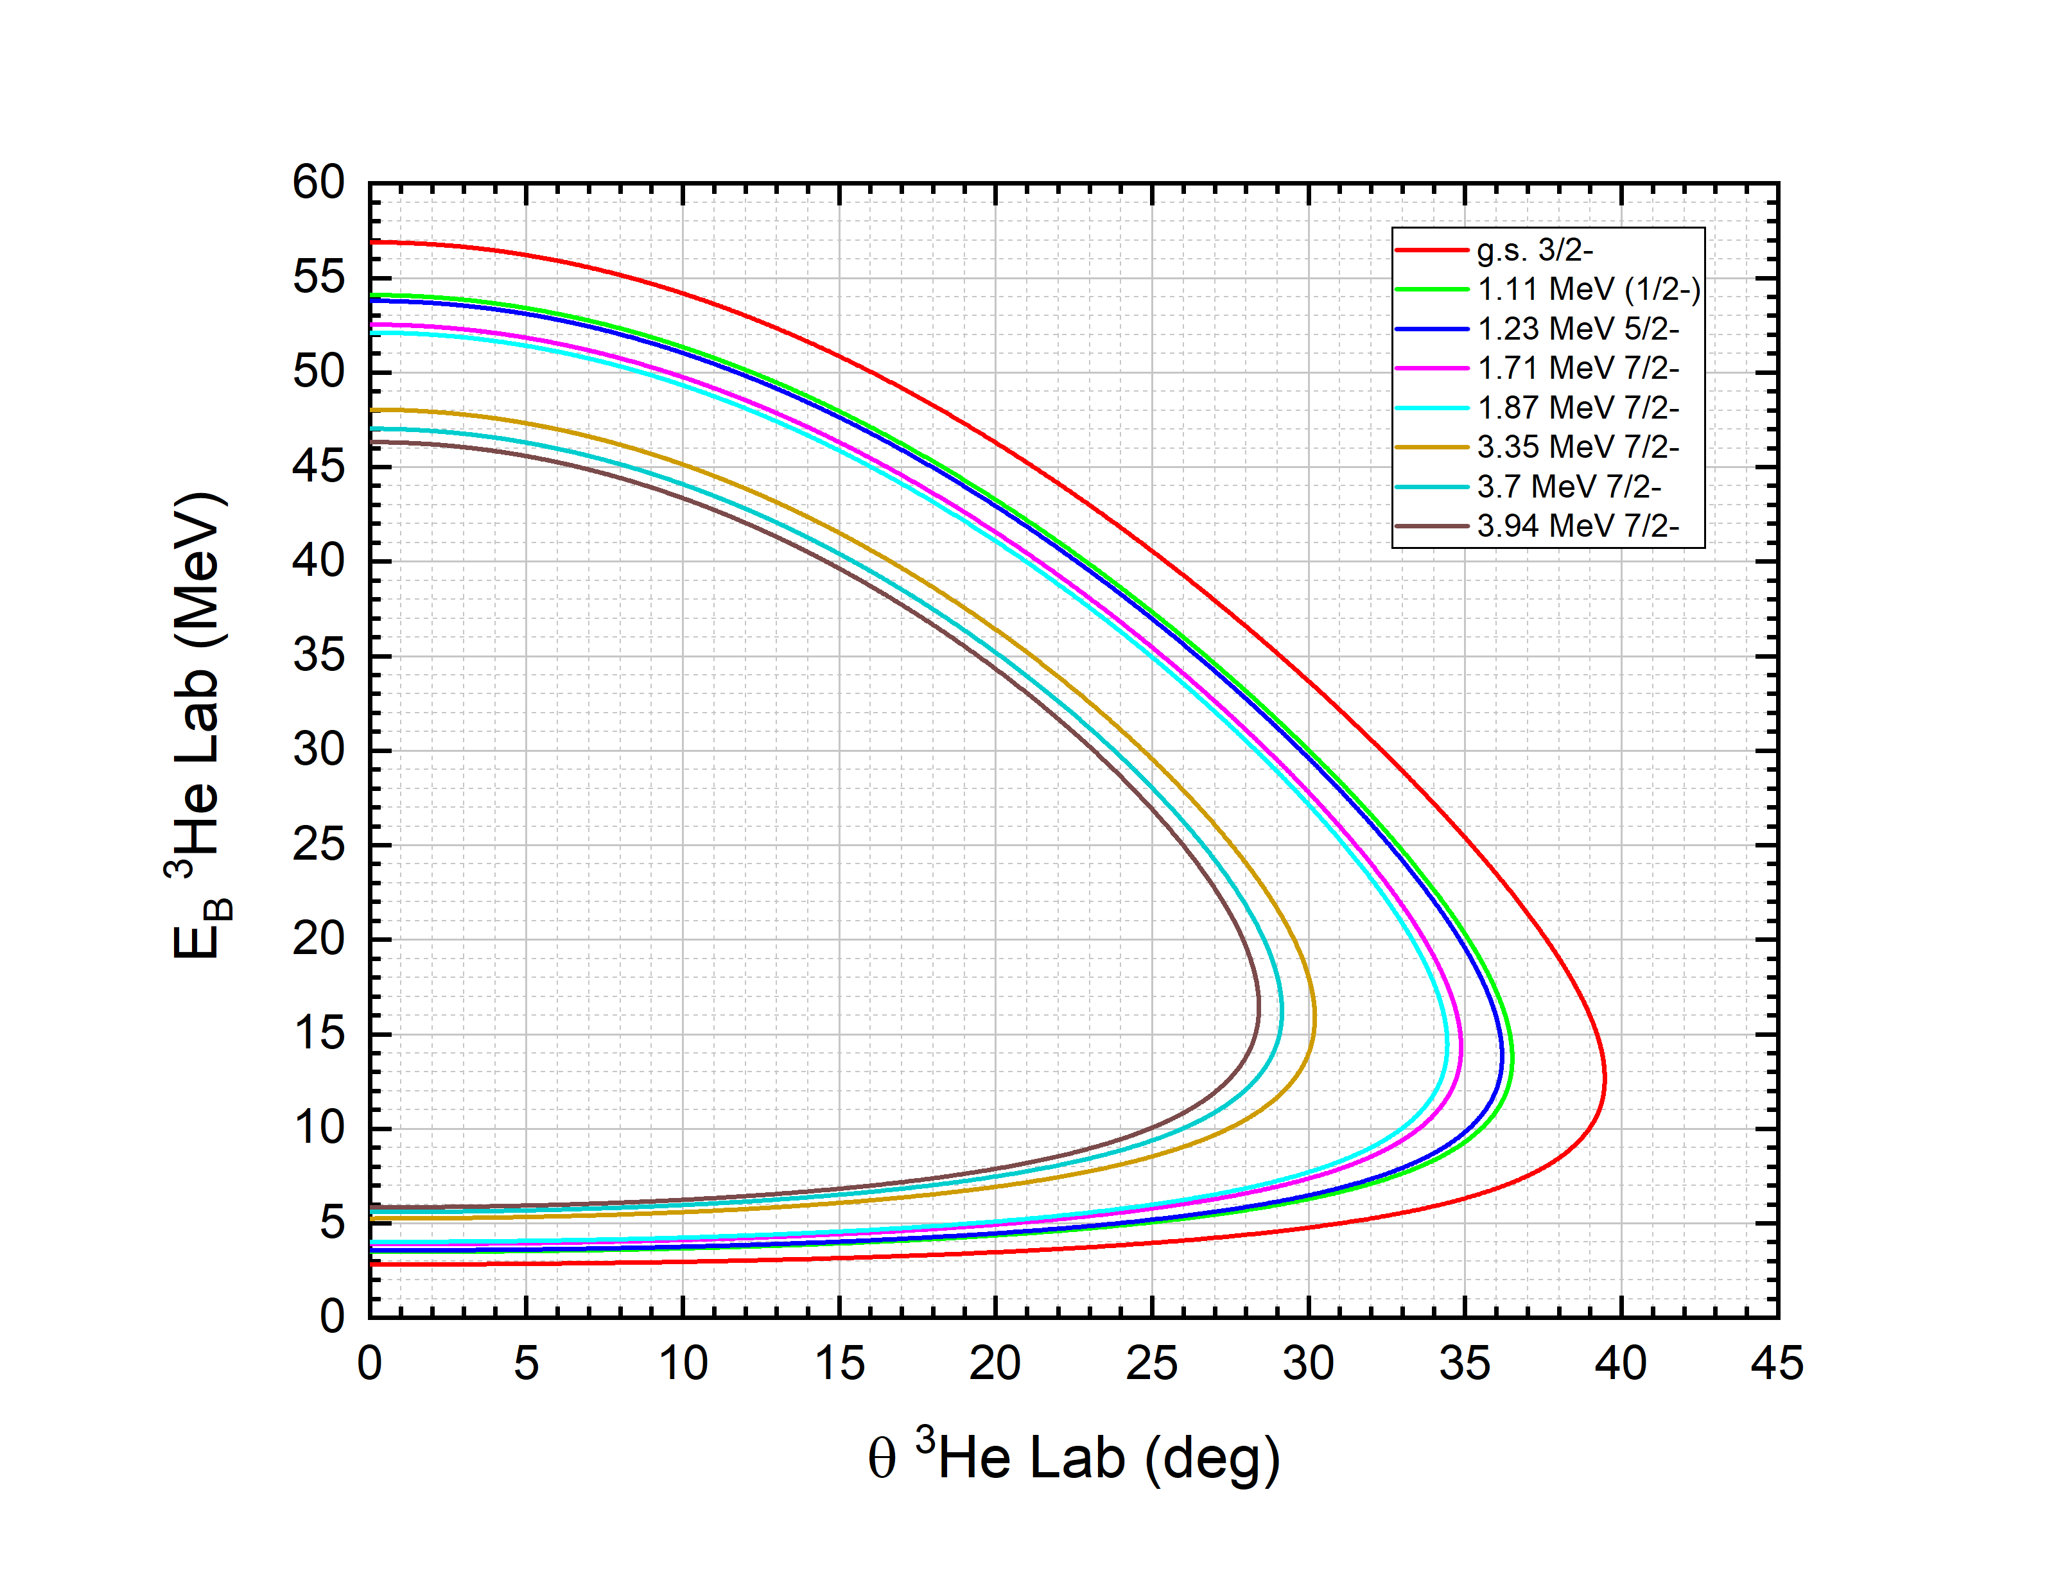
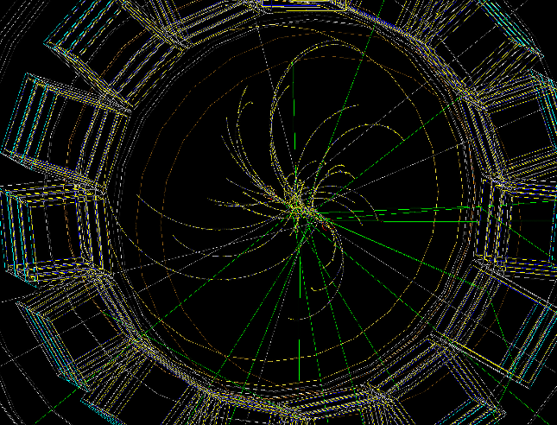
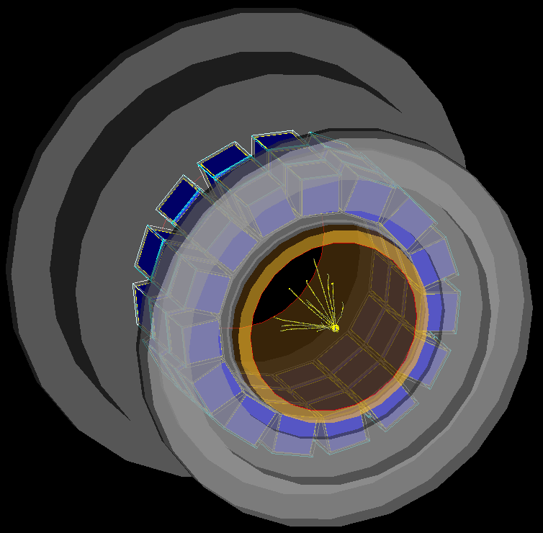

⁷⁰Zn(d, ³He)⁶⁹Cu reaction simulation
in G4 for SpecMAT
+ B-field =
4T
Cross section data from [P. Morfouace https://doi.org/10.1103/PhysRevC.93.064308], DWBA by J.C. Yang

Slide 29



Proposing a new analysis method
4T no MICROMEGAS binning

Slide 30

Excitation spectra obtained with the new analysis method
g.s.
1.11 & 1.23 MeV
3.35 MeV
1.71 & 1.87 MeV
3.7 & 3.94 MeV

Slide 31

Analysis based on (full+partial)-track length
Gating on the gamma-ray spectrum

Slide 32




Ejectile particle
Analysis based on (full+partial)-track length
Gating on the gamma-ray spectrum
Polar angle (𝜃 lab)
Azimuthal angle

Slide 33

Analysis based on (full+partial)-track length
Gating on the gamma-ray spectrum

Slide 34


Analysis based on (full+partial)-track length
Gating on the gamma-ray spectrum

Slide 35




Summary
The SpecMAT active target was designed, built and tested.
The active target was characterised in 0T and in 2.5T.
An experimentally verified set of simulations was developed.
A novel analysis method of the spiral tracks was proposed.
Online commissioning of the detector with a ²²Ne beam was successful.
We are upgrading the detector with THGEMs and preparing to the first experimental campaign with exotic RIBs.

Slide 36
Thank you for your attention!

Slide 37
Backup slides

Slide 38





⁷⁰Zn(d, ³He)⁶⁹Cu--9.5MeV/u--2.5T--D₂@1bar
g.s.
1 MeV
2 MeV
3 MeV
4 MeV
DWBA by B. Kay

Slide 39






Measurement vs G4
α-particle length spectra
Measurement
Geant4

Slide 40

Geant4

Slide 41

Geant4
Phi > 0 deg

Slide 42

Geant4
Phi > 30 deg

Slide 43






Analysis based on full-track length
0T with MICROMEGAS binning
Track parameters (θ, L) from fitting
4T no MICROMEGAS binning
Track parameters from G4

Slide 44

Analysis based on full-track length
0T with MICROMEGAS binning
Track parameters (θ, L) from fitting
4T no MICROMEGAS binning
Track parameters from G4
Beam
Beam

Slide 45
Analysis based on full-track length
0T with MICROMEGAS binning
Track parameters (θ, L) from fitting
4T no MICROMEGAS binning
Track parameters from G4

Slide 46
Analysis based on full-track length
0T with MICROMEGAS binning
Track parameters (θ, L) from fitting
4T no MICROMEGAS binning
Track parameters from G4

Slide 47
Analysis based on full-track length
0T with MICROMEGAS binning
4T no MICROMEGAS binning

Slide 48

Analysis based on full-track length
Excitation spectra
g.s.
Res: 111 keV
Res: 186 keV
1.11 & 1.23 MeV
1.71 & 1.87 MeV

