Slide 1




TID effects study on the monitoring system of the RD53 chip
Mohsine Menouni
On behalf of the RD53 collaboration
Aix Marseille University, CNRS/IN2P3, CPPM
Technology & Instrumentation in Particle Physics Conference TIPP2023
CTICC - Cape Town - South Africa – 4-8 September 2023

Slide 2
Outline
Introduction
  RD53 project
  RD53 chip description
  Test results
Monitoring functions
  Description
  General Purpose ADC
  TID effects
RD53B sensors
  Temperature sensor principle
  Measurements based on the direct method
  Measurements based on the self-referencing method
  TID effects
Monitoring correction
Summary and Conclusion

Slide 3
RD53 project
RD53 collaboration was established to design and develop pixel chips for ATLAS/CMS phase 2 upgrades
The RD53 project includes 24 institutes - ~20 designers
Extremely challenging requirements for HL-LHC
  Hit rates: 3 GHz/cm², Small pixels: 50 x 50 µm²
  Radiation: 500 Mrad - 10¹⁶ neq/cm² over 5 years
Technology: 65nm CMOS
Characterization of the 65nm process in radiation
Several prototypes to qualify IP blocs (Analog FE, ADC, DAC, CDR/PLL, ShuntLDO …)
RD53A chip, Large-scale demonstrator with 3 FE flavors, Submitted in August 2017 and tested in an intensive way
ATLAS and CMS chips are two instances of the same common design, having different sizes and different Analog Front-End
RD53B chip (preproduction)
  ITkPix-V1 (ATLAS chip) submitted in March 2020
  CROC-V1 (CMS chip) submitted in May 2021
RD53C chip (Production)
  ITkPix-V2 (ATLAS chip) received in July 2023 and is still under tests and characterization
  CROC-V2 (CMS chip) to be submitted in September 2023
RD53A
Size: 20 x 11.5 mm²
submitted in August 2017
RD53B-ATLAS (ITkPix-V1)
size: 20 x 21 mm²
Submitted in March 2020
RD53B-CMS (CROC-V1)
size: 21.6 x 18.6 mm²
Submitted in May 2021
RD53C-ATLAS (ITkPix-V2)
Submitted in March 2023
RD53C-CMS (CROC-V2)
size: 21.6 x 18.6 mm²
To be submitted in Sept 2023
ITkPix-V1 test board

Slide 4
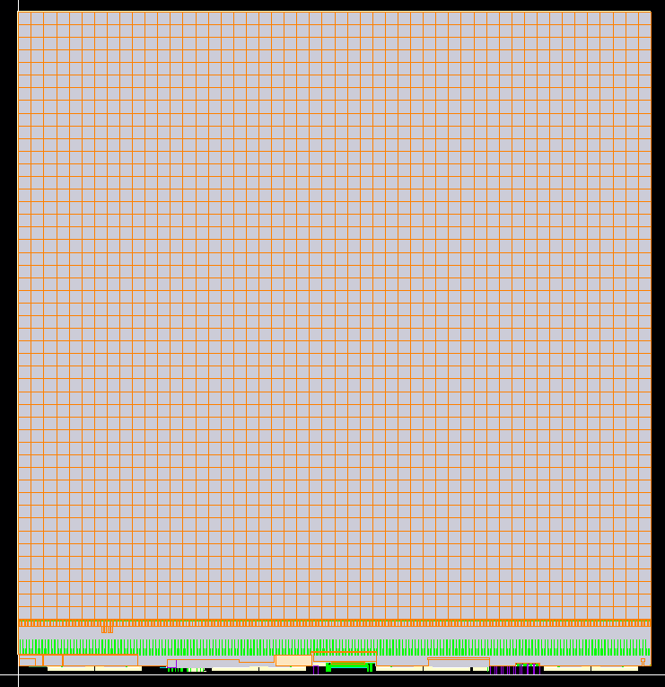
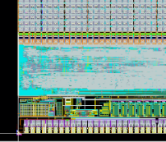


RD53B Floorplan
Core : 64 pixels
Chip Bottom (Periphery)
  Analog Chip Bottom (ACB):
    Analog and mixed/signals building block for Bias, Calibration, Monitoring, and Clock/Data Recovery (CDR)
  Digital Chip Bottom (DCB):
    Synthesized digital logic
  Pad frame
    I/O blocks with ESD protections, ShuntLDO for serial powering
    Readout via serial links (1-4 x1.28Gbit/s) using Aurora64/66 encoding
Chip Bottom
Pixel : 50 µm×50 µm
Pixel array
  384 x 400 pixels of 50 x 50 µm²
  153 600 pixels organized in 2400 identical cores
  1 core → 16 analog islands
  4 fronts ends per island
  Analog FE are embedded in a flat digital synthesized “sea”
  Time Over Threshold (ToT) digitization
  Shared Pixel Region buffer : Hit storage during Trigger latency

Slide 5
RD53B-ATLAS test results
Before tuning:
Threshold: ~ 1860 e-
Thresh. dispersion: ~ 300 e-
Noise: 41 e-
After tuning:
Thresh. dispersion: ~ 80 e-
Noise: 40 e-
Threshold: ~ 700 e-

Slide 6
  Monitoring functions

Slide 7
Monitoring description
The PAD “V_mux pad” is dedicated for optional external measurement
Monitored voltages (VMUX)
  Sensors, Calibration, FE, Reference voltages, Power supplies, and SLDO voltages
Monitored currents (IMUX)
  FE (Global DACs), CDR, CML, IREF, SLDO current
The IMUX output current is converted to voltage thanks to the external resistance R_IMUX and measured by selecting IMUX_OUT input in the VMUX
External NTC can be read out through the VMUX or the ADC
  It is supplied by a current from the I_NTC DAC (on-chip 10-bit DAC)
The on-chip 12-bit ADC is based on SAR architecture
The Integral Non-Linearity (INL) of the ADC is estimated to ±2 LSB
IMUX
VMUX
The Monitoring in the RD53 chip enables the digitization of several sensitive parameters in the chip :
  Voltages or currents in different parts of the chip
  Temperature
  Total ionizing dose
The Monitoring block contains :
  An analog current multiplexer (IMUX) followed by an analog voltage multiplexer (VMUX)
  A 12-bit Analog to Digital Converter (ADC)

Slide 8
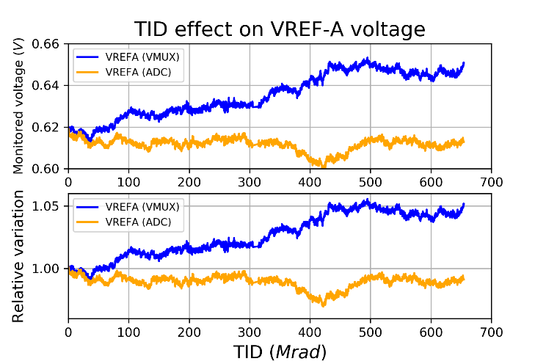
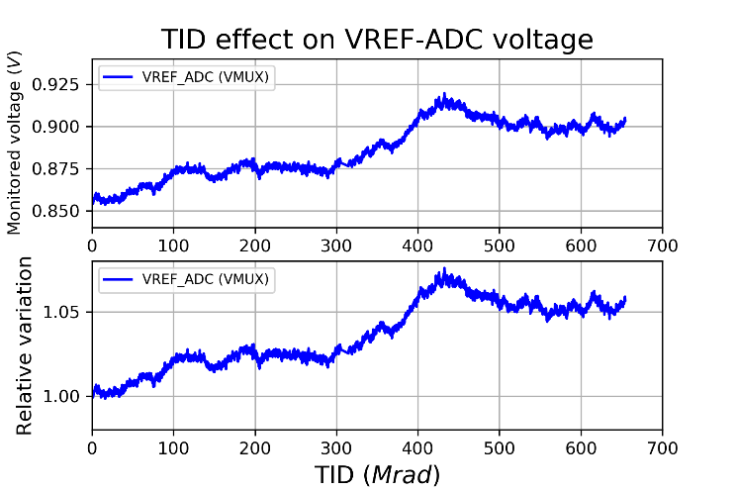
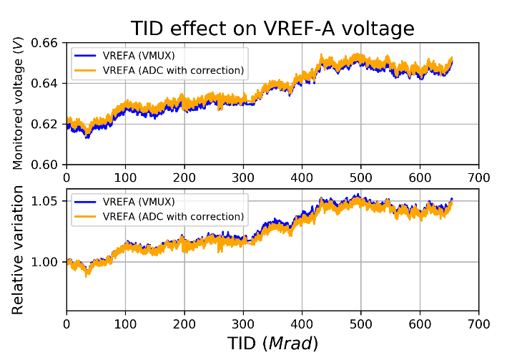
TID test results
Several TID test campaigns have been performed with X-ray sources at low temperatures (<-10 °C)
Measurements of the monitored voltages and currents as a function of the TID up to 650 Mrad were done with:
  External voltmeter at the VMUX_PAD and directly with the on-chip ADC
Example of the reference voltage Vref_{A} that defines the value of power supply V_{DDA}
Measurement Through the VMUX_PAD (Voltmeter)
  Vref_{A} value is sensitive to the TID level
  At 500 Mrad: Vref_{A} shift is +5%
Vref_{A} (ADC) is different from Vref_{A} (VMUX)
  The pre-irradiation value of Vref_{ADC} is used to convert the Vref_{A} code, assuming that Vref_{ADC} is invariant with the TID
Vref_{ADC} is in fact sensitive to the TID and it shifts by +8% at 500 Mrad
If the variation of Vref_{ADC} with the TID is considered :
  Vref_{A} (ADC) is very close to Vref_{A} (VMUX)
Vref_{ADC} variation with the TID has the most significant impact on the measurement accuracy for the monitoring bloc
During the experiment runs, monitoring can be done only through the ADC. The VMUX out is not accessible at all
Find an entity in the chip with a very small variation with the TID that can be used as a reference for ADC measurements
This seems to be possible using some properties of the temperature sensor

Slide 9
  RD53B sensors

Slide 10
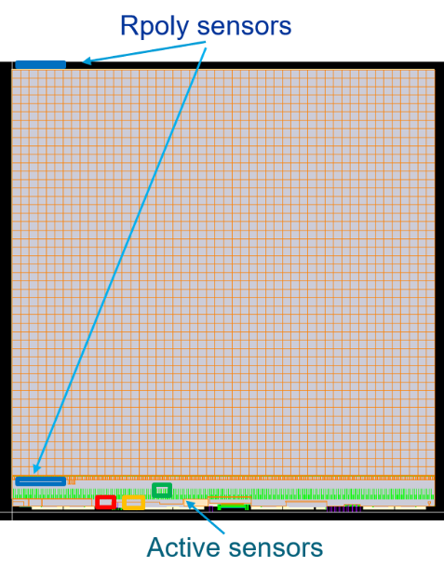
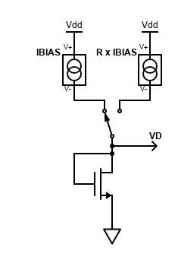






RD53 temperature sensor
Different temperature sensors are implemented in the RD53B chip :
  Three active sensors are implemented in the chip bottom close to the shunt LDO circuit, considered the hottest part of the chip
    Based on NMOS diode-connected transistor
    Large area devices -> very tolerant to the TID effect
  Two sensors based on r-poly resistances are placed on the top and the bottom of the chip
    Monitor the temperature difference between the top and the bottom of the pixel array
  NTC device implemented outside the chip but the bias current is provided from the chip
The direct method for temperature measurement:
The two biases I_{BIAS} and R×I_{BIAS} are applied consecutively to the sensor
The temperature is calculated off-line based on the difference between D_{OUT2} and D_{OUT1}
The potential sources of temperature measurement error:
  ADC non-linearity (INL -> ±1°C)
  The ratio R of the two sensor bias currents
  The N_{f} factor defining the weak-inversion slope
  Vref_{ADC} variation
Basic sensor structure
$$V_{D1}=V_{D}\left(I_{BIAS}\right)$$
$$V_{D2}=V_{D}\left(R×I_{BIAS}\right)$$
${\text{}V}_{D}=$ $V_{D2}−V_{D1}$
$$T_{ab}=\frac{q}{N_{f}×k_{B}×\ln{R}}×∆V_{D}$$
$$T_{ab}=\frac{q}{N_{f}×k_{B}×\ln{R}}×\left(D_{OUT2}−D_{OUT1}\right)×LSB$$
$$LSB=0.947×\frac{Vref_{ADC}}{4096}$$

Slide 11
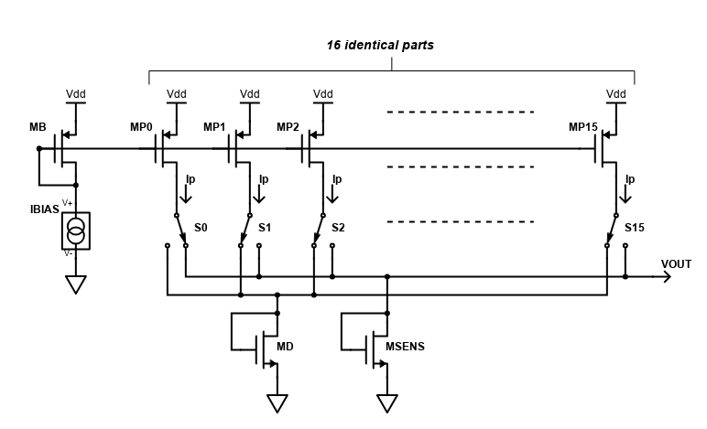


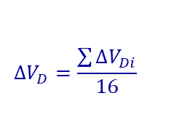
RD53B temperature sensor
Dynamic Element Matching (DEM)
The mismatch of the ratio R of the current mirror can strongly reduce the measurement accuracy
  Dynamic Element Matching (DEM) is implemented to reduce this mismatch
    Interchanging the unit bias transistor using a switch array
    Up to 16 different values of ΔV_{D} are measured and averaged
    Requires 32 ADC conversions to measure one temperature value
    Reduces significantly the error due to the ratio R
The weak-inversion slope factor N_{f} is sensitive to the process and the mismatch
  A calibration method was developed at ambient temperature and uses the external NTC to give the reference temperature
  Determine the N_{f} factor for each sensor with a high-precision
  Large area device used for the sensor makes N_{f} invariant with the TID
Vref_{ADC} is sensitive to the TID and the increase is 8% at 500 Mrad
  The temperature measurement variation with the TID is directly proportional to the variation of Vref_{ADC}
  A measurement error of about 20◦C at -10°C (263°K) can be reached at 500 Mrad →Not acceptable
$$∆V_{D}=\frac{\sum{∆V_{Di}}}{16}$$
$$T_{ab}=\frac{q}{N_{f}×k_{B}×\ln{R}}×∆V_{D}$$
$$T_{ab}=\frac{q}{N_{f}×k_{B}×\ln{R}}×\left(D_{OUT2}−D_{OUT1}\right)×LSB$$
$$LSB=0.947×\frac{Vref_{ADC}}{4096}$$

Slide 12
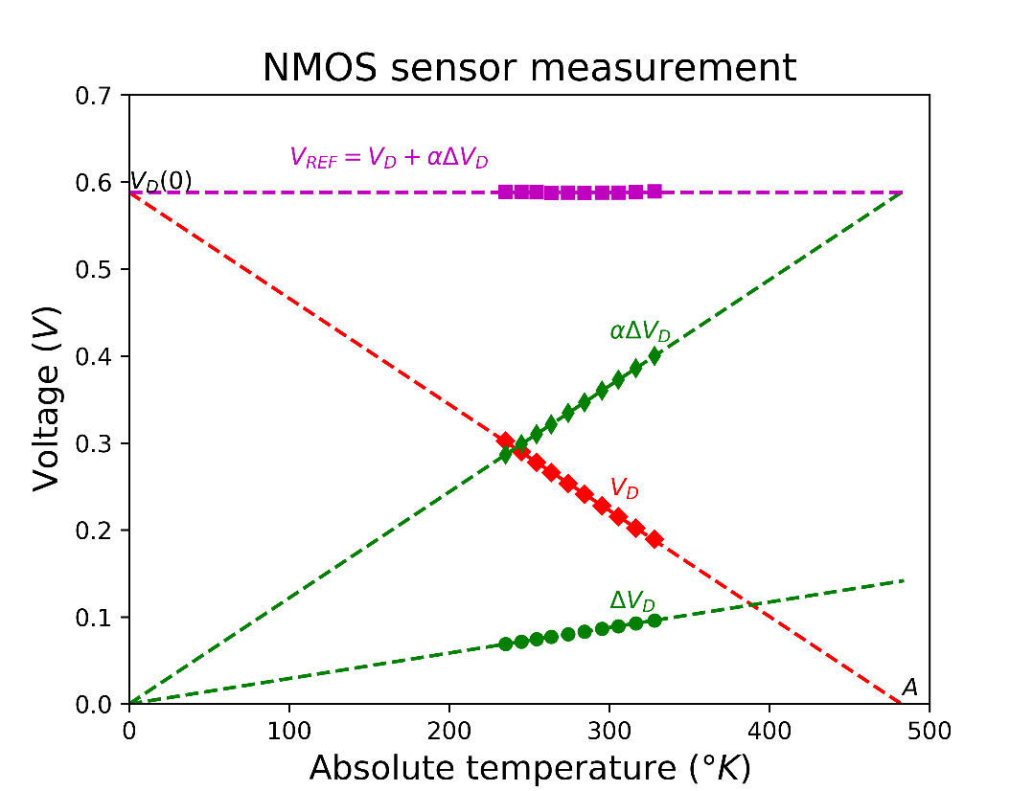

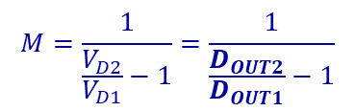


Self-referencing method
The main purpose of this method is to avoid to include VrefADC for the temperature calculation
The new reference voltage is determined directly from the voltages across the sensor itself (V_{D} and ΔV_{D} )
The absolute temperature is determined as :
A, α and V_{D}(0) are process parameters
α represents the slope of V_{D} (T), determined by measuring V_{D} versus the temperature for each wafer batch process
V_{D}(0) determined by extrapolating VD(T) for T=0K
A and α depends also on the sensor current → Needs chip-to-chip adjustment that can be done during the sensor calibration
The absolute temperature can be written as:
Temperature measurement depends directly on the D_{OUT2}/D_{OUT1} ratio and so Vref_{ADC} is not considered in the calculation
$V_{REF}=α×ΔV_{D}+V_{D}=$ $V_{D}\left(0\right)$
$$T_{ab}=A×\frac{α×ΔV_{D}}{V_{REF}}$$
$$T_{ab}=A×\frac{α}{α+M}$$
$$M=\frac{1}{\frac{V_{D2}}{V_{D1}}−1}=\frac{1}{\frac{D_{OUT2}}{D_{OUT1}}−1}$$

Slide 13

Measurement error
The drift of the bias current (I_{BIAS}) with the TID is the principal cause of loss of precision in the temperature measurement
ΔV_{D} is not depending on the bias current (I_{BIAS})
V_{D} increases with I_{BIAS} and so V_{REF} also increases
  The amount of V_{D} increase is proportional to the absolute temperature T_{ab}
If P denotes the relative change of I_{BIAS} with the TID, V_{D} shift is estimated to:
The table shows the drift of V_{D} and of the temperature for P = 1% (50 Mrad) and P = 8% (500 Mrad)
The logarithmic variation of V_{D} versus the I_{BIAS} makes the relative variation of V_{D} as well as the temperature less critical than that of the I_{BIAS}
At 500 Mrad, the measurement error is less than 1◦C at
-20 ◦C
This method remains largely more accurate since it is insensitive to Vref_{ADC} variation
The results look acceptable
Effects of I_{BIAS} drift
$$V_{D}−V_{D−prerad}=\frac{N_{f}×k_{B}×T_{ab}}{q}×ln\left(1+P\right)$$
TID effects on the temperature measurements
(50 Mrad)
(500 Mrad)

Slide 14
  ADC reference voltage correction

Slide 15
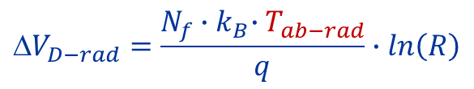


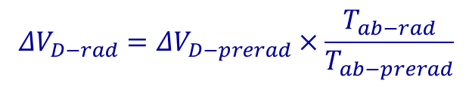
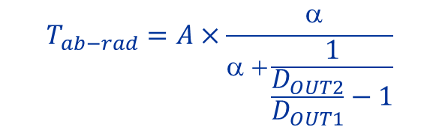
Monitoring correction
All the reference voltages in the RD53B chip including Vref_{ADC}, are based on the reference current I_{REF}
generated from a band-gap circuit
I_{REF} is sensitive to the TID → All the monitored voltages vary with the TID
ΔV_{D} = V_{D2} - V_{D1} related to the temperature sensor is insensitive to the current I_{REF} and so it is insensitive to the TID if the temperature measurement is not shifting with the TID
The self-referencing method should be used during the experiment runs
ΔV_{D} can therefore be used as the reference voltage for the ADC
ΔV_{D-rad} voltage during the operation of the detector is calculated based on the pre-radiation value
The value of the effective LSB (LSB_{rad})of the ADC can thus be determined. (It corresponds to the Vref_{ADC} correction)
This LSB_{rad} is then used to calculate directly the other voltages and current based on the output ADC codes
Adjusting some critical voltages can be applied if necessary
$${\text{}V}_{D−rad}=\frac{N_{f}{∙k}_{B}∙T_{ab−rad}}{q}∙ln\left(R\right)$$
$$T_{ab−rad}=A×\frac{ α}{α +\frac{1}{\frac{D_{OUT2}}{D_{OUT1}}−1}}$$
$$ΔV_{D−rad}=ΔV_{D−prerad}×\frac{T_{ab−rad}}{T_{ab−prerad}}$$
$$LSB_{rad}=\frac{ΔV_{D−rad}}{ΔD_{OUT}}$$
$$ΔD_{OUT} = D_{OUT2} − D_{OUT1}$$

Slide 16
Summary and conclusion
Radiation test campaigns have been performed with X-ray sources at low temperatures (<-10 °C)
  Variation of Vref_{ADC} with the TID -> increase by about 8% for 500 Mrad
  Temperature measurement using the direct method is not acceptable
A new method that does not use Vref_{ADC} is proposed and allows a good accuracy even for high TID levels.
Based on the two measurement methods of the temperature, a monitoring correction method is developed
It should respect the following steps :
Before the experiment runs:
  Calibrate temperature sensor chip by chip to compensate for the mismatch effect → N_{f}
  Determine process parameters for the temperature sensor : VD(0), α, and A
  Perform pre-irradiation measurements for each chip: ΔV_{D_prerad} and T_{ab_prerad} , all the monitored Voltages, currents
During the experiment runs :
  The absolute temperature T_{ab-rad} is measured with the self-referencing method
  The post-radiation ΔV_{D_rad} is determined knowing T_{ab-rad} , ΔV_{D_prerad} and the corresponding T_{ab_prerad}
  The LSB of the ADC (LSB_{rad}) is then calculated and is used for the ADC code conversion
  Correction can be done at regular time intervals

Slide 17
  Thank you for your attention

Slide 18
Monitored signals (Voltages)
Monitored signals : Sensors, Calibration voltages, FE, BG
SLDO voltages are monitored
Sensors : Temperature based on the voltage difference measurement
  Offset is compensated
Other Voltages : Variation from a starting value
  No need for ADC offset compensation
Value |  |  | Value
0 | VREF_ADC |  | 19-30 | NOT USED
1 | IMUX_OUT |  | 31 | VMON_VREF_CORE
2 | NTC |  | 32 | VMON_VREF_PRE
3 | VREF_VDAC |  | 33 | VMON_VINA
4 | VMON_HALFVDDA_INJCAP |  | 34 | VMON_VDDA
5 | RPOLYTSENS_TOP |  | 35 | VMON_VREFA
6 | RPOLYTSENS_BOTTOM |  | 36 | VMON_VOFS
7 | CAL_HI_GBL |  | 37 | VMON_VIND
8 | CAL_MI_GBL |  | 38 | VMON_VDDD
9 | VTH2G |  | 39 | VMON_VREFD
10 | VTH1G_M
11 | VTH1G_L
12 | VTH1G_R
13 | RADSENS_SLDOA
14 | TEMPSENS_SLDOA
15 | RADSENS_SLDOD
16 | TEMPSENS_SLDOD
17 | RADSENS_ACB
18 | TEMPSENS_ACB

Slide 19
Monitored signals (Currents)
Value |  |  | Value
0 | MON_IREF |  | 16 | MON_TH1_M
1 | MON_VCO_CDR |  | 17 | MON_LCC
2 | MON_VCOBUFF_CDR |  | 18 | MON_VFF
3 | MON_CP_CDR |  | 19 | MON_PREAMP_L
4 | MON_CP_FD_CDR |  | 20 | MON_TH1_L
5 | MON_CP_BUFF_CDR |  | 21 | MON_PREAMP_R
6 | MON_CML_BIAS_2 |  | 22 | MON_PREAMP_TL
7 | MON_CML_BIAS_1 |  | 23 | MON_TH1_R
8 | MON_CML_BIAS_0 |  | 24 | MON_PREAMP_T
9 | MON_BIAS_NTC |  | 25 | MON_PREAMP_TR
10 | MON_INJCAP |  | 26 | NOT USED
11 | MON_INJCAP_PAR |  | 27 | NOT USED
12 | MON_PREAMP_M |  | 28 | MON_IINA
13 | MON_PRECOMP |  | 29 | MON_ISHUNTA
14 | MON_COMP |  | 30 | MON_IIND
15 | MON_TH2 |  | 31 | MON_ISHUNTD
Select the IMUX_OUT channel of the voltage multiplexer
IREF, FE (Global DACs), CDR, CML, NTC
New features in RD53B :
  The external NTC will be read through the ADC
    The NTC current bias is provided inside the chip
  SLDO currents are monitored

Slide 20
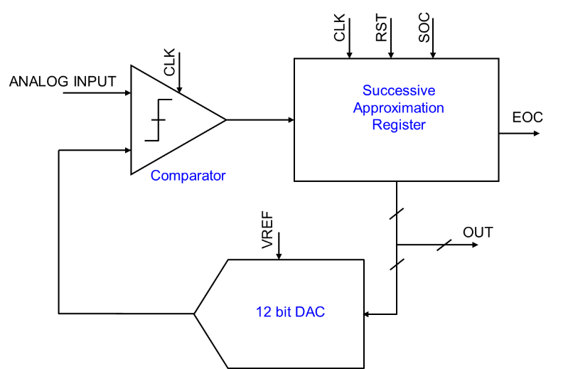
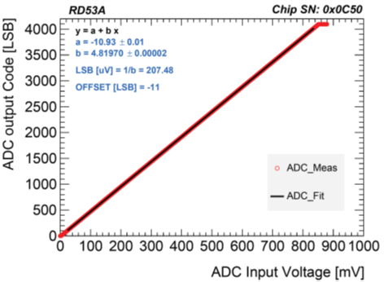
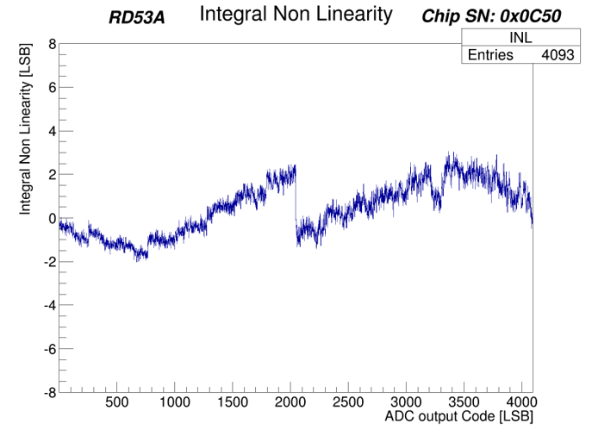

General Purpose 12-bit ADC
The ADC main clock is set to 39 kHz (40 MHz/1024)
The ADC tests and characterization were done with commercial 16-bit DACs (LSB is 27.5μV)
For a reference voltage of 900 mV, the LSB value is 208 μV and related to the Vref_{ADC} value by :
The factor 0.947 takes into account the effect of the load capacitance seen at DAC on the output
The peak INL is estimated to be ±2 LSB and the plot shows that the INL has a jump at the middle of output codes
$$LSB=0.947×\frac{Vref_{ADC}}{4096}$$
The 12-bit ADC is based on a Successive-Approximation Register (SAR) architecture and consists of 3 main circuits
  A 12-bit DAC based on a capacitance network
  A high-sensitivity comparator
  A SAR logic block

Slide 21
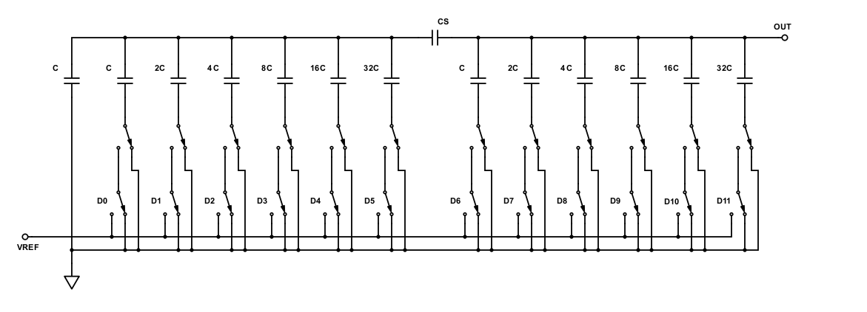
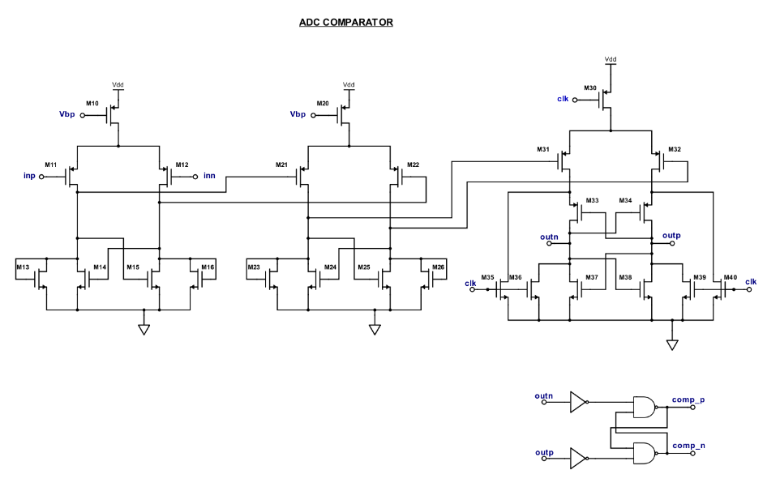
General Purpose 12-bit ADC
The 12-bit ADC is based on a Successive-Approximation Register (SAR) architecture
The circuit takes the chip bunch crossing clock, nominally 40 MHz, and divides it down with a 1024:1 frequency divider to generate the internal clock driving the ADC at 39 kHz
The SAR ADC consists of three main circuits (Fig. 2):
  A 12-bit DAC based on a capacitance network supplied through the reference voltage (VrefADC) to generate the voltage scaling
  A high-sensitivity comparator
  A SAR logic block including the frequency divider mentioned above

Slide 22
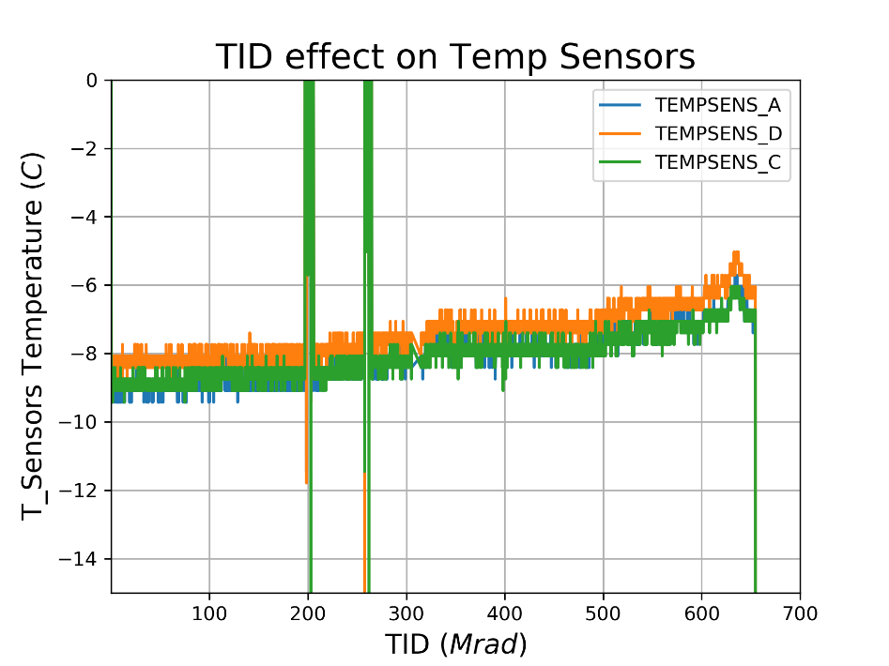
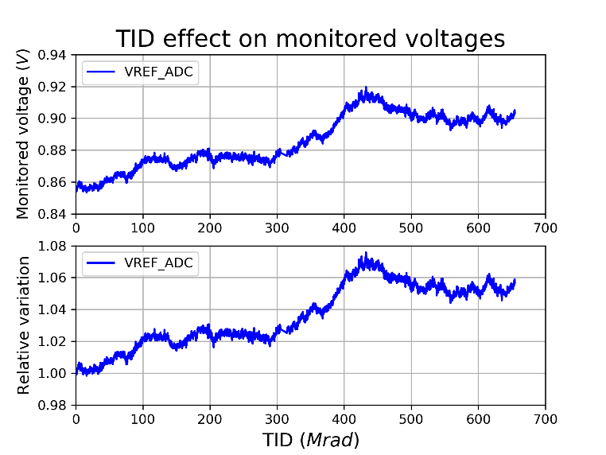
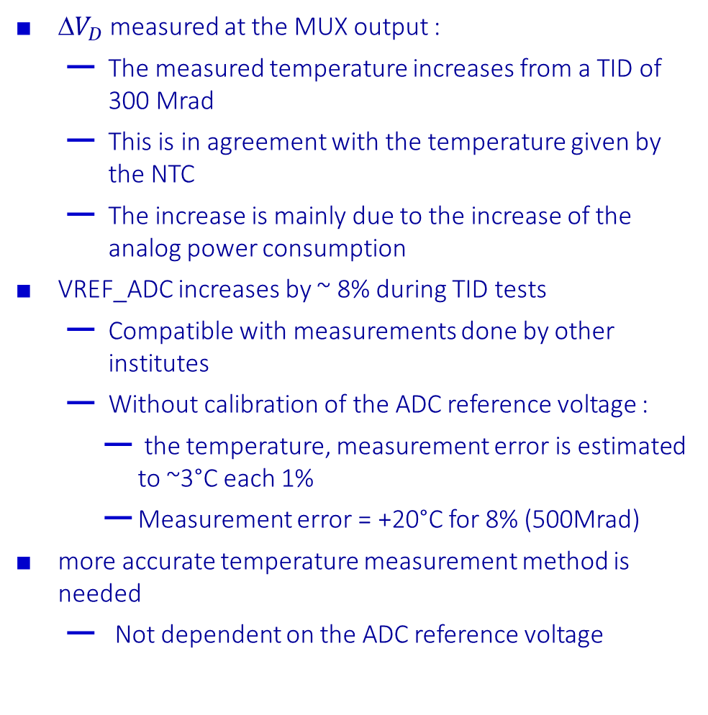
TID effects on temperature sensors
${\text{}V}_{D}$ measured at the MUX output :
  The measured temperature increases from a TID of 300 Mrad
  This is in agreement with the temperature given by the NTC
  The increase is mainly due to the increase of the analog power consumption
VREF_ADC increases by ~ 8% during TID tests
  Compatible with measurements done by other institutes
  Without calibration of the ADC reference voltage :
    the temperature, measurement error is estimated to ~3°C each 1%
    Measurement error = +20°C for 8% (500Mrad)
more accurate temperature measurement method is needed
  Not dependent on the ADC reference voltage

Slide 23
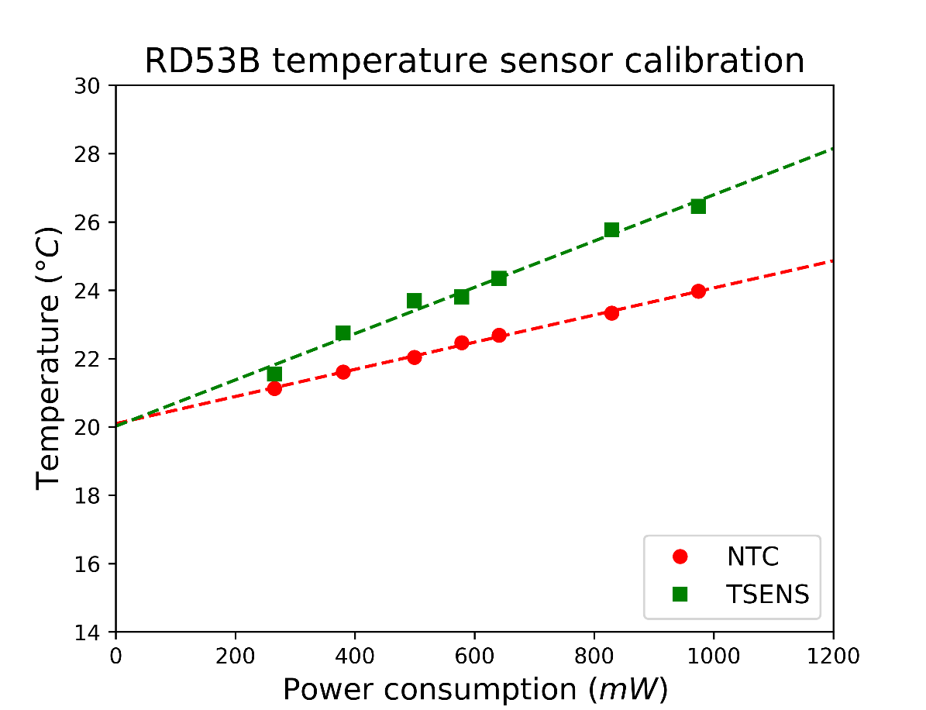


Global calibration with the NTC
$T_{ab}=\frac{q}{N_{f}×k_{B}×\ln{R}}×∆V_{D}$
$T=\frac{1}{N_{f}}×4.285 {10}^{3}×∆V_{D}−273 \left(℃\right)$
 | Default | Low Analog Power | Low global power | High power
IDIG | 450 mA | 444 mA | 130 mA | 1166 mA
IANA | 300 mA | 71 mA | 55 mA | 1087 mA
The global calibration consists in defining the ideality factor N_{f} to be used by default for all the 4 sensors
This calibration is based on the voltage measured at the output PADs (The ADC is not yet used)
Measurements with climate chamber done for the different RD53A configurations
  Default : Default configuration BDAQ software
  Low Analog Power : Switch off all the analog pixel bias currents
  Low global power : Switch off all the pixel bias currents and disable the pixel array clock
  High current: Default configuration + Shunt mode setting
For the power off : Temp-TS = Temp-TNC
Adjust the ideality factor N_{f} regarding the NTC temperature
  Default Power : Temp-TS = Temp-TNC + 3°C @ ~25°C
  Low Power : Temp-TS = Temp-TNC + 1°C @ ~25°C
For the RD53A, the default ideality factor for the sensor
  BJT: Nf = 1.008
  NMOS : Nf = 1.225

Slide 24
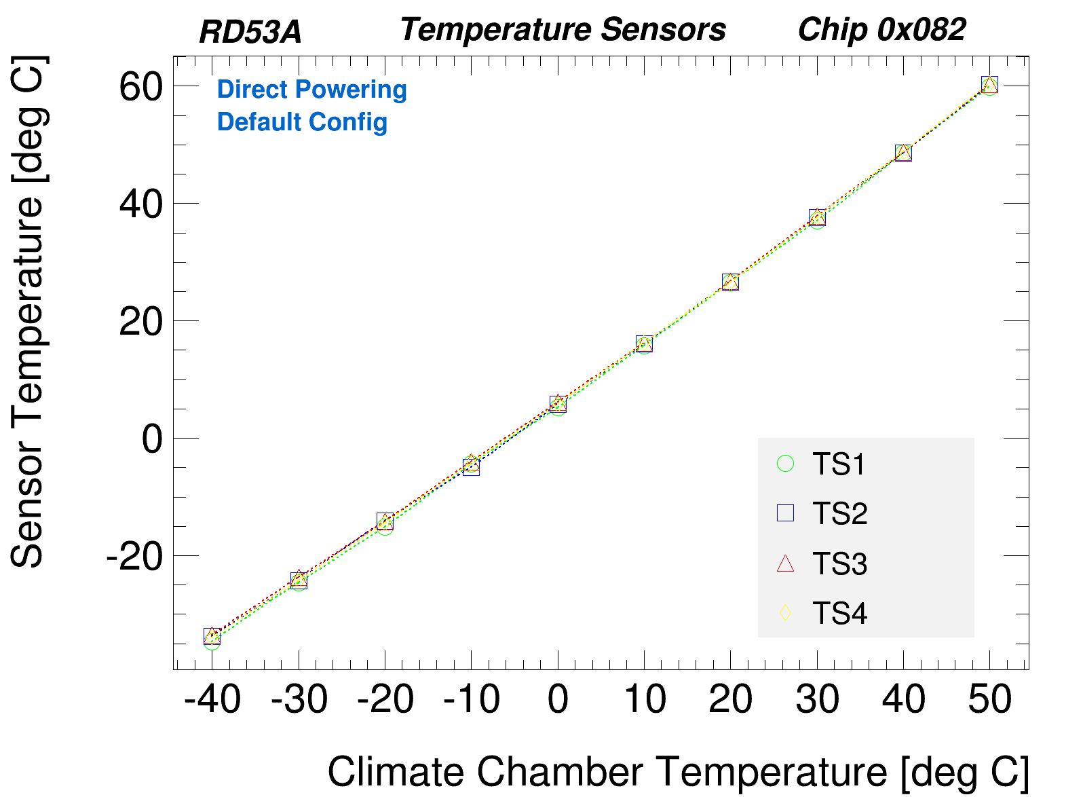
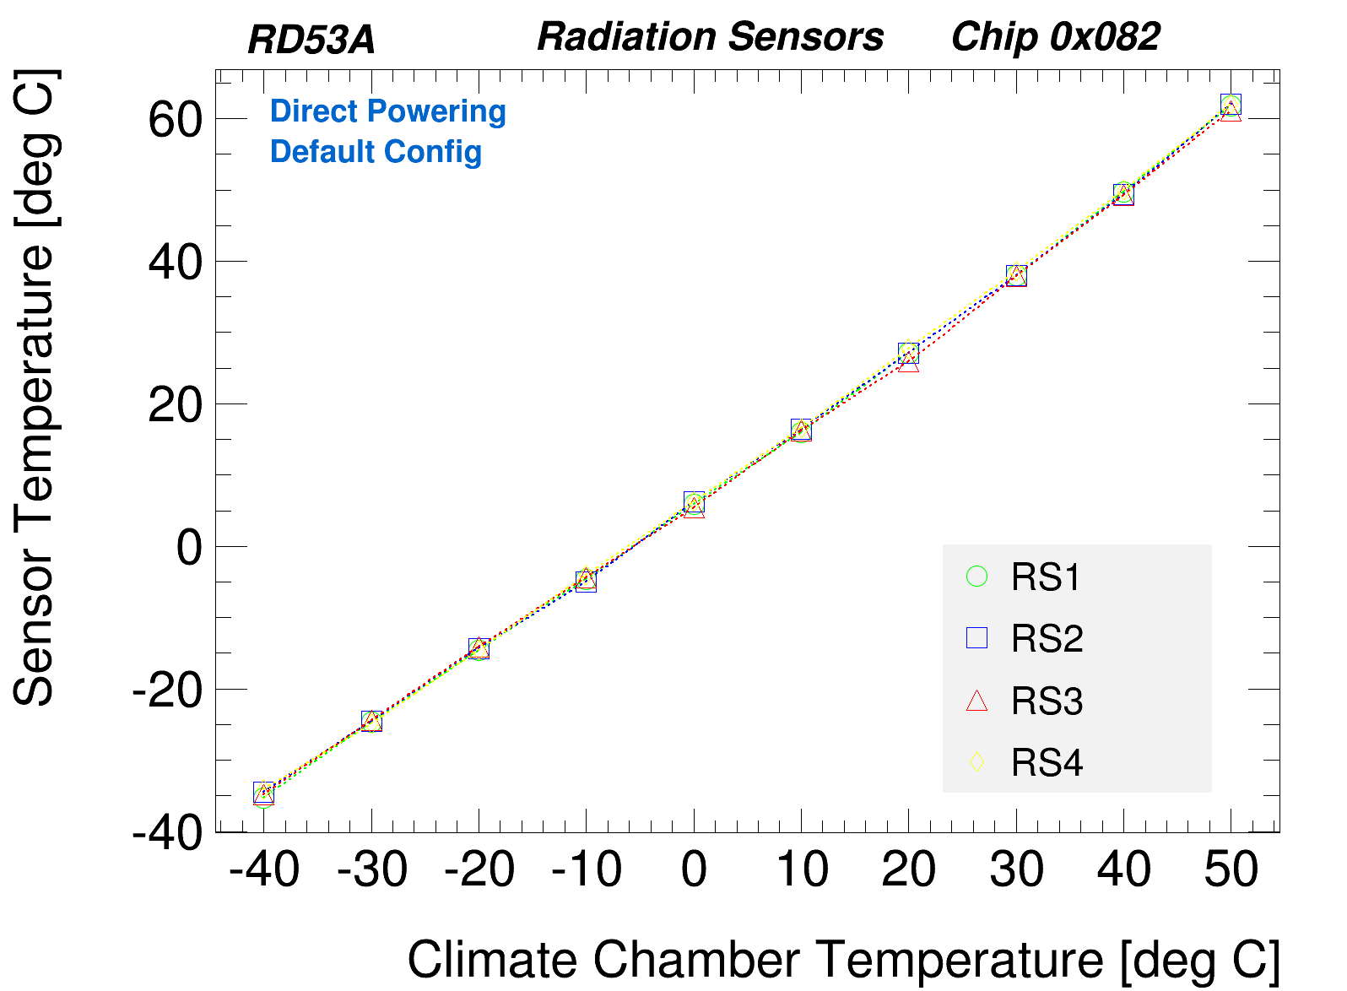
Mismatch in the same chip
Measurements done for Direct Powering
  Default power : 974 mW (Ivdda= 392 mA Ivddd=362 mA)
Default ideality factor :
  BJT: Nf = 1.008
  NMOS : Nf = 1.225
Small effect of the mismatch inside the same chip
For T>30°C Temp(TS) is higher than expected (+3°C at 50°C)
  The power Increase with the temperature can explain a part of this error

Slide 25
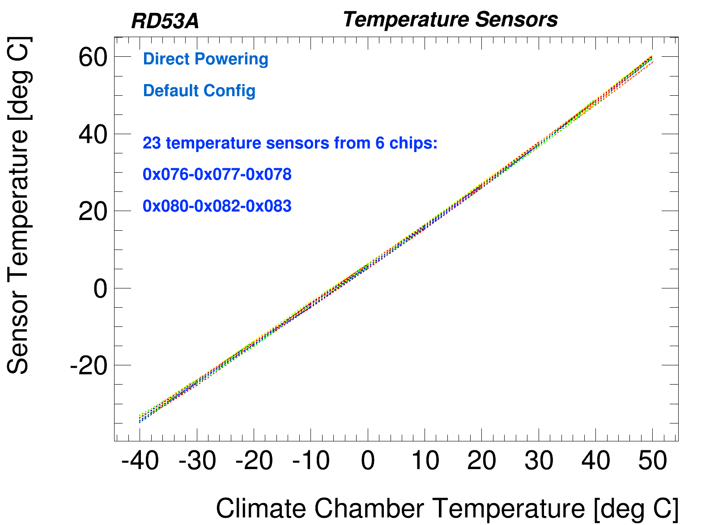
TS Mismatch effect and calibration
10 chips were tested from -40°C to 50°C using climatic chamber
Statistics on 6 chips biased in direct powering with applying the same parameter Nf=1.255 (default settings)
Calibration chip by chip is required
  Define the ideality factor Nf
  Only one measurement point is required
  Use direct powering
  Adjust Nf regarding the NTC temperature
    Default Power : Temp-TS = Temp-TNC + 3°C @ ~25°C
    Low Power : Temp-TS = Temp-TNC + 1°C @ ~25°C

Slide 26
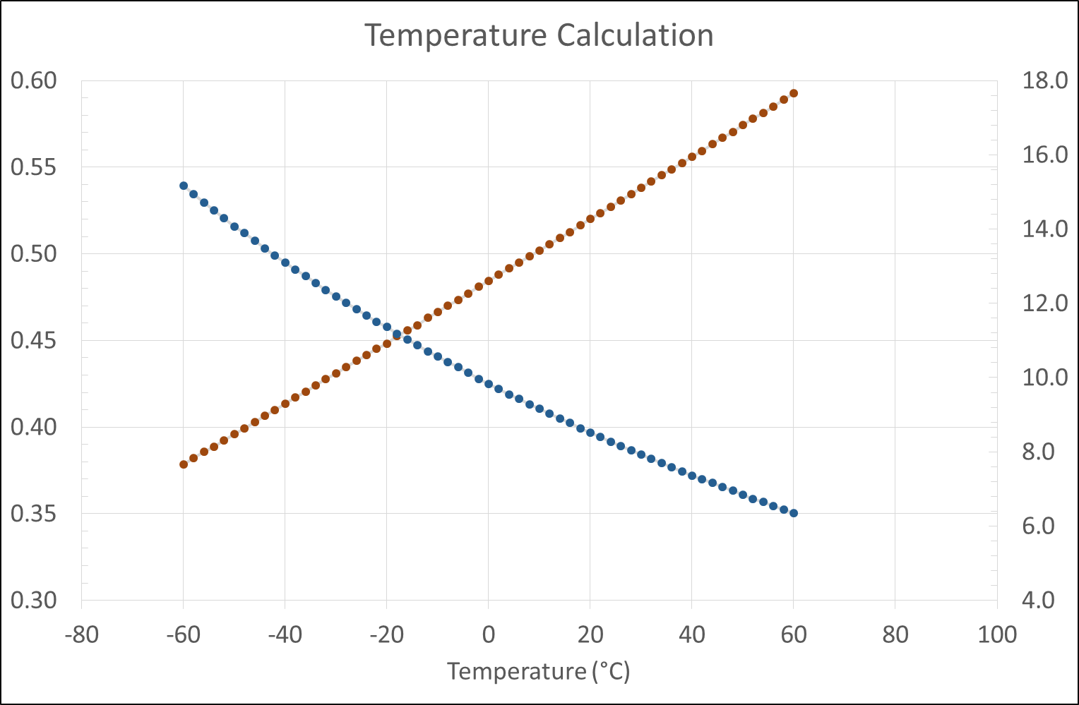

Temperature calculation
V_{D}/ΔV_{D}
μ=α.ΔV_{D}/(V_{D}+α. ΔV_{D})
α is a constant
  Used as a mapping coefficient between non linear and linear
  Used for trimming purpose
$=\frac{α.{\text{Δ}V}_{D}}{{ V}_{BGR}}=\frac{α.{\text{Δ}V}_{D}}{{α.{ΔV}_{D}+V}_{D} }=$ $\frac{1}{α+\frac{V_{D}}{{ΔV}_{D}}}$

Slide 27
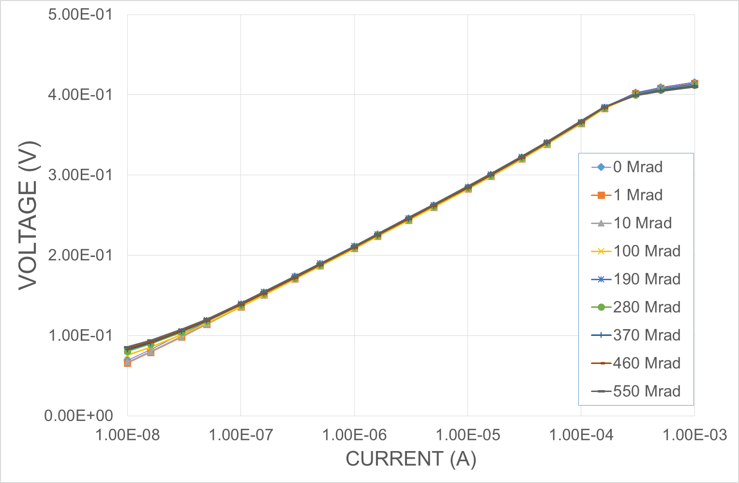
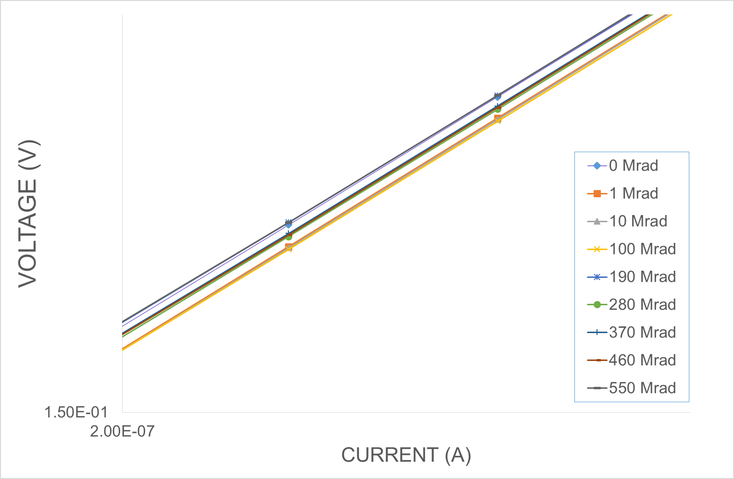
NMOS Temperature Sensor
NMOS : W/L = 20/1*32
Less damage than the BJT
Very small shift in the characteristics

Slide 28


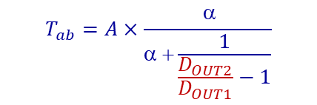
Monitoring calibration
During the detector production period
  Use ΔV_{D} = V_{D2}-V_{D1} for the temperature measurement
  Measurements based on external precise voltmeter
  Calibration is mandatory
During the detector exploitation period
  Use the ratio D_{OUT2}/D_{OUT1} for the temperature measurement
  A and α are process parameters
  α needs to be adjusted taking into account the N_{f} factor variation (chip to chip)
During the detector exploitation period
  ΔV_{D} voltage is insensitive to the I_{REF} and insensitive to the TID. It is also insensitive to the power supply variation
  Depends on the temperature that can be measured with a good precision
Consider ΔV_{D} as a reference voltage for monitoring and calibration
$$T_{ab}=\frac{q}{N_{f}×k_{B}×\ln{R}}×{\text{Δ}V}_{D}$$
$$T_{ab}=A×\frac{ α}{α +\frac{1}{\frac{D_{OUT2}}{D_{OUT1}}−1}}$$
$${\text{}V}_{D}=\frac{N_{f}{∙k}_{B}∙T_{ab}}{q}∙ln\left(R\right)$$

Slide 29
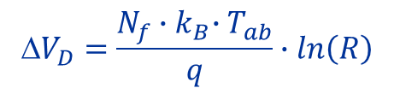

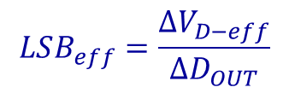
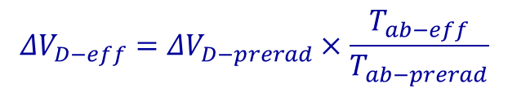
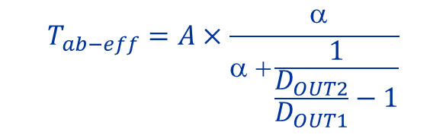
Monitoring correction
All the reference voltages in the RD53B chip including Vref_{ADC}, are based on a copy of the reference current I_{REF} generated from a band-gap circuit
I_{REF} is sensitive to the TID → All the monitored voltages vary with the TID
ΔV_{D} = V_{D2}-V_{D1} measured across the temperature sensor is insensitive to the current I_{REF} and so insensitive to the TID
But ΔV_{D} depends on the temperature of the chip
Temperature measurement with good accuracy is needed and this can be done with the self-referencing method :
ΔV_{D} can therefore be used as the reference voltage for the ADC
The effective ΔV_{D} voltage during the operation of the detector is calculated as :
The value of the effective LSB of the ADC can thus be determined by:
    Where :
This LSB_{eff} is then used to calculate directly the other voltages and current values based the output ADC codes
Adjusting some critical voltages can be applied if necessary
$$ΔV_{D−eff}=ΔV_{D−prerad}×\frac{T_{ab−eff}}{T_{ab−prerad}}$$
$${\text{}V}_{D}=\frac{N_{f}{∙k}_{B}∙T_{ab}}{q}∙ln\left(R\right)$$
$$LSB_{eff}=\frac{ΔV_{D−eff}}{ΔD_{OUT}}$$
$$ΔD_{OUT} = D_{OUT2} − D_{OUT1}$$
$$T_{ab−eff}=A×\frac{ α}{α +\frac{1}{\frac{D_{OUT2}}{D_{OUT1}}−1}}$$

