Slide 1




South African contribution towards the ATLAS Tile Calorimeter PreProcessor
Author: Mpho Gift Doctor Gololo
Co-Author: Claudia Tsima
Co-Author: Prof. Bruce Mellado
University of the Witwatersrand
TIPP2023

Slide 2
Contents
ATLAS Tile Calorimeter Phase II Upgrades
Tile Pre-Processor Overview
South African contribution
  Production of boards in South Africa
    TileCoM and Tile GbE Switch
  Technical developments
    Configuration of power chips for TileCoM
    Software development of the OPC UA server
Conclusion

Slide 3
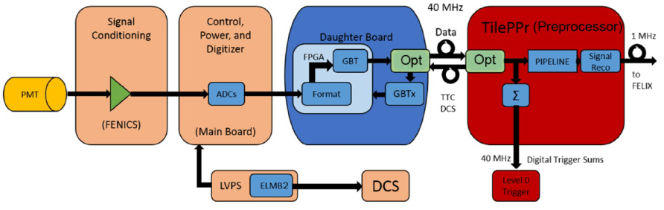
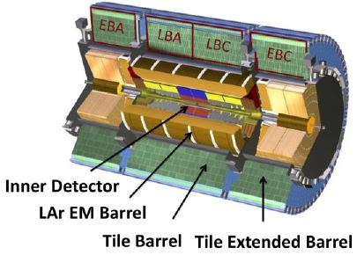
ATLAS Tile Calorimeter Phase II Upgrade
ATLAS Tile Calorimeter Phase II Upgrade to accommodate an increase in the luminosity
Complete replacement of Front-End and Back-End electronics
  Due to radiation and time aging
  To be compatibility with full digital TDAQ and trigger processing at 40 MHz (L0) and to fulfill Phase-II radiation requirements.
New readout strategy for HL-LHC: On-detector electronics will transmit digitized data to the off-electronics at the LHC frequency (40 Tbps to read out the entire detector!)

Slide 4
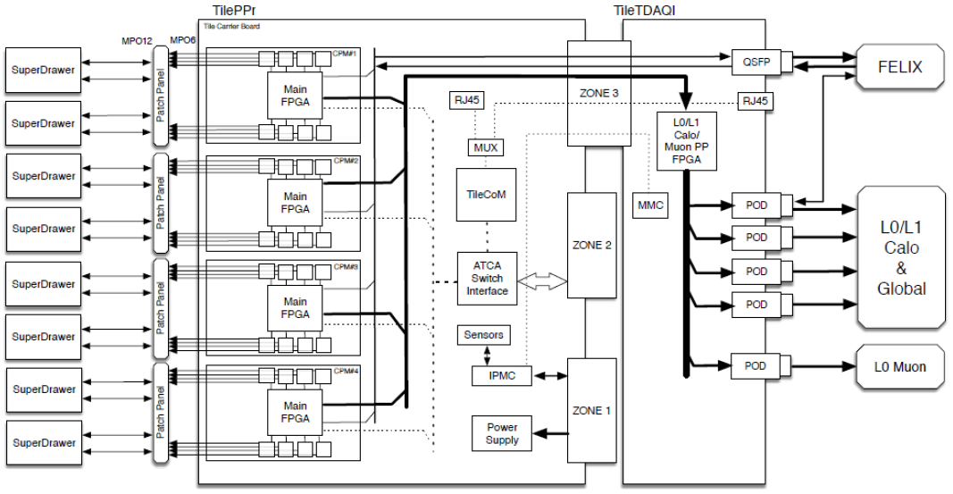
ATLAS Tile Pre-Processor (TilePPr) Overview
TilePPr is part of the off-detector electronics for the ATLAS TileCal electronic chain
The main functionality of this board is data processing using FPGAs
Contribution from South Africa is mainly focused on the TileCoM and the Tile GbE
These two boards are mainly used for control and monitoring of the system

Slide 5
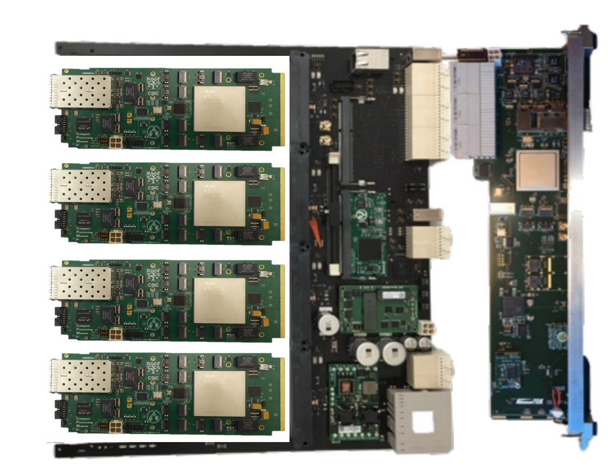
South African contribution
32 TilePPr boards for the final design
Contributing 24 % of the Tile PPr
Production of boards in S.A.
Current focus on the TileCoM and Tile GbE Switch
TileCoM
GbE
Switch

Slide 6
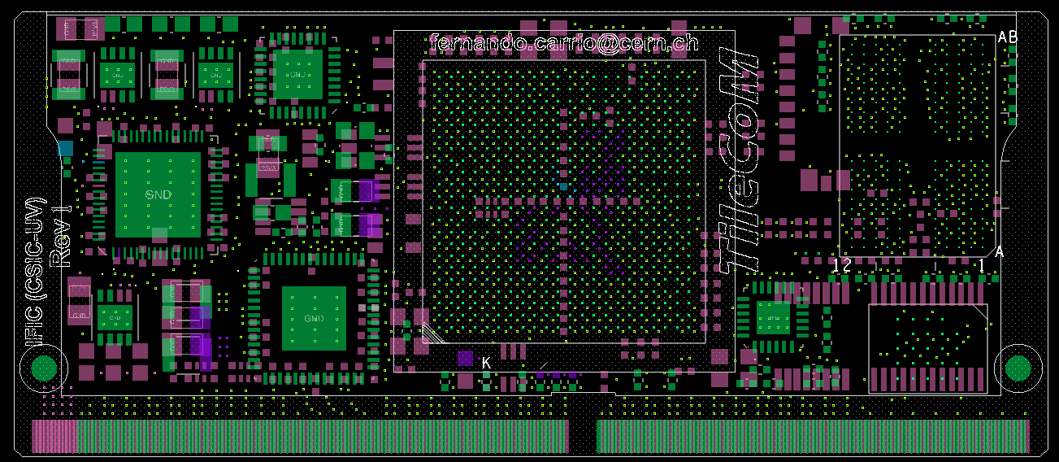
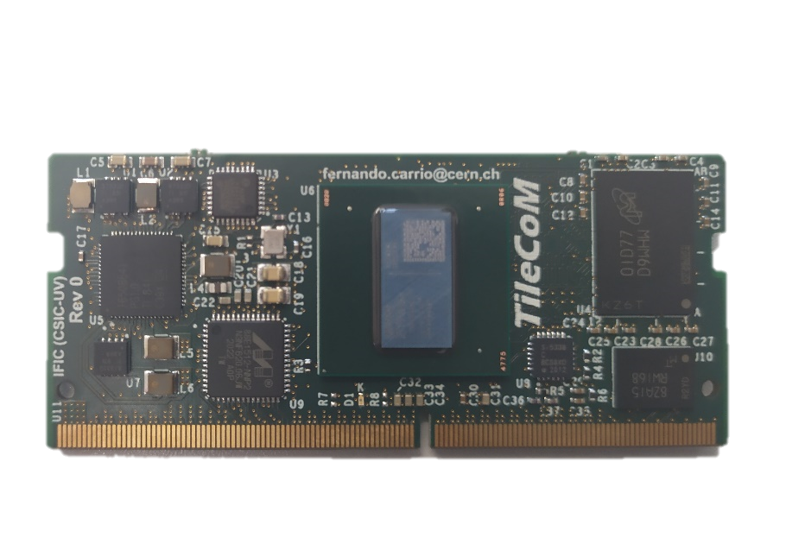
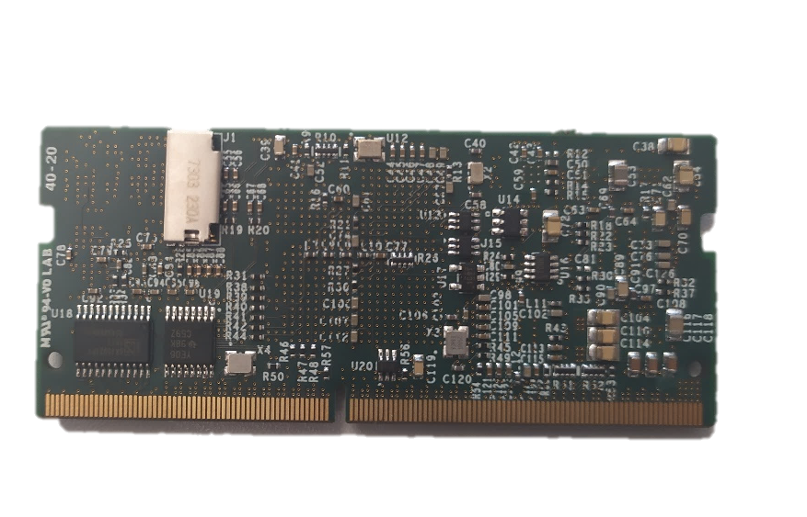
TileCoM Production in South Africa
Main components:
  Zynq UltraScale+ ZU2CG, 2GB DDR4
  SD card, GbE, USB 2.0, SPI, I²C, UART, 82 x GPIO (1.8V)
  TPS6508641 – Power regulator
  Test board to validate all funcionalities
    PCB with 10 layers (1.2 mm), FR4
    PCB production currently taking place
    Continuity test of components
USB 2.0
Power
2GB DDR4
SD Card
30 mm
GbE PHY
ZU+
Jitter
cleaner
Flash
Memo
69.6 mm

Slide 7
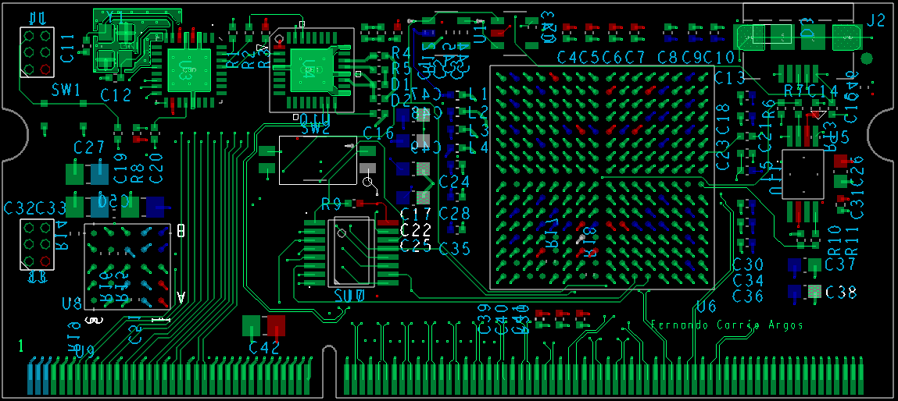
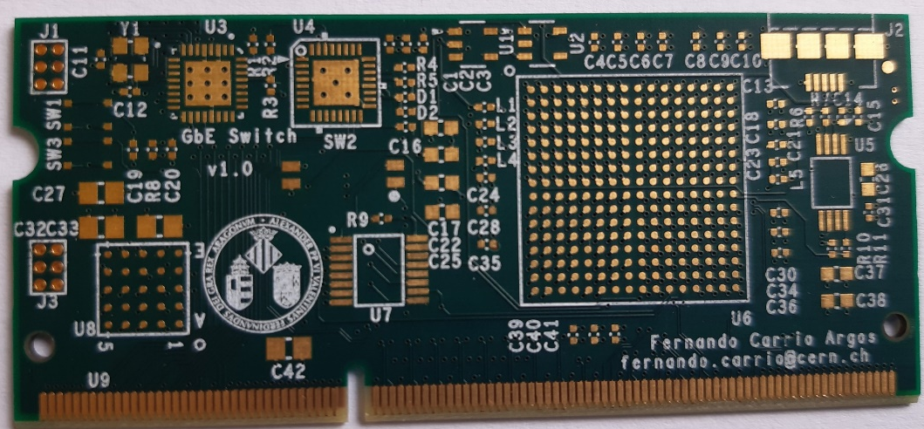
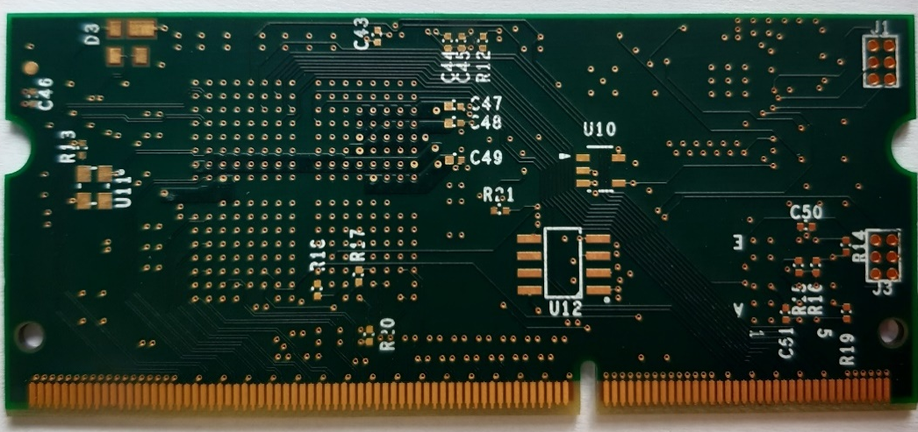
Tile GbE Switch Production in South Africa
Main components:
  Broadcom BCM5396 chip – Core component
  ATMEGA168A – For configuration
  LTM4622IV – step-down DC/DC regulator
  Test board to validate all functionalities
    These boards passed the electrical and communication tests
    All the developments from S.A have been tested using these boards and are all working as expected

Slide 8
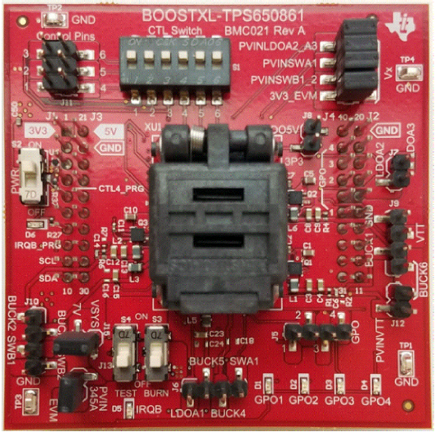
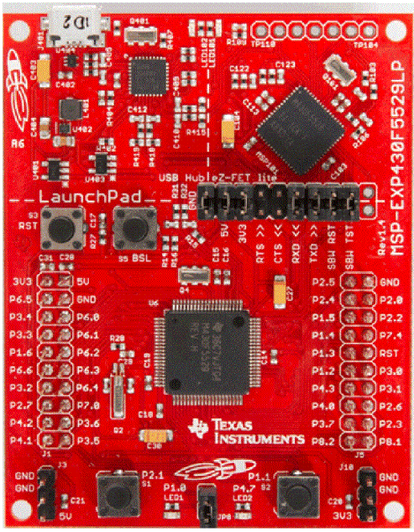
Technical developments: TileCoM Power chip configuration
Two commercial evaluation boards from Texas Instrument
Slot for TPS65086100 to load the configuration file on the power chip
The MSP430F5529 LaunchPad development kit serves as a way to communicate between the IPG-UI software and the TPS65086100 / TPS6508641 device.
The BOOSTXL-TPS650861 BoosterPack plug-in module is a socketed board that can be used with an MSP430F5529 LaunchPad development kit to program TPS65086100 OTP memory.
USB slot to integrate the evaluation boards with the computer and the user interface

Slide 9
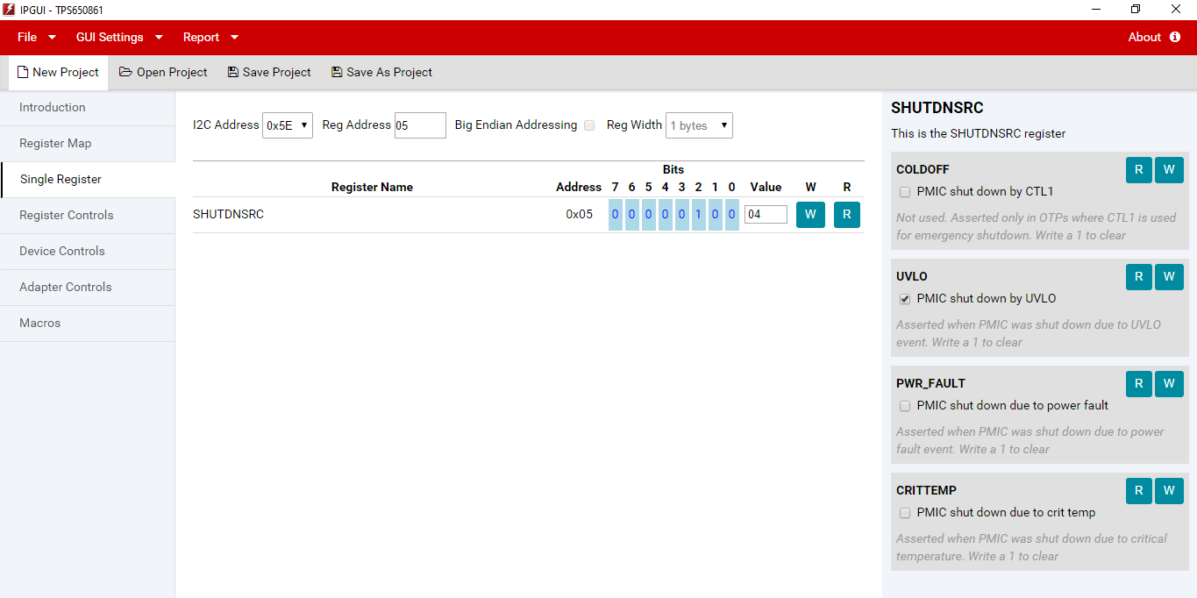
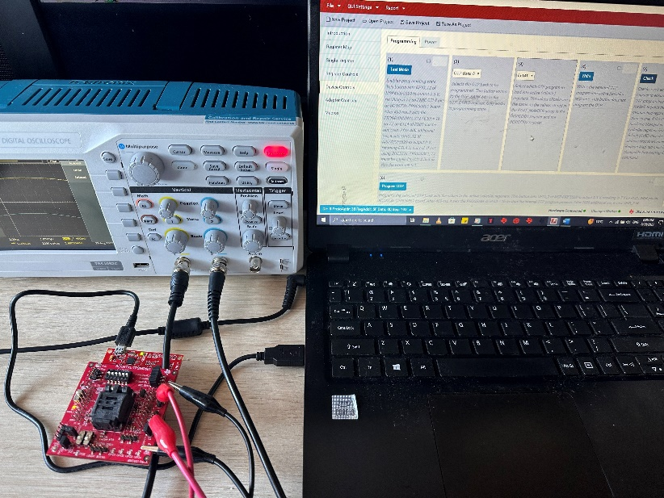
Technical developments: TileCoM Power chip configuration
OTP Generator Excel based tool is used for TPS6508641 settings
This excel file is used to generate a json file with the configuration settings
These settings in a json file are then loaded on the IPG-UI connected to the evaluation board using UART interface
An oscilloscope is used for measurement purposes for each buck converter
Oscilloscope
IPG-UI on the computer to upload configuration files
Evaluation boards withTPS65086100

Slide 10
Technical developments: TileCoM Power chip configuration
Integrate the BOOSTXL-TPS650861 Booster Pack board into the MSP430FR5994 LaunchPad development kit.
Update the firmware of the evaluation boards before inserting TPS650861
Load the JSON configuration files in on the IPG-UI and flash these settings on the TPS650861
Solder these TPS650861 on the TileCoM PCBs to regulate power on the TileCoM boards
Integrate the TileCoM boards with the TilePPr for different functionalities

Slide 11
Technical developments: TileCoM Power chip configuration
Six (6) buck converters were targeted in the TPS6508641 settings
Input voltage supplied to each buck converter with an expected output voltage
An output voltage range between 0.41 V and 3.575 V is a target to regulate the TileCoM voltage for all the components
Rail | Type | Input Voltage (V) |  | Output Voltage Range (V) |  | Measured Voltage (V)
 |  | MIN | MAX | MIN | MAX | MAX
BUCK1 | Step-down controller | 4.5 | 21 | 0.41 | 3.575 | 3.2
BUCK2 | Step-down controller | 4.5 | 21 | 0.41 | 3.575 | 3.1
BUCK3 | Step-down converter | 3 | 5.5 | 0.41 | 3.575 | 2.8
BUCK4 | Step-down converter | 3 | 5.5 | 0.41 | 3.575 | 2.8
BUCK5 | Step-down converter | 3 | 5.5 | 0.41 | 3.575 | 2.9
BUCK6 | Step-down controller | 4.5 | 21 | 0.41 | 3.575 | 3.0

Slide 12
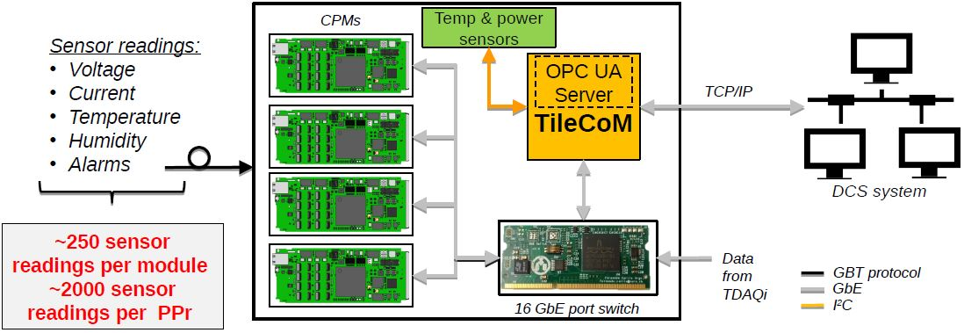
Technical developments: PPr and DCS system
Interface with the DCS system through dedicated GbE port
  TileCoM runs an OPC UA Server as middleware
Sensor monitoring reading from ATCA carrier, RTM and on-detector electronics
  Power consumption, optics diagnostics, temperature sensors, …
  I²C interface for reading local ATCA carrier sensors
  CPMs retrieve sensor data from on-detector through GBT links
  TileCoM reads out sensor data from CPM and RTM through GbE (IPbus)
Control and monitoring of the HV distribution (HV Opto) → not baseline for Phase-II

Slide 13
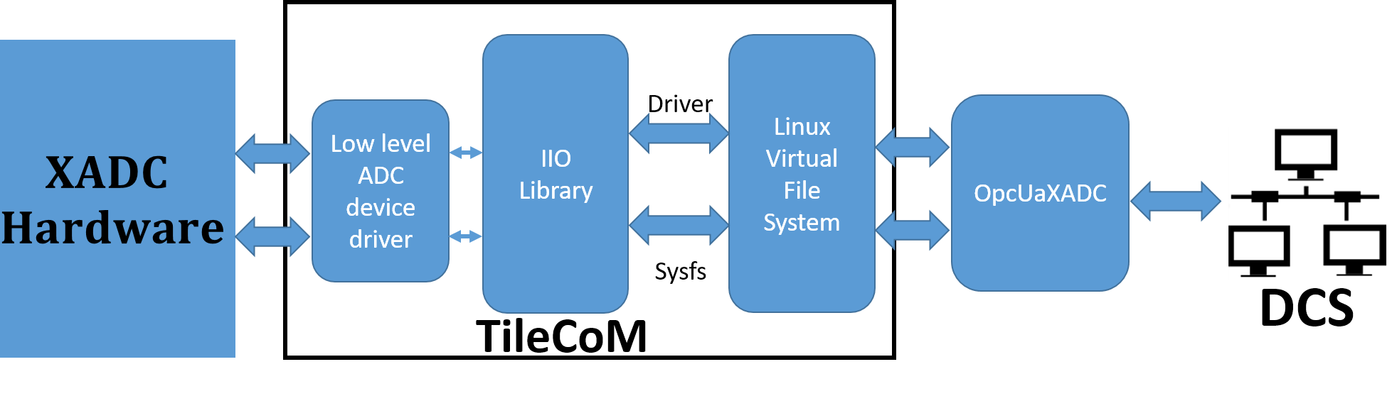
Technical developments: PPr and DCS system
First OPC UA server – XADC sensor reading server
This application is implemented using the open source and stable framework called the quasar framerwork.
This is achieved by allowing the developer to create design files using XML documents with minimal C++ development.
The XML files are also used for configuration purposes in order to publish to the client.
The main objective of this functionality is to read data from the XADC servers and publish the data to the DCS.

Slide 14
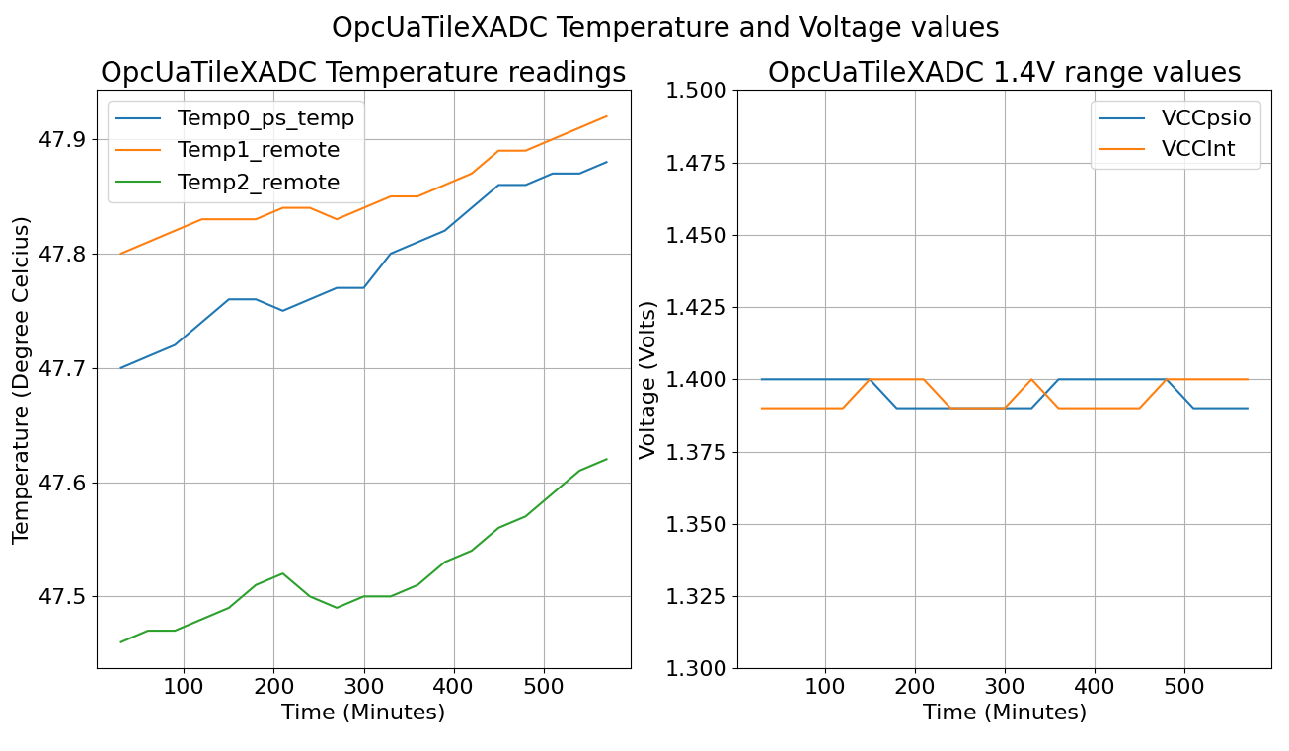
Technical developments: PPr and DCS system
xADC measurements for both the temperature and voltages
Expected voltage levels were measured from the xADC sensors
Temperature measurements for the same period of time

Slide 15
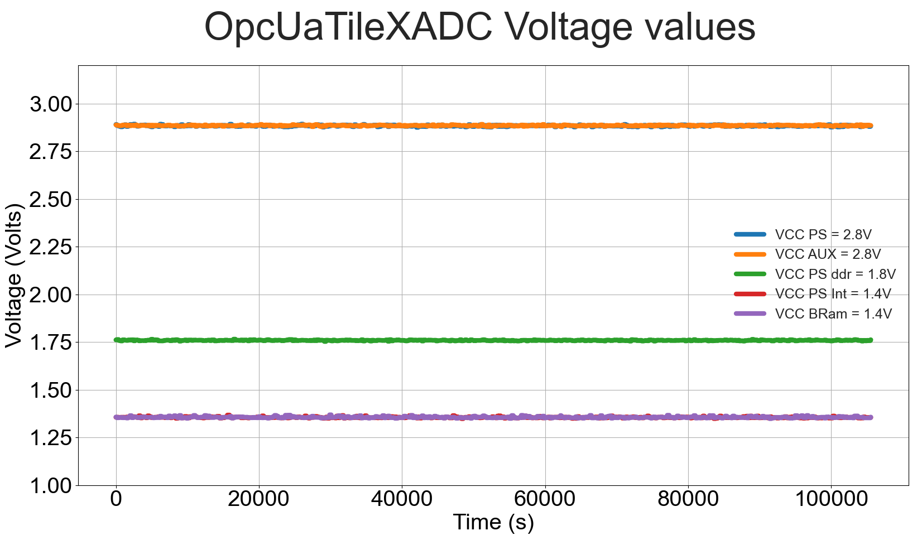
Technical developments: PPr and DCS system
Further xADC measurements for voltages
Expected voltage levels were measured from the xADC sensors

Slide 16
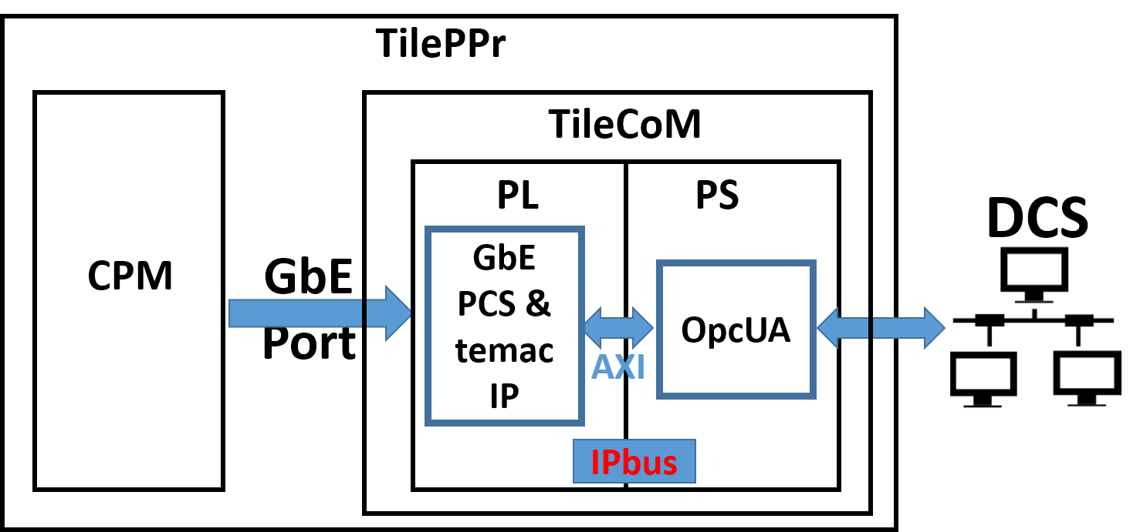
Technical developments: PPr and DCS system
Second server – Upgrade electronic chain sensor reading server
The current contribution towards the TilePPr is implementation of the monitoring system for the ATLAS Tile Calorimeter Phase II upgrade system
This is in terms of the firmware and software developments using the TileCoM
All the developments are currently tested on the Avnet Ultra96-V2 Zynq UltraScale+MPSoC evaluation board

Slide 17
2023 contribution schedule towards the TilePPr
All the developments for the TileCoM have been deployed in schedule time
TileCoM PCBs are have been produced from Trax Interconnect
Power configuration of power chips have been completed
Development of the second server to read sensor data from the electronic chain

Slide 18
Conclusion
Working towards Phase II upgrades of the Tile Calorimeter
South African contribution to the off-detector electronics development
  University of Valencia (76%) & University of the Witwatersrand (24%)
  This involves developments and production of boards in South Africa
The prototypes of Tile GbE Switch produced in South Africa are functional
Production of TileCoM boards currently taking place at Trax Interconnect
First OPC UA server has been validated and fully functional
Second OPC UA server currently being developed to integrate the TilePPr modules with DCS

