Slide 1
Development of low-pressure Time Projection Chamber
for ion identification in Accelerator Mass Spectrometry
A. Bondar, A. Buzulutskov, V. Parkhomchuk, A. Petrozhitskiy, T. Shakirova, A. Sokolov
Budker Institute of Nuclear Physics
Novosibirsk State University

Slide 2
Outline
Accelerator mass spectrometry
New concept of ion identification
Experimental setup
Measurements of energy spectra and track ranges from alpha particles
Measurements of energy spectra and ion ranges at AMS

Slide 3
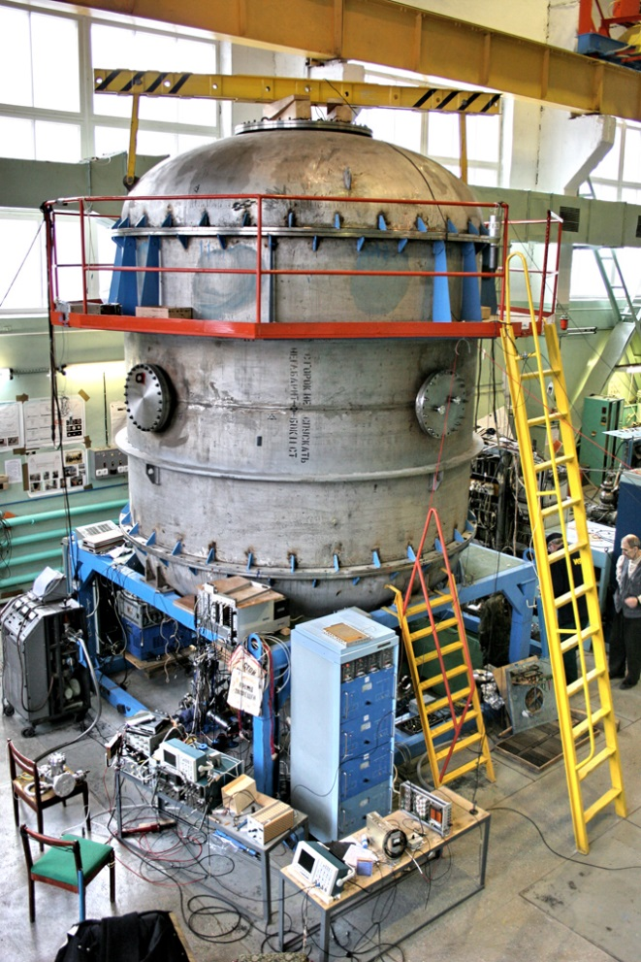
Accelerator Mass Spectrometry
Accelerator mass spectrometry (AMS) is an ultra-sensitive method of counting individual atoms.
Typical application – radiocarbon dating
Date interval – less than 50000 years to 100 years
Sample size – 1 mg
Count rate – 100 Hz
Accuracy – 0.2 %
AMS facilities operate in more than 140 physical laboratories worldwide, one of which is located in Novosibirsk at Geochronology of the Cenozoic Era Center for Collective Use.
Notes:
Accelerator mass spectrometry (AMS) is currently the standard technique for measuring rare cosmogenic radionuclides with a long half-life. This technique is based on the extraction of individual atoms from a sample with subsequent counting of the isotopes of interest.
One of the most common example of AMS application is the radiocarbon dating. Using AMS, the radiocarbon age of a small sample around 1 mg of less than 50,000 years can be determined with an accuracy of 0.2% in less than an hour.
There are approximately 140 AMSs worldwide, one of which was developed at Budker Institute of Nuclear Physics. This photo shows BINP AMS. Currently, radiocarbon dating is being successfully carried out here.

Slide 4
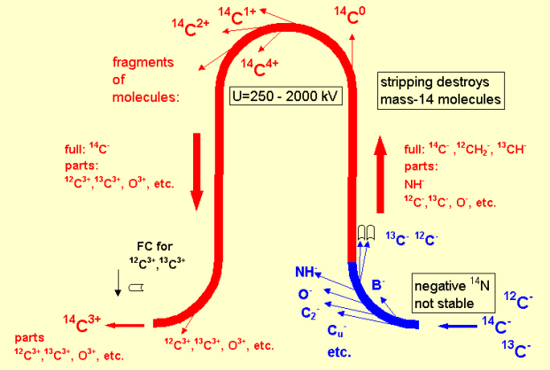
BINP AMS
1. Formation of an ion beam from atoms of the test sample
2. Ion selection at low energy
3. Ion acceleration
4. Recharging of atomic ions and destruction of molecular ions
5. Ion selection in a high voltage terminal
6. Ion acceleration
7. Ion selection at high energy
8. Identification and counting of ions
BINP AMS provides reliable separation of a pure beam of radiocarbon ions from the accompanying ion background.
Notes:
This figure schematically shows the principle of BINP AMS operation. Negative ions are generated from the sample in a cesium sputter source and mass-analyzed by a magnet. In the case of 14C the choice of negative ions eliminates the isobaric background because 14N do not form stable negative ions.
The mass-analyzed negative ions are accelerated to the positive high voltage terminal of the tandem accelerator, where they pass through the magnesium vapors stripping target. Here the molecular ions are destroyed and the atomic ions are recharged into 3+. The specific feature of this accelerator is 180° electrostatic bend of particles. Only those ions that have a 3+ charge pass through this band.
The now positively charged ions are further accelerated back to ground potential in the second stage of the tandem accelerator. Subsequent magnetic analyzer select the ions of interest.
Then individual ions are identified and counted by a detector. A time-of-flight system is installed at BINP AMS.
These AMS provides reliable separation of a pure beam of radiocarbon ions from the accompanying ion background.

Slide 5
Cosmogenic isotopes
Analyzed isotopes | Half life | Stable isotopes | Stable isobars (background)
¹⁰Ве | 1.39 million years | ⁹Be | ¹⁰B
¹⁴C | 5730 years | ^{12,13}С | ¹⁴N*
²⁶Al | 717 thousand years | ²⁷Al | ²⁶Mg*
³⁶Cl | 301 thousand years | ^{35,37}Cl | ³⁶Ar*, ³⁶S
⁴¹Ca | 102 thousand years | ^{40,42,43,44}Ca | ⁴¹K
¹²⁹I | 15.7 million years | ¹²⁷I | ¹²⁹Xe*
In the current BINP AMS setup the time-of-flight technique is used for the isotopes separation. But this technique has a serious problem of separating the isobars - different chemical elements having the same atomic mass. The typical example is radioactive isotopes ¹⁰Be and ¹⁰B.
* - isobars that do not form stable negative ions.
Notes:
The use of AMS is not limited by 14C alone; many other isotopes are amenable to the technique, the most important of which are 10Be, 26Al, 36Cl and 129I. The relative abundance of these isotopes is usually less than 10⁻¹² which requires precise separation techniques. AMS allows to measure fraction of cosmogenic isotopes at the level of 10⁻¹⁵ of the total content of the element.
In the current AMS of BINP setup, the time-of-flight technique is used for the isotope separation. One of limitations of the BINP AMS is the isobaric background. Isobars are nuclides of different chemical elements that have the same mass number, such as 10Be and 10B.

Slide 6
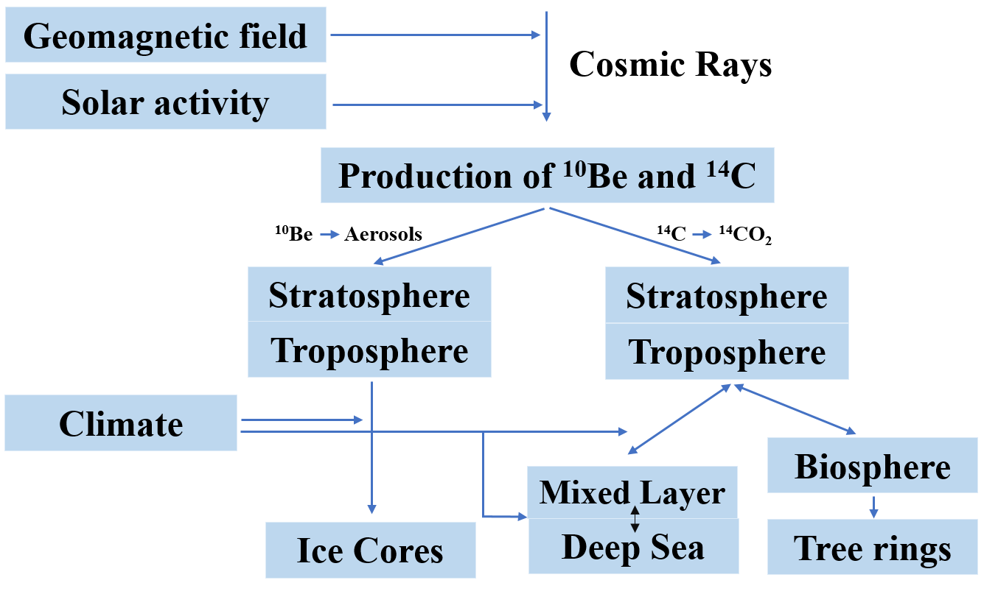
Formation and application ¹⁰Be
Time intervals of dating:
¹⁴C from 100 years to 50 thousand years
¹⁰Be from 1 thousand years to 10 million years
Application in-situ and
meteoric ¹⁰Be:
exposure dating to identified the growths and decays of the Antarctic ice sheet;
understanding ice shelf collapse history;
paleomagnetic excursions history reconstructions using ice cores;
understanding the erosion rates using depth profiles of mid latitudes outcrops;
identifying the timing of formation of the impact crater and so forth.
Notes:
10Be is the second most important radionuclide in the Earth and Environmental Sciences (besides radiocarbon).
Beryllium has a longer half-life than the radiocarbon, so the time interval of dating is ranged from 1 thousand to 10 million years. The radioactive isotope of beryllium is produced under the constant cosmic irradiation in the atmosphere as well as in situ in rocks. Atmospheric beryllium is adsorbed by aerosols and then it precipitates to the earth’s surface, where it is included in various sediment.
Beryllium has following applications: exposure dating to identified the growths and decays of the Antarctic ice sheet, understanding ice shelf collapse history, understanding the erosion rates and so on.

Slide 7
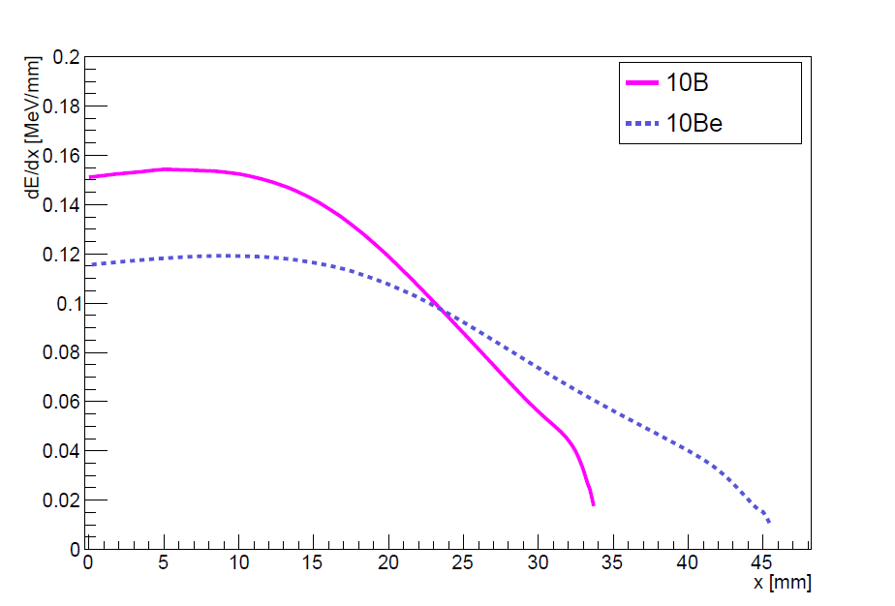
Traditional concept of ion identification at AMS
Detectors used to count the AMS ions:
silicon detectors;
time-of-flight systems;
ionization chambers.
∆Е-Е detectors
Anode 1
Anode 2
Anode 3
Frisch grid
e⁻
Ion track
$$\vec{E}$$
Window
Ions⁺
Cathode
Schematic drawing of a sample gas ionization detector with split anode. Such detector is installed at AMS that carry out multi-isotope measurements.
Mean stopping power for ¹⁰B and ¹⁰Be projectiles against penetration depth in 50 torr isobutane.
7
Notes:
A range of ion detectors have been used to count the AMS isotope: silicon detectors, time-of-flight systems and ionization chambers.
Silicon detectors and time-of-flight systems can provide only isotope separation.
Split anode ionization chambers are used to separate isobaric ions. A typical multielement ionization chamber is depicted in figure. The electrons formed during the passage of ions drift towards the anode in a transverse electric field. The anode is divided into sections, each of which collects the electrons generated below it. Since ions with different charge number lose energy with different rates, this energy-loss information permits the separation of isobars.
The disadvantage of such a detector is a poor signal-to-noise ratio, since the chamber operates in the ionization mode and imposes requirements on the electronics.

Slide 8
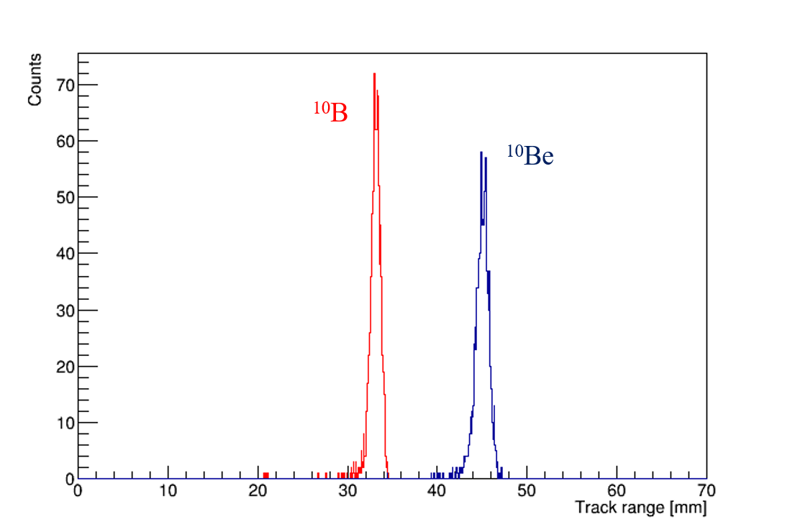
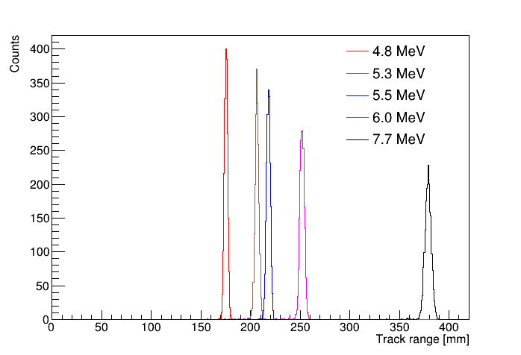
New concept of ion identification: measuring track ranges
SRIM simulation
SRIM simulation
Track ranges distribution of 4 MeV ¹⁰Be and ¹⁰B passing through 200 nm silicon nitride window into 50 torr isobutane at room temperature.
Track ranges distribution of alpha particles with different energies passing through 200 nm silicon nitride window into 50 torr isobutane at room temperature.
Notes:
The new concept of identifying isobaric ions at AMS is to separate them by their track ranges. This is possible because ions with different atomic numbers have different energy losses in matter. The SRIM software package was used to determine the possibility of separating the 10Be and 10B isobars according to the track ranges.
The first picture shows track ranges distribution of 4 MeV 10Be and 10B passing through 200 nm silicon nitride window into 50 torr isobutane at room temperature. It can be seen that the ion track ranges differ by about 12 mm. Therefore, the low-pressure TPC with a spatial resolution of the order of 2–3mm will be sufficient to separate such ions.
To determine the spatial resolution of the TPC, the detector was calibrated using the alpha particles source from ²²⁶Radium. This source emits 5 alpha particles with given energies. The track ranges in isobutane from alpha particles were also simulated under the same conditions. The simulation result is shown in the second figure.
Alpha particles with energies of 5.3 and 5.5 MeV have the same range difference as boron and beryllium (about 12 mm). If we can distinguish such tracks using the low-pressure TPC, we will certainly be able to distinguish the tracks from 10B and 10Be ions at AMS.

Slide 9
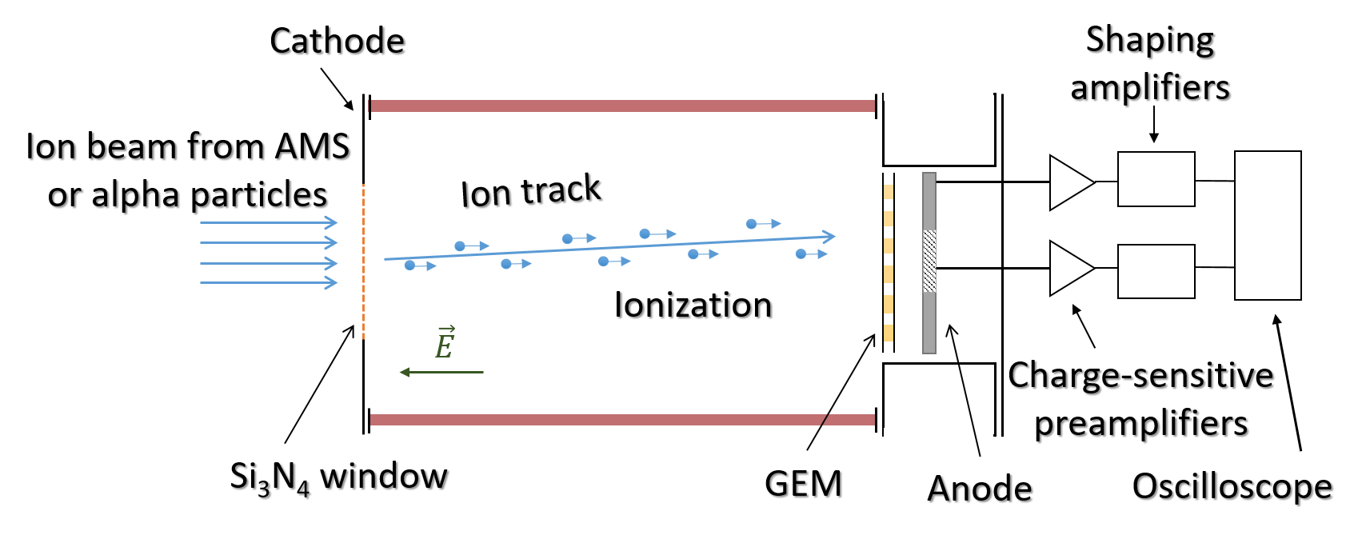
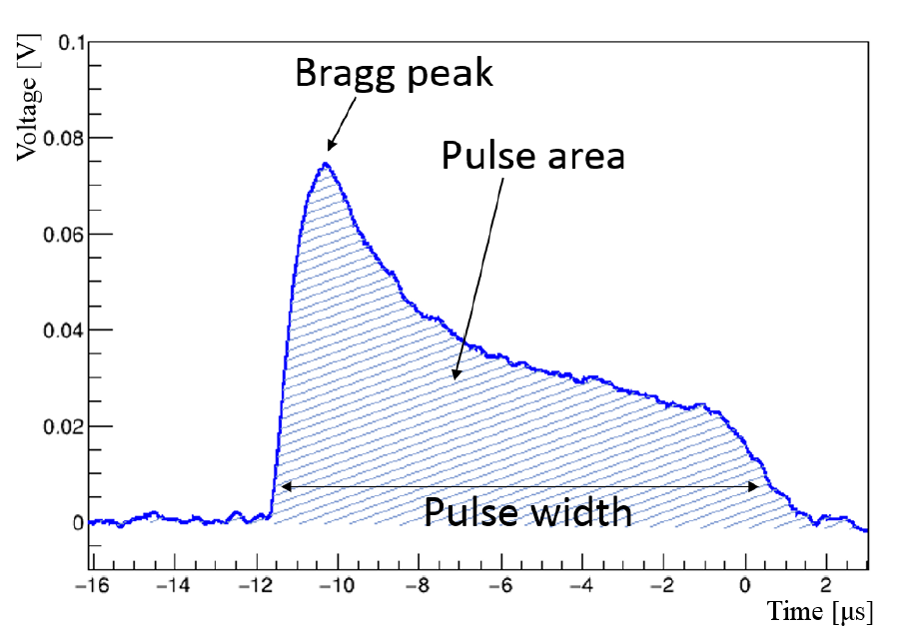
Proof of concept: low-pressure TPC
A waveform example from alpha particle in the low-pressure TPC
Schematic layout of the low-pressure TPC
Diameter ≈ 8 cm
Length ≈ 11 cm
Gas filled - Isobutane
pulse width $\sim$ track range
pulse area $\sim$ energy
Notes:
As a proof of principle, a low-pressure TPC with charge readout using Gas Electron Multiplier has been developed. A schematic representation of the detector is shown in this figure.
The chamber is 11 cm long ceramic cylinder that is divided by copper field-shaping rings. The internal diameter of the chamber is 8 cm. Potentials are applied to these rings, so a uniform electric field is created in the detector volume. The volume is filled with isobutane at room temperature and 50 Torr pressure. One flange has a silicon nitride inlet window. The Si3N4 membrane 10x10mm² (10 by 10 square millimeters) area and 200 nm in thickness provides the passage for an ion beam from the AMS with energy of 4MeV or for alpha particles from the radioactive source. On the opposite flange GEM is installed on nylon rods, followed by an anode. The low-pressure TPC is placed in an external volume, which is pumped out to a vacuum.
Alpha particles or ions from the AMS create primary ionization in the detector volume passing through the gas. The resulting electrons drift towards the GEM where avalanche multiplication takes place. After that induced signal is read out at the anode and then it is amplified and digitized. The second figure shows the typical waveform from an alpha particle. When analyzing the data, the pulse width and area were determined, where the pulse width is proportional to the ion track range, and the pulse area is proportional to the deposited energy.

Slide 10
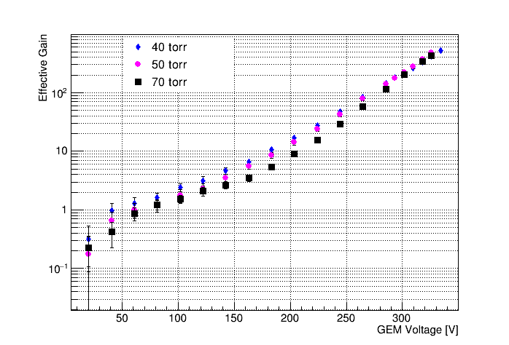
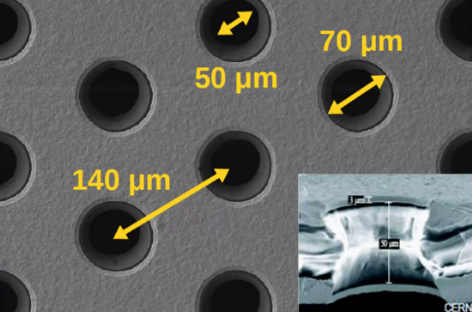
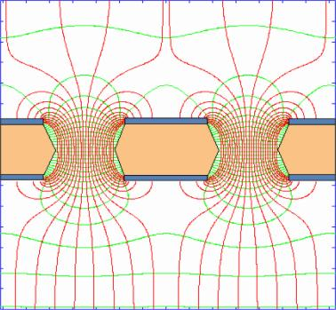
Signal amplification with GEM
Electric field inside the holes.
GEM effective gain as a function of the voltage in isobutane at pressures varying from 40 to 70 torr in the low-pressure TPC.
10
Notes:
To amplify the charge signal, we use a thin gas electron multiplier.
GEM is a thin polymer foil, copper-coated on both sides and pierced with a high density of holes. A potential difference applied across the electrodes generates sharp electric fields in the holes. Each hole acts as an individual proportional amplifier.
We studied the GEM performance at different pressures and voltages. This figure depicts GEM effective gain as a function of the voltage in isobutane at pressures varying from 40 to 70 torr in the low-pressure TPC.

Slide 11
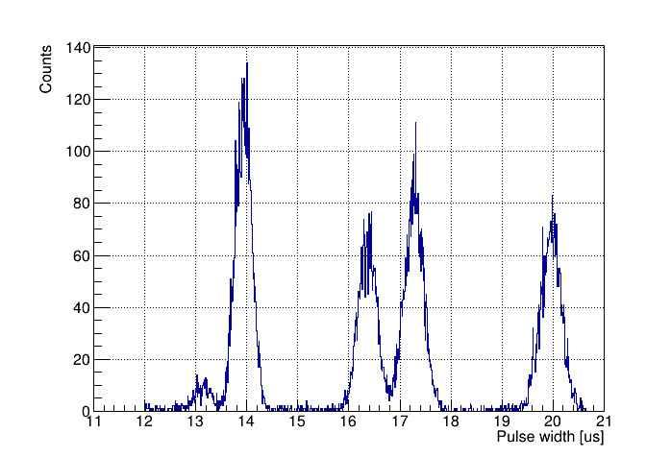
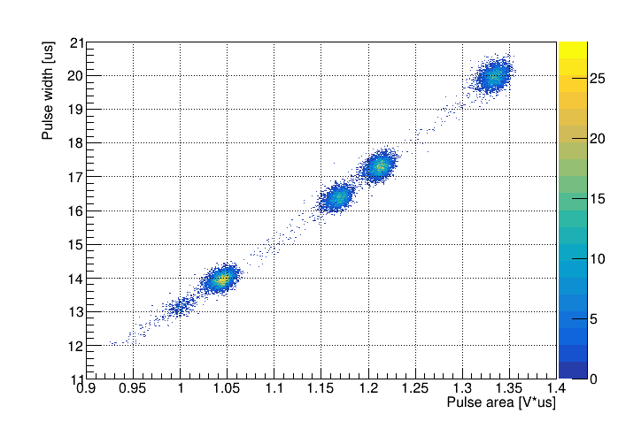
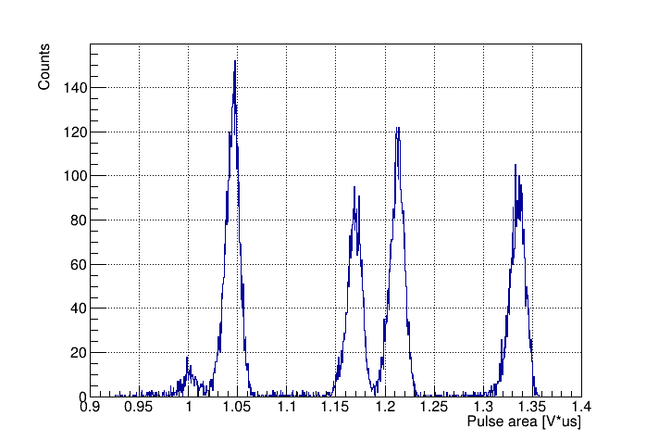
Measurements of energy spectra and track ranges from alpha particles
The alpha-particle source - ²²⁶Ra
$$E_{α}=4. 8 MeV$$
$$E_{α}=5.3 MeV$$
$$E_{α}=5.5 MeV$$
$$E_{α}=6.0 MeV$$
$$E_{α}=7.7 MeV$$
Pressure = 50 Torr
Gain = 225
Source | Sigma/Range | Separation level
²²⁶Ra | 1.13% | 5σ
Using these results and SRIM simulations it is shown that isobaric boron and beryllium ions can be effectively separated at AMS at the 5σ level.
11
Notes:
The spectrum of alpha-particles source was measured in the low-pressure TPC with GEM. A two-dimensional distribution of the pulse width and area is shown in this figure. These figures show projections on the pulse width and area axes. We can see 4 clusters from alpha-particles with energies 4.8, 5.3, 5.5 and 6 MeV. An alpha particle with an energy of 7.7 MeV has a greater track range than the detector length. These clusters are well separated both in pulse width and pulse area.
We are interested in two clusters in the center. These alpha particles have the same track range difference as boron and beryllium ions. We can separate these peaks at the 5 sigma level.
Using these results and SRIM simulations it is shown that isobaric boron and beryllium ions can be effectively separated at the 5 sigma level at AMS as well.
In the future, we plan to make an independent trigger, which will significantly reduce the degree of dependence on diffusion and improve the time resolution.

Slide 12
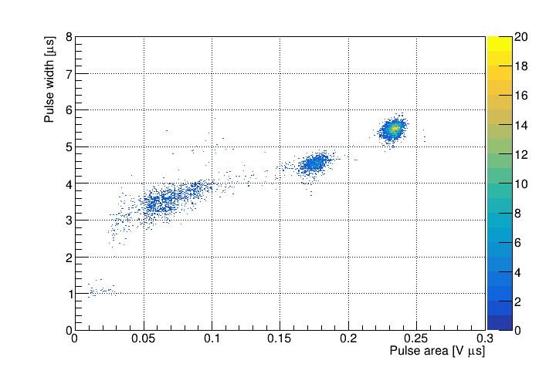
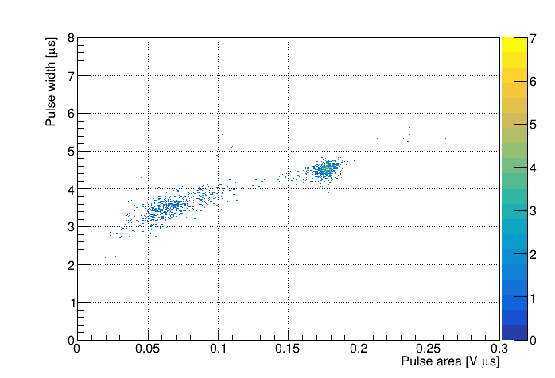
Measurements of energy spectra and ion ranges at AMS
2D plots of pulse width versus pulse area for ions from BINP AMS measured in low-pressure TPC in isobutane at 50 torr.
¹⁴C
Reference Sample
Australian National University standard.
Made from sucrose (sugar) and is one of the IAEA-certified radiocarbon standards.
Background Sample
Blank carbon samples was made from fine-grained dense graphite (dead carbon without 14C).
12
Notes:
We installed the low-pressure TPC for testing at BINP AMS after the time-of-flight system. Thus, the calibration of our detector will not affect the routine measurements at AMS. We carried out test measurements with two types of samples: reference sample and background sample. This slide shows 2d plots of pulse width versus pulse area for ions from BINP AMS measured in low-pressure TPC in isobutane at 50 torr.
Reference sample is Australian National University standard. Made from sucrose and is one of the certified radiocarbon standards. In such samples, the exact content of radiocarbon is known.
Blank carbon samples was made from fine-grained dense graphite (dead carbon without 14C). In routine measurements, all results are background corrected and calibrated against reference samples.
In the first figure from the reference sample, we can see 3 clusters. While in the figure from the background sample, we see 2 clusters. Thus, we can conclude that this peak belongs to carbon-14 ions, and the other two clusters are the background. The time-of-flight detector, which is installed at the BINP AMS, successfully suppresses this background, since these ions have different times of flight.

Slide 13
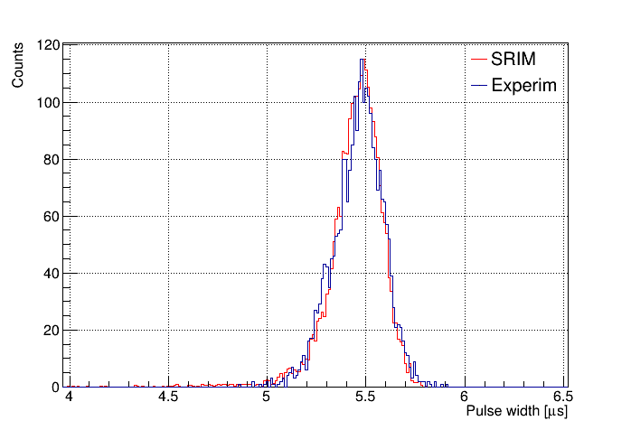
Carbon-14: experiment vs simulation
Distribution of pulse width from carbon-14 ions. Low-pressure TPC measurements are fitted with simulation using SRIM.
Experiment: υ_{dr} = 0.53 cm/µs
Drift velocity in Isobutane at 50 torr and E = 13.5 V/cm is calculated using Magboltz.
Magboltz: υ_{dr} = 0.58 cm/µs
Experiment and simulation are in good agreement.
There is currently work in progress on determination of experimental errors.
13
Notes:
This slide shows a comparison of experiment with simulation. The distribution of the pulse width from carbon-14 ions was obtained. Measurements of low-pressure TPC are fitted with simulation using SRIM. The drift velocity in the experiment is 0,53 cm/us.
Drift velocity in Isobutane at 50 torr and electrical field strength of 13.5 V/cm is calculated using Magboltz. The drift velocity in the simulation is 0.58 cm/us.
Experiment and simulation are in good agreement. There is currently work in progress on determination of experimental errors.
After the modernization of BINP AMS we plan to conduct experiments with samples containing beryllium.

Slide 14
Summary
We have developed and successfully tested a low-pressure TPC with GEM readout for AMS.
A new ion identification technique based on measuring both the ion track ranges and the ion energies in the low-pressure TPC has been developed.
Using these results and SRIM simulations, it was shown that isobaric boron and beryllium ions can be effectively separated at the BINP AMS at a level of 5σ. It provides efficient dating for up to 10 million years (for the geochronology of the Cenozoic Era).
The low-pressure TPC was installed at the BINP AMS. Measurements were successfully carried out with samples containing radiocarbon.
14
Notes:
Let's move on to the results.

Slide 15
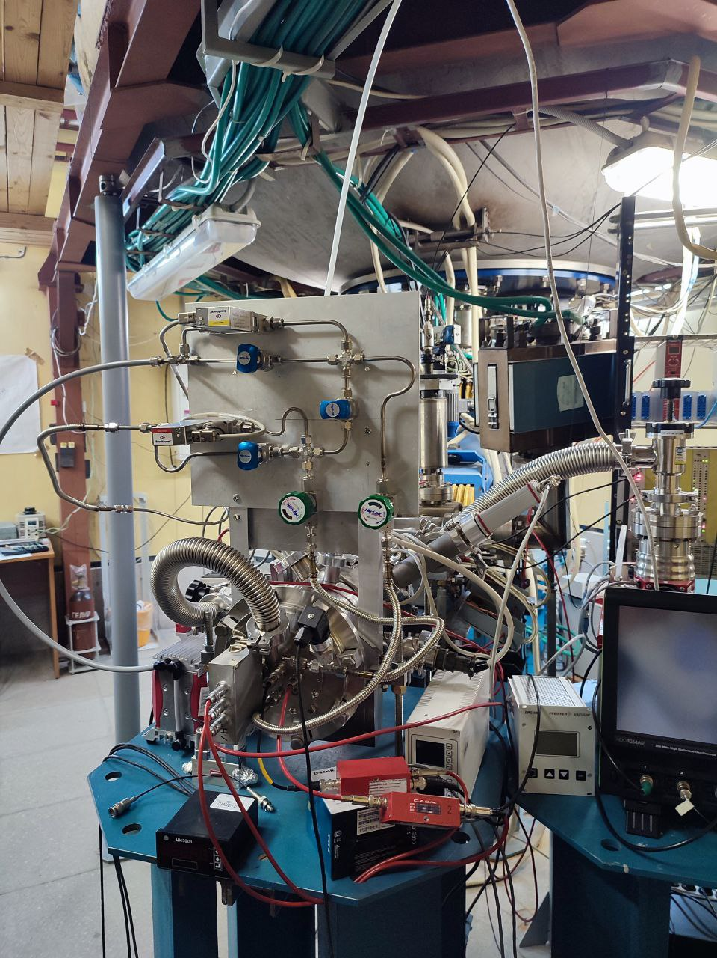
Thank you for
your attention
15

Slide 16
Backup slides
16

Slide 17
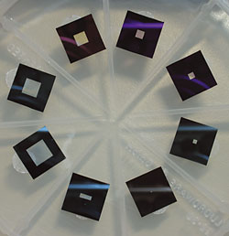
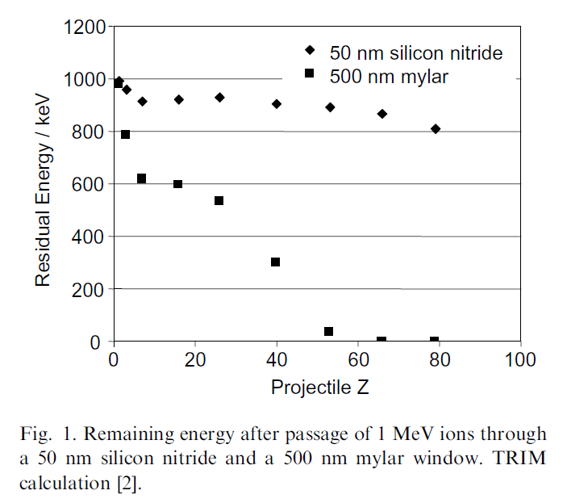
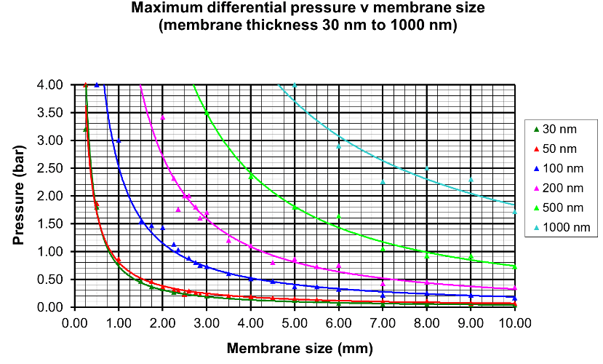
Silicon nitride membrane windows
Figure of silicon nitride membrane windows
M. Dobeli et al., Nucl. Instr. and Meth. B, 219-220 (2004) 415-419 doi:10.1016/j.nimb.2004.01.093
17

