Slide 1
Detector challenges of the strong-field QED experiment LUXE at the European XFEL
M. Bruschi (INFN Bologna, ITALY) for the LUXE collaboration
TIPP 2023 Conference – Cape Town (South Africa)
September 4-8, 2023

Slide 2
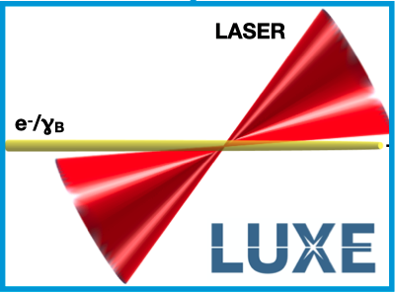
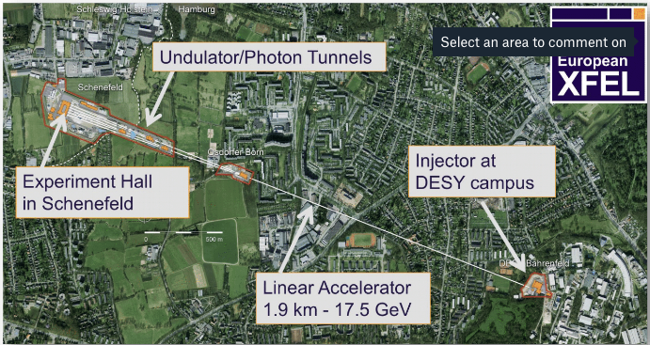
Overview
A new HEP experiment is being proposed at DESY and Eu.XFEL
Collisions of a small fraction of XFEL electron beam and state-of-the-art high-power LASER
Unprecedented density of electromagnetic energy reached in a lab
Strong-field QED regime can be studied
This regime is present in
magnetars and other astrophysical phenomena (i.e. Hawking Radiation)
Atomic and laser physics
High energy colliders, e.g. ILC or CLIC
LASER Und XFEL Experiment

Slide 3
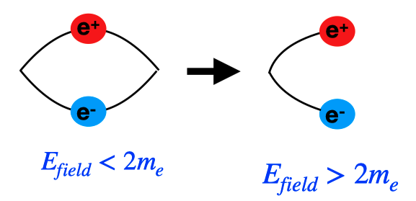
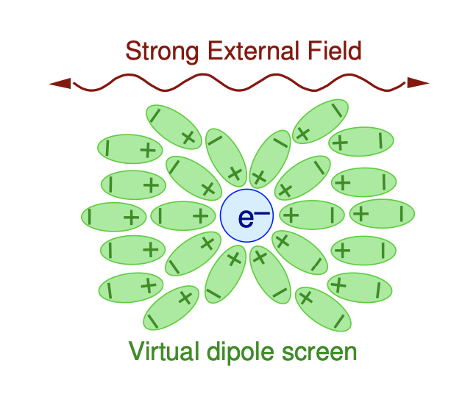
Introduction: Strong-Field QED
QED: most well tested theory in physics
Based on perturbative calculations
LUXE will study QED in Strong-Field Regime
work by field over λ_{Compton} > 2m_{e}→ critical field (Schwinger-limit)
Field-Induced Pair creation
pair production from vacuum $P∝exp\left(−π\frac{ε_{cr}}{ε}\right)$
Modified Compton spectrum
in strong fields, electron becomes “dressed” → $m_{∗}>me$
Schwinger Limit:
$$ℇ_{cr}=\frac{m_{e}^{2}c^{3}}{ℏe}≃1.3∙{10}^{18}\frac{V}{m}$$

Slide 4
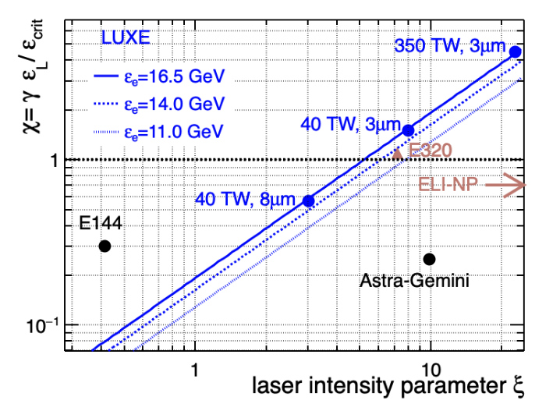
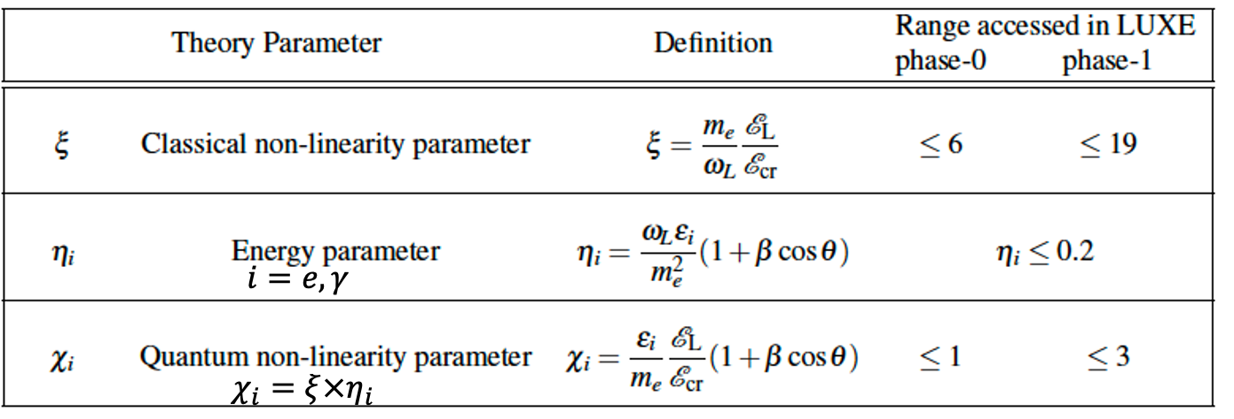
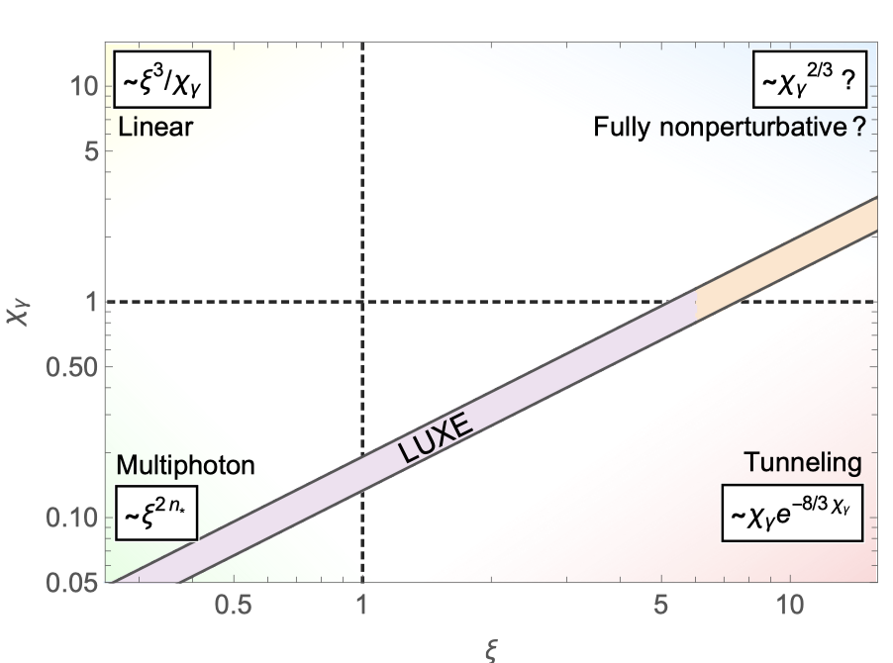
Definitions
$$η_{i}=\frac{χ_{i}}{ξ}$$
${ ℰ}_{L}:$ Laser field
${ ℰ}_{cr}:$ Schwinger critical field
${ ω}_{L}:$ Laser frequency
$θ$: e/γ – laser crossing angle
$ℰ_{e/γ}:$ Probe electron/photon energy
Parameter ξ
Depends only on laser properties $∝\sqrt{I_{Laser}}$ where $I_{laser}=\frac{ℰ_{L}}{ΔtπR^{2}}$
Different values of ξ obtained by defocusing or stretching pulse
Parameter χ=1
corresponds to Schwinger limit in rest frame of electron for e-laser collisions
Relative field strength
Laser intensity

Slide 5
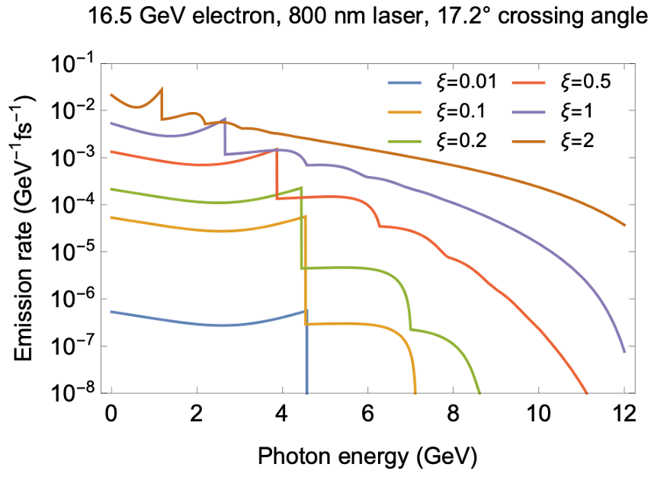
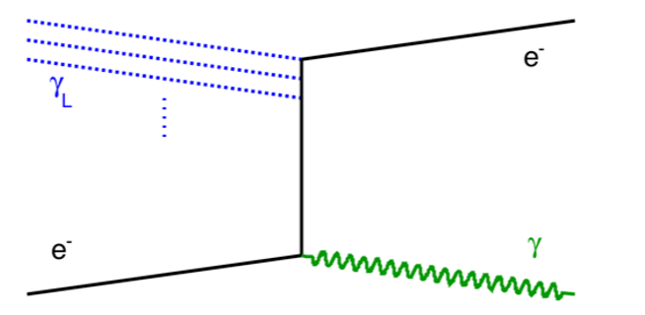
Non-linear Compton scattering
In strong fields, electrons obtain larger effective mass, m∗ = m_{e} (1+ξ²)^{1⁄2}
Compton edge shifts as function of ξ
Higher harmonics appear, i.e. interaction with n laser photons
Strong- field QED:
Classical limit:

Slide 6
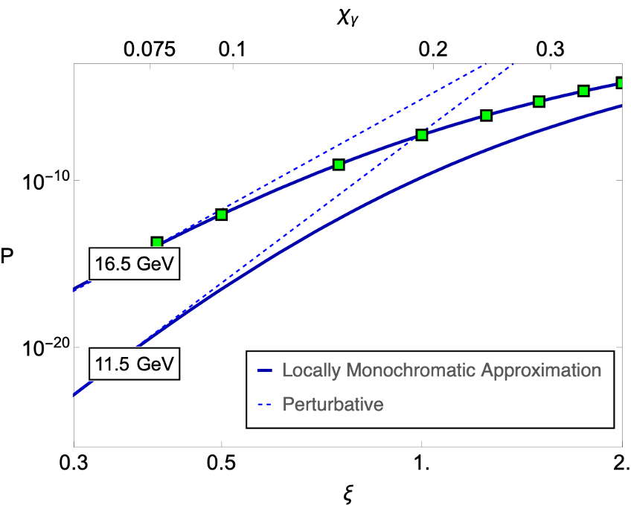
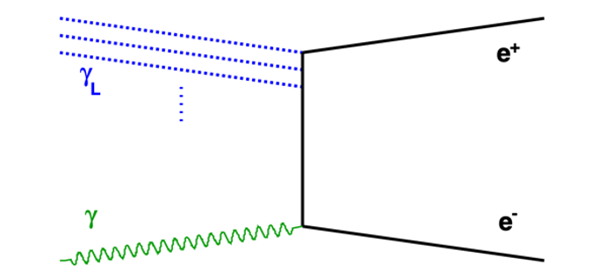
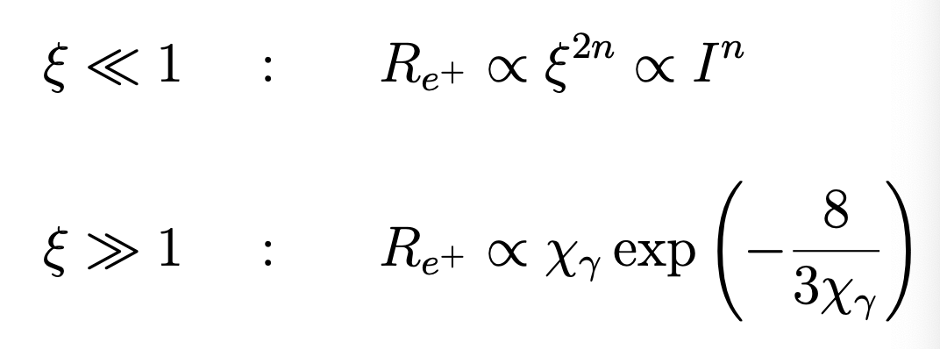
Non-linear Breit-Wheeler pair production
Photon from Compton scattering or secondary beam.
Perturbative regime: power law
Non-perturbative regime

Slide 7
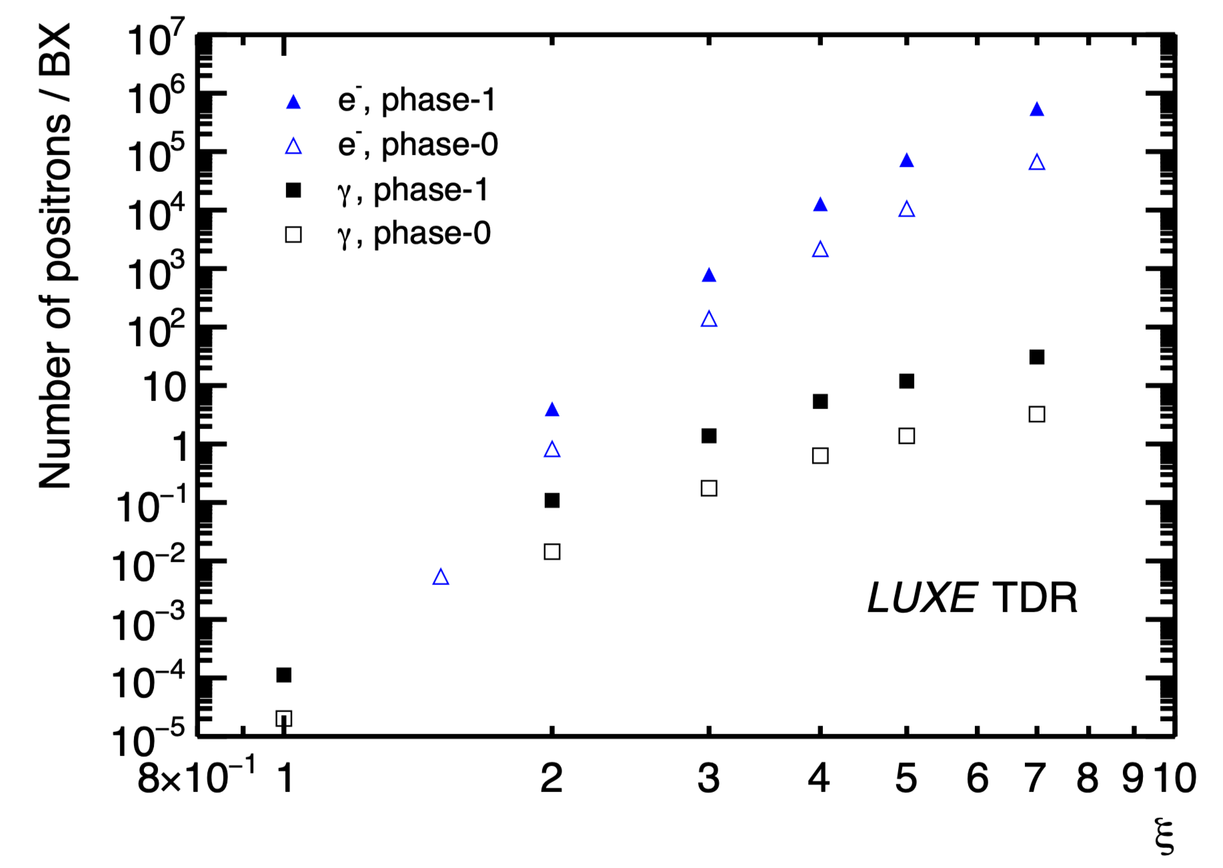
Detector requirements and challanges
Pick one bunch per bunch train from EU.XFEL => 10 Hz
Each bunch train contains up to 2700 bunches
No impact on photon science program
Collide 1 Hz with laser and keep 9 Hz for background measurements
Ideal to determine background in-situ => subtract statistically
Measure electrons, positrons and photons in adequate detectors
Measure fluxes and energy spectra O(GeV)
Running mode | Electrons/BX | Positrons/BX | Photons/BX
e-laser | 10⁷-10⁹ | 10⁻² -10⁵ | 10⁷-10⁹
γ-laser | 10⁻³ -10 | 10⁻⁴ -10 | 10⁷

Slide 8
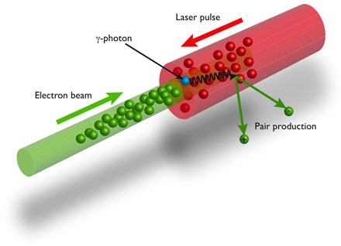
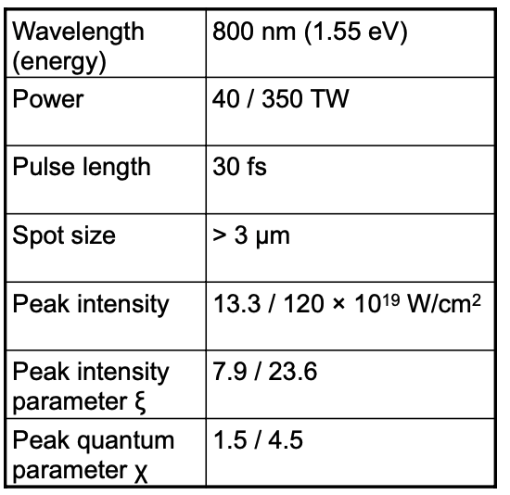
The beams
Electron Beam
Energy: 16.5 GeV
Bunch: 1.5 10⁹ e⁻
Bunch rate: 10 Hz
Laser Beam
Repetition rate: 1 Hz
Crossing angle: 17°
Power
Phase 0: 40 TW
Phase 1: upgrade to 350 TW
3D Diagnostics
Energy, Pulse Length, Spot Size
Goal uncertainties
<5% uncertainty on laser intensity,
1% shot-to-shot

Slide 9
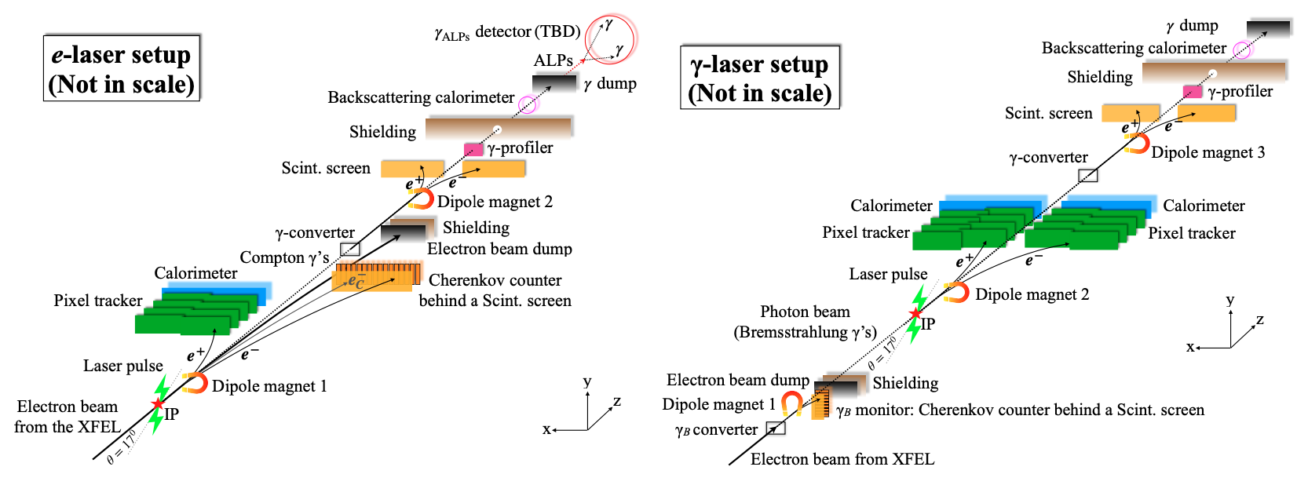
Experiment overview
•Goal: measure fluxes and energy spectra of electrons, positrons and photons.
•Challenge: particle fluxes vary between ~10⁻⁴ e⁺ and 10⁹ (e⁻ and γ) per laser shot.
•Solution: use different detector technologies adapted to respective signal and background fluxes.

Slide 10
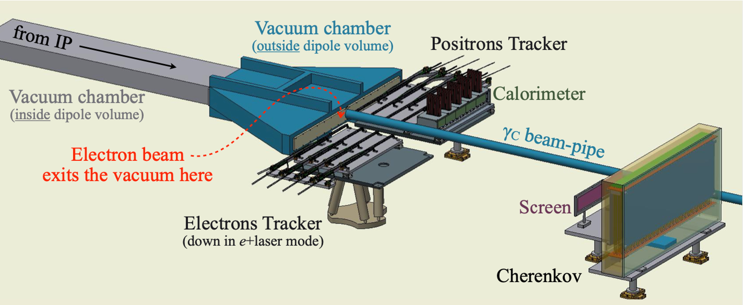
IP detectors
Electron/positron detectors in (e-laser)
High-flux (e⁻) regions
Scintillation screens
GadOx, readout by CMOS/CCD
Cherenkov detectors
finely segmented (⌀=4mm) air-filled reflective guides readout by SiPM/APD
High rate tolerance, large dynamic range
Low-flux (e⁺) regions
Silicon pixel detectors
4 layers, based on ALICE ALPIDE pixel chips
ΔE/E<1%
High granularity sampling calorimeters
Tungsten plates (3.5 mm)
20 layers, based on (LC) FCAL collaboration technology
Read out by FLAME ASIC
Silicon sensors of 9x9 cm² with pads 5.5x5.5 mm²
ΔE/E=20%/$\sqrt{E}$, Δr~750μm
Two complementary detector technologies per measurement
Different sensitivities, cross calibration, reduction of systematic uncertainties
Electron calorimeter (γ-laser)
Collision rate is lower
Si-W EM calorimeter based on CALICE developments
7 W layers 2.8 mm / 8 layers 4.2 mm
Sensors as for the positron calorimeter

Slide 11
Overview of photon detectors
Gamma-ray spectrometer
Measures photon spectrum as obtained from 1% converted e⁺e⁻
Scintillation screens and CCD camera
ΔE/E<2%
Gamma flux monitor
Measure energy flow of particles back-scattered from γ beam dump
Lead glass blocks,
3.8x3.8x45 cm³
Measure 10⁹ photons summing up to TeV energies
Three complementary systems
γ spectrometer using a small fraction of converted e⁺e⁻
γ profiler using radiation hard sapphire
γ flux monitor which relies on backscattering from photon dump

Slide 12
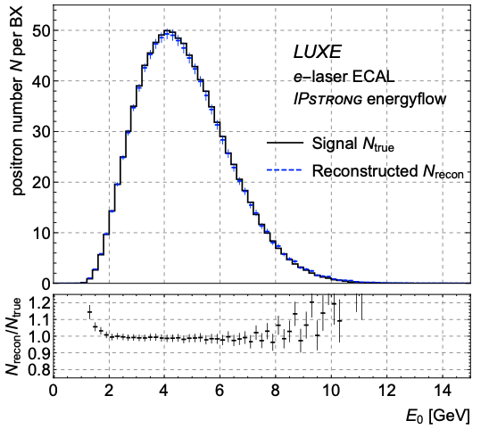
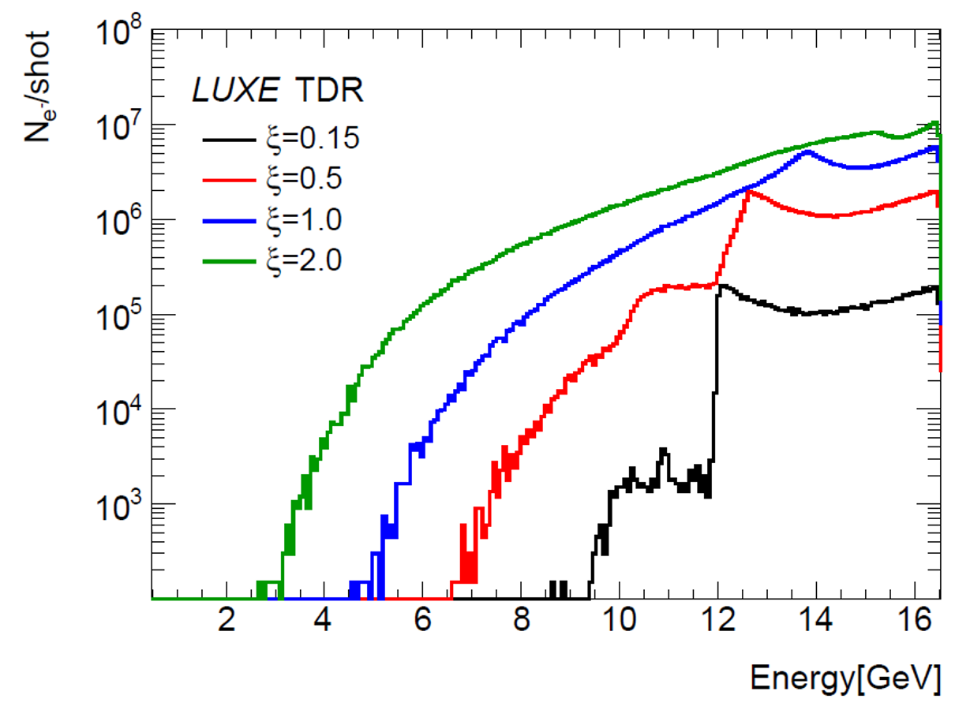
Systematic uncertainties – particle detection
Low multiplicities (e+e⁻ pair production):
Efficiencies for individual particles < 2 − 3% (cross-checks and in-situ calibration).
Linearity of response < 2% based on current tests.
Background: statistical uncertainty based on 9 Hz data, significant at low ξ.
High multiplicities (Compton):
Linearity of response < 2% for Cherenkov (and scintillator) based on test beam and experience from other experiments.
Calibration < 2% based on test-beam calibration.
Background (for scintillators): constrain in situ.
Energy scales (all):
Calibration/knowledge of magnetic field ~ 1%.
Alignment of < 50 μm results in < 0.5% uncertainty.

Slide 13
Importance of the Gamma Profiler
The transition to the non-perturbative QED regime is characterised by the intensity of the laser pulse
$$ξ∝\sqrt{I_{Laser}}$$
Physics process depends very strongly on ξ
Small shift in $ξ$ causes large change in rate
A 5% uncertainty on the absolute intensity results in $≤40\%$ uncertainty on predicted rate
Two direct methods to measure ξ
3D laser diagnostics (Energy, pulse duration and width) → 5% on I_{Laser}
Gamma Beam Profiler (GBP)
GBP: The only LUXE detector able to measure ILaser in the interaction zone as experienced by the electron beam

Slide 14
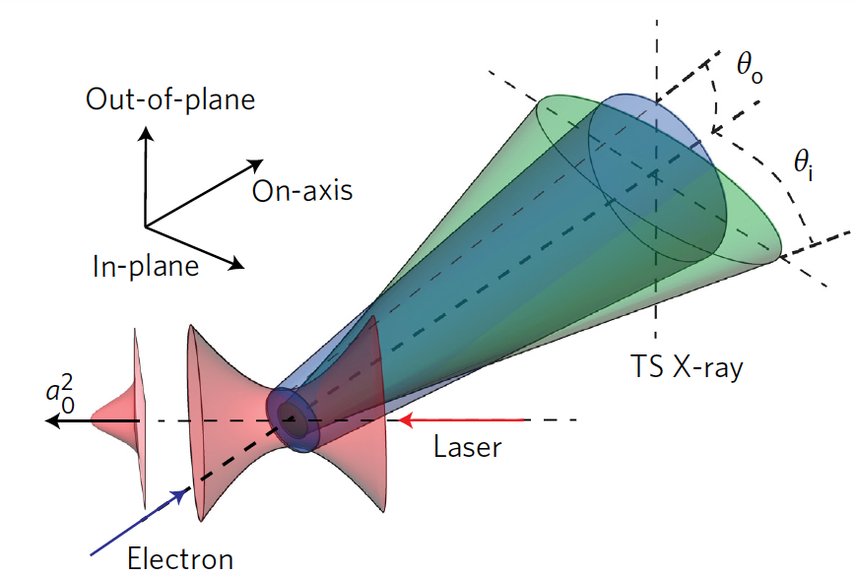
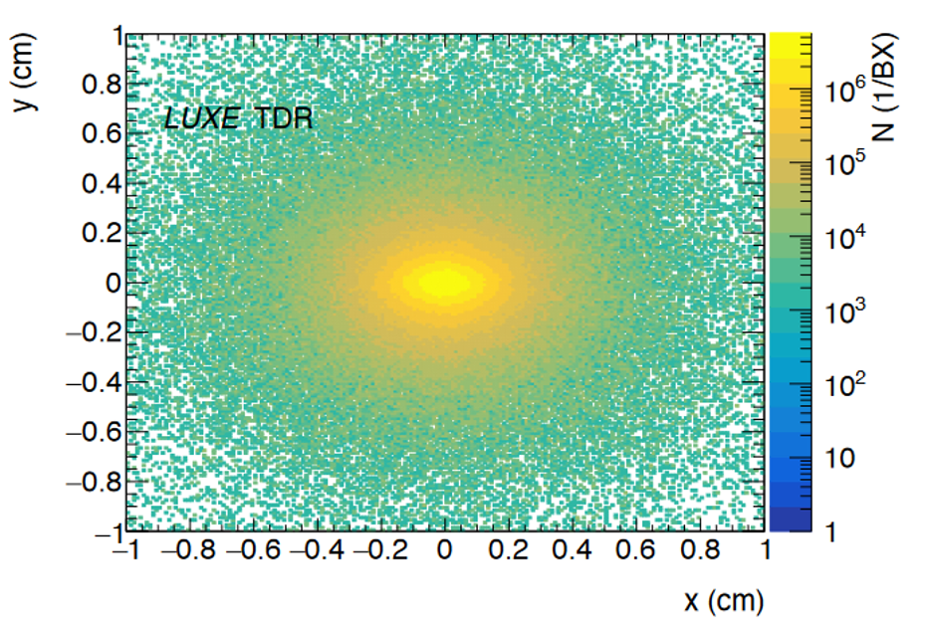
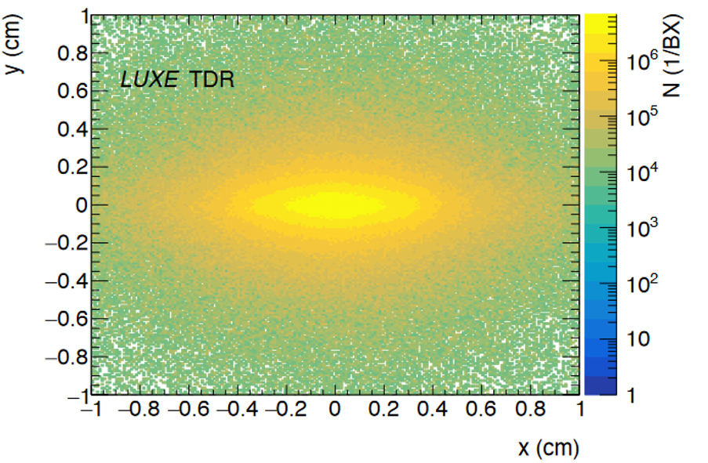
Principle of the GBP measuremen of ξ
An electron oscillating in an intense laser field (dimensionless intensity ξ > 1) undergoes non-linear Thomson scattering
In a linearly polarized laser pulse, the cone angle of photon emission results in an elliptic transverse distribution of the gamma-ray beam
The laser intensity experienced by the electron at the moment of emission will be inferred by measuring the width of the beam profiles in X and Y
A precise (few μm) measurement of the beam width in X and Y will allow a Δξ/ξ~2.5%
ξ = 5
ξ = 10

Slide 15
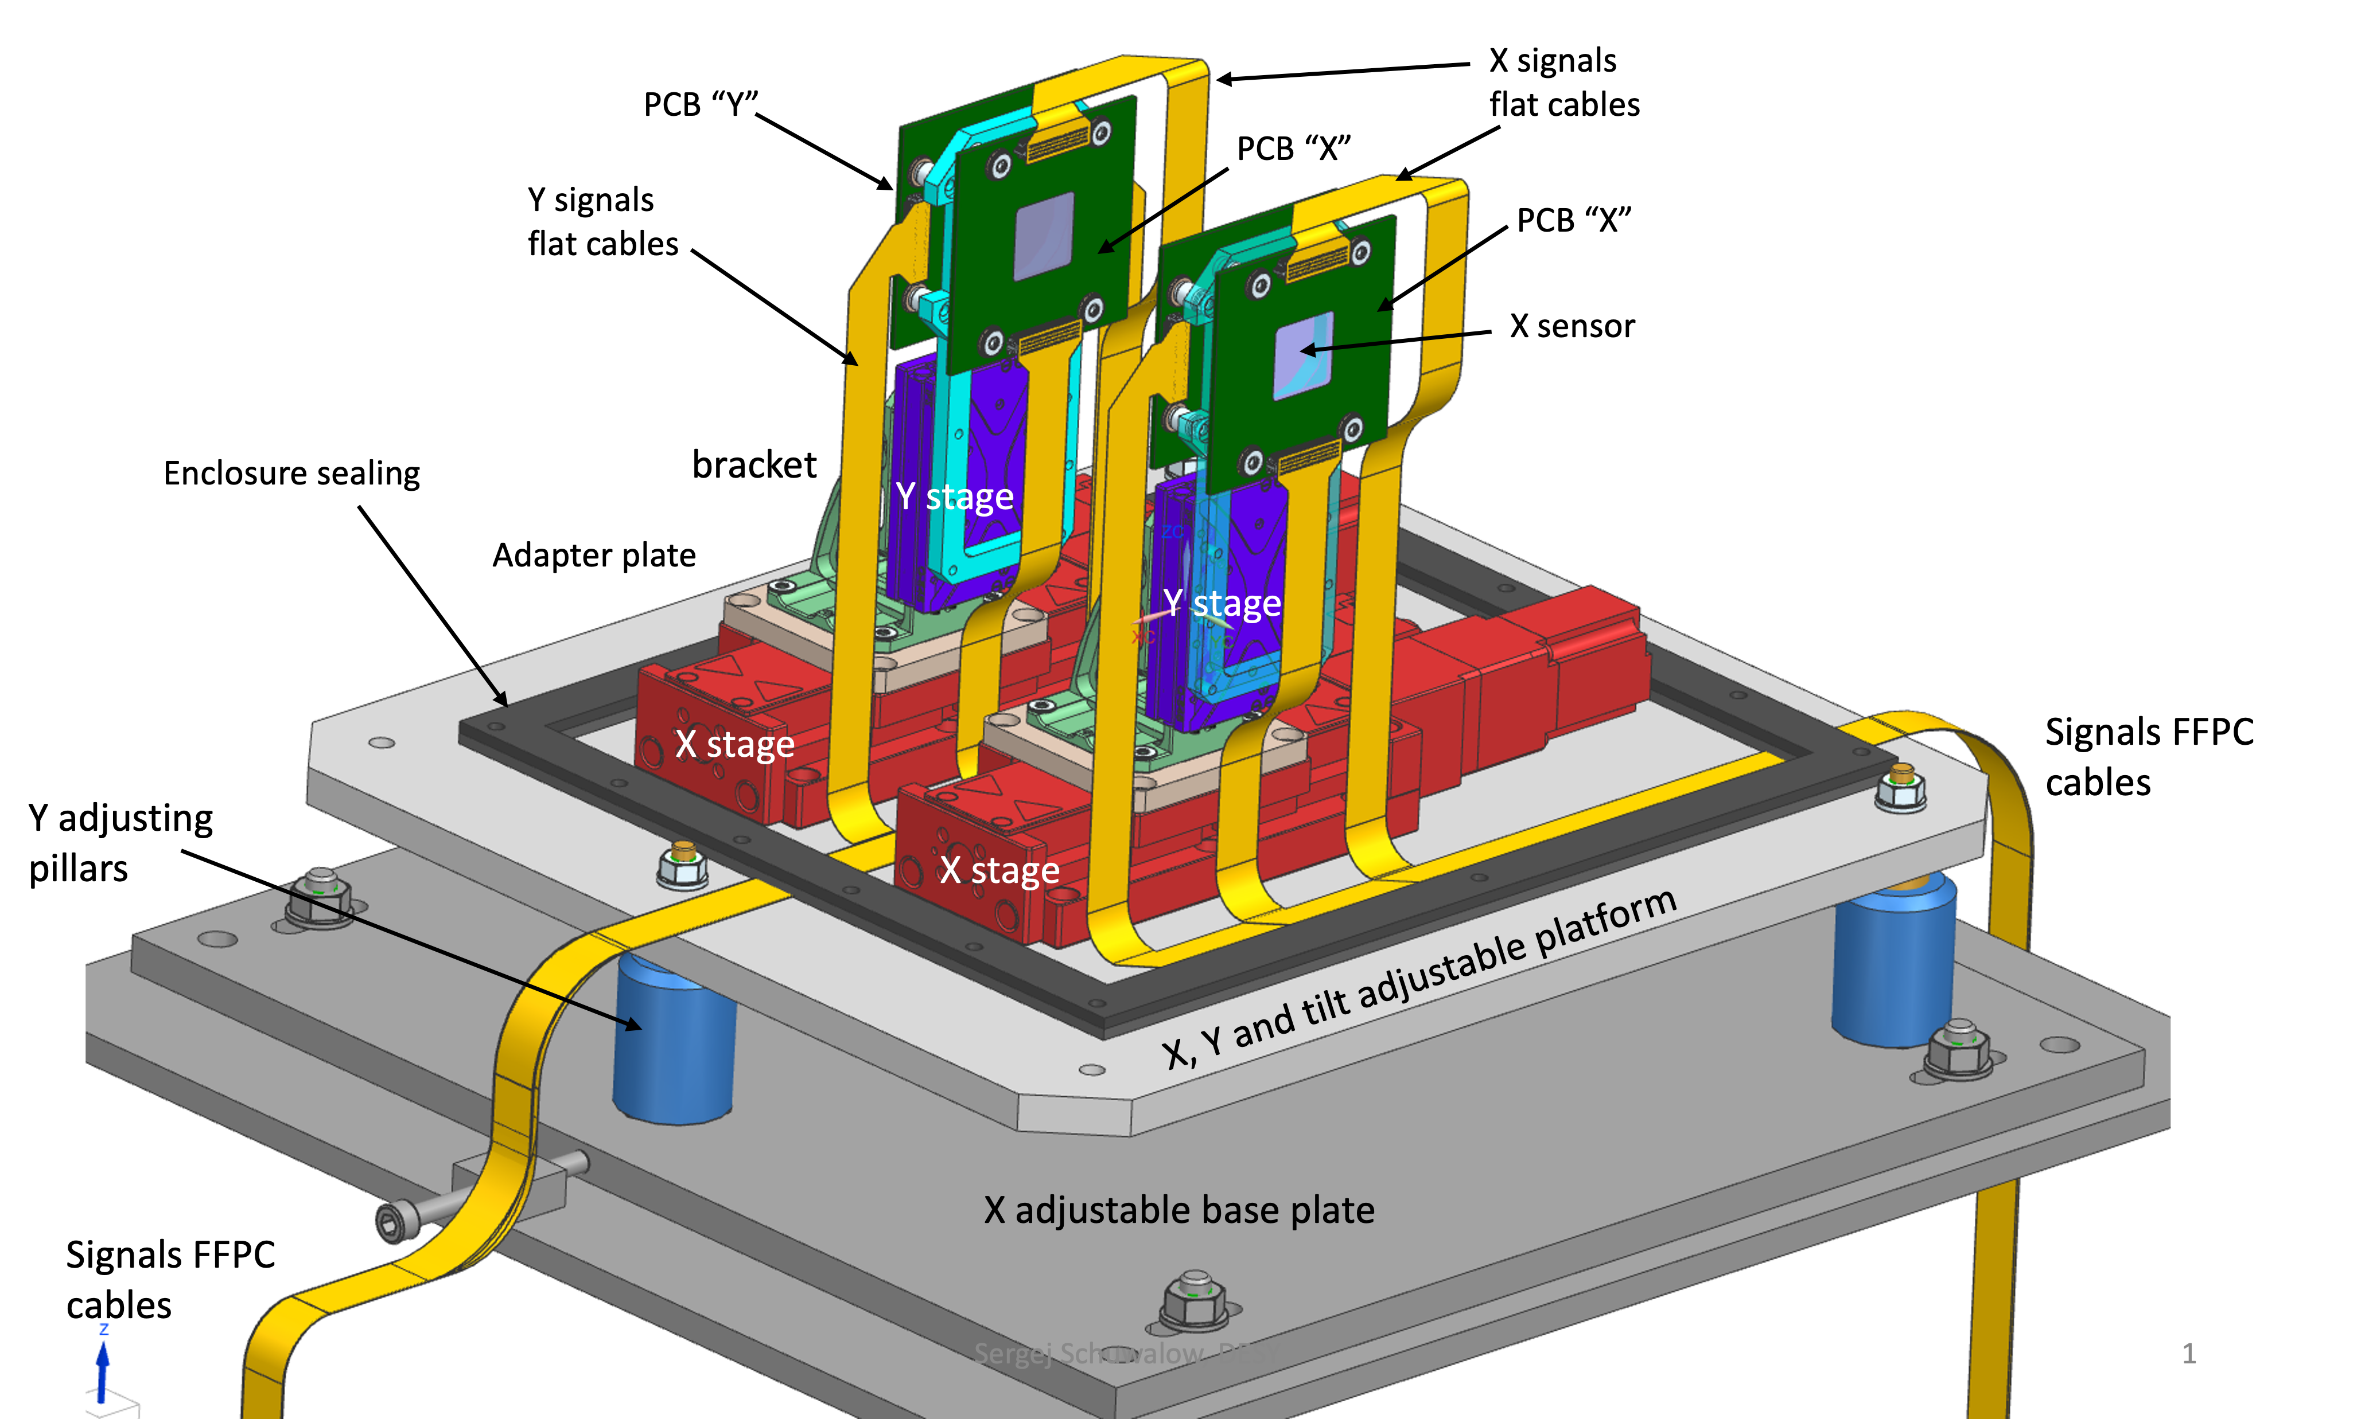
Proposed detector
1 Detector Station
Beam profile contained in a 2x2 cm² detector
Extremely high dose suggests to use two detectors with strips placed orthogonally each other to mitigate dose on readout electronics
High particle density can be dealt only with analog readout of the strips and center of gravity algorithm to reconstruct the beam profile shape
Strips with 100 μm pitch are an acceptable compromise to reach the target precision (5 μm) using a reasonable number of readout channels (400)
Since the dose absorbed by the second detector (and MS) depends on the detector thickness and there is no problem with signal strength, the detector should be as thin as possible
Optimal measurement system consists of TWO fully instrumented STATIONS
Redundancy
Calibrations (micrometric movements of one system with respect to the other which is kept fixed)
Movements also important to use different detector areas to mitigate irradiation effects
Chosen Material: Sapphire

Slide 16
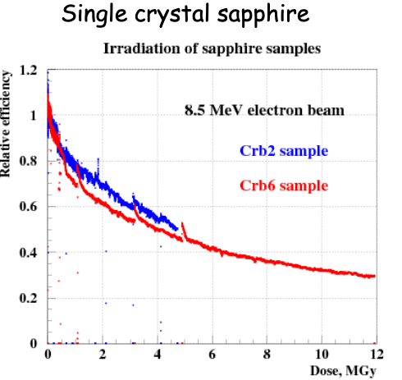
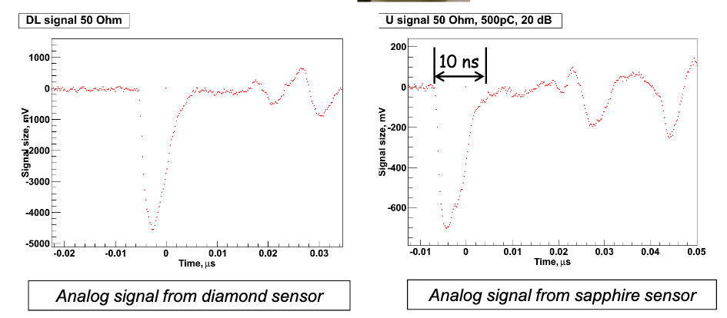
Sapphire properties
Sapphire is Al₂O₃
O. Karacheban et al.: Investigation of a direction sensitive sapphire detector stack at the 5 GeV electron beam at DESY-II / JINST 10 P08008
Specific characteristics of sapphire:
☺ High radiation resistance: ~ 10 MGy
☺ Leakage current does not increase with dose
☹ High eh creation energy
☹ Low collection efficiency (~10%)
☺ Fast response (low electron mobility compensated by reduced distance travelled by electrons)
☺ Low Cost: 1euro/cm² (compared to diamond 3000 euro/cm²)
LUXE GBP group: Intensive TB campaigns at LNF (Frascati) and CLEAR (CERN) to assess detector performances
Charge Collection Efficiency
CCE vs doses
Profile reconstruction vs absorbed dose

Slide 17
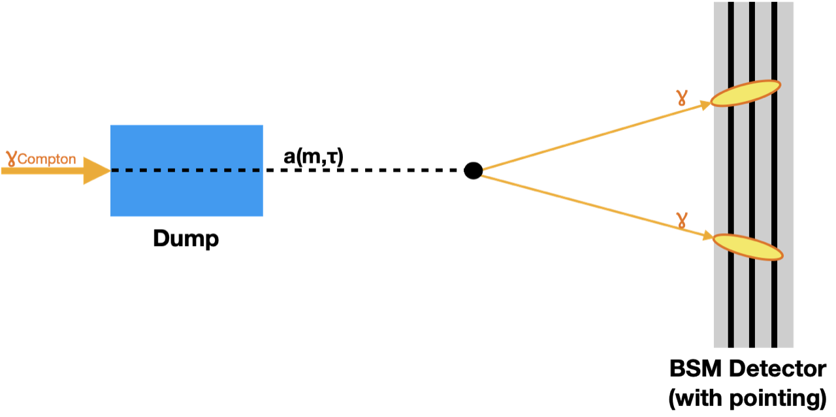
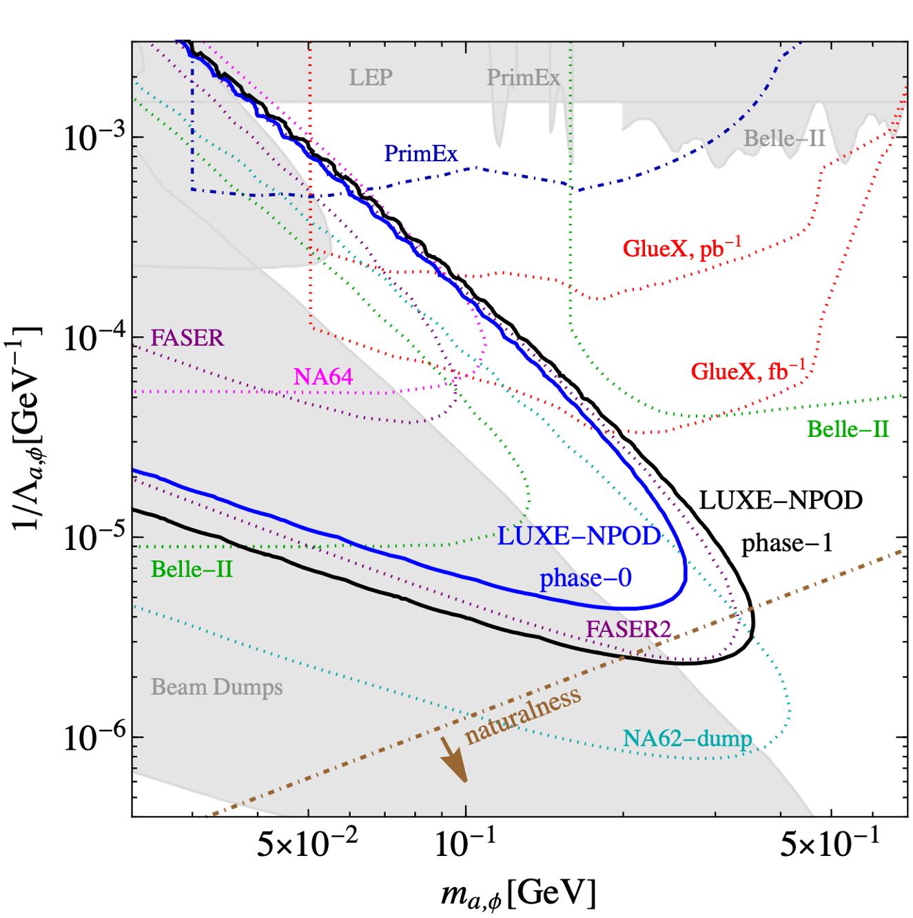
Detectors for BSM search for ALPS
~1 m long detector, ~2.5 m after photon dump
Search for axion-like particles or milli-charged particles
High-flux photon beam offers great potential
Sensitivity competitive with other experiments ongoing and planned
Detector still to be decided
LUXE-NPOD: Z. Bai et al., Phys. Rev. D 106 (2022) 115034, arXiv:2107.13554

Slide 18
SUMMARY
The LUXE experiment at DESY is aiming to explore uncharted territory in the realm of QED
Strong fields, encountered in various scientific domains, necessitate in-depth laboratory investigations
The experiment's large photon flux provides opportunities for exploring phenomena that go beyond the predictions of the Standard Model
While the detectors pose certain challenges, solutions have been devised with high confidence
Some solutions are also innovative and interesting for HEP, like the use of sapphire as gamma beam profiler
The experiment is expected to start the data taking in 2026
Officially recognized as a DESY experiment in November 2022
29 institutes
TDR arXiv link

Slide 19
Backup

Slide 20
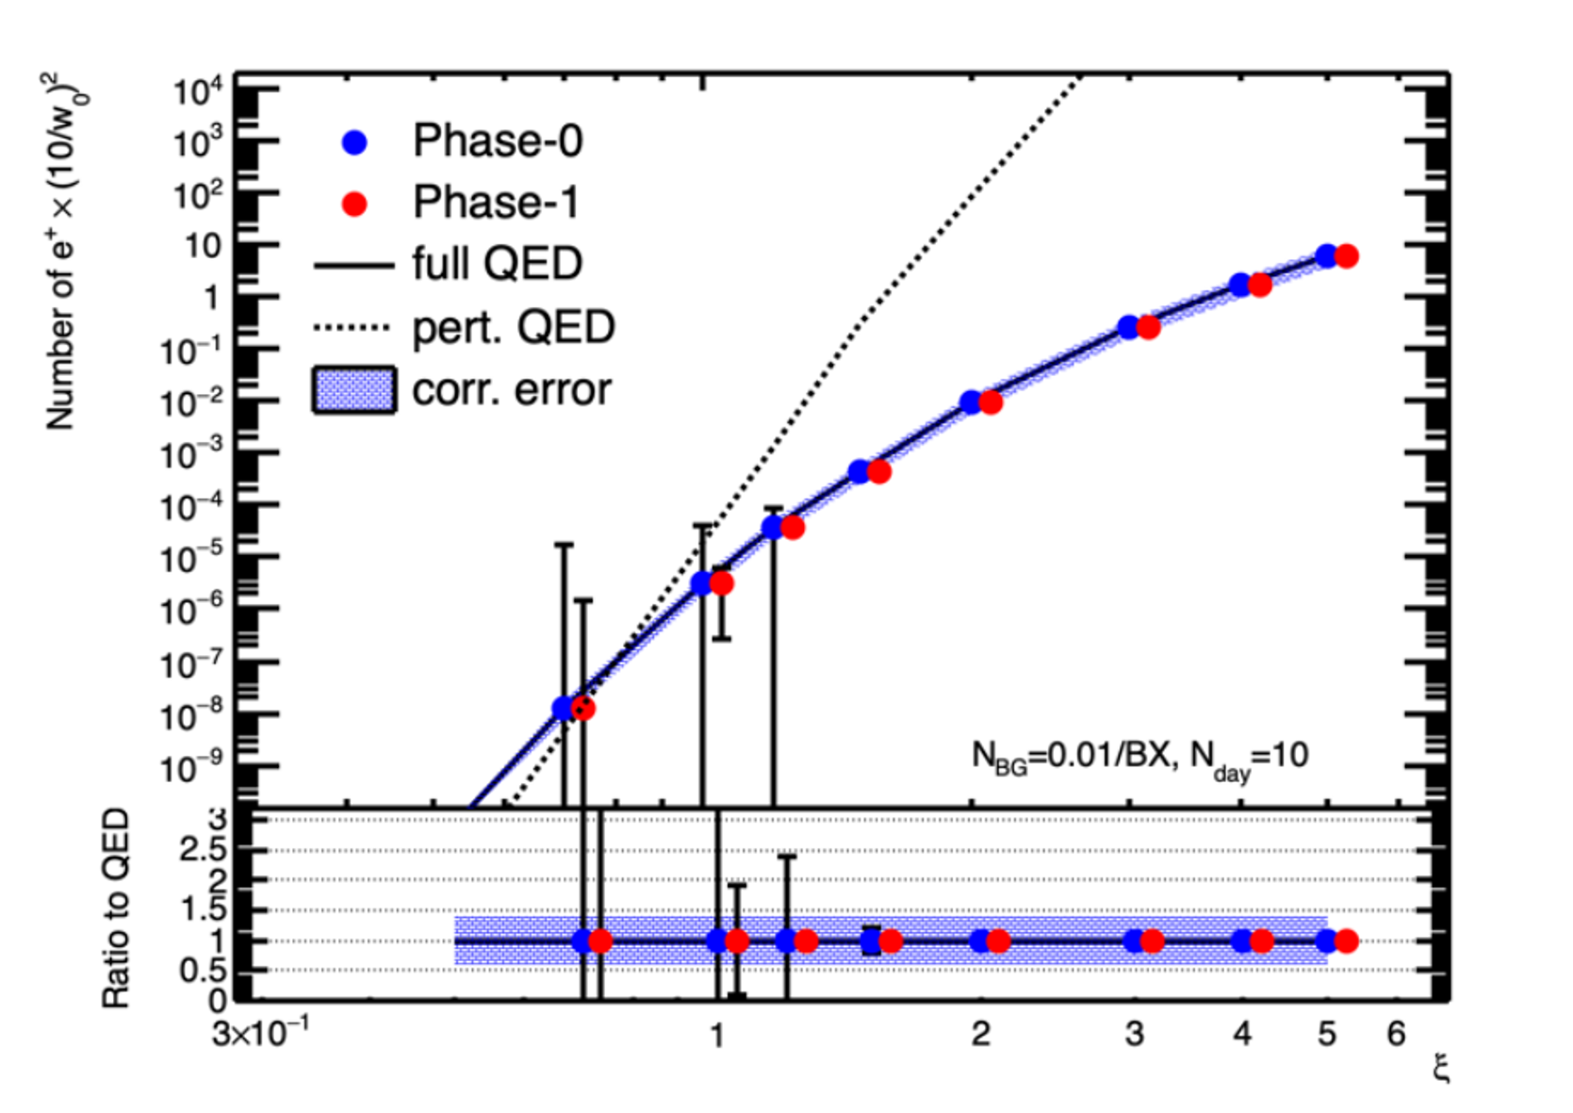
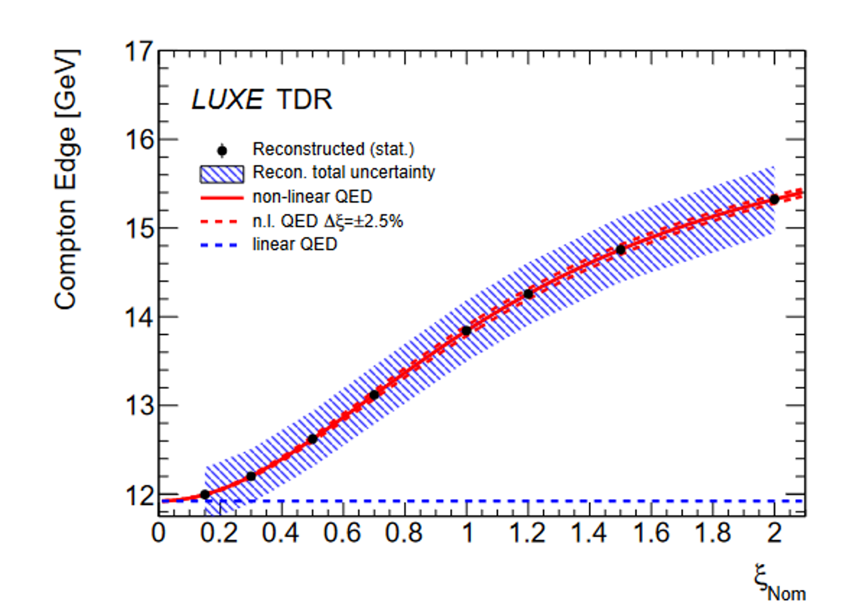
Expected results
Upper Plot
Number of Breit-Wheeler pairs produced in γ-laser collisions
Assume 10 days of data taking and 0.01 background events/BX
40% correlated uncertainty illustrates effect of uncertainty on ξ
Lower Plot
Compton edge position as a function of x in e-laser collisions
Assuming 1 hour data taking, no background
Illustrative 2% energy scale uncertainty

Slide 21
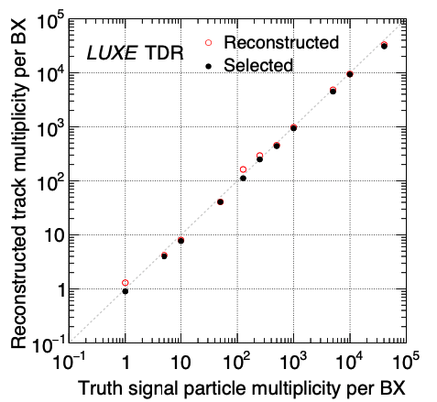
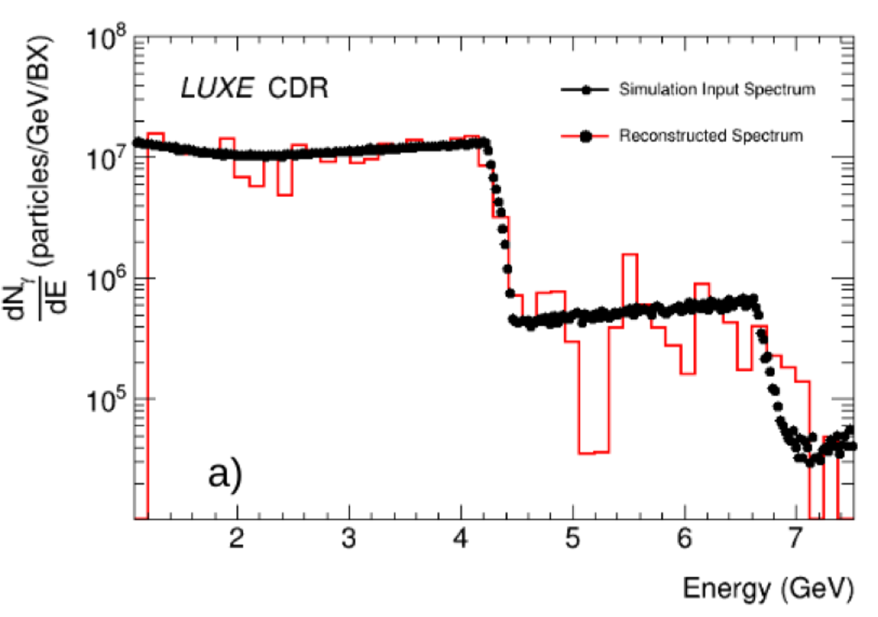
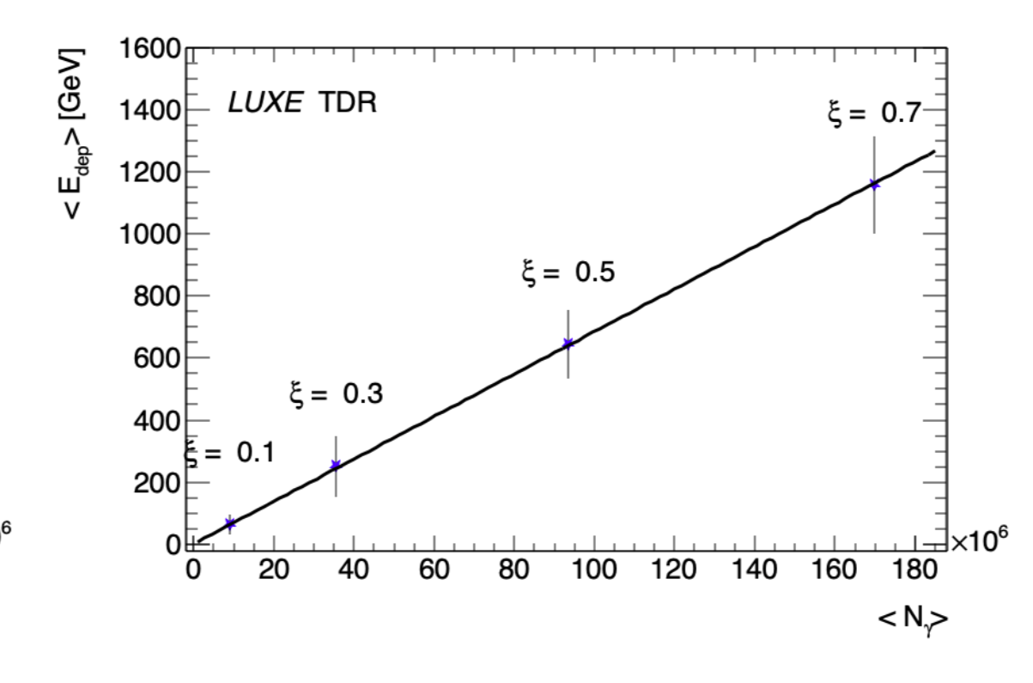
LUXE Detectors Performances
Excellent capabilities to reconstruct e⁻,e⁺
Multiplicities
Energy
and γ
Energy
Flux
Wide multiplicity ranges
Good radiation resistance
Scintillation screen
Pixel tracker
Gamma
spectrometer
Gamma flux monitor

Slide 22
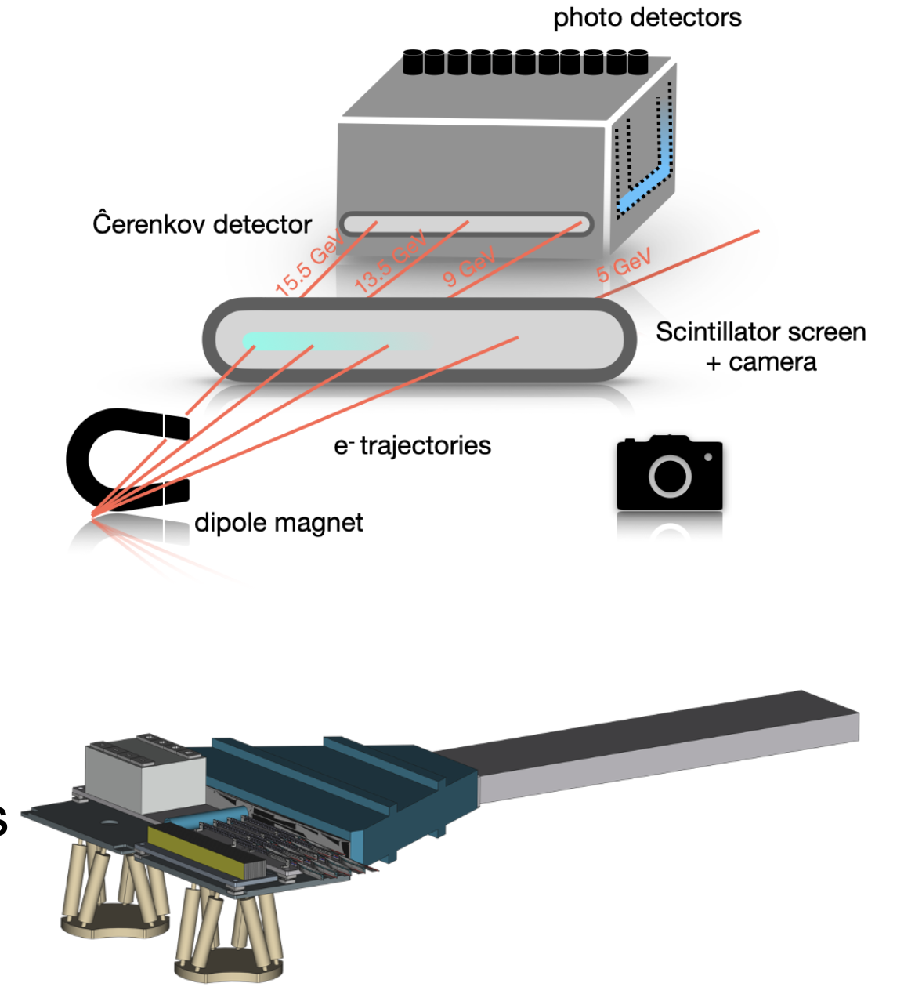
Overview of electron/positron detectors
High flux regions
Scintillation screens
Cherenkov detectors
High rate tolerance, large dynamic range
Low flux regions
Silicon pixel detectors
High granularity calorimeters
High signal efficiency, high resolution

Slide 23
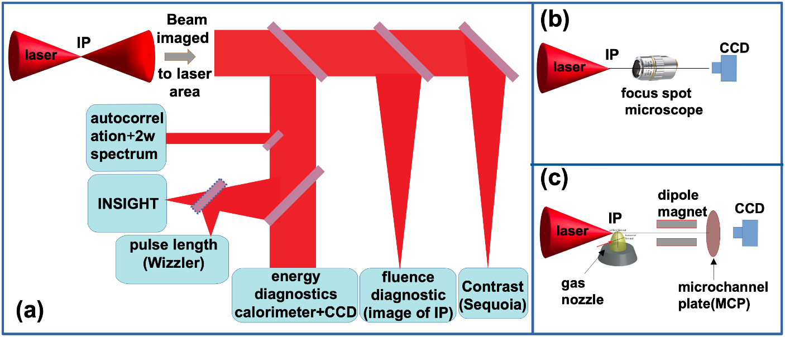
LASER DIAGNOSTICS
Need to characterise energy, pulse length,spot size
Diagnostics in IP chamber and laser clean room
Uncertainty on laser intensity impacts physics results
Goal: <5% uncertainty on laser intensity, 1% shot to shot uncertainty

Slide 24
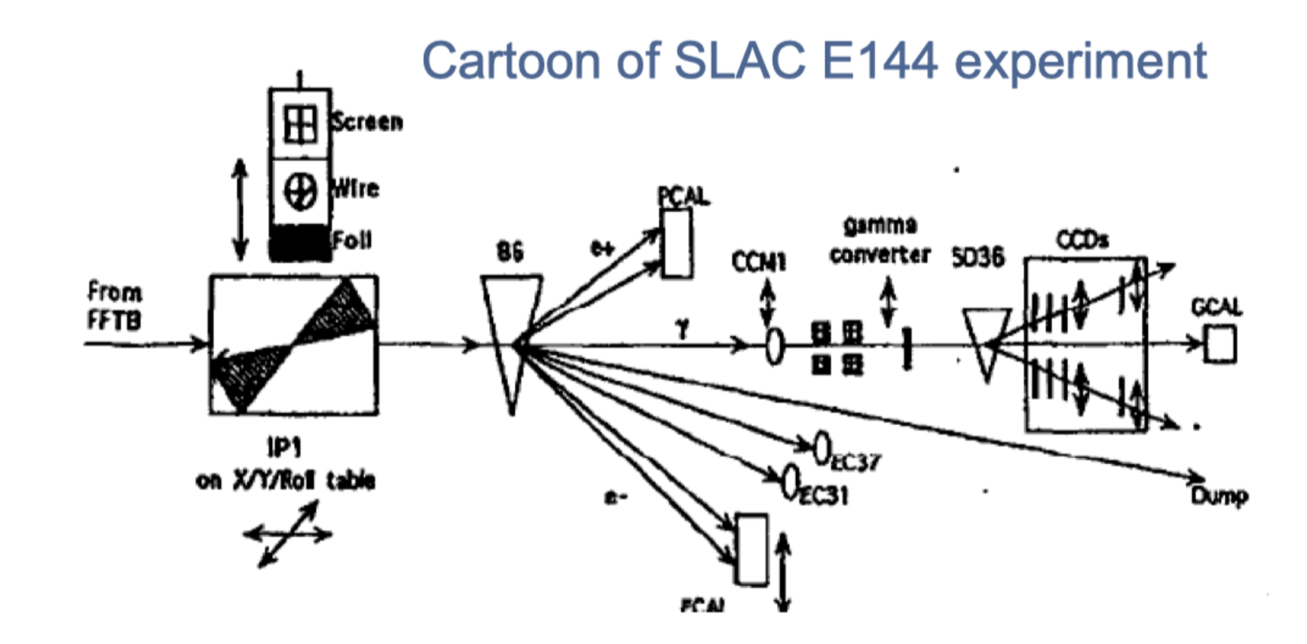
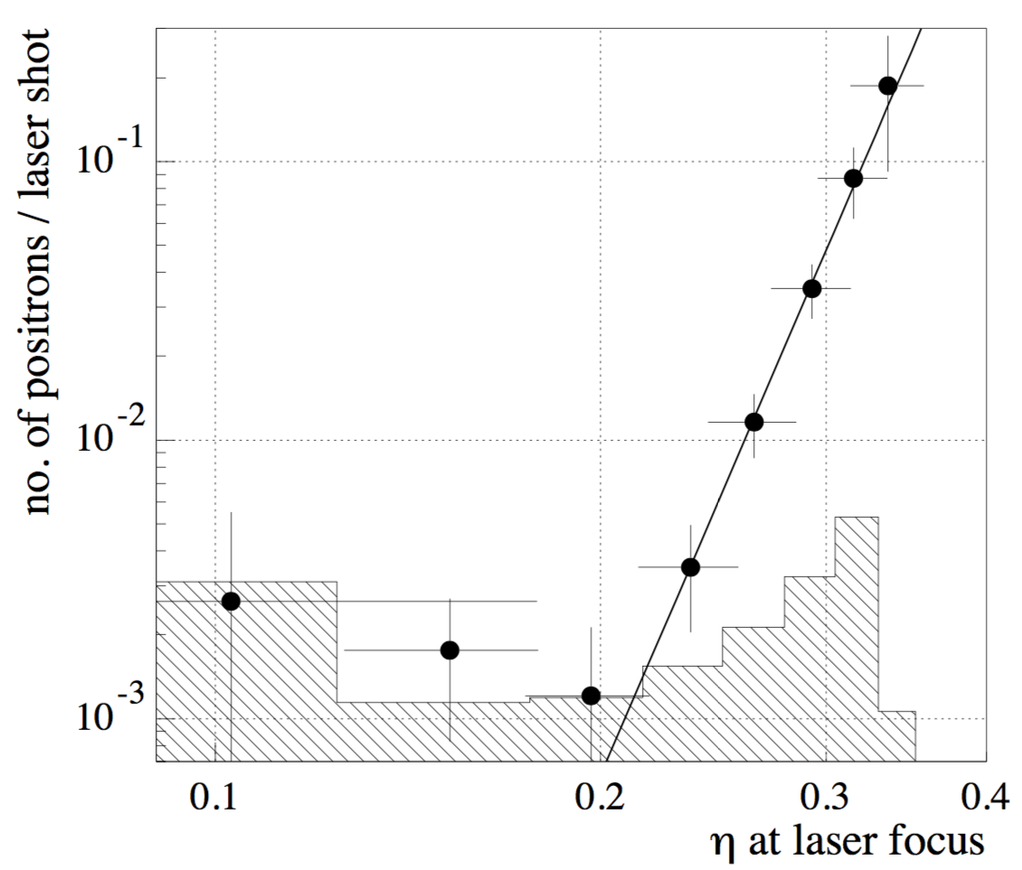
E144 experiment at SLAC
Groundbreaking experiment at SLAC in the 1990s
Used 1 TW laser and 46.6 GeV electron beam
Reached χ ~ 0.25, ξ ~ 0.4
Observed process: e⁻ +nγ_{L} →e⁻ +e⁺ +e⁻
The start of ξ^{2n} power law was observed, but not the departure from it
η~ξ

Slide 25
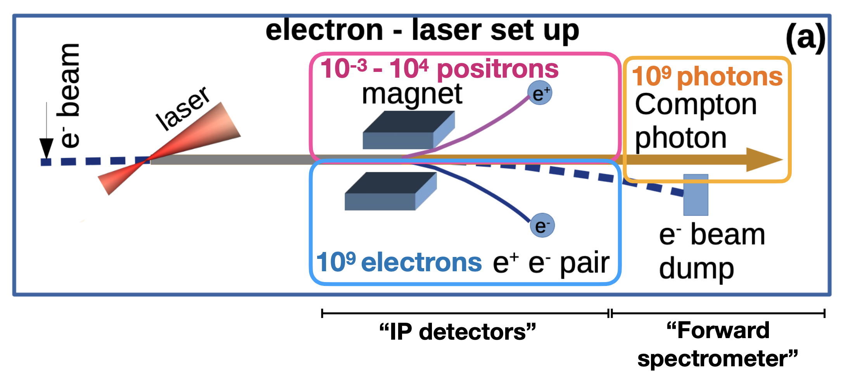
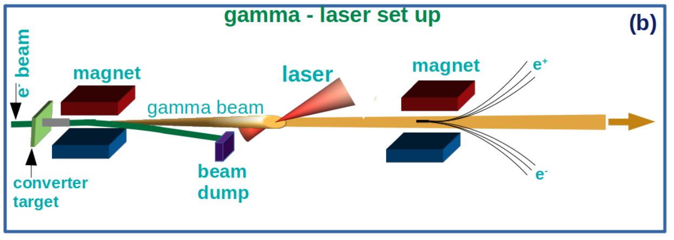
Detector requirements and challanges
Take one bunch per bunch train from EU.XFEL => 10 Hz
Each bunch train contains up to 2700 bunches
Collide 1 Hz with laser and keep 9 Hz for background measurements
Ideal to determine background in-situ => subtract statistically
Measure electrons, positrons and photons in adequate detectors
Measure fluxes and energy spectra O(GeV)
Running mode | Electrons/BX | Positrons/BX | Photons/BX
e-laser | 10⁷-10⁹ | 10⁻³ -10⁴ | 10⁷-10⁹
γ-laser | 10⁻³ -10 | 10⁻³ -10 | 10⁷

Slide 26
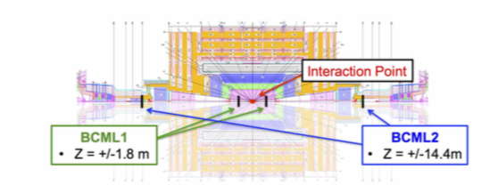
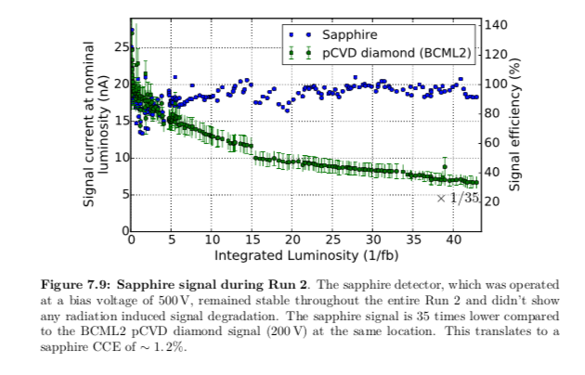
Sapphire in HEP
Intensive beam tests for FLASH and XFEL (electron beams)
Sapphire detectors have been extensively tested as beam halo and beam loss monitors at the Large Hadron Collider (CMS)
A sapphire version of BCM has been succesfully tested during RUN2 (BCML2 sapphire) and the performances can be compared with BCML2 pCVD diamond version
Improved version (increased signal strength) of sapphire detector under consideration by CMS also for HL-LHC
Intensive TB campaigns at LNF (Frascati) and CLEAR (CERN) to assess detector performances
Charge Collection Efficiency
CCE vs doses
Profile reconstruction vs absorbed dose
CERN-THESIS-2017-071

Slide 27
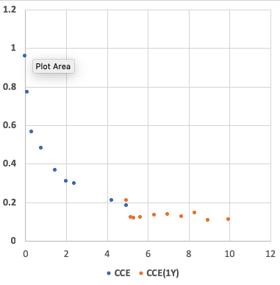
Sapphire Radiation Hardness
Relative Efficiency
Dose, MGy

