Slide 1
Design and prototyping of large-scale flex circuits for the ATLAS ITk Pixel detector
Presenter: Steven Welch from Oklahoma State University
On Behalf of the ITk Pixel Collaboration

Slide 2
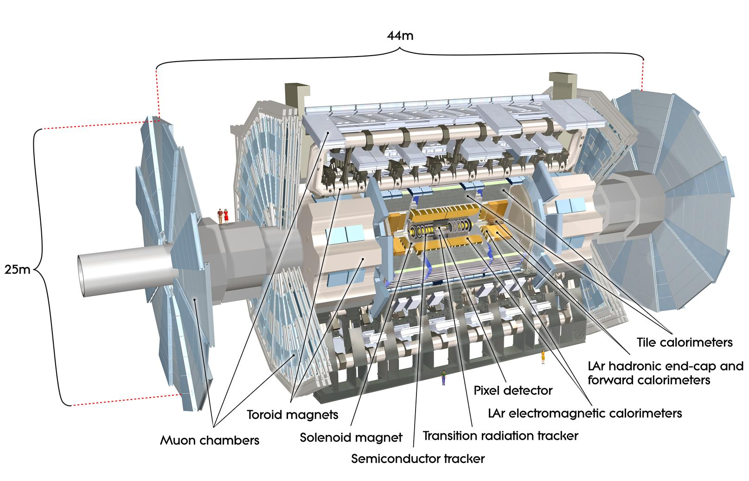
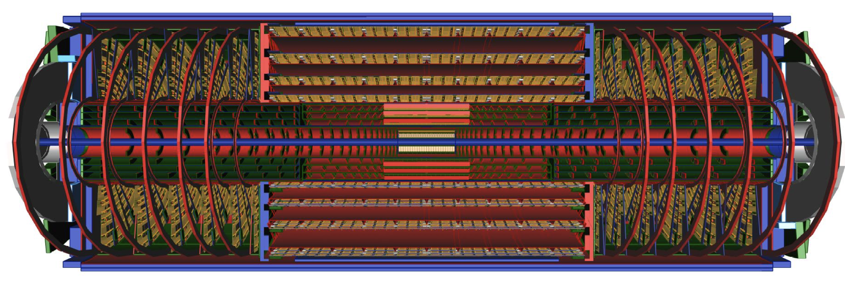
ATLAS
25 Meters in diameter
44 Meters Long
7000 tons
The ITk Pixel is only
~6 meters long
1 meter in diameter
6m
ITk Pixel Detector
700cm

Slide 3
Pixel
L0 Radius is 50mm
L1 Radius 100mm
Radiation is up to 1G Rad TID
~900 serial power chains
~8400 sensors
~26000 data transmission lines running at 1.28Gbps
ITk Layout 23-00-03
Plots and Figures: https://atlas.web.cern.ch/Atlas/GROUPS/PHYSICS/PUBNOTES/ATL-PHYS-PUB-2021-024/
Overview Talk: https://indico.tlabs.ac.za/event/112/contributions/2963/

Slide 4
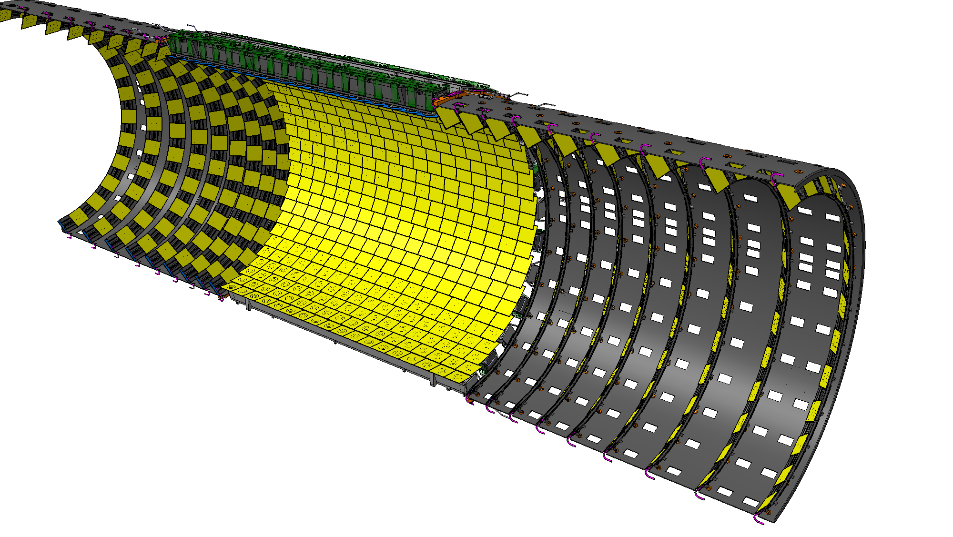
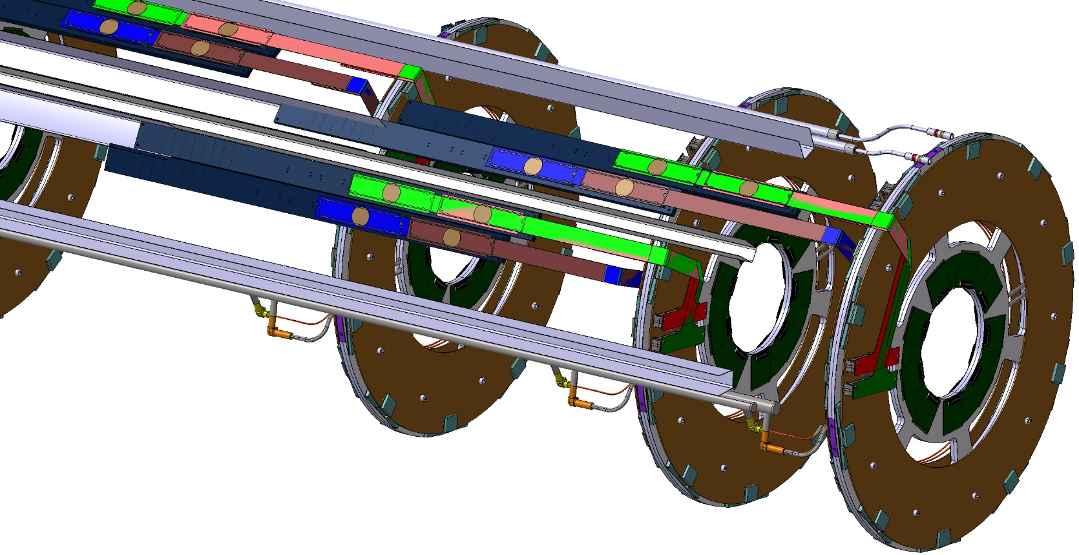
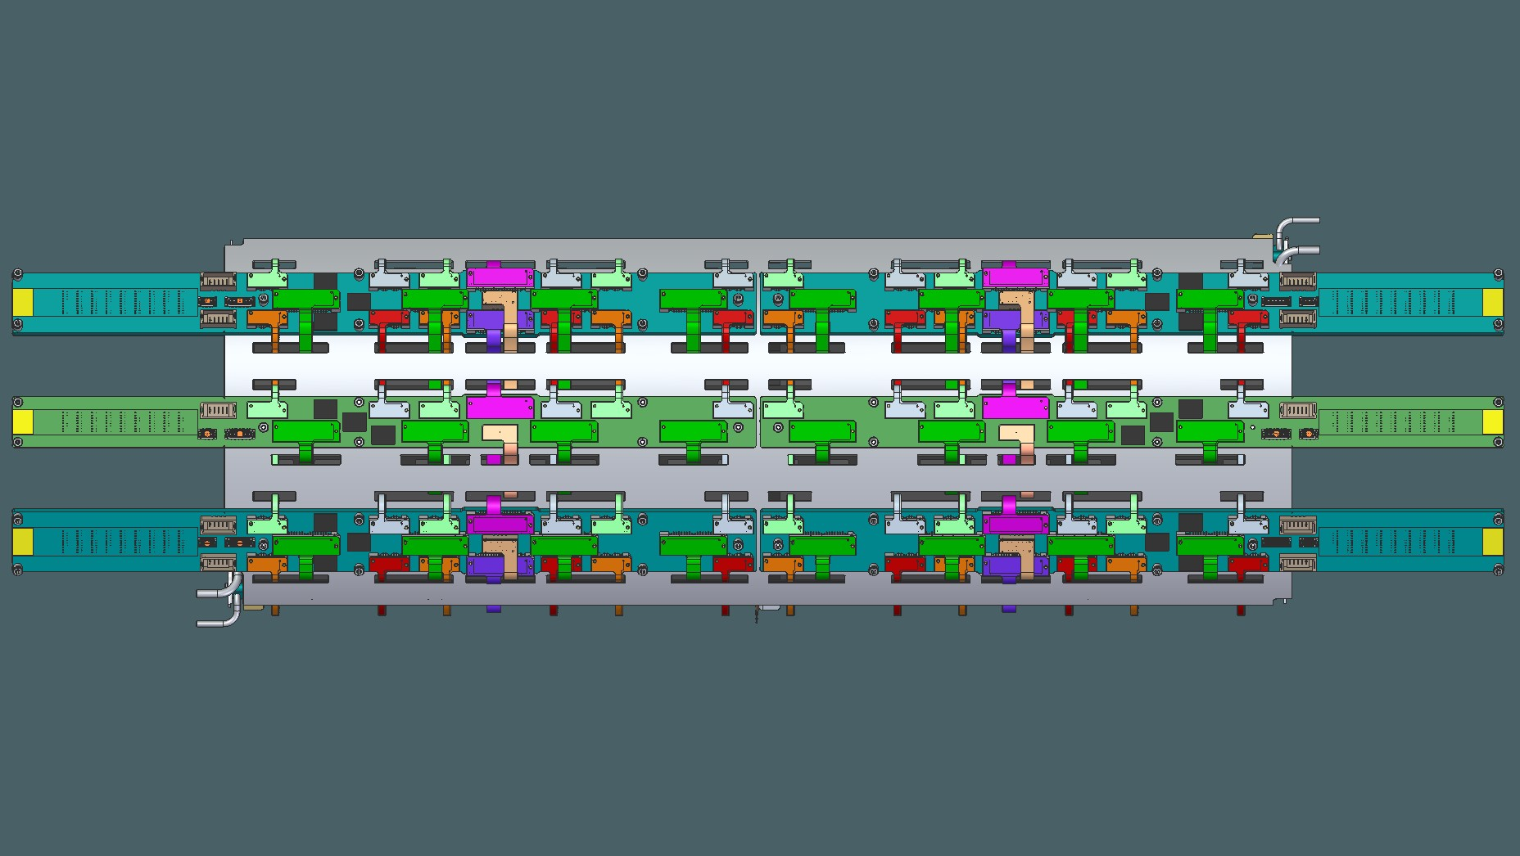
Pixel Structures and Services
End Cap Half Rings
Outer Barrel: Inclined Half Rings and Longerons
Inner System End Cap
Inner System Barrel

Slide 5
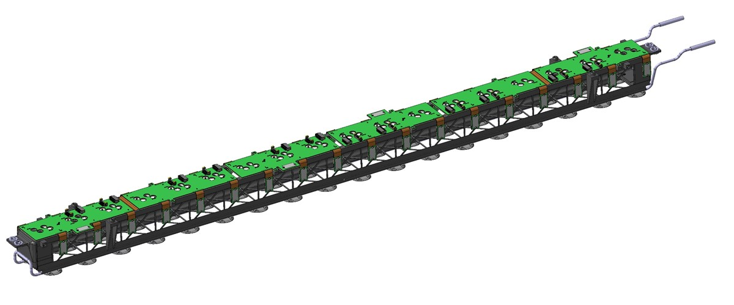
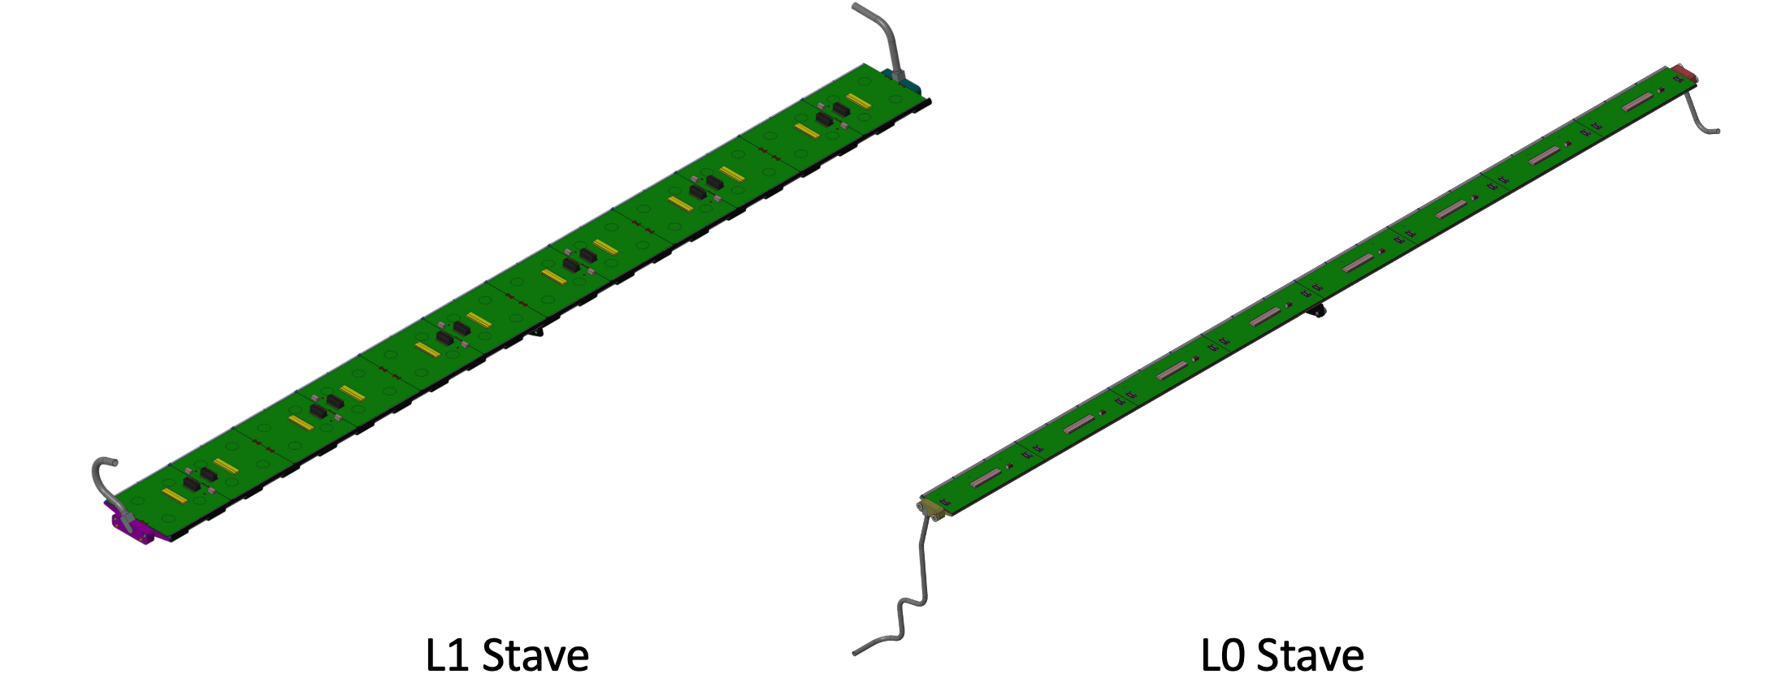
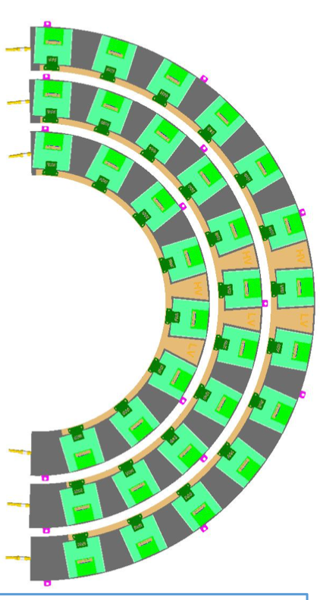
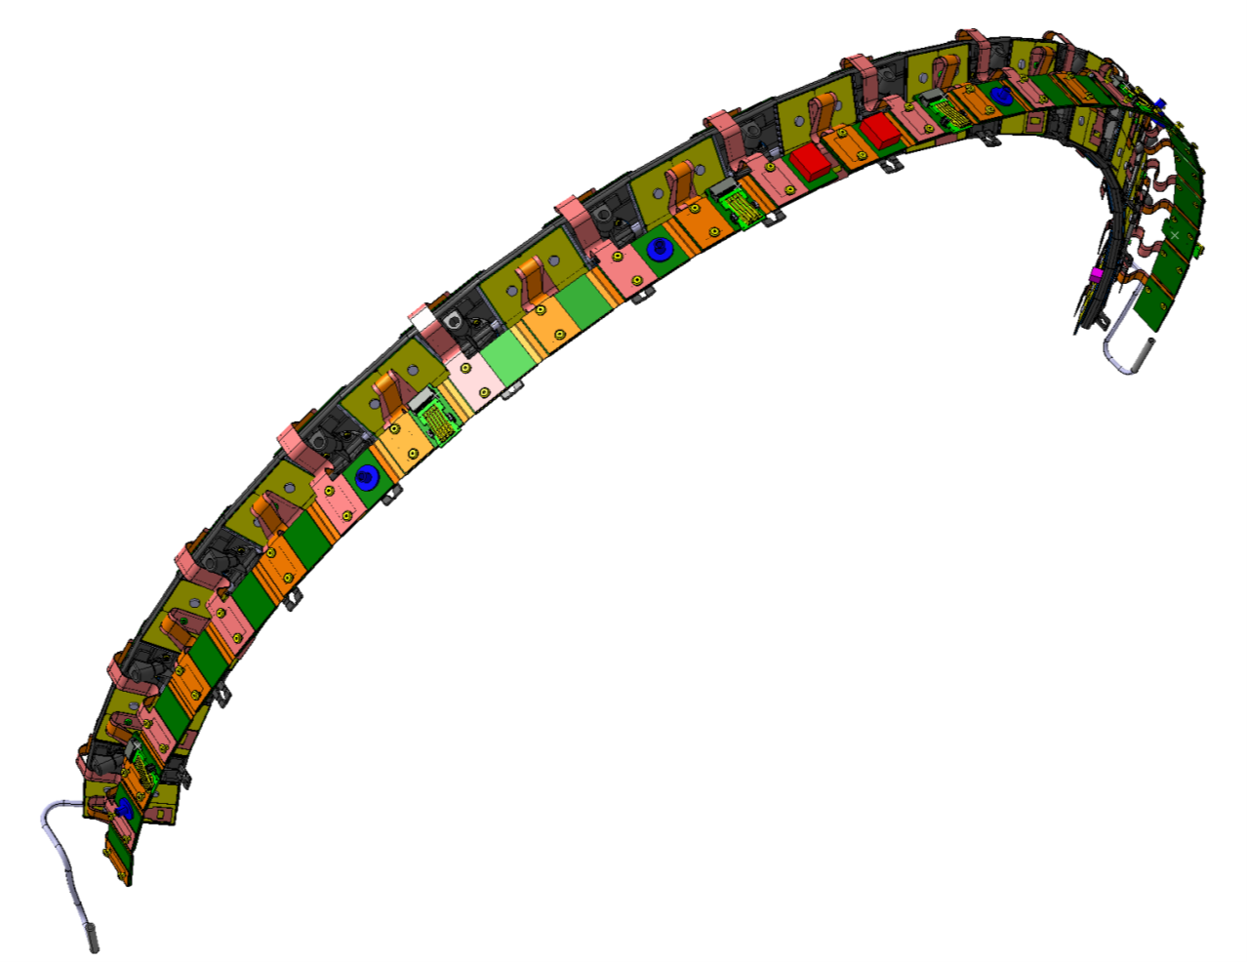
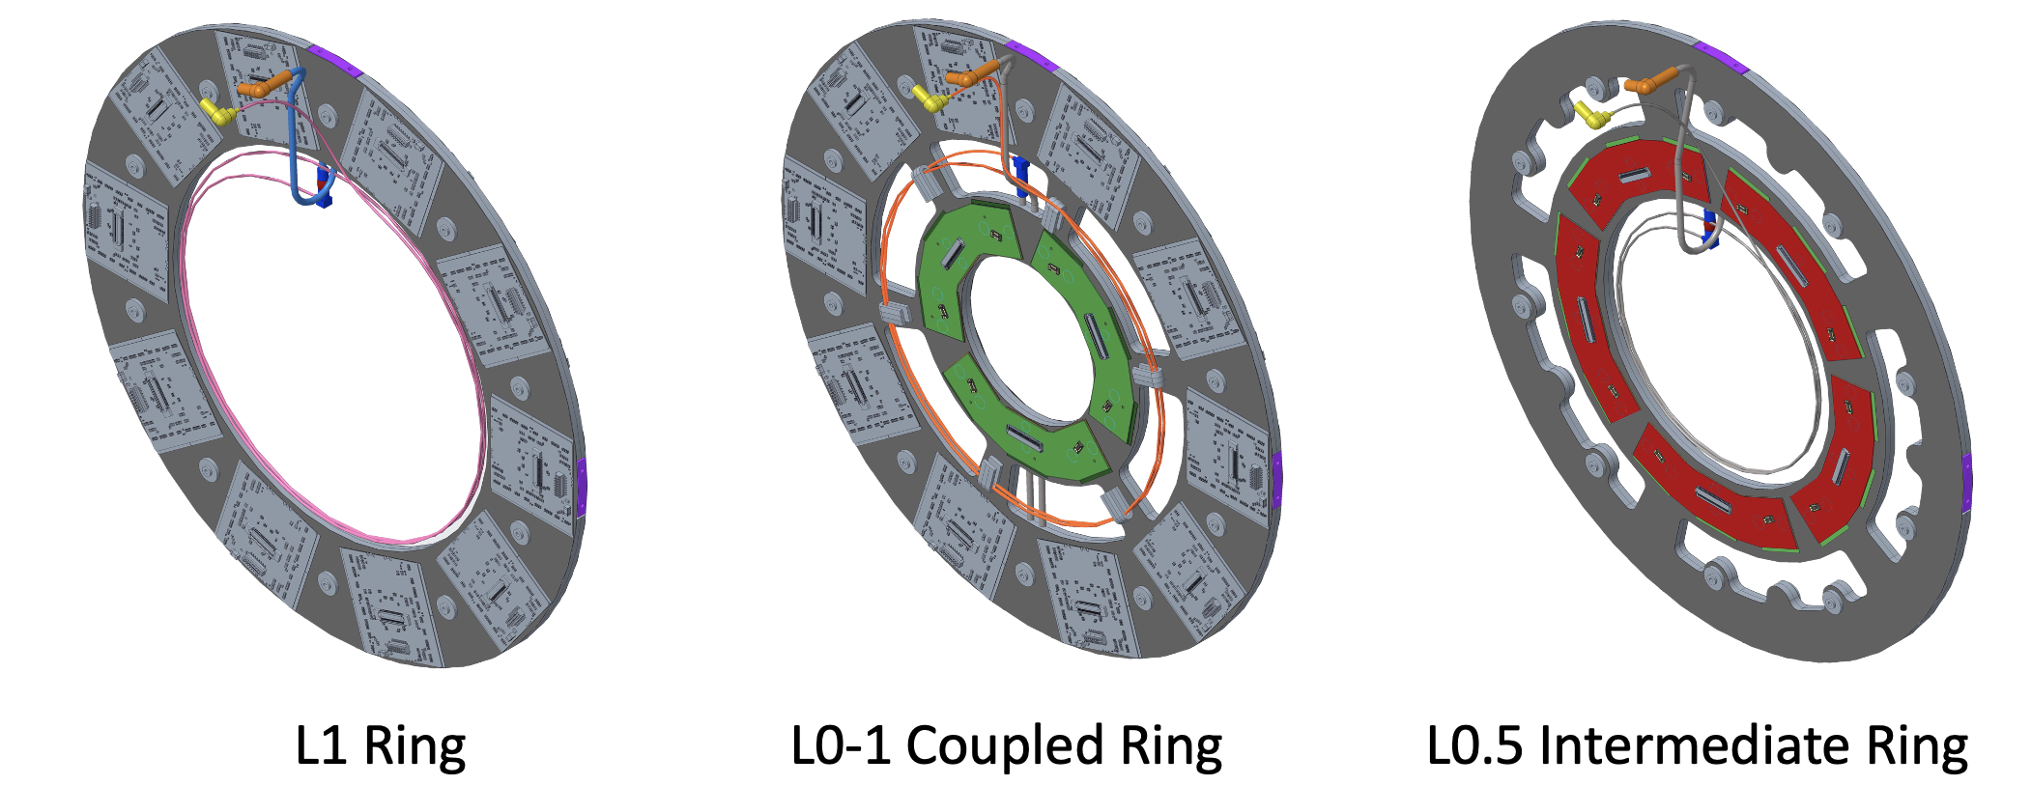
Local Support Flavors
Longeron
Inclined Half Ring
Layer 2,3,4
L1 Quad Ring
Notes:
Describe a bit more here and talk about radius 50mm to 300mm radius

Slide 6
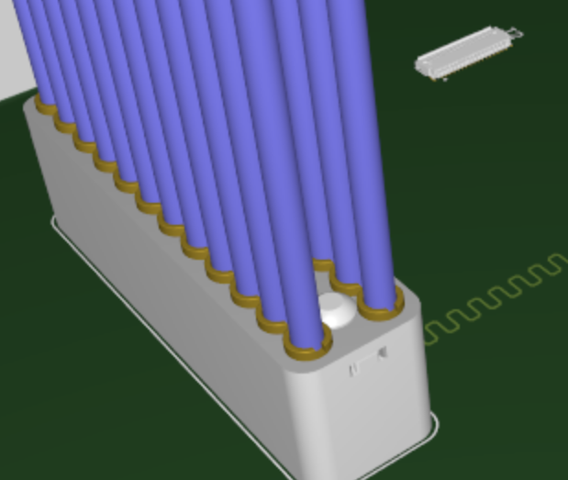
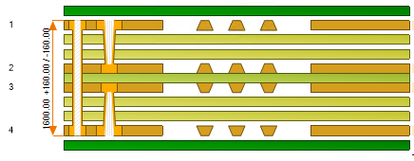
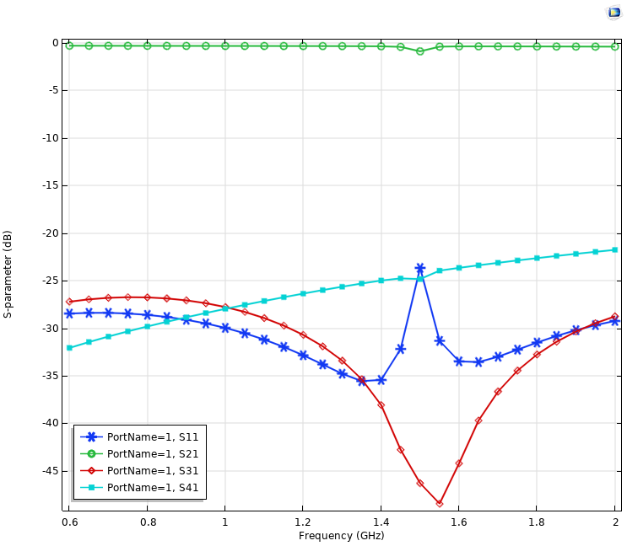
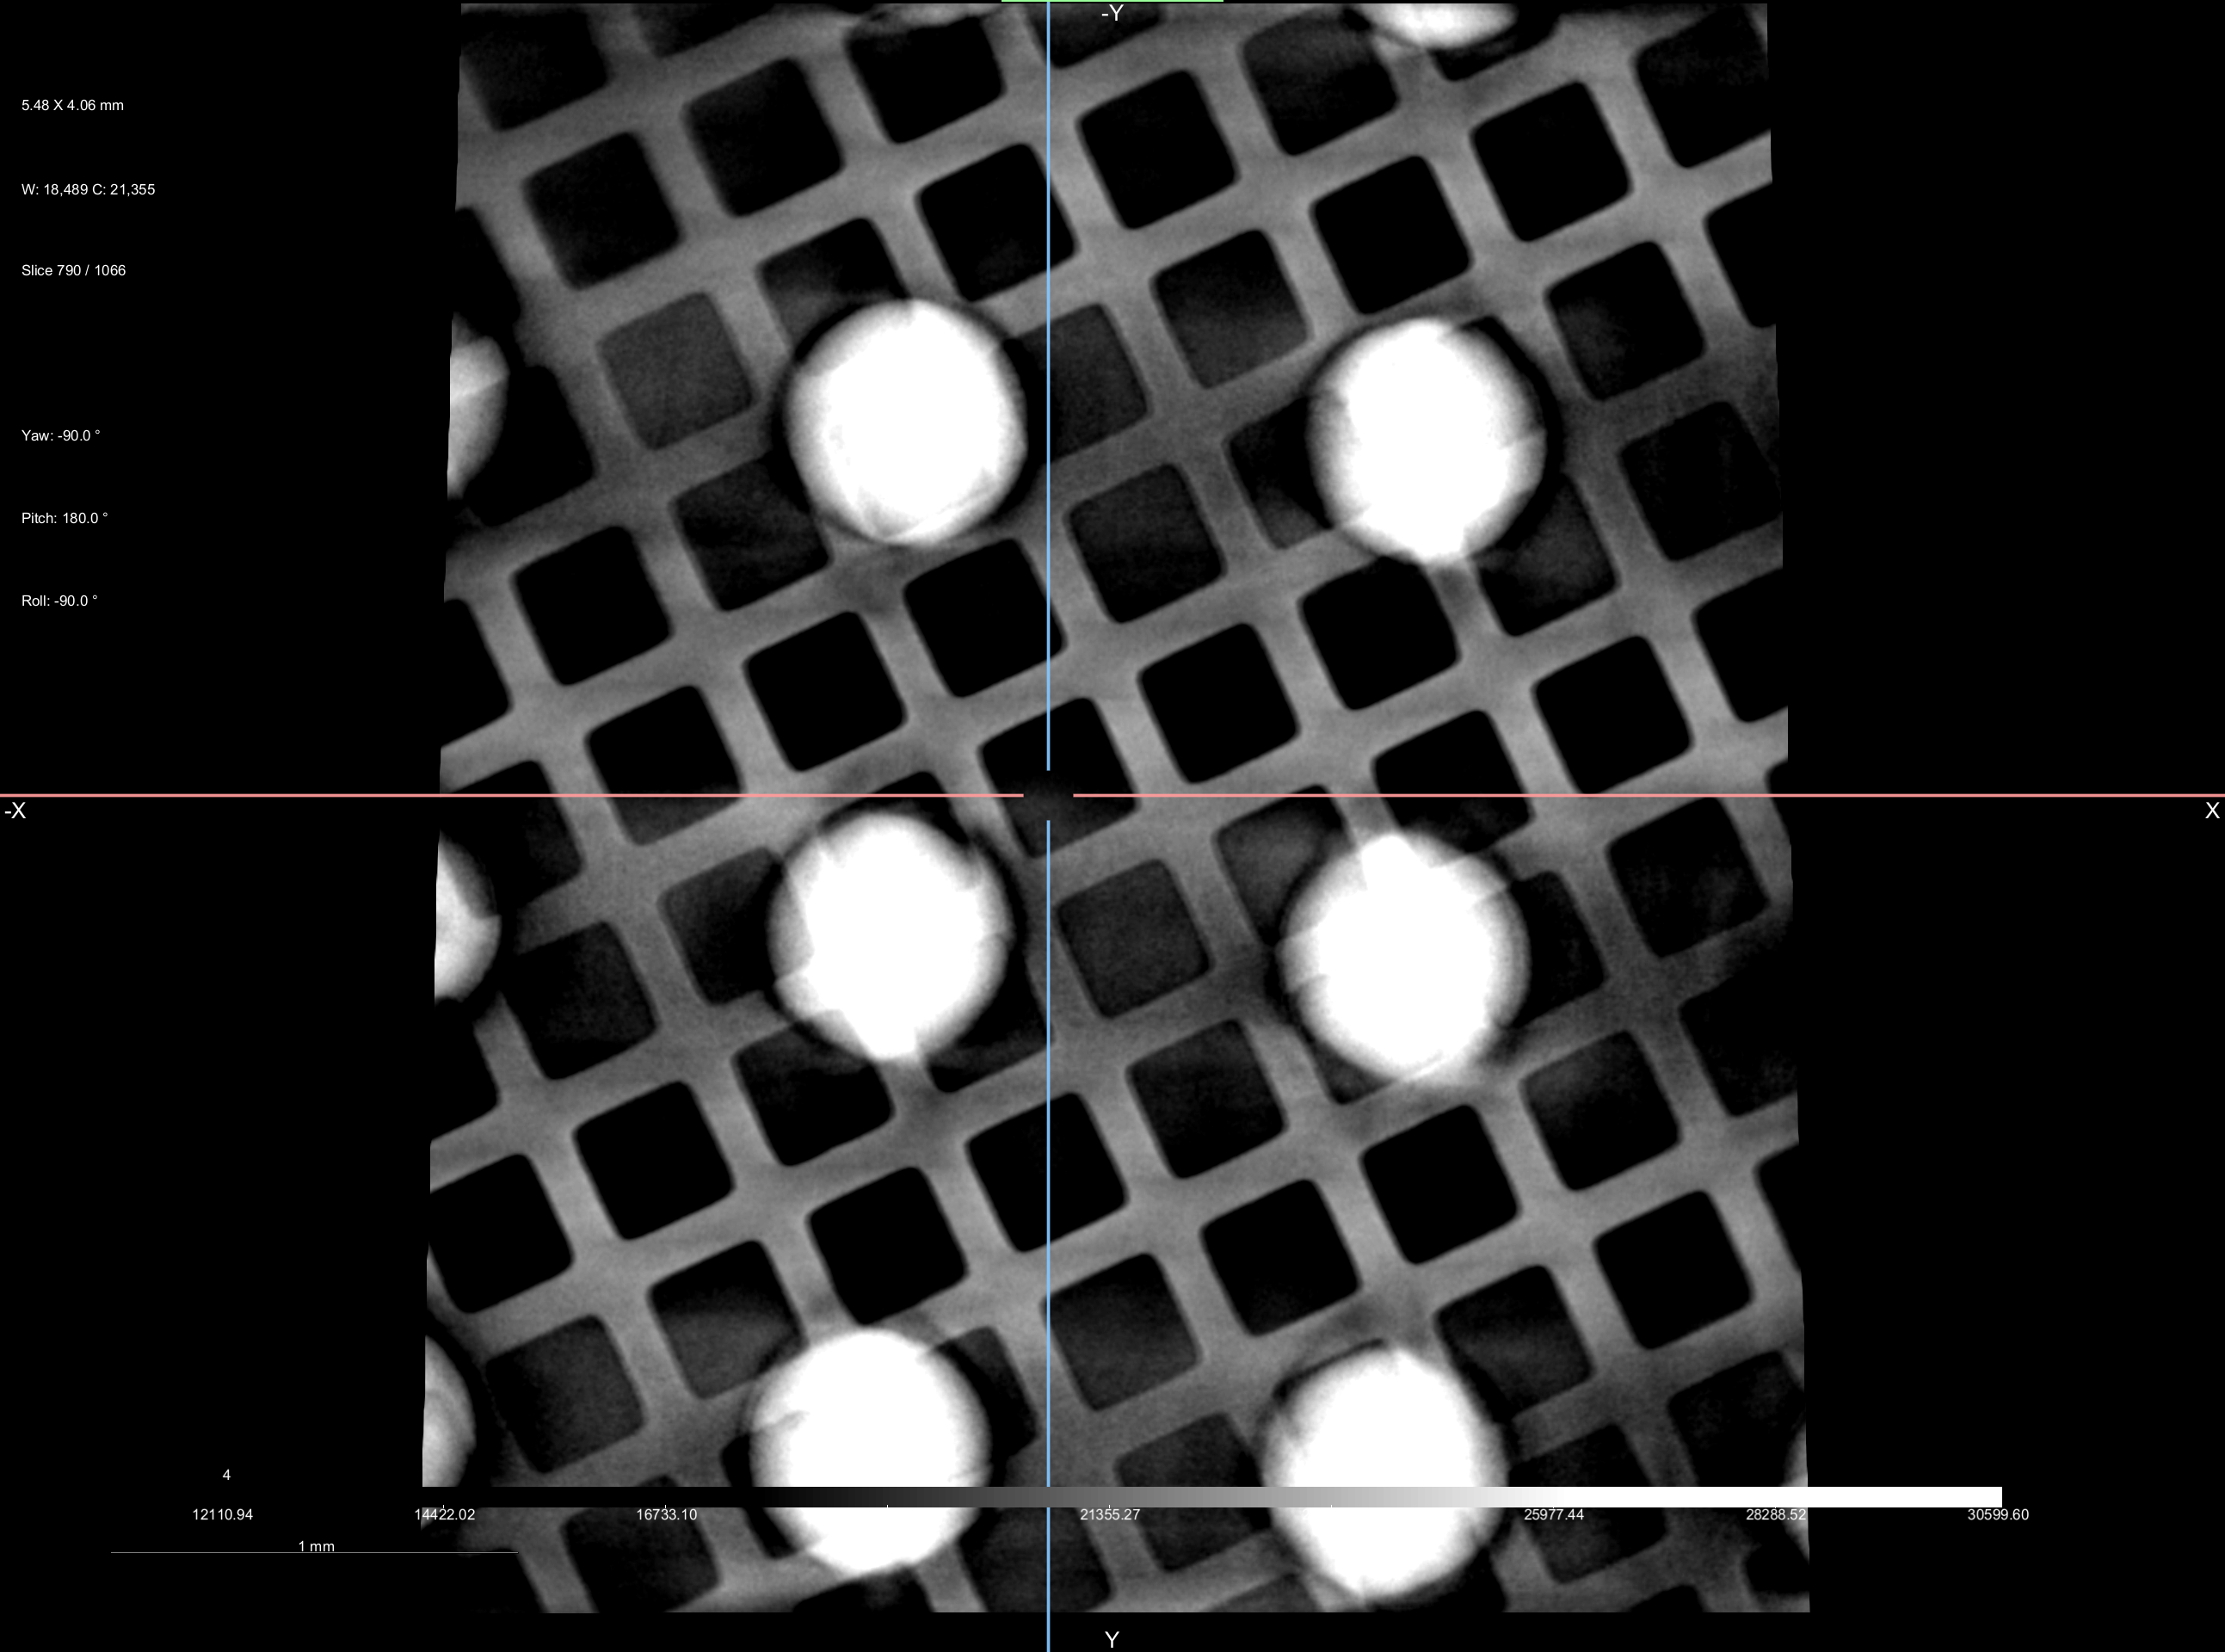
Design Philosophy
Polar Instruments
Stack-up and VIA Model
Our design process attempts to validate design concepts before they are integrated into final designs
Transmission line Validation
Design
Simulate
Fabricate Coupon
Validate Design
SI (Signal Integrity) tests, X-Rays, SEM, etc.
This process helps ensure that the expensive and complex designs are right the first time
We do this for every controlled impedance structure
We do something similar for HV structures
We don’t validate LV structures as the are predictable enough.
These validated stack-ups and structures are then used in multiple designs
SEM Analysis of VIA
Samtec BDRA on
Transmission Line Coupon
COMSOL Simulation
Hatched Ground Plane S11 S21
X-Ray of Flex PCB
with BGA
Notes:
For example if we need a transmission line for a coupled ring for example we design, simulate, build a test coupon, and then validate that structure before we integrate it into a more complex design like a coupled ring.

Slide 7
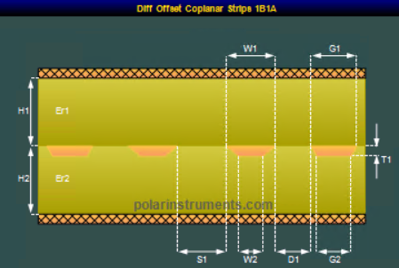
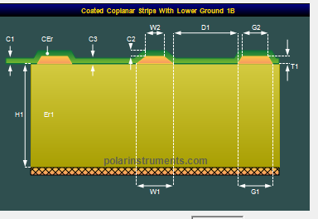
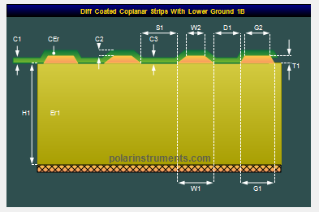
Stack-ups
Polar Instruments
Differential Co-planar Stripline
Polar Instruments
Co-planar Microstrip
Polar Instruments
Differential Co-planar Microstrip
Polar Instruments
6-Layer Flex Stack-up
Polar Instruments
2-Layer Flex Stack-up
Notes:
We start our simulations with choosing and modeling a stack-up. We then create some preliminary simulations for the controlled impedance structures we need and start communicating with the vendors (3 vendors normally) in Speed Sack, or ADS, Hyperlynx

Slide 8
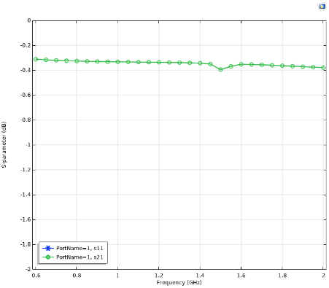
Loss Simulations
COMSOL
Co-Planer Differential Micro-strip
hatched ground
Line Length = 50mm
Rise time = 110ps
Loss @600Mhz = -0.3dB
Polar Instruments
Co-Planer Differential Strip-line
Line Length = 330mm
Rise time = 110ps
Loss @600Mhz = -1.33dB
Loss with roughness (0.35um) = -1.41dB
Notes:
After the stack-up is validated we can move on to loss simulations. For systems with hatched ground planes we have to use 3D FEAs to calculate loss as most of the tools don’t support loss calculations with hatched ground planes.

Slide 9
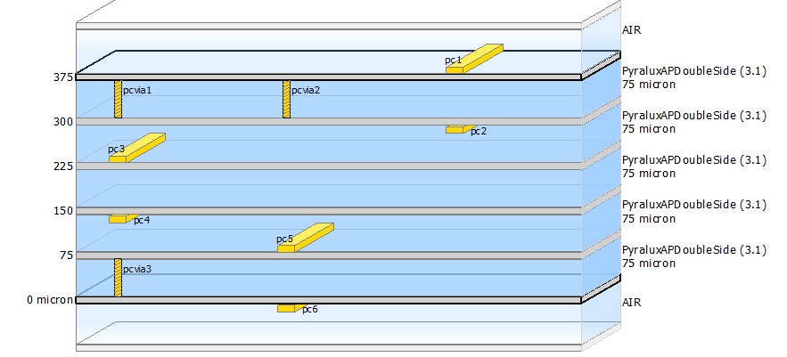
VIA Simulations
Impedance Vs Time
Simulated TDR
(Time Domain Reflectometry)
Stack-up
Using ADS
VIA Layout
Using ADS
Loss Vs Frequency
Simulated VNA
(Vector Network Analyzer)
Frequency Domain
Notes:
Lastly we can simulate the VIA structures. ADS and Hyperlynx, System Level Simulations allow you to calculate the loss of the whole system

Slide 10
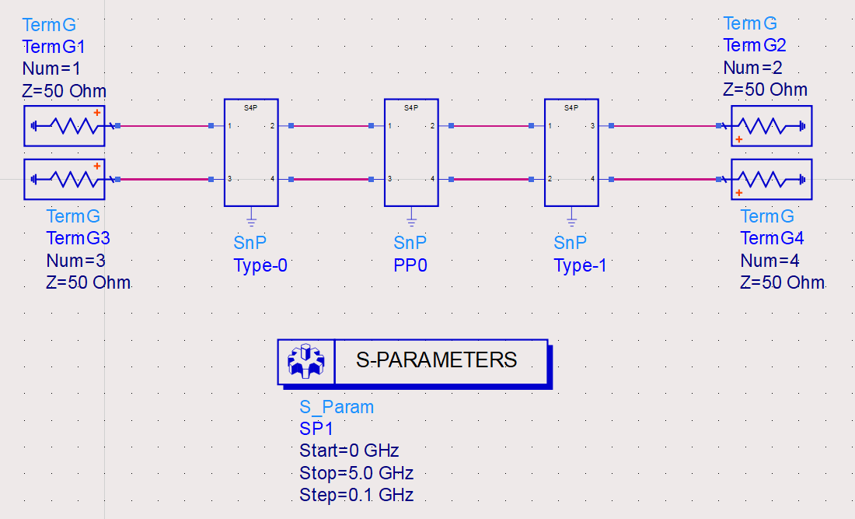
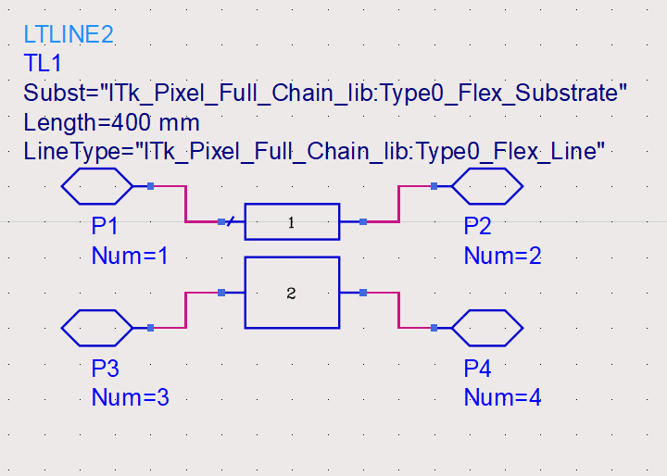
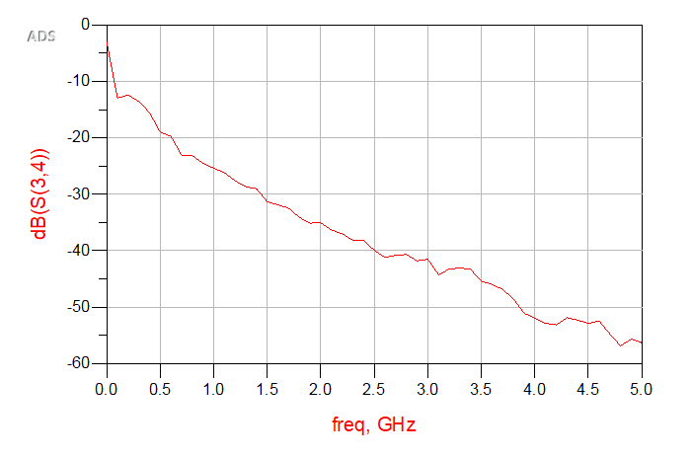
System Simulations
Each Block Represents all the components that make up the service type
The Blocks contain models of connectors and transmission lines
We can put together a bunch of these blocks to model the whole system and look at things like loss at a system level

Slide 11
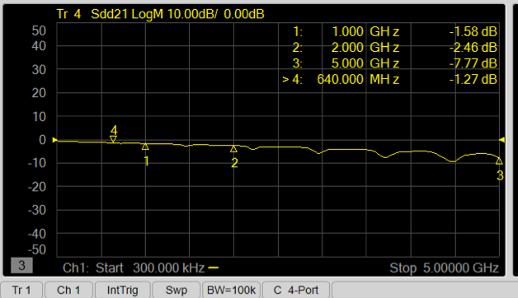
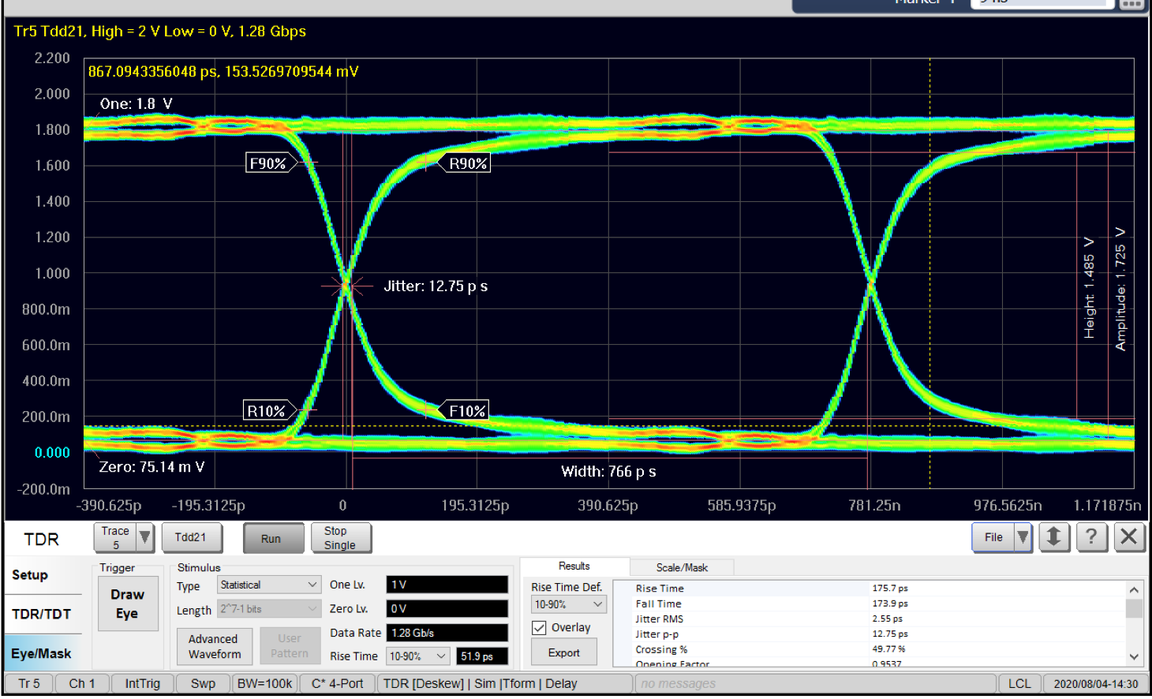
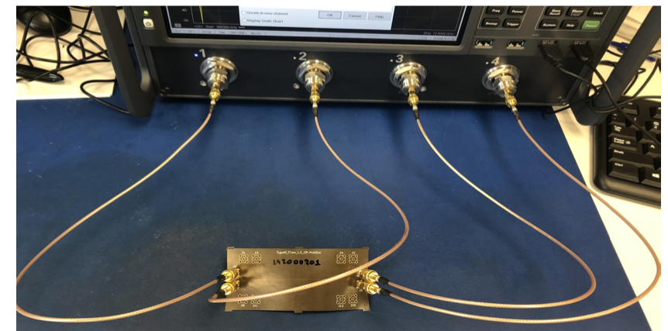
Test Coupons Testing
This is a sample of a type-0 to PP0 flex PCB
Has a line length of ~80mm
We predicted loss at 0.006dB/mm
That means coupon should have ~0.5dB of loss
Cables have a loss of about 0.25dB
Connectors have about 0.12dB
Total loss is -1.27dB
0.25*2+0.12*2+0.5 = 1.24
VNA Loss Measurement
Controlled Impedance Flex Coupon
Connected to VNA
VNA Loss TDR Calculated Eye-Diagram

Slide 12
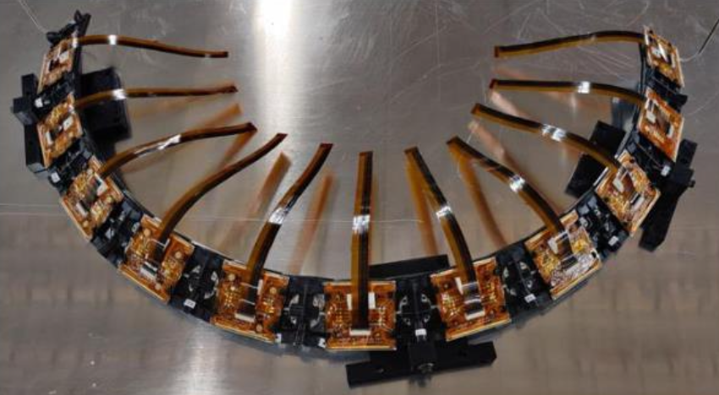
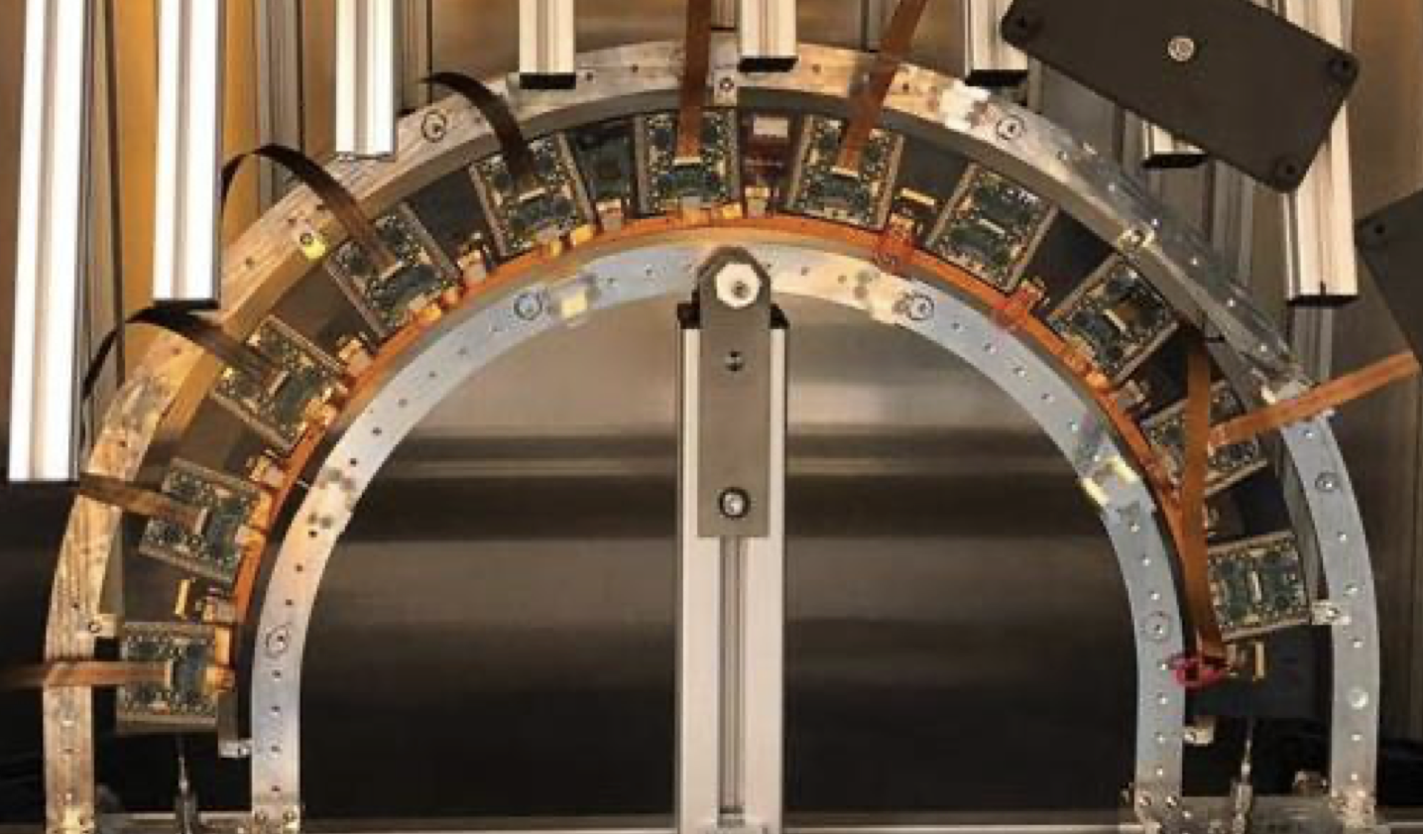
Prototypes - Large Scale Flex Circuits
Outer Barrel
Inclined Half Ring
Outer Endcap
Half Ring
Outer Barrel
Two Longerons
Notes:
What do we mean by large scale, well large from many perspectives physical size, the quantity. Some of these flexes are more than 1m long and in many cases we have thousands of them.

Slide 13
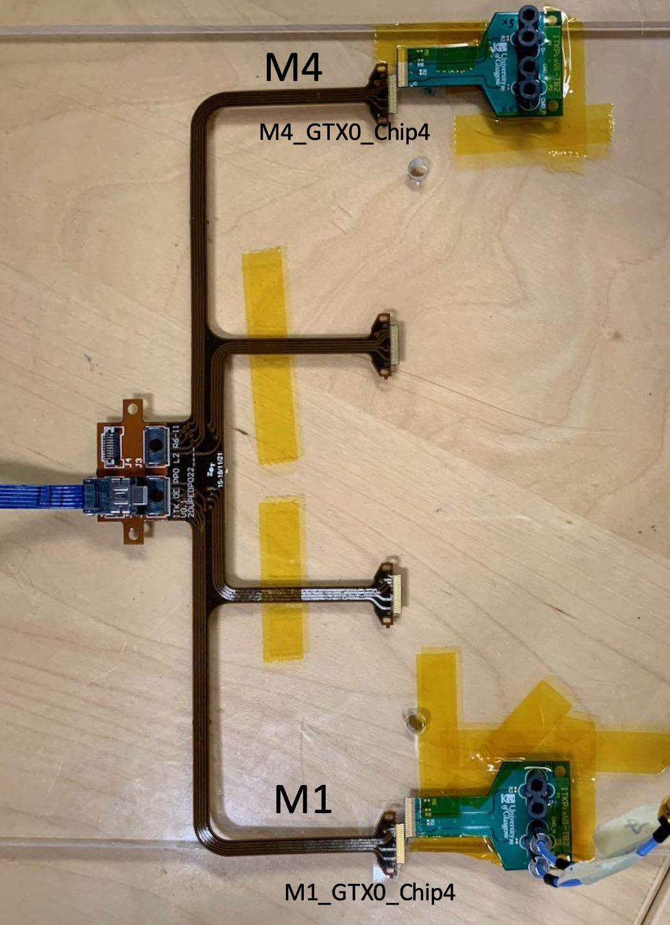
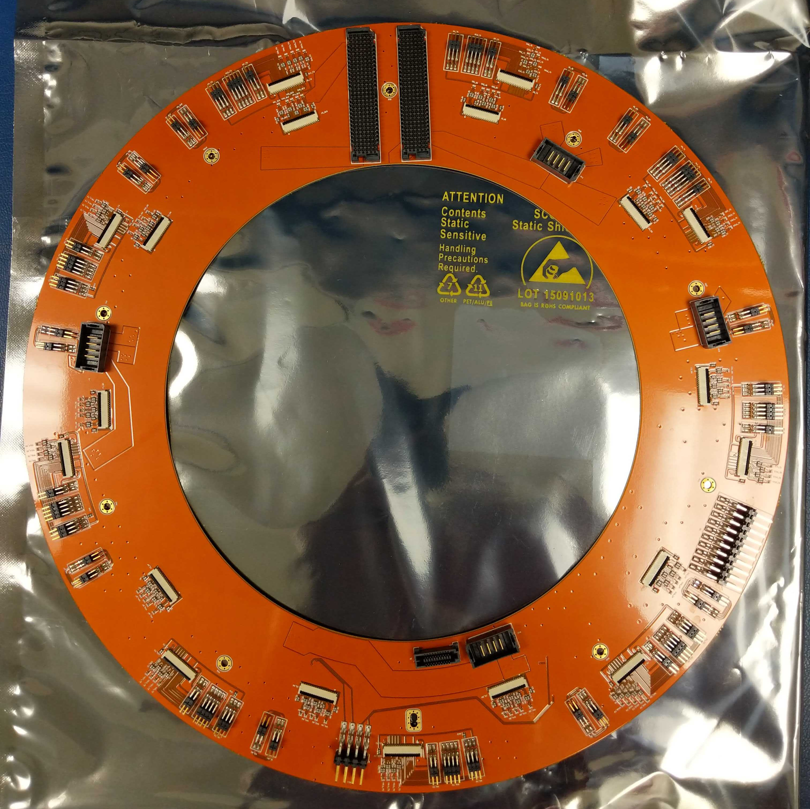
Prototypes - High Density Data Flexes
Outer Barrel PP0
Outer Endcap
Data PP0
Inner System Type-0 to PP0 Flex
Inner System
Ring Flex
Notes:
Another form of large scale comes from the quantity of combined services in a single flex.
These flexes carry up to 50 differential pairs each over a long distance, for a flex PCB anyway. These flexes also carry up to 8A of current and 1000V of sensor bias voltage. All on the same flexes

Slide 14
Testing Flex PCBs – Radiation Hardness
Typical Flex PCB Adhesives
None
Epoxy
Acrylic
Teflon (PTFE)
Polyester
Typical Flex PCB Dielectrics
Polyimide
Teflon (PTFE)
Kevlar
Vinyl
PET
IPC-4204 and IPC-4203
We tend to use:
IPC-4203/2 – Epoxy Adhesive on one or both sides of polyimide dielectric
IPC-4204/11 – Copper Clad Adhesive-less Polyimide
There are only a few Materials used in the services
Known to be Radiation Hard
Kapton (Pyralux AP)
Copper
Liquid Crystal Polymer (LCP) (Connectors)
Tested
Epoxy (Thinflex, Pyralux HP, etc.)
Terra Green (Rings and PP0)
Low Density Polyethylene (LDPE) (Twin-ax)

Slide 15
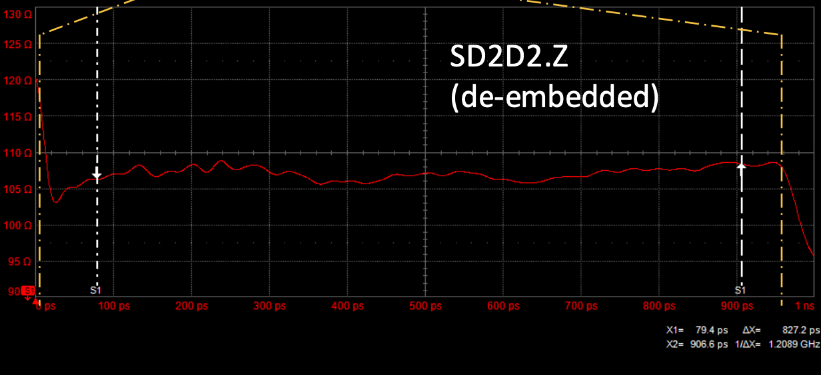
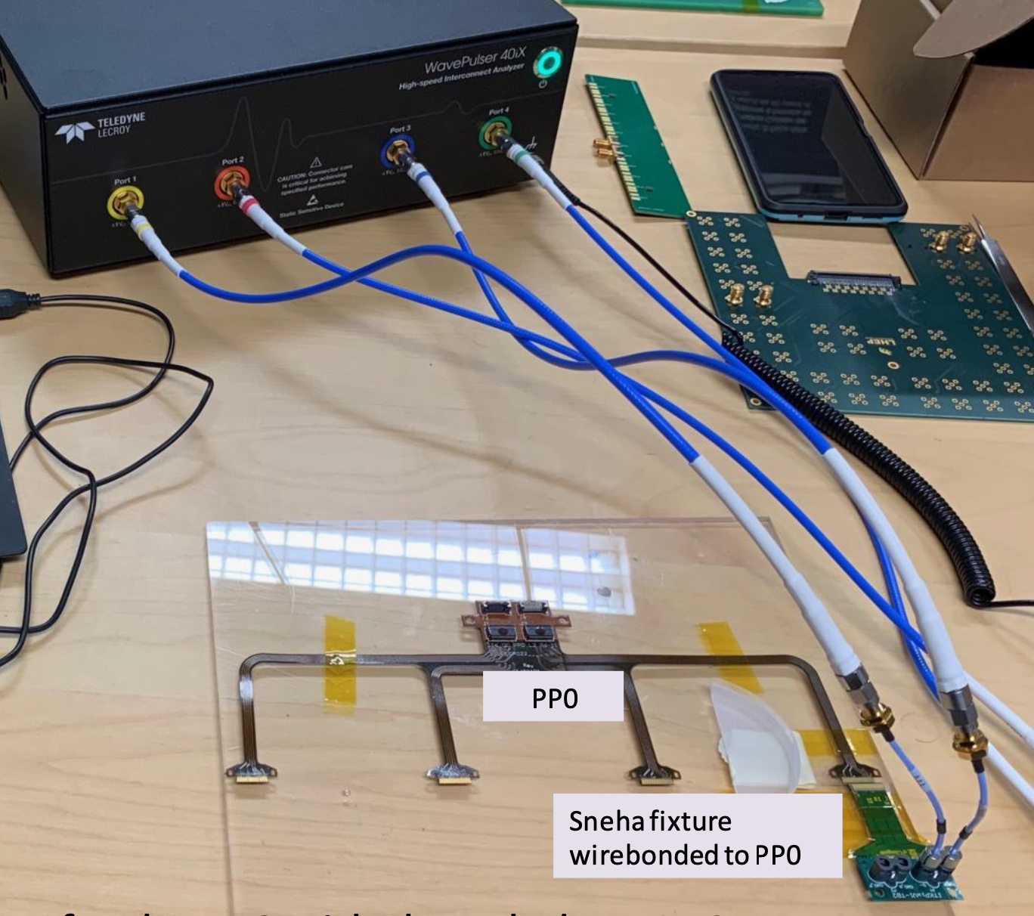
Testing Flex PCBs – TDR (Time Domain Reflectometry)
TDR Testing helps us understand the impedance vs time/distance
The plot shows the impedance along the signal path
We can identify issues in the PCBs and VIAs and where the issues are in the data transmission chain
Can calculate Bit Error Rate and Eye Diagrams
TDR Measurement of Impedance
Ohms
Pico Seconds
TDR connected to
Outer Endcap PP0

Slide 16
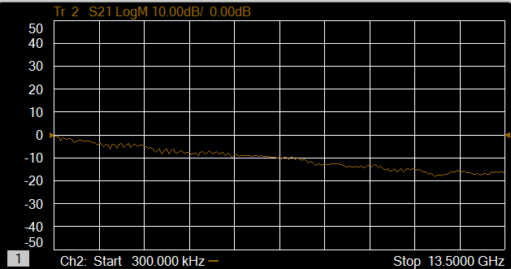
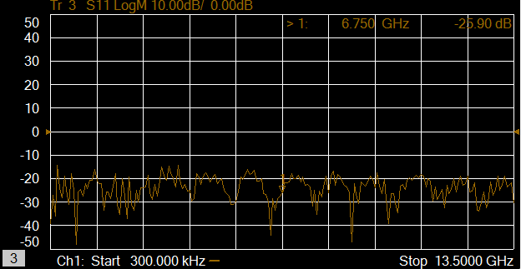
Testing Flex PCBs – VNA (Vector Network Analyzer)
VNA Measurement of S11 and S21
VNA combined with multiplexers allow us to scale the test stand and scan multiple transmission lines
BDRA cables and Low Loss Test fixtures help reduce the loss in the test stand
Easily measure insertion loss, FEXT & NEXT Crosstalk
VNA connected to
Inner System Type-0 to PP0 Flex

Slide 17
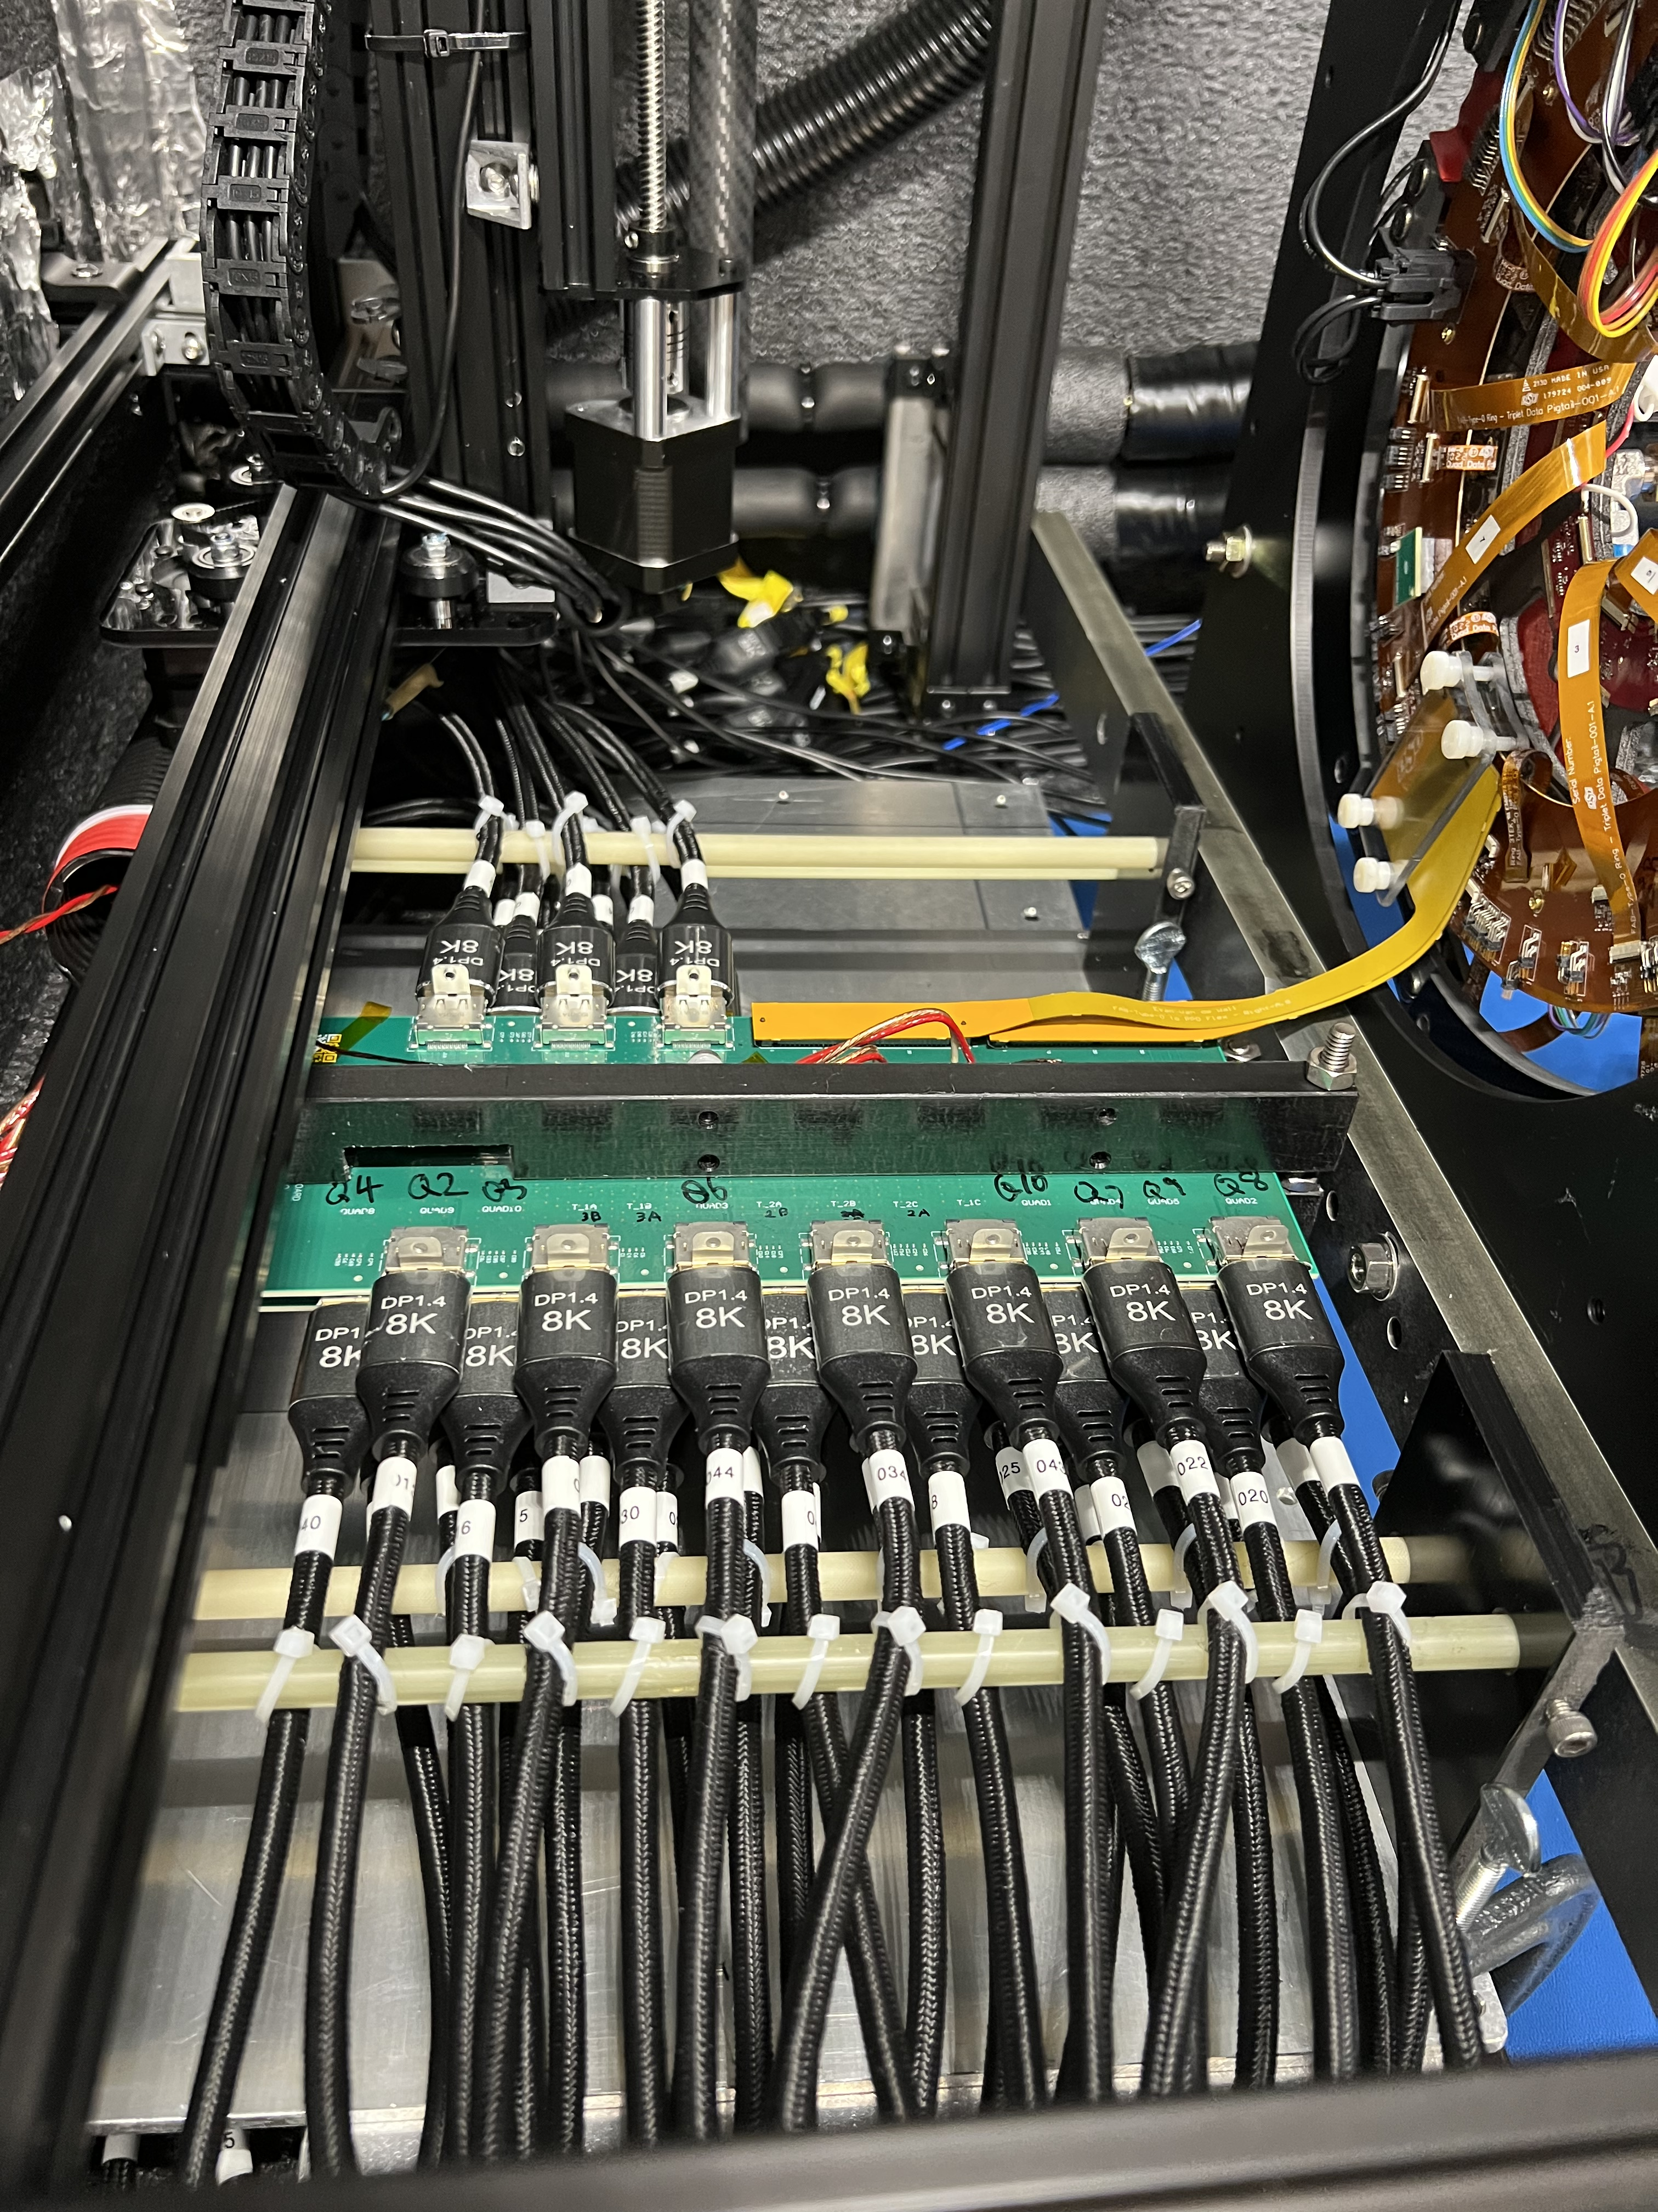
Testing Flex PCBs – BERT (Bit Error Rate Test)
BERT testing allows us to evaluate the performance of the channel or cable plant as an integrated system
Great tool for system testing and design validation
BERT connected to Integrated
Inner System Coupled Ring
BERT test of Integrated
Inner System Coupled Ring

Slide 18
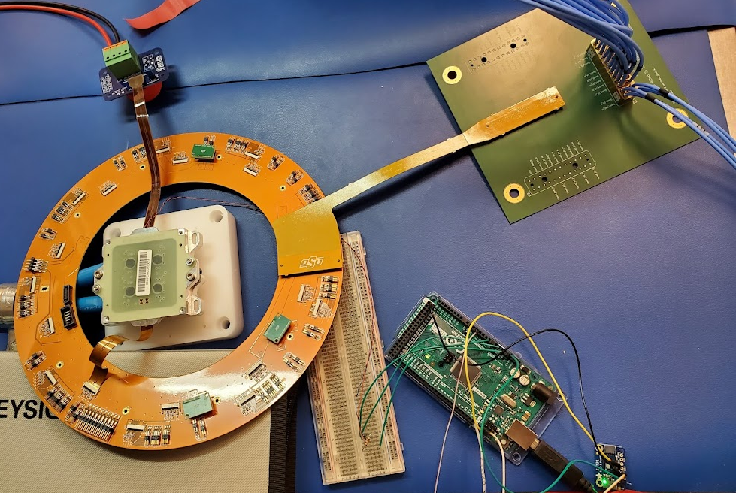
Testing Flex PCBs – Oscilloscope
The Oscilloscope allows us to measure at the system level
We can use the actual detector components in this kind of test
We can look at the Eye diagram, jitter, and inter-symbol interference at any point in the system
Essential, but not scalable
Great tool for system testing and design validation
Top -Oscilloscope Measurement of Data Through the Coupled Ring Assembly
Left – Test System containing Module, Coupled Ring Assembly and Readout

Slide 19
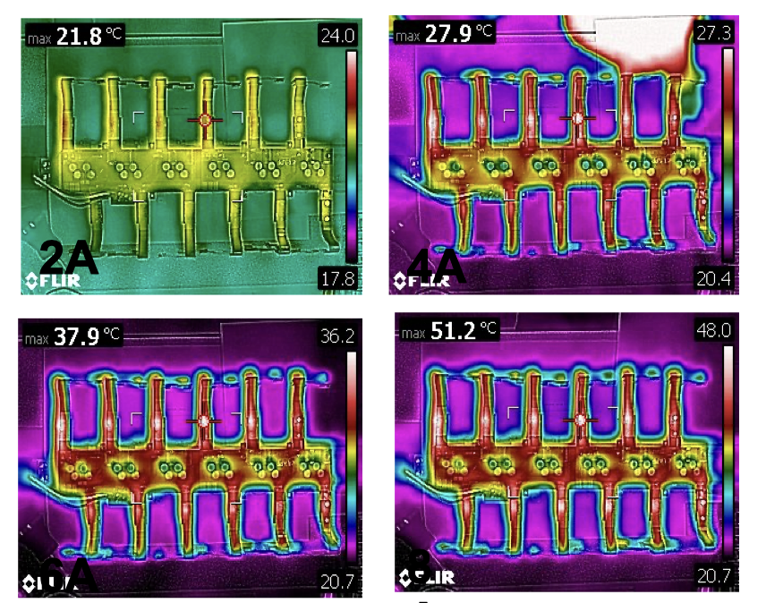
Testing Flex PCBs – Connectivity, Resistance, HV
Inner System Flex on Cirris HV Tester
Cirris High Voltage Tester checks for connectivity, resistance, capacitance, and High Voltage (DWV, Dielectric Breakdown, and Insulation Resistance)
Easily scales to production
FLIR Cameras look at temperature and help evaluate current density and power dissipation
High Precision multimeters and high current power supplies evaluate overall resistance
Outer Barrel PP0
Power Distribution Test with FLIR
Notes:
This is the tester we use for Connectivity, Resistance and High Voltage Tests.

Slide 20
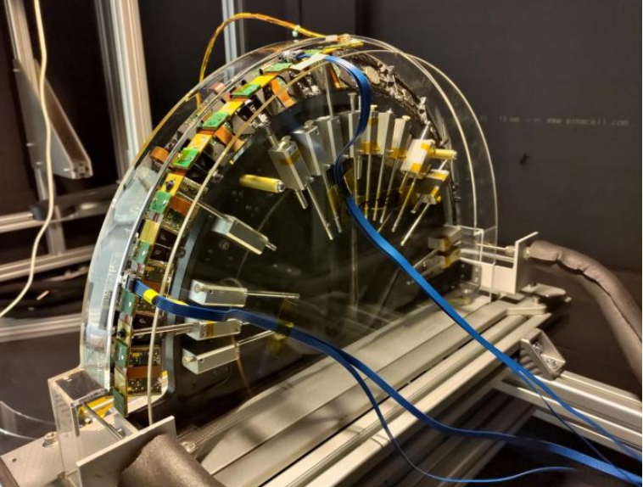
Initial integration test
Inner System Integrated
Coupled Ring
Outer Barrel
Integrated Inclined Half Ring
Outer End Cap
Integrated Half Ring ->

Slide 21
Summary
We have developed a process for design, fabrication, and testing of flex PCBs
Flex PCBs are extremely versatile and have made their way into every subsystem
We have pushed the use case, density, and and size of Flex PCBs as far as we can
The use of Large Scale Flex PCBs has enabled us to substantially increase the capability of our detectors while reducing the size and increasing the data rate of the detectors
Fabricating the PCBs requires careful definition of requirements and proper design techniques
Testing of Large Scale Flex PCBs almost always requires complicated custom test fixtures as well as test systems that can be easily scaled
Essential to the development of high performance detectors
All of the On Detector services are in Pre-Production now.
We expect a Production readiness review in the Spring of 2024

Slide 22
The End
Questions?
TIPP 2023 @ Cape Town

Slide 23
Backup Slides

Slide 24
Collaboration Structure
CERN
LHC
ATLAS
CMS
ETC.
Pixel
LAR
Strips
ETC
Inner System
Outer Barrel
Outer End-cap

Slide 25
Type-0 Status
All of the prototypes Type-0 services that were delivered to SLAC

Slide 26
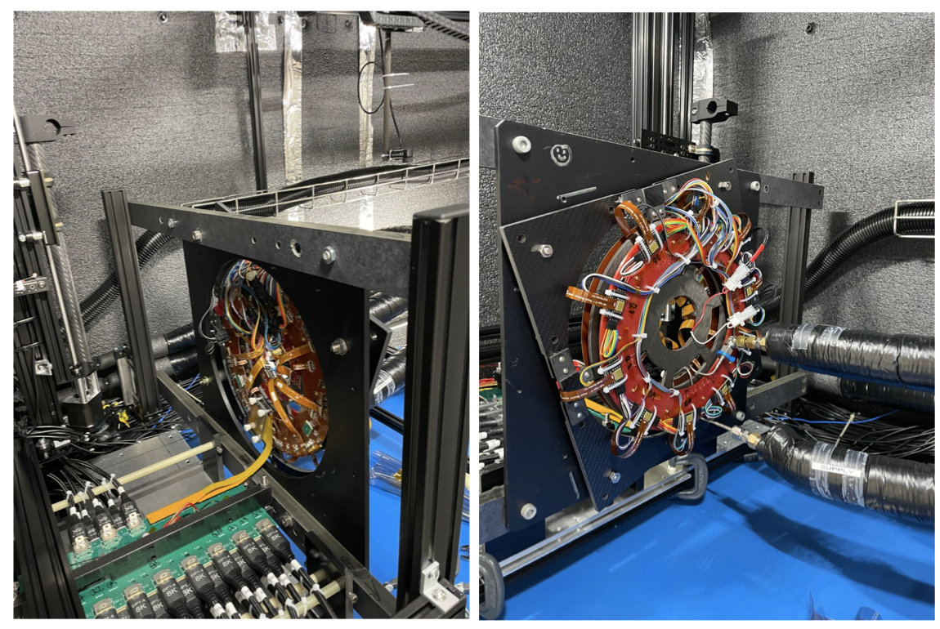
Prototype Integrated Coupled Ring in the cold box

Slide 27
Loaded Local Supports
These local supports were loaded by the team at SLAC
They are used as the foundation of our system test
We have one coupled ring with RD53a and one L1 half stave

Slide 28
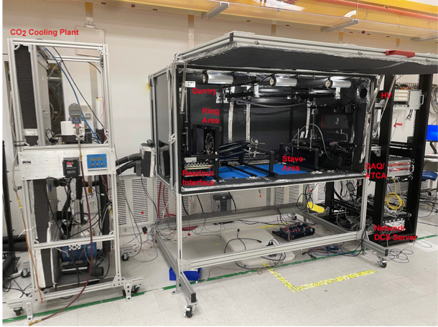
SLAC System Test Stand/Cold Box

Slide 29
Coupled Ring and PP0

Slide 30
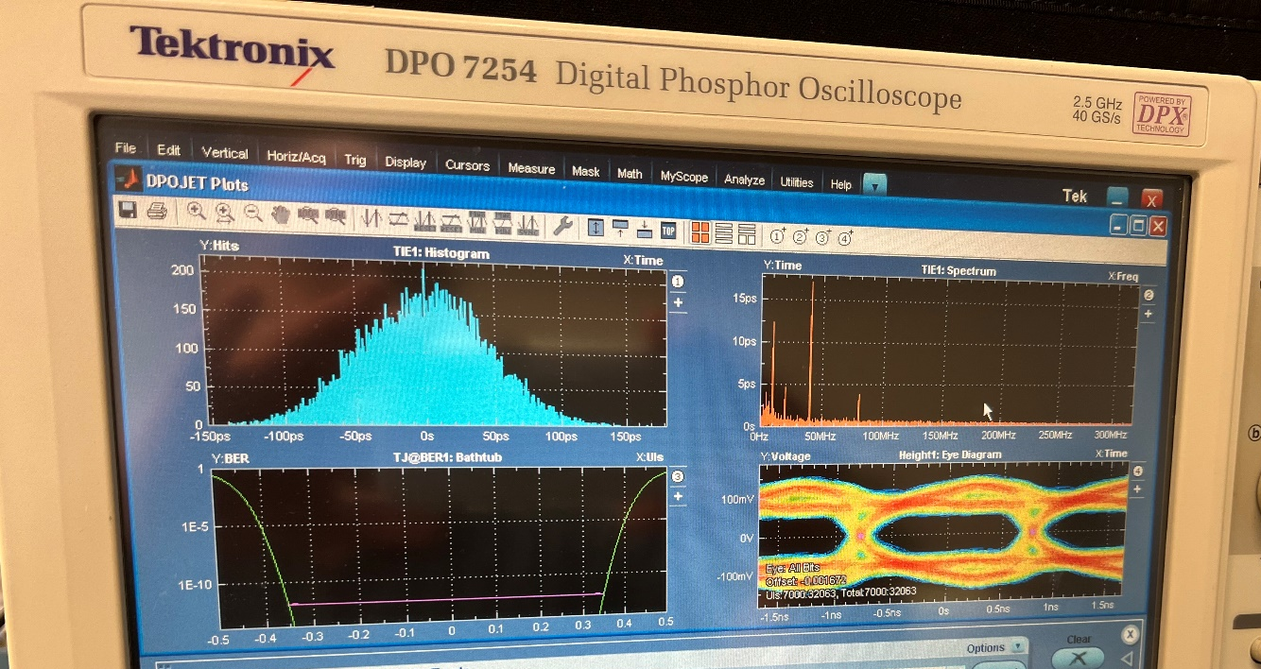
Testing with PP0 and RCE @ SLAC
The same tests were done at SLAC
Results are more or less the same
Design changes were made to the quad data flex that improved impedance matching and therefore performance
30
Services FDR 2022
9/5/23

Slide 31
Test R0/1 Coupled Ring in QC Box
Serial Power Chain of 10 Quads and 3 Triplets worked quite nicely
Complete Data Transmission Chain with RD53A @ Half Speed
14 Ft of Display port cable ~14dB
~5dB of Loss from Module to Display Port
Modules got to almost -30C, with CO2 at -40C or below
5 quad modules tested with digital/analog/threshold/discBB scans at 5 $℃$
4 quad modules tested with digital/analog/threshold/discBB scans at -30 $℃$
No significant changes

Slide 32
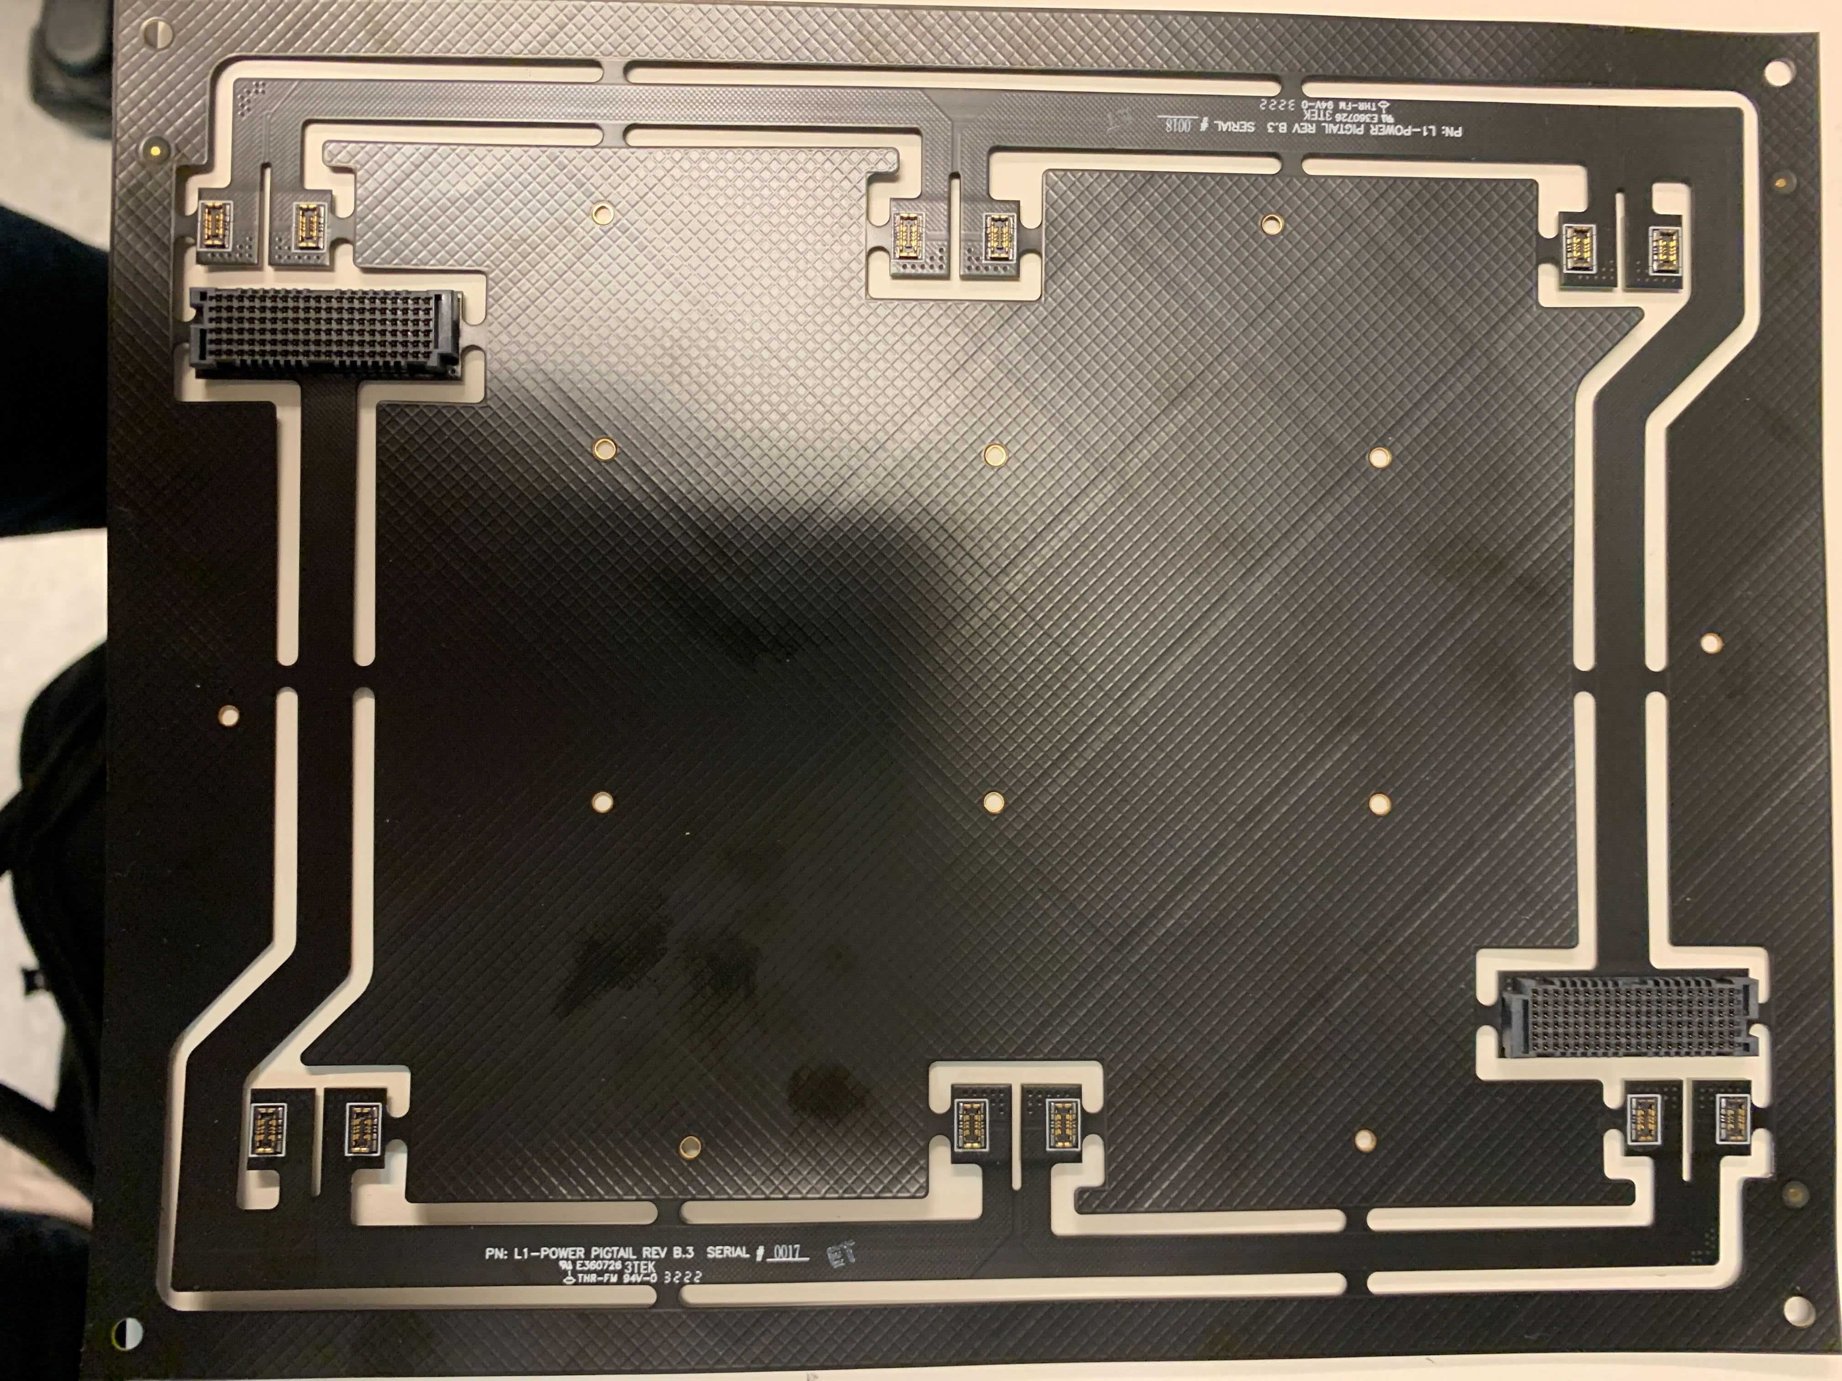
Prototype Barrel
The same process is ongoing for the barrel
All the flexes and PP0 are fabricated assembled, and tested
Integration is ongoing
L1 Power Flex
L1 Data Flex

Slide 33
Radiation Testing
There are only a few Materials used in the services
Known to be Radiation Hard
Kapton
Copper
Liquid Crystal Polymer (LCP) (Connectors)
Tested
Epoxy (Thinflex, Pyralux HP, etc.)
Terra Green (Rings and PP0)
Low Density Polyethylene (LDPE) (Twin-ax)
Many Samples were irradiated
PP0 samples were received
Twin-ax samples were received
Type-0 samples are stuck at irradiation facility
No visible delamination seen by the staff
Twin-ax will be discussed in another talk
PP0(terra green) is below
These dose was 1GRad, Protons
You can see a slight discoloration on the irradiated PP0
PCB did not delaminate

Slide 34
Quarter Shell Map
Coupled Ring

Slide 35
Barrel Quarter Shell
DSG-000018000 1.jpg

Slide 36
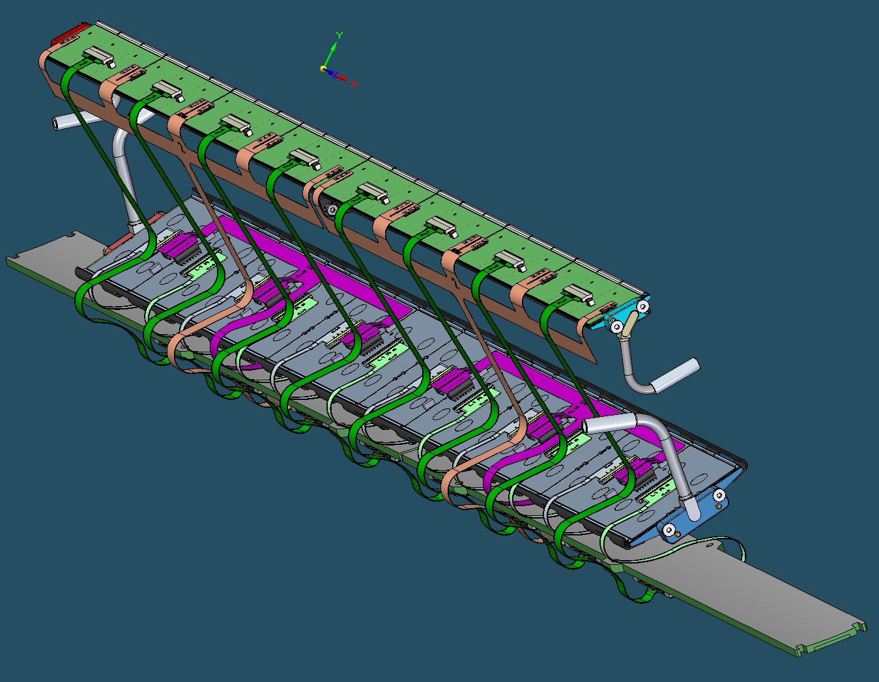
L0 and L1 Barrel Flexes

Slide 37
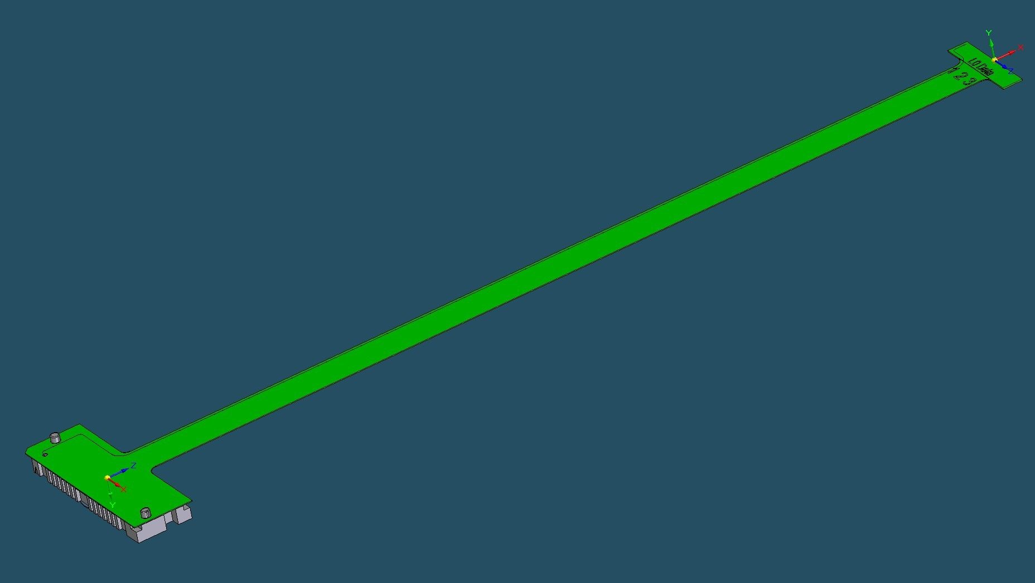
L0 Barrel Data Flex
The L0 Barrel has only one flavor of data flex and one flavor of data flex
Total Loss is ~ 1dB in the flex

Slide 38
L0 Barrel Power Flex
The L0 Barrel has only one flavor of data flex and one flavor of power flex
Total power dissipation is ~1.2W
Budget was 1.26W

Slide 39
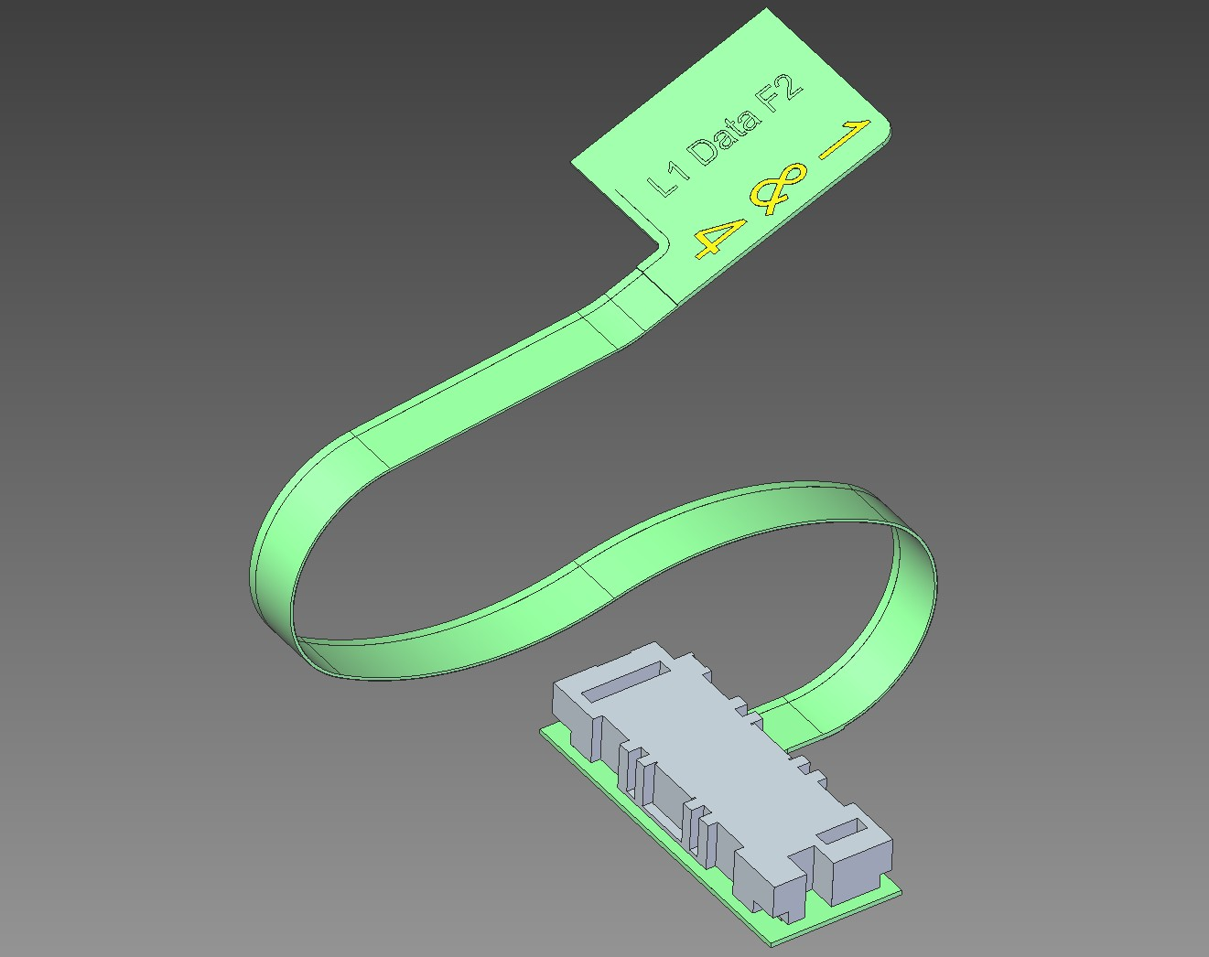
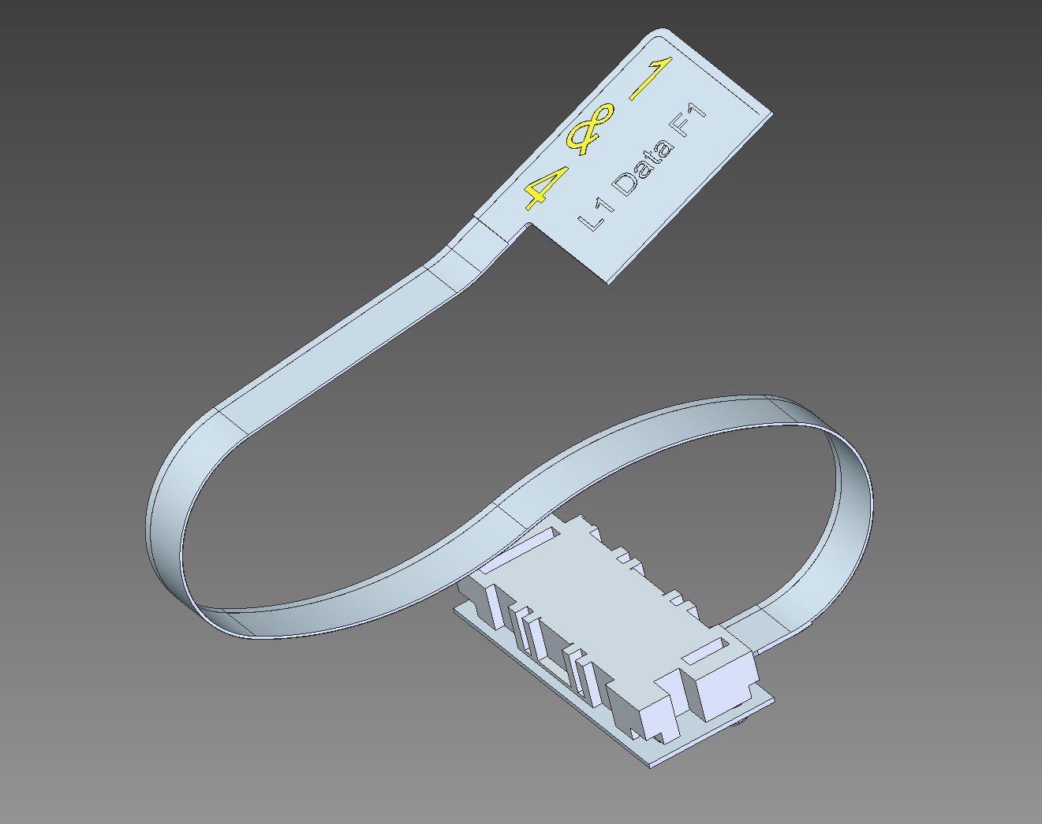
L1 Barrel
Notes:
There are four flavors of the L1 data flexes and they are all about 118mm long with a loss of about 0.07dB
We use the IPC standards to calculate the bend radius and validate the results with our mechanical engineering team. The we validate the results with practical tests. Most flexes don’t need test fixtures to be bent and they will hold their shape well enough.

Slide 40
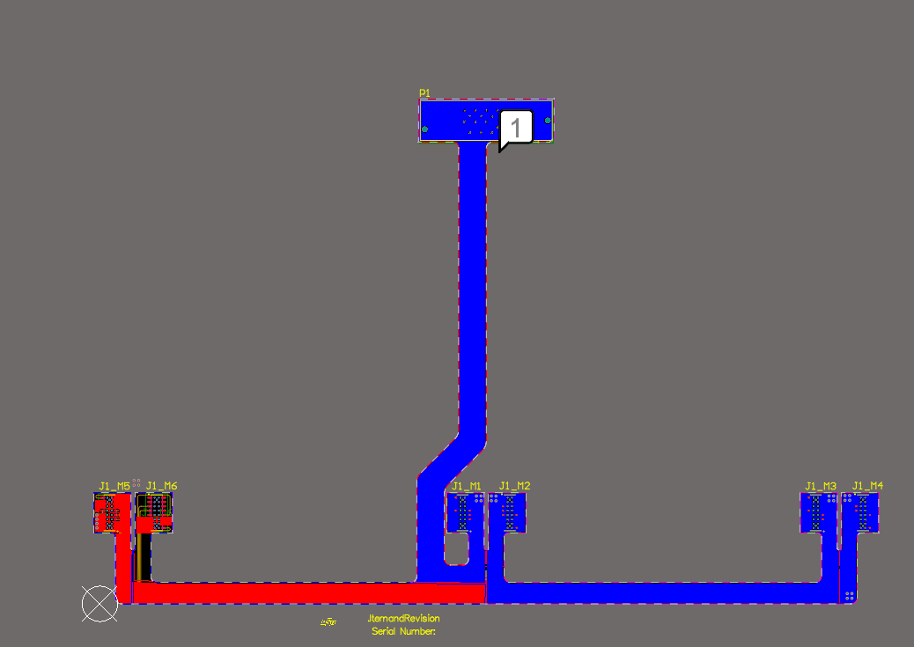
L1 Power Flex
Notes:
There are 2 flavors of the L1 Power flexes and ~1.8 they dissipate about 2.5 watt with a budget of xxx

Slide 41
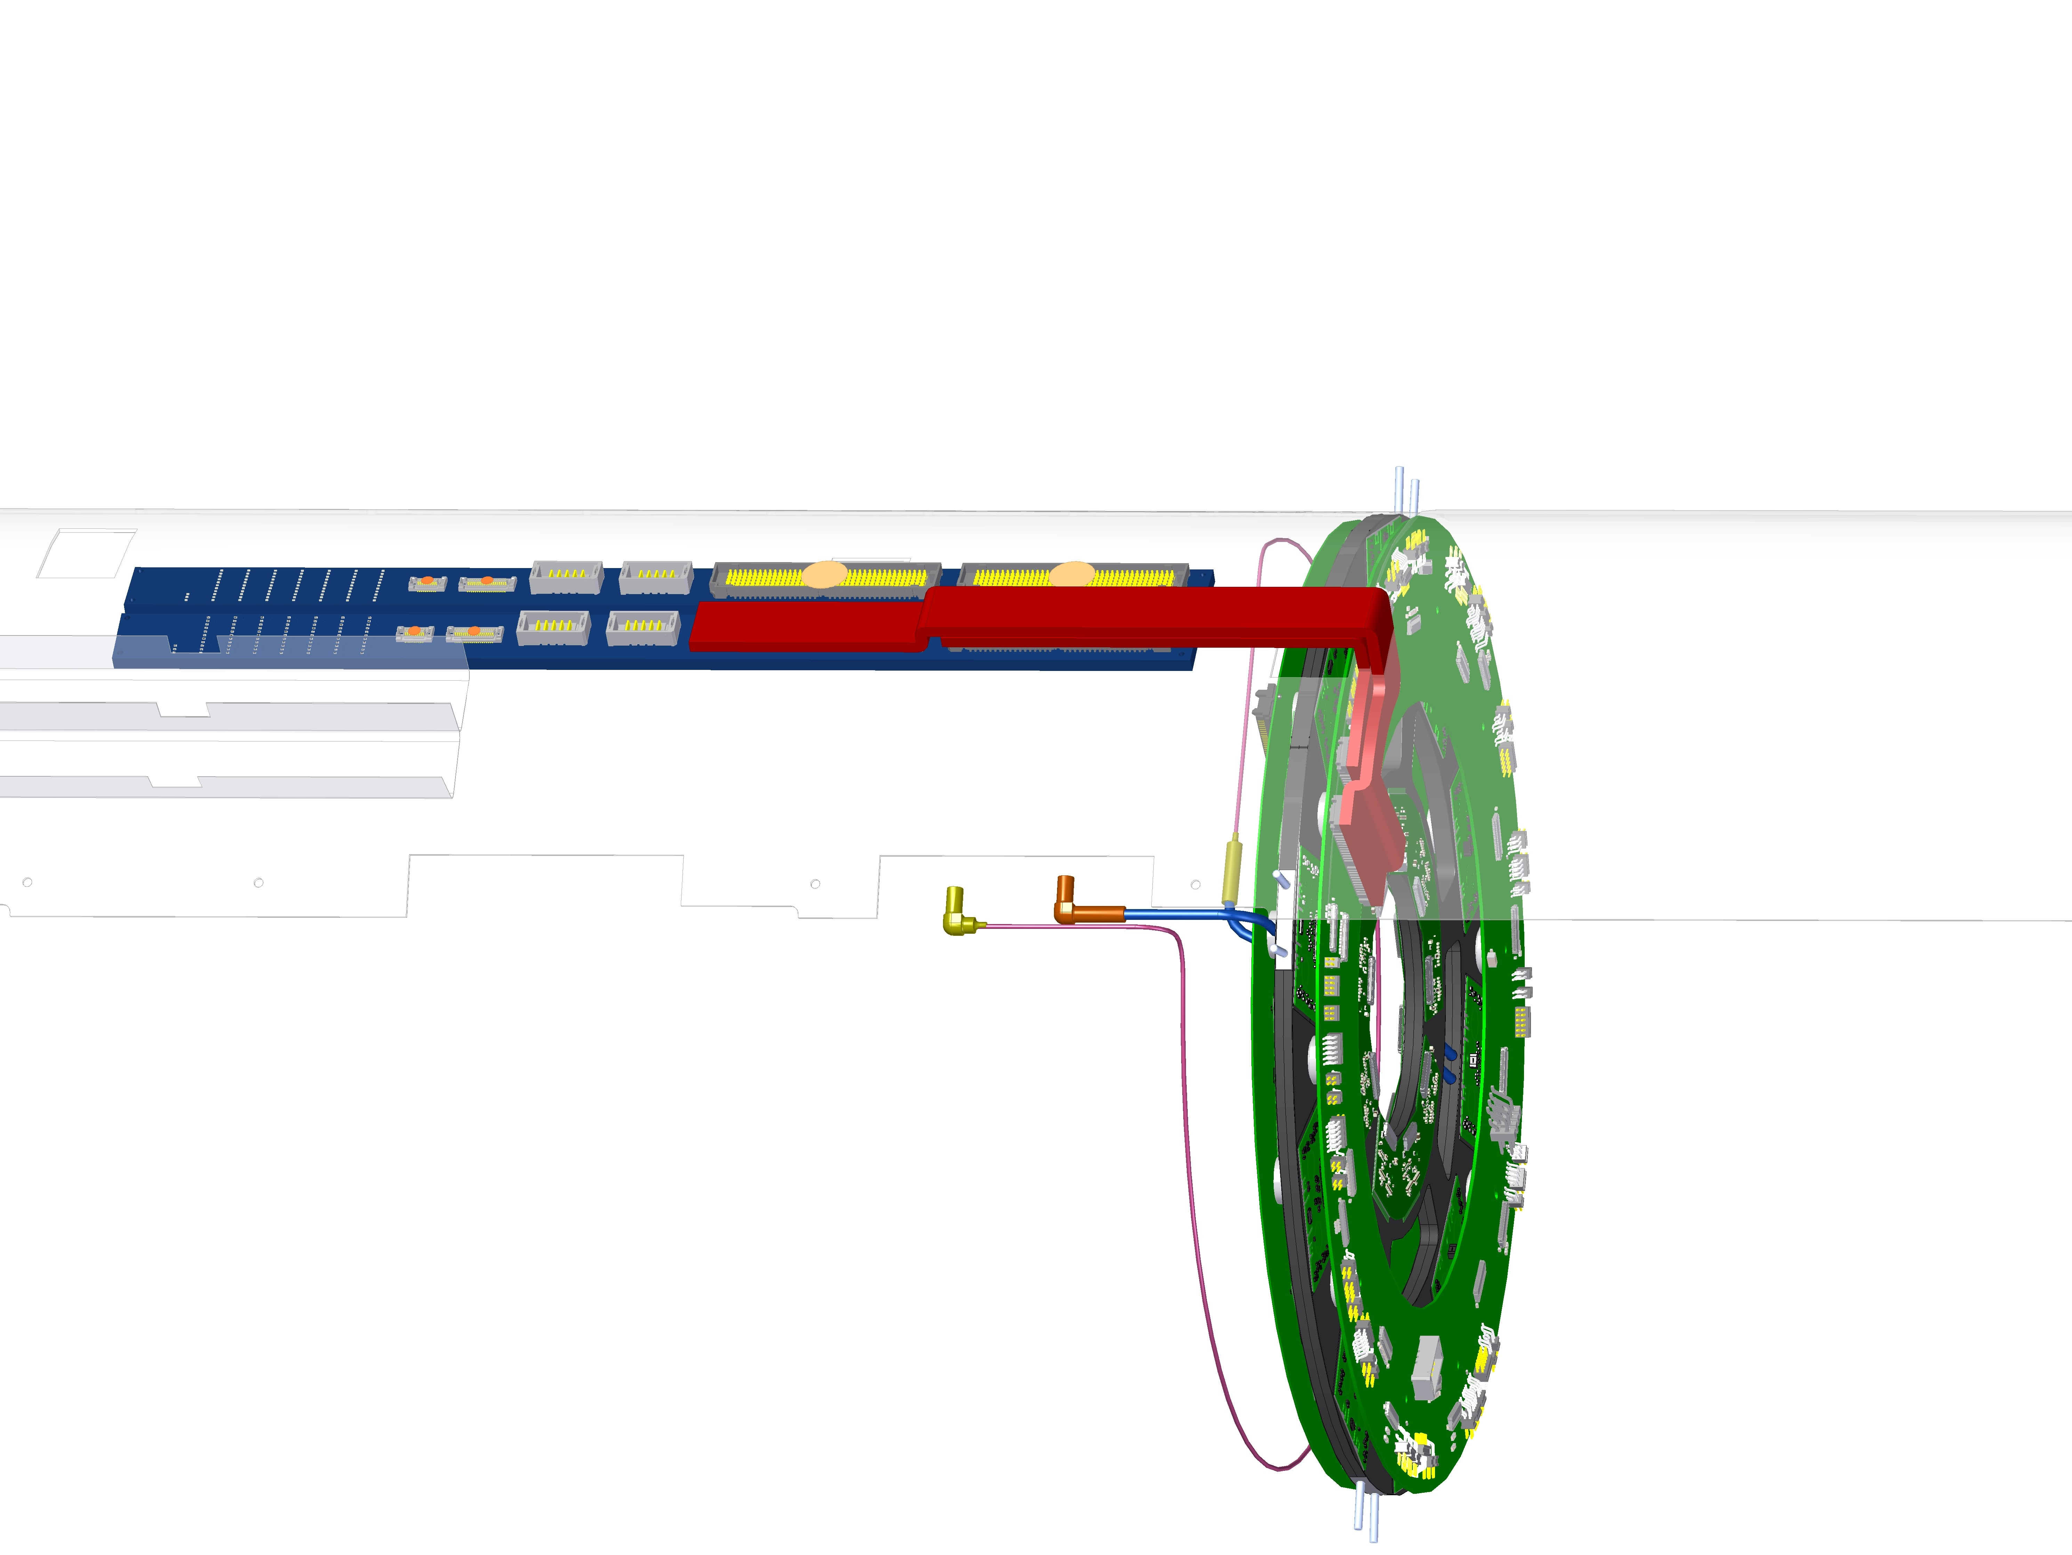
Coupled Ring Components
Not Shown
Quad Module Data Flex
Triplet Module Data Flex
PP0
Type-0 to PP0 Flex
Rigid Ring
41
Services FDR 2022
9/5/23

Slide 42
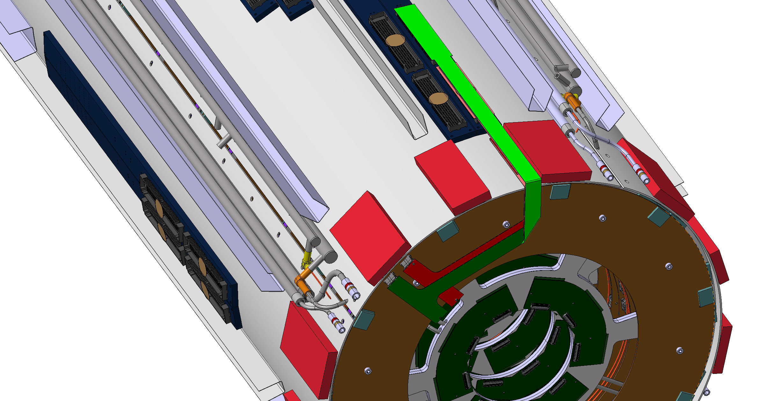
Endcap to Barrel Interface with Type-0 to PP0 Flex
One Flex contains connections for:
52 differential pairs
2 serial power chains
5 High Voltage Lines
1 interlocks
1 Mops Channels
Take up of extra length
Flex in Folded State
Natural bend not folded
Back Flavor
Front Flavor
42
Services FDR 2022
9/5/23

Slide 43
Only 2 flavors
Approx. 315mm
Connectors on different sides
43
Services FDR 2022
9/5/23

Slide 44
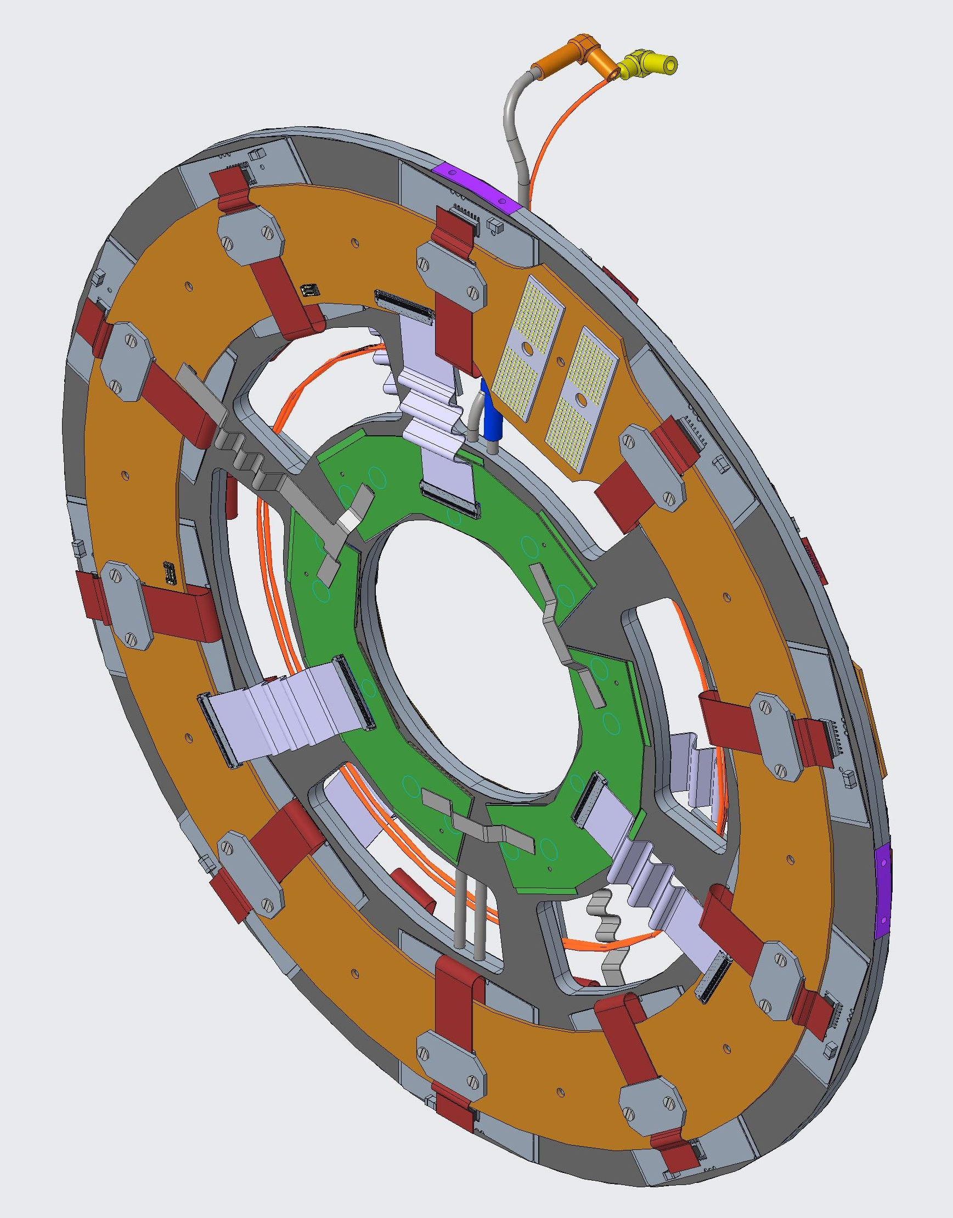
End-cap Integration Model
Coupled Ring Attached to a loaded local support
Quad Module Power Flexes in Red
Triplet Data Flexes in White
Triplet Power T in Grey
Not Shown
Quad Module Data Flex
Triplet Power Jumper
44
Services FDR 2022
9/5/23

Slide 45
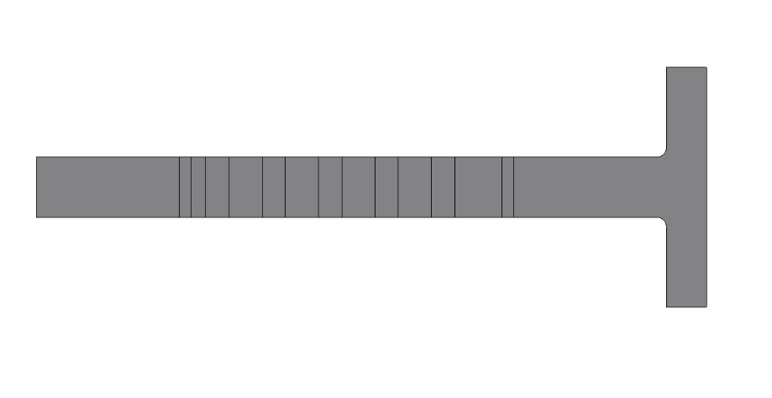
R0 Services Details
Due to the clocking of the rigid ring for Type 0 to PPO connections there are 3 different types of disk configurations. To accommodate these configurations we need the flavor of flexes as follows.
Three flavors of triplet data flexes
One flavor of triplet power to ring flex by adding 2 extra connectors
Triplet power connector
Triplet power jumper
45
Services FDR 2022
9/5/23

Slide 46
Type-0 Triplet Flex Flavors
Configuration 1
Configuration 2
Configuration 3
View from IP
View from HO
46
Services FDR 2022
9/5/23

Slide 47
End-cap L0
The total power budget for the L0 Triplet serial power chain was quite difficult to meet. However, we believe we have. Our simulations show that we are within budget (0.94W).
The signal loss in the triplet data flex is ~0.325dB

Slide 48
End Cap L1
The total power budget for the L1 Quad serial power chain was easier to meet. Our simulations show that we are within budget (4.28W).
The signal loss in the quad data flex is ~0.36dB
Loss in the coupled ring is ~1.5dB (0.0044dB/mm)

Slide 49
Type-0 to PP0
This is quite a dense flex to route
It drives our connectivity
The longest differential pairs here are 330mm long.
This give us a maximum loss of about 2dB
It also means there is no room for length matching which has to be done on the ring services to compensate.
Notes:
There are 52 differential pairs in this 6 layer flex PCB. Along with 4 LV channels,5 HV channels, an Interlock, MOPS services, and LP Enable.

Slide 50
Type-0 to PP0 Folding tool
Our End-cap integration strategy relies heavily on the Type-0 to PP0 flex
We recently changed the connector to z-ray to accommodate the end-cap barrel clearance and resolve potential connectivity issues
This flex carries all of our services
It is quite complicated to design and expensive to make
We use this folding tool to create the different “flavors” which allows us to limit ourselves to two versions of the flex

Slide 51
Z-Ray Demonstrator
The Z-Ray Demonstrator is designed to do many things
Demonstrate the use of Z-ray on flex PCBs
Demonstrate Data Transmission with ITkPixV1
Demonstrate the mechanical feasibility of long and folded type-0 to PP0 Flex
Demonstrate the Barrel to End Cap interface
Production is ongoing
This is another example of using a lower cost set of services to validate a more complex design
51
Services FDR 2022
9/5/23

Slide 52
Other interfaces
RCE board for DAQ @ full speed
SMA to mDP to interface with Network Analyzer, TDR, and Oscilloscope
Network analyzer & TDR for measuring signal loss and impedance
Oscilloscope for measuring Signal Integrity

Slide 53
QC Testing - Visual Inspection
BGA Pads on the Type-0 to PP0 Flex
Digital Microscope
Stereo Microscope
Type-0 to PP0
Notes:
For visual inspection we use microscopes
You can see an image of the BGA pads of the Type0 to PP0 flex (shown below)

Slide 54
Failure Analysis
The Type-0 to PP0 Flex had some issues
We X-Rayed the flex
Found a broken track
This is a PCB Fabrication error
We also discovered that many of the BGA joints were disconnected
This is an assembly error
Fixed in two ways, design changes and assembly vendor changes
Tear Drops were expanded, track size was increased, Z-Ray and LPAMs stiffener thickness increased (0.064in 1.63mm total thickness)
Edge of connector
Notes:
To verify if the copper was broken in the flex, we removed the connector from the flex and hand tested the flex.
Hand testing without the connector found only 5 errors in the flex.
The edge of the connector is below the bottom edge of the connector, so its not from handling.

Slide 55
SEM Material Analysis – Coupon Testing

Slide 56
QC Testing – X-Ray Inspection
Ray Image
Notes:
We also are able to use a micro CT tool to Xray the PCBs. You can even look at individual layers.

Slide 57
Example Test – Reception SEM

Slide 58
References
Grounding and Shielding Requirements
https://edms.cern.ch/document/1841188/2
Module ICD
https://edms.cern.ch/ui/#!master/navigator/document?D:100951222:100951222:subDocs
Quad Hybrid Design
https://edms.cern.ch/document/2391603/1
Linear Triplet Design
https://edms.cern.ch/document/2391605/1
ITk Pixel Services Specifications
https://edms.cern.ch/document/1817540/3

Slide 59
Quad Ring
Should be One connector

Slide 60
Intermediate Ring
Should be One connector

Slide 61
Type-0 Module Interface
Small radius board with separate Quad power flexes

Slide 62
Triplet Power Jumper Flex
Mechanical Design by Erik Richards
Pixel Workshop

Slide 63
Strain Relief to be added here

Slide 64
Triplet Power Flex To Ring
Mechanical Design by Erik Richards
Pixel Workshop

Slide 65
Strain Relief to be added here
This connector could be rotated differently and there would be minimal impact to our design.

