Slide 1




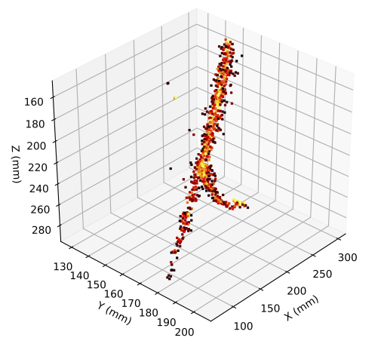
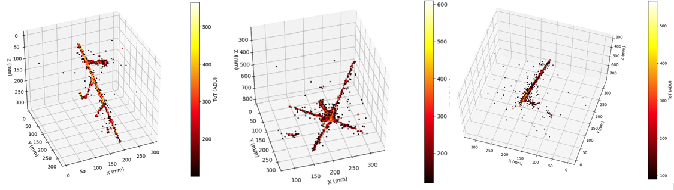
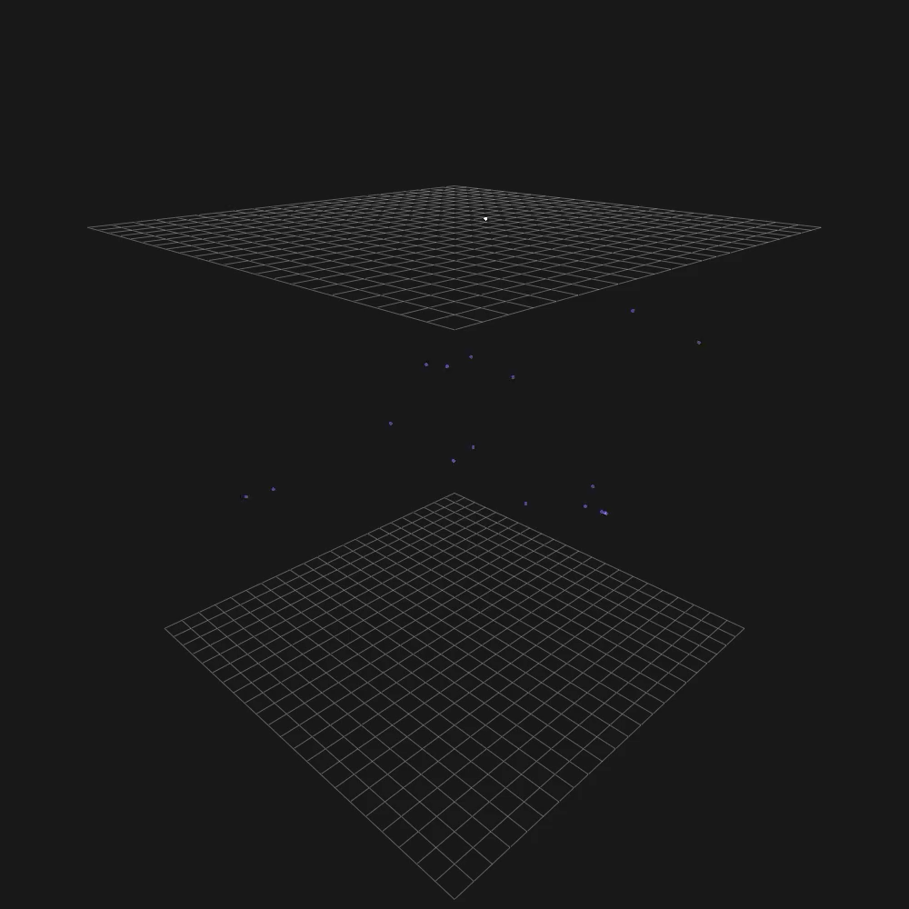

ARIADNE⁺: Large scale demonstration of fast optical readout for dual-phase LArTPCs at the CERN Neutrino Platform
+
http://hep.ph.liv.ac.uk/ariadne
Kostas Mavrokoridis
(on behalf of the ARIADNE+ collaboration)
k.mavrokoridis@liv.ac.uk
TIPP2023, Cape Town, September 2023

Slide 2
Talk Outline
Background to the ARIADNE program
  TPX3Cam results taken with the ARIADNE 1-ton dual phase LAr detector
ARIADNE⁺: Larger scale demonstration using the CERN “Cold Box” at the Neutrino Platform
  Results and informing next steps
Next Steps
Dual phase Optical protoDUNE run proposal to SPSC
New ARIADNE ongoing run
  Preparing the LoI to SPSC

Slide 3
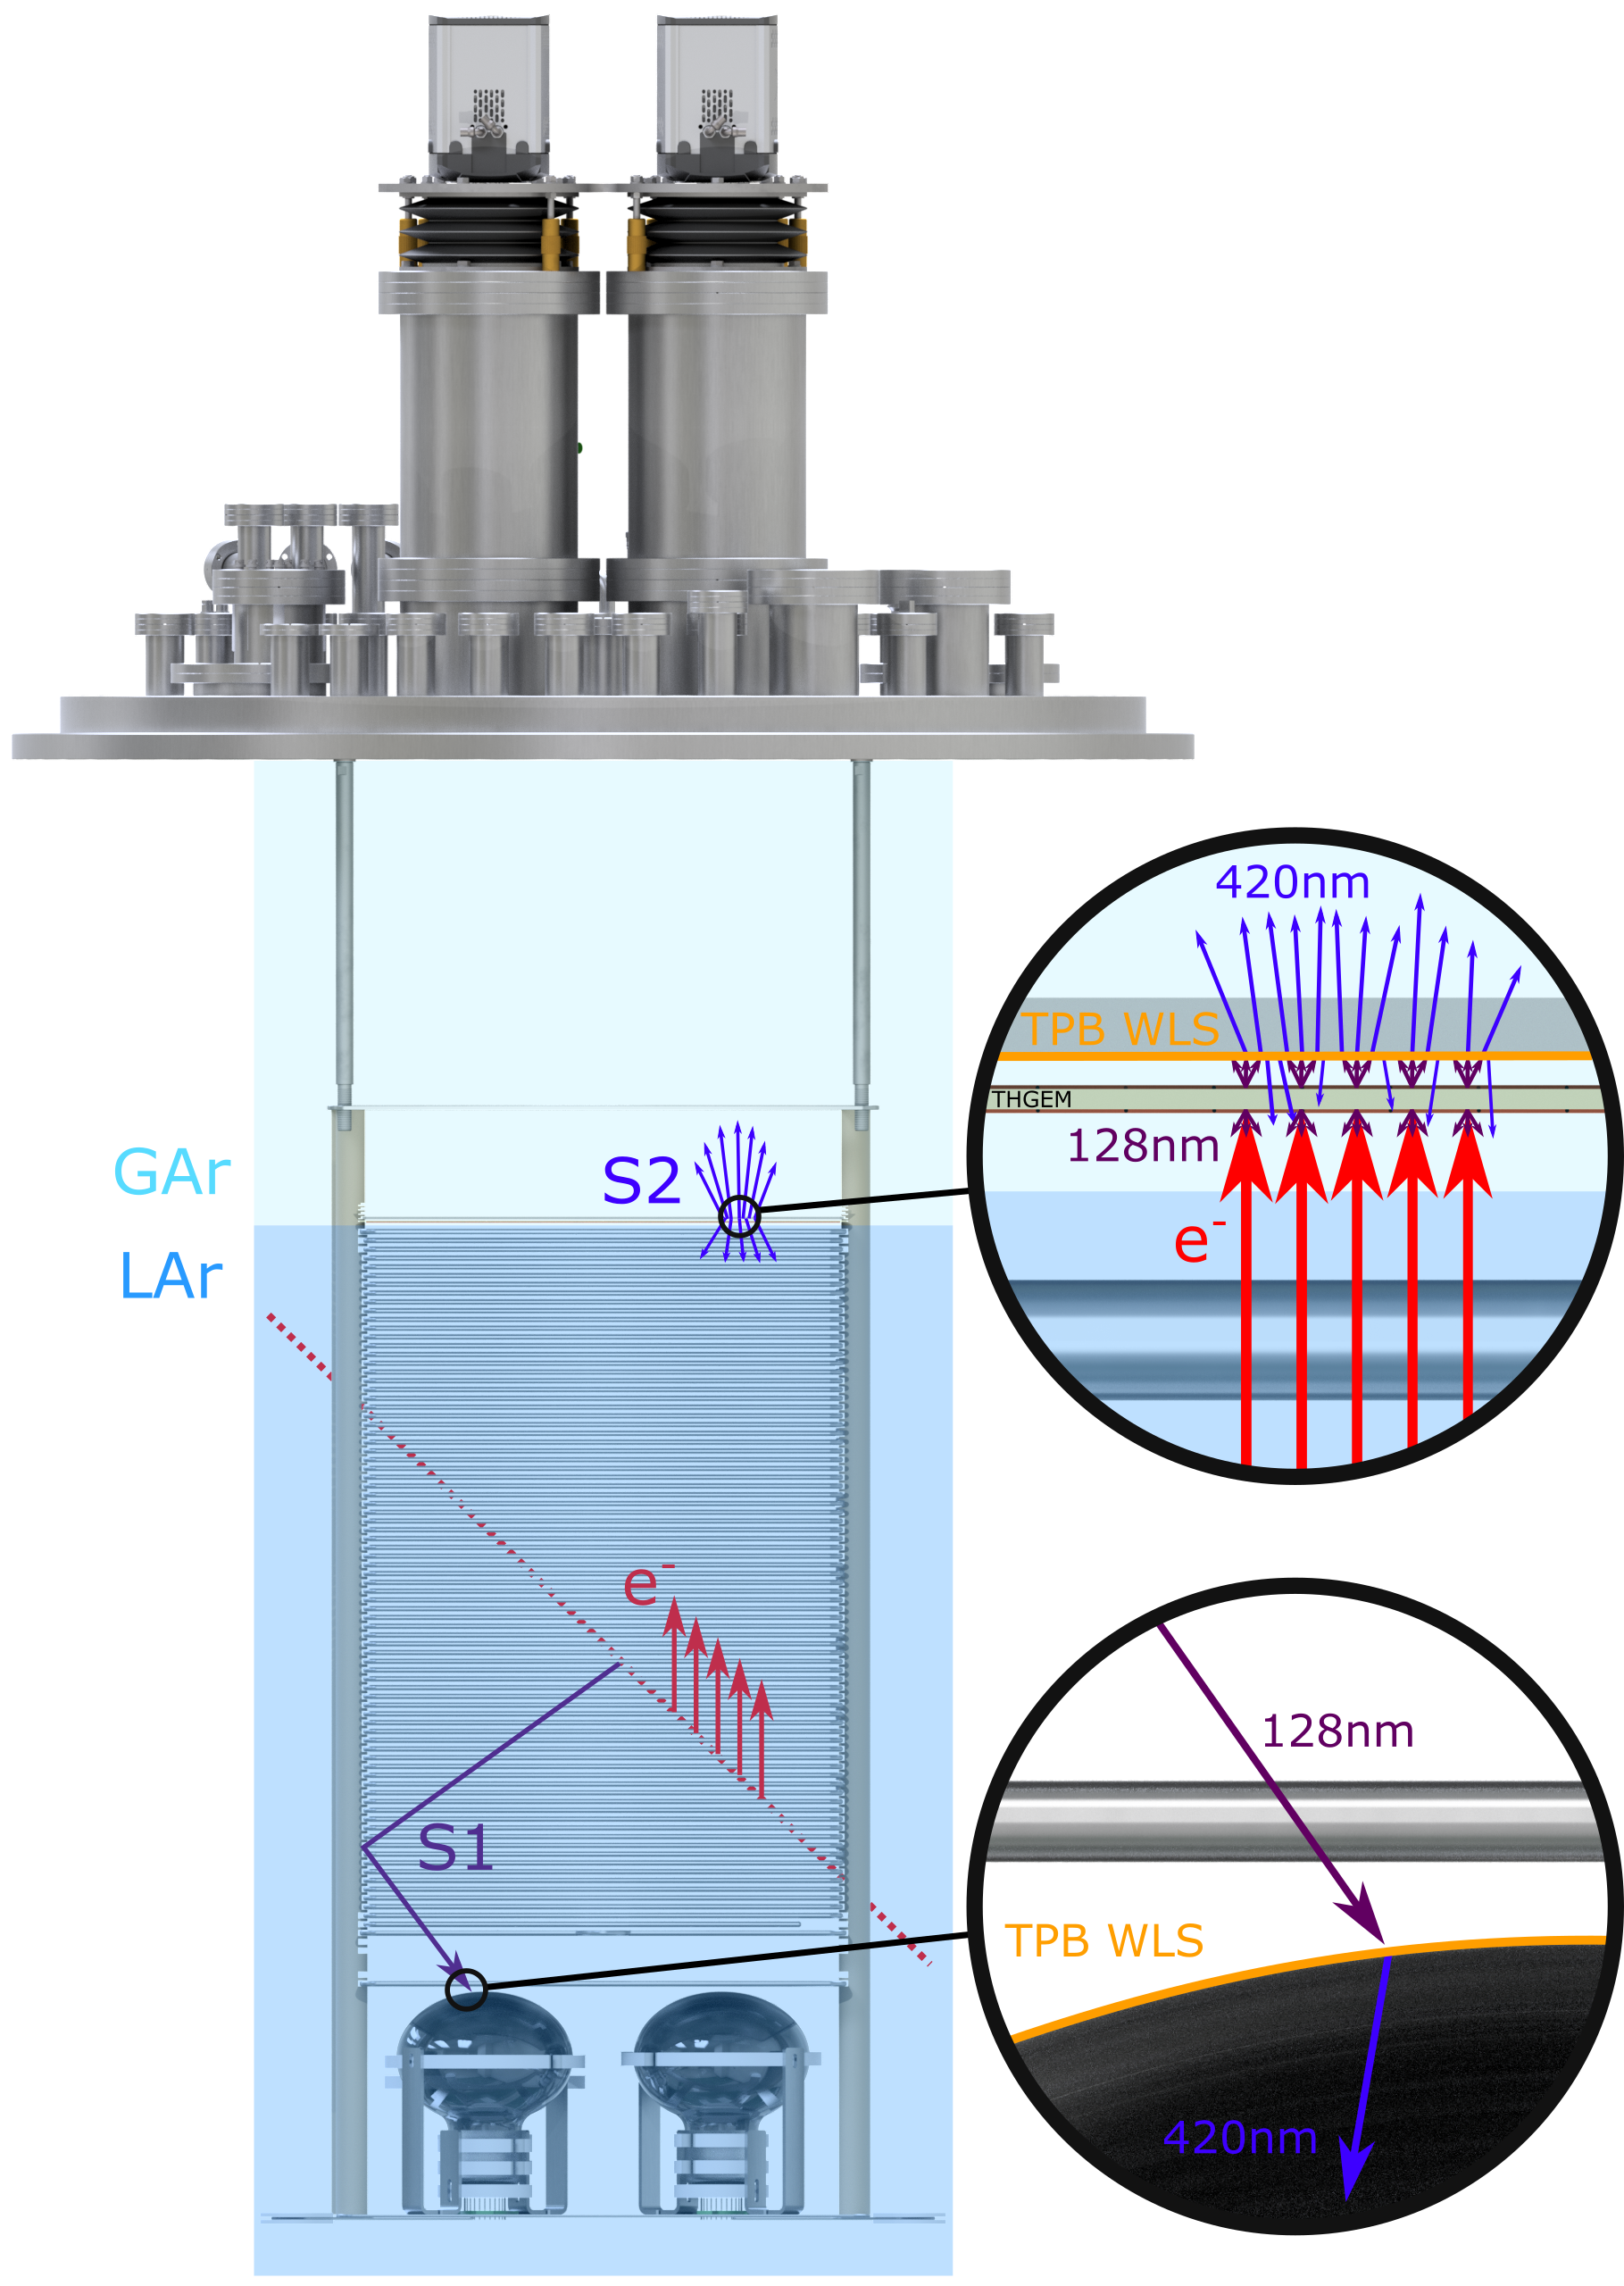
ARIADNE Detection Principle
Cameras
ARIADNE has demonstrated light readout as a viable alternative to charge in dual-phase TPC neutrino experiments
Incoming particles ionise LAr and create prompt scintillation light (S1)
Electrons drift towards the extraction grid situated below the liquid level
A THGEM (THick-Gaseous Electron Multiplier) amplifies drift charge (capable of >30 kV/cm in LAr) generating secondary scintillation light (S2)
WLS (Wavelength Shifting) before imaging with Timepix3 camera
ARIADNE (ARgon ImAging DetectioN chambEr)

Slide 4
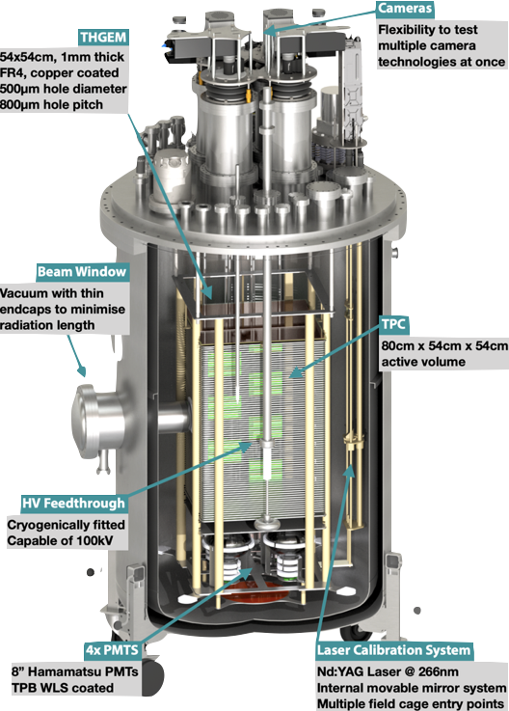
The ARIADNE Advantage - Optical TPCs
  Benefits over previous charge readout methods:
    High Resolution: For e.g. TPX3 camera has 256 x 256 pixels, imaging 35 x 35 cm area, as on ARIADNE, gives ≈1 mm resolution
    Sensitivity to low energies: Gain is generated by the THGEM; a THGEM accelerated electron can generate upwards of 100 photons, cameras can be sensitive to single photons
    Very low Noise: Externally mounted cameras are decoupled from TPC electronic noise sources/acoustics
    Ease of Access: Technology can be swapped in and out even with TPC operating. First tests EMCCDs.
    Cost Efficient: No need for thousands of internal charge TPC readout channels, pre-amps etc.
    Available NOW
TDR: https://iopscience.iop.org/article/10.1088/1748-0221/15/03/P03003
ARIADNE 1-ton detector

Slide 5
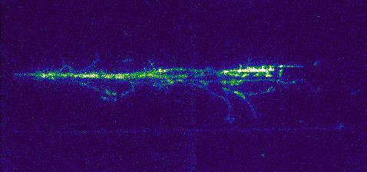
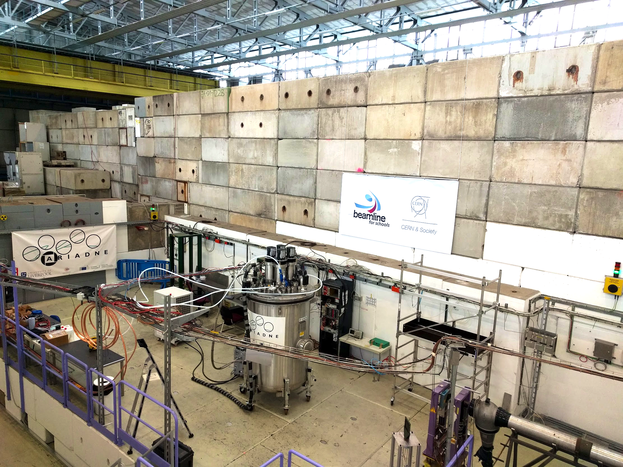
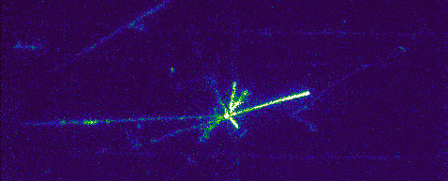
ARIADNE at CERN T9
EMCCD data taking 3 weeks April 2018.
T9 Beamline, East Area, CERN.
Mix of particles: e ±, μ ±, π ±, p±. (0.5 – 8 GeV/c.)
43 cm
35 cm

Slide 6
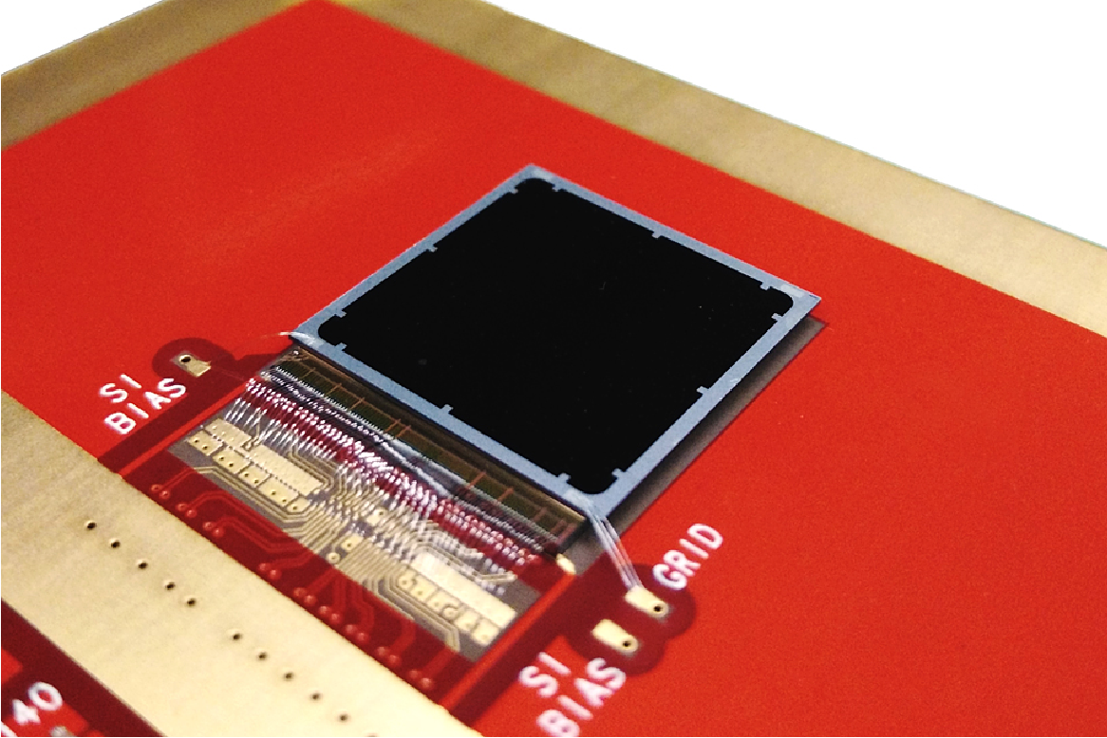
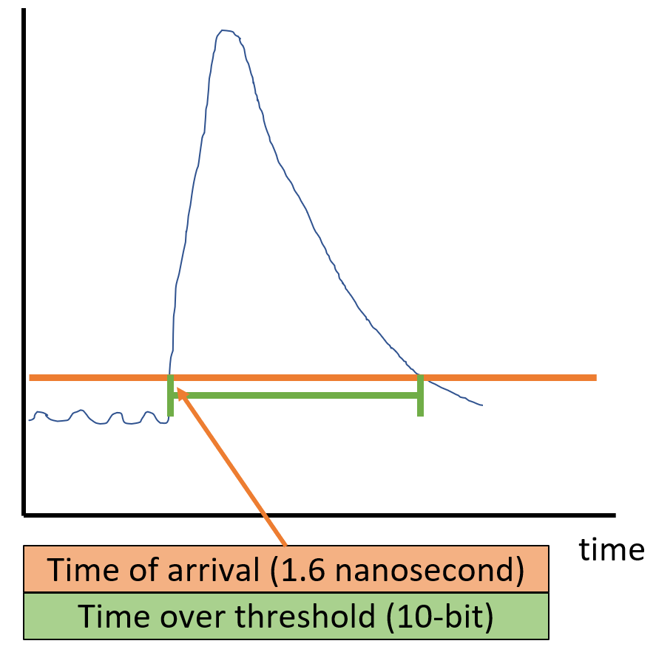
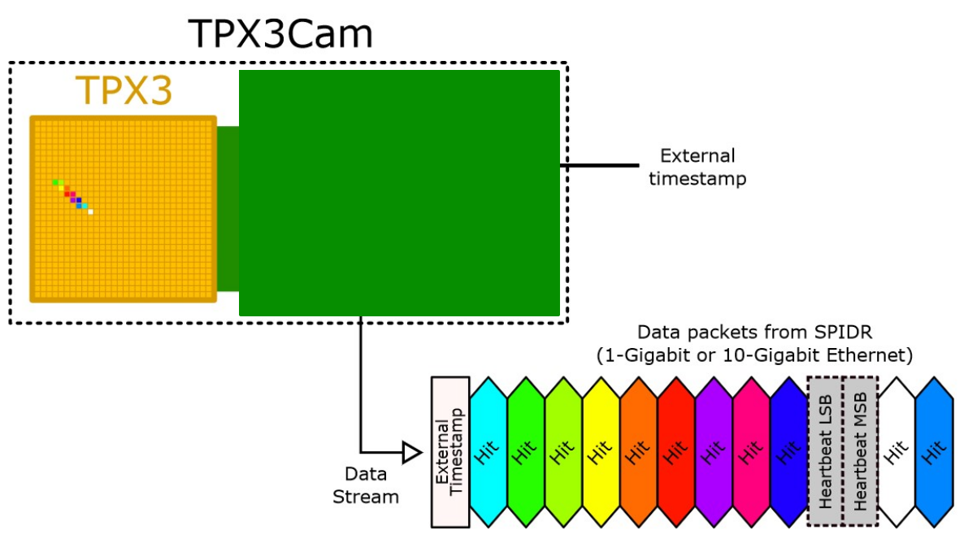
2D-> Full 3D Optical Readout
Silicon pixel readout chip developed by the Medipix collaboration. Very well established technology at CERN.
TPX3 ASIC bonded to optical sensor
TPX3 provides simultaneous time-over-threshold (ToT) and time-of-arrival (ToA). Complete (x,y,z,E) event reconstruction using a single device.
Time over threshold provides intensity / energy measurement ->10-bit resolution.
Time of arrival provides z (drift) axis position information -> 1.6 nanosecond resolution.
Data driven readout -> Event streaming with native zero suppression.
Efficient raw data storage. Triggerless operation.
Sensor resolution | 256x256 pixels
Pixel size | 55µm x 55µm
Max readout rate | 40Mhits•cm⁻² •sec⁻¹
Time resolution | 1.6 ns

Slide 7
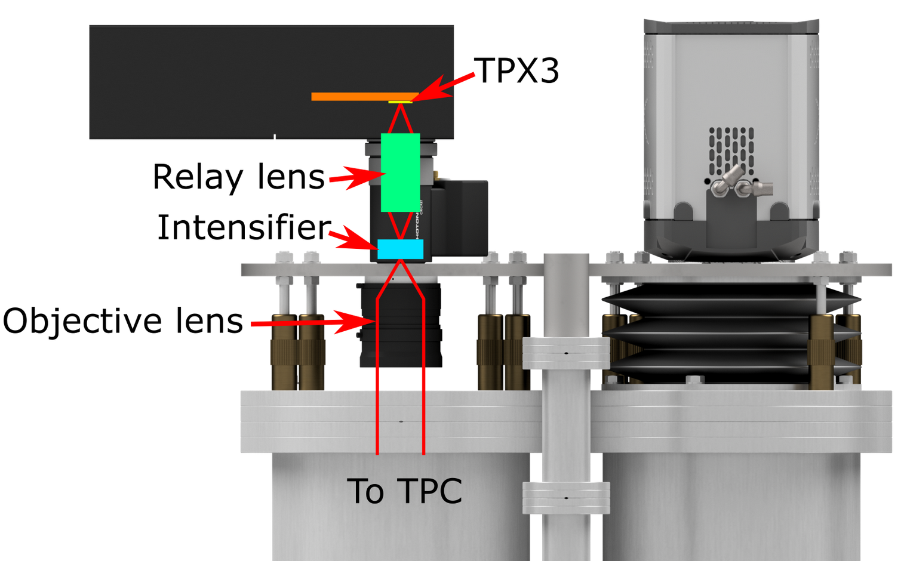
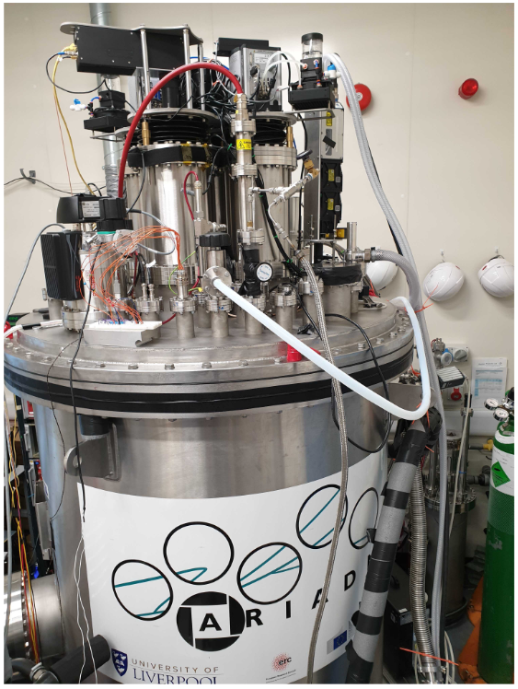
TPX3Cam Optical Readout
Single photon sensitivity when combined with image intensifier.
Intensifier gain ~1E6 photons/photon.
Relay lens couples intensified image onto light sensitive
sensor which is bump bonded onto TPX3 ASIC.
Intensifier provides flexibility -> Many photocathode options are available to customise spectral sensitivity.
– Now also Direct VUV!
Timepix3 camera installed in place of an EMCCD camera.
~ 30cm x 30cm field of view
Photonis Cricket image intensifier with Hi-QE green photocathode.
30% quantum efficiency at 430nm (TPB peak emission)
Coldbox Intensifier
ARIADNE results
TPB emission

Slide 8
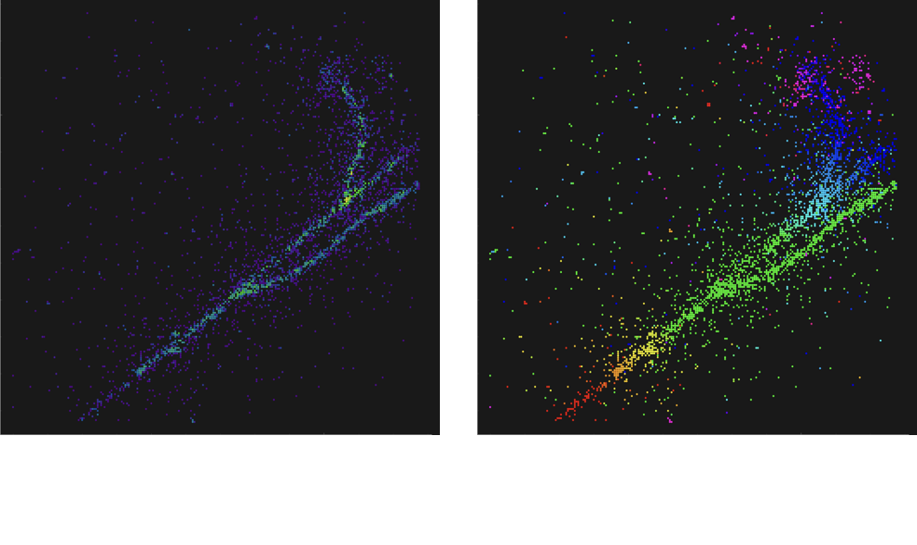
TPX3Cam Optical Readout

Slide 9
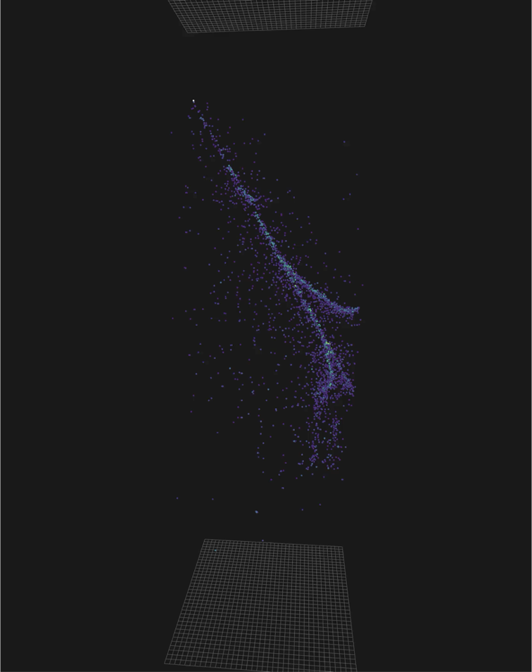
TPX3Cam Optical Readout

Slide 10
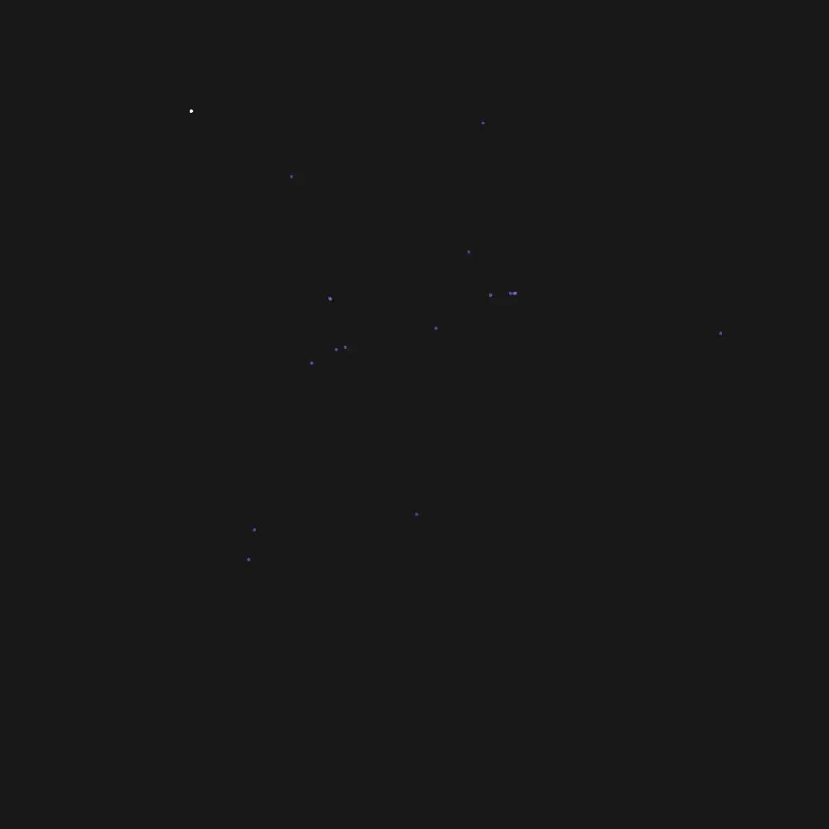
TPX3Cam 3D Cosmics LAr
Continuous streaming, 10 msec slice (playing 1ms jump per frame)
Side View
Top View

Slide 11
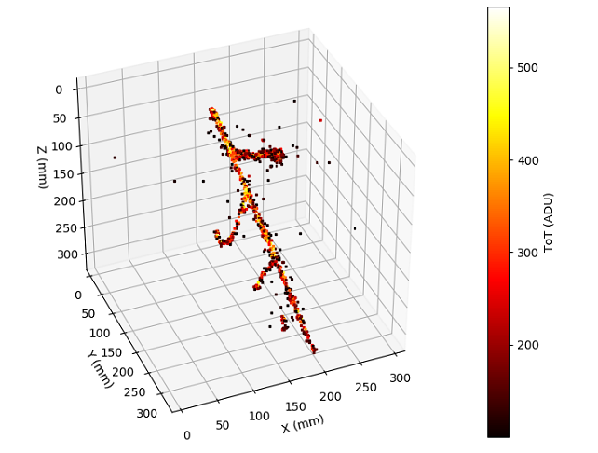
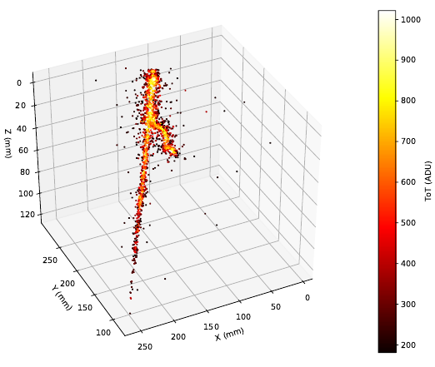
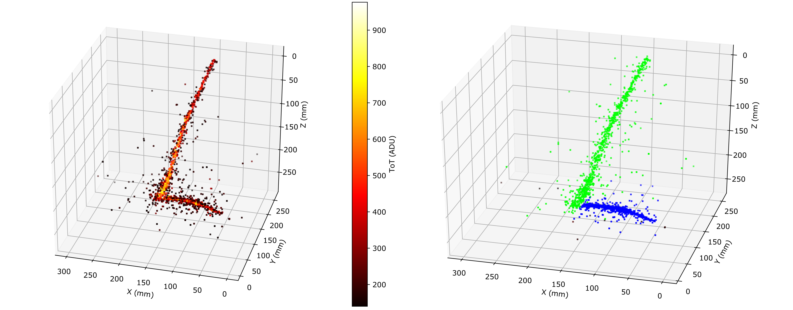
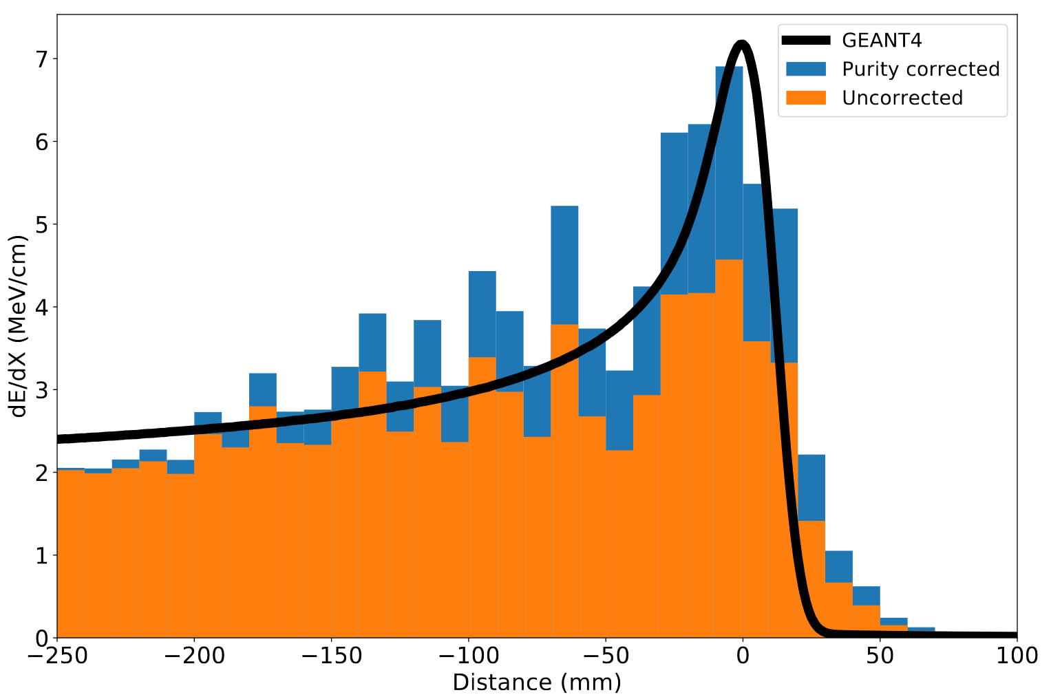
ARIADNE TPX3 Results
https://www.mdpi.com/2410-390X/4/4/35
Stopping Muon
MIP Energy Calibration
ADU (ToT) vs. THGEM Bias
11% energy resolution
Cameras are sensitive to the linear light production regime

Slide 12
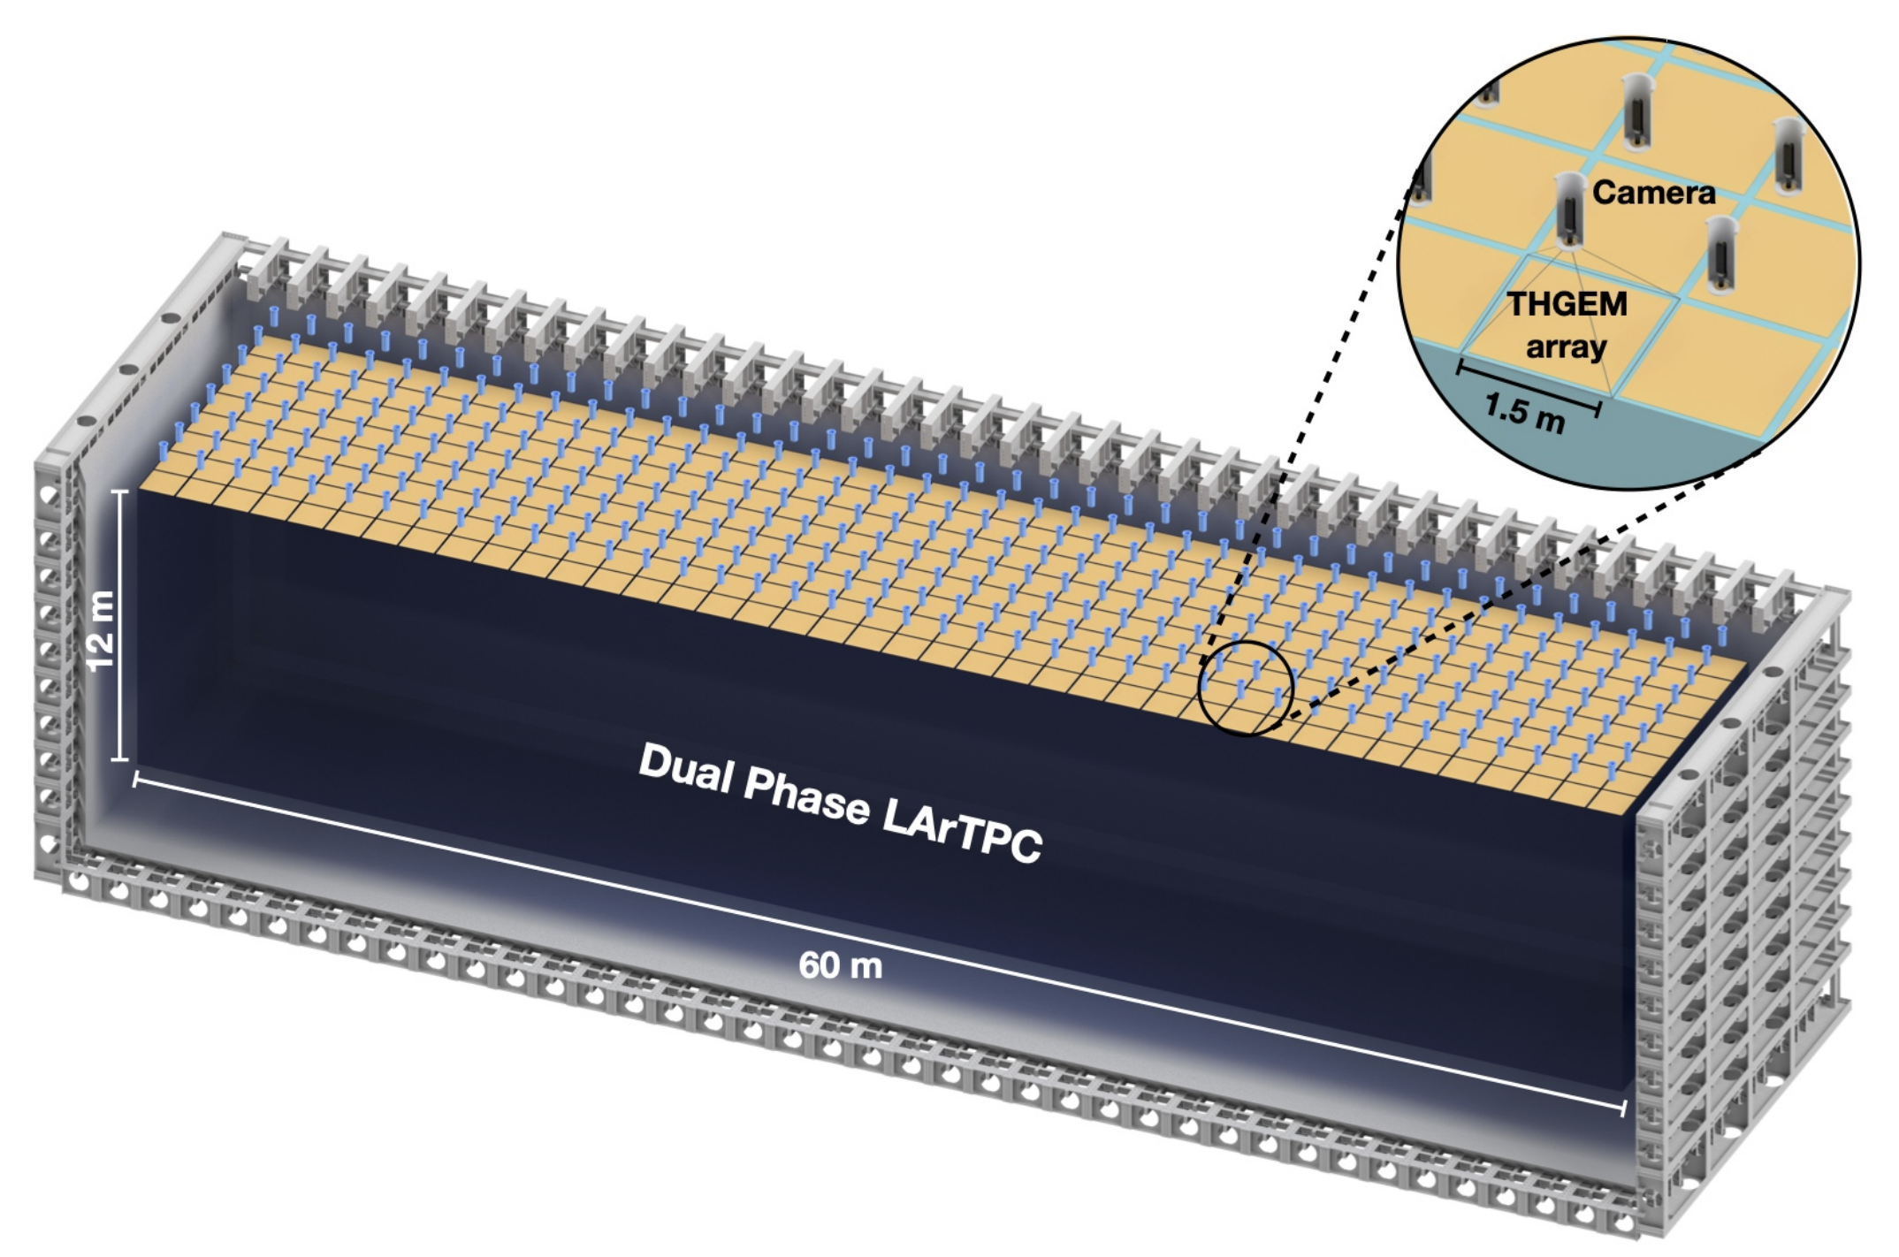
Module of Opportunity Workshops
Conceptual DUNE Dual Phase with Optical Readout
320 TPX4Cams within the cryostat chimneys
Each camera images 1.5mx1.5m with 3mm/pixel resolution
Total camera commercial cost with optics ~3M Euro
Table: As an example, demonstration figures for use of TimePix within Dune - 720m², 60m x 12m
Camera type | Sen. Size (pixels) | Cameras to cover 1m² | Resolution (mm/pix) | Total cameras (to cover 720m²) | Total cost (assuming €5k /camera*)
TPX3 | 256x256 | 9 | 1.3 (~ARIADNE) | 6480 | 32.4M
TPX3 | 256x256 | 4 | 2 | 2880 | 14.4M
TPX3 | 256x256 | 1 | 4 (~ARIADNE⁺) | 720 | 3.6M
TPX4 | 512x448 | 4 | 1 | 2880 | 14.4M
TPX4 | 512x448 | 1 | 2 | 720 | 3.6M
TPX4 | 512x448 | 0.66 (1.5m/cam) | 3 | 320 | 1.6M
* Cost is a place holder based on discussions with ASI, assumes large production. Intensifiers and optics will double total cost

Slide 13


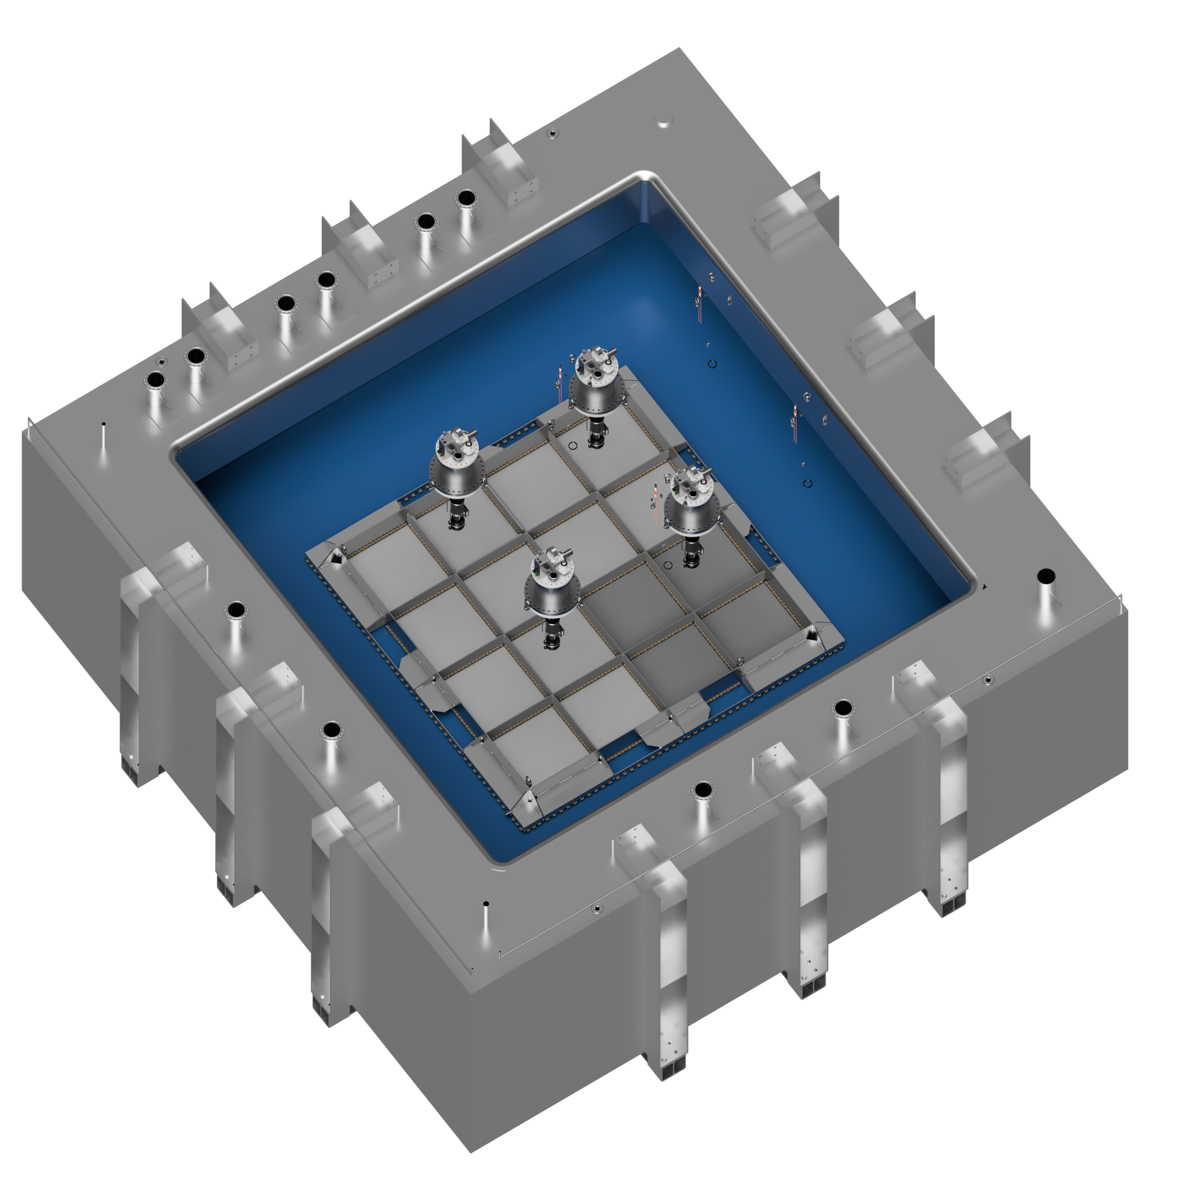
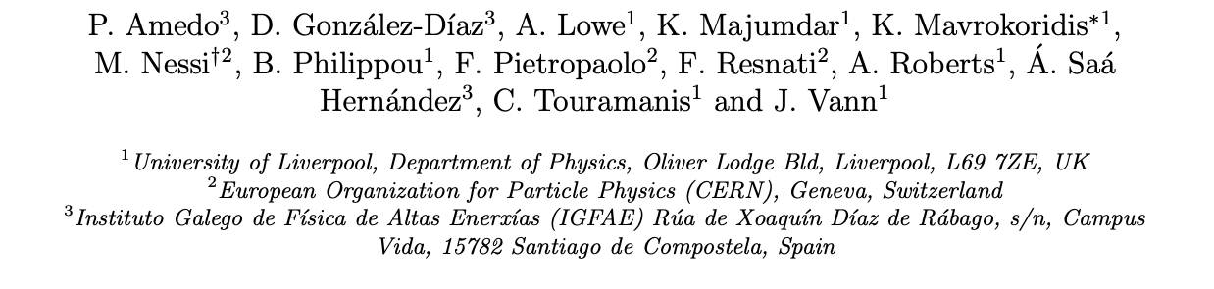
Larger Scale Demonstration at the CERN Neutrino Platform
Operation March/April 2022
Test optical readout on a scale relevant for DUNE using the existing cold box
CERN LOI: https://cds.cern.ch/record/2739360

Slide 14
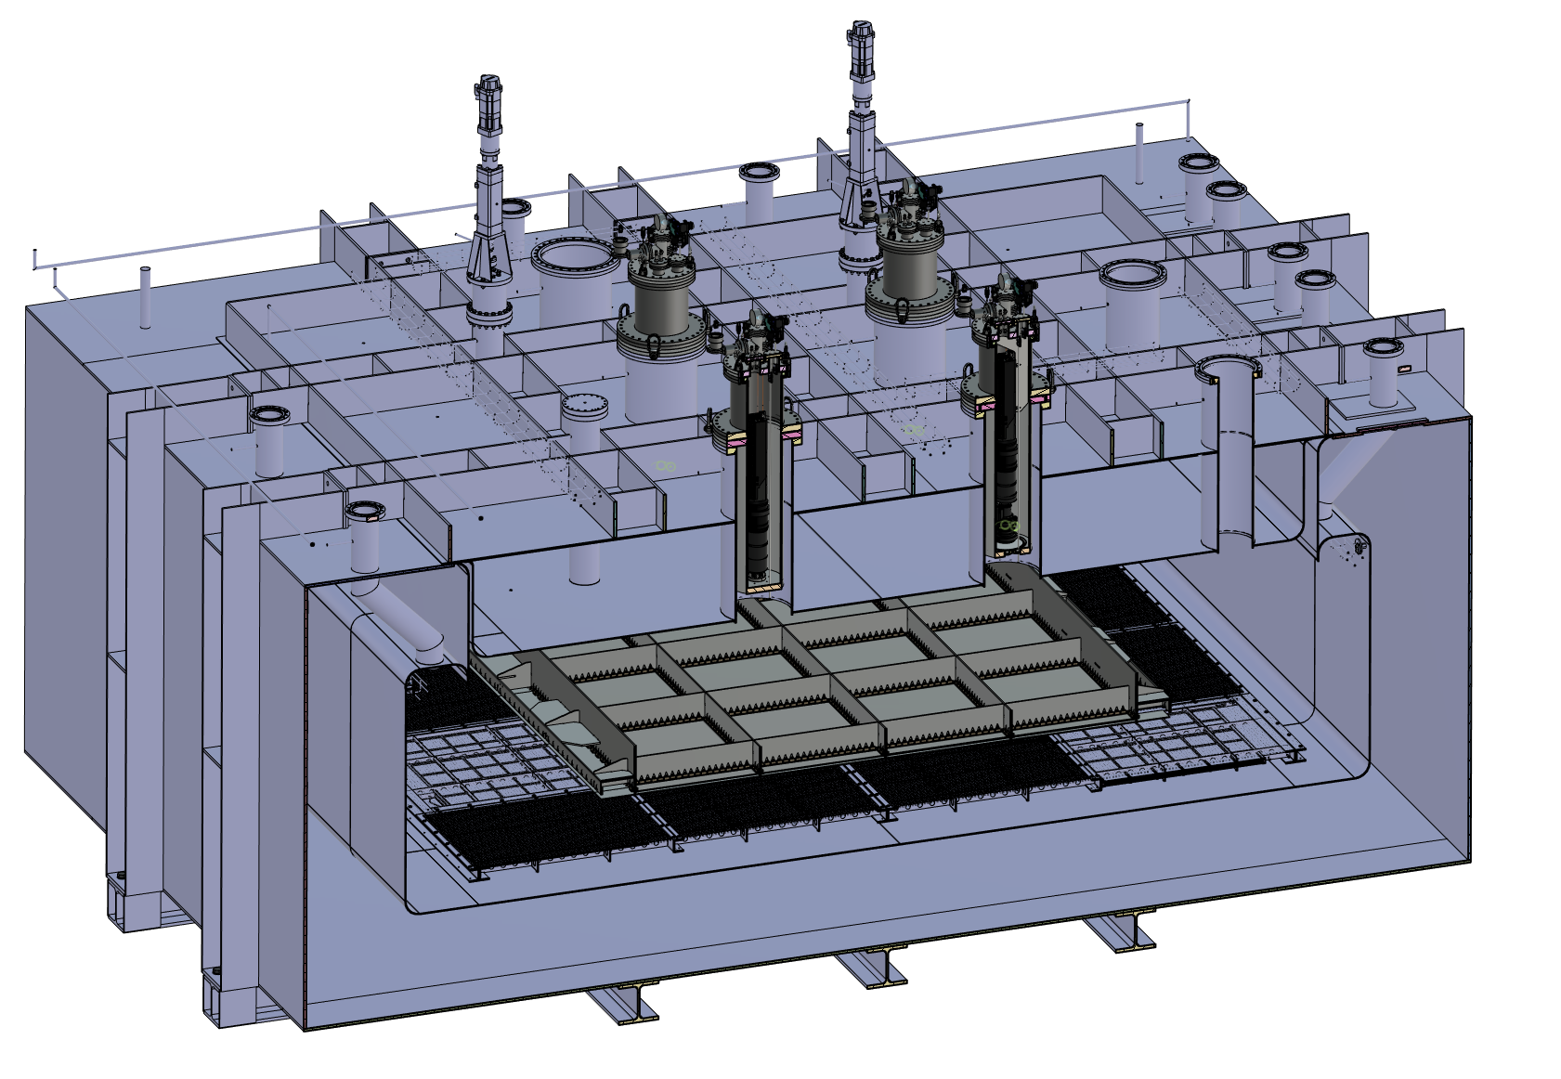
ARIADNE⁺: Cryostat Optical Configuration
TPX3 Camera
Assembly (1 x VUV)
TPX3 Camera
Assembly (3 x visible)
Large scale test of ARIADNE optical readout principle for dual-phase LArTPCs.
Four Timepix3 based cameras, each covering 1m x 1m readout area.
Three cameras detect visible light (wavelength shifter installed above THGEMs)
One camera directly detects VUV.
Light Readout Plane (LRP)
Cathode

Slide 15
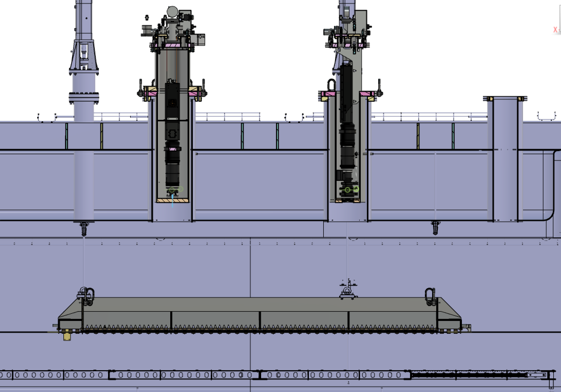
ARIADNE⁺: Cryostat Optical Configuration
Re-entrance viewports, cameras in gas nitrogen
20 cm electron drift

Slide 16
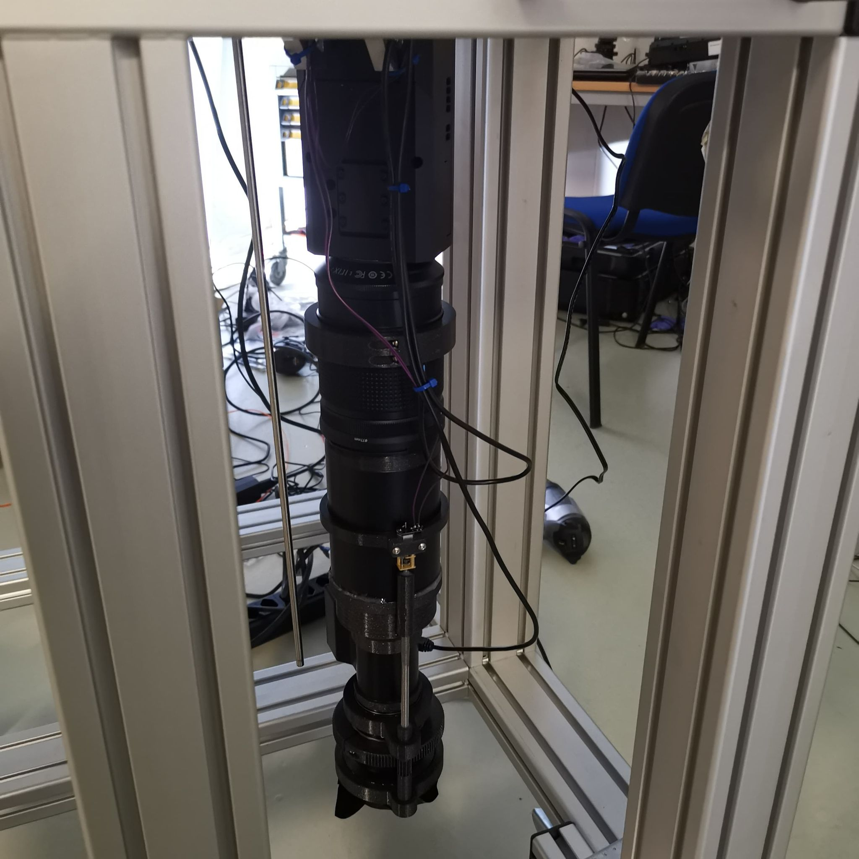
TPX3 Camera System
Timepix 3 Camera
Relay optics
Image intensifier
Objective lens

Slide 17
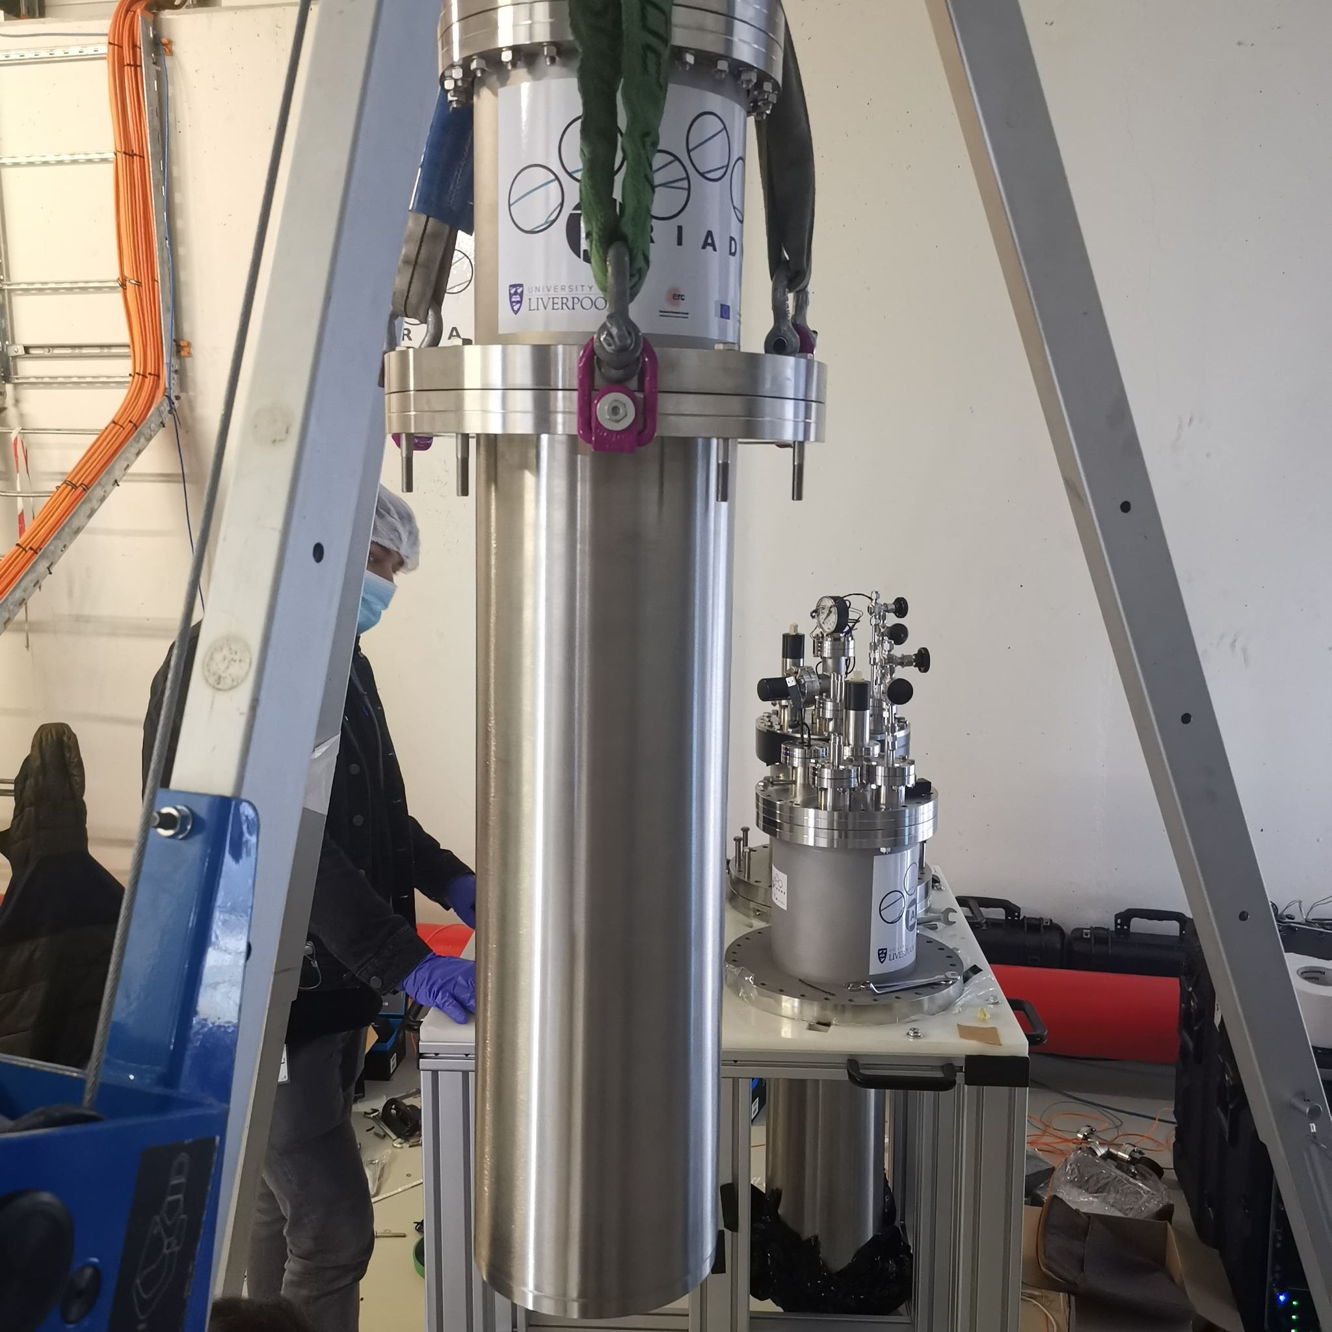
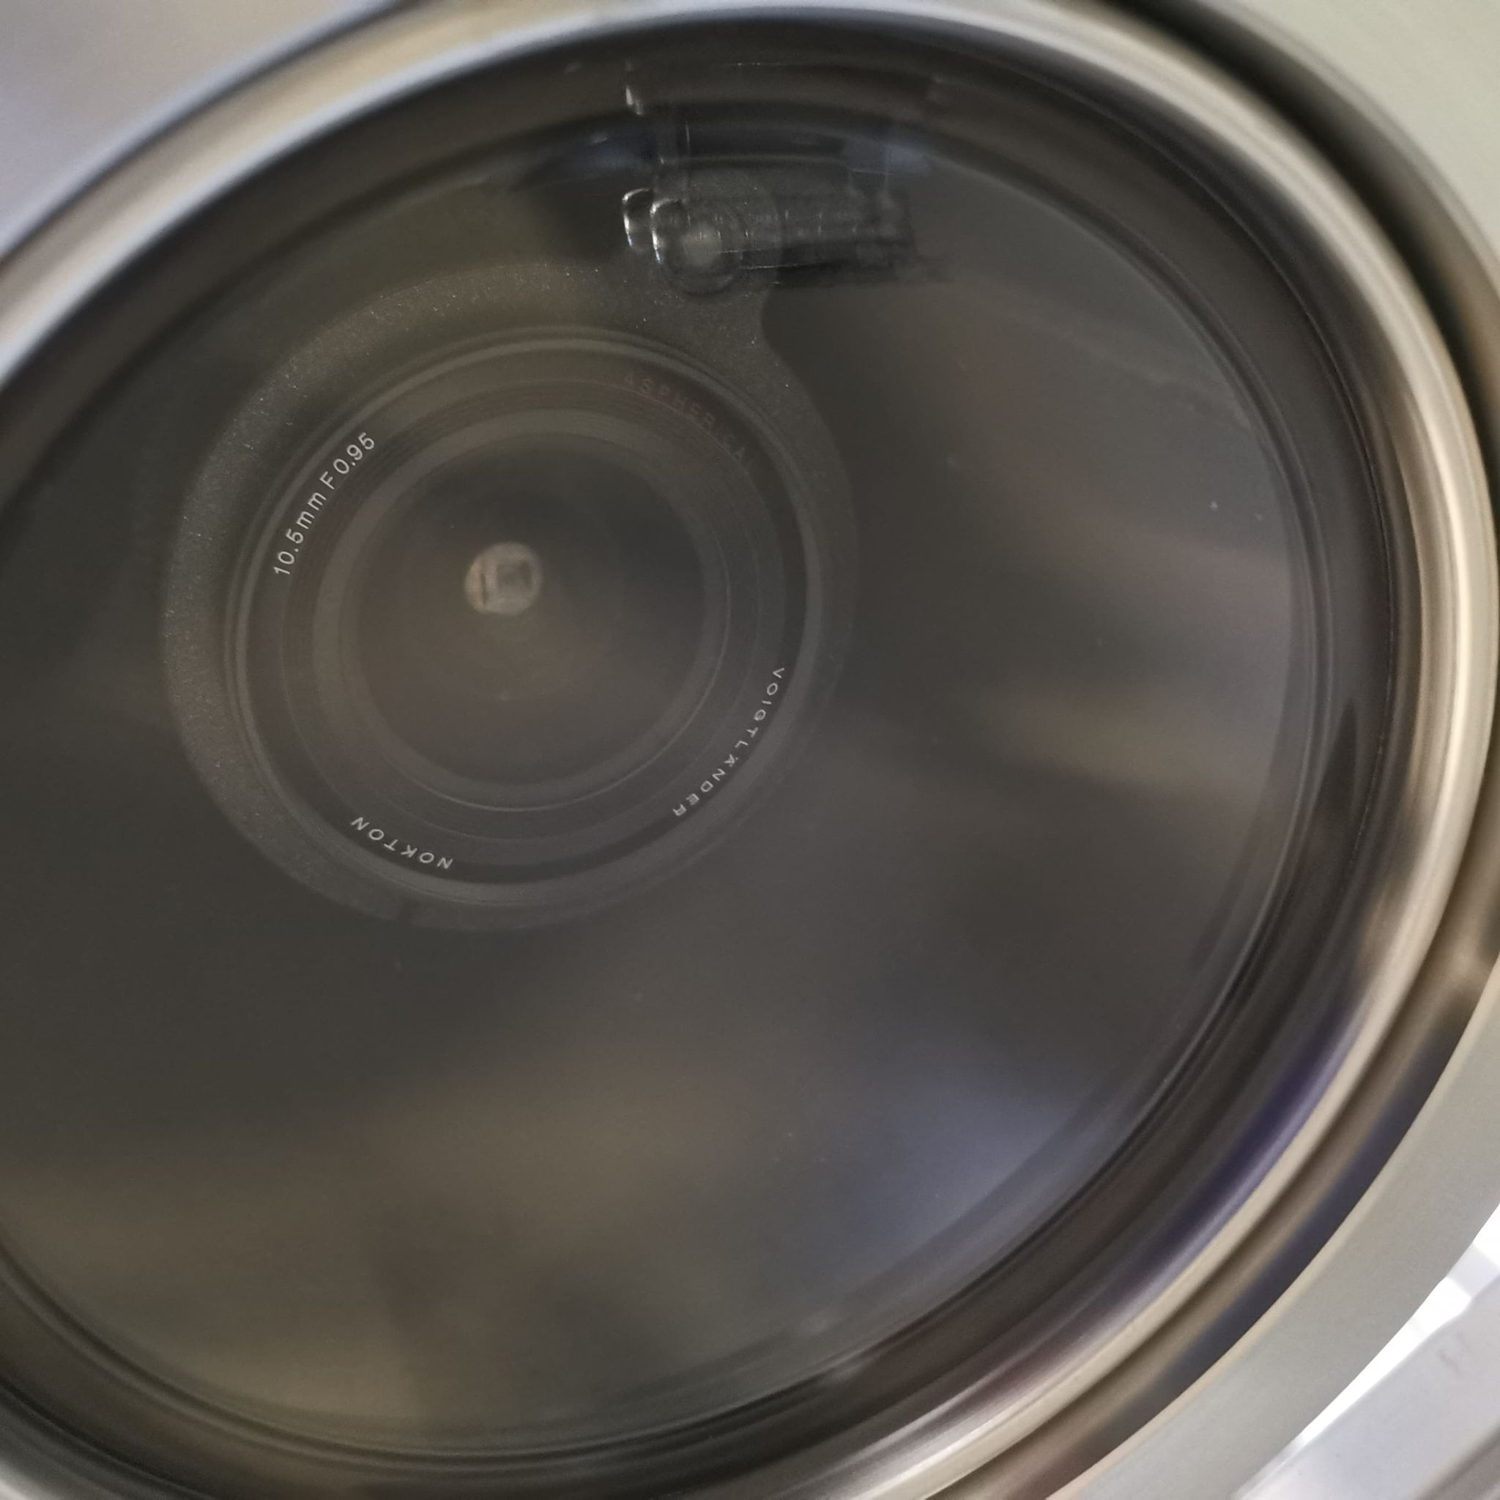
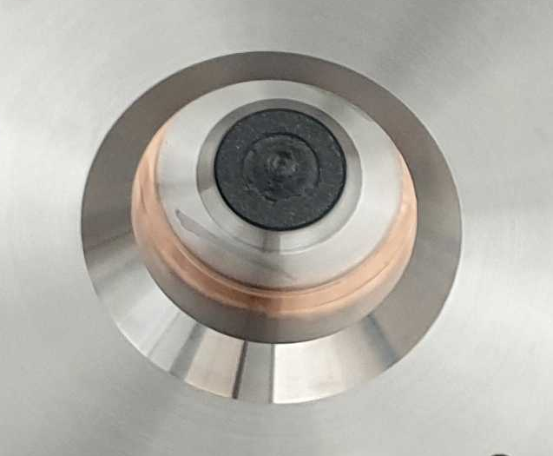
Re-entrance Viewport
Visible lenses (f0.95, 10.5 mm)
Custom made VUV MgF₂ Lens (f3, 11mm, 5mm diameter)

Slide 18
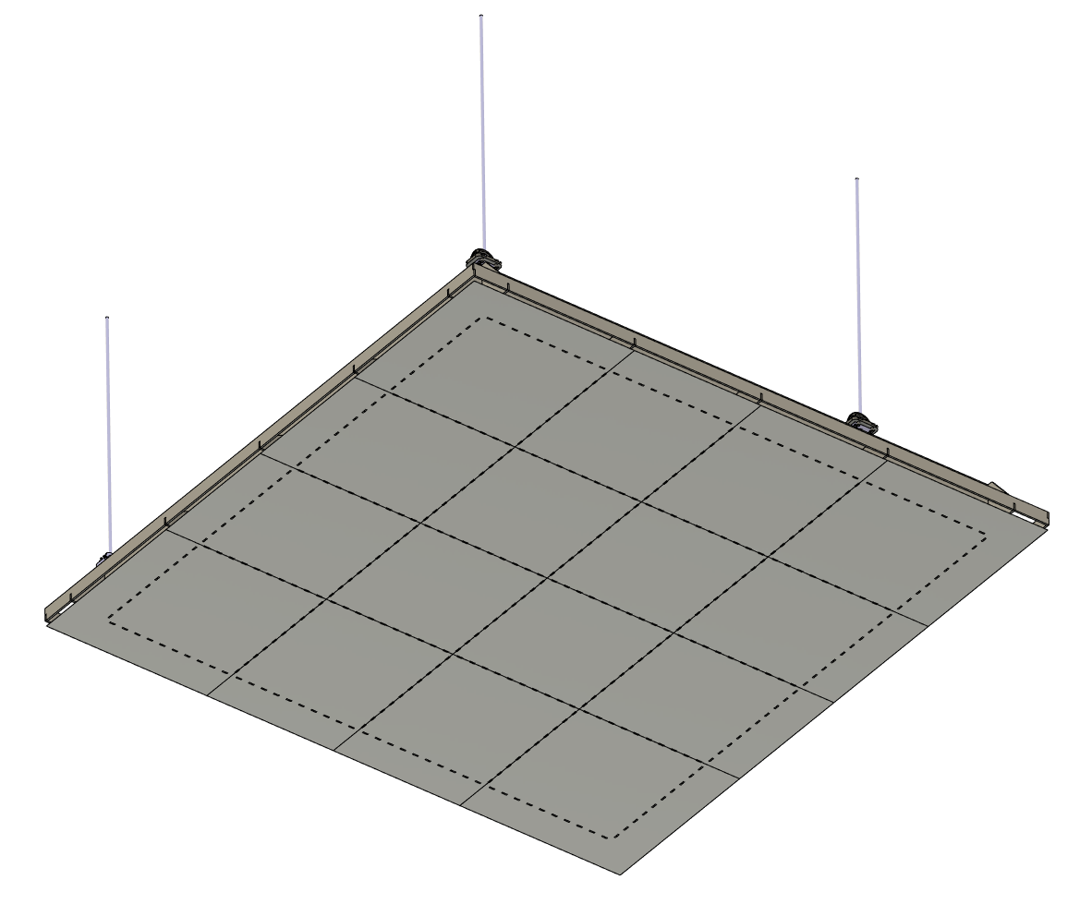
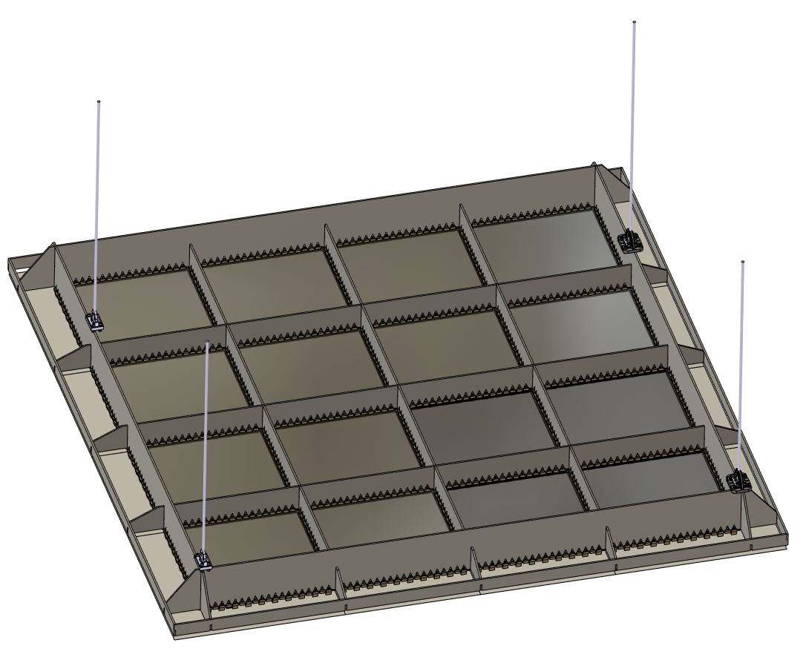
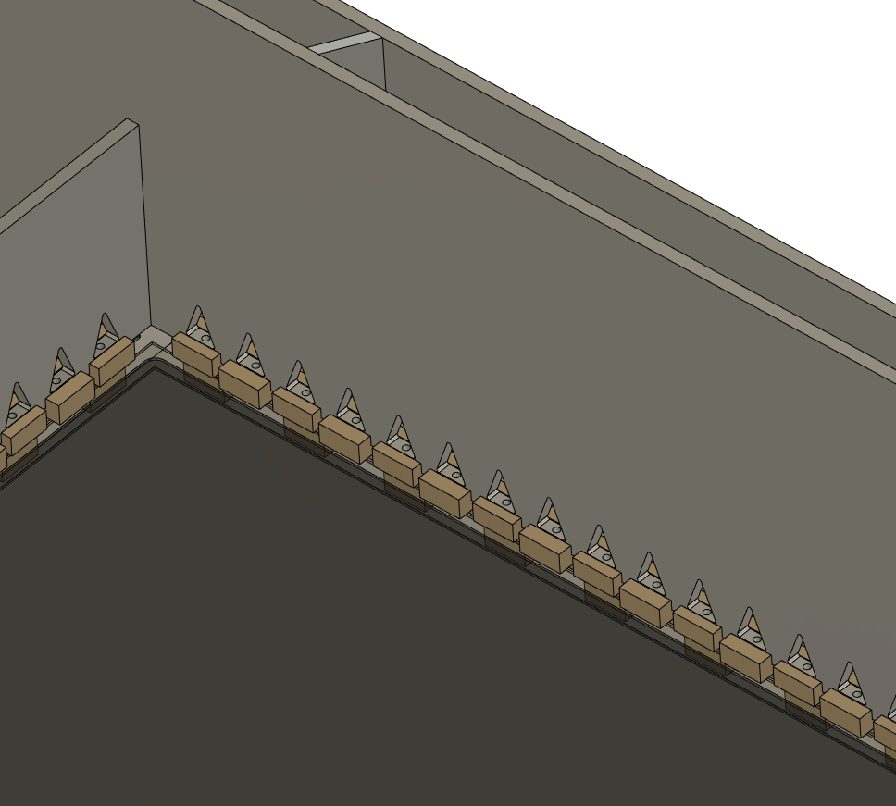
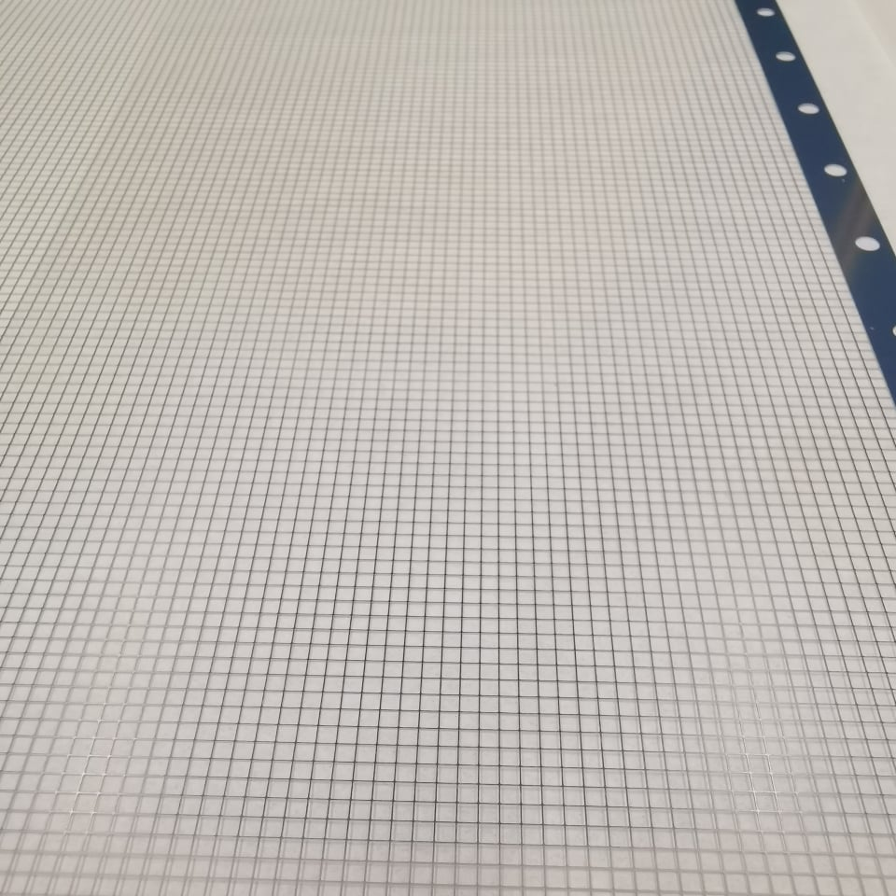
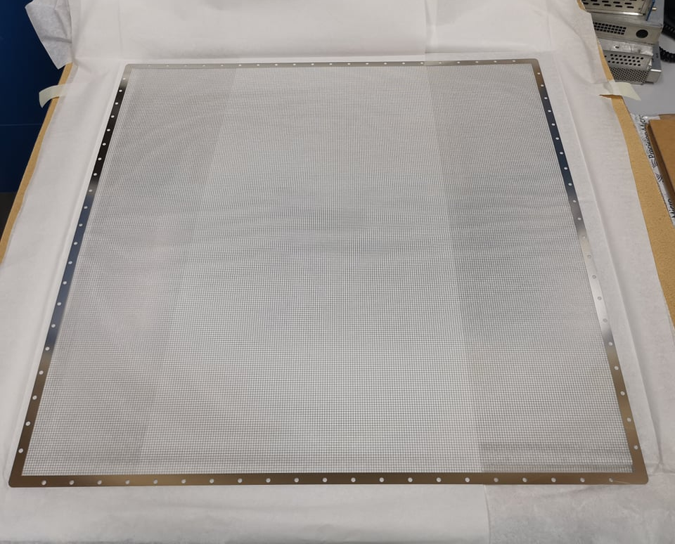
Light Readout Plane (LRP) Design
Modular design and can be applied directly to a DUNE module
Bottom view
Welded Invar structure (Uniquely low coefficient of thermal contraction)
16x 50cm square G-THGEMs
2.3m
Photochemically etched extraction grids
THGEMs/Extraction grids supported by PEEK Spacers

Slide 19
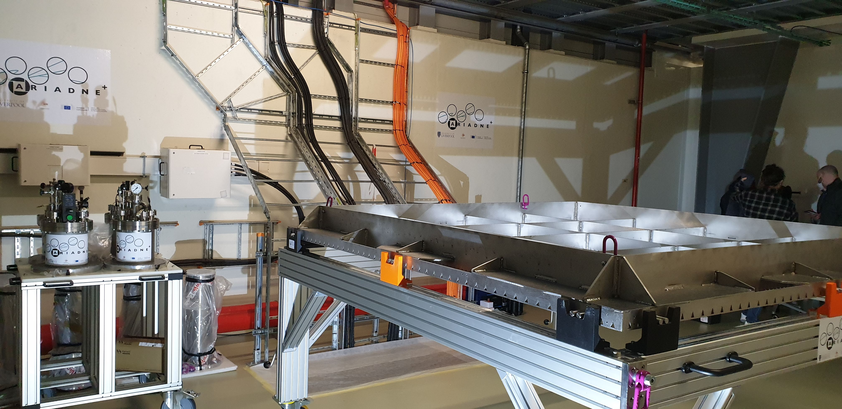
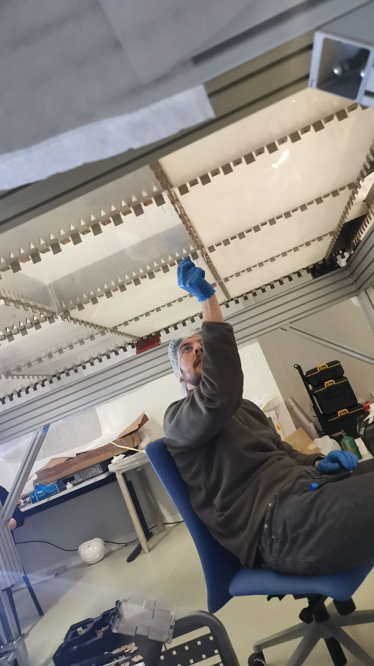
Light Readout Plane (LRP)
LRP assembly at CERN

Slide 20
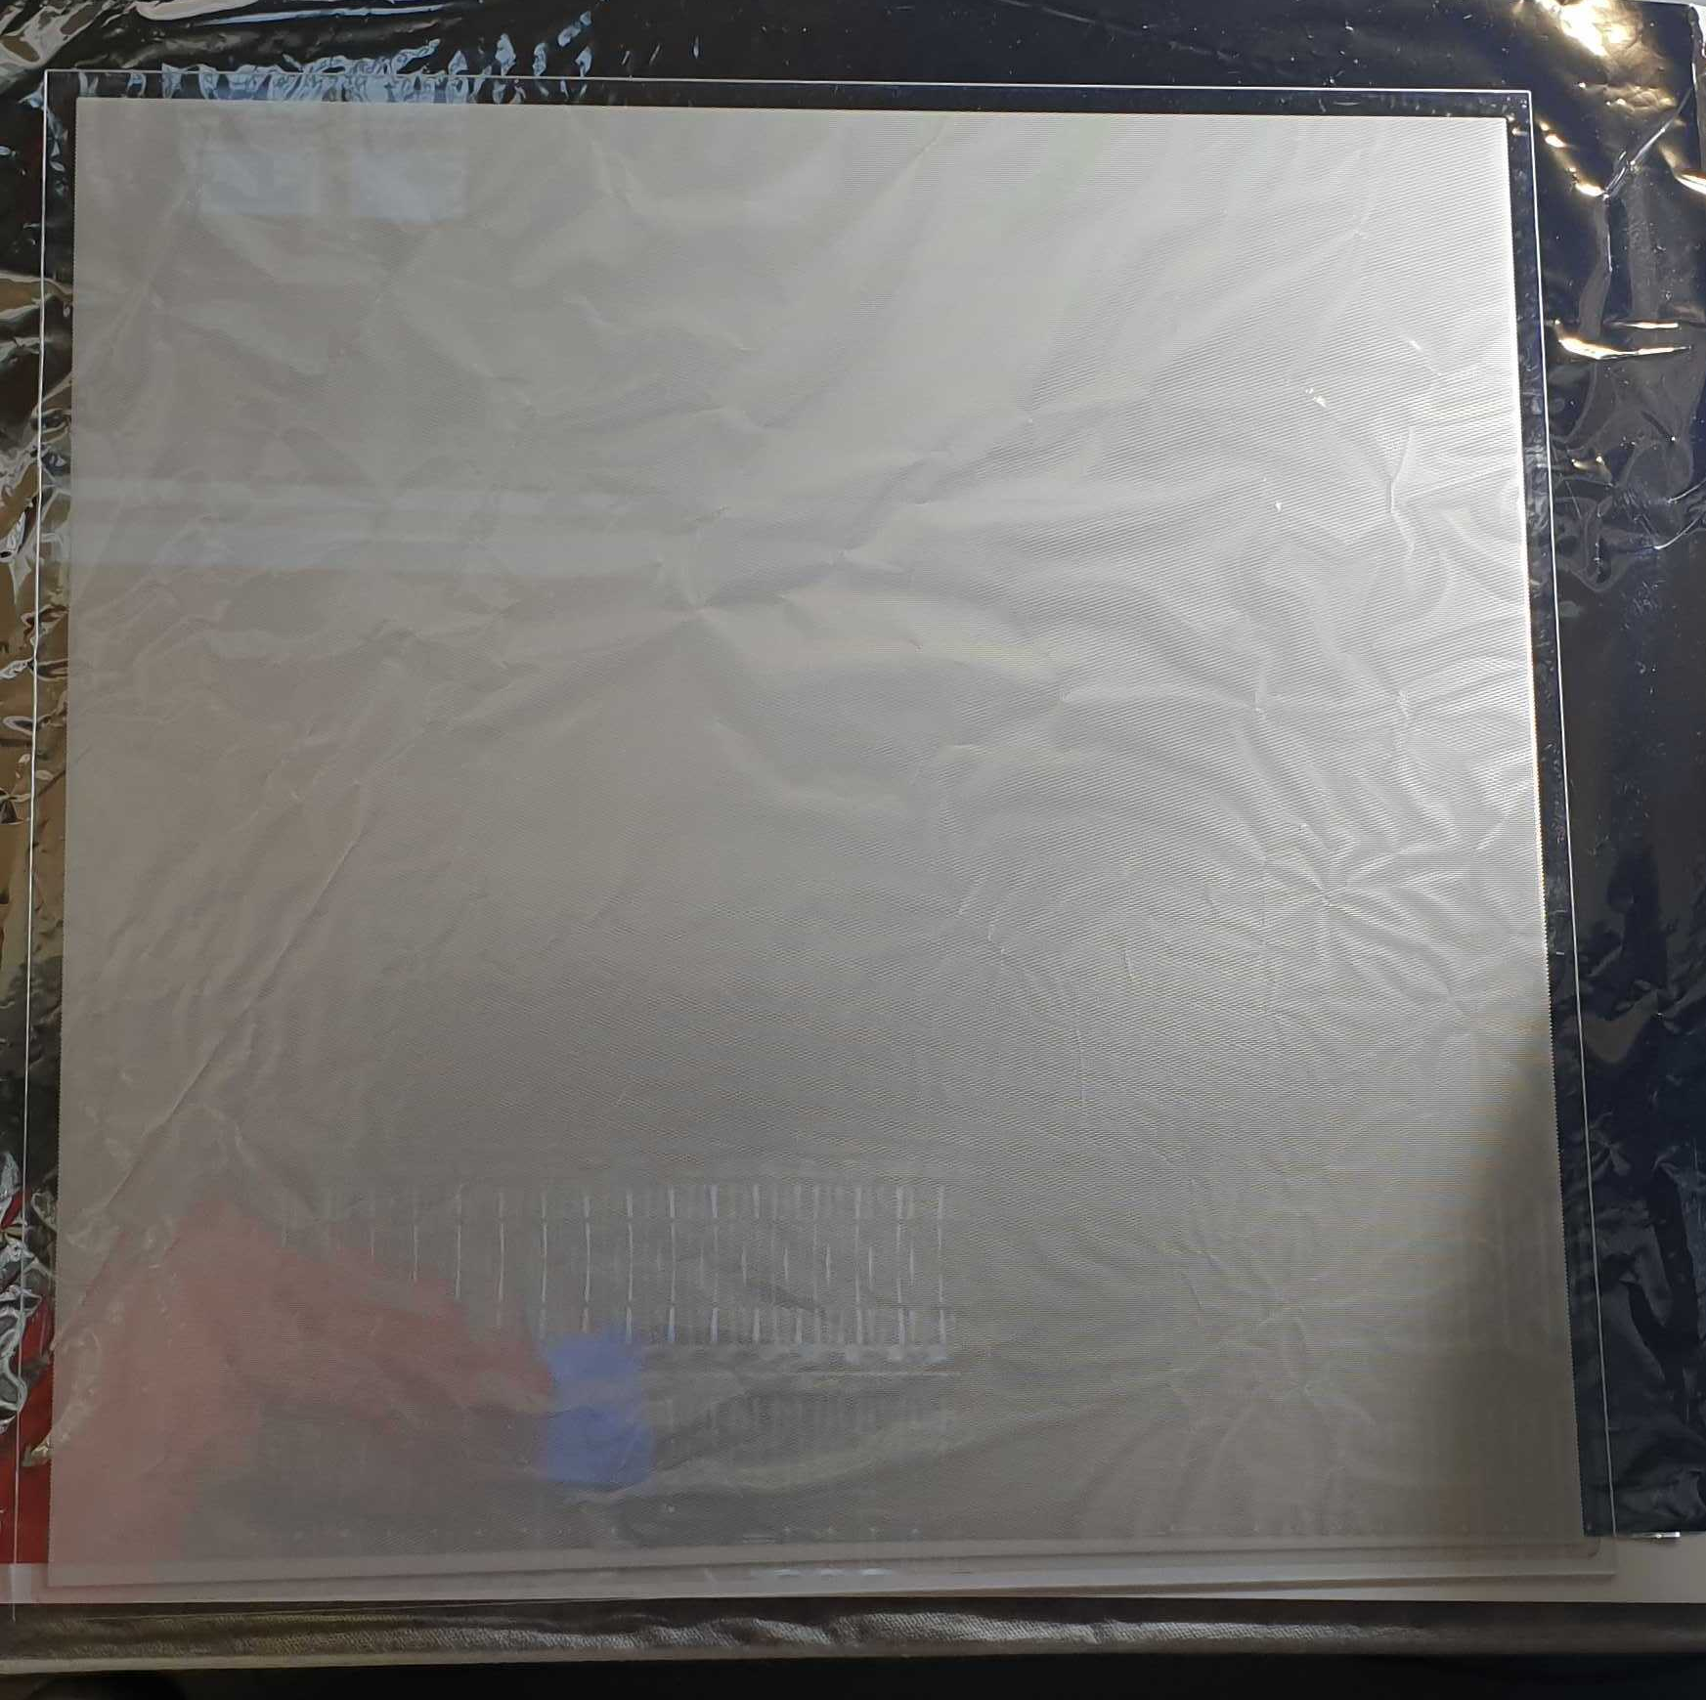
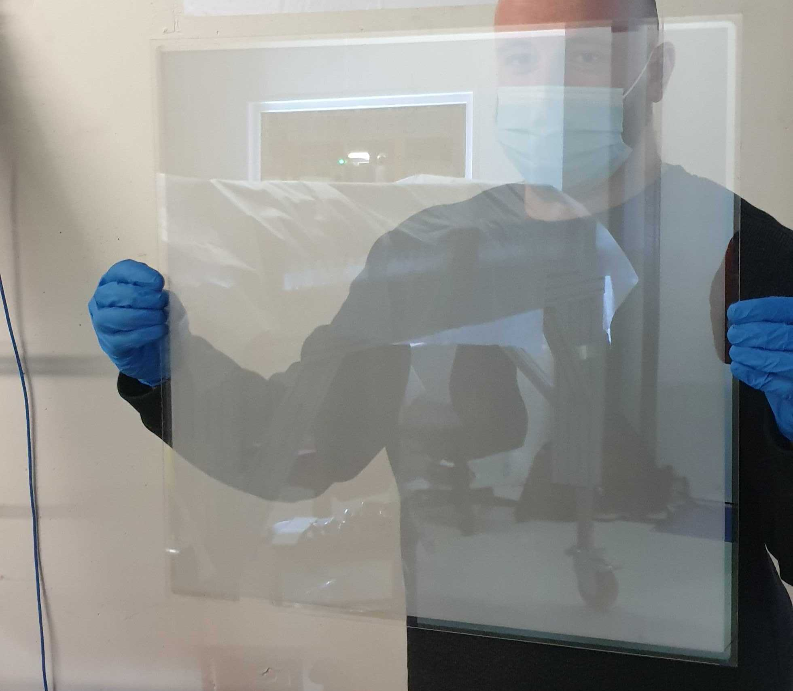
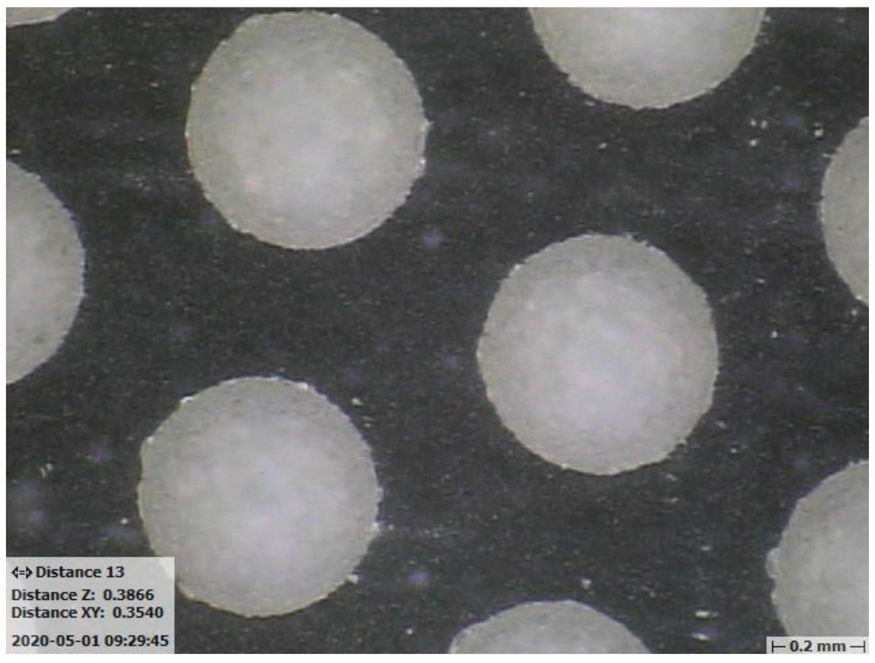
50cm Glass THGEMs
Novel Glass THGEMs developed at Liverpool (Patent accepted GB2019563.2)
Sixteen 50cm x 50cm glass THGEMs
1.1mm thick,
500μm ID holes,
800μm pitch hexagonal array
See for more details:
https://www.mdpi.com/2076-3417/11/20/9450

Slide 21
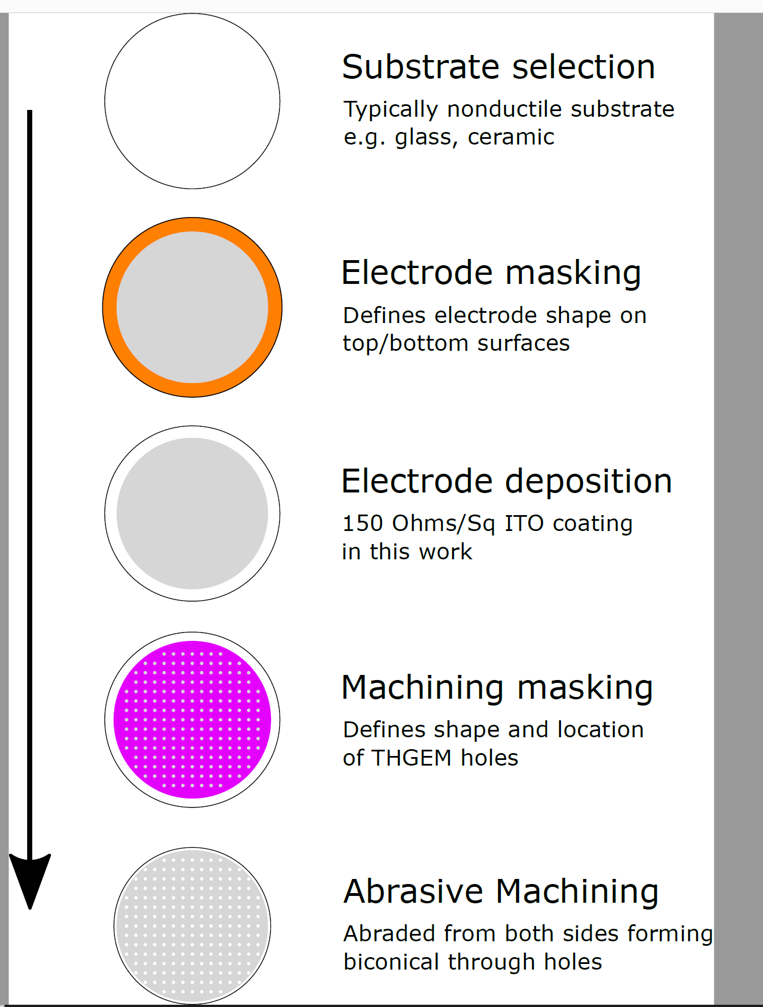
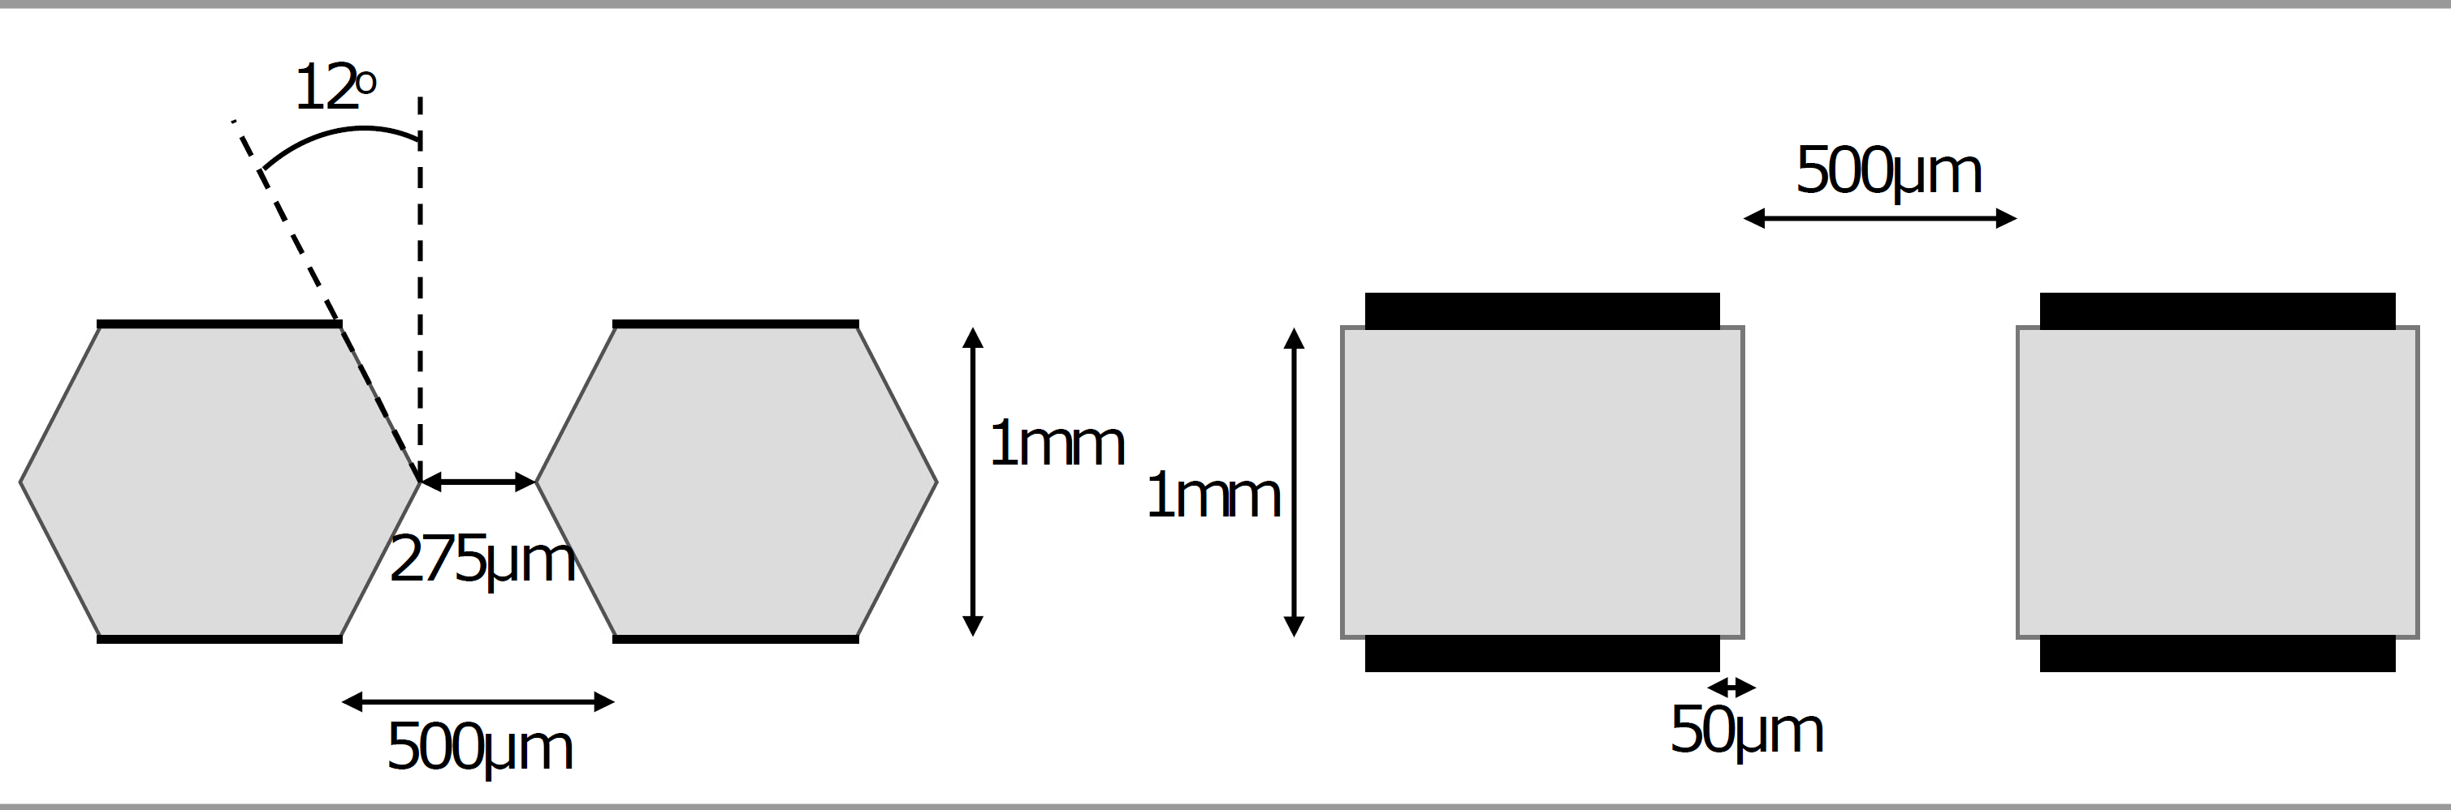
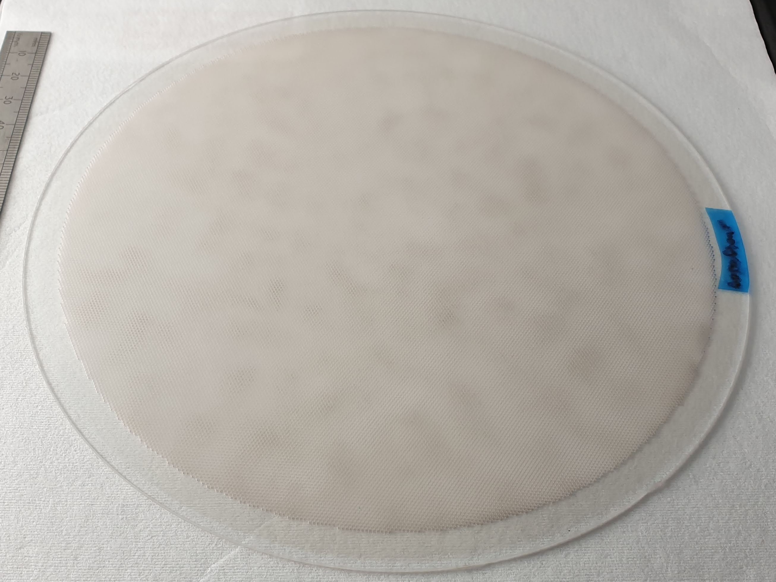
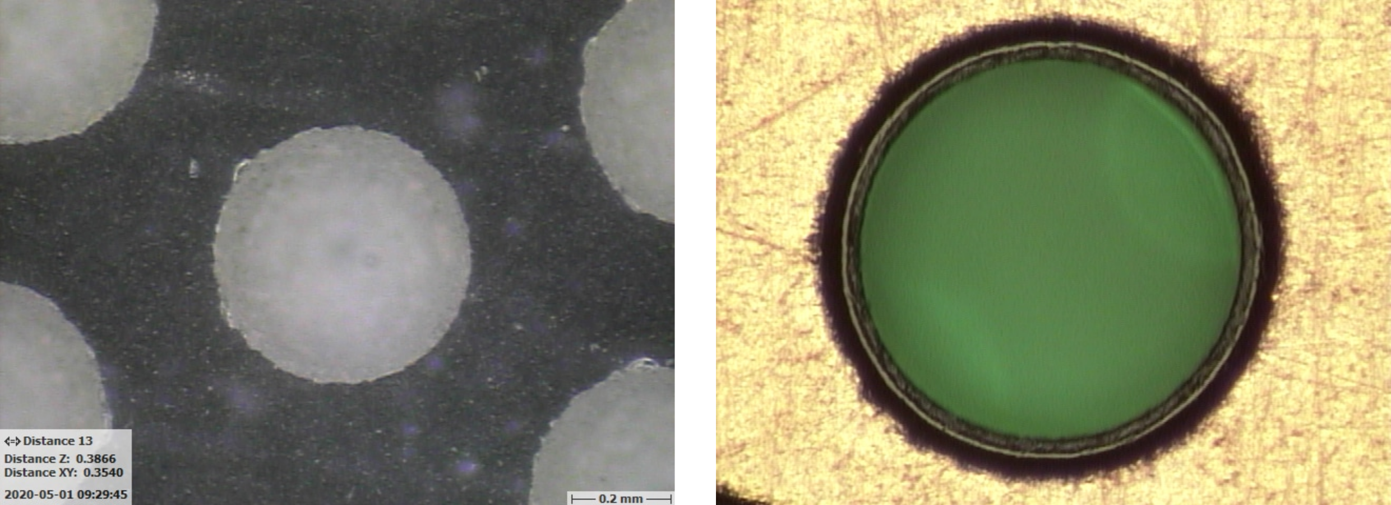
Novel G-THGEM Production
G-THGEM: https://www.mdpi.com/2076-3417/11/20/9450
FR4 THGEM with Copper electrodes and holes formed by mechanical drilling.
Borofloat 33 substrate G-THGEM
G-THGEM with ITO electrodes and holes formed by abrasive machining.
Abrasive machining vs drilled holes with chemically etched rims.
New production facility with 1m x 1m capability is planned in Liverpool

Slide 22
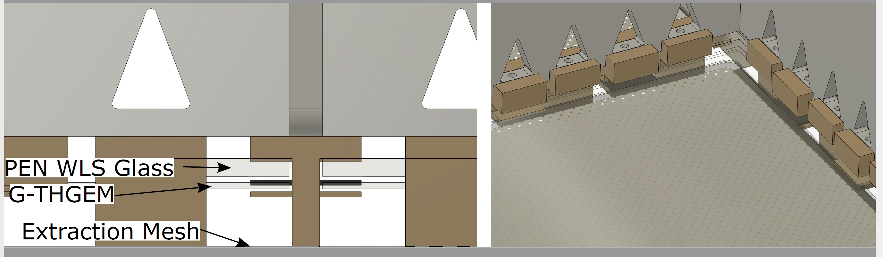
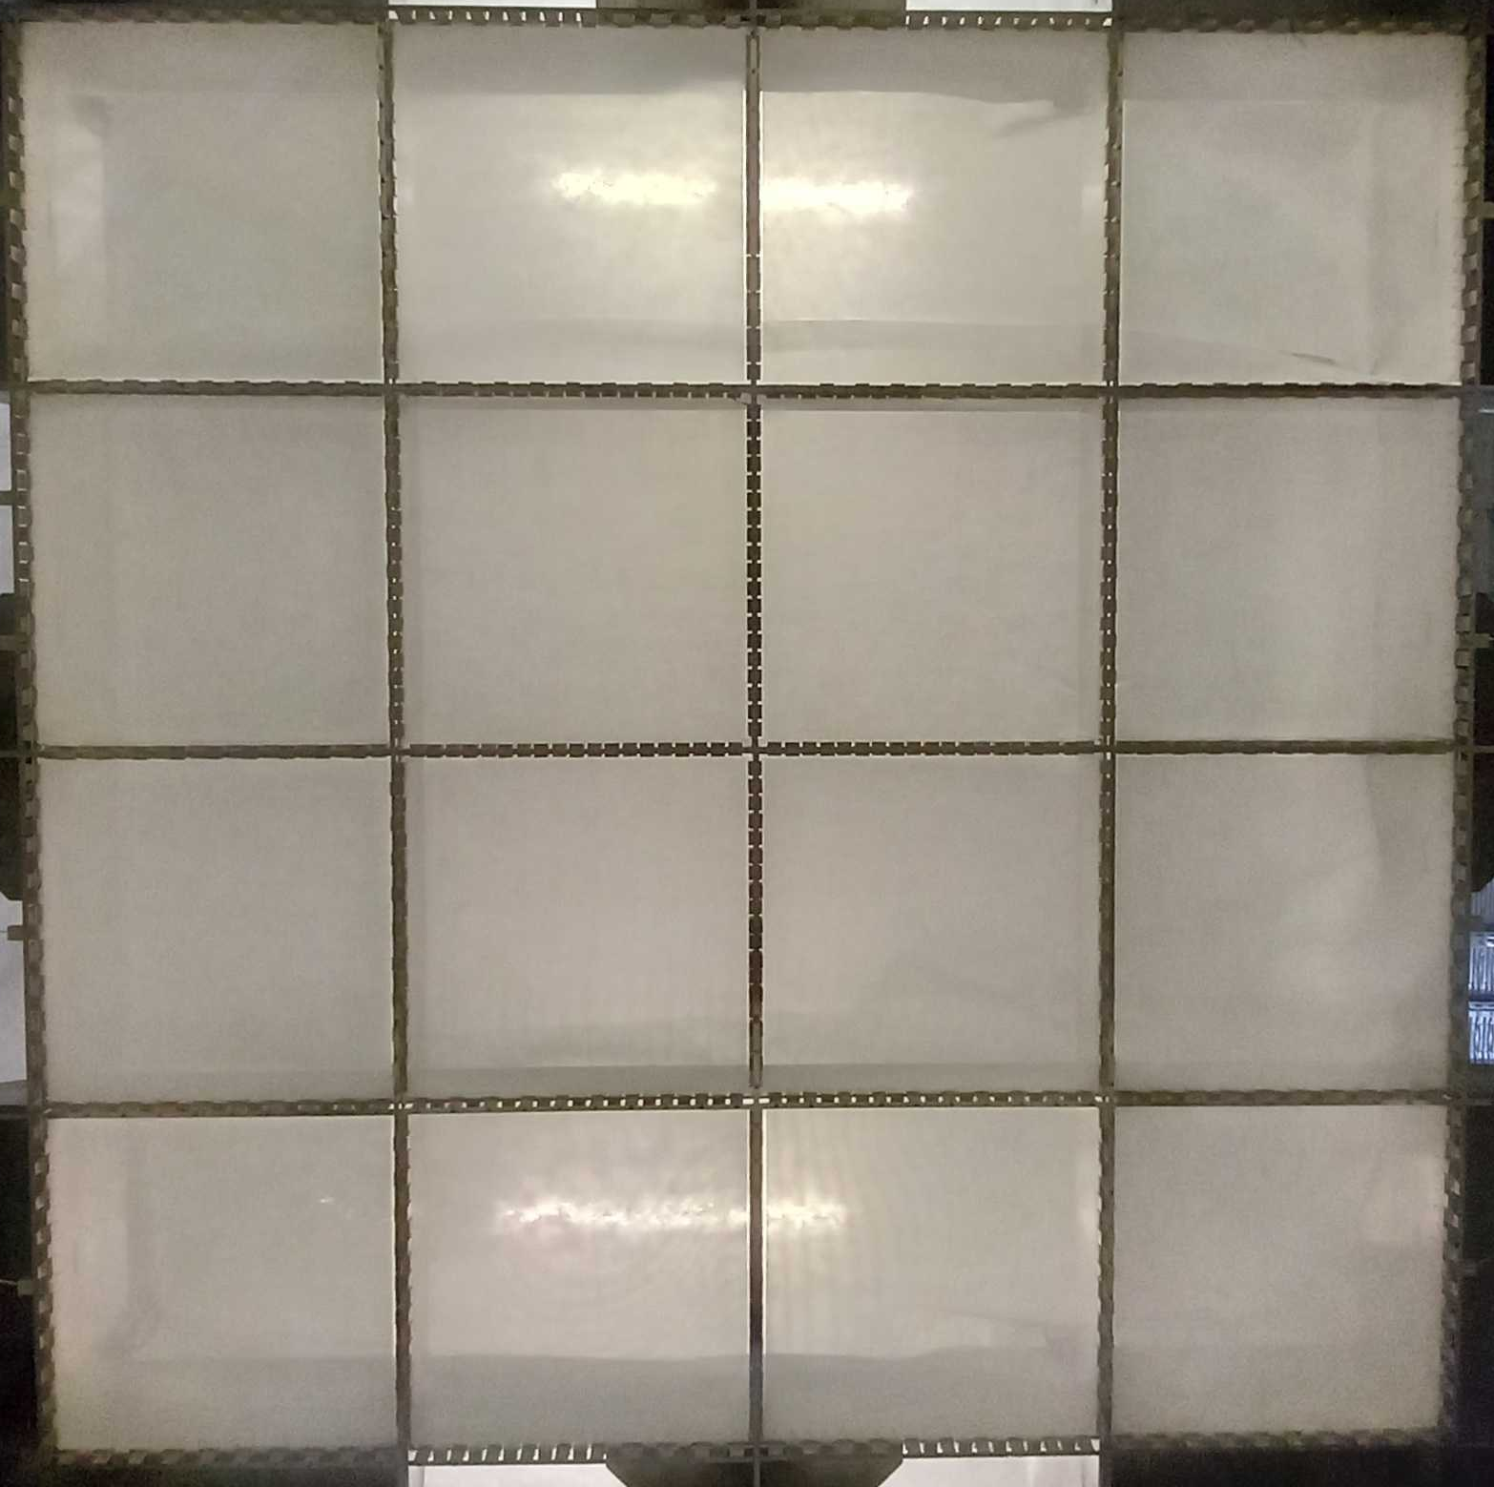
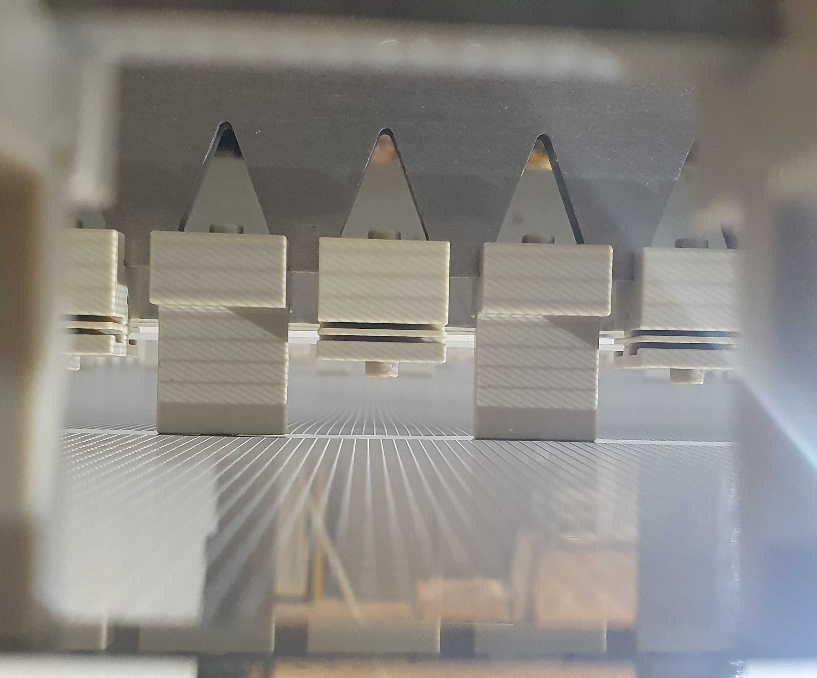
Light Readout Plane
LRP CAD
LRP grids, G-THGEMs and WLS
2x2m LRP G-THGEMs from underneath
The 15mm modular extraction region provided a very stable extraction field!

Slide 23
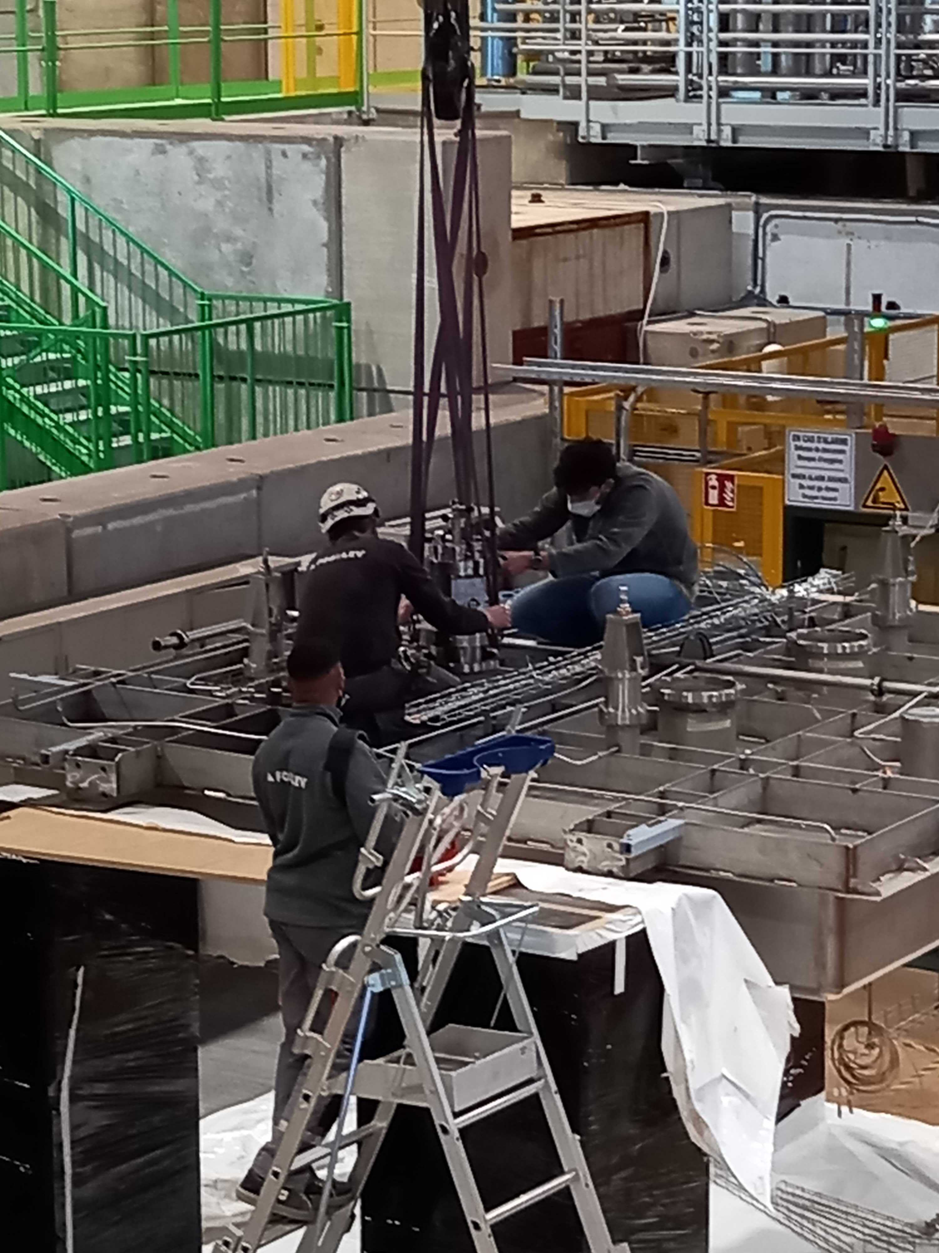
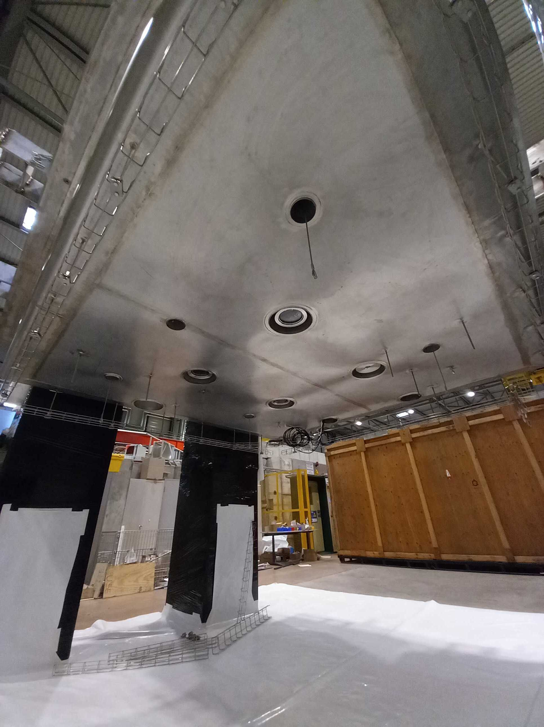
Cold box Integration

Slide 24
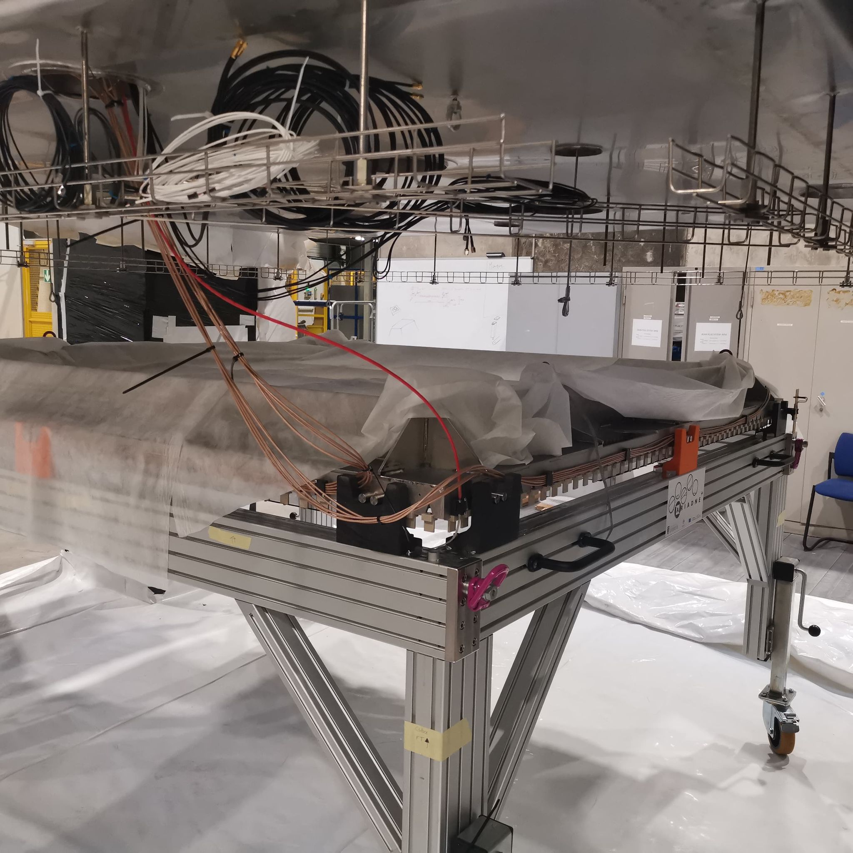
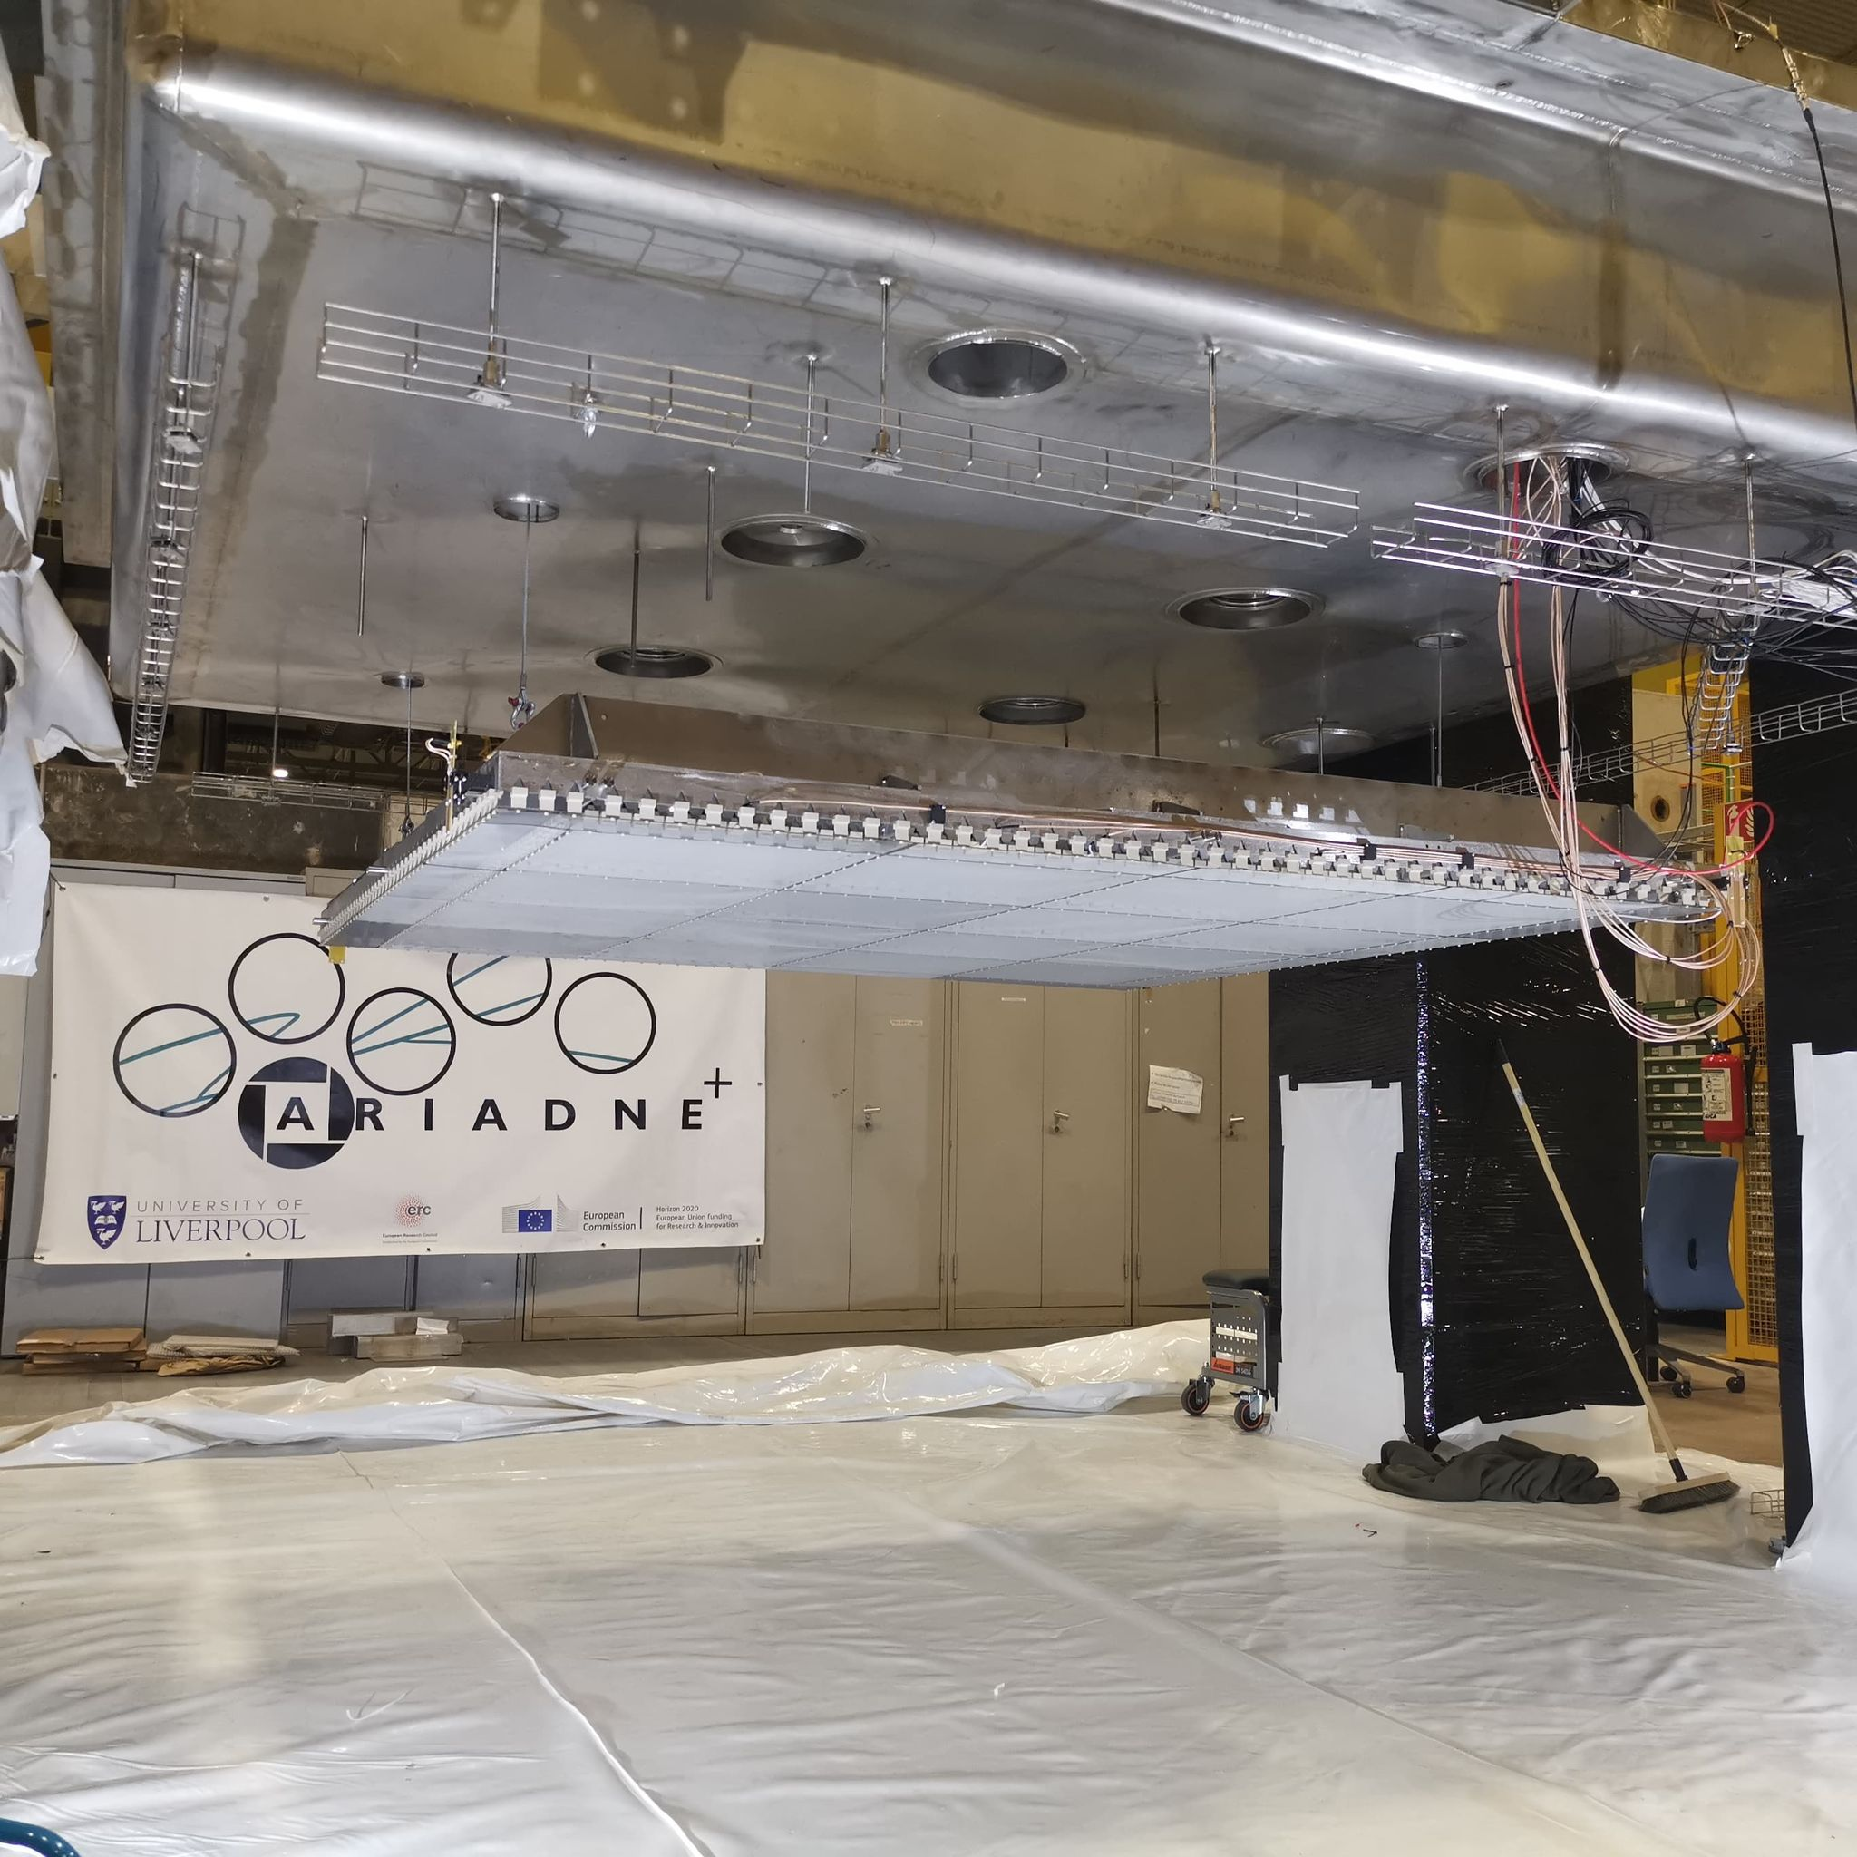
Cold box Integration

Slide 25

Closing the Detector

Slide 26



Closing the Detector
Capacitor Level meter
X-Arapuca

Slide 27


Detector Closed/Running
Very stable cryogenic operation thanks to the CERN team
Argon purity was approximately 0.5 msec
Three weeks of data collection refilled twice

Slide 28


Glass THGEM Light Gain Study
Visible Intensifier
VUV Intensifier

Slide 29


30 Seconds Integral Cosmics
Visible cosmics
VUV cosmics
(vignetting effect needs correction)

Slide 30


Sample Events
Successful imaging of LAr interactions from Cosmics
Visible image intensifier
VUV image intensifier
4 mm Resolution

Slide 31
Energy Calibration and Resolution
Track fitting to through going muons (Through THGEM and greater than 19 cm depth)
Energy conversion : 199.10 ± 1.73 ADU / MeV
Energy resolution : 16.73 ± 0.16 %
https://arxiv.org/pdf/2301.02530v2.pdf
Preliminary
Preliminary

Slide 32



X-ARAPUCAS S1&S2 signals
USC collected data using the X-ARAPUCAS embedded within the cathode of the cold box. - Powered via LASER worked nicely.
Combined camera and X-Arapucas -progress on analysis
As seen by X-Arapucas
As seen by TPX3 Cam
Cosmic Muon
S1
S2
X-ARAPUCAS

Slide 33

ARIADNE+ Conclusions
Optical readout achieved with stable detector conditions has been demonstrated at large scale (CERN Neutrino Platform Cold Box)
Dual phase extraction region very stable at large scale!
TPX3 and Glass THGEM technology is ready for deployment now
An option for DUNE LAr Far Detector, DUNE LAr Near Detector and DUNE GAr Near Detector (if enough light is produced in pressurised gas Argon. – Tests are in preparation in collaboration with USC )
TPX3Cam TPC Benefits
Raw data is natively 3D
Huge readout rates possible (80 MHits/s)
Zero suppressed readout (approx. few kbytes per event)
High resolution with approx. 1 mm per pixel
Easy access for swapping in/out technologies
Same readout is possible for dual phase or gas TPCs
Comparatively low cost to other readout methods
ProtoDUNE will be the natural platform to perform the next essential step

Slide 34


Using ProtoDUNE dual phase to test optical readouts for Neutrinos and DM; TPX3Cams, DarkSide PDUs & X-Arapucas
Next Step
Proposal to SPSC:
TPX Cameras

Slide 35

ProtoDUNE dual phase instrumentation with optical readout
Darkside PDUs, along the beam line
TPX3 Cams in the existing cryostat ports
X-ARAPUCAs
Two LRPs with glass THGEMs, similar to the ARIADNE cold box test
Modify partially existing field cage, with embedded X-ARAPUCAS in H shape profile. Low energy threshold S1 (extended collaboration)
Cathode at the bottom for larger drift volume

Slide 36

TOP VIEW Optical ProtoDUNE
12 Darkside-20k PDUs produced in the UK
In dark green shade is the FoV of the TPX cameras(1mx1m) using the current cryostat ports
TPX3Cams ports
Space to test more optical sensors for very low energy thresholds such as Darkside20k SiPMs
X- Arapucas will be used to cover the field cage (sides only and retain the rest of the field cage). X-Arapucas in the Field cage are of high importance to correlate S2/S1 signals for DM
X-ARAPUCAs
CERN SPSC proposal in preparation with extended collaborators

Slide 37



Ongoing new ARIADNE 1-ton Run
Meanwhile in Liverpool a new ongoing ARIADNE runs to test some of the proposed instrumentation for protoDUNE.
Three TPX cameras installed, with the remaining ¼ of the detector dedicated to Darkside SiPMs.
Measure the response of Darkside SiPMs to varying THGEM bias and determine the correct gain for ProtoDUNE operation (in collaboration with Naples)
Test different types of intensifier - one previously used on ARIADNE and the new intensifier on ARIADNE+
Test TPB coated glass for WLS instead of PEN - assessing difference in light quantity
Test imaging S1 tracks with VUV Timepix cameras
Doping studies at the end of the run with 15ppm Isobutylene (photosensitive dopant)
Very happy in the future to accommodate new ideas in ARIADNE

Slide 38


Stay tuned more results to come soon
Thank you
The A. Team

Slide 39
Extra Slides

Slide 40


TPX3 -> TPX4

Slide 41


THGEM S2 light production
VUV (126nm) light produced through de-excitation of Argon gas.
TPB Wavelength shifter above THGEM converts to 430nm.
At low field (<2kV/cm), S2 light production is linearly proportional to THGEM field. No charge gain. Very stable operation without discharges. No ion production.
At higher fields, electron multiplication occurs (Townsend avalanche).
Exponentially increasing S2 light production -> Improved sensitivity/threshold
Simulation

Slide 42

ProtoDUNE optical Run open side

Slide 43


PEN WLS
Two grades of TEONEX PEN foil investigated Q51 and Q53.
Thinner PEN consistently found to have a better conversion efficiency than thicker sheets (surface interaction).
Q51 consistently found to have a better conversion efficiency than Q53.
50cmx50cm Q51 25μm PEN film glued on glass panel

Slide 44





Focusing VUV Intensifier using GAr TPC
Alphas from Am-241 in 1100mb pure argon
+1mm
+2mm
Spacer rings
MgF₂ objective lens position is fixed into viewport.
Spacers change focal length position between objective lens and intensifier photocathode.
+2mm found produce sharpest image (in GAr).
+3mm
Intensifier photocathode QE

Slide 45



First Demonstration using Gaseous TPC
TPX3Cam coupled with an Image intensifier
Time-over-threshold (ToT) – TPX3Cam
Initial demonstration / testing performed using a gaseous TPC (100mb CF4)
Dual THGEMs for increased light output.
Am-241 alpha source installed within the TPC.
Publication:
https://iopscience.iop.org/article/10.1088/1748-0221/14/06/P06001

Slide 46

First Demonstration using Gaseous TPC
Time-over-threshold (ToT)
Time-of-arrival (ToA)
https://iopscience.iop.org/article/10.1088/1748-0221/14/06/P06001

Slide 47




First Demonstration using Gaseous TPC
1.6ns time-of-arrival resolution sufficient for precise Z axis reconstruction even in gaseous TPCs with fast drift.

