Slide 1
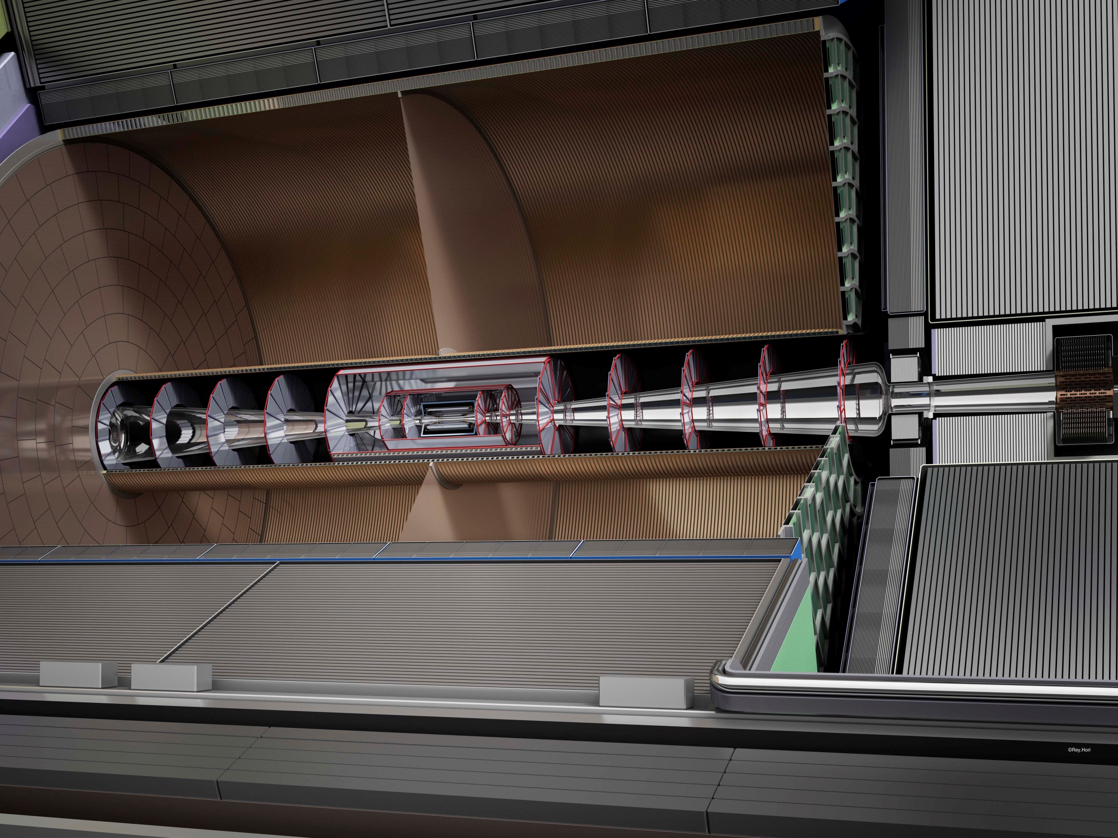
New Ideas on ILC Detector Technologies
& Sustainability Studies for Linear Colliders
Maxim Titov
CEA Saclay, Irfu, France / CERN
on behalf of the ILC International Development
Team Detector and Physics Group
6th Technology and Instrumentation in Particle Physics (TIPP 2023)
Conference, Cape Town, South Africa, September 4-8, 2023

Slide 2
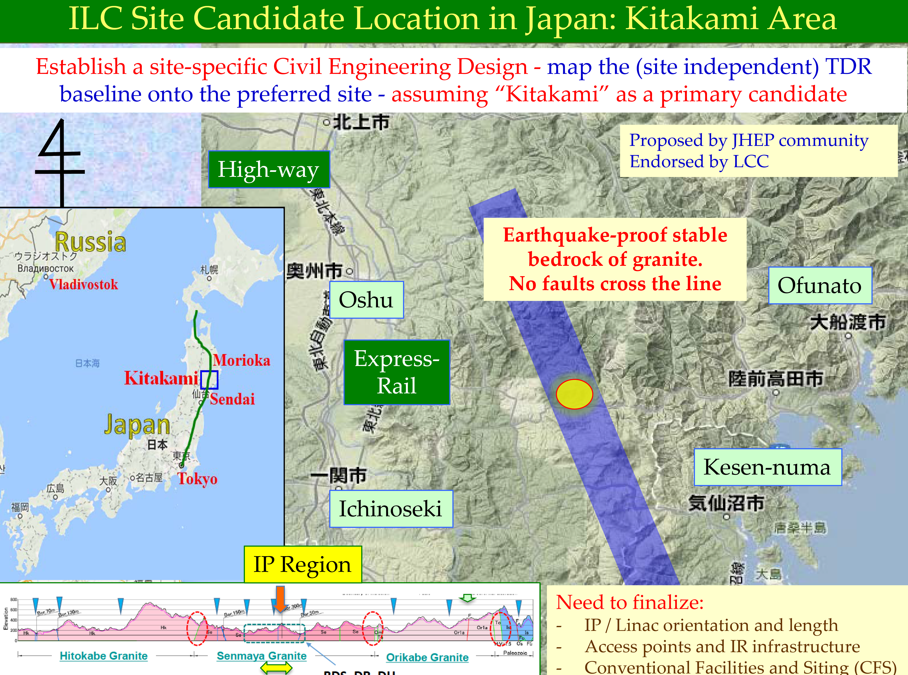
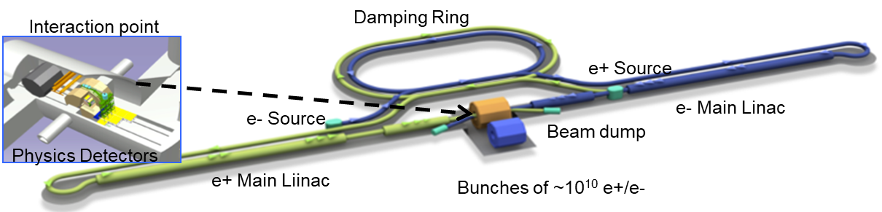
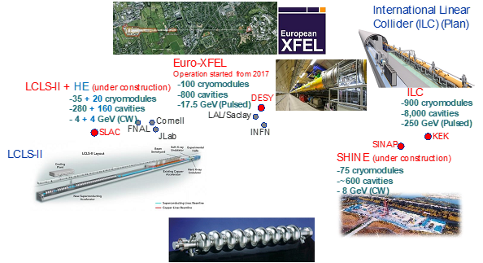
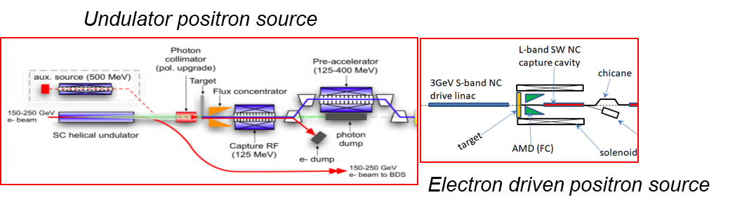
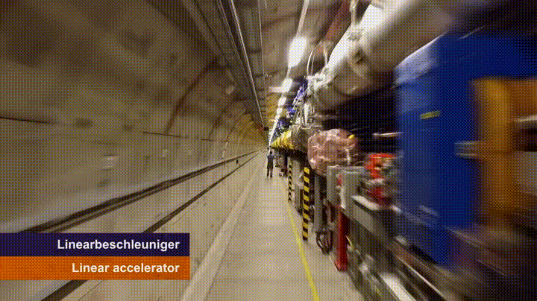
The ILC (250 GeV) Accelerator:
http://www.linearcollider.org/
ITN focus areas (>2023):
Creating particles
  → polarized elections/positrons Sources
High quality beam Damping ring
  → low emittance beams
Acceleration Main linac
  → superconducting radio frequency (SRF)
Collide them Final focus
  → nano-meter beams
Go to Beam dumps
Worldwide SRF Collaboration:
International partner labs lend their expertize
Recent talks (2022 eeFACT Symposium):
https://agenda.infn.it/event/21199/

Slide 3

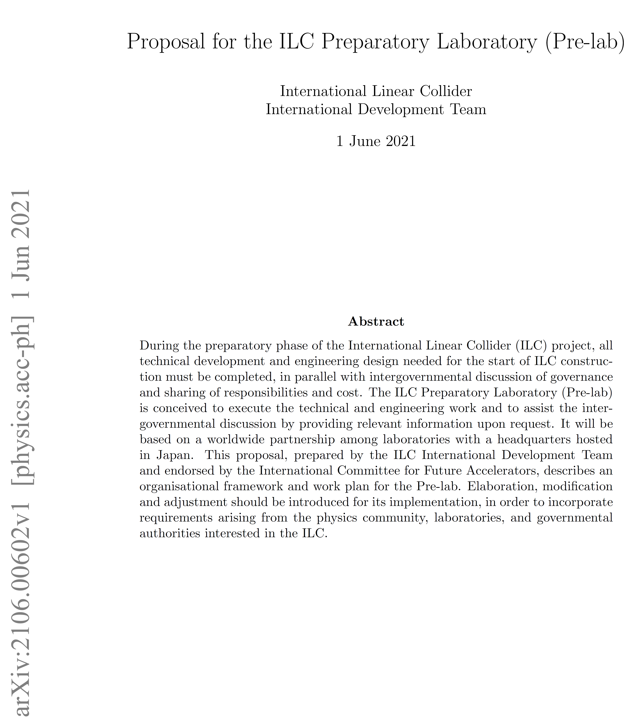
International Development Team (IDT) to Prepare ILC Pre-Lab
Established in
August 2020
The original timescale to start the ILC Pre-lab in 2022 was too optimistic:
→ there was no progress in the “top-down”
political-governmental approach (> 2021)
→ The IDT Pre-lab plan was reviewed by a
MEXT appointed panel and deemed
premature, referring to that the prospects for
ILC international cost sharing are not clear.
→ increased support for technical developments
& accelerator R&D was recommended (these
plans were included MEXT budget request
and has been approved by the JP Finance
Ministry in FY2023 → double KEK resources
for ILC preparation for the ILC ITN)
https://linearcollider.org/
IDT-WG2 TP document:
ILC Pre-lab proposal developed by IDT-WG1
and submitted
to MEXT on Jun. 2, 2021:
IDT - WG2 summarized the technical preparation as Work Packages (WPs) for the Pre-Lab stage in the Technical Preparation (TP) Document
http://doi.org/10.5281/ zenodo.4742018
arXiv: 2106.00602

Slide 4
ILC Technology Network (ITN) – European Focus Areas
Personnel with interest and skills in European labs/Univ., local infrastructure.
See text left
Material funds as estimated (major/core part from KEK), in some cases complemented by local funding.
Agreement between CERN & KEK signed in July 2023
EAJADE, MC exchange project supporting Higgs factory personnel exchange to Japan and the US.
Started 1.3.2023
CERN LC, project office (within existing LC resources at CERN).
LC budget line in MTP until end 2028
A subset of the initial plan for the ILC preparation phase activities (“Pre-lab”) have been identified at the most critical, and the priorities emphasized in the ITN:
→ European Preparation for the ITN (2023 ->) distributed on five main activity areas, and foreseen to concentrate for the accelerator part (ILD-WG2) & technical activities :
A1 SC RF related: Cavities, Module, Crab-cavities
A2 Sources: Concentrate on undulator positron scheme – fast pulses magnet, consult on conventual one (used by CLIC and FCC-ee)
A3 Damping Ring including kickers: low Emittance Ring community, and also kicker work in CLIC and FCC
A4 ATF activities for final focus and nanobeams: many European groups active in ATF, more support for its operation expected using the fresh funding
A5 Implementation including Project Office: Dump, CE, Cryo, Sustainability, MDI, others (many of these are continuations of on-going collaborative activities)
S. Stapnes:
https://indico.cern.ch/event/1297278/contributions/5453722/attachments/2675796/4641399/linear-colliders.pptx

Slide 5
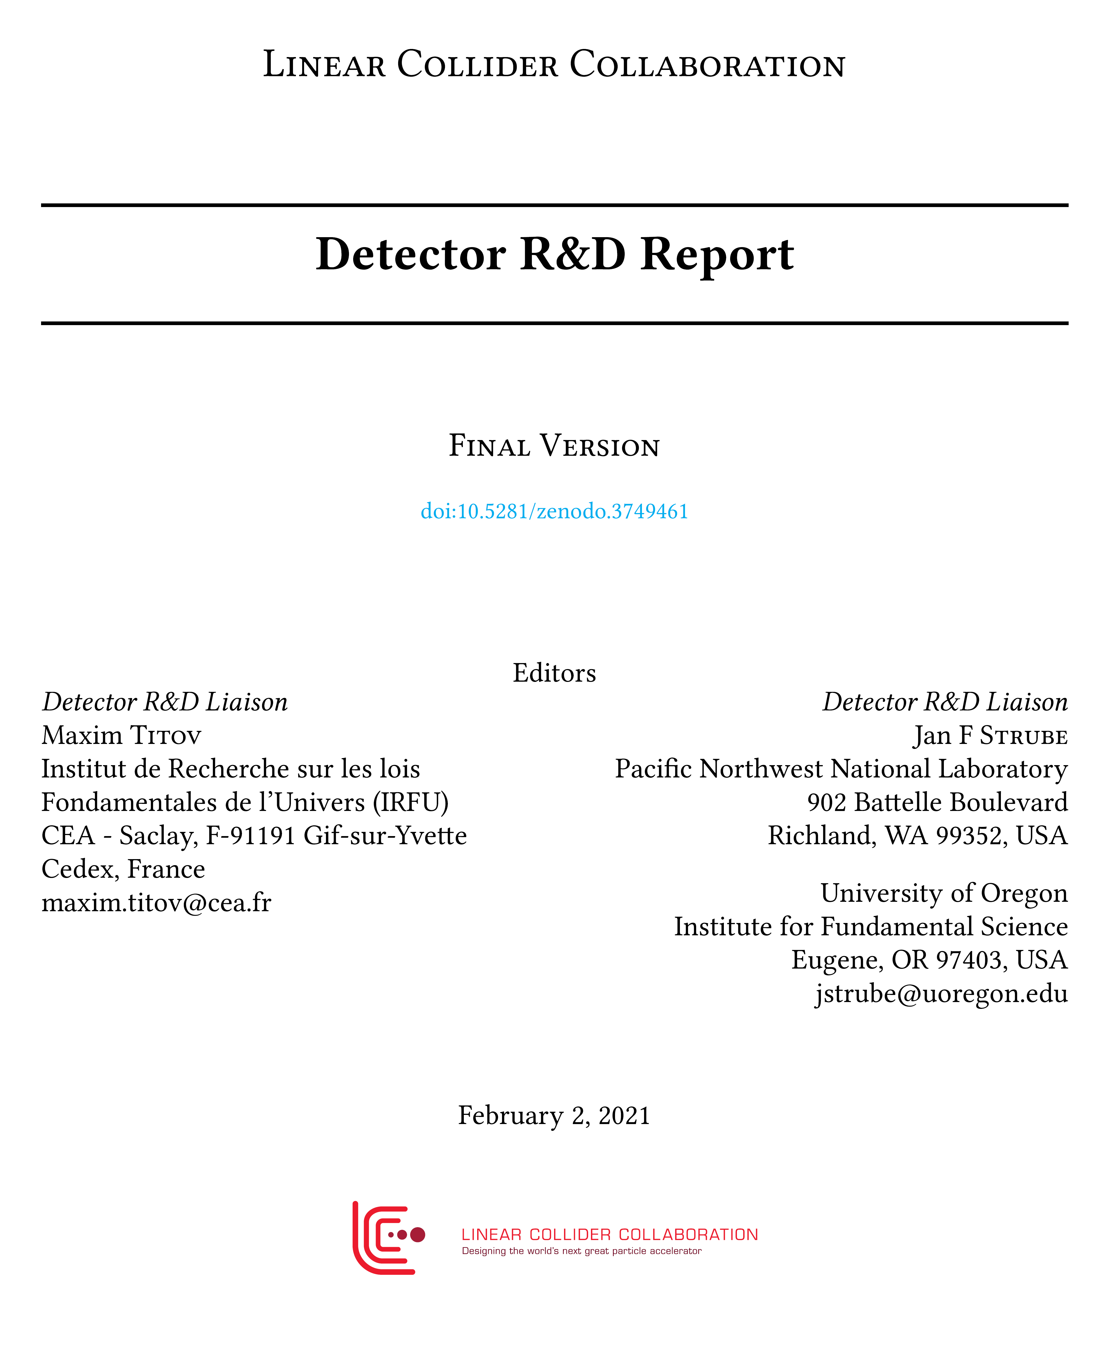




Many Forms of Linear Collider Detector R&D Efforts
RPC DHCAL
Silicon ECAL
(ILD)
LCTPC
RPC
Muon
KPIX
SDHCAL
GEM DHCAL
CMOS MAPS
https://doi.org/10.5281/zenodo.3749461
Scintillator HCAL
Silicon ECAL
(SiD)
VIP
FPCCD
TPAC
DEPFET
SOI
Scintillator
ECAL
FCAL
Dual Readout
ChronoPixel
CLICPix
IDT-WG3: ensure interplay between detector concepts (ILD, SiD, Clicdp) & more generic R&D
Keep various detector technology options and do not prioritize. This has the advantage that the technologies can be further developed until specific choices have to made once future Higgs Factory is approved.
Furthermore — and as important — this keeps a broad community of detector research groups at universities and laboratories involved and increases the chance to arrive at the best technically possible detector solution when it has to be built.

Slide 6
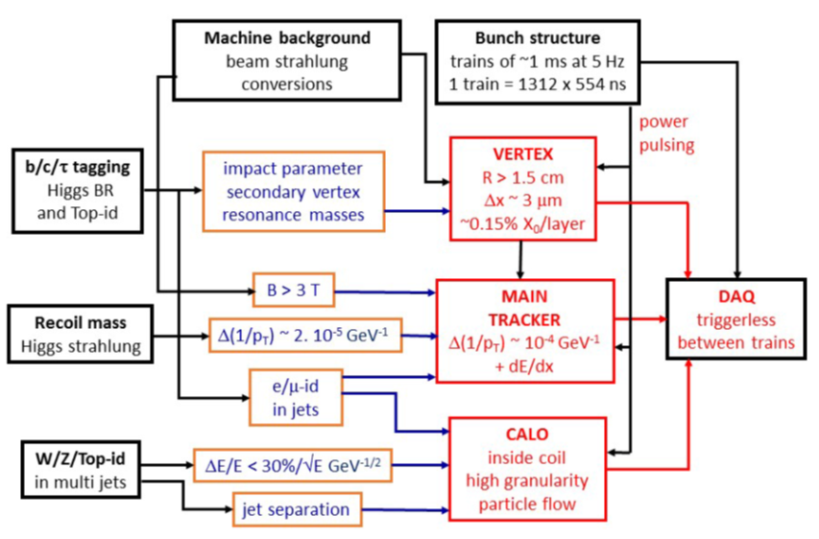
ILC Detector Concept Groups: ILD and SiD
ILD: International Large Detector
SiD: Silicon Detector
SiD
ILD
ILD Re-optimisation: Large (L) & small (S) options
Reduced tracker radius,
length unchanged
ILD “L”
ILD “S”
ILD Interim Design Report:
arXiv: 2003.01116
ILD (“L” & “S”) | SiD
Both optimized for PFA Performance: ~ B･R_{ECAL,inner}² (two-track separation @ ECAL)
B = 3.5 T / 4 T | B = 5 T
R_{ECAL,inner} = 1.8 / 1.46 m | R_{ECAL,inner} = 1.27 m
Si + TPC tracking Outer radius: 1.77 / 1.43 m | Silicon Tracking only Outer radius: 1.22 m
SiD Design Update: arXiv: 2110.09965

Slide 7
ILC Tracking (ILD vs SiD): Two Complementary Approaches
ILD: Silicon + Gaseous Tracking SiD: All-Silicon Tracking
long barrel of 3 double layers of Si-pixels
Intermediate Si-tracker (SIT, SET, FTD)
- SIT/FTD: silicon pixel sensors (e.g. CMOS)
- SET: silicon strip sensors
Time Projection Chamber with MPGDs
- High hit redundancy (200 hits / track)
→ 3D tracking / pattern recognition;
→ dE/dx information for PID
short barrel of 5 single layers of Si-pixels
5 layers Silicon-strip tracker
(25um strips, 50 um readout pitch)
Fewer highly precise hits (max. 12)
Robustness, single bunch time stamping
VERTEXING:
TRACKING:
ILD:
SiD:
Vertex detector
Strip detector
Still a lot of opportunities in ILD/SiD
optimization : physics goals, software developments and technology options
X₀

Slide 8
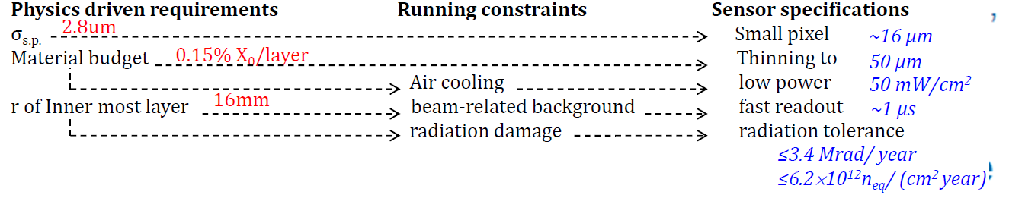
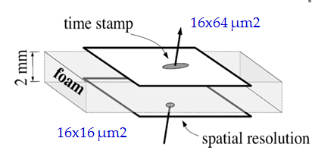
Vertex Technologies for Future Linear Colliders (ILC)
Sensor’s contribution to the total X₀ is 15-30% (majority cables + cooling + support)
Readout strategies exploiting the ILC low duty cycle 0(10⁻³): triggerless readout, power-pulsing
→ continuous during the train with power cycling → mechanic. stress from Lorentz forces in B-field
→ delayed after the train → either ~5μm pitch for occupancy or in-pixel time-stamping
180 nm CMOS technology: VALIDATED
CMOS (MAPS): 2-sided ladders:
« mini-vectors » concept for ILC with
high spatial resolution & time stamping
ALPIDE@ ALICE
ITS-3 (bending
50 um sensor)
ALICE-ITS3 upgrade drives the R&D:
Bending thin Si-layers (MAPS):
Industrial stitching & large surfaces for low-mass detect.:
Truly cylindrical, supportless CPS
for ALICE-ITS3 upgrade (65 nm)
using several reticles from the same wafer
(possible with both 180 and 65 nm)
arXiv: 2105.13000
MIMOSIS @
CBM-MVD
https://indico.cern.ch/event/1071914/

Slide 9
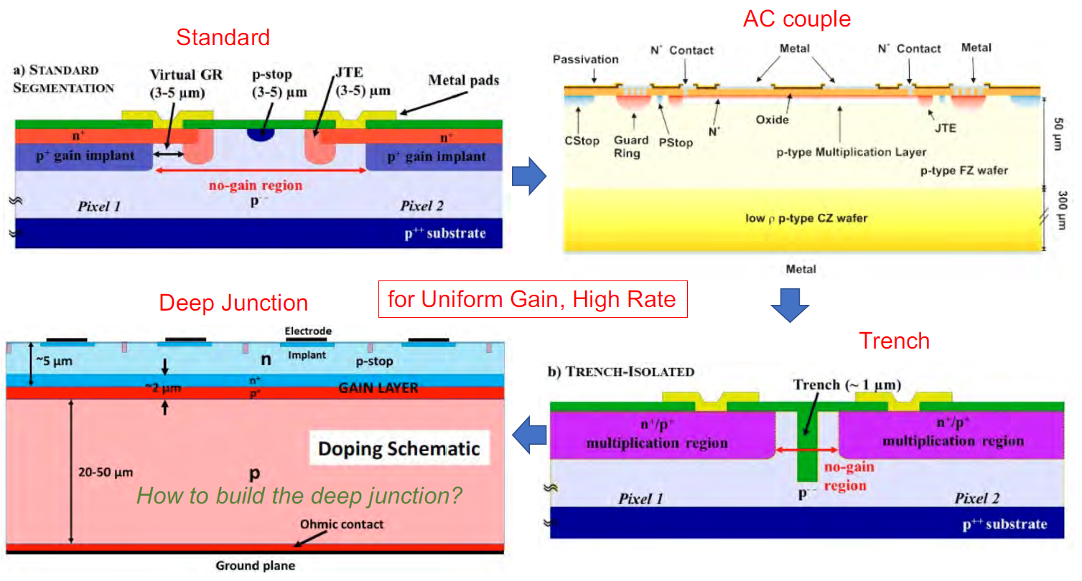
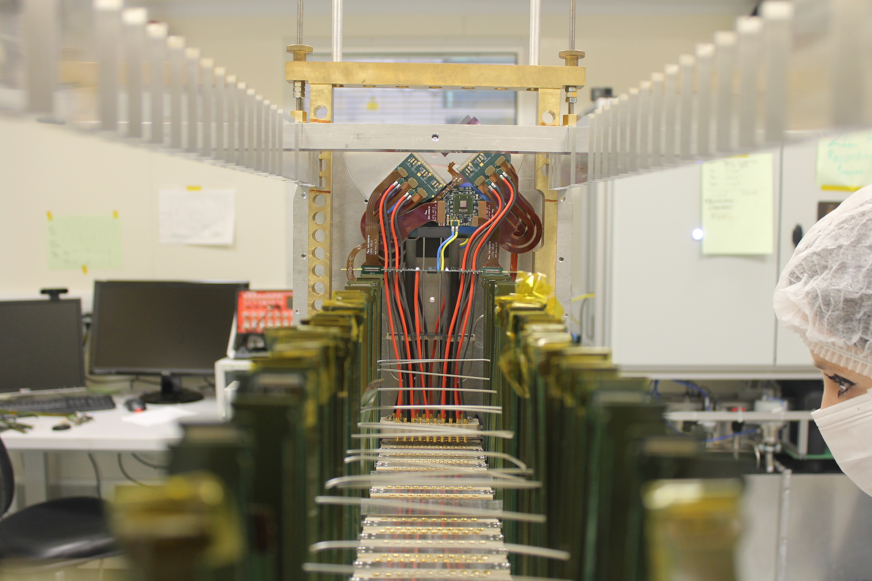
Silicon Tracking Conceptual Studies for ILC
Not much dedicated development work recently on Silicon tracking technologies
→ Baseline solution: silicon-microstrip tracker; also some enabling technologies (e.g. based on LGAD concept)
Timing Detectors open up 4D (and 5D) tracking → ATLAS/CMS upgrades include several m² of LGADs:
Large area detectors
High-precision tracking
→ a few um per layer
High-precision timing
→ tens of ps per layer
Optimal geometrical
acc. (large fill-factor).
Low material (50 μm
thickness per plane).
iLGAD:
Trench
iLGAD:
B. Schumm @ILCX2021
A. Doblas @ILCX2021
Readout ASICs (power dissipation) may limit the intrinsic sensor performance
→ power pulsing to reduce energy consumprion or the use of microchannnels to complement air cooling
Forward
Tracking:
M. Vos @ ILCX2021
Working MALTA CMOS sensor
with integrated μ-channels:
LHCb VELO: P. Collins;
arXiv: 2112.12763
Ultra-light microchannel cooiling:

Slide 10
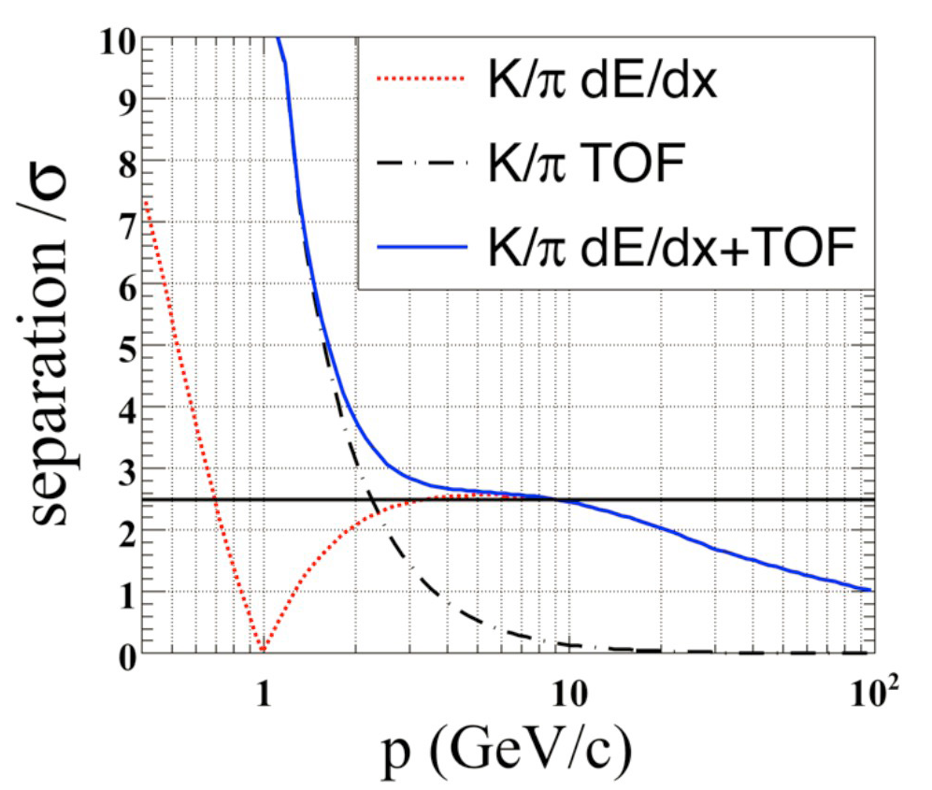
Gaseous Tracking: TPC with MPGD-based Readout
Three MPGD options are foreseen for the ILC-TPC:
→ Wet-etched / Laser-etched GEMs
→ Resistive Micromegas with dispersive anode
→ GEM + CMOS ASICs, « GridPix » concept
(integrated Micromegas grid with Timepix chip)
Spatial resolution of σ_{T} ~ 100 um and dE/dx res. < 5% have been reached with GEM, MM and InGrid)
InGrid
Micromegas GEM
arXiv: 2003.01116
ILC: gating scheme, based on large-aperture GEM
Machine-induced background and ions from gas amplific.
Exploit ILC bunch structure (gate opens 50 us before
the first bunch and closes 50 us after the last bunch)
→ see A. Bellerive talk
in parallel session
dE/dx ~ <4 % can be
achieved with Gridpix
(cluster-counting)
→ See Huirong Qi (LCTPC talk) in this session
Added value of TIME
information for ILC:
dE/dx combined
with ToF (SiW-ECAL)
for K-PID
Electron transparancy
> 80% for ΔV ~ 5V
3D-printed monolithic
cooling plate for a
TPC using 2-phase CO2
CHALLENGES / FUTURE PLANS:
Common modules with a final design (with gating)
Optimization of cooling & material budget
GridPix development (dN/dx cluster counting)
P. Colas @ ILCX2021

Slide 11

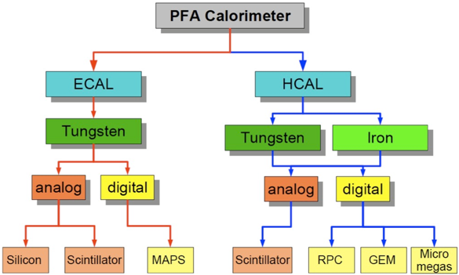
Particle Flow Calorimeters: CALICE Collaboration
Development and study of finely segmented / imaging calorimeters: initially focused on the ILC, now widening to include developments of all imaging calorimeters, e.g. CMS HGCAL for Phase II):
Imaging Calorimetry → high granularity
(in 4D), efficient software (PFA).
Mixture of matured concepts
and advanced ideas:
MATURED (CALICE):
SiW-ECAL
SciW-ECAL
AHCAL
DHCAL (sDHCAL)
→ (Almost) ready for
large-scale prototype
→ Prepare for quick realization
of 4-5 years to real detector
ADVANCED (beyond CALICE):
MAPS ECAL
Dual-readout ECAL
LGAD ECAL (CALICE)
→ Evaluate additional physics
impact to ILC experiment
→ Needs intensive R&D effort
to realize as real detector
Issues: overlap between showers,
complicated topology, sep. “physics
event” from beam-induced bkg.
Example: ILD detector for ILC, proposing CALICE collaboration tech.

Slide 12
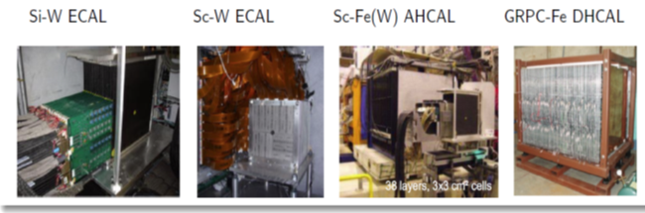
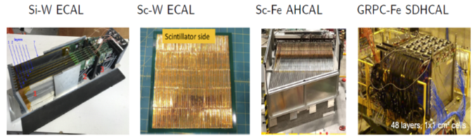
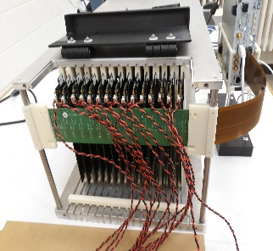
Particle Flow Calorimeters: CALICE Collaboration
Proof-of-principle with first
generation physics prototypes (2003-2012)
Scalability tests with 2nd generation (>2010)
technological prototypes (power pulsing,
compact mechanical design, embedded
electronics, assembly, calibration approaches)
J. Nanni;
F. Morales;
@ILCX2021
T. Takeshita;
N. Tsuji;
@ILCX2021
A. Laudrain;
@ILCX2021
B. Bilki;
@ILCX2021
Timing measurement for shower development (from 4D to 5D):
Today’s CALICE prototypes (SiW ECAL, AHCAL) provides unprecedented granularity and cell-by-cell
ns-level timing for validation hadronic models on different readout technologies (gas, silicon, schint.)
ILC AHCAL & CMS HGCAL common test-beam
JINST9 (2014) P07022
CMS
HGCAL
ILC:
Sci-
AHCAL
CMS HGCAL has measured evoluton of hadronic showers in the time domain with ~80ps
accuracy (50ps TDC binning)
→ improve GEANT
simulation models

Slide 13
Particle Flow (Imaging) Calorimeters: The 5th Dimension ?
Impact of 5D calorimetry (x,y,z, energy, time) needs to be evaluated more deeply to undertand optimal time acc.
What are the real goals (physics wise)?
Mitigation of pile-up (basically all high rates)
Support for full 5D PFA → unchartered territory
Calorimeters with ToF functionality in first layers?
Longitudinally unsegmented fibre calorimeters
Replace (part of) ECAL with LGAD for
O(10 ps) timing measurement
20 ps TOF per hit can separate
π/k/p up to 5-10 GeV
T. Suehara @ILCX2021
R. Poeschl
Timing resolution
Is affected by noise
The added value of timing information is recognized in the ILC concepts
→ Gain in scientific return of complete analysis still to be quantified
(Tracking PID ? Calorimetry PID ? Shower development ? )
Trade-off between power consumption &
timing capabilities (maybe higher noise level)
Timing in calorimeters / energetic showers?
→ intelligent reconstruction using O(100) hits &
NN can improve “poor” single cell timing
→ can help to distinguish particle types:
usable for flavour tagging (b/c/s),
long-lived searches (decaying to neutrals) ,
enhance σ(E) / E
ILC AHCAL & CMS HGCAL common test-beam
CMS
HGCAL
ILC:
Sci-
AHCAL
CMS HGCAL has measured evoluton of hadronic showers in the time domain with ~80ps
accuracy (50ps TDC binning)

Slide 14
Fast Timing in Higgs Factory Detectors
A. Schwartzman
@LCWS2023
Z. Zhang
@LCWS2023

Slide 15
New Trends: Ultra-High Granularity (MAPS ECAL)
CMOS Sensors for calorimetry → Synergies between LC Detector R&D and ALICE FoCAL
ALICE FoCAL: 24 layer MIMOSA CMOS sensor calorimeter Si-W stack
Forward electromagnetic and hadronic calorimeters;
FoCal-E: high-granularity Si-W sampling calorimeter → direct 𝛄, 𝜋0
FoCal-H: Pb-Sc sampling calorimeter for photon isolation and jets
FoCAL: assuming ≈ 1m²
detector surface
A. Rossi @
ICHEP2020
 | LG | HG
pixel/pad size | ≈ 1 cm² | ≈ 30x30 µm²
total # pixels/pads | ≈ 2.5 x 10⁵ | ≈ 2.5 x 10⁹
readout channels | ≈ 5 x 10⁴ | ≈ 2 x 10⁶
Could be a unique tool to improve shower simulation …
MAPS ECAL (SiD)
25 x 100 um2 monolithic pixels
→ Common design to trackers
J. Brau @ILCX2021
MIMOSA HG
T. Peitzmann, PH Detector Seminar, 25/10/2019
P. Allport, PH Detector Seminar, 10/09/2020
De Haas, JINST13 (2018) P01014
2.25 mm² prototype production
in 2022 (WP1.2 CERN)

Slide 16
New Ideas: Dual-Readout Calorimetry + High Granularity
Extensive R&D by the DREAM/RD52/IDEA collaborations
(Rev. Mod. Phys. 90, 025002, 2018): an old idea in 4th ILC concept
→ Recent technological progress (SiPM, 3D-printed
absorber material) enables highly granular DREAM calorimetry
Dual-readout (DRO) crystal ECAL:
J. Zhu @ILCX2021
for relativistic
(EM) component
for non-relativistic (hadronic)
Building
Blocks:
SiPM for much
better separation
of Ch. & Sci. light
arXiv: 2008.00338
Readout Detector Development R&D:
S. Magill @ILCX2021
R&D Focus : Optimal readout technologies for scintillation and Cherenkov signals – includes minimization of material between crystals to maximize sampling (-> homogeneous calorimeter)
Wavelength conversion by nanoparticles discussed
for detection of Cherenkov light

Slide 17
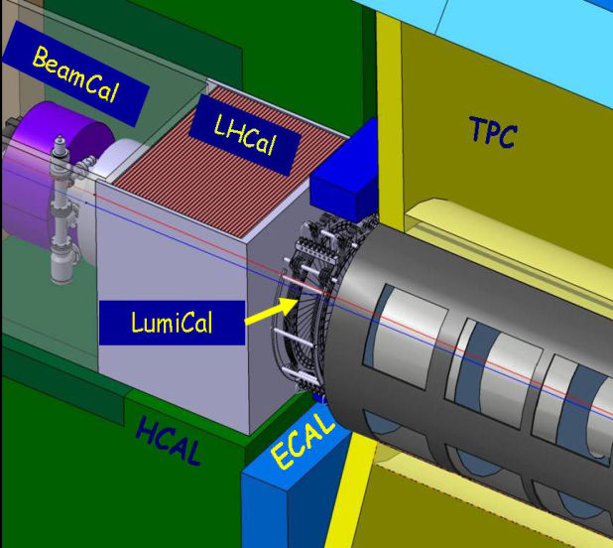
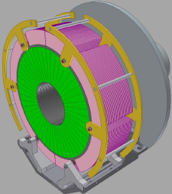
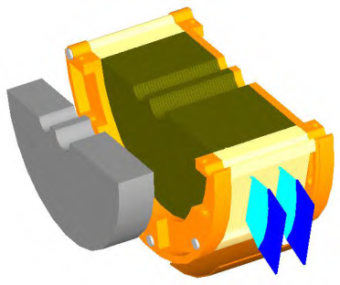
Forward Calorimetry R&D: FCAL Collaboration
LumiCal:
→ precise luminosity
measurement
10⁻³ - 500 GeV @ ILC
BeamCal:
inst. lumi
measurement /
beam tuning,
beam diagnostics
LumiCal: Two Si-W sandwich EM calo at a ~ 2.5 m from the IP (both sides)
BeamCal: very high radiation load (up to 1MGy/ year) → similar W-absorber,
but radiation hard sensors (GaAs, CVD diamond, sapphire)
LHCAL: sampling calo (tungsten or iron with SI) → extend HCAL coverage
Beam-test campaings:
LumiCal prototypes multi-plane operation:
LumiCal Challenges:
Build a ultra compact LumiCal (alignment, deformation);
Edgeless sensors (to avoid dead areas)
Milti-layer LumiCal prototype with new (FLAME) ASIC;
BeamCal Challenges:
Development of sapphire sensors with dedicated ASIC;
Ongoing radiation damage studies (GaAs, Si diode,
CVD diamond, sapphire …)
A. Neagu @ ILCX2021

Slide 18
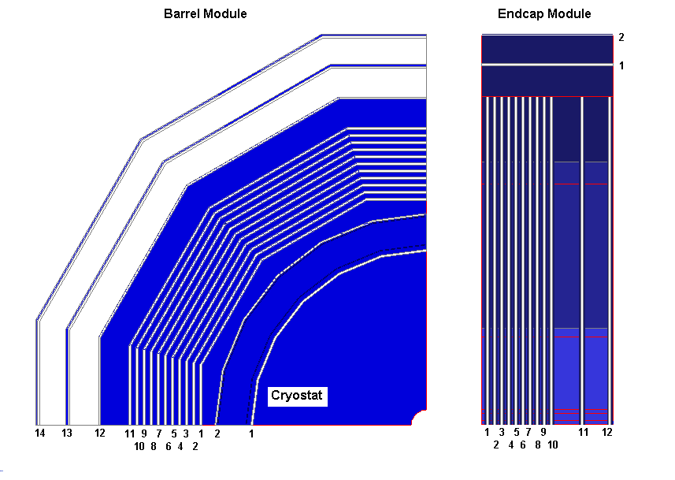
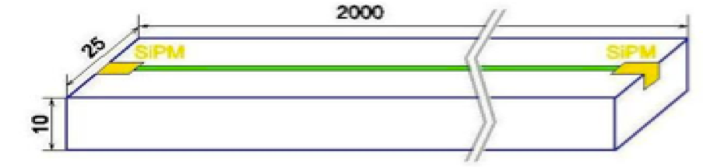
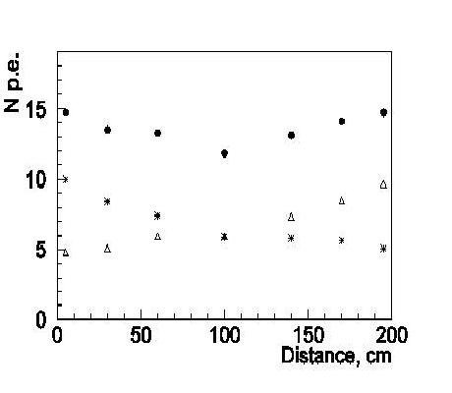
Muon System / York Instrumentation
Efficient Muon Identification & Measurement of the Energy Leakage from Hadron Calorimeter
Main technology (compatible with HCAL) – Scintillation strips with WLS and SiPM readout
Number of photons detected from both side by SiPMs
and sum of signals, as function of distance along strip
Muon efficiency & Pion contamination:
Baseline option under development:
→ Scintillator + WaveLengthShifter + SiPM;
Development of the Key Elements Sc/WLS/SiPM – Digital Silicon Photomultiplier in CMOS technology is in progress;
Gas Detector - RPC (high coordinate resolution, excellent granularity up to 1 x 1 cm² pads) → not active for now;
Not many groups are participating in the Muon System Study
No significant challenges in terms of particle fluxes and radiation environment → many technologies feasible

Slide 19
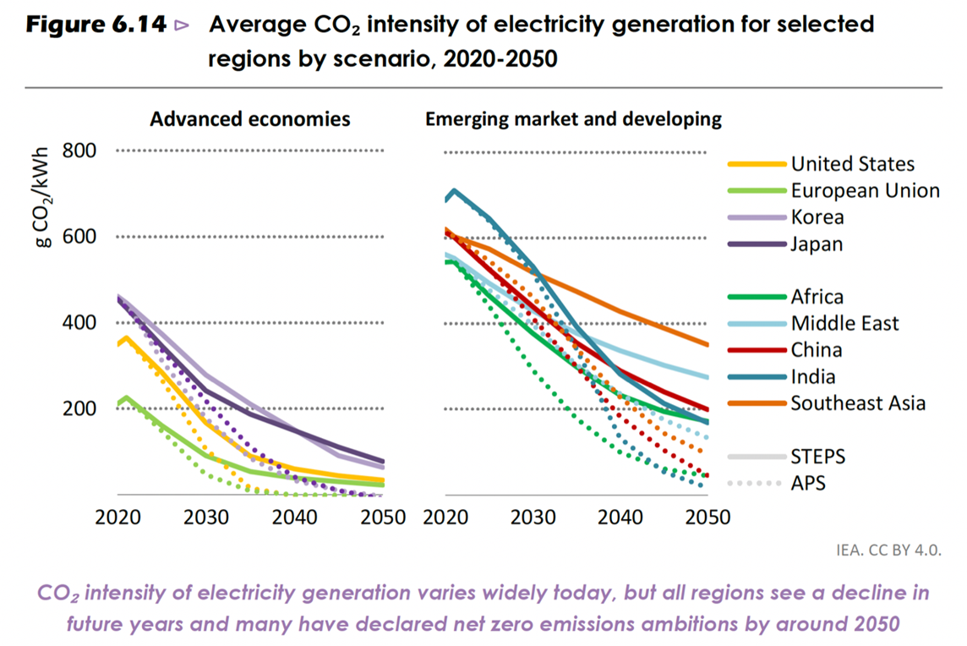
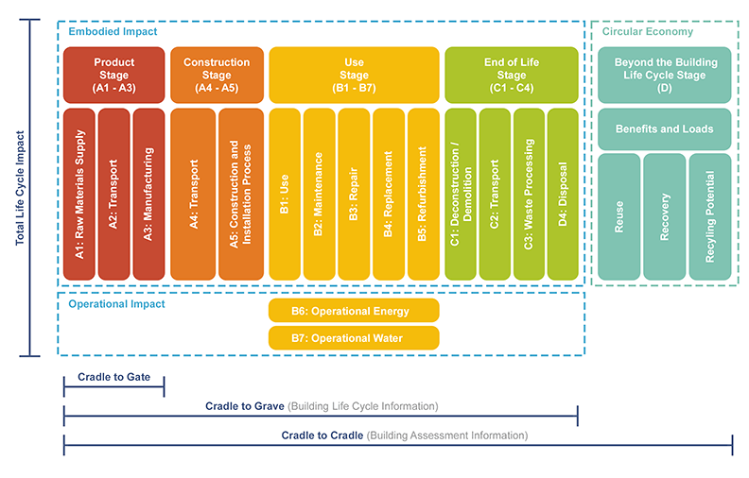
Sustainable Linear Collider Operation
Data of carbon intensity of electric power
(Nuclear energy remains very important, on the timescale of a future CERN facility):
Power Projections Europe (2040):
- 50% nuclear at 5g CO₂/kWh;
- 50% renewables at 20g CO₂/kWh
(mix sun, wind, hydro,…)
IEA (2022), World Energy Outlook 2022, IEA, Paris https://www.iea.org/reports/world-energy-outlook-2022,
License: CC BY 4.0 (report); CC BY NC SA 4.0 (Annex A)
Whole Lifecycle is Important –
Lifecyle Assessment (LCA):
Ultimate Goal:
- Quantify the environmental
impact of a whole accelerator
project, i.e., CLIC / ILC
Accepted method:
- LCA = Life Cycle Assessment
Define Scope:
- System Boundaries
- Lifecycle Stages
Lifecycle stages according to EN 15978

Slide 20
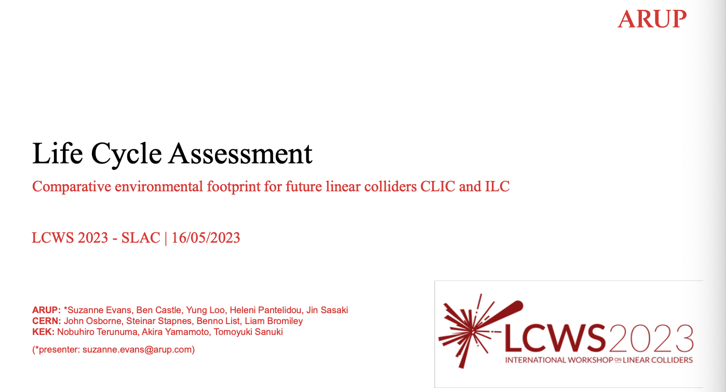
Sustainable Construction: Life-Cycle Assessment
Full ARUP report is now available and public:
https://edms.cern.ch/document/2917948/1
Inherent tension between invest and operation requires a quantitative approach:
Lifecycle Assessment
LCWS2023: ARUP talk –
https://indico.slac.stanford.edu/event/7467/contributions/5902/attachments/2851/7968/ARUP_CERN_LCA_LCWS_-_2023.pdf

Slide 21
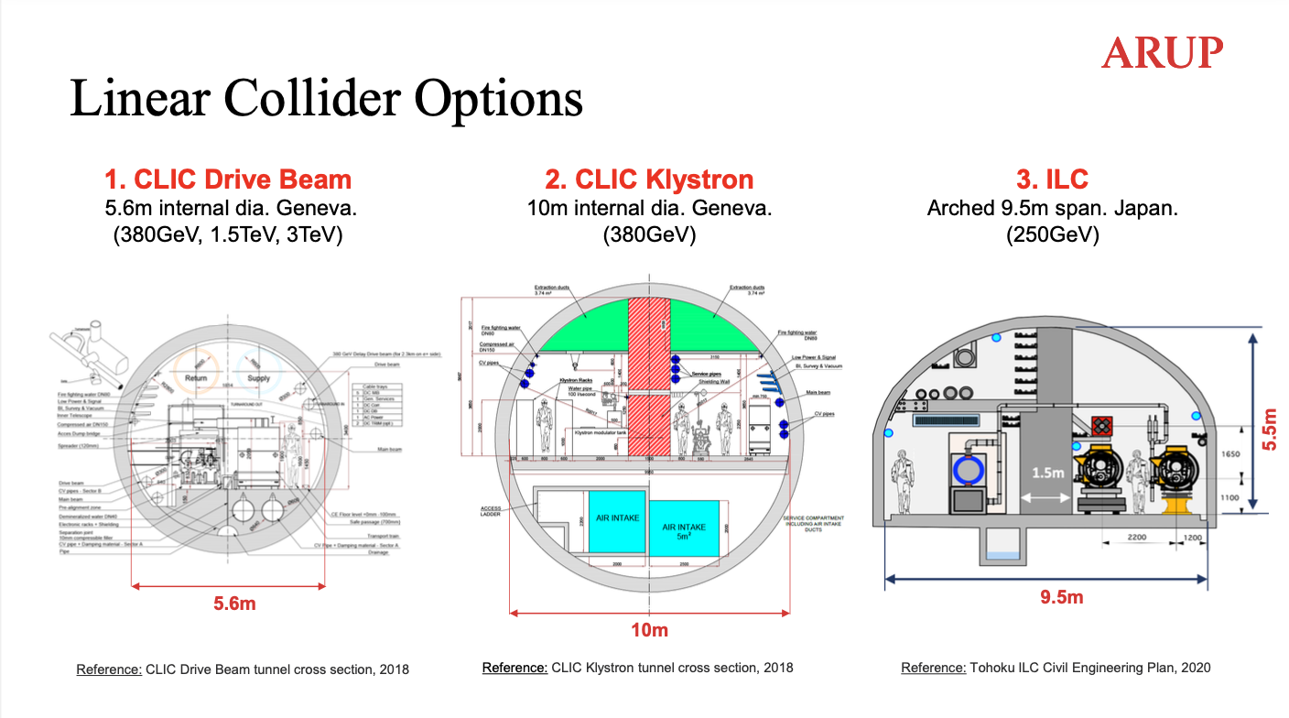
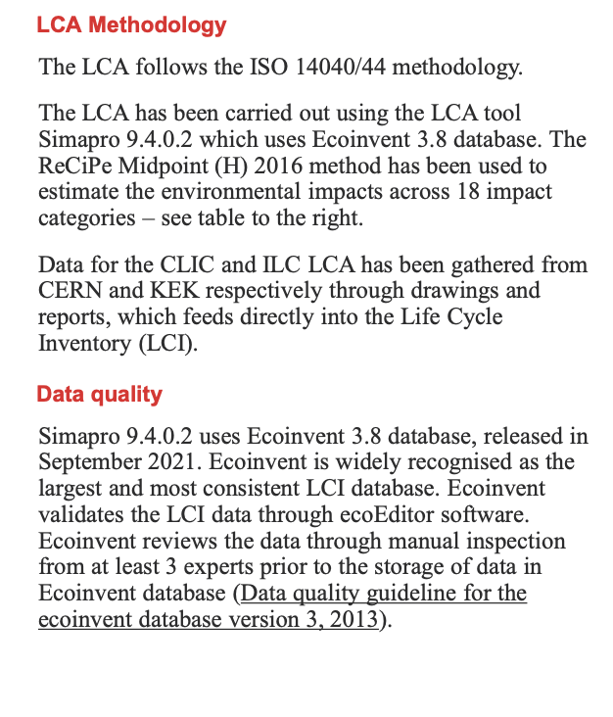
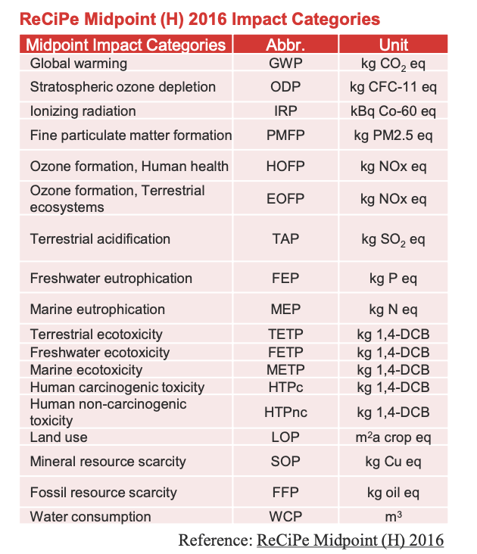
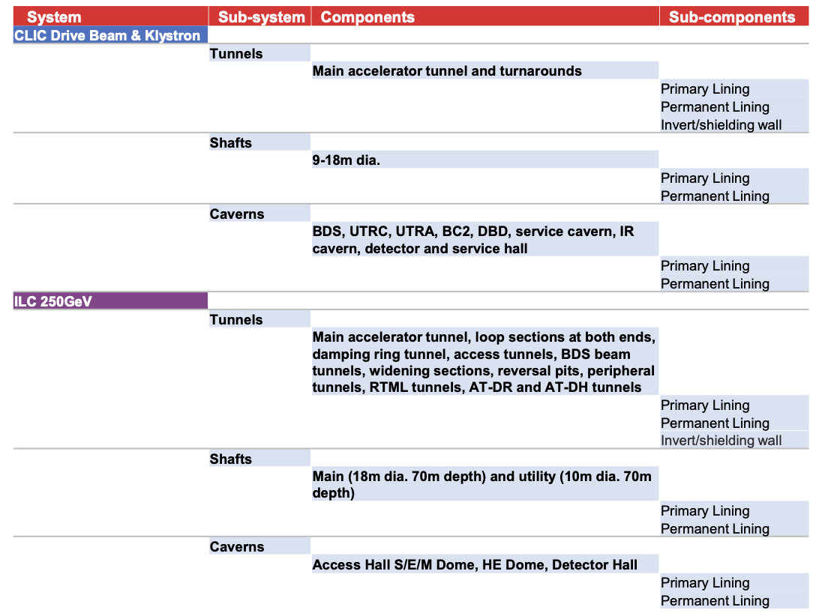
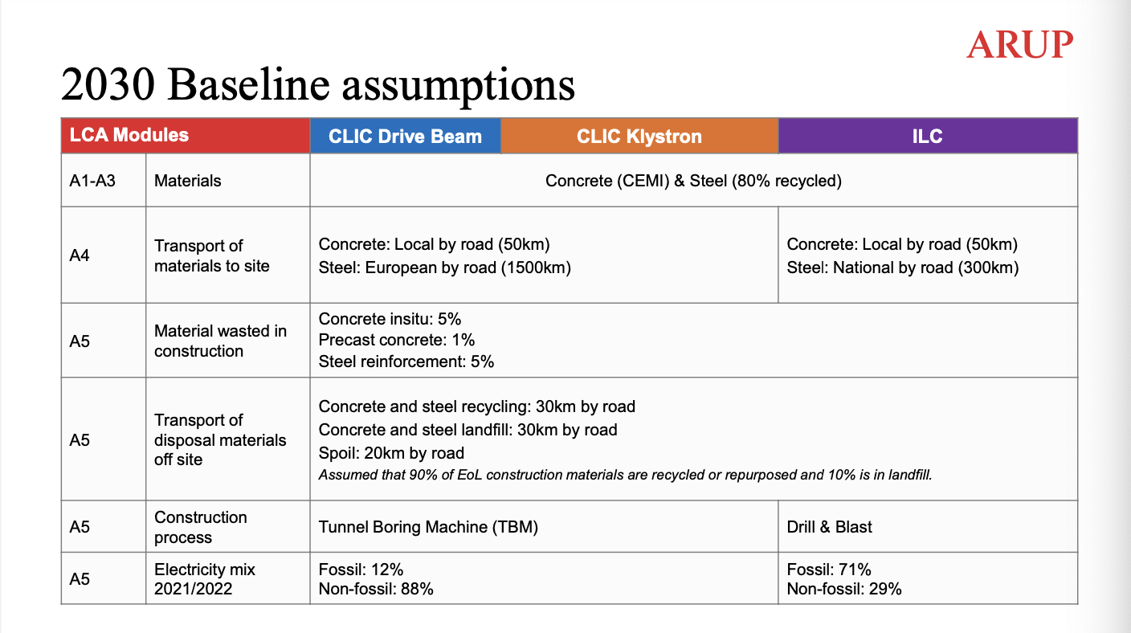
Sustainable Construction: Life-Cycle Assessment
Ref: ISO 14040:2006
Full ARUP report:
https://edms.cern.ch/document/2917948/1

Slide 22
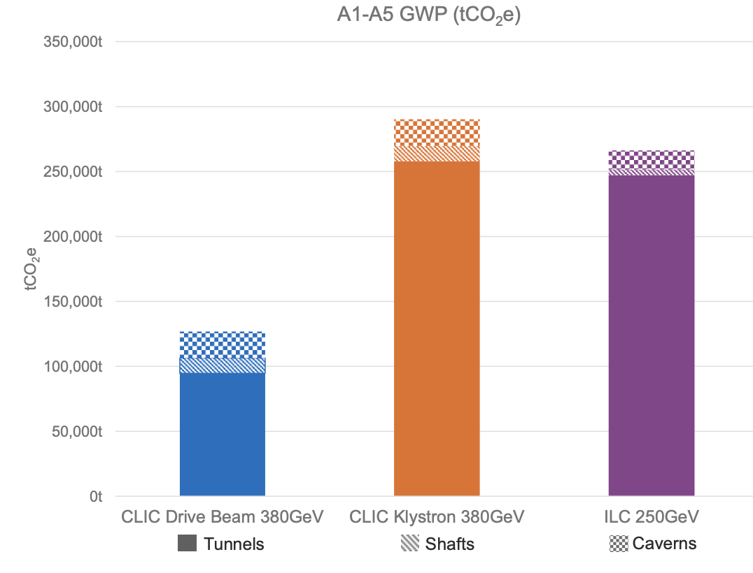
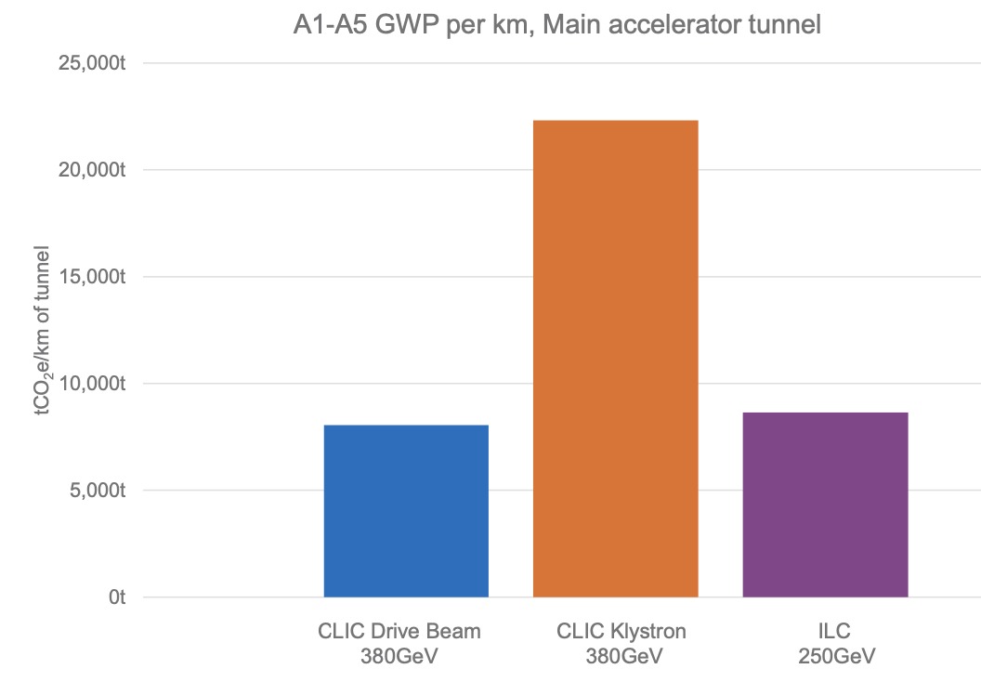
Sustainable Construction: Life-Cycle Assessment
Full ARUP report: https://edms.cern.ch/document/2917948/1
Comparative environmental footprint for future linear colliders CLIC & ILC
Assuming a small CLIC tunnel (~5.6m diameter) and that the equipment has the same carbon footprint as the tunnel itself,
20 km accelerator (tunnel plus components) correspond to 240 kton CO₂ equivalent
CLIC around 11km, ILC around 20 km
A1-A3 material only
dominates
Around 6 kton/km
for CLIC DB & ILC
Include all tunnels (access, transfer, damping rings), shafts and caverns.
A1-A5
Scaling to main linac tunnel lengths we are now at 11-14 kton/km for the CLIC DB and ILC

Slide 23
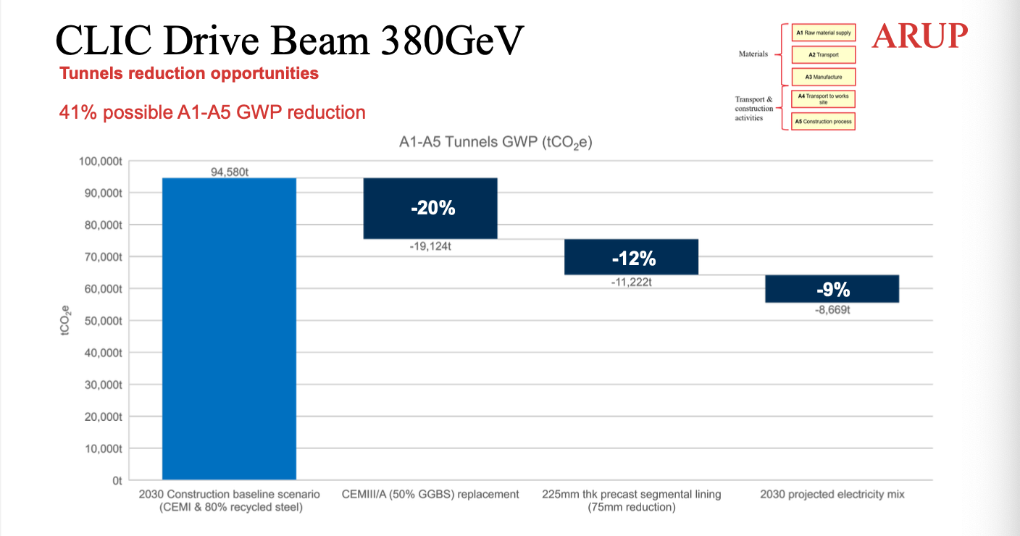
Sustainable Construction: Life-Cycle Assessment
Many caveats, first of all this is a very first indication of the scale:
many more components in tunnel (also infrastructure), injectors, shafts, detectors, construction, spoils, etc …
upgrades and decommissioning, this is not only an initial important contribution
improvement and optimisations (e.g. less and/or better concrete mixes, support structures, steel in tunnels)
responsible purchasing (understanding the impact of supply chain, costs and potential for changes – will be essential for future projects – CERN implementation information from E. Cennini)
Full ARUP report:
https://edms.cern.ch/document/2917948/1
If we have energy available at 12.5 g CO₂ /kWh = 12.5 kton CO₂/TWh (not unlikely in 2050):
20km accelerator construction ~ 20 years of operation.
1 km accelerator construction ~ 1 TWh annual electricity (annual LC operation 0.6 TWh)

Slide 24
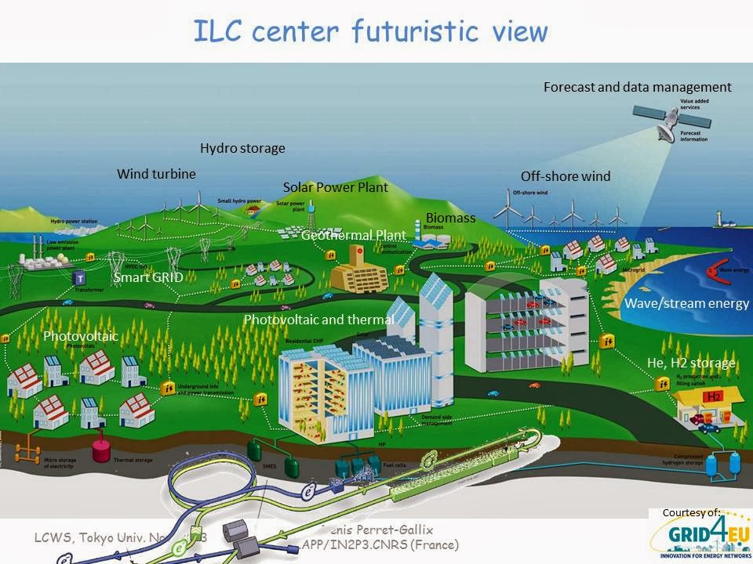

EAJADE Workshop on Sustainability in Future Accelerators
Tohoku, Japan, September 25-27, 2023:
https://indico.desy.de/event/39980; https://wsfa2023.huhep.org/
ILC Energy Center (Arthistic View)

