Slide 1
In-Silico generation of random bit streams
TITLE
the value of unpredictability
Massimo Caccia
Università dell’Insubria & Random Power s.r.l.
massimo.caccia@randompower.eu
I
François Morellet
Random Distribution of 40,000 Squares using the Odd and Even Numbers of a Telephone Directory 1960
TIPP 2023
Cape Town, South Africa, Sept. 6

Slide 2
1
1
0
1
0
0

Slide 3
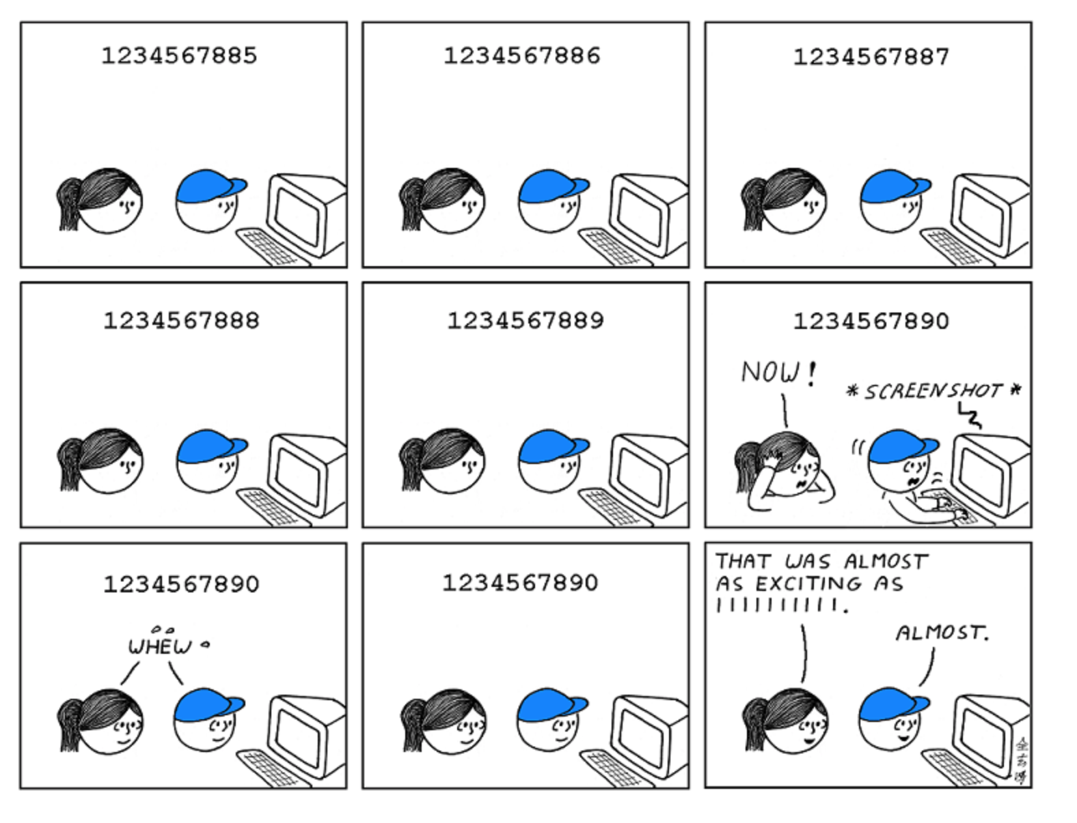
1. introduction:
WHAT FOR?
Unpredictability to preserve the predictability of our clockwork world
the RSA (Rivest–Shamir–Adleman) public key cryptography protocol uses two random prime numbers of length up to 2048 bits to generate the keys
https://xkcd.com; Randall Munroe

Slide 4
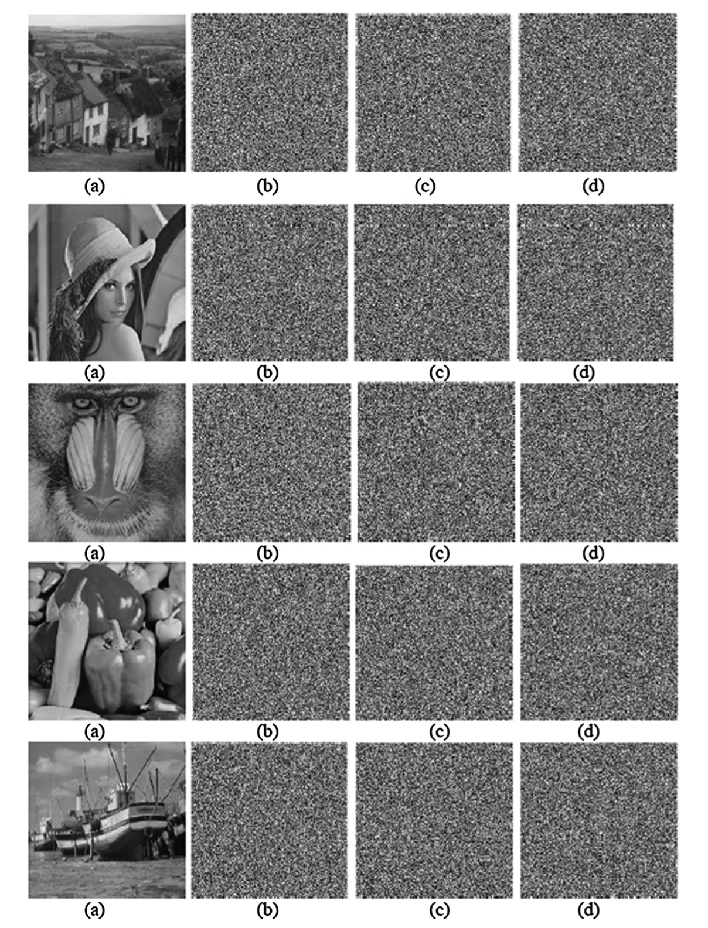
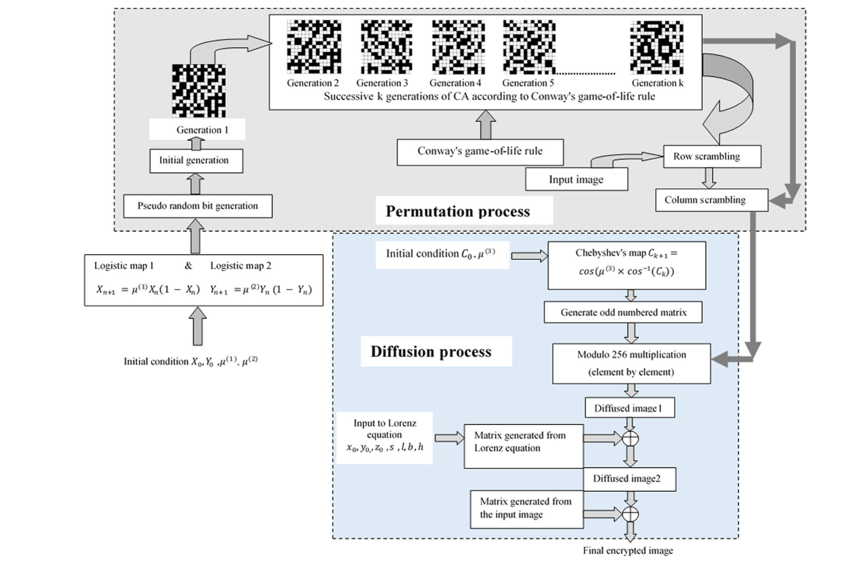
1. introduction:
WHAT FOR?
Unpredictability to preserve the predictability of our clockwork world
row scrambling
column
Image encryption is also relying on random single-bit arrays:
scrambling
diffusion
B. Murugan et al., A hybrid image encryption algorithm using chaos and Conway’s game-of-life cellular automata, Security Comm. Networks 2016; 9:634–651, DOI: 10.1002/sec.1386
,

Slide 5
1. introduction:
WHAT FOR?
there is definitely a hype about Random bit streams, not only for crypto but also for gaming, virtual reality , Monte Carlo simulations, IoT, Satellite communication & control and notably Privacy Preservation Procedures
row scrambling
a 2020 paper by the U.S. Census Bureau:
a 2023 article on FORBES:

Slide 6
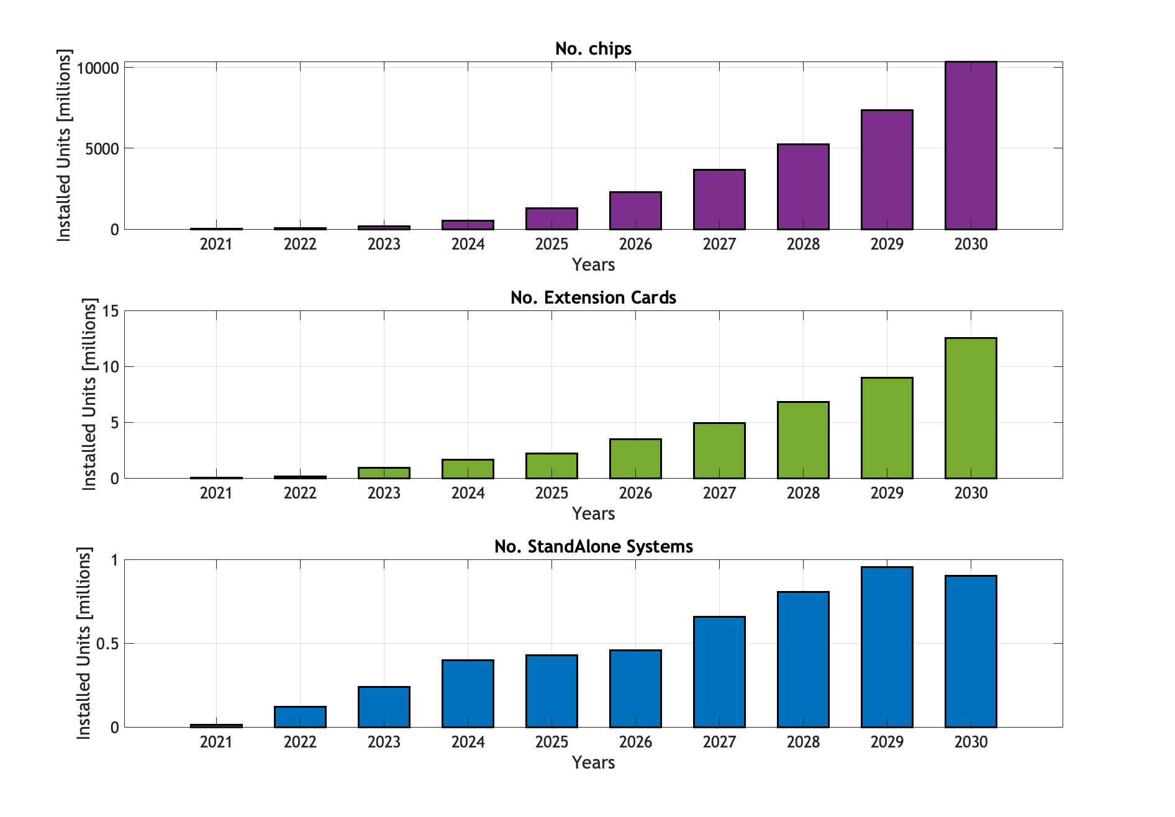
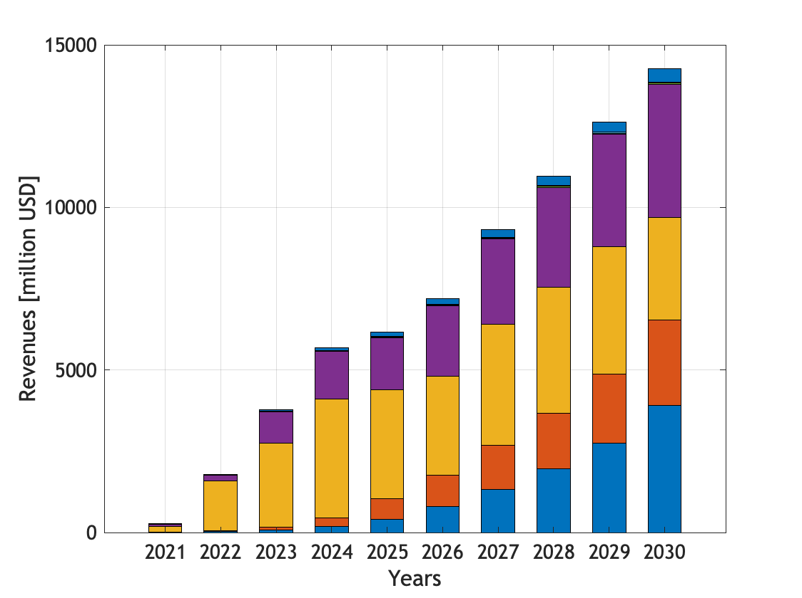
2. market potential:
Chips
2.3 Billions
$7.2B
Finance
Data centres
3.5 Millions
Cards
Installed Units vs Time
Mobile
IoT
0.5 Millions
Systems

Slide 7
3. the essence of random number generation:
HOW TO GENERATE AN UNPREDICTABLE RANDOM NUMBER?
It is always nice to consider an artist’s point of view:
“With Random Distribution, the purpose of my system was to cause a reaction between two colours of equal intensity. I drew horizontal and vertical lines to make 40,000 squares. Then my wife or my sons would read out the numbers from the phone book (except the first repetitive digits), and I would mark each square for an even number while leaving the odd ones blank. The crossed squares were painted blue and the blank ones red. For the 1963 Paris Biennale I made a 3-D version of it that was shown among the Groupe de Recherche d’Art Visuel installations (and re-created it again on different occasions). I wanted to create a dazzling fight between two colours that shared the same luminosity. This balance of colour intensity was hard to adjust because daylight enhances the blue and artificial light boosts the red. I wanted the visitors to have a disturbing experience when they walked into this room – to almost hurt their eyes with the pulsating, flickering balance of two colours. I like that kind of aggression.”
excerpt from https://www.tate.org.uk/context-comment/articles/65-38-21-4-72
François Morellet (1926-2016)
Random Distribution of 40,000 Squares using the Odd and Even Numbers of a Telephone Directory 1960
MOMA, New York

Slide 8
3. the essence of random number generation:
HOW TO GENERATE AN UNPREDICTABLE RANDOM NUMBER?
PRNG
(PseudoRandom Number Generators)
are essentially a piece of software code
⇒ they deterministic and in principle predictable
TRNG
(True Random Number Generators)
are essentially coin flipping,
namely get bits out observing unpredictable natural phenomena
an example of linear congruential generator
J. Von Neumann: Anyone who considers arithmetical methods of producing random digits is, of course, in a state of sin.
Von Neumann, John (1951). "Various techniques used in connection with random digits" (PDF). National Bureau of Standards Applied Mathematics Series. 12: 36–38.
http://glee.wikia.com/wiki/File:281735_1342370254-coin-flip.gif.gif

Slide 9
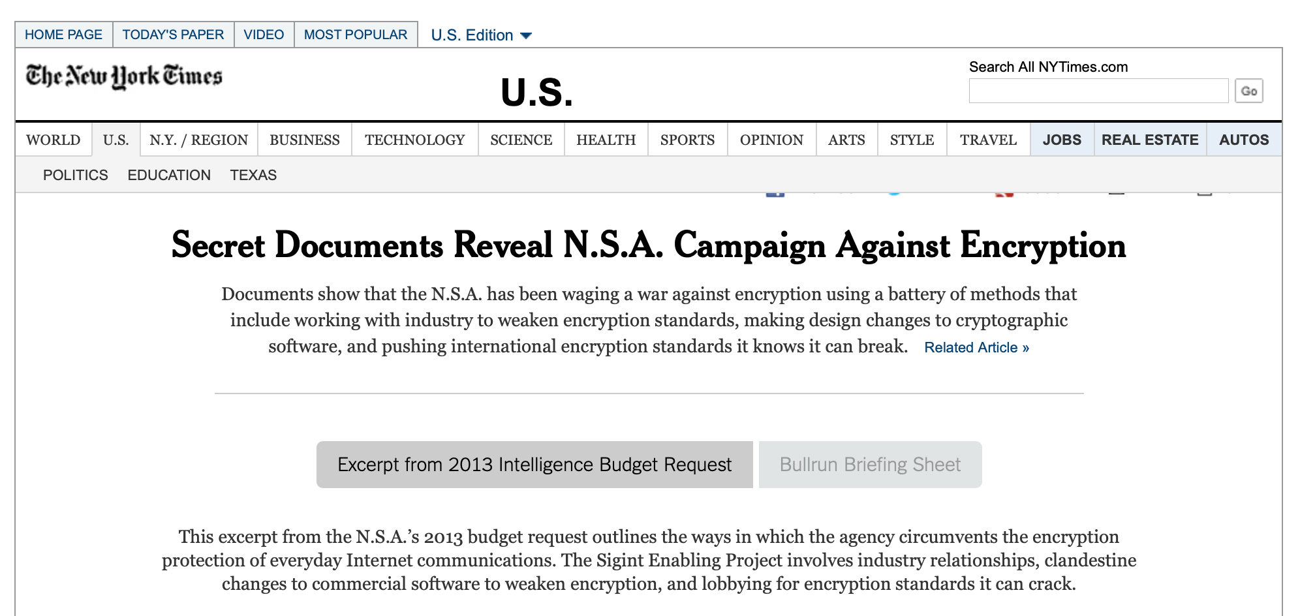
3. the essence of random number generation:
HOW TO GENERATE AN UNPREDICTABLE RANDOM NUMBER?
PRNG
(PseudoRandom Number Generators)
TRNG
(True Random Number Generators)
Fast, cheap & reasonably easy. However:
software Random Number Generation is PSEUDO
code can be bugged
and it may have a BACKDOOR
Extracting bits from the observation of natural phenomena is not trivial and you may suffer from
“coin bias” by the embodiment of a great principle
weakness against environmental parameters
a significant “attack surface”, conditioning the device in use
low bit rate
2006
2013

Slide 10
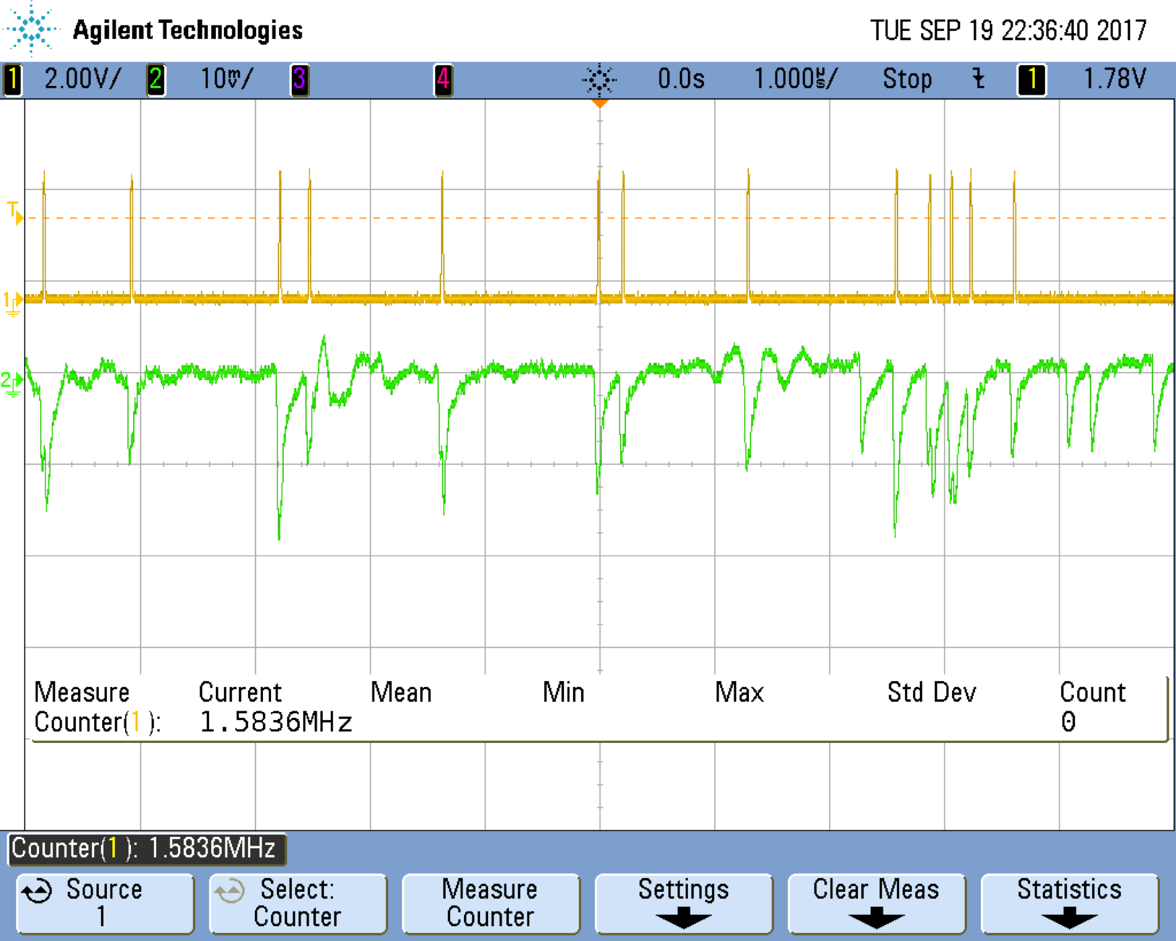
4. the Random Power principle:
HOW DO WE DO IT?
Inspired by Forrest Gump, we say:
RADIOACTIVE IS AS RADIOACTIVE DOES
emission by a radioactive source is due to the quantum laws of Nature
decays of unstable nuclei are unpredictable
⇒
the sequence of detected decays can be used to generate random bits with different recipes:
check the parity of the number of pulses in a time window
pre-define the time window in a way that is equally like to have or not to have a single pulse
Sequence of pulses by the decay of a radioactive source in a nuclear physics detector
The idea behind is to replace a radioactive source with something safer, more handy, cost effective, simple, robust, providing sequences of pulses mimicking radioactive decays.

Slide 11
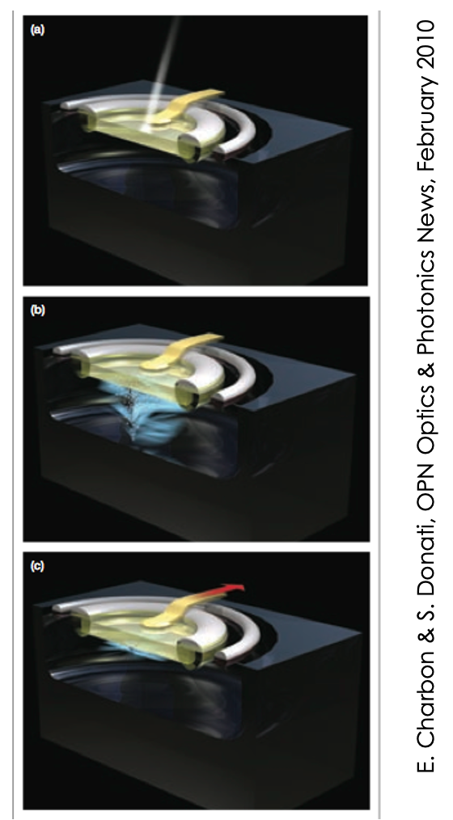
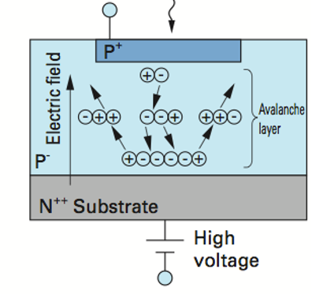
The generator, an array of Single Photon Avalanche Diodes, namely p-n junctions operated beyond the breakdown voltage:
A pioneering development by Prof. S. Cova at Politecnico di Milano
Cova, S., Ghioni, M., Lacaita, A. L., Samori, C., and Zappa, F. “Avalanche photodiodes and quenching circuits for single-photon detection”, Applied Optics, 35(12), 1956—1976 (1996)
The essence of a cell
Simulation of an avalanche development
Courtesy of Ivan Rech, Politecnico di Milano
[50 μm cell size]
• Very shallow p-n junction è ~ 1 μm
• High electric field è > 3 x 10⁵ V/cm
• Mean free path è ≈ 0.01 μm
Multiplication by about 1 000 000
Photon induced charge carrier generation

Slide 12
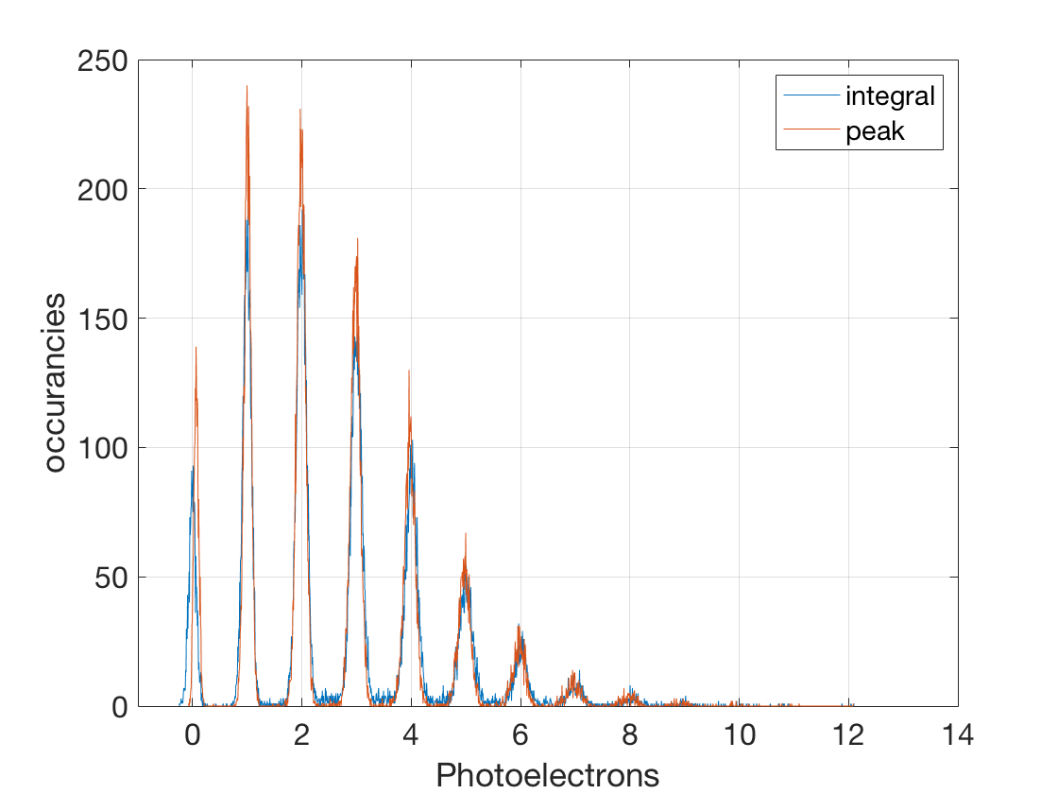
Not indexed arrays of SPAD, with a single output node, are nowadays known as Silicon Photomultipliers, the state-of-the-art room T detectors with single photon sensitivity and photon-number resolving capability:
Two fired cells
Single fired cell
Three fired cells
Vover = 2.5V
No fired cell
SiPM may be seen as a collection of binary cells, fired when a photon in absorbed
[in principle, a NATIVE DIGITAL DEVICE]
histogram of the response to a high statistics of low intensity light pulses

Slide 13
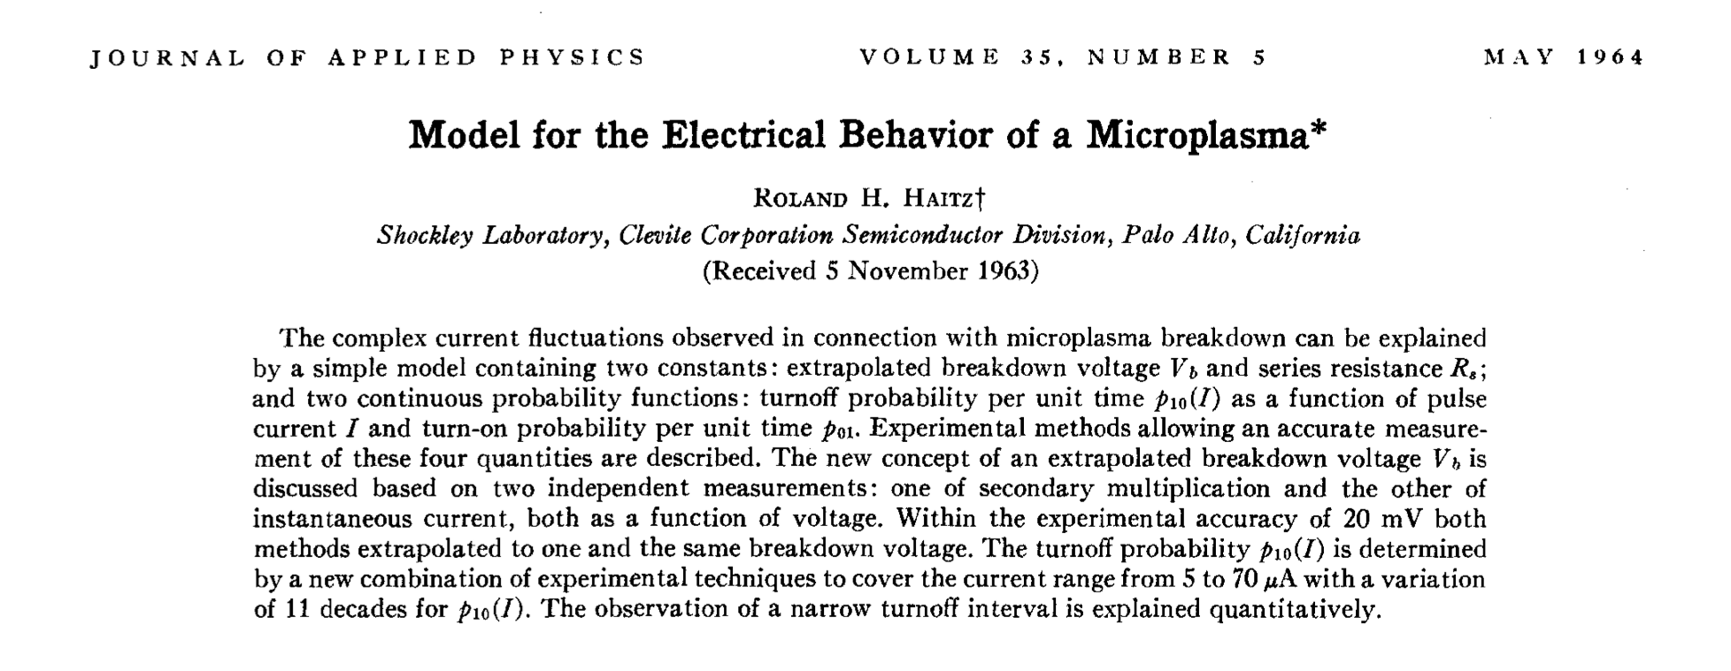
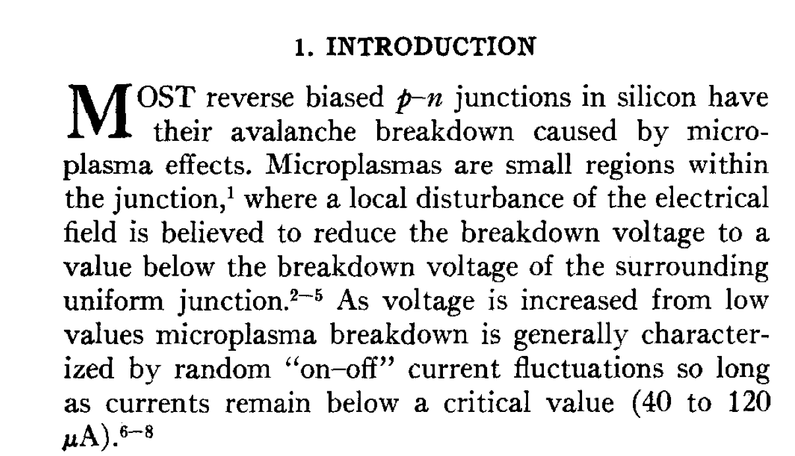
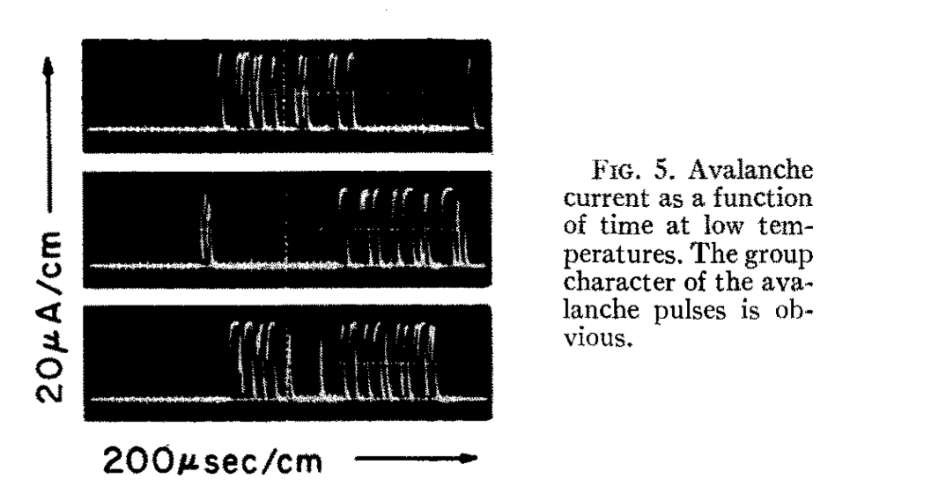
The name of the game: charge carriers can be generated “spontaneously”, also when no light is illuminating the sensor
A lesson from the past, when this was known since the early days of the Silicon technology development:
1
2
from paper
2
from paper
3
3

Slide 14
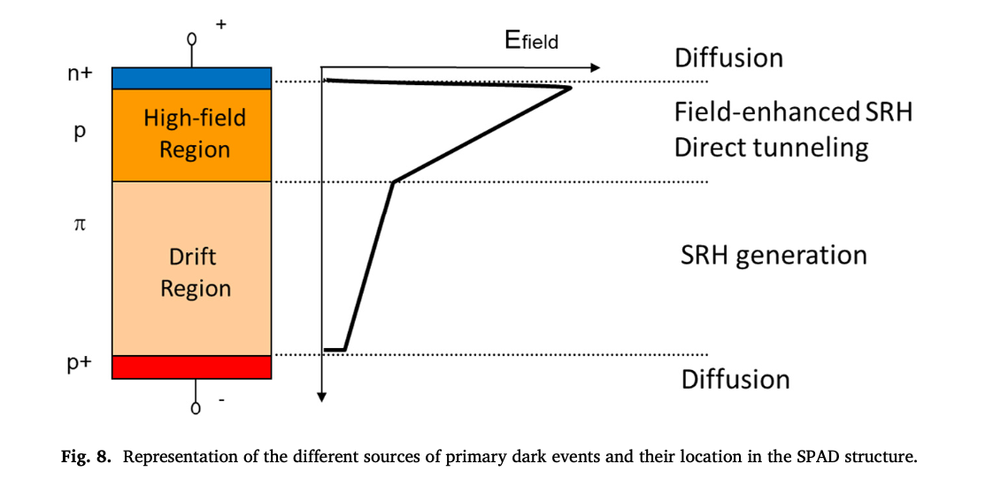
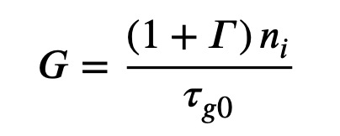
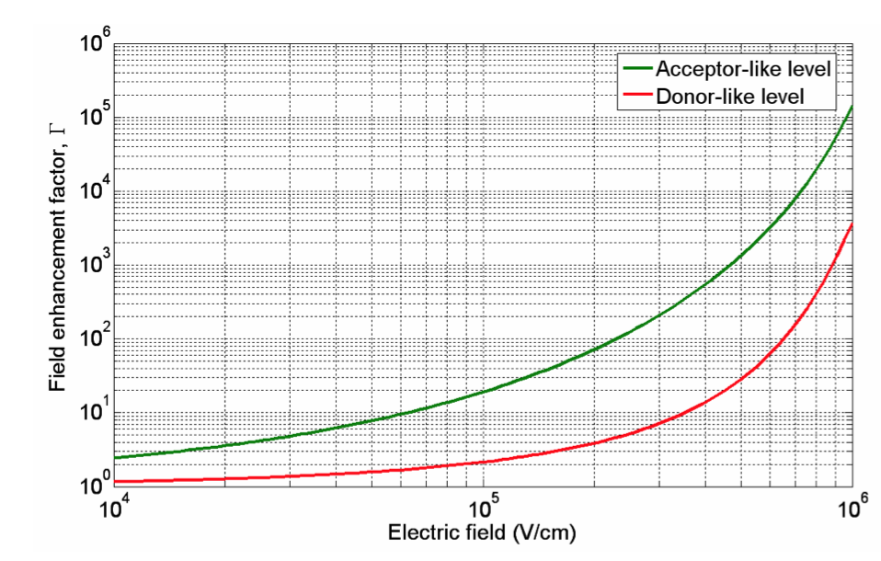
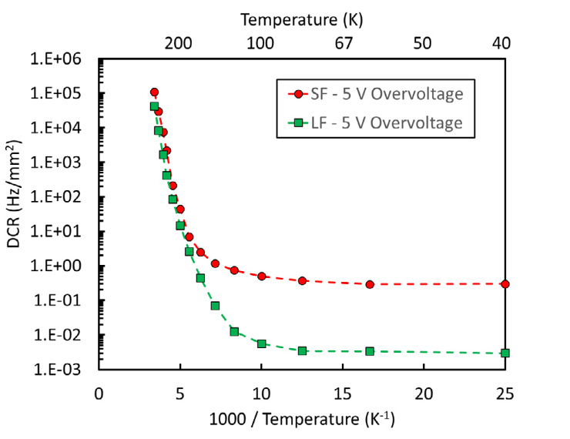
The name of the game: charge carriers can be generated “spontaneously”, also when no light is illuminating the sensor, by quantum tunnelling
Thermal generation of carriers by states in the bang-gap (Shockley-Read-Hall statistics), where trapping and de-trapping is increased by the high electric field in the junction. The Generation rate can be written as:
E0 = Fermi level
Et = trapping level
ni = intrinsic carrier concentration
Nt = trapping concentration
σ = trapping cross section
vth = thermal velocity
Γ “boost” by the field
after A. Gola, C. Piemonte, NIM A926 (2019) 2-15
Key issues:
in SiPM, the Dark Count Rate is O(1 KHz)/cell, 50 μm pitch (it may be higher for SPAD arrays in CMOS technology)
provided the nature of the Dark Pulses, we have a significant dependence on Temperature
forget-me-not: the Over-voltage is affecting the triggering probability
F. Acerbi, et al., IEEE Trans. Electron Devices 64 (2) (2017) 521–526.
Notes:
cosh(x) = 0.5*(e^x+e^(-x))
Tau_g0=generation lifetime = O(70 us)
n_i = O(10^10 cm_3) @300K
When a high electric field is applied to silicon, SRH statistics changes because the rate at which electrons are captured and emitted by a trap is increased significantly by tunneling.

Slide 15
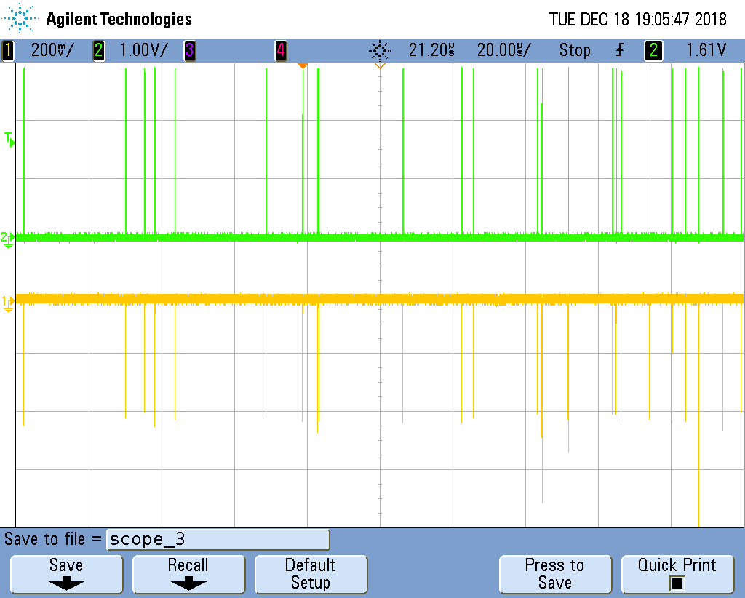
The essence: turning unpredictable “Dark Pulses” into bits
1. tag & time stamp the occurrences of the random pulses
2. analyse the time series of the pulses:
Start
1
2
3
4
5
6
7
8
9
bit 1: Δt12 vs Δt34
bit 2: Δt23 vs Δt45
bit 3: Δt56 vs Δt78
Δt12
Δt23
Δt34
Δt45
Δt56
Δt67
Δt78
Δt89
bit 4: Δt67 vs Δt89

Slide 16
4. the Random Power principle:
This is the essence of
- Italian Patent granted in Sept. 2020
EU & US patent granted in 2022
in the examination phase in China, JP, Korea (since April 2021)
A genuine Q(quantum)-True Random Number Generator, namely a Quantum Coin Flipper providing virtually endless streams of
RANDOM BITS ➜ CRYPTOGRAPHIC KEYS
shielded against any bias by the fundamentals of Quantum Mechanics

Slide 17
5. a glance at competitors:
ARE WE ALONE IN THE UNIVERSE?
History | Established in 2001 | Starting-up
Technology floor | QTRNG platform + services | Minimum Viable Product
Complexity | HIGH | LOW
Efficiency | LOW | HIGH
Robustness | LOW | HIGH
Miniaturisation | BIG chip | SMALL chip viable
Cost of the single generator board | 1000+ EUR | 500 EUR
+ a handful of other players:
ID Quantique - https://www.idquantique.com
Major advantage of the Random Power technology, fully CMOS compliant, offering the possibility to integrate the device into a custom chip with advanced features

Slide 18
6. state-of-the-art:
WHERE ARE WE NOW - completed developments
The MINIMUM VIABLE PRODUCT [MVP], the progenitor of a class of Quantum Random Bit Generators:
Developed thanks to the seed capital [100 000 €] granted by
https://attract-eu.com
8 cm
which selected Random Power as one of 170 “breakthrough projects” out of 1211 submissions [May 2019- October 2020]
3.5 cm
Qualified according to the NIST standards
(National Institute of Standard & Technology)

Slide 19
6. state-of-the-art:
WHERE ARE WE NOW
Upon request, bits can be routed on pins
FTDI chip for data routing on the USB
FPGA embedding a proprietary TDC and implementing the bit extraction + real-time sanity checks (MONOBIT&RUNS) + conditioning function (SHA-256)
8 cm
Amplification & discrimination
Single generator (either 1x1 mm2 or 3x3 mm2 - Bit rate for the smaller area device: O(100 kbps) - operated with overvoltage stabilisation against Temperature variations
3.5 cm

Slide 20
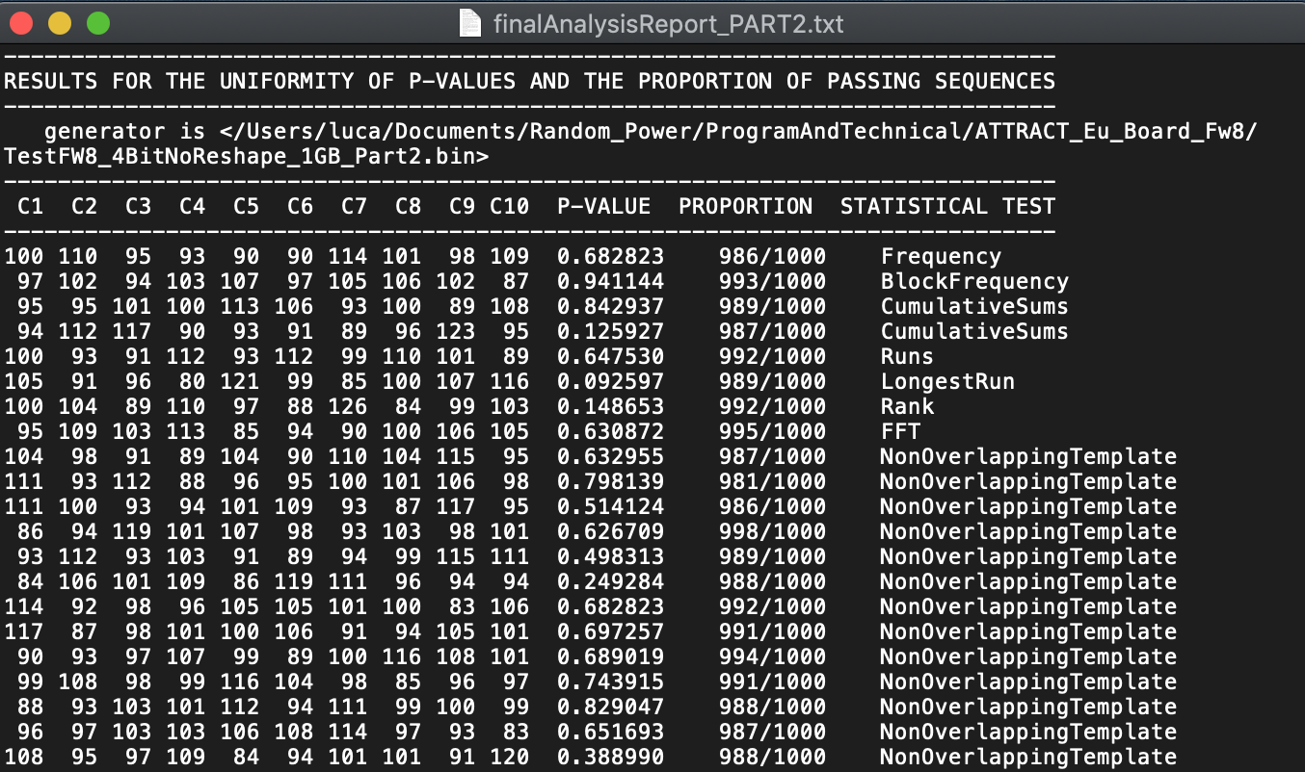
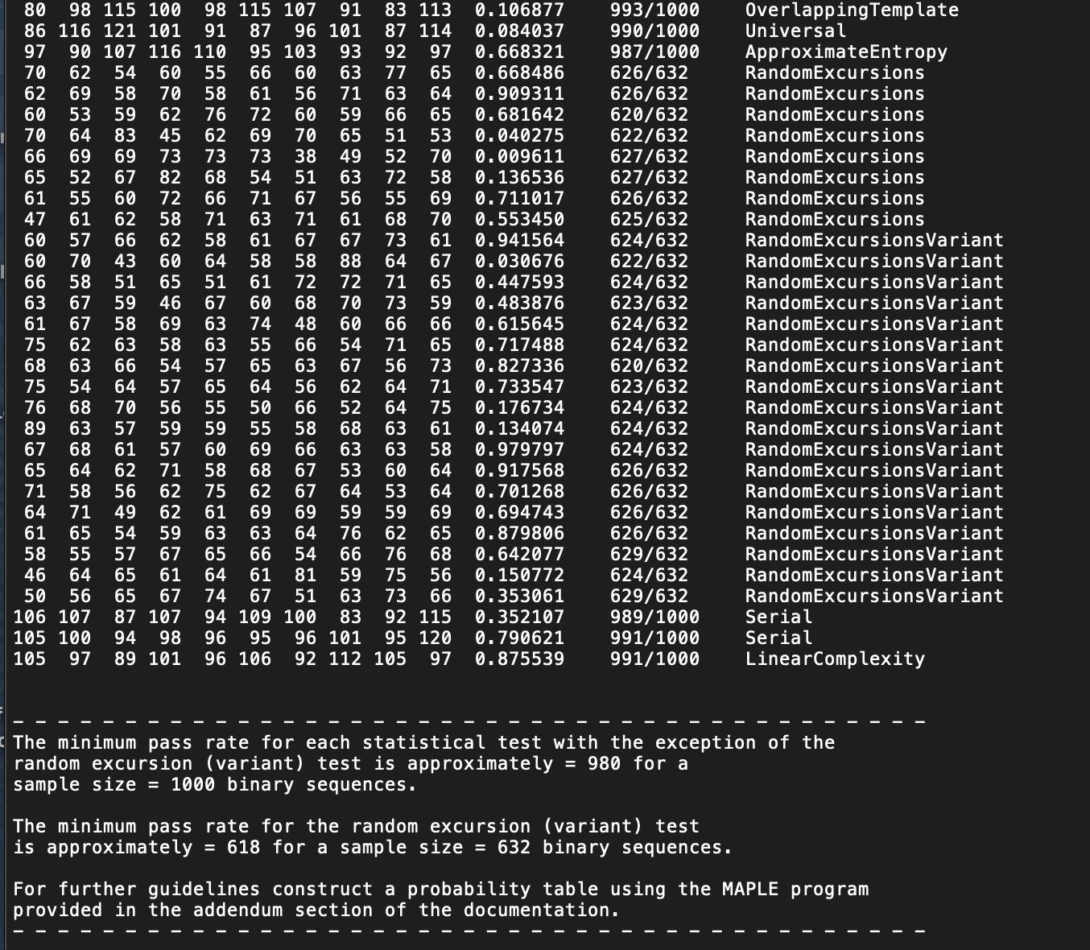
6. state-of-the-art:
A proto-randomness farm based on 10 boards have been collecting about 1.5 Tb, qualified through the NIST and TESTU01 suites.
Results show that the stream looks extremely “white”, essentially with no failures on the raw data beside what can be statistically expected.
A SHA256 vetted conditioning function firmware implemented
series of tests on non-overlapping templates
Two tests have been implemented in firmware to guarantee real-time sanity checks:
MONOBIT: essentially testing the asymmetries between 0’s and 1’s in a bit string:
1 1 1 1 1 0 1 0 0 1 1 1 0 0 0 1
RUNS: testing the statistics of the number of sequences of identical bits in a string
1 1 1 1 1 0 1 0 0 1 1 1 0 0 0 1
5 bits
1 bit
2 bits
3 bits
3 bits
1 bit

Slide 21
WHAT’S NEXT?
on-going developments
&
beyond

Slide 22
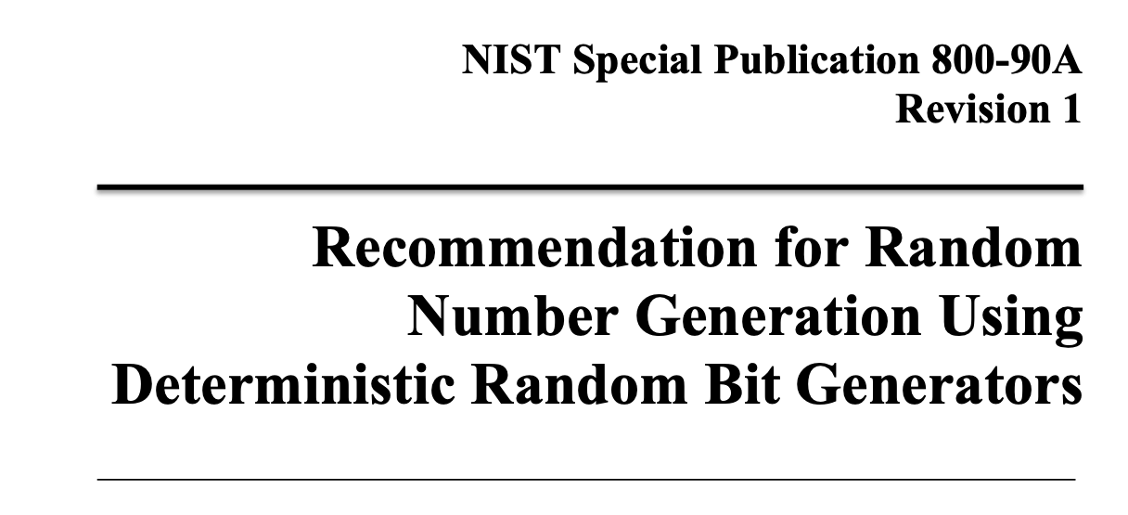
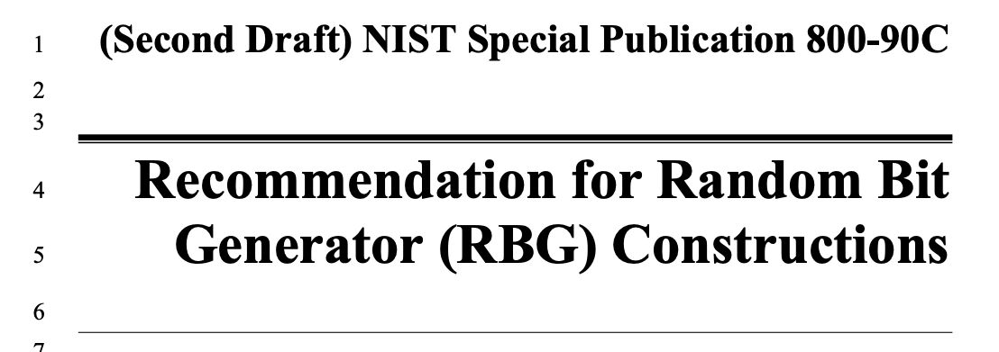
7.on going developments:
BEYOND A PURE TRUE RANDOM NUMBER GENERATOR (TRNG)
How to design and test entropy sources to be used to feed Deterministc Random Bit Generators (DRBG)
Approved DRBG mechanisms
Construction of RBG from A+B
pre-requisites for entering the programs eventually leading to the FIPS-140-3 certification
impacting on the design of both the ASIC, the multiple generator board and its embodiment in a “system”

Slide 23
7.on going developments:
BEYOND A PURE TRUE RANDOM NUMBER GENERATOR (TRNG)
Queries
Bootstrap
Essentially, the True Random Bits generated by Random Power are used to seed a NIST approved Pseudo Random Bit Generator
when reseeding occurs after EVERY iteration of the Deterministic machine, you obtain the highest level of security, namely Prediction Resistance*
Entropy producer
Entropy consumer
A Deterministic Random Bit Generator (DRBG), as of the NIST recipe
* QUOTING NIST: Prediction resistance means that a compromise of the DRBG internal state has no effect on the security of future DRBG outputs.
Output

Slide 24
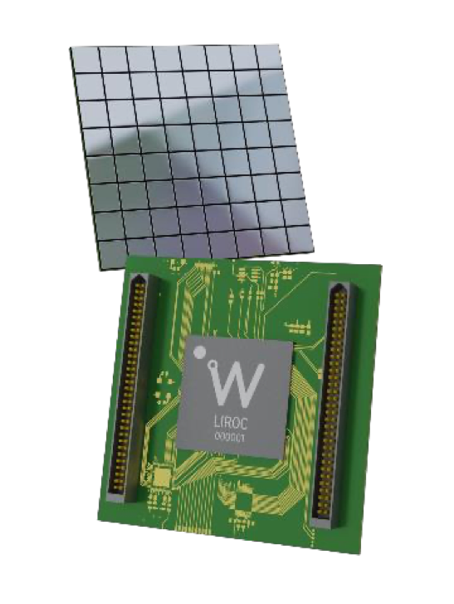
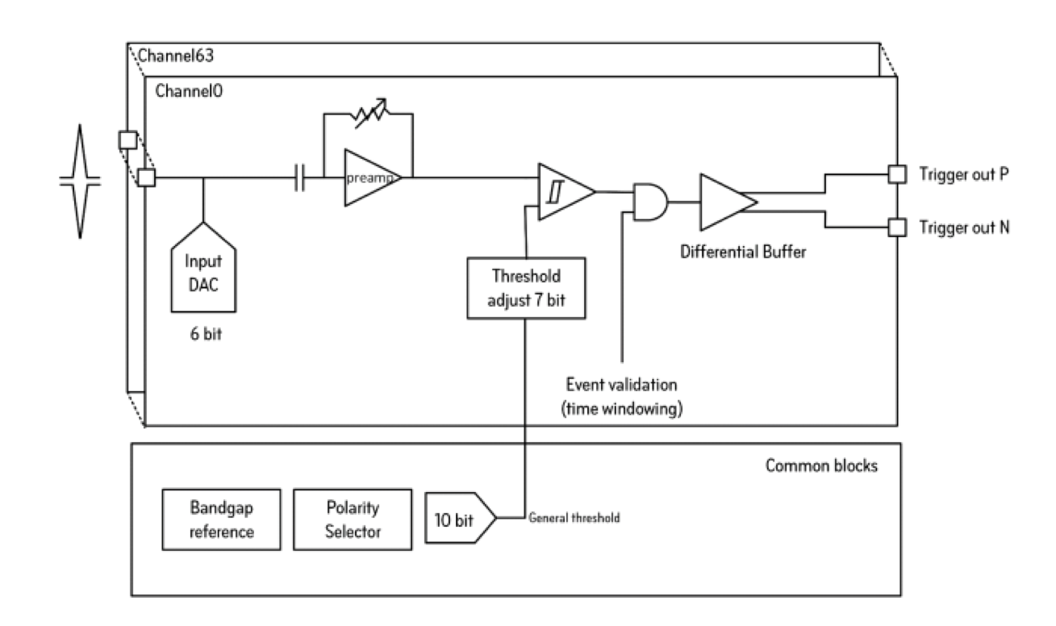
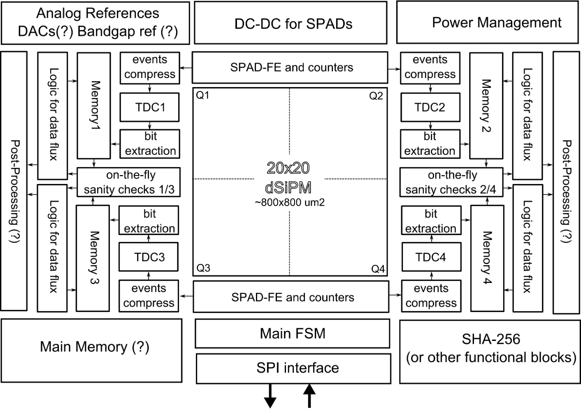
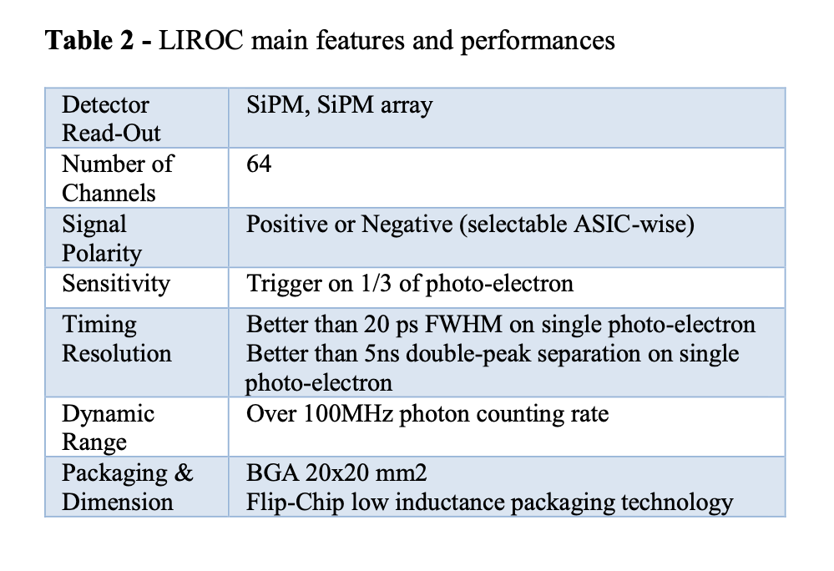
7.on going developments:
design a FIPS-compliant ASIC embedding a SPAD array in standard CMOS technology:
design a scalable multi-generator system based on an array of SiPM and a LIROC front end ASIC by LIROC
the “generator”
raw bit rate: 50 Mbps/board
FIPS mode (NIST DRBG): 32x the raw bit stream
DRBG isolated in the Trusted Execution Environment of a KRIA KR26 System-On-chip
raw bit rate: 1 Mbps
FIPS mode (NIST DRBG): 4096 Bytes in 1050 μs (31.2 Mbps) with prediction resistance
bits delivered in an encrypted stream - expected power: 100 mW
expected to be back from the foundry in Dec. 2023
Hw for the 64 generator board delivered in July 2023

Slide 25
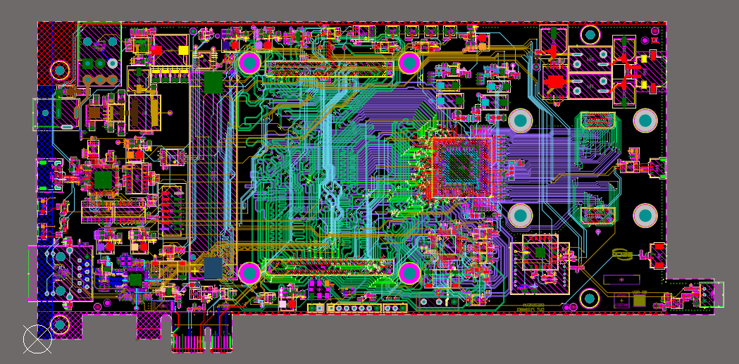
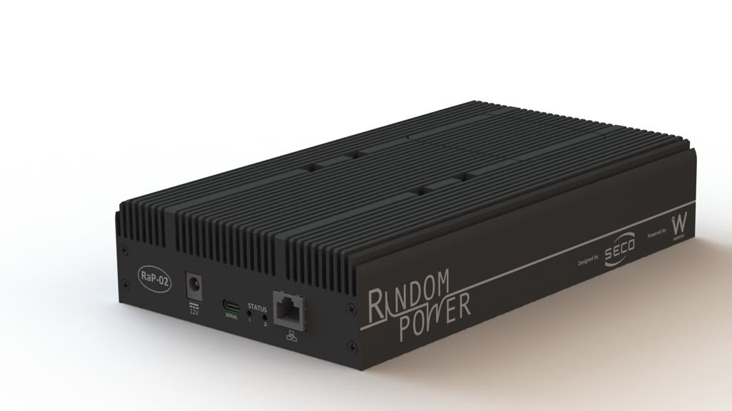
7.on going developments:
design a FIPS-compliant ASIC embedding a SPAD array in standard CMOS technology:
design a scalable multi-generator system based on an array of SiPM and a LIROC front end ASIC by LIROC
the “generator”
raw bit rate: 1 Mbps
FIPS mode (NIST DRBG): 4096 Bytes in 1050 μs (31.2 Mbps) with prediction resistance
bits delivered in an encrypted stream - expected power: 100 mW
expected to be back from the foundry in Dec. 2023
v1.0 delivered in July 2023, currently under test

Slide 26
8. how do we do it?:
Phase II:
submission Sept. 20th, 2021
notification of approval Jan. 31st, 2022
Duration: May 2022 to August 2024
funding: 2 MEUR
selection & competitiveness:
1211 submissions in Phase 1 ➜ 170 approved ➜ 87 submissions for phase II (68 R&D proposals) ➜ 18 R&D approved
combined success rate: 18/1211 = 1.5%, so we did well!

Slide 27
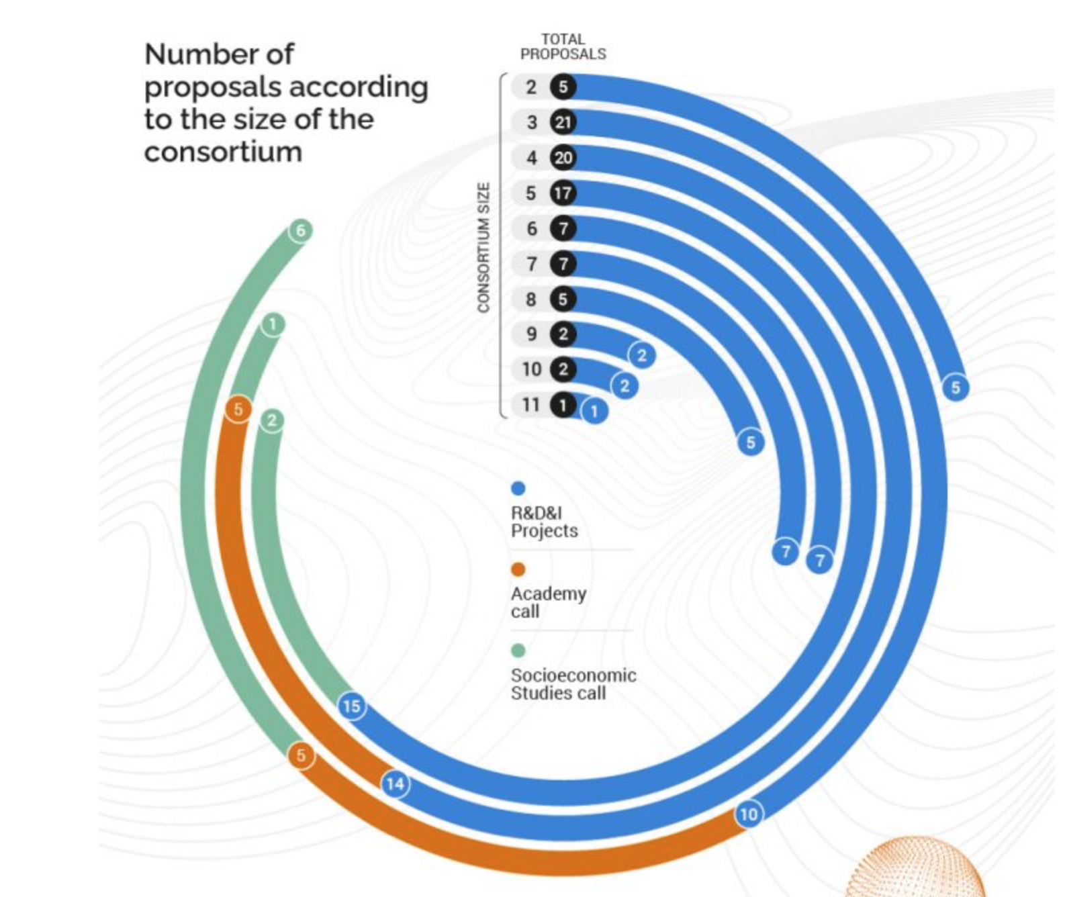
8. how do we do it?:
Our consortium:
leading party
18 man-years dedicated to the project

Slide 28
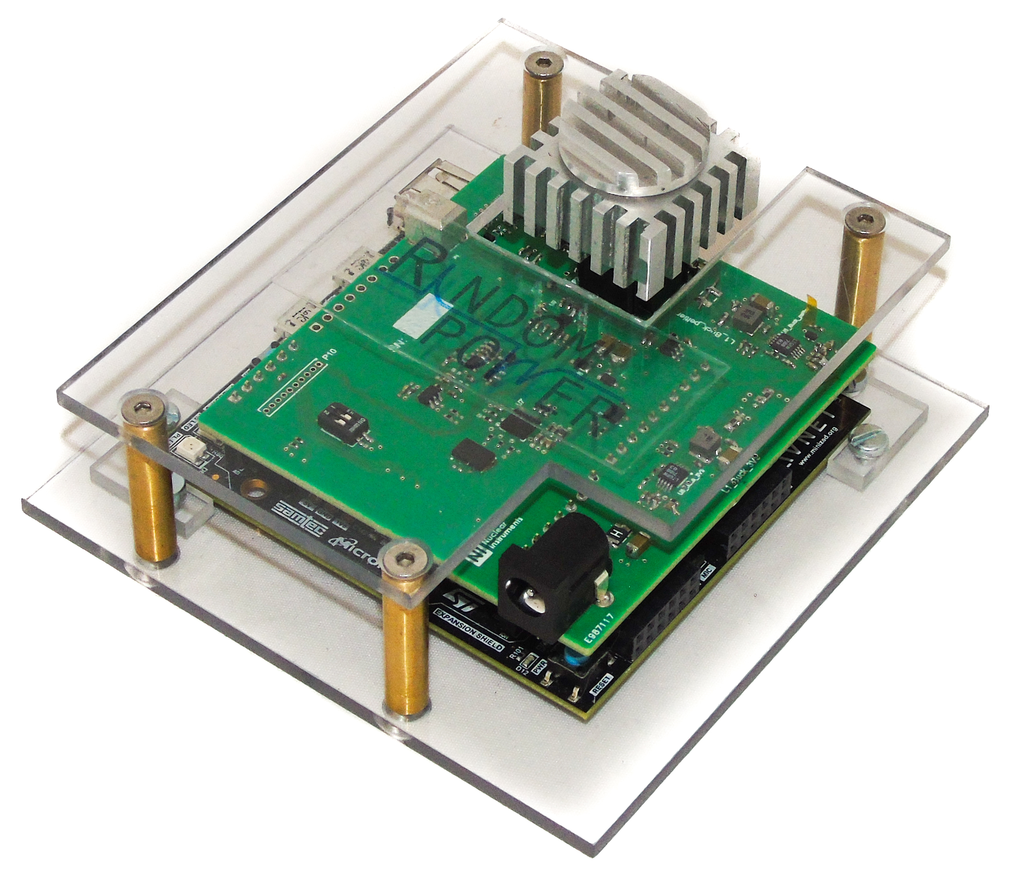
9. last but not least:
A BIT OF HISTORY
Approval & kick-off of the ATTRACT Phase 1 proposal (May)
design, commissioning and production of the single generator board;
The 2018 Demo Board
Unpredictability of the generated random bit sequence is assessed using the NIST standards
2016
2018
2020
2017
2019
The principle at the base of RandomPower emerges, as result of a genuine serendipity event. Initial tests performed with lab equipment
A demo board is designed, commissioned and qualified;
Italian patent filing completed (October)
launch at the CyberSecurity week in Le Hague (October)
submission of the ATTRACT Phase 1 proposal (October) (100 kEUR)
End of the ATTRACT Phase 1 project (October)
Full characterisation of the single generator board
winner of the Start-Cup competition (regional level; 20 kEUR)
winner of two special prizes by investors at PNI, start-up competition at national level
Italian patent granted

Slide 29
9. last but not least:
Chip delivery (February)
Chip qualification and packaging (May-June)
v1.0 of the FIPS compliant sw architecture for the multi-age board
FIPS 140-3 certification started
Business plan v2.0
End of the ATTRACT Phase 2 (August?)
Execution of the next investment round
Engineer co-development of applications
GO TO MARKET!
approval of the ATTRACT Phase 2 proposal (January) (2 MEUR)
kick-off of the ATTRACT Phase 2 (May)
proto-farm commissioned
implementation of the TESTU01 suite, complementing the NIST test (1.5 Tb qualified)
winner of the Falling Walls venture int’l competition (November)
US and EU patent granted
2021
2023
2022
2024
first implementation of real-time sanity checks
company establishment (June)
investment (200 kEUR) by LifTT, our VC (June)
Submission of the ATTRACT Phase 2 proposal (September)
real-time sanity check implemented
design of the multi-gen board completed (April) v1.0
commissioning of v1.0 started (July) ; qualification expected by December
chip submission expected by mid-September
Engineering of the next investment round (including Exploitation agreements)

Slide 30
Join us, we will be happy to walk with you!
2020 Winner of 2 “special prizes”
2020 Winner - ICT
2021 PoC investment by LifTT, a VC located in Torino (ITALY)
www.randompower.eu
2022 winner @the Falling Walls venture competition
for curious people:
here & and there
Established in June 2021
CONTACT US at:
massimo.caccia@randompower.eu
marcello.esposito@randompower.eu
lorenza.paolucci@randompower.eu
This project has received funding from the ATTRACT project funded by the EC under Grant Agreement 777222
Notes:
To change the image behind the Mock up.
Select the layer - > Right Click -> Send to Back -> Delete the image -> Drag & Drop your Own Picture -> Send to Back (again)

