Slide 2
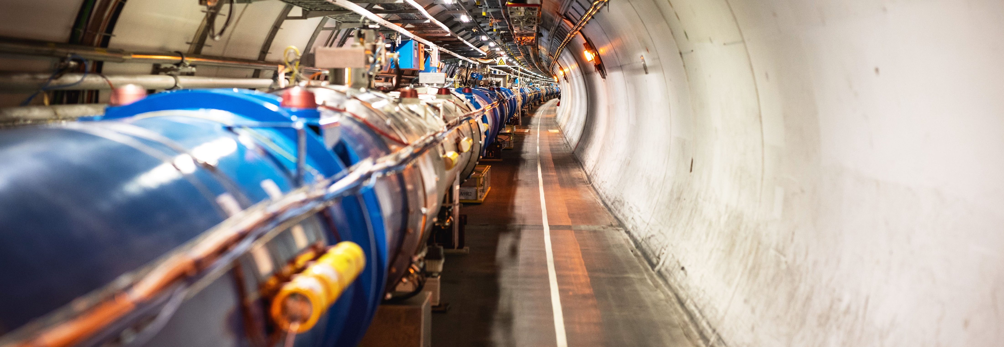
Accelerating Innovation
How CERN Technology Makes its Way into Society
Giovanni Anelli, Head of Knowledge Transfer Group, CERN

Slide 3
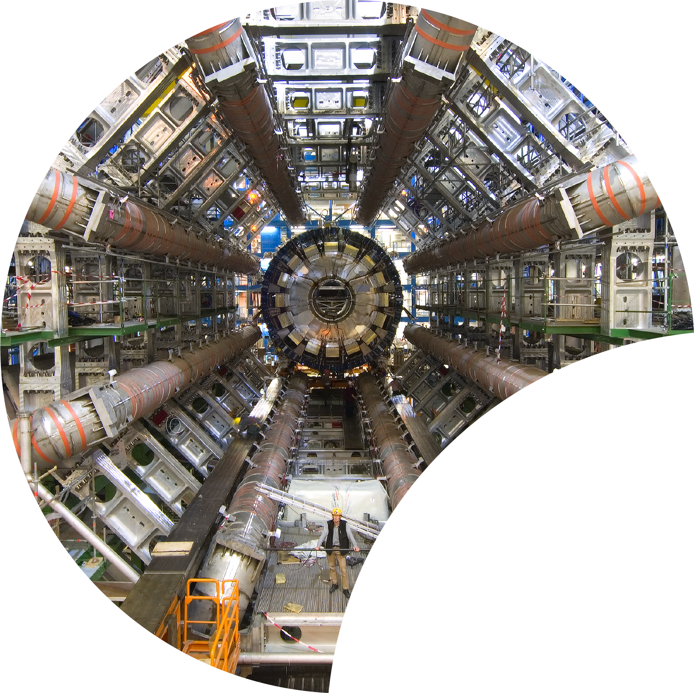
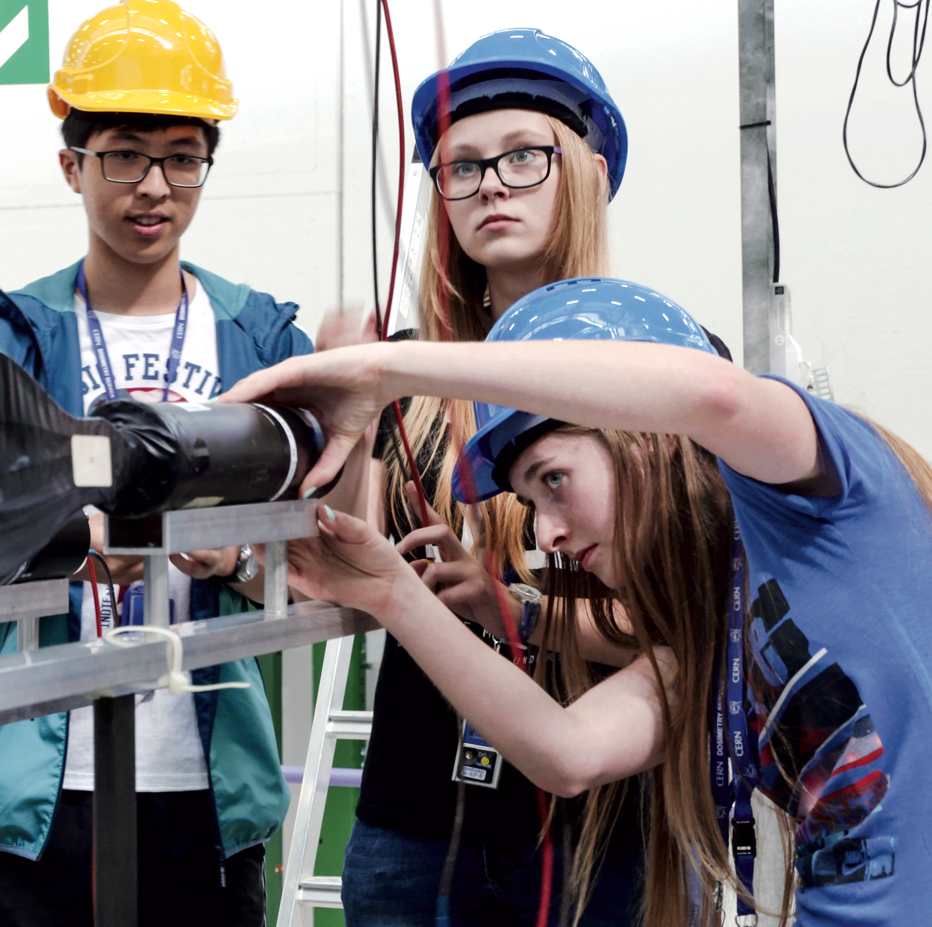

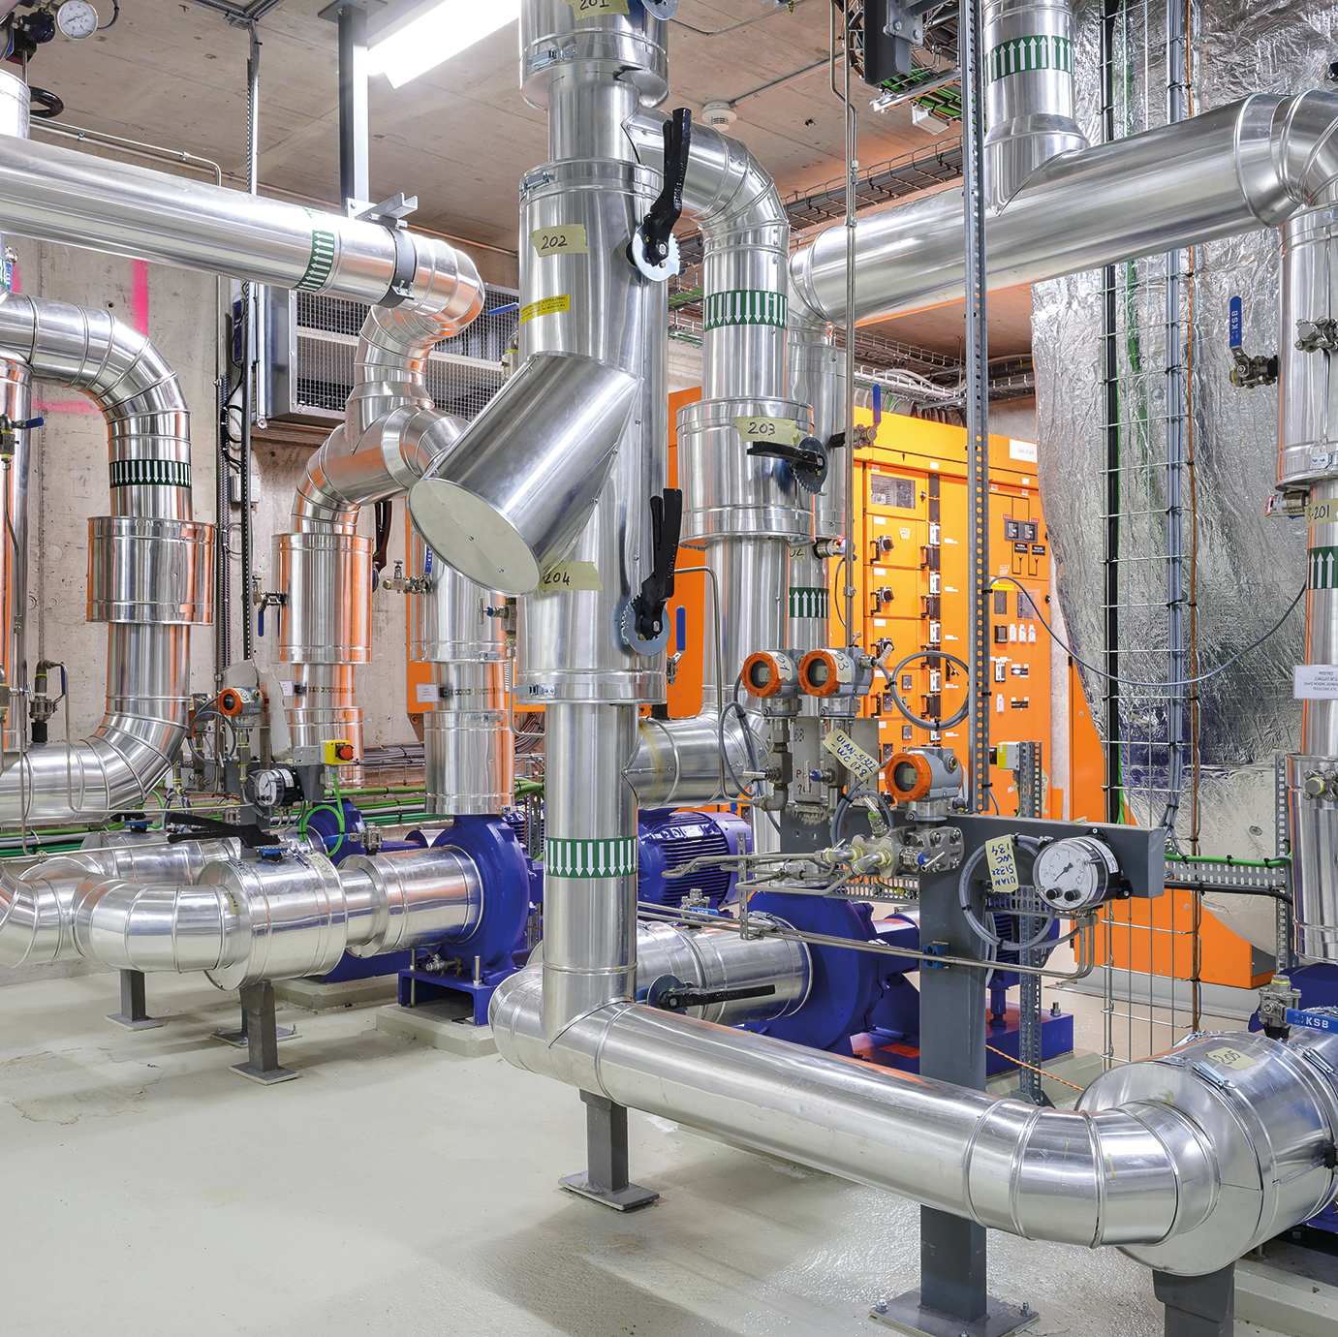

Four pillars underpin CERN’s mission
RESEARCH
EDUCATION
& TRAINING
COLLABORATION
TECHNOLOGY
& INNOVATION

Slide 4
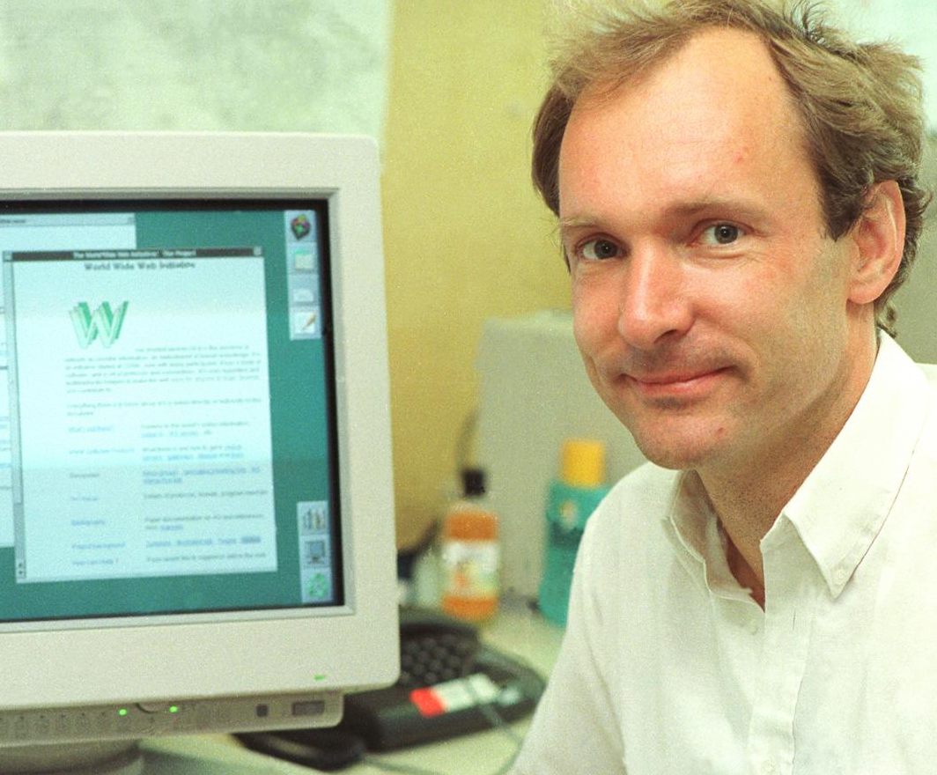
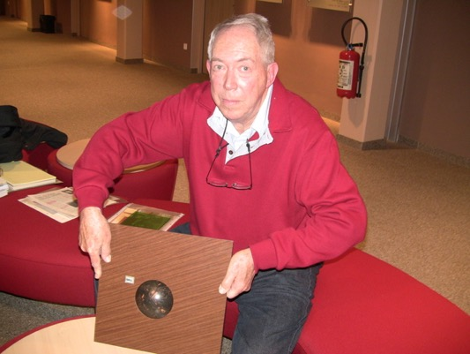
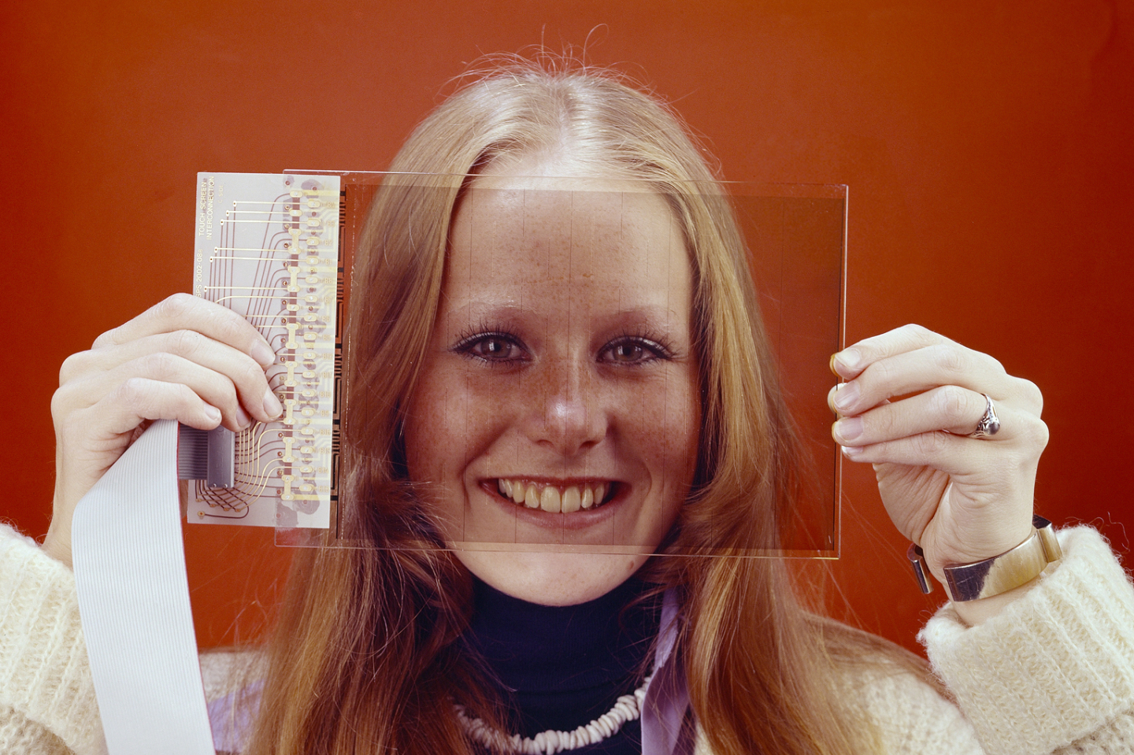
Some historic examples
WWW
TRACKERBALL
TOUCHSCREEN

Slide 5
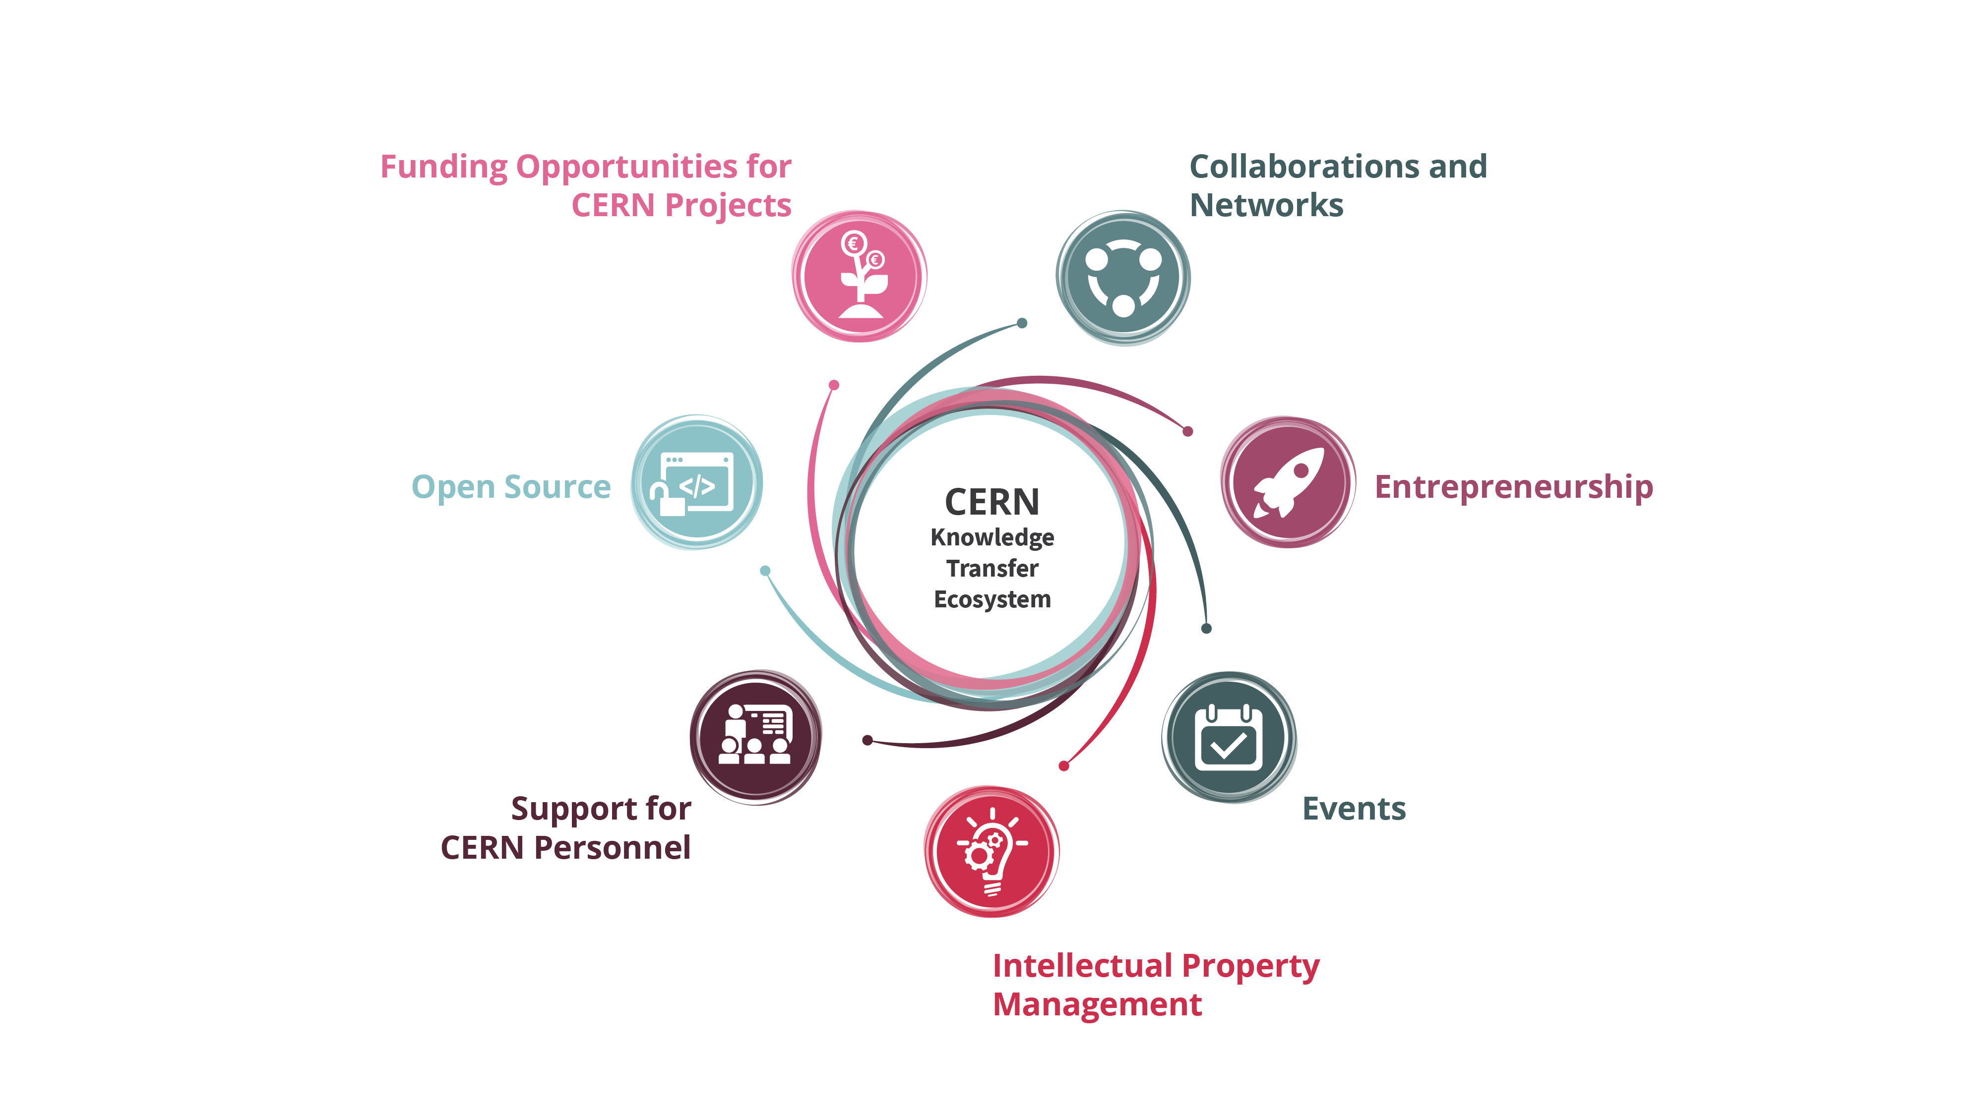
Our toolbox to accelerate innovation

Slide 6
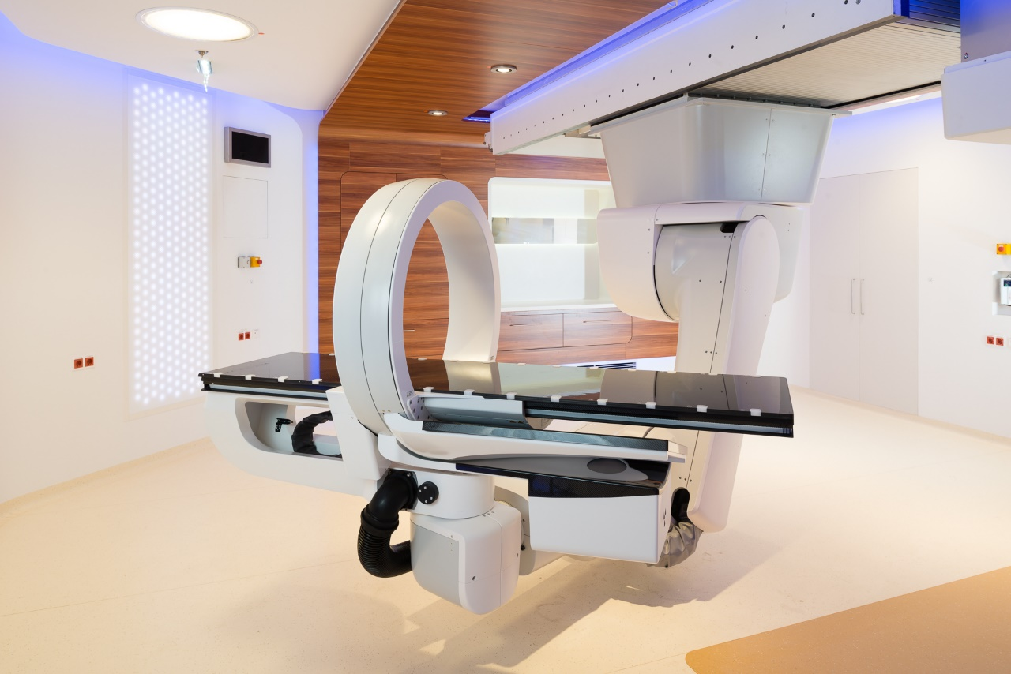
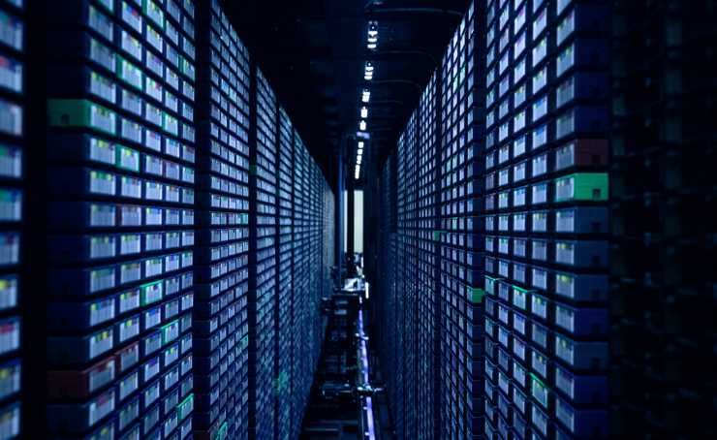
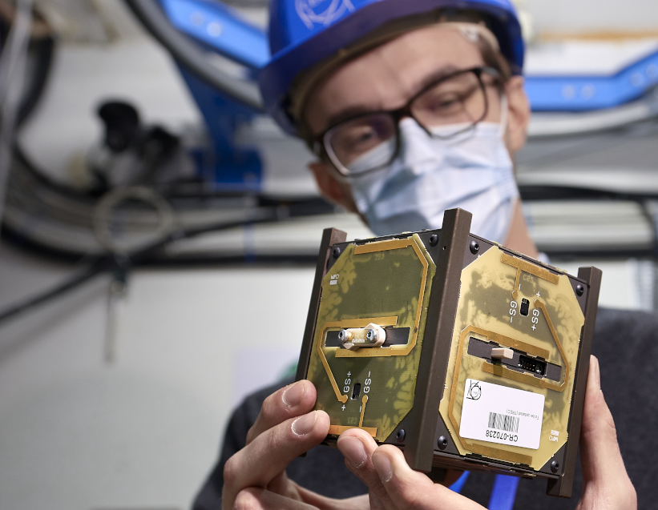

CERN as trusted non-commercial innovation partner
HEALTHCARE
ENVIRONMENT
DIGITAL
AEROSPACE
QUANTUM

Slide 7
Hybrid strategy: tech push & market pull
Scout for technologies
Search unmet needs
Mobilize tech experts
Mobilize innovation partners
Create tech and IP dossiers
Create value propositions

Slide 8
Shaping innovation partnerships
Discover
Discussion with Innovation / R&D management
Discovery day program at CERN
Shape
Define innovation ambitions and technical needs
Discuss expertise contributed by partners
Execute
Formalize partnership:
- Collaborative R&D
- License
- Consultancy
- Contract Research
Find mutual interest
Timeline, resources, IP

Slide 9
MedAustron and CNAO offer hadron therapy using CERN technology.
Collaborative R&D

Slide 10
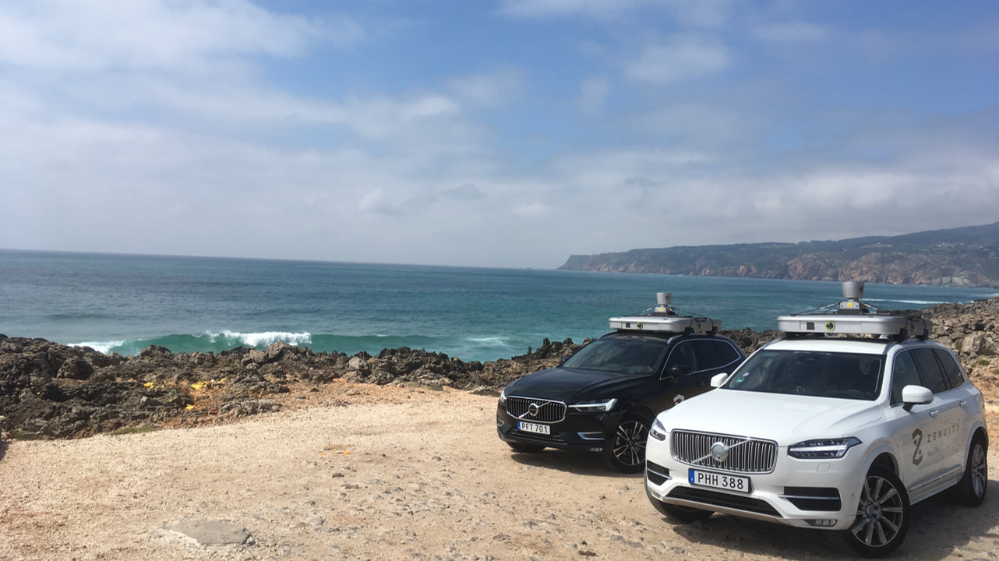
ZENSEACT (Volvo Cars Company) teams up with CERN on extremely fast machine learning using FPGAs.
Collaborative R&D

Slide 11
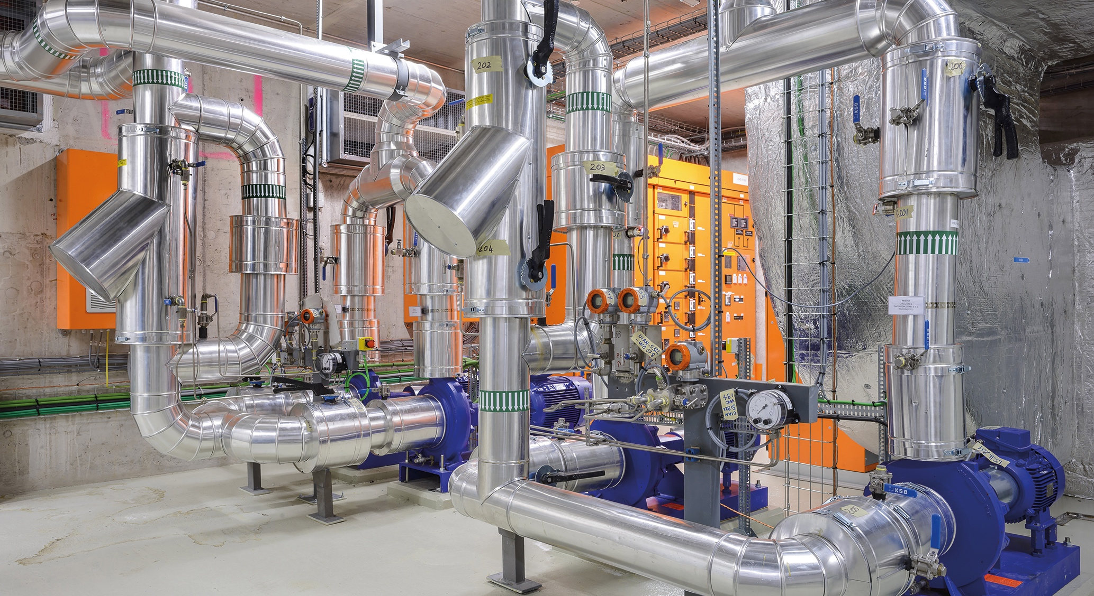
ZENSEACT (Volvo Cars Company) teams up with CERN on fast machine learning using FPGAs.
Collaborative R&D
Collaborative R&D
CERN and ABB team up on reducing electricity in cooling and ventilation.

Slide 12

Collaborative R&D
Collaboration with CORMEC and WUR to support national banks and regulators to detect trading anomalies in stock market.

Slide 13
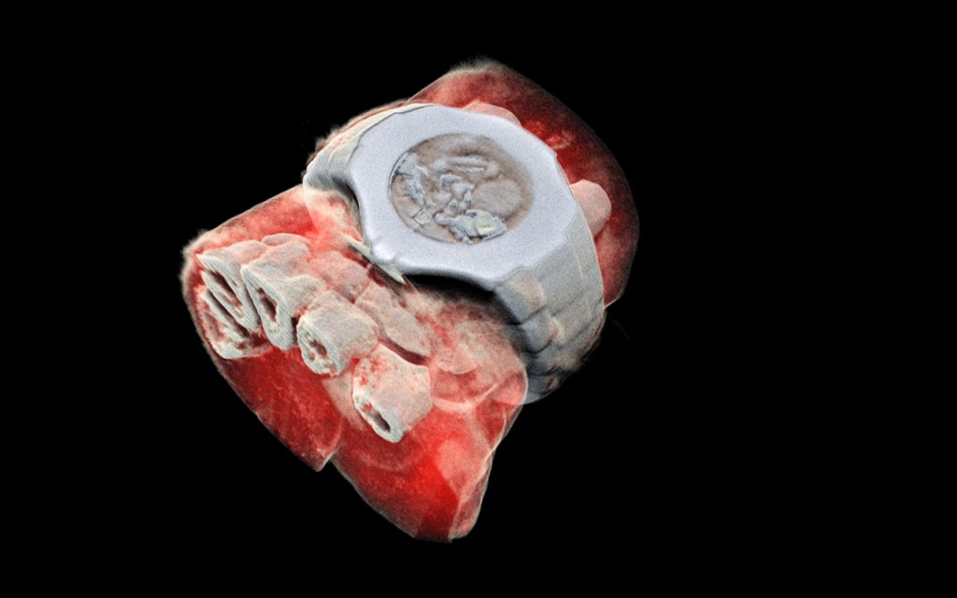
License
MARS Bio Imaging: next generation X ray finally in color using CERN chips

Slide 14
Key lessons learned when innovating together
  CERN is strong in the ‘extremes’ of the technology scale
  You need passionate experts on both sides to succeed
  Start with a concrete project and clear business need
  Mind the gap – in language, ‘clockspeed’ and culture
  Driving deep tech innovation requires courage
Key challenges
  CERN experts are busy
  Our technologies have low TRL
  What is our Unique Value Proposition?

