Slide 1












Why ATTRACT?
Pablo Garcia Tello and Markus Nordberg,
ATTRACT Coordinators

Slide 2

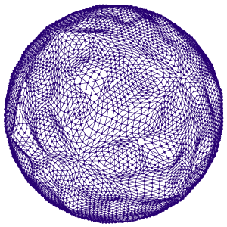
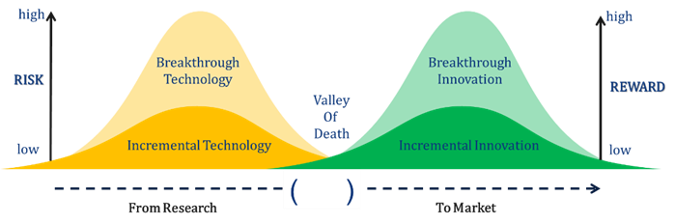
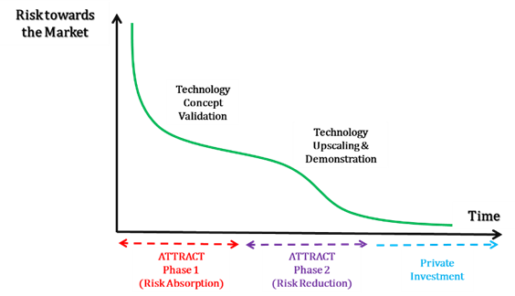
ATTRACT: Key pillars (2)
“Not two Valleys of Death look the same”
ATTRACT Phase 1 → Risk Absorption → 170 projects funded out of 1200 for achieving TRL 3.
ATTRACT Phase 2 → Risk Mitigation → 18 R&D&I projects funded coming from Phase 1 for achieving TRL 7.
Upscaling of the involvement of young innovators with the ATTRACT Academy.
A foresight socio-economic study about the impact of ATTRACT started.

Slide 3
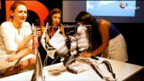
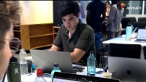
ATTRACT ACADEMY
“Young people want to change the world”
Young Innovators Projects:
ATTRACT is facilitating the integration of interdisciplinary MSc level students tems working side by side with professional researchers from academia and industry developing the R&D&I funded projects.
These Young Innovators’ goal is prototyping technology solutions specifically addressing the United Nations Sustainable Development Goals,
They use a Design Thinking approach inspired by the technology developed by the projects.

Slide 4
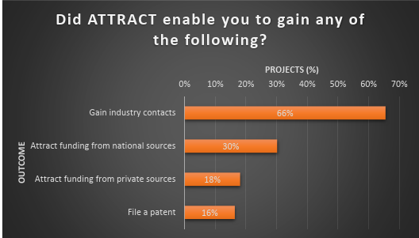
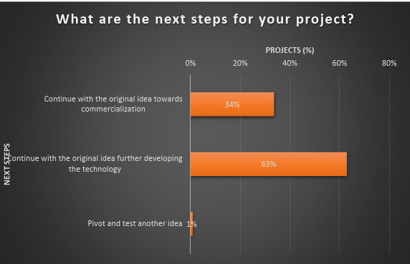
ATTRACT: Some figures of merit (1)
“How are we doing even just after Phase 1?”
Even at low TRL, 18% of the funded projects got private investment.
30% of the project got additional National Funding.
34% of the project will go towards commercialization.

Slide 5
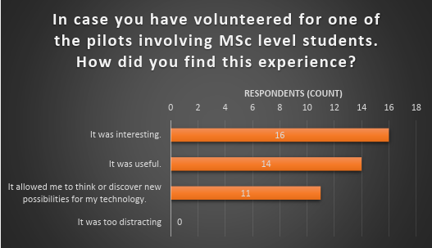
ATTRACT: Some figures of merit (2)
“How are we doing even just after Phase 1?”
11 projects discovered new potential applications of their technology proposed by the interdisciplinary MSc student teams.

Slide 6
ATTRACT model: The Future?
Why:
Ensuring long term EU Science and Deep Tech sovereignty and competitiveness.
Uniting the whole National and pan-European RIs under a common technology-based roadmap in collaboration with Industry.
Training and retaining young European talent and providing them with hands-on opportunities for accessing the job market.
Alignment with the NEIA:
Accelerating and strengthening innovation in European Innovation Ecosystems across the EU
Addressing the innovation divide.
Fostering, attracting, and retaining talents.

Slide 7


Thanks!
This project has received funding from the European Union’s Horizon 2020 research and innovation programme under grant agreement No. 101004462

