Slide 1


Technology Transfer in particle physics research institutes:
the case of the National Institute of Nuclear Physics (INFN)
Mariangela Cestelli Guidi
INFN KTT Coordinator

Slide 2
Outline
INFN overview and KTT framework
Strategy and actions supporting KTT
Success stories

Slide 3
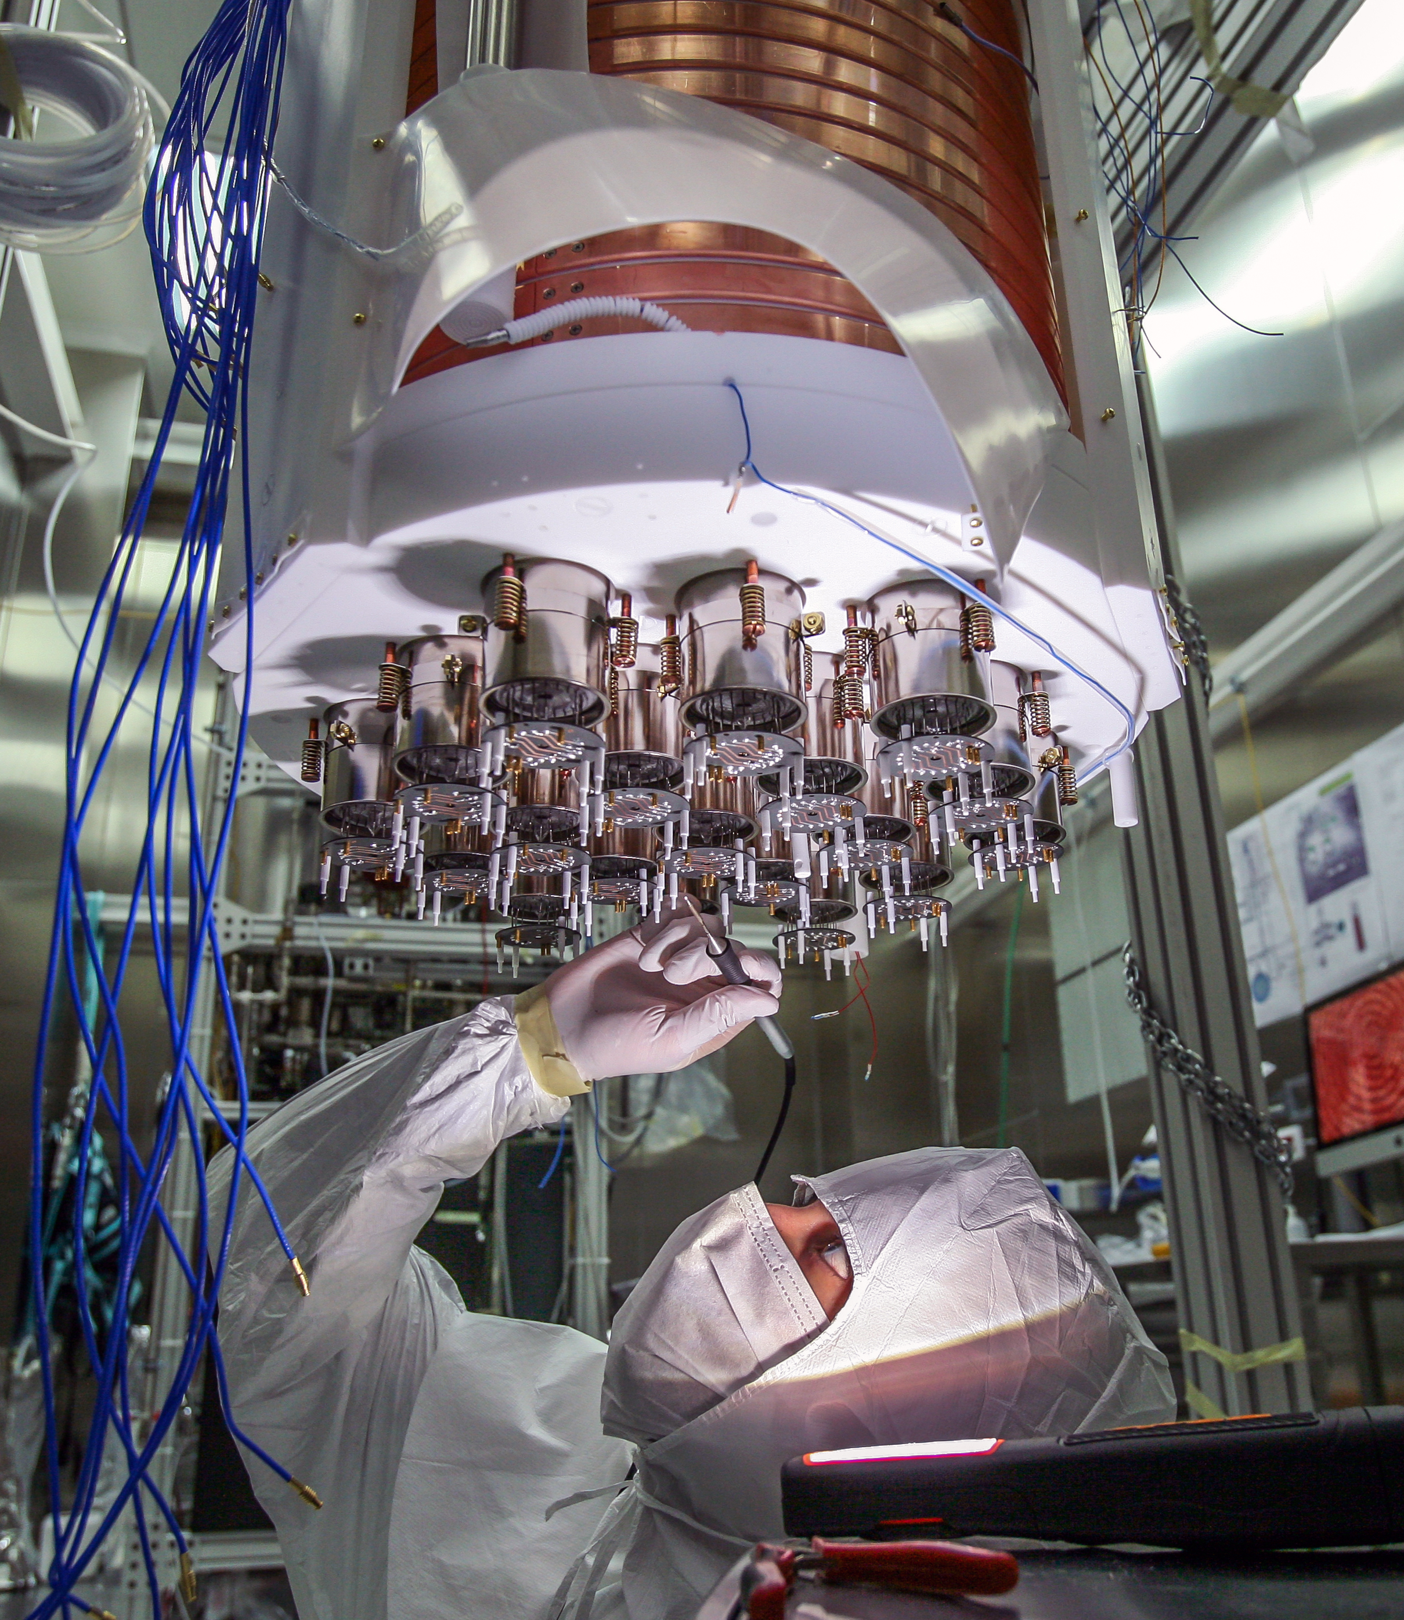


The INFN is
a community of over 6,000 people,
with a very focused mission on theoretical and experimental research in the fields of subnuclear, nuclear and astroparticle physics.

Slide 4





INFN facilities
LNF
Laboratori Nazionali di Frascati
4 National Laboratories
LNGS
Laboratori Nazionali del Gran Sasso
LNS
Laboratori Nazionali del Sud
LNL
Laboratori Nazionali di Legnaro
TIPP2023 | M. Cestelli Guidi

Slide 5




INFN facilities
3 National Centres
CNAF
Centro per la ricerca e lo sviluppo
nelle tecnologie informatiche e telematiche
TIFPA
Trento Institute for Fundamental
Physics and Applications
GGI
Galileo Galilei Institute
TIPP2023 | M. Cestelli Guidi

Slide 6
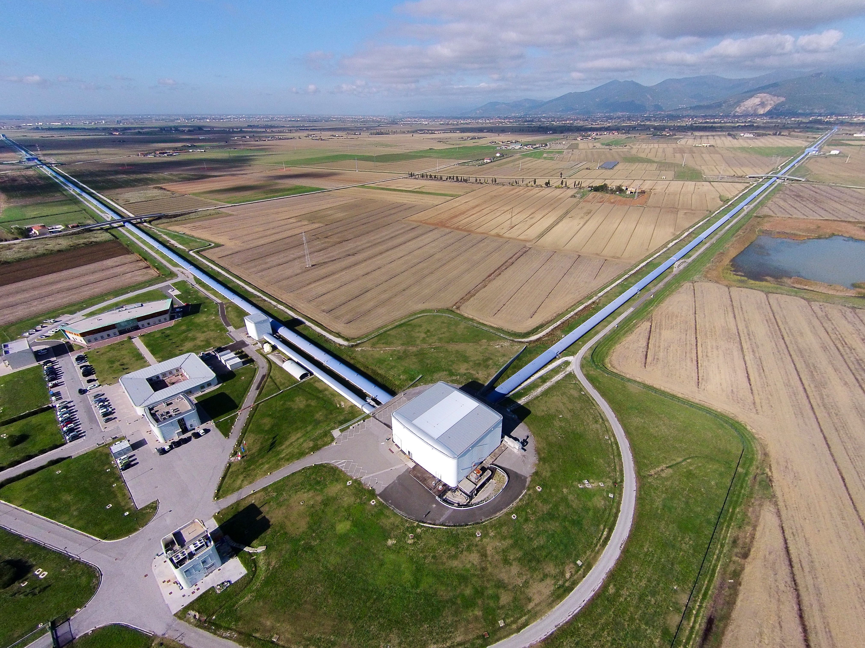
INFN facilities
EGO-VIRGO
European Gravitational Observatory
1 International Consortium
TIPP2023 | M. Cestelli Guidi

Slide 7
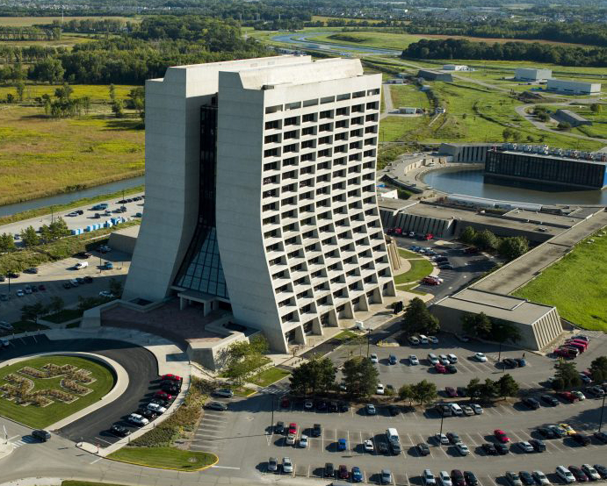
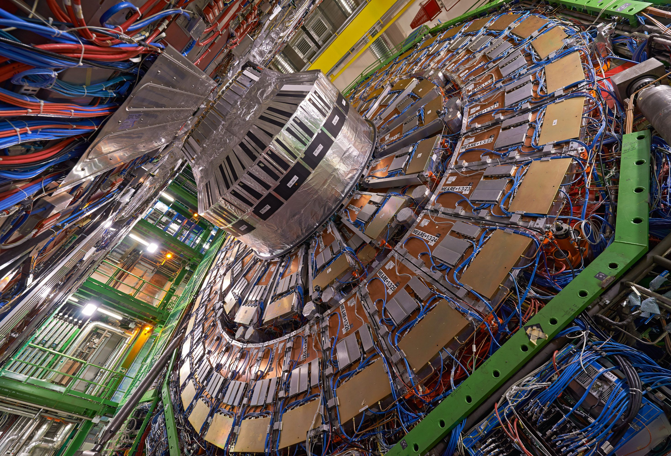
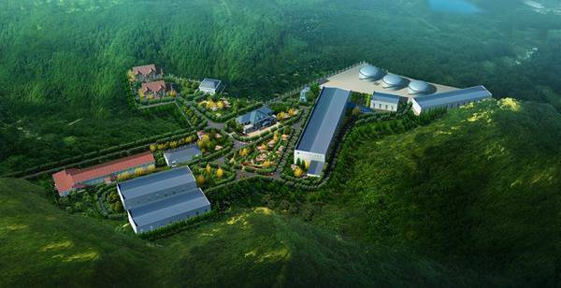
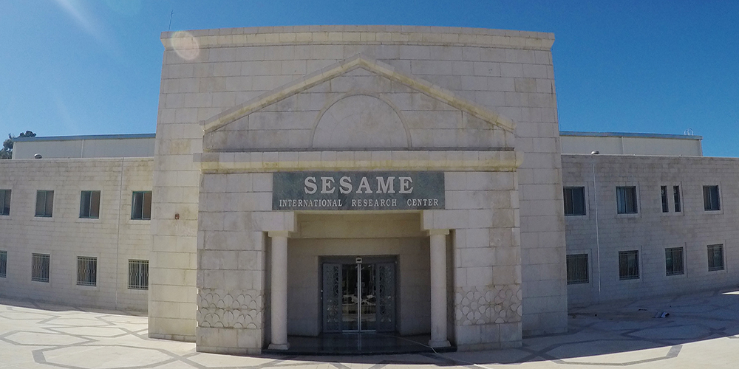
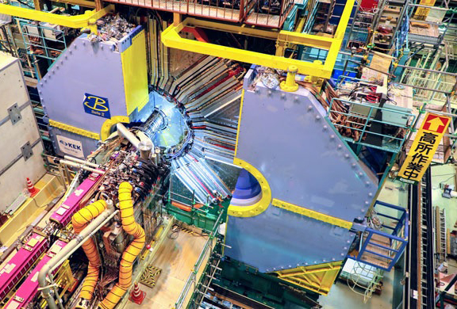
An
international DNA
TIPP2023 | M. Cestelli Guidi

Slide 8
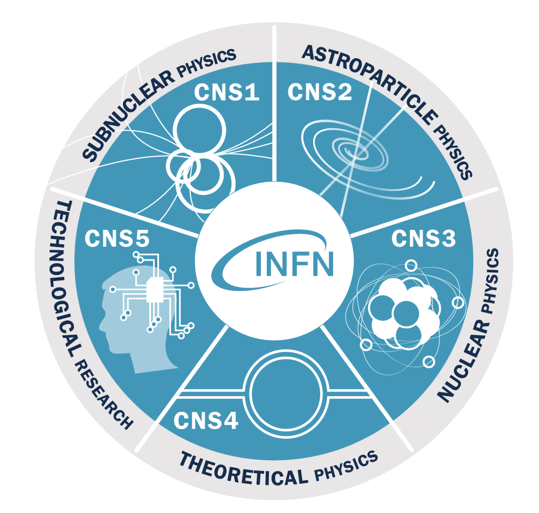

All of the INFN’s research activities are undertaken within a framework of international competition, in close collaboration with Italian universities.
The 5 research lines
and the National
Scientific Committee
CSN5 coordinates technological research and promotes the development of instruments, methods, and technologies for fundamental physics, as well as their application also in other scientific fields
TIPP2023 | M. Cestelli Guidi

Slide 9



KTT organization
Accelerators
Computing
Electronics
Materials
Detectors
TT referents
TT Office
TT Committee
CSN1
CSN2
CSN3
CSN5
CSN4

Slide 10
Where we are:
Applied/fundamental research
Development
Innovation
Market
Multinational
SME
INFN
Engeneering departments
TIPP2023 | M. Cestelli Guidi

Slide 11
KTT Unit: Internal actions
Training/
support
IP protection
(patents, contracts)
Technology Scouting and funding projects

Slide 12


Technology scouting and valorization:
PoC strategic actions
31 project founded since 2018, total budget 150K€/year
12 months → increase TRL (4-6)
Internal peer review panel
External advisory board
Co-development with industry is strongly encouraged
19 Licences
3 Spin-off
11 Patent related
16 co-funded projetcs (2020-2024)
Existing patents
Budget 800 K€
TIPP2023 | M. Cestelli Guidi

Slide 13
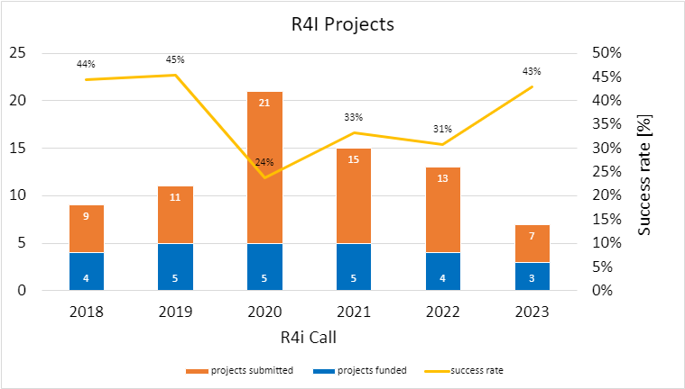
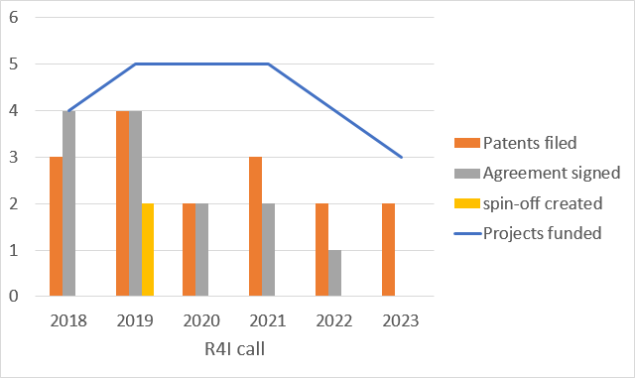
PoC program outcome
2024 edition: external advisory panel to evaluate business opportunities
TIPP2023 | M. Cestelli Guidi

Slide 14
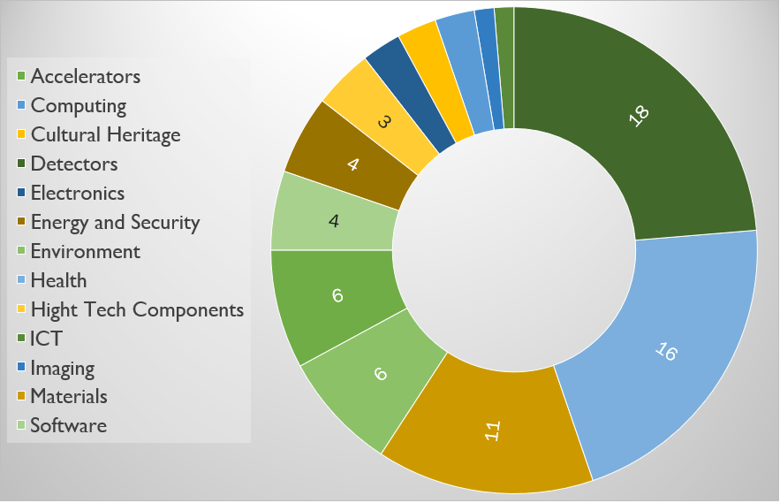
Technology Portfolio
https://web.infn.it/TechTransfer/index.php/en/technologies
TIPP2023 | M. Cestelli Guidi

Slide 15
KTT Unit: Partnership/exploitation
Consultancy and services
Licencing/
spin-off companies
Collaborative/
contract research

Slide 16
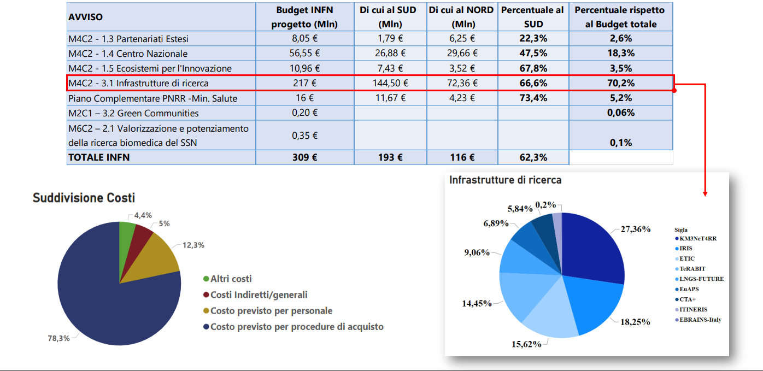
EU Recovery fund
TIPP2023 | M. Cestelli Guidi

Slide 17
Strenghtening partnership with industry
DEVELOPMENT OF NEW TECHNOLOGY /
PROTOTYPE
INNOVATIVE PROCUREMENT | CO-DEVELOPMENT
PROCUREMENT
Technical content
EXISTING TECHNOLOGY
NO TECHNOLOGICAL CONTENT
Already existing in the company
Non Existing in the company
Industry technical competences
TIPP2023 | M. Cestelli Guidi

Slide 18
~200 company profiling
Mainly SME
Active in the national market
High/low investment in R&D
TIPP2023 | M. Cestelli Guidi

Slide 19
Impact on supplier companies
Learning and innovation
Relationship with the market
Alliances and networking
TIPP2023 | M. Cestelli Guidi

Slide 20
Measuring the impact of Big Science on suppliers companies
Dal Molin, M., Lazzarotti, V. And Manzini, M., «Revealing the impact of basic research –industry collaboration: the case of the Italian National Institute for Nuclear Physics» - submitted to Research Policy
Dal Molin, M. and Previtali, E. , «Does public procurement in basic research favor technology and knowledge transfer to companies?» – to be submitted to Journal of Public Procurement
TIPP2023 | M. Cestelli Guidi

Slide 21


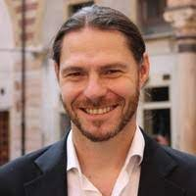

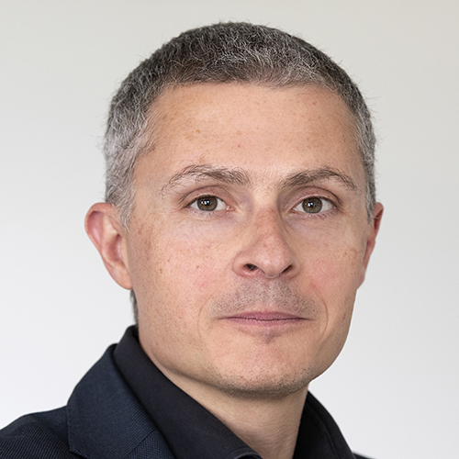
Platform for in-silico drug discovery.
The innovation is based on applying innovative algorithms derived from advanced mathematical methods of theoretical physics to transformative drug discovery protocols.
These proprietary techniques have enabled to reveal with atomic resolution the folding and misfolding mechanisms of bio-medically relevant proteins, thereby unveiling an entirely new class of pharmacological targets and at the same time enabling ultra-fast assessment of druggability of complex proteins, slashing development costs and computing time by order of magnitudes.
1° round 2.5 M€
2° round 23 M€

Slide 22


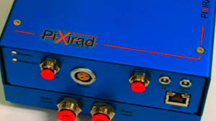
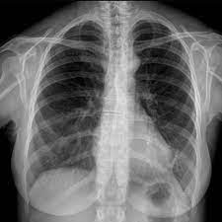
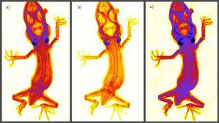
TIPP2023 | M. Cestelli Guidi

Slide 23
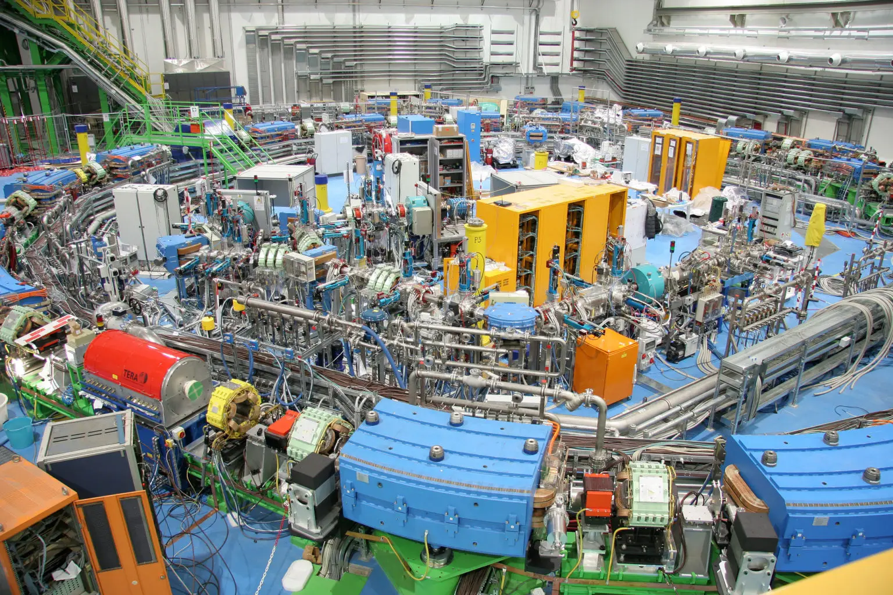
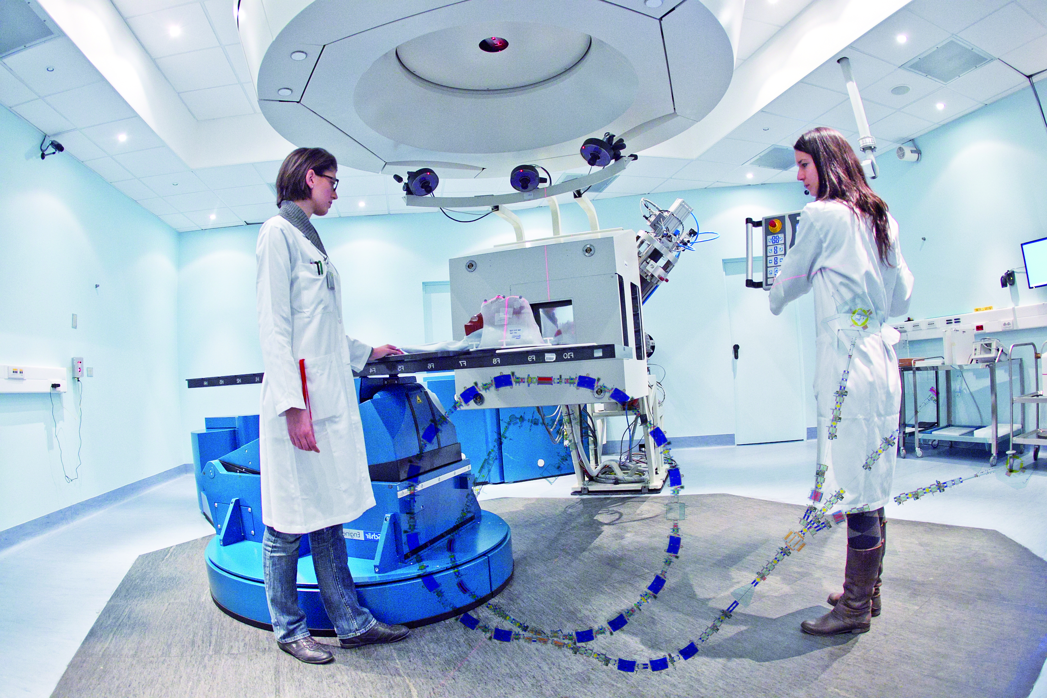

Centro Nazionale di Adroterapia Oncologica

Slide 24
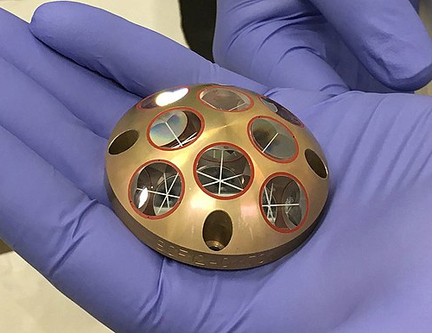


Galileo
Laser retroreflectors
12 LRR will be mounted on the II generation Galileo satellites
TIPP2023 | M. Cestelli Guidi

Slide 25

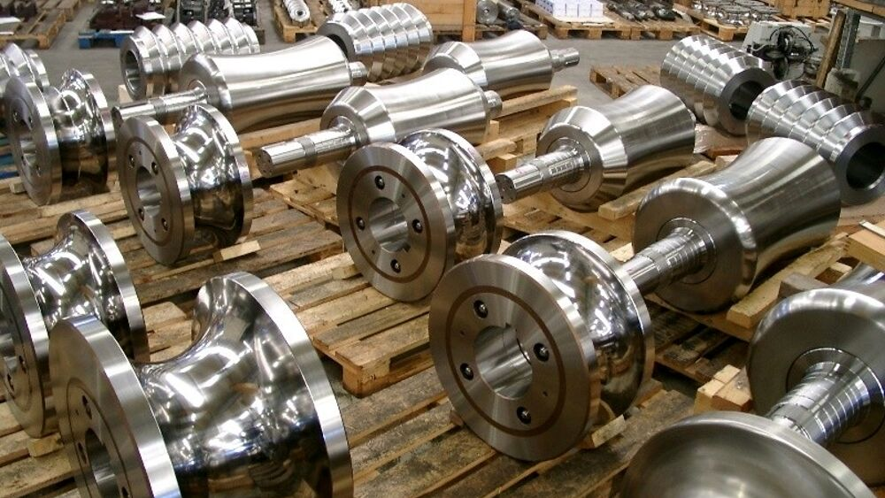
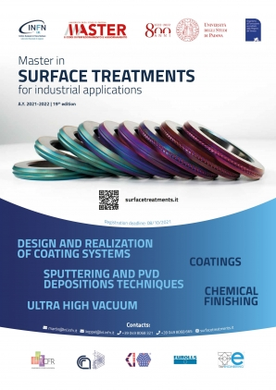
A physical vapor deposition system was developed to coat the mechanical components produced by Eurolls;
this is one of the most advanced technologies used in surface coating processes.
These physical processes are particularly ecological, they do not generate any harmful residues.
(Co-development, co-patenting)
TIPP2023 | M. Cestelli Guidi

Slide 26
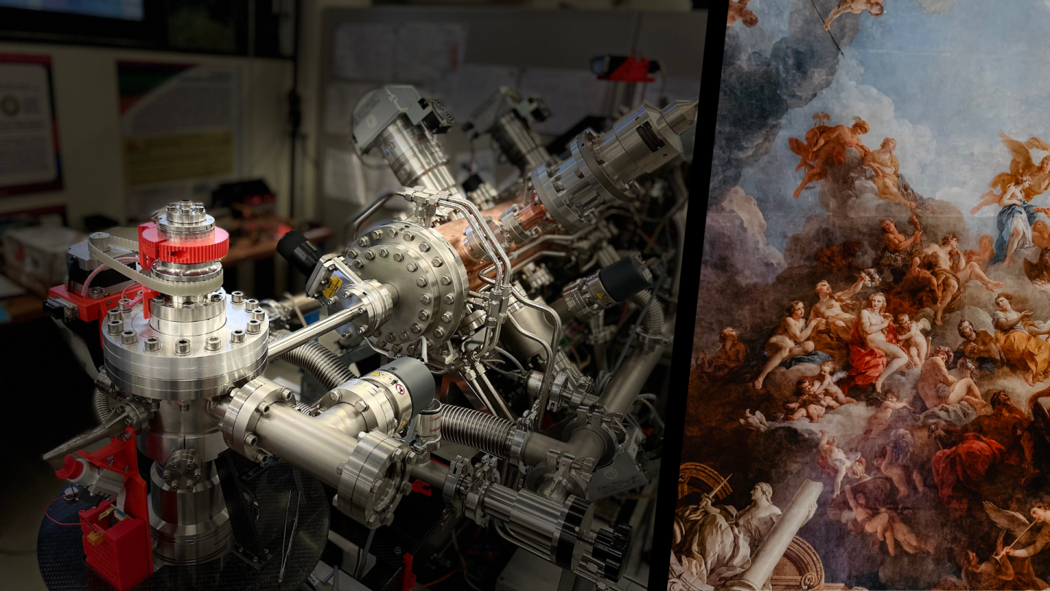

The MACHINA project
Compact accelerator for PIXE (Particle Induced X ray Emission)
analysis on cultural heritage. Under commissioning, installation
in 2024 in Florence

Slide 27
Challenges
Cultural change: increase the engagement of our researchers ….
Increase the industrial partnerships: it goes a long way to define a balance between push and pull-driven KTT strategies
Co-development must be supported by proper instruments: Firs bench test of an innovation center on additive manufacturing @LNGS is ongoing…
EU framework
TIPP2023 | M. Cestelli Guidi

Slide 28

Thank you

Slide 29
Backup

Slide 30
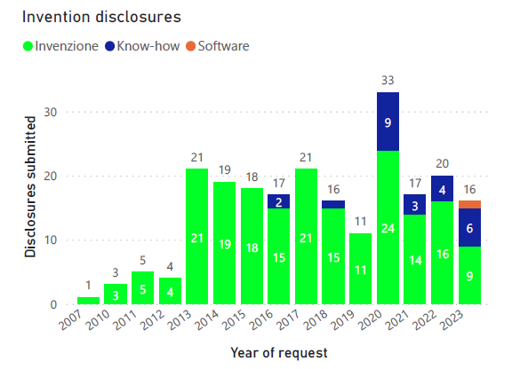
Invention disclosures
TIPP2023 | M. Cestelli Guidi

Slide 31
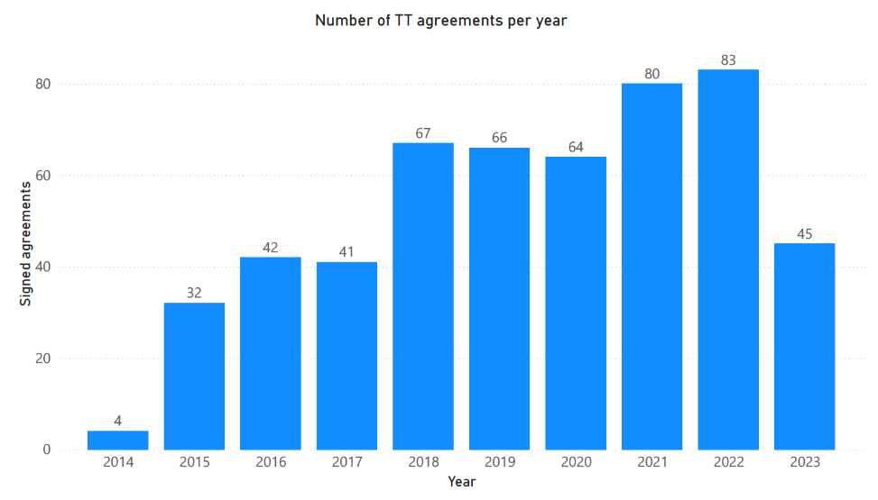
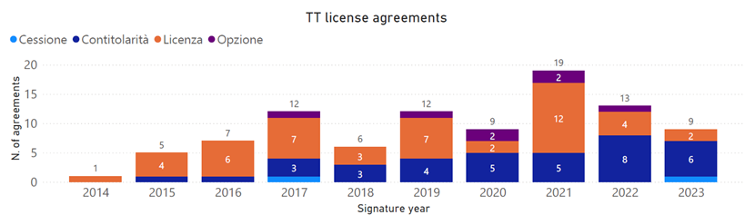
Licence agreements
(patents and know-how)
TIPP2023 | M. Cestelli Guidi

Slide 32
PoC evaluation criteria
Criteria | Description
Target Market | Clearly defined target market? Is large now or in future? Stable or high growth? High priced niche?
Problem or Need | Problem / need is real? Fad / Short term trend? Sustainable pain, challenge, need?
Solution/technology | Scientific POC? Industrial POC,? Better, Faster, Cheaper? Brand? Quality? Efficient? Convenient? Unique? Price? Value Prop? Development stage? Regulatory?
IP | Filed, granted, FTO analysis realised, patent portfolio, patent strategy, trade secrets, know how
Team, Board, Advisors | Industry knowledge, unique skills, leadership, key relationships, prior successes and/or failures
Competition vs. Competitive Advantages | Market positioning? Direct vs. indirect? Barriers to entry? Differentiation? Simpler alternative exists? Future obsolescence? Unfair or sustainable advantage? Patents? Partners? Key Risks?

