Slide 1
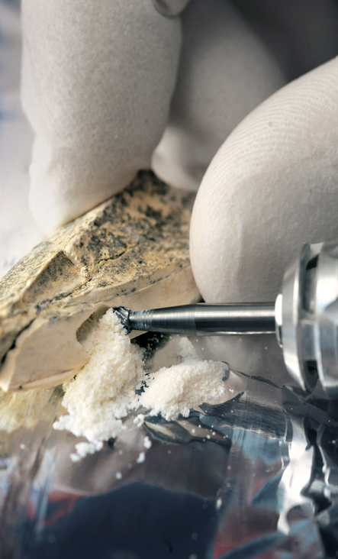
Max Planck Innovation: Patents and Licensing, and Startups – A Comprehensive Service for Max Planck Scientists
Wolfgang Tröger
September 6, 2023, TIPP 2023, Cape Town, South Africa

Slide 2
Agenda
MPG – Max Planck Gesellschaft zur Föderung der Wissenschaften e.V.
Max Planck Innovation GmbH (MI)
Basic Research – Game Changer
1st startup. UltraFast Innovations GmbH
2nd terraplasma GmbH
Max!mize Programme

Slide 3
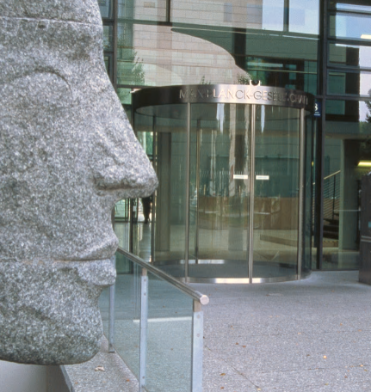
Max Planck Gesellschaft
"Knowledge must precede application.“
(Max Planck)
23,969 total staff as of Dec 2020
21, 187 contractually employed
542 sholarship holders
2,240 guest scientists
30 nobel laureates
Top 3 in the global list of highly cited researchers and in nature index
ca. € 2.22B total subsidy funding in 2020
ca. € 1.92B institutional funds, mainly from the federal government and the federal states
ca. € 300M project funds, governmental and federal, EU, DFG, other
86 MPIs
32 in natural sciences
29 in life sciences
22 in humanities

Slide 4
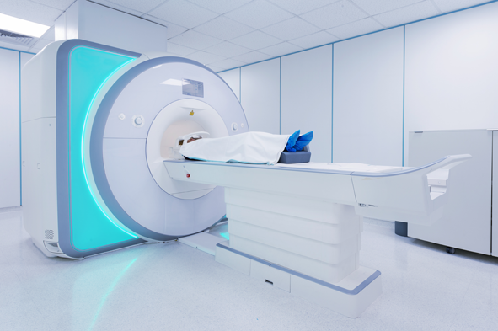
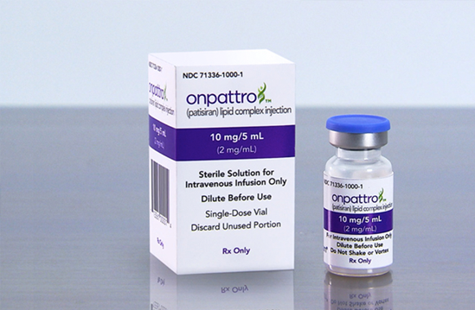
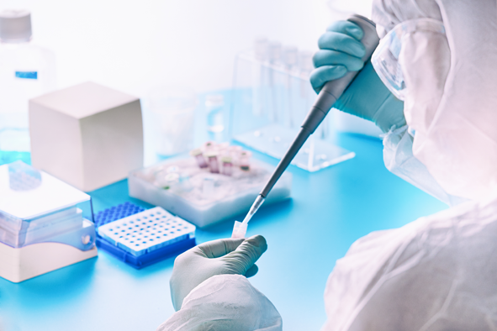
Basic research has game-changing potential
Knowledge & technology transfer at the MPG
Karl Ziegler MPI for Coal Research
Ziegler-Natta-Catalysts, 1953
Polyethylene production at normal pressure
€ 500+ m
Jens Frahm MPI for Biophysical Chemistry
FLASH, 1985
Magnetic resonance imaging
€ 155 m
Thomas Tuschl MPI for Biophysical Chemistry
RNAi, 2000
Tools and therapeutics
Alnylam Pharmaceuticals
€ 30 m
Igor Ivanov et Qiagen MPI for Molecular Genetics
HotStarTaq, 1998
DNA-Polymerase Kit
Qiagen
€ 13 m

Slide 5
Mandated by the MPG
Knowledge & technology transfer at the MPG
We have been helping scientists for more than 50 years to leverage the potential of their work.
MPG
MI
Society
Insights & ideas
by 86 Max Planck Institutes
Valuable products & services
New companies & jobs
100% MPG subsidiary
Central service unit for patenting, licensing and spin-off support
Exclusive partner for MPG scientists
Service free of charge for MPG scientists
All revenues passed through to MPG (33.3%), MPI (36.7%) and inventors (30% inventor’s remuneration)

Slide 6
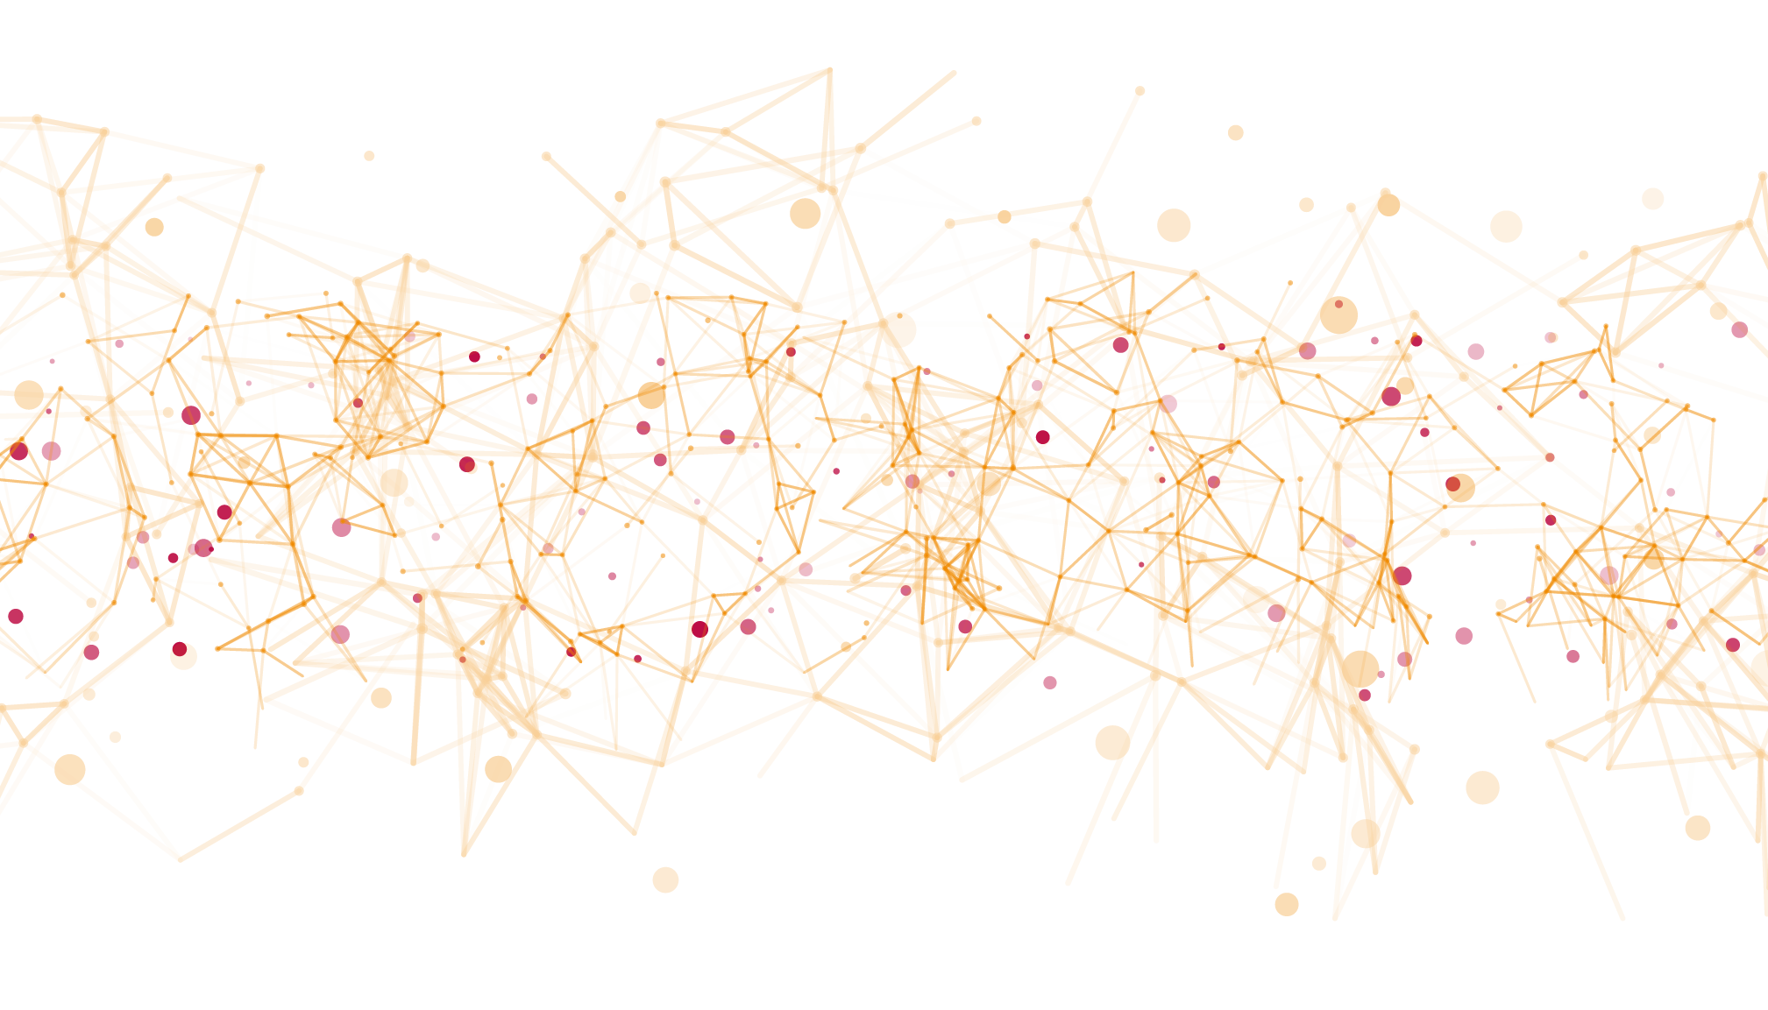
Connecting science and business.
Flexible collaboration with inventors, depending on each project’s needs.
Admin professionals
General managers
Start-up & portfolio managers
Inventors
Entrepreneurs
Patent & licensing managers
Inhouse counsels
Patent law firms*
Investors*
Founders
* External partners

Slide 7
A-Z partner on the road to application
Collaboration
Support the MPG legal team in complex deals
Conclude license agreements
Attract industry partner
Negotiate agreement
Follow compliance / manage law suits
Evaluate ideas
Educate on IP
Identify promising inventions
Evaluate commercial potential
Secure IP
Develop IP-Strategy
Apply for patents
Manage portfolio
Consult on translation
Help access 3rd party instruments for funding & validation
Support start-ups
Coach founders
Attract experts, managers, investors
Negotiate equity agreement
Consult / manage equity

Slide 8
Proven approach: MI figures since 1970
Knowledge & technology transfer at the MPG
€ 550M Revenues from license agreements
2,935 License agreements concluded. including 2,650 License agreements
50% in Germany, 50% globally
4,860 Inventions identified
2,600 approx. patent families filed
thousands of jobs created by licensing
€ 31.4M Revenues from M&As from 26 spin-offs
184* Start-ups, most of which were supported by MI
> 9,000 Jobs created by start-ups
*since 1990

Slide 9
Innovation is a risky business
We‘re fully committed to each single project. It might become a blockbuster.
About 25% of MPG technologies are commercialized
<1% > € 1M*
3% € 0.5 – 1M
20% € 0.05 – 0.5M
72% < € 0.05M
10 – 90 % attrition rate, 2 – 20 years development time, depending on the project type and sector
*numbers until 2019
Idea
Marketed product

Slide 10
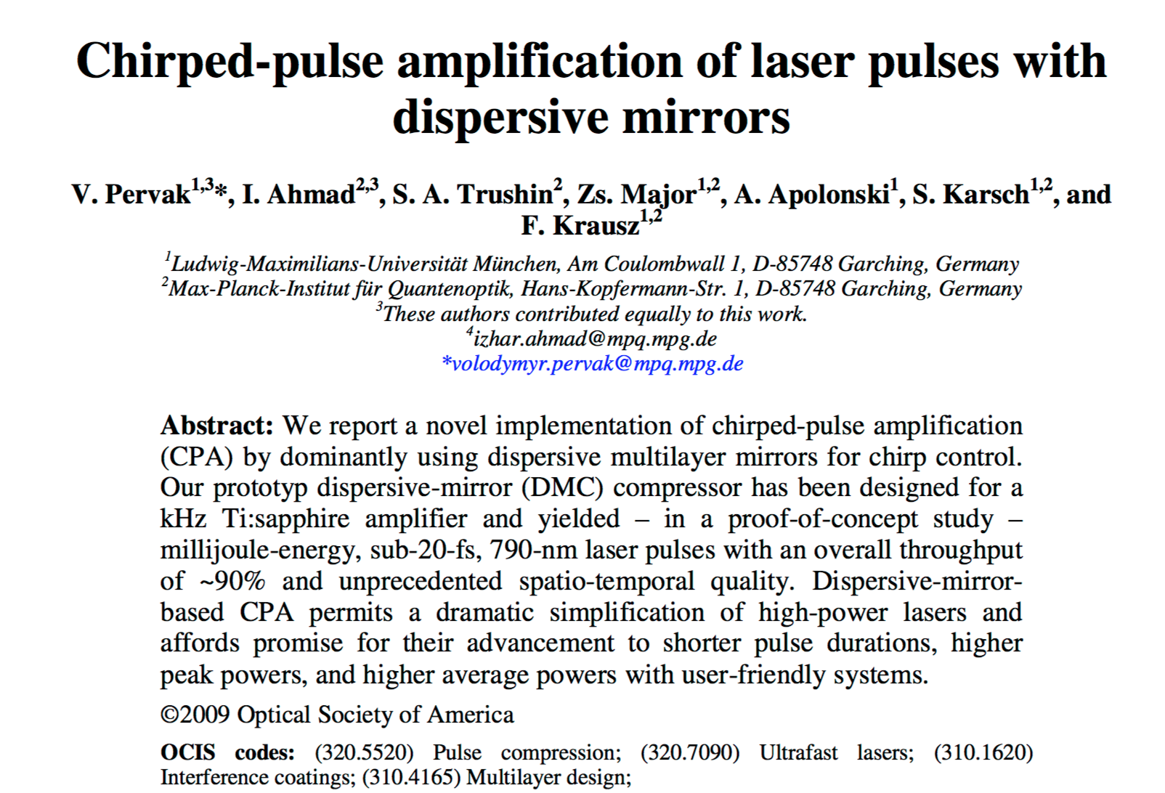
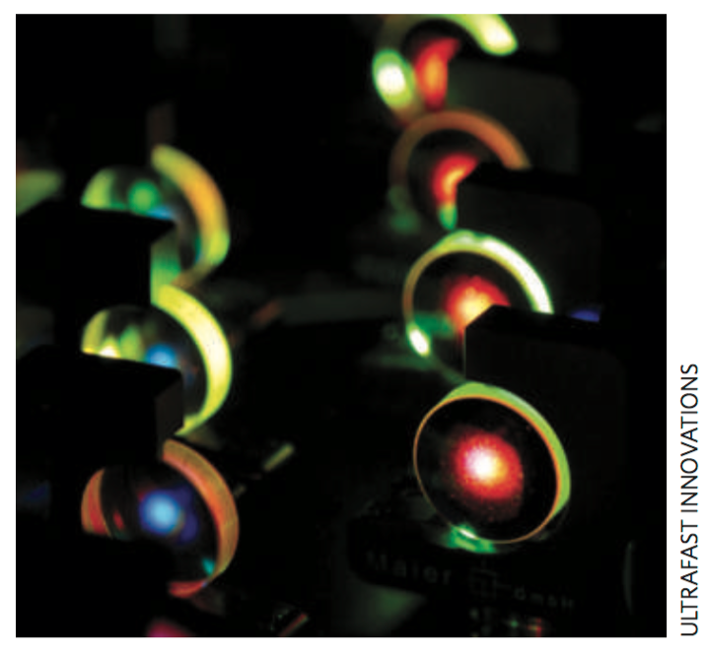
UltraFast Innovations GmbH 2009
Metallic multilayer mirrors can be used for the creation of ultra short
high power laser pulses

Slide 11
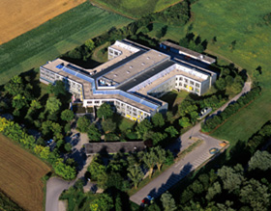
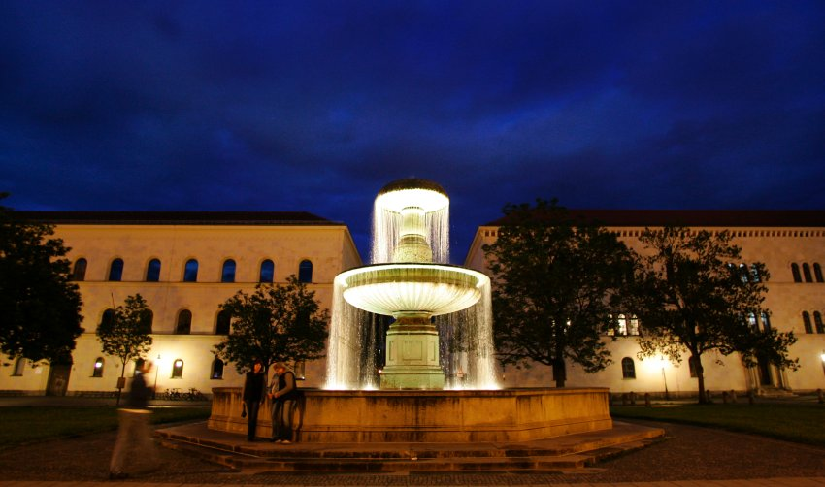
UltraFast Innovations GmbH 2009
Founding July 2009
by
Max Planck Institute of Quantum Optics (MPQ)
Max Planck Gesellschaft
Department of Physics
Ludwig-Maximilians-Universität München
Shareholders (50% each)
Owners of 3 coating machines
2009: 1 CEO and 1-5 part-time employees (project related)
2023: 1 CEO (the 5th) and 17 full-time employees – no investors

Slide 12
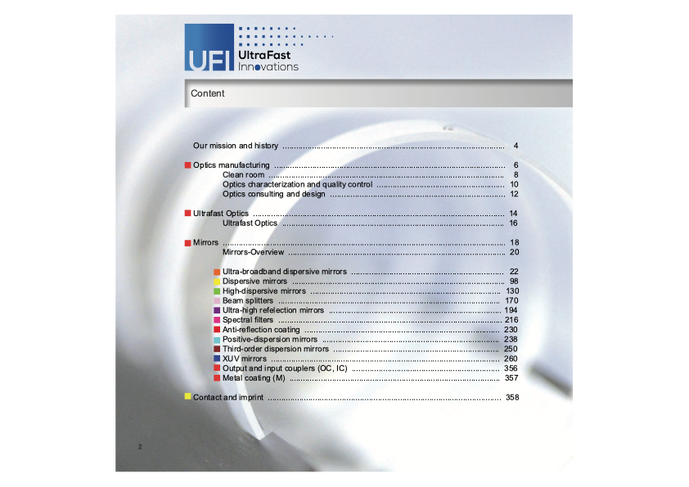
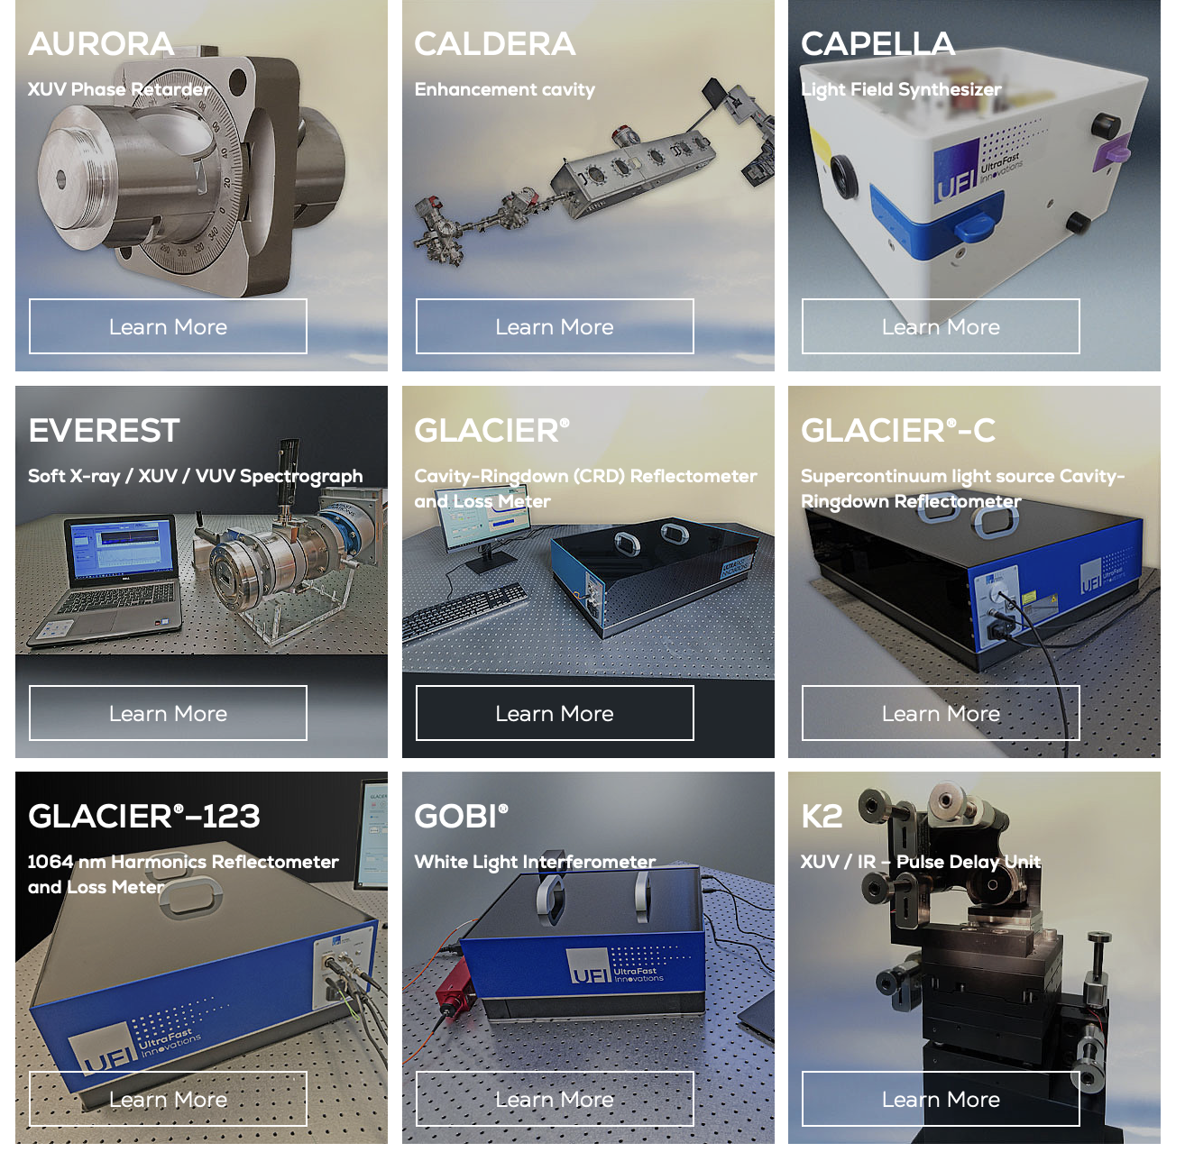
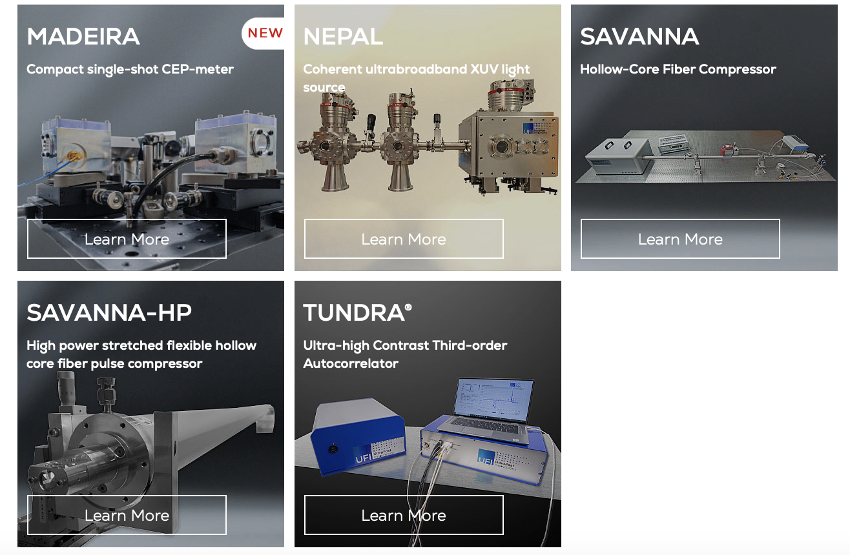
UltraFast Innovations GmbH 2023

Slide 13
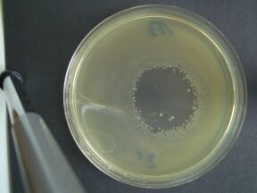
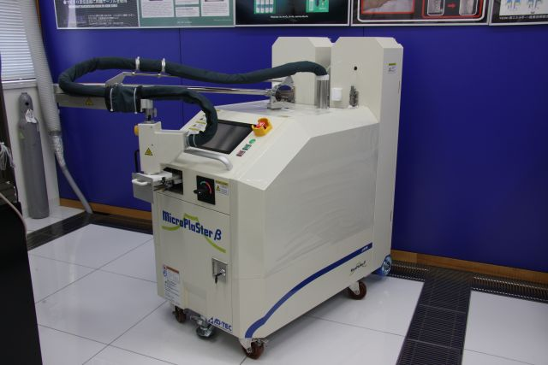
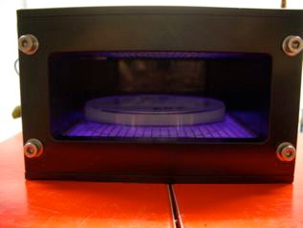
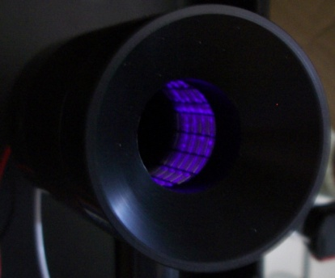
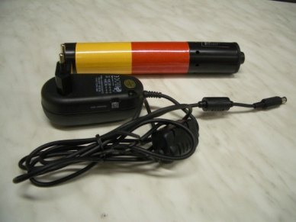
terraplasma GmbH - 2011
MPI for extraterrestrial Physics: Dusty Plasmas in space –
“plasma crystals” & creation of cold atmospheric plasma gas by electric discharges – 2004 Plasma Health Care – 2011 terraplasma GmbH”
Reduction of the germ load
by 10⁵ after 5 seconds
(“disinfection”)
Surface Micro Discharge Plasma (SMD) cheap, scalable, any shape
Micro Wave Plasma
Wound Treatment
Hygiene
Medical technology
Cosmetics
Odor management
Water treatment
Air purification
Agriculture
Surface treatment
Venturi Plasma
Compressed air,
dental technology
Piezo Plasma "power-free" plasma
for small, local applications

Slide 14
terraplasma GmbH - 2023

Slide 15
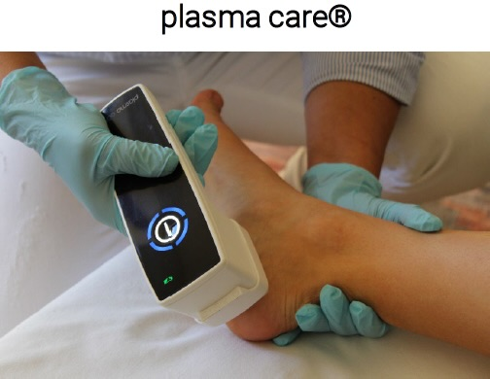
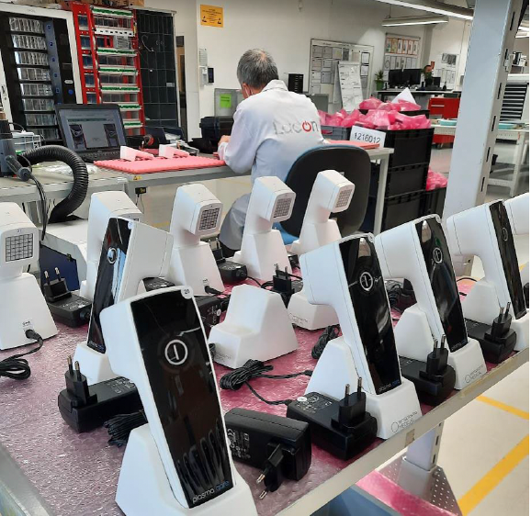
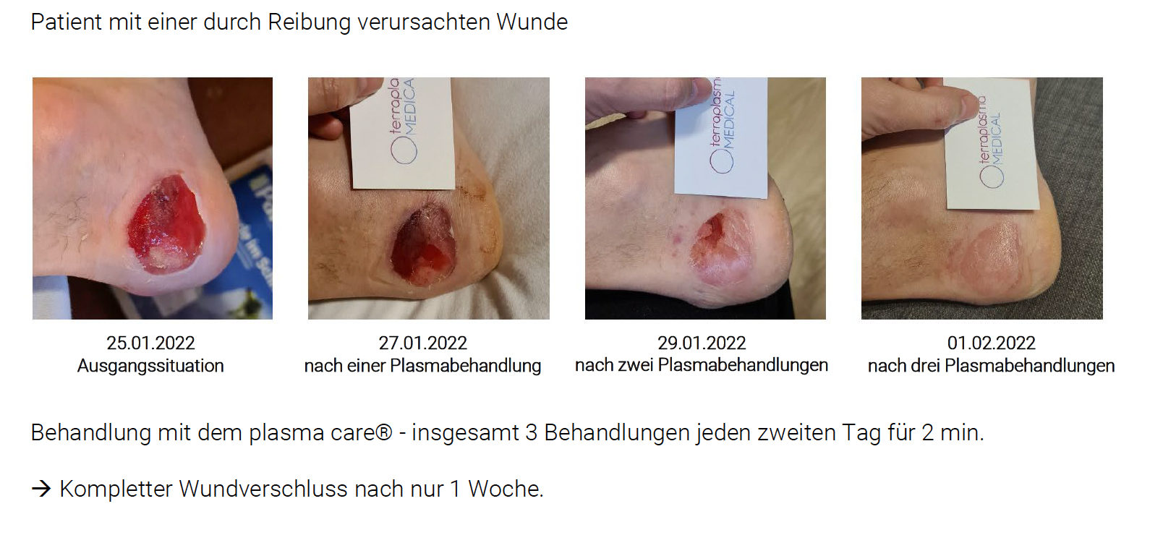
terraplasma GmbH - 2023
A medical device class IIa for the treatment of wounds
certified
FDA approval in process
clinical tested
Patient with a wound caused by friction
small, handy, battery-powered
sterile disposable attachments
Treatment with plasma care: every second day once for 2 min,
after the third treatment (1 week) complete wound closure.

Slide 16
Start-up Incubation Program for Max Planck Scientists

Slide 17
Program overview
Bootcamp
Phase 1: Exploration
Phase 2: Venture building
Idea stress test
Validation of venture idea with regards to market, team, product
Venture incorporation
3 days
Max. 6 months
Max. 18 months (Market challenge track) or from 18-30 months (Development challenge track)
Phase 1 (upon success)
Max. 50,000 € need-based funding upon jury-decision
Max. 220,000 € need-based funding upon jury decision (Market challenge track) or
External support program co-funded by MPG (Development challenge track)

Slide 18
Thank you!
Questions?
Open for discussions!
Wolfgang Tröger
Senior Patent & License Manager
Phone: +49 (0)89 29 09 19-27
E-Mail: troeger@max-planck-innovation.de
www.max-planck-innovation.de

