Slide 1
KEDR LKr calorimeter operation and performance
By Yuriy Tikhonov
(KEDR collaboration at Budker INP, Novosibirsk, Russia)
With participation of institutes: Budker INP, IHEP Protvino,
INFN Milano, INFN Pavia, INFN Bologna and BNL Upton NY
TIPP2023, Cape Town, 06/09/2023

Slide 2
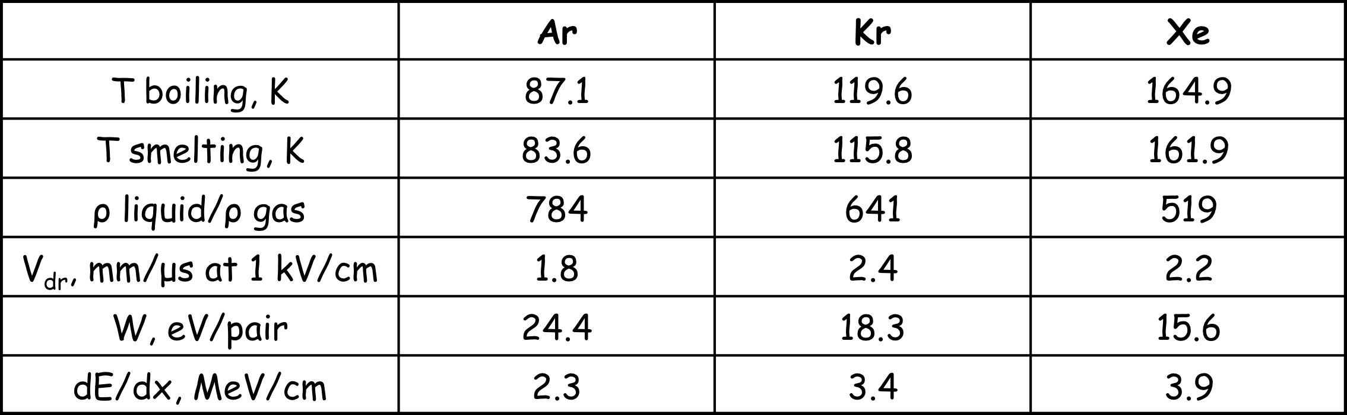
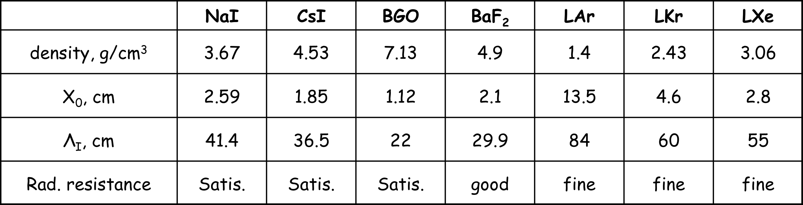
Introduction
Liquid noble gases are widely used for calorimetry in particle physics:
Ease of calibration (no intrinsic amplification, uniformity)
Stability
High level of segmentation
Radiation hardness
Krypton is much more accessible and significantly cheaper (by 10 times) than xenon.
Natural krypton contains β-radioactive isotope ⁸⁵Kr with the spectrum edge energy of 0.67 MeV. For this reason, liquid krypton was considered unsuitable for calorimetry.
Experiments with prototypes based on liquid krypton at the Budker INP (Novosibirsk) in early 1990s, showed that the energy resolution can be comparable to that of crystal calorimeters. The spatial resolution of the LKr calorimeter for photons is much better (by ~5 times) than in crystal calorimeters due to the possibility of measuring the photon conversion point.
As a result of the experiments with the prototypes, the LKr calorimeter for the KEDR experiment was designed and built and LKr was used in some other projects.

Slide 3
LKr calorimeters in particle physics
LKr calorimeter for study of nonlinear QED processes: photon splitting and Dellbruck scattering (1995-2000).
0.2 м³ of LKr, 18 X0, σ_{E} ⁄E≈2%⁄√E (quasi-homogeneous)
LKr calorimeter of KEDR detector at VEPP-4M e⁺e⁻ collider (2004- up to now).
11 м³ of LKr, 15 X0, σ_{E} ⁄E≈2.8%⁄√E (quasi-homogeneous)
LKr calorimeter NA-48 and NA-62 at CERN :
search of rare and forbidden kaon decays (1995-up to now).
10 м³ of LKr, 27 X0, σ_{E} ⁄E≈3.5%⁄√E (quasi-homogeneous)
LKr calorimeter prototypes for GEM detector at the SSC (1992-1993)
0.3 м³ (?) of LKr, 20 Xo, σ_{E} ⁄E≈6.7%⁄√E (sampling)

Slide 4
VEPP-4M e+e- collider and KEDR (in operation since 2004…)
Beam energy 1 – 5 GeV
Number of bunches 2 x 2
Luminosity at 1.5 GeV 2·10³⁰ cm⁻² s⁻¹
Luminosity at 5.0 GeV 2·10³¹ cm⁻² s⁻¹
Vacuum chamber
Vertex detector
Drift chamber
Aerogel counters
ToF counters
Liquid krypton calorimeter
Superconducting coil
Magnet yoke
Muon tubes
CsI Calorimeter
Compensating s/c solenoid
Physics:
• High precision measurement of particle
masses; J/ψ and ϒ -families, D-mesons,
τ- lepton
Rare J/ψ decays
R- measurements in the region 2E=2-7 GeV
• Two photon physics
Beam energy measurement:
• Resonant depolarization method
Instant measurement accuracy 1-3 keV
Energy interpolation accuracy 10-30 keV
• Infrared light Compton backscattering Monitoring the beam energy with accuracy ~ 60-100 keV

Slide 5
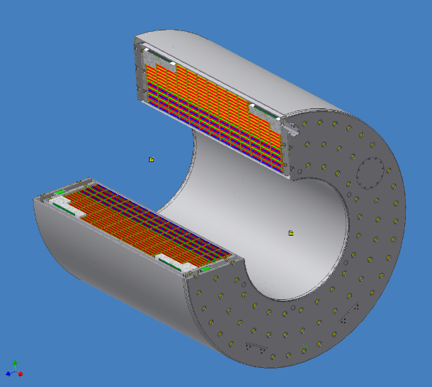
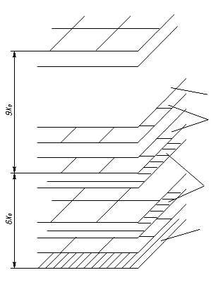
KEDR Liquid Krypton Calorimeter (quasi-gomogeneous)
Main parameters:
V_{LKr}= 11 m³
M_{LKr} = 27 tons
Calorimeter thickness = 14.8 X₀
Entrance wall thickness = 0.22 X₀
Electrodes number: 35
Electrodes total thickness = 0.33 X₀
Inner ∅ of electrode system: 1533 mm
Outer ∅ of electrode system : 2894 mm
Length of electrode system : 2600 mm
Anode-cathode gap: 19.46 mm
Electrode thickness: 0.54 mm of G10
Working HV: 1 kV
Number of towers: 2304
Number of strips: 4936
ground
towers
The electrode system has three layers of towers in the radius,
the grounded electrodes of the first layers are divided into strips
(4 strip layers for ϕ angle measurement and 4 for Ɵ).
z-strips
φ-strips

Slide 6
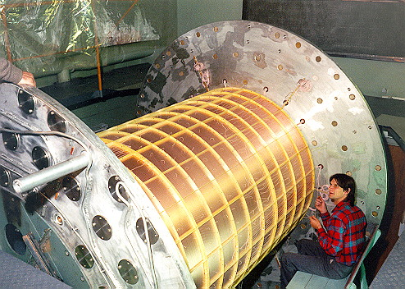
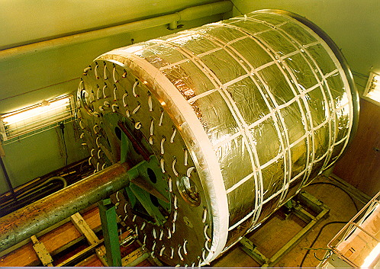
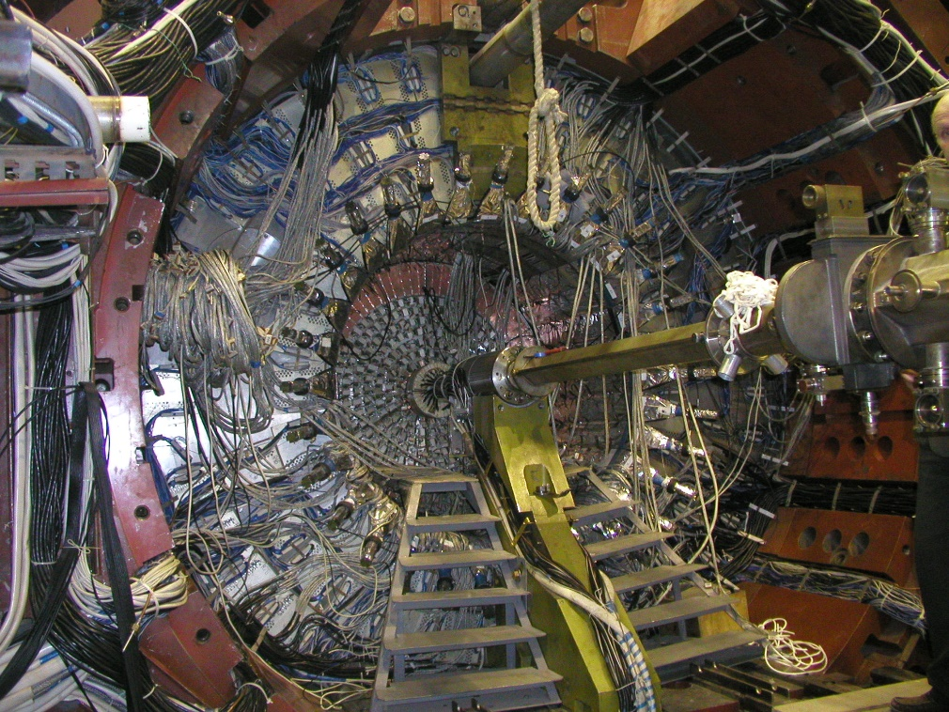
Liquid Krypton Calorimeter assembly

Slide 7
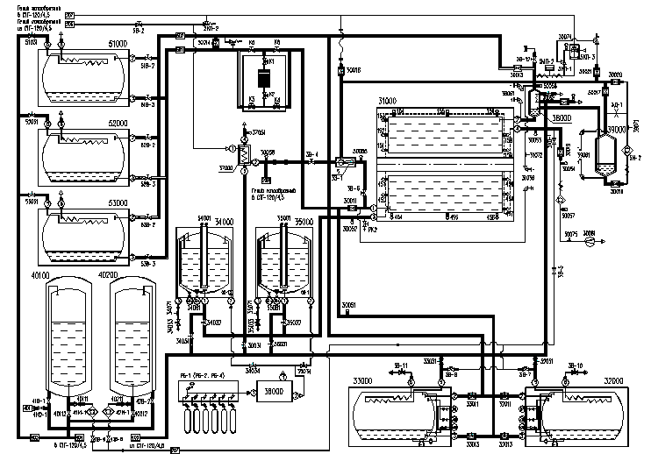
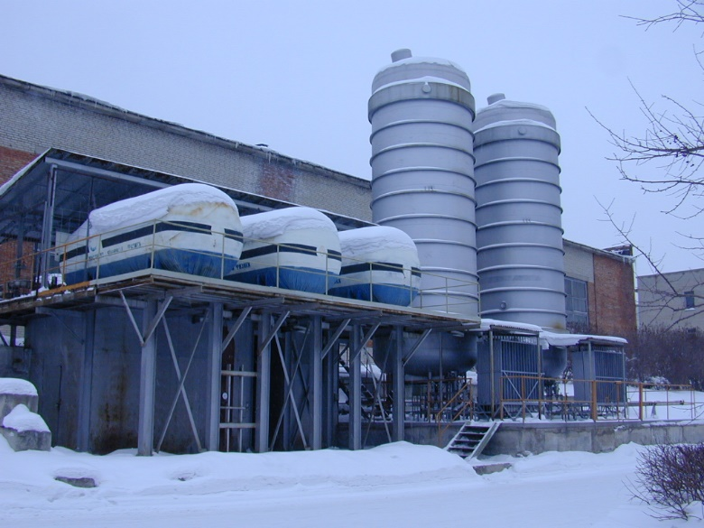
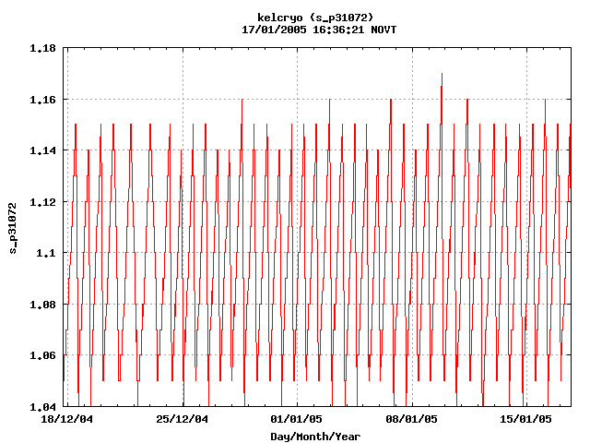
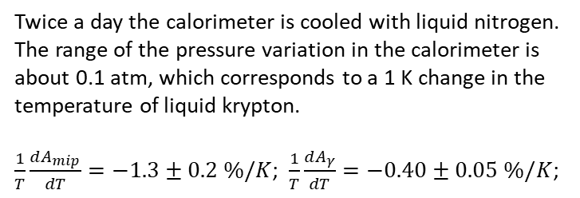
Cryogenic system
Twice a day the calorimeter is cooled with liquid nitrogen.
The range of the pressure variation in the calorimeter is about 0.1 atm, which corresponds to a 1 K change in the temperature of liquid krypton.
$\frac{1}{T}\frac{dA_{mip}}{dT}=−1.3±0.2 \%/K$; $\frac{1}{T}\frac{dA_{γ}}{dT}=−0.40±0.05 \%/K$;

Slide 8
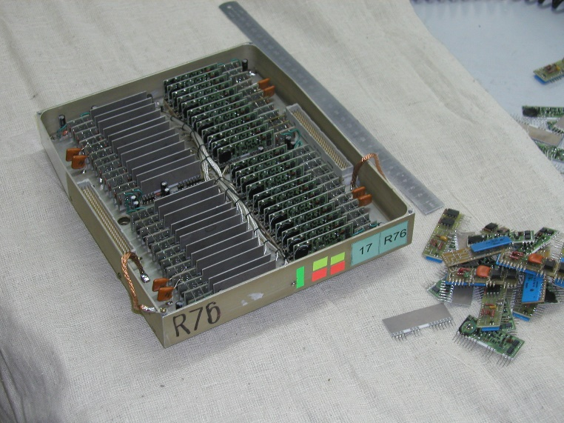
Readout electronics
The channal of the readout electronics consists of the following elements:
Charge sensitive preamplifier based on FET NJ1800D
RC-2CR pulse shaper (τ = 1.5 μs for towers, τ = 5.2 μs for strips)
Peak ADC (12-bit)
In addition, there are commutation blocks between preamplifiers and shapers that contain the special generators that mimic the input current of real particles for relative calibration of the electronic channels.
Preamplifier
RC-2CR shaper

Slide 9
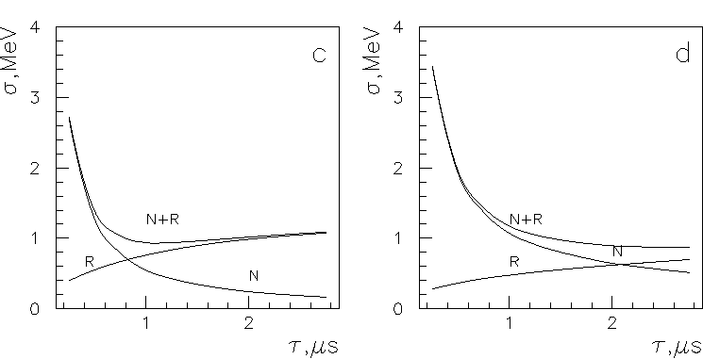
Electronics optimization
The value of the radioactivity noise increases with the shaping time (τ) and the electronic noise decreases with τ, so there is an optimal shaping time. In addition, the contribution of electronic noise and radioactivity to the energy resolution of the calorimeter depends on the free path length (L) of the ionization electrons.
For the parameters of LKr in use, the optimal shaping time for towers is about 1.5 μs.
For the strip channels, the shaping time of 5.2 μs was chosen.
L = ∞
L = 1 cm

Slide 10
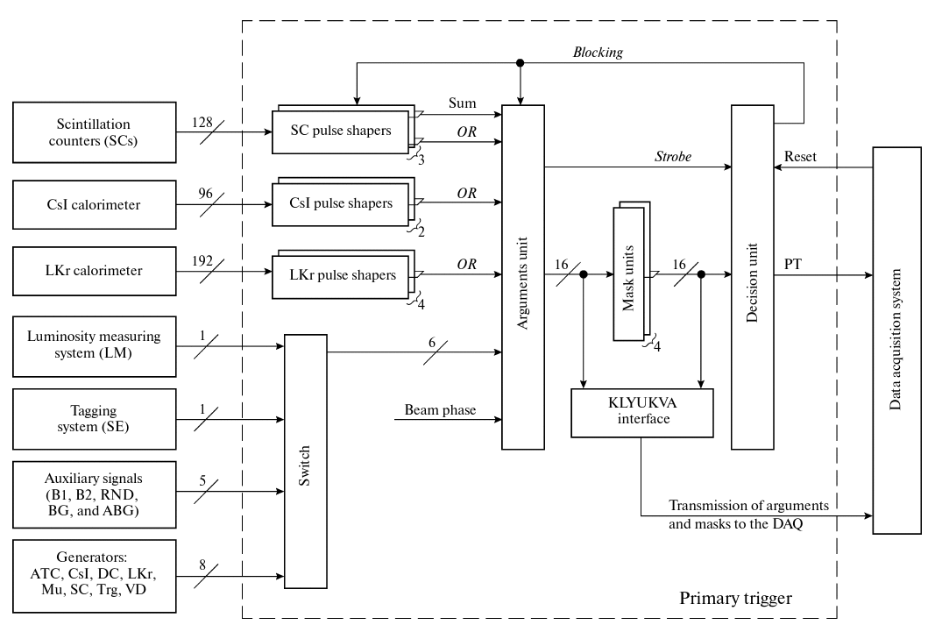
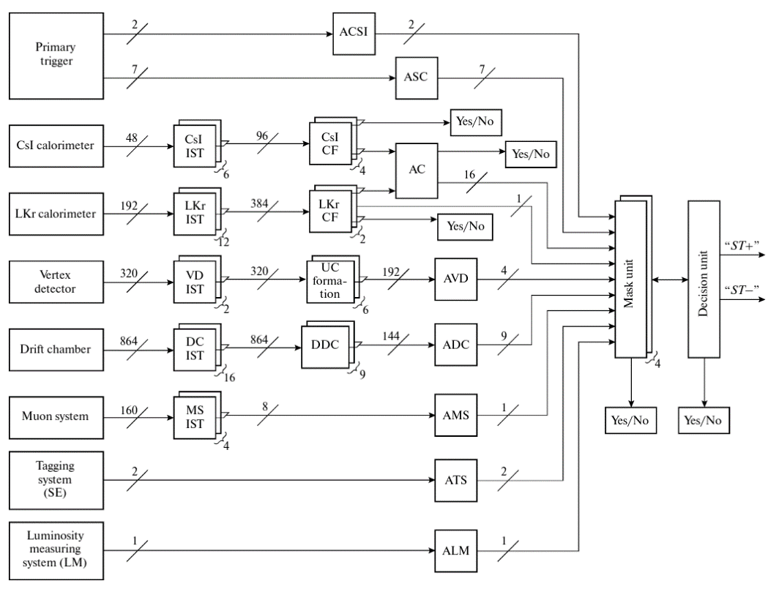
Trigger
The KEDR has a two-level hardware trigger.
The towers of the first two layers of the LKr calorimeter are combined into super-towers for use in the trigger. There are 192 super-towers in the calorimeter, each consisting of eight LKr towers –
2 × 2 × 2 for all coordinates (r, ϕ, z). The signals from the super-towers arrive at the discriminators with adjustable thresholds, and their logical sum goes to the 1st level trigger.
The 2nd level trigger receives 192 analog signals from the super-towers of the calorimeter, which are fed to discriminators with two computer-controlled thresholds - thr1 and thr2 (thr1 < thr2). The output signals from the discriminators are fed to the cluster finder (CF). The CF separately counts the number of clusters with thresholds of thr1 and thr2 and forms the corresponding arguments to be passed to the decision block of the 2nd level trigger.

Slide 11
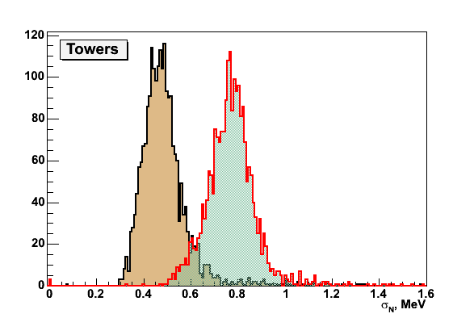
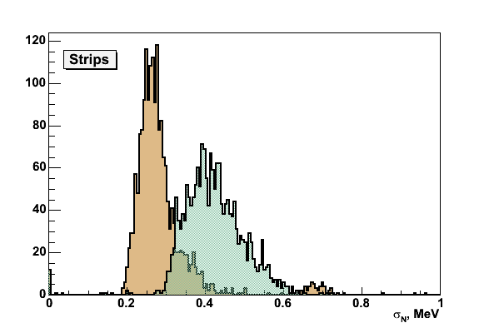
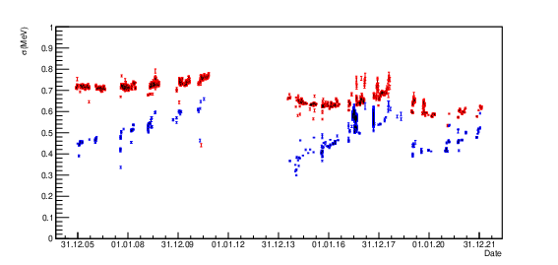
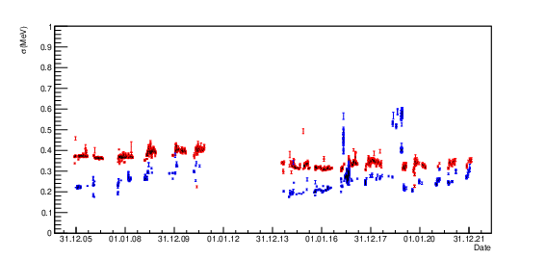
Electronic noise and radioactivity
N = 0.5 MeV; N+R = 0.8 MeV; R = 0.6 MeV
N = 0.3 MeV; N+R = 0.4 MeV; R = 0.3 MeV
Towers
Strips

Slide 12
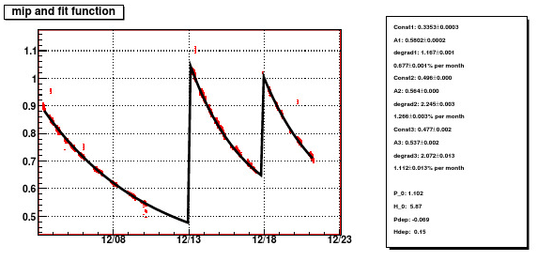
Krypton Purification
The LKr calorimeter does not have a system to permanently purify the krypton from electronegative impurities. Therefore, the signal amplitude in the calorimeter decreases with time. When the amplitude falls below a certain level, the krypton was completely purified during a technical shutdown.
Amplitude of M.I.P. as a function of time (2003 - 2023)
Reconstruction of events
in the LKr calorimeter takes this time dependence of the amplitude into account. All signals are normalized to the average amplitude of the minimum ionizing particle.

Slide 13
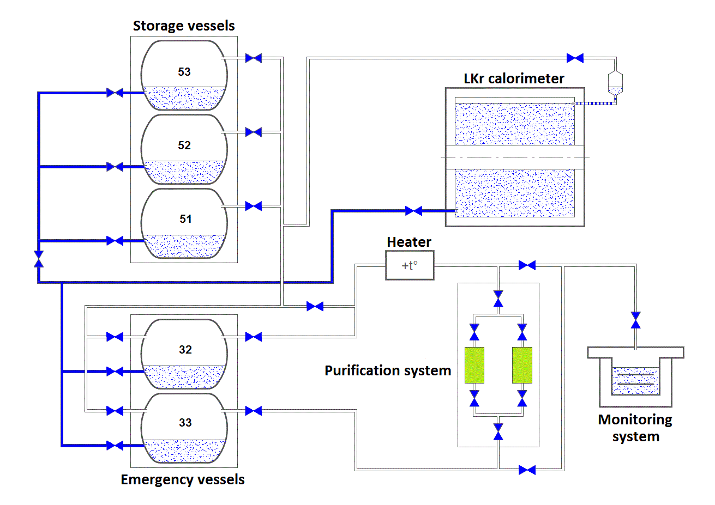
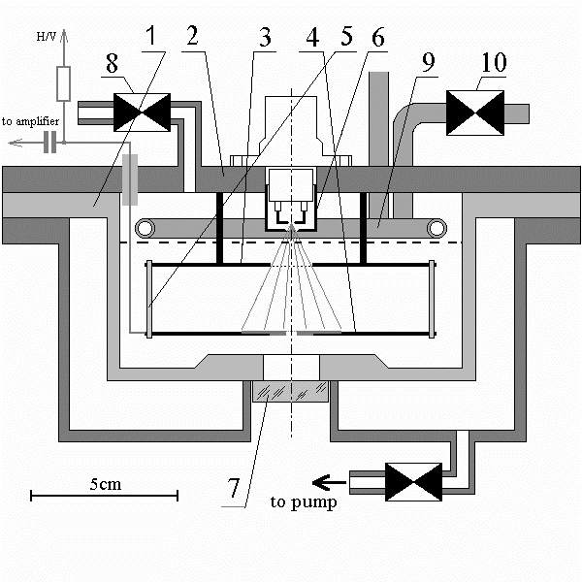
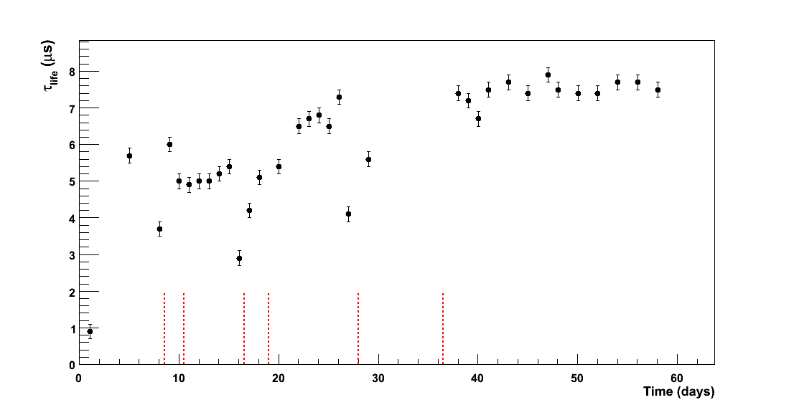
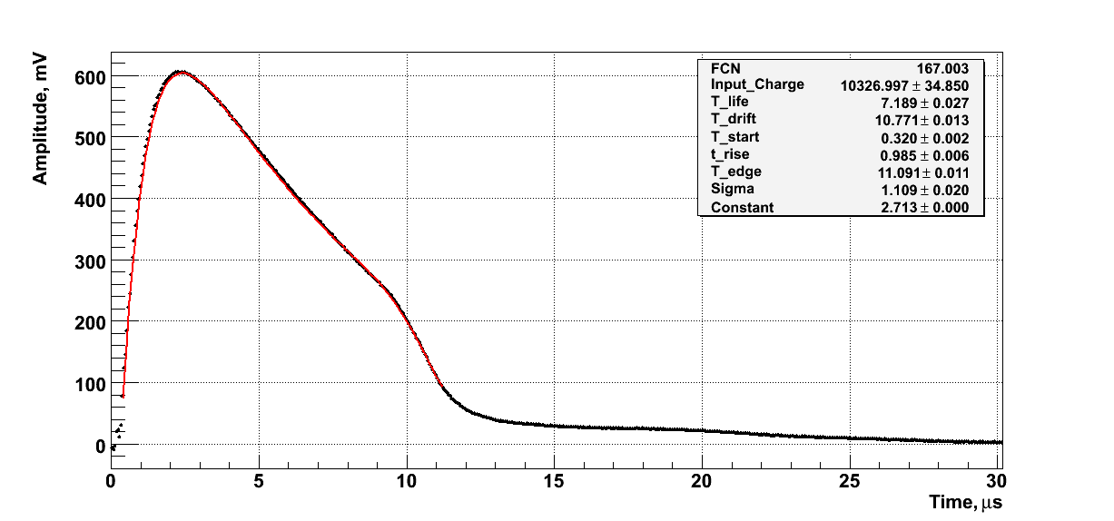
Krypton Purification
The UTOA-40/A industrial purifier with two large cartridges is used for krypton purification. The purification system could only operate with gaseous krypton at room temperature.
Purity monitor
Purity monitor signal

Slide 14
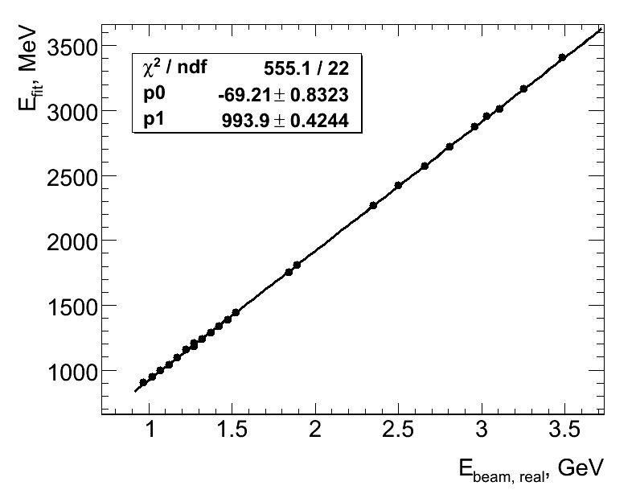
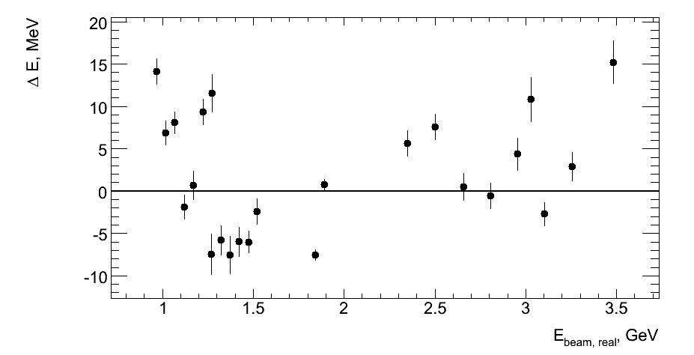
Linearity and Long-term stability
KEDR has performed a series of experiments in 2015-2022 to measure the R value (the ratio of the hadron production cross section to the muon pair production cross section) over a wide energy range from 1.84 GeV to 7.0 GeV.
These experiments provide an opportunity to study the linearity and long-term stability of the calorimeter response over a wide range of cluster energies using electron-positron scattering events.
The dependence of the cluster energy in the LKr calorimeter on the beam energy in the collider is shown, as well as the deviation from the linear fit.

Slide 15
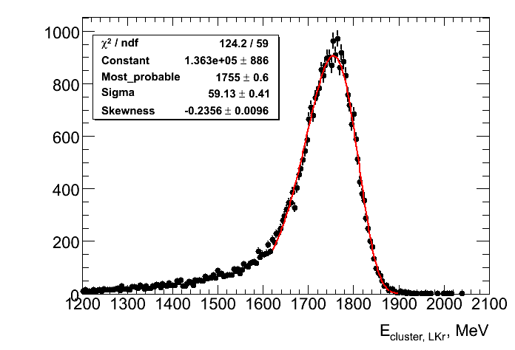
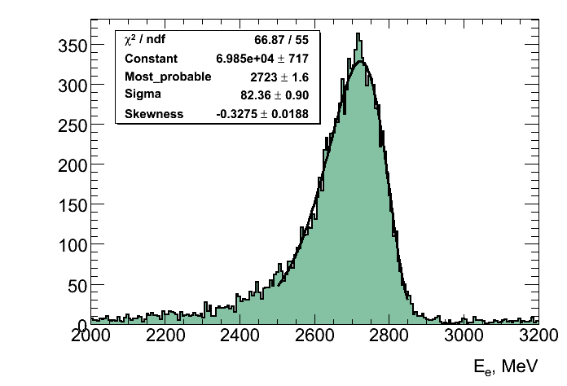
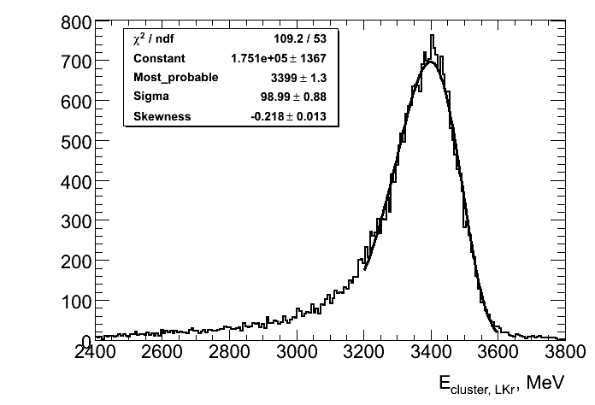
Energy resolution with electrons (positrons)
E_{beam} = 1.75 GeV σ_{E}/E = (3.36 ± 0.02)%
The energy resolution for electron-positron scattering events was measured on the same data set.
Several spectra for the energy of the cluster in the LKr calorimeter are given as examples.
E_{beam} = 2.7 GeV σ_{Е}/Е = (3.02 ± 0.03)%
E_{beam} = 3.4 GeV σ_{Е}/Е = (2.91 ± 0.03)%

Slide 16
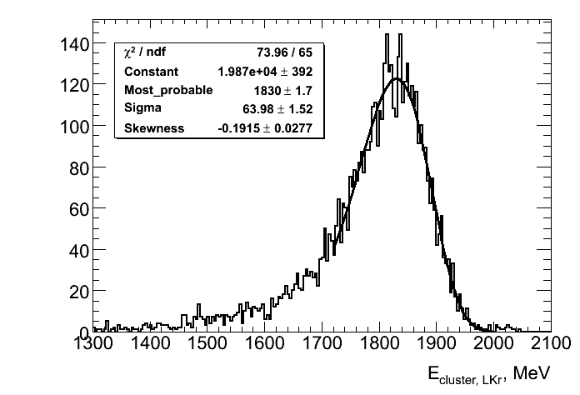
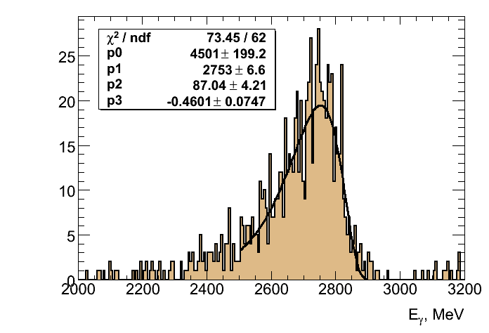
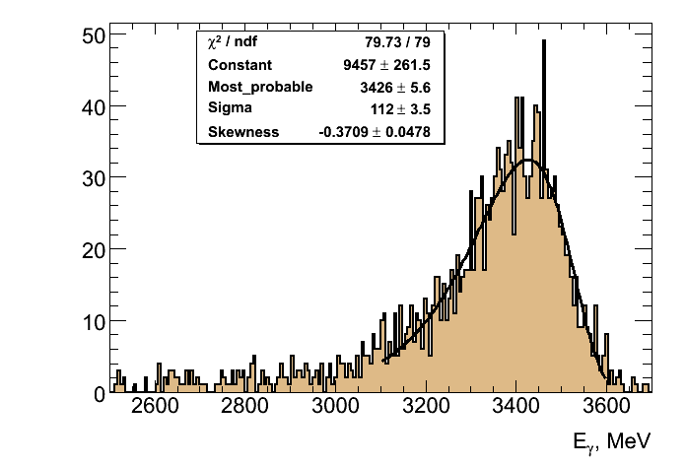
Energy resolution with photons
E_{beam} = 1.8 GeV σ_{E}/E = (3.50 ± 0.08)%
The same for photons in е⁺е⁻ -> γγ events.
E_{beam} = 2.7 GeV σ_{Е}/Е = (3.16 ± 0.15)%
E_{beam} = 3.4 GeV σ_{Е}/Е = (3.27 ± 0.10)%

Slide 17
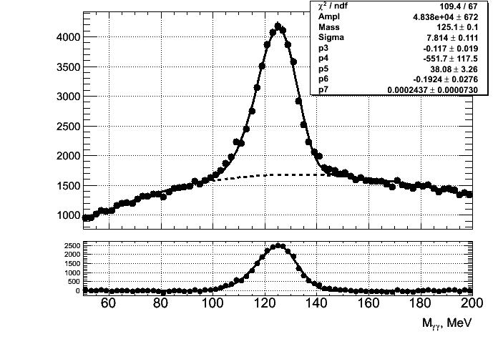
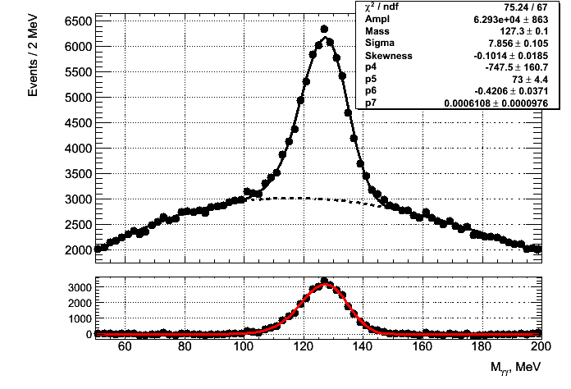
Invariant mass of two photons
The peak from π⁰ decay.
Experimental data at the Ψ(2S) peak.
MC
σ_{M}/M = (6.24 ± 0.09)%
σ_{M}/M = (6.17 ± 0.12)%

Slide 18
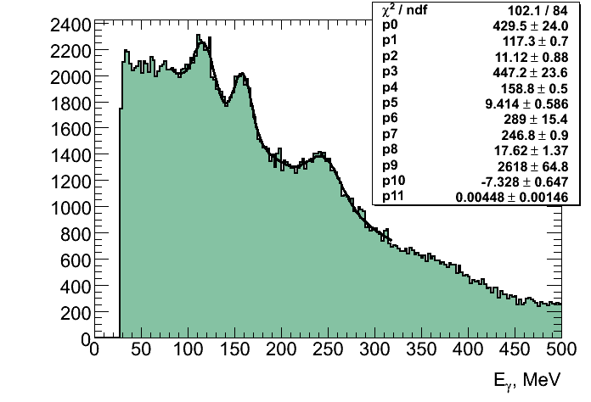
Energy resolution at low energies
Experimental data collected at the Ψ(2S) peak.
Inclusive photon spectrum.
Photons from π⁰ decays are excluded.
The peaks are photons from radiative transitions Ψ(2s)→ γχ_{c0,1,2}
χ_{с0} χ_{с1} χ_{с2}
ΔM, MeV 271.4 175.4 129.9
Γ, MeV 10.8±0.6 0.84±0.04 1.97±0.09
σ_{exp} 17.6±1.4 9.4±0.6 11.1±0.9
σ_{MC} 16.7±2.1 10.0±0.8 7.4±0.7

Slide 19
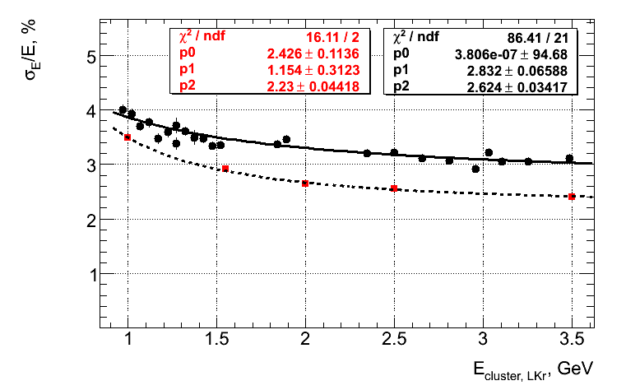
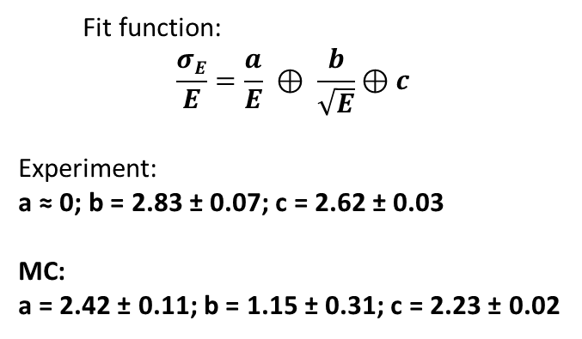
Energy resolution for electrons (positrons)
The energy resolution of the LKr calorimeter for electrons (positrons).
Black points – experiment, Red points – MC.
Fit function:
$$\frac{σE}{E}=\frac{a}{E} ⊕ \frac{b}{\sqrt{E}}⊕c$$
Experiment:
a ≈ 0; b = 2.83 ± 0.07; c = 2.62 ± 0.03
MC:
a = 2.42 ± 0.11; b = 1.15 ± 0.31; c = 2.23 ± 0.02

Slide 20
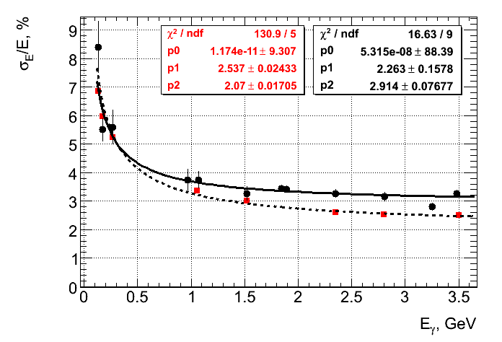
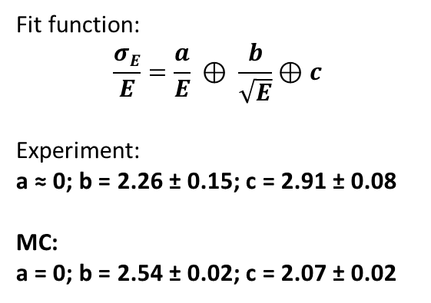
Energy resolution for photons
The energy resolution of the LKr calorimeter for photons.
Black points – experiment, Red points – MC.
Fit function:
$$\frac{σE}{E}=\frac{a}{E} ⊕ \frac{b}{\sqrt{E}}⊕c$$
Experiment:
a ≈ 0; b = 2.26 ± 0.15; c = 2.91 ± 0.08
MC:
a = 0; b = 2.54 ± 0.02; c = 2.07 ± 0.02

Slide 21
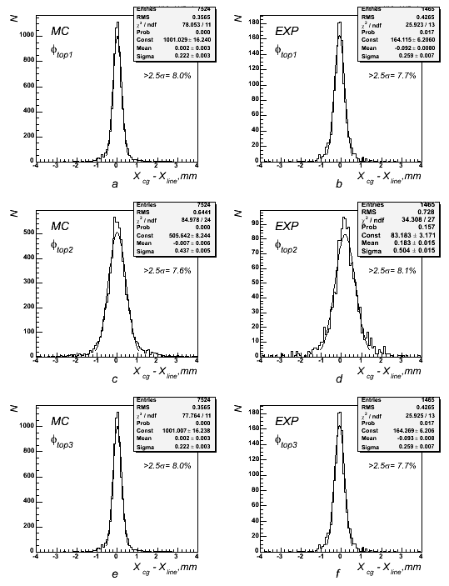
Spatial resolution for MIP
The spatial resolution for MIP was measured using data from the cosmic ray runs. The distributions of the difference between the strip cluster coordinate and the reconstructed track position are shown for three layers of φ strips.
Resolution for ϕ2 layer:

Slide 22
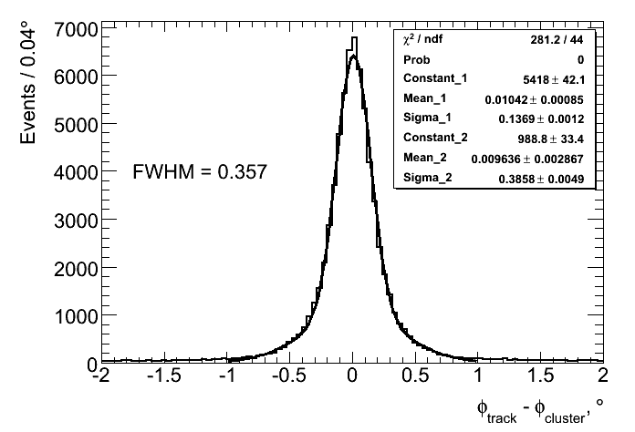
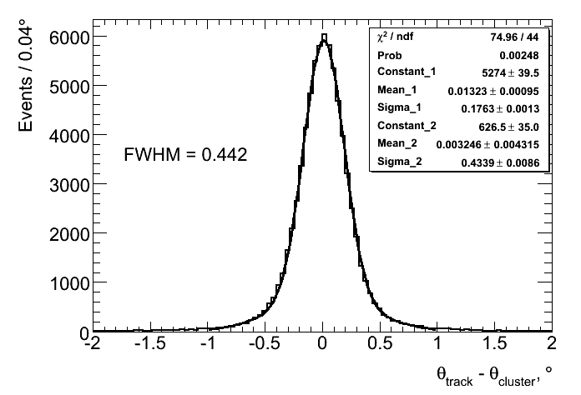
Spatial resolution for electrons
The spatial resolution for showers can be estimated with the Bhabha events.
Distributions on the difference of angles ϕ and θ between the electron cluster in the calorimeter and the hit points in the calorimeter of the track reconstructed in the drift chamber.
E_{beam} = 3.5 GeV
σ=1.4 mm σ=2.0 mm
If we use the only towers we have σ~5-8 mm !

Slide 23
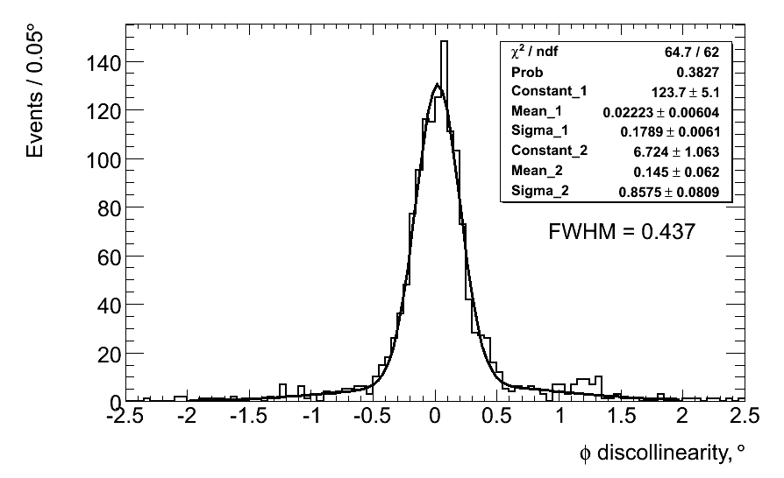
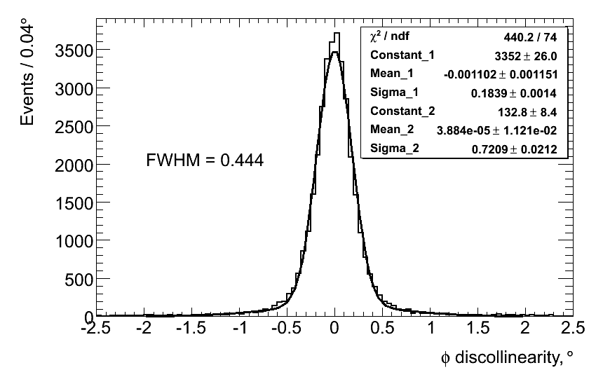
Spatial resolution for photons
Acollinearity angle distributions of photon clusters in the LKr calorimeter for
e⁺e⁻ -> γγ events.
E_{beam} = 3.5 GeV
Experiment
MC
σ ≈ 1.8 мм
If we use the only towers we have σ~5-8 mm !

Slide 24
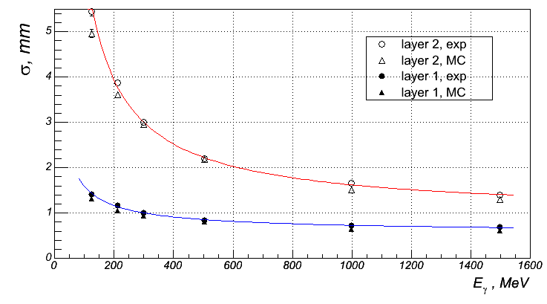
Spatial resolution for photons
Directly, the spatial resolution for photons was only measured in the experiment with a prototype of the calorimeter on a tagged photon beam. The dependence of the spatial resolution on the photon energy is shown for two layers of strips. The first layer is the layer where the photon conversion took place. The second layer is the one following it.
The strip width is 1 cm.

Slide 25
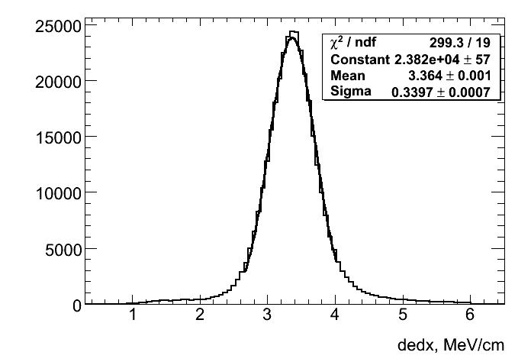
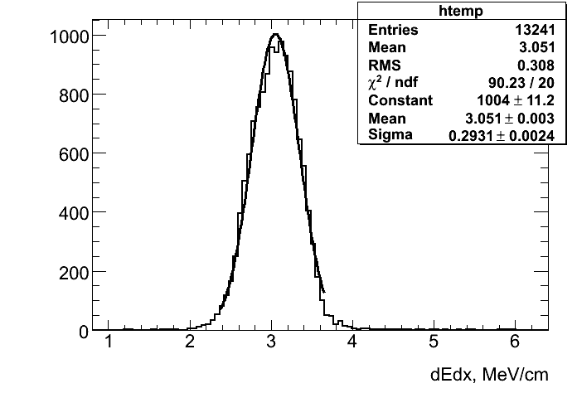
dE/dx measurement
The presence of 8 strip layers in the electrode system allows the measurement of ionization energy loss for MIPs.
Distribution on the energy loss of cosmic muons
MC
σ_{dEdx}/dEdx = 10.1%
σ_{dEdx}/dEdx = 9.6%

Slide 26
Conclusion
The KEDR liquid krypton calorimeter has been used in experiments for 20 years. During this time, it has proven to be a reliable, stable, unpretentious instrument with good performance.
Wide physics program was realized with KEDR detector:
High precision measurement of particle masses; J/ψ -families, D-mesons, τ- lepton
Rare J/ψ decays
R- measurements in the region 2E=2-7 GeV
• Two photon physics
Particle masses of ϒ -families and rare decays are currently measured with a goal to improve PDG data

Slide 27
List of selected publications
1) “Investigation of an an electromagnetic calorimeter based on liquid krypton"
NIM A289 (1990) 468-474
2) "Liquid krypton calorimeter for KEDR detector"
NIM A316 (1992) 8-13
3) "Liquid krypton electromagnetic calorimeter"
NIM A327 (1993) 193-198
4) "Precision timing with liquid ionization calorimeters"
Nuclear Instruments and Methods in Physics Research A332(1993)78-84
5) "Performance of an accordion electromagnetic calorimeter with liquid krypton and argon"
NIM A344 (1994) 363-377
6) "Liquid ionization calorimetry with time sampled signals"
NIMA 349(1994) 367-383

Slide 28
8) "Liquid krypton calorimeter for KEDR detector and last prototype results"
NIM A379 (1996) 475-477
9) "The test of the LKr calorimeter prototype at the tagged photon beam"
NIM A394 (1997) 35-45
10) "First observation of photon splitting in a strong coulomb field. Current status
of the experiment."
PHOTON'97, the XIth International Workshop on Gamma-Gamma Collisions,
Egmond aan Zee, Netherlands, 246-250
11) "High-accuracy measurement of photon position in a liquid krypton calorimeter"
NIM A419 (1998) 602-608
12) "Delbruck scattering at energies of 140-450 MeV"
Phys. Rev. C58 (1998) 2844-2850
13) "Experimental investigation of high-energy photon splitting in atomic fields“
PRL, v.89 (2002) 061802
14) “A purity monitor for the KEDR liquid krypton calorimeter”
http://dx.doi.org/10.1088/1748-0221/11/06/P06004, 2016 JINST 11 P06004

Slide 29
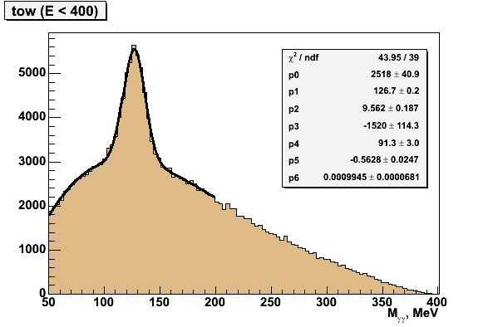

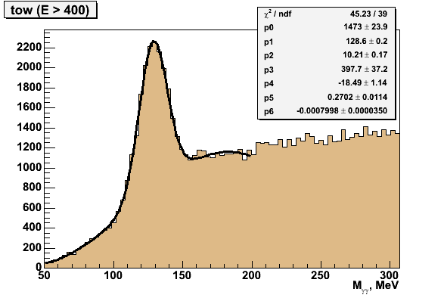
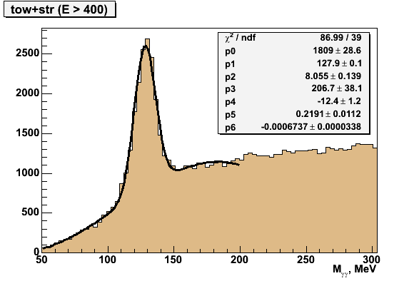
Invariant mass of two photons
The peak from π⁰ decay. Experimental data at the Ψ(2S) peak.
σ_{M}= (9.6 ± 0.2) MeV
σ_{M}= (9.1 ± 0.2) MeV
σ_{M}= (10.2 ± 0.2) MeV
σ_{M}= (8.1 ± 0.2) MeV

Slide 30


Energy resolution for electrons (positrons)
The energy resolution of the LKr calorimeter for Bhabha events.
Black points – experiment, Red points – MC.
Fit function:
$$\frac{σE}{E}=\frac{a}{E} ⊕ \frac{b}{\sqrt{E}}⊕c$$
Experiment:
a ≈ 0; b = 2.74 ± 0.06; c = 2.67 ± 0.03
MC:
a = 0; b = 2.60 ± 0.03; c = 1.97 ± 0.02

