Slide 2
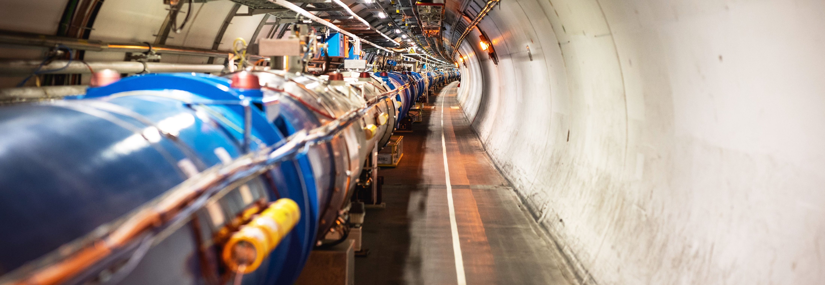
CERN
The International Laboratory for Particle Physics
Manfred Krammer

Slide 3
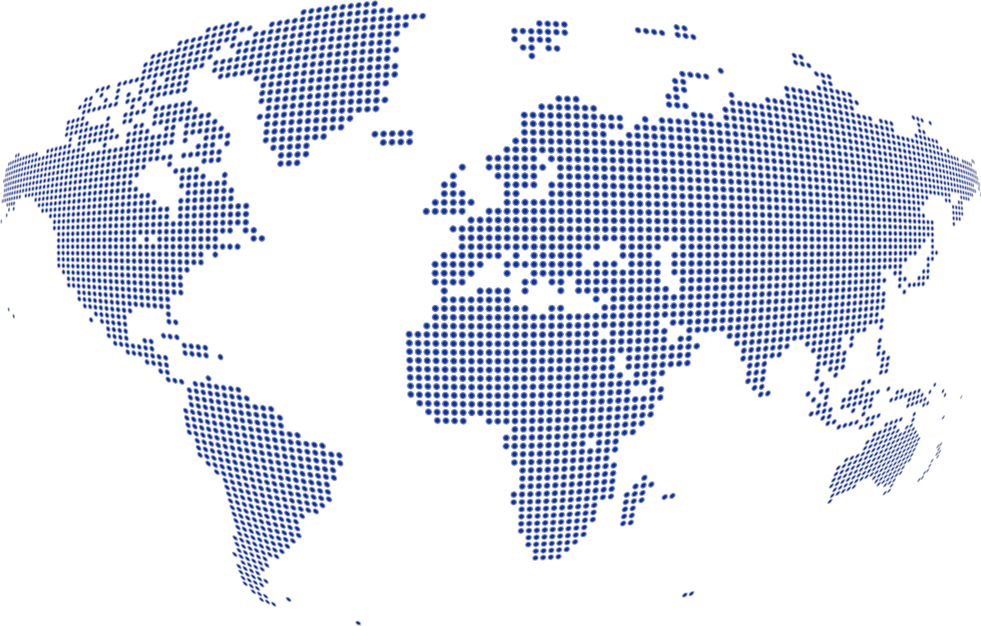
Science for peace
CERN was founded in 1954 with 12 European Member States
23 Member States
Austria – Belgium – Bulgaria – Czech Republic
Denmark – Finland – France – Germany – Greece Hungary – Israel – Italy – Netherlands – Norway
Poland – Portugal – Romania – Serbia – Slovakia Spain – Sweden – Switzerland – United Kingdom
CERN’s annual budget
is 1200 MCHF (equivalent
to a medium-sized European university)
3 Associate Member States
in the pre-stage to membership
Cyprus – Estonia – Slovenia
7 Associate Member States
Croatia – India – Latvia – Lithuania – Pakistan
Türkiye – Ukraine
6 Observers
Japan – Russia (suspended) – USA
European Union – JINR (suspended) – UNESCO
As of 31 December 2022
Employees:
2658 staff, 900 fellows
Associates:
11 860 users, 1516 others
Around 50 Cooperation Agreements
with non-Member States and Territories
Albania – Algeria – Argentina – Armenia – Australia – Azerbaijan – Bangladesh – Belarus – Bolivia
Bosnia and Herzegovina – Brazil – Canada – Chile – Colombia – Costa Rica – Ecuador – Egypt – Georgia – Honduras
Iceland – Iran – Jordan – Kazakhstan – Lebanon – Malta – Mexico – Mongolia – Montenegro – Morocco – Nepal
New Zealand – North Macedonia – Palestine – Paraguay – People's Republic of China – Peru – Philippines – Qatar
Republic of Korea – Saudi Arabia – Sri Lanka – South Africa – Thailand – Tunisia – United Arab Emirates – Vietnam

Slide 4
Science for peace
CERN was founded in 1954 with 12 European Member States
23 Member States
Austria – Belgium – Bulgaria – Czech Republic
Denmark – Finland – France – Germany – Greece Hungary – Israel – Italy – Netherlands – Norway
Poland – Portugal – Romania – Serbia – Slovakia Spain – Sweden – Switzerland – United Kingdom
CERN’s annual budget
is 1200 MCHF (equivalent
to a medium-sized European university)
3 Associate Member States
in the pre-stage to membership
Cyprus – Estonia – Slovenia
7 Associate Member States
Croatia – India – Latvia – Lithuania – Pakistan
Türkiye – Ukraine
6 Observers
Japan – Russia (suspended) – USA
European Union – JINR (suspended) – UNESCO
As of 31 December 2022
Employees:
2658 staff, 900 fellows
Associates:
11 860 users, 1516 others
Around 50 Cooperation Agreements
with non-Member States and Territories
Albania – Algeria – Argentina – Armenia – Australia – Azerbaijan – Bangladesh – Belarus – Bolivia
Bosnia and Herzegovina – Brazil – Canada – Chile – Colombia – Costa Rica – Ecuador – Egypt – Georgia – Honduras
Iceland – Iran – Jordan – Kazakhstan – Lebanon – Malta – Mexico – Mongolia – Montenegro – Morocco – Nepal
New Zealand – North Macedonia – Palestine – Paraguay – People's Republic of China – Peru – Philippines – Qatar
Republic of Korea – Saudi Arabia – Sri Lanka – South Africa – Thailand – Tunisia – United Arab Emirates – Vietnam
Egypt and Morocco have signalled
interest in applying for CERN
Associate Membership
Additional interest in ICA from Rwanda, Sudan, Tanzania

Slide 5
A laboratory for people around the world
Distribution of all CERN Users by the country of their home institutes as of 31 December 2022
Geographical & cultural diversity
Users of 110 nationalities
19.4% women
Member States 7147
Austria 85 – Belgium 129 – Bulgaria 43 – Czech Republic 244 Denmark 49 – Finland 90 – France 844 – Germany 1225 Greece 119 – Hungary 73 – Israel 64 – Italy 1527
Netherlands 169 – Norway 79 – Poland 305 – Portugal 100 Romania 109 – Serbia 33 – Slovakia 70 – Spain 383
Sweden 103 – Switzerland 406 – United Kingdom 898
Associate Member States
in the pre-stage to membership 69
Cyprus 15 – Estonia 30 – Slovenia 24
Associate Member States 382
Croatia 38 – India 132 – Latvia 16 – Lithuania 14 – Pakistan 35
Türkiye 122 – Ukraine 25
Observers 2991
Japan 216 – Russia (suspended) 873 – United States of America 1902
Non-Member States and Territories 1271
Algeria 2 – Argentina 13 – Armenia 8 – Australia 21 – Azerbaijan 2 – Bahrain 4 – Belarus 18 – Brazil 122
Canada 199 – Chile 34 – Colombia 21 – Costa Rica 2 – Cuba 3 – Ecuador 4 – Egypt 20 – Georgia 32
Hong Kong 15 – Iceland 3 – Indonesia 5 – Iran 11 – Ireland 5 – Jordan 5 – Kuwait 4 – Lebanon 13 – Madagascar 1
Malaysia 4 – Malta 1 – Mexico 49 – Montenegro 4 – Morocco 19 – New Zealand 5 – Nigeria 1 – Oman 1
Palestine 1 – People’s Republic of China 333 – Peru 2 – Philippines 1 – Republic of Korea 147 – Singapore 2 South Africa 52 – Sri Lanka 10 – Taiwan 45 – Thailand 17 – Tunisia 2 – United Arab Emirates 7 – Viet Nam 1

Slide 6
A laboratory for people around the world
Distribution of all CERN Users by the country of their home institutes as of 31 December 2022
Geographical & cultural diversity
Users of 110 nationalities
19.4% women
CERN Users from Africa: 97
Member States 7147
Austria 85 – Belgium 129 – Bulgaria 43 – Czech Republic 244 Denmark 49 – Finland 90 – France 844 – Germany 1225 Greece 119 – Hungary 73 – Israel 64 – Italy 1527
Netherlands 169 – Norway 79 – Poland 305 – Portugal 100 Romania 109 – Serbia 33 – Slovakia 70 – Spain 383
Sweden 103 – Switzerland 406 – United Kingdom 898
Associate Member States
in the pre-stage to membership 69
Cyprus 15 – Estonia 30 – Slovenia 24
Associate Member States 382
Croatia 38 – India 132 – Latvia 16 – Lithuania 14 – Pakistan 35
Türkiye 122 – Ukraine 25
Observers 2991
Japan 216 – Russia (suspended) 873 – United States of America 1902
Non-Member States and Territories 1271
Algeria 2 – Argentina 13 – Armenia 8 – Australia 21 – Azerbaijan 2 – Bahrain 4 – Belarus 18 – Brazil 122
Canada 199 – Chile 34 – Colombia 21 – Costa Rica 2 – Cuba 3 – Ecuador 4 – Egypt 20 – Georgia 32
Hong Kong 15 – Iceland 3 – Indonesia 5 – Iran 11 – Ireland 5 – Jordan 5 – Kuwait 4 – Lebanon 13 – Madagascar 1
Malaysia 4 – Malta 1 – Mexico 49 – Montenegro 4 – Morocco 19 – New Zealand 5 – Nigeria 1 – Oman 1
Palestine 1 – People’s Republic of China 333 – Peru 2 – Philippines 1 – Republic of Korea 147 – Singapore 2 South Africa 52 – Sri Lanka 10 – Taiwan 45 – Thailand 17 – Tunisia 2 – United Arab Emirates 7 – Viet Nam 1

Slide 7
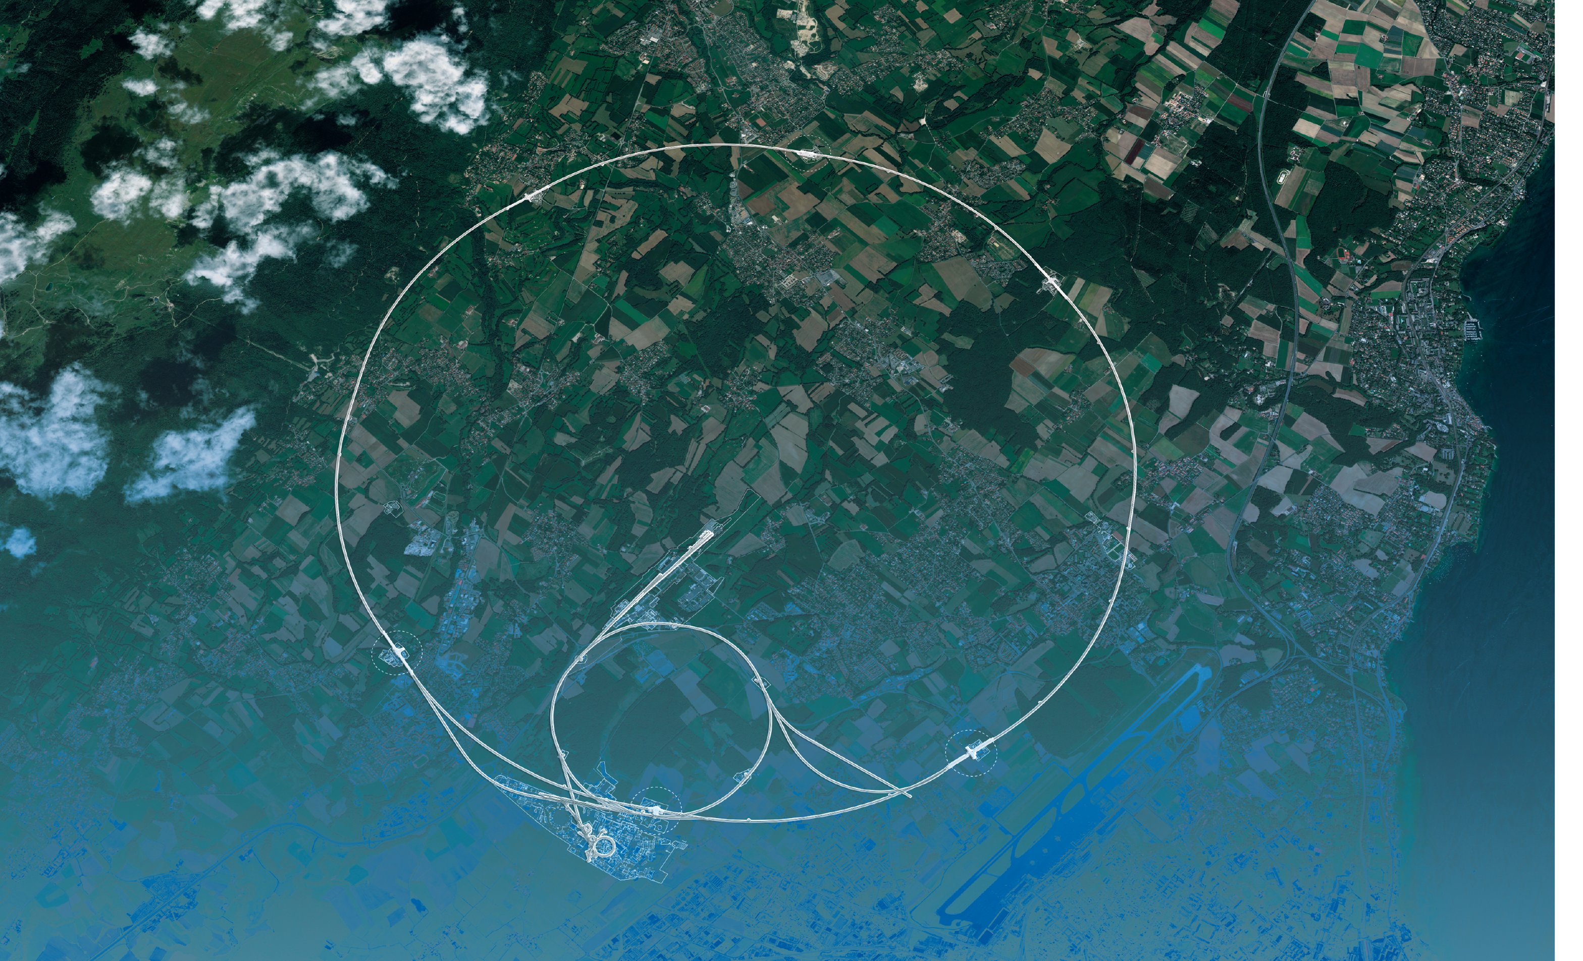
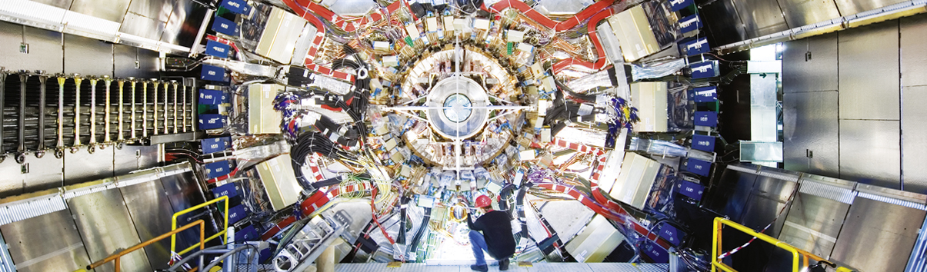
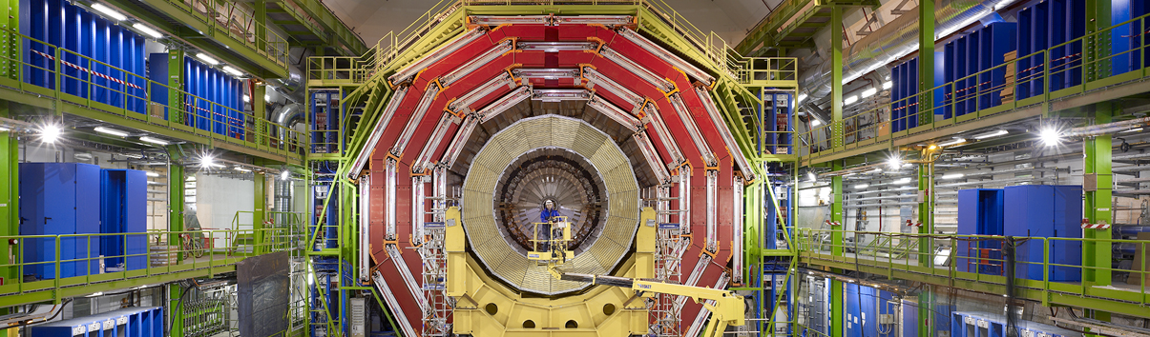
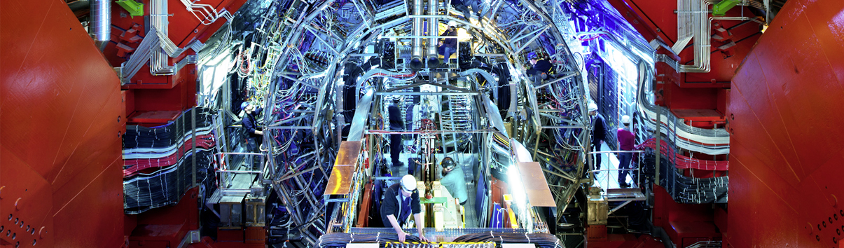
The Large Hadron Collider (LHC) is the flagship project of CERN
ATLAS
CMS
CMS
ALICE
ALICE
ATLAS
LHCb
LHCb
+ TOTEM, LHCf, MoEDAL-MAPP, FASER, SND@LHC

Slide 8
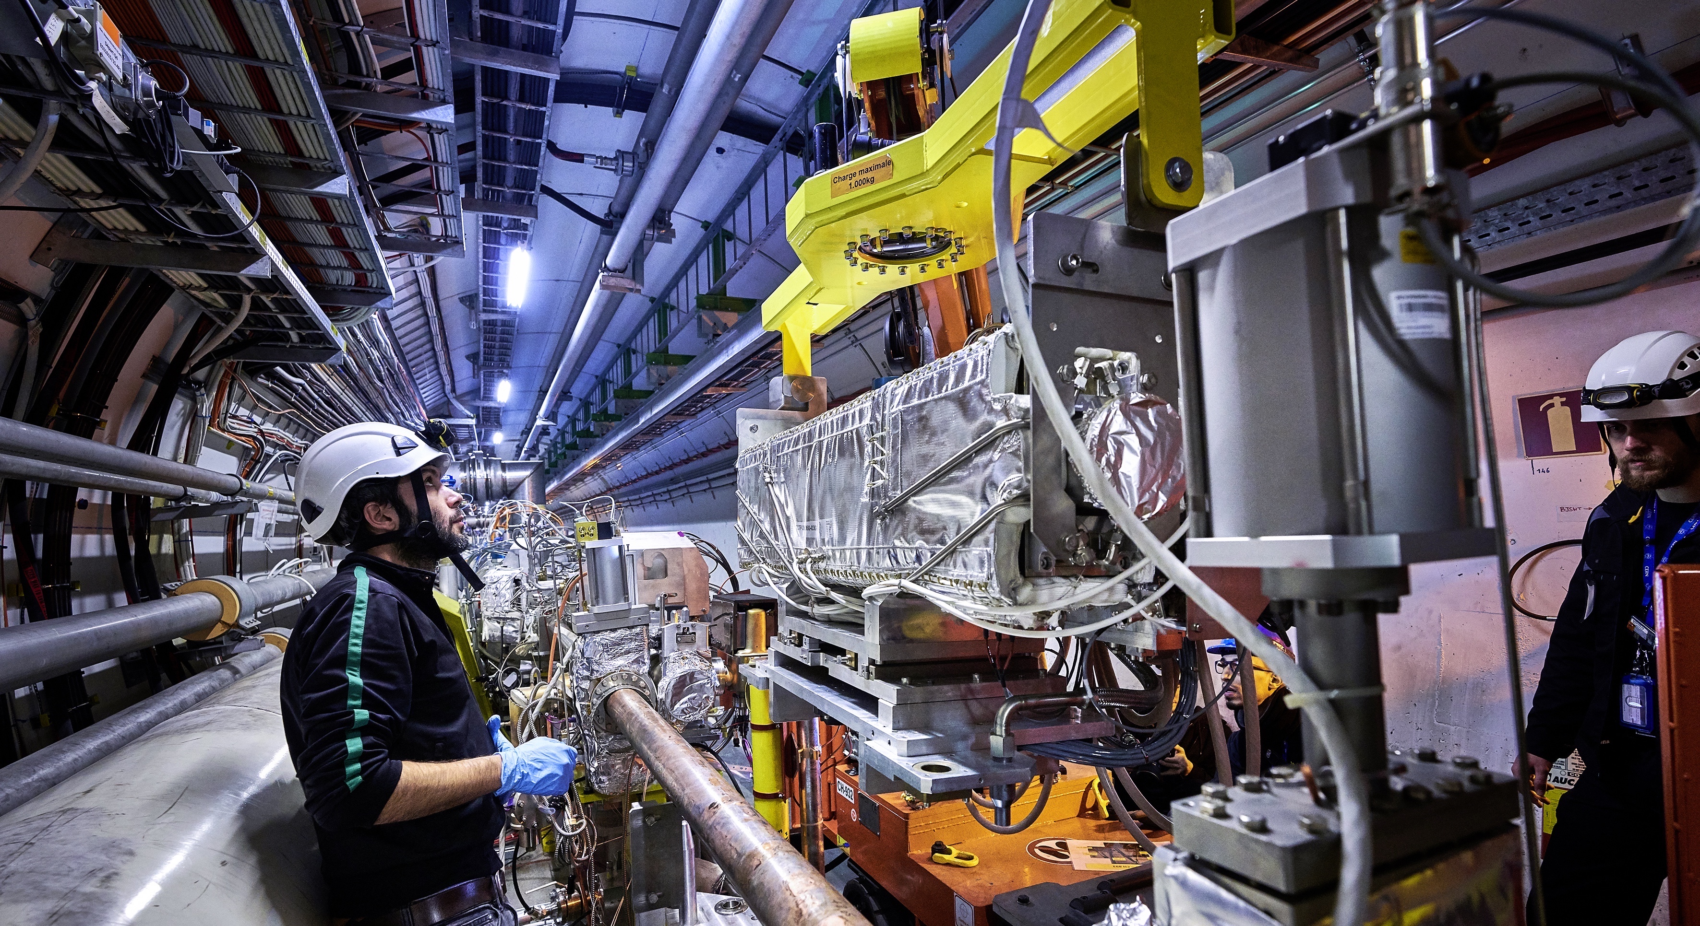
Upgrade to the
High-Luminosity LHC is under way
The HL-LHC will use new technologies to provide
10 times more collisions
than the LHC.
Large detector upgrade programmes.
It will give access to rare phenomena, greater precision and discovery potential.
It will start operating in 2029, and run until 2041.

Slide 9
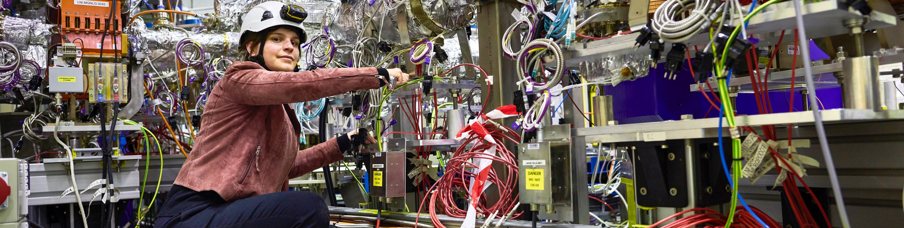
CERN has a diverse scientific programme
Nuclear Physics
(ISOLDE, n_TOF)
Antimatter Research
(Antiproton Decelerator)
Cosmic rays and cloud formation
(CLOUD)
Fixed-target experiments,
which include searches for rare phenomena
Contribution to the Long Baseline
Neutrino Facility in the USA (LBNF)
CERN Theory Programme

Slide 10
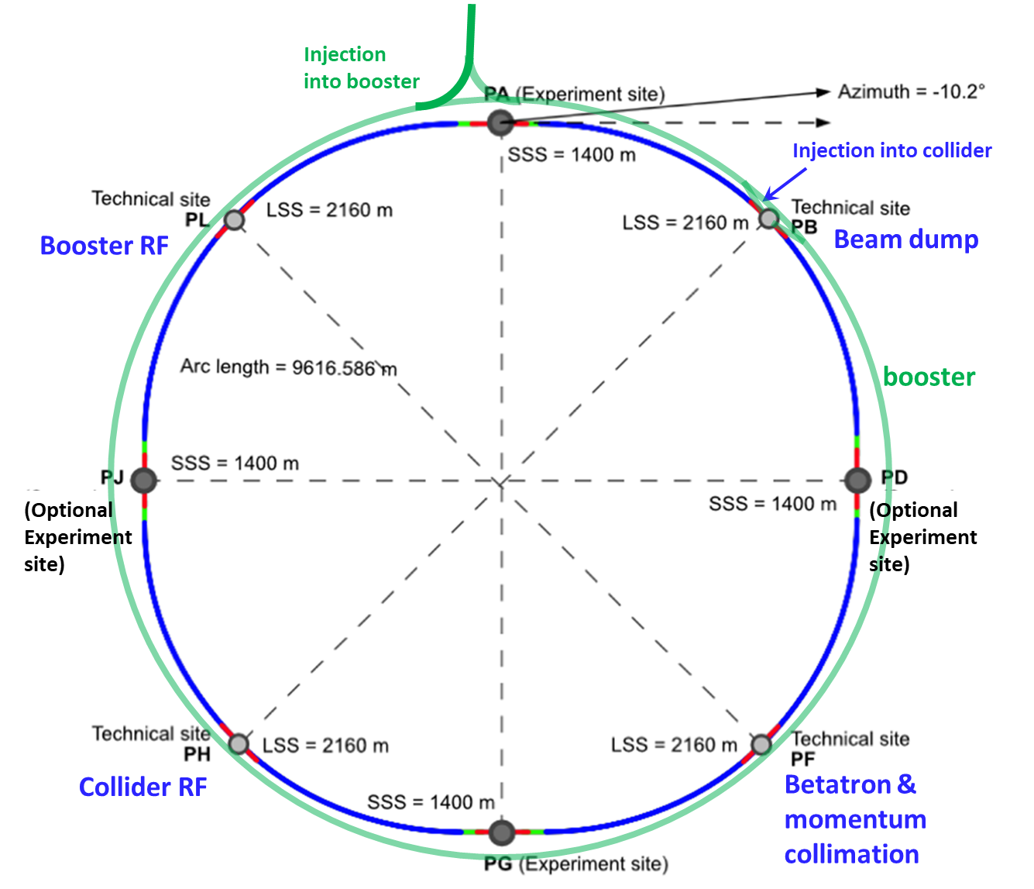
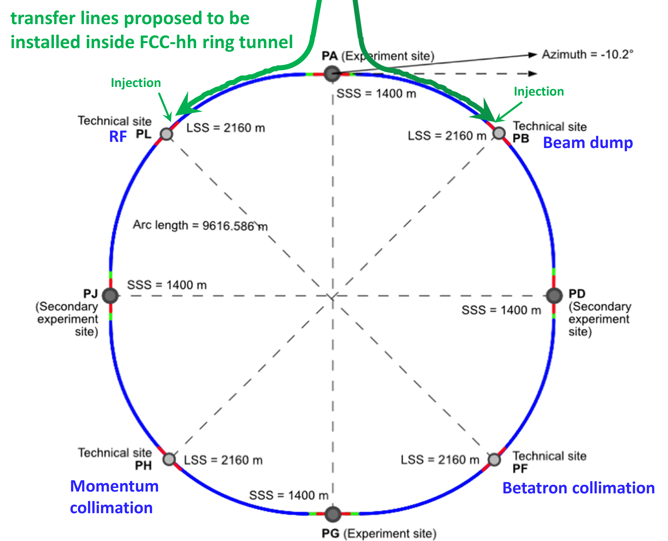

CERN has a plan for the future: The FCC
Comprehensive long-term program maximizing physics opportunities
stage 1: FCC-ee (Z, W, H, $\text{t}\overline{\text{t}}$) as Higgs factory, electroweak & top factory at highest luminosities
stage 2: FCC-hh (~100 TeV) as natural continuation at energy frontier, pp & AA collisions; e-h option
Common civil engineering and technical infrastructures, building on and reusing CERN’s existing infrastructure
FCC integrated project allows the start of a new, major facility at CERN within a few years of the end of HL-LHC
Realistic schedule:
2025 FCC Feasibility Study delivered
~2028 Project approval by CERN Council
~2030 Construction of tunnel and FCC-ee starts
~2041 HL-LHC ends
2045-2048 Operation of FCC-ee
15 years physics operation
~2070 Operation of FCC-hh starts
  ~20 years physics operation
FCC-ee
FCC-hh
2020 - 2040
2045 - 2063
2070 - 2095
28 July 2023
10

Slide 11
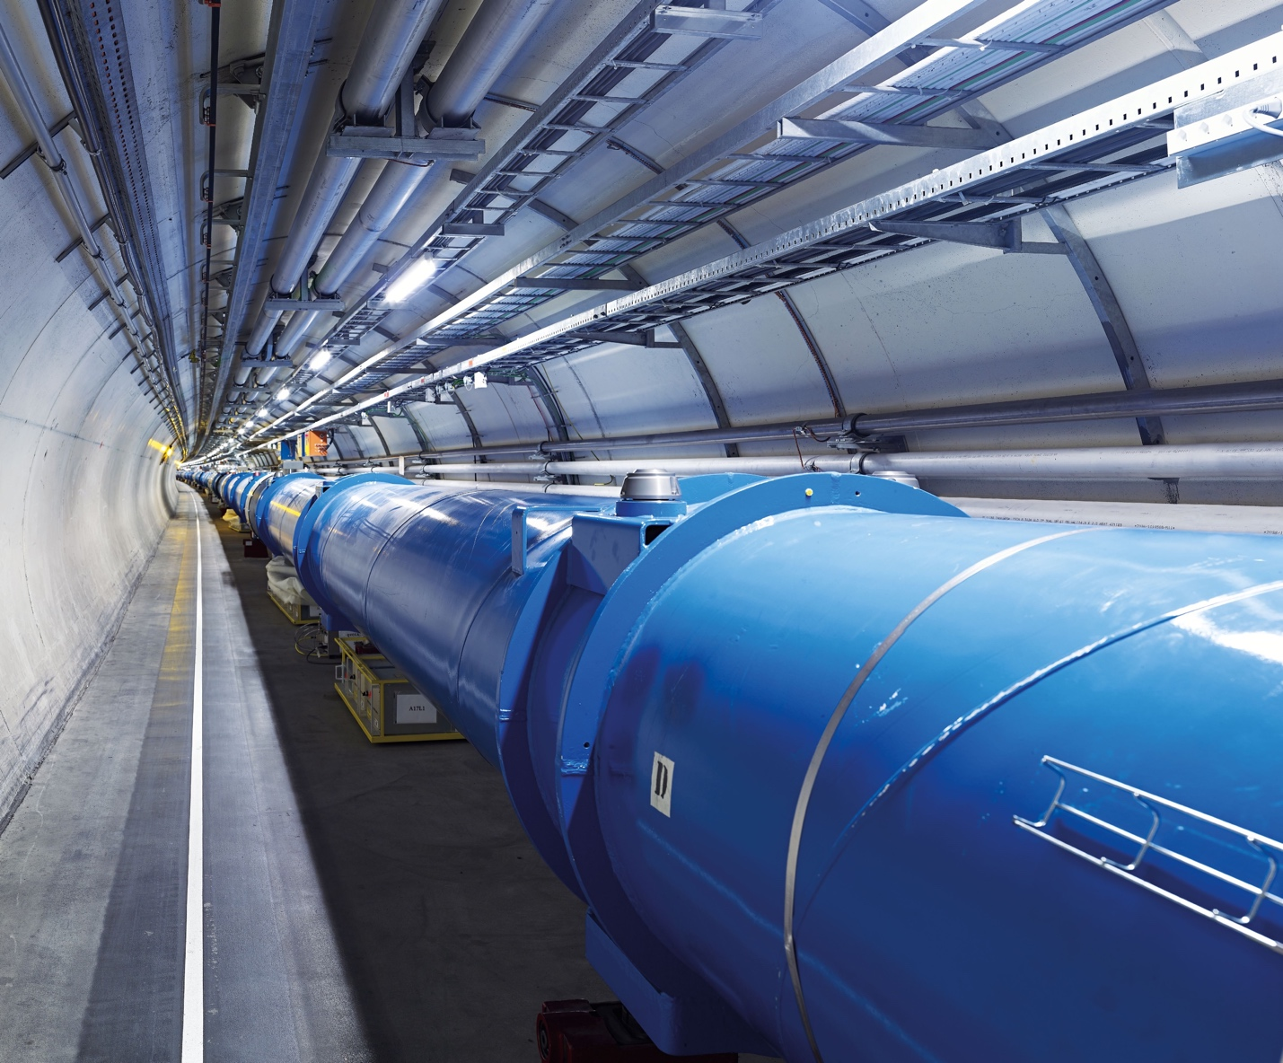
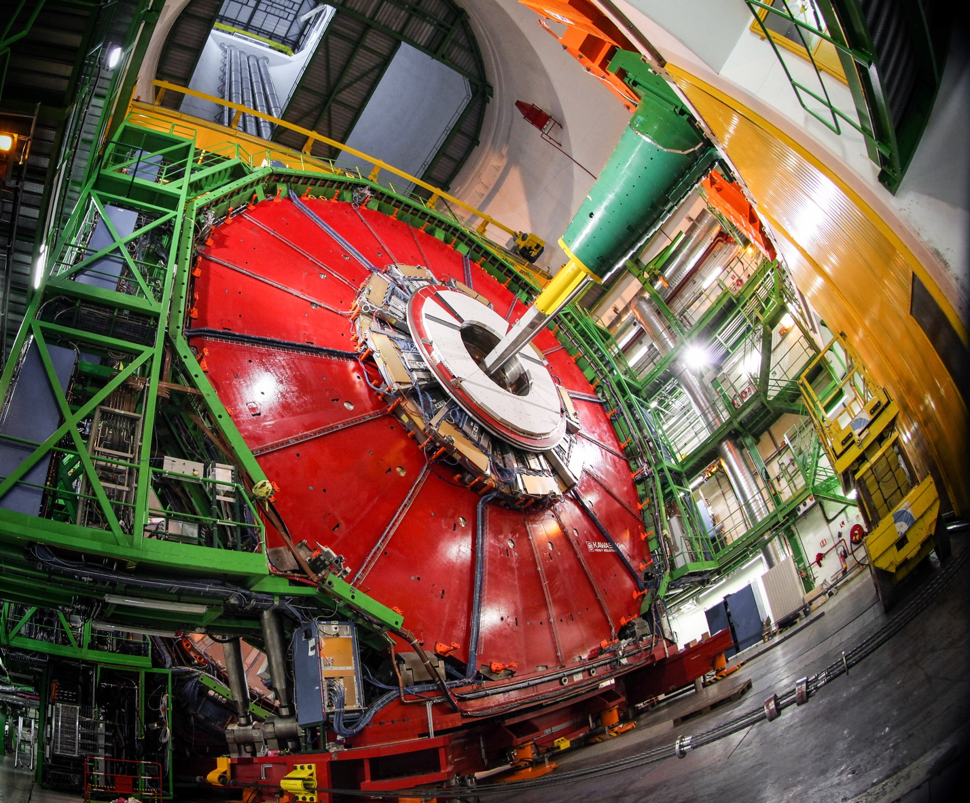
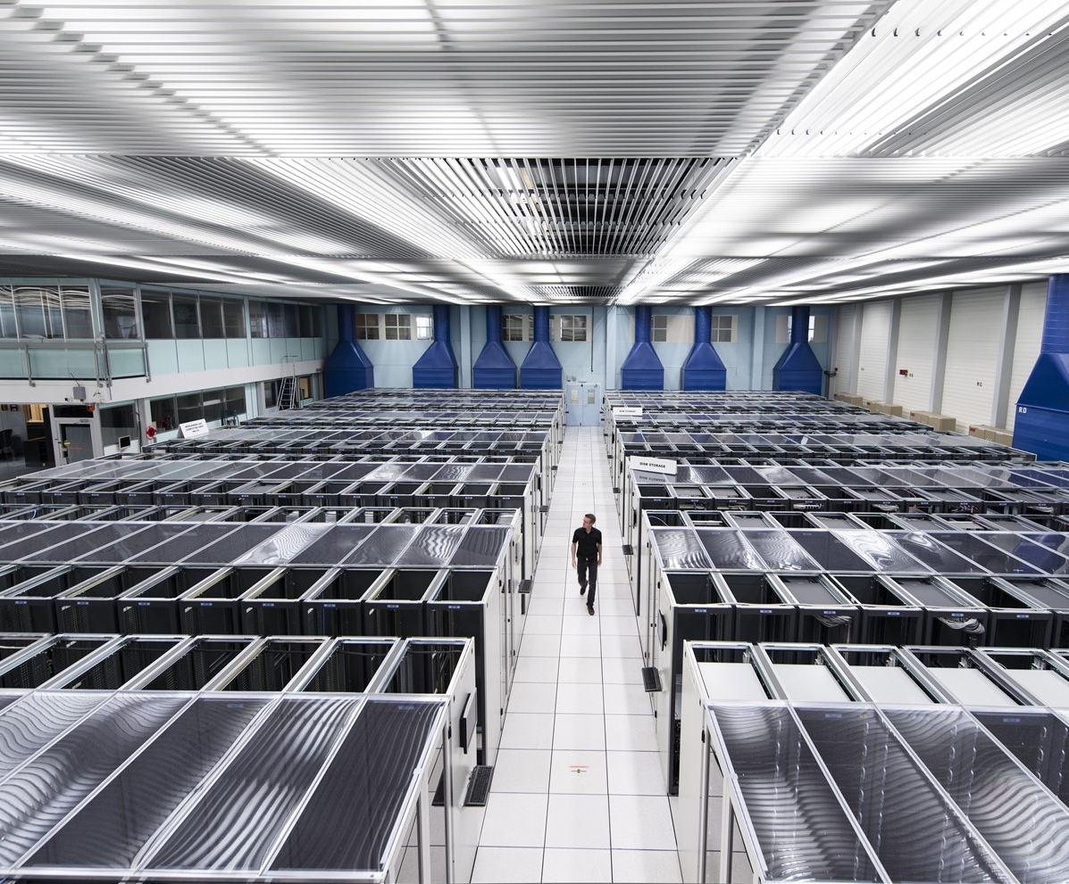
We develop technologies in three key areas
ACCELERATORS
DETECTORS
COMPUTING

Slide 12
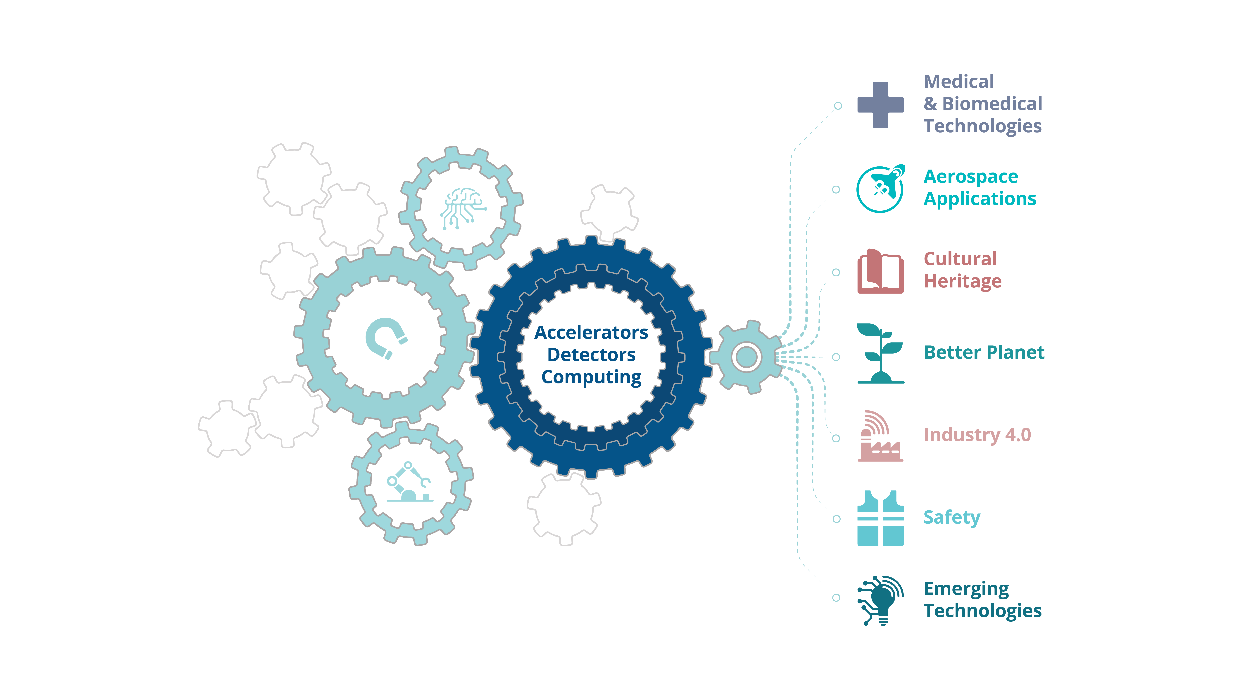
CERN’s mission extends beyond science

Slide 13
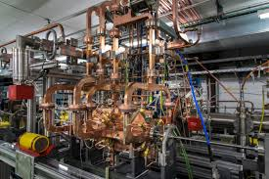
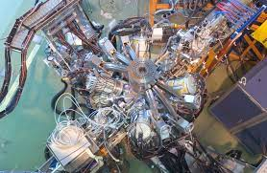
Involvement from Africa
The participation of physicists, computer scientists and engineers from Africa in CERN experiments and other activities has become increasingly visible, offering interesting prospects for the future.
Algeria – PhD student in ATLAS.
Egypt – Member of CMS.
Madagascar – CLIC / CTF3.
Morocco – Member of ATLAS.
Nigeria – Member of CMS.
South Africa – Member of ALICE, ATLAS, ISOLDE.
Sudan – Expressed interest to join CMS.
Tunisia – Associated Institute of CMS.
ATLAS
CMS
ALICE
CLIC/CTF3
ISOLDE
13

Slide 14
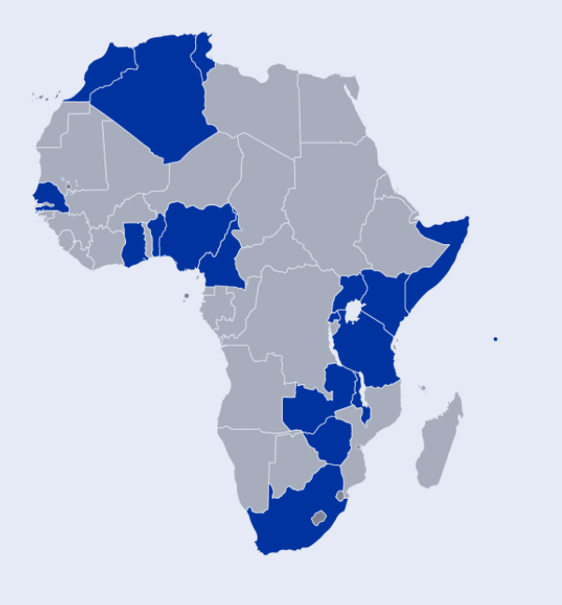
Capacity-building in Africa
Participation in CERN education & training programmes
  Students in the Summer Student Programme for nationals of non-Member States.
  Teachers in the teacher programme.
  Students in Beamline for Schools.
Support for African School for Fundamental Physics and Applications (7 editions; latest in Nov/Dec 2022)
Capacity-building activities - CERN & Society Foundation
  CERN-UNESCO Schools on Digital Libraries → 5 schools organized across Africa with 15+ countries.
  Arts at CERN “Connect” programme with residencies for African artists at CERN with South African Astronomical Observatory & South African Radio Astronomy Observatory.
Reach of CERN-UNESCO School on Digital Libraries
14
14
Notes:
CERN Summer Student Programme 2021/2022/2023: Students from Africa: 12/13/11
Beamline for Schools: Winner from South Africa (2015) and Egypt (2022)
Teacher Programme Participants 1998-2022: From Africa 129

Slide 15
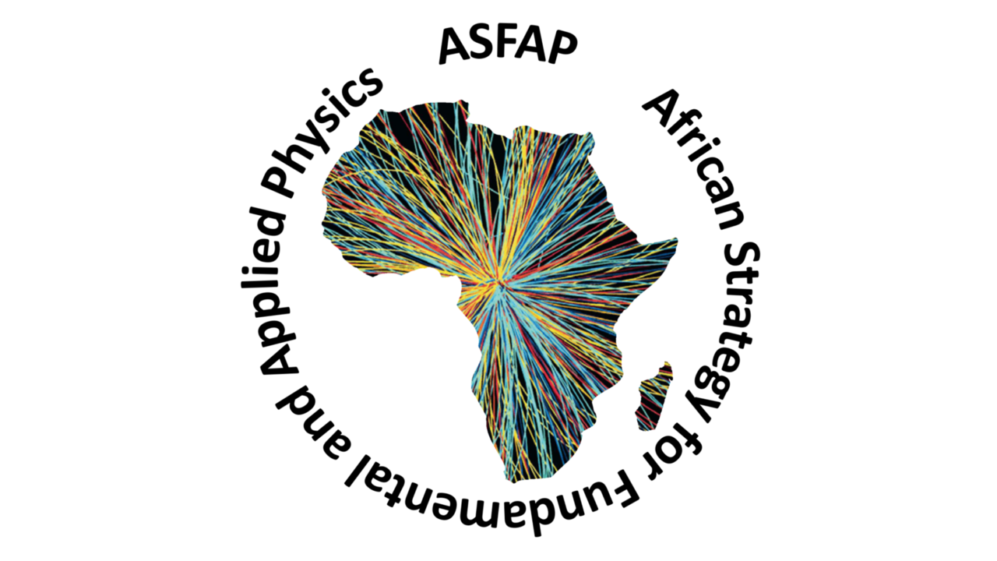
African Strategy for Fundamental & Applied Physics
Support for process of development of African Strategy for Fundamental and Applied Physics to increase African education and research capabilities:
  launched in 2020, engaging African scientists and the international community in the Strategy development;
  suggest the direction for the field, with actionable items for the next decade, to repeated periodically, every 7-10 years;
  expecting further opportunities for closer collaboration between Africa, CERN and other partners.
15
15

Slide 16
Thank you for your attention.

