Slide 1
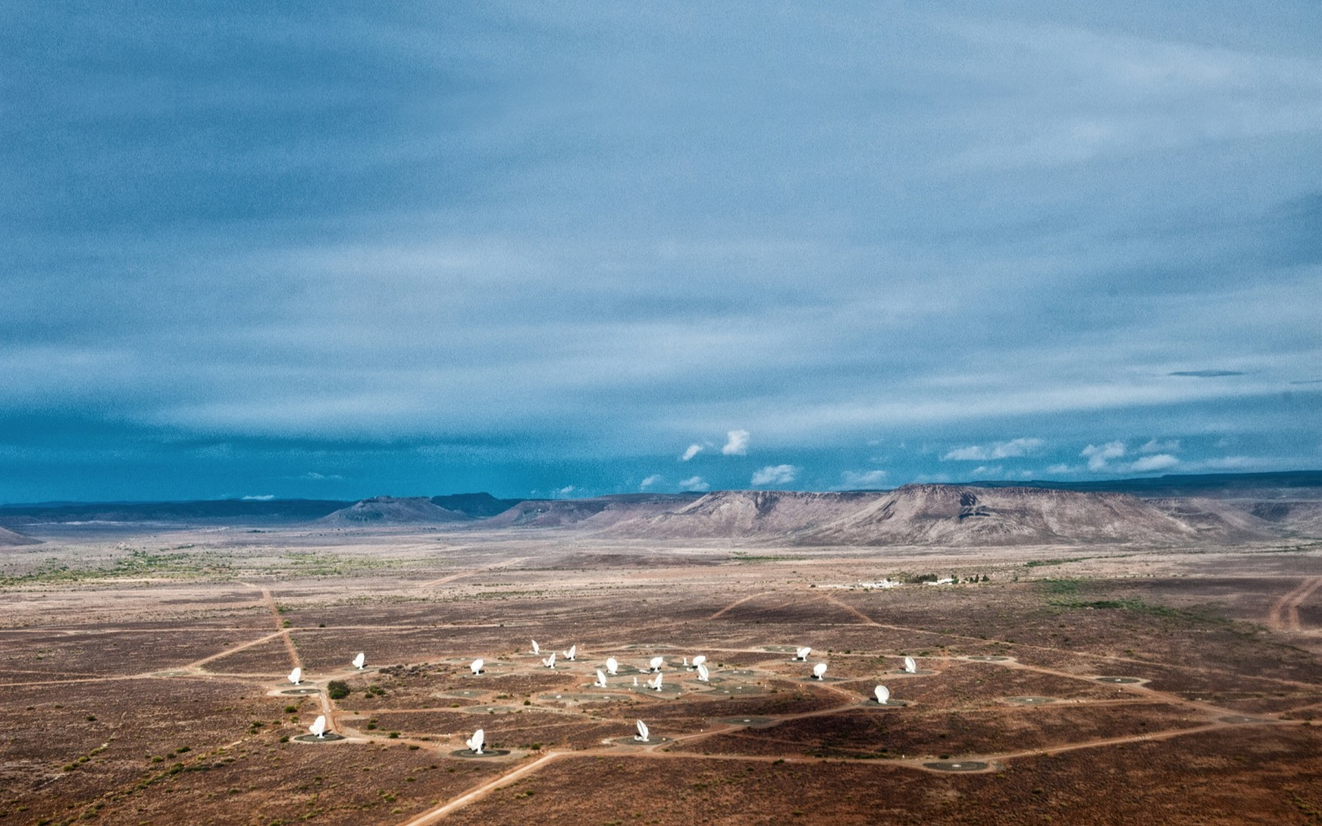

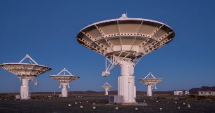
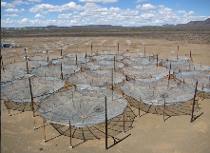
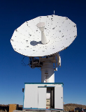
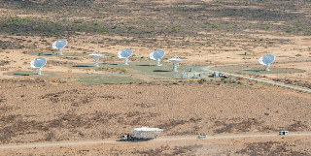
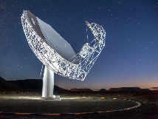
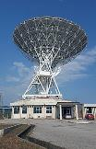

Searching for the Origins of the Universe…
An African Story about the SKA
TIPP 2023 – 5th September 2023
PRESENTER: Dr. Adrian Tiplady
www.sarao.ac.za
Notes:
Introduction on SARAO
Hisrorically operated HartRAO… has grown with SA’s strategic investments

Slide 2
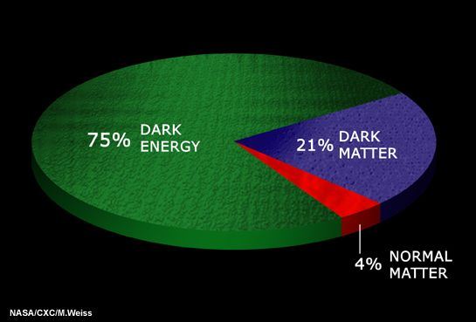
The universe as we don’t know it

Slide 3
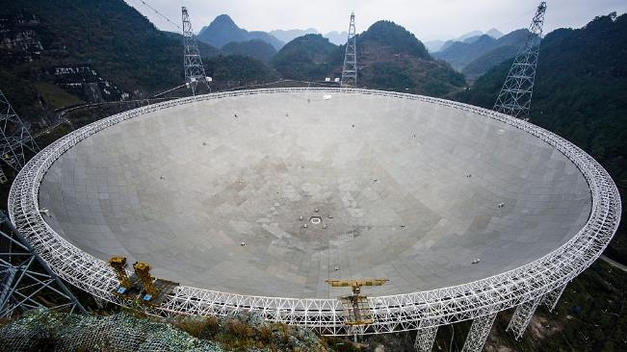
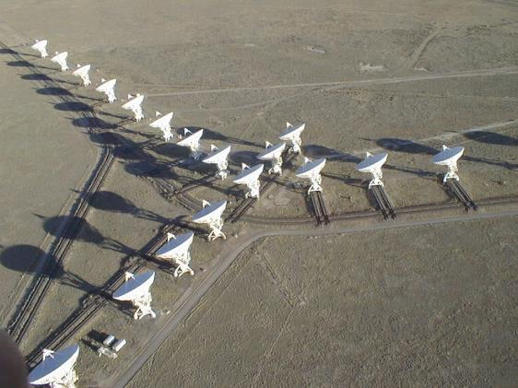
So… what is the SKA?
500m diameter
FAST telescope, China
(collecting area for sensitivity)
VLA, USA
(extent for resolution)
Notes:
Big dish – weaker signals – time machine

Slide 4
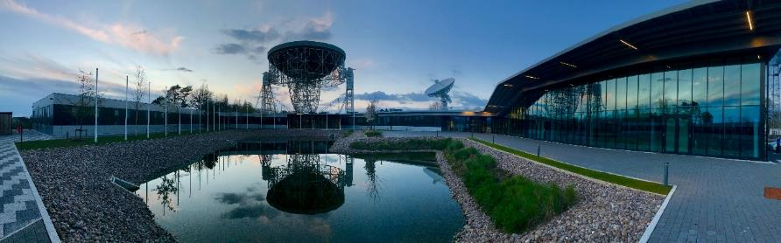

So… what is the SKA?
A Global Endeavour
  Over 1,000 scientists and engineers involved from 20 countries already
  SKA Observatory launched January 2021 – an inter-governmental organisation
Phased deployment
  Phase 1: €1.3 billion instrument – construction from 2022 – 2028, €0.7 billion for 10 years operation
Global Headquarter (United Kingdom)
Africa
Australia
Notes:
Technical description
International enterprise from the outset
Single dish versus large dishes
The SKA is a €2bn project (in 2021 €), comprising: a construction cost for two world-class telescopes of €1.3bn, and €0.7bn for the first 10 years of operations (2021-2030).

Slide 5
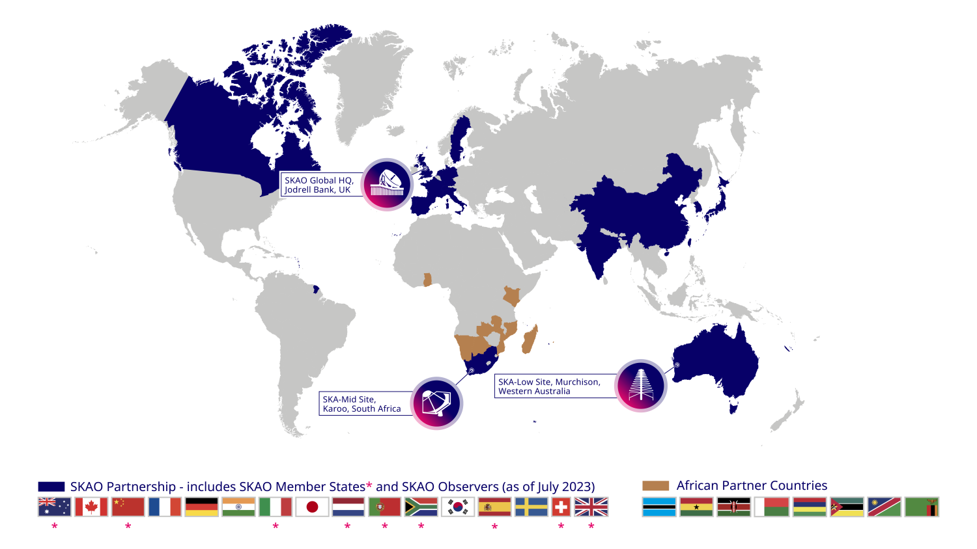
So… what is the SKA?
Notes:
Global endeavor to

Slide 7

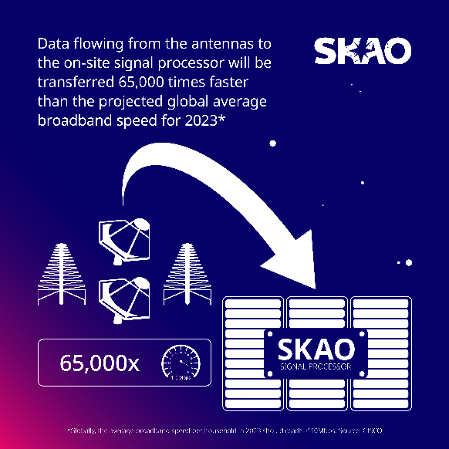

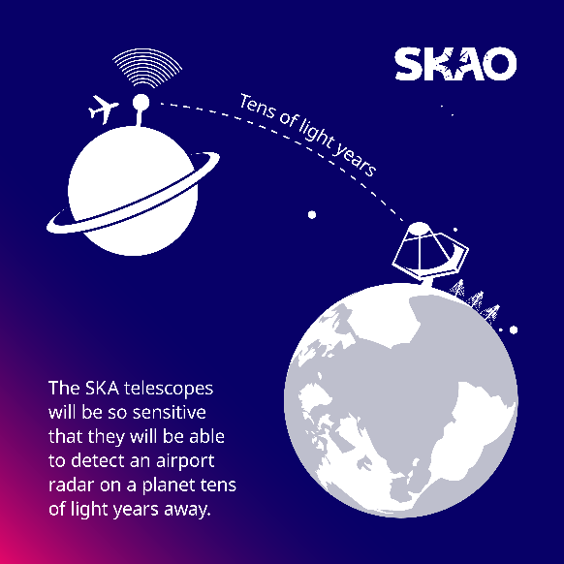
So… what is the SKA?
Vision of the SKA was premised on future technology availability
Next-Generation Technology Machine
  Solving key technology challenges in ‘Big Data’ super-computing, data storage and distribution – extremely relevant for the 4th Industrial Revolution
  Complex data processing and machine learning
Notes:
In total, the SKAO will archive 710 petabytes of data per year. This would fill the data storage capacity of about 1.5 million typical laptops every year by today’s standard.

Slide 8
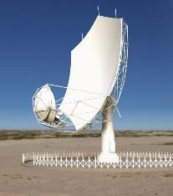
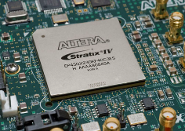
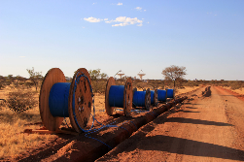
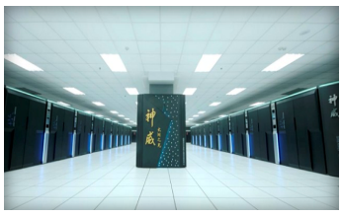
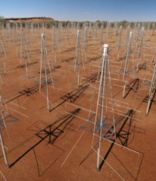
Data Flow through the SKA
~50 PFLOPS
8.8 Tb/s
~5 Tb/s
SKA1-MID
7.2 Tb/s
~2 Pb/s
100 PFLOPS
SKA1-LOW
Users

Slide 9
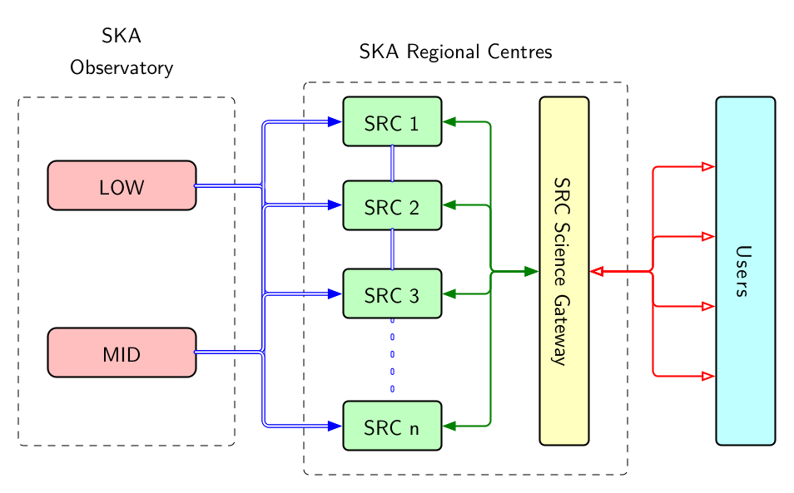
So… what is the SKA?
SKA Regional Centres to enable exploitation of SKA data products
Notes:
In total, the SKAO will archive 710 petabytes of data per year. This would fill the data storage capacity of about 1.5 million typical laptops every year by today’s standard.

Slide 10
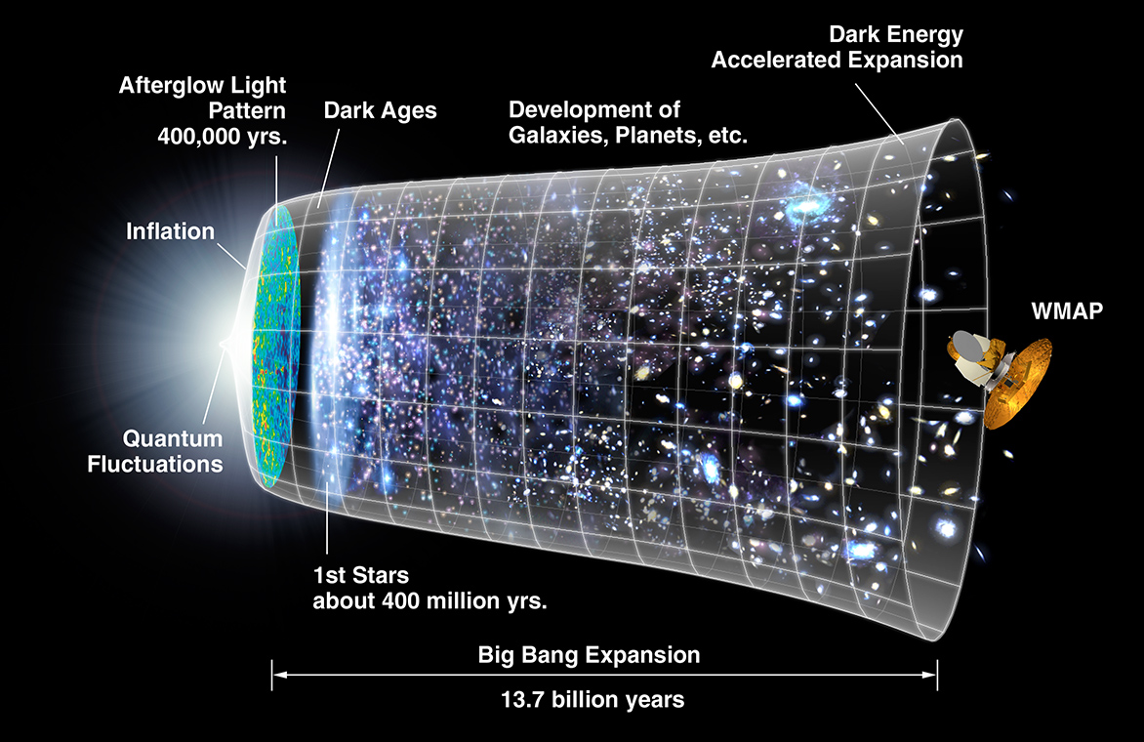
Some SKA science – Cosmic evolution

Slide 11
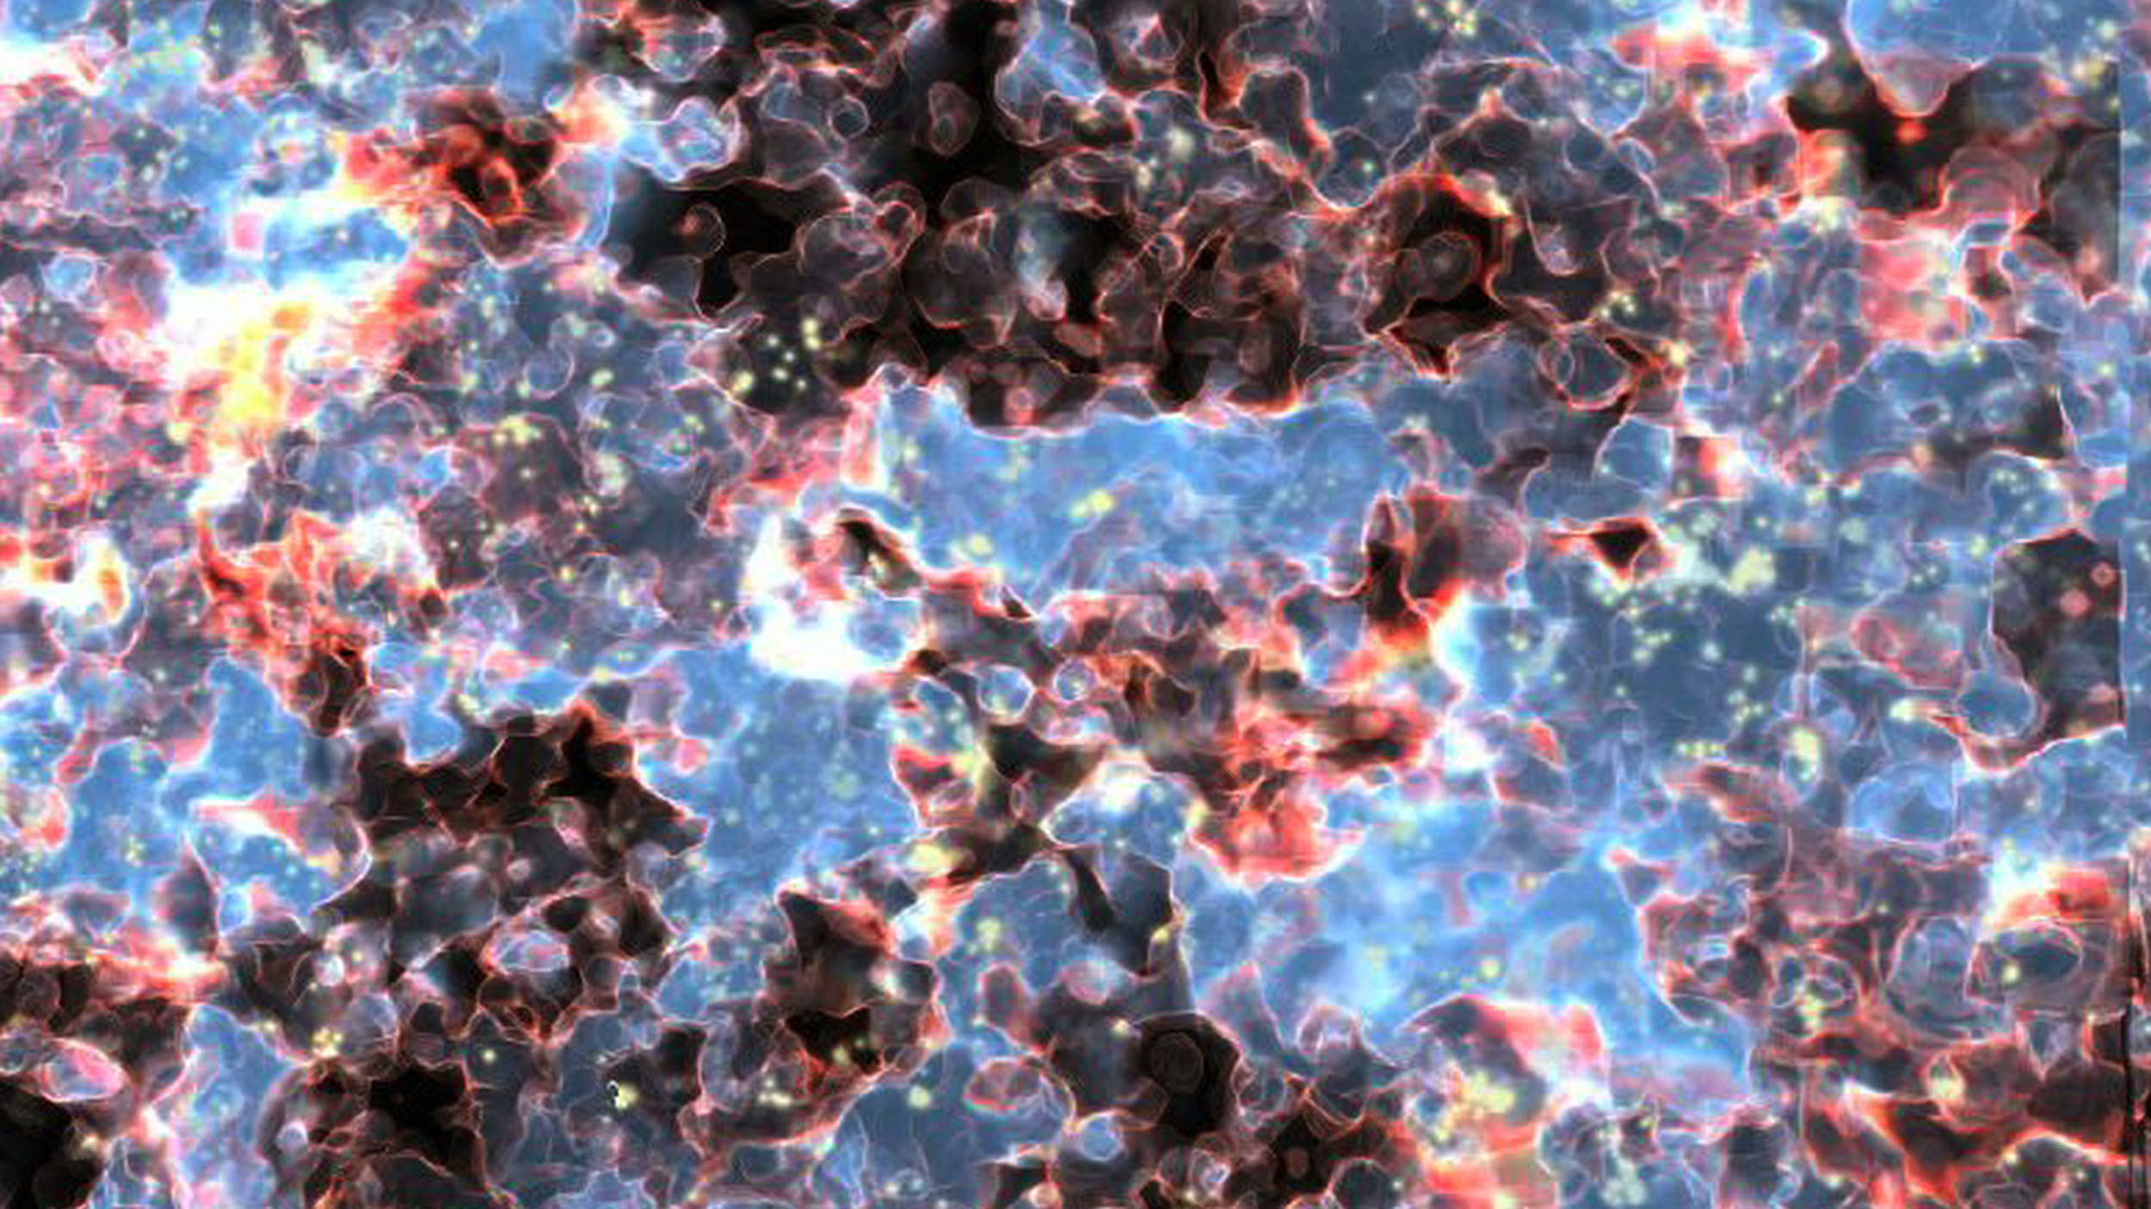
Some SKA science –Cosmic Dawn

Slide 12

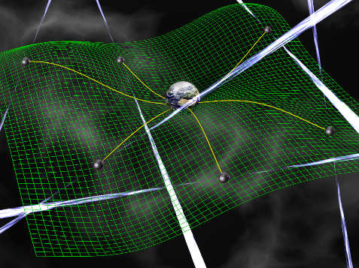
Some SKA science - was Einstein right?
Use radio pulsars to:
“See” black holes
  Mass
  Lense-Thirring precession (spin)
  No-hair conjecture (Quadrupole)
Test theories of gravity
  Gravitational waves
  Grav. Dipole radiation
  Strong equivalence principle
  Cosmological GWs

Slide 13

Some SKA science - is there evidence of life elsewhere?
Search for complex organic molecules, pebbles orbiting stars, and ETI

Slide 14
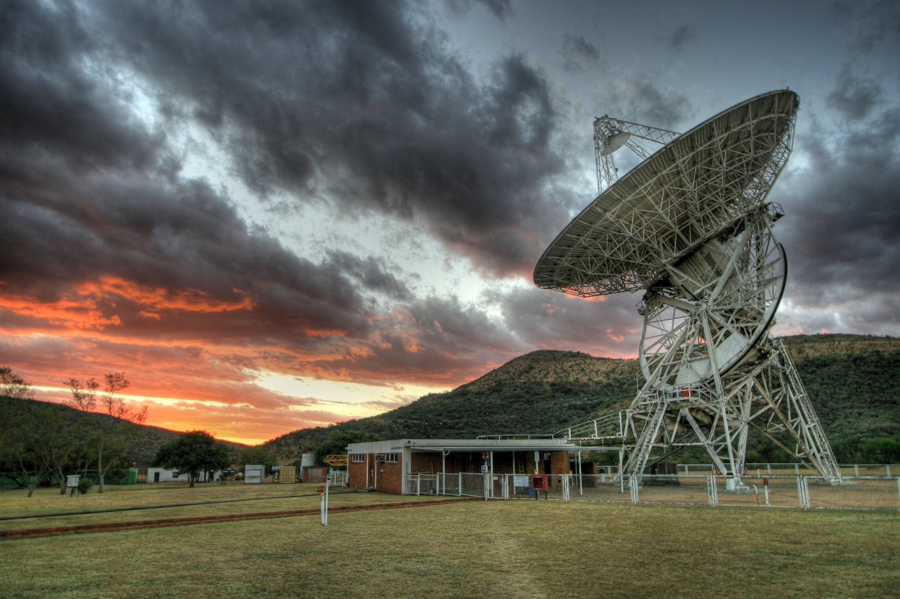
Why in Africa?
History of radio astronomy for five decades
  Conversion of NASA Deep Space Network station to the Hartbeesthoek Radio Astronomy Observatory
Dawn of democracy in South Africa (1994)
  Declining State investment in R&D, with loss of major technology missions
  R&D not aligned to priorities of new government

Slide 15
Why in Africa?
Policy (1996 White Paper, R&D Strategy, 10 Year Plan) and visionary leadership
  “One way to achieve national excellence is to focus our basic science on areas where we are most likely to success because of important natural or knowledge advantages”
    Astronomy geographic advantage – exhibited scientific qualities necessary to host next-generation astronomical facilities (dark and radio quiet skies)
  Key strategic objectives
    “Become the preferred destination for major astronomy projects and associated international investment in construction and operations.”
    “Will have constructed a powerful radio-astronomy telescope and used it for world-class projects.”
Multi-layered Value Proposition
  Local and global value proposition

Slide 16
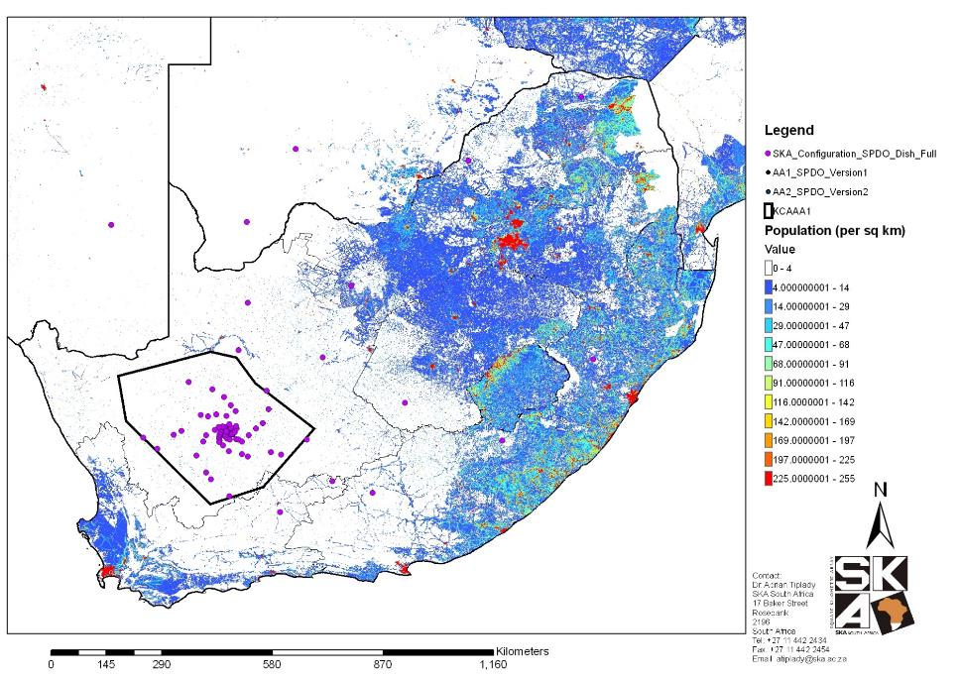
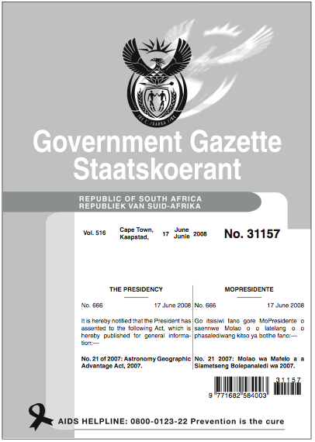
Why in Africa?
One perspective of astronomy advantage
  Low population densities -> dark and radio quiet skies
  Protected through unique legislation

Slide 17
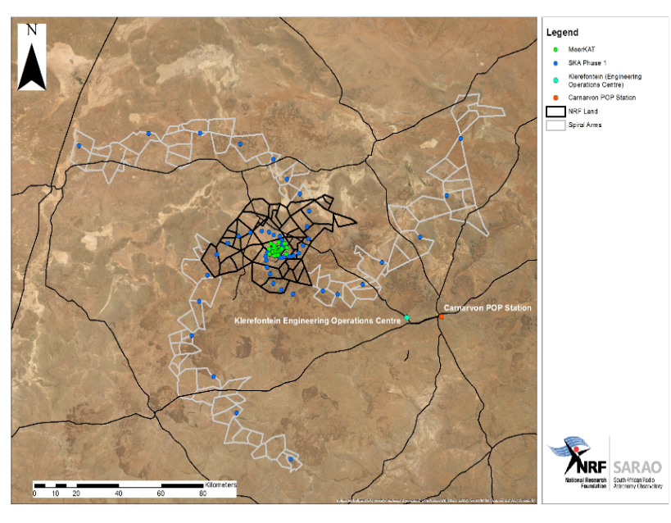

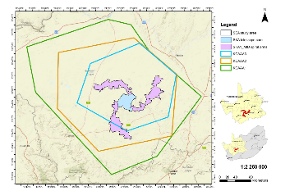
Why in Africa?
MeerKAT & SKA constructed within two protected reserves
  4 million hectares radio astronomy reserve
  Environmental conservation area (140,000 hectares)
Inter-disciplinary research opportunities
Meerkat
National Park

Slide 18
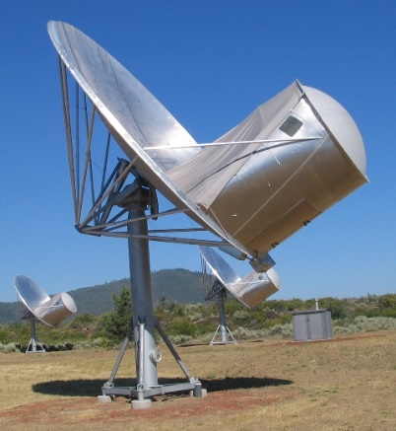
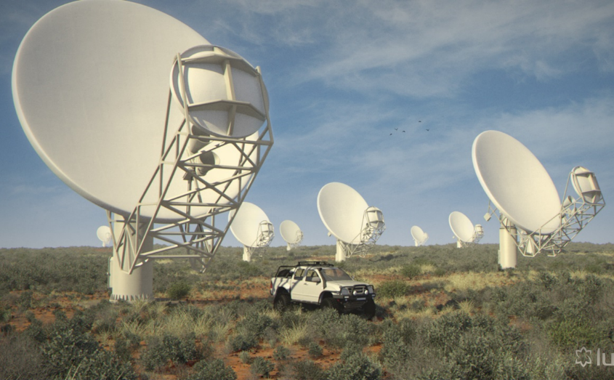
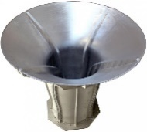
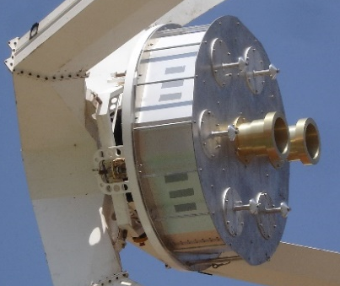
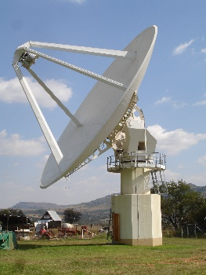
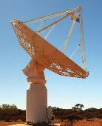
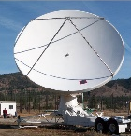
Time to build something… circa 2007
Derive maximum return on investment as an SKA partner
  Establish an engineering and scientific capacity to ensure local participation in international program
  Develop new technologies and methods deemed critical for delivery of SKA
Validation of South Africa as a viable site to host the SKA

Slide 19
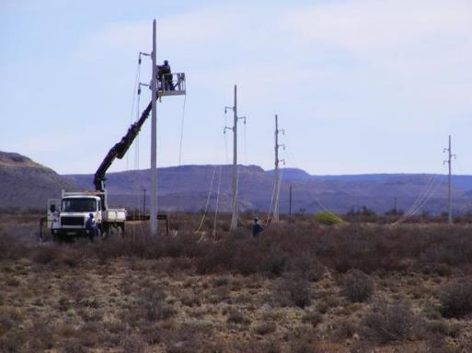
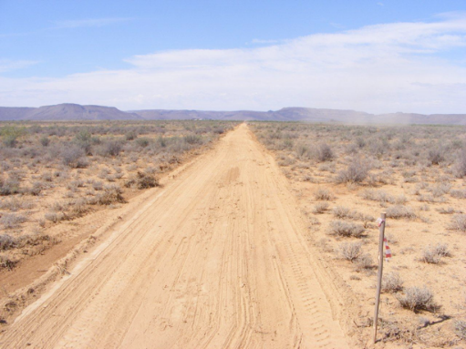
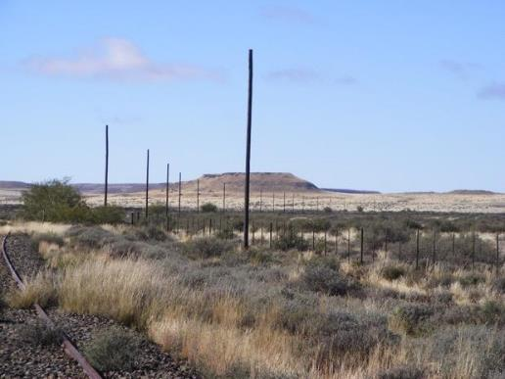
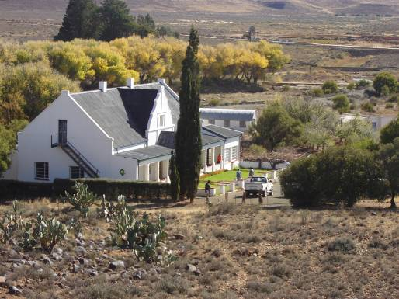
MeerKAT: an SKA Precursor
Establishing a Site
Spark-free power
Roads
Data
Klerefontein

Slide 20
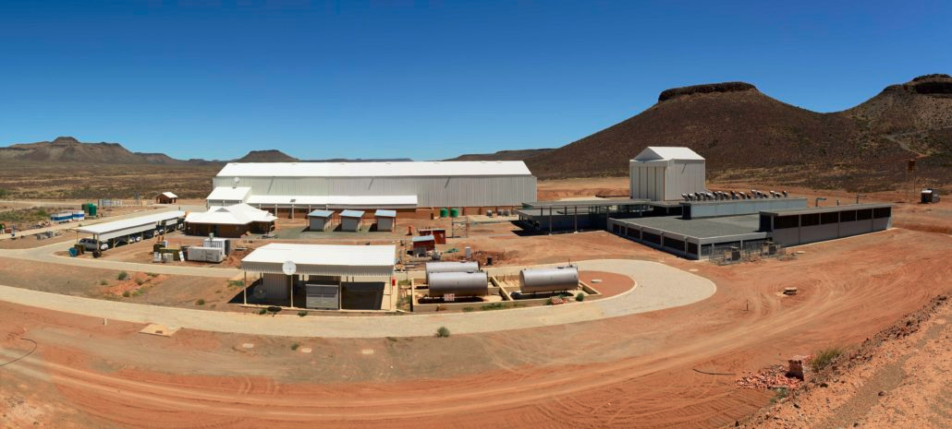
MeerKAT: an SKA Precursor
Losberg Onsite Facility
Underground Processing Facility
Power Conditioning

Slide 21
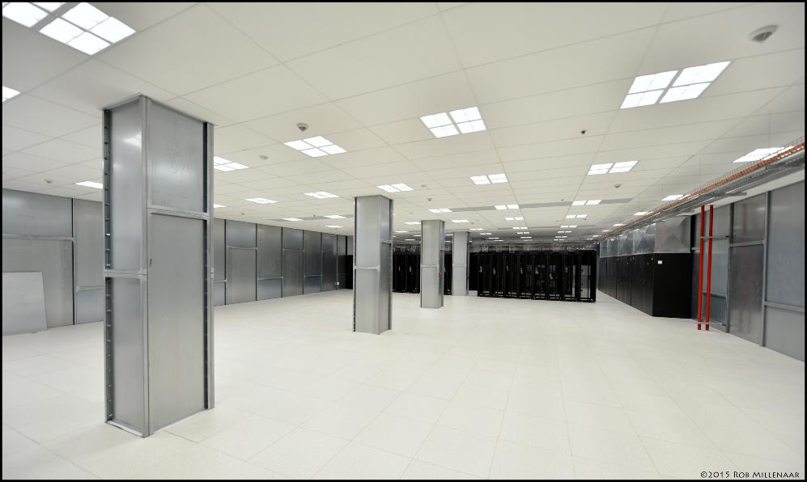
MeerKAT: an SKA Precursor
Underground Processing Facility – Shielded Room

Slide 22
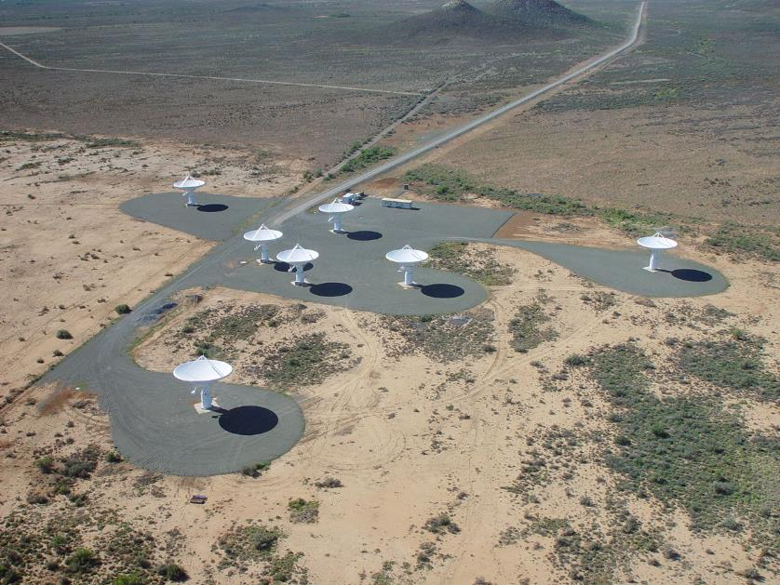
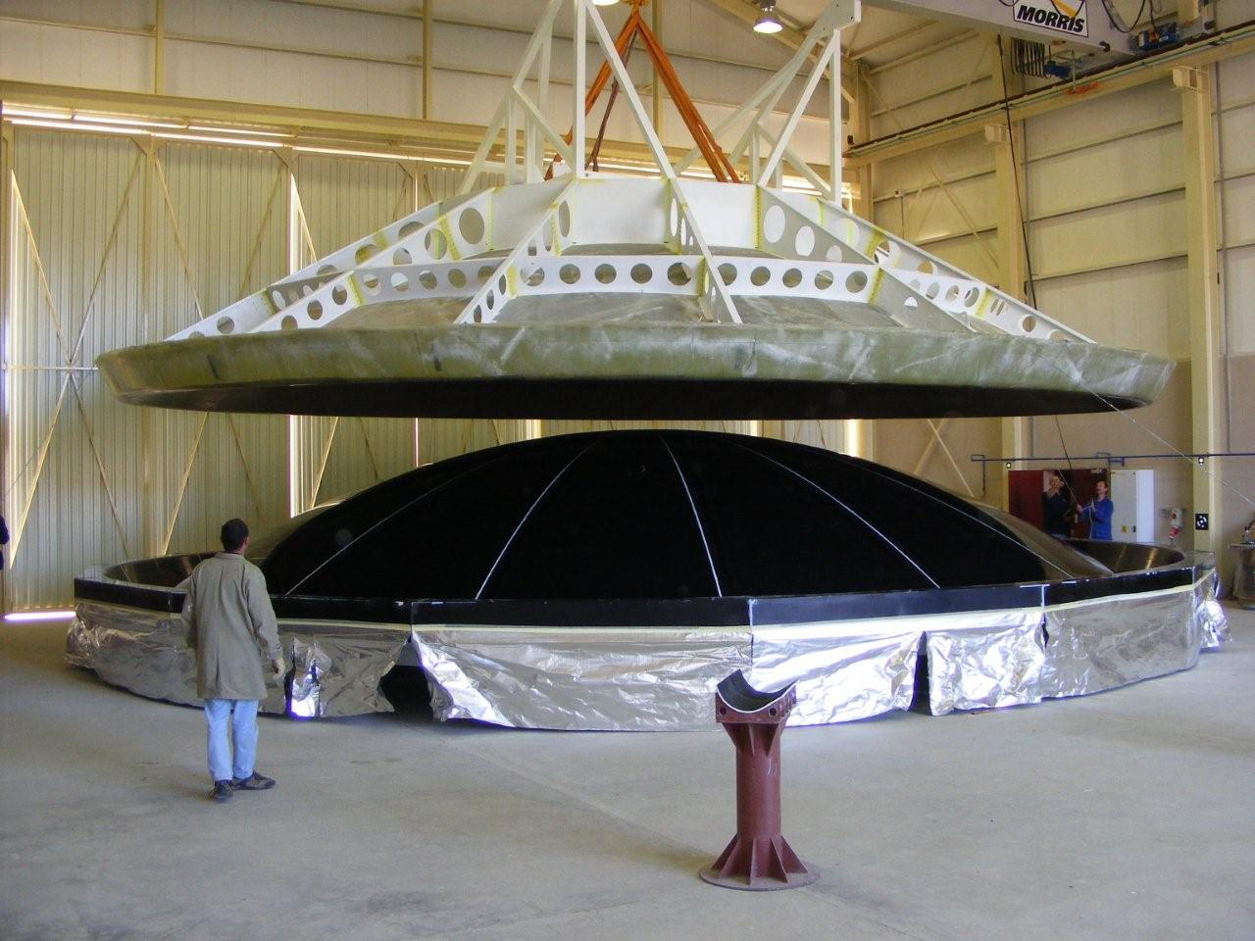
MeerKAT: an SKA Precursor
KAT-7 – a MeerKAT Precursor and Engineering Prototype
Rigorous system engineering
  Worked first time
  Substantial return on investment – design changes for MeerKAT resulting in innovation in every element
Notes:
Symmetric centre-fed dish (changed in MeerKAT
Wide flare corrugated horn
Compact OMT
Stirling cycle cryogenics (changed in meerKAT)
Water cooling (changed in meerKAT)
Ion vacuum pump (changed in meerKAT)
RF-over-fibre (changed in meerKAT)
Heterodyne Rx (changed in meerKAT)
Casper/Roach DSP

Slide 23
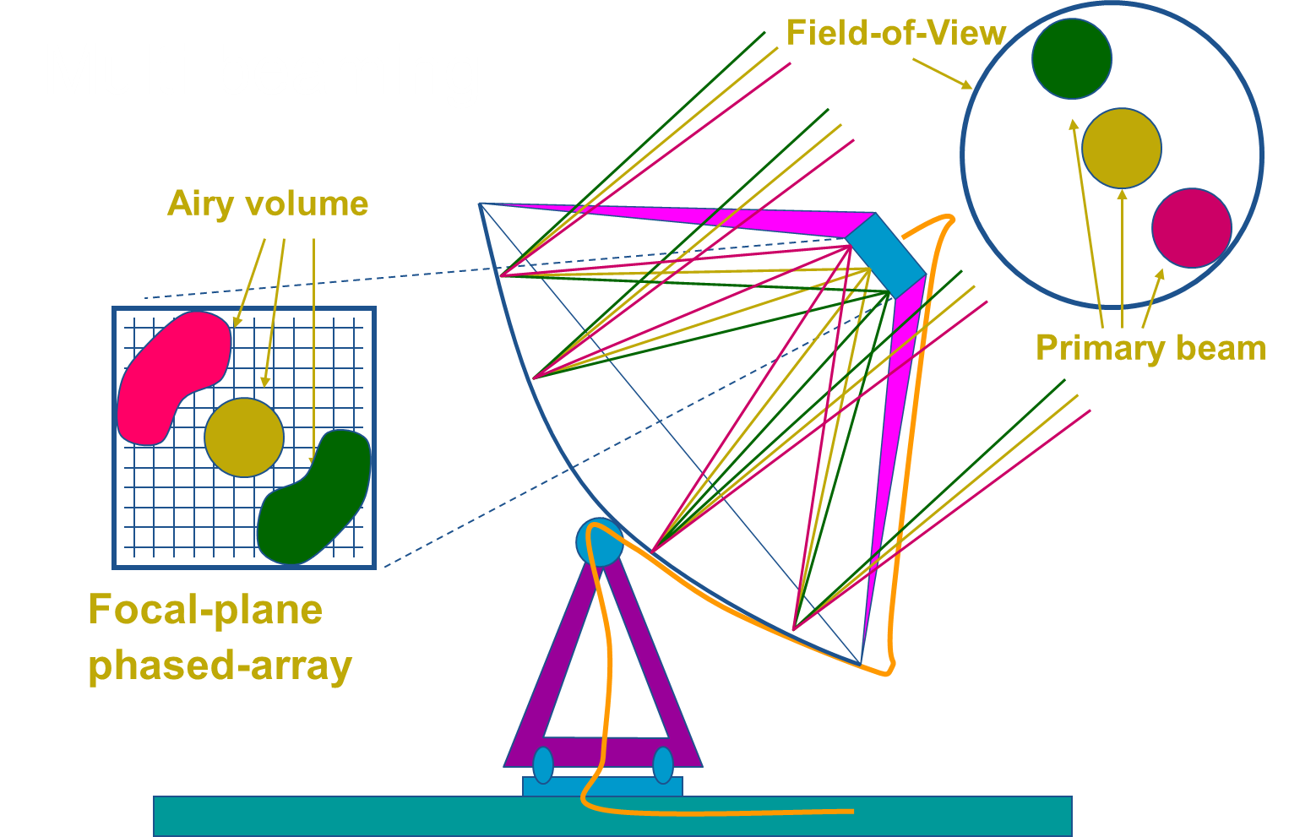
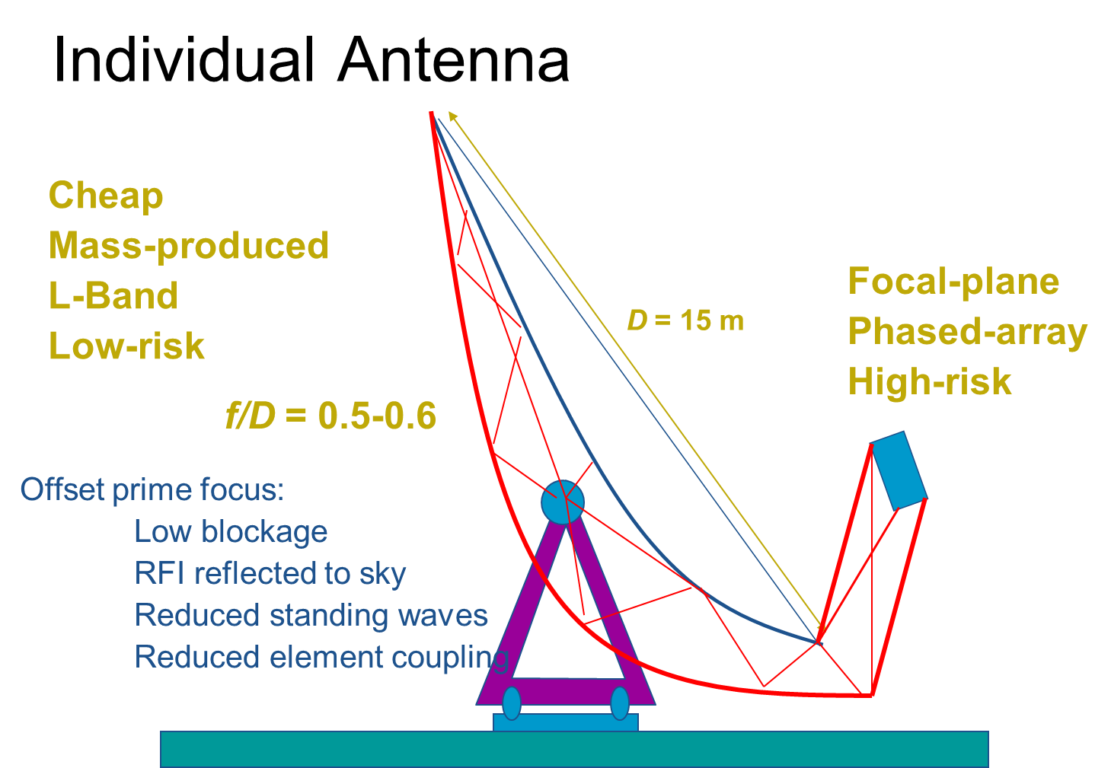
MeerKAT: an SKA Precursor
KAT-7 – a MeerKAT Precursor and Engineering Prototype
Rigorous system engineering
  Worked first time
  Substantial return on investment – design changes for MeerKAT resulting in innovation in every element
Value engineering
Notes:
Symmetric centre-fed dish (changed in MeerKAT
Wide flare corrugated horn
Compact OMT
Stirling cycle cryogenics (changed in meerKAT)
Water cooling (changed in meerKAT)
Ion vacuum pump (changed in meerKAT)
RF-over-fibre (changed in meerKAT)
Heterodyne Rx (changed in meerKAT)
Casper/Roach DSP

Slide 24
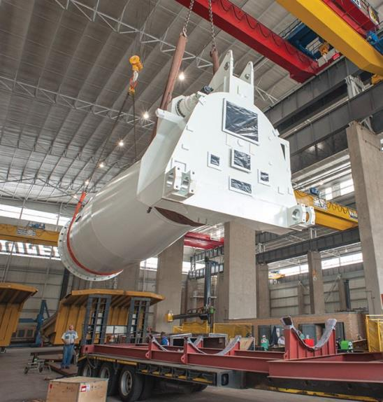
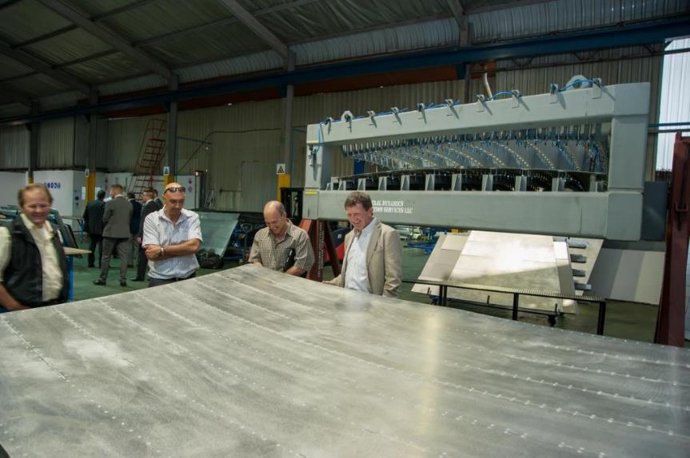
MeerKAT: an SKA Precursor
First MeerKAT dish under construction (>75% Localisation): Pedestal and Dish Panel (Johannesburg)

Slide 25
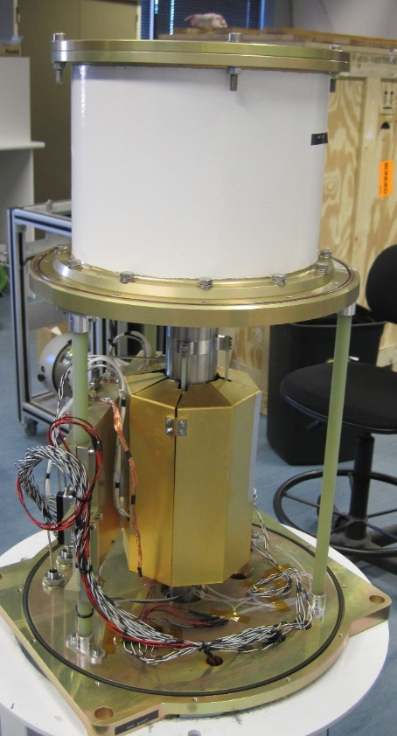
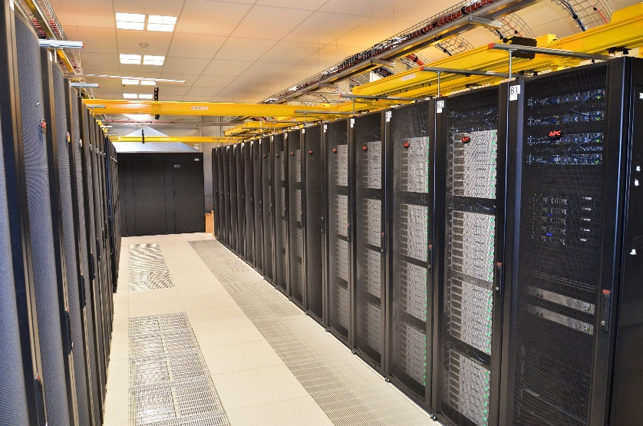
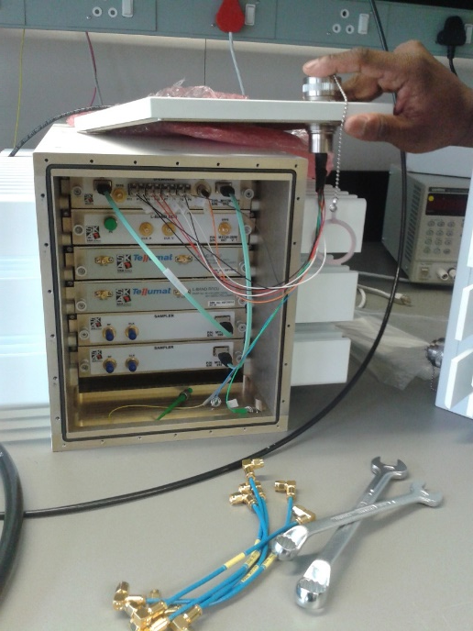

MeerKAT: an SKA Precursor
Correlator & beamformer
Digitisers producing 1 x DVD data per second per antenna
Best L-band receivers in the world – South African company
Reconfigurable hardware with CASPER architecture – used to image black hole for the first time
Notes:
CBF's HW is theoretically capable of roughly 6TOP/s (integer, not floating point) per SKARAB * 288 nodes = 1728TOP/s total, burning about 40kW in 10 racks (more than twice as efficient than current Green500 leader, if you equate an integer operation to a floating point operation, which is actually not fair).

Slide 26






MeerKAT: an SKA Precursor
Significant return in low cost deployment of data compute and storage infrastructure
  >R103 million in savings per year
Compute Specifications
  1.5 PFlop compute, 3 Tbps network, 42 PiB storage
  Custom metrics to allow fine grain control of resources such as GPUs
Cardboard
Metal
System
Notes:
Cardboard -> Metal -> System in one day

Slide 27

MeerKAT: an SKA Precursor

Slide 28


Notes:
75% local content
After 5 years – No variation orders, no cost increases, fixed price contract
Winner of 2015 SA Steel Awards (the tolerances are unheard of – 1,000ths of a degree, in a league of its own)

Slide 29

MeerKAT Today (Inaugurated 2018)
64 x 13.5-metre highly efficient offset Gregorian dishes spread over 8 km (70% within 1 km diameter)
Better than promised performance
  Nearly 4 times advertised survey speed at no additional cost
On time, on budget
Attracted further international investment to extend MeerKAT by a further 13-16 dishes (approximately 37M Euros)
  Germany (Max Planck)
  Italy (INAF)
To be integrated with SKA Phase1

Slide 30
SARAO Grew - Strategic Activities and Programs
Design, construct and operate radio astronomy facilities
Protected areas for radio astronomy
Technology Research and Development
Commercialisation
Human Capital Development
Communications & Science Engagement
Development of astronomy infrastructure and capacity in Africa

Slide 31
What’s MeerKAT been doing?
5 years of scientific operations
  199 papers (and counting)
  Last Open Time call had over-subscription rate of 4.3
  Many datasets are no longer proprietary, and (mainly visibilities) are available through the archive interface: https://apps.sarao.ac.za/katpaws/archive-search

Slide 32

First ‘commissioning image’
Radio image made with MeerKAT of the centre of our Milky Way galaxy
Clearest such image ever made – unveiled at MeerKAT inauguration, July 2018

Slide 33

The 1.28 GHz MeerKAT Galactic Center Mosaic (Heywood et al. 2022, ApJ)

Slide 34


(1st MeerKAT-64 paper, Sep 2019)

Slide 35



X-shaped galaxies: mystery solved
Hydrodynamical backflow in giant radio galaxy PKS 2014-55
(Cotton et al. 2020)
New mystery
Collimated synchrotron threads
(Ramatsoku et al. 2020)
Notes:
The Sneeze. This image is cut off at primary attenuation = 0.03.

Slide 36

… some science
Ultra-high precision pulsar timing
PSR J2241-5236
~4 ns timing in 1 hour – new world record!
Parthasarathy et al. (2021)
Notes:
Milky Way 1.4 GHz L ~ 2.5e21 W/Hz, 10X evolved L ~ 2.5e22 W/Hz. From cosmocalc.f with alpha = -0.7, this is 250 nJy at z = 4.0.
y

Slide 37
Oh… what about the rest of the value proposition?

Slide 38
SARAO Impact Framework
Education & Skills Development
Community & Cultural Investments
Business & Enterprise Development
Research Enterprise & Science Products
Innovation & Industrial Spillover
Public Good
Mission Driven
Directed Strategic Thrusts

Slide 39
Research Enterprise & Science Products

Slide 40

Innovation & Industrial Spillover
COMRAD Passive Radar
“Data Cube” for SA National Space Agency

Slide 41
Education & Skills Development
Education & Skills Development
Schools Programs
Artisan
Training
Bursary
Program
Research Chairs
Big Data and Strategic Partnerships
Establishing a sustainable research community
  SARAO Local Schools Program
    Education programs and teacher support
    Grants to invest in educational physical infrastructure
  Bursary Program
    >1500 bursaries since 2007, from under-graduate through to post-doctoral fellowships and Research Chairs
    Some ring-fenced for local learners

Slide 42
Education & Skills Development
Education & Skills Development
Schools Programs
Artisan
Training
Bursary
Program
Research Chairs
Big Data Programs
  Partnership with universities
  Data Science Intensive Programs
    2022 Program – 20 participants, 2268 applicants, representing 10 African countries
Artisan Training
  Over 110 artisans trained from community
  Artisan Training Facility

Slide 43


Business & Enterprise Development: Lowering the Barriers to Economic Opportunity
Two-pronged Strategy
  Interventions for business support and entrepreneurial training
  Structured procurement opportunities to maximise local participation
Karoo Enterprise Development Program
  Successful participation of local business in MeerKAT construction, and future SKA
MeerKAT Creative Community Initiative
ICT Support Programs in communities
Karoo Innovation Challenges

Slide 44




Community & Cultural Investment
Activities and programs to ensure SARAO is a ‘responsible, participatory citizen’
  Annual development grants supporting local social development initiatives
  Science engagement
  Cultural preservation
    Annual Riel Dance
    Medicinal Plant Studies
  Social development programs
  Furthering the Sustainable Development Goals
  Women in Data Science initiatives to increase diversity in STEM fields

Slide 45

Public Good
Global positioning as a viable destination for investment in science and technology
  International partnerships, such as the Development of Africa through Radio Astronomy (DARA) and DARA BigData
Profile of transferable skills to respond to national opportunities or threats
  National Ventilator Project
Transferable skills enabled delivery of National Ventilator Project to respond to COVID-19 pandemic

Slide 46

Some Other Projects: Leveraged through MeerKAT & SKA Investment
Diversity in STEM
HERA Telescope: Built by the local community
Africa Program: Deployment of VLBI capable telescopes, and supporting human capacity, in various African Partner Countries

Slide 47



SKA Construction Commencement: 5th December 2022
Minister Blade Nzimande & Catherine Cersarsky (SKAO Council Chair)

Slide 48

“… the project has had a largely positive and significant impact on the national socio-economic conditions and scientific activity. Substantial contribution has been made towards education, skills development and employment opportunities in the country, as well as towards innovation, society and scientific activity.”
Dr. Adrian Tiplady, SARAO Deputy Managing Director: Strategy & Partnerships
Email: atiplady@ska.ac.za

