Slide 1
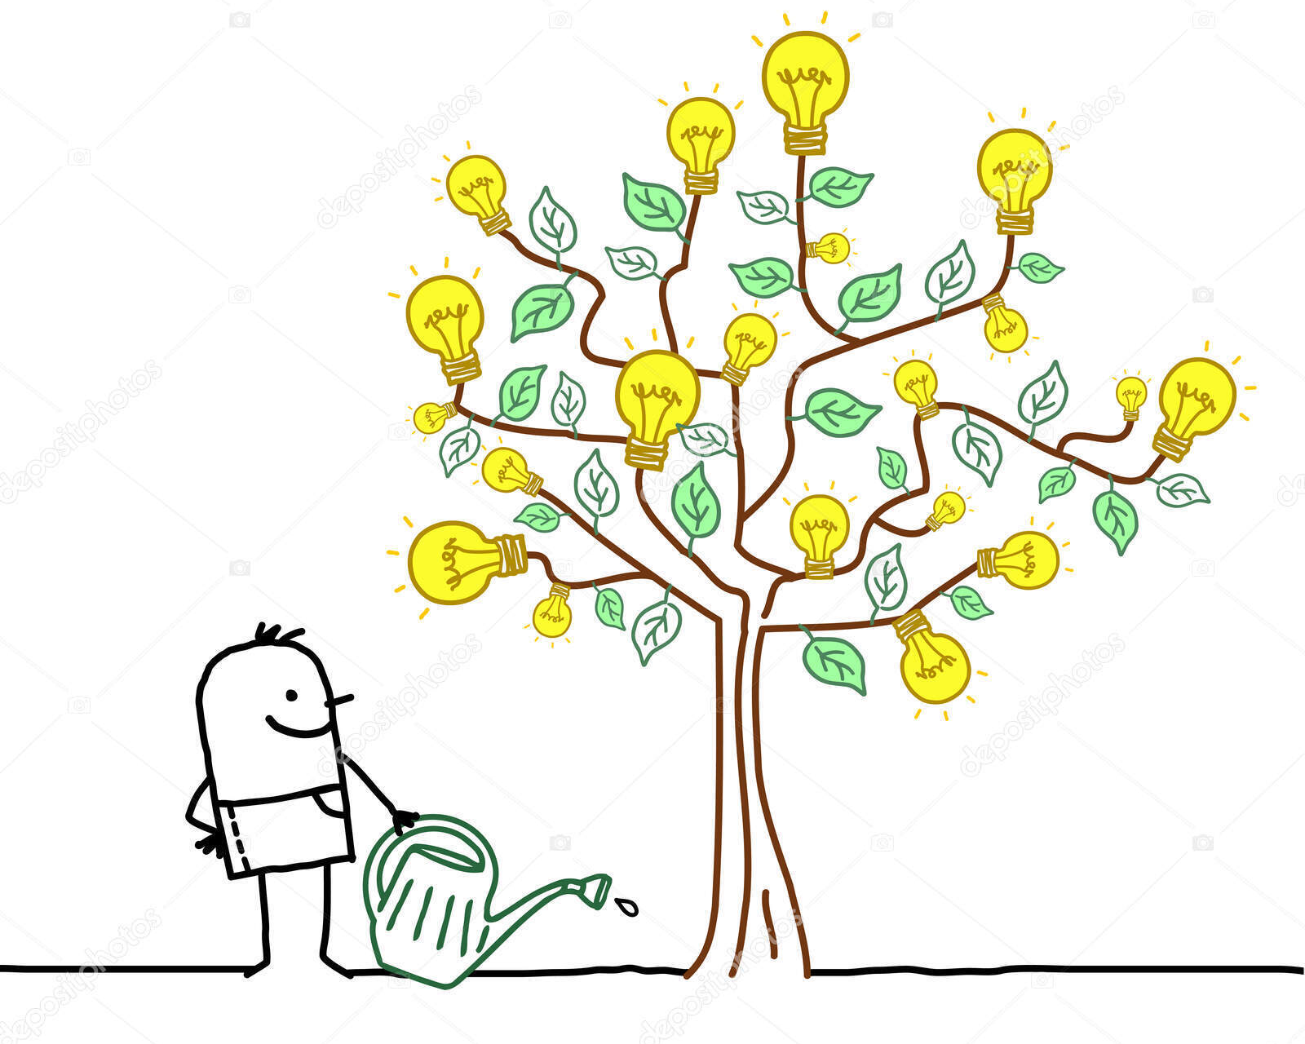
Growing Ideas
Excerpts from the
Knowledge and Technology Exchange session
(and beyond)
TIPP 2023
Cape Town, ZA, 20230907
Massimo Caccia
Uni. Insubria & Random Power
massimo.caccia@uninsubria.it

Slide 2
THANKS! to the conference board for supporting our proposal + Paolo Giacomelli, Christophe De la Taille, Maxim Titov, co-organisers of the KTT session + all the speakers at the session!
DISCLAIMER: views and opinions in the following are my personal view, for sure debatable. Mistakes and misunderstandings are also mine, no need to debate!
APOLOGIES: Things Take Time and I’m slow. I had to skip the conference banquet. Apologies to the organisers and all the attendees

Slide 3
the plan of our session, intended to present & discuss measures to support innovation and foster Knowledge & Technology Exchange:
European Innovation Council (EIC): support of breakthrough technologies and disruptive innovation (Maciej Lopatka, EIC)
KTT with industry in EU [framework program] projects (Paolo Giacomelli, INFN-Bologna)
ATTRACT: an EU funded project to foster the transition from the lab to the market (Pablo Garcia Tello, PAO, CERN)
KT at CERN: opportunities and challenges (G. Anelli, CERN)
At continental and trans-national level (Europe):

Slide 4
back to our session, enfin!, intended to present & discuss measures to support innovation and foster Knowledge & Technology Transfer:
Max Planck Innovation: a comprehensive service for MP scientists (Wolfgang Troeger, MPI)
The DESY innovation ecosystem: from basic research to deep-tech business (Denny Drossmann, DESY)
TT in Particle Physics research institutes: the case of the [Italian] National Institute of Nuclear Physics (INFN) (Mariangela Cestelli-Guidi, INFN)
At national level (Europe):

Slide 5
back to our session, enfin!, intended to present & discuss measures to support innovation and foster Knowledge & Technology Transfer:
Knowledge exchange through collaboration with industry partners: a perspective from a University team (Georg Steinbrueck, Uni. Hamburg)
Random Power: from single photon sensitive detectors o random bit generation. An entrepreneurial endeavour(Massimo Caccia, Uni. Insubria & Random Power)
At research team level (use cases):

Slide 6
The EIC report:
The rationale:

Slide 7
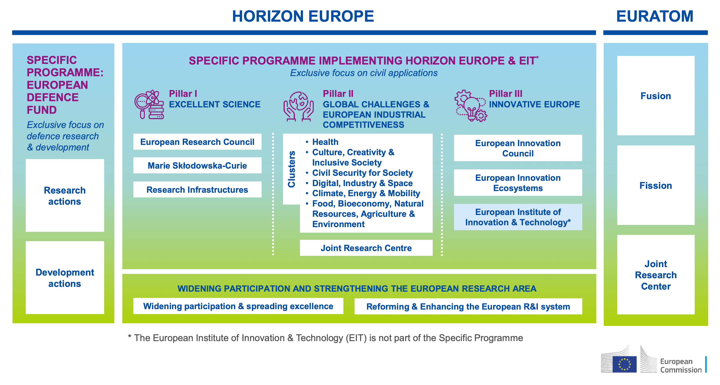
The EIC report:
7 years, about 95.5 Billion EUR

Slide 8
The EIC report:

Slide 9
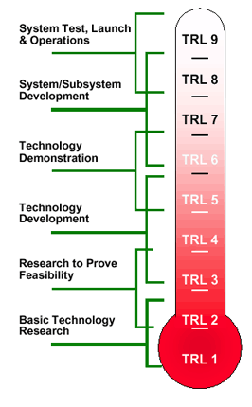
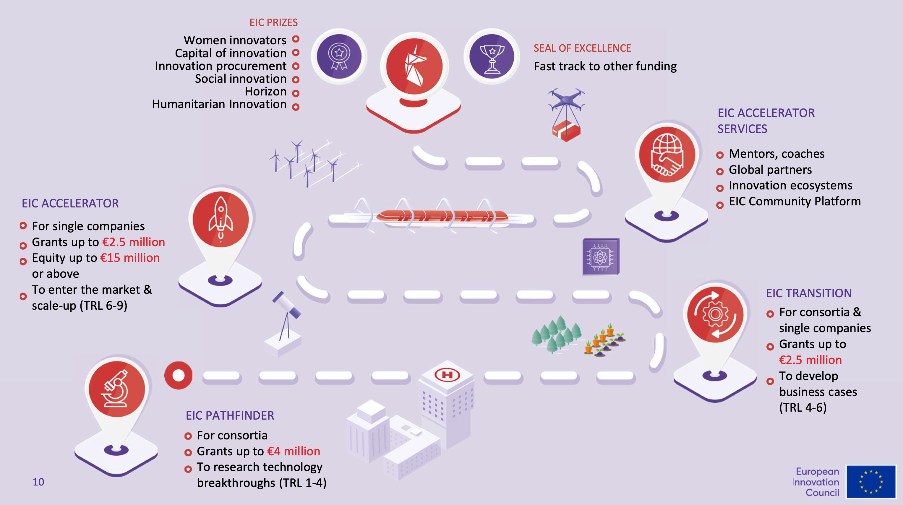
The EIC report:
The NASA Technology Readiness Level

Slide 10
The EIC report:

Slide 11
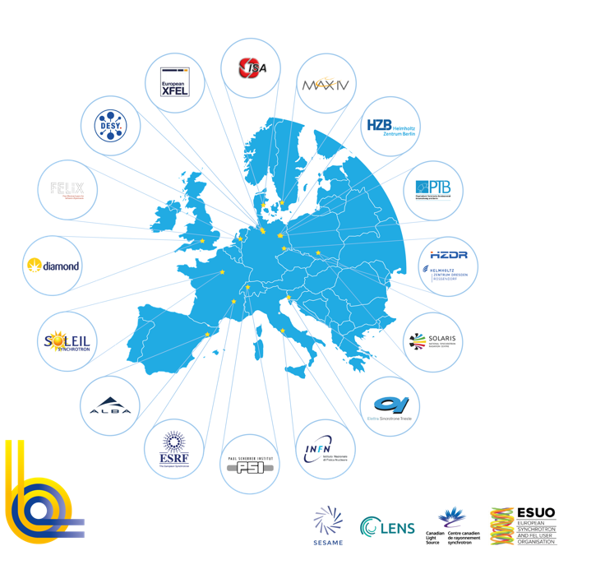
Collaboration with Industry within EC funded research infrastructure projects (O(4 years & 10 MEUR)):
Innovation Fostering in Accelerator Science and Technology
LEAPS is the largest consortium of analytical facilities world-wide
Offers TA to 44 Research Infrastructures (RIs): https://web.infn.it/EURO-LABS/
Notes:
and EASI-Stress

Slide 12
Collaboration with Industry within EC funded research infrastructure projects:
Collaboration with Industry within EC funded research infrastructure projects (O(4 years & 10 MEUR)):
all in all, more than 100 industrial partners involved, at different levels; exemplary illustrations:
Lithoz (A): ceramics (WP 10)
Picotech (F): fast RPCs (WP 7)
Weeroc (F): ASICs (WP 11)
Workshop (F): composite materials (WP 10)
CAEN (I): Electronics and power supplies for Nuclear and Particle Physics (WPs 4, 7, 8)
ELTOS (I): PCBs (WP 7)
FBK* (I): silicon detectors and SiPMs (WP 10)
Conpart (N): Metalised polymers (WP 6)
FYLA (E): ultrafast fibre lasers (WP 4)
ITAINNOVA* (E): electrom. compatibility (WP 4)
CSEM* (CH): Electronics and power supplies
RTO (Research and Technology Organisation)
Essentially, co-development of advances in detectors, electronics, DAQ, processes and material science at the core of our field
Mind exploitation agreements!

Slide 13
Collaboration with Industry within EC funded research infrastructure projects (O(4 years & 10 MEUR)):
15 industrial partners, 1/3 of the consortium (possibly “tier 1” providers to big players)
Opportunities:
Strong demand for R&D: accelerators are crucial tools in the progress of modern science and technology (physics, biology, medicine, material science, etc.).
Mature technology, with large industry involvement.
Supported by a wide, motivated, and rapidly expanding scientific and technological community, spanning across continents.
Challenges:
Presence of many actors, many projects, many technologies, with different priorities and time-scales.
Long time scale and high cost of accelerator R&D, well beyond the capabilities of single EU projects.
Strong dependence on post-ww2 technologies increasingly faraway from modern industry’s focus.
Needs coordination and sharing of resources.
My comment: there’s some “meat”

Slide 14
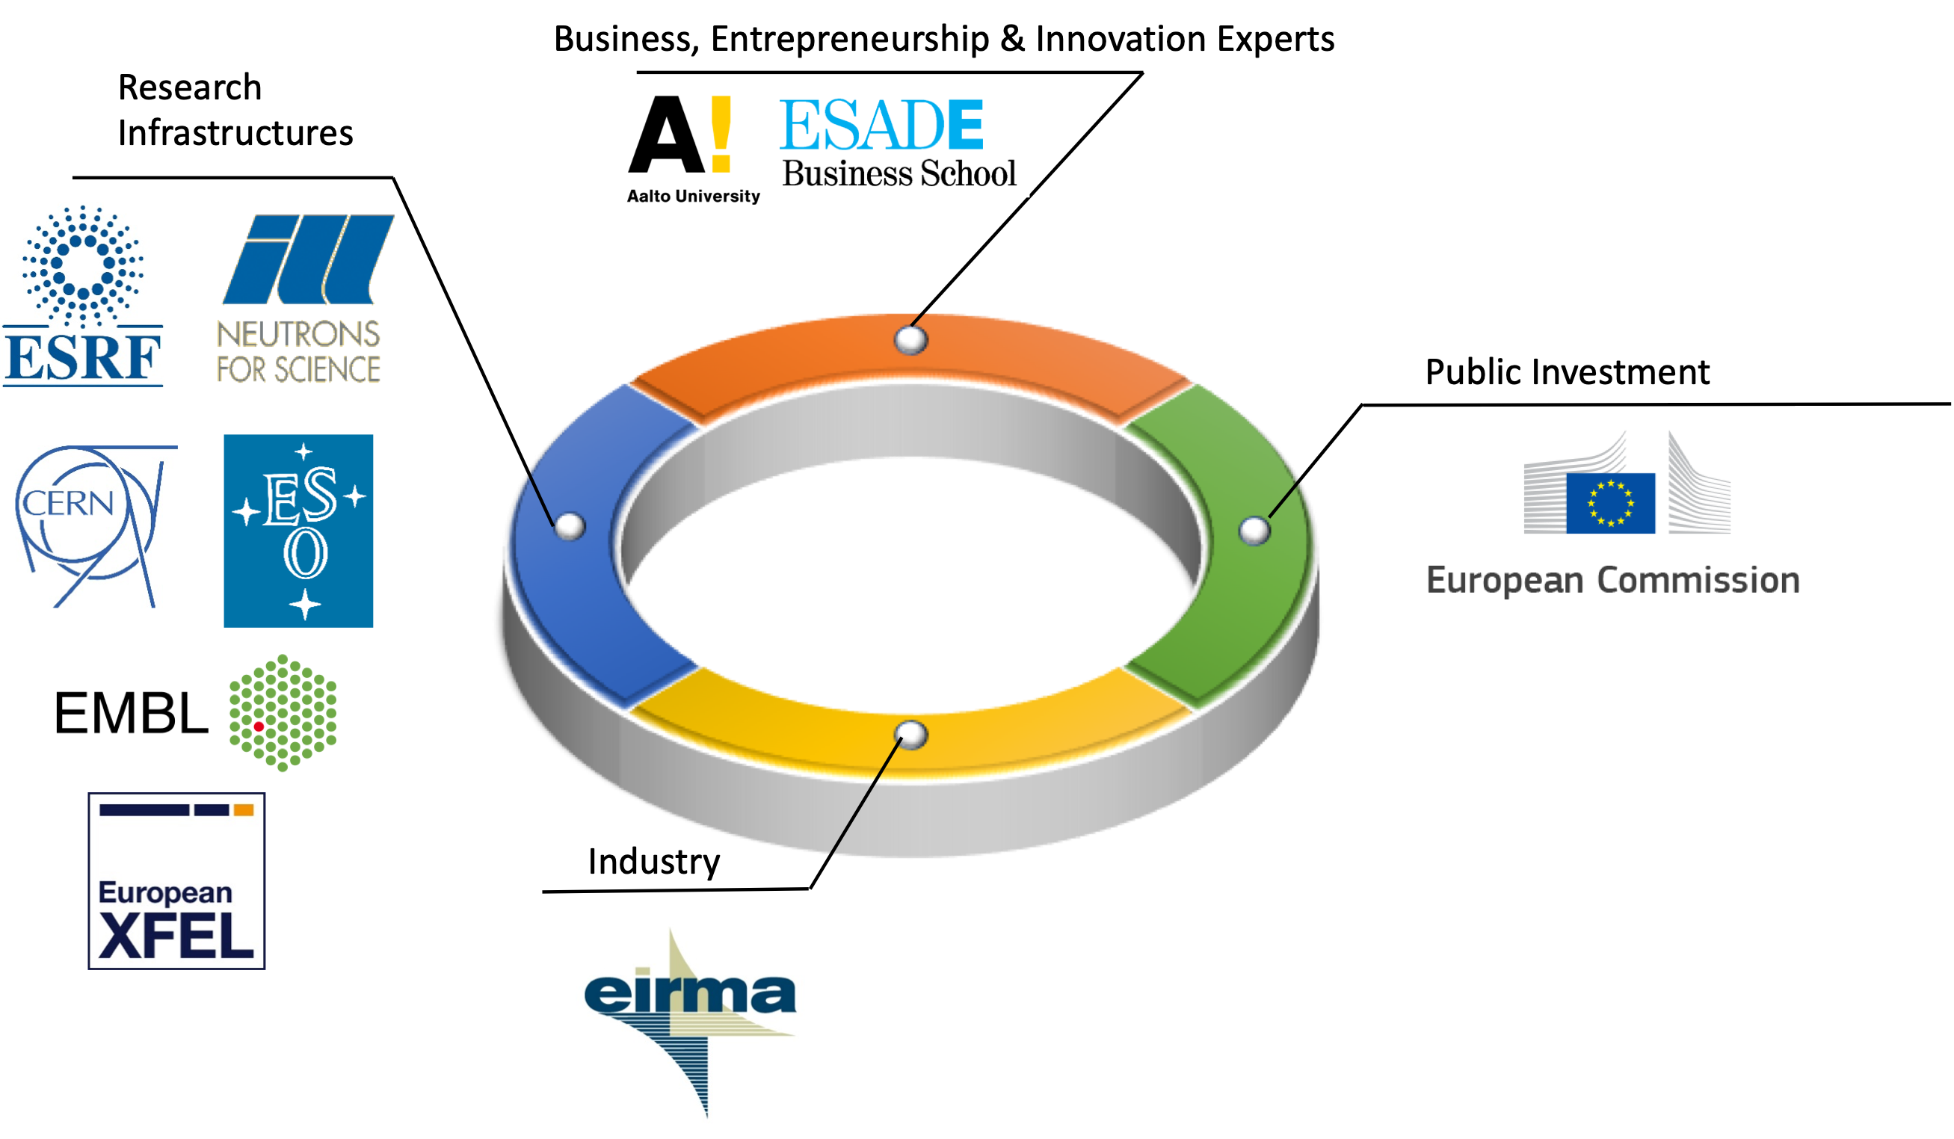
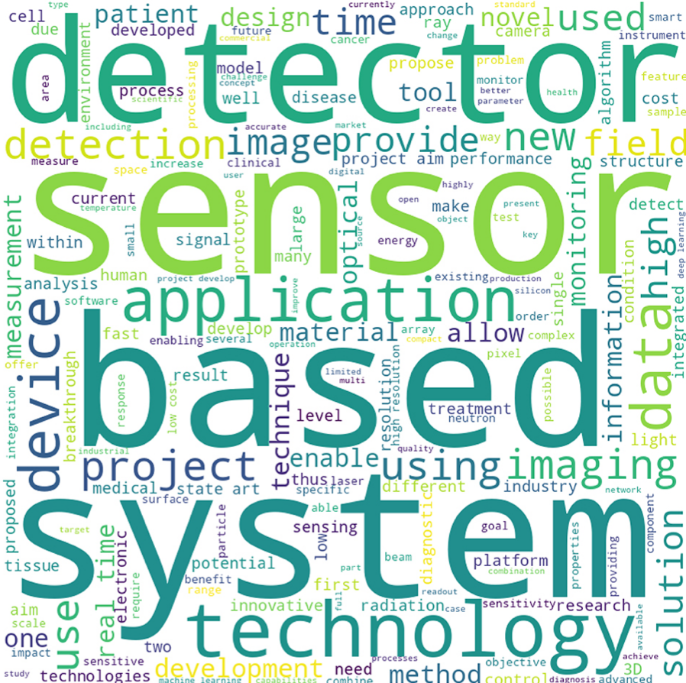
ATTRACT:
A two-phase “cascade grant” program to lead breakthrough ideas
from the lab towards the market, from low TRL up to TRL 7-8, getting projects ready to take off and gain access to private investment
focus of the first round on detection & imaging technologies

Slide 15
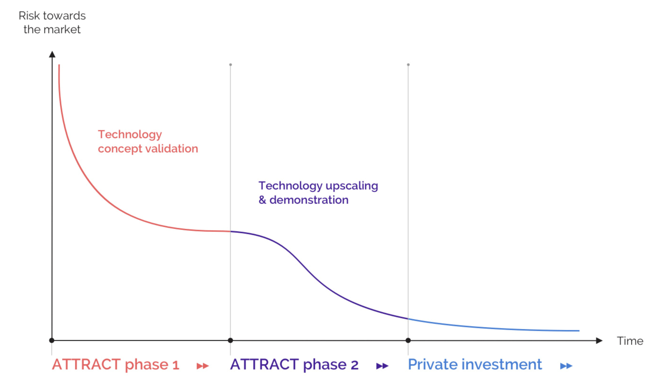
Phase I:
submission October 31st, 2018
Duration: May 2019 to October 2020
funding: 100 kEUR
selection & competitiveness: 1211 proposals received, 170 approved
Phase II:
submission Sept. 20th, 2021
notification of approval Jan. 31st, 2022
Duration: May 2022 to August 2024
funding: up to 2 MEUR
selection & competitiveness: 68 R&D proposals received, 18 approved
A two-phase “cascade grant” program to lead breakthrough ideas
from the lab towards the market, from low TRL up to TRL 7-8, getting projects ready to take off and gain access to private investment
focus of the first round on detection & imaging technologies
Combined success rate: 18/1211 = 1.5%

Slide 16
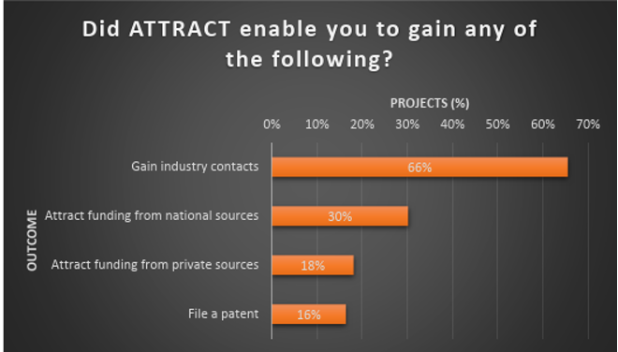
A few facts & figures (Phase II):
R&D projects are complemented by Student’s Academies and Socio-economical analysis of the Deep-tech revolution
Even at low TRL, 18% of the funded projects got private investment.
30% of the project got additional National Funding
34% of the projects intend to proceed towards commercialisation

Slide 17
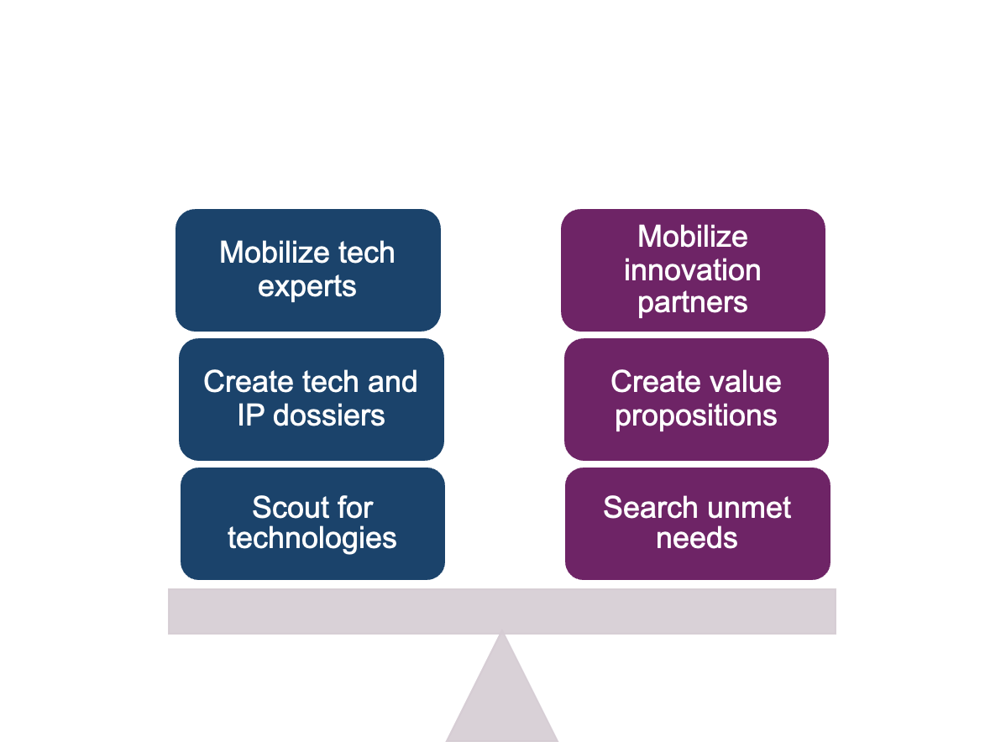
Knowledge Transfer at a Science & Innovation hub:
The toolbox
Balance between technology push & pull

Slide 18
Knowledge Transfer at CERN by numbers:

Slide 19
Knowledge Transfer at CERN by numbers:

Slide 20
Innovation at Max-Planck:

Slide 21
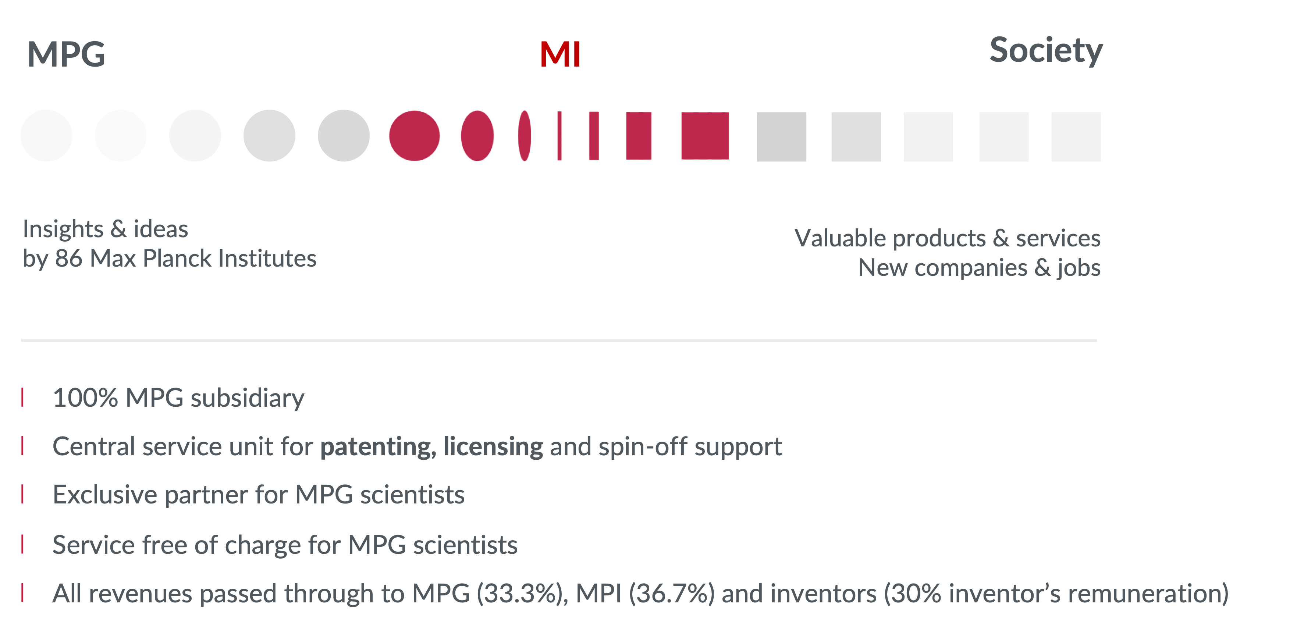
Innovation at Max-Planck proceeds through a dedicated legal entity (Max Planck Innovation) with highly skilled internal professionals, providing support from scouting to licensing & start-up support:

Slide 22
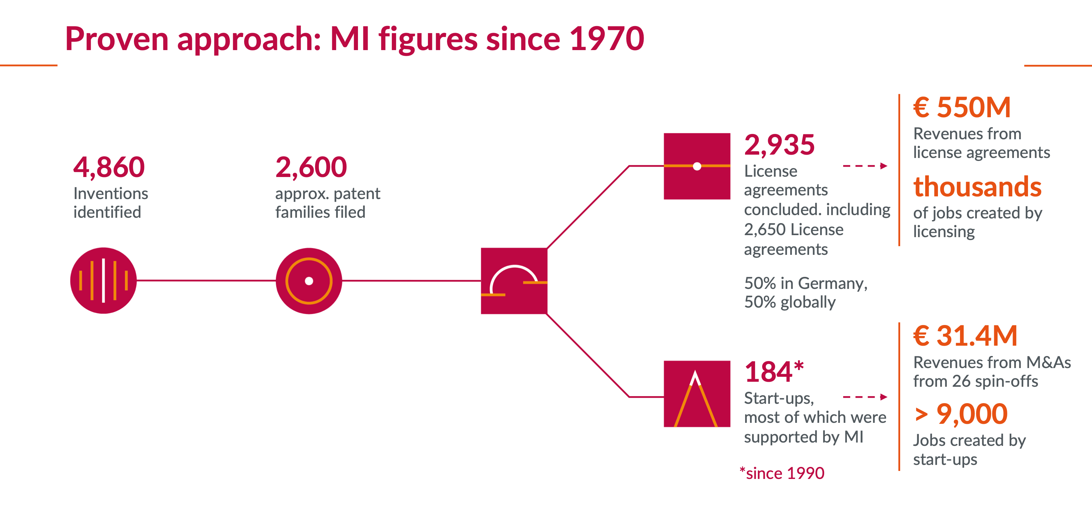
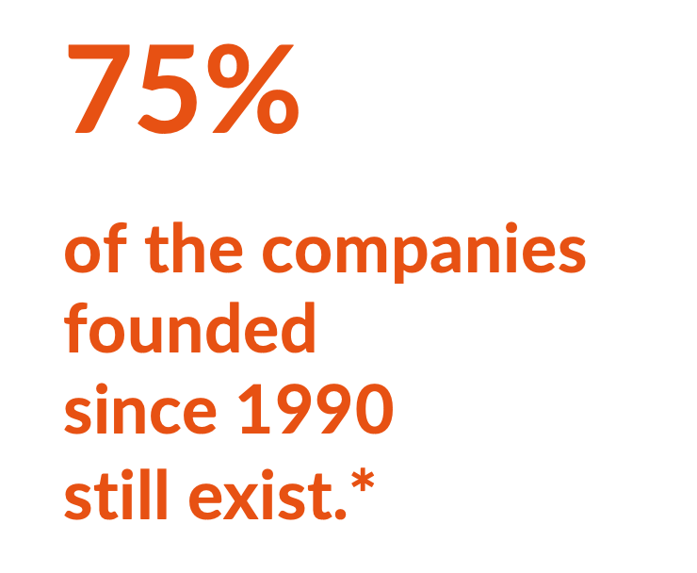
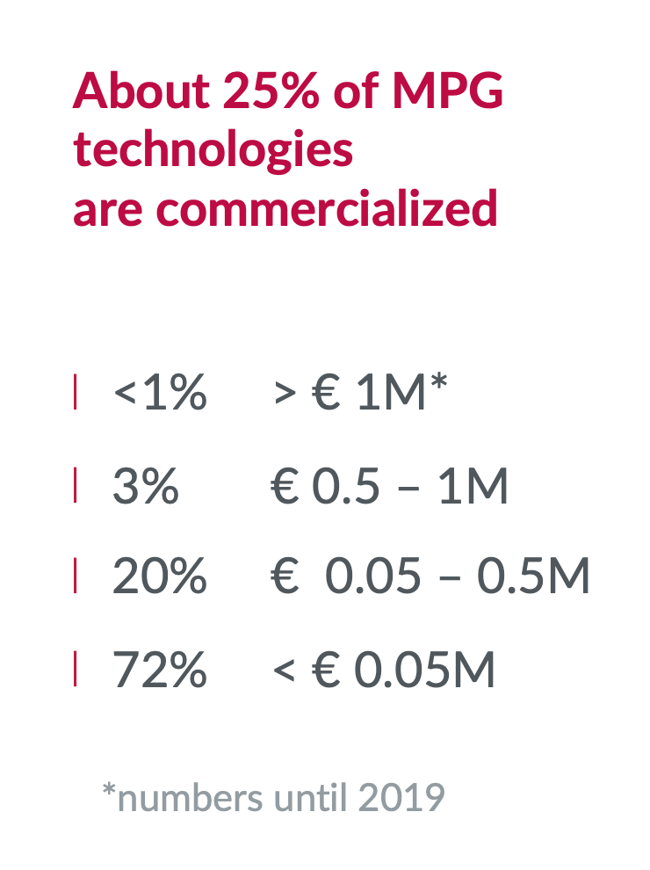
Innovation at Max-Planck:

Slide 23
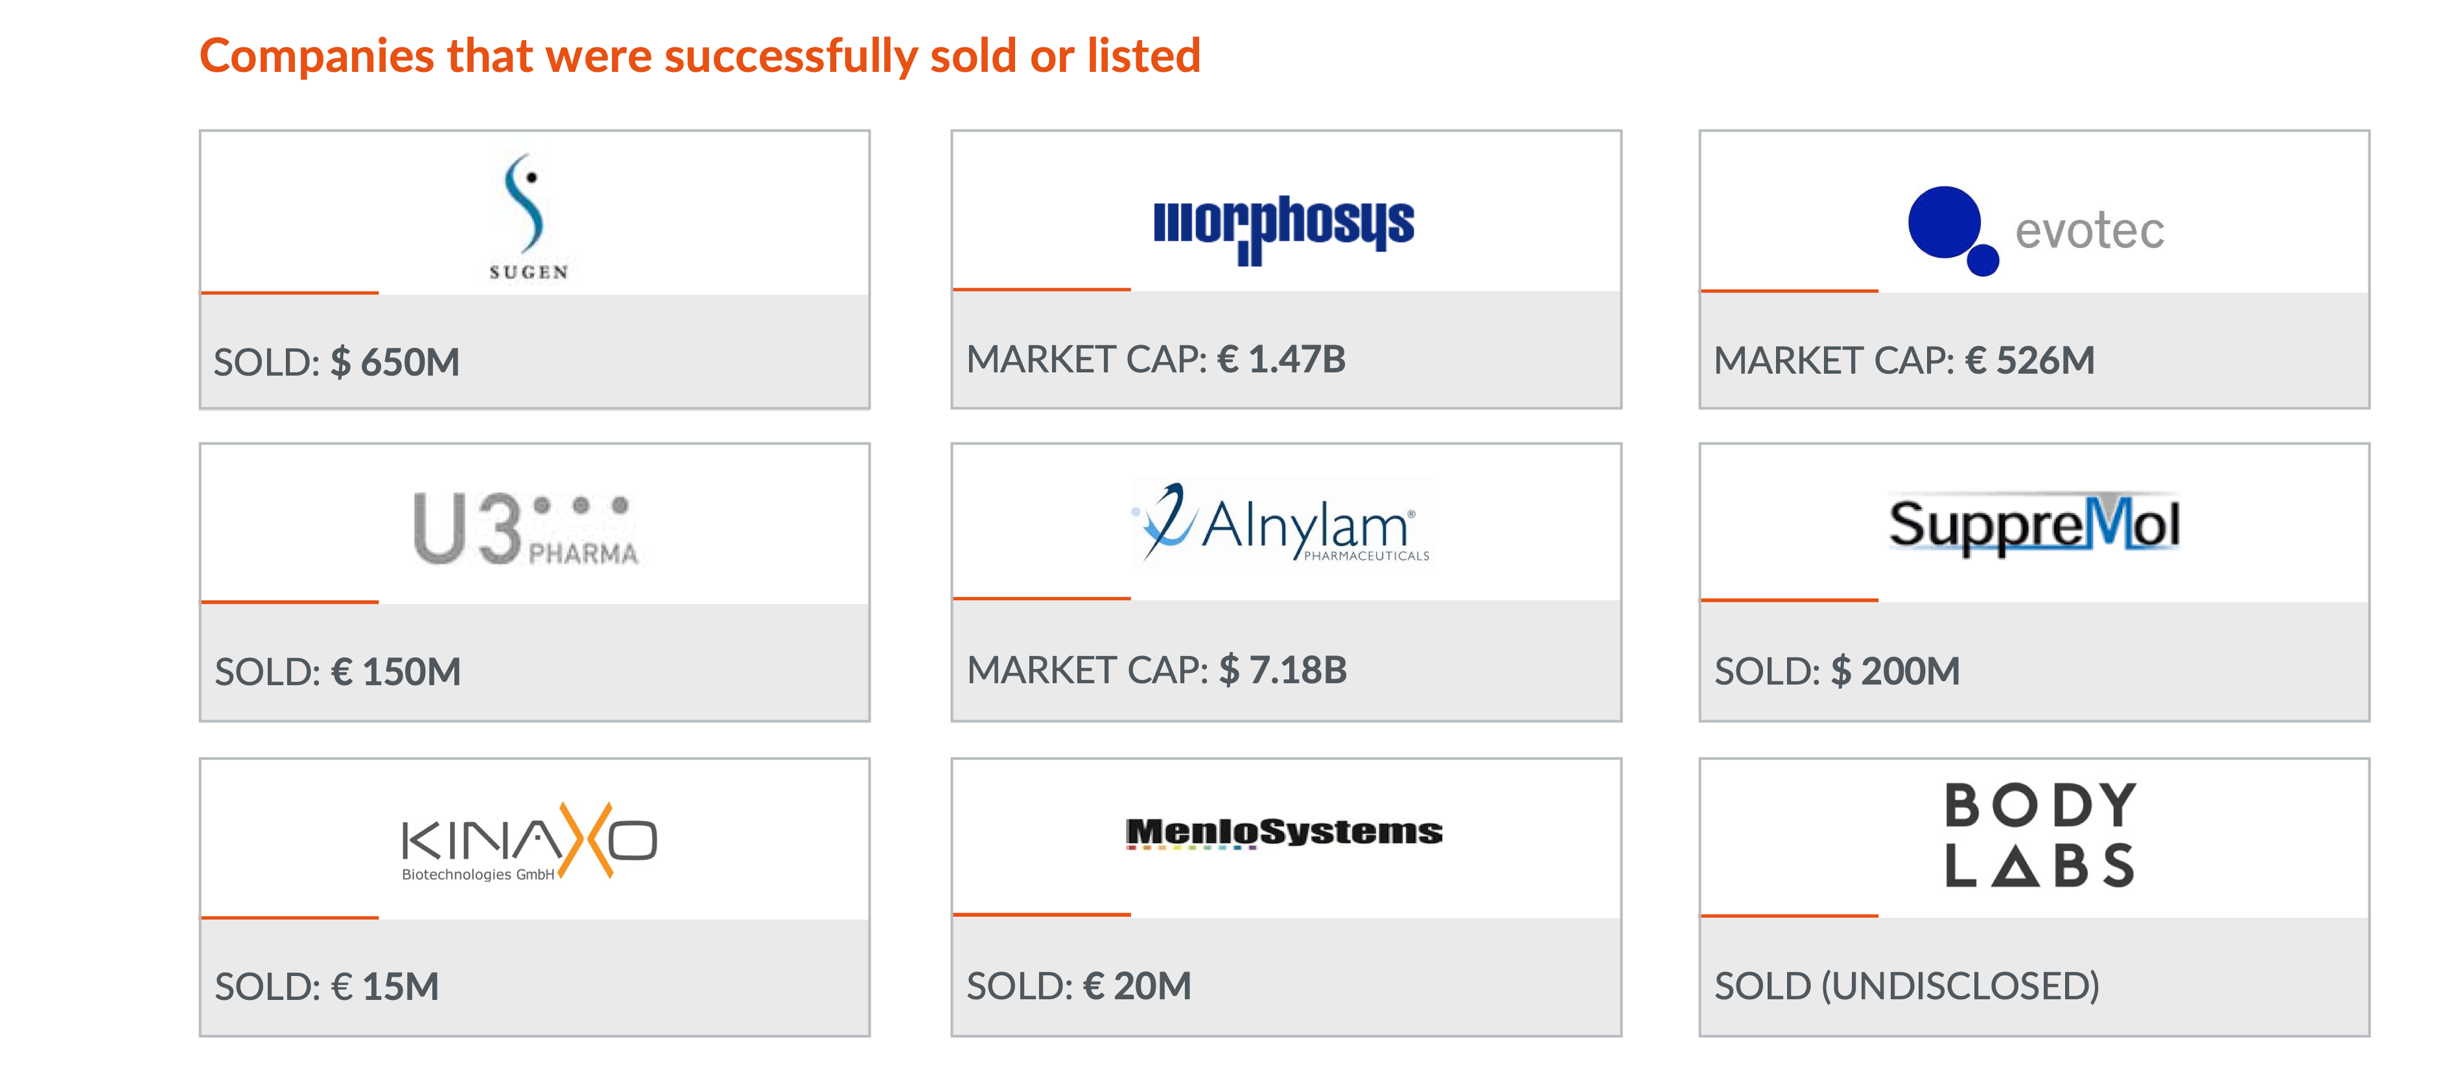
Innovation at Max-Planck; blockbusters:

Slide 24
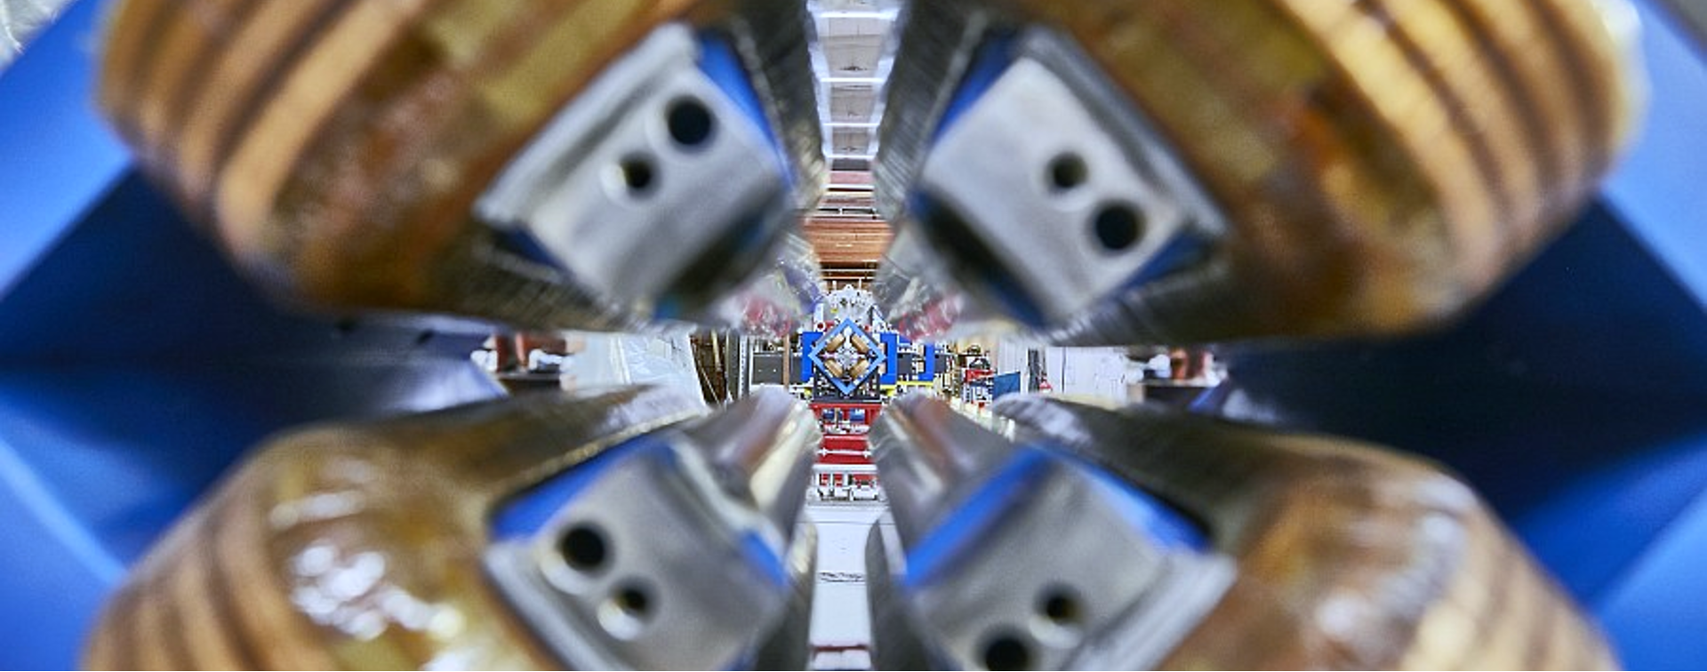
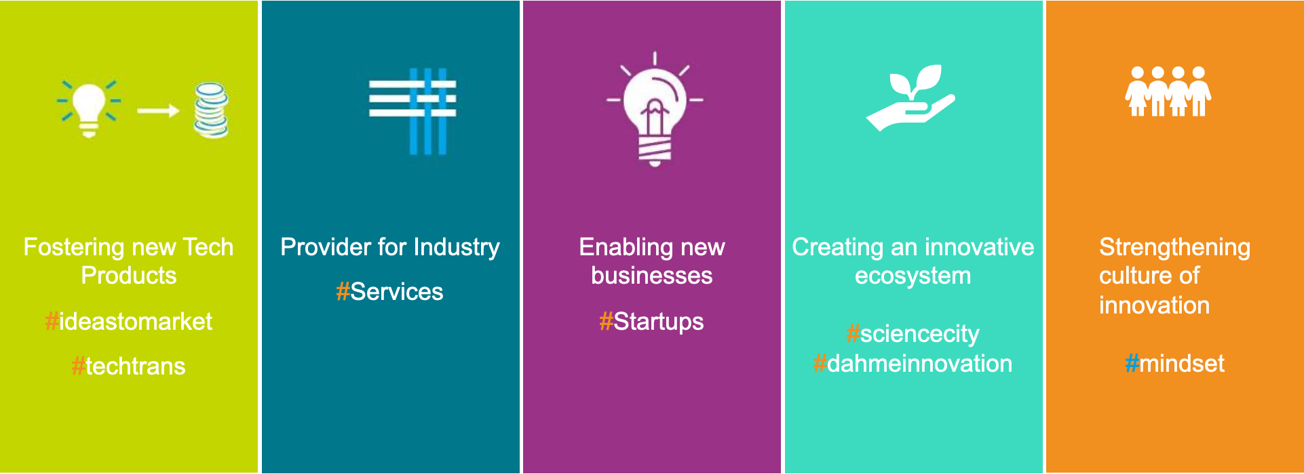
Innovation at DESY:

Slide 25
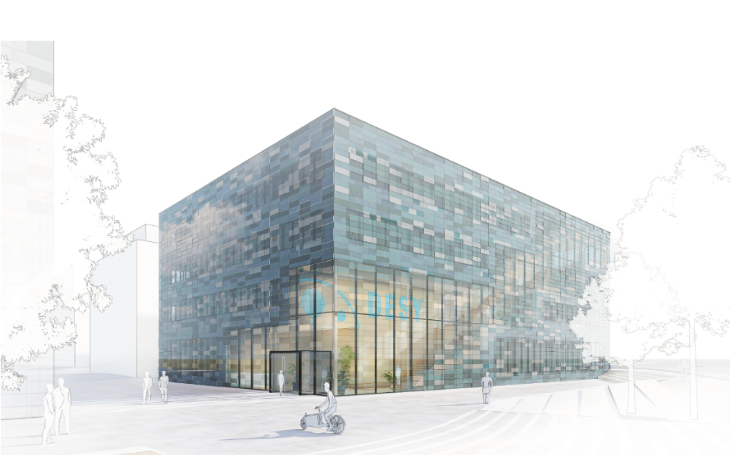
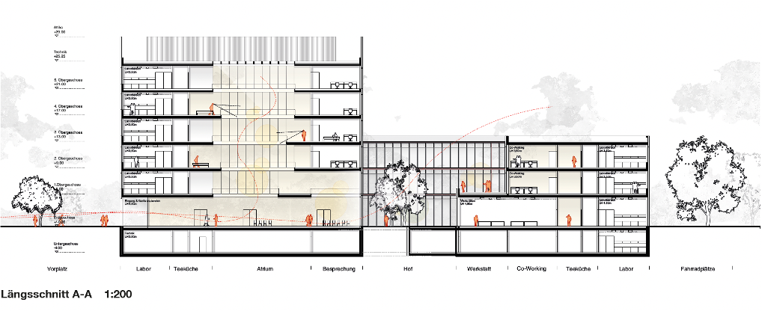
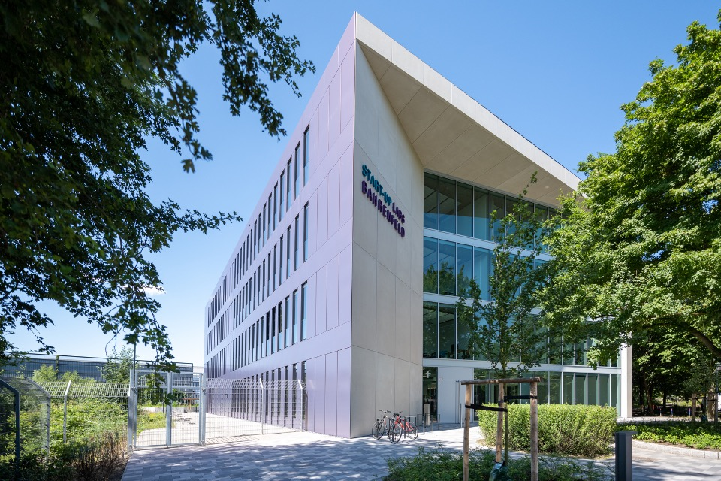
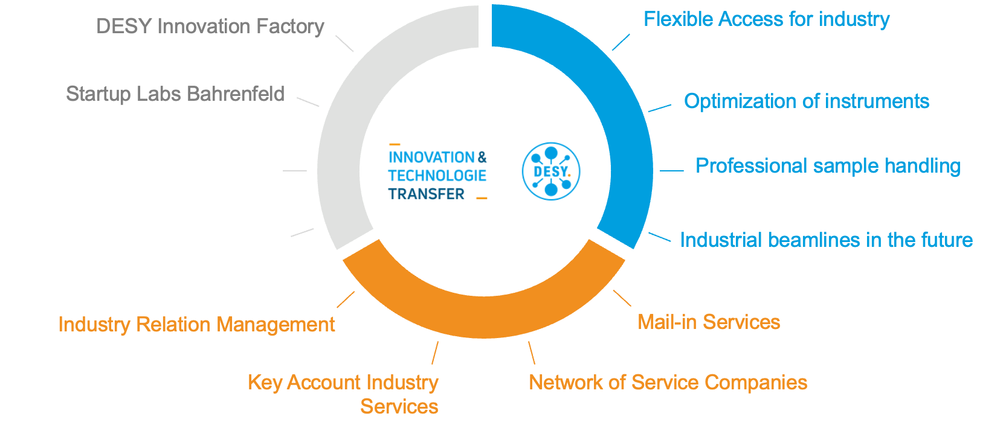
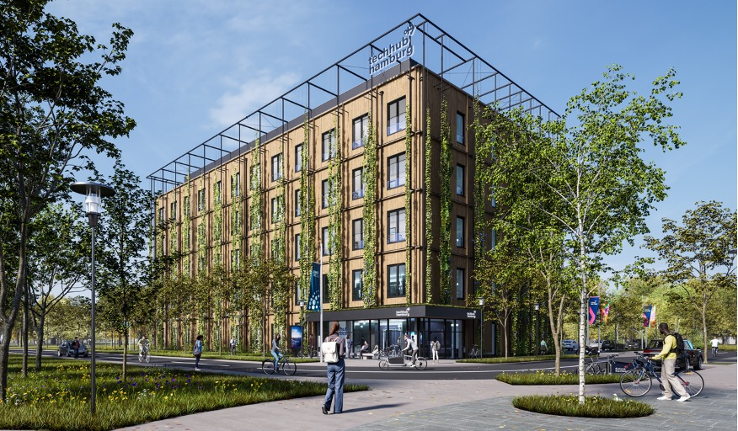
Innovation at DESY: an amazing investment on infrastructures
ca. 5.600 m² Rental Space, Offices, Labs, Workshops and Shared Spaces (2026)
Physics Labs and Workshops, not equip (2700 m²) (2026)
ca. 2.200 m² Rental Space, 50/50 for Office and Labs/Workshops
ca. 3.500 m² rental space, not equiped (2023)

Slide 26
Innovation at DESY: an amazing investment on infrastructures

Slide 27
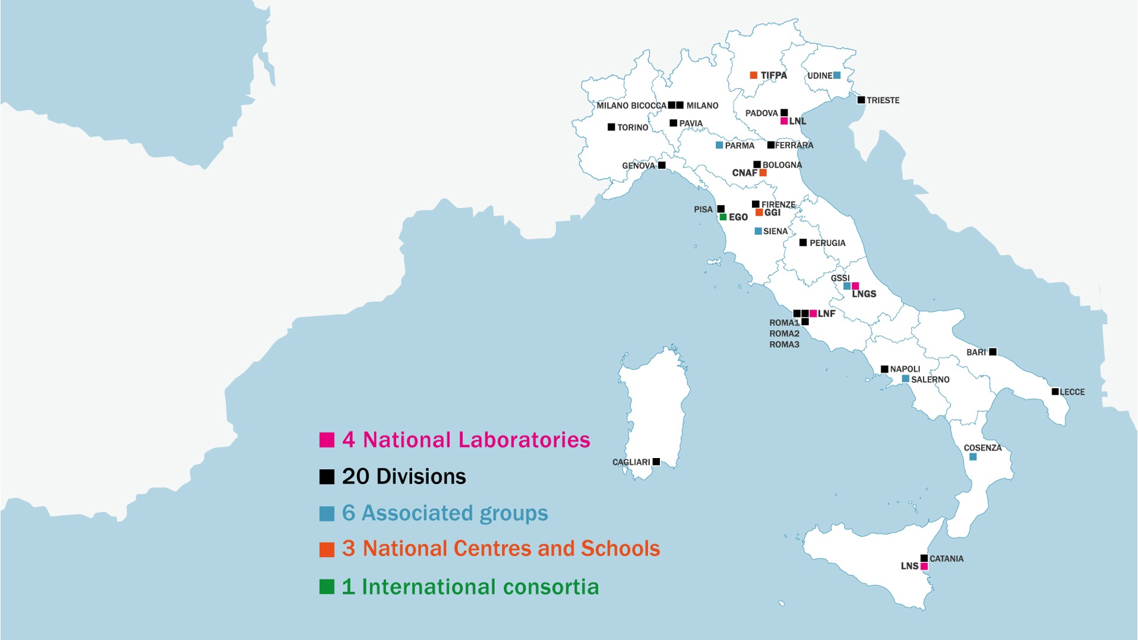
KTT @INFN, the Italian National Institute of Nuclear Physics:
2163 employees (2000 permanent positions) [2021-12 data]
661 Researchers
392 Technologists
619 technicians
4210 research associates

Slide 28
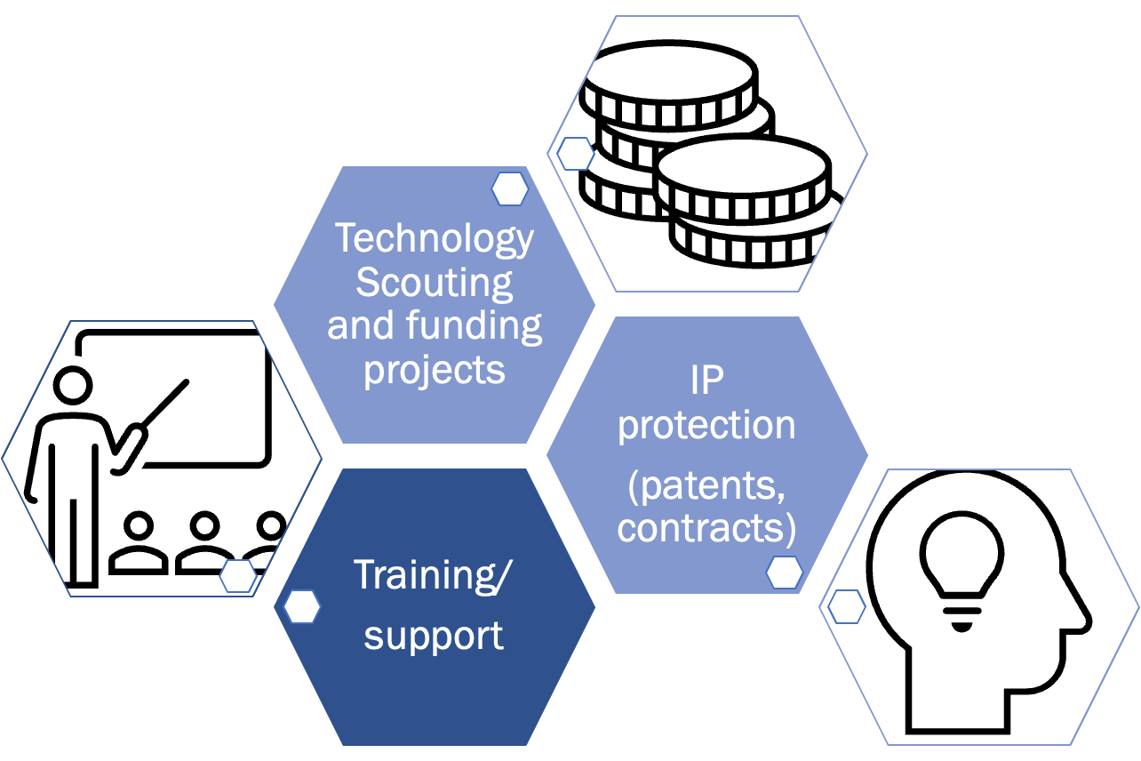
KTT @INFN, the Italian National Institute of Nuclear Physics:
The three-fold way

Slide 29
KTT @INFN, the Italian National Institute of Nuclear Physics:

Slide 30
KTT @INFN, the Italian National Institute of Nuclear Physics:

Slide 31
KTT @INFN, the Italian National Institute of Nuclear Physics:
Innovation through procurement: a survey on the INFN suppliers

Slide 32
Knowledge exchange through collaboration and procurement: the point of view of a University group (Uni. Hamburg)
The rationale behind it:
•Detectors in experimental physics are custom made devices
•They are developed by the research groups who later use them for their experiments
•The production of such detectors requires industrial processes
•Mutual understanding of our experimental needs and the technologies offered by the companies is critical
•Adaptations of the processes might be required
•Open collaborations with industry partners are essential for the field of instrumentation for experimental physics

Slide 33
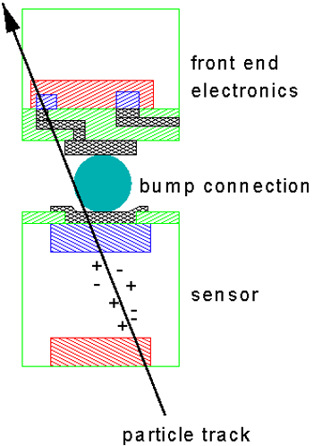
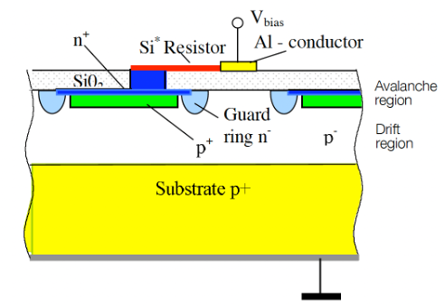
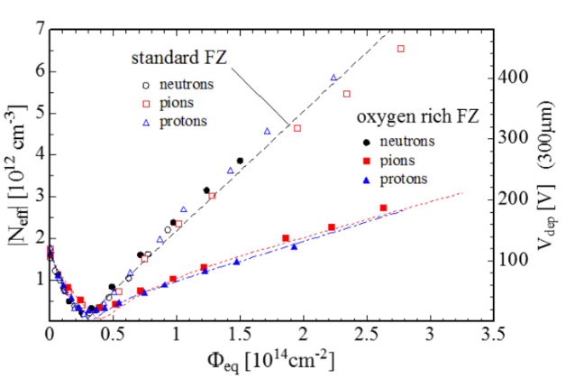
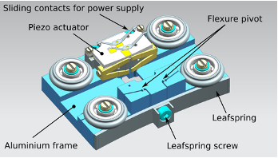
Knowledge exchange through collaboration and procurement: the point of view of a University group (Uni. Hamburg) - co-development
Fine pitch bump bonding
Rad-hard sensors
Rad-hard SiPM
Piezo-actuators
•Dedicated R&D production of silicon structures with gain
•Novel implant designs
•Open exchange of layout parameters as input for device simulation
Actuators that work
in vacuum,
magnetic field up to 10 T, at 4 K,
long stroke (up to a meter),
high precision (better than 10 µm)
Oxigen rich material is beneficial
solution for a problem related to sensor warping
CiS Research Institute for micro-sensors (D)
KETEK Gmbh - Munich
Janssen Precission Engineering - Netherlands
IZM Fraunhofer - Berlin

Slide 34
Knowledge exchange through collaboration and procurement: the point of view of a University group (Uni. Hamburg) - lessons learned
Research Institutes | Companies | How to overcome
Long timescales from ideas to final product à15 years | Interested in faster turnaround | Work with R&D SME or break into well defined blocks
Open source policy | Patents, company specific processes | Sign NDAs, define clear boundaries for publication of information
Niche applications and smallish productions | Mass application/ productions | Become active in identifying spinoffs, import existing solutions where possible
Fundamental understanding of underlying science | Often application of existing knowledge | Knowledge exchange via secondments, industry-academia events
Education driven | Market driven | “

Slide 35
Last but not least, my experience (after 23 years of applied physics projects in collaboration with industry, through 6 EC funded proposals)
In-Silico generation of random bit streams
the value of unpredictability
A spin-off company of:
Università dell’Insubria (Como - Italy)
AGH - University of Science and Technology (Krakow - Poland)

Slide 36
Last but not least, my experience (after 23 years of applied physics projects in collaboration with industry, through 6 EC funded proposals)
In-Silico generation of random bit streams
the value of unpredictability
A “quantum coin flipper” to enhance the strength of
cyber security procedures
privacy preservation
zero-knowledge proof mechanisms
Total expected addressable market: 7.2 B$ by 2026
A spin-off company of:
Università dell’Insubria (Como - Italy)
AGH - University of Science and Technology (Krakow - Poland)

Slide 37
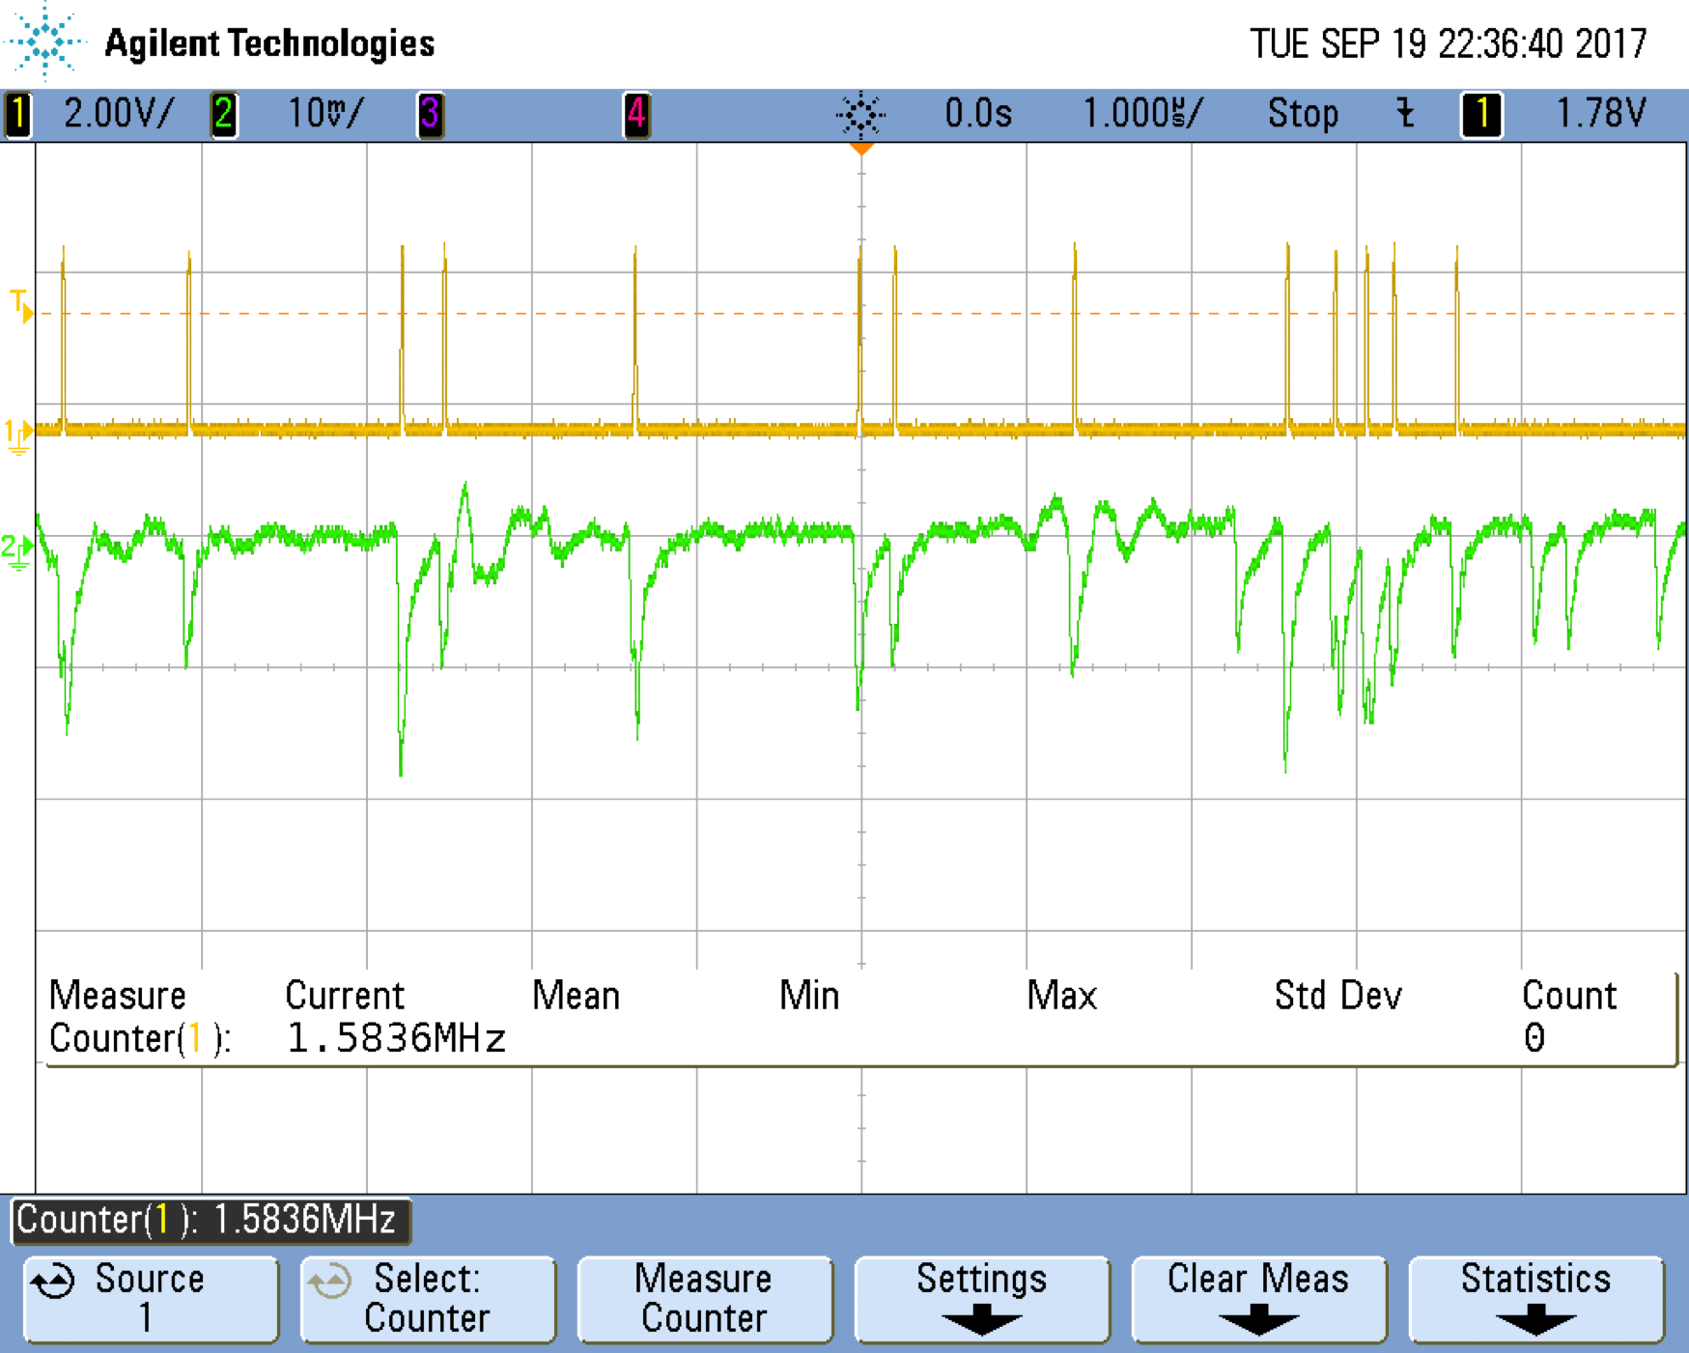
the Random Power principle:
HOW DO WE DO IT?
Inspired by Forrest Gump, we say:
RADIOACTIVE IS AS RADIOACTIVE DOES
emission by a radioactive source is due to the quantum laws of Nature
decays of unstable nuclei are unpredictable
⇒
the sequence of detected decays can be used to generate random bits with different recipes:
check the parity of the number of pulses in a time window
pre-define the time window in a way that is equally like to have or not to have a single pulse
Sequence of pulses by the decay of a radioactive source in a nuclear physics detector
The idea behind is to replace a radioactive source with something safer, more handy, cost effective, simple, robust, providing sequences of pulses mimicking radioactive decays.

Slide 38
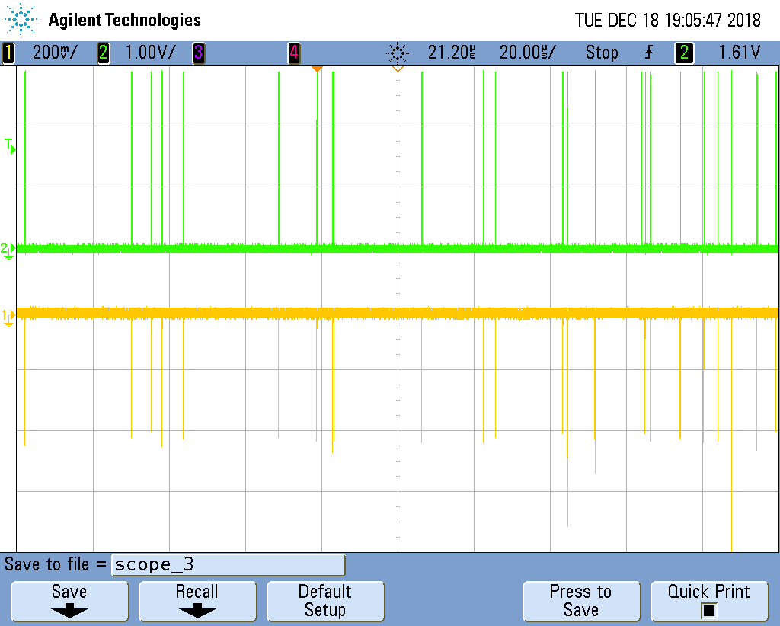
Essentially, we turn unpredictable “Dark Pulses” in Silicon Photomultipliers into bits:
1. tag & time stamp the occurrences of the random pulses
- Italian Patent granted in Sept. 2020
EU & US patent granted in 2022
in the examination phase in China, JP, Korea (since April 2021)
2. analyse the time series of the pulses:
Start
1
2
3
4
5
6
7
8
9
bit 1: Δt12 vs Δt34
bit 2: Δt23 vs Δt45
bit 3: Δt56 vs Δt78
Δt12
Δt23
Δt34
Δt45
Δt56
Δt67
Δt78
Δt89
bit 4: Δt67 vs Δt89

Slide 39
state-of-the-art:
WHERE ARE WE NOW - completed developments
The MINIMUM VIABLE PRODUCT [MVP], the progenitor of a class of Quantum Random Bit Generators:
Developed thanks to the seed capital [100 000 €] granted by
https://attract-eu.com
8 cm
which selected Random Power as one of 170 “breakthrough projects” out of 1211 submissions [May 2019- October 2020]
(Phase 1)
3.5 cm
Qualified according to the NIST standards
(National Institute of Standard & Technology)

Slide 40
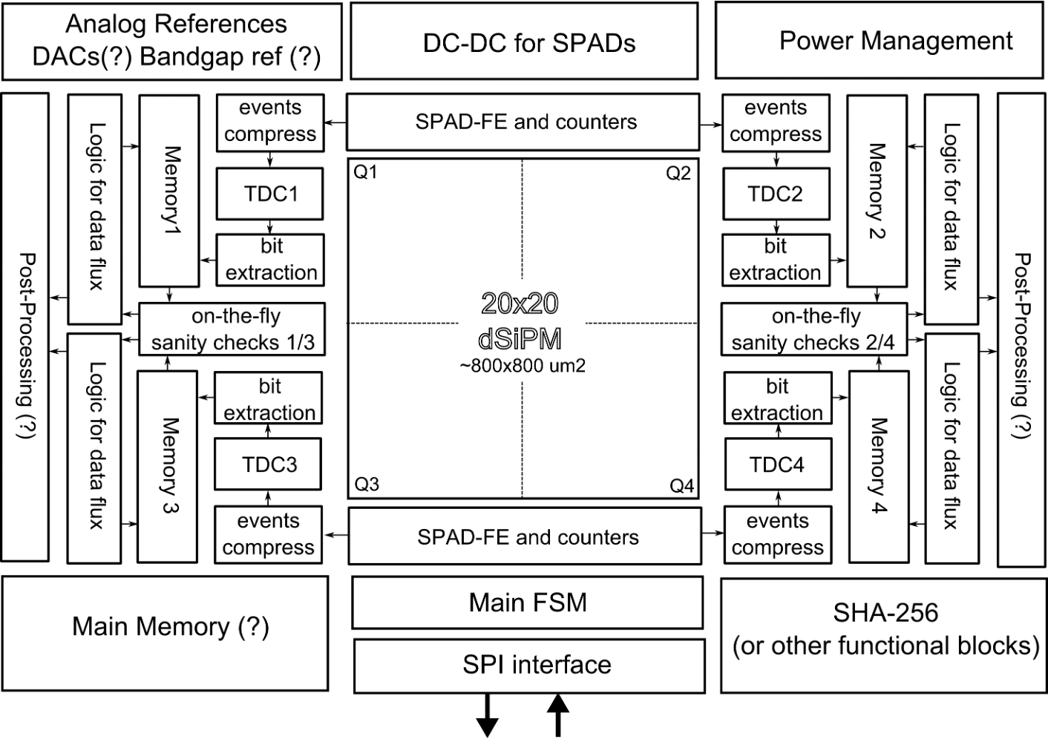
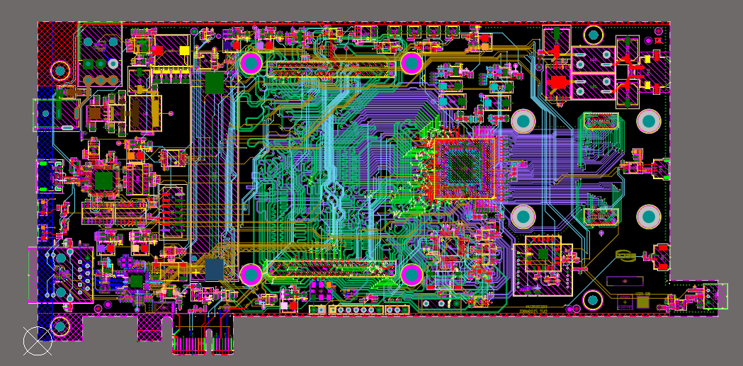
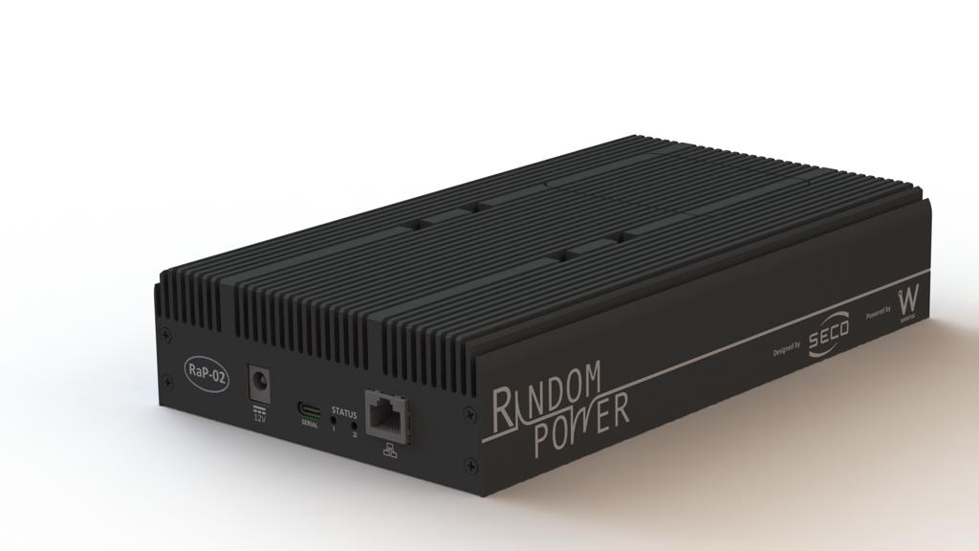
on going developments:
design a FIPS-compliant ASIC embedding a SPAD array in standard CMOS technology:
design a scalable multi-generator system based on an array of SiPM and a LIROC front end ASIC by LIROC
the “generator”
raw bit rate: 1 Mbps
FIPS mode (NIST DRBG): 4096 Bytes in 1050 μs (31.2 Mbps) with prediction resistance
bits delivered in an encrypted stream - expected power: 100 mW
expected to be back from the foundry in Dec. 2023
v1.0 delivered in July 2023, currently under test

Slide 41
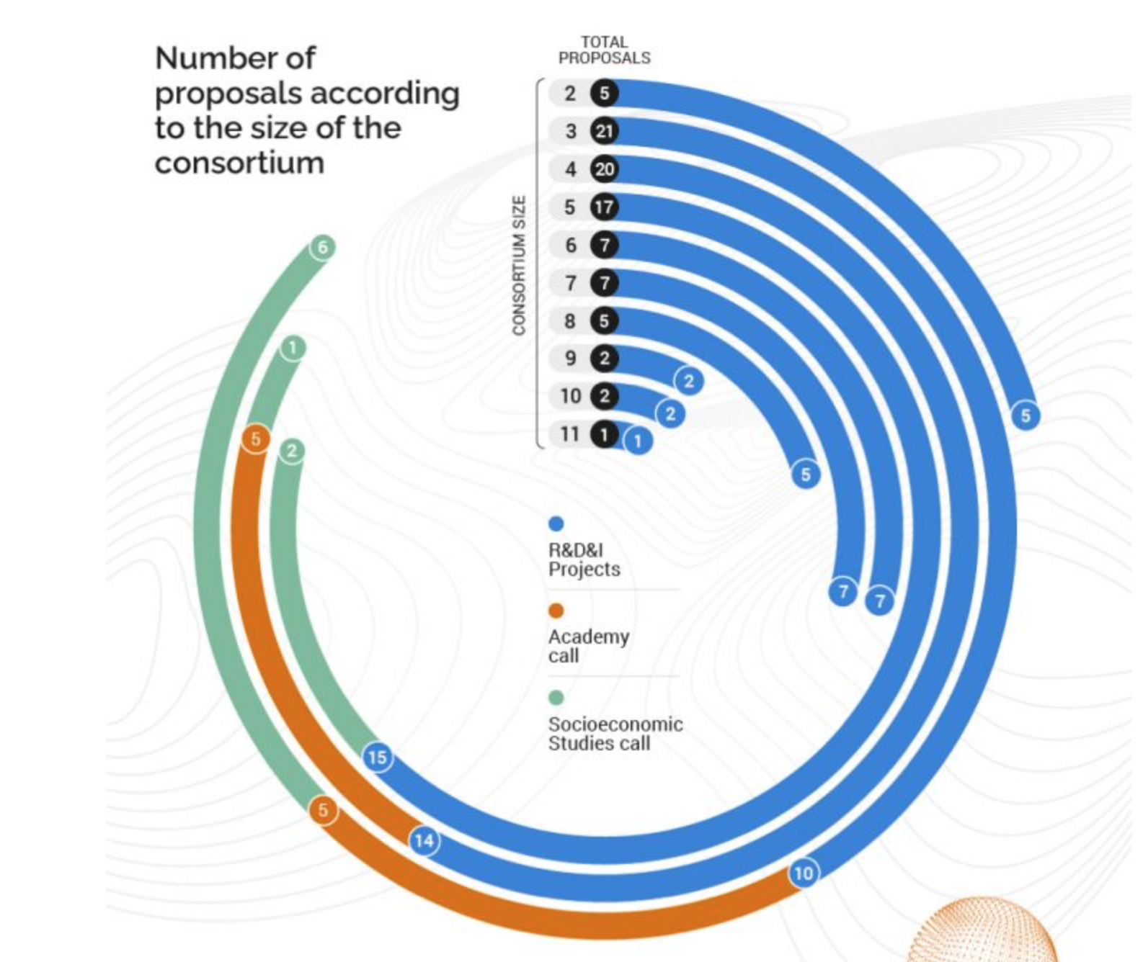
how do we do it?:
our VC: 0.2 Million in equity)
(Phase 2: 2 Million grant)
Our consortium:
leading party
18 man-years dedicated to the project

Slide 43
Food for thought: what is the role of Research performed with public funding in the Innovation mechanism?
which is the most risk-prone investor?
courtesy of P.G.Tello
M.M. says: any way to avoid “socialising risks” and “privatising returns”?
Others say: shall the State drive or act as a “facilitator”?
I’m saying: Most of the analysts and innovation economists focus on INVENTIONS (which possibly changed the world). Is it really what matters most?
published in 2013
Notes:
preamble

Slide 44
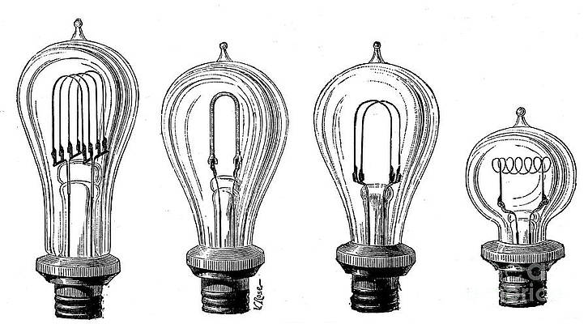
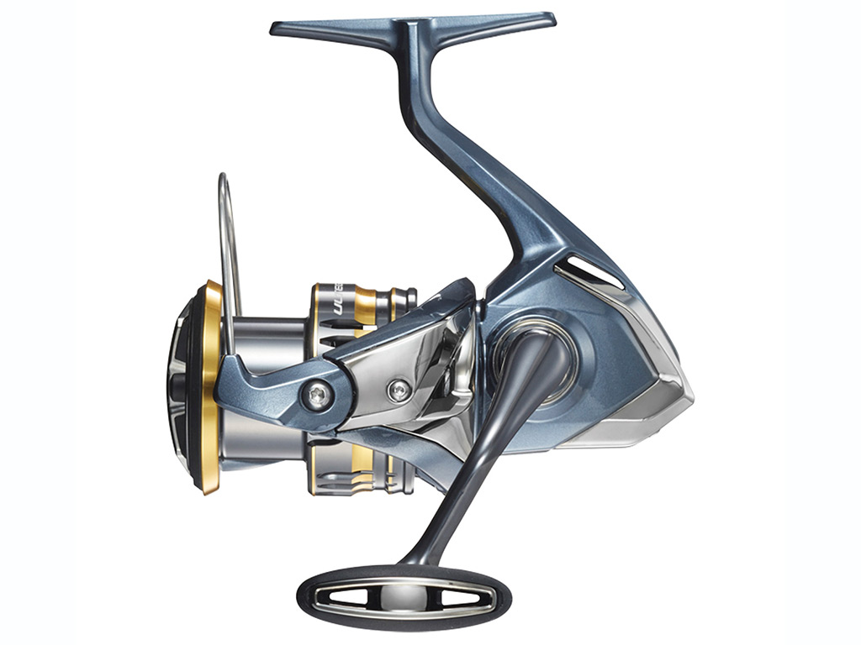
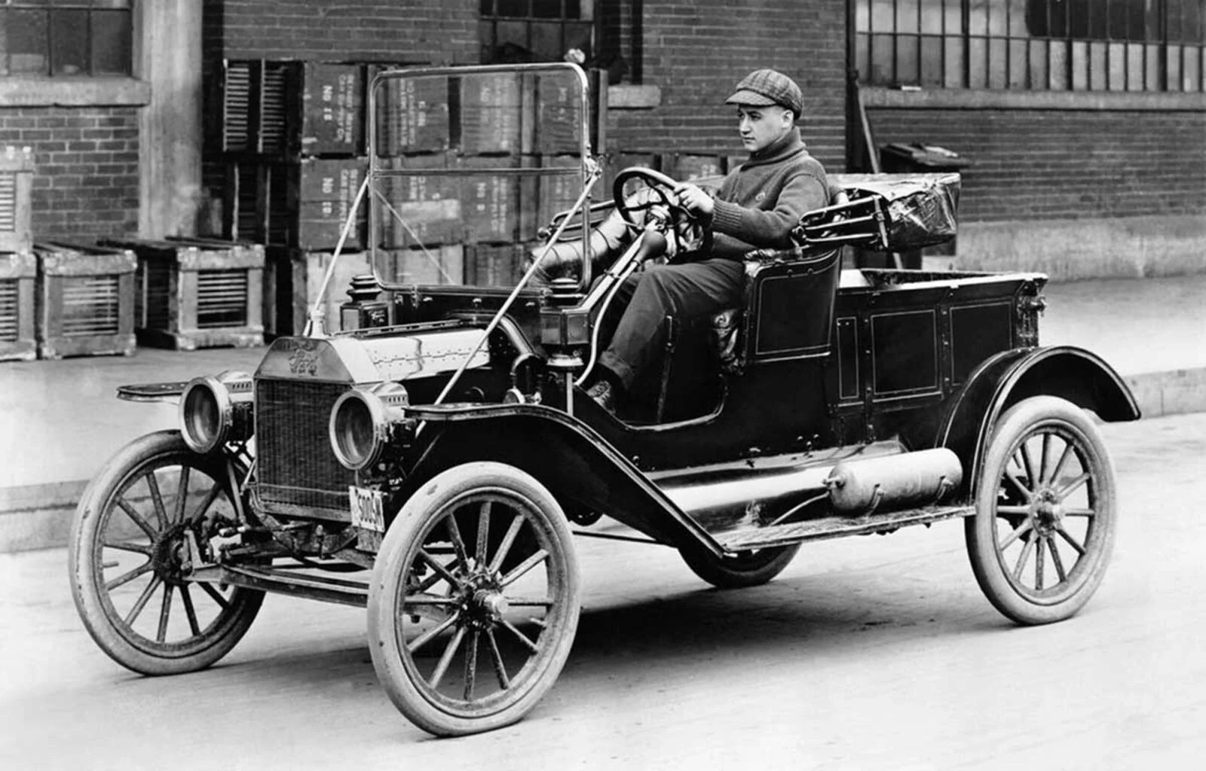
Food for thought: four shades of Innovation
stage 1: novelty ($→$ start-up entrepreneurship)
stage 2: design, prototype, development & production engineering
stage 3: second-generation product and component innovation
stage 4: production and assembly
Dan Breznitz
Ford T - 1908-1927
published in 2021
Invention: the process of coming up with truly novel idea
Innovation: process of using ideas to offer new products & services (possibly at reduced factor cost)

Slide 45
Food for thought: four shades of Innovation
Inventions (at the base of stage 1 innovation) are shining bright and are an easy way to tell the world (and the Minister of Science) that we are doing well.
Is there possibly a hype on this mechanism (and the financial framework that goes with it)?
Dan Breznitz
published in 2021

Slide 46
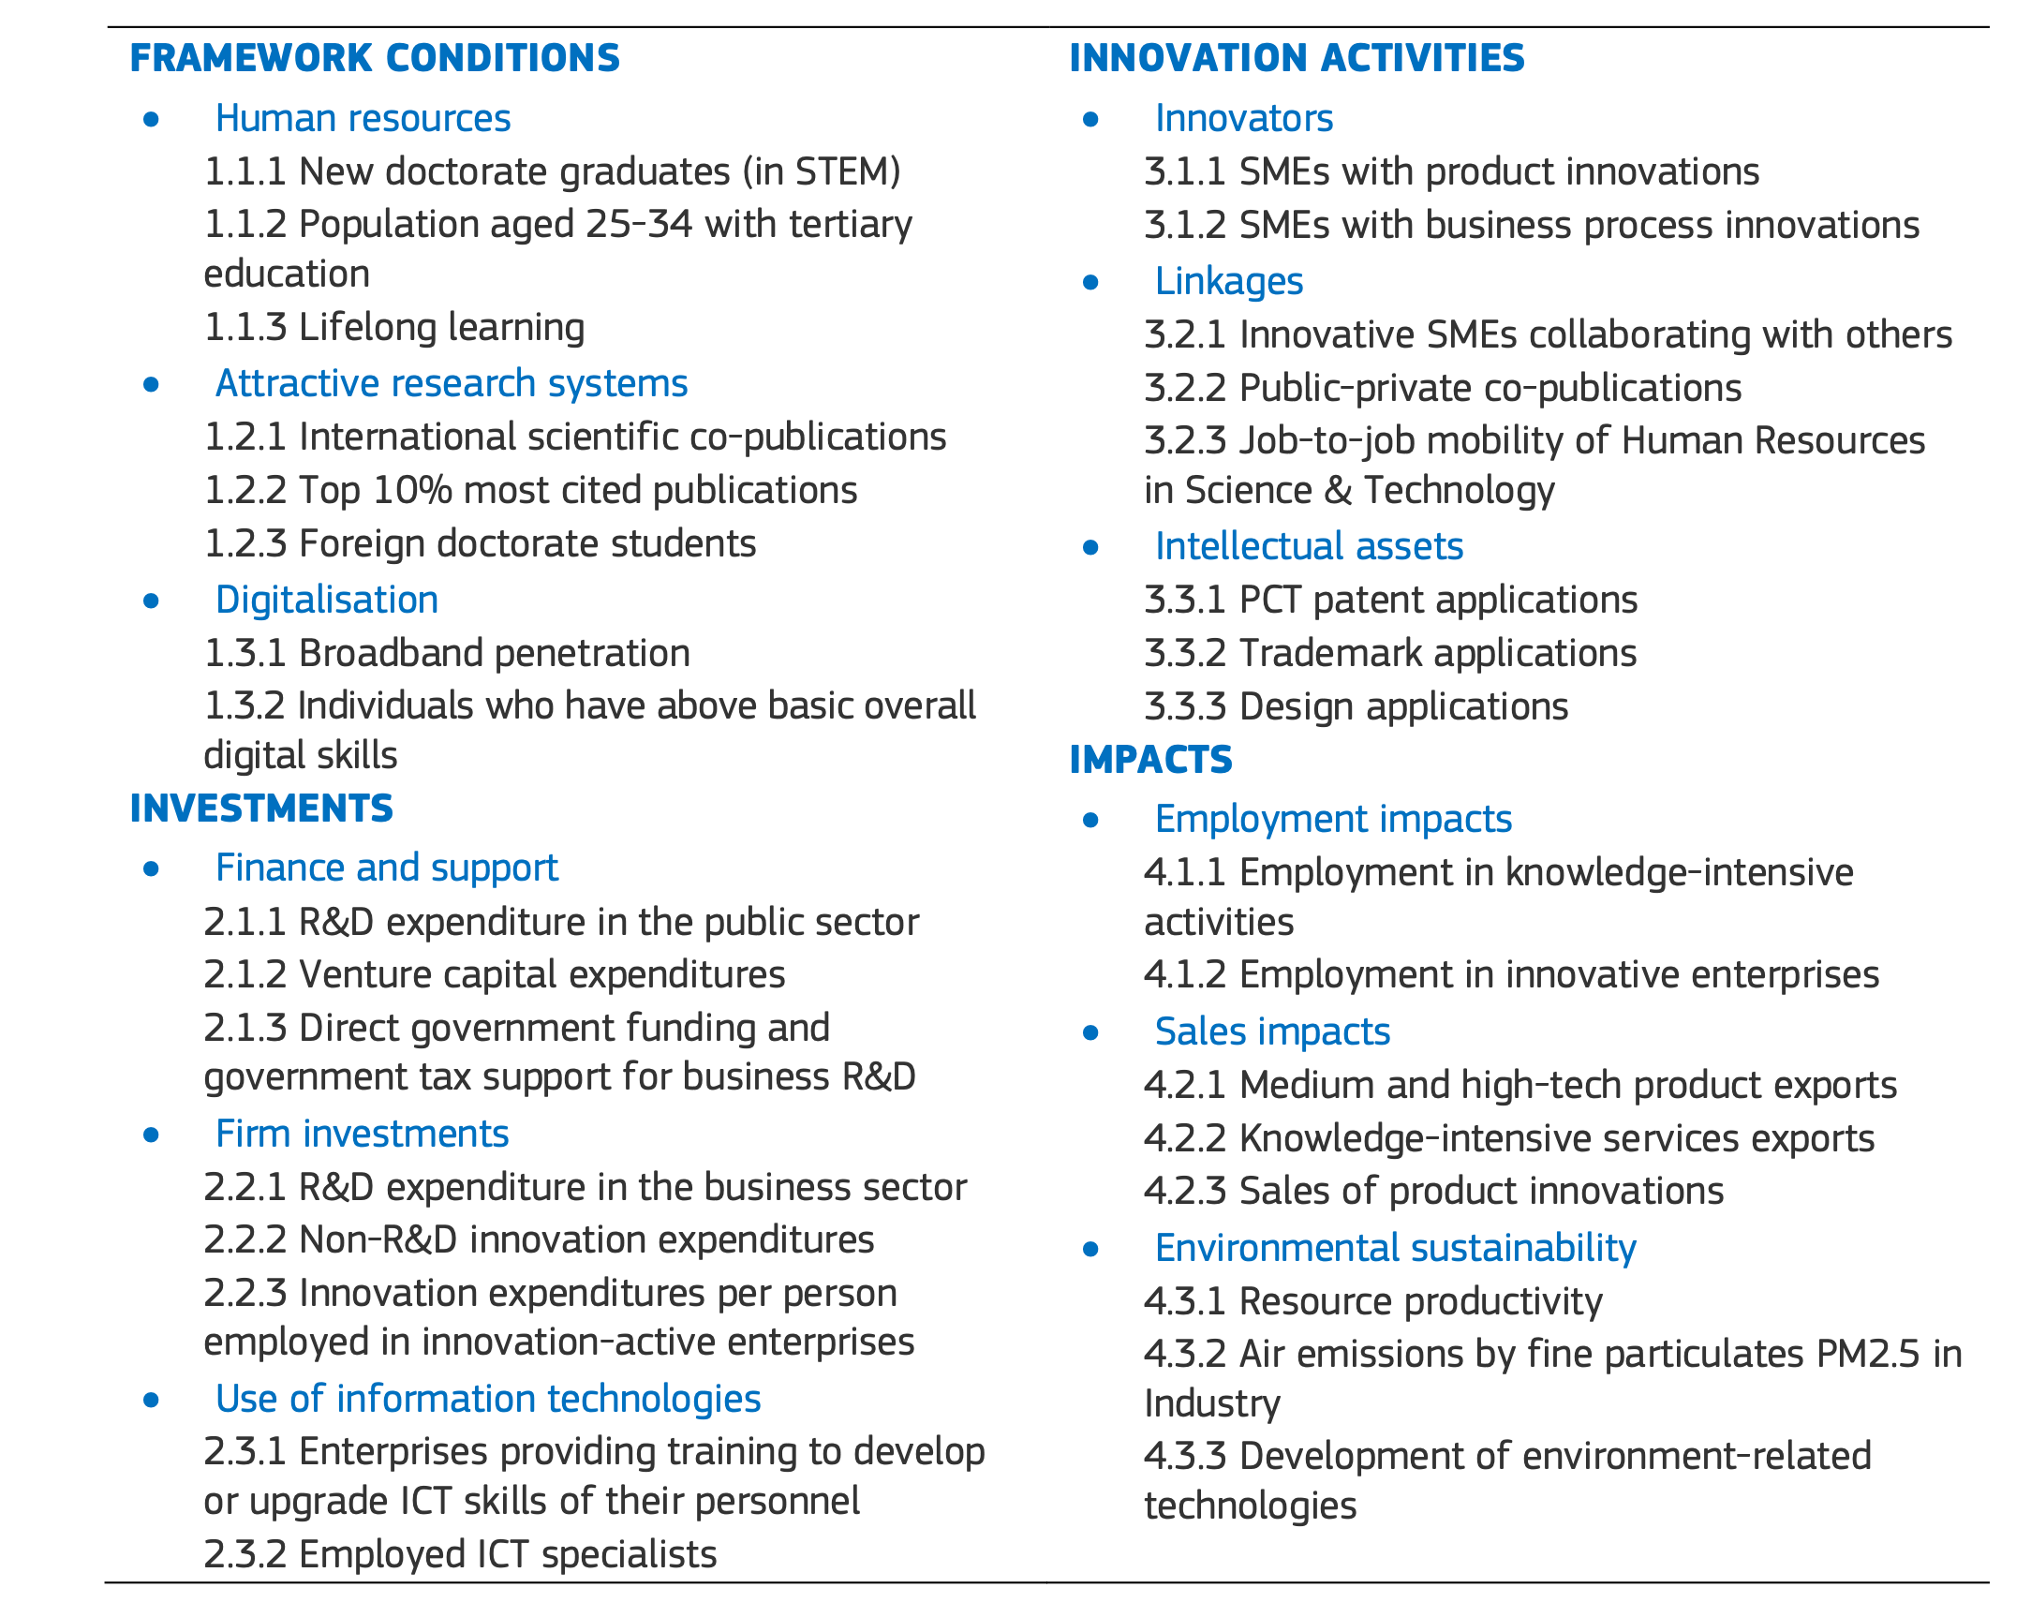
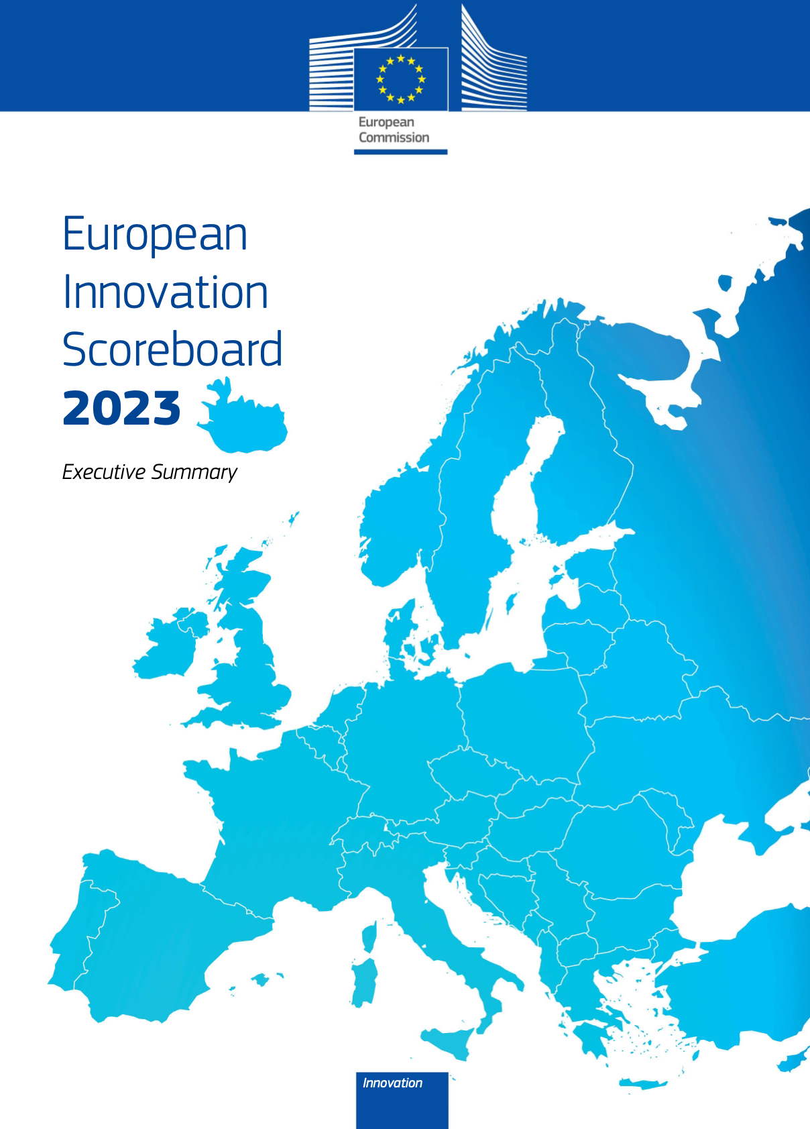
How do we measure innovation?
Chief Scientist: Hugo Hollanders
Maastricht University - ONU MERIT
32 indicators, all normalised
summed up with equal weight to define a Summary Innovation Index (SII)

Slide 47
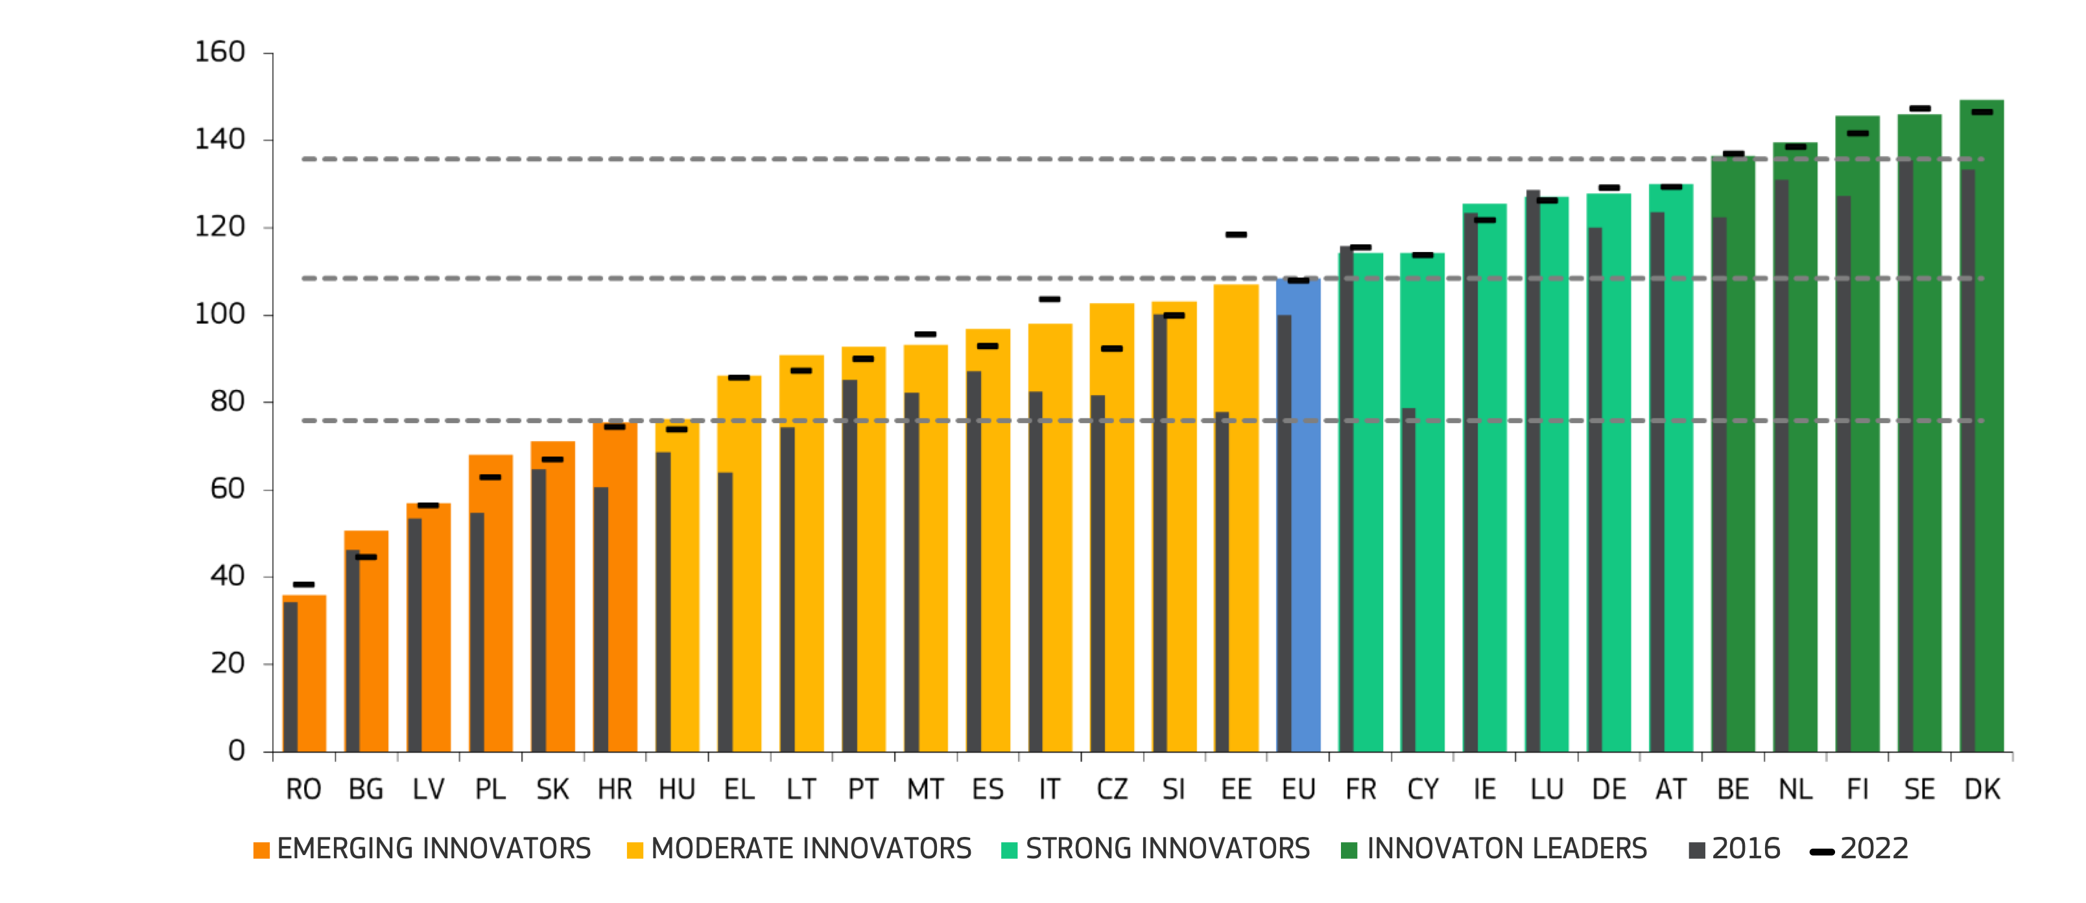
How innovative is Europe?
2023 values
2016 values
EU as a single country in 2016
2022 values
Mind the fact that SWITZERLAND is at 140, with an Attractive Research System at 224.
The UK is at 5, with indicators connected to collaboration among SME’s and private/public links at 207

Slide 48
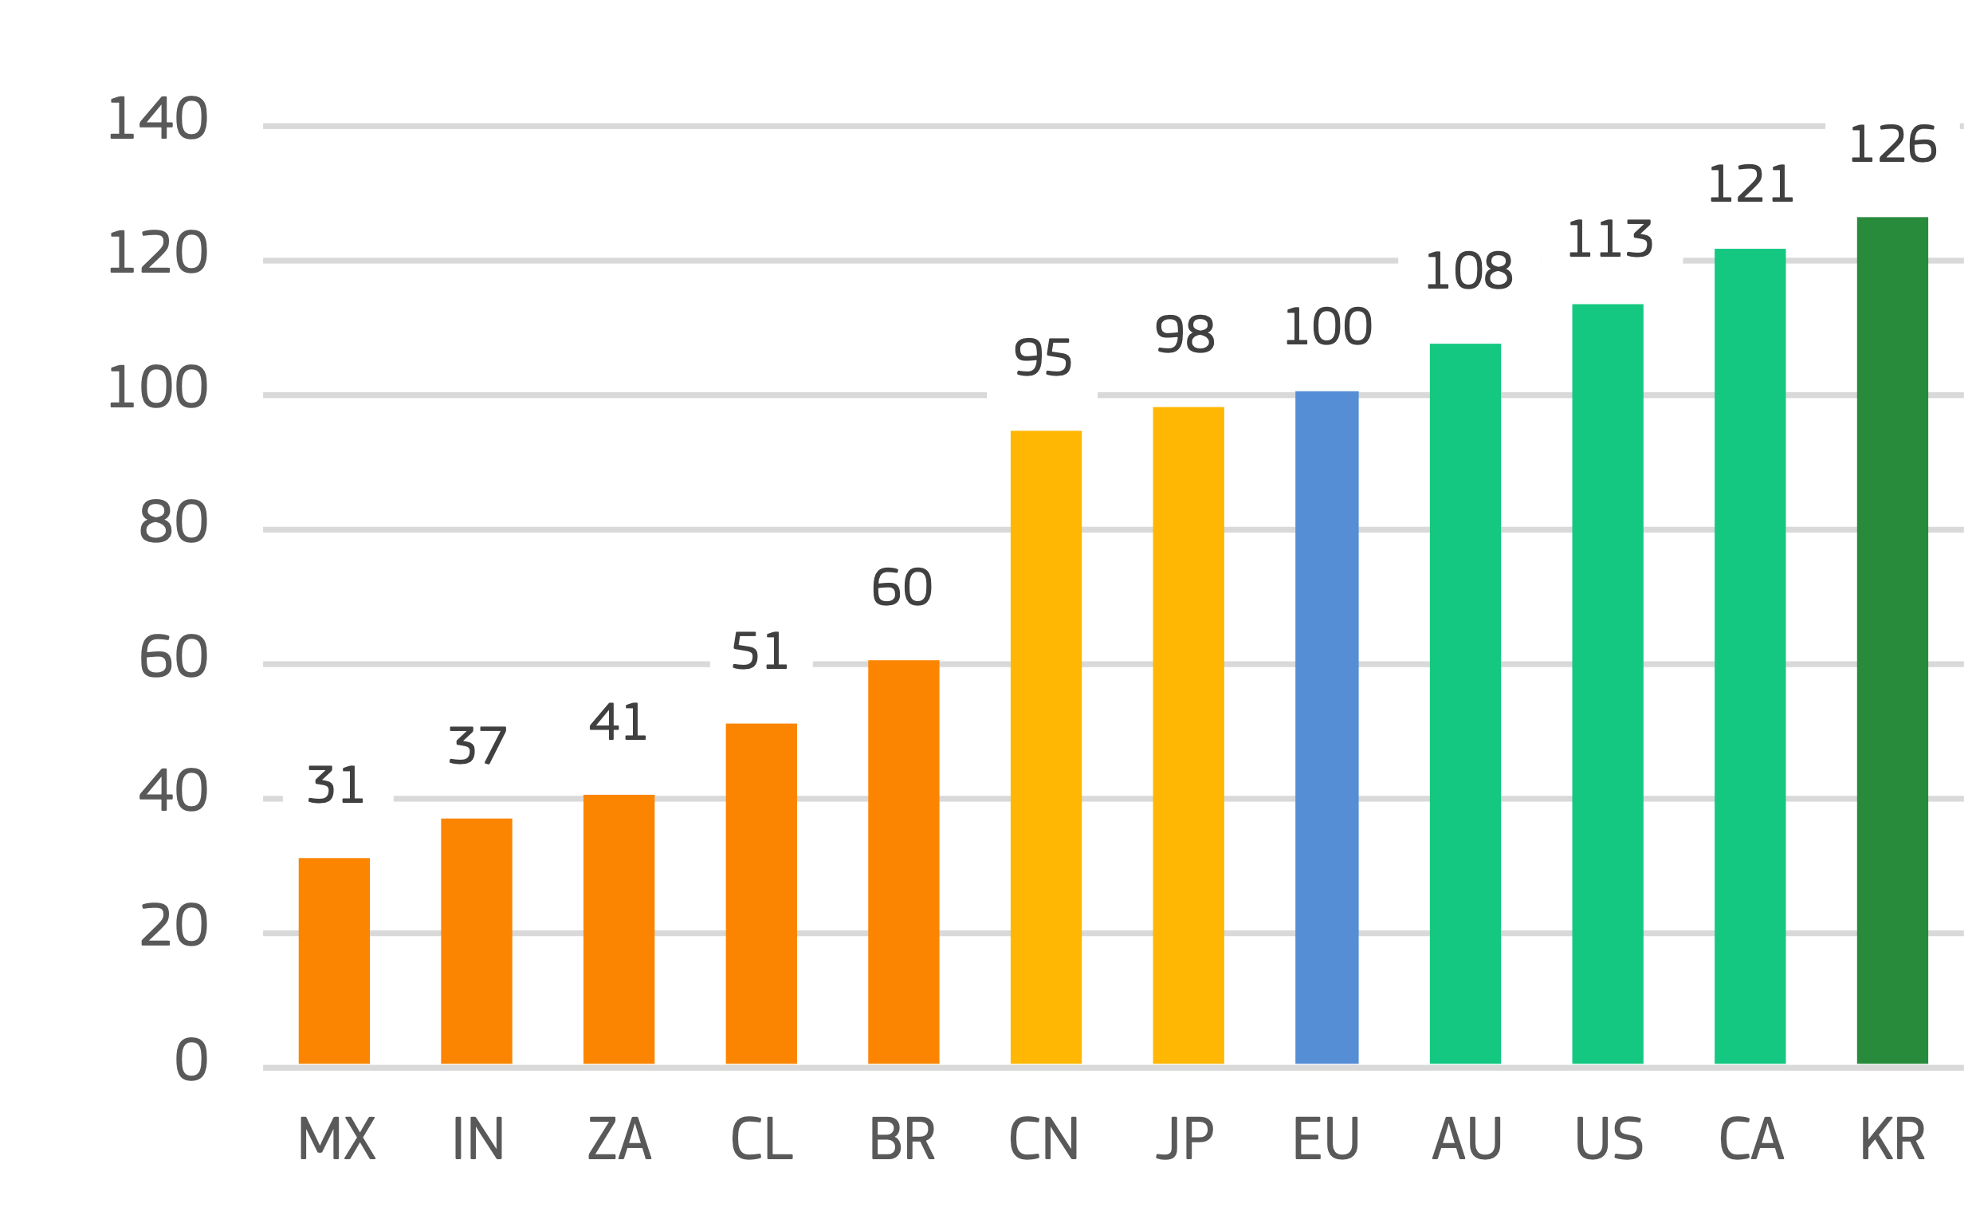
Where Europe stands with respect to others?

Slide 49
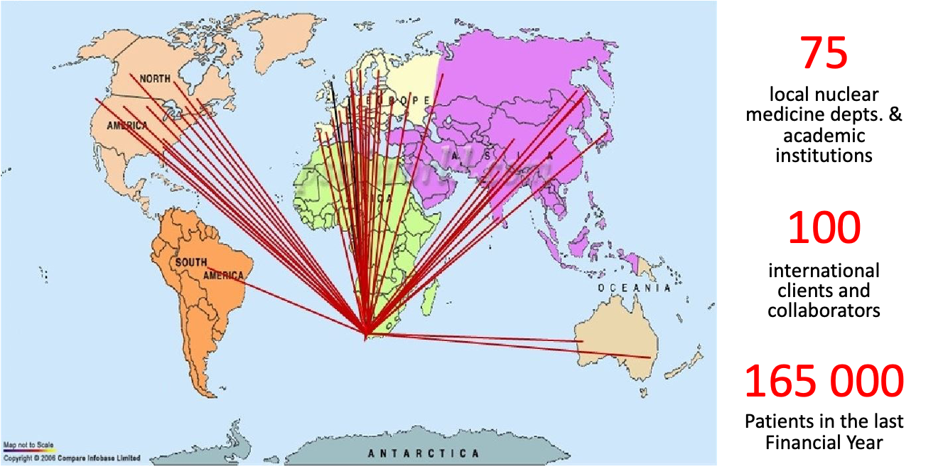
A note of general value from South Africa:
Q (M. Caccia):
what is your business model?
A (Makondele Victor Tshivhase):
essentially,
Radioisotope production, distribution & marketing at

Slide 50
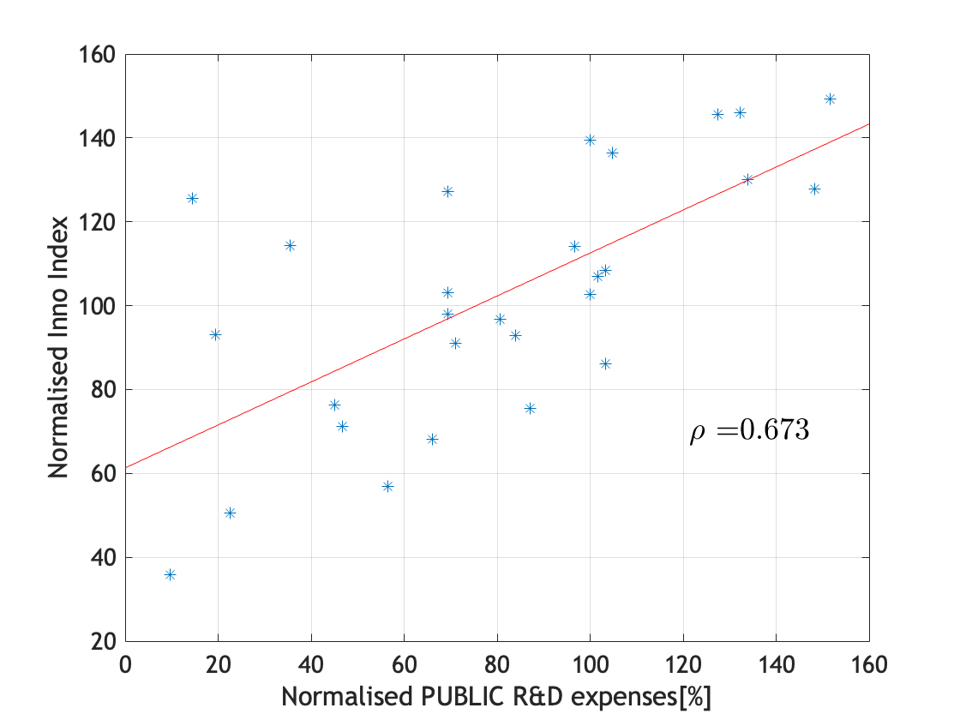
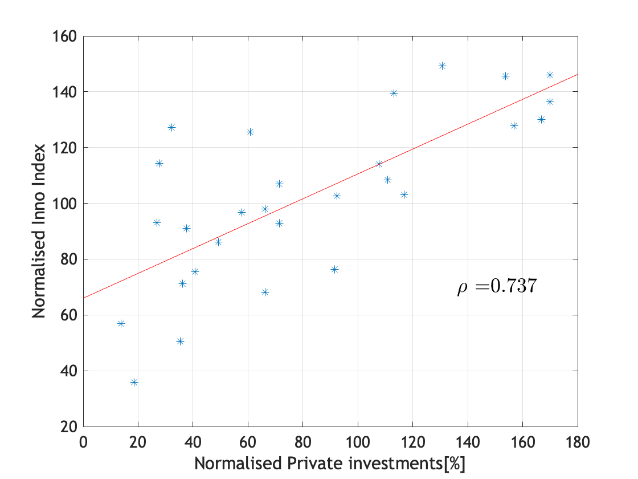
a few remarks (limited, since correlation does not imply causation!):
is it all about money?
https://ec.europa.eu/research-and-innovation/en/statistics/performance-indicators/european-innovation-scoreboard/eis

Slide 51
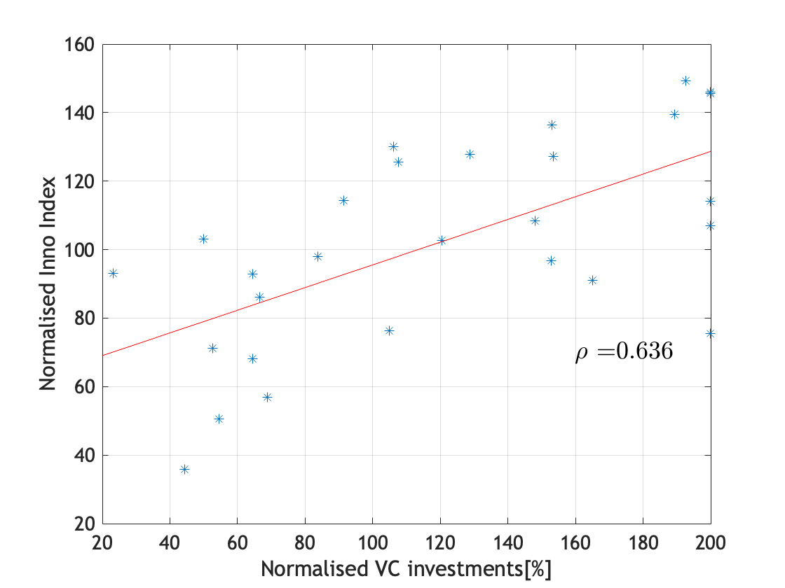
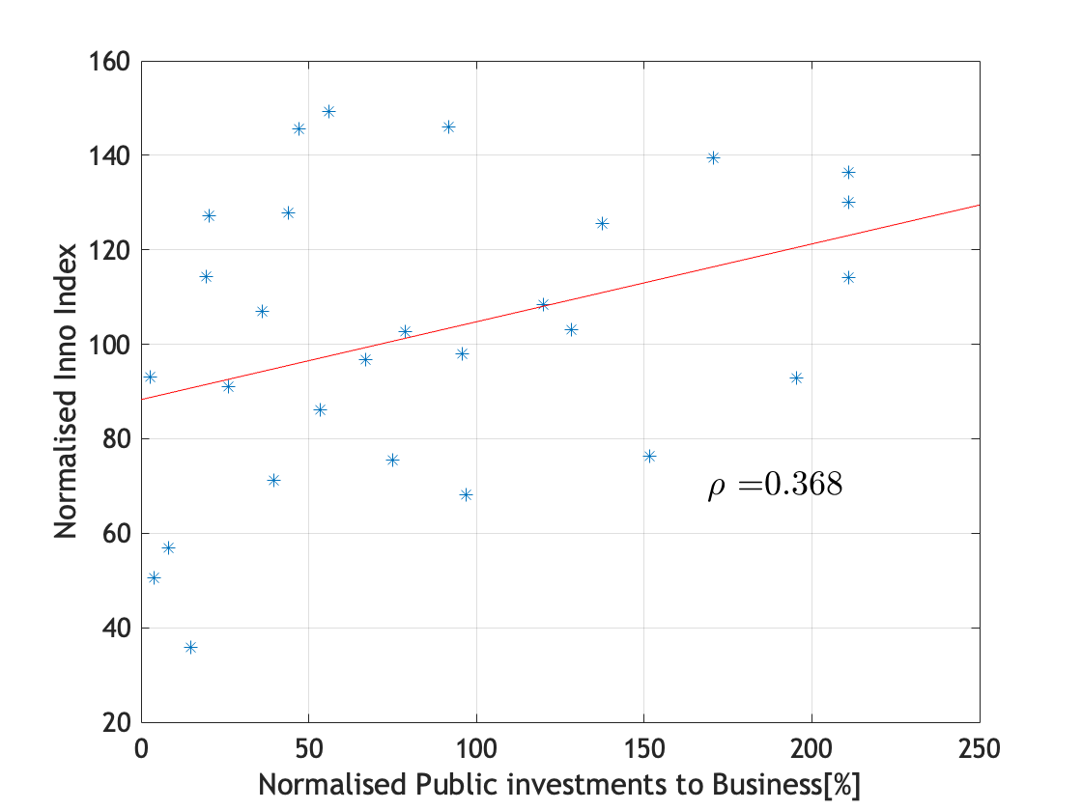
a few remarks (limited, since correlation does not imply causation!):

Slide 52
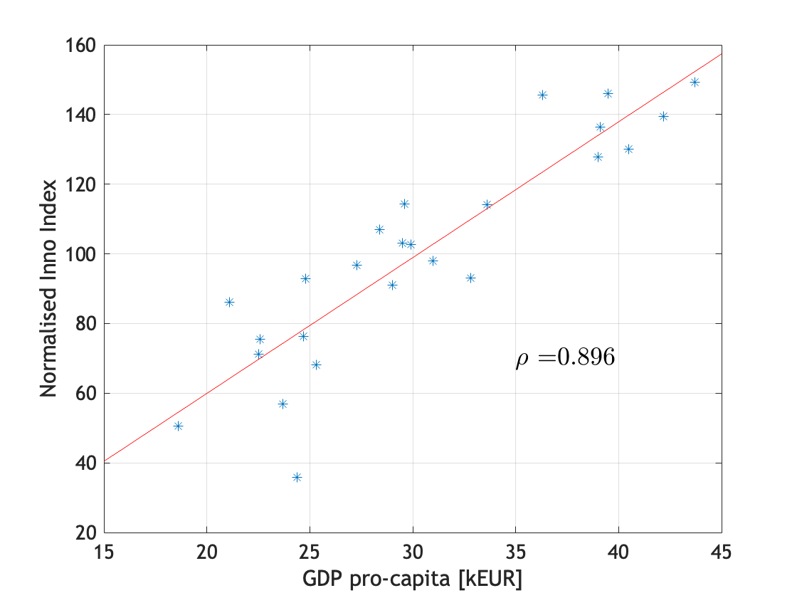
a few remarks (limited, since correlation does not imply causation!):
Maybe is not all about money but once you have it, life is easier
(mind the fact I excluded Ireland & Luxemburg, clear outliers on the x-axis)

Slide 53
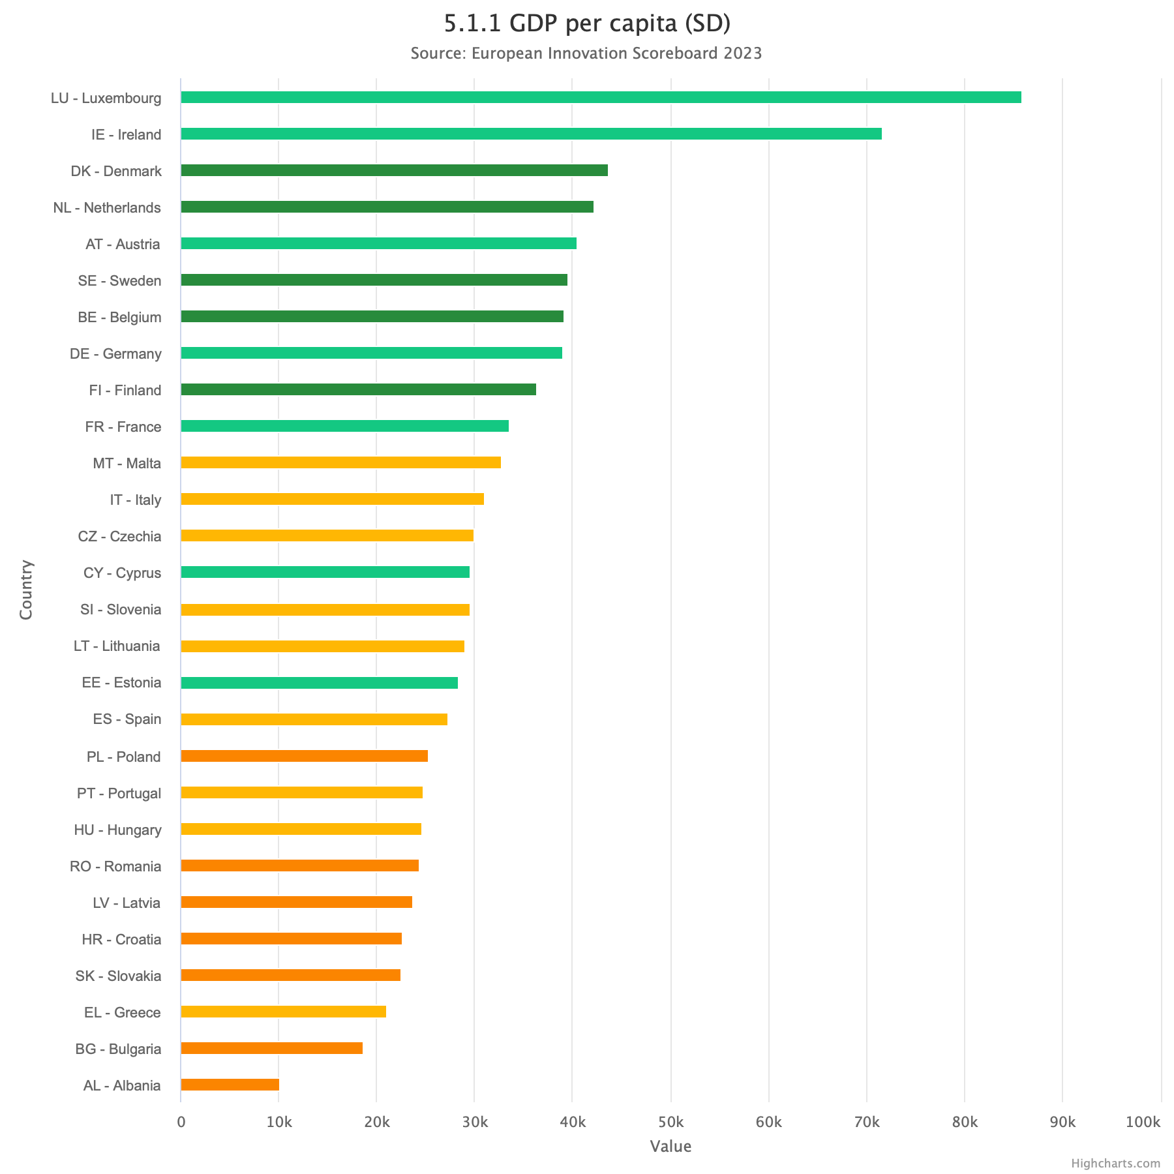
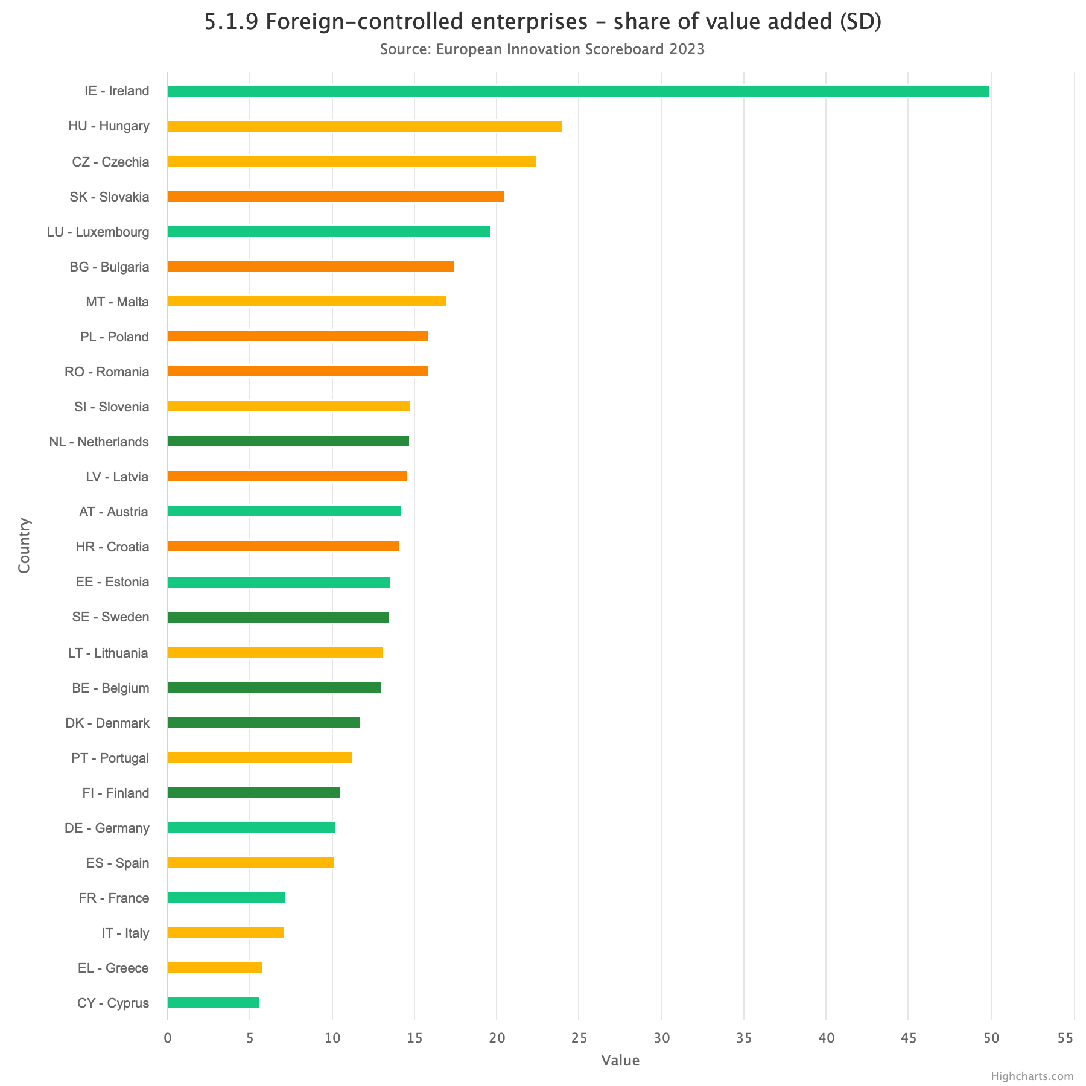
a few remarks; on the long run, mind property:
Ireland
Denmark
Ireland
Sweden
Belgium
Sweden
Belgium
Denmark

Slide 54
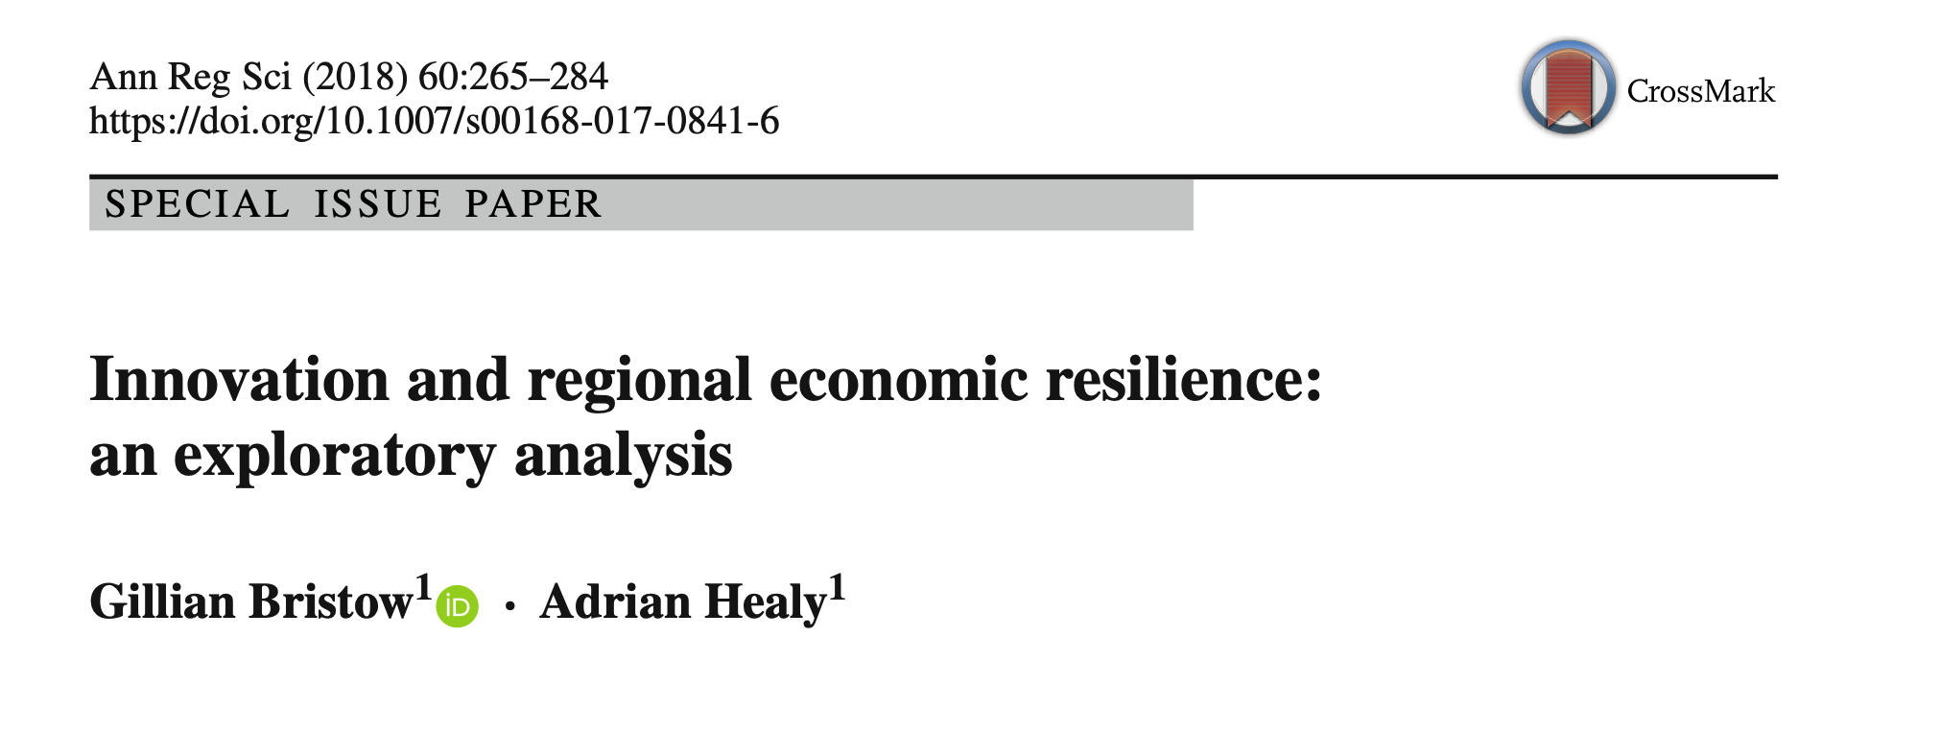
can we measure the major outcome of innovation policies?
How did country respond to the 2008 shock?
regions classified according to the EU scoreboard, at regional level (NUTS 1 + NUTS 2 classification)
qualifier: recovery of the employment level within 3 years
Notes:
mind chicken & egg questions (e.g. correlated to employment or GDP)

Slide 55
Final remarks:
Knowledge & Technology Transfer: shall I really DO it?
do not feel obliged!
do not feel compelled even by who refers to the ACCOUNTABILITY of Science
however:
think a bit in terms of SOCIAL RESPONSABILITY
turn TRANSFER into EXCHANGE
and you will discover it does represent a great OPPORTUNITY
(here)

