Slide 1
The 2023 ICFA Instrumentation Awards
Ian Shipsey
Oxford University
(Chair, ICFA Instrumentation, Innovation and Development Panel
of the International Committee for Future Accelerators of IUPAP )
r

Slide 2
Multiple theoretical
solutions – experiment
must guide the way
How do quarks and gluons give rise to the properties of nuclei
The mystery of the origin and engine of high energy cosmic particles
We are very much in a data driven era for which we need new tools!

Slide 3
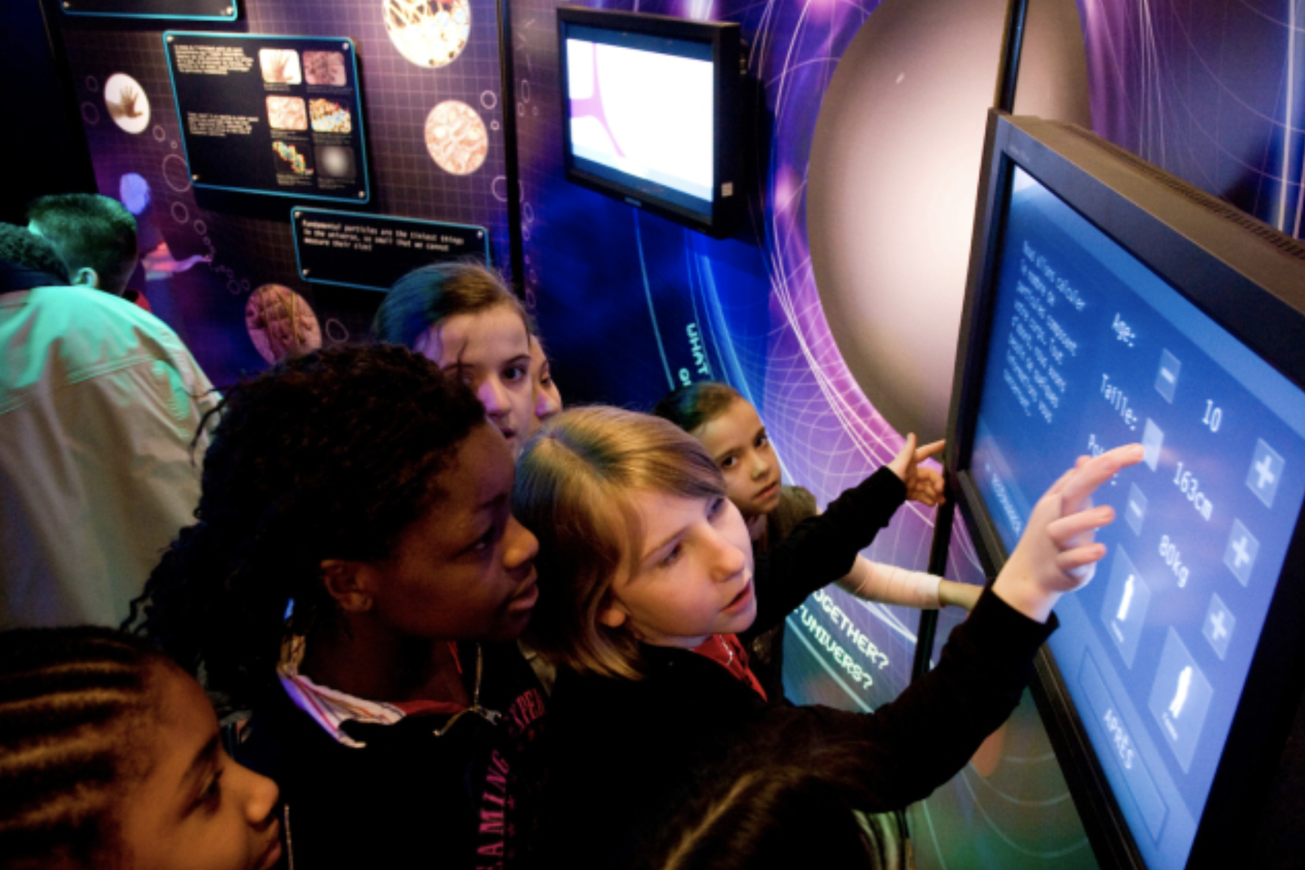
“New directions in science are launched by new tools
much more often than by new concepts.
The effect of a concept-driven revolution is to explain old things in new ways. The effect of a tool-driven revolution is to discover new things that have to be explained” (Freeman Dyson)
Photo credit: CERN
Notes:
If history is our guide, realizing these new tools will open new doors because

Slide 4
“Measure what is measurable, and
make measurable what is not so” (Galileo Galilei)
Photo credit: CERN
Notes:
The challenge we are faced with inspires us the next generation of scientists

Slide 5
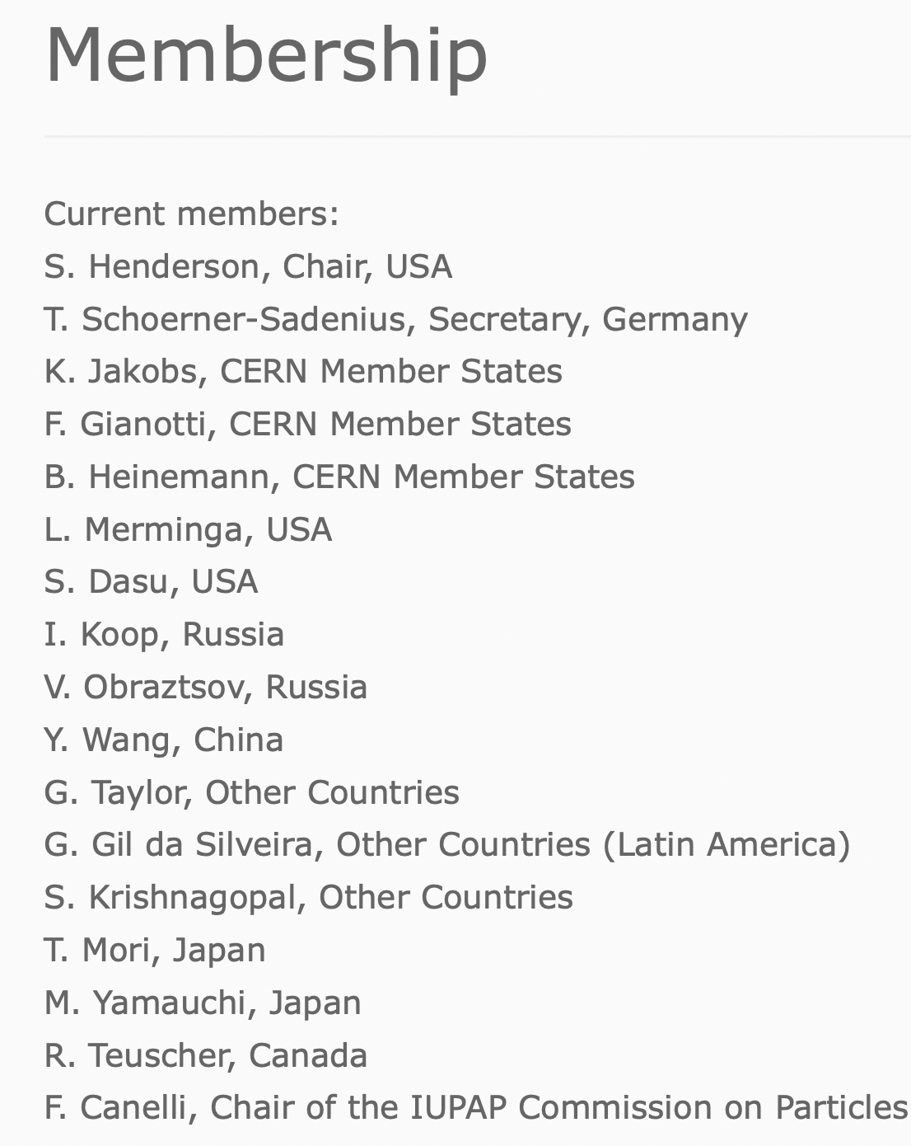
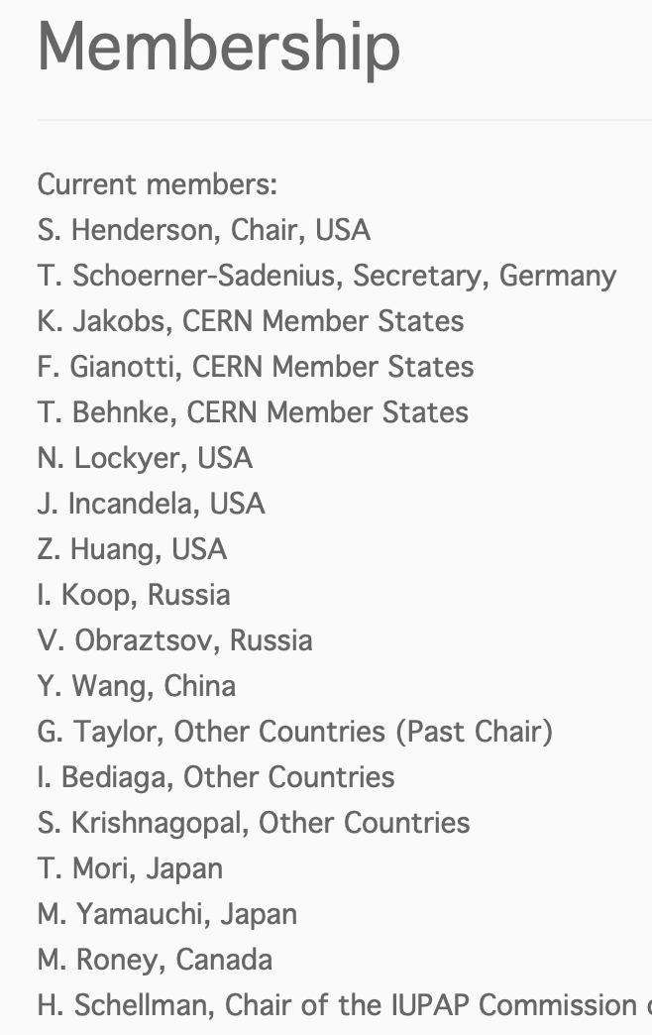
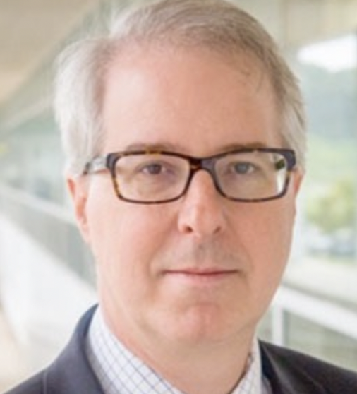
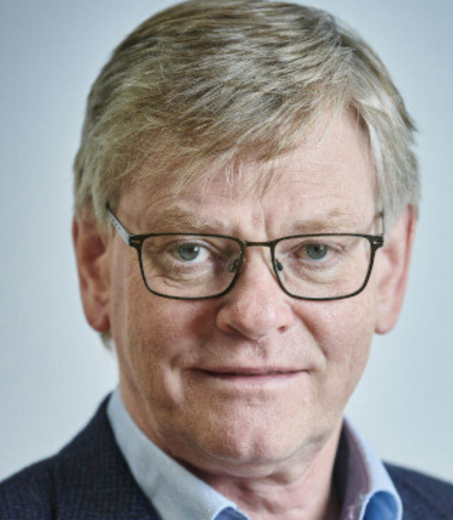
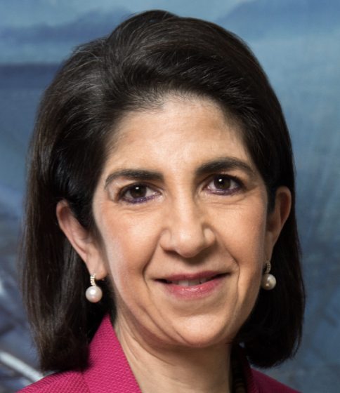
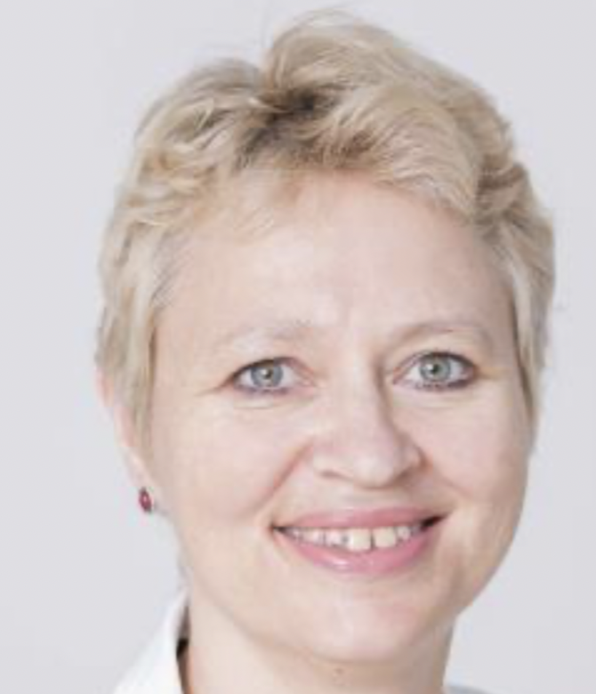
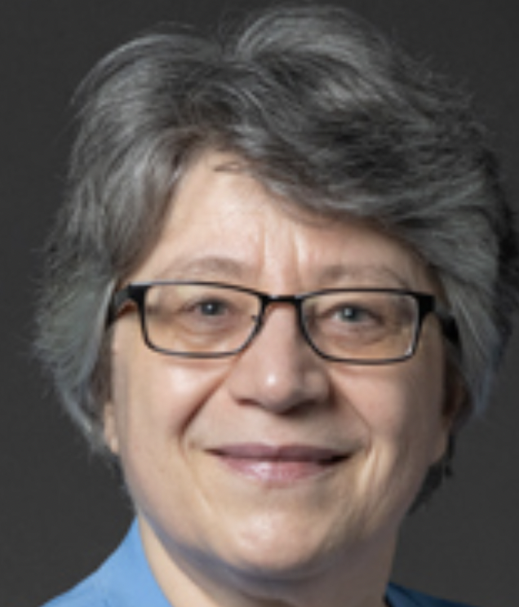
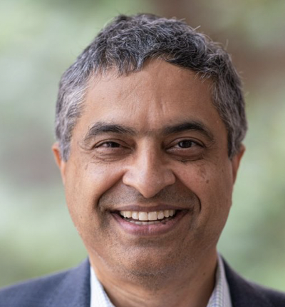
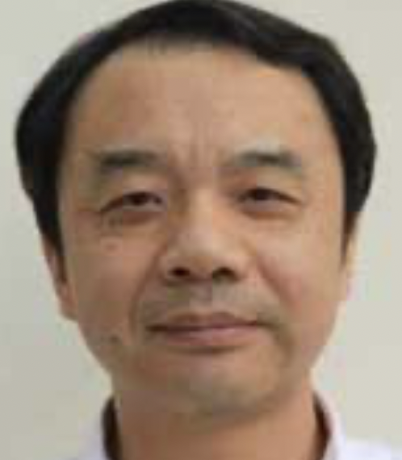
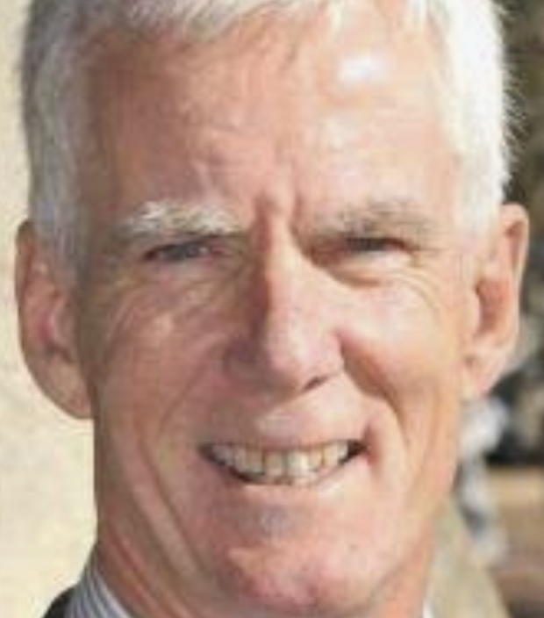
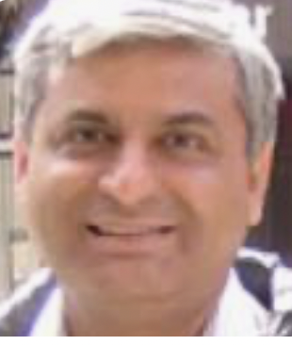
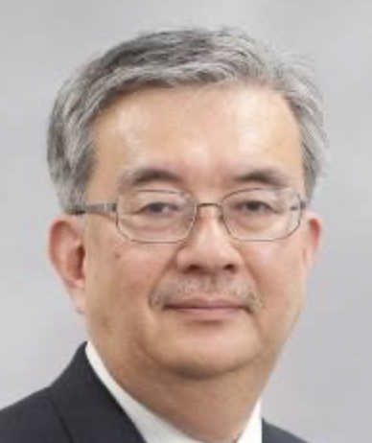
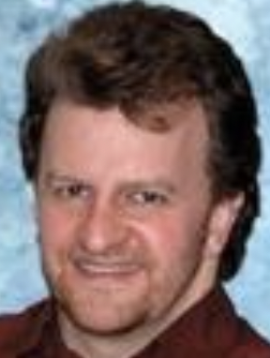
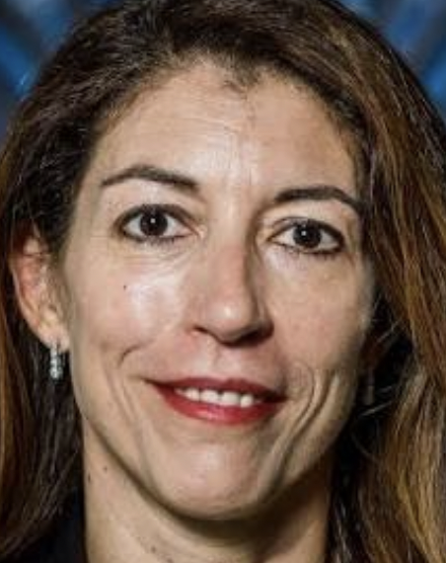
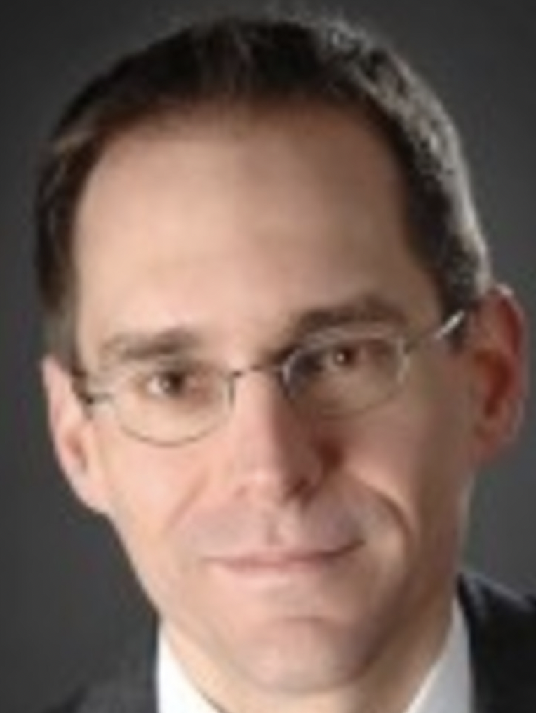
https://icfa.hep.net
ICFA, the International Committee for Future Accelerators
Not pictured: I Koop,
V. Obrastov,
G. Gil da Silveira ,
& T. Mori

Slide 6
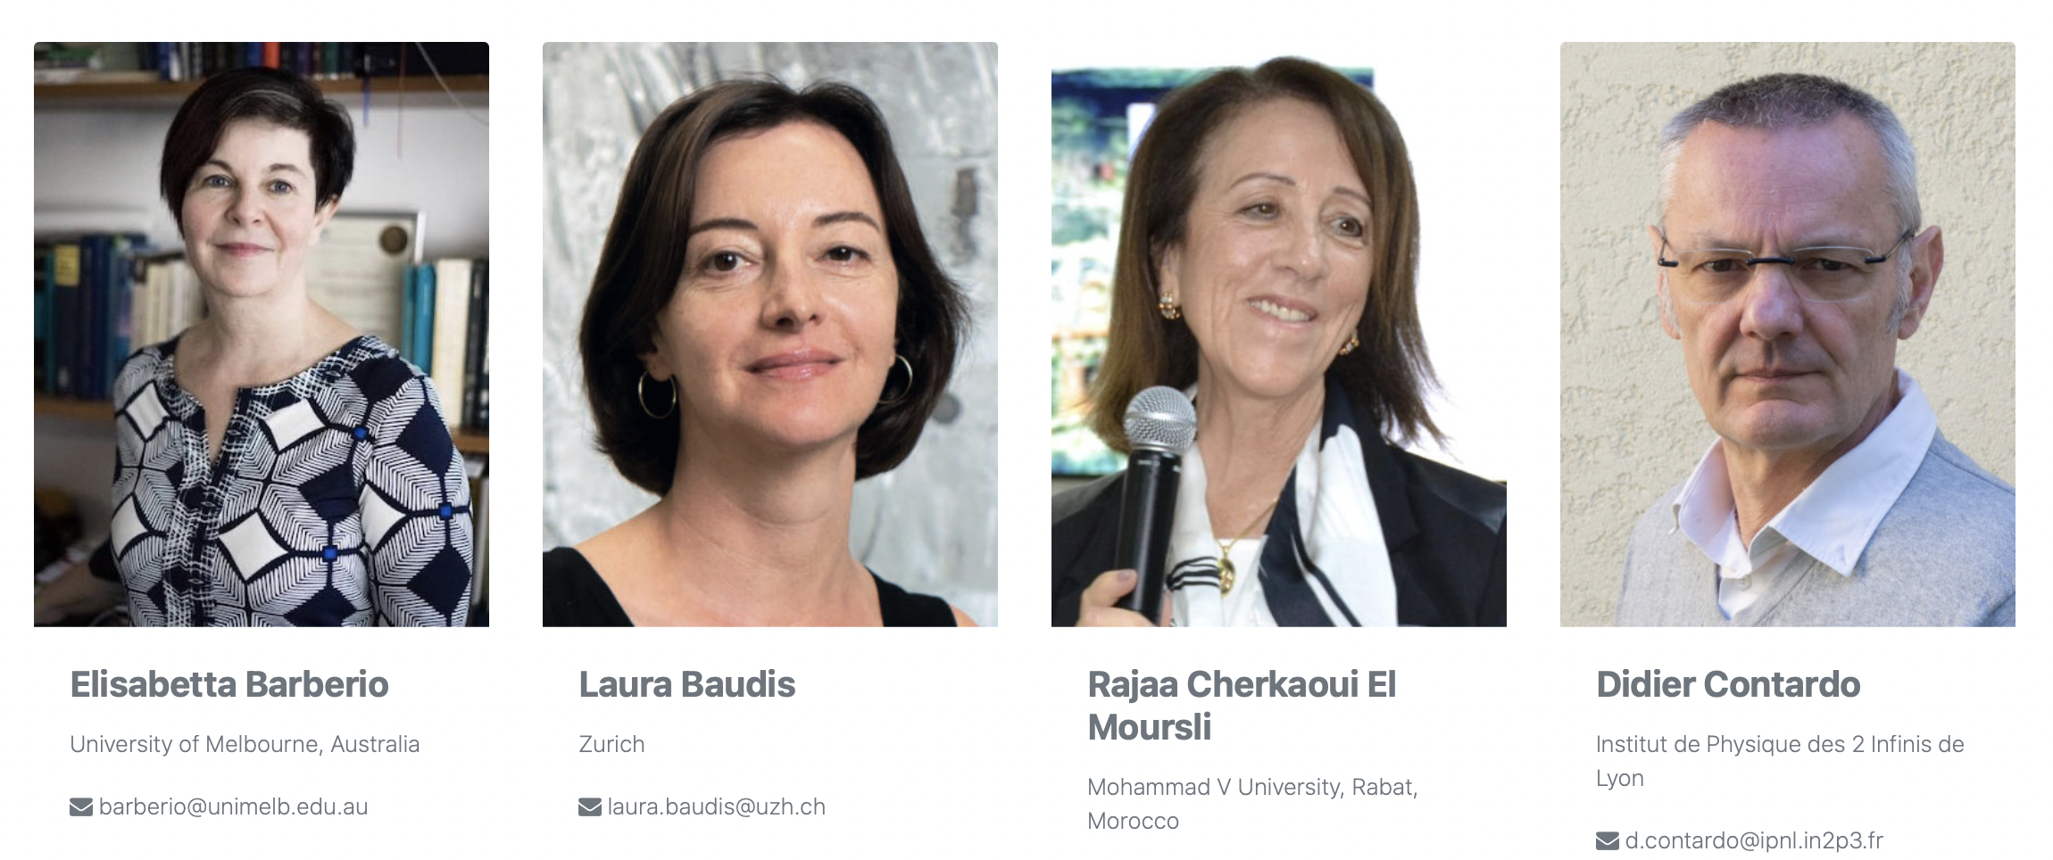
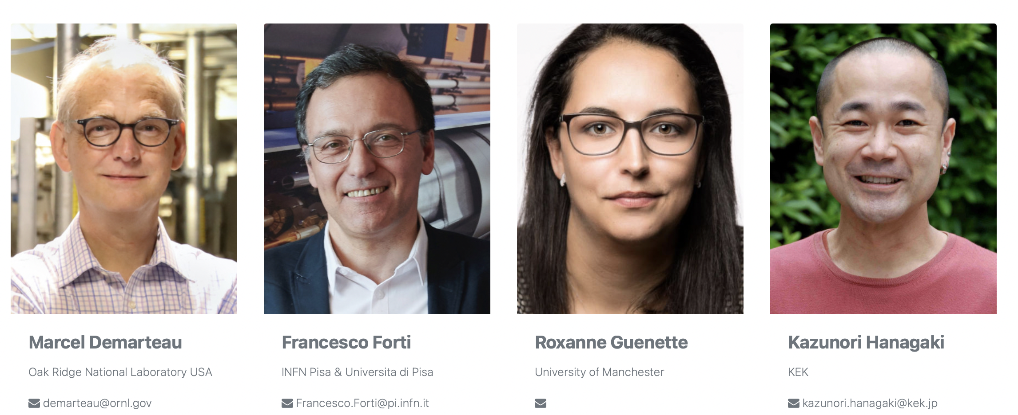
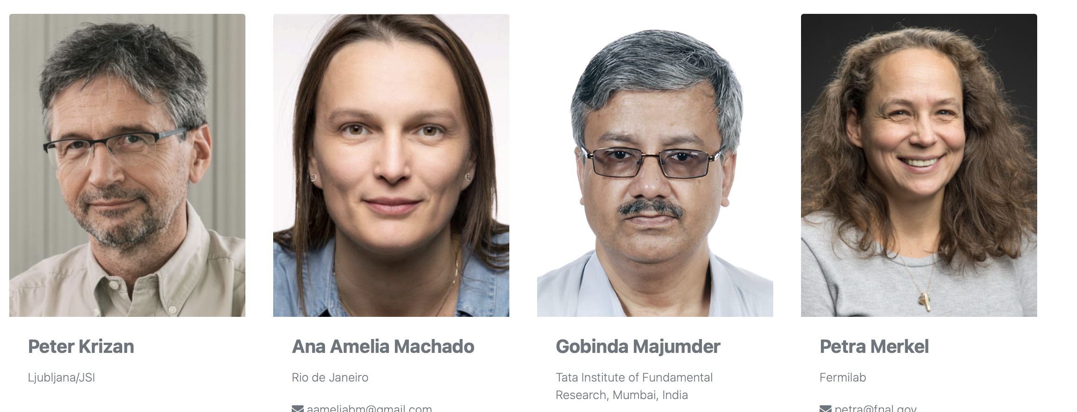
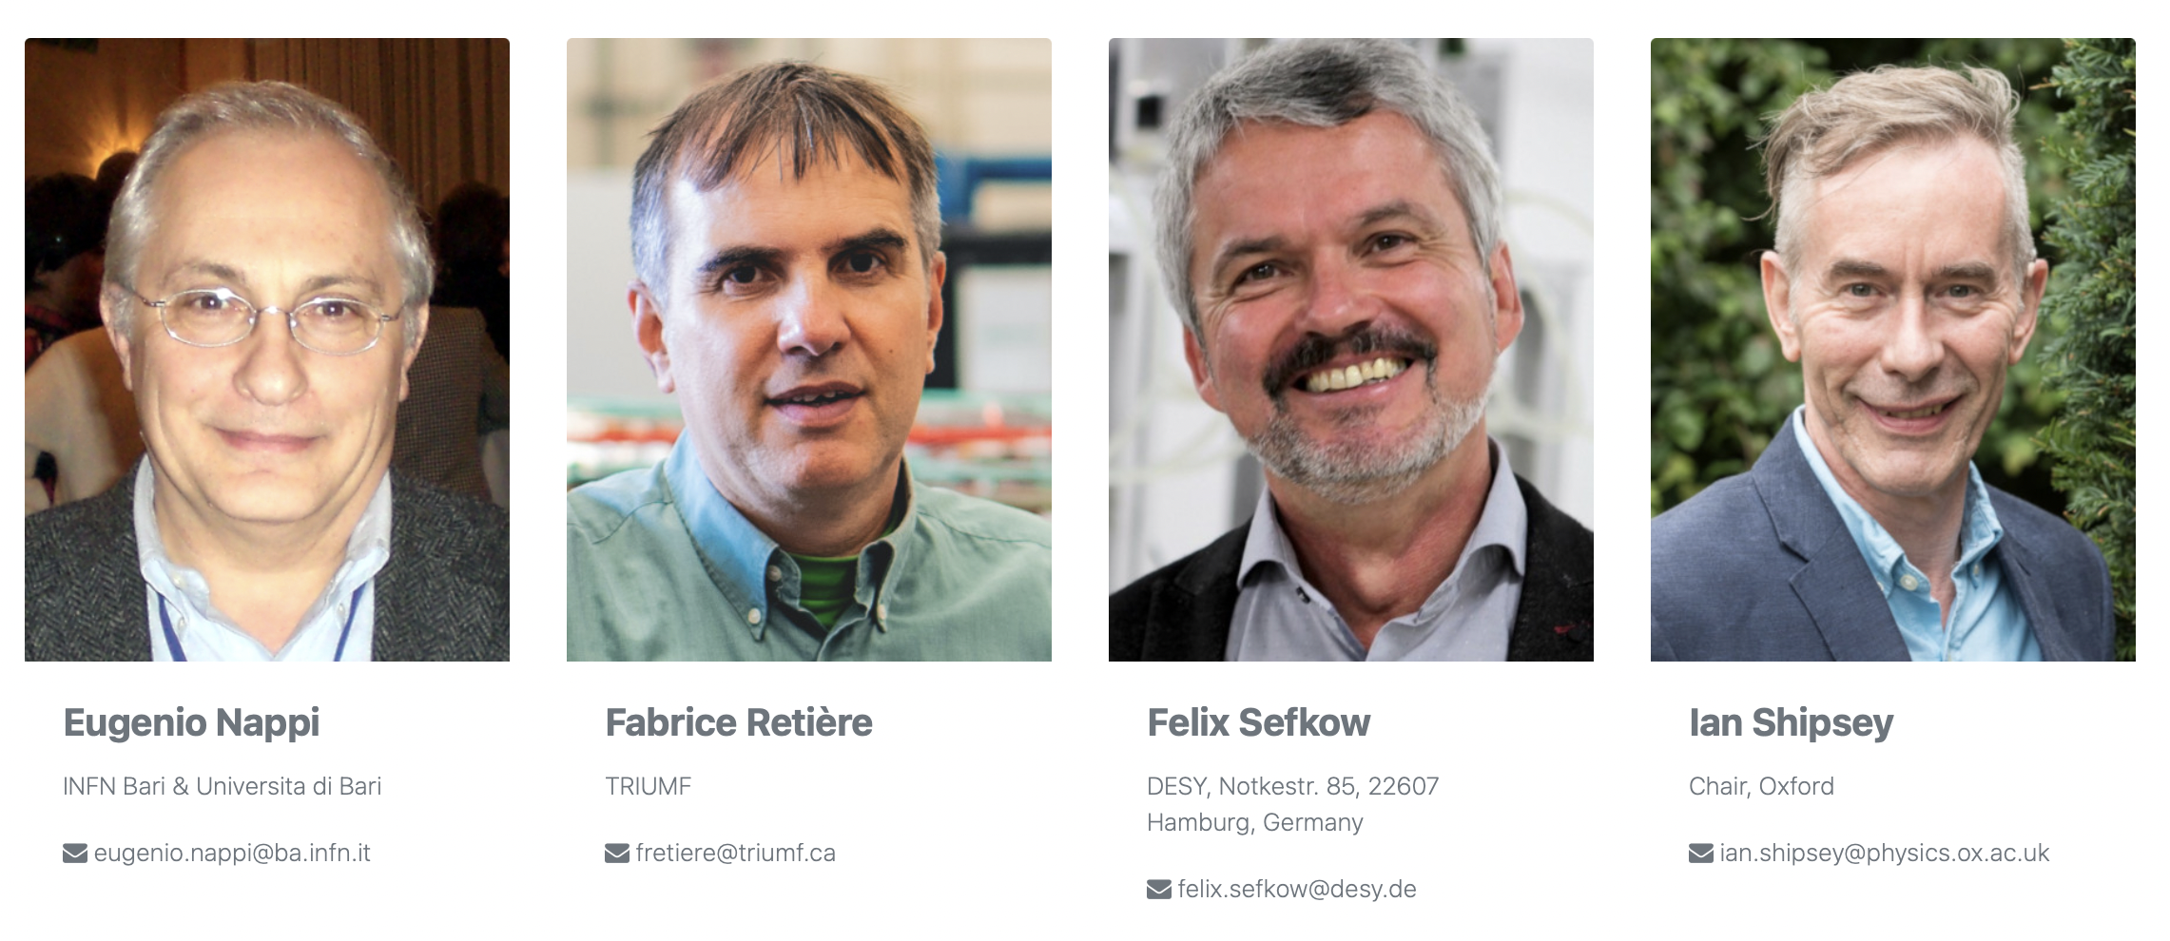
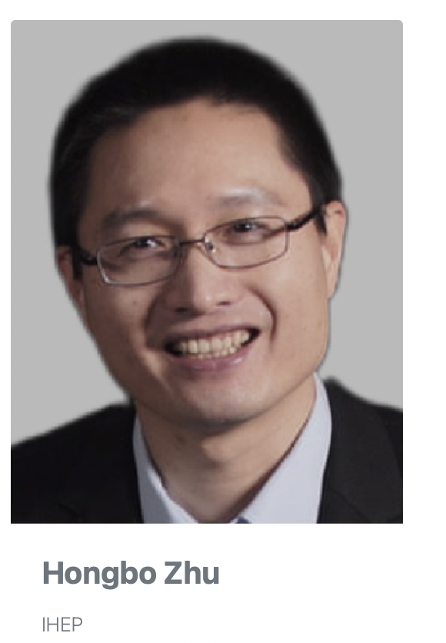
https://icfa-iid.physics.ox.ac.uk
Notes:
Our panel charge is to stimulate the world community to innovate and develop new instrumentation that creates new wasys of looking at the world. We have terrific 17 member panel with immesans experience and a succesfu track records of doing exactly that.

Slide 7
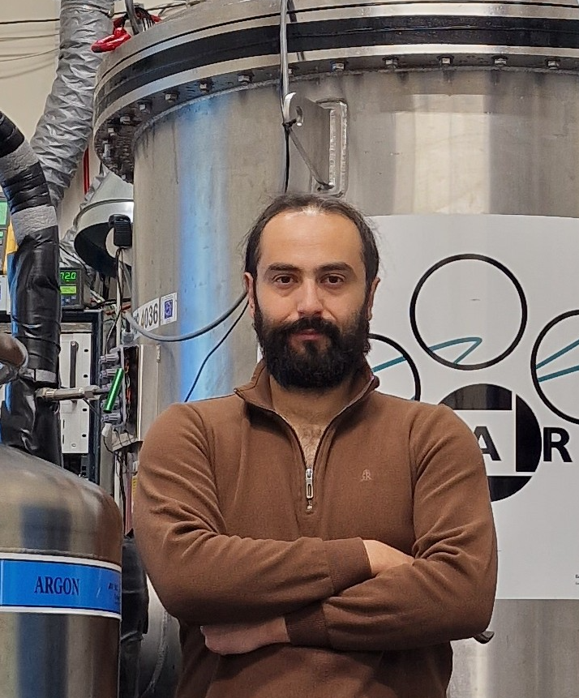
For the development of an innovative 3D optical readout for liquid argon time projection chambers that use novel glass thick GEMS (THGEM) coupled to very fast Timepix cameras to provide high-granularity images and low-energy thresholds.
The 2023 ICFA Instrumentation
Early Career Award
is presented to:
Konstantinos Mavrokoridis
(Liverpool)
s

Slide 8
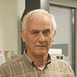
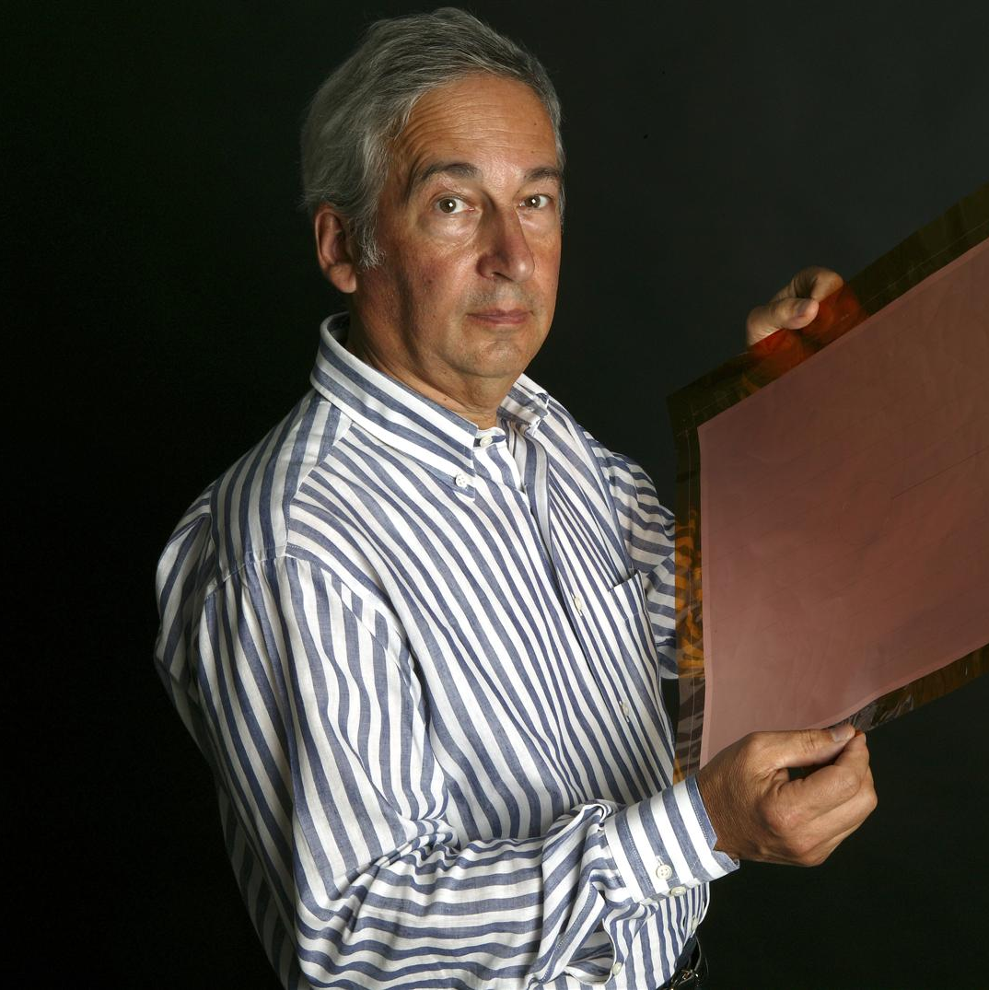
For the development of new micropattern gas detector technologies enabling the construction of large-scale detectors with novel geometries for particle physics, and also widespread application to other fields.
The 2023 ICFA Instrumentation Award
is presented jointly to:
Ioannis
Giomataris
(CEA Saclay)
Fabio
Sauli
(CERN)

Slide 9
https://icfa.hep.net
ICFA, the International Committee for Future Accelerators, was created to facilitate international collaboration in the construction and use of accelerators for high energy physics in 1976 by the International Union of Pure and Applied Physics.
To promote international collaboration in all phases of the construction and exploitation of very high energy accelerators.
To organize regularly world-inclusive meetings for the exchange of information on future plans for regional facilities and for the formulation of advice on joint studies and uses.
ICFA has 7 sub-panels

Slide 10
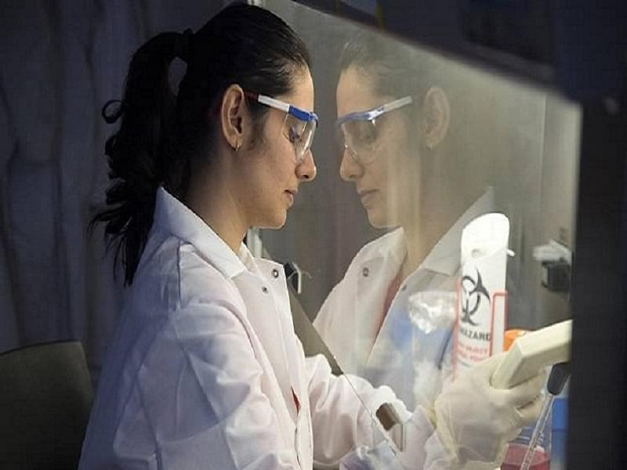
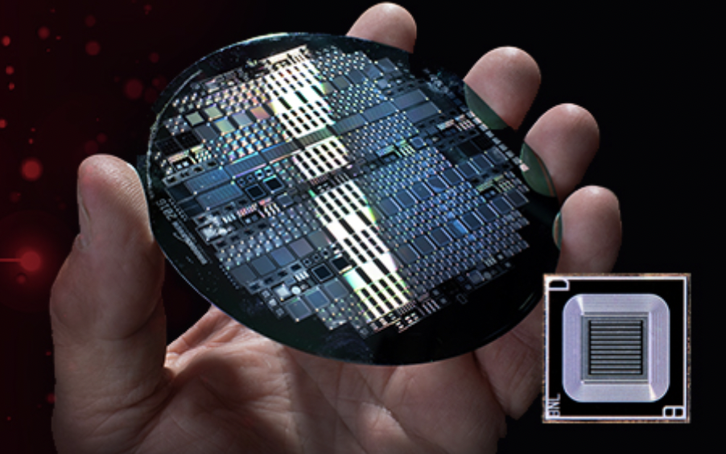
Instrumentation, Innovation and Development Panel
ICFA Instrumentation School
Excellence in Detector Instrumentation Technology (EDIT) Schools
Inaugural Instrumentation Awards
Instrumentation Studentships
(in progress)
ICFA School 2023
BNL
Year 2 Instrumentation Awards

