Slide 1
DEVELOPMENT AND APPLICATIONS
OF THE GAS ELECTRON MULTIPLIER
Fabio Sauli
CERN
ICFA Instrumentation Award
TIPP 2023 Cape Town Sept 8
Dedicated to present and past friends of

Slide 2
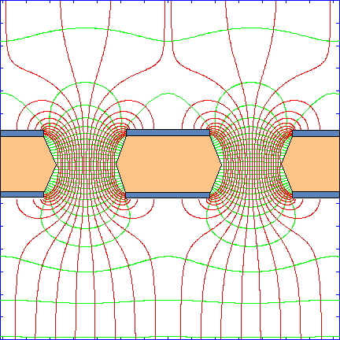
THE GAS ELECTRON MULTIPLIER (GEM)
THIN POLYMER FOIL PIERCED BY A HIGH DENSITY OF HOLES
DRIFT
MAIN CHARACTERISTICS:
Fat Electron Signal
Position accuracy ~ 50 µm
Freedom of detector shape
Arbitrary pattern of readout
High rate Capability > 1 MHz mm²
Reduced positive ions backflow
No discharge propagation to anode
INDUCTION
F. Sauli,
Nucl. Instr. Meth. A386 (1997) 531

Slide 3
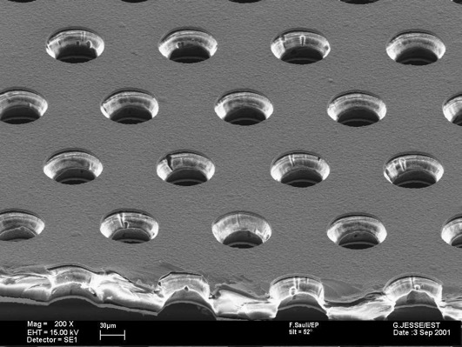
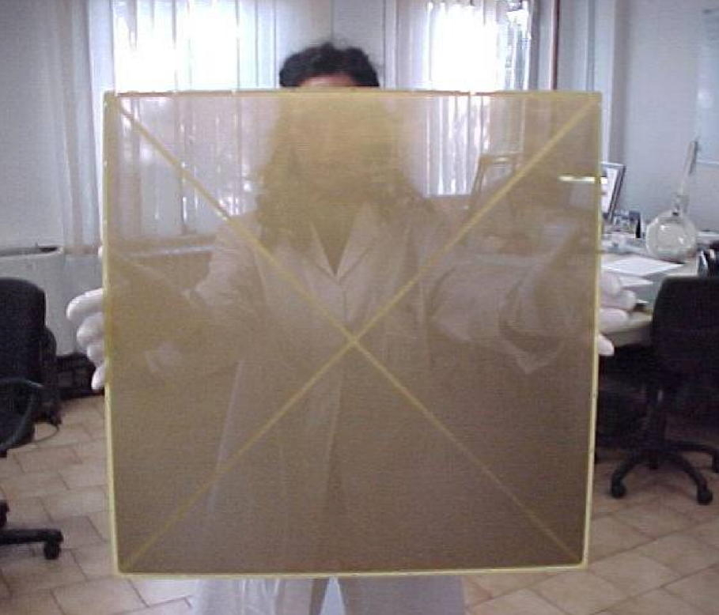
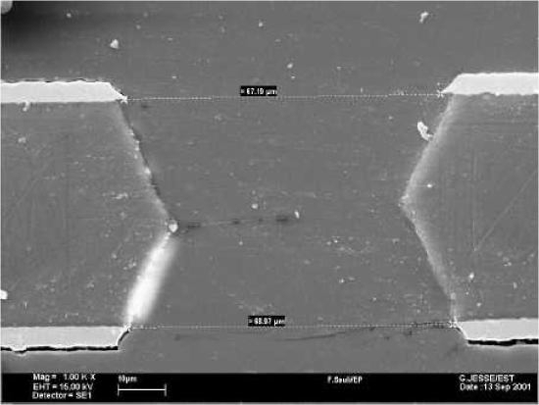
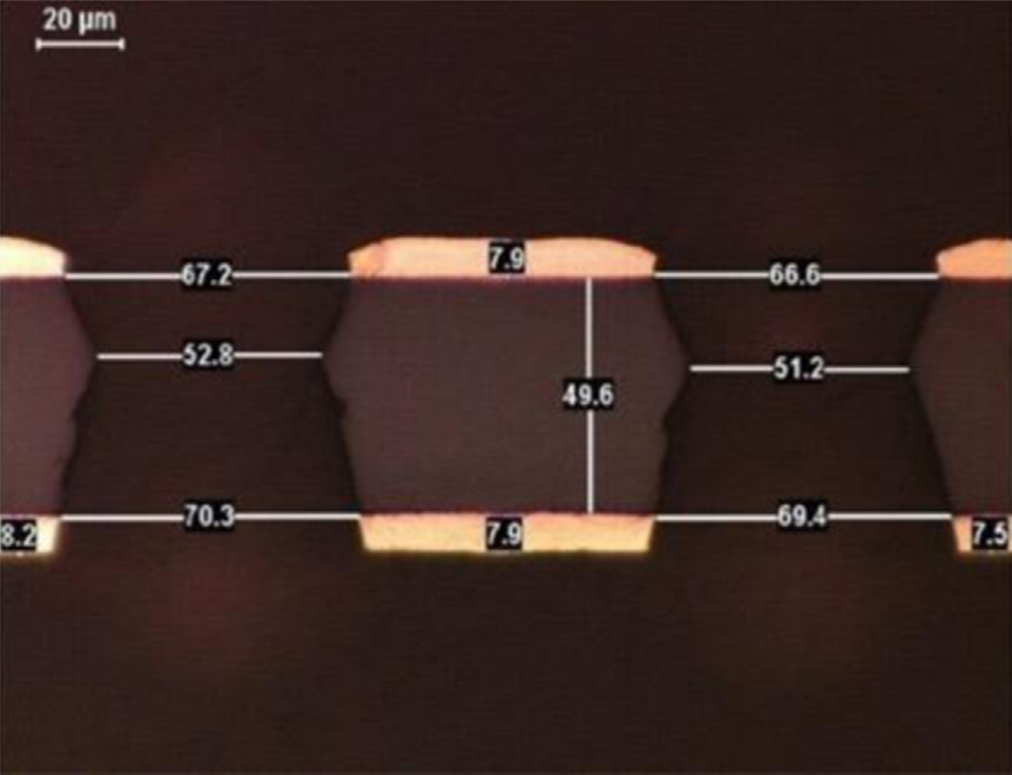
GEM MANUFACTURING
Photolithography & Wet Etching
Mechanical drilling
Large GEM (LEM)
Thick GEM (TH-GEM)
70 µm
140 µm

Slide 4
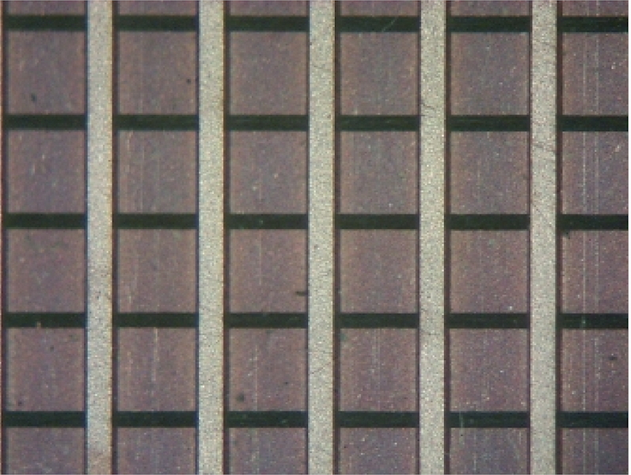
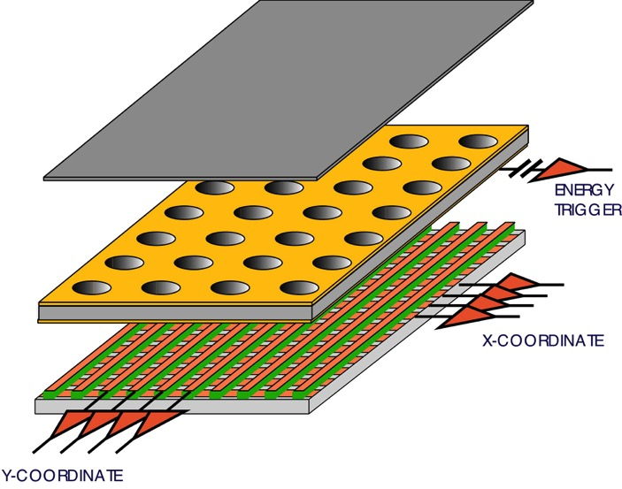
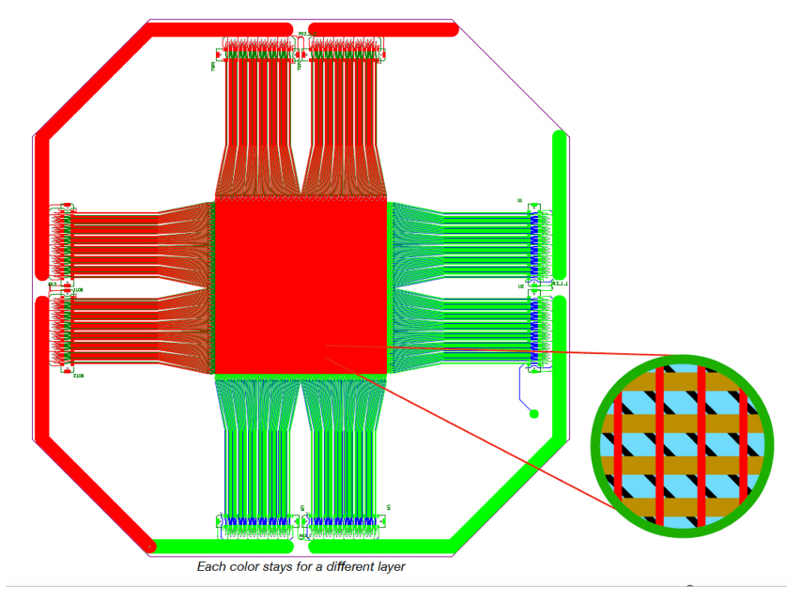
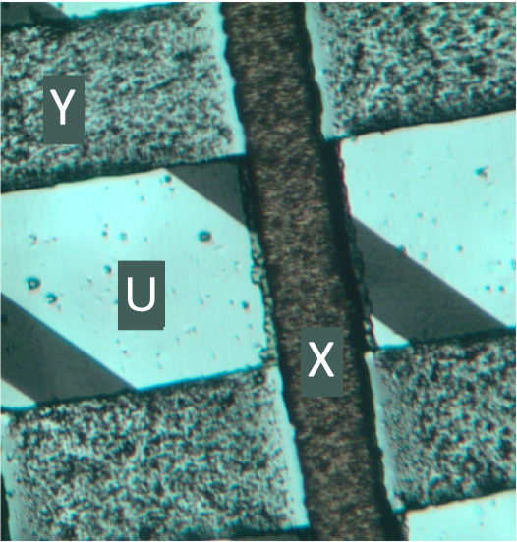
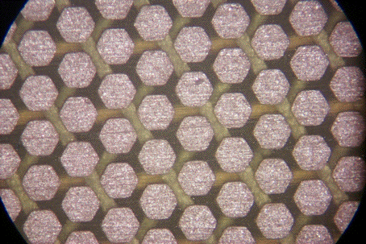
SINGLE GEM
XY STRIPS
STANDARD 2-D XY READOUT
400 µm PITCH
XYU
PADS

Slide 5
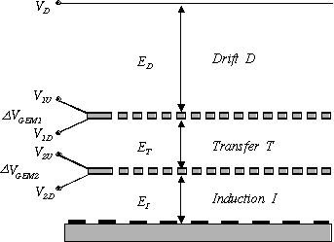
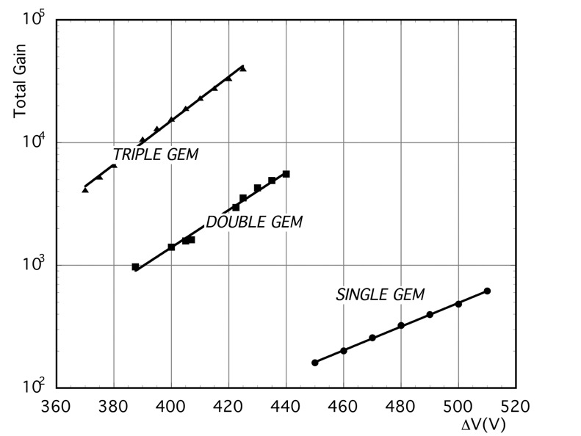
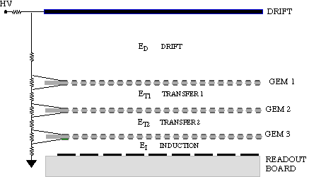
CASCADED MULTI-GEM
HIGHER GAIN AT LOWER VOLTAGES
DOUBLE GEM
HIGHER DISCHARGE THRESHOLD
TRIPLE GEM
S. Bachmann et al,
Nucl. Instr. and Meth. A479(2002)294

Slide 6
GEM APPLICATIONS
HIGH ENERGY PHYSICS:
COMPASS Spectrometer
LHCB Fast Trigger
TOTEM
KLOE & BONUS RADIAL TPCs
PHENIX Hadron Blind
CMS Forward Muon
ALICE TPC Upgrade
COMPASS RICH
ASTROPHYSICS:
OPTICAL GEM Dark Matter Detector
DUNE, ARIADNE:
Dual Phase LA, LX detector
NEUTRON DETECTION:
Plasma Diagnostics
Spallation Source Monitoring
CASCADE: Neutron Radiography
SOFT X-RAY
Radiography
Fluorescence Analysis
Plasma Diagnostics
SPACE:
INTEGRAL JEM-X Monitor
IXPIE X-Ray Polarimter
CUBESAT
100

Slide 7
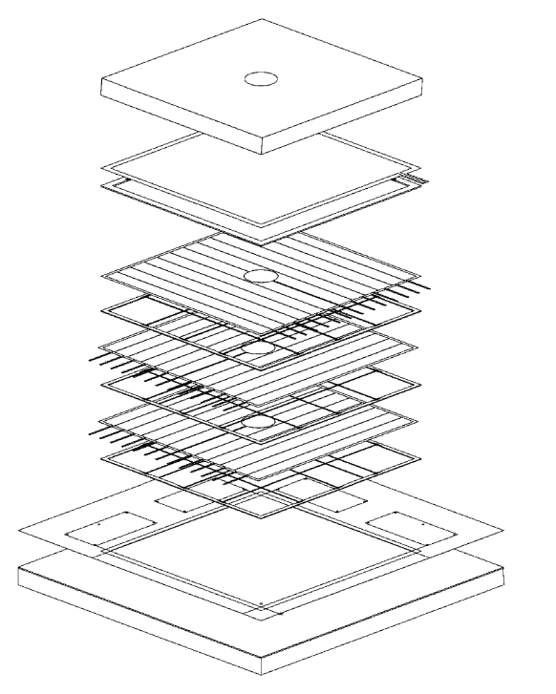
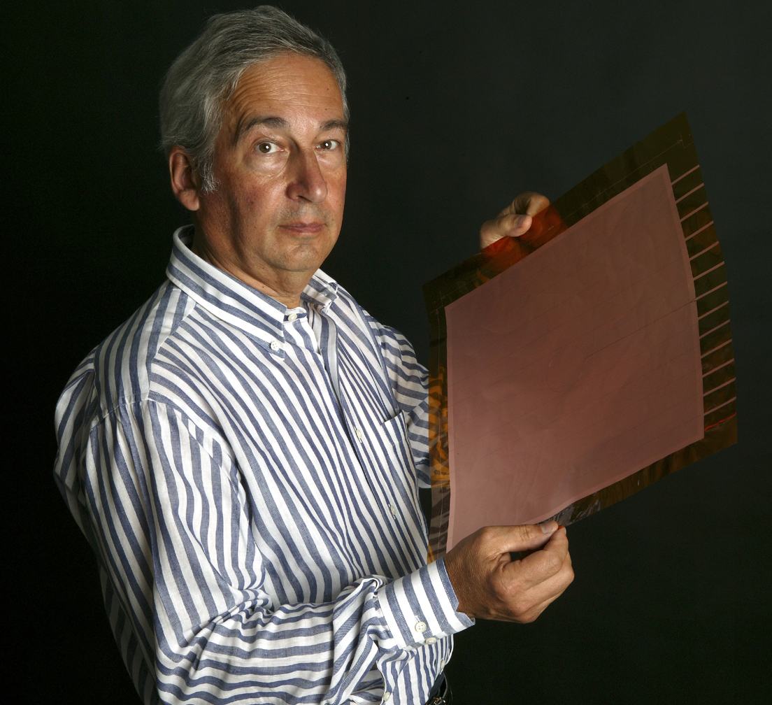
2001: COMPASS TRIPLE-GEM TRACKER
30x30 cm² SECTORED GEM
~ 200 ELECTRODES BUILT AT CERN
C. Altunbas et al,
Nucl. Instr. Meth. A490(2002)480

Slide 8
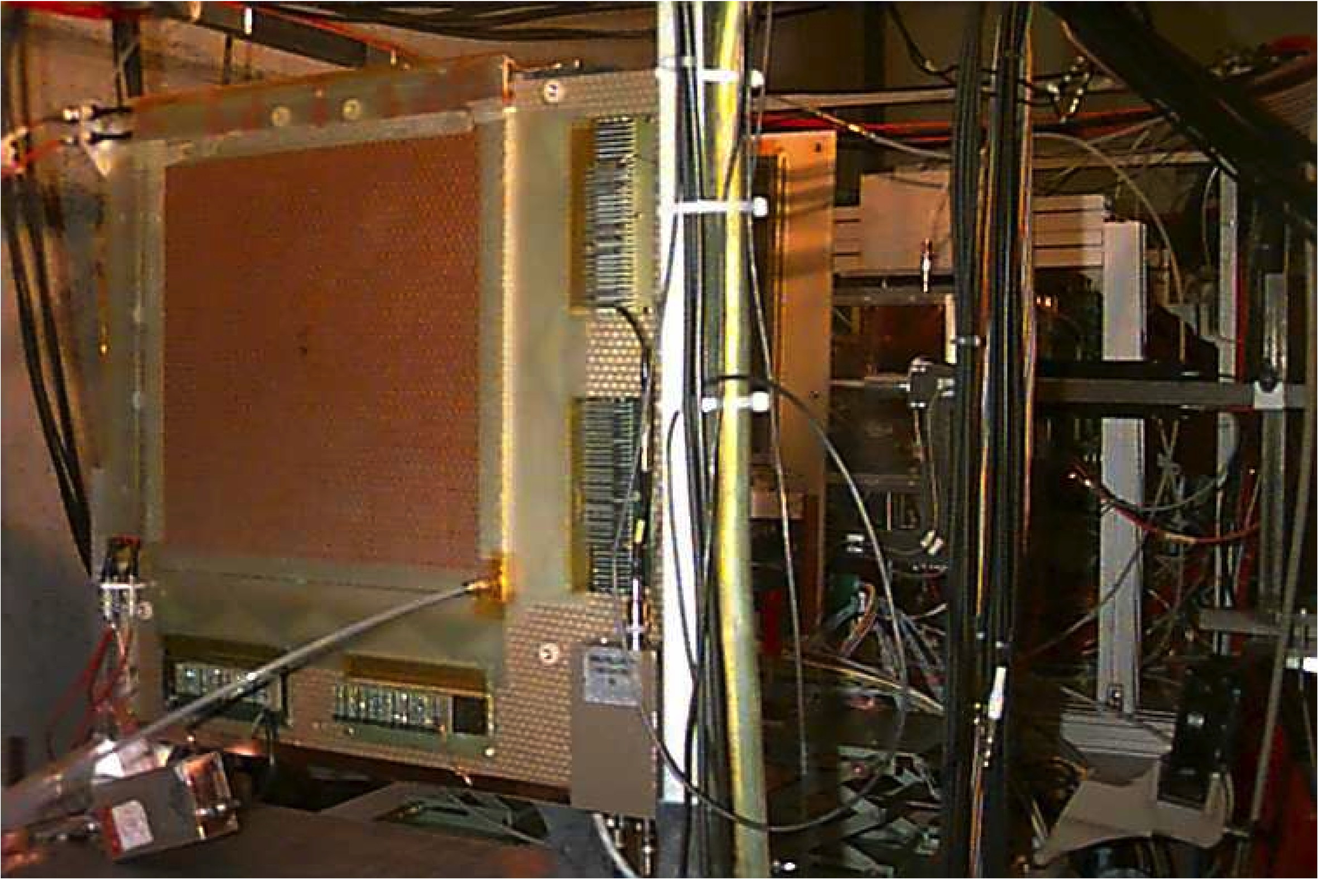
COMPASS SPECTROMETER GEM TRACKER
~ 30 TRIPLE-GEM CHAMBERS OPERATING SINCE 2002
P. Abbon et al, Nucl. Instr. Meth. A577(2007)455

Slide 9
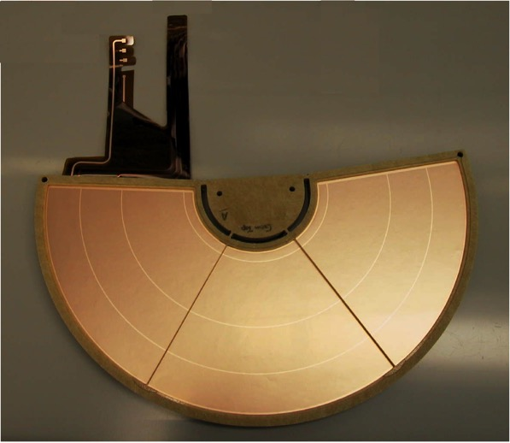
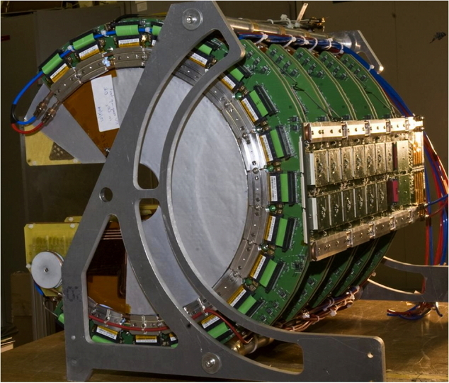
TOTEM T2 CMS GEM TRACKER
OPERATING SINCE 2012
HALF-MOON TRIPLE-GEM GEM DETECTORS FOR TOTEM AT CERN
M.G. Bagliesi et al, Nucl. Instr. Meth. A617(2010)134

Slide 10
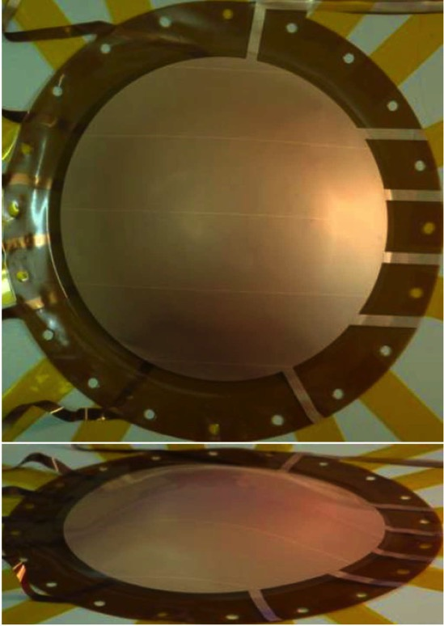
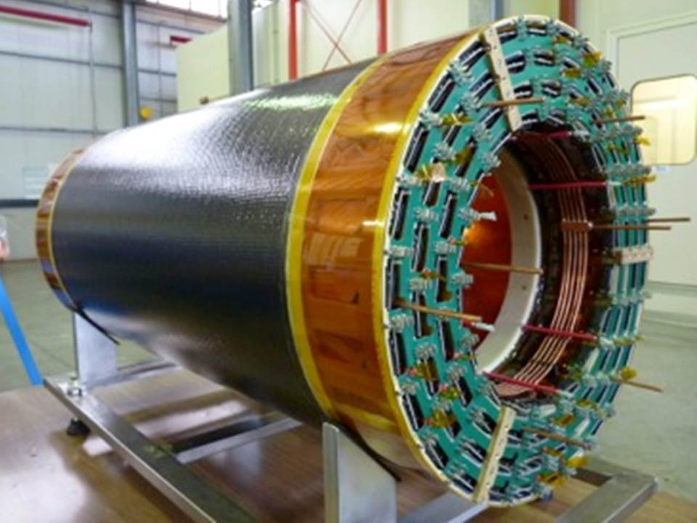
CYLINDRICAL AND SPHERICAL GEMS
KLOE-2 INNER TRACKER
A. Balla et al,
Nucl. Instr. Meth. A732(2013)221
S. Duarte Pinto arXiv:1011.5528v1
IEEE 2011 Nucl. Sci. Symp. Conf. Rec.

Slide 11
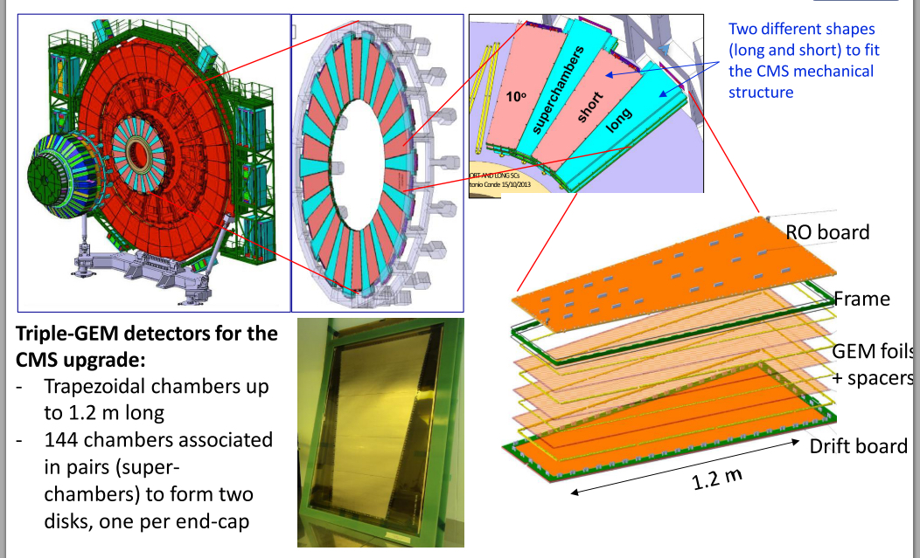
CMS FORWARD MUON DETECTOR
M. Bianco, CERN Seminar July 8, 2022

Slide 12
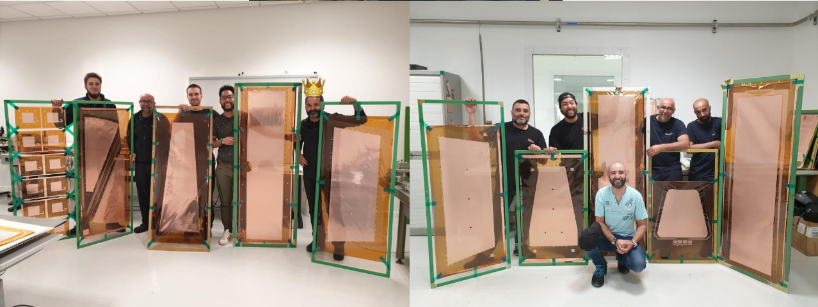
CMS FORWARD MUON DETECTOR
GEM PRODUCTION AT CERN'S DETECTORS TECHNOLOGIES WORKSHOP

Slide 13
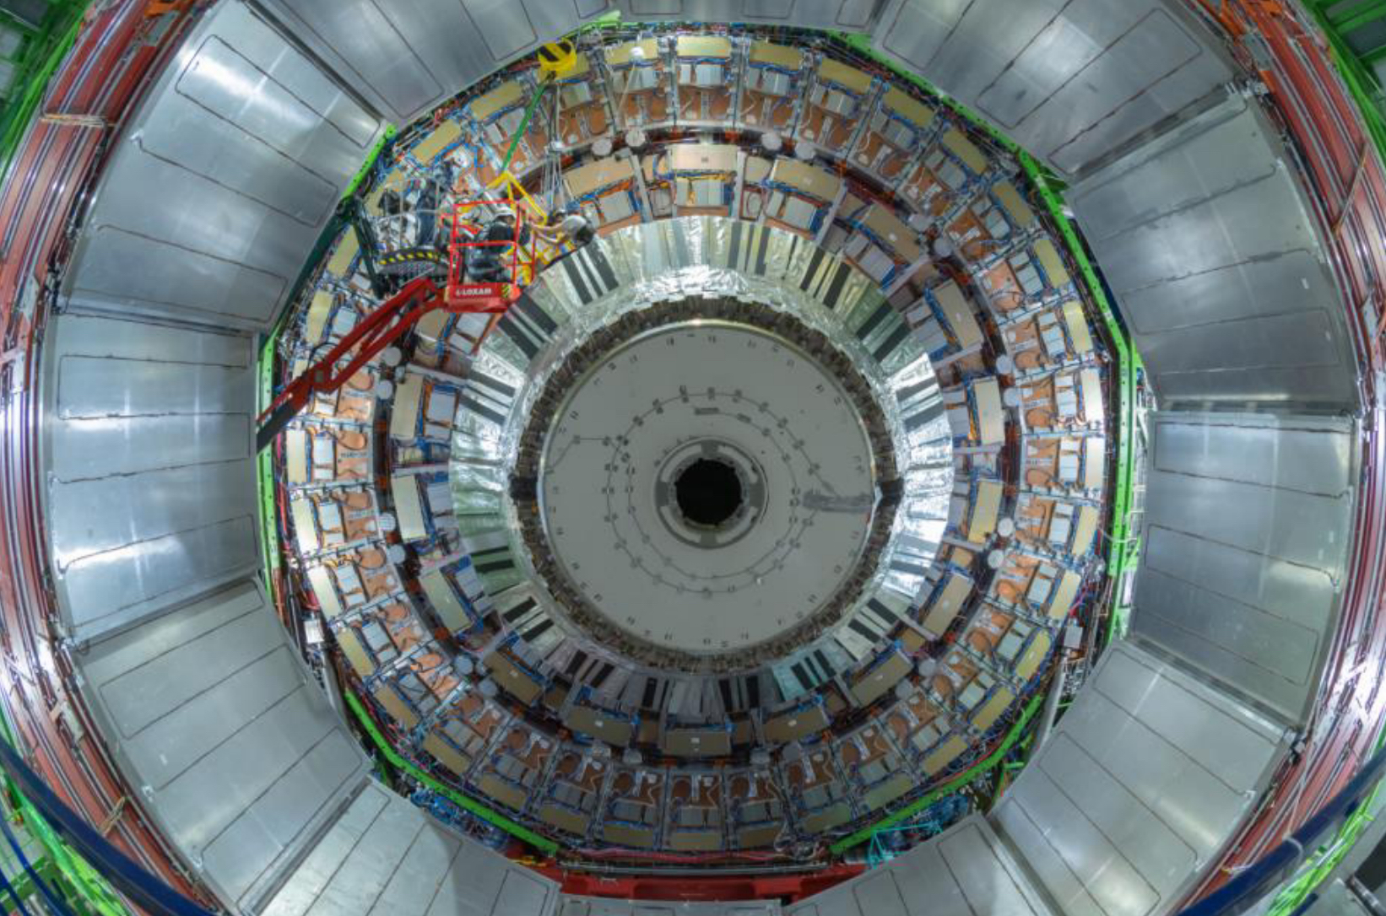
CMS FORWARD MUON DETECTOR
2019: INSTALLATION OF 36 SUPER-CHAMBERS FOR FIRST
AND SECOND END-CAP
M. Bianco, JINST 15 (2020) C09045

Slide 14
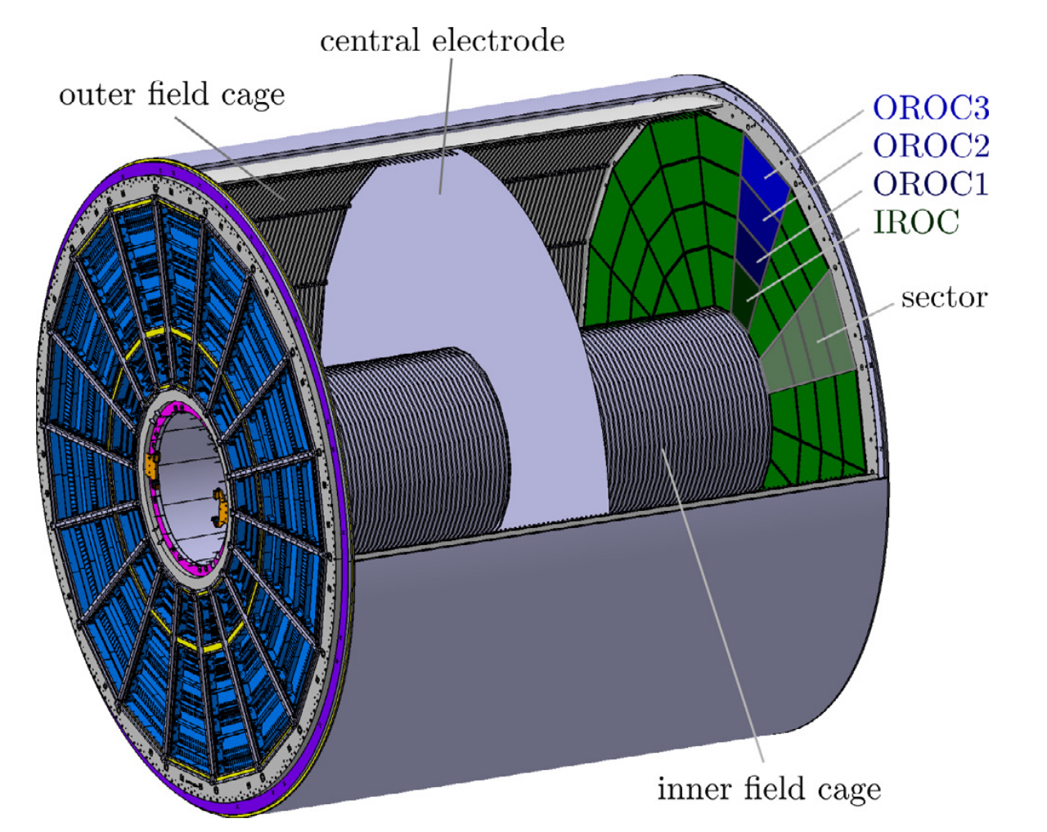
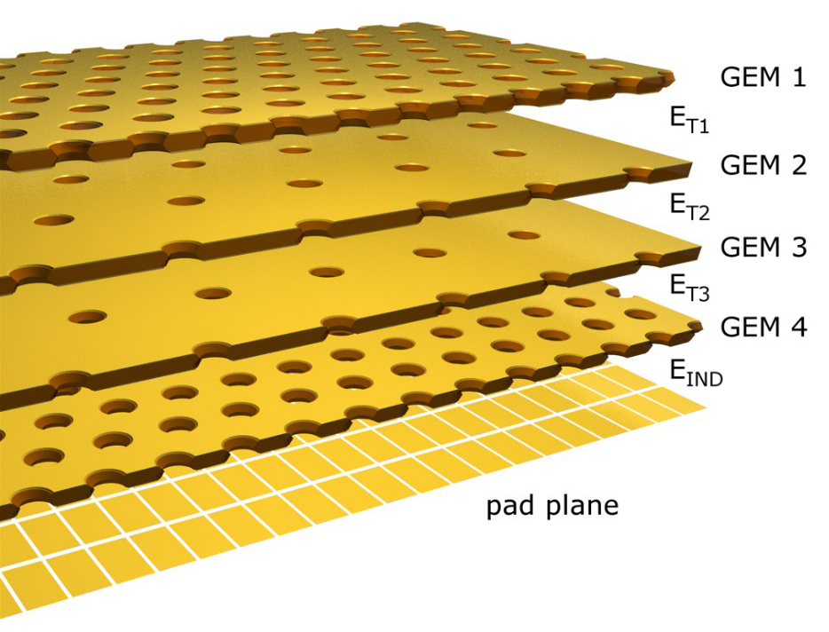
ALICE TPC GEM UPGRADE
QUAD ALTERNATING GEMs FOR POSITIVE IONS BACKFLOW REDUCTION
72 GEM MODULES
J. Adolfsson et al, JINST 16 (20210) P03021

Slide 15
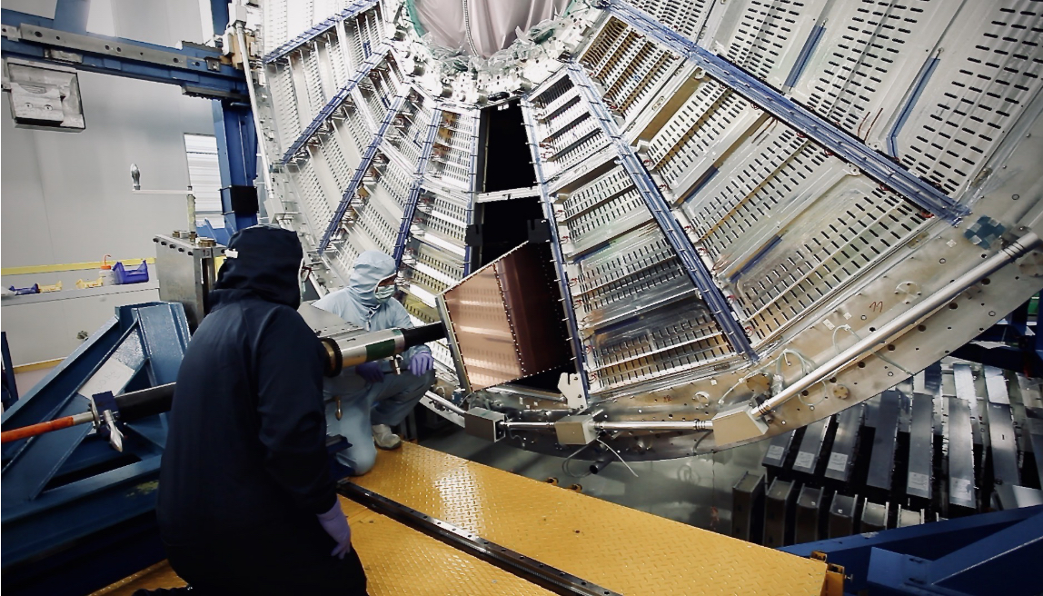
ALICE TPC UPGRADE
OPERATING 2022
REPLACEMENT OF THE ENDCAP MWPCs WITH QUAD-GEM DETECTORS

Slide 16
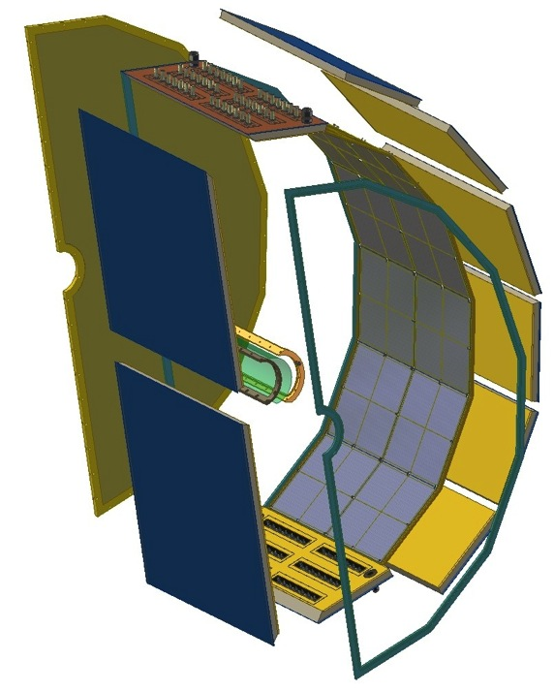
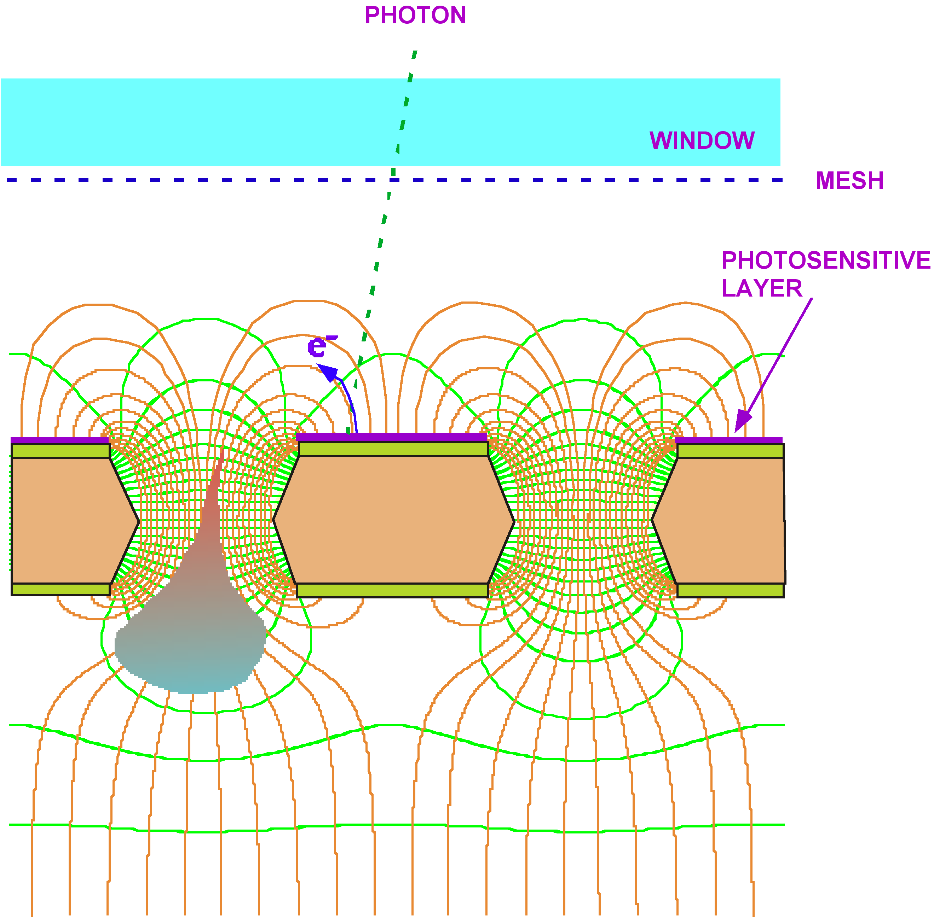
UV PHOTONS DETECTION
PHENIX HADRON BLIND DETECTOR
GEM WITH REVERSE CsI PHOTOCATHODE
T. Meinschad, L. Ropelewski and F. Sauli, Nucl. Instr. Meth. A 535(2004)324
W. Anderson et al,
Nucl. Instr. Meth. A646(2011)35

Slide 17
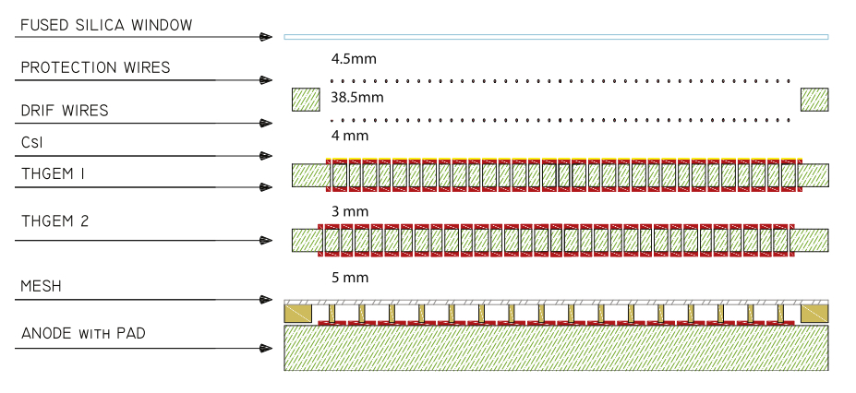
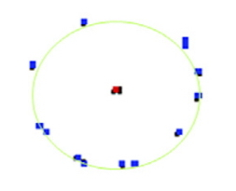
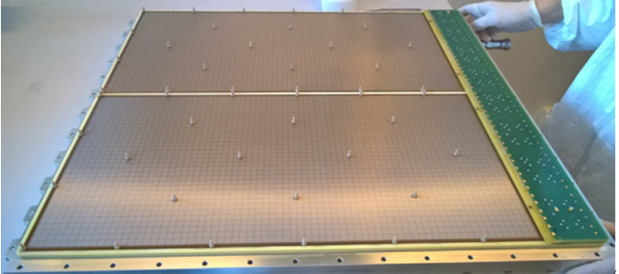
BEST OF BOTH WORDS: COMPASS RICH
HYBRID MPGD: GEM + MICROMEGAS
LARGE GAINS, REDUCED POSITIVE IONS BACKFLOW
CHERENKOV RING
J. Agarwala et al, Nucl. Instr. Meth. A952(2020) ﻿161832

Slide 18
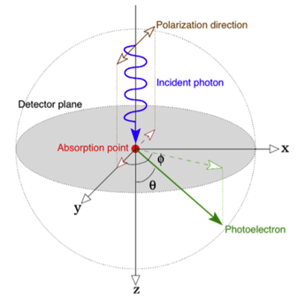
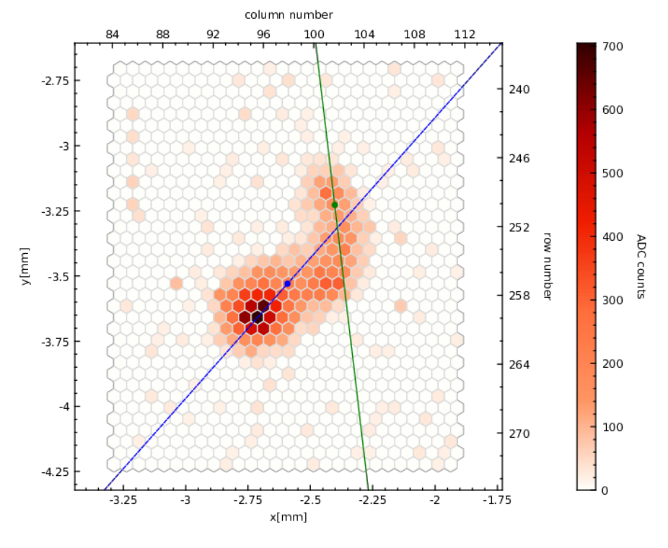
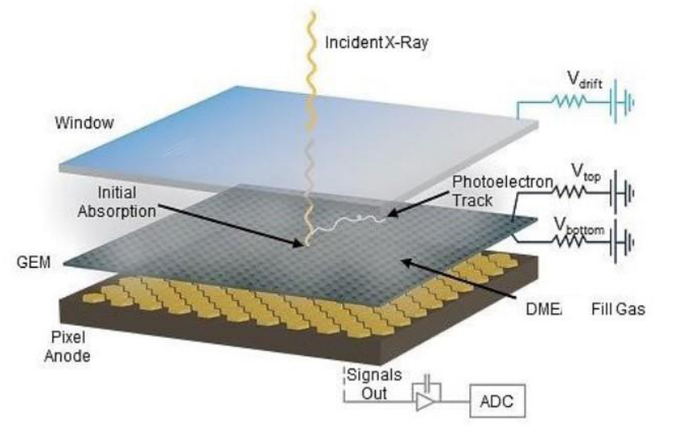
GEM APPLICATIONS OUTSIDE HEP
SOFT X-RAY POLARIMETRY
5.9 keV PHOTOELECTRON
80 µm pixels pitch:
~ 1 mm
R. Bellazzini et al, Nucl. Instr. and Meth. A720(2013)173

Slide 19
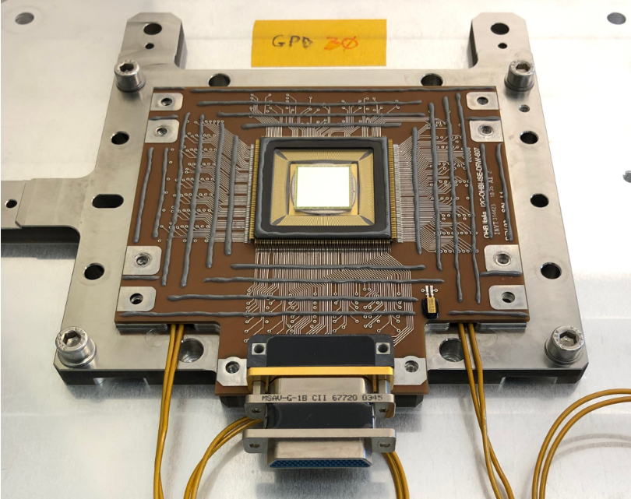
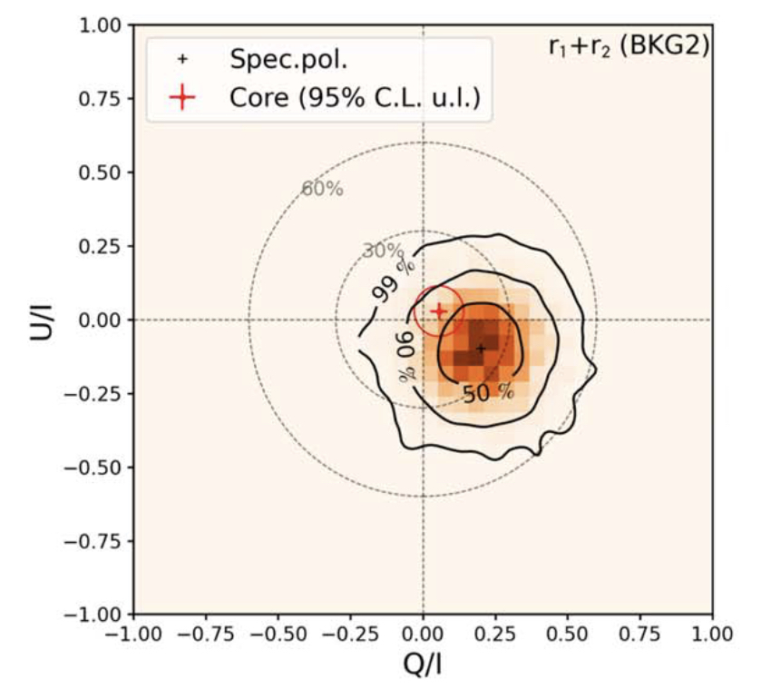
X-RAY POLARIMETRY EXPLORER (IXPE)
2-8 keV
POLARIZATION MAP OF
221009A GAMMA RAY BURST
GAS PIXEL DETECTOR
L. Baldini et al,
Astroparticle Physics (2021)
LAUNCHED DECEMBER 15, 2021
M. Negro et al,
Astro. J. Letters 946(1923)L21
https://ixpe.msfc.nasa.gov/

Slide 20
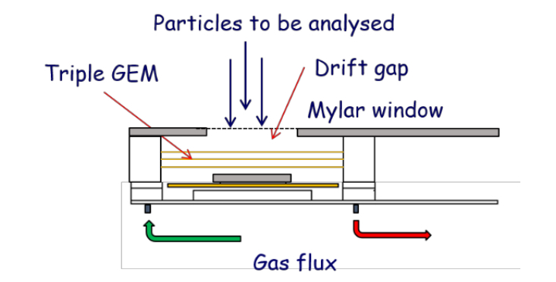
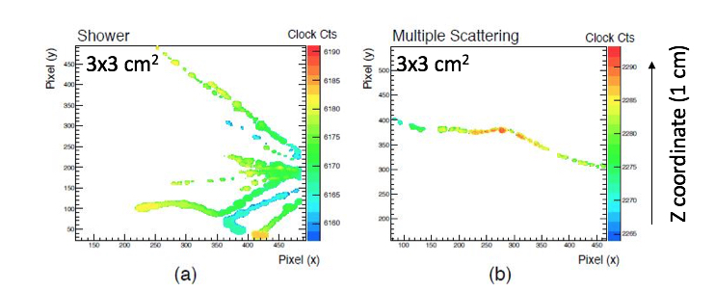
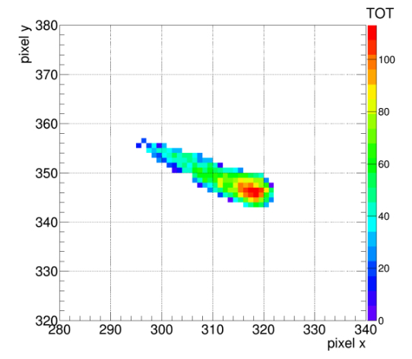
GEMPIX: HIGH ACCURACY TRACKING
TRIPLE GEM COUPLED TO A TMEPIX READOUT
~262,000) 55x55 µm PIXELS
INTERACTING BEAM PARTICLES:
F. Murtas, JINST9(2014)C01058
S.P. George et al, JINST10(2015)P11003
MICRODOSIMETRY:
STOPPING PROTON
J. Leidner et al, Appl. Sci. 11(2021)440

Slide 21
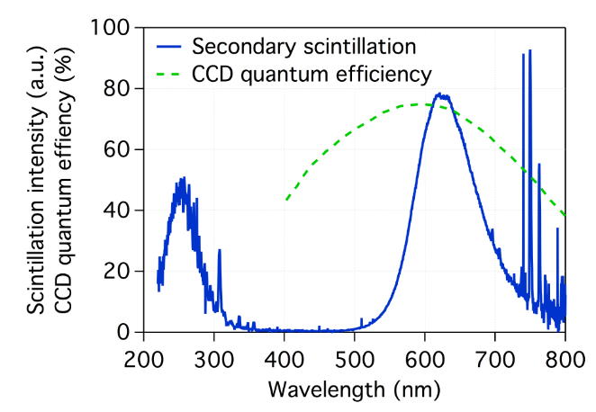
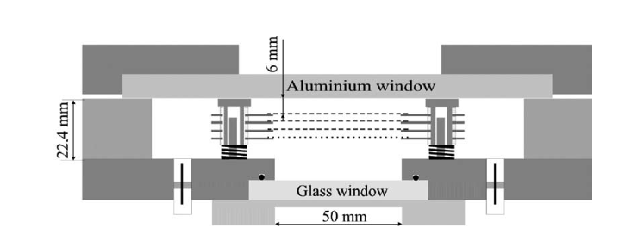
OPTICAL GEM IMAGING
TRIPLE GEM
CCD CAMERA
MUON TRACKS
TRIPLE GEM
DELTA RAY
HADRONIC SHOWER
CCD CAMERA
F. Brunbauer et al, JINST 13(2018) ﻿T02006

Slide 22
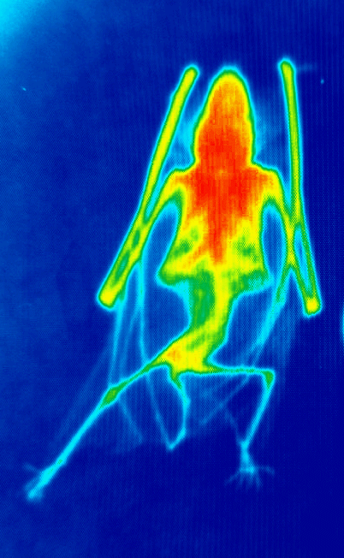
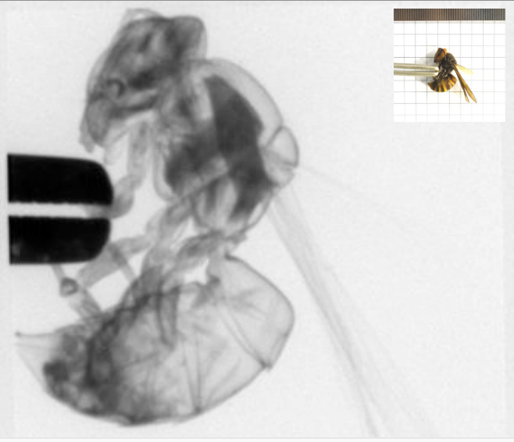
SOFT X-RAY ABSORPTION RADIOGRAPHY
GLASS GEM
T. Fujiwara et al, Nucl. Instr. Meth. 878(2018)40
OPTICAL GEM
CERN-GDD

Slide 23
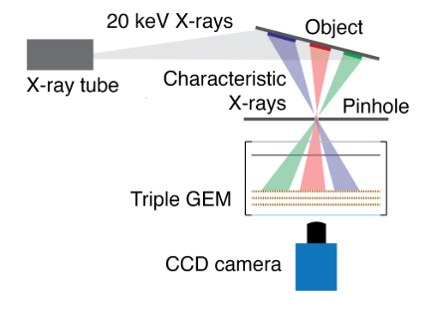
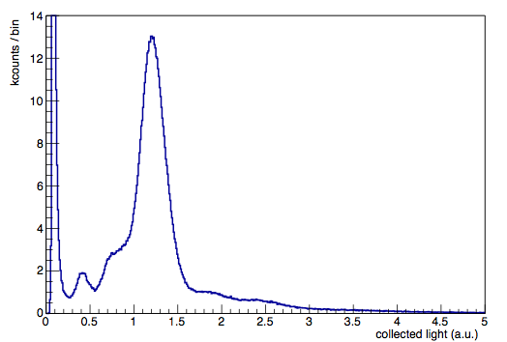
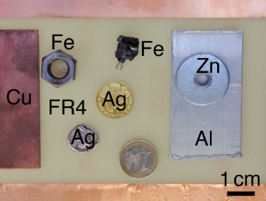
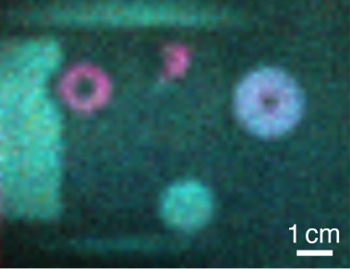
X-RAY FLUORESCENCE ANALYSIS
F. Brunbauer et al, JINST 13(2018) ﻿T02006

Slide 24
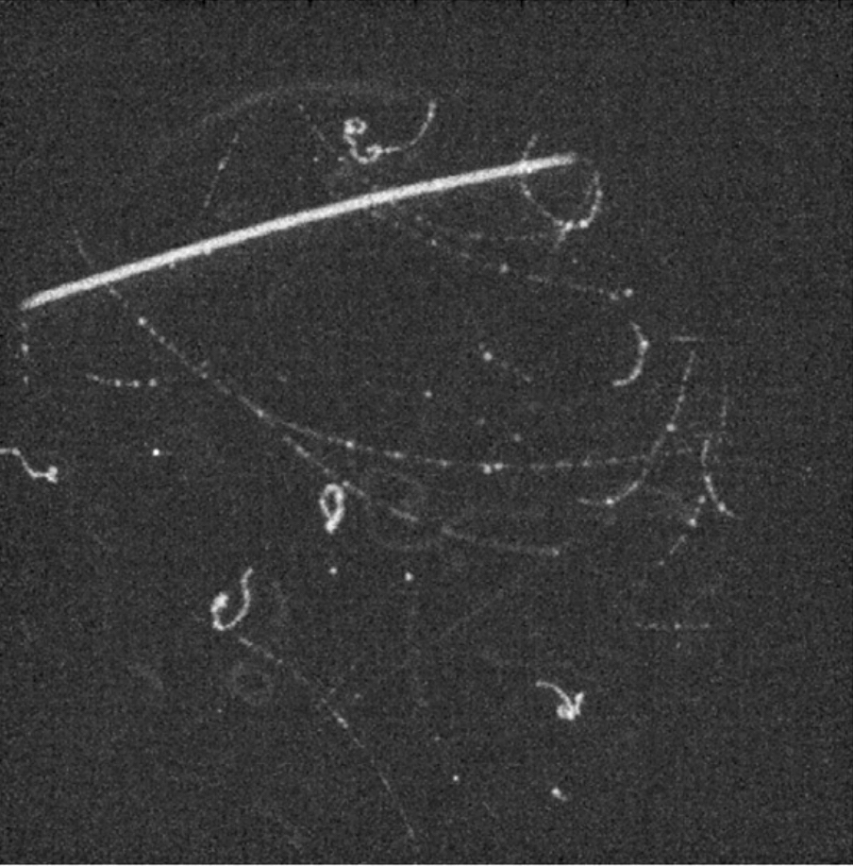
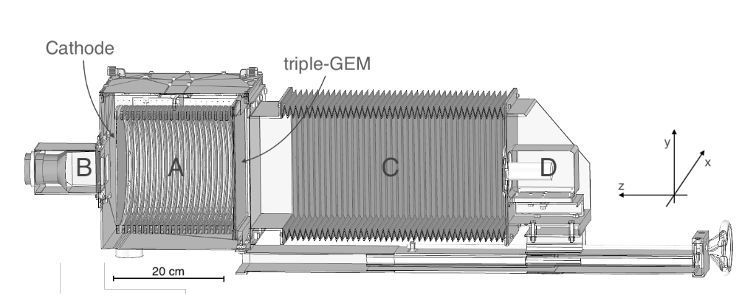
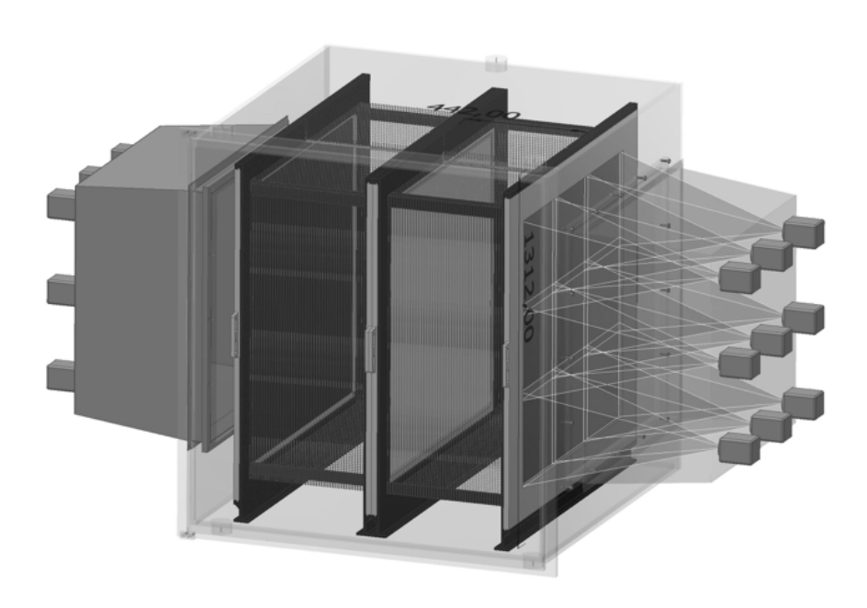
OPTICAL GEM TPC
CYGNO:
DIRECTIONAL DARK MATTER SEARCH
D. Pinci et al,
Nucl. Instr. Meth. A936(2019)453
﻿I. Abritta et al,
J. Phys.Conf.Ser. 1498(2020)012016

Slide 25
DUAL-PHASE CRYOGENIC TPC
LEM:
LARGE ELECTRON MULTIPLIER
1.6 mm PCB
500 µm holes at 800 µm pitch
(THICK-GEM)
A. Badertscher et al,
Nucl. Instr. Meth. A617(2009)188
XENON 100: Liquid Xenon Dark matter search detector
E. Aprile et al, Astroparticle Physics 35(2012)573

Slide 26
ProtoDUNE:
DUAL PHASE LIQUID ARGON TPC
C. Cuesta et al, ﻿arXiv:1910.10115v1(2019)

Slide 27
BUBBLE-ASSISTED
LIQUID HOLE MULTIPLIER
Amos Breskin 2015
L. Arazi et al, JINST10 (2015)P08015

Slide 28
THE FUTURE ?

Slide 29
THE FUTURE ?
LARGE AREA TPC WITH SOLID STATE PIXEL READOUT
FAST (MHz?) OPTICAL GEM IMAGERS
LIQUID HOLE MULTIPLIERS
………..
DRD1:
DEVELPMENT OF GASEOUS DETECTOR TECHNOLOGIES

Slide 30
THANKS FOR YOUR ATTENTION
AND THE APPRECIATION OF MY WORK

